Slide 1
CSC 161 Section 8
CA: [Name of CA]

Slide 2
Minimum Spanning Tree

Slide 3
Minimum Spanning Tree Say we have an undirected weighted graph
8
7
This is a minimum spanning tree.
B
C
D
It has cost 37
4
9
2
11
4
A
I
14
E
7
6
8
10
1
2
H
G
F
minimum
of minimal cost
A spanning tree is a tree that connects all of the vertices.

Slide 4

Algorithms for Minimum Spanning Tree Plan 1: Start growing a tree, greedily add the shortest edge we can to grow the tree.
8
7
B
C
D
4
9
2
11
4
A
I
14
E
7
6
8
10
1
2
H
G
F

Slide 5
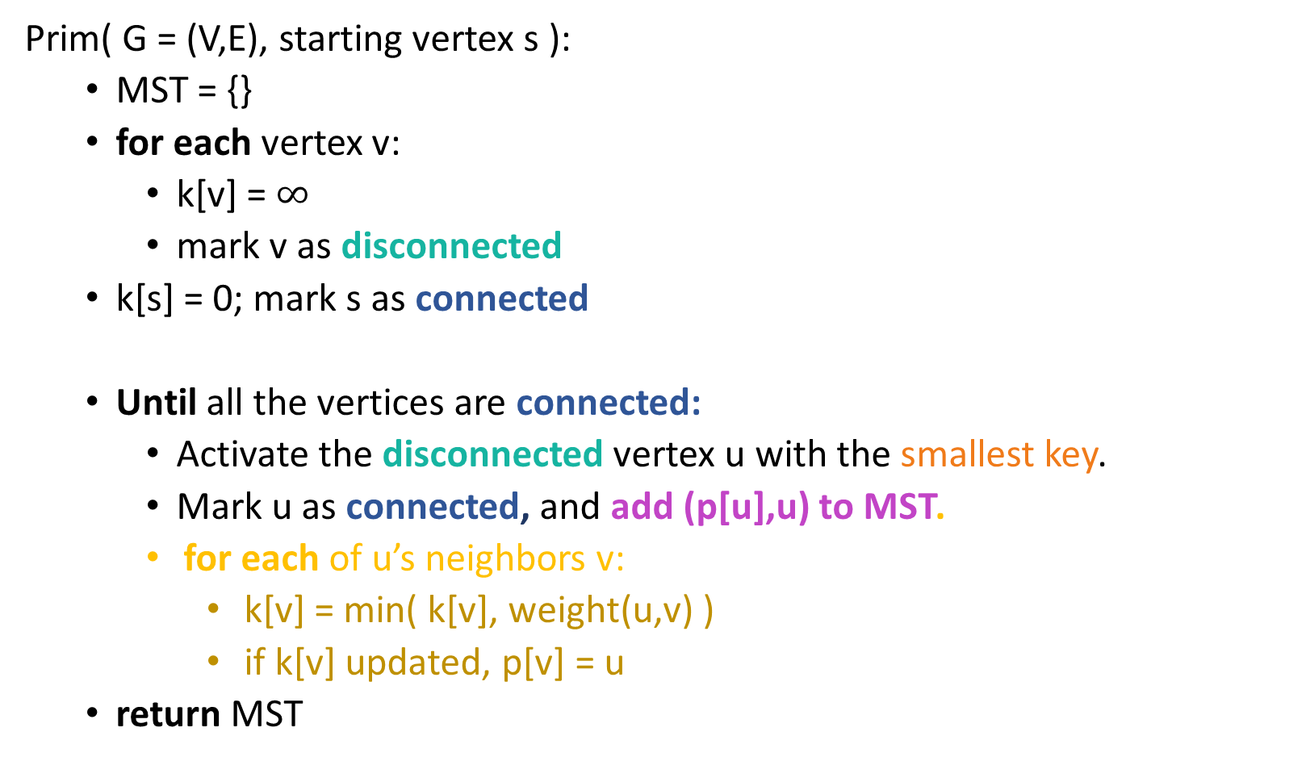
Prim’s Algorithm

Slide 6
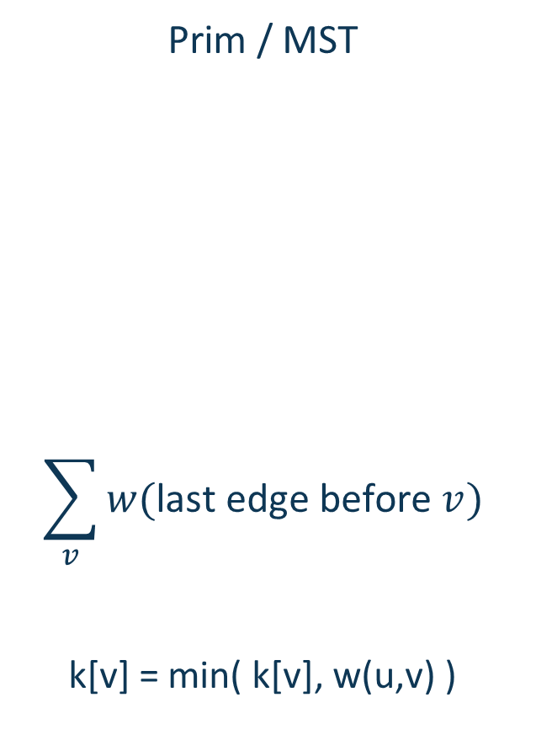
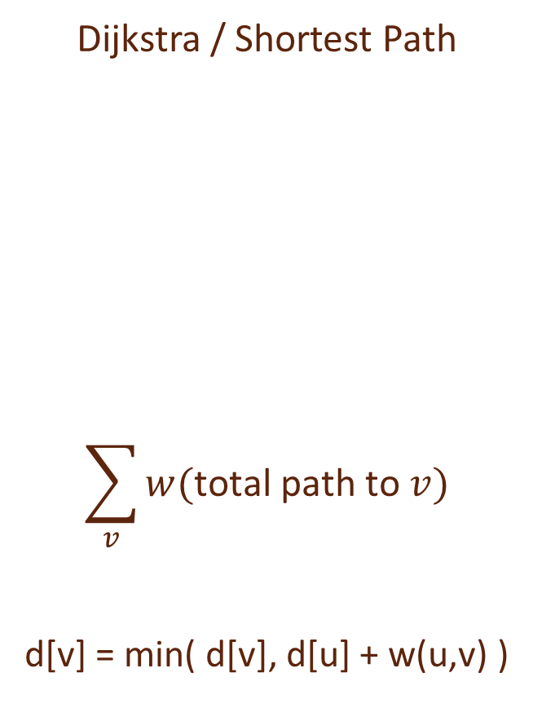
This should look pretty familiar…
Both grow a tree:
A
A
2
2
8
8
D
B
D
B
9
3
9
3
2
2
E
C
E
C
But optimize different functions:
w/ corresponding update rules:

Slide 7
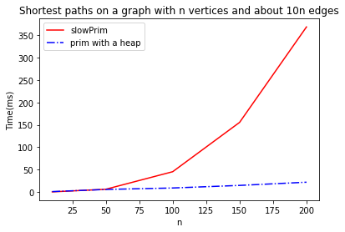
One thing that is similar: Running time
Exactly the same as Dijkstra:
O(mlog(n)) using a Red-Black tree or binary heap as a priority queue.
O(m + nlog(n)) if we use a Fibonacci Heap*.
*See CS166

Slide 8
Idea 2 what if we just always take the cheapest edge? whether or not it’s connected to what we have so far?
That won’t cause a cycle
8
7
B
C
D
4
9
2
11
4
A
I
14
E
7
6
8
10
1
2
H
G
F

Slide 9
Union-find data structure also called disjoint-set data structure
Used for storing collections of sets
Supports:
makeSet(u): create a set {u}
find(u): return the set that u is in
union(u,v): merge the set that u is in with the set that v is in.
makeSet(x)
makeSet(y)
makeSet(z)
union(x,y)
find(x)
x
y
z

Slide 10
Kruskal’s algorithm
kruskal(G = (V,E)):
Sort E by weight in non-decreasing order
MST = {} // initialize an empty tree
for v in V:
makeSet(v) // put each vertex in its own tree in the forest
for (u,v) in E: // go through the edges in sorted order
if find(u) != find(v): // if u and v are not in the same tree
add (u,v) to MST
union(u,v) // merge u’s tree with v’s tree
return MST

Slide 11
Compare and contrast
Prim might be a better idea on dense graphs if you can’t radixSort edge weights
Prim:
Grows a tree.
Time O(mlog(n)) with a red-black tree
Time O(m + nlog(n)) with a Fibonacci heap
Kruskal:
Grows a forest.
Time O(mlog(n)) with a union-find data structure
If you can do radixSort on the edge weights, O(mα(n))
Kruskal might be a better idea on sparse graphs if you can radixSort edge weights

Slide 12
s-t min-cut max-flow

Slide 13
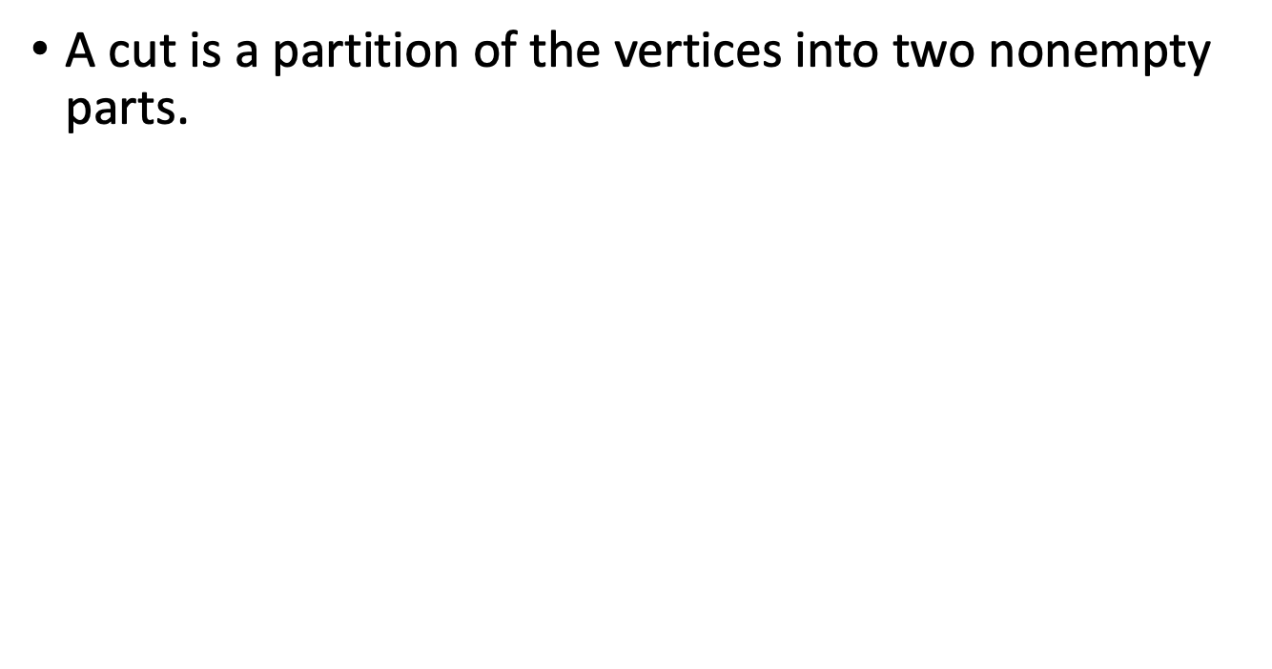
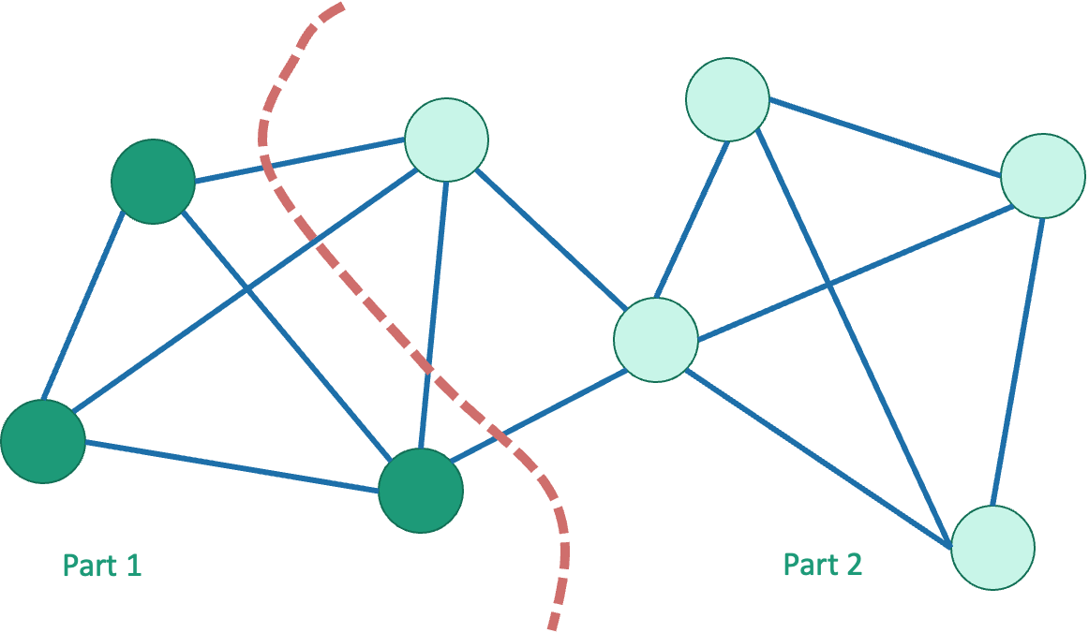
Cuts in graphs

Slide 14
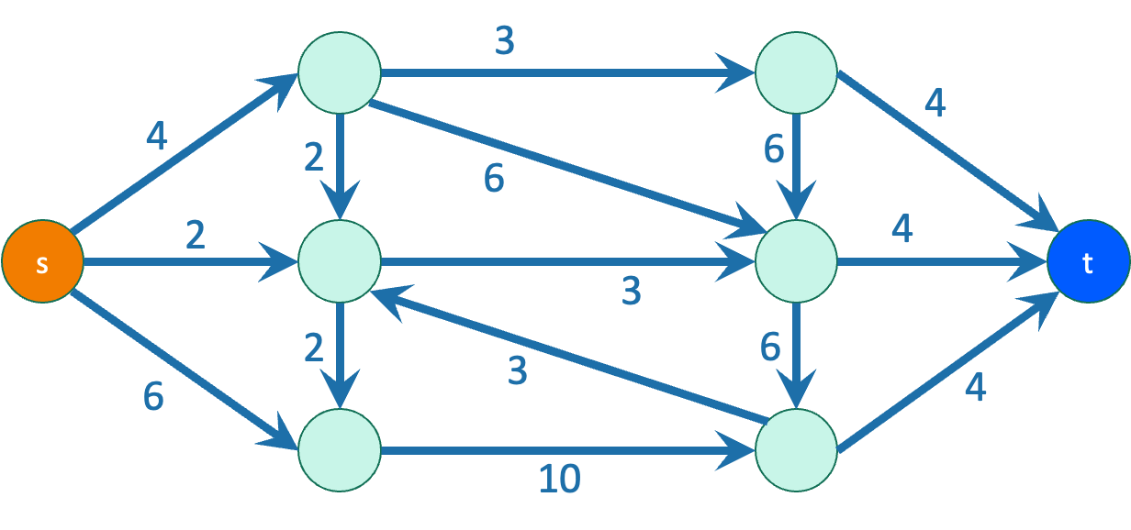
Today: s-t Cuts
Graphs are directed and edges have “capacities” (weights)
We have a special “source” vertex s and “sink” vertex t.
s has only outgoing edges*
t has only incoming edges*
s and t are on different sides of the cut
*at least for this class

Slide 15
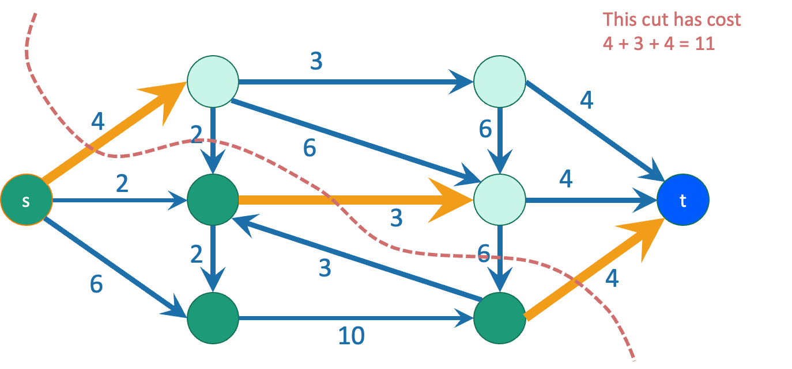
A minimum s-t cut is a cut which separates s from t with minimum capacity.
Question: how do we find a minimum s-t cut?

Slide 16
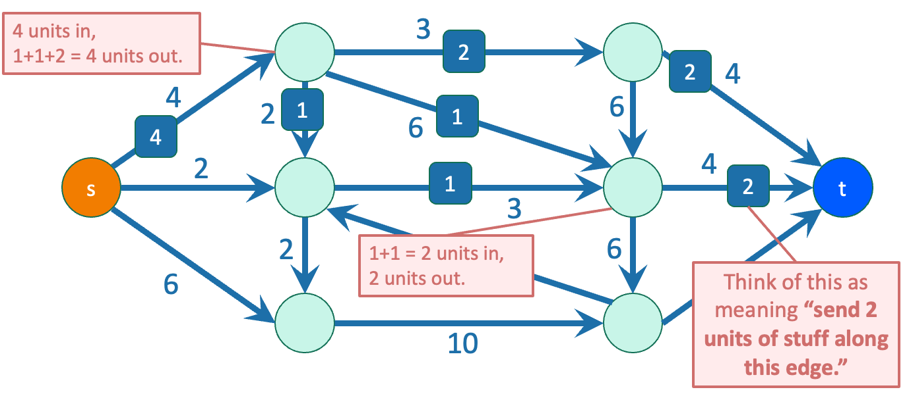
Flows
flow
In addition to a capacity, each edge has a
(unmarked edges in the picture have flow 0)
The flow on an edge must be less than or equal to its capacity.
At each vertex other than s and t, the incoming flows must equal the outgoing flows.

Slide 17
But what is a “flow,” really?
Think of s as a “water source” and t as a “water sink”
Each edge is a pipe, and the capacity is the amount of water that can flow through the edge
Clearly, for each pipe, as much water comes in must go out!
Some pipes will be the “bottleneck” pipes… could these be related to the min-cut somehow?

Slide 18
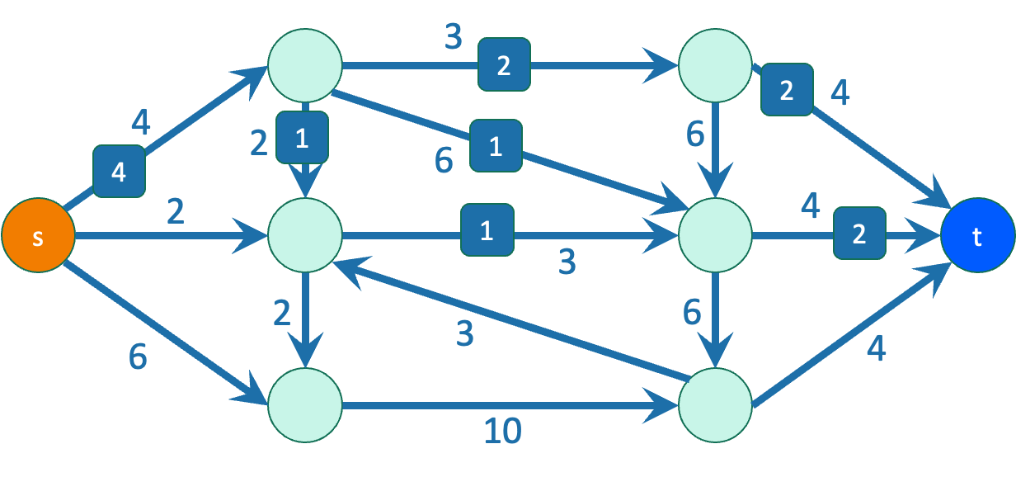
Flows
Because of conservation of flows at vertices,
stuff you put in
=
stuff you take out.
The value of a flow is:
The amount of stuff coming out of s
The amount of stuff flowing into t
These are the same!
The value of this flow is 4.

Slide 19

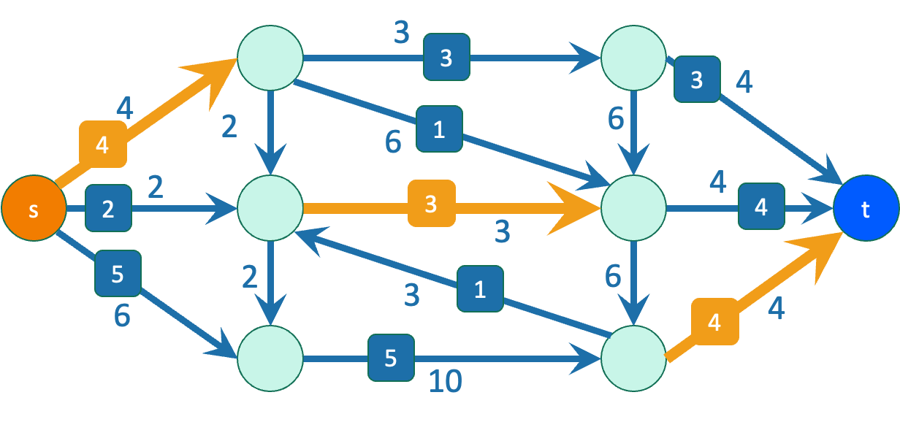
Theorem Max-flow min-cut theorem
The value of a max flow from s to t
is equal to
the capacity of a min s-t cut.
Intuition: in a max flow, the min cut better fill up, and this is the bottleneck.

Slide 20
Max-flow min-cut in water pipes
What does the max-flow min-cut theorem mean in the context of our water pipes example before?
Max-flow = maximum amount of water we can send
Min-cut = the minimum capacity of pipes, which when removed, completely disconnects the water source and sink (i.e., no water flows)
Intuitively makes sense!

Slide 21
Ford-Fulkerson algorithm
Outline of algorithm:
Start with zero flow
While we haven’t found the max flow:
Find a way to send more from s to t
Original graph:
a
2
2
s
2
t
2
b
2
Iteration 3: optimal flow!
Iteration 2: increase the flow again:
a
increased flow on this edge
a
2
2
2
0
2
2
decreased flow on this edge
2
2
0
2
s
2
t
2
t
s
2
2
2
2
b
2
2
0
b
2

Slide 22
2 key ideas
In order to increase total flow, we decreased flow on some edges
Decreasing flow in one direction = increasing flow in the opposite direction
= “sending back” this flow
Iteration 3: optimal flow!
Iteration 2: increase the flow again:
a
increased flow on this edge
a
2
2
2
0
2
2
decreased flow on this edge
2
2
0
2
s
2
t
2
t
s
2
2
2
2
b
2
2
0
b
2

Slide 23

Why residual graphs?
Let’s think of a greedy idea for finding flows:
Pick an arbitrary augmenting path, and push the maximum flow you can through this path
Keep repeating this until no paths exist!
We reach a “blocking” flow: no more paths exist, even though the flow is not optimal… what to do?
Reference: https://cs.stackexchange.com/a/71505

Slide 24

Why residual graphs?
Fix this issue by allowing “undo” operations!
Akin to reversing our previous decision in a greedy algorithm
Encoding these operations is the main goal of a residual graph
Reference: https://cs.stackexchange.com/a/71505

Slide 25


What is a residual graph?
Stores how much flow can be pushed through an edge
Having the reverse edge capacities = current flow represents that the current flow can be “undone!”
Reference: https://cs.stackexchange.com/a/71505

Slide 26
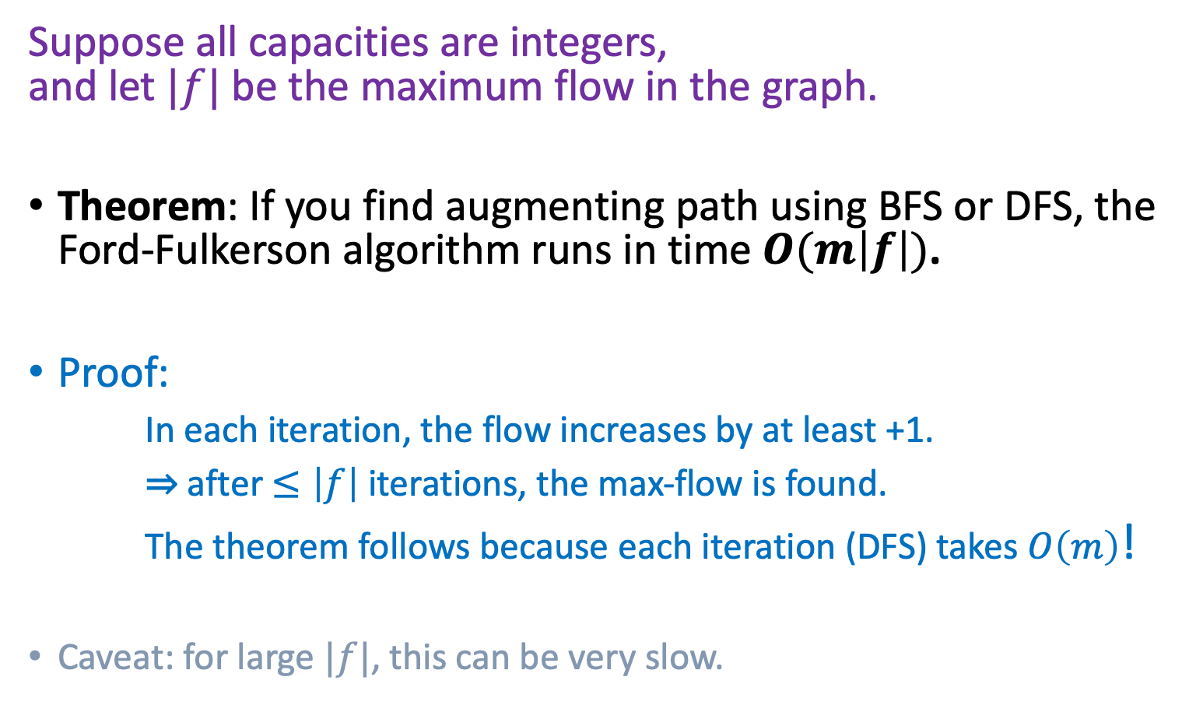
Time complexity of max flow?

Slide 27
How not to pick the augmenting path
a
Choose a really big number C.
C
C
0
0
0
1
t
s
C
0
C
0
b
a
C
C
1
t
s
C
C
b

Slide 28
How not to pick the augmenting path
a
Choose a really big number C.
C
C
0
0
0
1
t
s
C
0
C
0
b
a
C
C
1
t
s
C
C
b

Slide 29
How not to pick the augmenting path
a
Choose a really big number C.
C
C
1
0
1
1
t
s
C
1
C
0
b
a
1
C
C-1
1
The edge (b,a) disappeared from the residual graph!
t
s
1
C
C-1
b

Slide 30
How not to pick the augmenting path
a
Choose a really big number C.
C
C
1
0
1
1
t
s
C
1
C
0
b
a
1
C
C-1
1
t
s
1
C
C-1
b

Slide 31
How not to pick the augmenting path
a
Choose a really big number C.
C
C
1
1
0
1
t
s
C
1
C
1
b
a
1
1
C-1
C-1
The edge (b,a) re-appeared in the residual graph!
1
t
s
1
1
b
C-1
C-1

Slide 32
How not to pick the augmenting path
a
Choose a really big number C.
C
C
1
1
0
1
t
s
C
1
C
1
b
a
1
1
C-1
C-1
1
t
s
1
1
b
C-1
C-1

Slide 33
How not to pick the augmenting path
a
Choose a really big number C.
C
C
2
1
1
1
t
s
C
2
C
1
b
a
2
1
C-1
C-2
1
The edge (b,a) disappeared from the residual graph!
t
s
2
1
b
C-1
C-2

Slide 34
How not to pick the augmenting path
a
Choose a really big number C.
C
C
2
This will go on for C steps, adding flow along (b,a) and then subtracting it again.
1
1
1
t
s
C
2
C
1
b
a
2
1
C-1
C-2
1
The edge (b,a) disappeared from the residual graph!
t
s
2
1
b
C-1
C-2

Slide 35
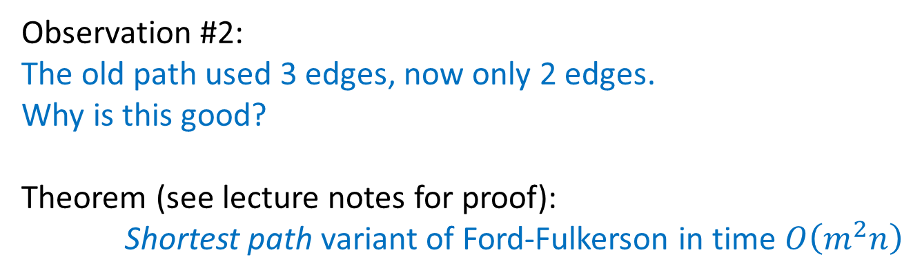
So how should we pick the path?
a
C
In this example, red+green paths would have been much better!
What about in a general graph?
C
1
t
s
C
C
b
Notes:
Shortest path proof idea: use the distance of the shortest path from s to t (aka how many vertices there are between them) to get an upper-bound for # iterations until t is no longer reachable from s

Slide 36
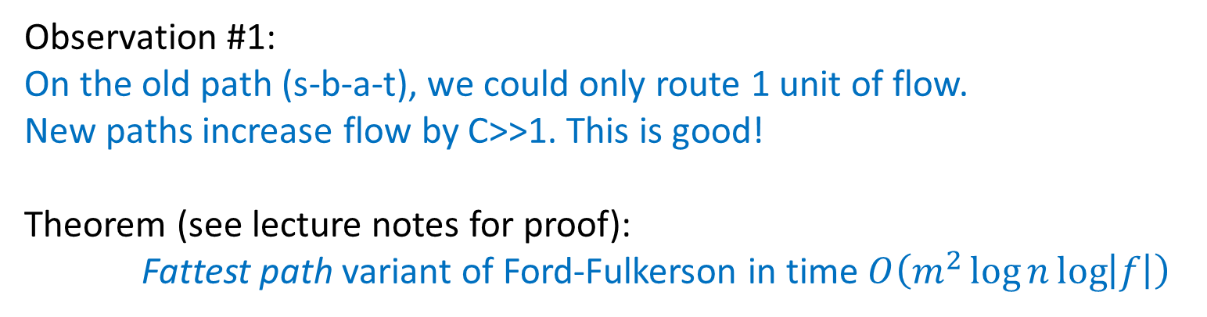
So how should we pick the path?
a
C
In this example, red+green paths would have been much better!
What about in a general graph?
C
1
t
s
C
C
b
Notes:
Fattest path proof idea: use the min edge on the fattest path (aka the flow of the augmenting path) to get an upper-bound for # iterations until the max flow is reached

Slide 37
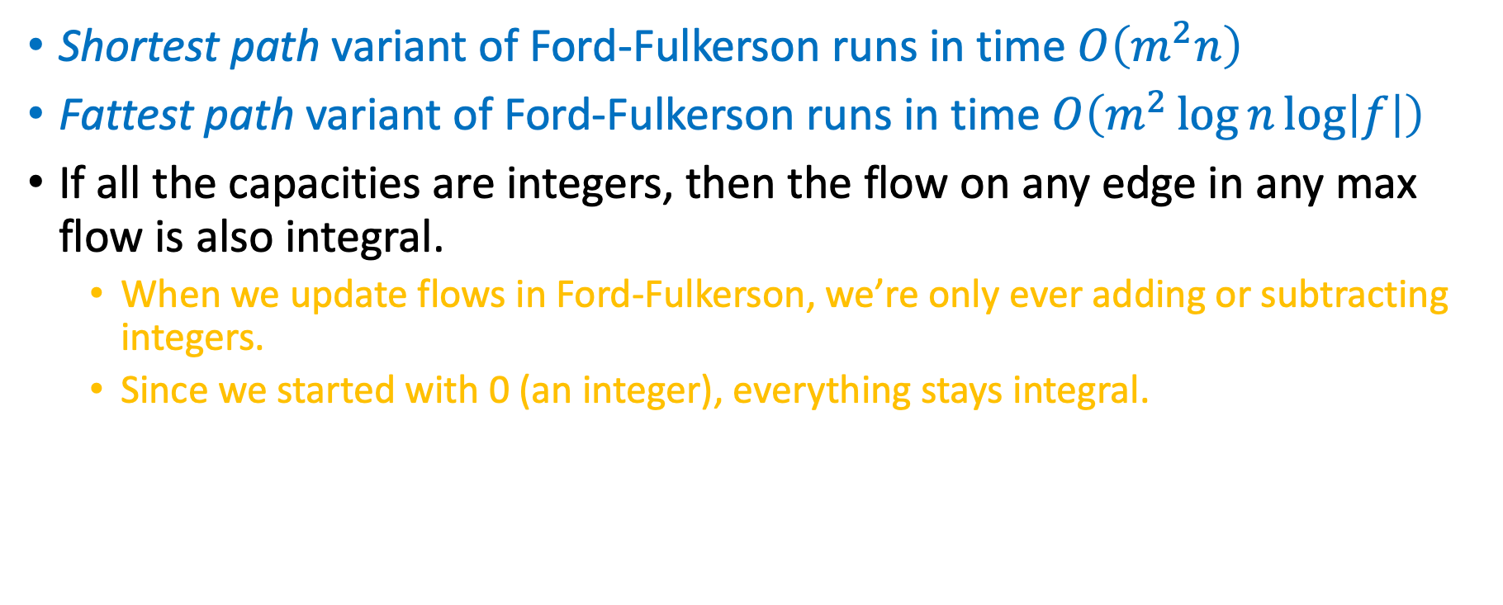
Ford Fulkerson additional notes!
Notes:
Take CS261 if you want to learn more!

