Slide 1
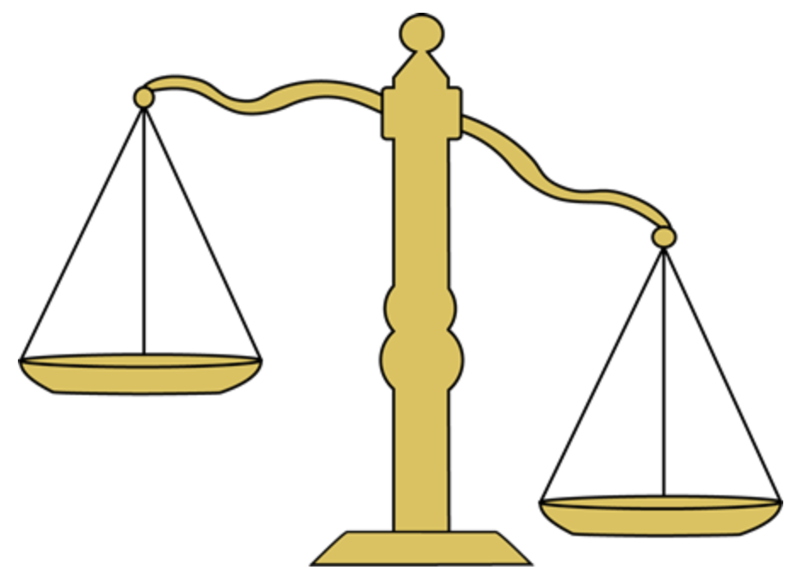
Lecture 14.5
Making Value Judgments
Dan Webber, PhD

Slide 2
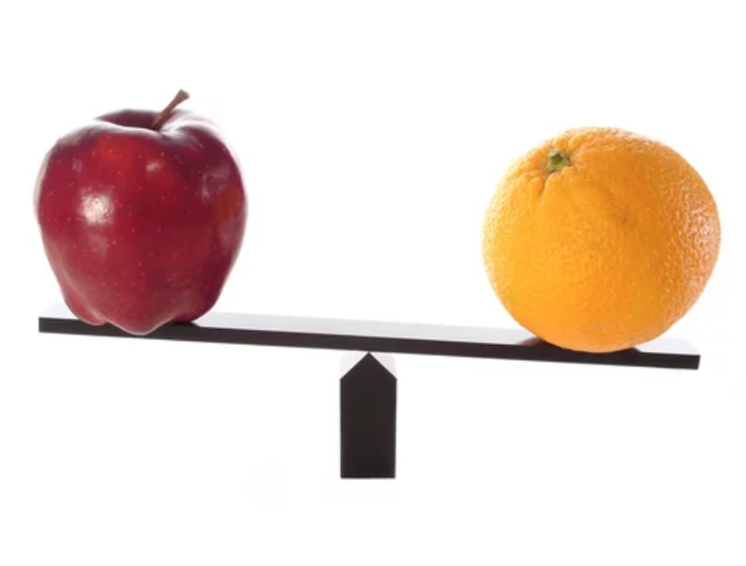
Recap: What was our first EthiCS lecture about?
Incommensurability!
… in the context of sorting!

Slide 3
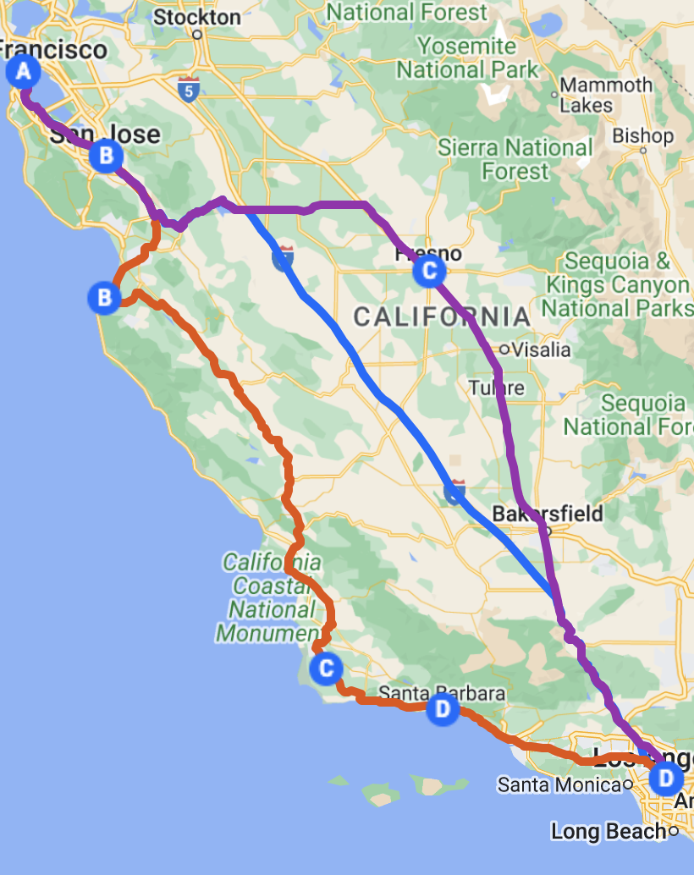
We looked at problems like this:
How do we sort when each item to be sorted has multiple values attached to it?
Route Name | Time SF -> LA | Emissions reduction
Coastal | 180 | 2
I-5 Express | 135 | 1.5
Eastern Valley | 160 | 2
… | … | …
… | … | …

Slide 4
We had an idea: sorting with a weight function
Route Name | Time SF -> LA | Emissions reduction | f(t, e)
Coastal | 180 | 2
I-5 Express | 135 | 1.5
Eastern Valley | 160 | 2
… | … | …
… | … | …

Slide 5
… but that still left us with a problem
Which function should we use for f?
Route Name | Time SF -> LA | Emissions reduction | f(t, e)
Coastal | 180 | 2 | ???
I-5 Express | 135 | 1.5 | ???
Eastern Valley | 160 | 2 | ???
… | … | … | …
… | … | … | …

Slide 6
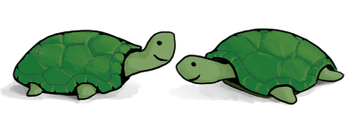
Where we ended up
When incommensurable values are afoot, technical considerations alone won’t determine the correct weight function
Weighing or trading off between different values requires a value judgment
Unanswered question: How do we make good value judgments?

Slide 7
Today
Value judgments in algorithms: examples
Philosophical theories for weighing values
Pluralism
Utilitarianism
Prioritarianism
Deontology and rights
Throughout:
How would these theories help us make the kind of value judgments our algorithms rely on?
What can these theories not tell us?

Slide 8

Warning
My hope is that this lecture leaves you better equipped to think about value judgments. But…
You should not expect to leave with a simple, precise algorithm for making value judgments
I can’t give you this because I don’t have it myself! It’s an open philosophical question whether there is any such algorithm and, if so, what it is
Just because it’s an open question doesn’t mean it has no answer or that it’s not worth thinking about! Compare: It’s an open question whether P = NP

Slide 9
Warning, cont.
My hope is that this lecture leaves you better equipped to think about value judgments. But…
Some of you, I hope, will leave this lecture less confident in how to make value judgments than you were before!
Informed vs. uninformed uncertainty
It’s better to be uncertain because you’re aware of hard questions and nuance than to be uncertain because you’re totally in the dark
It’s also better to be informed and uncertain than uninformed and confident!

Slide 10

Value judgments in algorithms

Slide 11
Last time, we found difficult value judgments in a sorting example
Which function should we use for f?
Route Name | Time SF -> LA | Emissions reduction | f(t, e)
Coastal | 180 | 2 | ???
I-5 Express | 135 | 1.5 | ???
Eastern Valley | 160 | 2 | ???
… | … | … | …
… | … | … | …

Slide 12
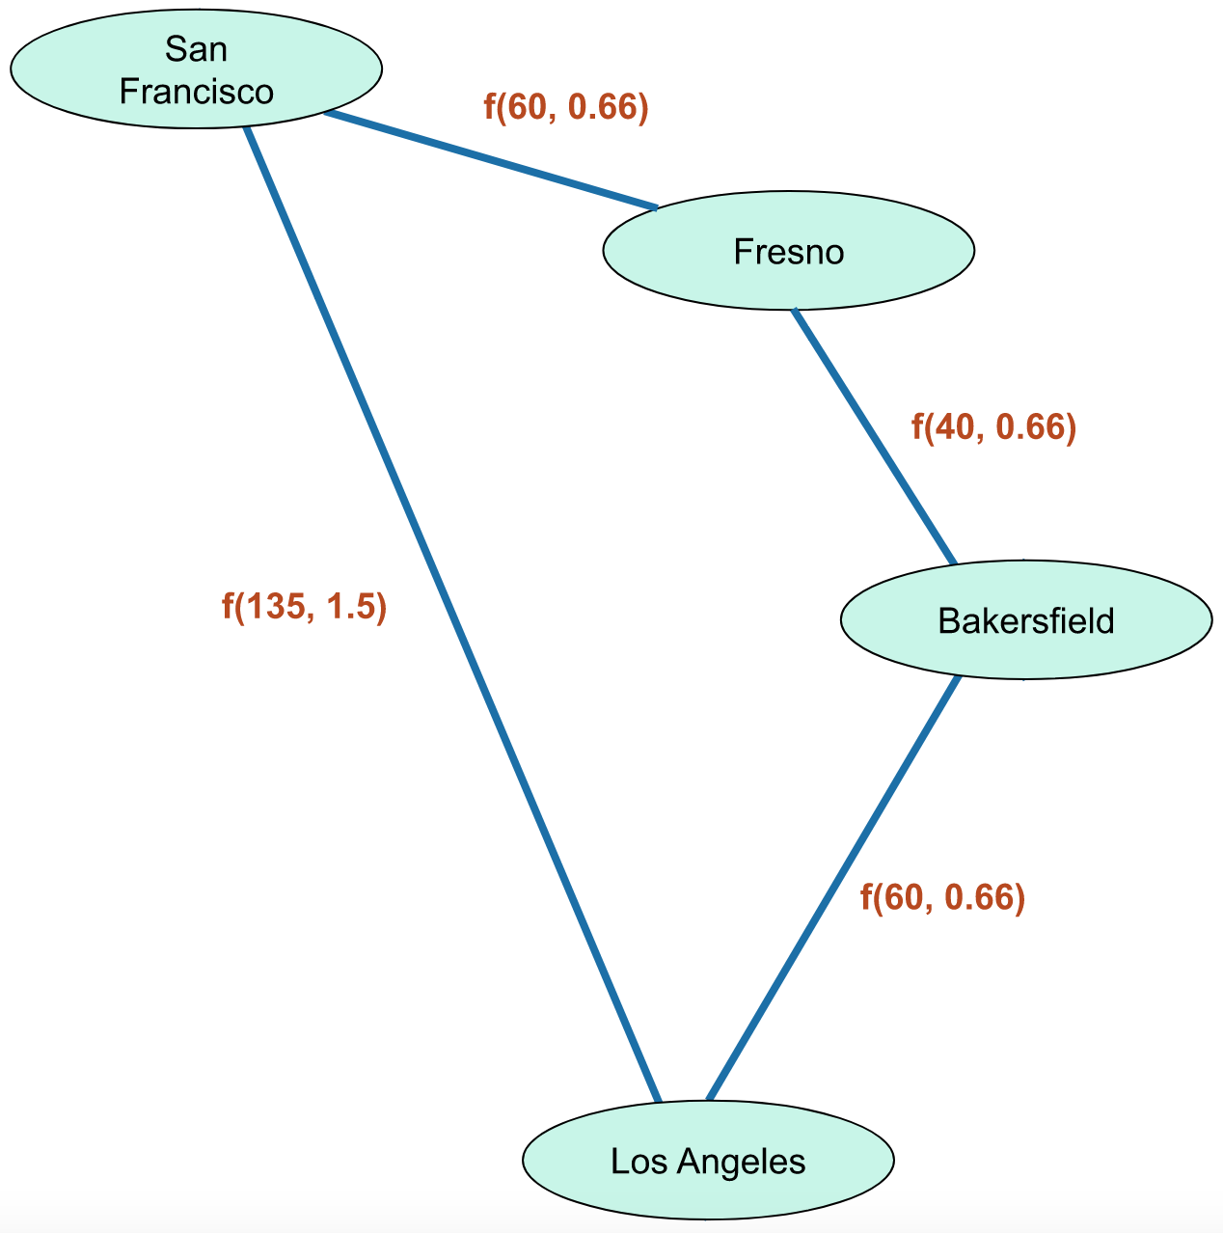
But many kinds of algorithms presuppose value judgments
For example, we would have faced the same issue if we had framed our high-speed rail problem as a shortest path problem

Slide 13

Another example
Suppose you’re crafting a playlist of classic rock singalong anthems for a drive up to San Francisco.
The drive is 45 minutes long, but there’s way more than 45 min of jams you’d like to include.
Does this sound like a problem you’ve encountered in this class?

Slide 14
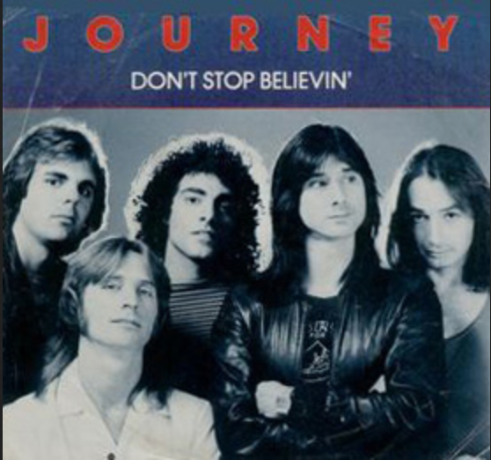
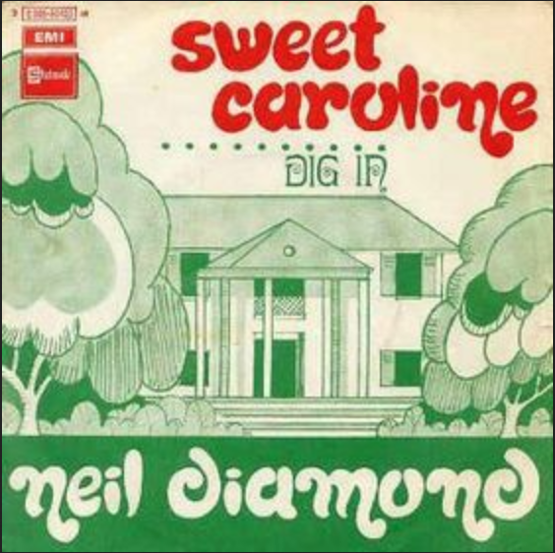

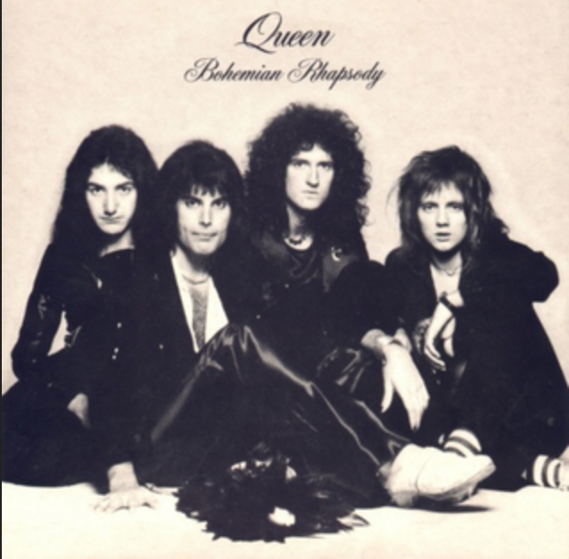
It’s a knapsack problem!
The playlist (knapsack) can fit 45 minutes worth of tunes
…
Length (weight):
4:10
Length (weight):
3:23
Length (weight):
8:36
Length (weight):
5:55
Value: ???
Value: ???
Value: ???
Value: ???
How much value does “Sweet Caroline” add to the playlist compared to “Don’t Stop Believin’”?
Notes:
Remember, we need not just a ranking of songs by value, but a scalar value for each of them. Maybe American Pie is better than Bohemian Rhapsody, but if it’s only a little bit better, it might not be worth the extra 3 minutes.

Slide 15

Lots of algorithms operate on items that have a value or weight
In this class, you usually just take the values or weights for granted, as arbitrary input into your algorithm
When solving problems in real life, sometimes the hardest part isn’t the algorithm—it’s figuring out the correct values or weights!

Slide 16
Even harder when the problem involves multiple values and people!
Suppose you’re responsible for allocating $N of discretionary government funding. This funding can be used for anything: repairing roads, expanding the hospital system, funding an endowment for the arts, mitigating climate change, etc.
How would you begin to approach this problem?
(Is it an instance of a kind of problem you’ve seen before?)

Slide 17

Yep, it’s another knapsack!
…
Road repair
Hospital expansion
Arts endowment
Climate mitigation
🛣️
🏥
🎨
🌎
Cost (weight):
$W (per unit)
Cost (weight):
$X (per unit)
Cost (weight):
$Y (per unit)
Cost (weight):
$Z (per unit)
Value: ???
Value: ???
Value: ???
Value: ???
The $N question: What’s the value of each of these projects?

Slide 18
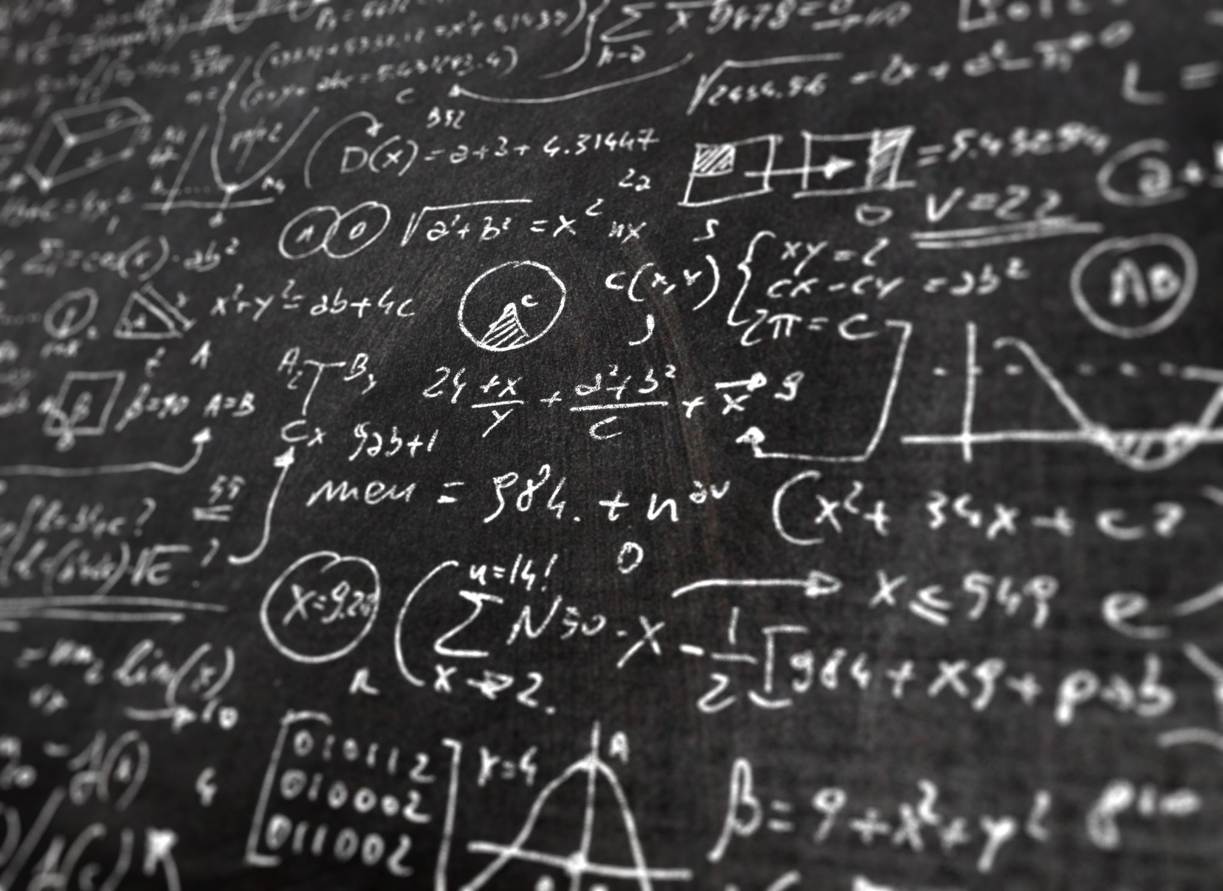
Ethical Theory

Slide 19

One Answer: Pluralism
There are many kinds of value, and no single value in terms of which they’re all commensurable.
There’s no common measure of the value of smooth roads, good healthcare, and the arts.
To assign comparable numerical values to each of these things, we just exercise our best judgment about which are more or less valuable—but not in terms of anything else!
Notes:
This was basically what we said last time about the values involved in high-speed rail.

Slide 20

But are all these values really incommensurable?
Aren’t smooth roads valuable because people prefer to drive on them?
Isn’t good healthcare valuable because people like to be healthy?
Isn’t art valuable because people enjoy it?
Isn’t climate change mitigation valuable because it’s necessary for us to live happy lives?
Notes:
This question came up last time.

Slide 21

Utilitarianism
All valuable goods are commensurable in terms of a single fundamental value: happiness
The value of a thing x is the sum, over all people, of the happiness it produces:
$$v_{x}=\sum_{p}{h_{p, x}}$$
You should choose the highest value; that is, you should maximize overall happiness
(What about unhappiness?)

Slide 22
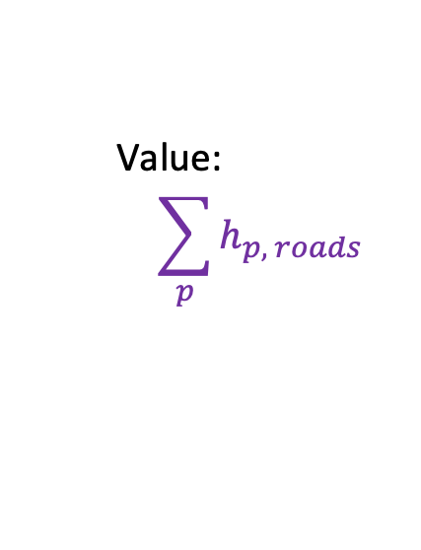
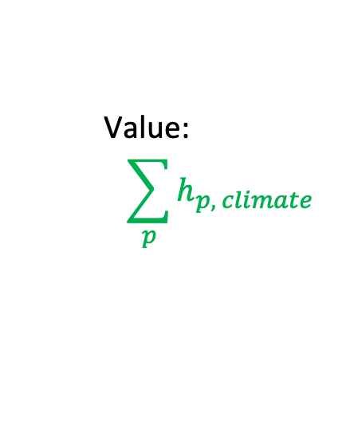
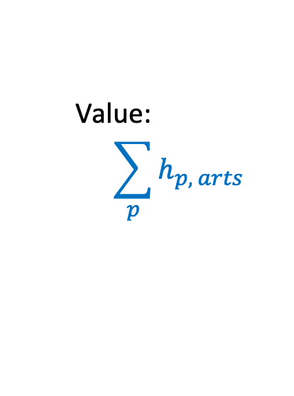
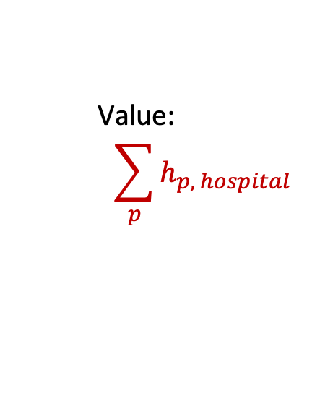
Utilitarianism makes it easy to formulate our problem—right?
…
Road repair
Hospital expansion
Arts endowment
Climate mitigation
🛣️
🏥
🎨
🌎
Cost (weight):
$W (per unit)
Cost (weight):
$X (per unit)
Cost (weight):
$Y (per unit)
Cost (weight):
$Z (per unit)
Value:
$$\sum_{p}{h_{p, roads}}$$
Value:
$$\sum_{p}{h_{p, hospital}}$$
Value:
$$\sum_{p}{h_{p, arts}}$$
Value:
$$\sum_{p}{h_{p, climate}}$$
Okay… but how do we evaluate these sums?

Slide 23

Utilitarianism: measurement problems
How do we measure happiness?
Even harder: how do we measure happiness precisely enough to allow for commensurability?
How do we measure the happiness of future people when we don’t know what the future holds, or when it depends on what we do now?
Notes:
The return of measurement problems!

Slide 24
Case Study: Effective Altruism
Effective Altruism (EA) is a social movement, often inspired by utilitarian thinking, that advocates doing the most good possible with your charitable giving
In the 2010s, EA consensus was that the way to do this was to donate to efforts to prevent malaria
Malaria kills lots of people and can be prevented with cheap mosquito nets—lots of bang for the buck, happiness-wise!

Slide 25
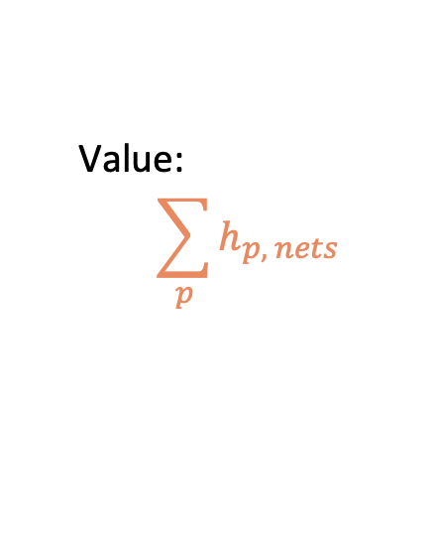
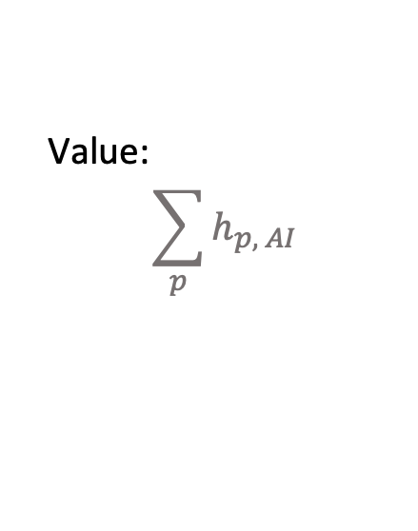
Case Study: Effective Altruism
Recently, many EAs have endorsed longtermism: the idea that we can do more good by trying to improve the lives of people in the distant future
The way to do this, many of them claim, is by investing in safeguards to prevent AI from taking over the world and killing us all
Mosquito Nets
Stop Killer Robots
🦟
Cost (weight):
$5n
Cost (weight):
$X
🤖
Value:
$$\sum_{p}{h_{p, nets}}$$
Value:
$$\sum_{p}{h_{p, AI}}$$
= h_{life} * n
= h_{life} * 10⁵⁸ * c
Notes:
Basically, the EA are doing our knapsack problem. You have some amount to donate, and you have to decide the most valuable way to distribute it.
There are philosophers out there right now who are trying to do and compare these sums! Some longtermists estimate that if humanity survives long enough, there could eventually be 10^58 people (almost all living only digitally, in virtual realities, of course).

Slide 26

Utilitarianism is just the tip of an iceberg
The top-line view is seductively simple: produce as much happiness as you can
But this simplicity is deceptive: below the surface are hard questions about how happiness can be measured and compared (especially at global scale!)
That doesn’t mean utilitarianism is false. Morality is complex! But it’s not a silver bullet that makes value judgments easy
(Is it really more helpful than pluralism?)
Notes:
And hard questions about how many people will exist in the future, etc.

Slide 27
… and is utilitarianism even true?
Whoo boy, I don’t even know, and trying to answer questions like that one is literally my job
Let’s try an easier one: Why might someone think it’s false? That is, what might be wrong with just trying to maximize overall happiness?
Notes:
Is there more to value or ethics than maximizing overall happiness?

Slide 28

Prioritarianism
Maybe there’s more that matters about happiness than how much there is—maybe it also matters how it’s distributed
The value of a thing x is the weighted sum, over all people, of the happiness it produces:
$$v_{x}=\sum_{p}{{(h}_{p, x})(w_{p})}$$
The worse off you are, the greater your weight—that is, the more value there is in increasing your happiness

Slide 29
Prioritarianism
Prioritarianism doesn’t solve the measurement problems of utilitarianism
And it adds another problem: What’s the function from a person’s level of utility to their weight in the sum?
But if we’re given some happiness numbers and a weight function, we can contrast the two views

Slide 30
Prioritarianism vs Utilitarianism
Suppose we use a simple step function: people who are more well off than average have a weight of 1, while people less well off have a weight of 2
Road repair
Hospital expansion
🛣️
🏥
Value: 10 util for each of all 1mm citizens
Value: 1000 util for each of 9,000 citizens
… who are all less well-off than average

Slide 31
Value beyond utility
Maybe some things, like the environment or artistic achievement, have value beyond their effect on human happiness
If we think this, we are saying that utilitarianism or prioritarianism is incomplete. We are back to the pluralist view we started with: there are multiple values that we need to weigh against each other
🎨
🌎

Slide 32
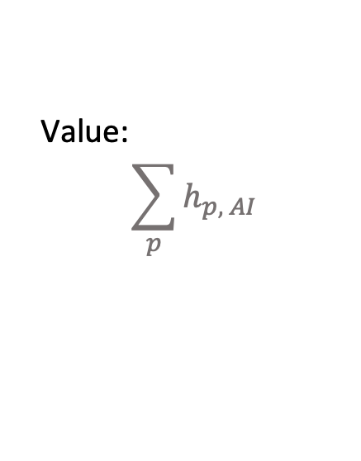
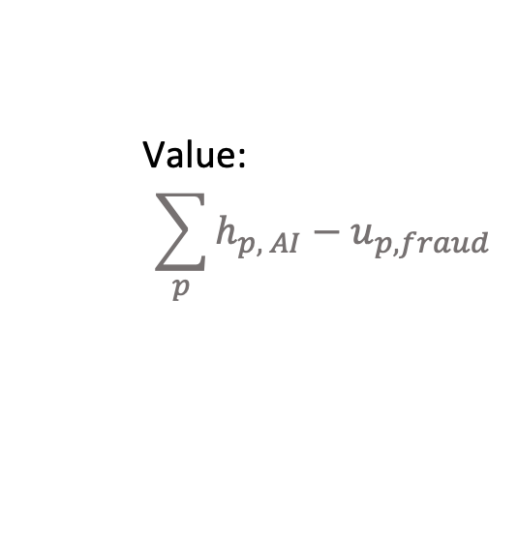
Constraints on pursuing the good
But we might go even further: we might think that value judgments are shaped not just by the values to be weighed, but also by values that can’t be weighed against others
Stop Killer Robots
Stop Killer Robots by Defrauding Customers
Cost (weight):
$Y (per unit)
🤖
Cost (weight):
$0 (per unit)
🤖
Value:
$$\sum_{p}{h_{p, AI}}$$
Value:
$$\sum_{p}{h_{p, AI}}−u_{p, fraud}$$
Notes:
If you’re a utilitarian, the fraud only makes a difference if it causes enough unhappiness. But it might not, especially if the other terms are huge. Still, you might think that it’s just wrong to defraud people, no matter what good you can accomplish by doing so.

Slide 33
Constraints on pursuing the good
…
Road repair
Hospital expansion
Arts endowment
Climate mitigation
🛣️
🏥
🎨
🌎
Cost (weight):
$W (per unit)
Cost (weight):
$X (per unit)
Cost (weight):
$Y (per unit)
Cost (weight):
$Z (per unit)
Value: ???
Value: ???
Value: ???
Value: ???
Promised: all $N
Considerations like these don’t just weigh against others (like happiness). They seem to override the balance of other considerations
Notes:
What looked like a knapsack problem really wasn’t—we’re not trying to maximize value returned on the $N, we’re obligated to give it to the endowment like we said we would.

Slide 34
Deontology and Rights
Views that have these sorts of constraints are sometimes called deontological
Deontologists think that there are moral principles that shouldn’t be violated no matter how much value we could produce by doing so
Often, these principles are taken to express people’s rights. Rights limit what we can do to people even in pursuit of valuable goals

Slide 35
Deontology and Rights
…
Road repair
Hospital expansion
Arts endowment
Climate mitigation
🛣️
🏥
🎨
🌎
Cost (weight):
$W (per unit)
Cost (weight):
$X (per unit)
Cost (weight):
$Y (per unit)
Cost (weight):
$Z (per unit)
Value: ???
Value: ???
Value: ???
Value: ???
What are some other ways that moral principles or people’s rights might play a role in our decision about how to allocate funding?
Notes:
Maybe you think that, e.g., people have a right to healthcare access, so that you’re obligated to expand the hospital into underserved areas, even if more overall good could be done by allocating the money to road repair.

Slide 36
Today
Value judgments in algorithms: examples ✔️
Philosophical theories for weighing values
Pluralism ✔️
Utilitarianism ✔️
Prioritarianism ✔️
Deontology and rights ✔️
Throughout:
How would these theories help us make the kind of value judgments our algorithms rely on? ✔️
What can these theories not tell us? ✔️

Slide 37
Satisfied? I hope not!
I hope you feel a burning need for answers:
What’s the right way to weigh different people’s interests in deciding what to do?
Why should we care about moral principles or rights if they stop us from doing more good?
How can we know which moral views to accept?

Slide 38
… but I hope you also feel you learned something:
Lots of algorithms—not just sorting—work on input data that have values attached
To solve real-world problems algorithmically, you first need to determine these values
That can be hard to do, even with the help of a theory like utilitarianism!
Measurement problems abound
Utilitarianism might be too simple
It also seems to matter how goods are distributed, and that we respect people’s rights

Slide 39
Embedded Ethics survey!
Coming soon, be on the lookout
Your thoughts on Embedded Ethics in your current courses
First 800 participants get $10 gift card
Whether you choose to participate or not will not affect your grade in any way

Slide 40
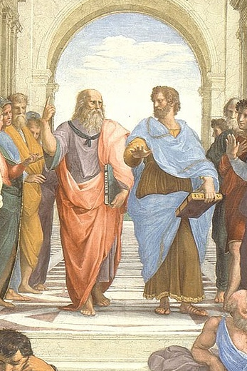
Want to talk more about ethics?
Dan Webber webberdf@stanford.edu
Email to set up a meeting!

