Slide 1

Final Review II CS 161 Winter 25
Ruiquan Gao
Stanford University

Slide 2
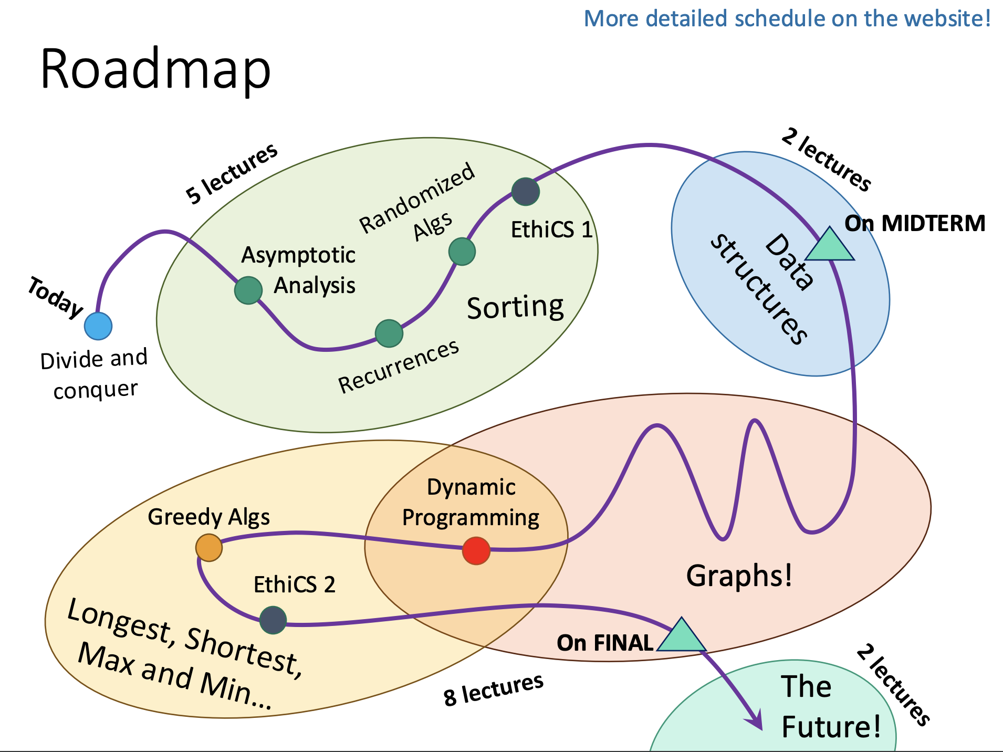

Slide 3
What are the main focuses in final?
Lecture 8~16
Hashing
Graphs (e.g., SCC, shortest paths, MST)
Dynamic Programming
Greedy
Max Flow
Don’t forget about the related sections and past exams!
Notes:
New concepts introduced in the sections are fair games in the exam.
However, they are not the main focus, so we suggest you avoid spending too much time on them.

Slide 4
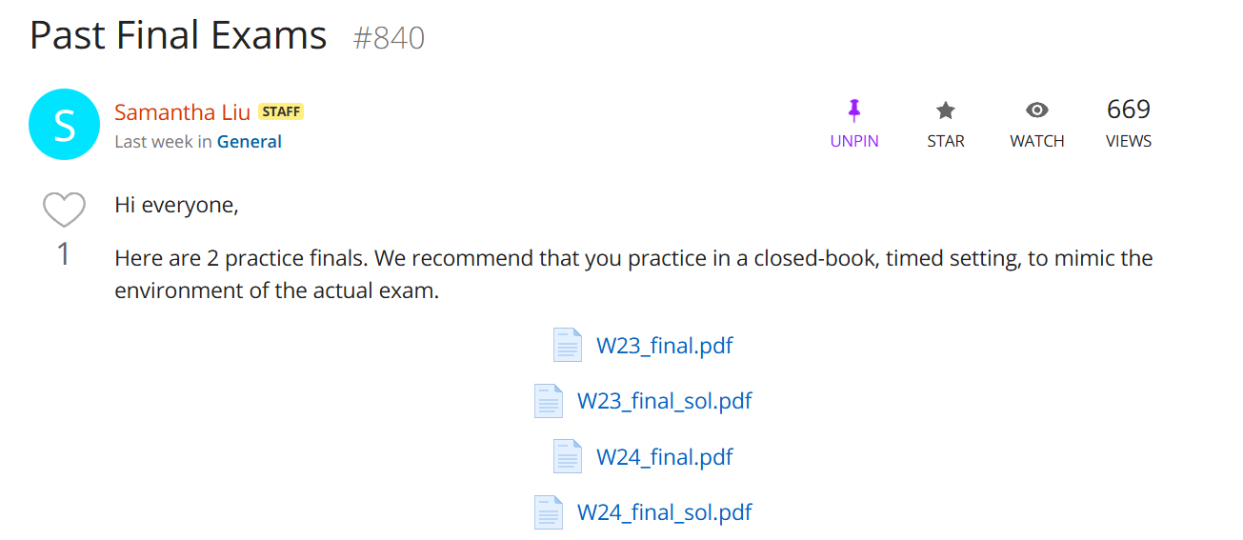
Notes:
(TO replace the screenshot)
Try to practice yourself on these past exams as soon as possible.

Slide 5
Today’s Agenda
Hashing
Graphs (e.g., SCC, shortest paths, MST)
Greedy
Max Flow
Practice Problems

Slide 6
Hashing

Slide 7
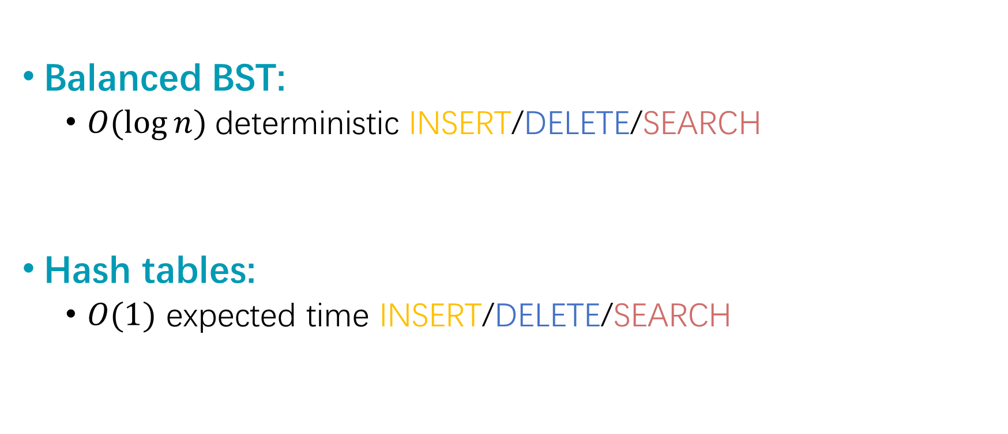
Balanced BST vs Hashing
Balanced BST:
$O(\log{n})$deterministic INSERT/DELETE/SEARCH
Hash tables:
$O(1)$ expected time INSERT/DELETE/SEARCH

Slide 8
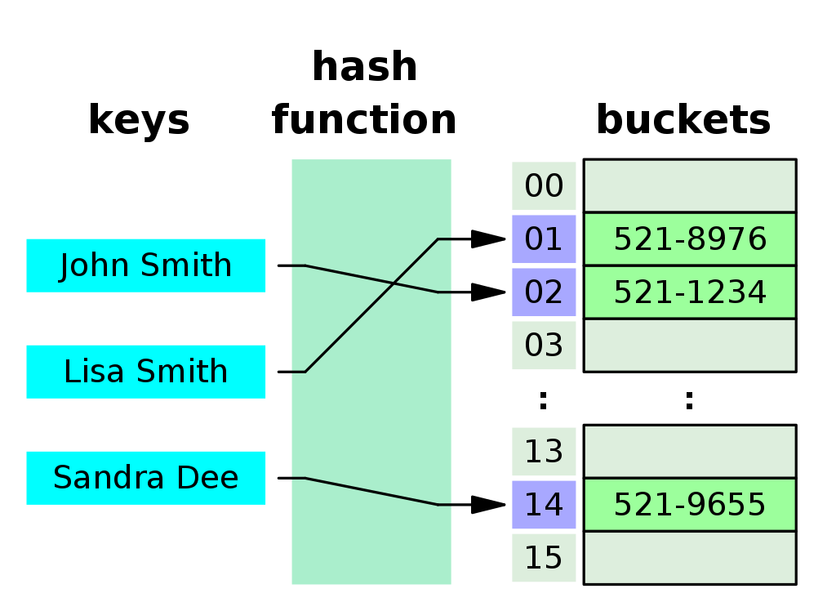
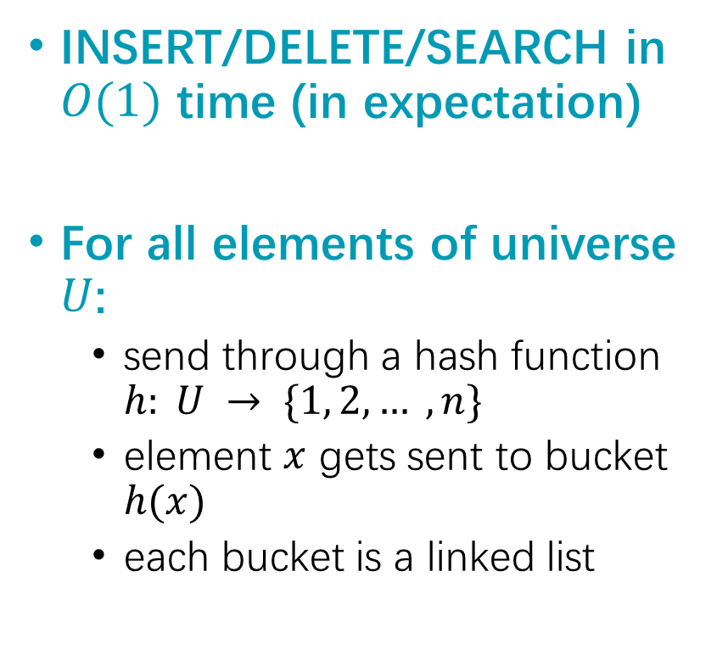
Goal of Hashing
INSERT/DELETE/SEARCH in $O(1)$ time (in expectation)
For all elements of universe $U$:
send through a hash function $h: U → \{1, 2, … , n\}$
element $x$ gets sent to bucket $h(x)$
each bucket is a linked list

Slide 9
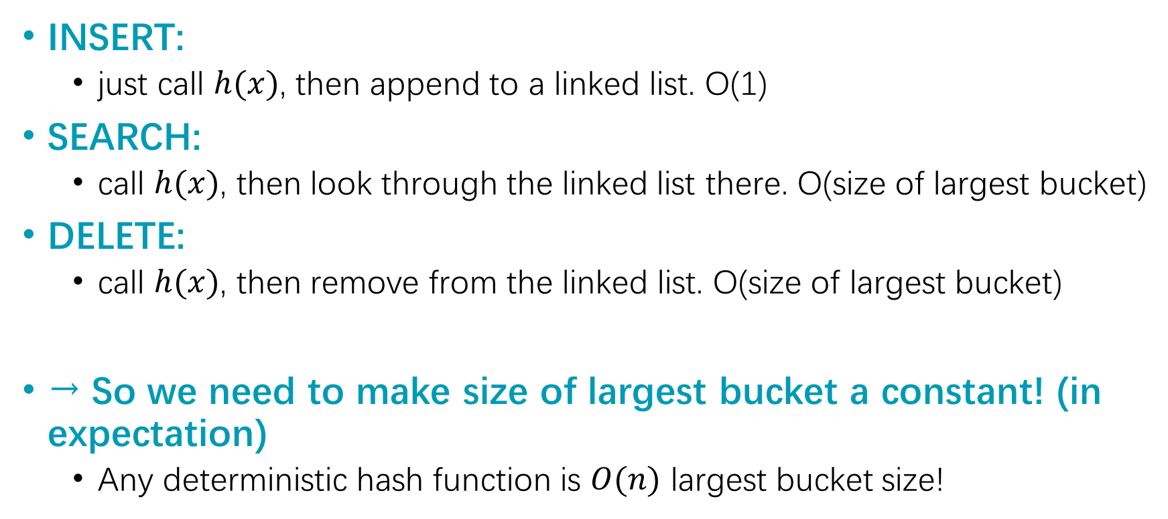
Runtimes
INSERT:
just call $h(x)$, then append to a linked list. O(1)
SEARCH:
call $h(x)$, then look through the linked list there. O(size of largest bucket)
DELETE:
call $h(x)$, then remove from the linked list. O(size of largest bucket)
→ So we need to make size of largest bucket a constant! (in expectation)
Any deterministic hash function is $O(n)$ largest bucket size!

Slide 10
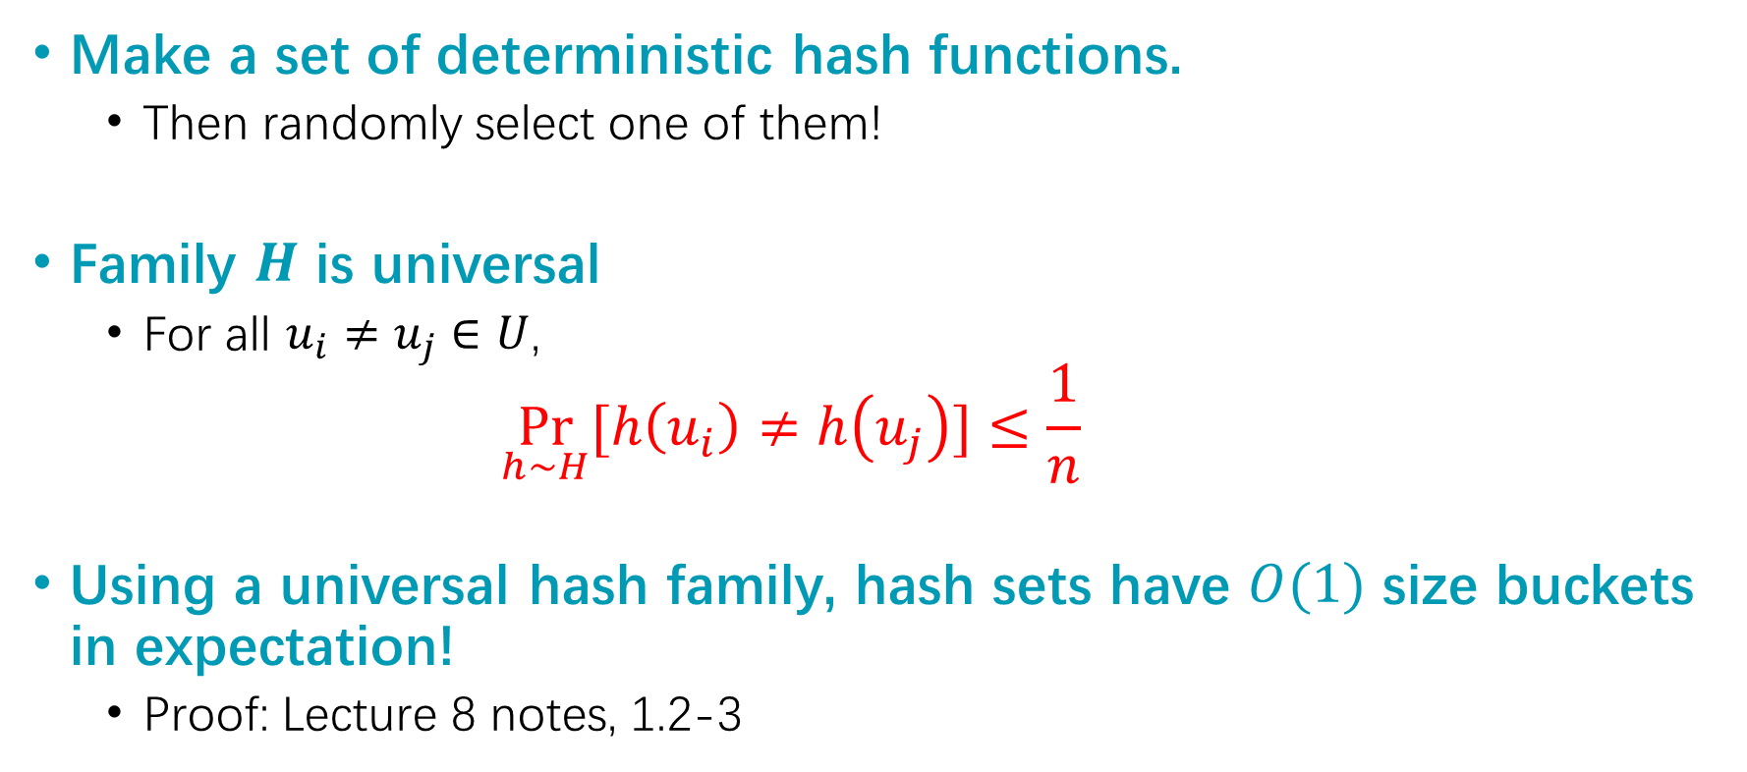
Universal Hash Families
Make a set of deterministic hash functions.
Then randomly select one of them!
Family $H$ is universal
For all $u_{i}≠u_{j}∈U$,
$$\underset{h∼H}{Pr}{[h\left(u_{i}\right)≠h\left(u_{j}\right)]}≤\frac{1}{n}$$
Using a universal hash family, hash sets have $O(1)$ size buckets in expectation!
Proof: Lecture 8 notes, 1.2-3

Slide 11
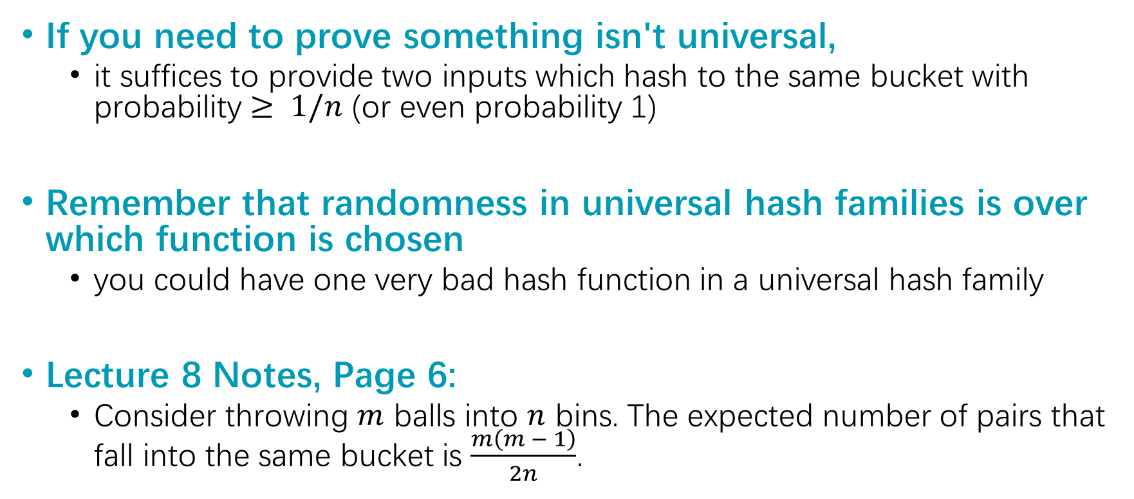
Problem-Solving Tips for Hashing
If you need to prove something isn't universal,
it suffices to provide two inputs which hash to the same bucket with probability $≥ 1/n$ (or even probability 1)
Remember that randomness in universal hash families is over which function is chosen
you could have one very bad hash function in a universal hash family
Lecture 8 Notes, Page 6:
Consider throwing $m$ balls into $n$ bins. The expected number of pairs that fall into the same bucket is $\frac{m\left(m − 1\right)}{2n}$.

Slide 12
Greedy

Slide 13
Definition
Greedy is an algorithmic strategy revolving around "making the locally optimal choice every time"
Recipe as follows:
Make a series of choices
Prove that at each step, our choice doesn't rule out all optimal solutions; we are still "on track" to reach the optimum
After we've made all our choices, we're still "on track" to reach the optimal solution, so we must have found one!
Notes:
Usually easy to come up with a greedy algorithm, and intuitive to informally convince yourself it works (pick the earliest finish time, the most efficient item, etc)
Can be delicate work to rigorously prove correctness via induction

Slide 14
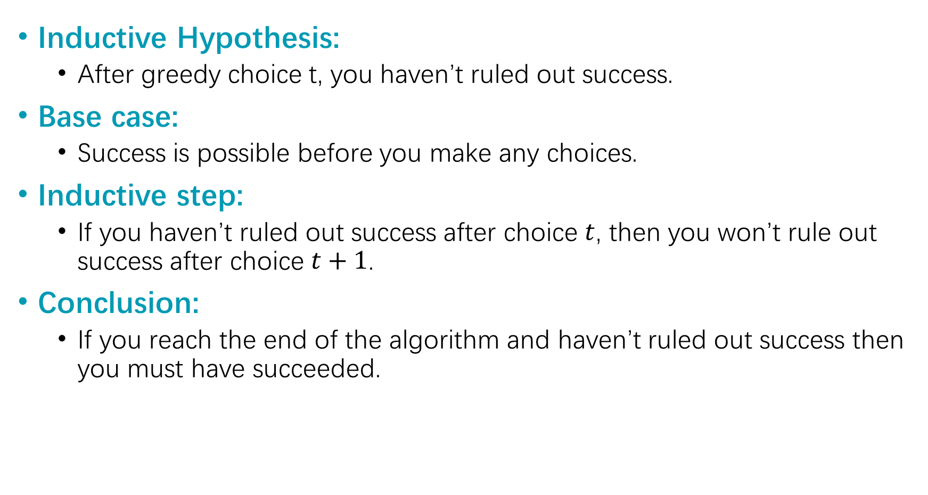
One Common strategy (formally) for greedy algorithms
Inductive Hypothesis:
After greedy choice t, you haven’t ruled out success.
Base case:
Success is possible before you make any choices.
Inductive step:
If you haven’t ruled out success after choice $t$, then you won’t rule out success after choice $t+1$.
Conclusion:
If you reach the end of the algorithm and haven’t ruled out success then you must have succeeded.
“Success” here means “finding an optimal solution.”

Slide 15
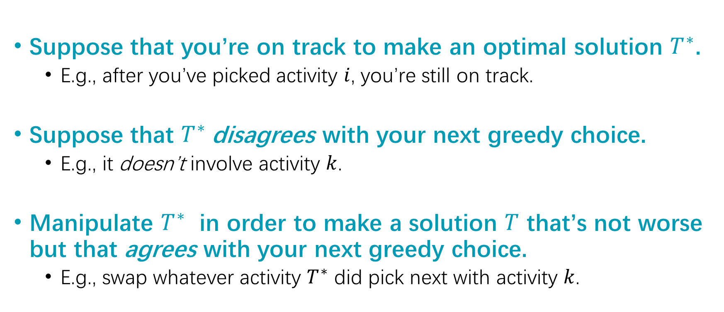
One Common strategy for showing we don’t rule out success
Suppose that you’re on track to make an optimal solution $T^{∗}$.
E.g., after you’ve picked activity $i$, you’re still on track.
Suppose that $T^{∗}$disagrees with your next greedy choice.
E.g., it doesn’t involve activity $k$.
Manipulate $T^{∗}$ in order to make a solution $T$ that’s not worse but that agrees with your next greedy choice.
E.g., swap whatever activity $T^{∗}$ did pick next with activity $k$.
Notes:
Could we go over when to use to proof by contradiction in a proof of correctness for greedy.

Slide 16





Example: Activity Selection
Algorithm
Pick the activity you can add with the smallest finish time.
Inductive step:
You can always replace the first disagreement in any optimal solution $T^{∗}$ by your greedy choice (so that the number of activities does not decrease)
a₅
a₁
$$a_{3}$$
$$a7$$
a₄
a₂
$$a6$$
$$a_{8}$$
time

Slide 17
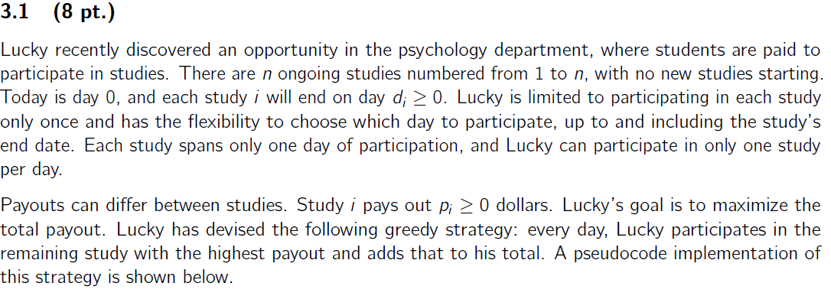
Practice Problems in Exams
Final 2024 Q3
Q3.1 is to find some counter-example
Q3.2 is to analyze the correct algorithm

Slide 18
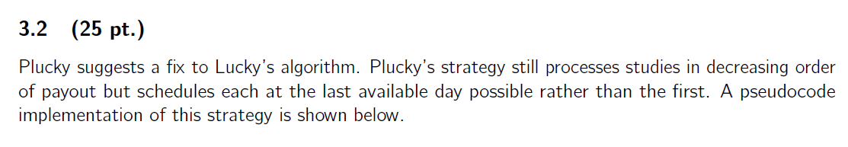
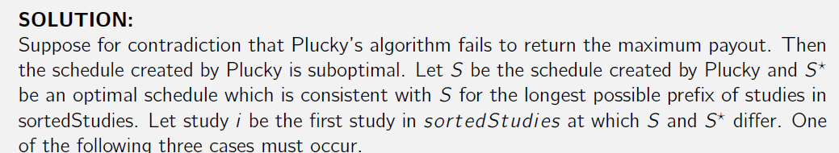
Practice Problems in Exams

Slide 19
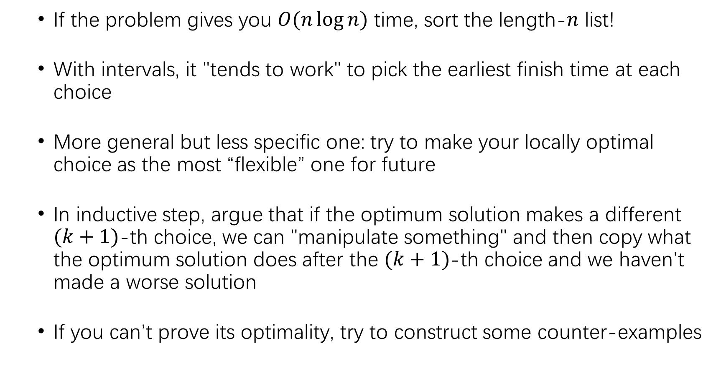
Problem-Solving Tips for Greedy
If the problem gives you $O(n\log{n})$ time, sort the length-$n$ list!
With intervals, it "tends to work" to pick the earliest finish time at each choice
More general but less specific one: try to make your locally optimal choice as the most “flexible” one for future
In inductive step, argue that if the optimum solution makes a different $(k+1)$-th choice, we can "manipulate something" and then copy what the optimum solution does after the $(k+1)$-th choice and we haven't made a worse solution
If you can’t prove its optimality, try to construct some counter-examples

Slide 20
Graphs

Slide 21
For every graph algorithm …
Does it work with
Weighted / unweighted edges?
Directed / undirected edges?
Negative edge weights?
Example:
Dijkstra algorithm only works for non-negative edge weights
Bellman-Ford & Floyd-Warshall works for negative edge weights

Slide 22
Concepts
Graphs
Undirected, directed, weighted, unweighted
Adjacency matrix, adjacency list
DFS & BFS
Topological sorting, in-order traversals of BST
Shortest path on unweighted graphs, testing bipartiteness
(Strongly) connected component

Slide 23
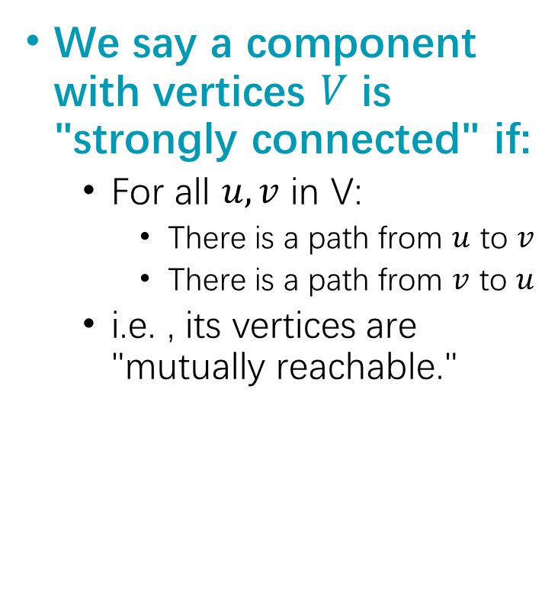
Strongly Connected Component (SCC)
We say a component with vertices $V$ is "strongly connected" if:
For all $u,v$ in V:
There is a path from $u$ to $v$
There is a path from $v$ to $u$
i.e. , its vertices are "mutually reachable."

Slide 24
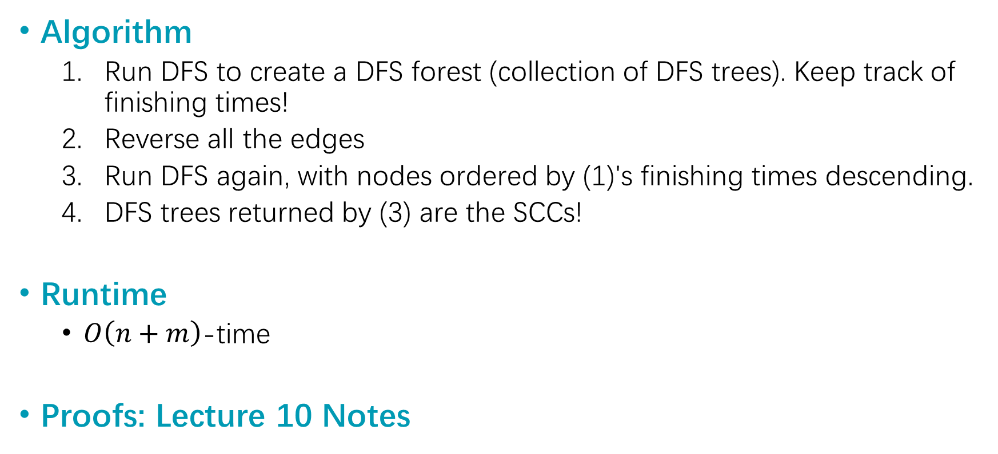
Kosaraju's Algorithm
Algorithm
Run DFS to create a DFS forest (collection of DFS trees). Keep track of finishing times!
Reverse all the edges
Run DFS again, with nodes ordered by (1)'s finishing times descending.
DFS trees returned by (3) are the SCCs!
Runtime
$O\left(n+m\right)$-time
Proofs: Lecture 10 Notes
SCC-DAG
“treat each SCC like a node”
even if G might have cycles, if we SCC-ify it, the resultant graph is a DAG
Notes:
Easy to visualize SCCs as cliques or cycles
In any question that says the word "connectedness" or any of its variants, consider transforming into an SCC-DAG
In questions where cycles present problems, or are a separate case you'd like to avoid, consider transforming into an SCC-DAG

Slide 25
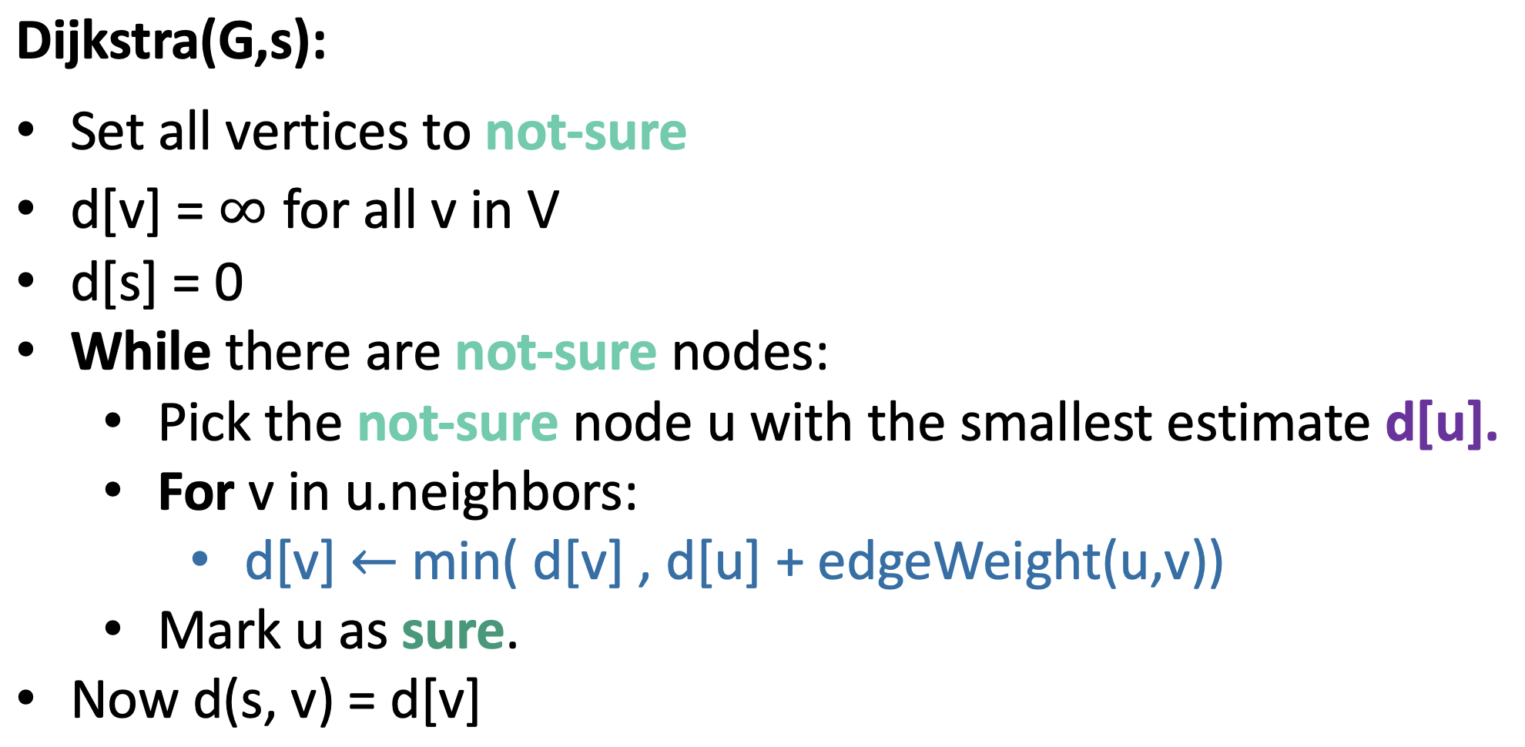
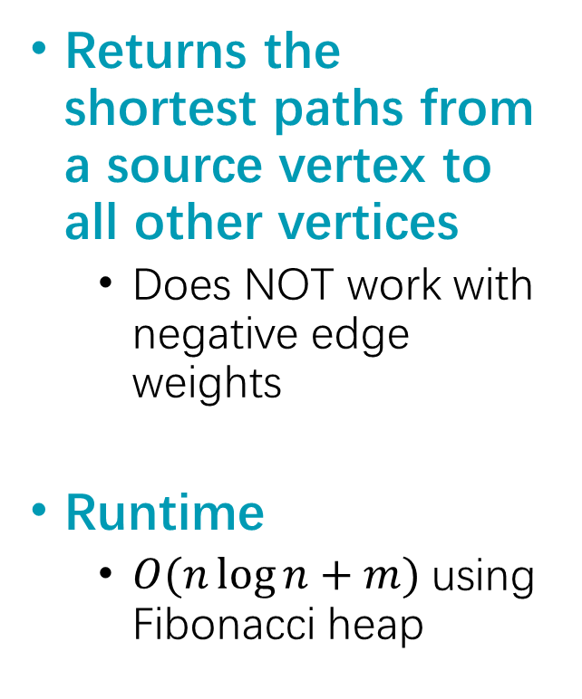
Dijkstra
Returns the shortest paths from a source vertex to all other vertices
Does NOT work with negative edge weights
Runtime
$O(n\log{n}+m)$using Fibonacci heap

Slide 26
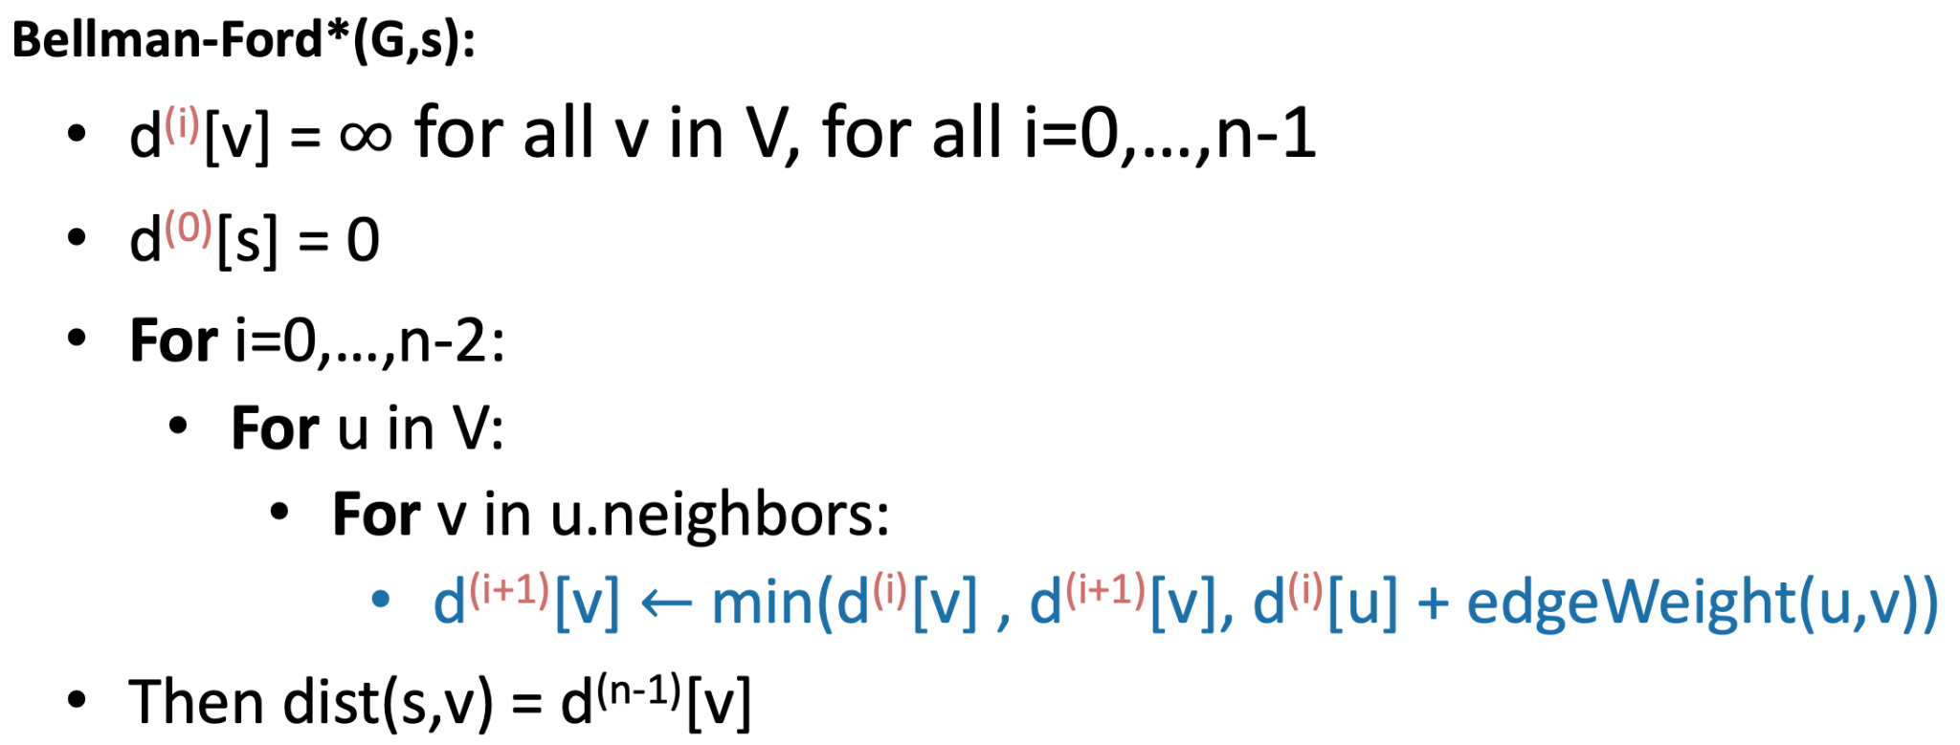
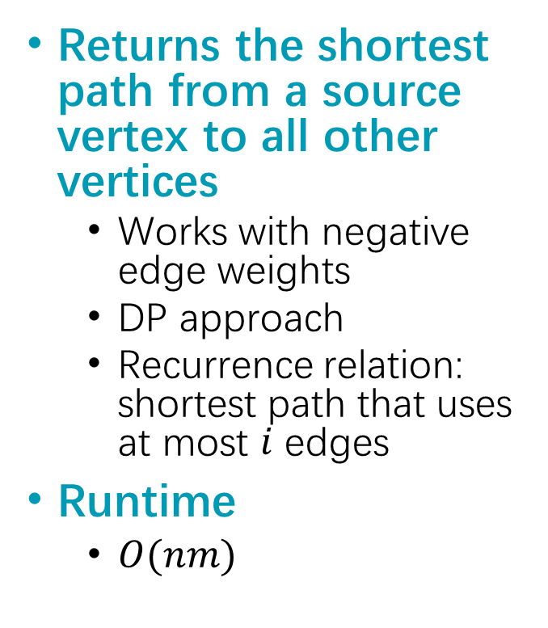
Bellman-Ford
Returns the shortest path from a source vertex to all other vertices
Works with negative edge weights
DP approach
Recurrence relation: shortest path that uses at most $i$ edges
Runtime
$O(nm)$

Slide 27
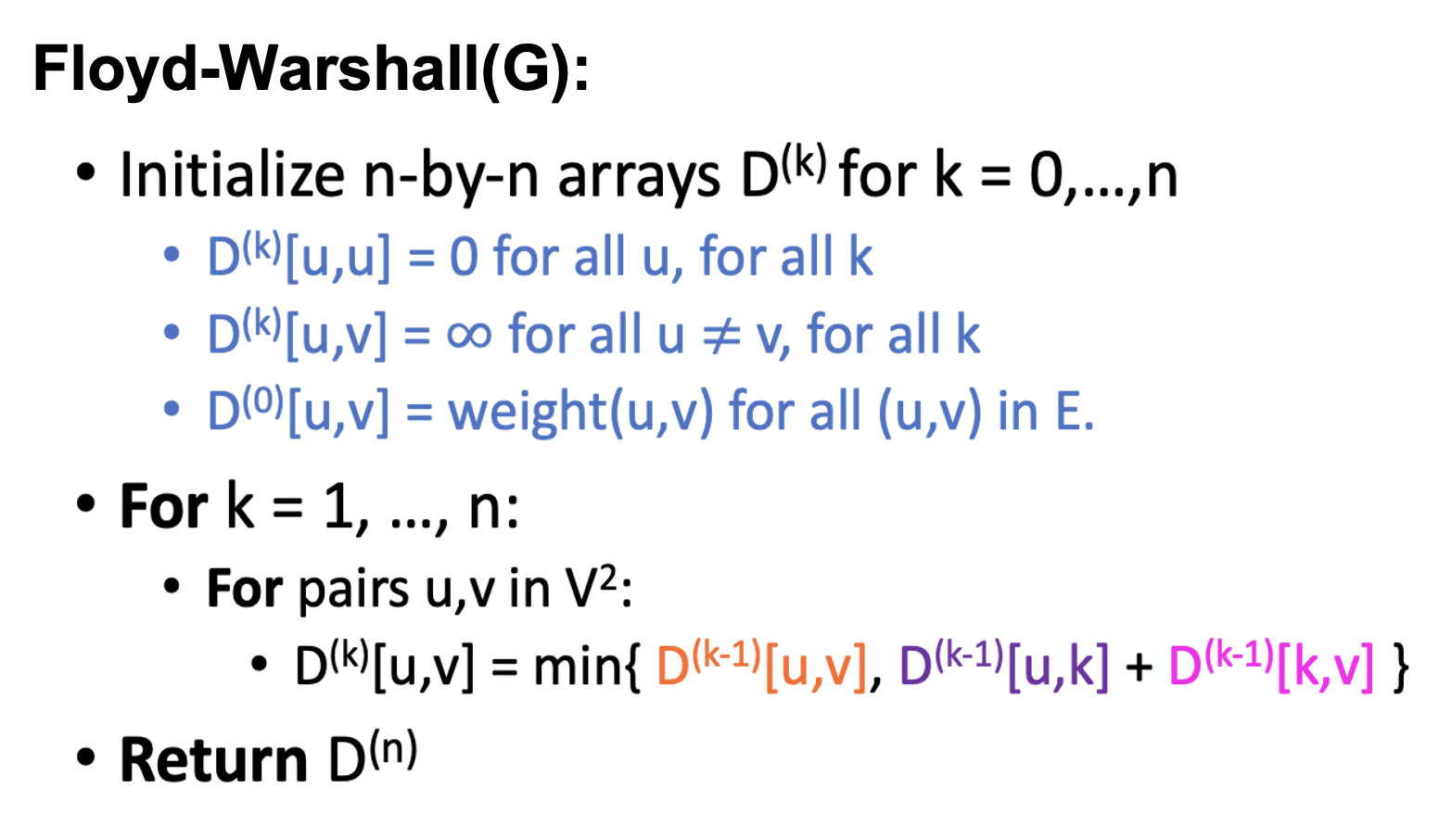
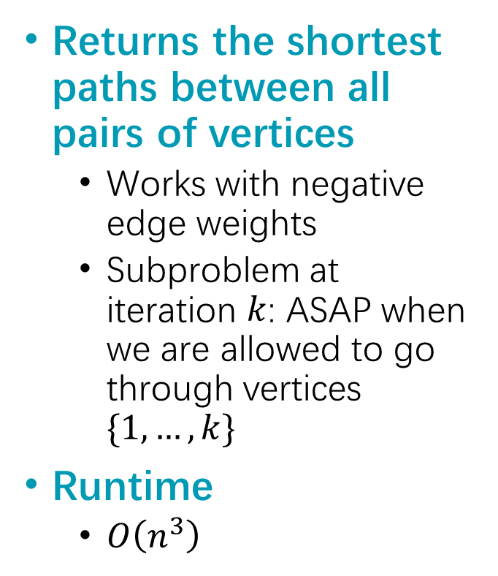
Floyd-Warshall
Returns the shortest paths between all pairs of vertices
Works with negative edge weights
Subproblem at iteration $k$: ASAP when we are allowed to go through vertices $\{1,…,k\}$
Runtime
$O\left(n^{3}\right)$

Slide 28
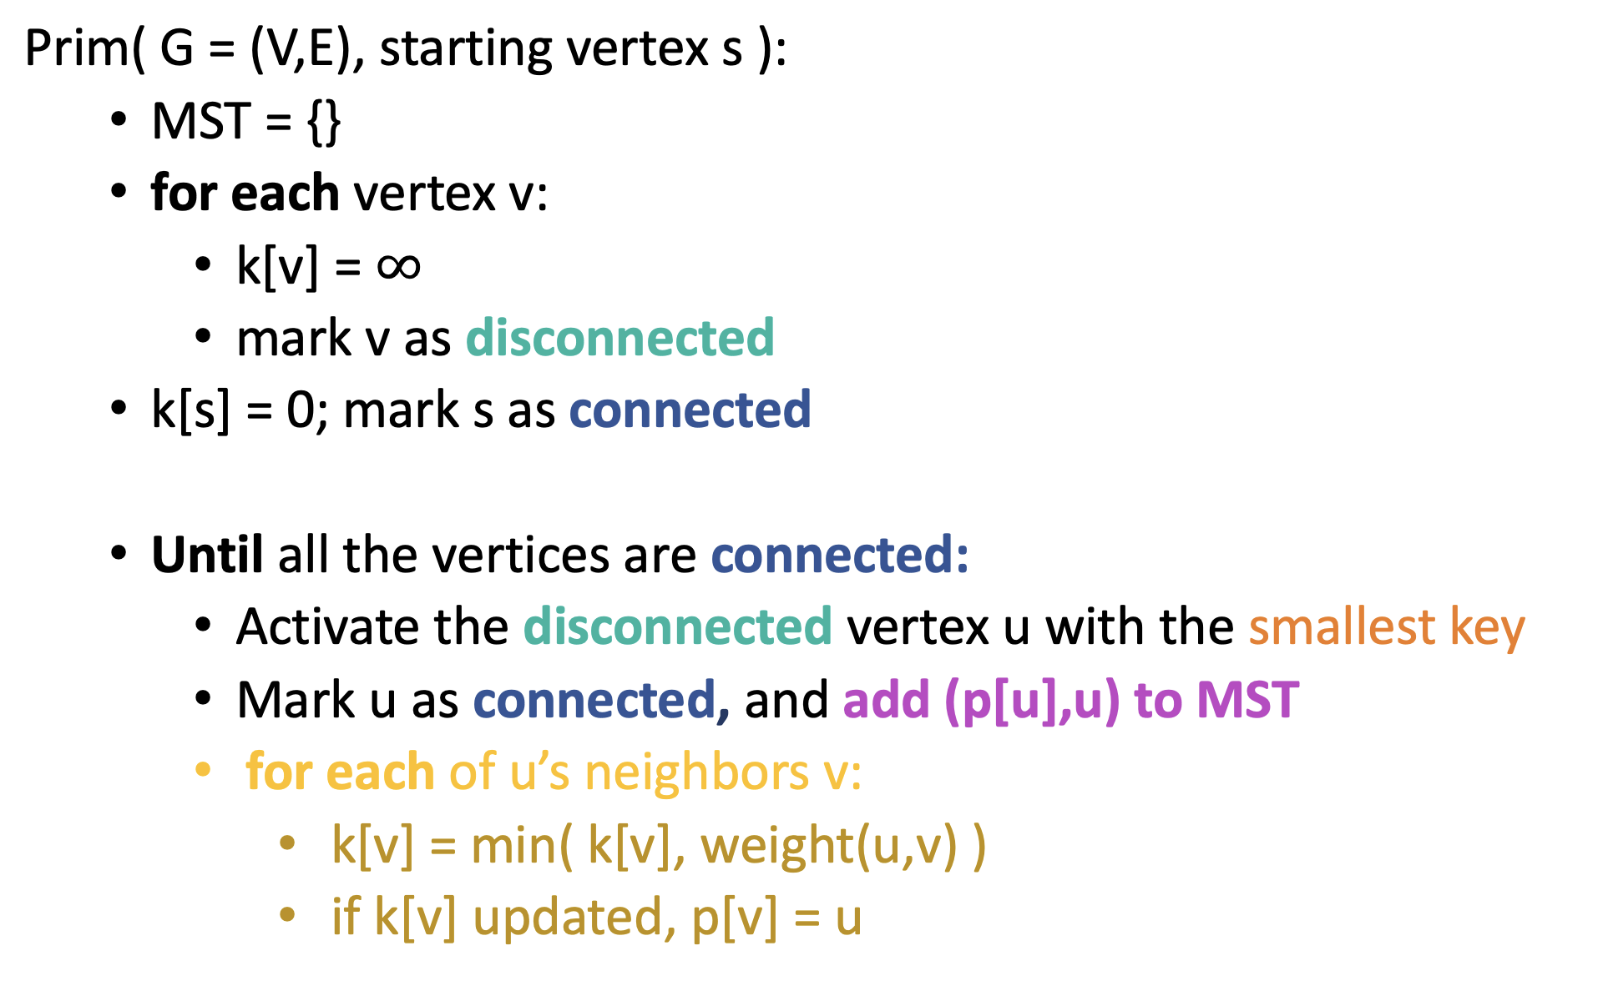
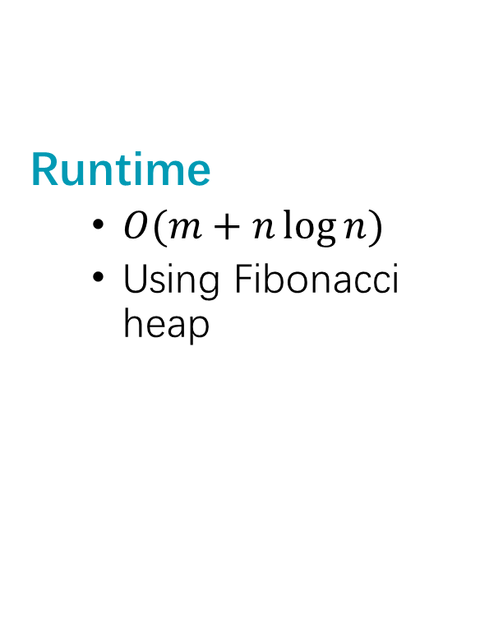
Prim
Runtime
$O(m+n\log{n})$
Using Fibonacci heap

Slide 29
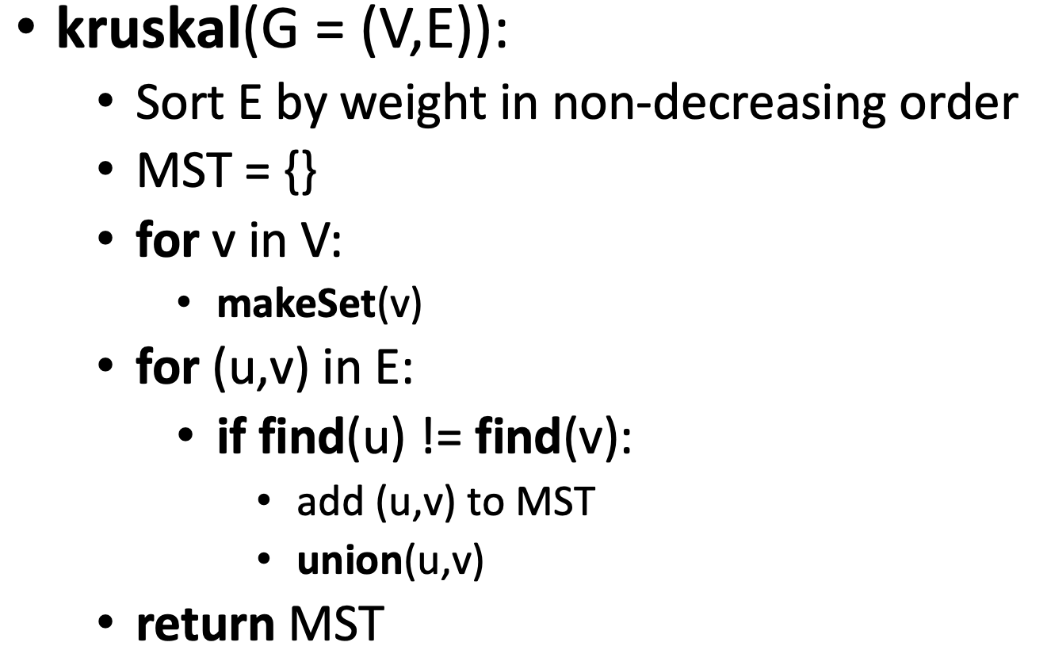
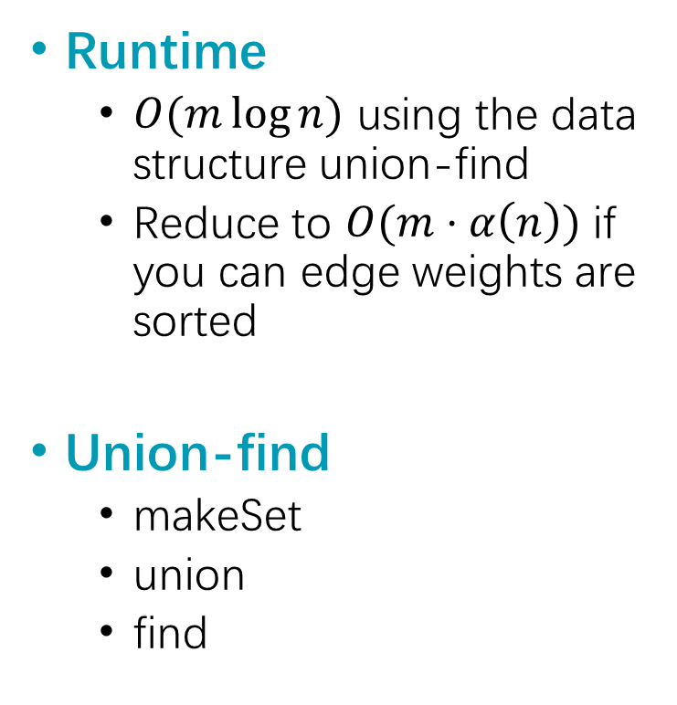
Kruskal
Runtime
$O(m\log{n})$ using the data structure union-find
Reduce to $O(m⋅α\left(n\right))$ if you can edge weights are sorted
Union-find
makeSet
union
find

Slide 30
Max Flow

Slide 31
Max Flow A flow of maximum value
A Flow
Each edge has a flow, less than its capacity
At each vertex, other than s, t, the incoming flows must equal the outgoing flows.
Value: the amount of stuff coming out of s (the amount of stuff flowing into t)
3
3
3
4
4
6
2
1
4
6
2
4
s
2
3
4
t
3
5
2
6
3
1
6
4
4
5
10

Slide 32
Min Cut A minimum cut separating s from t
The value of a max flow from s to t
is equal to
the cost of a min s-t cut.
A cut separating s from t
An edge crosses the cut if it goes from s’s side to t’s side.
The cost (or capacity) of a cut is the sum of the capacities of the edges that cross the cut.
This cut has cost
4 + 3 + 4 = 11
3
4
4
6
2
6
2
4
s
t
3
2
6
3
4
6
10

Slide 33
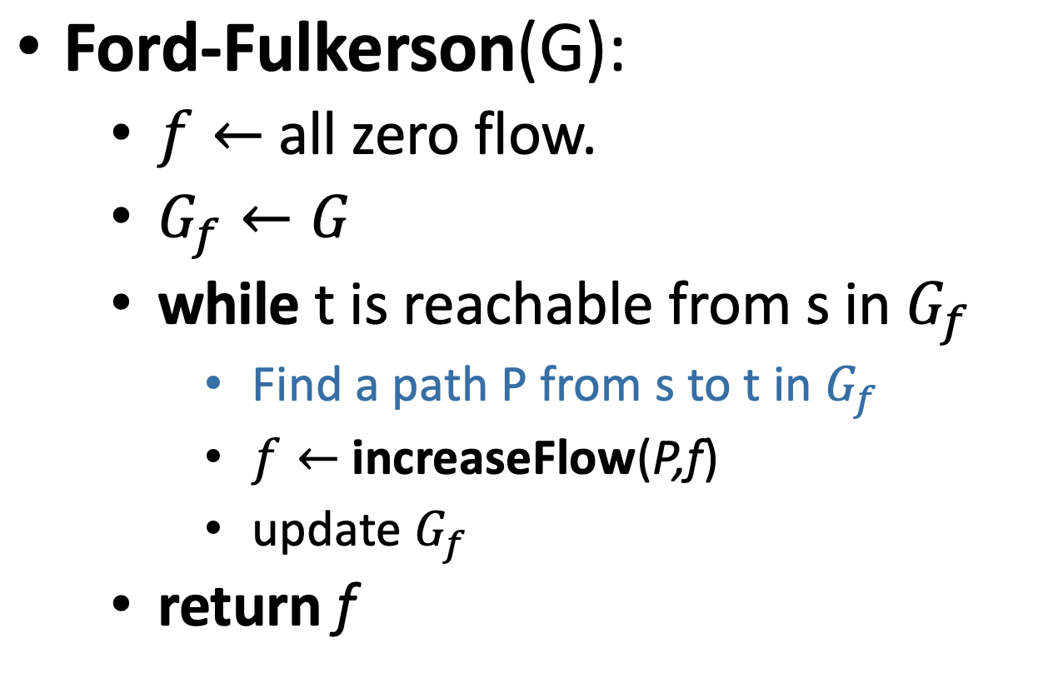


Ford-Fulkerson
Residual graph
Make sure you know how to draw a residual graph, find an augmenting path, and update the flow using that path
a
a
2
1
1
2
1
3
6
5
t
s
1
t
s
7
7
1
2
b
1
b
Call this graph $G_{f}$
Call this graph $G_{f}$

Slide 34
Maximum Bipartite Matching
1
All edges have capacity 1.
1
1
1
s
1
1
t
1
1
1
1
1
1
Stanford Students
Stanford Swag

Slide 35
Additional Tips

Slide 36
Draw Examples for …
BFS and DFS yielding the same / different trees
A graph with negative edge weights that makes Dijkstra return the wrong result
Prim and Kruskal yielding the same / different MST’s
An MST that’s different from the tree formed by the shortest paths from a source vertex
A graph that makes FF run really slowly if it chooses certain paths
The minimum cut, given the maximum flow graph

Slide 37
Final tips
Practice yourself!
Do practice exam 1 timed, with your completed cheatsheet
Review the homeworks and handouts; focus on big ideas
Looking at the runtime for an algo, can you recall where each component comes from in the code?
During the final:
Try the algorithm on examples
Start as small as you can, add your own edge cases
Focus on writing a correct algorithm first => identify the bottleneck in runtime => make it faster
Runtime could be a clue on which algorithm to use

Slide 38
More Exercises

Slide 39
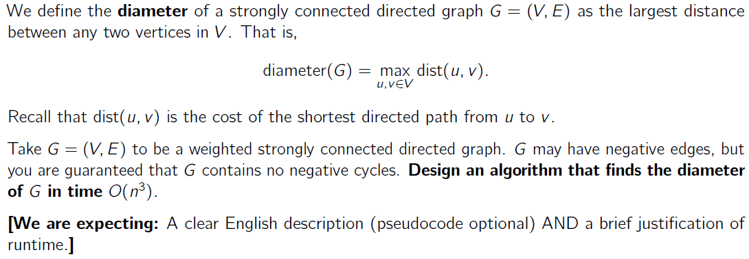
Final 2024 – Q5.1

Slide 40
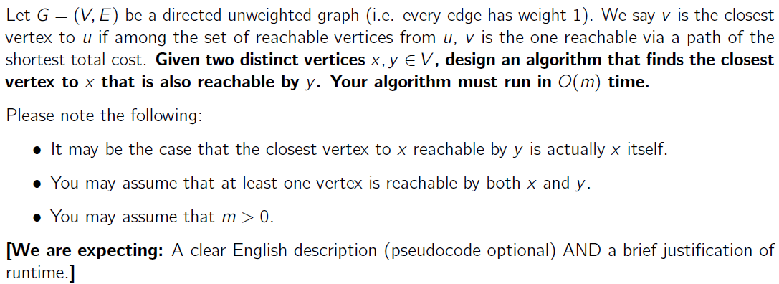
Final 2024 – Q5.2

Slide 41
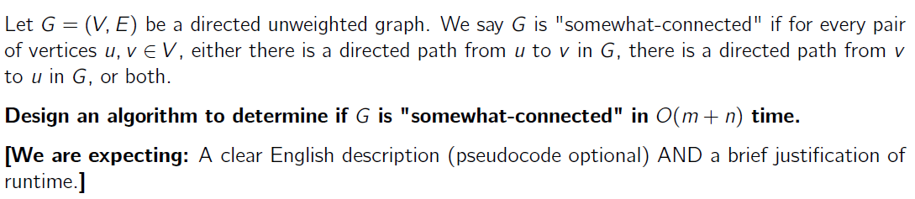
Final 2024 – Q5.3

Slide 42
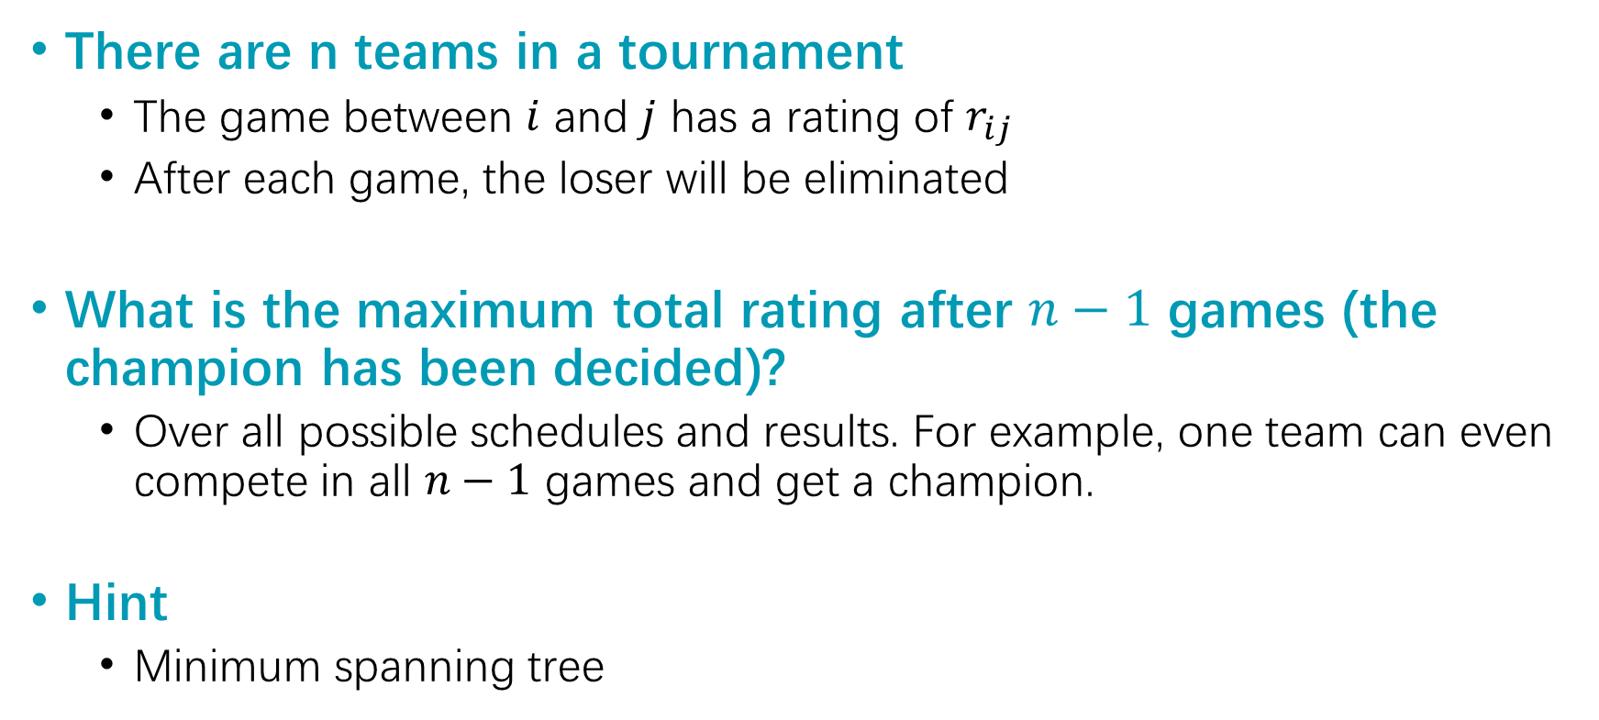
Q1
There are n teams in a tournament
The game between $i$ and $j$ has a rating of $r_{ij}$
After each game, the loser will be eliminated
What is the maximum total rating after $n−1$ games (the champion has been decided)?
Over all possible schedules and results. For example, one team can even compete in all $n−1$ games and get a champion.
Hint
Minimum spanning tree

Slide 43
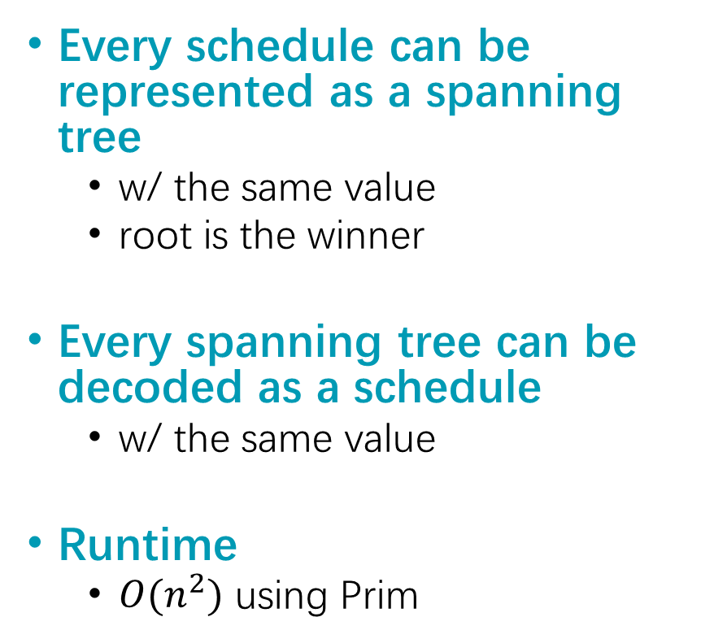
Q1 - Solution
B
C
D
Every schedule can be represented as a spanning tree
w/ the same value
root is the winner
Every spanning tree can be decoded as a schedule
w/ the same value
Runtime
$O(n^{2})$ using Prim
A
I
E
H
G
F
C
B
F
D
I
E
A
G
H

Slide 44
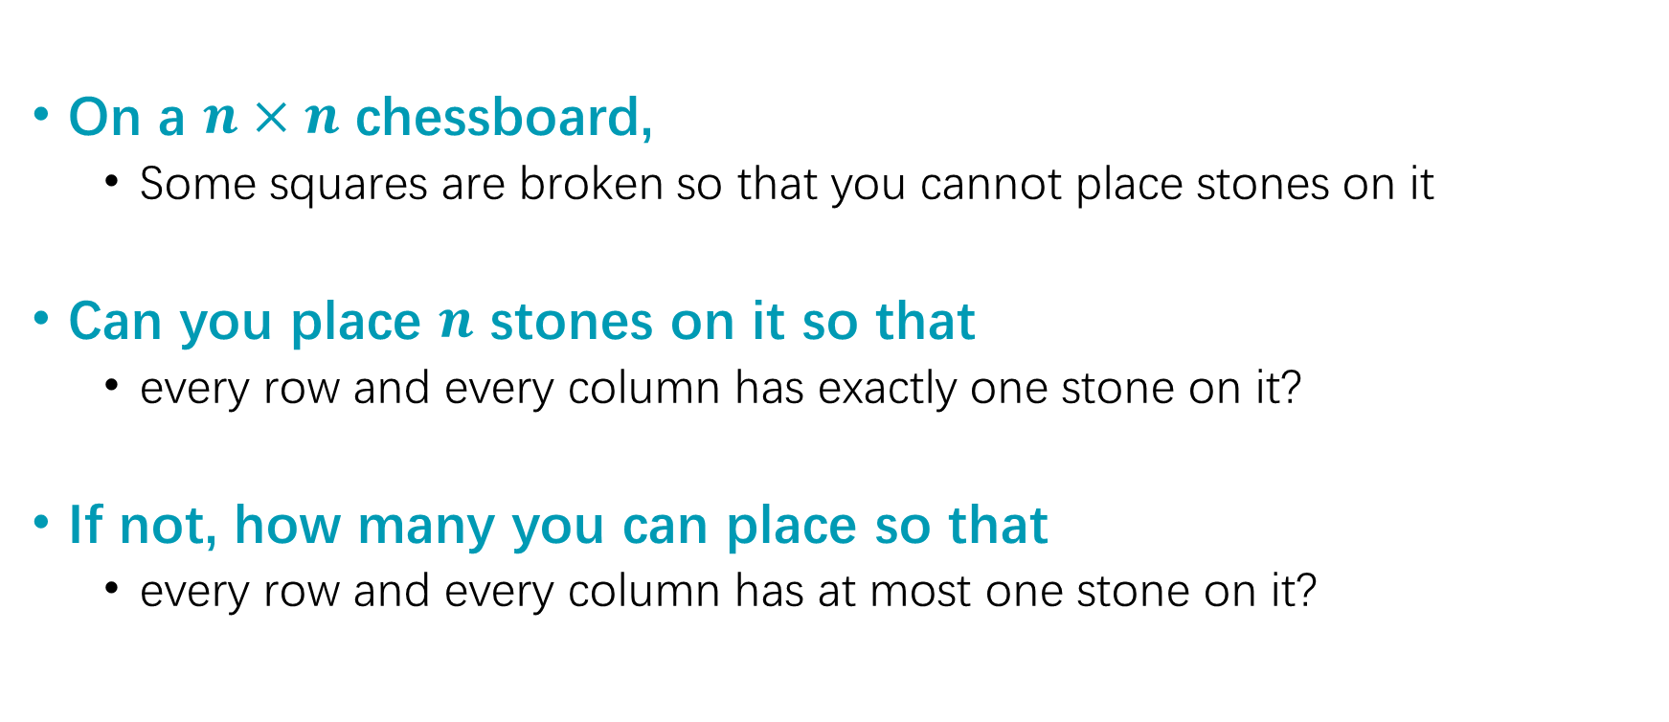
Q2
On a $n×n$ chessboard,
Some squares are broken so that you cannot place stones on it
Can you place $n$ stones on it so that
every row and every column has exactly one stone on it?
If not, how many you can place so that
every row and every column has at most one stone on it?

Slide 45
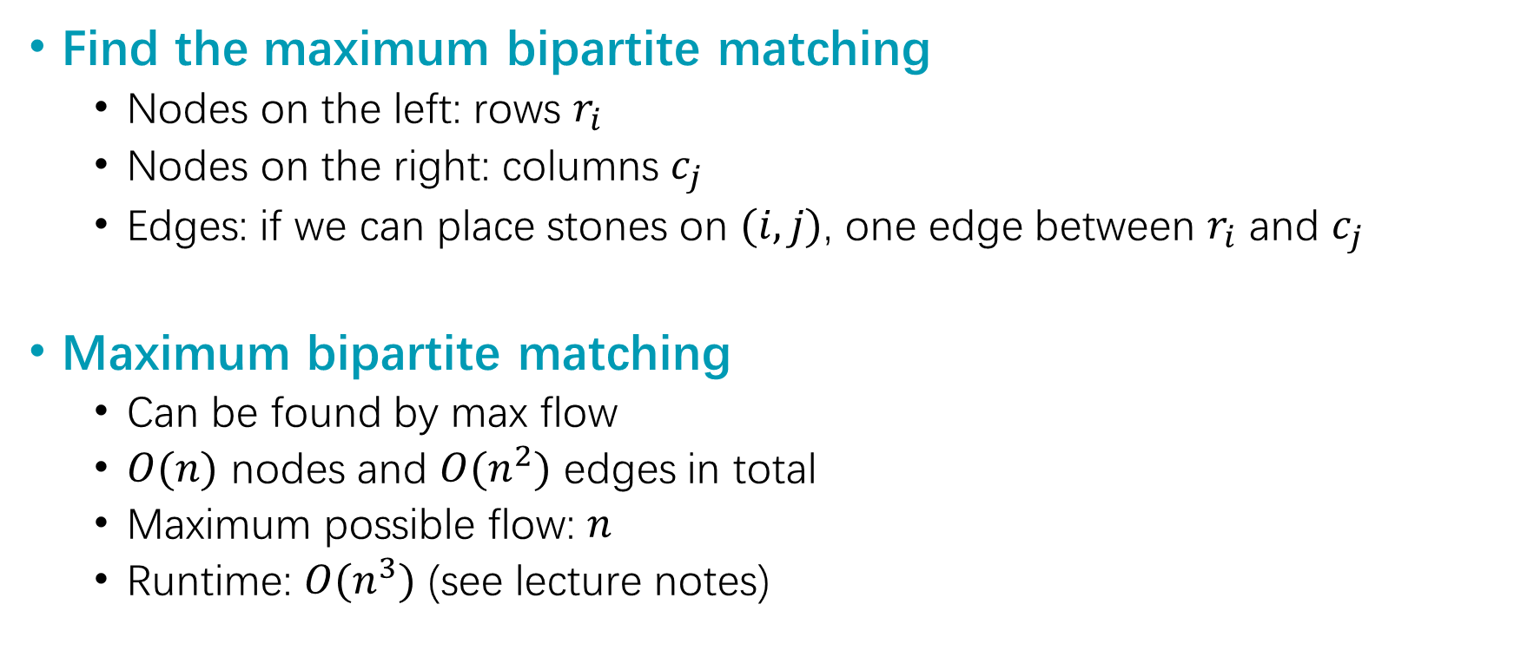
Q2 - Solution
Find the maximum bipartite matching
Nodes on the left: rows $r_{i}$
Nodes on the right: columns $c_{j}$
Edges: if we can place stones on $(i,j)$, one edge between $r_{i}$ and $c_{j}$
Maximum bipartite matching
Can be found by max flow
$O(n)$ nodes and $O(n^{2})$ edges in total
Maximum possible flow: $n$
Runtime: $O(n^{3})$ (see lecture notes)

Slide 46
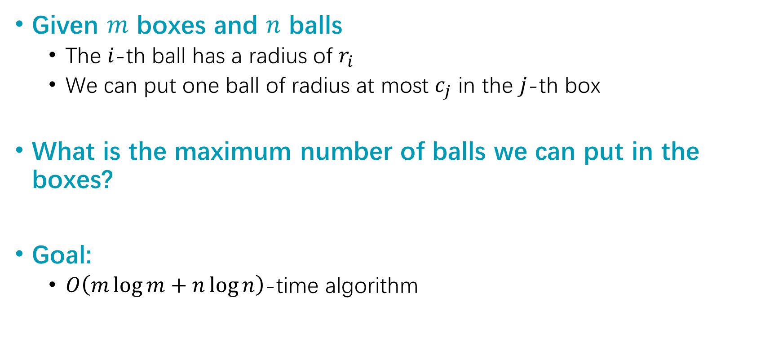
Q3
Given $m$ boxes and $n$ balls
The $i$-th ball has a radius of $r_{i}$
We can put one ball of radius at most $c_{j}$ in the $j$-th box
What is the maximum number of balls we can put in the boxes?
Goal:
$O\left(m\log{m}+n\log{n}\right)$-time algorithm

Slide 47
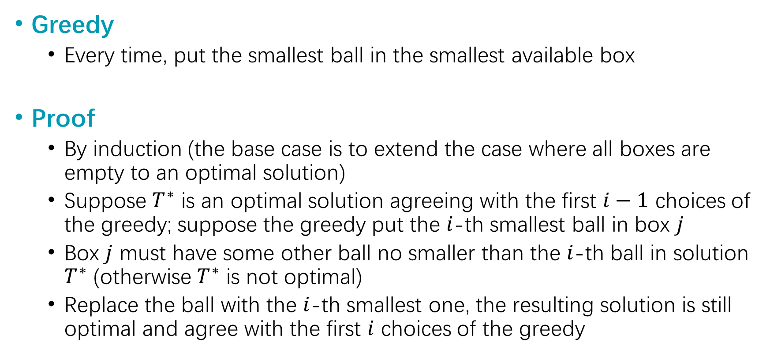
Q3 - Solution
Greedy
Every time, put the smallest ball in the smallest available box
Proof
By induction (the base case is to extend the case where all boxes are empty to an optimal solution)
Suppose $T^{∗}$ is an optimal solution agreeing with the first $i−1$ choices of the greedy; suppose the greedy put the $i$-th smallest ball in box $j$
Box $j$ must have some other ball no smaller than the $i$-th ball in solution $T^{∗}$ (otherwise $T^{∗}$ is not optimal)
Replace the ball with the $i$-th smallest one, the resulting solution is still optimal and agree with the first $i$ choices of the greedy

Slide 48
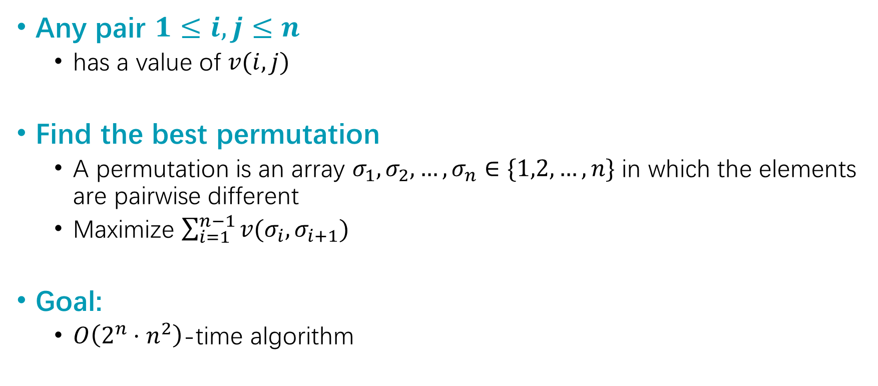
Q4
Any pair $1≤i,j≤n$
has a value of $v(i,j)$
Find the best permutation
A permutation is an array $σ_{1},σ_{2}, …, σ_{n}∈\{1,2,…, n\}$ in which the elements are pairwise different
Maximize $\sum_{i=1}^{n−1}{v(σ_{i},σ_{i+1})}$
Goal:
$O\left(2^{n}⋅n^{2}\right)$-time algorithm

Slide 49
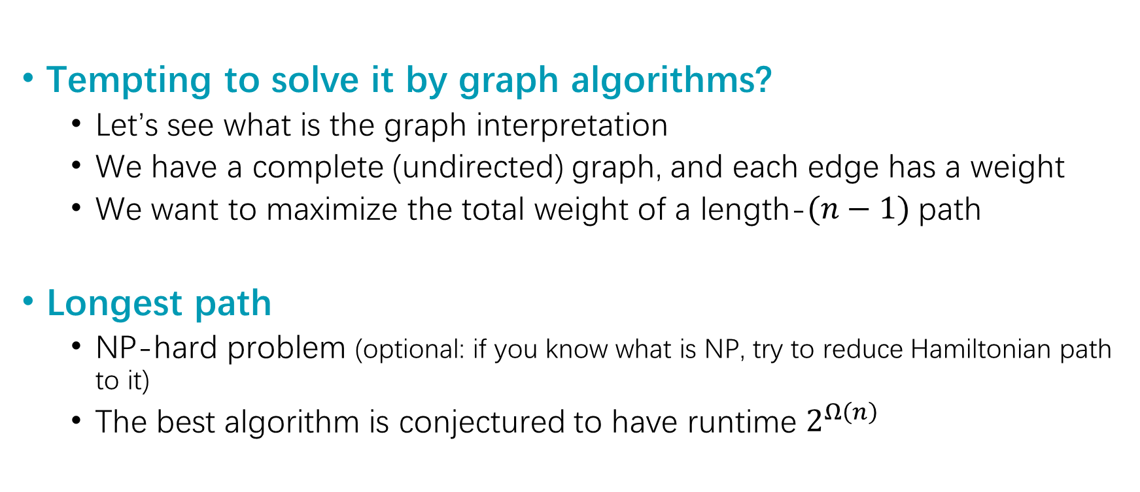
Q4 - Solution
Tempting to solve it by graph algorithms?
Let’s see what is the graph interpretation
We have a complete (undirected) graph, and each edge has a weight
We want to maximize the total weight of a length-$(n−1)$ path
Longest path
NP-hard problem (optional: if you know what is NP, try to reduce Hamiltonian path to it)
The best algorithm is conjectured to have runtime $2^{Ω\left(n\right)}$

Slide 50
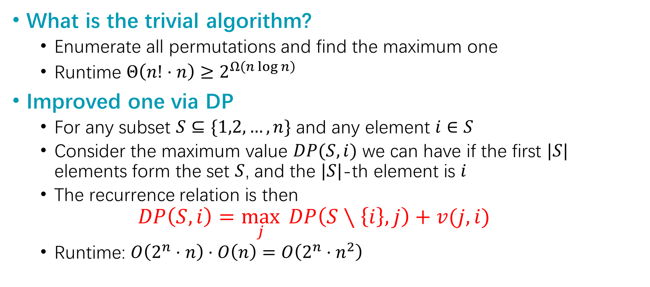
Q4 - Solution
What is the trivial algorithm?
Enumerate all permutations and find the maximum one
Runtime $Θ\left(n!⋅n\right)≥2^{Ω\left(n\log{n}\right)}$
Improved one via DP
For any subset $S⊆\{1,2,…,n\}$ and any element $i∈S$
Consider the maximum value $DP(S,i)$ we can have if the first $|S|$ elements form the set $S$, and the $|S|$-th element is $i$
The recurrence relation is then
$$DP\left(S,i\right)=\max_{j}{ DP\left(S∖\left\{i\right\}, j\right)+v(j,i)}$$
Runtime: $O\left(2^{n}⋅n\right)⋅O\left(n\right)=O\left(2^{n}⋅n^{2}\right)$

Slide 51
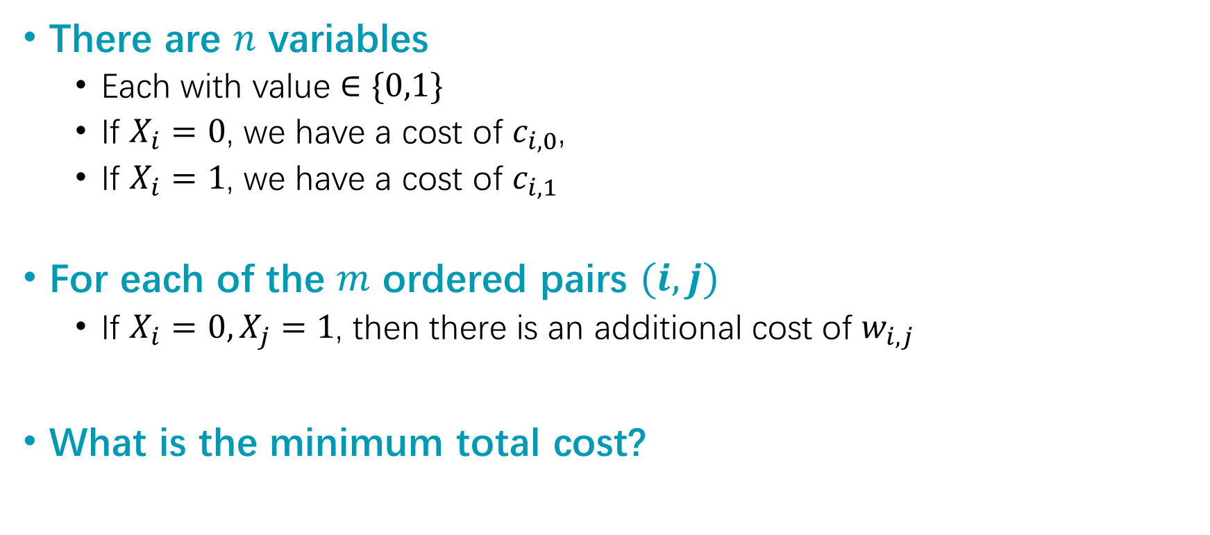
Q5
There are $n$ variables
Each with value $∈\{0,1\}$
If $X_{i}=0$, we have a cost of $c_{i,0}$,
If $X_{i}=1$, we have a cost of $c_{i,1}$
For each of the $m$ ordered pairs $(i,j)$
If $X_{i}=0, X_{j}=1$, then there is an additional cost of $w_{i,j}$
What is the minimum total cost?

Slide 52

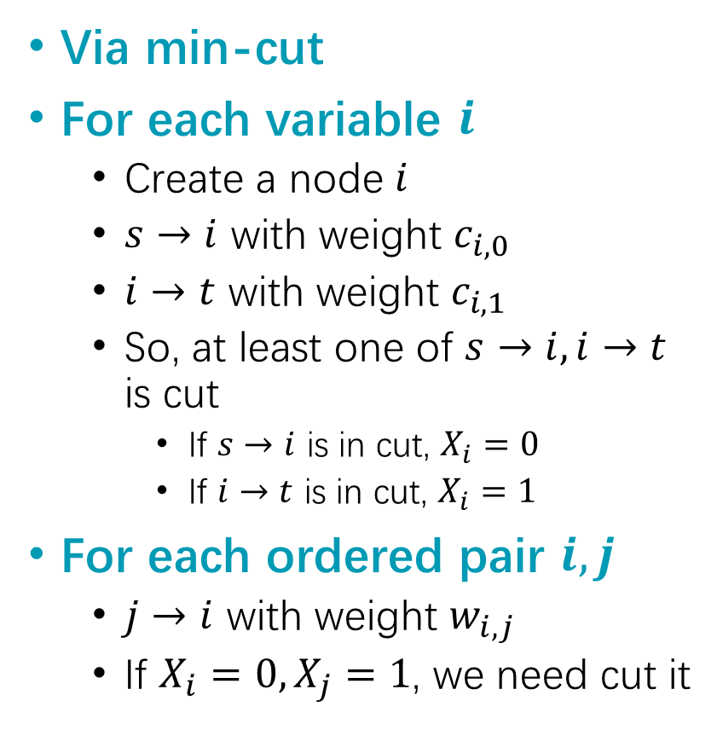
Q5 - Solution
 | 0 | 1
1 | 5 | 2
2 | 3 | 4
Via min-cut
For each variable $i$
Create a node $i$
$s→i$ with weight $c_{i,0}$
$i→t$ with weight $c_{i,1}$
So, at least one of $s→i, i→t$ is cut
If $s→i$ is in cut, $X_{i}=0$
If $i→t$ is in cut, $X_{i}=1$
For each ordered pair $i,j$
$j→i$ with weight $w_{i,j}$
If $X_{i}=0,X_{j}=1$, we need cut it
1
2
5
s
t
1 ordered pair:
(2,1) w/ weight 5
5
3
2
4
$$val=9$$
1
2
5
s
t
1 ordered pair:
(2,1) w/ weight 3
3
3
2
4
$$val=8$$

Slide 53
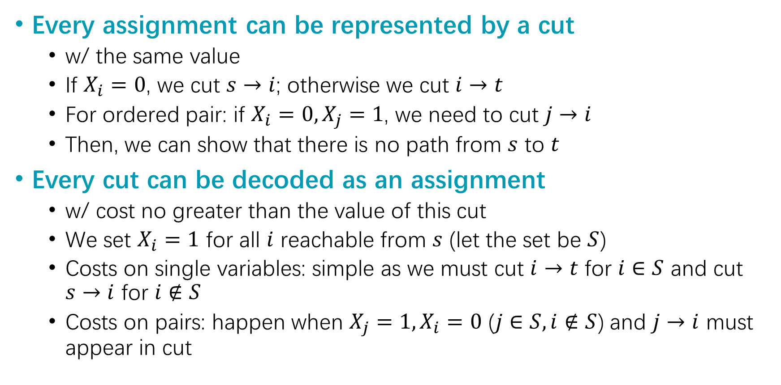
Q5 - Solution
Every assignment can be represented by a cut
w/ the same value
If $X_{i}=0$, we cut $s→i$; otherwise we cut $i→t$
For ordered pair: if $X_{i}=0,X_{j}=1$, we need to cut $j→i$
Then, we can show that there is no path from $s$ to $t$
Every cut can be decoded as an assignment
w/ cost no greater than the value of this cut
We set $X_{i}=1$ for all $i$ reachable from $s$ (let the set be $S$)
Costs on single variables: simple as we must cut $i→t$ for $i∈S$ and cut $s→i$ for $i∉S$
Costs on pairs: happen when $X_{j}=1,X_{i}=0$ ($j∈S, i∉S$) and $j→i$ must appear in cut

Slide 54

Q&A

