Slide 1
Lecture 10
Finding strongly connected components

Slide 2


Slide 3
Last time
Graph representation and depth-first search (DFS)
Plus, applications!
Topological sorting
In-order traversal of BSTs
The key was paying attention to the structure of the tree that the search algorithm implicitly builds.

Slide 4
Last time
Breadth-First Search (BFS) with an application:
Shortest path in unweighted graphs
(Note: on the slides from last week there’s another application to testing bipartite-ness – we didn’t get to that in lecture due to time constraints, but you might want to check out the slides if you are interested!)
Does DFS work for testing bipartite-ness?

Slide 5
Today
One more application of DFS:
Finding
Strongly Connected Components
But first! Let’s briefly recap DFS…

Slide 6
Recall: DFS It’s how you’d explore a labyrinth with chalk and a piece of string.
Today, all graphs are directed! Check that the things we did last week still all work!
6
5
7
2
8
1
3
4

Slide 7
Depth First Search Exploring a labyrinth with chalk and a piece of string
Not been there yet
Been there, haven’t explored all the paths out.
Been there, have explored all the paths out.
start
This is the same picture we had in the last lecture, except I’ve directed all the edges. Notice that there ARE cycles.

Slide 8
Depth First Search Exploring a labyrinth with chalk and a piece of string
Not been there yet
Been there, haven’t explored all the paths out.
Been there, have explored all the paths out.
start=0
Recall we also keep track of start and finish times for every node.

Slide 9
Depth First Search Exploring a labyrinth with chalk and a piece of string
Not been there yet
Been there, haven’t explored all the paths out.
Been there, have explored all the paths out.
start
start=0
start=1
Recall we also keep track of start and finish times for every node.

Slide 10
Depth First Search Exploring a labyrinth with chalk and a piece of string
Not been there yet
Been there, haven’t explored all the paths out.
Been there, have explored all the paths out.
start
start=0
start=1
Recall we also keep track of start and finish times for every node.
start=2

Slide 11
Depth First Search Exploring a labyrinth with chalk and a piece of string
Not been there yet
Been there, haven’t explored all the paths out.
Been there, have explored all the paths out.
start
start=0
start=1
Recall we also keep track of start and finish times for every node.
start=3
start=2

Slide 12
Depth First Search Exploring a labyrinth with chalk and a piece of string
Not been there yet
Been there, haven’t explored all the paths out.
start=4
Been there, have explored all the paths out.
start
start=0
start=1
Recall we also keep track of start and finish times for every node.
start=3
start=2

Slide 13
Depth First Search Exploring a labyrinth with chalk and a piece of string
Not been there yet
Been there, haven’t explored all the paths out.
start=4
leave=5
Been there, have explored all the paths out.
start
start=0
start=1
Recall we also keep track of start and finish times for every node.
start=3
start=2

Slide 14
Depth First Search Exploring a labyrinth with chalk and a piece of string
Not been there yet
Been there, haven’t explored all the paths out.
start=4
leave=5
Been there, have explored all the paths out.
start
start=0
start=1
Recall we also keep track of start and finish times for every node.
start=3
start=2

Slide 15
Depth First Search Exploring a labyrinth with chalk and a piece of string
start=6
Not been there yet
Been there, haven’t explored all the paths out.
start=4
leave=5
Been there, have explored all the paths out.
start
start=0
start=1
Recall we also keep track of start and finish times for every node.
start=3
start=2

Slide 16
Depth First Search Exploring a labyrinth with chalk and a piece of string
start=6
leave=7
Not been there yet
Been there, haven’t explored all the paths out.
start=4
leave=5
Been there, have explored all the paths out.
start
start=0
start=1
Recall we also keep track of start and finish times for every node.
start=3
start=2

Slide 17
Depth First Search Exploring a labyrinth with chalk and a piece of string
start=6
leave=7
Not been there yet
Been there, haven’t explored all the paths out.
start=4
leave=5
Been there, have explored all the paths out.
start
start=0
start=1
Recall we also keep track of start and finish times for every node.
start=3
leave=8
start=2

Slide 18
Depth First Search Exploring a labyrinth with chalk and a piece of string
start=6
leave=7
Not been there yet
Been there, haven’t explored all the paths out.
start=4
leave=5
Been there, have explored all the paths out.
start
start=0
start=0
start=1
start=1
Recall we also keep track of start and finish times for every node.
start=3
leave=8
start=2
leave=9

Slide 19
Depth First Search Exploring a labyrinth with chalk and a piece of string
start=6
leave=7
Not been there yet
Been there, haven’t explored all the paths out.
start=4
leave=5
Been there, have explored all the paths out.
start
start=0
start=1
leave=10
Recall we also keep track of start and finish times for every node.
start=3
leave=8
start=2
leave=9

Slide 20
Depth First Search Exploring a labyrinth with chalk and a piece of string
start=6
leave=7
Not been there yet
Been there, haven’t explored all the paths out.
start=4
leave=5
Been there, have explored all the paths out.
start=0
start=1
leave=10
Recall we also keep track of start and finish times for every node.
start=3
leave=8
start=2
leave=9

Slide 21
Depth First Search Exploring a labyrinth with chalk and a piece of string
start=6
leave=7
Not been there yet
start=11
leave=12
Been there, haven’t explored all the paths out.
start=4
leave=5
Been there, have explored all the paths out.
start=0
start=1
leave=10
Recall we also keep track of start and finish times for every node.
start=3
leave=8
start=2
leave=9

Slide 22
Depth First Search Exploring a labyrinth with chalk and a piece of string
start=6
leave=7
Not been there yet
start=11
leave=12
Been there, haven’t explored all the paths out.
start=4
leave=5
Been there, have explored all the paths out.
start=0
leave=13
start=1
leave=10
Labyrinth:
explored!
start=3
leave=8
start=2
leave=9

Slide 23
Depth first search implicitly creates a tree on everything you can reach
YOINK!
D
E
A
F
B
A
E
C
B
Call this the “DFS tree”
G
G
C
F
D

Slide 24
When you can’t reach everything
Run DFS repeatedly to get a depth-first forest
D
E
F
A
H
B
I
J
G
C

Slide 25
When you can’t reach everything
Run DFS repeatedly to get a depth-first forest
D
E
F
What about these vertices???
A
H
B
I
J
G
C

Slide 26
When you can’t reach everything
Run DFS repeatedly to get a depth-first forest
D
E
F
A
H
B
I
J
G
C

Slide 27
When you can’t reach everything
Run DFS repeatedly to get a depth-first forest
D
E
F
A
H
B
I
J
G
C

Slide 28
When you can’t reach everything
Run DFS repeatedly to get a depth-first forest
D
E
F
A
H
B
I
J
G
C

Slide 29
When you can’t reach everything
Run DFS repeatedly to get a depth-first forest
D
E
F
A
H
B
I
J
G
C

Slide 30
When you can’t reach everything
Run DFS repeatedly to get a depth-first forest
D
E
F
A
H
B
I
J
G
C

Slide 31
When you can’t reach everything
Run DFS repeatedly to get a depth-first forest
YOINK!
D
E
YOINK!
F
A
H
B
I
J
G
C

Slide 32
When you can’t reach everything
Run DFS repeatedly to get a depth-first forest
A
H
B
E
I
C
J
G
The DFS forest is made up of DFS trees
F
D

Slide 33
Recall:
(Works the same with DFS forests)
DFS tree
If v is a descendent of w in this tree:
If w is a descendent of v in this tree:
If neither are descendants of each other:
w.start
v.start
v.finish
w.finish
timeline
v.start
w.start
w.finish
v.finish
v.start
v.finish
w.start
w.finish
If v and w are in different trees, it’s always this last one.
(or the other way around)

Slide 34
Enough of review
Strongly connected components

Slide 35
Strongly connected components
A directed graph G = (V,E) is strongly connected if:
for all v, w in V:
there is a path from v to w and
there is a path from w to v.
strongly connected
not strongly connected

Slide 36
We can decompose a graph into strongly connected components (SCCs)
(Definition by example)
Definition by definition: The SCCs are the equivalence classes under the “are mutually reachable” equivalence relation.

Slide 37
Why do we care about SCCs?
stanford.edu
Consider the internet:
wikipedia.org
nytimes.com
berkeley.edu
4chan.org
reddit.com
google image
search for “puppies”
Let’s ignore this corner of the internet for now…but everything today works fine if the graph is disconnected.
Google terms
and conditions

Slide 38
Why do we care about SCCs?
stanford.edu
Consider the internet:
wikipedia.org
nytimes.com
berkeley.edu
google image
search for “puppies”
(In real life, turns out there’s one “giant” SCC in the internet graph and then a bunch of tendrils.)
Google terms
and conditions

Slide 39
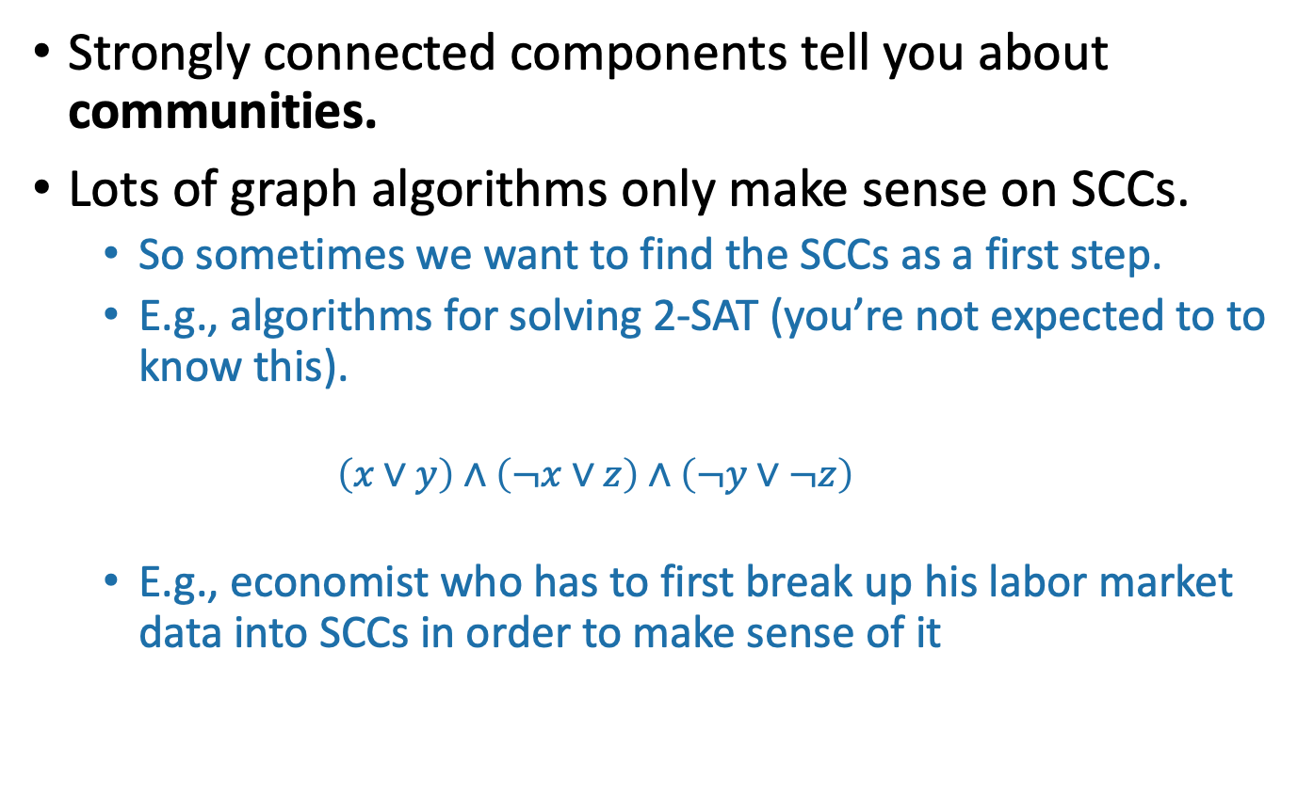
Why do we care about SCCs?
Strongly connected components tell you about communities.
Lots of graph algorithms only make sense on SCCs.
So sometimes we want to find the SCCs as a first step.
E.g., algorithms for solving 2-SAT (you’re not expected to to know this).
$$\left(x∨y\right)∧\left(¬x∨z\right)∧\left(¬y∨¬z\right)$$
E.g., economist who has to first break up his labor market data into SCCs in order to make sense of it

Slide 40
How to find SCCs?
Try 1:
Consider all possible decompositions and check.
Something like…
Run DFS a bunch to find out which u’s and v’s belong in the same SCC.
Aggregate that information to figure out the SCCs
Try 2:
Come up with a straightforward way to use DFS to find SCCs. What’s the running time?
More than n² or less than n²?
Think: 1-2 minutes.
Pair+Share: (wait) 1 minute

Slide 41

One straightforward solution
This will not be our final solution so don’t worry too much about it…
SCCs = [ ]
For each u:
Run DFS from u
For each vertex v that u can reach:
If v is in an SCC we’ve already found:
Run DFS from v to see if you can reach u
If so, add u to v’s SCC
Break
If we didn’t break, create a new SCC which just contains u.
Running time AT LEAST $Ω\left(n^{2}\right)$, no matter how smart you are about implementing the rest of it…

Slide 42
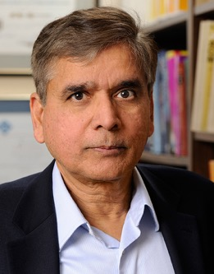
Today
We will see how to find strongly connected components in time O(n+m)
!!!!!
This is called Kosaraju’s algorithm.

Slide 43
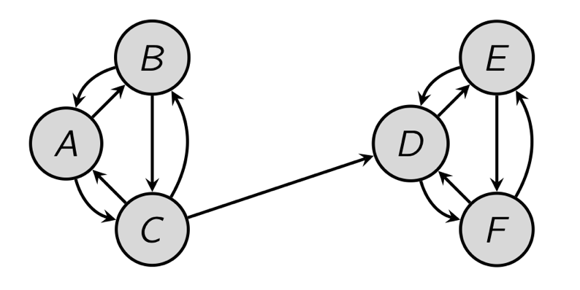
Pre-Lecture exercise
Run DFS starting at D:
That will identify SCCs…
Issues:
How do we know where to start DFS?
It wouldn’t have found the SCCs if we started from A.

Slide 44
Algorithm
Running time: O(n + m)
Do DFS to create a DFS forest.
Choose starting vertices in any order.
Keep track of finishing times.
Reverse all the edges in the graph.
Do DFS again to create another DFS forest.
This time, order the nodes in the reverse order of the finishing times that they had from the first DFS run.
The SCCs are the different trees in the second DFS forest.

Slide 45
But let’s break that down a bit…
Look, it works!
(See Python notebook)

Slide 46
Example

Slide 47
Example

Slide 48
Example
Start with an arbitrary vertex and do DFS.

Slide 49
Example
Start:0
Start with an arbitrary vertex and do DFS.

Slide 50
Example
Start:0
Start:1
Start with an arbitrary vertex and do DFS.

Slide 51
Example
Start:0
Start:1
Start:2
Start with an arbitrary vertex and do DFS.

Slide 52
Example
Start:0
Start:1
Start:2
Start with an arbitrary vertex and do DFS.
Start:3

Slide 53
Example
Start:0
Start:1
Start:2
Start with an arbitrary vertex and do DFS.
Start:3
Finish:4

Slide 54
Example
Start:0
Start:1
Start:2
Finish:5
Start with an arbitrary vertex and do DFS.
Start:3
Finish:4

Slide 55
Example
Start:0
Start:1
Start:2
Finish:5
Start with an arbitrary vertex and do DFS.
Start:3
Finish:4

Slide 56
Example
Start:0
Start:1
Start:2
Finish:5
Start:6
Start with an arbitrary vertex and do DFS.
Start:3
Finish:4

Slide 57
Example
Start:0
Start:1
Start:2
Finish:5
Start:6
Finish:7
Start with an arbitrary vertex and do DFS.
Start:3
Finish:4

Slide 58
Example
Start:0
Start:1
Finish:8
Start:2
Finish:5
Start:6
Finish:7
Start with an arbitrary vertex and do DFS.
Start:3
Finish:4

Slide 59
Example
Start:0
Finish:9
Start:1
Finish:8
Start:2
Finish:5
Start:6
Finish:7
Start with an arbitrary vertex and do DFS.
Start:3
Finish:4

Slide 60
Example
Start:0
Finish:9
Start:1
Finish:8
Start:2
Finish:5
Start:6
Finish:7
Start with an arbitrary vertex and do DFS.
Repeat until done.
Start:3
Finish:4

Slide 61
Example
Start:0
Finish:9
Start:1
Finish:8
Start:10
Finish:11
Start:2
Finish:5
Start:6
Finish:7
Start with an arbitrary vertex and do DFS.
Repeat until done.
Start:3
Finish:4

Slide 62
Example
Start:0
Finish:9
Start:1
Finish:8
Start:10
Finish:11
Start:2
Finish:5
Start:6
Finish:7
Reverse all the edges.
Start:3
Finish:4

Slide 63
Example
Start:0
Finish:9
Start:1
Finish:8
Start:10
Finish:11
Start:2
Finish:5
Start:6
Finish:7
Reverse all the edges.
Start:3
Finish:4

Slide 64
Example
Start:0
Finish:9
Start:1
Finish:8
Start:10
Finish:11
Start:2
Finish:5
Start:6
Finish:7
Do DFS again, but this time, start with the vertices with the largest finish time.
Start:3
Finish:4

Slide 65
Example
Start:0
Finish:9
Start:1
Finish:8
Start:10
Finish:11
Start:2
Finish:5
Start:6
Finish:7
Do DFS again, but this time, start with the vertices with the largest finish time.
Start:3
Finish:4

Slide 66
Example
Start:0
Finish:9
Start:1
Finish:8
Start:10
Finish:11
Start:2
Finish:5
Start:6
Finish:7
This is one DFS tree in the DFS forest!
Do DFS again, but this time, start with the vertices with the largest finish time.
Start:3
Finish:4

Slide 67
Example
Start:0
Finish:9
Start:1
Finish:8
Start:10
Finish:11
Start:2
Finish:5
Start:6
Finish:7
This is one DFS tree in the DFS forest!
Do DFS again, but this time, start with the vertices with the largest finish time.
Start:3
Finish:4

Slide 68
Example
Start:0
Finish:9
Start:1
Finish:8
Start:10
Finish:11
Start:2
Finish:5
Start:6
Finish:7
This is one DFS tree in the DFS forest!
Do DFS again, but this time, start with the vertices with the largest finish time.
Start:3
Finish:4

Slide 69
Example
Start:0
Finish:9
Start:1
Finish:8
Start:10
Finish:11
Start:2
Finish:5
Start:6
Finish:7
This is one DFS tree in the DFS forest!
Do DFS again, but this time, start with the vertices with the largest finish time.
Start:3
Finish:4
Notice that I’m not changing the start and finish times – I’m keeping them from the first run.

Slide 70
Example
Start:0
Finish:9
Start:1
Finish:8
Start:10
Finish:11
Start:2
Finish:5
Start:6
Finish:7
This is one DFS tree in the DFS forest!
Do DFS again, but this time, start with the vertices with the largest finish time.
Start:3
Finish:4
Notice that I’m not changing the start and finish times – I’m keeping them from the first run.

Slide 71
Example
Start:0
Finish:9
Start:1
Finish:8
Start:10
Finish:11
Start:2
Finish:5
Start:6
Finish:7
This is one DFS tree in the DFS forest!
Do DFS again, but this time, start with the vertices with the largest finish time.
Start:3
Finish:4
Notice that I’m not changing the start and finish times – I’m keeping them from the first run.

Slide 72
Example
Start:0
Finish:9
Start:1
Finish:8
Start:10
Finish:11
Start:2
Finish:5
Start:6
Finish:7
This is one DFS tree in the DFS forest!
Do DFS again, but this time, start with the vertices with the largest finish time.
Start:3
Finish:4
Notice that I’m not changing the start and finish times – I’m keeping them from the first run.

Slide 73
Example
Start:0
Finish:9
Start:1
Finish:8
Start:10
Finish:11
Start:2
Finish:5
Start:6
Finish:7
This is one DFS tree in the DFS forest!
Do DFS again, but this time, start with the vertices with the largest finish time.
Start:3
Finish:4
Notice that I’m not changing the start and finish times – I’m keeping them from the first run.

Slide 74
Example
Here’s another DFS tree in the DFS forest!
Start:0
Finish:9
Start:1
Finish:8
Start:10
Finish:11
Start:2
Finish:5
Start:6
Finish:7
This is one DFS tree in the DFS forest!
Do DFS again, but this time, start with the vertices with the largest finish time.
Start:3
Finish:4
Notice that I’m not changing the start and finish times – I’m keeping them from the first run.

Slide 75
Example
Here’s another DFS tree in the DFS forest!
Start:0
Finish:9
Start:1
Finish:8
Start:10
Finish:11
Start:2
Finish:5
Start:6
Finish:7
This is one DFS tree in the DFS forest!
Do DFS again, but this time, start with the vertices with the largest finish time.
Start:3
Finish:4
Notice that I’m not changing the start and finish times – I’m keeping them from the first run.

Slide 76
Example
Here’s another DFS tree in the DFS forest!
Start:0
Finish:9
Start:1
Finish:8
Start:10
Finish:11
Start:2
Finish:5
Start:6
Finish:7
This is one DFS tree in the DFS forest!
Do DFS again, but this time, start with the vertices with the largest finish time.
Start:3
Finish:4
Notice that I’m not changing the start and finish times – I’m keeping them from the first run.

Slide 77
Example
Here’s another DFS tree in the DFS forest!
Start:0
Finish:9
Start:1
Finish:8
Start:10
Finish:11
Start:2
Finish:5
Start:6
Finish:7
This is one DFS tree in the DFS forest!
Do DFS again, but this time, start with the vertices with the largest finish time.
Start:3
Finish:4
Notice that I’m not changing the start and finish times – I’m keeping them from the first run.

Slide 78
Example
Here’s another DFS tree in the DFS forest!
Start:0
Finish:9
Start:1
Finish:8
Start:10
Finish:11
Start:2
Finish:5
Start:6
Finish:7
This is one DFS tree in the DFS forest!
Do DFS again, but this time, start with the vertices with the largest finish time.
Start:3
Finish:4
Notice that I’m not changing the start and finish times – I’m keeping them from the first run.

Slide 79
Example
Here’s another DFS tree in the DFS forest!
Start:0
Finish:9
Start:1
Finish:8
Start:10
Finish:11
Start:2
Finish:5
Start:6
Finish:7
This is one DFS tree in the DFS forest!
Do DFS again, but this time, start with the vertices with the largest finish time.
Start:3
Finish:4
Notice that I’m not changing the start and finish times – I’m keeping them from the first run.

Slide 80
Example
Here’s another DFS tree in the DFS forest!
Start:0
Finish:9
Start:1
Finish:8
Start:10
Finish:11
Start:2
Finish:5
Start:6
Finish:7
This is one DFS tree in the DFS forest!
The last DFS tree!
Do DFS again, but this time, start with the vertices with the largest finish time.
Start:3
Finish:4
Notice that I’m not changing the start and finish times – I’m keeping them from the first run.

Slide 81
Example
Here’s another DFS tree in the DFS forest!
Start:0
Finish:9
Start:1
Finish:8
Start:10
Finish:11
Start:2
Finish:5
Start:6
Finish:7
This is one DFS tree in the DFS forest!
The last DFS tree!
Do DFS again, but this time, start with the vertices with the largest finish time.
Start:3
Finish:4
IT WORKED!

Slide 82
One question

Slide 83
The SCC graph
Pretend that each SCC is a vertex in a new graph.

Slide 84
The SCC graph
Lemma 1: The SCC graph is a Directed Acyclic Graph (DAG).
Proof idea: if not, then two SCCs would collapse into one.

Slide 85
Starting and finishing times in a SCC
all times are with respect to the first DFS run
Definitions:
The finishing time of a SCC is the largest finishing time of any element of that SCC.
The starting time of a SCC is the smallest starting time of any element of that SCC.
Start:0
Finish:9
Start:1
Finish:8
Start: 0
Finish: 9
Start:6
Finish:7

Slide 86
Our SCC DAG with start and finish times
Last time we saw that Finishing times allowed us to topologically sort of the vertices.
Notice that works in this example too…
Start: 0
Finish: 9
Start: 2
Finish: 5
Start: 10
Finish: 11

Slide 87
Main idea
Let’s reverse the edges.
Start: 0
Finish: 9
Start: 2
Finish: 5
Start: 10
Finish: 11

Slide 88
Main idea
Let’s reverse the edges.
Now, the SCC with the largest finish time has no edges going out.
If it did have edges going out, then it wouldn’t be a good thing to choose first in a topological ordering!
If I run DFS there, I’ll find exactly that component.
Remove and repeat.
Start: 0
Finish: 9
Start: 2
Finish: 5
Start: 10
Finish: 11

Slide 89
Let’s make this idea formal.

Slide 90
Recall
If v is a descendent of w in this tree:
If w is a descendent of v in this tree:
If neither are descendents of each other:
w.start
v.start
v.finish
w.finish
timeline
w
v.start
w.start
w.finish
v.finish
v.start
v.finish
w.start
w.finish
v
(or the other way around)

Slide 91
As we saw last time…
Claim: In a DAG, we’ll always have:
A
B
finish: [larger]
finish: [smaller]

Slide 92
Same thing, in the SCC DAG.
Claim: we’ll always have
finish: [larger]
finish: [smaller]

Slide 93
Let’s call it Lemma 2
If there is an edge like this:
Then A.finish > B.finish.
A
B

Slide 94
Proof idea
A
B
Want to show A.finish > B.finish.
Two cases:
We reached A before B in our first DFS.
We reached B before A in our first DFS.

Slide 95

Proof idea
A
B
Want to show A.finish > B.finish.
Case 1: We reached A before B in our first DFS.
Say that:
y has the largest finish in B;
z was discovered first in A;
Then:
Reach A before B
=> we will discover y via z
=> y is a descendant of z in the DFS forest.
Then
B.finish = y.finish
A.finish >= z.finish
y.start
z.finish
B.finish=
aka,
A.finish > B.finish
z.start
y.finish
$≤$A.finish

Slide 96
Proof idea
A
B
Want to show A.finish > B.finish.
Case 2: We reached B before A in our first DFS.
There are no paths from B to A
because the SCC graph has no cycles
So we completely finish exploring B and never reach A.
A is explored later after we restart DFS.
aka,
A.finish > B.finish

Slide 97
Proof idea
A
B
Want to show A.finish > B.finish.
Two cases:
We reached A before B in our first DFS.
We reached B before A in our first DFS.
In either case:
A.finish > B.finish
which is what we wanted to show.
Notice: this is exactly the same two-case argument that we did last time for topological sorting, just with the SCC DAG!

Slide 98
This establishes: Lemma 2
If there is an edge like this:
Then A.finish > B.finish.
A
B

Slide 99
This establishes: Corollary 1
If there is an edge like this in the reversed graph:
Then A.finish > B.finish.
A
B

Slide 100
Now we see why this finds SCCs.
Remember that after the first round of DFS, and after we reversed all the edges, we ended up with this SCC DAG:
Start: 0
Finish: 9
The Corollary says that all blue arrows point towards larger finish times.
So if we start with the largest finish time, all blue arrows lead in.
Thus, that connected component, and only that connected component, are reachable by the second round of DFS
Now, we’ve deleted that first component.
The next one has the next biggest finishing time.
So all remaining blue arrows lead in.
Repeat.
Start: 2
Finish: 5
Start: 10
Finish:11

Slide 101
Formally, we prove it by induction
Theorem: The algorithm we saw before will correctly identify strongly connected components.
Inductive hypothesis:
The first t trees found in the second (reversed) DFS forest are the t SCCs with the largest finish times.
Base case: (t=0)
The first 0 trees found in the reversed DFS forest are the 0 SCCs with the largest finish times. (TRUE)

Slide 102
Inductive step [drawing on board to supplement]
Assume by induction that the first t trees are the last-finishing SCCs.
Consider the (t+1)^{st} tree produced, suppose the root is x.
Suppose that x lives in the SCC A.
Then A.finish > B.finish for all remaining SCCs B.
This is because we chose x to have the largest finish time.
Then there are no edges leaving A in the remaining SCC DAG.
This follows from the Corollary.
Then DFS started at x recovers exactly A.
It doesn’t recover any more since nothing else is reachable.
It doesn’t recover any less since A is strongly connected.
(Notice that we are using that A is still strongly connected when we reverse all the edges).
So the (t+1)^{st} tree is the SCC with the (t+1)^{st} biggest finish time.

Slide 103
Formally, we prove it by induction
Theorem: The algorithm we saw before will correctly identify strongly connected components.
Inductive hypothesis:
The first t trees found in the second (reversed) DFS forest are the t SCCs with the largest finish times.
Base case: [done]
Inductive step: [done]
Conclusion: The second (reversed) DFS forest contains all the SCCs as its trees!
(This is the IH when t = #SCCs)

Slide 104
Punchline: we can find SCCs in time O(n + m)
Algorithm:
Do DFS to create a DFS forest.
Choose starting vertices in any order.
Keep track of finishing times.
Reverse all the edges in the graph.
Do DFS again to create another DFS forest.
This time, order the nodes in the reverse order of the finishing times that they had from the first DFS run.
The SCCs are the different trees in the second DFS forest.
(Clearly it wasn’t obvious since it took all class to do! But hopefully it is less mysterious now.)

Slide 105
Recap
Depth First Search reveals a very useful structure!
We saw last week that this structure can be used to do Topological Sorting in time O(n + m)
Today we saw that it can also find Strongly Connected Components in time O(n + m)
This was pretty non-trivial.

Slide 106
Next time
Dijkstra’s algorithm!
Pre-lecture exercise: weighted graphs!
BEFORE Next time

