Slide 1
Lecture 11
Weighted Graphs: Dijkstra and Bellman-Ford
NOTE: We may not get to Bellman-Ford!
We will spend more time on it next time.

Slide 2
Announcements
The midterm is today, 6-9pm. Good luck!
Don’t talk about it after you are done – we will tell you when it is ok to discuss the midterm.
See Ed post for detailed midterm instructions and logistics.

Slide 3
Midterm instructions (condensed)
Double check time and location
One 2-sided cheat sheet allowed
No scratch paper; extra blank sheets in exam
DO NOT tear off any pages!
Sign out with the TA before you leave

Slide 4
Previous two lectures
Graphs!
DFS
Topological Sorting
Strongly Connected Components
BFS
Shortest Paths in unweighted graphs

Slide 5
Today
What if the graphs are weighted?
Part 1: Dijkstra!
This will take most of today’s class
Part 2: Bellman-Ford!
Real quick at the end if we have time!
We’ll come back to Bellman-Ford in more detail, so today is just a taste.

Slide 6
Caltrain
Hospital
Stadium
Gates
YOU
ARE
HERE
Packard
CS161
Union
Dish

Slide 7
Just the graph
Caltrain
Hospital
Gates
Stadium
Packard
CS161
Union
Dish

Slide 8
Shortest path from Gates to the Union?
Caltrain
10
17
Hospital
15
Gates
10
1
Stadium
Packard
1
25
CS161
Run BFS …
22
4
Union
I should go to the dish and then back to the union!
20
That doesn’t make sense if I label the edges by walking time.
Dish

Slide 9
Shortest path from Gates to the Union?
Caltrain
10
17
Hospital
15
weighted graph
Gates
10
1
Stadium
w(u,v) = weight of edge between u and v.
For now, edge weights are non-negative.
Packard
1
25
CS161
4
If I pay attention to the weights, I should go to Packard, then CS161, then the union.
22
Union
20
Dish

Slide 10
Shortest path problem
What is the shortest path between u and v in a weighted graph?
the cost of a path is the sum of the weights along that path
The shortest path is the one with the minimum cost.
The distance d(u,v) between two vertices u and v is the cost of the the shortest path between u and v.
For this lecture all graphs are directed, but to save on notation I’m just going to draw undirected edges.
This path from s to t has cost 25.
3
20
2
s
1
1
t
2
1
This path is shorter, it has cost 5.
=

Slide 11
Shortest paths
Caltrain
10
17
Hospital
15
This is the shortest path from Gates to the Union.
It has cost 6.
Gates
10
Stadium
1
Packard
CS161
1
4
25
22
Union
Q: What’s the shortest path from Packard to the Union?
20
Dish

Slide 12
Warm-up
A sub-path of a shortest path is also a shortest path.
Say this is a shortest path from s to t.
Claim: this is a shortest path from s to x.
Suppose not, this one is a shorter path from s to x.
But then that gives an even shorter path from s to t!
CONTRADICTION!!
x
t
s

Slide 13
Single-source shortest-path problem
I want to know the shortest path from one vertex (Gates) to all other vertices.
Destination | Cost | To get there
Packard | 1 | Packard
CS161 | 2 | Packard-CS161
Hospital | 10 | Hospital
Caltrain | 17 | Caltrain
Union | 6 | Packard-CS161-Union
Stadium | 10 | Stadium
Dish | 23 | Packard-Dish
(Not necessarily stored as a table – how this information is represented will depend on the application)

Slide 14
Example
“what is the shortest path from Palo Alto to [anywhere else]” using BART, Caltrain, lightrail, MUNI, bus, Amtrak, bike, walking, uber/lyft.
Edge weights have something to do with time, money, hassle.

Slide 15
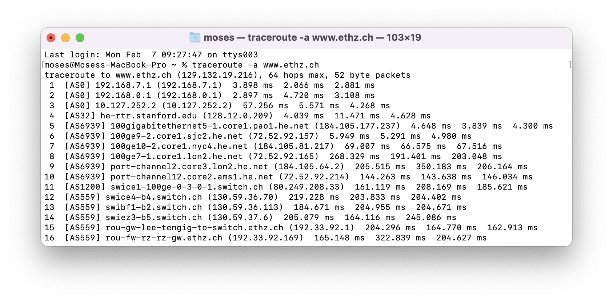
Example
Network routing
I send information over the internet, from my computer to to all over the world.
Each path has a cost which depends on link length, traffic, other costs, etc..
How should we send packets?

Slide 16
Aside: These are difficult problems
Costs may change
If it’s raining the cost of biking is higher
If a link is congested, the cost of routing a packet along it is higher
The network might not be known
My computer doesn’t store a map of the internet
We want to do these tasks really quickly
I have time to bike to Berkeley, but not to think about whether I should bike to Berkeley…
More seriously, the internet.
This is a joke.
But let’s ignore them for now.

Slide 17
Caltrain
Hospital
Stadium
Gates
Packard
Back to this example
CS161
Union
Dish

Slide 18
Dijkstra’s algorithm
Gates
1
CS161
Finds shortest paths from Gates to everywhere else.
1
Packard
4
22
Union
25
20
Dish

Slide 19
Dijkstra intuition
YOINK!
Gates
Packard
Dish
CS161
Union

Slide 20
Dijkstra intuition
A vertex is done when it’s not on the ground anymore.
YOINK!
Gates
Packard
Dish
CS161
Union

Slide 21
Dijkstra intuition
YOINK!
Gates
1
Packard
Dish
CS161
Union

Slide 22
Dijkstra intuition
YOINK!
Gates
1
Packard
1
CS161
Dish
Union

Slide 23
Dijkstra intuition
YOINK!
Gates
1
Packard
1
CS161
4
Union
Dish

Slide 24
Dijkstra intuition
YOINK!
Gates
1
Packard
1
CS161
4
22
Union
Dish

Slide 25
Dijkstra intuition
YOINK!
Gates
1
Packard
This creates a tree!
1
CS161
The shortest paths are the lengths along this tree.
4
22
Union
Dish

Slide 26
How do we actually implement this?
Without string and gravity?

Slide 27


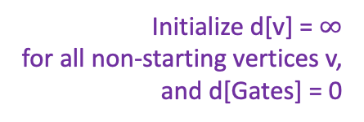


Dijkstra by example
Gates
0
How far is a node from Gates?
$$∞$$
1
CS161
I’m not sure yet
I’m sure
1
x
x = d[v] is my best over-estimate for dist(Gates,v).
Packard
$$∞$$
4
Initialize d[v] = $∞$
for all non-starting vertices v,
and d[Gates] = 0
22
$$∞$$
Pick the not-sure node u with the smallest estimate d[u].
Union
25
20
Dish
$$∞$$

Slide 28
Dijkstra by example
Gates
0
How far is a node from Gates?
$$∞$$
1
CS161
I’m not sure yet
I’m sure
1
x
x = d[v] is my best over-estimate for dist(Gates,v).
Packard
$$∞$$
4
Current node u
22
$$∞$$
Pick the not-sure node u with the smallest estimate d[u].
Update all u’s neighbors v:
d[v] = min( d[v] , d[u] + edgeWeight(u,v))
Union
25
20
Dish
$$∞$$

Slide 29

Dijkstra by example
Gates
0
How far is a node from Gates?
$$∞$$
1
CS161
I’m not sure yet
I’m sure
1
x
x = d[v] is my best over-estimate for dist(Gates,v).
Packard
$$1$$
4
Current node u
22
$$∞$$
Pick the not-sure node u with the smallest estimate d[u].
Update all u’s neighbors v:
d[v] = min( d[v] , d[u] + edgeWeight(u,v))
Mark u as sure.
Union
25
20
Dish
25

Slide 30
Dijkstra by example
Gates
0
How far is a node from Gates?
$$∞$$
1
CS161
I’m not sure yet
I’m sure
1
x
x = d[v] is my best over-estimate for dist(Gates,v).
Packard
$$1$$
4
Current node u
22
$$∞$$
Pick the not-sure node u with the smallest estimate d[u].
Update all u’s neighbors v:
d[v] = min( d[v] , d[u] + edgeWeight(u,v))
Mark u as sure.
Repeat
Union
25
20
Dish
25

Slide 31
Dijkstra by example
Gates
0
Packard has three neighbors. What happens when we update them?
1 min. think; 1 min. share
How far is a node from Gates?
$$∞$$
1
CS161
I’m not sure yet
I’m sure
1
x
x = d[v] is my best over-estimate for dist(Gates,v).
Packard
$$1$$
4
Current node u
22
$$∞$$
Pick the not-sure node u with the smallest estimate d[u].
Update all u’s neighbors v:
d[v] = min( d[v] , d[u] + edgeWeight(u,v))
Mark u as sure.
Repeat
Union
25
20
Dish
25

Slide 32

Dijkstra by example
Gates
0
Packard has three neighbors. What happens when we update them?
How far is a node from Gates?
$$2$$
1
CS161
I’m not sure yet
I’m sure
1
x
x = d[v] is my best over-estimate for dist(Gates,v).
Packard
$$1$$
4
Current node u
22
$$∞$$
Pick the not-sure node u with the smallest estimate d[u].
Update all u’s neighbors v:
d[v] = min( d[v] , d[u] + edgeWeight(u,v))
Mark u as sure.
Repeat
Union
25
20
Dish
23

Slide 33
Dijkstra by example
Gates
0
How far is a node from Gates?
$$2$$
1
CS161
I’m not sure yet
I’m sure
1
x
x = d[v] is my best over-estimate for dist(Gates,v).
Packard
$$1$$
4
Current node u
22
$$∞$$
Pick the not-sure node u with the smallest estimate d[u].
Update all u’s neighbors v:
d[v] = min( d[v] , d[u] + edgeWeight(u,v))
Mark u as sure.
Repeat
Union
25
20
Dish
23

Slide 34
Dijkstra by example
Gates
0
How far is a node from Gates?
$$2$$
1
CS161
I’m not sure yet
I’m sure
1
x
x = d[v] is my best over-estimate for dist(Gates,v).
Packard
$$1$$
4
Current node u
22
$$∞$$
Pick the not-sure node u with the smallest estimate d[u].
Update all u’s neighbors v:
d[v] = min( d[v] , d[u] + edgeWeight(u,v))
Mark u as sure.
Repeat
Union
25
20
Dish
23

Slide 35

Dijkstra by example
Gates
0
How far is a node from Gates?
$$2$$
1
CS161
I’m not sure yet
I’m sure
1
x
x = d[v] is my best over-estimate for dist(Gates,v).
Packard
$$1$$
4
Current node u
22
$$6$$
Pick the not-sure node u with the smallest estimate d[u].
Update all u’s neighbors v:
d[v] = min( d[v] , d[u] + edgeWeight(u,v))
Mark u as sure.
Repeat
Union
25
20
Dish
23

Slide 36
Dijkstra by example
Gates
0
How far is a node from Gates?
$$2$$
1
CS161
I’m not sure yet
I’m sure
1
x
x = d[v] is my best over-estimate for dist(Gates,v).
Packard
$$1$$
4
Current node u
22
$$6$$
Pick the not-sure node u with the smallest estimate d[u].
Update all u’s neighbors v:
d[v] = min( d[v] , d[u] + edgeWeight(u,v))
Mark u as sure.
Repeat
Union
25
20
Dish
23

Slide 37
Dijkstra by example
Gates
0
How far is a node from Gates?
$$2$$
1
CS161
I’m not sure yet
I’m sure
1
x
x = d[v] is my best over-estimate for dist(Gates,v).
Packard
$$1$$
4
Current node u
22
$$6$$
Pick the not-sure node u with the smallest estimate d[u].
Update all u’s neighbors v:
d[v] = min( d[v] , d[u] + edgeWeight(u,v))
Mark u as sure.
Repeat
Union
25
20
Dish
23

Slide 38
Dijkstra by example
Gates
0
How far is a node from Gates?
$$2$$
1
CS161
I’m not sure yet
I’m sure
1
x
x = d[v] is my best over-estimate for dist(Gates,v).
Packard
$$1$$
4
Current node u
22
$$6$$
Pick the not-sure node u with the smallest estimate d[u].
Update all u’s neighbors v:
d[v] = min( d[v] , d[u] + edgeWeight(u,v))
Mark u as sure.
Repeat
Union
25
20
Dish
23

Slide 39
Dijkstra by example
Gates
0
How far is a node from Gates?
$$2$$
1
CS161
I’m not sure yet
I’m sure
1
x
x = d[v] is my best over-estimate for dist(Gates,v).
Packard
$$1$$
4
Current node u
22
$$6$$
Pick the not-sure node u with the smallest estimate d[u].
Update all u’s neighbors v:
d[v] = min( d[v] , d[u] + edgeWeight(u,v))
Mark u as sure.
Repeat
Union
25
20
Dish
23

Slide 40
Dijkstra by example
Gates
0
How far is a node from Gates?
$$2$$
1
CS161
I’m not sure yet
I’m sure
1
x
x = d[v] is my best over-estimate for dist(Gates,v).
Packard
$$1$$
4
Current node u
22
$$6$$
Pick the not-sure node u with the smallest estimate d[u].
Update all u’s neighbors v:
d[v] = min( d[v] , d[u] + edgeWeight(u,v))
Mark u as sure.
Repeat
Union
25
20
Dish
23

Slide 41
Dijkstra by example
Gates
0
How far is a node from Gates?
$$2$$
1
CS161
I’m not sure yet
I’m sure
1
x
x = d[v] is my best over-estimate for dist(Gates,v).
Packard
$$1$$
4
Current node u
22
$$6$$
Pick the not-sure node u with the smallest estimate d[u].
Update all u’s neighbors v:
d[v] = min( d[v] , d[u] + edgeWeight(u,v))
Mark u as sure.
Repeat
Union
25
20
Dish
23
After all nodes are sure, say that d(Gates, v) = d[v] for all v

Slide 42
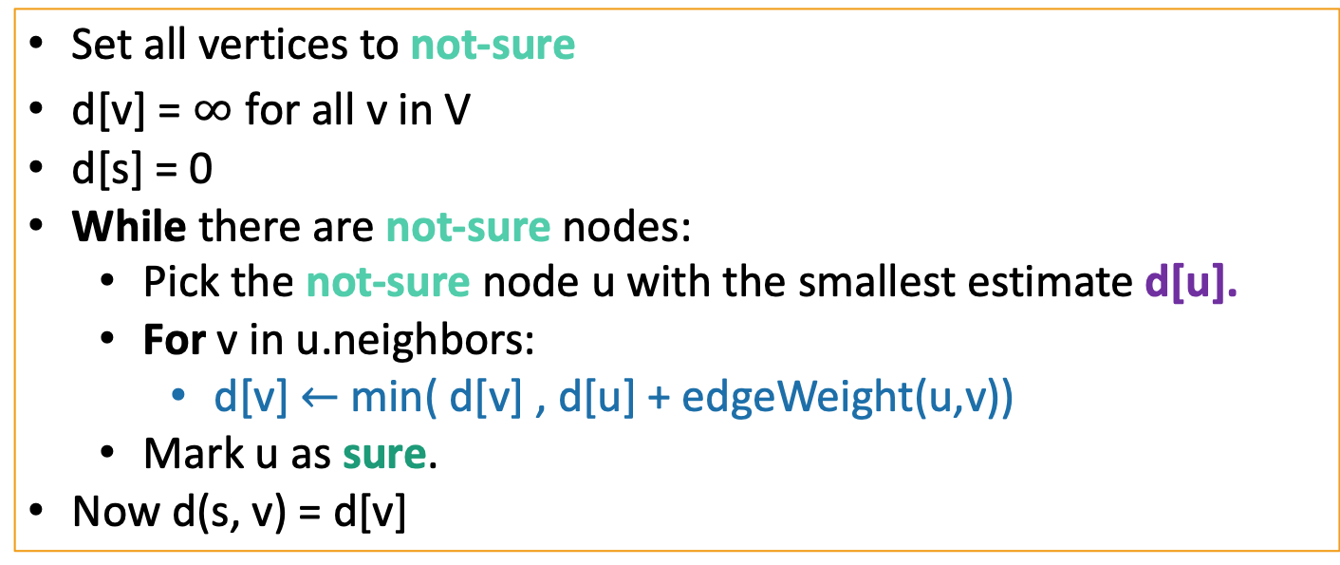
Dijkstra’s algorithm
Dijkstra(G,s):
Set all vertices to not-sure
d[v] = $∞$ for all v in V
d[s] = 0
While there are not-sure nodes:
Pick the not-sure node u with the smallest estimate d[u].
For v in u.neighbors:
d[v] $←$min( d[v] , d[u] + edgeWeight(u,v))
Mark u as sure.
Now d(s, v) = d[v]
Lots of implementation details left un-explained. We’ll get to that!
See IPython Notebook for code!

Slide 43
As usual
Does it work?
Yes.
Is it fast?
Depends on how you implement it.

Slide 44
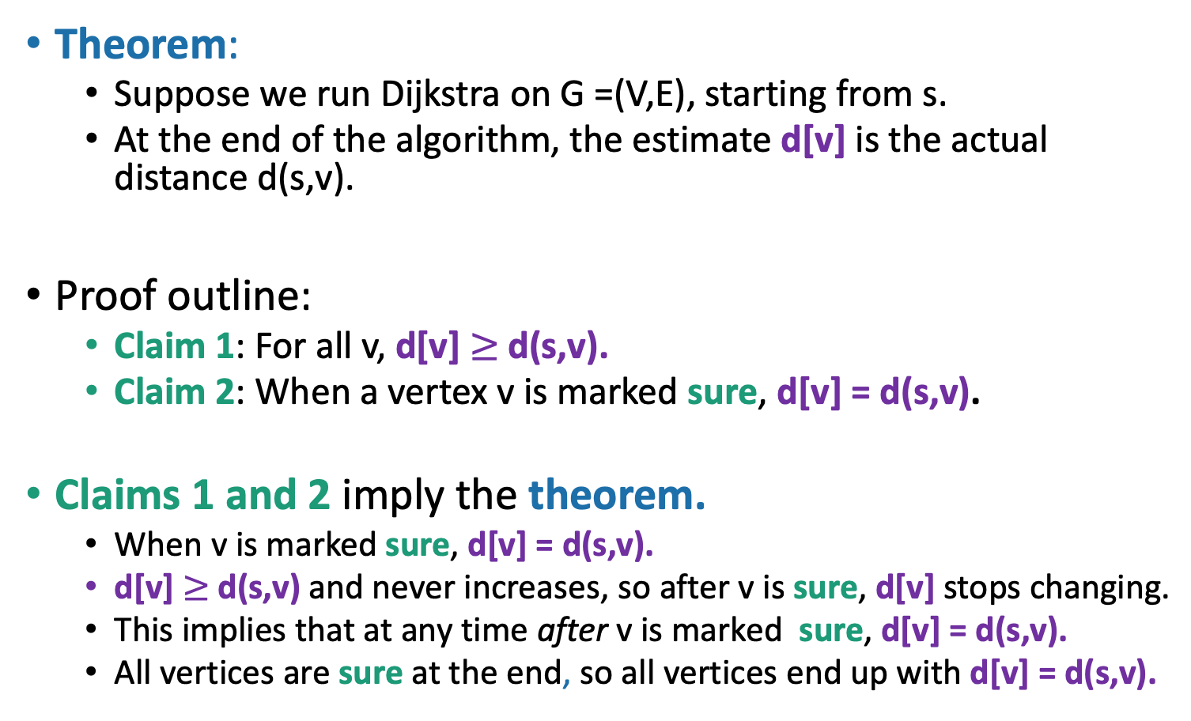
Why does this work?
Theorem:
Suppose we run Dijkstra on G =(V,E), starting from s.
At the end of the algorithm, the estimate d[v] is the actual distance d(s,v).
Proof outline:
Claim 1: For all v, d[v] $≥$d(s,v).
Claim 2: When a vertex v is marked sure, d[v] = d(s,v).
Claims 1 and 2 imply the theorem.
When v is marked sure, d[v] = d(s,v).
d[v] $≥$d(s,v) and never increases, so after v is sure, d[v] stops changing.
This implies that at any time after v is marked sure, d[v] = d(s,v).
All vertices are sure at the end, so all vertices end up with d[v] = d(s,v).
Let’s rename “Gates” to “s”, our starting vertex.
Claim 2
Claim 1 + def of algorithm
Next let’s prove the claims!

Slide 45

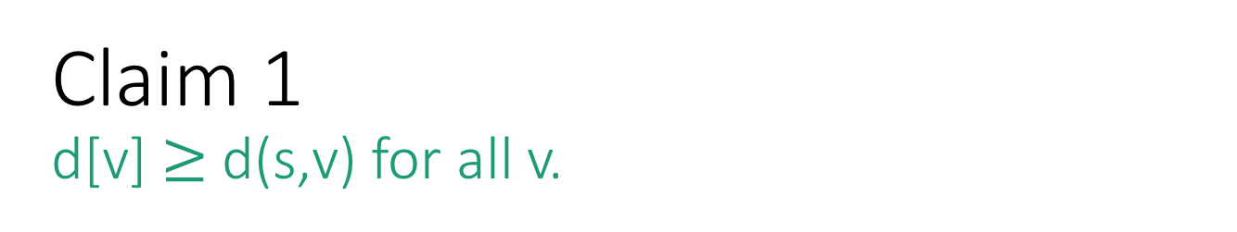



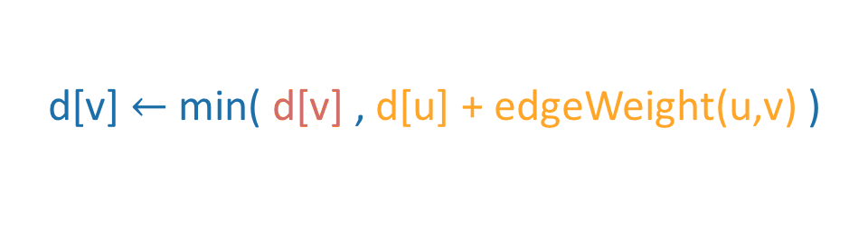
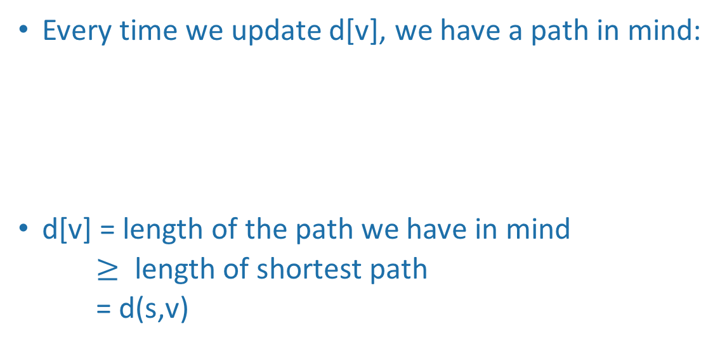
Claim 1 d[v] $≥$ d(s,v) for all v.
Intuition!
Gates
0
Informally:
$$2$$
Every time we update d[v], we have a path in mind:
d[v] = length of the path we have in mind
$≥$ length of shortest path
= d(s,v)
1
CS161
d[v] $←$min( d[v] , d[u] + edgeWeight(u,v) )
1
Whatever path we had in mind before
Packard
The shortest path to u, and then the edge from u to v.
25
$$1$$
4
$$6$$
$$∞$$
22
Union
20
Formally:
Dish
23
We should prove this by induction.
(See skipped slide or do it yourself)

Slide 46


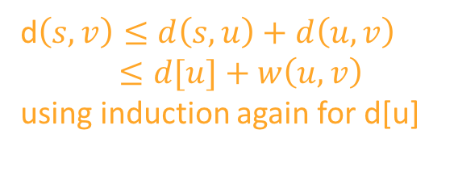
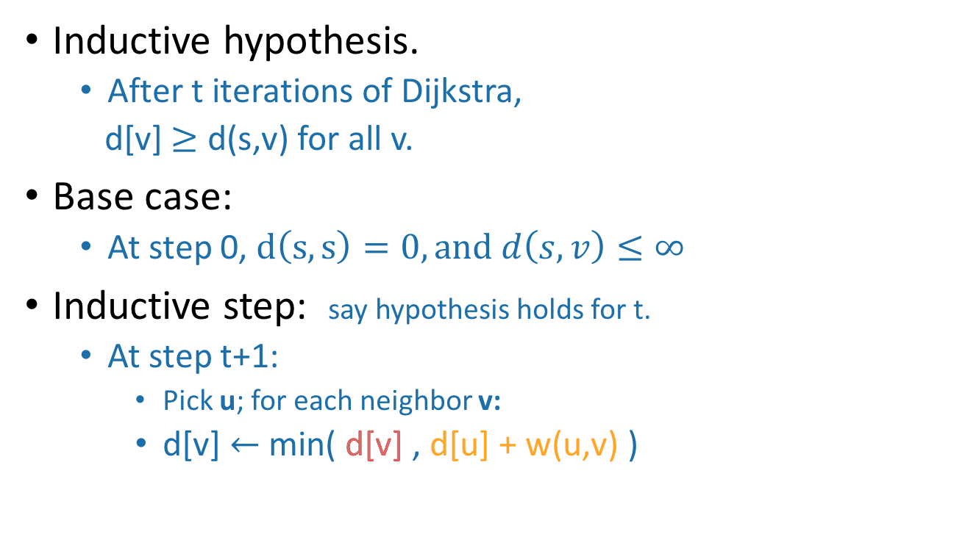
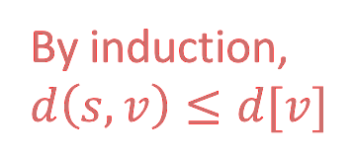
Claim 1 d[v] $≥$ d(s,v) for all v.
THIS SLIDE SKIPPED IN CLASS
Gates
0
$$2$$
1
CS161
u
Inductive hypothesis.
After t iterations of Dijkstra,
d[v] $≥$ d(s,v) for all v.
Base case:
At step 0, $d\left(s,s\right)=0, and d\left(s,v\right)≤∞$
Inductive step: say hypothesis holds for t.
At step t+1:
Pick u; for each neighbor v:
d[v] $←$ min( d[v] , d[u] + w(u,v) )
1
Packard
25
$$1$$
4
$$6$$
$$∞$$
22
Union
v
20
Dish
$$≥d(s,v)$$
23
By induction, $d\left(s,v\right)≤d[v]$
d$\left(s,v\right)≤d\left(s,u\right)+d\left(u,v\right)$
$≤d[u]+w\left(u,v\right)$
using induction again for d[u]
So the inductive hypothesis holds for t+1, and Claim 1 follows.

Slide 47
Intuition for Claim 2 When a vertex u is marked sure, d[u] = d(s,u)
YOINK!
Gates
s
The first path that lifts u off the ground is the shortest one.
Let’s prove it!
Or at least see a proof outline.
1
Packard
1
CS161
4
u
Union
Dish

Slide 48
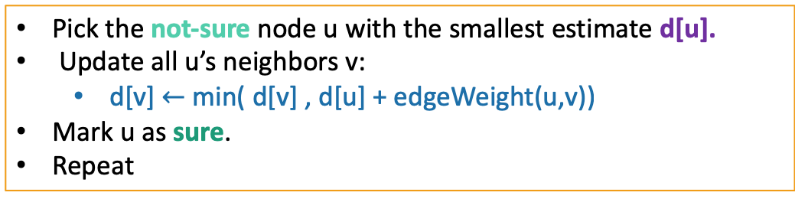
Claim 2 When a vertex u is marked sure, d[u] = d(s,u)
Informal outline!
Inductive Hypothesis:
When we mark the t’th vertex v as sure, d[v] = dist(s,v).
Base case (t=1):
The first vertex marked sure is s, and d[s] = d(s,s) = 0.
Inductive step:
Assume by induction that every v already marked sure has d[v] = d(s,v).
Suppose that we are about to add u to the sure list.
That is, we picked u in the first line here:
Want to show that d[u] = d(s,u).
(Assuming edge weights are non-negative!)
Pick the not-sure node u with the smallest estimate d[u].
Update all u’s neighbors v:
d[v] $←$min( d[v] , d[u] + edgeWeight(u,v))
Mark u as sure.
Repeat

Slide 49
Claim 2 Inductive step
Temporary definition:
v is “good” means that d[v] = d(s,v)
Want to show that u is good.
Consider a true shortest path from s to u:
s
u
The vertices in between are beige because they may or may not be sure.
True shortest path.

Slide 50
Claim 2 Inductive step
Temporary definition:
v is “good” means that d[v] = d(s,v)
means good
means not good
“by way of contradiction”
BWOC, suppose u isn’t good.
Want to show that u is good.
Say z is the last good vertex before u (on shortest path to u).
z’ is the vertex after z.
z’
s
z
It may be that z = s.
u
u
It may be that z’ = u.
The vertices in between are beige because they may or may not be sure.
z != u, since u is not good.
True shortest path.

Slide 51

Claim 2 Inductive step
Temporary definition:
v is “good” means that d[v] = d(s,v)
means good
means not good
BWOC, suppose u isn’t good.
Want to show that u is good.
$$d\left[z\right]=d\left(s,z\right)≤d\left(s,u\right)≤d[u]$$
z is good
Subpaths of shortest paths are shortest paths.
(We’re also using that the edge weights are non-negative here).
d(s,z)
r
d(s,u)
z’
s
z
u

Slide 52
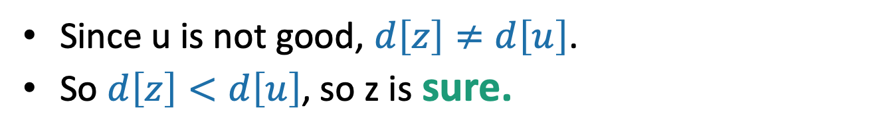
Claim 2 Inductive step
Temporary definition:
v is “good” means that d[v] = d(s,v)
means good
means not good
BWOC, suppose u isn’t good.
Want to show that u is good.
$$d\left[z\right]=d\left(s,z\right)≤d\left(s,u\right)≤d[u]$$
z is good
Subpaths of shortest paths are shortest paths.
Claim 1
Since u is not good, $d\left[z\right]≠d\left[u\right]$.
So $d\left[z\right]<d\left[u\right]$, so z is sure.
We chose u so that d[u] was smallest of the unsure vertices.
r
z’
s
z
u

Slide 53
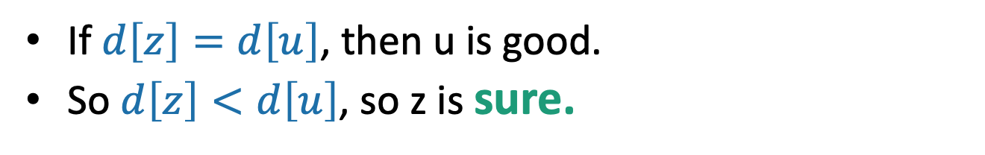
Claim 2 Inductive step
Temporary definition:
v is “good” means that d[v] = d(s,v)
means good
means not good
BWOC, suppose u isn’t good.
Want to show that u is good.
$$d\left[z\right]=d\left(s,z\right)≤d\left(s,u\right)≤d[u]$$
z is good
Subpaths of shortest paths are shortest paths.
Claim 1
But u is not good!
If $d\left[z\right]=d\left[u\right]$, then u is good.
So $d\left[z\right]<d\left[u\right]$, so z is sure.
We chose u so that d[u] was smallest of the unsure vertices.
r
z’
s
z
u

Slide 54


Claim 2 Inductive step
Temporary definition:
v is “good” means that d[v] = d(s,v)
means good
means not good
BWOC, suppose u isn’t good.
Want to show that u is good.
If z is sure then we’ve already updated z’:
$d\left[z′\right]≤d\left[z\right]+w\left(z,z^{′}\right)$
$= d\left(s,z\right)+w(z,z^{′})$
$= d\left(s,z^{′}\right)$
$≤d[z^{′}]$
$d\left[z′\right]←min\{ d\left[z^{′}\right], d\left[z\right]+w\left(z,z^{′}\right)\}$
def of update
By induction when z was added to the sure list it had d(s,z) = d[z]
That is, the value of d[z] when z was marked sure…
sub-paths of shortest paths are shortest paths
Claim 1
So d(s,z’) = d[z’] and so z’ is good.
r
z’
CONTRADICTION!!
s
w(z,z’)
z
z
So u is good!
u

Slide 55

Claim 2 When a vertex u is marked sure, d[u] = d(s,u)
Back to this slide
Inductive Hypothesis:
When we mark the t’th vertex v as sure, d[v] = dist(s,v).
Base case:
The first vertex marked sure is s, and d[s] = d(s,s) = 0.
Inductive step:
Suppose that we are about to add u to the sure list.
That is, we picked u in the first line here:
Assume by induction that every v already marked sure has d[v] = d(s,v).
Want to show that d[u] = d(s,u).
Pick the not-sure node u with the smallest estimate d[u].
Update all u’s neighbors v:
d[v] $←$min( d[v] , d[u] + edgeWeight(u,v))
Mark u as sure.
Repeat
Conclusion: Claim 2 holds!

Slide 56
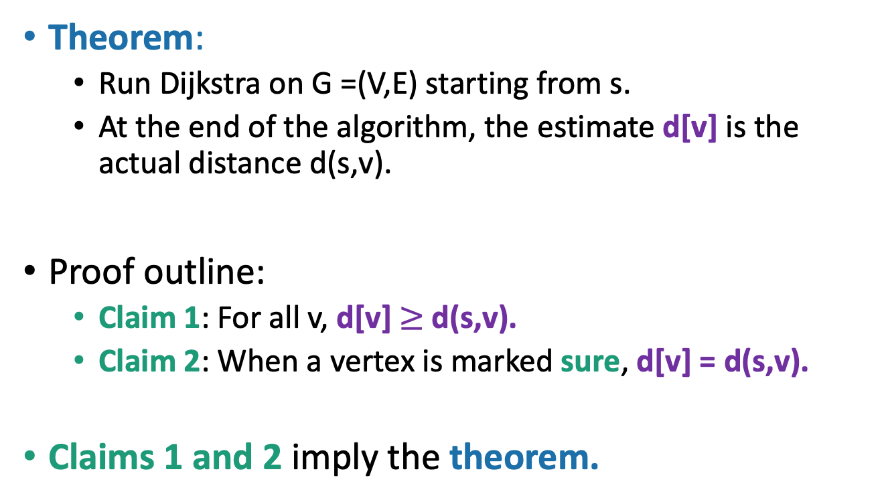
Why does this work?
Now back to this slide
Theorem:
Run Dijkstra on G =(V,E) starting from s.
At the end of the algorithm, the estimate d[v] is the actual distance d(s,v).
Proof outline:
Claim 1: For all v, d[v] $≥$d(s,v).
Claim 2: When a vertex is marked sure, d[v] = d(s,v).
Claims 1 and 2 imply the theorem.

Slide 57
What have we learned?
YOINK!
Gates
1
Dijkstra’s algorithm finds shortest paths in weighted graphs with non-negative edge weights.
Along the way, it constructs a nice tree.
We could post this tree in Gates!
Then people would know how to get places quickly.
Packard
1
CS161
4
22
Union
Dish

Slide 58
As usual
Does it work?
Yes.
Is it fast?
Depends on how you implement it.

Slide 59

Running time?
Dijkstra(G,s):
Set all vertices to not-sure
d[v] = $∞$ for all v in V
d[s] = 0
While there are not-sure nodes:
Pick the not-sure node u with the smallest estimate d[u].
For v in u.neighbors:
d[v] $←$min( d[v] , d[u] + edgeWeight(u,v) )
Mark u as sure.
Now dist(s, v) = d[v]
n iterations (one per vertex)
How long does one iteration take?
Depends on how we implement it…

Slide 60
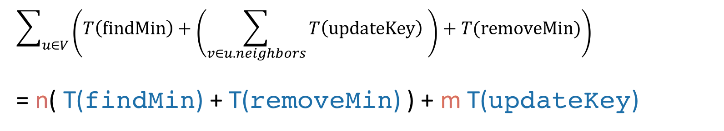
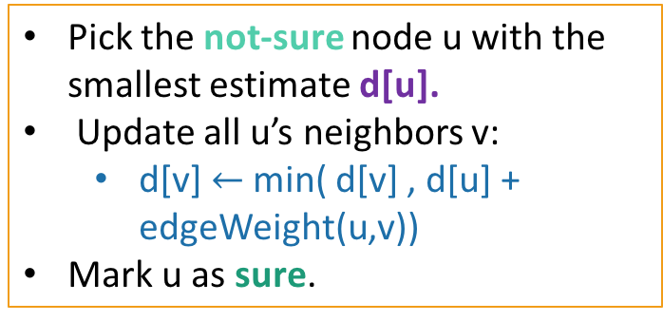
We need a data structure that:
Just the inner loop:
Stores unsure vertices v
Keeps track of d[v]
Can find u with minimum d[u]
findMin()
Can remove that u
removeMin(u)
Can update (decrease) d[v]
updateKey(v,d)
Pick the not-sure node u with the smallest estimate d[u].
Update all u’s neighbors v:
d[v] $←$ min( d[v] , d[u] + edgeWeight(u,v))
Mark u as sure.
Total running time is big-oh of:
$$\sum_{u∈V}{\left(T\left(findMin\right)+\left(\sum_{v∈u.neighbors}{T\left(updateKey\right) }\right)+T(removeMin)\right)}$$
= n( T(findMin) + T(removeMin) ) + m T(updateKey)

Slide 61
If we use an array
T(findMin) = O(n)
T(removeMin) = O(n)
T(updateKey) = O(1)
Running time of Dijkstra
O(n( T(findMin) + T(removeMin) ) + m T(updateKey))
O(n²) + O(m)
O(n²)

Slide 62
If we use a red-black tree
T(findMin) = O(log(n))
T(removeMin) = O(log(n))
T(updateKey) = O(log(n))
Running time of Dijkstra
O(n( T(findMin) + T(removeMin) ) + m T(updateKey))
O(nlog(n)) + O(mlog(n))
O((n + m)log(n))
Better than an array if the graph is sparse!
aka if m is much smaller than n²

Slide 63
Is a hash table a good idea here?
O(n( T(findMin) + T(removeMin) ) + m T(updateKey))
Not really:
Search(v) is fast (in expectation)
But findMin() will still take time O(n) without more structure.
Slide skipped in class

Slide 64
Heaps support these operations
0
findMin
removeMin
updateKey
A heap is a tree-based data structure that has the property that every node has a smaller key than its children.
Not covered in this class – see CS166
But! We will use them.
2
3
6
5
4
10

Slide 65
Many heap implementations
Nice chart on Wikipedia:

Slide 66
Say we use a Fibonacci Heap
T(findMin) = O(1) (amortized time*)
T(removeMin) = O(log(n)) (amortized time*)
T(updateKey) = O(1) (amortized time*)
See CS166 for more!
Running time of Dijkstra
O(n( T(findMin) + T(removeMin) ) + m T(updateKey))
O(nlog(n) + m) (amortized time)
*This means that any sequence of d removeMin calls takes time at most O(dlog(n)). But a few of the d may take longer than O(log(n)) and some may take less time..

Slide 67
In practice
See IPython Notebook for Lecture 11
The heap is implemented using heapdict
Dijkstra using a Python list to keep track of vertices has quadratic runtime.
Dijkstra using a heap looks a bit more linear (actually nlog(n))
BFS is really fast by comparison! But it doesn’t work on weighted graphs.

Slide 68
Dijkstra is used in practice
eg, OSPF (Open Shortest Path First), a routing protocol for IP networks, uses Dijkstra.
But there are some things it’s not so good at.

Slide 69
Dijkstra Drawbacks
Needs non-negative edge weights.
If the weights change, we need to re-run the whole thing.
in OSPF, a vertex broadcasts any changes to the network, and then every vertex re-runs Dijkstra’s algorithm from scratch.

Slide 70
Bellman-Ford algorithm
(-) Slower than Dijkstra’s algorithm
(+) Can handle negative edge weights.
Can be useful if you want to say that some edges are actively good to take, rather than costly.
Can be useful as a building block in other algorithms.
(+) Allows for some flexibility if the weights change.
We’ll see what this means later

Slide 71
Today: intro to Bellman-Ford
We’ll see a definition by example.
We’ll come back to it next lecture with more rigor.
Don’t worry if it goes by quickly today.
There are some skipped slides with pseudocode, but we’ll see them again next lecture.
Basic idea:
Instead of picking the u with the smallest d[u] to update, just update all of the u’s simultaneously.

Slide 72
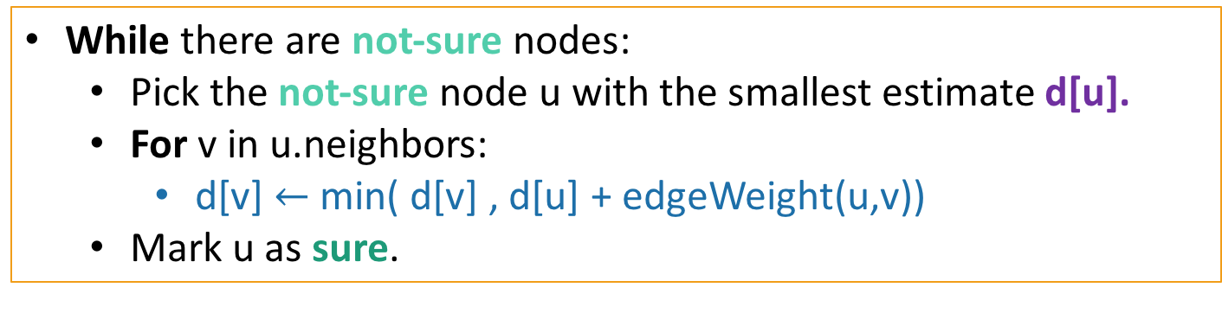
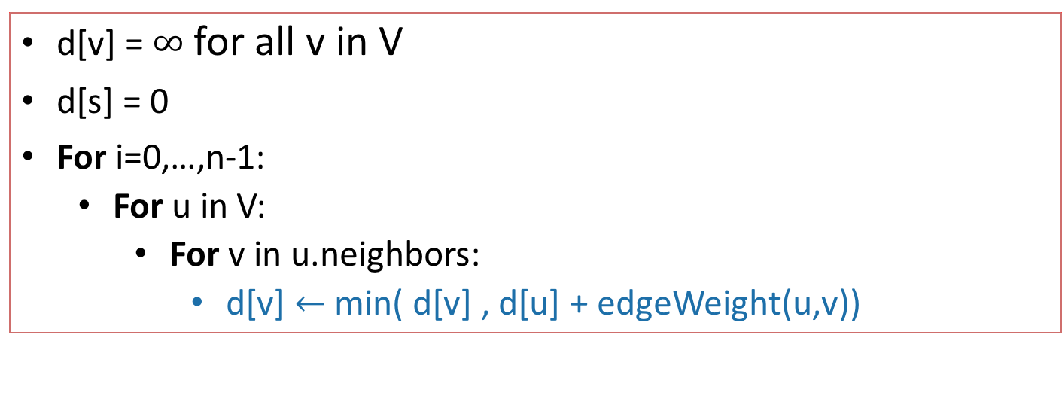
Bellman-Ford algorithm
Bellman-Ford(G,s):
d[v] = $∞$ for all v in V
d[s] = 0
For i=0,…,n-1:
For u in V:
For v in u.neighbors:
d[v] $←$min( d[v] , d[u] + edgeWeight(u,v))
Instead of picking u cleverly, just update for all of the u’s.
Compare to Dijkstra:
While there are not-sure nodes:
Pick the not-sure node u with the smallest estimate d[u].
For v in u.neighbors:
d[v] $←$min( d[v] , d[u] + edgeWeight(u,v))
Mark u as sure.

Slide 73
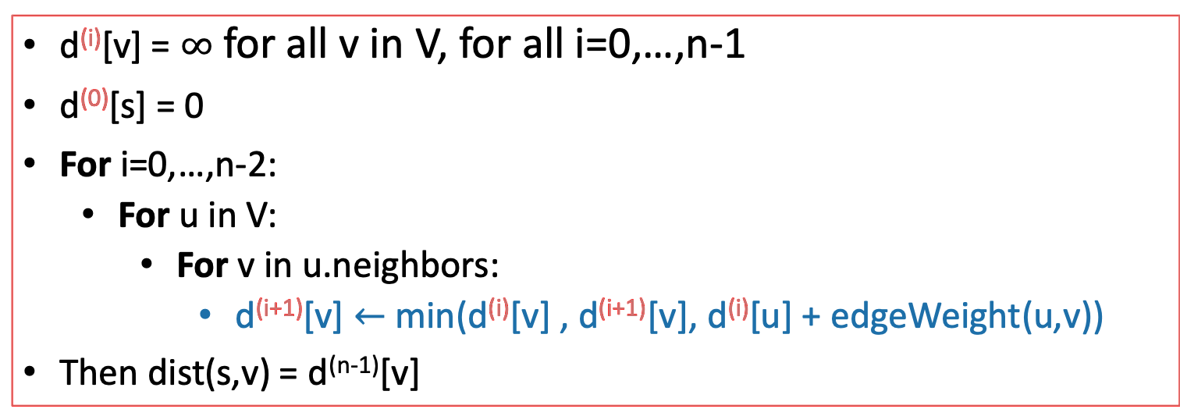
For pedagogical reasons which we will see next lecture
We are actually going to change this to be less smart.
Keep n arrays: d⁽⁰⁾, d⁽¹⁾, …, d^{(n-1)}
Bellman-Ford*(G,s):
d^{(i)}[v] = $∞$ for all v in V, for all i=0,…,n-1
d⁽⁰⁾[s] = 0
For i=0,…,n-2:
For u in V:
For v in u.neighbors:
d^{(i+1)}[v] $←$min(d^{(i)}[v] , d^{(i+1)}[v], d^{(i)}[u] + edgeWeight(u,v))
Then dist(s,v) = d^{(n-1)}[v]
Slightly different than the original Bellman-Ford algorithm, but the analysis is basically the same.

Slide 74

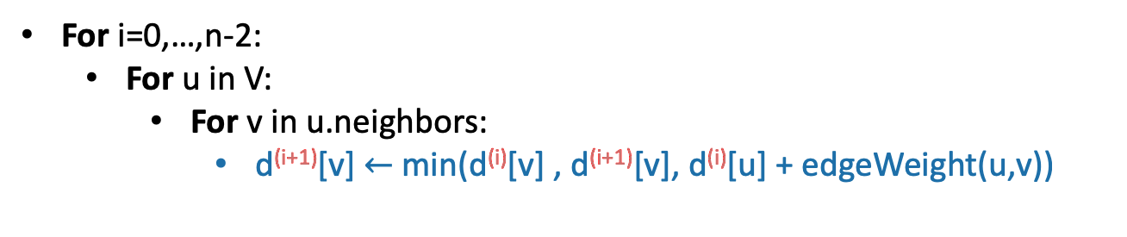


Bellman-Ford
Start with the same graph, no negative weights.
Gates
0
=
How far is a node from Gates?
$$∞$$
1
Gates Packard CS161 Union Dish
CS161
d⁽⁰⁾
0
$$∞$$
$$∞$$
$$∞$$
$$∞$$
d⁽¹⁾
1
Packard
d⁽²⁾
4
$$∞$$
d⁽³⁾
22
$$∞$$
Union
d⁽⁴⁾
25
20
For i=0,…,n-2:
For u in V:
For v in u.neighbors:
d^{(i+1)}[v] $←$min(d^{(i)}[v] , d^{(i+1)}[v], d^{(i)}[u] + edgeWeight(u,v))
Dish
$$∞$$

Slide 75
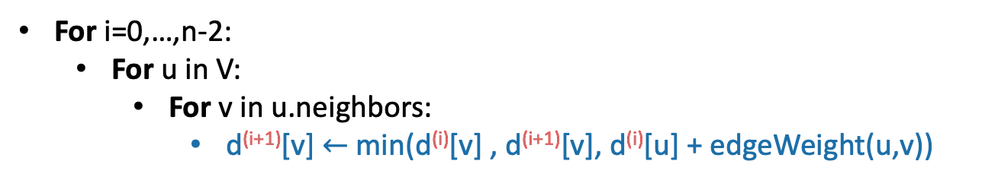


Bellman-Ford
Start with the same graph, no negative weights.
Gates
0
=
How far is a node from Gates?
$$∞$$
1
Gates Packard CS161 Union Dish
CS161
d⁽⁰⁾
0
$$∞$$
$$∞$$
$$∞$$
$$∞$$
d⁽¹⁾
1
0
1
$$∞$$
$$∞$$
25
Packard
d⁽²⁾
4
$$1$$
d⁽³⁾
22
$$∞$$
Union
d⁽⁴⁾
25
20
For i=0,…,n-2:
For u in V:
For v in u.neighbors:
d^{(i+1)}[v] $←$min(d^{(i)}[v] , d^{(i+1)}[v], d^{(i)}[u] + edgeWeight(u,v))
Dish
$$25$$

Slide 76




Bellman-Ford
Start with the same graph, no negative weights.
Gates
0
=
How far is a node from Gates?
$$2$$
1
Gates Packard CS161 Union Dish
CS161
d⁽⁰⁾
0
$$∞$$
$$∞$$
$$∞$$
$$∞$$
d⁽¹⁾
1
0
1
$$∞$$
$$∞$$
25
Packard
d⁽²⁾
0
1
2
45
23
4
$$1$$
d⁽³⁾
22
$$45$$
Union
d⁽⁴⁾
25
20
For i=0,…,n-2:
For u in V:
For v in u.neighbors:
d^{(i+1)}[v] $←$min(d^{(i)}[v] , d^{(i+1)}[v], d^{(i)}[u] + edgeWeight(u,v))
Dish
$$23$$

Slide 77

Bellman-Ford
Start with the same graph, no negative weights.
Gates
0
=
How far is a node from Gates?
$$2$$
1
Gates Packard CS161 Union Dish
CS161
d⁽⁰⁾
0
$$∞$$
$$∞$$
$$∞$$
$$∞$$
d⁽¹⁾
1
0
1
$$∞$$
$$∞$$
25
Packard
d⁽²⁾
0
1
2
45
23
4
$$1$$
d⁽³⁾
0
1
2
6
23
22
$$6$$
Union
d⁽⁴⁾
25
20
For i=0,…,n-2:
For u in V:
For v in u.neighbors:
d^{(i+1)}[v] $←$min(d^{(i)}[v] , d^{(i+1)}[v], d^{(i)}[u] + edgeWeight(u,v))
Dish
$$23$$

Slide 78
Bellman-Ford
Start with the same graph, no negative weights.
Gates
0
=
How far is a node from Gates?
$$2$$
1
Gates Packard CS161 Union Dish
CS161
d⁽⁰⁾
0
$$∞$$
$$∞$$
$$∞$$
$$∞$$
d⁽¹⁾
1
0
1
$$∞$$
$$∞$$
25
Packard
d⁽²⁾
0
1
2
45
23
4
$$1$$
d⁽³⁾
0
1
2
6
23
22
$$6$$
Union
d⁽⁴⁾
0
1
2
6
23
25
These are the final distances!
20
For i=0,…,n-2:
For u in V:
For v in u.neighbors:
d^{(i+1)}[v] $←$min(d^{(i)}[v] , d^{(i+1)}[v], d^{(i)}[u] + edgeWeight(u,v))
Dish
$$23$$

Slide 79


As usual
Gates Packard CS161 Union Dish
d⁽⁰⁾
0
$$∞$$
$$∞$$
$$∞$$
$$∞$$
d⁽¹⁾
0
1
$$∞$$
$$∞$$
25
Does it work?
Yes
Idea to the right.
(See hidden slides for details)
Is it fast?
Not really…
d⁽²⁾
0
1
2
45
23
d⁽³⁾
0
1
2
6
23
d⁽⁴⁾
0
1
2
6
23
Idea: proof by induction.
Inductive Hypothesis:
d^{(i)}[v] is equal to the cost of the shortest path between s and v with at most i edges.
Conclusion:
d^{(n-1)}[v] is equal to the cost of the shortest simple path between s and v. (Since all simple paths have at most n-1 edges).
A simple path is a path with no cycles.

Slide 80
Proof by induction
Skipped in class
Inductive Hypothesis:
After iteration i, for each v, d^{(i)}[v] is equal to the cost of the shortest path between s and v with at most i edges.
Base case:
After iteration 0…
Inductive step:

Slide 81
Inductive step
Skipped in class
Hypothesis: After iteration i, for each v, d^{(i)} [v] is equal to the cost of the shortest path between s and v with at most i edges.
Suppose the inductive hypothesis holds for i.
We want to establish it for i+1.
Let u be the vertex right before v in this path.
Say this is the shortest path between s and v of with at most i+1 edges:
u
w(u,v)
s
v
at most i edges
By induction, d^{(i)}[u] is the cost of a shortest path between s and u of i edges.
By setup, d^{(i)}[u] + w(u,v) is the cost of a shortest path between s and v of i+1 edges.
In the i+1’st iteration, we ensure d^{(i+1)}[v] <= d^{(i)}[u] + w(u,v).
So d^{(i+1)}[v] <= cost of shortest path between s and v with i+1 edges.
But d^{(i+1)}[v] = cost of a particular path of at most i+1 edges >= cost of shortest path.
So d[v] = cost of shortest path with at most i+1 edges.

Slide 82
Proof by induction
Skipped in class
Inductive Hypothesis:
After iteration i, for each v, d^{(i)}[v] is equal to the cost of the shortest path between s and v of length at most i edges.
Base case:
After iteration 0…
Inductive step:
Conclusion:
After iteration n-1, for each v, d[v] is equal to the cost of the shortest path between s and v of length at most n-1 edges.
Aka, d[v] = d(s,v) for all v as long as there are no negative cycles!

Slide 83
Pros and cons of Bellman-Ford
Running time: O(mn) running time
For each of n steps we update m edges
Slower than Dijkstra
However, it’s also more flexible in a few ways.
Can handle negative edges
If we constantly do these iterations, any changes in the network will eventually propagate through.

Slide 84
Wait a second…
Gates
1
CS161
What is the shortest path from Gates to the Union?
1
Packard
4
Cost: 6
-2
Union
-3
10
Dish

Slide 85
Wait a second…
Gates
1
CS161
What is the shortest path from Gates to the Union?
1
Packard
4
-2
Cost: 2
Union
-3
10
Dish

Slide 86

Negative edge weights?
Gates
1
CS161
What is the shortest path from Gates to the Union?
Shortest paths aren’t defined if there are negative cycles!
1
Packard
4
-2
Union
-3
Cost: $−∞$
10
Dish

Slide 87
Bellman-Ford and negative edge weights
B-F works with negative edge weights…as long as there are no negative cycles.
A negative cycle is a path with the same start and end vertex whose cost is negative.
However, B-F can detect negative cycles.

Slide 88
Back to the correctness
Gates Packard CS161 Union Dish
d⁽⁰⁾
0
$$∞$$
$$∞$$
$$∞$$
$$∞$$
d⁽¹⁾
0
1
$$∞$$
$$∞$$
25
Does it work?
Yes
Idea to the right.
d⁽²⁾
0
1
2
45
23
d⁽³⁾
0
1
2
6
23
d⁽⁴⁾
0
1
2
6
23
Idea: proof by induction.
Inductive Hypothesis:
d^{(i)}[v] is equal to the cost of the shortest path between s and v with at most i edges.
Conclusion:
d^{(n-1)}[v] is equal to the cost of the shortest simple path between s and v. (Since all simple paths have at most n-1 edges).
If there are negative cycles, then non-simple paths matter!
So the proof breaks for negative cycles.

Slide 89
Negative edge weights
Gates
Gates Packard CS161 Union Dish
d⁽⁰⁾
1
0
$$∞$$
$$∞$$
$$∞$$
$$∞$$
CS161
d⁽¹⁾
0
1
$$∞$$
$$∞$$
3
1
d⁽²⁾
0
0
2
13
3
Packard
4
d⁽³⁾
0
0
1
6
3
d⁽⁴⁾
0
0
1
5
3
-3
Union
3
10
For i=0,…,n-2:
For u in V:
For v in u.neighbors:
d^{(i+1)}[v] $←$min(d^{(i)}[v] , d^{(i+1)}[v], d^{(i)}[u] + edgeWeight(u,v))
Dish

Slide 90
B-F with negative cycles
Gates
Gates Packard CS161 Union Dish
d⁽⁰⁾
1
0
$$∞$$
$$∞$$
$$∞$$
$$∞$$
CS161
d⁽¹⁾
0
1
$$∞$$
$$∞$$
-3
1
d⁽²⁾
0
-5
2
7
-3
Packard
4
d⁽³⁾
-4
-5
-4
6
-3
This is not looking good!
-2
Union
-3
10
For i=0,…,n-2:
For u in V:
For v in u.neighbors:
d^{(i+1)}[v] $←$min(d^{(i)}[v] , d^{(i+1)}[v], d^{(i)}[u] + edgeWeight(u,v))
Dish

Slide 91
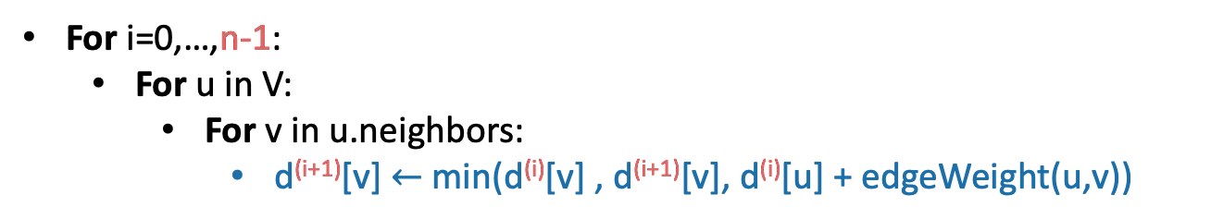
B-F with negative cycles
Gates
Gates Packard CS161 Union Dish
d⁽⁰⁾
1
0
$$∞$$
$$∞$$
$$∞$$
$$∞$$
CS161
d⁽¹⁾
0
1
$$∞$$
$$∞$$
-3
1
d⁽²⁾
0
-5
2
7
-3
Packard
4
d⁽³⁾
-4
-5
-4
6
-3
d⁽⁴⁾
-4
-5
-4
6
-7
-2
Union
But we can tell that it’s not looking good:
d⁽⁵⁾
-4
-9
-4
3
-3
-7
10
Some stuff changed!
For i=0,…,n-1:
For u in V:
For v in u.neighbors:
d^{(i+1)}[v] $←$min(d^{(i)}[v] , d^{(i+1)}[v], d^{(i)}[u] + edgeWeight(u,v))
Dish

Slide 92
How Bellman-Ford deals with negative cycles
If there are no negative cycles:
Everything works as it should.
The algorithm stabilizes after n-1 rounds.
Note: Negative edges are okay!!
If there are negative cycles:
Not everything works as it should…
it couldn’t possibly work, since shortest paths aren’t well-defined if there are negative cycles.
The d[v] values will keep changing.
Solution:
Go one round more and see if things change.
If so, return NEGATIVE CYCLE ☹
(Pseudocode on skipped slide)

Slide 93
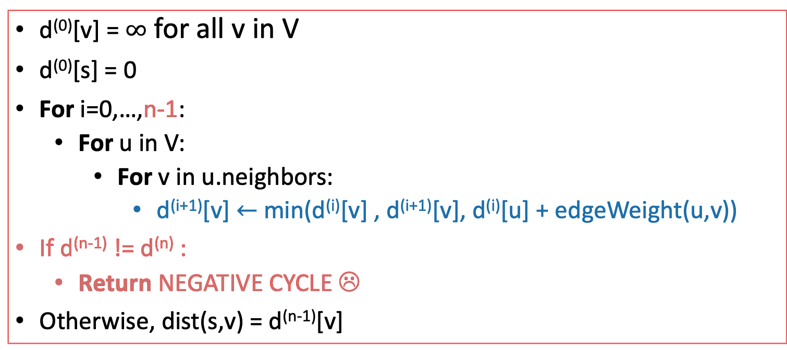
Bellman-Ford algorithm
SLIDE SKIPPED IN CLASS
Bellman-Ford*(G,s):
d⁽⁰⁾[v] = $∞$ for all v in V
d⁽⁰⁾[s] = 0
For i=0,…,n-1:
For u in V:
For v in u.neighbors:
d^{(i+1)}[v] $←$min(d^{(i)}[v] , d^{(i+1)}[v], d^{(i)}[u] + edgeWeight(u,v))
If d^{(n-1)} != d^{(n)} :
Return NEGATIVE CYCLE ☹
Otherwise, dist(s,v) = d^{(n-1)}[v]

Slide 94
Summary It’s okay if that went by fast, we’ll come back to Bellman-Ford
The Bellman-Ford algorithm:
Finds shortest paths in weighted graphs with negative edge weights
runs in time O(nm) on a graph G with n vertices and m edges.
If there are no negative cycles in G:
the BF algorithm terminates with d^{(n-1)}[v] = d(s,v).
If there are negative cycles in G:
the BF algorithm returns negative cycle.

Slide 95
Bellman-Ford is also used in practice.
eg, Routing Information Protocol (RIP) uses something like Bellman-Ford.
Older protocol, not used as much anymore.
Destination | Cost to get there | Send to whom?
172.16.1.0 | 34 | 172.16.1.1
10.20.40.1 | 10 | 192.168.1.2
10.155.120.1 | 9 | 10.13.50.0
Each router keeps a table of distances to every other router.
Periodically we do a Bellman-Ford update.
This means that if there are changes in the network, this will propagate. (maybe slowly…)
Notes:
In general this is called a “distance-vector” routing protocol which means it maintains a vector of distances. OTOH, the OSPF algorithm that uses Dijkstra is “link-state” routing protocol which means that a node should broadcast to everyone if the topology changes.

Slide 96
Recap: shortest paths
BFS:
(+) O(n+m)
(-) only unweighted graphs
Dijkstra’s algorithm:
(+) weighted graphs
(+) O(nlog(n) + m) if you implement it right.
(-) no negative edge weights
(-) very “centralized” (need to keep track of all the vertices to know which to update).
The Bellman-Ford algorithm:
(+) weighted graphs, even with negative weights
(+) can be done in a distributed fashion, every vertex using only information from its neighbors.
(-) O(nm)

Slide 97
Bonus
Tomorrow (Feb 13) 4-5pm in CoDa E160: Bob Tarjan speaking on Universal Optimality of Dijkstra's Shortest Path Algorithm IEEE FOCS (Foundations of Computer Science) 2024 Best Paper Award

Slide 98
Next Time
Dynamic Programming!!!
Pre-lecture exercise for Lecture 12
Remember the Fibonacci numbers from HW1?
Before next time

Slide 99
Mini-topic (bonus slides) Amortized analysis!
We mentioned this when we talked about implementing Dijkstra.
What’s the difference between this notion and expected runtime?
*Any sequence of d deleteMin calls takes time at most O(d log(n)). But some of the d may take longer and some may take less time.

Slide 100
Example
0
1
10
11
100
101
110
111
1000
1001
1010
1011
1100
1101
1110
1111
Incrementing a binary counter n times.
Say that flipping a bit is costly.
Above, we’ve noted the cost in terms of bit-flips.
1 2 1 3 1 2 1 4 1 2 1 3 1 2 1

Slide 101
Example
0
1
10
11
100
101
110
111
1000
1001
1010
1011
1100
1101
1110
1111
Incrementing a binary counter n times.
Say that flipping a bit is costly.
Some steps are very expensive.
Many are very cheap.
Amortized over all the inputs, it turns out to be pretty cheap.
O(n) for all n increments.
1 2 1 3 1 2 1 4 1 2 1 3 1 2 1

Slide 102
This is different from expected runtime.
The statement is deterministic, no randomness here.
But it is still weaker than worst-case runtime.
We may need to wait for a while to start making it worth it.

