Slide 1
Lecture 12
Bellman-Ford, Floyd-Warshall,
and Dynamic Programming!

Slide 2
Announcements
Homework 5 due today
Homework 6 out today
Almost done grading the midterm – grades will be released soon
I think the midterm was hard!

Slide 3
Today
Bellman-Ford Algorithm
Bellman-Ford is a special case of Dynamic Programming!
What is dynamic programming?
Warm-up example: Fibonacci numbers
Another example:
Floyd-Warshall Algorithm

Slide 4
Recall
Weights on edges represent costs.
The cost of a path is the sum of the weights along that path.
A shortest path from s to t is a directed path from s to t with the smallest cost.
The single-source shortest path problem is to find the shortest path from s to v for all v in the graph.
A weighted directed graph:
u
s
3
32
1
5
1
This is a path from s to t of cost 22.
b
v
13
a
21
2
16
t
This is a path from s to t of cost 10. It is the shortest path from s to t.

Slide 5
Last time
Dijkstra’s algorithm!
Solves the single-source shortest path problem in weighted graphs.
u
s
3
32
1
5
1
b
v
13
a
21
2
16
t

Slide 6
Dijkstra Drawbacks
Needs non-negative edge weights.
If the weights change, we need to re-run the whole thing.

Slide 7
Bellman-Ford algorithm
(-) Slower than Dijkstra’s algorithm
(+) Can handle negative edge weights.
Can be useful if you want to say that some edges are actively good to take, rather than costly.
Can be useful as a building block in other algorithms.
(+) Allows for some flexibility if the weights change.
We’ll see what this means later

Slide 8
Aside: Negative Cycles
A negative cycle is a cycle whose edge weights sum to a negative number.
Shortest paths aren’t defined when there are negative cycles!
A
-10
2
B
The shortest path from A to B has cost…negative infinity?
C
1

Slide 9
Bellman-Ford algorithm
(-) Slower than Dijkstra’s algorithm
(+) Can handle negative edge weights.
Can detect negative cycles!
Can be useful if you want to say that some edges are actively good to take, rather than costly.
Can be useful as a building block in other algorithms.
(+) Allows for some flexibility if the weights change.
We’ll see what this means later

Slide 10
Bellman-Ford vs. Dijkstra
Dijkstra:
Find the u with the smallest d[u]
Update u’s neighbors: d[v] = min( d[v], d[u] + w(u,v) )
Bellman-Ford:
Don’t bother finding the u with the smallest d[u]
Everyone updates!

Slide 11


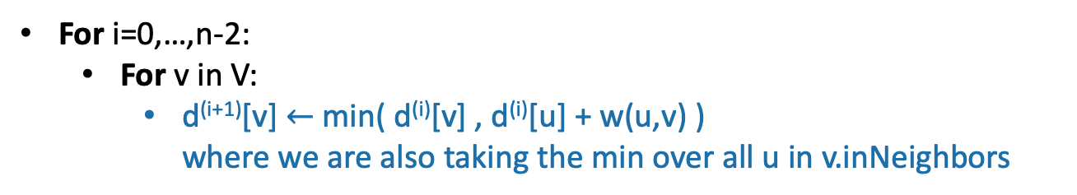






Bellman-Ford
=
Gates
0
How far is a node from Gates?
$$∞$$
1
Gates Packard CS161 Union Dish
CS161
d⁽⁰⁾
0
$$∞$$
$$∞$$
$$∞$$
$$∞$$
d⁽¹⁾
1
Packard
d⁽²⁾
4
$$∞$$
d⁽³⁾
22
$$∞$$
Union
d⁽⁴⁾
25
20
For i=0,…,n-2:
For v in V:
d^{(i+1)}[v] $←$min( d^{(i)}[v] , d^{(i)}[u] + w(u,v) )
where we are also taking the min over all u in v.inNeighbors
Dish
$$∞$$

Slide 12




Bellman-Ford
Gates
0
How far is a node from Gates?
$$∞$$
1
Gates Packard CS161 Union Dish
CS161
d⁽⁰⁾
0
$$∞$$
$$∞$$
$$∞$$
$$∞$$
d⁽¹⁾
1
0
1
$$∞$$
$$∞$$
25
Packard
d⁽²⁾
4
$$1$$
d⁽³⁾
22
$$∞$$
Union
d⁽⁴⁾
25
20
For i=0,…,n-2:
For v in V:
d^{(i+1)}[v] $←$min( d^{(i)}[v] , d^{(i)}[u] + w(u,v) )
where we are also taking the min over all u in v.inNeighbors
Dish
$$25$$

Slide 13




Bellman-Ford
Gates
0
How far is a node from Gates?
$$2$$
1
Gates Packard CS161 Union Dish
CS161
d⁽⁰⁾
0
$$∞$$
$$∞$$
$$∞$$
$$∞$$
d⁽¹⁾
1
0
1
$$∞$$
$$∞$$
25
Packard
d⁽²⁾
0
1
2
45
23
4
$$1$$
d⁽³⁾
22
$$45$$
Union
d⁽⁴⁾
25
20
For i=0,…,n-2:
For v in V:
d^{(i+1)}[v] $←$min( d^{(i)}[v] , d^{(i)}[u] + w(u,v) )
where we are also taking the min over all u in v.inNeighbors
Dish
$$23$$

Slide 14

Bellman-Ford
Gates
0
How far is a node from Gates?
$$2$$
1
Gates Packard CS161 Union Dish
CS161
d⁽⁰⁾
0
$$∞$$
$$∞$$
$$∞$$
$$∞$$
d⁽¹⁾
1
0
1
$$∞$$
$$∞$$
25
Packard
d⁽²⁾
0
1
2
45
23
4
$$1$$
d⁽³⁾
0
1
2
6
23
22
$$6$$
Union
d⁽⁴⁾
25
20
For i=0,…,n-2:
For v in V:
d^{(i+1)}[v] $←$min( d^{(i)}[v] , d^{(i)}[u] + w(u,v) )
where we are also taking the min over all u in v.inNeighbors
Dish
$$23$$

Slide 15
Bellman-Ford
Gates
0
How far is a node from Gates?
$$2$$
1
Gates Packard CS161 Union Dish
CS161
d⁽⁰⁾
0
$$∞$$
$$∞$$
$$∞$$
$$∞$$
d⁽¹⁾
1
0
1
$$∞$$
$$∞$$
25
Packard
d⁽²⁾
0
1
2
45
23
4
$$1$$
d⁽³⁾
0
1
2
6
23
22
$$6$$
Union
d⁽⁴⁾
0
1
2
6
23
25
These are the final distances!
20
For i=0,…,n-2:
For v in V:
d^{(i+1)}[v] $←$min( d^{(i)}[v] , d^{(i)}[u] + w(u,v) )
where we are also taking the min over all u in v.inNeighbors
Dish
$$23$$

Slide 16





Interpretation of d^{(i)}
Gates
0
$$2$$
1
d^{(i)}[v] is equal to the cost of the shortest path between s and v with at most i edges.
CS161
1
Gates Packard CS161 Union Dish
Packard
d⁽⁰⁾
$$1$$
4
0
$$∞$$
$$∞$$
$$∞$$
$$∞$$
d⁽¹⁾
0
1
$$∞$$
$$∞$$
25
22
$$6$$
Union
d⁽²⁾
0
1
2
45
23
25
d⁽³⁾
0
1
2
6
23
20
d⁽⁴⁾
0
1
2
6
23
Dish
$$23$$

Slide 17
Why does Bellman-Ford work?
Inductive hypothesis:
d^{(i)}[v] is equal to the cost of the shortest path between s and v with at most i edges.
Conclusion:
d^{(n-1)}[v] is equal to the cost of the shortest path between s and v with at most n-1 edges.
Do the base case and inductive step!

Slide 18
Aside: simple paths Assume there is no negative cycle.
Then there is a shortest path from s to t, and moreover there is a simple shortest path.
A simple path in a graph with n vertices has at most n-1 edges in it.
So there is a shortest path with at most n-1 edges
s
-2
v
10
t
2
-5
x
y
This cycle isn’t helping. Just get rid of it.
3
s
u
“Simple” means that the path has no cycles in it.
Can’t add another edge without making a cycle!
t
v

Slide 19
Why does it work?
Inductive hypothesis:
d^{(i)}[v] is equal to the cost of the shortest path between s and v with at most i edges.
Conclusion:
d^{(n-1)}[v] is equal to the cost of the shortest path between s and v with at most n-1 edges.
If there are no negative cycles, d^{(n-1)}[v] is equal to the cost of the shortest path.
Notice that negative edge weights are fine. Just not negative cycles.

Slide 20
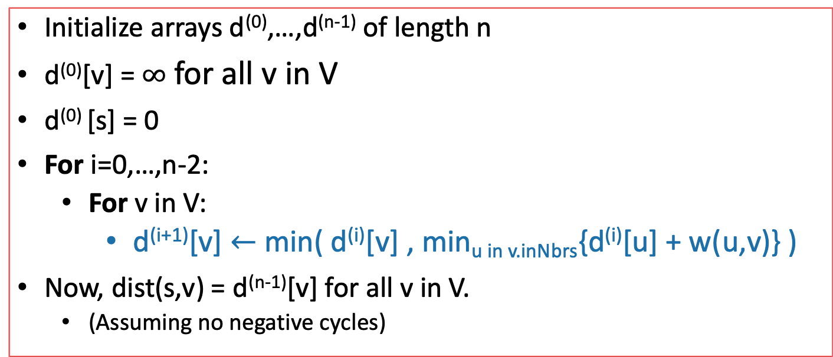
Bellman-Ford* algorithm
G = (V,E) is a graph with n vertices and m edges.
Bellman-Ford*(G,s):
Initialize arrays d⁽⁰⁾,…,d^{(n-1)} of length n
d⁽⁰⁾[v] = $∞$ for all v in V
d⁽⁰⁾ [s] = 0
For i=0,…,n-2:
For v in V:
d^{(i+1)}[v] $←$min( d^{(i)}[v] , min_{u in v.inNbrs}{d^{(i)}[u] + w(u,v)} )
Now, dist(s,v) = d^{(n-1)}[v] for all v in V.
(Assuming no negative cycles)
Here, Dijkstra picked a special vertex u and updated u’s neighbors – Bellman-Ford will update all the vertices.
*Slightly different than some versions of Bellman-Ford…but this way is pedagogically convenient for today’s lecture.

Slide 21





Note on implementation
We don’t even need two, just one array is fine. Why?
Don’t actually keep all n arrays around.
Just keep two at a time: “last round” and “this round”
Gates Packard CS161 Union Dish
d⁽⁰⁾
0
$$∞$$
$$∞$$
$$∞$$
$$∞$$
d⁽¹⁾
0
1
$$∞$$
$$∞$$
25
d⁽²⁾
0
1
2
45
23
d⁽³⁾
0
1
2
6
23
Only need these two in order to compute d⁽⁴⁾
d⁽⁴⁾
0
1
2
6
23

Slide 22
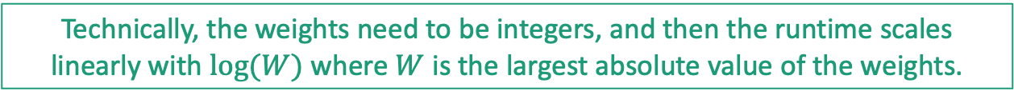
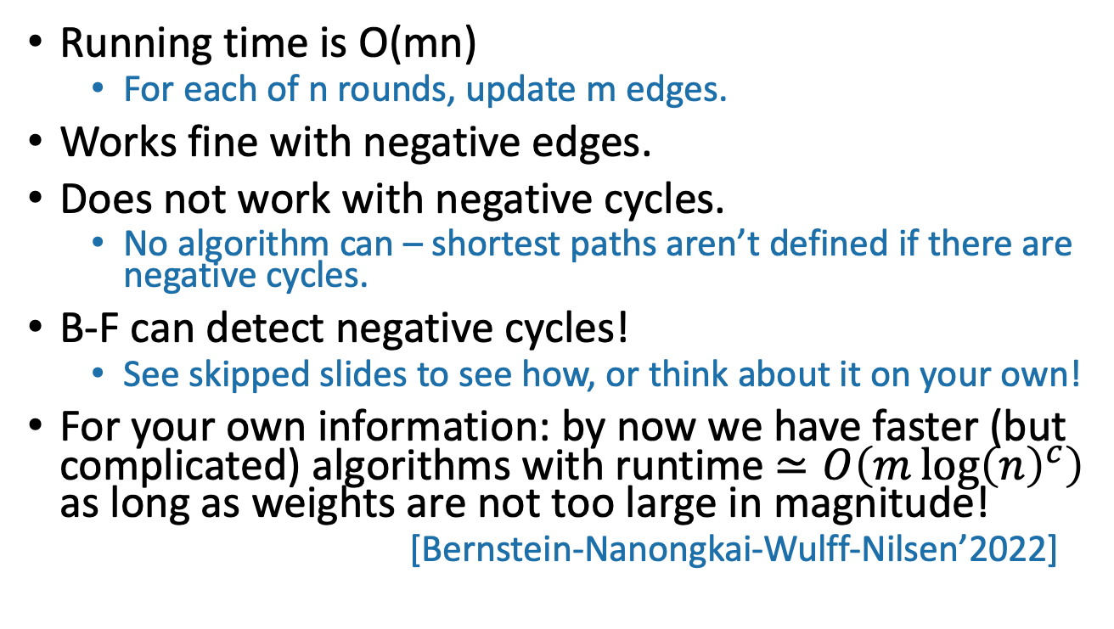
Bellman-Ford take-aways
Running time is O(mn)
For each of n rounds, update m edges.
Works fine with negative edges.
Does not work with negative cycles.
No algorithm can – shortest paths aren’t defined if there are negative cycles.
B-F can detect negative cycles!
See skipped slides to see how, or think about it on your own!
For your own information: by now we have faster (but complicated) algorithms with runtime $≃O\left(m\log{{\left(n\right)}^{c}}\right)$ as long as weights are not too large in magnitude!
[Bernstein-Nanongkai-Wulff-Nilsen’2022]
Technically, the weights need to be integers, and then the runtime scales linearly with $\log{(W)}$ where $W$ is the largest absolute value of the weights.

Slide 23

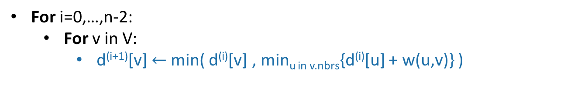



BF with negative cycles
SLIDE SKIPPED IN CLASS
Gates
Gates Packard CS161 Union Dish
d⁽⁰⁾
1
0
$$∞$$
$$∞$$
$$∞$$
$$∞$$
CS161
d⁽¹⁾
0
1
$$∞$$
$$∞$$
-3
1
d⁽²⁾
0
-5
2
7
-3
Packard
4
d⁽³⁾
-4
-5
-4
6
-3
d⁽⁴⁾
-4
-5
-4
6
-7
-2
Union
This is not looking good!
-3
10
For i=0,…,n-2:
For v in V:
d^{(i+1)}[v] $←$min( d^{(i)}[v] , min_{u in v.nbrs}{d^{(i)}[u] + w(u,v)} )
Dish

Slide 24

BF with negative cycles
SLIDE SKIPPED IN CLASS
Gates
Gates Packard CS161 Union Dish
d⁽⁰⁾
1
0
$$∞$$
$$∞$$
$$∞$$
$$∞$$
CS161
d⁽¹⁾
0
1
$$∞$$
$$∞$$
-3
1
d⁽²⁾
0
-5
2
7
-3
Packard
4
d⁽³⁾
-4
-5
-4
6
-3
d⁽⁴⁾
-4
-5
-4
6
-7
-2
Union
But we can tell that it’s not looking good:
d⁽⁵⁾
-4
-9
-4
3
-3
-7
10
Some stuff changed!
For i=0,…,n-2:
For v in V:
d^{(i+1)}[v] $←$min( d^{(i)}[v] , min_{u in v.nbrs}{d^{(i)}[u] + w(u,v)} )
Dish

Slide 25
Negative cycles in Bellman-Ford
SLIDE SKIPPED IN CLASS
If there are no negative cycles:
Everything works as it should, and stabilizes in n-1 rounds.
If there are negative cycles:
Not everything works as it should…
The d[v] values will keep changing.
Solution:
Go one round more and see if things change.

Slide 26
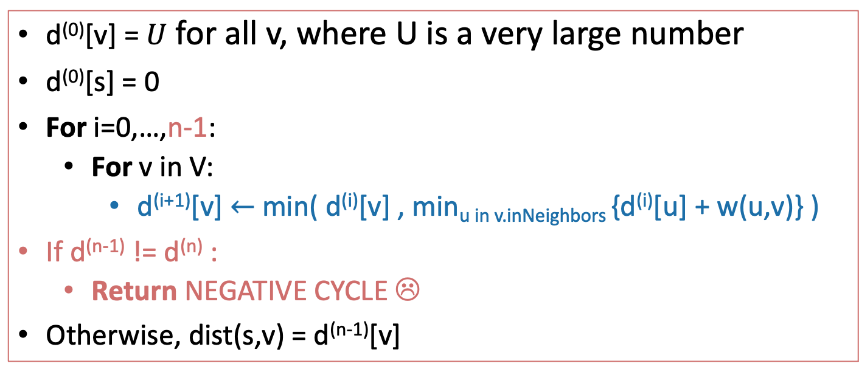
Bellman-Ford algorithm
SLIDE SKIPPED IN CLASS
Bellman-Ford*(G,s):
d⁽⁰⁾[v] = $U$ for all v, where U is a very large number
d⁽⁰⁾[s] = 0
For i=0,…,n-1:
For v in V:
d^{(i+1)}[v] $←$min( d^{(i)}[v] , min_{u in v.inNeighbors} {d^{(i)}[u] + w(u,v)} )
If d^{(n-1)} != d^{(n)} :
Return NEGATIVE CYCLE ☹
Otherwise, dist(s,v) = d^{(n-1)}[v]
Running time: O(mn)

Slide 27

Important thing about B-F for the rest of this lecture
Gates
0
$$2$$
1
d^{(i)}[v] is equal to the cost of the shortest path between s and v with at most i edges.
CS161
1
Packard
Gates Packard CS161 Union Dish
$$1$$
4
d⁽⁰⁾
0
$$∞$$
$$∞$$
$$∞$$
$$∞$$
22
$$6$$
d⁽¹⁾
0
1
$$∞$$
$$∞$$
25
Union
d⁽²⁾
0
1
2
45
23
25
d⁽³⁾
0
1
2
6
23
20
d⁽⁴⁾
0
1
2
6
23
Dish
$$23$$

Slide 28
Bellman-Ford is an example of… Dynamic Programming!
Today:
Example of Dynamic programming:
Fibonacci numbers.
(And Bellman-Ford)
What is dynamic programming, exactly?
And why is it called “dynamic programming”?
Another example: Floyd-Warshall algorithm
An “all-pairs” shortest path algorithm

Slide 29
Pre-Lecture exercise: How not to compute Fibonacci Numbers
Definition:
F(n) = F(n-1) + F(n-2), with F(1) = F(2) = 1.
The first several are:
1
1
2
3
5
8
13, 21, 34, 55, 89, 144,…
Question:
Given n, what is F(n)?

Slide 30
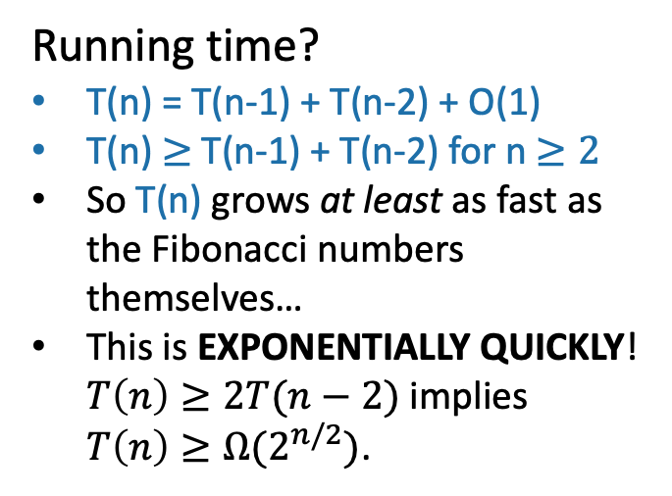
Candidate algorithm
def Fibonacci(n):
if n == 0, return 0
if n == 1, return 1
return Fibonacci(n-1) + Fibonacci(n-2)
Running time?
T(n) = T(n-1) + T(n-2) + O(1)
T(n) $≥$T(n-1) + T(n-2) for n $≥2$
So T(n) grows at least as fast as the Fibonacci numbers themselves…
This is EXPONENTIALLY QUICKLY! $T\left(n\right)≥2T(n−2)$ implies $T\left(n\right)≥Ω(2^{n/2})$.
See IPython notebook for lecture 12

Slide 31
What’s going on? Consider Fib(8)
That’s a lot of repeated computation!
8
6
7
4
5
5
6
2
3
3
4
3
4
4
5
0
1
1
2
1
2
2
3
1
2
2
3
2
3
3
4
1
2
2
etc
0
1
0
1
0
1
1
2
0
1
0
1
0
1
1
1
2
0
1
0
1
0
1
0
1

Slide 32
Maybe this would be better:
8
def fasterFibonacci(n):
F = [0, 1, None, None, …, None ]
\\ F has length n + 1
for i = 2, …, n:
F[i] = F[i-1] + F[i-2]
return F[n]
7
6
Much better running time!
5
4
3
2
1
0

Slide 33
This was an example of…
Dynamic
Programming!

Slide 34
What is dynamic programming?
It is an algorithm design paradigm
like divide-and-conquer is an algorithm design paradigm.
Usually, it is for solving optimization problems
E.g., shortest path
(Fibonacci numbers aren’t an optimization problem, but they are a good example of DP anyway…)

Slide 35
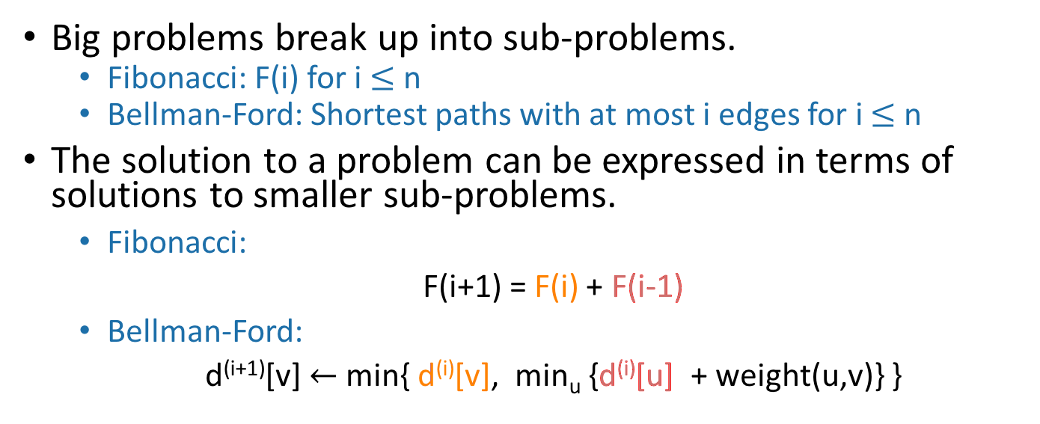
Elements of dynamic programming
1. Optimal sub-structure:
Big problems break up into sub-problems.
Fibonacci: F(i) for i $≤$ n
Bellman-Ford: Shortest paths with at most i edges for i $≤$ n
The solution to a problem can be expressed in terms of solutions to smaller sub-problems.
Fibonacci:
F(i+1) = F(i) + F(i-1)
Bellman-Ford:
d^{(i+1)}[v] $←$ min{ d^{(i)}[v], min_{u} {d^{(i)}[u] + weight(u,v)} }
Shortest path with at most i edges from s to v
Shortest path with at most i edges from s to u.

Slide 36
Elements of dynamic programming
2. Overlapping sub-problems:
The sub-problems overlap.
Fibonacci:
Both F[i+1] and F[i+2] directly use F[i].
And lots of different F[i+x] indirectly use F[i].
Bellman-Ford:
Many different entries of d^{(i+1)} will directly use d^{(i)}[v].
And lots of different entries of d^{(i+x)} will indirectly use d^{(i)}[v].
This means that we can save time by solving a sub-problem just once and storing the answer.

Slide 37
Elements of dynamic programming
Optimal substructure.
Optimal solutions to sub-problems can be used to find the optimal solution of the original problem.
Overlapping subproblems.
The subproblems show up again and again
Using these properties, we can design a dynamic programming algorithm:
Keep a table of solutions to the smaller problems.
Use the solutions in the table to solve bigger problems.
At the end we can use information we collected along the way to find the solution to the whole thing.

Slide 38
Two ways to think about and/or implement DP algorithms
Top down
Bottom up

Slide 39
Bottom up approach what we just saw.
For Fibonacci:
Solve the small problems first
fill in F[0],F[1]
Then bigger problems
fill in F[2]
…
Then bigger problems
fill in F[n-1]
Then finally solve the real problem.
fill in F[n]

Slide 40
Bottom up approach what we just saw.
For Bellman-Ford:
Solve the small problems first
fill in d⁽⁰⁾
Then bigger problems
fill in d⁽¹⁾
…
Then bigger problems
fill in d^{(n-2)}
Then finally solve the real problem.
fill in d^{(n-1)}

Slide 41
Top down approach
Think of it like a recursive algorithm.
To solve the big problem:
Recurse to solve smaller problems
Those recurse to solve smaller problems
etc..
The difference from divide and conquer:
Keep track of what small problems you’ve already solved to prevent re-solving the same problem twice.
Aka, “memo-ization”

Slide 42
Example of top-down Fibonacci
define a global list F = [0,1,None, None, …, None]
def Fibonacci(n):
if F[n] != None:
return F[n]
else:
F[n] = Fibonacci(n-1) + Fibonacci(n-2)
return F[n]
Memo-ization: Keeps track (in F) of the stuff you’ve already done.

Slide 43
Memo-ization visualization
Collapse repeated nodes and don’t do the same work twice!
8
6
7
4
5
5
6
2
3
3
4
3
4
4
5
0
1
1
2
1
2
2
3
1
2
2
3
2
3
3
4
1
2
2
etc
0
1
0
1
0
1
1
2
0
1
0
1
0
1
1
1
2
0
1
0
1
0
1
0
1

Slide 44
Memo-ization Visualization ctd
8
7
Collapse repeated nodes and don’t do the same work twice!
But otherwise treat it like the same old recursive algorithm.
6
5
4
define a global list F = [0,1,None, None, …, None]
def Fibonacci(n):
if F[n] != None:
return F[n]
else:
F[n] = Fibonacci(n-1) + Fibonacci(n-2)
return F[n]
3
2
1
0

Slide 45
What have we learned?
Dynamic programming:
Paradigm in algorithm design.
Uses optimal substructure
Uses overlapping subproblems
Can be implemented bottom-up or top-down.
It’s a fancy name for a pretty common-sense idea:
Don’t duplicate work if you don’t have to!

Slide 46
Why “dynamic programming” ?
Programming refers to finding the optimal “program.”
as in, a shortest route is a plan aka a program.
Dynamic refers to the fact that it’s multi-stage.
But also it’s just a fancy-sounding name.
Manipulating computer code in an action movie?

Slide 47
Why “dynamic programming” ?
Richard Bellman invented the name in the 1950’s.
At the time, he was working for the RAND Corporation, which was basically working for the Air Force, and government projects needed flashy names to get funded.
From Bellman’s autobiography:
“It’s impossible to use the word, dynamic, in the pejorative sense…I thought dynamic programming was a good name. It was something not even a Congressman could object to.”

Slide 48
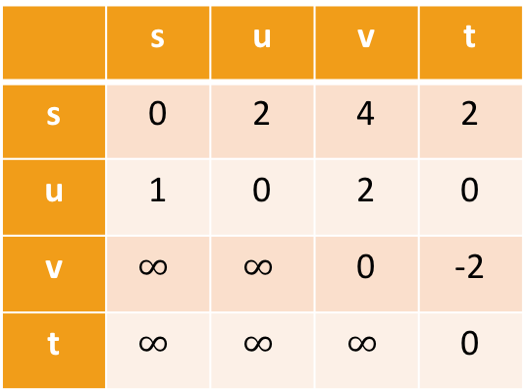
Floyd-Warshall Algorithm Another example of DP
This is an algorithm for All-Pairs Shortest Paths (APSP)
That is, I want to know the shortest path from u to v for ALL pairs u,v of vertices in the graph.
Not just from a special single source s.
Destination
Source
 | s | u | v | t
s | 0 | 2 | 4 | 2
u | 1 | 0 | 2 | 0
v | $$∞$$ | $$∞$$ | 0 | -2
t | $$∞$$ | $$∞$$ | $$∞$$ | 0
s
2
u
1
5
2
t
v
-2

Slide 49
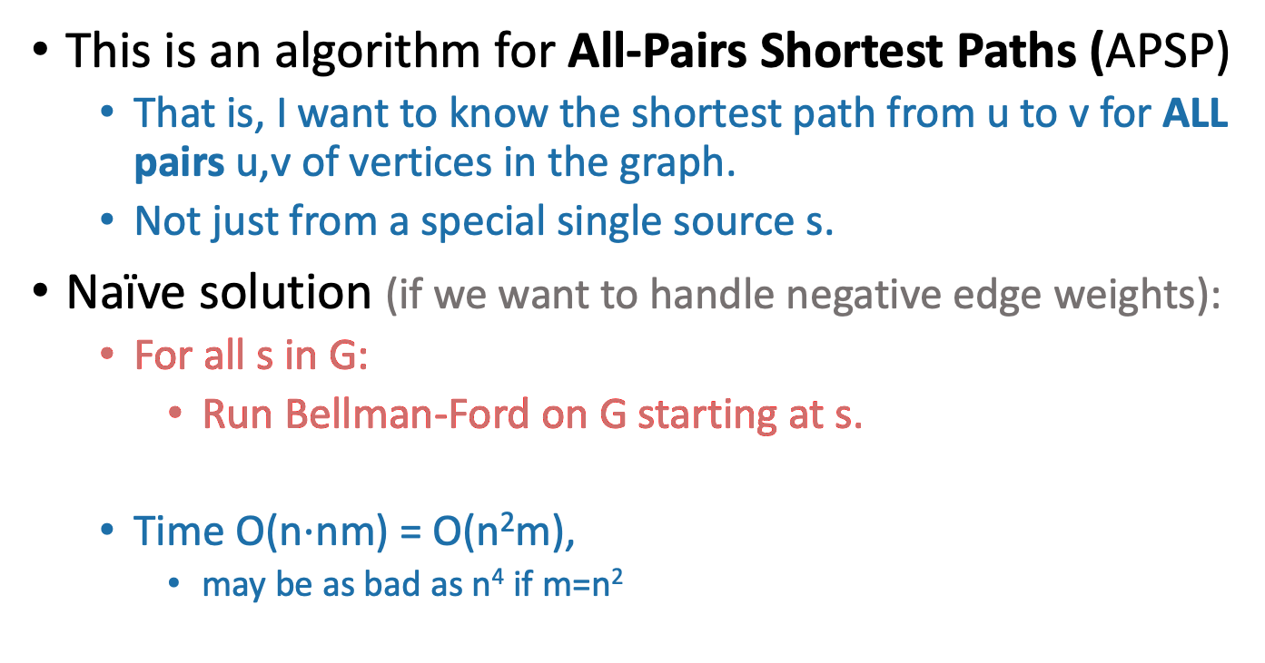
Floyd-Warshall Algorithm Another example of DP
This is an algorithm for All-Pairs Shortest Paths (APSP)
That is, I want to know the shortest path from u to v for ALL pairs u,v of vertices in the graph.
Not just from a special single source s.
Naïve solution (if we want to handle negative edge weights):
For all s in G:
Run Bellman-Ford on G starting at s.
Time O(n$⋅$nm) = O(n²m),
may be as bad as n⁴ if m=n²
Can we do better?

Slide 50
Optimal substructure
Label the vertices 1,2,…,n
k
k+1
u
1
2
v
3
…
k-1
n

Slide 51
Optimal substructure
Label the vertices 1,2,…,n
(We omit some edges in the picture below – meant to be a cartoon, not an example).
Sub-problem(k-1):
For all pairs, u,v, find the cost of the shortest path from u to v, so that all the internal vertices on that path are in {1,…,k-1}.
Our DP algorithm will fill in the
n-by-n arrays
D⁽⁰⁾, D⁽¹⁾, …, D^{(n)} iteratively and then we’ll be done.
k
Let D^{(k-1)}[u,v] be the solution to Sub-problem(k-1).
k+1
u
1
2
v
3
…
k-1
This is the shortest path from u to v through the blue set. It has cost D^{(k-1)}[u,v]
n
Vertices 1, …, k-1

Slide 52
Optimal substructure
Label the vertices 1,2,…,n
(We omit some edges in the picture below – meant to be a cartoon, not an example).
Sub-problem(k-1):
For all pairs, u,v, find the cost of the shortest path from u to v, so that all the internal vertices on that path are in {1,…,k-1}.
Our DP algorithm will fill in the
n-by-n arrays
D⁽⁰⁾, D⁽¹⁾, …, D^{(n)} iteratively and then we’ll be done.
k
Let D^{(k-1)}[u,v] be the solution to Sub-problem(k-1).
k+1
Question: How can we find D^{(k)}[u,v] using D^{(k-1)}?
u
1
2
v
3
…
k-1
This is the shortest path from u to v through the blue set. It has cost D^{(k-1)}[u,v]
n
Vertices 1, …, k-1

Slide 53
How can we find D^{(k)}[u,v] using D^{(k-1)}?
D^{(k)}[u,v] is the cost of the shortest path from u to v so that all internal vertices on that path are in {1, …, k}.
k
k+1
Vertices 1, …, k
u
1
2
v
3
…
k-1
n
Vertices 1, …, k-1

Slide 54
How can we find D^{(k)}[u,v] using D^{(k-1)}?
D^{(k)}[u,v] is the cost of the shortest path from u to v so that all internal vertices on that path are in {1, …, k}.
Case 1: we don’t need vertex k.
k
k+1
Vertices 1, …, k
u
1
2
v
3
…
k-1
This path was the shortest before, so it’s still the shortest now.
n
Vertices 1, …, k-1
D^{(k)}[u,v] = D^{(k-1)}[u,v]

Slide 55
How can we find D^{(k)}[u,v] using D^{(k-1)}?
D^{(k)}[u,v] is the cost of the shortest path from u to v so that all internal vertices on that path are in {1, …, k}.
Case 2: we need vertex k.
k
k+1
Vertices 1, …, k
u
1
2
v
3
…
k-1
n
Vertices 1, …, k-1

Slide 56
Case 2 continued
Suppose there are no negative cycles.
Then WLOG the shortest path from u to v through {1,…,k} is simple.
If that path passes through k, it must look like this:
This path is the shortest path from u to k through {1,…,k-1}.
sub-paths of shortest paths are shortest paths
Similarly for this path.
Case 2: we need vertex k.
k
Vertices 1, …, k
u
1
2
v
3
…
k-1
n
Vertices 1, …, k-1
D^{(k)}[u,v] = D^{(k-1)}[u,k] + D^{(k-1)}[k,v]

Slide 57
How can we find D^{(k)}[u,v] using D^{(k-1)}?
Case 1: we don’t need vertex k.
Case 2: we need vertex k.
k
k
Vertices 1, …, k
Vertices 1, …, k
u
1
u
1
2
2
v
v
3
3
…
…
k-1
k-1
Vertices 1, …, k-1
Vertices 1, …, k-1
D^{(k)}[u,v] = D^{(k-1)}[u,v]
D^{(k)}[u,v] = D^{(k-1)}[u,k] + D^{(k-1)}[k,v]

Slide 58
How can we find D^{(k)}[u,v] using D^{(k-1)}?
D^{(k)}[u,v] = min{ D^{(k-1)}[u,v], D^{(k-1)}[u,k] + D^{(k-1)}[k,v] }
Optimal substructure:
We can solve the big problem using solutions to smaller problems.
Overlapping sub-problems:
D^{(k-1)}[k,v] can be used to help compute D^{(k)}[u,v] for lots of different u’s.
Case 1: Cost of shortest path through {1,…,k-1}
Case 2: Cost of shortest path from u to k and then from k to v through {1,…,k-1}

Slide 59
How can we find D^{(k)}[u,v] using D^{(k-1)}?
D^{(k)}[u,v] = min{ D^{(k-1)}[u,v], D^{(k-1)}[u,k] + D^{(k-1)}[k,v] }
Using our Dynamic programming paradigm, this immediately gives us an algorithm!
Case 1: Cost of shortest path through {1,…,k-1}
Case 2: Cost of shortest path from u to k and then from k to v through {1,…,k-1}

Slide 60
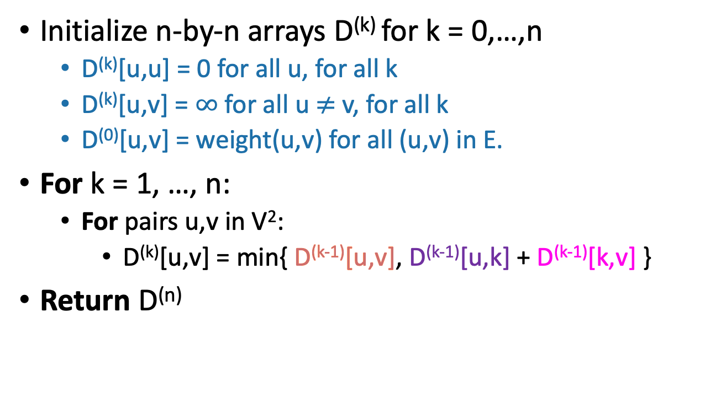
Floyd-Warshall algorithm
Initialize n-by-n arrays D^{(k)} for k = 0,…,n
D^{(k)}[u,u] = 0 for all u, for all k
D^{(k)}[u,v] = $∞$ for all u $≠$ v, for all k
D⁽⁰⁾[u,v] = weight(u,v) for all (u,v) in E.
For k = 1, …, n:
For pairs u,v in V²:
D^{(k)}[u,v] = min{ D^{(k-1)}[u,v], D^{(k-1)}[u,k] + D^{(k-1)}[k,v] }
Return D^{(n)}
The base case checks out: the only path through zero other vertices are edges directly from u to v.
This is a bottom-up Dynamic programming algorithm.

Slide 61
We’ve basically just shown
Theorem:
If there are no negative cycles in a weighted directed graph G, then the Floyd-Warshall algorithm, running on G, returns a matrix D^{(n)} so that:
D^{(n)}[u,v] = distance between u and v in G.
Running time: O(n³)
Better than running Bellman-Ford n times!
Storage:
Need to store two n-by-n arrays, and the original graph.
Work out the details of a proof!
We don’t even need two, just one array is fine. Why?
As with Bellman-Ford, we don’t really need to store all n of the D^{(k)}.

Slide 62
What if there are negative cycles?
Just like Bellman-Ford, Floyd-Warshall can detect negative cycles:
“Negative cycle” means that there’s some v so that there is a path from v to v that has cost < 0.
Aka, D^{(n)}[v,v] < 0.
Algorithm:
Run Floyd-Warshall as before.
If there is some v so that D^{(n)}[v,v] < 0:
return negative cycle.

Slide 63
What have we learned?
The Floyd-Warshall algorithm is another example of dynamic programming.
It computes All Pairs Shortest Paths in a directed weighted graph in time O(n³).

Slide 64
Can we do better than O(n³)? Nothing on this slide is required knowledge for this class
There is an algorithm that runs in time O(n³/log¹⁰⁰(n)).
[Williams, “Faster APSP via Circuit Complexity”, STOC 2014]
If you can come up with an algorithm for All-Pairs-Shortest-Path that runs in time O(n^{2.99}), that would be a really big deal.
Let me know if you can!
See [Abboud, Vassilevska-Williams, “Popular conjectures imply strong lower bounds for dynamic problems”, FOCS 2014] for some evidence that this is a very difficult problem!

Slide 65
Recap
Two shortest-path algorithms:
Bellman-Ford for single-source shortest path
Floyd-Warshall for all-pairs shortest path
Dynamic programming!
This is a fancy name for:
Break up an optimization problem into smaller problems
The optimal solutions to the sub-problems should be sub-solutions to the original problem.
Build the optimal solution iteratively by filling in a table of sub-solutions.
Take advantage of overlapping sub-problems!

Slide 66
Next time
More examples of dynamic programming!
No pre-lecture exercise for next time
We will stop bullets with our action-packed coding skills, and also maybe find longest common subsequences.

