Slide 1
Lecture 13
More dynamic programming!
Longest Common Subsequences, Knapsack, and
(if time) independent sets in trees.

Slide 2
Last time
Dynamic
Programming!
Not coding in an action movie.
Tom Cruise programs dynamically in Mission Impossible

Slide 3
Last time
Dynamic
Programming!
Dynamic programming is an algorithm design paradigm.
Basic idea:
Identify optimal sub-structure
Optimum to the big problem is built out of optima of small sub-problems
Take advantage of overlapping sub-problems
Only solve each sub-problem once, then use it again and again
Keep track of the solutions to sub-problems in a table as you build to the final solution.

Slide 4
Today
Examples of dynamic programming:
Longest common subsequence
Knapsack problem
Two versions!
Independent sets in trees
If we have time…
(If not the slides will be there as a reference)
Yet more examples of DP in CLRS!
Optimal order of matrix multiplications
Optimal binary search trees
Longest paths in DAGs, …

Slide 5
The goal of this lecture
For you to get really bored of dynamic programming

Slide 6
Longest Common Subsequence
How similar are these two species?
DNA:
DNA:
AGCCCTAAGGGCTACCTAGCTT
GACAGCCTACAAGCGTTAGCTTG

Slide 7
Longest Common Subsequence
How similar are these two species?
Pretty similar, their DNA has a long common subsequence:
DNA:
DNA:
AGCCCTAAGGGCTACCTAGCTT
GACAGCCTACAAGCGTTAGCTTG
AGCCTAAGCTTAGCTT

Slide 8
Longest Common Subsequence
Subsequence:
BDFH is a subsequence of ABCDEFGH
If X and Y are sequences, a common subsequence is a sequence which is a subsequence of both.
BDFH is a common subsequence of ABCDEFGH and of ABDFGHI
A longest common subsequence…
…is a common subsequence that is longest.
The longest common subsequence of ABCDEFGH and ABDFGHI is ABDFGH.

Slide 9
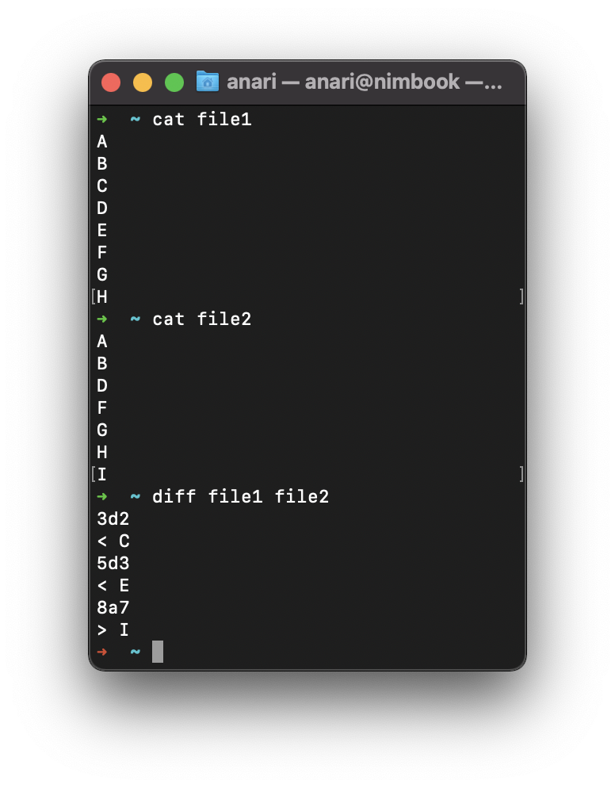
We sometimes want to find these
Applications in bioinformatics
The unix command diff
Merging in version control
svn, git, etc…

Slide 10
Recipe for applying Dynamic Programming
Step 1: Identify optimal substructure.
Step 2: Find a recursive formulation for the length of the longest common subsequence.
Step 3: Use dynamic programming to find the length of the longest common subsequence.
Step 4: If needed, keep track of some additional info so that the algorithm from Step 3 can find the actual LCS.
Step 5: If needed, code this up like a reasonable person.

Slide 11
Step 1: Optimal substructure
Prefixes:
X
A
C
G
G
T
Y
A
C
G
C
T
T
A
Notation: denote this prefix ACGC by Y₄
Our sub-problems will be finding LCS’s of prefixes to X and Y.
Let C[i,j] = length_of_LCS( X_{i}, Y_{j} )
Examples:
C[2,3] = 2
C[4,4] = 3

Slide 12
Recipe for applying Dynamic Programming
Step 1: Identify optimal substructure.
Step 2: Find a recursive formulation for the length of the longest common subsequence.
Step 3: Use dynamic programming to find the length of the longest common subsequence.
Step 4: If needed, keep track of some additional info so that the algorithm from Step 3 can find the actual LCS.
Step 5: If needed, code this up like a reasonable person.

Slide 13
Goal
Write C[i,j] in terms of the solutions to smaller sub-problems
i
X_{i}
A
C
G
G
A
j
Y_{j}
A
C
G
C
T
T
A
C[i,j] = length_of_LCS( X_{i}, Y_{j} )

Slide 14
Two cases
Our sub-problems will be finding LCS’s of prefixes to X and Y.
Let C[i,j] = length_of_LCS( X_{i}, Y_{j} )
Case 1: X[i] = Y[j]
i
These are the same
X_{i}
A
C
G
G
A
j
Y_{j}
A
C
G
C
T
T
A
Then C[i,j] = 1 + C[i-1,j-1].
because LCS(X_{i},Y_{j}) = LCS(X_{i-1},Y_{j-1}) followed by
A

Slide 15
Two cases
Our sub-problems will be finding LCS’s of prefixes to X and Y.
Let C[i,j] = length_of_LCS( X_{i}, Y_{j} )
Case 2: X[i] != Y[j]
i
These are not the same
X_{i}
A
C
G
G
T
j
Y_{j}
A
C
G
C
T
T
A
Then C[i,j] = max{ C[i-1,j], C[i,j-1] }.
either LCS(X_{i},Y_{j}) = LCS(X_{i-1},Y_{j}) and is not involved,
or LCS(X_{i},Y_{j}) = LCS(X_{i},Y_{j-1}) and is not involved,
(maybe both are not involved, that’s covered by the “or”).
T
A

Slide 16
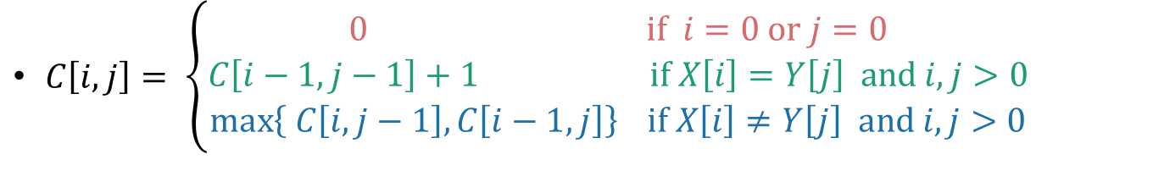
Recursive formulation of the optimal solution
X₀
Y_{j}
A
C
G
C
T
T
A
Case 0
$C\left[i,j\right]= \left\{\begin{aligned}0 \text{if} i=0 \text{or} j=0 \\ C\left[i−1,j−1\right]+1 \text{if} X\left[i\right]=Y\left[j\right] \text{and} i,j>0 \\ \max\left\{ C\left[i,j−1\right], C\left[i−1,j\right]\right\} \text{if} X\left[i\right]≠Y\left[j\right] \text{and} i,j>0\end{aligned}\right.$
Case 1
Case 2
X_{i}
A
C
G
G
A
X_{i}
A
C
G
G
T
Y_{j}
A
C
G
C
T
T
A
Y_{j}
A
C
G
C
T
T
A

Slide 17
Recipe for applying Dynamic Programming
Step 1: Identify optimal substructure.
Step 2: Find a recursive formulation for the length of the longest common subsequence.
Step 3: Use dynamic programming to find the length of the longest common subsequence.
Step 4: If needed, keep track of some additional info so that the algorithm from Step 3 can find the actual LCS.
Step 5: If needed, code this up like a reasonable person.

Slide 18
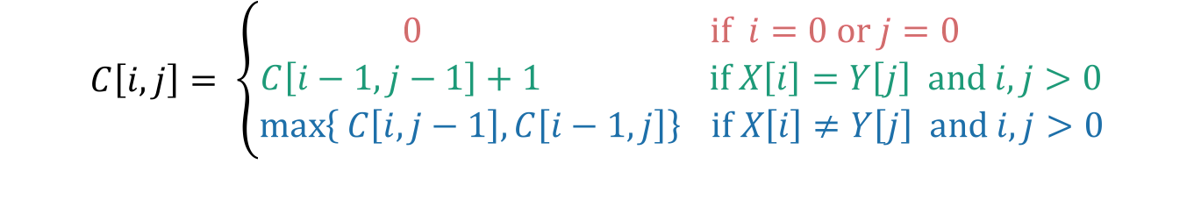
LCS DP
LCS(X, Y):
C[i,0] = C[0,j] = 0 for all i = 0,…,m, j=0,…n.
For i = 1,…,m and j = 1,…,n:
If X[i] = Y[j]:
C[i,j] = C[i-1,j-1] + 1
Else:
C[i,j] = max{ C[i,j-1], C[i-1,j] }
Return C[m,n]
Running time: O(nm)
$$C\left[i,j\right]= \left\{\begin{aligned}0 \text{if} i=0 \text{or} j=0 \\ C\left[i−1,j−1\right]+1 \text{if} X\left[i\right]=Y\left[j\right] \text{and} i,j>0 \\ \max\left\{ C\left[i,j−1\right], C\left[i−1,j\right]\right\} \text{if} X\left[i\right]≠Y\left[j\right] \text{and} i,j>0\end{aligned}\right.$$

Slide 19

Example
X
A
C
G
G
A
Y
A
C
T
G
Y
A
C
T
G
0
0
0
0
0
A
0
C
0
X
G
0
G
0
A
0
$$C\left[i,j\right]= \left\{\begin{aligned}0 \text{if} i=0 \text{or} j=0 \\ C\left[i−1,j−1\right]+1 \text{if} X\left[i\right]=Y\left[j\right] \text{and} i,j>0 \\ \max\left\{ C\left[i,j−1\right], C\left[i−1,j\right]\right\} \text{if} X\left[i\right]≠Y\left[j\right] \text{and} i,j>0\end{aligned}\right.$$

Slide 20
Example
X
A
C
G
G
A
Y
A
C
T
G
Y
A
C
T
G
0
0
0
0
0
0
0
0
0
0
0
So the LCM of X and Y has length 3.
A
0
1
1
1
1
0
C
0
1
2
2
2
X
0
G
0
1
2
2
3
0
G
0
1
2
2
3
0
A
0
1
2
2
3
$$C\left[i,j\right]= \left\{\begin{aligned}0 \text{if} i=0 \text{or} j=0 \\ C\left[i−1,j−1\right]+1 \text{if} X\left[i\right]=Y\left[j\right] \text{and} i,j>0 \\ \max\left\{ C\left[i,j−1\right], C\left[i−1,j\right]\right\} \text{if} X\left[i\right]≠Y\left[j\right] \text{and} i,j>0\end{aligned}\right.$$

Slide 21
Recipe for applying Dynamic Programming
Step 1: Identify optimal substructure.
Step 2: Find a recursive formulation for the length of the longest common subsequence.
Step 3: Use dynamic programming to find the length of the longest common subsequence.
Step 4: If needed, keep track of some additional info so that the algorithm from Step 3 can find the actual LCS.
Step 5: If needed, code this up like a reasonable person.

Slide 22
Example
X
A
C
G
G
A
Y
A
C
T
G
Y
A
C
T
G
0
0
0
0
0
A
0
C
0
X
G
0
G
0
A
0
$$C\left[i,j\right]= \left\{\begin{aligned}0 \text{if} i=0 \text{or} j=0 \\ C\left[i−1,j−1\right]+1 \text{if} X\left[i\right]=Y\left[j\right] \text{and} i,j>0 \\ \max\left\{ C\left[i,j−1\right], C\left[i−1,j\right]\right\} \text{if} X\left[i\right]≠Y\left[j\right] \text{and} i,j>0\end{aligned}\right.$$

Slide 23
Example
X
A
C
G
G
A
Y
A
C
T
G
Y
A
C
T
G
0
0
0
0
0
0
0
0
0
0
0
A
0
1
1
1
1
0
C
0
1
2
2
2
X
0
G
0
1
2
2
3
0
G
0
1
2
2
3
0
A
0
1
2
2
3
$$C\left[i,j\right]= \left\{\begin{aligned}0 \text{if} i=0 \text{or} j=0 \\ C\left[i−1,j−1\right]+1 \text{if} X\left[i\right]=Y\left[j\right] \text{and} i,j>0 \\ \max\left\{ C\left[i,j−1\right], C\left[i−1,j\right]\right\} \text{if} X\left[i\right]≠Y\left[j\right] \text{and} i,j>0\end{aligned}\right.$$

Slide 24
Example
X
A
C
G
G
A
Y
A
C
T
G
Y
A
C
T
G
Once we’ve filled this in, we can work backwards.
0
0
0
0
0
0
0
0
0
0
0
A
0
1
1
1
1
0
C
0
1
2
2
2
X
0
G
0
1
2
2
3
0
G
0
1
2
2
3
0
A
0
1
2
2
3
$$C\left[i,j\right]= \left\{\begin{aligned}0 \text{if} i=0 \text{or} j=0 \\ C\left[i−1,j−1\right]+1 \text{if} X\left[i\right]=Y\left[j\right] \text{and} i,j>0 \\ \max\left\{ C\left[i,j−1\right], C\left[i−1,j\right]\right\} \text{if} X\left[i\right]≠Y\left[j\right] \text{and} i,j>0\end{aligned}\right.$$

Slide 25
Example
X
A
C
G
G
A
Y
A
C
T
G
Y
A
C
T
G
Once we’ve filled this in, we can work backwards.
0
0
0
0
0
0
0
0
0
0
0
A
0
1
1
1
1
0
C
0
1
2
2
2
X
0
G
0
1
2
2
3
0
G
0
1
2
2
3
That 3 must have come from the 3 above it.
0
A
0
1
2
2
3
$$C\left[i,j\right]= \left\{\begin{aligned}0 \text{if} i=0 \text{or} j=0 \\ C\left[i−1,j−1\right]+1 \text{if} X\left[i\right]=Y\left[j\right] \text{and} i,j>0 \\ \max\left\{ C\left[i,j−1\right], C\left[i−1,j\right]\right\} \text{if} X\left[i\right]≠Y\left[j\right] \text{and} i,j>0\end{aligned}\right.$$

Slide 26

Example
X
A
C
G
G
A
Y
A
C
T
G
Y
A
C
T
G
Once we’ve filled this in, we can work backwards.
Once we’ve filled this in, we can work backwards.
A diagonal jump means that we found an element of the LCS!
0
0
0
0
0
0
0
0
0
0
0
A
0
1
1
1
1
0
C
0
1
2
2
2
X
0
G
0
1
2
2
3
G
This 3 came from that 2 – we found a match!
0
G
0
1
2
2
3
0
A
0
1
2
2
3
$$C\left[i,j\right]= \left\{\begin{aligned}0 \text{if} i=0 \text{or} j=0 \\ C\left[i−1,j−1\right]+1 \text{if} X\left[i\right]=Y\left[j\right] \text{and} i,j>0 \\ \max\left\{ C\left[i,j−1\right], C\left[i−1,j\right]\right\} \text{if} X\left[i\right]≠Y\left[j\right] \text{and} i,j>0\end{aligned}\right.$$

Slide 27
Example
X
A
C
G
G
A
Y
A
C
T
G
Y
A
C
T
G
Once we’ve filled this in, we can work backwards.
A diagonal jump means that we found an element of the LCS!
0
0
0
0
0
0
0
0
0
0
0
A
0
1
1
1
1
0
C
0
1
2
2
2
That 2 may as well have come from this other 2.
X
0
G
0
1
2
2
3
G
0
G
0
1
2
2
3
0
A
0
1
2
2
3
$$C\left[i,j\right]= \left\{\begin{aligned}0 \text{if} i=0 \text{or} j=0 \\ C\left[i−1,j−1\right]+1 \text{if} X\left[i\right]=Y\left[j\right] \text{and} i,j>0 \\ \max\left\{ C\left[i,j−1\right], C\left[i−1,j\right]\right\} \text{if} X\left[i\right]≠Y\left[j\right] \text{and} i,j>0\end{aligned}\right.$$

Slide 28
Example
X
A
C
G
G
A
Y
A
C
T
G
Y
A
C
T
G
Once we’ve filled this in, we can work backwards.
A diagonal jump means that we found an element of the LCS!
0
0
0
0
0
0
0
0
0
0
0
A
0
1
1
1
1
0
C
0
1
2
2
2
X
0
G
0
1
2
2
3
G
0
G
0
1
2
2
3
0
A
0
1
2
2
3
$$C\left[i,j\right]= \left\{\begin{aligned}0 \text{if} i=0 \text{or} j=0 \\ C\left[i−1,j−1\right]+1 \text{if} X\left[i\right]=Y\left[j\right] \text{and} i,j>0 \\ \max\left\{ C\left[i,j−1\right], C\left[i−1,j\right]\right\} \text{if} X\left[i\right]≠Y\left[j\right] \text{and} i,j>0\end{aligned}\right.$$

Slide 29
Example
X
A
C
G
G
A
Y
A
C
T
G
Y
A
C
T
G
Once we’ve filled this in, we can work backwards.
A diagonal jump means that we found an element of the LCS!
0
0
0
0
0
0
0
0
0
0
0
A
0
1
1
1
1
0
C
0
1
2
2
2
X
0
G
0
1
2
2
3
C
G
0
G
0
1
2
2
3
0
A
0
1
2
2
3
$$C\left[i,j\right]= \left\{\begin{aligned}0 \text{if} i=0 \text{or} j=0 \\ C\left[i−1,j−1\right]+1 \text{if} X\left[i\right]=Y\left[j\right] \text{and} i,j>0 \\ \max\left\{ C\left[i,j−1\right], C\left[i−1,j\right]\right\} \text{if} X\left[i\right]≠Y\left[j\right] \text{and} i,j>0\end{aligned}\right.$$

Slide 30
Example
X
A
C
G
G
A
Y
A
C
T
G
Y
A
C
T
G
Once we’ve filled this in, we can work backwards.
A diagonal jump means that we found an element of the LCS!
0
0
0
0
0
0
0
0
0
0
0
A
0
1
1
1
1
0
C
0
1
2
2
2
X
0
G
0
1
2
2
3
A
C
G
0
G
0
1
2
2
3
This is the LCS!
0
A
0
1
2
2
3
$$C\left[i,j\right]= \left\{\begin{aligned}0 \text{if} i=0 \text{or} j=0 \\ C\left[i−1,j−1\right]+1 \text{if} X\left[i\right]=Y\left[j\right] \text{and} i,j>0 \\ \max\left\{ C\left[i,j−1\right], C\left[i−1,j\right]\right\} \text{if} X\left[i\right]≠Y\left[j\right] \text{and} i,j>0\end{aligned}\right.$$

Slide 31
Finding an LCS
Good exercise to write out pseudocode for what we just saw!
Or you can find it in lecture notes.
Takes time O(mn) to fill the table
Takes time O(n + m) on top of that to recover the LCS
We walk up and left in an n-by-m array
We can only do that for n + m steps.
Altogether, we can find LCS(X,Y) in time O(mn).

Slide 32
Recipe for applying Dynamic Programming
Step 1: Identify optimal substructure.
Step 2: Find a recursive formulation for the length of the longest common subsequence.
Step 3: Use dynamic programming to find the length of the longest common subsequence.
Step 4: If needed, keep track of some additional info so that the algorithm from Step 3 can find the actual LCS.
Step 5: If needed, code this up like a reasonable person.

Slide 33
Our approach actually isn’t so bad
If we are only interested in the length of the LCS we can do a bit better on space:
Since we go across the table one-row-at-a-time, we can only keep two rows if we want.
If we want to recover the LCS, we need to keep the whole table.
Can we do better than O(mn) time?
A bit better.
By a log factor or so.
But doing much better (polynomially better) is an open problem!

Slide 34
What have we learned?
We can find LCS(X,Y) in time O(nm)
if |Y|=n, |X|=m
We went through the steps of coming up with a dynamic programming algorithm.
We kept a 2-dimensional table, breaking down the problem by decrementing the length of X and Y.

Slide 35
Example 2: Knapsack Problem
We have n items with weights and values:
And we have a knapsack:
it can only carry so much weight:
Item:
Weight:
6
2
4
3
11
Value:
20
8
14
13
35
Capacity: 10

Slide 36
Item:
Weight:
6
2
4
3
11
Capacity: 10
Value:
20
8
14
13
35
Unbounded Knapsack:
Suppose I have infinite copies of all items.
What’s the most valuable way to fill the knapsack?
0/1 Knapsack:
Suppose I have only one copy of each item.
What’s the most valuable way to fill the knapsack?
Total weight: 10
Total value: 42
Total weight: 9
Total value: 35

Slide 37
Some notation
Item:
…
w₁
w₂
w₃
w_{n}
Weight:
v₁
v₂
v₃
v_{n}
Value:
Capacity: W

Slide 38
Recipe for applying Dynamic Programming
Step 1: Identify optimal substructure.
Step 2: Find a recursive formulation for the value of the optimal solution.
Step 3: Use dynamic programming to find the value of the optimal solution.
Step 4: If needed, keep track of some additional info so that the algorithm from Step 3 can find the actual solution.
Step 5: If needed, code this up like a reasonable person.

Slide 39
Optimal substructure
Sub-problems:
Unbounded Knapsack with a smaller knapsack.
K[x] = value you can fit in a knapsack of capacity x
First solve the problem for small knapsacks
Then larger knapsacks
Then larger knapsacks

Slide 40
Optimal substructure
item i
Suppose this is an optimal solution for capacity x:
Then this is optimal for capacity x - w_{i}:
Say that the optimal solution contains at least one copy of item i.
Weight w_{i}
Value v_{i}
Capacity x
Value V
Why?
1 minute think
(wait) 1 minute share
Capacity x – w_{i}
Value V - v_{i}

Slide 41
Optimal substructure
item i
Suppose this is an optimal solution for capacity x:
Then this is optimal for capacity x - w_{i}:
Say that the optimal solution contains at least one copy of item i.
Weight w_{i}
Value v_{i}
Capacity x
Value V
If I could do better than the second solution, then adding a turtle to that improvement would improve the first solution.
Capacity x – w_{i}
Value V - v_{i}

Slide 42
Recipe for applying Dynamic Programming
Step 1: Identify optimal substructure.
Step 2: Find a recursive formulation for the value of the optimal solution.
Step 3: Use dynamic programming to find the value of the optimal solution.
Step 4: If needed, keep track of some additional info so that the algorithm from Step 3 can find the actual solution.
Step 5: If needed, code this up like a reasonable person.

Slide 43
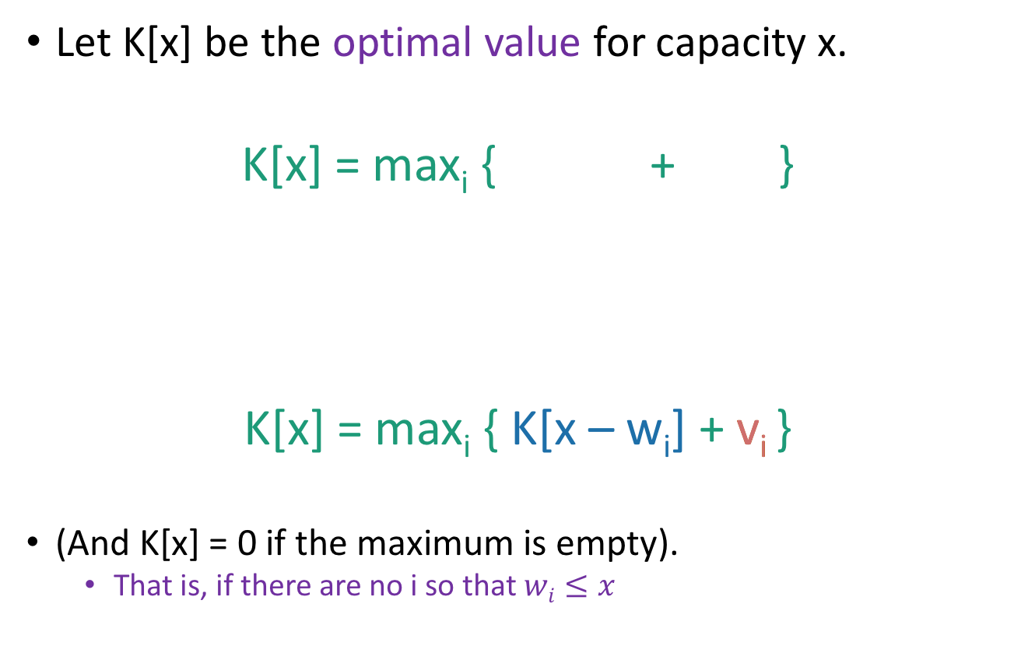
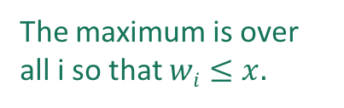
Recursive relationship
Let K[x] be the optimal value for capacity x.
K[x] = max_{i} { + }
K[x] = max_{i} { K[x – w_{i}] + v_{i} }
(And K[x] = 0 if the maximum is empty).
That is, if there are no i so that $wi≤x$
The maximum is over all i so that $wi≤x.$
Optimal way to fill the smaller knapsack
The value of item i.

Slide 44
Recipe for applying Dynamic Programming
Step 1: Identify optimal substructure.
Step 2: Find a recursive formulation for the value of the optimal solution.
Step 3: Use dynamic programming to find the value of the optimal solution.
Step 4: If needed, keep track of some additional info so that the algorithm from Step 3 can find the actual solution.
Step 5: If needed, code this up like a reasonable person.

Slide 45
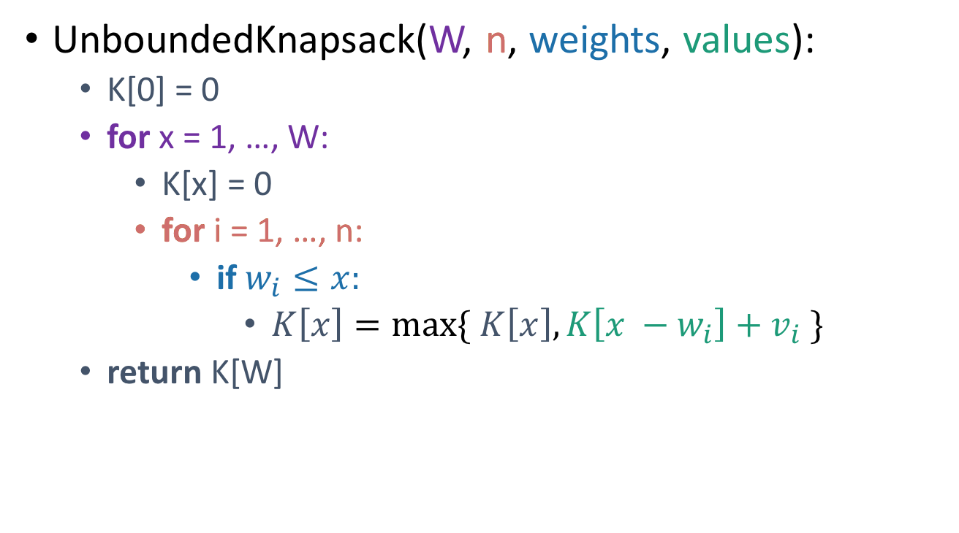
Let’s write a bottom-up DP algorithm
UnboundedKnapsack(W, n, weights, values):
K[0] = 0
for x = 1, …, W:
K[x] = 0
for i = 1, …, n:
if $w_{i}≤x:$
$K\left[x\right]=\max{\{ K\left[x\right], K\left[x −w_{i}\right]+v_{i} \}}$
return K[W]
Running time: O(nW)
K[x] = max_{i} { + }
= max_{i} { K[x – w_{i}] + v_{i} }

Slide 46
Can we do better?
Writing down W takes log(W) bits.
Writing down all n weights takes at most nlog(W) bits.
Input size: nlog(W).
Maybe we could have an algorithm that runs in time O(nlog(W)) instead of O(nW)?
Or even O( n¹⁰⁰⁰⁰⁰⁰ log¹⁰⁰⁰⁰⁰⁰(W) )?
Open problem!
(But probably the answer is no…otherwise P = NP)

Slide 47
Recipe for applying Dynamic Programming
Step 1: Identify optimal substructure.
Step 2: Find a recursive formulation for the value of the optimal solution.
Step 3: Use dynamic programming to find the value of the optimal solution.
Step 4: If needed, keep track of some additional info so that the algorithm from Step 3 can find the actual solution.
Step 5: If needed, code this up like a reasonable person.

Slide 48
Let’s write a bottom-up DP algorithm
UnboundedKnapsack(W, n, weights, values):
K[0] = 0
for x = 1, …, W:
K[x] = 0
for i = 1, …, n:
if $w_{i}≤x:$
$K\left[x\right]=\max{\{ K\left[x\right], K\left[x −w_{i}\right]+v_{i} \}}$
return K[W]
K[x] = max_{i} { + }
= max_{i} { K[x – w_{i}] + v_{i} }

Slide 49
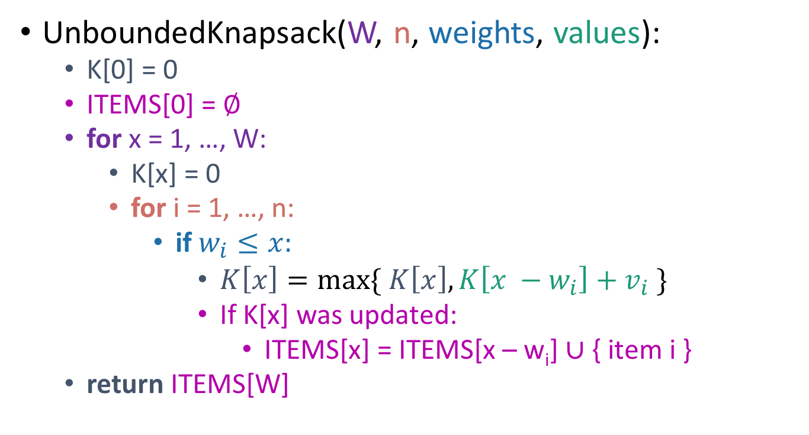
Let’s write a bottom-up DP algorithm
UnboundedKnapsack(W, n, weights, values):
K[0] = 0
ITEMS[0] = $∅$
for x = 1, …, W:
K[x] = 0
for i = 1, …, n:
if $w_{i}≤x:$
$K\left[x\right]=\max{\{ K\left[x\right], K\left[x −w_{i}\right]+v_{i} \}}$
If K[x] was updated:
ITEMS[x] = ITEMS[x – w_{i}] $∪$ { item i }
return ITEMS[W]
K[x] = max_{i} { + }
= max_{i} { K[x – w_{i}] + v_{i} }

Slide 50

Example
UnboundedKnapsack(W, n, weights, values):
K[0] = 0
ITEMS[0] = $∅$
for x = 1, …, W:
K[x] = 0
for i = 1, …, n:
if $w_{i}≤x:$
$K\left[x\right]=\max{\{ K\left[x\right], K\left[x −w_{i}\right]+v_{i} \}}$
If K[x] was updated:
ITEMS[x] = ITEMS[x – w_{i}] $∪$ { item i }
return ITEMS[W]
0
1
2
3
4
0
K
ITEMS
Item:
Weight:
1
2
3
Value:
1
4
6
Capacity: 4

Slide 51
Example
UnboundedKnapsack(W, n, weights, values):
K[0] = 0
ITEMS[0] = $∅$
for x = 1, …, W:
K[x] = 0
for i = 1, …, n:
if $w_{i}≤x:$
$K\left[x\right]=\max{\{ K\left[x\right], K\left[x −w_{i}\right]+v_{i} \}}$
If K[x] was updated:
ITEMS[x] = ITEMS[x – w_{i}] $∪$ { item i }
return ITEMS[W]
0
1
2
3
4
0
1
K
ITEMS
Item:
Weight:
1
2
3
Value:
1
4
6
ITEMS[1] = ITEMS[0] +
Capacity: 4

Slide 52
Example
UnboundedKnapsack(W, n, weights, values):
K[0] = 0
ITEMS[0] = $∅$
for x = 1, …, W:
K[x] = 0
for i = 1, …, n:
if $w_{i}≤x:$
$K\left[x\right]=\max{\{ K\left[x\right], K\left[x −w_{i}\right]+v_{i} \}}$
If K[x] was updated:
ITEMS[x] = ITEMS[x – w_{i}] $∪$ { item i }
return ITEMS[W]
0
1
2
3
4
0
1
2
K
ITEMS
Item:
Weight:
1
2
3
Value:
1
4
6
ITEMS[2] = ITEMS[1] +
Capacity: 4

Slide 53
Example
UnboundedKnapsack(W, n, weights, values):
K[0] = 0
ITEMS[0] = $∅$
for x = 1, …, W:
K[x] = 0
for i = 1, …, n:
if $w_{i}≤x:$
$K\left[x\right]=\max{\{ K\left[x\right], K\left[x −w_{i}\right]+v_{i} \}}$
If K[x] was updated:
ITEMS[x] = ITEMS[x – w_{i}] $∪$ { item i }
return ITEMS[W]
0
1
2
3
4
0
1
4
K
ITEMS
Item:
Weight:
1
2
3
Value:
1
4
6
ITEMS[2] = ITEMS[0] +
Capacity: 4

Slide 54
Example
UnboundedKnapsack(W, n, weights, values):
K[0] = 0
ITEMS[0] = $∅$
for x = 1, …, W:
K[x] = 0
for i = 1, …, n:
if $w_{i}≤x:$
$K\left[x\right]=\max{\{ K\left[x\right], K\left[x −w_{i}\right]+v_{i} \}}$
If K[x] was updated:
ITEMS[x] = ITEMS[x – w_{i}] $∪$ { item i }
return ITEMS[W]
0
1
2
3
4
0
1
4
5
K
ITEMS
Item:
Weight:
1
2
3
Value:
1
4
6
ITEMS[3] = ITEMS[2] +
Capacity: 4

Slide 55
Example
UnboundedKnapsack(W, n, weights, values):
K[0] = 0
ITEMS[0] = $∅$
for x = 1, …, W:
K[x] = 0
for i = 1, …, n:
if $w_{i}≤x:$
$K\left[x\right]=\max{\{ K\left[x\right], K\left[x −w_{i}\right]+v_{i} \}}$
If K[x] was updated:
ITEMS[x] = ITEMS[x – w_{i}] $∪$ { item i }
return ITEMS[W]
0
1
2
3
4
0
1
4
6
K
ITEMS
Item:
Weight:
1
2
3
Value:
1
4
6
ITEMS[3] = ITEMS[0] +
Capacity: 4

Slide 56
Example
UnboundedKnapsack(W, n, weights, values):
K[0] = 0
ITEMS[0] = $∅$
for x = 1, …, W:
K[x] = 0
for i = 1, …, n:
if $w_{i}≤x:$
$K\left[x\right]=\max{\{ K\left[x\right], K\left[x −w_{i}\right]+v_{i} \}}$
If K[x] was updated:
ITEMS[x] = ITEMS[x – w_{i}] $∪$ { item i }
return ITEMS[W]
0
1
2
3
4
0
1
4
6
7
K
ITEMS
Item:
Weight:
1
2
3
Value:
1
4
6
ITEMS[4] = ITEMS[3] +
Capacity: 4

Slide 57
Example
UnboundedKnapsack(W, n, weights, values):
K[0] = 0
ITEMS[0] = $∅$
for x = 1, …, W:
K[x] = 0
for i = 1, …, n:
if $w_{i}≤x:$
$K\left[x\right]=\max{\{ K\left[x\right], K\left[x −w_{i}\right]+v_{i} \}}$
If K[x] was updated:
ITEMS[x] = ITEMS[x – w_{i}] $∪$ { item i }
return ITEMS[W]
0
1
2
3
4
0
1
4
6
8
K
ITEMS
Item:
Weight:
1
2
3
Value:
1
4
6
ITEMS[4] = ITEMS[2] +
Capacity: 4

Slide 58
Recipe for applying Dynamic Programming
Step 1: Identify optimal substructure.
Step 2: Find a recursive formulation for the value of the optimal solution.
Step 3: Use dynamic programming to find the value of the optimal solution.
Step 4: If needed, keep track of some additional info so that the algorithm from Step 3 can find the actual solution.
Step 5: If needed, code this up like a reasonable person.
(Pass)

Slide 59
What have we learned?
We can solve unbounded knapsack in time O(nW).
If there are n items and our knapsack has capacity W.
We again went through the steps to create DP solution:
We kept a one-dimensional table, creating smaller problems by making the knapsack smaller.

Slide 60
Item:
Weight:
6
2
4
3
11
Capacity: 10
Value:
20
8
14
13
35
Unbounded Knapsack:
Suppose I have infinite copies of all of the items.
What’s the most valuable way to fill the knapsack?
0/1 Knapsack:
Suppose I have only one copy of each item.
What’s the most valuable way to fill the knapsack?
Total weight: 10
Total value: 42
Total weight: 9
Total value: 35

Slide 61
Recipe for applying Dynamic Programming
Step 1: Identify optimal substructure.
Step 2: Find a recursive formulation for the value of the optimal solution.
Step 3: Use dynamic programming to find the value of the optimal solution.
Step 4: If needed, keep track of some additional info so that the algorithm from Step 3 can find the actual solution.
Step 5: If needed, code this up like a reasonable person.

Slide 62
Optimal substructure: try 1
Sub-problems:
Unbounded Knapsack with a smaller knapsack.
First solve the problem for small knapsacks
Then larger knapsacks
Then larger knapsacks

Slide 63
This won’t quite work…
We are only allowed one copy of each item.
The sub-problem needs to “know” what items we’ve used and what we haven’t.
I can’t use any turtles…

Slide 64
Optimal substructure: try 2
Sub-problems:
0/1 Knapsack with fewer items.
First solve the problem with few items
We’ll still increase the size of the knapsacks.
Then more items
Then yet more items
(We’ll keep a two-dimensional table).

Slide 65
Our sub-problems:
Indexed by x and j
First j items
Capacity x
K[x,j] = optimal solution for a knapsack of size x using only the first j items.

Slide 66
Relationship between sub-problems
Want to write K[x,j] in terms of smaller sub-problems.
First j items
Capacity x
K[x,j] = optimal solution for a knapsack of size x using only the first j items.

Slide 67
Two cases
item j
Case 1: Optimal solution for j items does not use item j.
Case 2: Optimal solution for j items does use item j.
First j items
Capacity x
K[x,j] = optimal solution for a knapsack of size x using only the first j items.

Slide 68
Two cases
item j
Case 1: Optimal solution for j items does not use item j.
Capacity x
Value V
Use only the first j items
First j items
What lower-indexed problem should we solve to solve this problem?
1 min think; (wait) 1 min share

Slide 69
Two cases
item j
Case 1: Optimal solution for j items does not use item j.
Then this is an optimal solution for j-1 items:
Capacity x
Value V
Use only the first j items
First j items
Capacity x
Value V
Use only the first j-1 items.
First j-1 items

Slide 70
Two cases
item j
Case 2: Optimal solution for j items uses item j.
Weight w_{j}
Value v_{j}
Capacity x
Value V
Use only the first j items
First j items
What lower-indexed problem should we solve to solve this problem?
1 min think; (wait) 1 min share

Slide 71
Two cases
item j
Case 2: Optimal solution for j items uses item j.
Then this is an optimal solution for j-1 items and a smaller knapsack:
Weight w_{j}
Value v_{j}
Capacity x
Value V
Use only the first j items
First j items
Capacity x – w_{j}
Value V – v_{j}
Use only the first j-1 items.
First j-1 items

Slide 72
Recipe for applying Dynamic Programming
Step 1: Identify optimal substructure.
Step 2: Find a recursive formulation for the value of the optimal solution.
Step 3: Use dynamic programming to find the value of the optimal solution.
Step 4: If needed, keep track of some additional info so that the algorithm from Step 3 can find the actual solution.
Step 5: If needed, code this up like a reasonable person.

Slide 73
Recursive relationship
Let K[x,j] be the optimal value for:
capacity x,
with j items.
K[x,j] = max{ K[x, j-1] , K[x – w_{j,} j-1] + v_{j} }
(And K[x,0] = 0 and K[0,j] = 0).
Case 1
Case 2

Slide 74
Recipe for applying Dynamic Programming
Step 1: Identify optimal substructure.
Step 2: Find a recursive formulation for the value of the optimal solution.
Step 3: Use dynamic programming to find the value of the optimal solution.
Step 4: If needed, keep track of some additional info so that the algorithm from Step 3 can find the actual solution.
Step 5: If needed, code this up like a reasonable person.

Slide 75
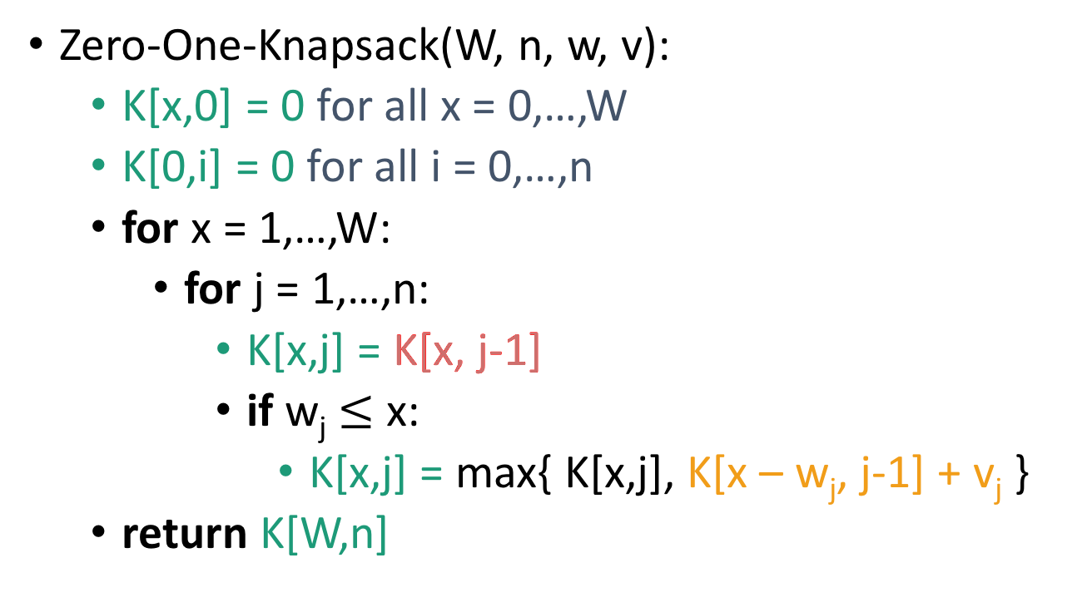
Bottom-up DP algorithm
Zero-One-Knapsack(W, n, w, v):
K[x,0] = 0 for all x = 0,…,W
K[0,i] = 0 for all i = 0,…,n
for x = 1,…,W:
for j = 1,…,n:
K[x,j] = K[x, j-1]
if w_{j} $≤$ x:
K[x,j] = max{ K[x,j], K[x – w_{j}, j-1] + v_{j} }
return K[W,n]
Case 1
Case 2
Running time O(nW)

Slide 76

Example
Zero-One-Knapsack(W, n, w, v):
K[x,0] = 0 for all x = 0,…,W
K[0,i] = 0 for all i = 0,…,n
for x = 1,…,W:
for j = 1,…,n:
K[x,j] = K[x, j-1]
if w_{j} $≤$ x:
K[x,j] = max{ K[x,j],
K[x – w_{j}, j-1] + v_{j} }
return K[W,n]
x=0
x=1
x=2
x=3
0
0
0
0
j=0
0
j=1
0
j=2
0
j=3
Item:
current entry
relevant previous entry
Weight:
1
2
3
Value:
1
4
6
Capacity: 3

Slide 77
Example
Zero-One-Knapsack(W, n, w, v):
K[x,0] = 0 for all x = 0,…,W
K[0,i] = 0 for all i = 0,…,n
for x = 1,…,W:
for j = 1,…,n:
K[x,j] = K[x, j-1]
if w_{j} $≤$ x:
K[x,j] = max{ K[x,j],
K[x – w_{j}, j-1] + v_{j} }
return K[W,n]
x=0
x=1
x=2
x=3
0
0
0
0
j=0
0
0
j=1
0
j=2
0
j=3
Item:
current entry
relevant previous entry
Weight:
1
2
3
Value:
1
4
6
Capacity: 3

Slide 78
Example
Zero-One-Knapsack(W, n, w, v):
K[x,0] = 0 for all x = 0,…,W
K[0,i] = 0 for all i = 0,…,n
for x = 1,…,W:
for j = 1,…,n:
K[x,j] = K[x, j-1]
if w_{j} $≤$ x:
K[x,j] = max{ K[x,j],
K[x – w_{j}, j-1] + v_{j} }
return K[W,n]
x=0
x=1
x=2
x=3
0
0
0
0
j=0
0
1
j=1
0
j=2
0
j=3
Item:
current entry
relevant previous entry
Weight:
1
2
3
Value:
1
4
6
Capacity: 3

Slide 79
Example
Zero-One-Knapsack(W, n, w, v):
K[x,0] = 0 for all x = 0,…,W
K[0,i] = 0 for all i = 0,…,n
for x = 1,…,W:
for j = 1,…,n:
K[x,j] = K[x, j-1]
if w_{j} $≤$ x:
K[x,j] = max{ K[x,j],
K[x – w_{j}, j-1] + v_{j} }
return K[W,n]
x=0
x=1
x=2
x=3
0
0
0
0
j=0
0
1
j=1
0
1
j=2
0
j=3
Item:
current entry
relevant previous entry
Weight:
1
2
3
Value:
1
4
6
Capacity: 3

Slide 80
Example
Zero-One-Knapsack(W, n, w, v):
K[x,0] = 0 for all x = 0,…,W
K[0,i] = 0 for all i = 0,…,n
for x = 1,…,W:
for j = 1,…,n:
K[x,j] = K[x, j-1]
if w_{j} $≤$ x:
K[x,j] = max{ K[x,j],
K[x – w_{j}, j-1] + v_{j} }
return K[W,n]
x=0
x=1
x=2
x=3
0
0
0
0
j=0
0
1
j=1
0
1
j=2
0
1
j=3
Item:
current entry
relevant previous entry
Weight:
1
2
3
Value:
1
4
6
Capacity: 3

Slide 81
Example
Zero-One-Knapsack(W, n, w, v):
K[x,0] = 0 for all x = 0,…,W
K[0,i] = 0 for all i = 0,…,n
for x = 1,…,W:
for j = 1,…,n:
K[x,j] = K[x, j-1]
if w_{j} $≤$ x:
K[x,j] = max{ K[x,j],
K[x – w_{j}, j-1] + v_{j} }
return K[W,n]
x=0
x=1
x=2
x=3
0
0
0
0
j=0
0
1
0
j=1
0
1
j=2
0
1
j=3
Item:
current entry
relevant previous entry
Weight:
1
2
3
Value:
1
4
6
Capacity: 3

Slide 82
Example
Zero-One-Knapsack(W, n, w, v):
K[x,0] = 0 for all x = 0,…,W
K[0,i] = 0 for all i = 0,…,n
for x = 1,…,W:
for j = 1,…,n:
K[x,j] = K[x, j-1]
if w_{j} $≤$ x:
K[x,j] = max{ K[x,j],
K[x – w_{j}, j-1] + v_{j} }
return K[W,n]
x=0
x=1
x=2
x=3
0
0
0
0
j=0
0
1
1
j=1
0
1
j=2
0
1
j=3
Item:
current entry
relevant previous entry
Weight:
1
2
3
Value:
1
4
6
Capacity: 3

Slide 83
Example
Zero-One-Knapsack(W, n, w, v):
K[x,0] = 0 for all x = 0,…,W
K[0,i] = 0 for all i = 0,…,n
for x = 1,…,W:
for j = 1,…,n:
K[x,j] = K[x, j-1]
if w_{j} $≤$ x:
K[x,j] = max{ K[x,j],
K[x – w_{j}, j-1] + v_{j} }
return K[W,n]
x=0
x=1
x=2
x=3
0
0
0
0
j=0
0
1
1
j=1
0
1
1
j=2
0
1
j=3
Item:
current entry
relevant previous entry
Weight:
1
2
3
Value:
1
4
6
Capacity: 3

Slide 84
Example
Zero-One-Knapsack(W, n, w, v):
K[x,0] = 0 for all x = 0,…,W
K[0,i] = 0 for all i = 0,…,n
for x = 1,…,W:
for j = 1,…,n:
K[x,j] = K[x, j-1]
if w_{j} $≤$ x:
K[x,j] = max{ K[x,j],
K[x – w_{j}, j-1] + v_{j} }
return K[W,n]
x=0
x=1
x=2
x=3
0
0
0
0
j=0
0
1
1
j=1
0
1
4
j=2
0
1
j=3
Item:
current entry
relevant previous entry
Weight:
1
2
3
Value:
1
4
6
Capacity: 3

Slide 85
Example
Zero-One-Knapsack(W, n, w, v):
K[x,0] = 0 for all x = 0,…,W
K[0,i] = 0 for all i = 0,…,n
for x = 1,…,W:
for j = 1,…,n:
K[x,j] = K[x, j-1]
if w_{j} $≤$ x:
K[x,j] = max{ K[x,j],
K[x – w_{j}, j-1] + v_{j} }
return K[W,n]
x=0
x=1
x=2
x=3
0
0
0
0
j=0
0
1
1
j=1
0
1
4
j=2
0
1
4
j=3
Item:
current entry
relevant previous entry
Weight:
1
2
3
Value:
1
4
6
Capacity: 3

Slide 86
Example
Zero-One-Knapsack(W, n, w, v):
K[x,0] = 0 for all x = 0,…,W
K[0,i] = 0 for all i = 0,…,n
for x = 1,…,W:
for j = 1,…,n:
K[x,j] = K[x, j-1]
if w_{j} $≤$ x:
K[x,j] = max{ K[x,j],
K[x – w_{j}, j-1] + v_{j} }
return K[W,n]
x=0
x=1
x=2
x=3
0
0
0
0
j=0
0
1
1
0
j=1
0
1
4
j=2
0
1
4
j=3
Item:
current entry
relevant previous entry
Weight:
1
2
3
Value:
1
4
6
Capacity: 3

Slide 87
Example
Zero-One-Knapsack(W, n, w, v):
K[x,0] = 0 for all x = 0,…,W
K[0,i] = 0 for all i = 0,…,n
for x = 1,…,W:
for j = 1,…,n:
K[x,j] = K[x, j-1]
if w_{j} $≤$ x:
K[x,j] = max{ K[x,j],
K[x – w_{j}, j-1] + v_{j} }
return K[W,n]
x=0
x=1
x=2
x=3
0
0
0
0
j=0
0
1
1
1
j=1
0
1
4
j=2
0
1
4
j=3
Item:
current entry
relevant previous entry
Weight:
1
2
3
Value:
1
4
6
Capacity: 3

Slide 88
Example
Zero-One-Knapsack(W, n, w, v):
K[x,0] = 0 for all x = 0,…,W
K[0,i] = 0 for all i = 0,…,n
for x = 1,…,W:
for j = 1,…,n:
K[x,j] = K[x, j-1]
if w_{j} $≤$ x:
K[x,j] = max{ K[x,j],
K[x – w_{j}, j-1] + v_{j} }
return K[W,n]
x=0
x=1
x=2
x=3
0
0
0
0
j=0
0
1
1
1
j=1
0
1
4
1
j=2
0
1
4
j=3
Item:
current entry
relevant previous entry
Weight:
1
2
3
Value:
1
4
6
Capacity: 3

Slide 89
Example
Zero-One-Knapsack(W, n, w, v):
K[x,0] = 0 for all x = 0,…,W
K[0,i] = 0 for all i = 0,…,n
for x = 1,…,W:
for j = 1,…,n:
K[x,j] = K[x, j-1]
if w_{j} $≤$ x:
K[x,j] = max{ K[x,j],
K[x – w_{j}, j-1] + v_{j} }
return K[W,n]
x=0
x=1
x=2
x=3
0
0
0
0
j=0
0
1
1
1
j=1
0
1
4
5
j=2
0
1
4
j=3
Item:
current entry
relevant previous entry
Weight:
1
2
3
Value:
1
4
6
Capacity: 3

Slide 90
Example
Zero-One-Knapsack(W, n, w, v):
K[x,0] = 0 for all x = 0,…,W
K[0,i] = 0 for all i = 0,…,n
for x = 1,…,W:
for j = 1,…,n:
K[x,j] = K[x, j-1]
if w_{j} $≤$ x:
K[x,j] = max{ K[x,j],
K[x – w_{j}, j-1] + v_{j} }
return K[W,n]
x=0
x=1
x=2
x=3
0
0
0
0
j=0
0
1
1
1
j=1
0
1
4
5
j=2
0
1
4
5
j=3
Item:
current entry
relevant previous entry
Weight:
1
2
3
Value:
1
4
6
Capacity: 3

Slide 91
Example
Zero-One-Knapsack(W, n, w, v):
K[x,0] = 0 for all x = 0,…,W
K[0,i] = 0 for all i = 0,…,n
for x = 1,…,W:
for j = 1,…,n:
K[x,j] = K[x, j-1]
if w_{j} $≤$ x:
K[x,j] = max{ K[x,j],
K[x – w_{j}, j-1] + v_{j} }
return K[W,n]
x=0
x=1
x=2
x=3
0
0
0
0
j=0
0
1
1
1
j=1
0
1
4
5
j=2
0
1
4
6
j=3
Item:
current entry
relevant previous entry
Weight:
1
2
3
Value:
1
4
6
Capacity: 3

Slide 92
Example
Zero-One-Knapsack(W, n, w, v):
K[x,0] = 0 for all x = 0,…,W
K[0,i] = 0 for all i = 0,…,n
for x = 1,…,W:
for j = 1,…,n:
K[x,j] = K[x, j-1]
if w_{j} $≤$ x:
K[x,j] = max{ K[x,j],
K[x – w_{j}, j-1] + v_{j} }
return K[W,n]
x=0
x=1
x=2
x=3
0
0
0
0
j=0
0
1
1
1
j=1
0
1
4
5
j=2
So the optimal solution is to put one watermelon in your knapsack!
0
1
4
6
j=3
Item:
current entry
relevant previous entry
Weight:
1
2
3
Value:
1
4
6
Capacity: 3

Slide 93
Recipe for applying Dynamic Programming
Step 1: Identify optimal substructure.
Step 2: Find a recursive formulation for the value of the optimal solution.
Step 3: Use dynamic programming to find the value of the optimal solution.
Step 4: If needed, keep track of some additional info so that the algorithm from Step 3 can find the actual solution.
Step 5: If needed, code this up like a reasonable person.
You do this one!
(We did it on the slide in the previous example, just not in the pseudocode!)

Slide 94
What have we learned?
We can solve 0/1 knapsack in time O(nW).
If there are n items and our knapsack has capacity W.
We again went through the steps to create DP solution:
We kept a two-dimensional table, creating smaller problems by restricting the set of allowable items.

Slide 95
Question
How did we know which substructure to use in which variant of knapsack?
Answer in retrospect:
This one made sense for unbounded knapsack because it doesn’t have any memory of what items have been used.
vs.
In 0/1 knapsack, we can only use each item once, so it makes sense to leave out one item at a time.
Operational Answer: try some stuff, see what works!

Slide 96
Example 3: Independent Set if we still have time
2
2
2
1
1
2
An independent set is a set of vertices so that no pair has an edge between them.
3
Given a graph with weights on the vertices…
What is the independent set with the largest weight?
5
5
1
1

Slide 97
Actually, this problem is NP-complete. So, we are unlikely to find an efficient algorithm.
But if we also assume that the graph is a tree…
3
2
3
3
3
5
5
A tree is a connected graph with no cycles.
2
3
1
2
5
5
5
2
5
2
Problem:
find a maximal independent set in a tree (with vertex weights).

Slide 98
Recipe for applying Dynamic Programming
Step 1: Identify optimal substructure.
Step 2: Find a recursive formulation for the value of the optimal solution
Step 3: Use dynamic programming to find the value of the optimal solution
Step 4: If needed, keep track of some additional info so that the algorithm from Step 3 can find the actual solution.
Step 5: If needed, code this up like a reasonable person.

Slide 99
Optimal substructure
Subtrees are a natural candidate.
There are two cases:
The root of this tree is not in a maximal independent set.
Or it is.

Slide 100
Case 1: the root is not in a maximal independent set
Use the optimal solution from these smaller problems.

Slide 101
Case 2: the root is in an maximal independent set
Then its children can’t be.
Below that, use the optimal solution from these smaller subproblems.

Slide 102
Recipe for applying Dynamic Programming
Step 1: Identify optimal substructure.
Step 2: Find a recursive formulation for the value of the optimal solution.
Step 3: Use dynamic programming to find the value of the optimal solution
Step 4: If needed, keep track of some additional info so that the algorithm from Step 3 can find the actual solution.
Step 5: If needed, code this up like a reasonable person.

Slide 103
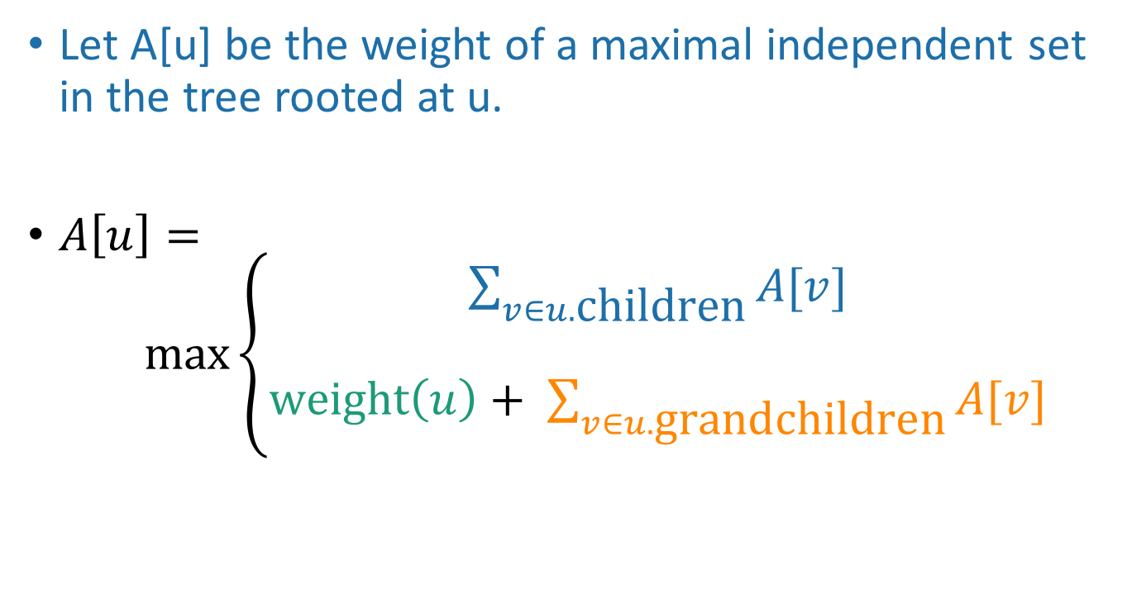
Recursive formulation: try 1
Let A[u] be the weight of a maximal independent set in the tree rooted at u.
$A\left[u\right]= \max\left\{\begin{aligned}\sum_{v∈u.\text{children}}{A[v]} \\ \\ \text{weight}\left(u\right)+ \sum_{v∈u.\text{grandchildren}}{A[v]}\end{aligned}\right.$
When we implement this, how do we keep track of this term?

Slide 104
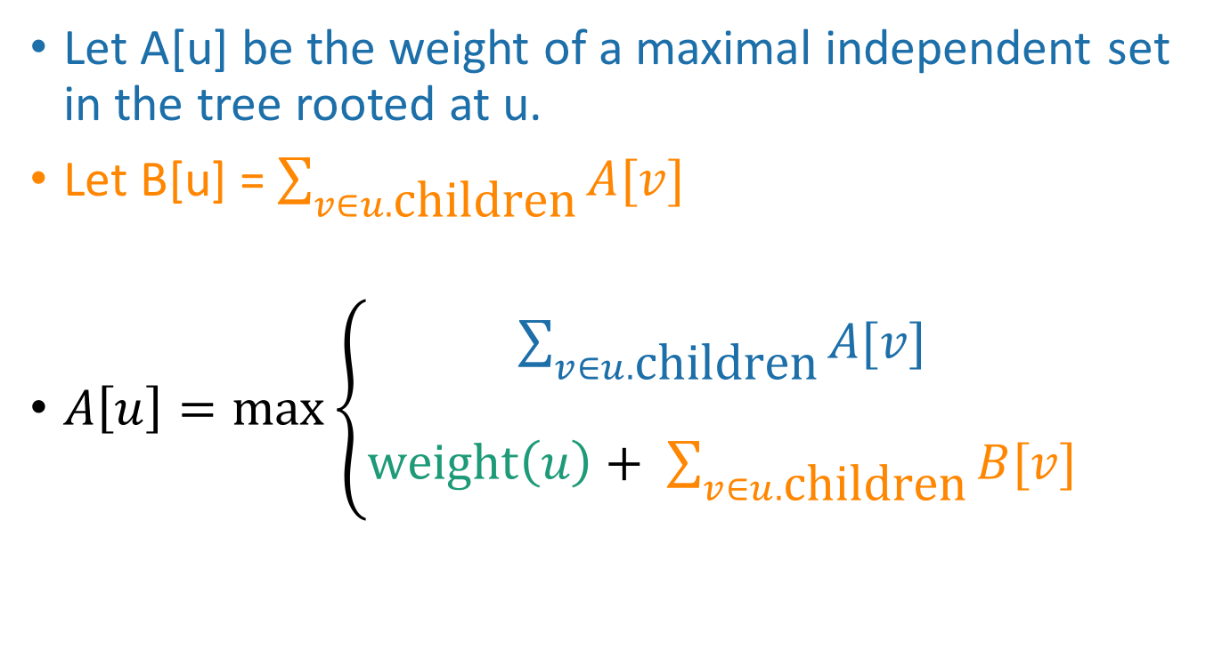
Recursive formulation: try 2 Keep two arrays!
Let A[u] be the weight of a maximal independent set in the tree rooted at u.
Let B[u] = $\sum_{v∈u.\text{children}}{A[v]}$
$A\left[u\right]=\max\left\{\begin{aligned}\sum_{v∈u.\text{children}}{A[v]} \\ \\ \text{weight}\left(u\right)+ \sum_{v∈u.\text{children}}{B[v]}\end{aligned}\right.$

Slide 105
Recipe for applying Dynamic Programming
Step 1: Identify optimal substructure.
Step 2: Find a recursive formulation for the value of the optimal solution.
Step 3: Use dynamic programming to find the value of the optimal solution.
Step 4: If needed, keep track of some additional info so that the algorithm from Step 3 can find the actual solution.
Step 5: If needed, code this up like a reasonable person.

Slide 106
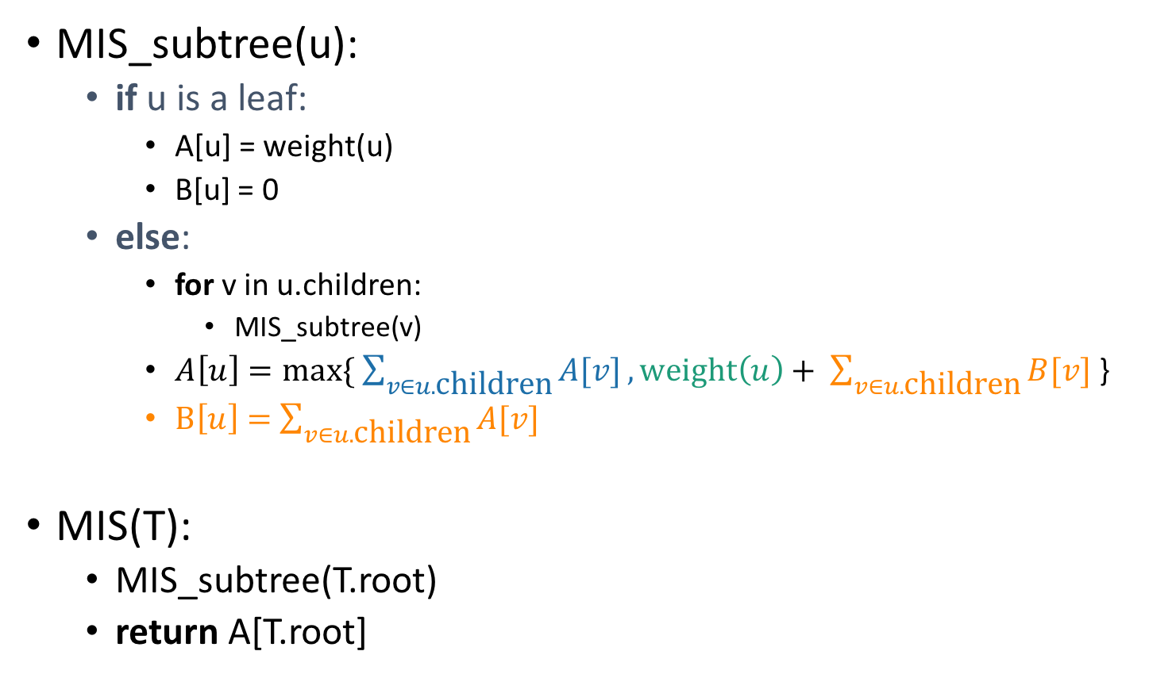
A top-down DP algorithm
MIS_subtree(u):
if u is a leaf:
A[u] = weight(u)
B[u] = 0
else:
for v in u.children:
MIS_subtree(v)
$A\left[u\right]=max⁡\{ \sum_{v∈u.\text{children}}{A[v]},\text{weight}\left(u\right)+ \sum_{v∈u.\text{children}}{B[v]}$ }
$B\left[u\right]=$ $\sum_{v∈u.\text{children}}{A[v]}$
MIS(T):
MIS_subtree(T.root)
return A[T.root]
Initialize global arrays A, B that we will use in all of the recursive calls.
Running time?
We visit each vertex once, and for every vertex we do O(1) work:
Make a recursive call
Participate in summations of parent node
Running time is O(|V|)

Slide 107
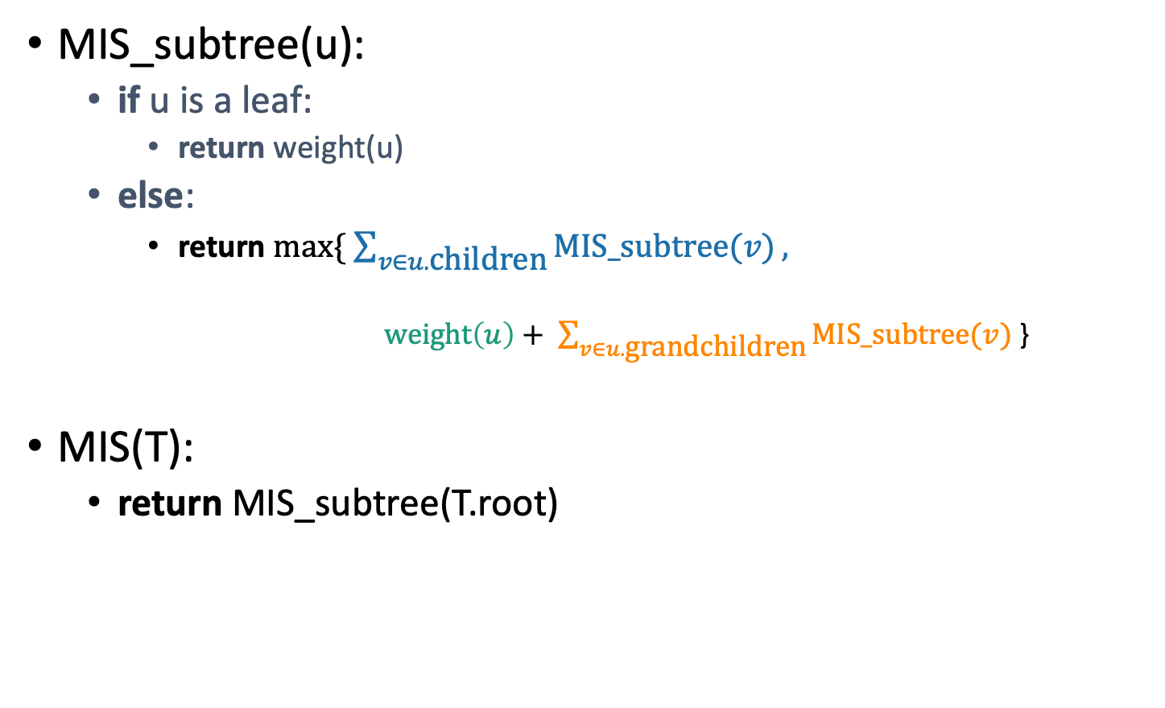
Why is this different from divide-and-conquer? That’s always worked for us with tree problems before…
MIS_subtree(u):
if u is a leaf:
return weight(u)
else:
return $max⁡\{ \sum_{v∈u.\text{children}}{MIS_subtree(v)},$
$\text{weight}\left(u\right)+ \sum_{v∈u.\text{grandc}\text{hildren}}{MIS_subtree(v)}$ }
MIS(T):
return MIS_subtree(T.root)
This is exactly the same pseudocode, except we’ve ditched the table and are just calling MIS_subtree(v) instead of looking up A[v] or B[v].

Slide 108
Why is this different from divide-and-conquer? That’s always worked for us with tree problems before…
How often would we ask about the subtree rooted here?
Once for this node and once for this one.
But we then ask about this node twice, here and here.
This will blow up exponentially without using dynamic programming to take advantage of overlapping subproblems.

Slide 109
Recipe for applying Dynamic Programming
Step 1: Identify optimal substructure.
Step 2: Find a recursive formulation for the value of the optimal solution.
Step 3: Use dynamic programming to find the value of the optimal solution.
Step 4: If needed, keep track of some additional info so that the algorithm from Step 3 can find the actual solution.
Step 5: If needed, code this up like a reasonable person.
You do this one!

Slide 110
What have we learned?
We can find maximal independent sets in trees in time O(|V|) using dynamic programming!
For this example, it was natural to implement our DP algorithm in a top-down way.

Slide 111
Recap
Today we saw examples of how to come up with dynamic programming algorithms.
Longest Common Subsequence
Knapsack two ways
(If time) maximal independent set in trees.
There is a recipe for dynamic programming algorithms.

Slide 112
Recipe for applying Dynamic Programming
Step 1: Identify optimal substructure.
Step 2: Find a recursive formulation for the value of the optimal solution.
Step 3: Use dynamic programming to find the value of the optimal solution.
Step 4: If needed, keep track of some additional info so that the algorithm from Step 3 can find the actual solution.
Step 5: If needed, code this up like a reasonable person.

Slide 113
Recap
Today we saw examples of how to come up with dynamic programming algorithms.
Longest Common Subsequence
Knapsack two ways
(If time) maximal independent set in trees.
There is a recipe for dynamic programming algorithms.
Sometimes coming up with the right substructure takes some creativity
Practice on homework! ☺
For even more practice check out additional examples/practice problems in CLRS or section!

Slide 114
Next time
Greedy algorithms!
Pre-lecture exercise: Greed is good!
Before next time

