Slide 1
Lecture 14
Greedy algorithms!

Slide 2
Announcements
Homework 6 due today
Homework 7 out later today
Second EthiCS lecture this Friday (same place and time as regular lectures)

Slide 3
Roadmap
More detailed schedule on the website!
5 lectures
Randomized Algs
2 lectures
Asymptotic Analysis
Data structures
Sorting
1st class
Divide and conquer
Recurrences
MIDTERM
We are here
Dynamic Programming
Greedy Algs
Graphs!
Longest, Shortest, Max and Min…
9 lectures
The
Future!
1 lecture

Slide 4
This week
Greedy algorithms!

Slide 5
Greedy algorithms
Make choices one-at-a-time.
Never look back.
Hope for the best.

Slide 6
Today
One example of a greedy algorithm that does not work:
Knapsack again
Three examples of greedy algorithms that do work:
Activity Selection
Job Scheduling
Huffman Coding (if time)
You saw these on your pre-lecture exercise!

Slide 7
Non-example
Unbounded Knapsack.

Slide 8
Item:
Weight:
6
2
4
3
11
Capacity: 10
Value:
20
8
14
13
35
Unbounded Knapsack:
Suppose I have infinite copies of all items.
What’s the most valuable way to fill the knapsack?
“Greedy” algorithm for unbounded knapsack:
Tacos have the best Value/Weight ratio!
Keep grabbing tacos!
Total weight: 10
Total value: 42
Total weight: 9
Total value: 39

Slide 9
Example where greedy works Activity selection
CS 161 Class
Math 51 Class
CS 161 Section
Sleep
Frisbee Practice
You can only do one activity at a time, and you want to maximize the number of activities that you do.
What to choose?
CS 161 Office Hours
Theory Seminar
Orchestra
Programming team meeting
CS 166 Class
Underwater basket weaving class
CS110 Class
CS161 study group
Swimming lessons
Theory Lunch
Combinatorics Seminar
Social activity
time

Slide 10
Activity selection
a_{i}
Input:
Activities a₁, a₂, …, a_{n}
Start times s₁, s₂, …, s_{n}
Finish times f₁, f₂, …, f_{n}
Output:
A way to maximize the number of activities you can do today.
s_{i}
f_{i}
time
In what order should you greedily add activities?

Slide 11
Shortest job first?

Slide 12
Fewest conflicts first?
????

Slide 13
Earliest ending time first?
This will do it!

Slide 14
Greedy Algorithm
a₅
a₁
a₃
a₇
a₄
a₂
a₆
time
Pick activity you can add with the smallest finish time.
Repeat.

Slide 15
Greedy Algorithm
a₅
a₁
a₃
a₇
a₄
a₂
a₆
time
Pick activity you can add with the smallest finish time.
Repeat.

Slide 16
Greedy Algorithm
a₅
a₁
a₃
a₇
a₄
a₂
a₆
time
Pick activity you can add with the smallest finish time.
Repeat.

Slide 17
Greedy Algorithm
a₅
a₁
a₃
a₇
a₄
a₂
a₆
time
Pick activity you can add with the smallest finish time.
Repeat.

Slide 18
Greedy Algorithm
a₅
a₁
a₃
a₇
a₄
a₂
a₆
time
Pick activity you can add with the smallest finish time.
Repeat.

Slide 19
Greedy Algorithm
a₅
a₁
a₃
a₇
a₄
a₂
a₆
time
Pick activity you can add with the smallest finish time.
Repeat.

Slide 20
Greedy Algorithm
a₅
a₁
a₃
a₇
a₄
a₂
a₆
time
Pick activity you can add with the smallest finish time.
Repeat.

Slide 21
Greedy Algorithm
a₅
a₁
a₃
a₇
a₄
a₂
a₆
time
Pick activity you can add with the smallest finish time.
Repeat.

Slide 22
At least it’s fast
Running time:
O(n) if the activities are already sorted by finish time.
Otherwise, O(n log(n)) if you have to sort them first.

Slide 23
What makes it greedy?
At each step in the algorithm, make a choice.
Hey, I can increase my activity set by one,
And leave lots of room for future choices,
Let’s do that and hope for the best!!!
Hope that at the end of the day, this results in a globally optimal solution.

Slide 24
Three Questions
Does this greedy algorithm for activity selection work?
Yes.
In general, when are greedy algorithms a good idea?
When the problem exhibits especially nice optimal substructure.
The “greedy” approach is often the first you’d think of…
Why are we getting to it now, in Week 8?
Proving that greedy algorithms work is often not so easy…
(We will see why in a moment…)

Slide 25
Back to Activity Selection
a₅
a₁
a₃
a₇
a₄
a₂
a₆
time
Pick activity you can add with the smallest finish time.
Repeat.

Slide 26
Why does it work?
Whenever we make a choice, we don’t rule out an optimal solution.
Our next choice would be this one:
There’s some optimal solution that contains our next choice
a₅
a₅
a₁
a₃
a₃
a₇
a₇
a₄
a₂
a₆
time

Slide 27
Assuming that statement…
We never rule out an optimal solution
At the end of the algorithm, we’ve got some solution.
So it must be optimal.
Lucky the Lackadaisical Lemur

Slide 28
We never rule out an optimal solution
Suppose we’ve already chosen a_{i}, and there is still an optimal solution T* that extends our choices.
a_{k}
a_{i}
a₃
a₇
a_{j}
a₂
a₆
time

Slide 29
We never rule out an optimal solution
Suppose we’ve already chosen a_{i}, and there is still an optimal solution T* that extends our choices.
Now consider the next choice we make, say it’s a_{k}.
If a_{k} is in T*, we’re still on track.
Greedy algorithm would choose this one.
a_{k}
a_{i}
a₃
a₇
a_{j}
a₂
a₆
time

Slide 30
We never rule out an optimal solution
Suppose we’ve already chosen a_{i}, and there is still an optimal solution T* that extends our choices.
Now consider the next choice we make, say it’s a_{k}.
If a_{k} is not in T*…
Greedy algorithm would choose this one.
a_{k}
a_{i}
a₃
a₇
a_{j}
a₂
a₆
time

Slide 31
We never rule out an optimal solution
ctd.
If a_{k} is not in T*…
Let a_{j} be the activity in T* with the smallest end time.
Now consider schedule T you get by swapping a_{j} for a_{k}
Greedy algorithm would choose this one.
a_{k}
a_{i}
a₃
a₇
a_{j}
a₂
a₆
Consider this one.
time

Slide 32
We never rule out an optimal solution
ctd.
If a_{k} is not in T*…
Let a_{j} be the activity in T* (after a_{i} ends) with the smallest end time.
Now consider schedule T you get by swapping a_{j} for a_{k}
a_{k}
a_{i}
a₃
SWAP!
a₇
a_{j}
a₂
a₆
time

Slide 33
We never rule out an optimal solution
ctd.
This schedule T is still allowed.
Since a_{k} has the smallest ending time, it ends before a_{j}.
Thus, a_{k} doesn’t conflict with anything chosen after a_{j}.
And T is still optimal.
It has the same number of activities as T*.
a_{k}
a_{i}
a₃
SWAP!
a₇
a_{j}
a₂
a₆
time

Slide 34
We never rule out an optimal solution
ctd.
We’ve just shown:
If there was an optimal solution that extends the choices we made so far…
…then there is an optimal schedule that also contains our next greedy choice a_{k}.
a_{k}
a_{i}
a₃
a₇
a_{j}
a₂
a₆
time

Slide 35
So the algorithm is correct
We never rule out an optimal solution
At the end of the algorithm, we’ve got some solution.
So it must be optimal.
Lucky the Lackadaisical Lemur

Slide 36
So the algorithm is correct
Plucky the Pedantic Penguin
Inductive Hypothesis:
After adding the t-th thing, there is an optimal solution that extends the current solution.
Base case:
After adding zero activities, there is an optimal solution extending that.
Inductive step:
We just did that!
Conclusion:
After adding the last activity, there is an optimal solution that extends the current solution.
The current solution is the only solution that extends the current solution.
So the current solution is optimal.

Slide 37
Three Questions
Does this greedy algorithm for activity selection work?
Yes.
In general, when are greedy algorithms a good idea?
When the problem exhibits especially nice optimal substructure.
The “greedy” approach is often the first you’d think of…
Why are we getting to it now, in Week 8?
Proving that greedy algorithms work is often not so easy…

Slide 38
One Common strategy for greedy algorithms
Make a series of choices.
Show that, at each step, our choice won’t rule out an optimal solution at the end of the day.
After we’ve made all our choices, we haven’t ruled out an optimal solution, so we must have found one.

Slide 39
One Common strategy (formally) for greedy algorithms
“Success” here means “finding an optimal solution.”
Inductive Hypothesis:
After greedy choice t, you haven’t ruled out success.
Base case:
Success is possible before you make any choices.
Inductive step:
If you haven’t ruled out success after choice t, then you won’t rule out success after choice t+1.
Conclusion:
If you reach the end of the algorithm and haven’t ruled out success then you must have succeeded.

Slide 40
One Common strategy for showing we don’t rule out success
Suppose that you’re on track to make an optimal solution T*.
E.g., after you’ve picked activity i, you’re still on track.
Suppose that T* disagrees with your next greedy choice.
E.g., it doesn’t involve activity k.
Manipulate T* in order to make a solution T that’s not worse but that agrees with your greedy choice.
E.g., swap whatever activity T* did pick next with activity k.

Slide 41
Note on “Common Strategy”
This common strategy is not the only way to prove that greedy algorithms are correct!
I’m emphasizing it in lecture because it often works, and it gives you a framework to get started.

Slide 42
Three Questions
Does this greedy algorithm for activity selection work?
Yes.
In general, when are greedy algorithms a good idea?
When the problem exhibits especially nice optimal substructure.
The “greedy” approach is often the first you’d think of…
Why are we getting to it now, in Week 8?
Proving that greedy algorithms work is often not so easy…

Slide 43
Optimal sub-structure in greedy algorithms
Our greedy activity selection algorithm exploited a natural sub-problem structure:
A[i] = number of activities you can do after the end of activity i
How does this substructure relate to that of divide-and-conquer or DP?
A[i] = solution to this sub-problem
a_{k}
a_{i}
a₃
a₇
a_{j}
a₂
a₆
time

Slide 44
Sub-problem graph view
Divide-and-conquer:
Big problem
sub-problem
sub-problem
sub-sub-problem
sub-sub-problem
sub-sub-problem
sub-sub-problem
sub-sub-problem

Slide 45
Sub-problem graph view
Dynamic Programming:
Big problem
sub-problem
sub-problem
sub-problem
sub-sub-problem
sub-sub-problem
sub-sub-problem
sub-sub-problem

Slide 46
Sub-problem graph view
Greedy algorithms:
Big problem
sub-problem
sub-sub-problem

Slide 47
Sub-problem graph view
Greedy algorithms:
Big problem
Not only is there optimal sub-structure:
optimal solutions to a problem are made up from optimal solutions of sub-problems
but each problem depends on only one sub-problem.
sub-problem
Write a DP version of activity selection (where you fill in a table)! [See hidden slides in the .pptx file for one way]
sub-sub-problem
Ollie the Over-achieving Ostrich

Slide 48
More detail: Greedy vs. DP
SLIDE SKIPPED IN CLASS
Just for pedagogy!
(This isn’t the best way to think about activity selection).

Slide 49
Recipe for applying Dynamic Programming
SLIDE SKIPPED IN CLASS
Step 1: Identify optimal substructure.
Step 2: Find a recursive formulation for the value of the optimal solution.
Step 3: Use dynamic programming to find the value of the optimal solution.
Step 4: If needed, keep track of some additional info so that the algorithm from Step 3 can find the actual solution.
Step 5: If needed, code this up like a reasonable person.

Slide 50
Optimal substructure
SLIDE SKIPPED IN CLASS
Subproblem i:
A[i] = number of activities you can do after Activity i finishes.
a₁
a_{i}
a₃
a₇
a₄
a₂
a₆
time

Slide 51
Recipe for applying Dynamic Programming
SLIDE SKIPPED IN CLASS
Step 1: Identify optimal substructure.
Step 2: Find a recursive formulation for the value of the optimal solution.
Step 3: Use dynamic programming to find the value of the optimal solution.
Step 4: If needed, keep track of some additional info so that the algorithm from Step 3 can find the actual solution.
Step 5: If needed, code this up like a reasonable person.

Slide 52
We did that already
SLIDE SKIPPED IN CLASS
Let a_{k} have the smallest finish time among activities do-able after a_{i} finishes.
Then A[i] = A[k] + 1.
A[k]: how many activities can I do here?
a₁
a_{k}
a_{i}
a₃
a₇
a₄
a₂
a₆
time
A[i]: how many activities can I do here?

Slide 53
Recipe for applying Dynamic Programming
SLIDE SKIPPED IN CLASS
Step 1: Identify optimal substructure.
Step 2: Find a recursive formulation for the value of the optimal solution.
Step 3: Use dynamic programming to find the value of the optimal solution.
Step 4: If needed, keep track of some additional info so that the algorithm from Step 3 can find the actual solution.
Step 5: If needed, code this up like a reasonable person.

Slide 54
Top-down DP
SLIDE SKIPPED IN CLASS
Initialize a global array A to [None,…,None]
Make a “dummy” activity that ends at time -1.
def findNumActivities(i):
If A[i] != None:
Return A[i]
Let Activity k be the activity I can fit in my schedule after Activity i with the smallest finish time.
If there is no such activity k, set A[i] = 0
Else, A[i] = findNumActivities(k) + 1
Return A[i]
Return findNumActivities(0)
This is a terrible way to write this!
The only thing that matters here is that the highlighted lines are our recursive relationship.

Slide 55
Recipe for applying Dynamic Programming
SLIDE SKIPPED IN CLASS
Step 1: Identify optimal substructure.
Step 2: Find a recursive formulation for the value of the optimal solution.
Step 3: Use dynamic programming to find the value of the optimal solution.
Step 4: If needed, keep track of some additional info so that the algorithm from Step 3 can find the actual solution.
Step 5: If needed, code this up like a reasonable person.

Slide 56
Top-down DP
SLIDE SKIPPED IN CLASS
Initialize a global array A to [None,…,None]
Initialize a global array Next to [None, …, None]
Make a “dummy” activity that ends at time -1.
def findNumActivities(i):
If A[i] != None:
Return A[i]
Let Activity k be the activity I can fit in my schedule after Activity i with the smallest finish time.
If there is no such activity k, set A[i] = 0
Else, A[i] = findNumActivities(k) + 1 and Next[i] = k
Return A[i]
findNumActivities(0)
Step through “Next” array to get schedule.
This is a terrible way to write this!
The only thing that matters here is that the highlighted lines are our recursive relationship.

Slide 57
Let’s step through it.
SLIDE SKIPPED IN CLASS
a₅
a₁
a₃
a₇
a₄
a₂
a₆
time
Start with the activity with the smallest finish time.

Slide 58
Let’s step through it
SLIDE SKIPPED IN CLASS
a₅
a₁
a₃
a₇
a₄
a₂
a₆
time
Now find the next activity still do-able with the smallest finish time, and recurse after that.

Slide 59
Let’s step through it
SLIDE SKIPPED IN CLASS
a₅
a₁
a₃
a₇
a₄
a₂
a₆
time
Now find the next activity still do-able with the smallest finish time, and recurse after that.

Slide 60
Let’s step through it
SLIDE SKIPPED IN CLASS
a₅
a₁
a₃
a₇
a₄
a₂
a₆
time
Now find the next activity still do-able with the smallest finish time, and recurse after that.

Slide 61
Let’s step through it
SLIDE SKIPPED IN CLASS
a₅
a₁
a₃
a₇
a₄
a₂
a₆
time
Ta-da!
It’s exactly the same* as the greedy solution!
*if you implement the top-down DP solution appropriately.

Slide 62
Three Questions
Does this greedy algorithm for activity selection work?
Yes.
In general, when are greedy algorithms a good idea?
When they exhibit especially nice optimal substructure.
The “greedy” approach is often the first you’d think of…
Why are we getting to it now, in Week 8?
Proving that greedy algorithms work is often not so easy.

Slide 63
Let’s see a few more examples

Slide 64
Another example: Scheduling
CS161 HW
Personal hygiene
Math HW
Administrative stuff for student club
Econ HW
Do laundry
Meditate
Practice musical instrument
Read lecture notes
Have a social life
Sleep

Slide 65

Scheduling
n tasks
Task i takes t_{i} hours
For every hour that passes until task i is done, pay c_{i}
CS161 HW, then Sleep: costs 10 $⋅$ 2 + (10 + 8) $⋅$ 3 = 74 units
Sleep, then CS161 HW: costs 8 $⋅$ 3 + (10 + 8) $⋅$ 2 = 60 units
10 hours
Cost: 2 units per hour until it’s done.
CS161 HW
Sleep
Cost: 3 units per hour until it’s done.
8 hours

Slide 66
Optimal substructure
This problem breaks up nicely into sub-problems:
Suppose this is the optimal schedule:
Job A
Job B
Job C
Job D
Then this must be the optimal schedule on just jobs B,C,D.
Why?

Slide 67
Optimal substructure
This problem breaks up nicely into sub-problems:
Suppose this is the optimal schedule:
Job A
Job B
Job C
Job D
Then this must be the optimal schedule on just jobs B,C,D.
If not, then rearranging B,C,D could make a better schedule than (A,B,C,D)!

Slide 68
Optimal substructure
Seems amenable to a greedy algorithm:
Take the best job first
Then solve this problem
Job A
Job B
Job C
Job D
Take the best job first
Then solve this problem
Job C
Job B
Job D
Take the best job first
Then solve this problem
Job D
Job B
(That one’s easy ☺ )

Slide 69
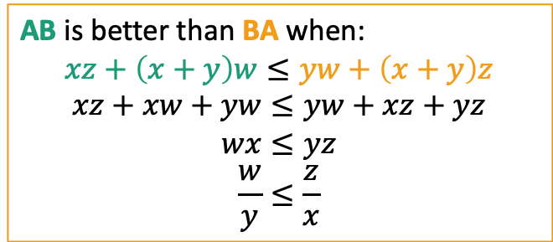


What does “best” mean?
AB is better than BA when:
$$xz+\left(x+y\right)w≤yw+\left(x+y\right)z$$
$$xz+xw+yw≤yw+xz+yz$$
$$wx≤yz$$
$$\frac{w}{y}≤\frac{z}{x}$$
Note: here we are defining x, y, z, and w. (We use c_{i} and t_{i} for these in the general problem, but we are changing notation for just this thought experiment to save on subscripts.)
Of these two jobs, which should we do first?
Cost( A then B ) = x$⋅$z + (x + y) $⋅$ w
Cost( B then A ) = y $⋅$w + (x + y) $⋅$z
x hours
Cost: z units per hour until it’s done.
Job A
Job B
Cost: w units per hour until it’s done.
y hours
What matters is the ratio:
$$\frac{\text{cost} \text{of} \text{delay}}{\text{time} \text{it} \text{takes}}$$
“Best” means
biggest ratio.

Slide 70

Idea for greedy algorithm
Choose the job with the biggest $\frac{\text{cost} \text{of} \text{delay}}{\text{time} \text{it} \text{takes}}$ ratio.

Slide 71
Lemma This greedy choice doesn’t rule out success
Suppose you have already chosen some jobs, and haven’t yet ruled out success:
Then if you choose the next job to be the one left that maximizes the ratio cost/time, you still won’t rule out success.
Proof sketch:
Say Job B maximizes this ratio, but it’s not the next job in the opt. soln.
Already chosen E
There’s some way to order A, B,C, D that’s optimal…
Job E
Job C
Job A
Job B
Job D
Say greedy chooses job B
How can we manipulate the optimal solution above to make an optimal solution where B is the next job we choose after E?
1 minute think; (wait) 1 minute share

Slide 72
Lemma This greedy choice doesn’t rule out success
Suppose you have already chosen some jobs, and haven’t yet ruled out success:
Then if you choose the next job to be the one left that maximizes the ratio cost/time, you still won’t rule out success.
Proof sketch:
Say Job B maximizes this ratio, but it’s not the next job in the opt. soln.
Switch A and B! Nothing else will change, and we just showed that the cost of the solution won’t increase.
Repeat until B is first.
Now this is an optimal schedule where B is first.
Already chosen E
There’s some way to order A, B,C, D that’s optimal…
Job E
Job C
Job A
Job B
Job D
Say greedy chooses job B
Job E
Job C
Job B
Job A
Job D
Job E
Job B
Job C
Job A
Job D

Slide 73
Back to our framework for proving correctness of greedy algorithms
Inductive Hypothesis:
After greedy choice t, you haven’t ruled out success.
Base case:
Success is possible before you make any choices.
Inductive step:
If you haven’t ruled out success after choice t, then you won’t rule out success after choice t+1.
Conclusion:
If you reach the end of the algorithm and haven’t ruled out success then you must have succeeded.
Just did the inductive step!
Fill in the details!

Slide 74

Greedy Scheduling Solution
scheduleJobs( JOBS ):
Sort JOBS in decreasing order by the ratio:
$r_{i}=\frac{c_{i}}{t_{i}}= \frac{\text{cost} \text{of} \text{delaying} \text{job} \text{i} }{\text{t}\text{ime} \text{job} \text{i} \text{takes} \text{to} \text{complete}}$
Return JOBS
Running time: O(n log(n))
Now you can go about your schedule peacefully, in the optimal way.

Slide 75
Formally, use induction!
SLIDE SKIPPED IN CLASS
Inductive hypothesis:
There is an optimal ordering so that the first t jobs are sorted_JOBS[:t].
Base case:
When t=0, this reads: “There is an optimal ordering so that the first 0 jobs are []”
That’s true.
Inductive Step:
Boils down to: there is an optimal ordering on sorted_JOBS[t:] so that sorted_JOBS[t] is first.
This follows from the Lemma.
Conclusion:
When t=n, this reads: “There is an optimal ordering so that the first n jobs are sorted_JOBS.”
aka, what we returned is an optimal ordering.

Slide 76
What have we learned?
A greedy algorithm works for scheduling
This followed the same outline as the previous example:
Identify optimal substructure:
Find a way to make choices that won’t rule out an optimal solution.
largest cost/time ratios first.
Job A
Job B
Job C
Job D

Slide 77
One more example Huffman coding
everyday english sentence
01100101 01110110 01100101 01110010 01111001 01100100 01100001 01111001 00100000 01100101 01101110 01100111 01101100 01101001 01110011 01101000 00100000 01110011 01100101 01101110 01110100 01100101 01101110 01100011 01100101
qwertyui_opasdfg+hjklzxcv
01110001 01110111 01100101 01110010 01110100 01111001 01110101 01101001 01011111 01101111 01110000 01100001 01110011 01100100 01100110 01100111 00101011 01101000 01101010 01101011 01101100 01111010 01111000 01100011 01110110

Slide 78
One more example Huffman coding
ASCII is pretty wasteful for English sentences. If e shows up so often, we should have a shorter way of representing it!
everyday english sentence
01100101 01110110 01100101 01110010 01111001 01100100 01100001 01111001 00100000 01100101 01101110 01100111 01101100 01101001 01110011 01101000 00100000 01110011 01100101 01101110 01110100 01100101 01101110 01100011 01100101
qwertyui_opasdfg+hjklzxcv
01110001 01110111 01100101 01110010 01110100 01111001 01110101 01101001 01011111 01101111 01110000 01100001 01110011 01100100 01100110 01100111 00101011 01101000 01101010 01101011 01101100 01111010 01111000 01100011 01110110

Slide 79
Suppose we have some distribution on characters

Slide 80
Suppose we have some distribution on characters
For simplicity, let’s go with this made-up example
How to encode them as efficiently as possible?
45
Percentage
A
16
D
13
B
12
9
C
E
5
F
Letter

Slide 81
Try 0 (like ASCII)
Every letter is assigned a binary string of three bits.
Wasteful!
110 and 111 are never used.
We should have a shorter way of representing A.
45
Percentage
A
16
D
13
B
12
9
C
E
5
F
000
001
010
011
100
101
Letter

Slide 82
Try 1
Every letter is assigned a binary string of one or two bits.
The more frequent letters get the shorter strings.
Problem:
Does 000 mean AAA or BA or AB?
45
Percentage
A
16
D
13
B
12
9
C
E
5
F
00
01
1
10
11
Letter
0

Slide 83
Try 2: prefix-free coding
Confusingly, “prefix-free codes” are also sometimes called “prefix codes” (e.g. in CLRS).
Every letter is assigned a binary string.
More frequent letters get shorter strings.
No encoded string is a prefix of any other.
45
Percentage
A
10010101
16
D
13
B
12
9
C
E
5
F
101
110
00
111
100
Letter
01

Slide 84
Try 2: prefix-free coding
Confusingly, “prefix-free codes” are also sometimes called “prefix codes” (including in CLRS).
Every letter is assigned a binary string.
More frequent letters get shorter strings.
No encoded string is a prefix of any other.
45
Percentage
F
A
10010101
16
D
13
B
12
9
C
E
5
F
101
110
00
111
100
Letter
01

Slide 85
Try 2: prefix-free coding
Confusingly, “prefix-free codes” are also sometimes called “prefix codes” (including in CLRS).
Every letter is assigned a binary string.
More frequent letters get shorter strings.
No encoded string is a prefix of any other.
45
Percentage
FB
A
10010101
16
D
13
B
12
9
C
E
5
F
101
110
00
111
100
Letter
01

Slide 86
Try 2: prefix-free coding
Confusingly, “prefix-free codes” are also sometimes called “prefix codes” (including in CLRS).
Every letter is assigned a binary string.
More frequent letters get shorter strings.
No encoded string is a prefix of any other.
45
Percentage
FBA
A
10010101
Question: What is the most efficient way to do prefix-free coding?
That is, how can we use as few bits as possible in expectation?
16
D
13
B
12
(This is not it).
9
C
E
5
F
101
110
00
111
100
Letter
01

Slide 87
A prefix-free code is a tree
B:13 below means that ‘B’ makes up 13% of the characters that ever appear.
0
1
0
1
1
0
A: 45
D: 16
00
01
0
1
0
1
F:5
B:13
C:12
E:9
As long as all the letters show up as leaves, this code is prefix-free.
100
101
110
111

Slide 88
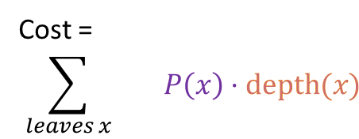
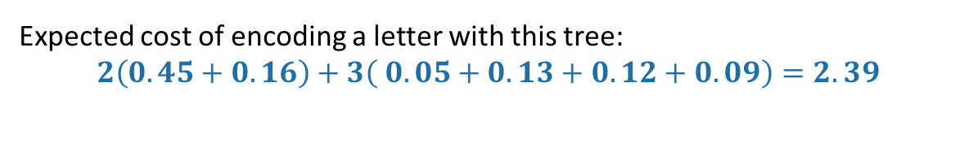
How good is a tree?
Imagine choosing a letter at random from the language.
Not uniformly random, but according to our histogram!
The cost of a tree is the expected length of the encoding of a random letter.
The depth in the tree is the length of the encoding
Cost =
$$\sum_{leaves x}{ P\left(x\right)⋅\text{depth}(x)}$$
0
1
P(x) is the probability of letter x
0
1
1
0
A: 45
D: 16
00
01
0
1
0
1
F:5
B:13
C:12
E:9
100
101
110
111
Expected cost of encoding a letter with this tree:
$$2\left(0.45+0.16\right)+3\left( 0.05+0.13+0.12+0.09\right)=2.39$$

Slide 89

Question
Given a distribution P on letters, find the lowest-cost tree, where
$$cost(tree)= \sum_{leaves x}{P\left(x\right)⋅\text{depth}(x)}$$
P(x) is the probability of letter x
The depth in the tree is the length of the encoding

Slide 90
Greedy algorithm
Greedily build sub-trees from the bottom up.
Greedy goal: less frequent letters should be further down the tree.

Slide 91
Solution greedily build subtrees, starting with the infrequent letters
14
0
1
A: 45
B:13
C:12
D: 16
E:9
F:5

Slide 92
Solution greedily build subtrees, starting with the infrequent letters
25
14
0
1
0
1
A: 45
B:13
C:12
D: 16
E:9
F:5

Slide 93
Solution greedily build subtrees, starting with the infrequent letters
30
1
25
14
0
0
1
0
1
A: 45
B:13
C:12
D: 16
E:9
F:5

Slide 94
Solution greedily build subtrees, starting with the infrequent letters
55
1
30
0
1
25
14
0
0
1
0
1
A: 45
B:13
C:12
D: 16
E:9
F:5

Slide 95
Solution greedily build subtrees, starting with the infrequent letters
100
1
55
1
30
0
0
1
25
14
0
0
1
0
1
A: 45
B:13
C:12
D: 16
E:9
F:5

Slide 96
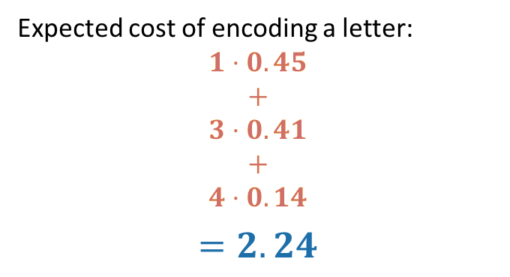
Solution greedily build subtrees, starting with the infrequent letters
100
Expected cost of encoding a letter:
$$1⋅0.45$$
$$+$$
$$3⋅0.41$$
$$+$$
$$4⋅0.14$$
$$=2.24$$
0
1
55
A: 45
0
1
0
30
25
0
0
1
1
C:12
D: 16
14
B:13
101
110
0
1
100
E:9
F:5
1110
1111

Slide 97
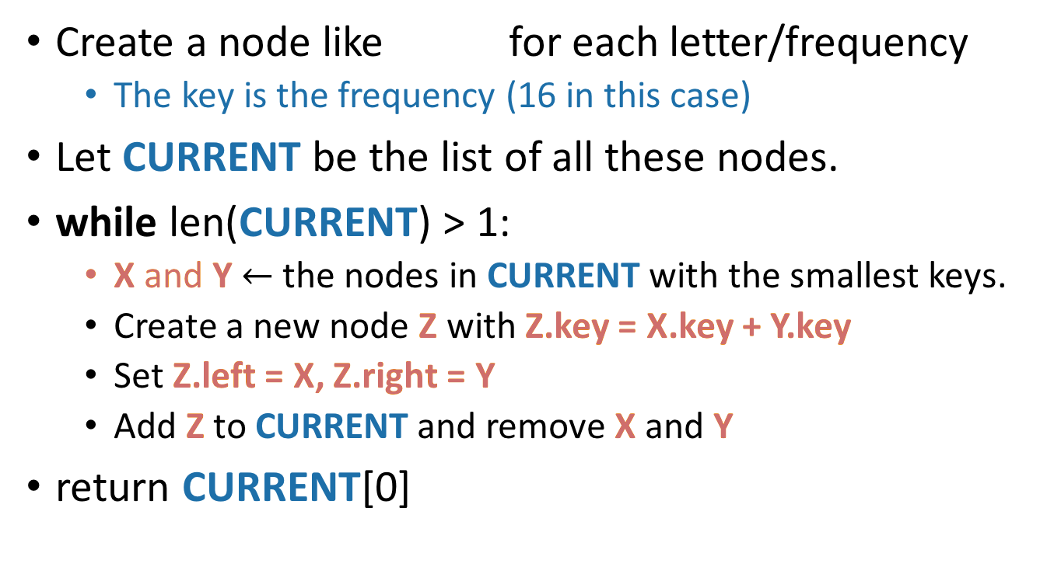
What exactly was the algorithm?
D: 16
Create a node like for each letter/frequency
The key is the frequency (16 in this case)
Let CURRENT be the list of all these nodes.
while len(CURRENT) > 1:
X and Y $←$ the nodes in CURRENT with the smallest keys.
Create a new node Z with Z.key = X.key + Y.key
Set Z.left = X, Z.right = Y
Add Z to CURRENT and remove X and Y
return CURRENT[0]
14
Z
0
1
A: 45
B:13
C:12
D: 16
F:5
E:9
X
Y

Slide 98
This is called Huffman Coding:
D: 16
Create a node like for each letter/frequency
The key is the frequency (16 in this case)
Let CURRENT be the list of all these nodes.
while len(CURRENT) > 1:
X and Y $←$ the nodes in CURRENT with the smallest keys.
Create a new node Z with Z.key = X.key + Y.key
Set Z.left = X, Z.right = Y
Add Z to CURRENT and remove X and Y
return CURRENT[0]
14
Z
0
1
A: 45
B:13
C:12
D: 16
F:5
E:9
X
Y

Slide 99
Does it work?
Yes.
We will sketch a proof here.
Same strategy:
Show that at each step, the choices we are making won’t rule out an optimal solution.
Lemma:
Suppose that x and y are the two least-frequent letters. Then there is an optimal tree where x and y are siblings.
14
0
1
A: 45
B:13
C:12
D: 16
E:9
F:5

Slide 100
Lemma proof idea
If x and y are the two least-frequent letters, there is an optimal tree where x and y are siblings.
Say that an optimal tree looks like this:
What happens to the cost if we swap x for a?
the cost can’t increase; a was more frequent than x, and we just made a’s encoding shorter and x’s longer.
Repeat this logic until we get an optimal tree with x and y as siblings.
The cost never increased so this tree is still optimal.
x
Lowest-level sibling nodes: at least one of them is neither x nor y
a

Slide 101
Lemma proof idea
If x and y are the two least-frequent letters, there is an optimal tree where x and y are siblings.
Say that an optimal tree looks like this:
What happens to the cost if we swap x for a?
the cost can’t increase; a was more frequent than x, and we just made a’s encoding shorter and x’s longer.
Repeat this logic until we get an optimal tree with x and y as siblings.
The cost never increased so this tree is still optimal.
Lowest-level sibling nodes: at least one of them is neither x nor y
x
y

Slide 102
Huffman Coding Works (idea)
Show that at each step, the choices we are making won’t rule out an optimal solution.
Lemma:
Suppose that x and y are the two least-frequent letters. Then there is an optimal tree where x and y are siblings.
That’s enough to show that we don’t rule out optimality on the first step.
14
0
1
A: 45
B:13
C:12
D: 16
E:9
F:5

Slide 103
Huffman Coding Works (idea)
Show that at each step, the choices we are making won’t rule out an optimal solution.
Lemma:
Suppose that x and y are the two least-frequent letters. Then there is an optimal tree where x and y are siblings.
That’s enough to show that we don’t rule out optimality on the first step.
To show that continue to not rule out optimality once we start grouping stuff…
30
1
25
14
0
0
0
1
1
A: 45
B:13
C:12
D: 16
E:9
F:5

Slide 104
Huffman Coding Works (idea)
To show that continue to not rule out optimality once we start grouping stuff…
The basic idea is that we can treat the “groups” as leaves in a new alphabet.
30
1
25
14
0
0
0
1
1
A: 45
B:13
C:12
D: 16
E:9
F:5

Slide 105
Huffman Coding Works (idea)
To show that continue to not rule out optimality once we start grouping stuff…
The basic idea is that we can treat the “groups” as leaves in a new alphabet.
Then we can use the lemma from before.
30
1
DEF:30
25
14
BC:25
0
0
0
1
1
A: 45
B:13
C:12
D: 16
E:9
F:5

Slide 106
Basic idea for point 2 you can treat internal nodes as “leaves” in some tree on a smaller alphabet.
THIS SLIDE SKIPPED IN CLASS
100
100
0
1
0
1
55
55
A: 45
A: 45
0
1
0
1
30
H: 30
25
G: 25
0
0
1
1
C:12
D: 16
14
The first thing is an optimal tree on {A,B,C,D,E,F}
if and only if
the second thing is an optimal tree on {A,G,H}
B:13
0
1
E:9
F:5

Slide 107
For a full proof
See lecture notes or CLRS!

Slide 108
What have we learned?
*If all we care about is number of bits.
ASCII isn’t an optimal way* to encode English, since the distribution on letters isn’t uniform.
Huffman Coding is an optimal way!
To come up with an optimal scheme for any language efficiently, we can use a greedy algorithm.
To come up with a greedy algorithm:
Identify optimal substructure
Find a way to make choices that won’t rule out an optimal solution.
Create subtrees out of the smallest two current subtrees.

Slide 109
Recap I
Greedy algorithms!
Three examples:
Activity Selection
Scheduling Jobs
Huffman Coding
If we had time

Slide 110
Recap II
Greedy algorithms!
Often easy to write down
But may be hard to come up with and hard to justify
The natural greedy algorithm may not always be correct.
A problem is a good candidate for a greedy algorithm if:
it has optimal substructure
that optimal substructure is REALLY NICE
solutions depend on just one other sub-problem.

Slide 111
Next time
Greedy algorithms for Minimum Spanning Tree!
Pre-lecture exercise: thinking about MSTs
Before next time

