Slide 1
Lecture 17
Gale-Shapley (Deferred Acceptance) Algorithm

Slide 2
Announcements
This week’s lectures (including this one) are NOT on the final exam.

Slide 3
Recap: One way to greedy algorithms
Greedy algorithms
Make a series of choices.
Choose this activity, then that one, ..
Never backtrack.
Show (or hope) that your choice never rules out success.
At every step, there exists an optimal solution consistent with the choices we’ve made so far.
At the end of the day:
you’ve built only one solution,
never having ruled out success,
so your solution must be correct.

Slide 4
Recap: A different approach to greedy
Greedy algorithms
Make a series of choices.
Choose this activity, then that one, ..
Never backtrack.
Instead: At each step, free to revert any of the choices we’ve already made – as long as the solution is improving!
Notes:
Improving solutions is also one way to bound the running time!

Slide 5
Recap: Ford-Fulkerson algorithm for s-t min-cut / max-flow
USA: s-t Min-Cut USSR: s-t Max-Flow
The value of a max flow from s to t
is equal to
the cost of a min s-t cut.
3
3
3
4
4
6
2
1
4
6
2
4
s
2
3
4
t
3
5
2
6
3
1
6
4
4
5
10

Slide 6
Recap: used s-t max-flow to solve assignment problems
1
1
1
1
s
1
1
t
1
1
1
1
1
1
Stanford Students
Stanford Swag

Slide 7
Today: matching when both sides have preferences
I want a CS161 CA to wear me!
1
1
1
1
s
1
1
t
1
1
1
1
1
1
Stanford Students
Stanford Swag

Slide 8
Today
Hospitals/residents problem
Stable matchings
Solve the hospitals/residents problem
But can we find them?
Deferred Acceptance Algorithm
Find stable matchings!
Discussion, applications and non-applications

Slide 9
The hospital residency problem
After completing medical school, students are finally ready to start their “residency” (similar to job internship)
Each doctor has a preference over different hospitals.
Each hospital has a preference over the doctors.
How should you match doctors with hospitals?
Simplifying assumption today:
Each hospital has 1 slot

Slide 10




One way to model this problem
This slide just for intuition!
Each doctor has a preference over hospitals
Each hospital has a preference over the doctor
How should you match doctors with hospitals?
9
1
2
9
2
7
9
8
n
n
4

Slide 11
One way to model this problem
This slide just for intuition!
Bipartite graph between doctors and hospitals
Weights on edges = some function of preferences (highest weight = most preferred)
9
1
2
9
2
7
9
8
n
n
4

Slide 12
One way to model this problem
This slide just for intuition:
You don’t need to know Hungarian Algorithm!
Bipartite graph between doctors and hospitals
Weights on edges = some function of preferences
“Hungarian Algorithm” (CS261) finds a max weight matching
9
1
2
9
2
7
9
8
n
n
4

Slide 13
One way to model this problem
This slide just for intuition:
You don’t need to know Hungarian Algorithm!
Bipartite graph between doctors and hospitals
Weights on edges = some function of preferences
“Hungarian Algorithm” (CS261) finds a max weight matching
9
1
2
9
2
7
9
8
n
n
4

Slide 14
“Each hospital/doctor has a list of preferences”
Missing step:
How does the algorithm get the preferences?

Slide 15


Where does your input come from?
… and what can go wrong if we don’t think about it carefully:
Some doctors may misreport their preferences
9
1
2
9
$$−∞$$
2
7
$$−∞$$
9
8
n
n
4

Slide 16
Where does your input come from?
… and what can go wrong if we don’t think about it carefully:
Some doctors may misreport their preferences
Some doc+hospital may match outside your algorithm
9
1
2
9
$$−∞$$
2
7
$$−∞$$
9
8
n
n
4

Slide 17
Today
Hospitals/residents problem
Stable matchings
Solve the hospitals/residents problem
But can we find them?
Deferred Acceptance Algorithm
Find stable matchings!
Discussion, applications and non-applications

Slide 18
Stable Matching
n
n

Slide 19
Stable Matching
Definition (blocking pair):
Given Matching M, (Doctor i, Hospital j) are a blocking pair if they prefer each other to their assignment in M
Stanfordwants Doctor n
n really wants Stanford
n
n

Slide 20
Stable Matching
Definition (blocking pair):
Given Matching M, (Doctor i, Hospital j) are a blocking pair if they prefer each other to their assignment in M
Definition (stable matching):
M is a stable matching if there are no blocking pairs.
n
n

Slide 21
Stable Matching
Definition (blocking pair):
Given Matching M, (Doctor i, Hospital j) are a blocking pair if they prefer each other to their assignment in M
Definition (stable matching):
M is a stable matching if there are no blocking pairs.
equivalent
For every unmatched pair (i, j):
Doctor i prefers Hospital M(i) over Hospital j, or;
Hospital j prefers Doctor M(j) over Doctor i

Slide 22
Unstable Matching and incentives
Problems we identified with unstable matchings:
Some doctors may misreport their preferences
Some doc+hospital may match outside your algorithm
9
$$−∞$$
2
7
$$−∞$$
n
n

Slide 23
Stable Matching and incentives
With stable matching:
Will doctors misreport their preferences?
Not obvious!
We’ll come back to this later (if time)
9
$$−∞$$
2
7
$$−∞$$
n

Slide 24
Stable Matching and incentives
With stable matching:
Doctor+hospital never prefer to match outside algorithm!
This is the point of stable matching:
Only a blocking pair would prefer to match outside.
Stable matching = no blocking pairs!
n

Slide 25
Stable Matching Problem
25
How to find stable matchings!
(do they even exist?)

Slide 26
Stable Matching Problem
26
Alice’s preferences
1st | Stanford
2nd | n
… | …
n^{th} | UCSF
Stanford’s preferences
1st | Alice
2nd | n
… | …
n^{th} | Bob
Stable Matching Problem
Input: each doctor/hospital submits a ranking (permutation) of {1,…,n}
Output: a stable matching
Definition (blocking pair):
Given Matching M, (Doctor i, Hospital j) are a blocking pair if they prefer each other to their assignment in M
Definition (stable matching):
M is a stable matching if there are no blocking pairs.

Slide 27
Naïve attempt #1
27
Greedy algorithm:
Step 1- match all the pairs (i, j) such that j is i’s top choice, and i is j’s top choice
Step 2- hopefully recurse on the rest somehow…
Observation: Step 1 never rules out any solution ☺

Slide 28
A slightly more ambitious attempt
28
Greedy attempt #2:
Step 1- try to match every doctor to her favorite hospital
Break ties by hospital preference
Step 2- hopefully recurse on the rest somehow…

Slide 29
A slightly more ambitious attempt
29
Think-pair-share!
Matching (C,y) was a bad idea… How could we avoid it?
Greedy attempt #2:
Step 1- try to match every doctor to her favorite hospital
Break ties by hospital preference
We’re already wrong!
Step 1: A,B want x, C wants y
so we match (A,x) and (C,y)
But now (B,y) is blocking!
Doctor’s #1 choice
A
x
doctors
Doctor’s #2 choice
B
hospitals
Hospital’s #1 choice
y
C

Slide 30
Today
Hospitals/residents problem
Stable matchings
Solve the hospitals/residents problem
But can we find them?
Deferred Acceptance Algorithm
Find stable matchings!
Discussion, applications and non-applications

Slide 31
Questions?
Definition (blocking pair):
Given Matching M, (Doctor i, Hospital j) are a blocking pair if they prefer each other to their assignment in M
Definition (stable matching):
M is a stable matching if there are no blocking pairs.
equivalent
For every unmatched pair (i,j):
Doctor i prefers Hospital M(i) over Hospital j, or;
Hospital j prefers Doctor M(j) over Doctor i

Slide 32
Deferred Acceptance Algorithm [Gale Shapley ‘62] -> 2012 Nobel Prize* in Econ! *- Joint w/ Al Roth from Stanford

Slide 33
Deferred Acceptance Algorithm
Main idea: try to match each doctor to top choice;
if you discover a blocking pair, just switch the matching!
Doctor’s #1 choice
A
x
The issue was: A,B want x, C wants y
we tried to match (A,x) and (C,y)
but then (B,y) was blocking!
Doctor’s #2 choice
B
Hospital’s #1 choice
y
C

Slide 34
Deferred Acceptance Algorithm
Main idea: try to match each doctor to top choice;
if you discover a blocking pair, just switch the matching!
Algorithm iteration 1:
A, B want x; C wants y
So we match (A,x) and (C,y)
A
x
B
y
C
Doctor’s #1 choice
A
x
The issue was: A,B want x, C wants y
we tried to match (A,x) and (C,y)
but then (B,y) was blocking!
Doctor’s #2 choice
B
Hospital’s #1 choice
y
C

Slide 35
Deferred Acceptance Algorithm
35
Main idea: try to match each doctor to top choice;
if you discover a blocking pair, just switch the matching!
Algorithm iteration 2(a):
Now notice that (B,y) is blocking ☹
A
x
B
y
C
Doctor’s #1 choice
A
x
The issue was: A,B want x, C wants y
we tried to match (A,x) and (C,y)
but then (B,y) was blocking!
Doctor’s #2 choice
B
Hospital’s #1 choice
y
C

Slide 36
Deferred Acceptance Algorithm
36
Main idea: try to match each doctor to top choice;
if you discover a blocking pair, just switch the matching!
Algorithm iteration 2(b):
Add (B,y) to the matching ☺
(and remove (C,y))
A
x
B
y
C
Doctor’s #1 choice
A
x
The issue was: A,B want x, C wants y
we tried to match (A,x) and (C,y)
but then (B,y) was blocking!
Doctor’s #2 choice
B
Hospital’s #1 choice
y
C

Slide 37
Deferred Acceptance Algorithm
37
Main idea: try to match each doctor to top choice;
if you discover a blocking pair, just switch the matching!
Algorithm iteration 2(b):
Add (B,y) to the matching ☺
(and remove (C,y))
A
x
B
y
C
Don’t worry Just switch around until no blocking pairs!
The issue was: A,B want x, C wants y
we tried to match (A,x) and (C,y)
but then (B,y) was blocking!
Lucky the Lackadaisical Lemur

Slide 38
Deferred Acceptance Algorithm
38
Main idea: try to match each doctor to top choice;
if you discover a blocking pair, just switch the matching!
Almost-pseudo-code:
While there is an unmatched doctor i:
Try to match i to next-favorite hospital on her list;
If this hospital doesn’t have a doctor yet:
Both Doctor i and hospital are happy with this new match ☺
Else-if this hospital prefers its current match i’ over i:
Doctor i remains unmatched
Else-if this hospital prefers i over i’:
Unmatch i’; Match (i, hospital)

Slide 39
Example run-through

Slide 40





DA Example Run 1
B, A, C
X, Y, Z
X
Alice
A, B, C
Y, X, Z
Y
Bob
B, C, A
Y, Z, X
Z
Charlie

Slide 41
DA Example Run 1
B, A, C
X, Y, Z
X
Alice
A, B, C
Y, X, Z
Y
Bob
B, C, A
Y, Z, X
Z
Charlie

Slide 42
DA Example Run 1
B, A, C
X, Y, Z
X
Alice
A, B, C
Y, X, Z
Y
Bob
B, C, A
Y, Z, X
Z
Charlie

Slide 43
DA Example Run 1
B, A, C
X, Y, Z
X
Alice
A, B, C
Y, X, Z
Y
Bob
B, C, A
Y, Z, X
Z
Charlie

Slide 44
DA Example Run 1
B, A, C
X, Y, Z
X
Alice
A, B, C
Y, X, Z
Y
Bob
B, C, A
Y, Z, X
Z
Charlie

Slide 45
DA Example Run 1
B, A, C
X, Y, Z
X
Alice
A, B, C
Y, X, Z
Y
Bob
B, C, A
Y, Z, X
Z
Charlie

Slide 46
Another example

Slide 47
DA Example Run 2
B, A, C
X, Y, Z
X
Alice
A, C, B
Y, X, Z
Y
Bob
B, C, A
Y, Z, X
Z
Charlie

Slide 48
DA Example Run 2
B, A, C
X, Y, Z
X
Alice
A, C, B
Y, X, Z
Y
Bob
B, C, A
Y, Z, X
Z
Charlie

Slide 49
DA Example Run 2
B, A, C
X, Y, Z
X
Alice
A, C, B
Y, X, Z
Y
Bob
B, C, A
Y, Z, X
Z
Charlie

Slide 50
DA Example Run 2
B, A, C
X, Y, Z
X
Alice
A, C, B
Y, X, Z
Y
Bob
B, C, A
Y, Z, X
Z
Charlie

Slide 51
DA Example Run 2
B, A, C
X, Y, Z
X
Alice
A, C, B
Y, X, Z
Y
Bob
B, C, A
Y, Z, X
Z
Charlie

Slide 52
DA Example Run 2
B, A, C
X, Y, Z
X
Alice
A, C, B
Y, X, Z
Y
Bob
B, C, A
Y, Z, X
Z
Charlie

Slide 53
DA Example Run 2
B, A, C
X, Y, Z
X
Alice
A, C, B
Y, X, Z
Y
Bob
B, C, A
Y, Z, X
Z
Charlie

Slide 54
DA Example Run 2
B, A, C
X, Y, Z
X
Alice
A, C, B
Y, X, Z
Y
Bob
B, C, A
Y, Z, X
Z
Charlie

Slide 55

Deferred Acceptance Algorithm
Deferred-Acceptance(Doctors,Hospitals):
freeDoctors ← Doctors
for all d in Doctors:
d.current ← 0
for all h in Hospitals:
h.doctor ← NIL
while (exists d in freeDoctors)
h ← d.ranking[d.current++]
if (h is free)
h.doctor ← d
remove d from freeDoctors
else-if (h.rank[d] < h.rank[h.doctor])
add h.doctor to freeDoctors
h.doctor ← d
remove d from freeDoctors
return (h,h.doctor) for all h in Hospitals
// initialize
// main loop
// h is d’s next favorite
// h prefers d to previous match
Think-pair-share!
Running time?

Slide 56
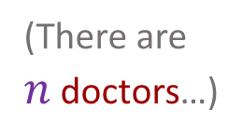
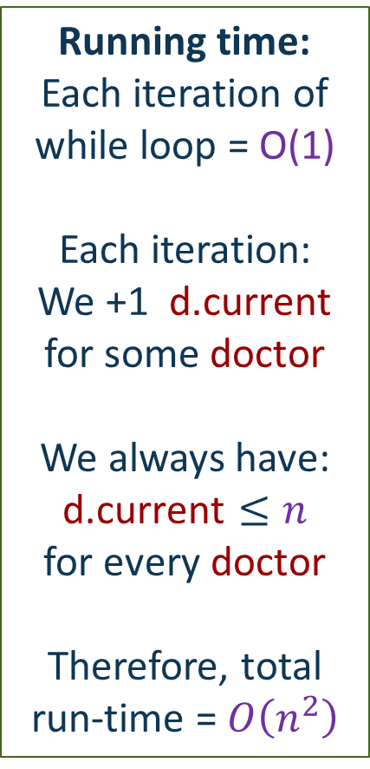
Deferred Acceptance Algorithm
Running time:
Each iteration of while loop = O(1)
Each iteration: We +1 $\text{d}\text{.}\text{current}$ for some doctor
We always have: $$\text{d}\text{.}\text{current}≤n$$
for every doctor
Therefore, total run-time = $O\left(n^{2}\right)$
while (exists d in freeDoctors)
h ← d.ranking[d.current++]
if (h is free)
h.doctor ← d
remove d from freeDoctors
else-if (h.rank[d] < h.rank[h.doctor])
add h.doctor to freeDoctors
h.doctor ← d
remove d from freeDoctors
return (h,h.doctor) for all h in Hospitals
// main loop
// h is d’s next favorite
(There are $n$ doctors…)

Slide 57
DA algorithm
Does it work?
Yes!
Is it fast?
O(n²) - this is linear in the input size!
At worst exhaust through every doctor’s preference list

Slide 58
Deferred Acceptance works!
Theorem: Given n doctors and n hospitals, DA algorithm outputs a complete stable matching.
Corollary: A stable matching exists.
(This is not obvious!)

Slide 59
Proof of Theorem
Theorem: Given n doctors and n hospitals, DA algorithm outputs a complete stable matching.
Proof: Follows from Claims 1+3 below…
Claim 1: At every iteration, current match is stable w.r.t. non-free doctors and hospitals.
Claim 2: Once a hospital is matched, it remains matched (possibly to a different doctor) until end of algorithm.
Claim 3: At the end of algorithm, every doctor/hospital is matched.

Slide 60
Proof of claims
Claim 1: At every iteration, current match is stable w.r.t. non-free doctors and hospitals.
Proof by contradiction: Suppose (d,h) blocking pair.
→ d is currently matched to worse hospital than h.
→ d already tried to match to h.
→ h either refused d or left d later. Why?
→ h must be matched to better doctor than d – contradiction!
Claim 2: Once a hospital is matched, it remains matched (possibly to a different doctor) until end of algorithm.
“Proof”: obvious from algorithm
Claim 3: At the end of algorithm, every doctor/hospital is matched.
Proof by contradiction: Suppose (d,h) still free.
End of algorithm → d already tried to match to h.
→ after that step, h wasn’t free → by Claim 2, contradiction!

Slide 61
Deferred Acceptance works!
Theorem: Given n doctors and n hospitals, DA algorithm outputs a complete stable matching.
Corollary: A stable matching exists.
Claim 1: At every iteration, current match is stable w.r.t. non-free doctors and hospitals.
Claim 2: Once a hospital is matched, it remains matched (possibly to a different doctor) until end of algorithm.
Claim 3: At the end of algorithm, every doctor/hospital is matched.

Slide 62
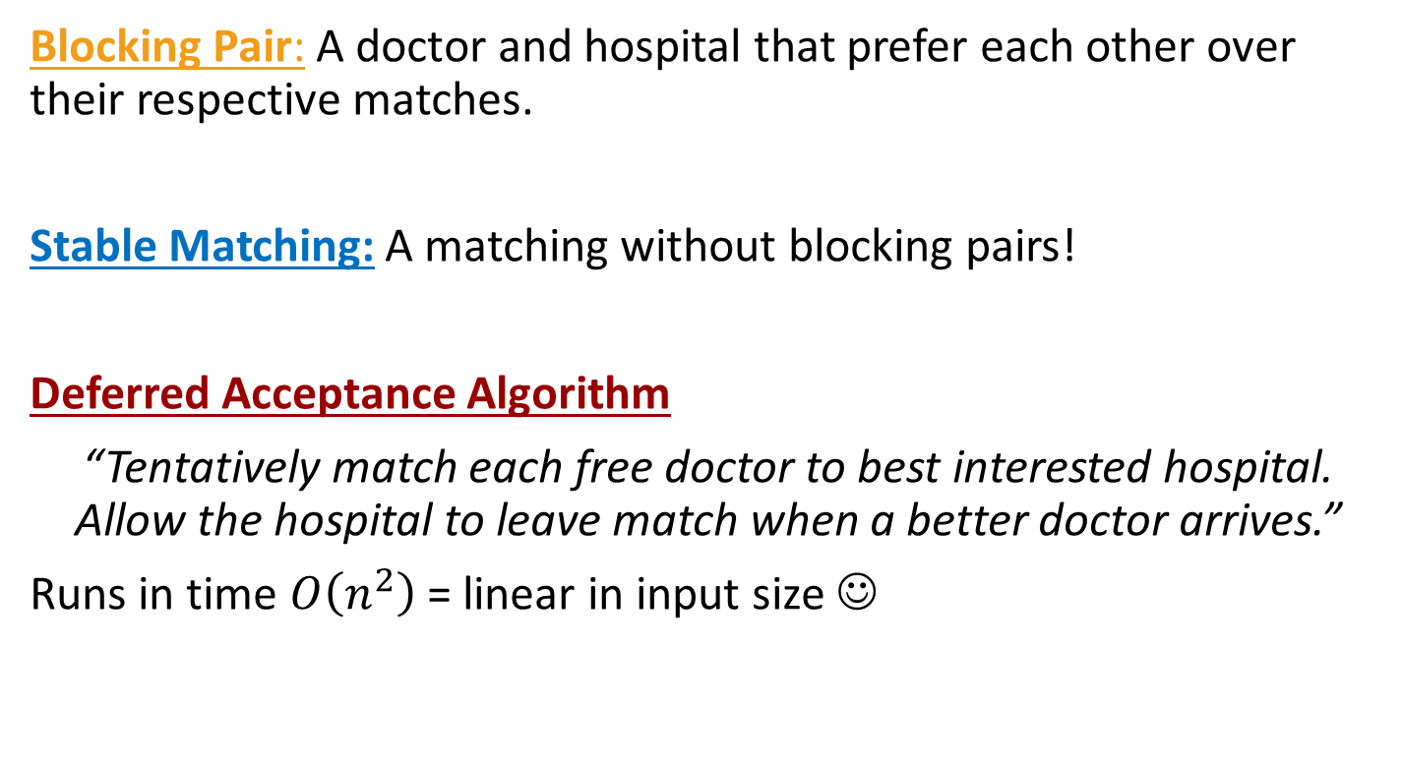
What have we learned?
Blocking Pair: A doctor and hospital that prefer each other over their respective matches.
Stable Matching: A matching without blocking pairs!
Deferred Acceptance Algorithm
“Tentatively match each free doctor to best interested hospital. Allow the hospital to leave match when a better doctor arrives.”
Runs in time $O\left(n^{2}\right)$ = linear in input size ☺

Slide 63
Today
Hospitals/residents problem
Stable matchings
Solve the hospitals/residents problem
But can we find them?
Deferred Acceptance Algorithm
Find stable matchings!
Discussion, applications and non-applications

Slide 64

The optimal stable matching?
DA algorithm found a stable matching…
Is it optimal?
What does optimality mean?
Theorem: The matching returned by DA is doctor-optimal,
i.e. every doctor is matched to the favorite hospital among those possible in any stable matching.
Corollary: Order of popping from freeDoctors does not change the output.
Theorem: Doctors cannot gain from misreporting their preferences.
Prove this theorem!

Slide 65
Stable Matching and Incentives
Doctor 2 may tell you he only wants to go to Stanford, but…
Corollary: This won’t help him if we find Stable Matching with DA!
9
$$−∞$$
2
7
$$−∞$$
n

Slide 66
The optimal stable matching?
Prove this theorem too!
Theorem: The matching returned by DA is hospital-worst,
i.e. every hospital is matched to least-favorite doctor possible in any stable matching.
Caution: Hospitals can gain from misreporting their preferences.
Think-pair-share: How would you find a hospital-optimal stable matching?
Should actual matching be doctor- or hospital-optimal?

Slide 67
What have we learned?
Doctor-optimality: The matching returned by DA is doctor-optimal (but hospital-worst)
Truthful preferences corollary: Doctors cannot gain from misreporting their preferences (but hospitals can).
Point:
It’s important to think about how our algorithms affect people.
Theorems can help!

Slide 68
Today
Hospitals/residents problem
Stable matchings
Solve the hospitals/residents problem
But can we find them?
Deferred Acceptance Algorithm
Find stable matchings!
Discussion, applications and non-applications

Slide 69


Doctors vs Packets
Bonus Application #1
Suppose that instead of doctors and hospitals, you want to match packets to servers on the internet.
Lecture17.pptx
Lecture17.pdf
n
n
69

Slide 70
Doctors vs Packets
Bonus Application #1
Suppose that instead of doctors and hospitals, you want to match packets to servers on the internet.
When you own all the servers, you don’t have to worry about them matching outside your algorithm...
But it turns out that Deferred Acceptance is just very fast in practice ☺
Lecture17.pdf
n
n
70

Slide 71

Doctors vs Packets
Bonus Application #1
Suppose that instead of doctors and hospitals, you want to match packets to servers on the internet.
When you own all the servers, you don’t have to worry about them matching outside your algorithm...
But it turns out that Deferred Acceptance is just very fast in practice ☺
Truncated preference lists
Packets typically get one of top servers
Total running time closer to $O\left(n\right)$!
Highly distributed:
Every packet looks for its own server!
71

Slide 72
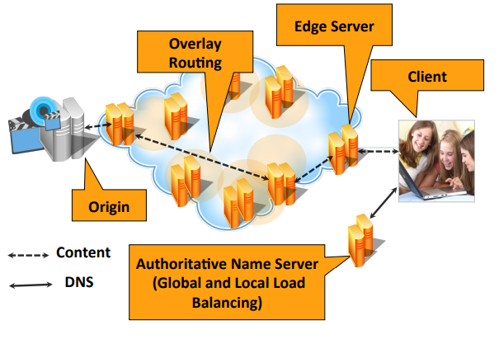
Doctors vs Packets
Bonus Application #1
See “Algorithmic Nuggets in Content Delivery“ (Maggs & Sitaraman, CCR’15) for details on how Akamai uses Deferred Acceptance to match packets to servers
72

Slide 73

Stanford Marriage Pact
Bonus (Non)application #2

Slide 74
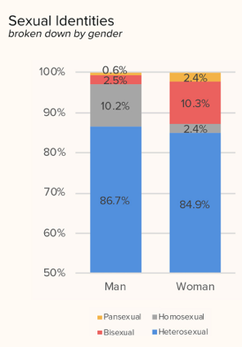
Stanford Marriage Pact
Bonus (Non)application #2
Matches between Stanford students who want to make a pact: “If we don’t get married by time X, we’ll marry each other.”
Historically, Gale-Shapley’s original paper talked about Stable Marriage
men = doctors; women = hospitals.
Original Marriage Pact used variant of Deferred Acceptance
It doesn’t any more…
Marriage Pact doesn’t need stability:
It is meant to be a back-up match-
Couples are encouraged to find outside matches!
Preference graph is not bipartite!

Slide 75
Recap
Hospitals/residents problem
Stable matchings
Solve the hospitals/residents problem
But can we find them?
Deferred Acceptance Algorithm
Find stable matchings!
Discussion, applications and non-applications

Slide 76

Next time
Quick and hand-wavey recap of past lectures.
Algorithms beyond 161 …

