Slide 1
Lecture 2
Asymptotic Notation,
Worst-Case Analysis, and MergeSort

Slide 2
Announcements
Midterm date: Wed Feb 12 6:00pm - 9:00pm
Please (continue to) send OAE letters to cs161-staff-win2425@cs.stanford.edu
ACE program …
CTL academic coaching …

Slide 3

In ACE Section, we’ll
Go over lecture materials!
Practice problem-solving strategies!
Have unbounded fun!
When: Tuesdays, 3:00pm-4:50pm
Where: 160-322
Apply on the 161 Website by:
Friday, January 10th BEFORE 5pm
161 ACE CA
Matthew Villescas
mattjv22@stanford.edu

Slide 4
Homework!
HW1 will be released today (Wednesday).
It is due the next Wednesday, 11:59pm (in one week), on Gradescope. As a reminder, HW1, HW2, and HW3 are solo submissions only.
Homework comes in two parts:
Exercises:
More straightforward.
Try to do them on your own.
Problems:
Less straightforward.
Try them on your own first, but then collaborate!
See the website for guidelines on homework:
Collaboration + late day policy (in the “Policies” tab)
Best practices (in the “Resources” tab)
Example homework (in the “Resources” tab)
LaTeX help (in the “Resources” tab)

Slide 5
Office Hours and Sections
Office hours calendar is on the course website.
(under "Staff / Office Hours”)
Sections have been scheduled.
See course website
One will be remote/recorded
Don’t need to formally enroll in sections, just show up!

Slide 6

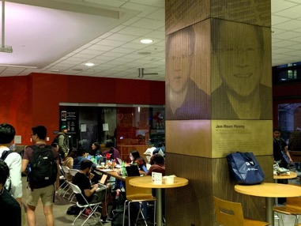

Huang basement

Slide 7
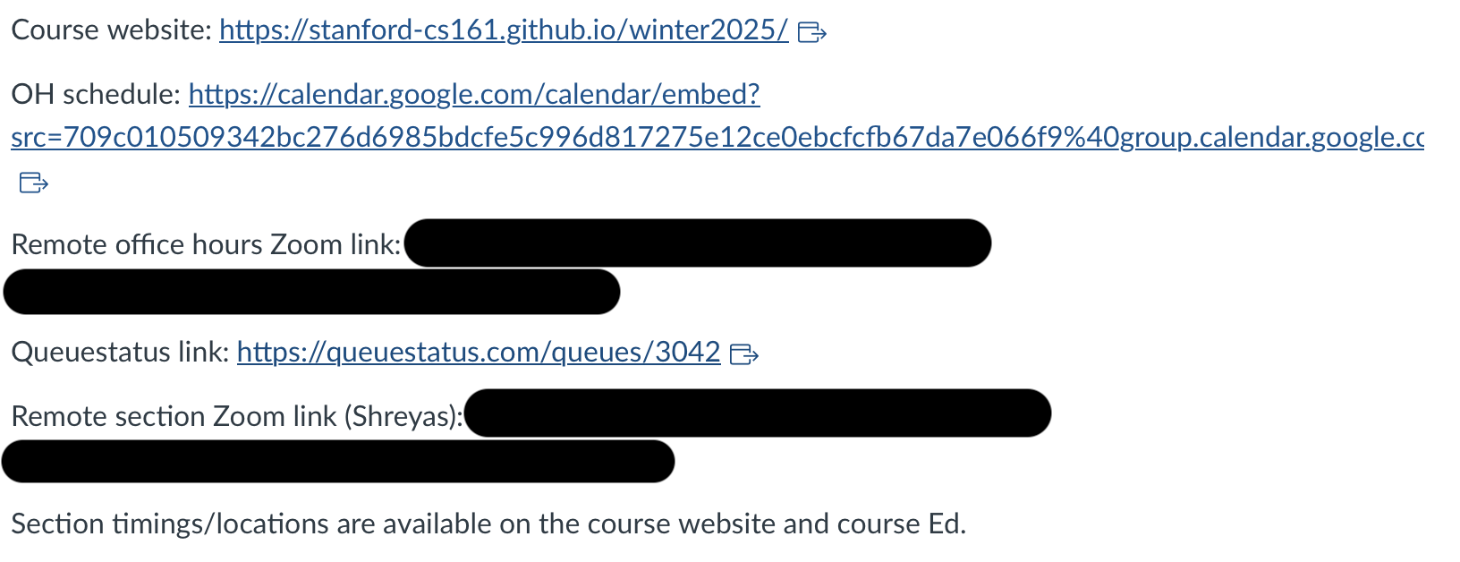
End of announcements!
Links on Canvas

Slide 8
Last time
Cast
Philosophy
Algorithms are awesome!
Our motivating questions:
Does it work?
Is it fast?
Can I do better?
Plucky the pedantic penguin
Lucky the lackadaisical lemur
Technical content
Think-Pair-Share Terrapins
Divide-and-conquer
Karatsuba integer multiplication
Not-so-rigorous analysis
Ollie the
over-achieving ostrich
Siggi the
studious stork

Slide 9
Sorting
We are going to ask:
Does it work?
Is it fast?
We’ll start to see how to answer these by looking at some examples of sorting algorithms.
InsertionSort
MergeSort
SortingHatSort not discussed

Slide 10
The Plan
Sorting!
Worst-case analysis
InsertionSort: Does it work?
Asymptotic Analysis
InsertionSort: Is it fast?
MergeSort
Does it work?
Is it fast?

Slide 11
Sorting
Important primitive
For today, we’ll pretend all elements are distinct.
6
4
3
8
1
5
2
7
1
2
3
4
5
6
7
8
Length of the list is n

Slide 12
Pre-lecture exercise:
def mysteryAlgorithmOne(A):
B = [None for i in range(len(A))]
for x in A:
for i in range(len(B)):
if B[i] == None or B[i] > x:
j = len(B)-1
while j > i:
B[j] = B[j-1]
j -= 1
B[i] = x
break
return B
What was the mystery sort algorithm?
MergeSort
QuickSort
InsertionSort
BogoSort
def mysteryAlgorithmTwo(A):
for i in range(1,len(A)):
current = A[i]
j = i-1
while j >= 0 and A[j] > current:
A[j+1] = A[j]
j -= 1
A[j+1] = current

Slide 13
Pre-lecture exercise:
def mysteryAlgorithmOne(A):
B = [None for i in range(len(A))]
for x in A:
for i in range(len(B)):
if B[i] == None or B[i] > x:
j = len(B)-1
while j > i:
B[j] = B[j-1]
j -= 1
B[i] = x
break
return B
What was the mystery sort algorithm?
MergeSort
QuickSort
InsertionSort
BogoSort
def mysteryAlgorithmTwo(A):
for i in range(1,len(A)):
current = A[i]
j = i-1
while j >= 0 and A[j] > current:
A[j+1] = A[j]
j -= 1
A[j+1] = current

Slide 14
InsertionSort example
6
4
3
8
5
Start by moving A[1] toward the beginning of the list until you find something smaller (or can’t go any further):
Then move A[3]:
6
4
3
8
5
3
4
6
8
5
4
6
3
8
5
3
4
6
8
5
Then move A[2]:
Then move A[4]:
4
6
3
8
5
3
4
6
8
5
3
4
6
8
5
3
4
5
6
8
Then we are done!

Slide 15
Insertion Sort
Does it work?
Is it fast?
What does that mean???
Plucky the Pedantic Penguin

Slide 16
The Plan
InsertionSort recap
Worst-case Analysis
Back to InsertionSort: Does it work?
Asymptotic Analysis
Back to InsertionSort: Is it fast?
MergeSort
Does it work?
Is it fast?

Slide 17
Claim: InsertionSort “works”
“Proof:” It just worked in this example:
6
4
3
8
5
6
4
3
8
5
3
4
6
8
5
4
6
3
8
5
3
4
6
8
5
4
6
3
8
5
3
4
6
8
5
3
4
6
8
5
3
4
5
6
8
Sorted!

Slide 18
Claim: InsertionSort “works”
“Proof:” I did it on a bunch of random lists and it always worked:

Slide 19
What does it mean to “work”?
Is it enough to be correct on only one input?
Is it enough to be correct on most inputs?
In this class, we will use worst-case analysis:
An algorithm must be correct on all possible inputs.
The running time of an algorithm is the worst possible running time over all inputs.

Slide 20
Worst-case analysis
Think of it like a game:
Pros: very strong guarantee
Cons: very strong guarantee
Here is my algorithm!
Algorithm:
Do the thing
Do the stuff
Return the answer
Here is an input!
(Which I designed to be terrible for your algorithm!)
Algorithm designer

Slide 21
Insertion Sort
Does it work?
Is it fast?
Okay, so it’s pretty obvious that it works.
HOWEVER! In the future it won’t be so obvious, so let’s take some time now to see how we would prove this rigorously.

Slide 22
Why does this work?
Say you have a sorted list, , and another element .
Insert right after the largest thing that’s still smaller than . (Aka, right after ).
Then you get a sorted list:
3
4
6
8
5
5
5
4
3
4
5
6
8

Slide 23
So just use this logic at every step.
6
4
3
8
5
4
3
8
5
The first element, [6], makes up a sorted list.
4
6
3
8
5
So correctly inserting 4 into the list [6] means that [4,6] becomes a sorted list.
4
6
3
8
5
The first two elements, [4,6], make up a sorted list.
3
4
6
8
5
So correctly inserting 3 into the list [4,6] means that [3,4,6] becomes a sorted list.
3
4
6
8
5
The first three elements, [3,4,6], make up a sorted list.
3
4
6
8
5
So correctly inserting 8 into the list [3,4,6] means that [3,4,6,8] becomes a sorted list.
3
4
6
8
5
The first four elements, [3,4,6,8], make up a sorted list.
3
4
5
6
8
So correctly inserting 5 into the list [3,4,6,8] means that [3,4,5,6,8] becomes a sorted list.
YAY WE ARE DONE!

Slide 24
This sounds like a job for…
Proof By Induction!

Slide 25
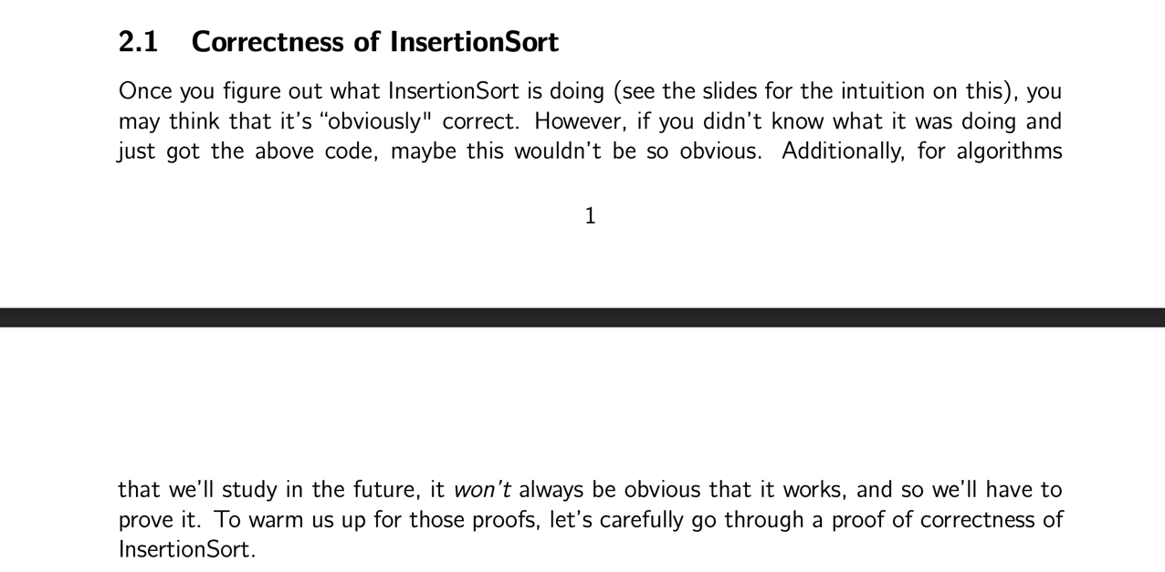
The notes contain the details!
See website!

Slide 26
Outline of a proof by induction
Let A be a list of length n
Inductive Hypothesis:
A[:i+1] is sorted at the end of the i^{th} iteration (of the outer loop).
Base case (i=0):
A[:1] is sorted at the end of the 0’th iteration. ✓
Inductive step:
For any 0 < k < n, if the inductive hypothesis holds for i=k-1, then it holds for i=k.
Aka, if A[:k] is sorted at step k-1, then A[:k+1] is sorted at step k
Conclusion:
The inductive hypothesis holds for i = 0, 1, …, n-1.
In particular, it holds for i=n-1.
At the end of the n-1’st iteration (aka, at the end of the algorithm), A[:n] = A is sorted.
That’s what we wanted! ✓
This logic
(see notes for details)
4
6
3
8
5
The first two elements, [4,6], make up a sorted list.
3
4
6
8
5
So correctly inserting 3 into the list [4,6] means that [3,4,6] becomes a sorted list.
This was iteration i=2.

Slide 27
Aside: proofs by induction
We’re going to see/do/skip over a lot of them.
I’m assuming you’re comfortable with them from CS103.
When you assume…
If that went by too fast and was confusing:
GO TO SECTION
GO TO SECTION
Notes
References
Office hours
Make sure you really understand the argument on the previous slide! Check out the notes for a more formal write-up and go to the sections for an overview of what we are looking for in proofs by induction.
Siggi the Studious Stork

Slide 28
What have we learned?
In this class we will use worst-case analysis:
We assume that a “bad guy” produces a worst-case input for our algorithm, and we measure performance on that worst-case input.
With this definition, InsertionSort “works”
Proof by induction!

Slide 29
The Plan
InsertionSort recap
Worst-case Analysis
Back to InsertionSort: Does it work?
Asymptotic Analysis
Back to InsertionSort: Is it fast?
MergeSort
Does it work?
Is it fast?

Slide 30
How fast is InsertionSort?
This fast:

Slide 31
Issues with this answer?
The “same” algorithm can be slower or faster depending on the implementations.
It can also be slower or faster depending on the hardware that we run it on.
With this answer, “running time” isn’t even well-defined!

Slide 32
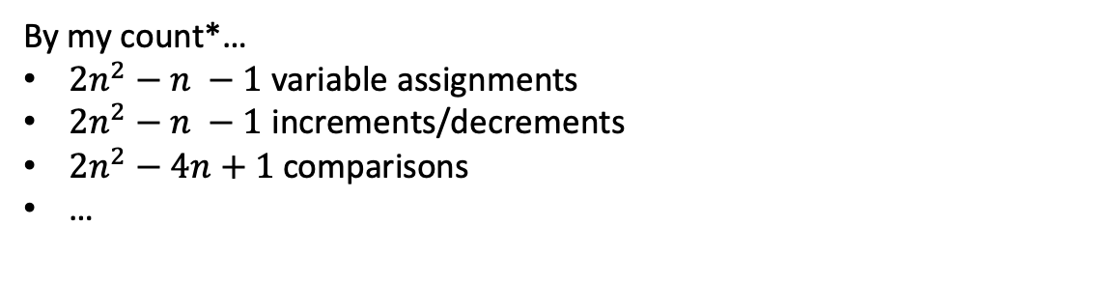
How fast is InsertionSort?
Let’s count the number of operations!
def InsertionSort(A):
for i in range(1,len(A)):
current = A[i]
j = i-1
while j >= 0 and A[j] > current:
A[j+1] = A[j]
j -= 1
A[j+1] = current
By my count*…
$2n^{2}−n −1$ variable assignments
$2n^{2}−n −1$ increments/decrements
$2n^{2}−4n+1$ comparisons
…
*Do not pay attention to these formulas, they do not matter. Also not valid for bug bounty (good citizenship) points.

Slide 33
Issues with this answer?
def InsertionSort(A):
for i in range(1,len(A)):
current = A[i]
j = i-1
while j >= 0 and A[j] > current:
A[j+1] = A[j]
j -= 1
A[j+1] = current
It’s very tedious!
In order to use this to understand running time, I need to know how long each operation takes, plus a whole bunch of other stuff…
Counting individual
operations is a lot of work and doesn’t seem very helpful!
Lucky the lackadaisical lemur

Slide 34
In this class we will use…
Big-Oh notation!
Gives us a meaningful way to talk about the running time of an algorithm, independent of programming language, computing platform, etc., without having to count all the operations.

Slide 35
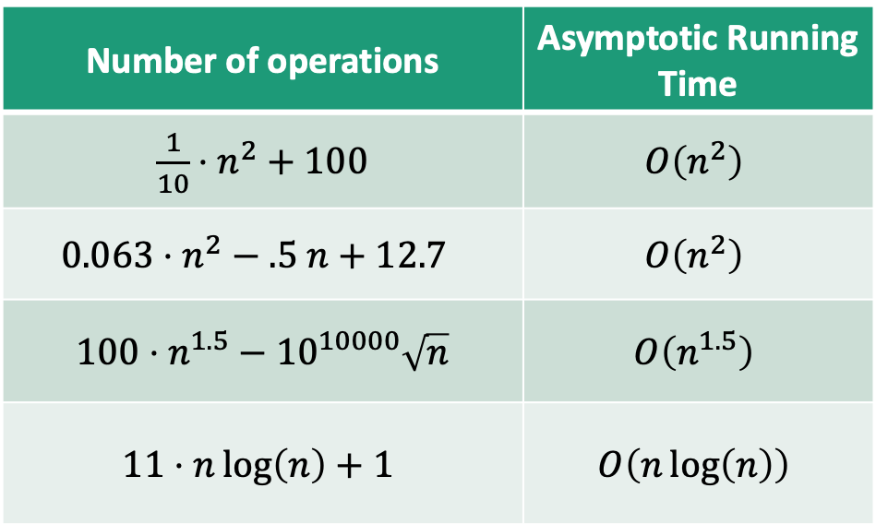
Main idea:
Focus on how the runtime scales with n (the input size).
Some examples…
(Heuristically: only pay attention to the largest function of n that appears.)
Number of operations | Asymptotic Running Time
$\frac{1}{10}⋅n^{2}+100$ | $$O\left(n^{2}\right)$$
$$0.063⋅n^{2}−.5 n+12.7$$ | $$O\left(n^{2}\right)$$
$100⋅n^{1.5}−{10}^{10000}\sqrt{n}$ | $$O\left(n^{1.5}\right)$$
$$11⋅n\log\left(n\right)+1$$ | $$O\left(n\log\left(n\right)\right)$$
We say this algorithm is “asymptotically faster” than the others.

Slide 36

Why is this a good idea?
Suppose the running time of an algorithm is:
$T\left(n\right)=10n^{2}+3n+7$ ms
This constant factor of 10 depends a lot on my computing platform…
These lower-order terms don’t really matter as n gets large.
We’re just left with the n² term! That’s what’s meaningful.

Slide 37
Pros and Cons of Asymptotic Analysis
Pros:
Cons:
Abstracts away from hardware- and language-specific issues.
Makes algorithm analysis much more tractable.
Allows us to meaningfully compare how algorithms will perform on large inputs.
Only makes sense if n is large (compared to the constant factors).
1000000000 n
is “better” than n² ?!?!

Slide 38
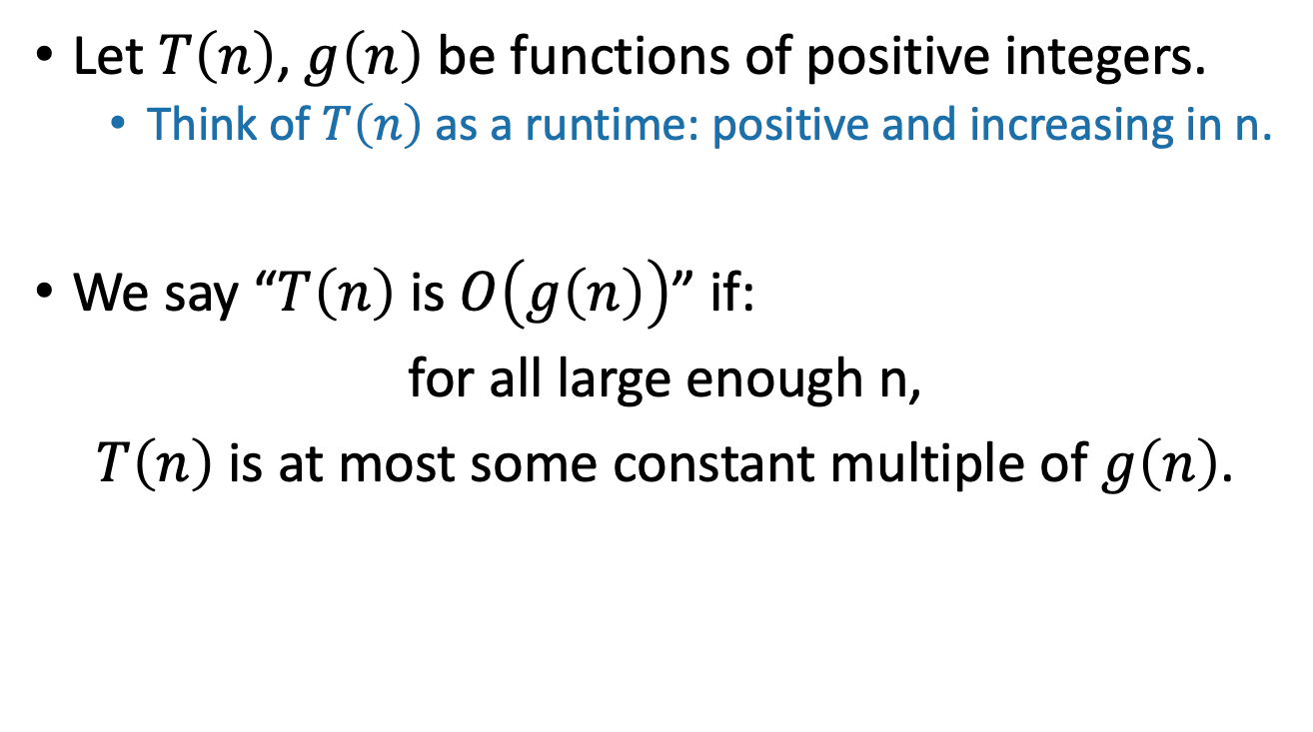
Informal definition for O(…)
pronounced “big-oh of …” or sometimes “oh of …”
Let $T\left(n\right)$, $g\left(n\right)$ be functions of positive integers.
Think of $T\left(n\right)$ as a runtime: positive and increasing in n.
We say “$T\left(n\right)$ is $O\left(g\left(n\right)\right)$” if:
for all large enough n,
$T\left(n\right)$ is at most some constant multiple of $g\left(n\right)$.
Here, “constant” means “some number that doesn’t depend on n.”

Slide 39
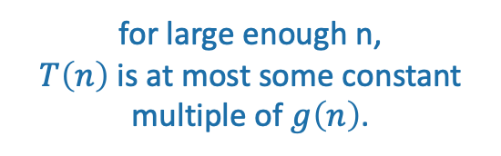
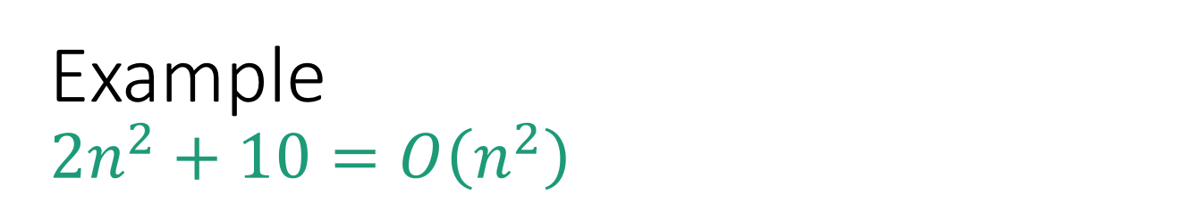
Example $$2n^{2}+10=O\left(n^{2}\right)$$
for large enough n,
$T\left(n\right)$ is at most some constant multiple of $g\left(n\right)$.
T(n) = 2n² + 10
g(n) = n²

Slide 40
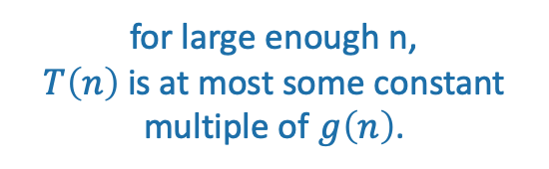
Example $$2n^{2}+10=O\left(n^{2}\right)$$
for large enough n,
$T\left(n\right)$ is at most some constant multiple of $g\left(n\right)$.
3g(n) = 3n²
T(n) = 2n² + 10
g(n) = n²

Slide 41
Example $$2n^{2}+10=O\left(n^{2}\right)$$
for large enough n,
$T\left(n\right)$ is at most some constant multiple of $g\left(n\right)$.
n₀=4
3g(n) = 3n²
T(n) = 2n² + 10
g(n) = n²

Slide 42
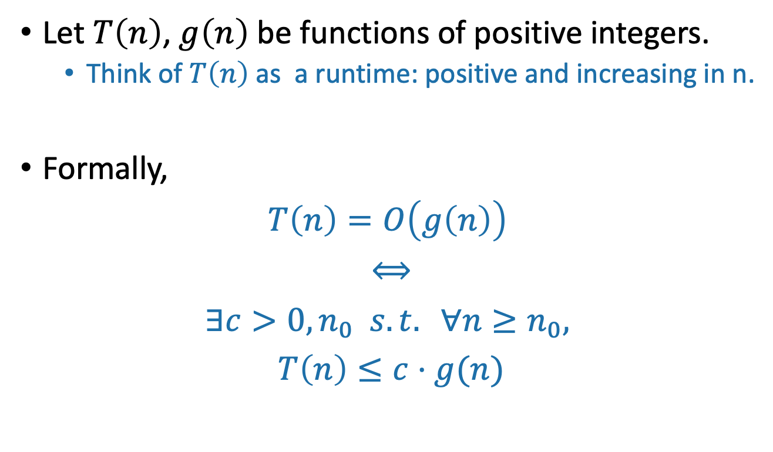
Formal definition of O(…)
Let $T\left(n\right)$, $g\left(n\right)$ be functions of positive integers.
Think of $T\left(n\right)$ as a runtime: positive and increasing in n.
Formally,
$$T\left(n\right)=O\left(g\left(n\right)\right)$$
$$⟺$$
$$∃c>0, n_{0} s.t. ∀n≥n_{0},$$
$$T\left(n\right)≤c⋅g(n)$$
“If and only if”
“For all”
“There exists”
“such that”

Slide 43

Example $$2n^{2}+10=O\left(n^{2}\right)$$
$$T\left(n\right)=O\left(g\left(n\right)\right)$$
$$⟺$$
$$∃c>0, n_{0} s.t. ∀n≥n_{0},$$
$$T\left(n\right)≤c⋅g(n)$$
T(n) = 2n² + 10
g(n) = n²

Slide 44
Example $$2n^{2}+10=O\left(n^{2}\right)$$
$$T\left(n\right)=O\left(g\left(n\right)\right)$$
$$⟺$$
$$∃c>0, n_{0} s.t. ∀n≥n_{0},$$
$$T\left(n\right)≤c⋅g(n)$$
3g(n) = 3n²
(c=3)
T(n) = 2n² + 10
g(n) = n²

Slide 45
Example $$2n^{2}+10=O\left(n^{2}\right)$$
$$T\left(n\right)=O\left(g\left(n\right)\right)$$
$$⟺$$
$$∃c>0, n_{0} s.t. ∀n≥n_{0},$$
$$T\left(n\right)≤c⋅g(n)$$
n₀=4
3g(n) = 3n²
(c=3)
T(n) = 2n² + 10
g(n) = n²

Slide 46

Example $$2n^{2}+10=O\left(n^{2}\right)$$
$$T\left(n\right)=O\left(g\left(n\right)\right)$$
$$⟺$$
$$∃c>0, n_{0} s.t. ∀n≥n_{0},$$
$$T\left(n\right)≤c⋅g(n)$$
n₀=4
Formally:
Choose c = 3
Choose n₀ = 4
Then:
3g(n) = 3n²
T(n) = 2n² + 10
$$∀n≥4,$$
$$2n^{2}+10≤3⋅n^{2}$$
g(n) = n²

Slide 47

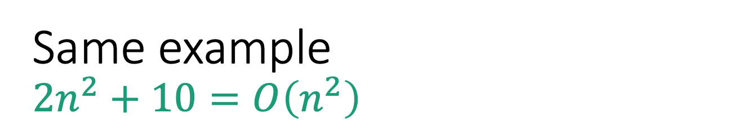
Same example $$2n^{2}+10=O\left(n^{2}\right)$$
$$T\left(n\right)=O\left(g\left(n\right)\right)$$
$$⟺$$
$$∃c>0, n_{0} s.t. ∀n≥n_{0},$$
$$T\left(n\right)≤c⋅g(n)$$
Formally:
Choose c = 7
Choose n₀ = 2
Then:
7g(n) = 7n²
T(n) = 2n² + 10
$$∀n≥2,$$
$$2n^{2}+10≤7⋅n^{2}$$
g(n) = n²
There is not a “correct” choice of c and n₀
n₀=2

Slide 48
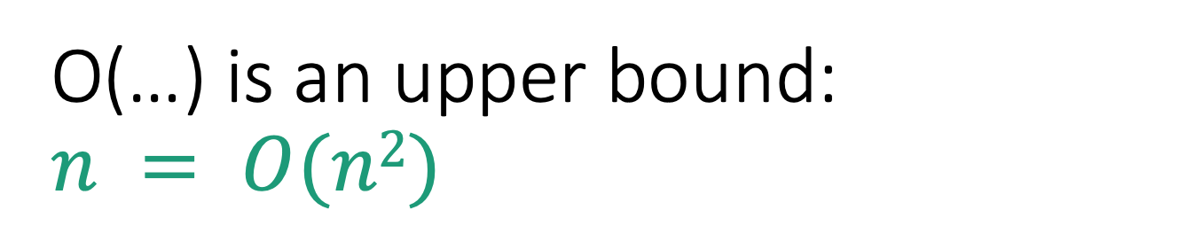

O(…) is an upper bound: $$n = O(n2)$$
$$T\left(n\right)=O\left(g\left(n\right)\right)$$
$$⟺$$
$$∃c>0, n_{0} s.t. ∀n≥n_{0},$$
$$T\left(n\right)≤c⋅g(n)$$
g(n) = n²
Choose c = 1
Choose n₀ = 1
Then
$$∀n≥1,$$
$$n≤n^{2}$$
T(n) = n

Slide 49
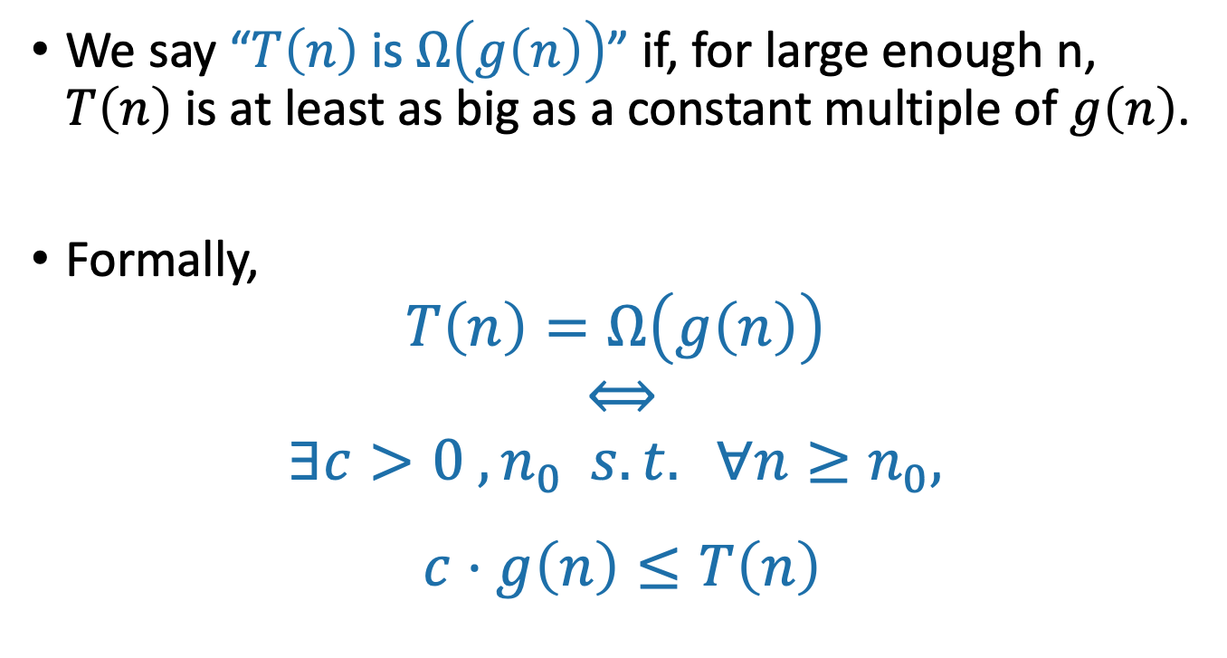
Ω(…) means a lower bound
We say “$T\left(n\right)$ is $Ω\left(g\left(n\right)\right)$” if, for large enough n, $T\left(n\right)$ is at least as big as a constant multiple of $g\left(n\right)$.
Formally,
$$T\left(n\right)=Ω\left(g\left(n\right)\right)$$
$$⟺$$
$$∃c>0 ,n_{0} s.t. ∀n≥n_{0},$$
$$c⋅g\left(n\right)≤T\left(n\right)$$
Switched these!!

Slide 50
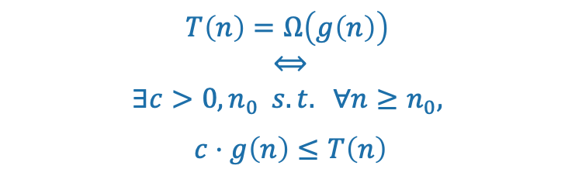
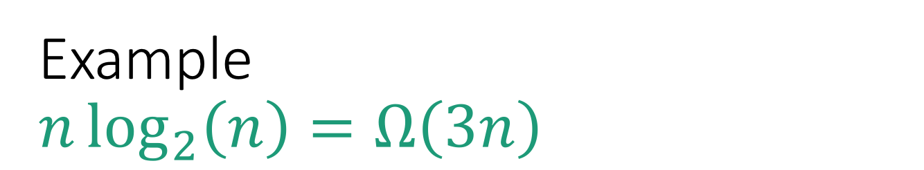
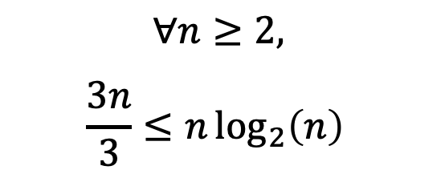
Example $$n\log_{2}\left(n\right)=Ω\left(3n\right)$$
$$T\left(n\right)=Ω\left(g\left(n\right)\right)$$
$$⟺$$
$$∃c>0, n_{0} s.t. ∀n≥n_{0},$$
$$c⋅g\left(n\right)≤T\left(n\right)$$
g(n) = 3n
Choose c = 1/3
Choose n₀ = 2
Then
T(n) = nlog(n)
$$∀n≥2,$$
$$\frac{3n}{3}≤n\log_{2}\left(n\right)⁡$$
g(n)/3 = n

Slide 51
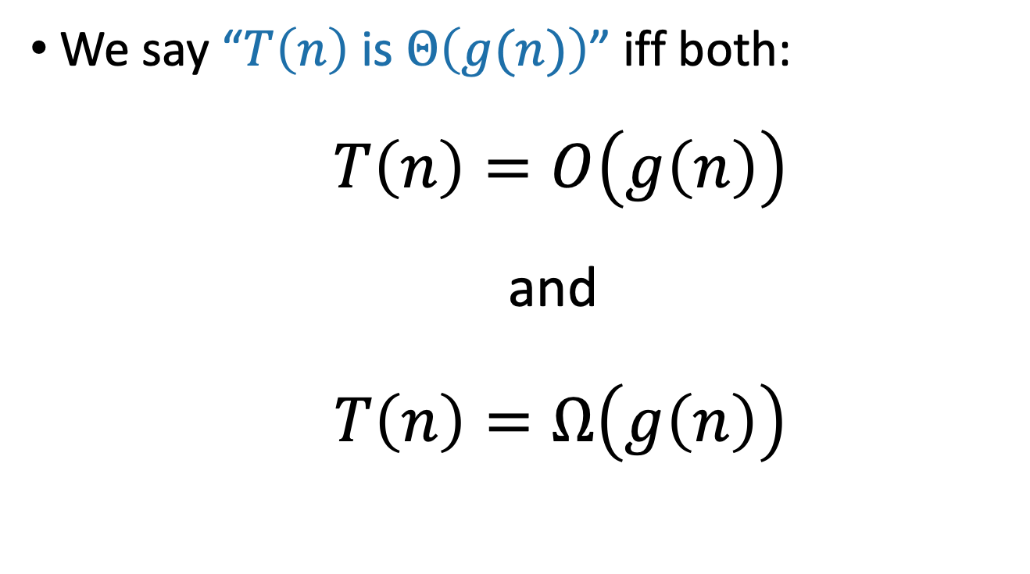
Θ(…) means both!
We say “$T\left(n\right)$ is $Θ\left(g(n)\right)$” iff both:
$T\left(n\right)=O\left(g\left(n\right)\right)$
and
$T\left(n\right)=Ω\left(g\left(n\right)\right)$

Slide 52
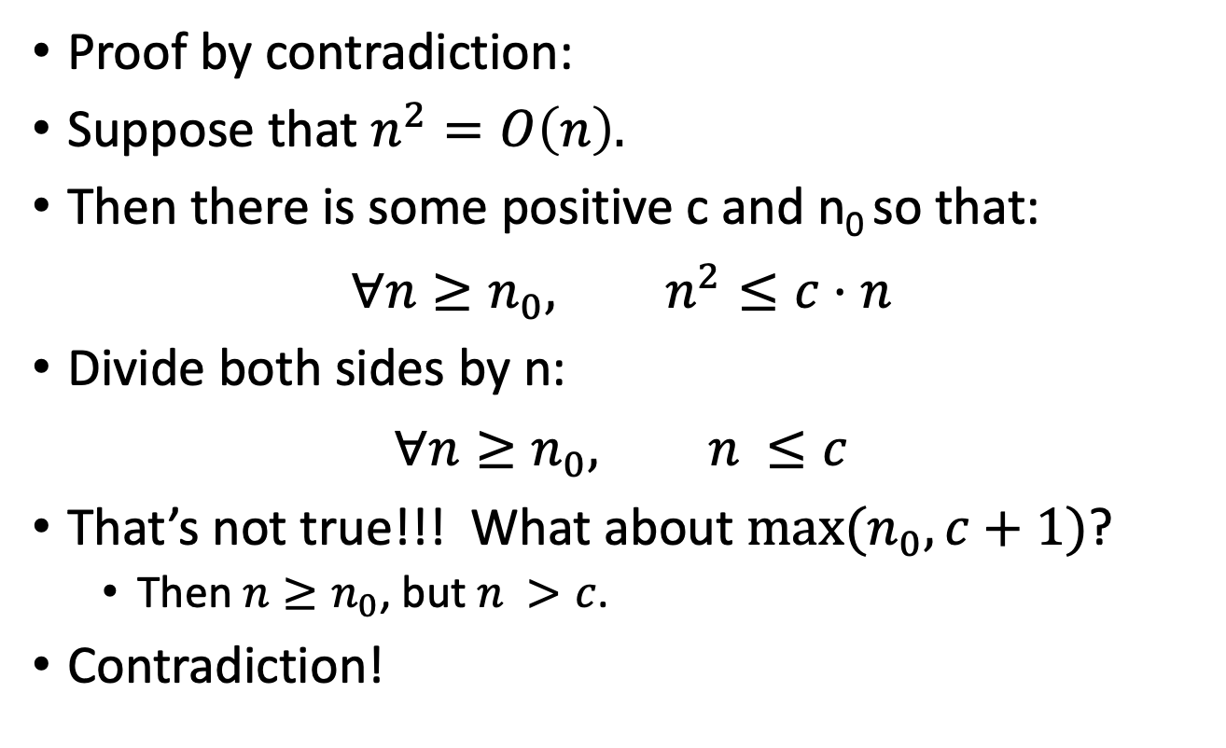
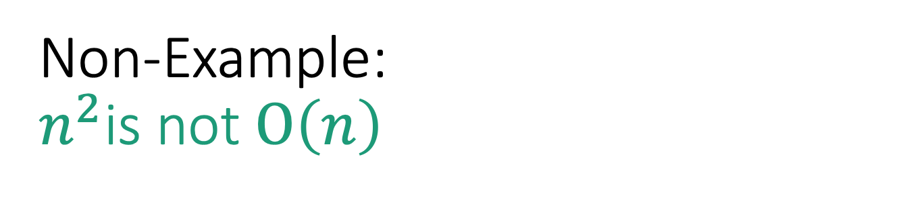
Non-Example: $n^{2}$is not $O\left(n\right)$
$$T\left(n\right)=O\left(g\left(n\right)\right)$$
$$⟺$$
$$∃c>0, n_{0} s.t. ∀n≥n_{0},$$
$$T\left(n\right)≤c⋅g(n)$$
Proof by contradiction:
Suppose that $n^{2}=O\left(n\right).$
Then there is some positive c and n₀ so that:
$$∀n≥n_{0}, n^{2}≤c⋅n$$
Divide both sides by n:
$$∀n≥n_{0}, n^{ }≤c$$
That’s not true!!! What about $\max{(n_{0},c+1)}$?
Then $n≥n_{0}$, but $n^{ }>c$.
Contradiction!

Slide 53
Take-away from examples
To prove T(n) = O(g(n)), you have to come up with c and n₀ so that the definition is satisfied.
To prove T(n) is NOT O(g(n)), one way is proof by contradiction:
Suppose (to get a contradiction) that someone gives you a c and an n₀ so that the definition is satisfied.
Show that this someone must be lying to you by deriving a contradiction.

Slide 54

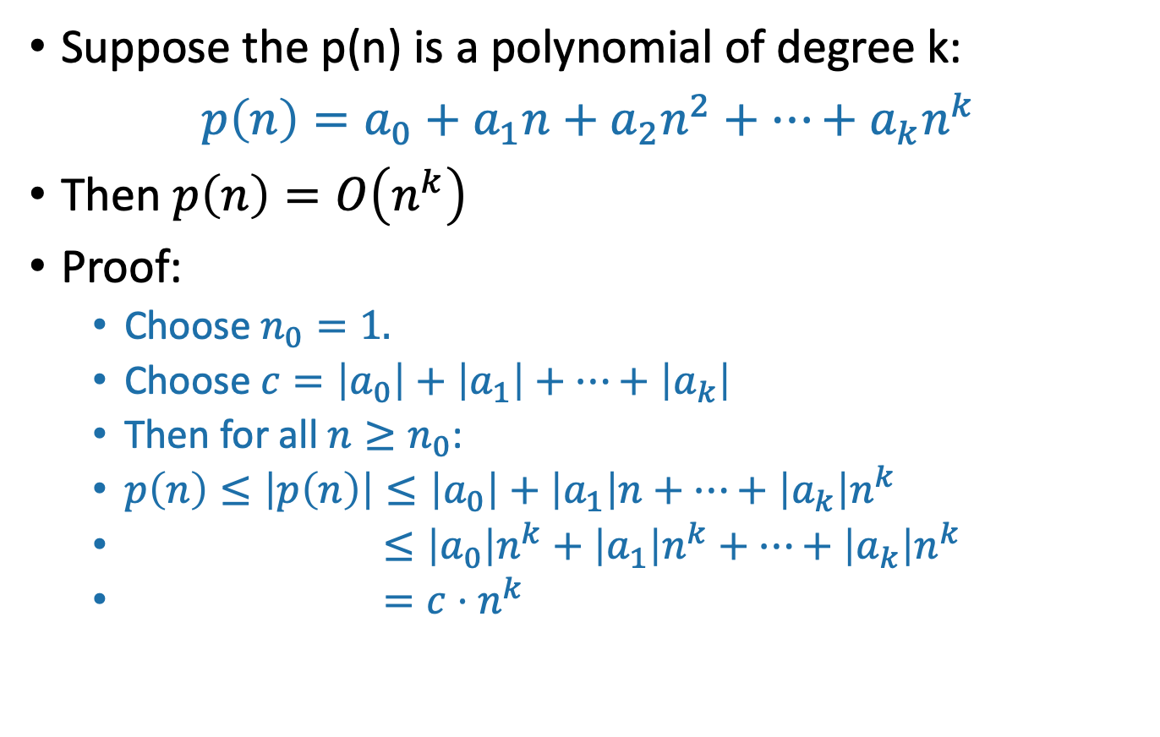
Another example: polynomials
SLIDE SKIPPED IN CLASS! (Note this is also in the reading).
Suppose the p(n) is a polynomial of degree k:
$p\left(n\right)=a_{0}+a_{1}n+a_{2}n^{2}+⋯+a_{k}n^{k}$
Then $p\left(n\right)=O\left(n^{k}\right)$
Proof:
Choose $n_{0}=1.$
Choose $c=\left|a_{0}\right|+\left|a_{1}\right|+⋯+\left|a_{k}\right|$
Then for all $n≥n_{0}$:
$p\left(n\right)≤\left|p\left(n\right)\right|≤\left|a_{0}\right|+\left|a_{1}\right|n+⋯+\left|a_{k}\right|n^{k}$
$≤\left|a_{0}\right|n^{k}+\left|a_{1}\right|n^{k}+⋯+\left|a_{k}\right|n^{k}$
$=c⋅n^{k}$
Triangle inequality!
Because $n≤n^{k}$ for $n≥n_{0}≥1.$
Definition of c

Slide 55
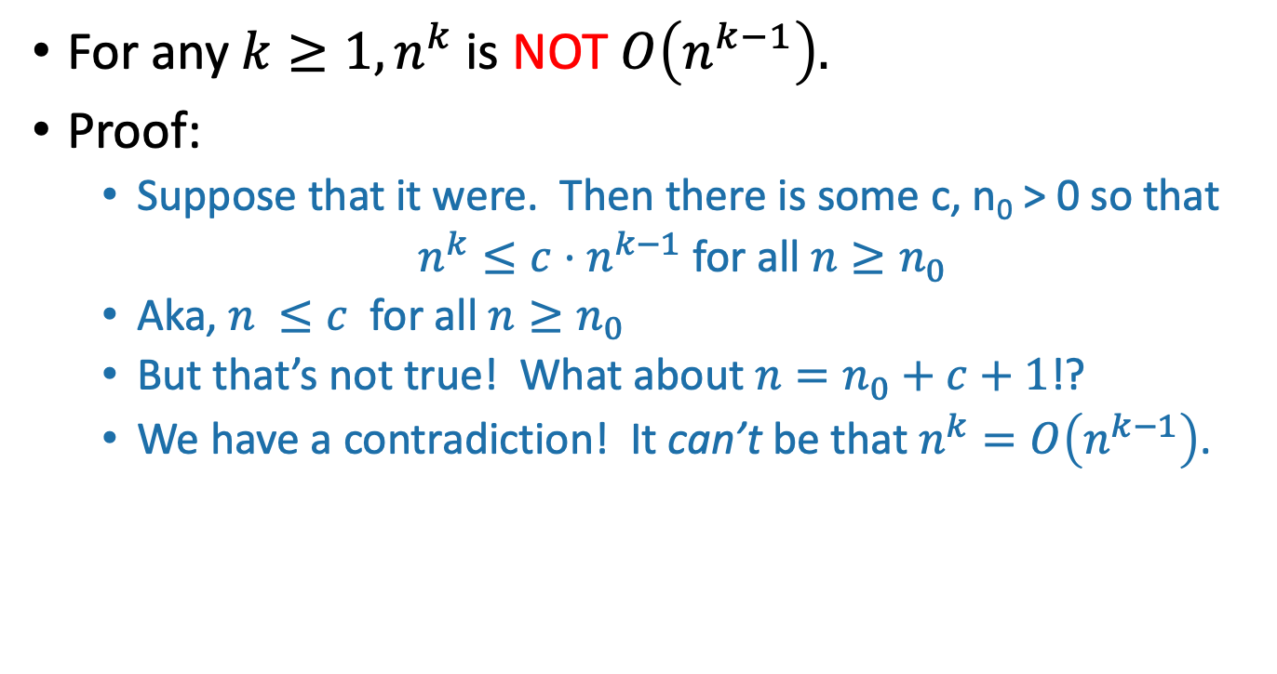
Example: more polynomials
SLIDE SKIPPED IN CLASS! (Note this is also in the reading).
For any $k≥1, n^{k}$ is NOT $O\left(n^{k−1}\right).$
Proof:
Suppose that it were. Then there is some c, n₀ > 0 so that
$n^{k}≤c⋅n^{k−1}$ for all $n≥n_{0}$
Aka, $n^{ }≤c$ for all $n≥n_{0}$
But that’s not true! What about $n=n_{0}+c+1$!?
We have a contradiction! It can’t be that $n^{k}=O\left(n^{k−1}\right)$.

Slide 56
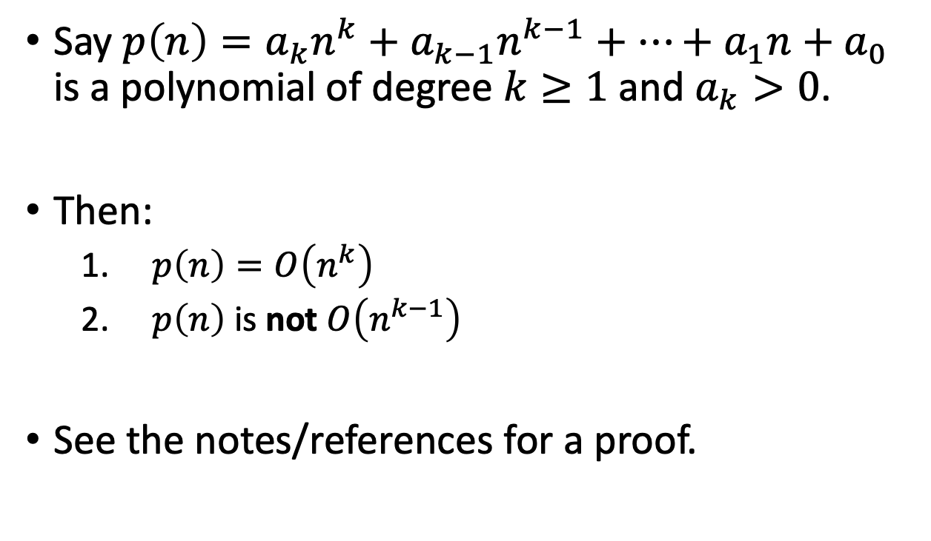
Another example: polynomials
Say $p\left(n\right)=a_{k}n^{k}+a_{k−1}n^{k−1}+…+a_{1}n+a_{0}$ is a polynomial of degree $k≥1$ and $a_{k}>0$.
Then:
$p\left(n\right)=O\left(n^{k}\right)$
$p\left(n\right)$ is not $O\left(n^{k−1}\right)$
See the notes/references for a proof.
Try to prove it yourself first!
Siggi the Studious Stork

Slide 57
More examples
n³ + 3n = O(n³ – n²)
n³ + 3n = Ω(n³ – n²)
n³ + 3n = Θ(n³ – n²)
3^{n} is NOT O(2^{n})
log₂(n) = Ω(ln(n))
log₂(n) = Θ( 2^{loglog(n)} )
Work through these on your own! Also look at the examples in the reading!
Siggi the Studious Stork

Slide 58
Brainteaser
Are there functions f, g so that NEITHER f = O(g) nor f = Ω(g)?
Ollie the Over-achieving Ostrich

Slide 59
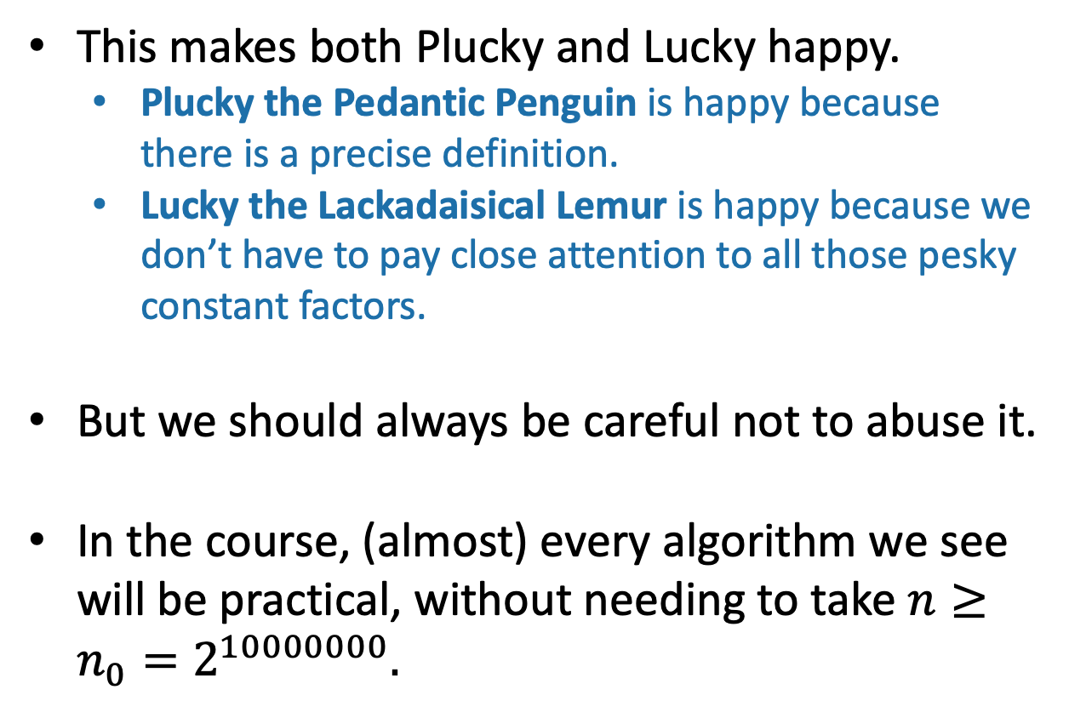
Recap: Asymptotic Notation
This is my happy face!
This makes both Plucky and Lucky happy.
Plucky the Pedantic Penguin is happy because there is a precise definition.
Lucky the Lackadaisical Lemur is happy because we don’t have to pay close attention to all those pesky constant factors.
But we should always be careful not to abuse it.
In the course, (almost) every algorithm we see will be practical, without needing to take $n≥n_{0}=2^{10000000}.$

Slide 60
Back to Insertion Sort
Does it work?
Is it fast?

Slide 61

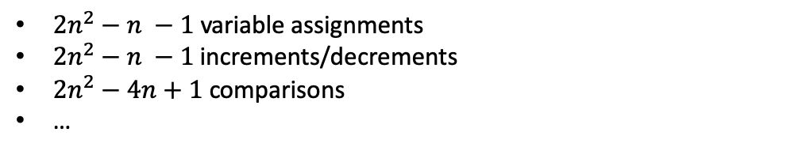
Insertion Sort: running time
Operation count was:
The running time is $O\left(n^{2}\right)$
$2n^{2}−n −1$ variable assignments
$2n^{2}−n −1$ increments/decrements
$2n^{2}−4n+1$ comparisons
…
Go back to the pseudocode and convince yourself of this!
Seems plausible

Slide 62
Insertion Sort: running time
SLIDE SKIPPED IN CLASS
As you get more used to this, you won’t have to count up operations anymore. For example, just looking at the pseudocode below, you might think…
def InsertionSort(A):
for i in range(1,len(A)):
current = A[i]
j = i-1
while j >= 0 and A[j] > current:
A[j+1] = A[j]
j -= 1
A[j+1] = current
n-1 iterations of the outer loop
In the worst case, about n iterations of this inner loop
“There’s O(1) stuff going on inside the inner loop, so each time the inner loop runs, that’s O(n) work. Then the inner loop is executed O(n) times by the outer loop, so that’s O(n²).”

Slide 63
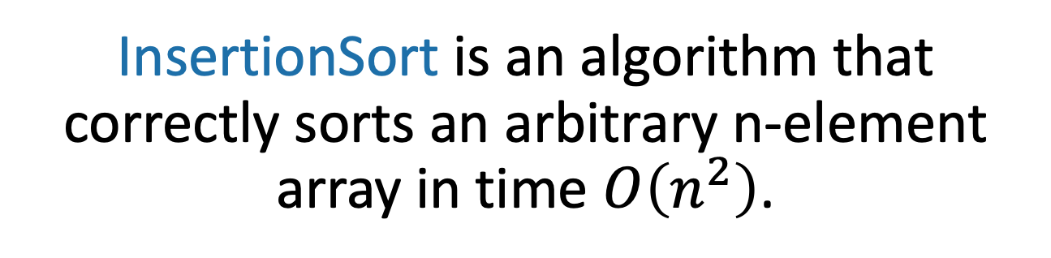
What have we learned?
InsertionSort is an algorithm that correctly sorts an arbitrary n-element array in time $O\left(n^{2}\right)$.
Can we do better?

Slide 64
The Plan
InsertionSort recap
Worst-case analyisis
Back to InsertionSort: Does it work?
Asymptotic Analysis
Back to InsertionSort: Is it fast?
MergeSort
Does it work?
Is it fast?

Slide 65
Can we do better?
MergeSort: a divide-and-conquer approach
Recall:
Divide and Conquer:
Big problem
Smaller problem
Smaller problem
Recurse!
Recurse!
Yet smaller problem
Yet smaller problem
Yet smaller problem
Yet smaller problem

Slide 66
MergeSort
6
4
3
8
1
5
2
7
6
4
3
8
1
5
2
7
Recursive magic!
Recursive magic!
3
4
6
8
1
2
5
7
How would you do this in-place?
MERGE!
1
2
3
4
5
6
7
8
Code for the MERGE step is given in the Lecture2 IPython notebook, or the notes
Ollie the over-achieving Ostrich

Slide 67
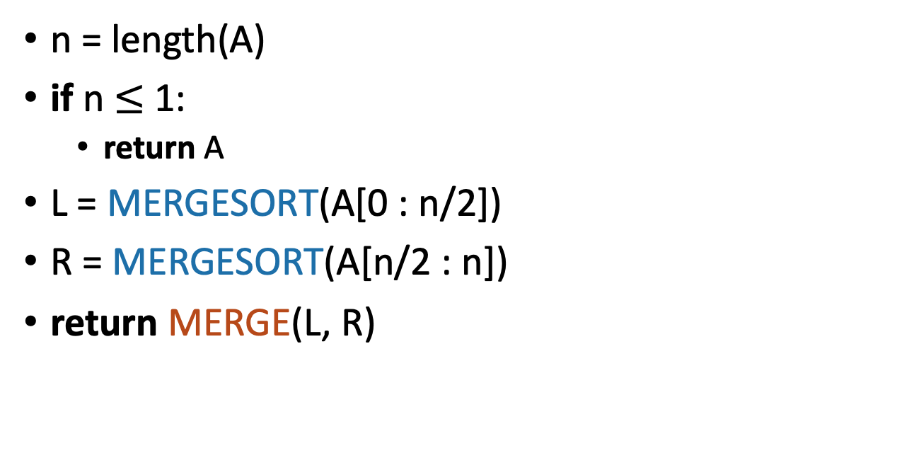
MergeSort Pseudocode
See Lecture 2 IPython notebook for MergeSort Python Code.
MERGESORT(A):
n = length(A)
if n $≤$ 1:
return A
L = MERGESORT(A[0 : n/2])
R = MERGESORT(A[n/2 : n])
return MERGE(L, R)
If A has length 1,
It is already sorted!
Sort the left half
Sort the right half
Merge the two halves
Notes:
Okay, this pseudo-code is actually pretty intuitive, it's follows our english description.
(Question to ponder: what if we wanted to do this in-place?)

Slide 68
What actually happens? First, recursively break up the array all the way down to the base cases
6
4
3
8
1
5
2
7
6
4
3
8
1
5
2
7
6
4
3
8
1
5
2
7
6
4
3
8
1
5
2
7
This array of length 1 is sorted!

Slide 69
Then, merge them all back up!
Sorted sequence!
1
2
3
4
5
6
7
8
Merge!
3
4
6
8
1
2
5
7
Merge!
Merge!
4
6
3
8
1
5
2
7
Merge!
Merge!
Merge!
Merge!
6
4
3
8
1
5
2
7
A bunch of sorted lists of length 1 (in the order of the original sequence).
Notes:
Here's a different way of looking at merge sort. Let's take the same example, and think about it in terms of what order the MERGE calls happen in (instead of what order the recursive calls happen in)

Slide 70
Two questions
Does this work?
Is it fast?
IPython notebook says…
Empirically:
Seems to work.
Seems fast.

Slide 71
It works
Yet another job for…
Proof By Induction!
Work this out! There’s a skipped slide with an outline to help you get started.

Slide 72
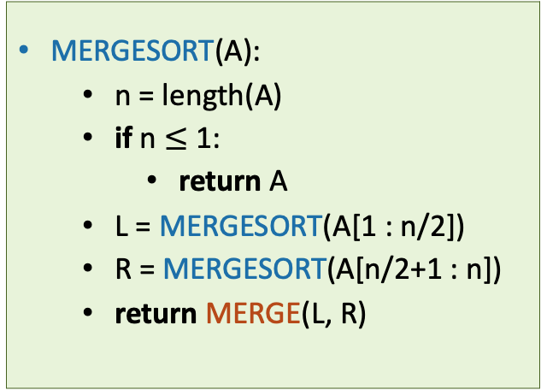
It works
THIS SLIDE SKIPPED IN CLASS
Assume that n is a power of 2 for convenience.
Inductive hypothesis:
“In every recursive call on an array of length at most i, MERGESORT returns a sorted array.”
Base case (i=1): a 1-element array is always sorted.
Inductive step: Need to show: if the inductive hypothesis holds for k<i, then it holds for k=i.
Aka, need to show that if L and R are sorted, then MERGE(L,R) is sorted.
Conclusion: In the top recursive call, MERGESORT returns a sorted array.
MERGESORT(A):
n = length(A)
if n $≤$ 1:
return A
L = MERGESORT(A[1 : n/2])
R = MERGESORT(A[n/2+1 : n])
return MERGE(L, R)
Fill in the inductive step!
HINT: You will need to prove that the MERGE algorithm is correct, for which you may need…another proof by induction!

Slide 73
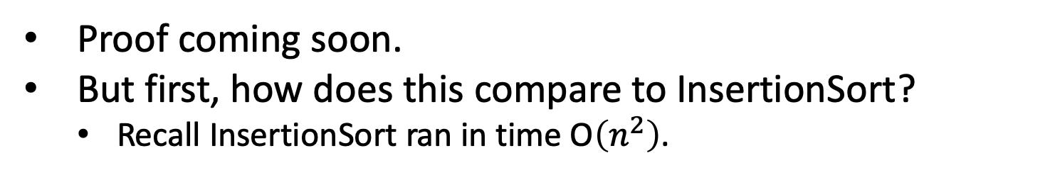
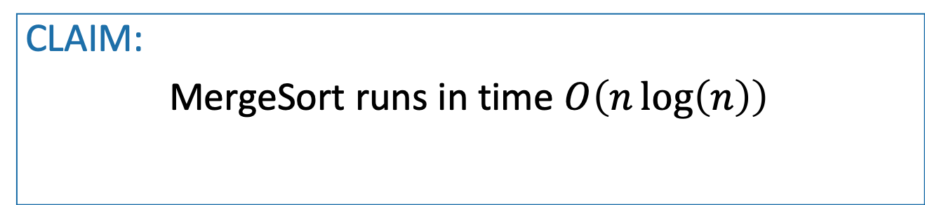
It’s fast
Assume that n is a power of 2 for convenience.
CLAIM:
MergeSort runs in time $O\left(n\log\left(n\right)\right)$
Proof coming soon.
But first, how does this compare to InsertionSort?
Recall InsertionSort ran in time O$\left(n^{2}\right)$.

Slide 74
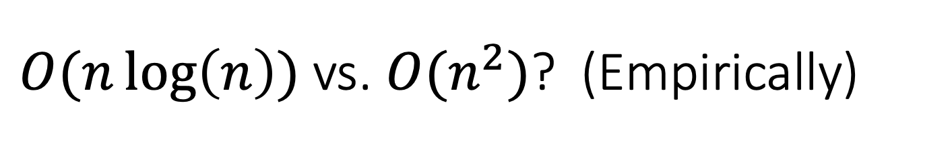
$O(n\log\left(n\right))$ vs. ${O(n}^{2})$? (Empirically)
[See Lecture 2 IPython Notebook for code]
O(n²)
Supposedly O(n logn)

Slide 75
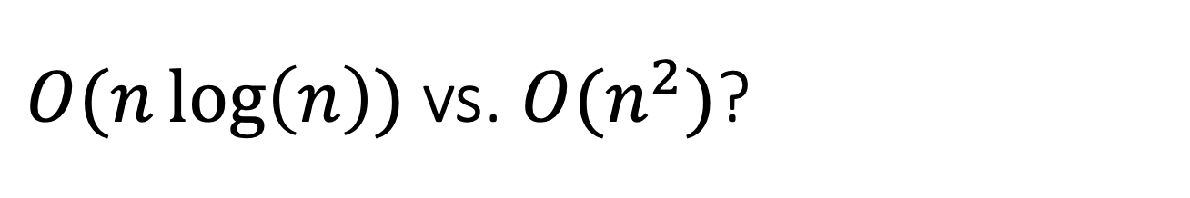
$O(n\log\left(n\right))$ vs. ${O(n}^{2})$?

Slide 76

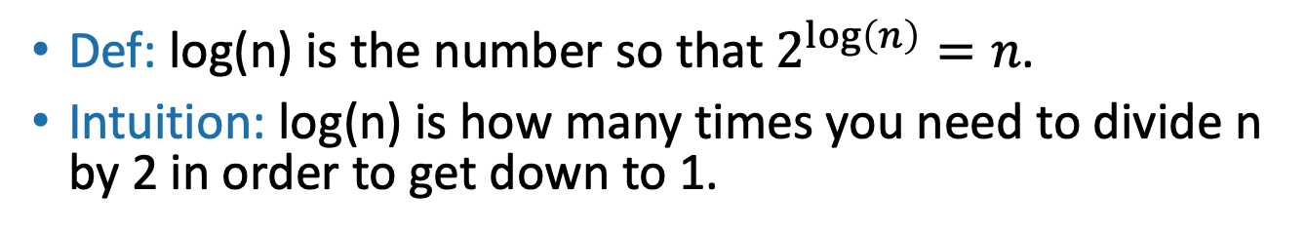

Quick log refresher
All logarithms in this course are base 2
Aside:
Def: log(n) is the number so that $2^{\log\left(n\right)}=n$.
Intuition: log(n) is how many times you need to divide n by 2 in order to get down to 1.
32, 16, 8, 4, 2, 1
log(32) = 5
$$⇒$$
Halve 5 times
$$⇒$$
log(64) = 6
64, 32, 16, 8, 4, 2, 1
log(128) = 7
log(256) = 8
log(512) = 9
….
log(# particles in the universe) < 280
Halve 6 times
log(n) grows very slowly!

Slide 77
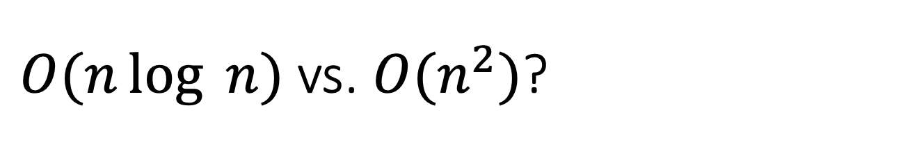

$O(n\log{ n)}$ vs. ${O(n}^{2})$?
$\log\left(n\right)$ grows much more slowly than $n$
$n\log\left(n\right)$ grows much more slowly than $n^{2}$
Punchline: A running time of O(n log n) is a lot better than O(n²)!

Slide 78

Now let’s prove the claim
Assume that n is a power of 2 for convenience.
CLAIM:
MergeSort runs in time $O\left(n\log\left(n\right)\right)$

Slide 79
Let’s prove the claim
Size n
Level 0
n/2
n/2
Level 1
n/4
n/4
n/4
n/4
Focus on just one of these sub-problems
…
Level t
2^{t} subproblems at level t.
n/2^{t}
n/2^{t}
n/2^{t}
n/2^{t}
n/2^{t}
n/2^{t}
…
(Size 1)
Level log(n)

Slide 80
How much work in this sub-problem?
n/2^{t}
Time spent MERGE-ing the two subproblems
+
n/2^{t+1}
n/2^{t+1}
Time spent within the two sub-problems

Slide 81
How much work in this sub-problem?
Let k=n/2^{t}…
k
Time spent MERGE-ing the two subproblems
+
k/2
k/2
Time spent within the two sub-problems

Slide 82
How long does it take to MERGE?
k
Code for the MERGE step is given in the Lecture2 notebook.
k/2
k/2
k/2
k/2
3
4
6
8
1
2
5
7
MERGE!
1
2
3
4
5
6
7
8
k

Slide 83
How long does it take to MERGE?
k
Code for the MERGE step is given in the Lecture2 notebook.
k/2
k/2
How long does it take to run MERGE on two lists of size k/2?
Think-Pair-Share Terrapins (if time)
Answer: It takes time O(k), since we just walk across the list once.

Slide 84
Recursion tree
Size n
n/2
n/2
n/4
n/4
n/4
n/4
…
n/2^{t}
n/2^{t}
n/2^{t}
n/2^{t}
n/2^{t}
n/2^{t}
There are O(k) operations done at this node.
…
k
(Size 1)
k/2
k/2

Slide 85
Recursion tree
Size n
How many operations are done at this level of the tree? (Just MERGE-ing subproblems).
n/2
n/2
How about at this level of the tree?
(between both n/2-sized problems)
n/4
n/4
n/4
n/4
This level?
…
This level?
n/2^{t}
n/2^{t}
n/2^{t}
n/2^{t}
n/2^{t}
n/2^{t}
There are O(k) operations done at this node.
…
k
(Size 1)
k/2
k/2

Slide 86
Recursion tree
Work this out yourself!
Size of each
problem
#
problems
Amount of work at this level
Level
Size n
0
1
2
4
2^{t}
n
n
n/2
n/4
n/2^{t}
1
O(n)
O(n)
O(n)
O(n)
O(n)
n/2
n/2
1
n/4
n/4
n/4
n/4
2
…
…
n/2^{t}
n/2^{t}
n/2^{t}
n/2^{t}
n/2^{t}
n/2^{t}
t
…
…
log(n)
(Size 1)

Slide 87
Total runtime…
O(n) steps per level, at every level
log(n) + 1 levels
O( n log(n) ) total!
That was the claim!

Slide 88
What have we learned?
MergeSort correctly sorts a list of n integers in time O(n log(n) ).
That’s (asymptotically) better than InsertionSort!

Slide 89
The Plan
InsertionSort recap
Worst-case analyisis
Back to InsertionSort: Does it work?
Asymptotic Analysis
Back to InsertionSort: Is it fast?
MergeSort
Does it work?
Is it fast?
Wrap-Up

Slide 90
Recap
InsertionSort runs in time O(n²)
MergeSort is a divide-and-conquer algorithm that runs in time O(n log(n))
How do we show an algorithm is correct?
Today, we did it by induction
How do we measure the runtime of an algorithm?
Worst-case analysis
Asymptotic analysis
How do we analyze the running time of a recursive algorithm?
One way is to draw a recursion tree.

Slide 91
Next time
A more systematic approach to analyzing the runtime of recursive algorithms.
Before next time
Pre-lecture Exercise:
A few recurrence relations (see website)

