Slide 1
Lecture 8
Hashing

Slide 2
Announcements
Midterm approaching: Wed, Feb 12 (6pm – 9pm)
Midterm covers up to (and including) lecture 7. This week’s lectures are not included.

Slide 3
Today: hashing
#
0
NIL
1
NIL
2
22
NIL
3
13
43
NIL
…
9
9
NIL
n=10 buckets

Slide 4
Outline
Hash tables are another sort of data structure that allows fast INSERT/DELETE/SEARCH.
like self-balancing binary trees
The difference is we can get better performance in expectation by using randomness.
Hash families are the magic behind hash tables.
Universal hash families are even more magical.

Slide 5
Goal
We want to store nodes with keys in a data structure that supports fast INSERT/DELETE/SEARCH.
INSERT
DELETE
SEARCH
node with key “2”
5
2
5
4
4
52
52
data structure
HERE IT IS

Slide 6
Today:
Last time
Self balancing trees:
O(log(n)) deterministic INSERT/DELETE/SEARCH
#prettysweet
Hash tables:
O(1) expected time INSERT/DELETE/SEARCH
Worse worst-case performance, but often great in practice.
#evensweeterinpractice
eg, Python’s dict, Java’s HashSet/HashMap, C++’s unordered_map
Hash tables are used for databases, caching, object representation, …

Slide 7
One way to get O(1) time
This is called “direct addressing”
Say all keys are in the set {1,2,3,4,5,6,7,8,9}.
INSERT:
DELETE:
SEARCH:
9
6
3
5
6
Are we delegating to hardware/memory? What are the assumptions behind our model of computation?
3
2
2 isn’t in the data structure.
3 is here.
3
5
6
9
1
2
3
4
5
6
7
8
9

Slide 8
That should look familiar
Kind of like CountingSort from Lecture 6.
Same problem: if the keys may come from a “universe” U = {1,2, …., 10000000000}, it takes a lot of space.
The universe is really big!

Slide 9
Solution?
Put things in buckets based on one digit
INSERT:
21
345
13
101
50
234
1
1
101
234
345
50
13
21
0
1
2
3
4
5
6
7
8
9
It’s in this bucket somewhere…
go through until we find it.
21
Now SEARCH

Slide 10
Problem…
2
232
INSERT:
52
22
342
12
102
52
232
2
102
12
342
22
0
1
2
3
4
5
6
7
8
9
22
….this hasn’t made our lives easier…
Now SEARCH

Slide 11
Hash tables
That was an example of a hash table.
not a very good one, though.
We will be more clever (and less deterministic) about our bucketing.
This will result in fast (expected time) INSERT/DELETE/SEARCH.

Slide 12
But first! Terminology.
U is a universe of size M.
M is really big.
But only a few (at most n) elements of U are ever going to show up.
M is waaaayyyyyyy bigger than n.
But we don’t know which ones will show up in advance.
All of the keys in the universe live in this blob.
Only n keys will ever show up.
22
Example: U is the set of all strings of at most 280 ascii characters. (128²⁸⁰ of them).
The only ones which I care about are those which appear as trending hashtags on the former twitter. #hashinghashtags
There are way fewer than 128²⁸⁰ of these.
13
Universe U

Slide 13
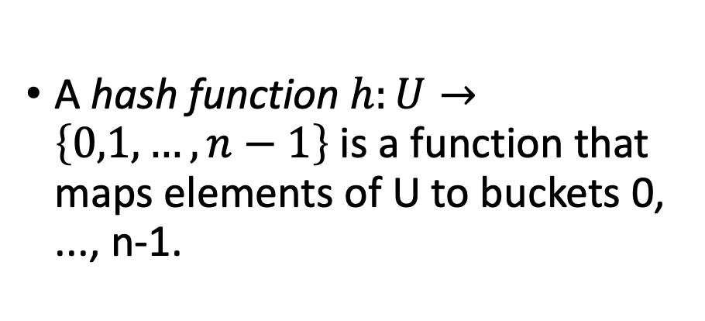
Hash Functions
For this lecture, we are assuming that the number of things that show up is the same as the number of buckets, both are n.
This doesn’t have to be the case, although we do want:
#buckets = O( #things which show up )
A hash function $h:U→\left\{0,1, …, n−1\right\}$ is a function that maps elements of U to buckets 0, ..., n-1.
All of the keys in the universe live in this blob.
Example:
h(x) = least significant digit of x.
22
0
n buckets
13
1
h(22) = 2
2
h(13) = 3
3
Universe U

Slide 14
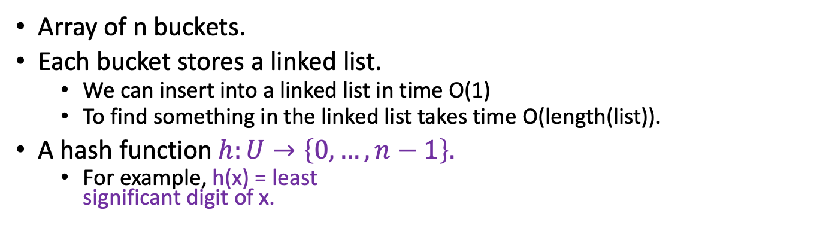
Hash Tables (with chaining)
For demonstration purposes only!
This is a terrible hash function! Don’t use this!
Array of n buckets.
Each bucket stores a linked list.
We can insert into a linked list in time O(1)
To find something in the linked list takes time O(length(list)).
A hash function $h:U→\left\{0, …, n−1\right\}.$
For example, h(x) = least significant digit of x.
0
INSERT:
1
2
22
13
22
43
9
3
13
43
SEARCH 43:
Scan through all the elements in bucket h(43) = 3.
…
9
9
DELETE 43:
n buckets (say n=10)
Search for 43 and remove it.

Slide 15
Aside: Hash tables with open addressing
The previous slide is about hash tables with chaining.
There’s also something called “open addressing”
You don’t need to know about it for this class.
0
0
1
1
2
2
13
43
13
3
3
bounce!
43
…
…
This is a “chain”
9
9
n=10 buckets
n=10 buckets
\end{Aside}

Slide 16
Hash Tables (with chaining)
For demonstration purposes only!
This is a terrible hash function! Don’t use this!
Array of n buckets.
Each bucket stores a linked list.
We can insert into a linked list in time O(1)
To find something in the linked list takes time O(length(list)).
A hash function $h:U→\left\{0, …, n−1\right\}.$
For example, h(x) = least significant digit of x.
0
INSERT:
1
2
22
13
22
43
9
3
13
43
SEARCH 43:
Scan through all the elements in bucket h(43) = 3.
…
9
9
DELETE 43:
n buckets (say n=10)
Search for 43 and remove it.

Slide 17
What we want from a hash table
We want there to be not many buckets (say, n).
This means we don’t use too much space
We want the items to be pretty spread-out in the buckets.
This means it will be fast to SEARCH/INSERT/DELETE
93
0
0
1
21
vs.
1
3
2
22
2
23
3
13
43
3
13
43
…
…
9
9
9
n=10 buckets
n=10 buckets

Slide 18
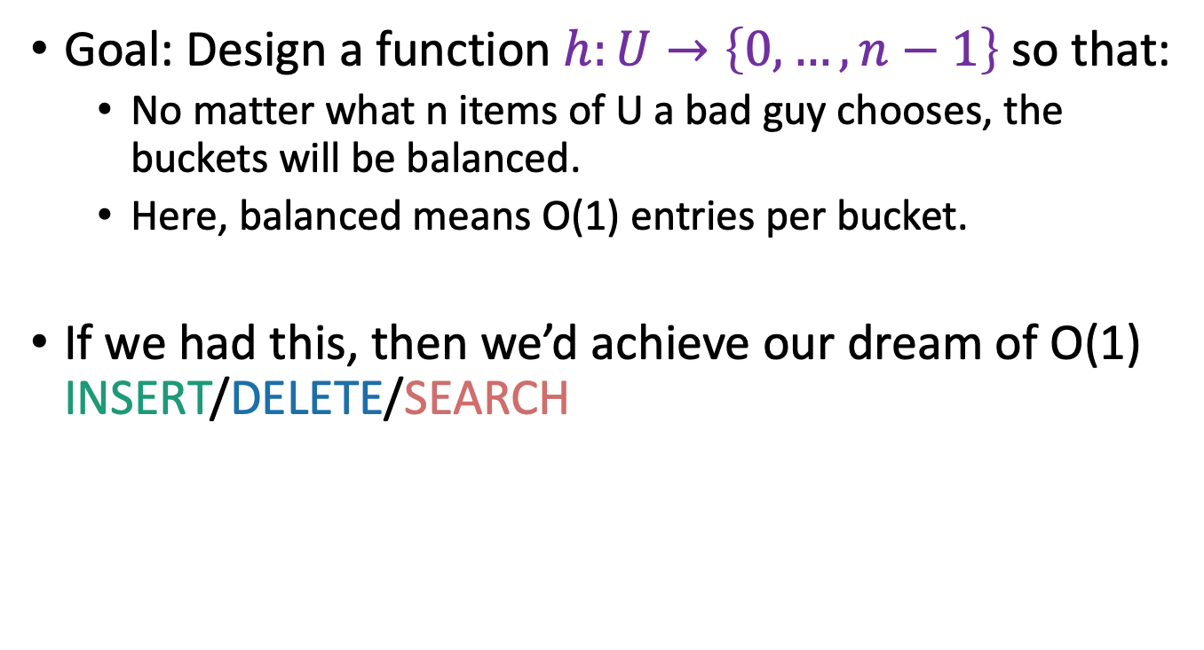
Worst-case analysis
Goal: Design a function $h:U→\left\{0, …, n−1\right\}$ so that:
No matter what n items of U a bad guy chooses, the buckets will be balanced.
Here, balanced means O(1) entries per bucket.
If we had this, then we’d achieve our dream of O(1) INSERT/DELETE/SEARCH
Can you come up with such a function?
Think-Share Terrapins

Slide 19
This is impossible!
93
3
23
13
43
No deterministic hash function can defeat worst-case input!

Slide 20
We really can’t beat the bad guy here.
The universe U has M items
They get hashed into n buckets
At least one bucket has at least M/n items hashed to it.
M is waayyyy bigger than n, so M/n is bigger than n.
Bad guy chooses n of the items that landed in this very full bucket.
.
h(x)
n buckets
These are all the things that hash to the first bucket.
Universe U

Slide 21
Solution: Randomness

Slide 22
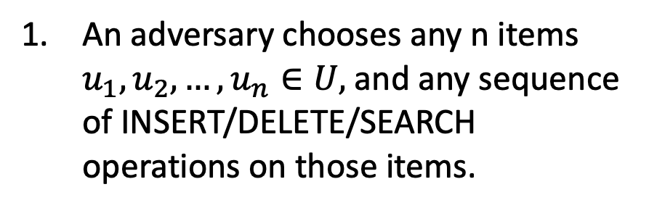
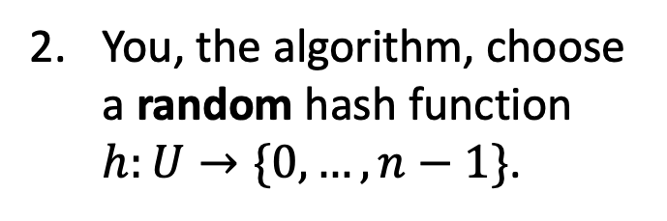
The game
What does random mean here? Uniformly random?
You, the algorithm, choose a random hash function $h:U→\{0,…,n−1\}$.
Plucky the pedantic penguin
An adversary chooses any n items $u_{1},u_{2},…, u_{n}∈U,$and any sequence of INSERT/DELETE/SEARCH operations on those items.
HASH IT OUT
#hashpuns
13
22
43
92
7
0
43
INSERT 13, INSERT 22, INSERT 43, INSERT 92, INSERT 7, SEARCH 43, DELETE 92, SEARCH 7, INSERT 92
22
1
2
13
u_{j}
…
u_{k}
7
u_{i}
n-1
92

Slide 23
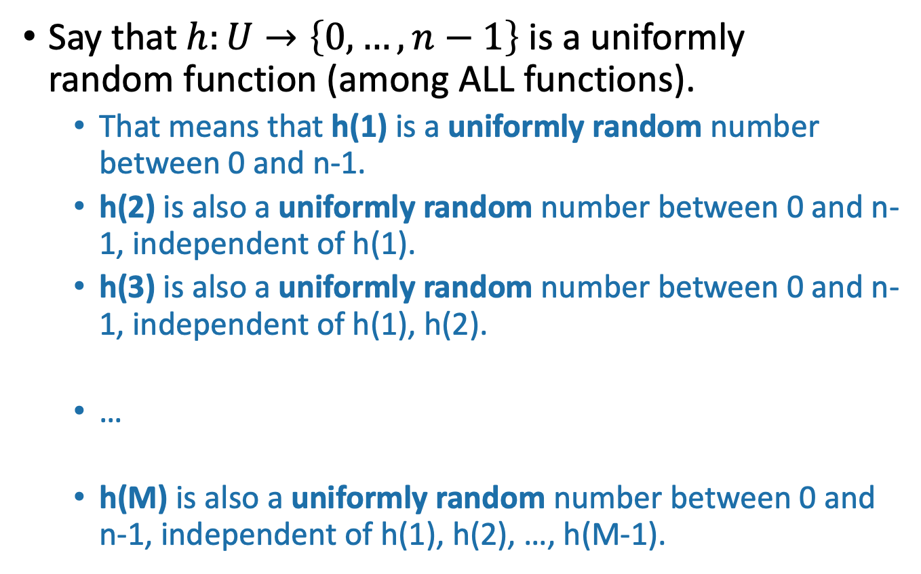
Example of a random hash function
Universe U
h
n buckets
Say that $h:U→\left\{0,…,n−1\right\}$ is a uniformly random function (among ALL functions).
That means that h(1) is a uniformly random number between 0 and n-1.
h(2) is also a uniformly random number between 0 and n-1, independent of h(1).
h(3) is also a uniformly random number between 0 and n-1, independent of h(1), h(2).
…
h(M) is also a uniformly random number between 0 and n-1, independent of h(1), h(2), …, h(M-1).

Slide 24
Randomness helps
Intuitively: The bad guy can’t foil a hash function that he doesn’t yet know.
Lucky the Lackadaisical Lemur
Why not? What if there’s some strategy that foils a random function with high probability?
Plucky the Pedantic Penguin
We’ll need to do some analysis…

Slide 25
What do we want?
It’s bad if lots of items land in u_{i}’s bucket.
So we want not that.
0
43
1
22
2
14
7
u_{i}
32
5
15
…
n-1
92
8

Slide 26

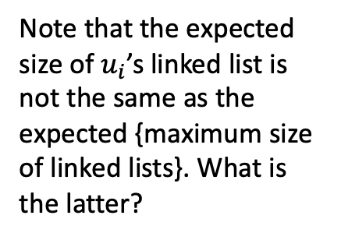
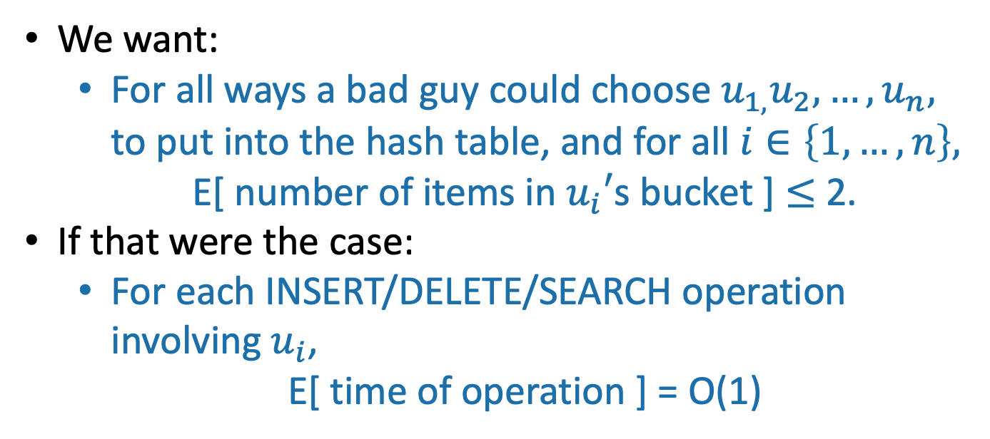
More precisely
We could replace “2” here with any constant; it would still be good. But “2” will be convenient.
We want:
For all ways a bad guy could choose $u_{1,}u_{2},…, u_{n},$ to put into the hash table, and for all $i∈\left\{1, …, n\right\},$
E[ number of items in $u_{i}′$s bucket ] $≤$ 2.
If that were the case:
For each INSERT/DELETE/SEARCH operation involving $u_{i}$,
E[ time of operation ] = O(1)
0
43
22
Note that the expected size of $u_{i}$’s linked list is not the same as the expected {maximum size of linked lists}. What is the latter?
1
2
14
$$u_{i}$$
This is what we wanted at the beginning of lecture!
…
n-1
92
8

Slide 27
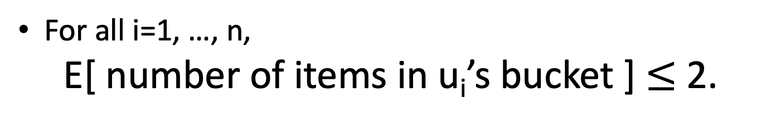
So we want:
For all i=1, …, n,
E[ number of items in u_{i}’s bucket ] $≤$ 2.

Slide 28
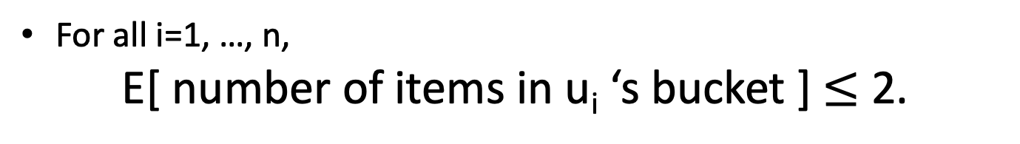
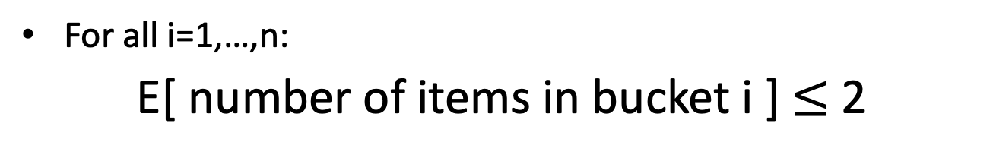
Aside
For all i=1, …, n,
E[ number of items in u_{i} ‘s bucket ] $≤$ 2.
vs
For all i=1,…,n:
E[ number of items in bucket i ] $≤$ 2
Suppose that:
43
14
22
92
8
0
this happens with probability 1/n
1
0
2
1
43
14
22
92
8
…
and this happens with probability 1/n
2
n-1
etc.
…
Then E[ number of items in bucket i ] = 1 for all i.
But E[ number of items in 43’s bucket ] = n
n-1

Slide 29
This distinction came up on your pre-lecture exercise!
Solution to pre-lecture exercise:
E[number of items in bucket 1] = n/6
E[number of items that land in the same bucket as item 1] = n

Slide 30
So we want:
For all i=1, …, n,
E[ number of items in u_{i}’s bucket ] $≤$ 2.

Slide 31



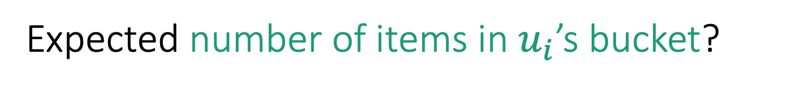

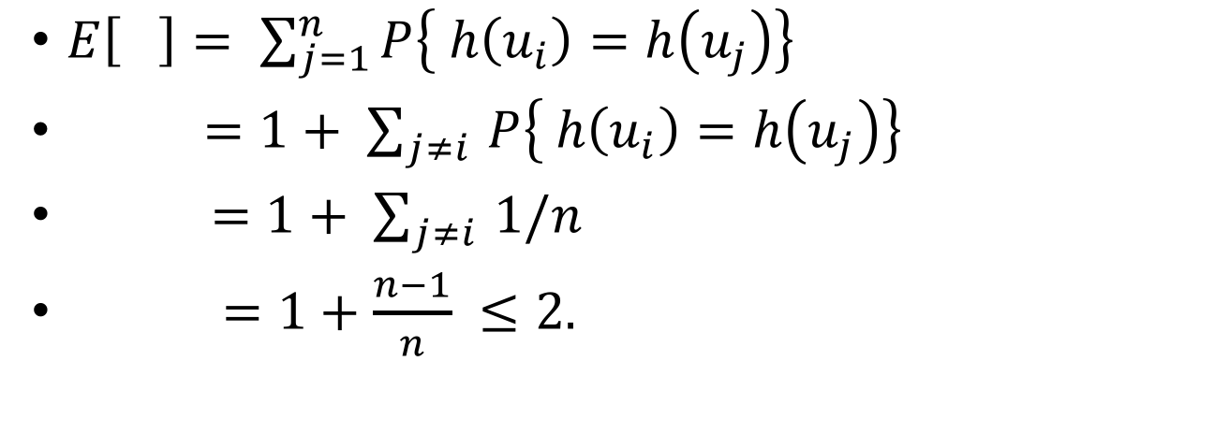


Expected number of items in $u_{i}$’s bucket?
h is uniformly random
$E\left[ \right]= \sum_{j=1}^{n}{P\left\{ h\left(u_{i}\right)=h\left(u_{j}\right)\right\}}$
$=1+ \sum_{j≠i }{P\left\{ h\left(u_{i}\right)=h\left(u_{j}\right)\right\}}$
$=1+ \sum_{j≠i }{1/n}$
$=1+\frac{n−1}{n} ≤2.$
That’s what we wanted!
Universe U
$$h$$
$$u_{k}$$
$$u_{i}$$
n buckets
$$u_{j}$$
$$u_{i}$$
$$u_{j}$$
COLLISION!

Slide 32
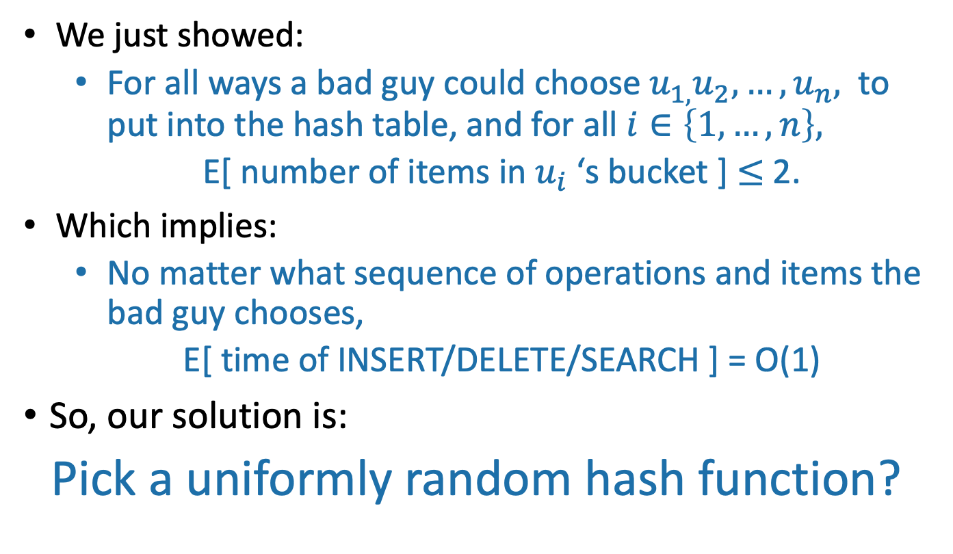
A uniformly random hash function leads to balanced buckets
We just showed:
For all ways a bad guy could choose $u_{1,}u_{2},…, u_{n},$ to put into the hash table, and for all $i∈\left\{1, …, n\right\},$
E[ number of items in $u_{i}$ ‘s bucket ] $≤$ 2.
Which implies:
No matter what sequence of operations and items the bad guy chooses,
E[ time of INSERT/DELETE/SEARCH ] = O(1)
So, our solution is:
Pick a uniformly random hash function?

Slide 33

What’s wrong with this plan?
Hint: How would you implement (and store) a uniformly random function $h:U→\{0,…,n−1\}$?
If h is a uniformly random function:
That means that h(1) is a uniformly random number between 0 and n-1.
h(2) is also a uniformly random number between 0 and n-1, independent of h(1).
h(3) is also a uniformly random number between 0 and n-1, independent of h(1), h(2).
…
h(M) is also a uniformly random number between 0 and n-1, independent of h(1), h(2), …, h(M-1).
Think-Share Terrapins

Slide 34
A uniformly random hash function is not a good idea.
In order to store/evaluate a uniformly random hash function, we’d use a lookup table:
x | h(x)
AAAAAA | 1
AAAAAB | 5
AAAAAC | 0
AAAAAD | 3
…
ZZZZZY | 7
ZZZZZZ | 3
Each value of h(x) takes log(n) bits to store.
Storing M such values requires Mlog(n) bits.
In contrast, direct addressing (initializing a bucket for every item in the universe) requires only M bits.
All of the M things in the universe

Slide 35
Another way to say this
There are lots of hash functions.
There are n^{M} of them.
Writing down a random one of them takes log(n^{M}) bits, which is M log(n).
All of the hash functions
h:U →{0,…,n-1}

Slide 36
Another thought…
THIS SLIDE SKIPPED IN CLASS
Just remember h on the relevant values
h(7) = 8
13
h(43) = 2
h(92) = 3
43
7
22
92
h(22) = 3
h(13) = 6
h(13) = 6
We need some way of storing keys and values with O(1) INSERT/DELETE/SEARCH…
h(22) = 3
Algorithm now
Algorithm later

Slide 37
Could we store a uniformly random h without using a lookup table?
THIS SLIDE SKIPPED IN CLASS
Maybe there’s a different way to store h that uses less space?

Slide 38
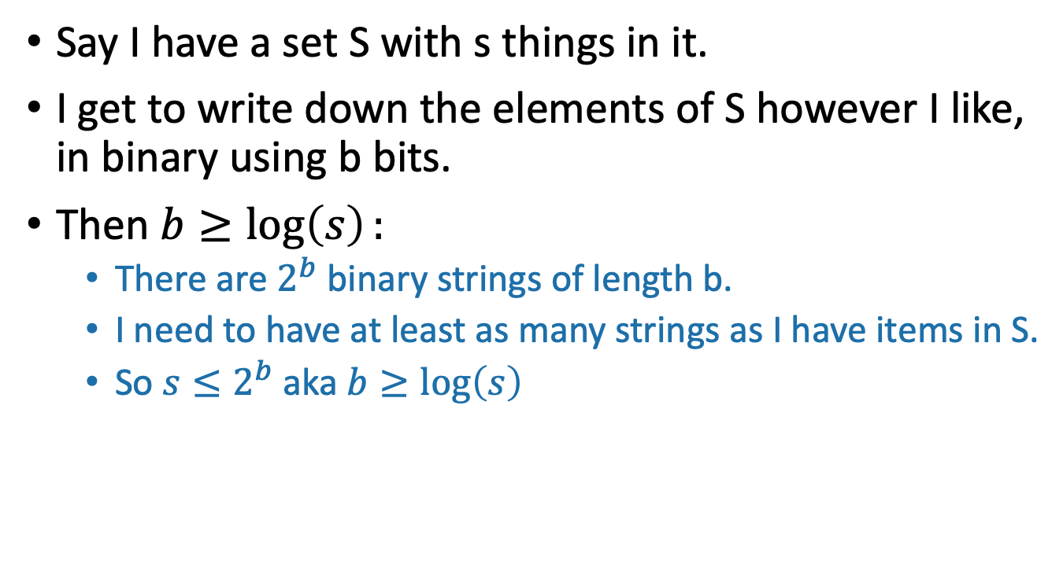
Aside: description length
THIS SLIDE SKIPPED IN CLASS
Say I have a set S with s things in it.
I get to write down the elements of S however I like, in binary using b bits.
Then $b≥\log\left(s\right):$
There are $2^{b}$ binary strings of length b.
I need to have at least as many strings as I have items in S.
So $s≤2^{b}$ aka $b≥\log\left(s\right)$
S
I’ll call this one “Fido”
This one is named “Hercules”
Or, 011011
Or, 101111

Slide 39
Could we store a uniformly random h without using a lookup table?
THIS SLIDE SKIPPED IN CLASS
Maybe there’s a different way to store h that uses less space?

Slide 40
We need Mlog(n) bits to store a random hash function h:U -> {0,…,n-1}
Say that this elephant-shaped blob represents the set of all hash functions.
It has size n^{M}. (Really big!)
THIS SLIDE SKIPPED IN CLASS
To write down a random hash function, we need log(n^{M}) = Mlog(n) bits.
All of the hash functions
h:U →{1,…,n}
Technically we should argue that we need at least Mlog(n) bits on average when we draw a random hash function… why can’t one item have a really long name and others have shorter names?

Slide 41
Solution
Pick from a smaller set of functions.
A cleverly chosen subset of functions. We call such a subset a hash family.
All of the hash functions h:U →{0,…,n-1}
H
We need only log|H| bits to store an element of H.

Slide 42
Outline
Hash tables are another sort of data structure that allows fast INSERT/DELETE/SEARCH.
like self-balancing binary trees
The difference is we can get better performance in expectation by using randomness.
Hash families are the magic behind hash tables.
Universal hash families are even more magic.

Slide 43
Hash families
A hash family is a collection of hash functions.
All of the hash functions h:U →{0,…,n-1}
“All of the hash functions” is an example of a hash family.

Slide 44
Example: a smaller hash family
This is still a terrible idea! Don’t use this example!
For pedagogical purposes only!
H = { function which returns the least sig. digit,
function which returns the most sig. digit }
Pick h in H at random.
Store just one bit to remember which we picked.
All of the hash functions h:U →{0,…,n-1}
H

Slide 45
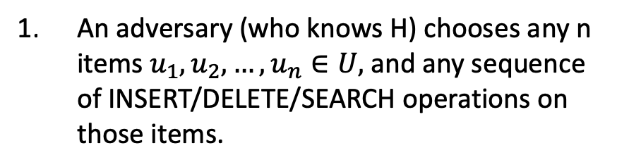
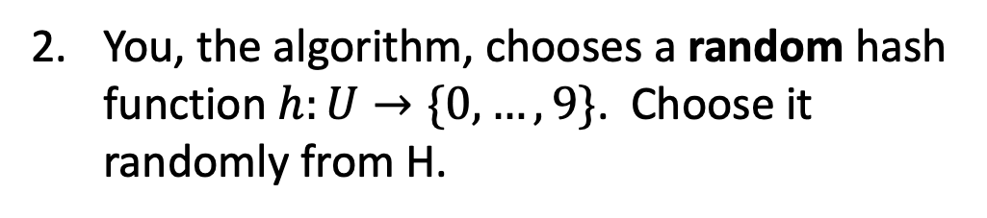
The game
You, the algorithm, chooses a random hash function $h:U→\{0,…, 9\}$. Choose it randomly from H.
h₀ = Most_significant_digit
h₁ = Least_significant_digit
H = {h₀, h₁}
I picked h₁
An adversary (who knows H) chooses any n items $u_{1},u_{2},…, u_{n}∈U,$and any sequence of INSERT/DELETE/SEARCH operations on those items.
HASH IT OUT
#hashpuns
19
22
42
92
0
0
0
INSERT 19, INSERT 22, INSERT 42, INSERT 92, INSERT 0, SEARCH 42, DELETE 92, SEARCH 0, INSERT 92
1
22
42
92
2
u_{j}
…
u_{k}
19
u_{i}
9

Slide 46
This is not a very good hash family
H = { function which returns least sig. digit,
function which returns most sig. digit }
On the previous slide, the adversary could have been a lot more adversarial…

Slide 47
The game
You, the algorithm, chooses a random hash function $h:U→\{0,…, 9\}$. Choose it randomly from H.
h₀ = Most_significant_digit
h₁ = Least_significant_digit
H = {h₀, h₁}
I picked h₁
An adversary (who knows H) chooses any n items $u_{1},u_{2},…, u_{n}∈U,$and any sequence of INSERT/DELETE/SEARCH operations on those items.
HASH IT OUT
#hashpuns
101
11
121
141
131
0
1
11
101
2
141
u_{j}
121
…
u_{k}
u_{i}
9
131

Slide 48
Outline
Hash tables are another sort of data structure that allows fast INSERT/DELETE/SEARCH.
like self-balancing binary trees
The difference is we can get better performance in expectation by using randomness.
Hash families are the magic behind hash tables.
Universal hash families are even more magic.

Slide 49
How to pick the hash family?
Definitely not like in that example.
Let’s go back to that computation from earlier….
H

Slide 50
Expected number of items in u_{i}’s bucket?
$E\left[ \right]= \sum_{j=1}^{n}{P\left\{ h\left(u_{i}\right)=h\left(u_{j}\right)\right\}}$
$=1+ \sum_{j≠i }{P\left\{ h\left(u_{i}\right)=h\left(u_{j}\right)\right\}}$
$=1+ \sum_{j≠i }{1/n}$
$=1+\frac{n−1}{n} ≤2.$
All that we needed was that this is 1/n
Universe U
h
u_{k}
u_{i}
n buckets
u_{j}
u_{i}
u_{j}
COLLISION!

Slide 51
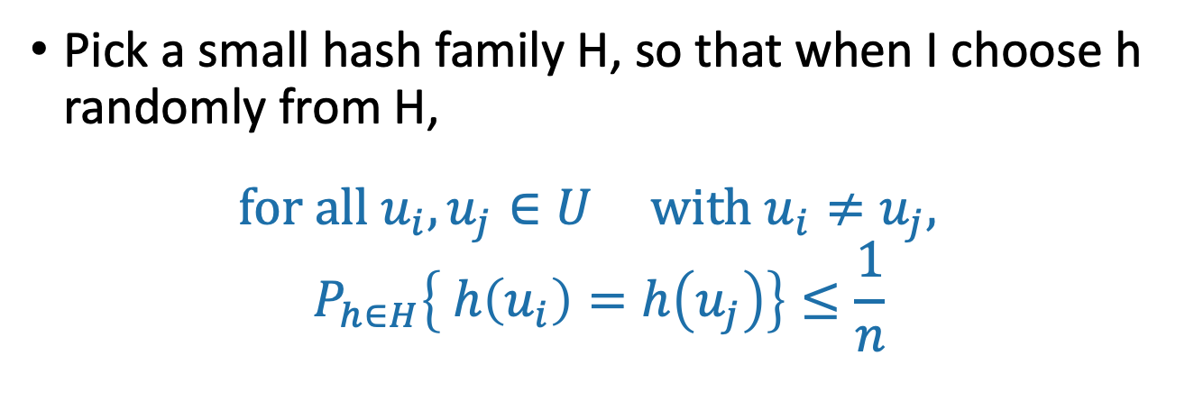
Strategy
Pick a small hash family H, so that when I choose h randomly from H,
$$for all u_{i}, u_{j}∈U with u_{i}≠u_{j},$$
$$P_{h∈H}\left\{ h\left(u_{i}\right)=h\left(u_{j}\right)\right\}≤\frac{1}{n}$$
In English: fix any two elements of U. The probability that they collide under a random h in H is small.
A hash family H that satisfies this is called a universal hash family.
h
H

Slide 52
So the whole scheme will be
Choose h randomly from a universal hash family H
We can store h using log|H| bits.
u₁
u_{k}
Probably these buckets will be pretty balanced.
u_{i}
u_{j}
h
n buckets
u_{i}
Universe U

Slide 53
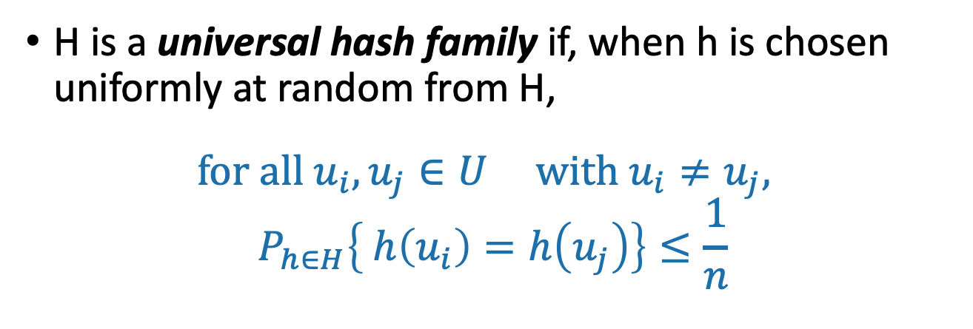
Universal hash family
H is a universal hash family if, when h is chosen uniformly at random from H,
$$for all u_{i}, u_{j}∈U with u_{i}≠u_{j},$$
$$P_{h∈H}\left\{ h\left(u_{i}\right)=h\left(u_{j}\right)\right\}≤\frac{1}{n}$$

Slide 54
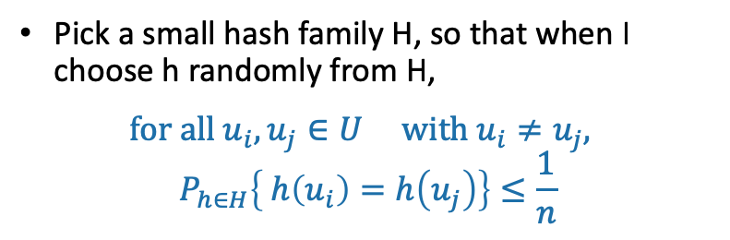

Example
Pick a small hash family H, so that when I choose h randomly from H,
$$for all u_{i}, u_{j}∈U with u_{i}≠u_{j},$$
$$P_{h∈H}\left\{ h\left(u_{i}\right)=h\left(u_{j}\right)\right\}≤\frac{1}{n}$$
H = the set of all functions $h:U→\left\{0,…,n−1\right\}$
We saw this earlier – it corresponds to picking a uniformly random hash function.
Unfortunately, this H is really really large.

Slide 55
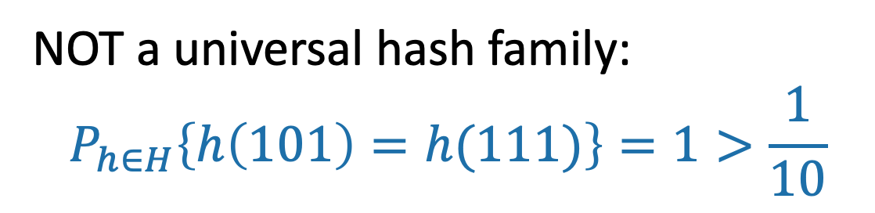

Non-example
Pick a small hash family H, so that when I choose h randomly from H,
$$for all u_{i}, u_{j}∈U with u_{i}≠u_{j},$$
$$P_{h∈H}\left\{ h\left(u_{i}\right)=h\left(u_{j}\right)\right\}≤\frac{1}{n}$$
h₀ = Most_significant_digit
h₁ = Least_significant_digit
H = {h₀, h₁}
NOT a universal hash family:
$$P_{h∈H}\left\{h\left(101\right)=h(111)\right\}=1>\frac{1}{10}$$

Slide 56
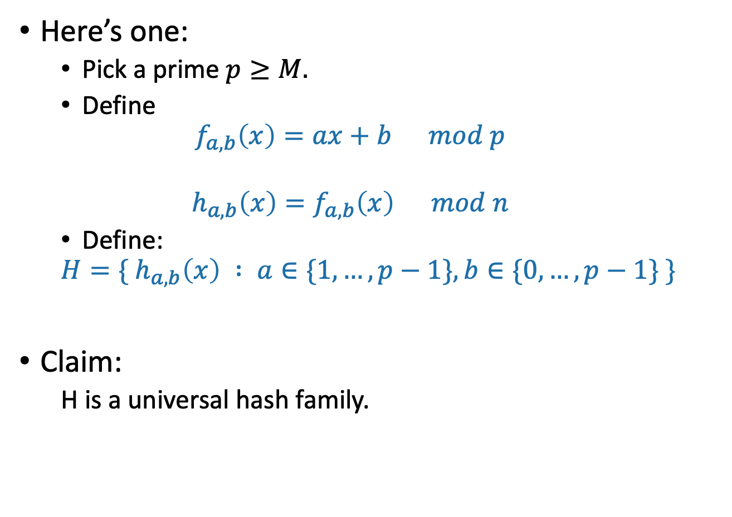
A small universal hash family??
Here’s one:
Pick a prime $p≥M.$
Define
$$f_{a,b}\left(x\right)=ax+b mod p$$
$$h_{a,b}\left(x\right)=f_{a,b}\left(x\right) mod n$$
Define:
$$H=\{ h_{a,b}\left(x\right) : a∈\{1,…, p−1\}, b∈\{0, …, p−1\} \}$$
Claim:
H is a universal hash family.
How do you pick the prime number p that’s not too larger than M?
??

Slide 57







Say what?
1,2,3,4,5
a = 2, b = 1
Example: M = p = 5, n = 3
To draw h from H:
Pick a random a in {1,…,4}, b in {0,…,4}
As per the definition:
$f_{2,1}\left(x\right)=2x+1 mod 5$
$h_{2,1}\left(x\right)=f_{2,1}\left(x\right) mod 3$
$$f_{2,1}\left(3\right)$$
$$f_{2,1}\left(1\right)$$
0
2
3
$$f_{2,1}\left(x\right)$$
3
2
1
mod 3
1
$$f_{2,1}\left(0\right)$$
1
4
0
4
0
$$f_{2,1}\left(4\right)$$
2
U =
This step just scrambles stuff up. No collisions here!
$$f_{2,1}\left(2\right)$$
This step is the one where two different elements might collide.

Slide 58
h takes O(log M) bits to store
1,2,3,4,5
a = 2, b = 1
Just need to store two numbers:
a is in {1,…,p-1}
b is in {0,…,p-1}
So about 2log(p) bits
By our choice of p (close to M), that’s O(log(M)) bits.
Also, given a and b, h is fast to evaluate!
It takes time O(1) to compute h(x).
Compare: direct addressing was M bits!
Twitter example: 2log(M) =2*280 log(128) = 3920 vs M = 128²⁸⁰

Slide 59
Why does this work?
This is actually a little complicated.
See lecture note if you are curious.
You are NOT RESPONSIBLE for the proof in this class.
But you should know that a universal hash family of size O(M²) exists.
Try to prove that this is a universal hash family!

Slide 60
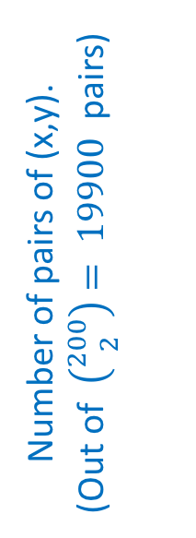
But let’s check that it does work
Check out the Python notebook for lecture 8
M=200, n=10
Number of pairs of (x,y).
(Out of $\left({200 \atop 2}\right)= 19900$pairs)
Empirical probability of collision out of 100 trials

Slide 61
So the whole scheme will be
Choose a and b at random and form the function h_{a,b}
We can store h in space O(log(M)) since we just need to store a and b.
u₁
u_{k}
Probably these buckets will be pretty balanced.
u_{i}
u_{j}
h_{a,b}
n buckets
u_{i}
Universe U

Slide 62
Outline
Hash tables are another sort of data structure that allows fast INSERT/DELETE/SEARCH.
like self-balancing binary trees
The difference is we can get better performance in expectation by using randomness.
Hash families are the magic behind hash tables.
Universal hash families are even more magic.
Recap

Slide 63
Want O(1) INSERT/DELETE/SEARCH
We are interested in putting nodes with keys into a data structure that supports fast INSERT/DELETE/SEARCH.
INSERT
DELETE
SEARCH
5
2
5
4
4
52
52
data structure
HERE IT IS

Slide 64
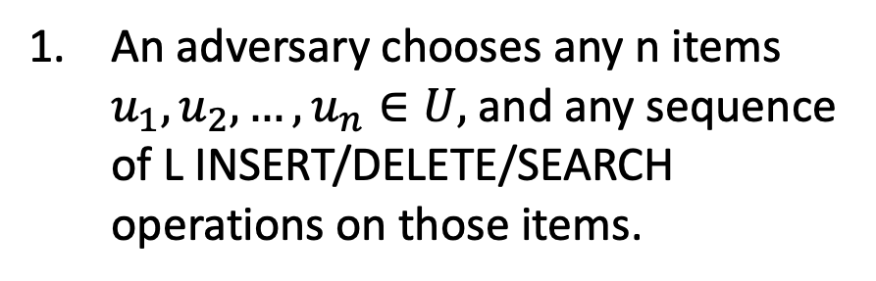
We studied this game
You, the algorithm, choose a random hash function $h:U→\{0,…,n−1\}$.
An adversary chooses any n items $u_{1},u_{2},…, u_{n}∈U,$and any sequence of L INSERT/DELETE/SEARCH operations on those items.
HASH IT OUT
13
22
43
92
7
0
43
INSERT 13, INSERT 22, INSERT 43, INSERT 92, INSERT 7, SEARCH 43, DELETE 92, SEARCH 7, INSERT 92
22
1
2
13
u_{j}
…
u_{k}
7
u_{i}
n-1
92

Slide 65
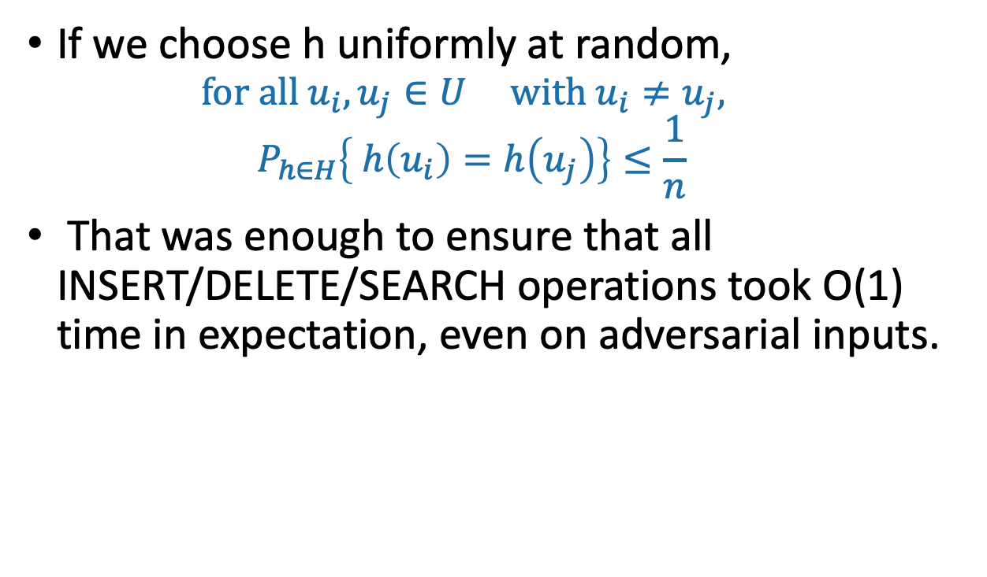
Uniformly random h was good
If we choose h uniformly at random,
$$for all u_{i}, u_{j}∈U with u_{i}≠u_{j},$$
$$P_{h∈H}\left\{ h\left(u_{i}\right)=h\left(u_{j}\right)\right\}≤\frac{1}{n}$$
That was enough to ensure that all INSERT/DELETE/SEARCH operations took O(1) time in expectation, even on adversarial inputs.

Slide 66
Uniformly random h was bad
If we actually want to implement this, we have to store the hash function h.
That takes a lot of space!
We may as well have just initialized a bucket for every single item in U.
All of the hash functions h:U →{0,…,n-1}
Instead, we chose a function randomly from a smaller set.

Slide 67
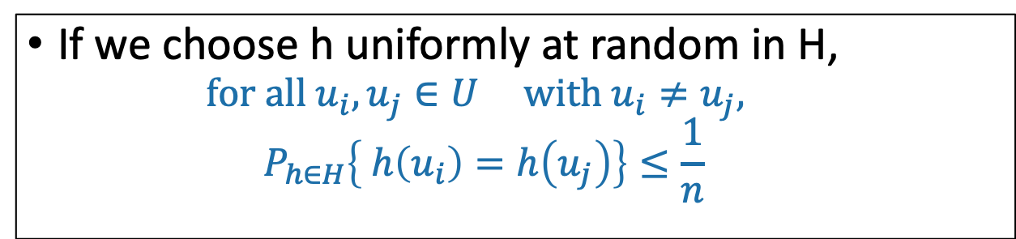
Universal Hash Families
H is a universal hash family if:
If we choose h uniformly at random in H,
$$for all u_{i}, u_{j}∈U with u_{i}≠u_{j},$$
$$P_{h∈H}\left\{ h\left(u_{i}\right)=h\left(u_{j}\right)\right\}≤\frac{1}{n}$$
This was all we needed to make sure that the buckets were balanced in expectation!
We gave an example of a really small universal hash family, of size O(M²)
That means we need only O(log M) bits to store it.

Slide 68
Conclusion:
Hashing a universe of size M into n buckets, where at most n of the items in M ever show up.
We can build a hash table that supports INSERT/DELETE/SEARCH in O(1) expected time
Requires O(n log(M)) bits of space.
O(n) buckets
O(n) items with log(M) bits per item
O(log(M)) to store the hash function

Slide 69
That’s it for data structures (for now)
Data Structure: RBTrees and Hash Tables
Now we can use these going forward!

Slide 70
Before Next Time
Next Time
Graph algorithms!
Pre-lecture exercise for Lecture 9
Intro to graphs

