Slide 1

Midterm Review (CS161)
Ruiquan Gao
Stanford University

Slide 2
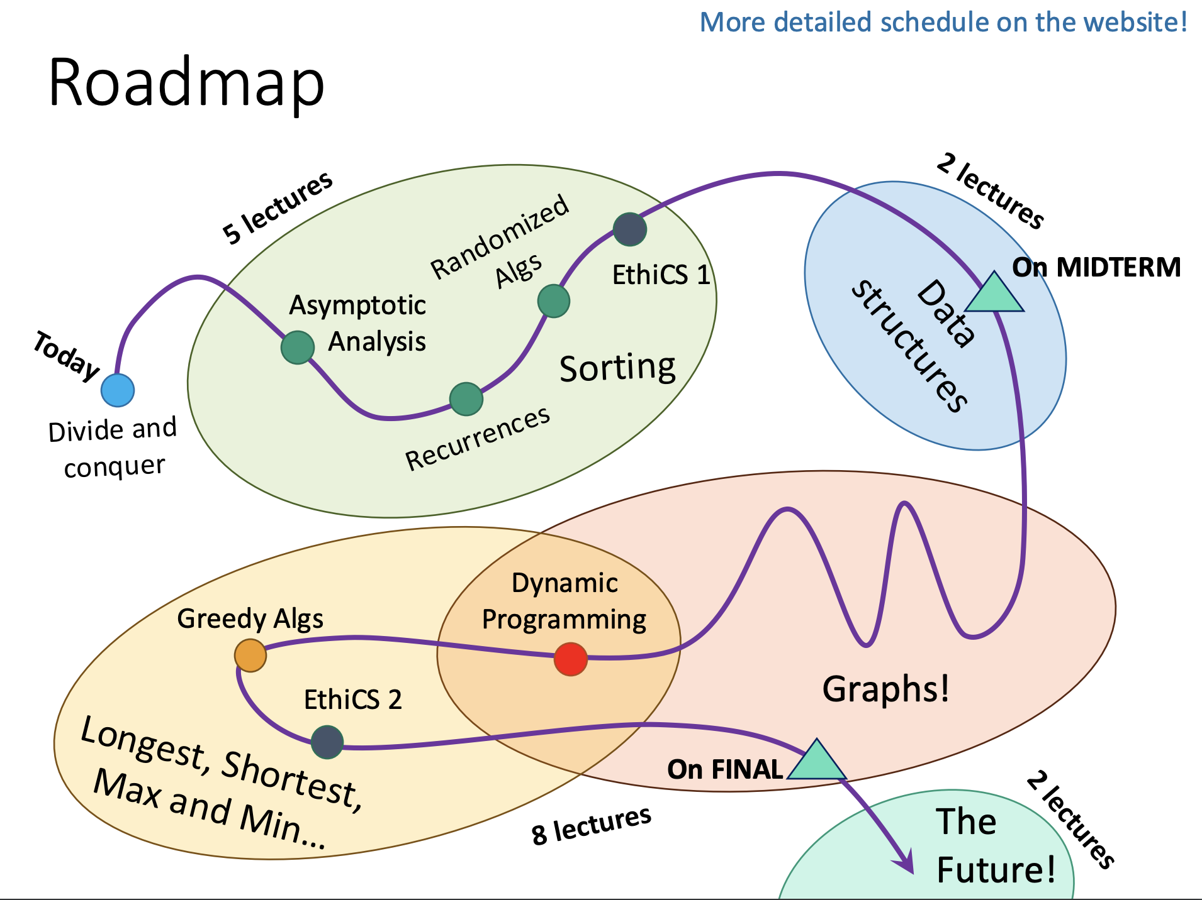

Slide 3
What will be covered in midterm?
Lecture 1~7
Divide-and-Conquer
Asymptotics, Worst-Case Analysis, and MergeSort
Solving Recurrences and the Master Theorem
Median and Selection
Randomized Algorithms and QuickSort
BucketSort and Lower Bounds for Sorting
Binary Search Trees and Red-Black Trees
Don’t forget about the related sections and past exams!

Slide 4
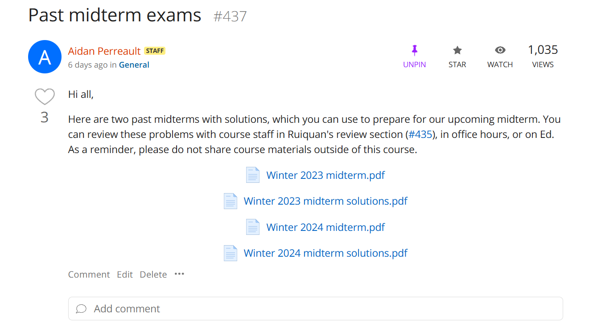

Slide 5
For your questions
Feel free to ask any questions from past exams
All CAs are expected to be prepared for them!
If you have questions about the past sections, we recommend
Asking on Ed
Going to office hours of CAs who teach the sections (other CAs may not be familiar with the contents)
https://stanford-cs161.github.io/winter2025/sections/

Slide 6
Big-Oh Notation

Slide 7
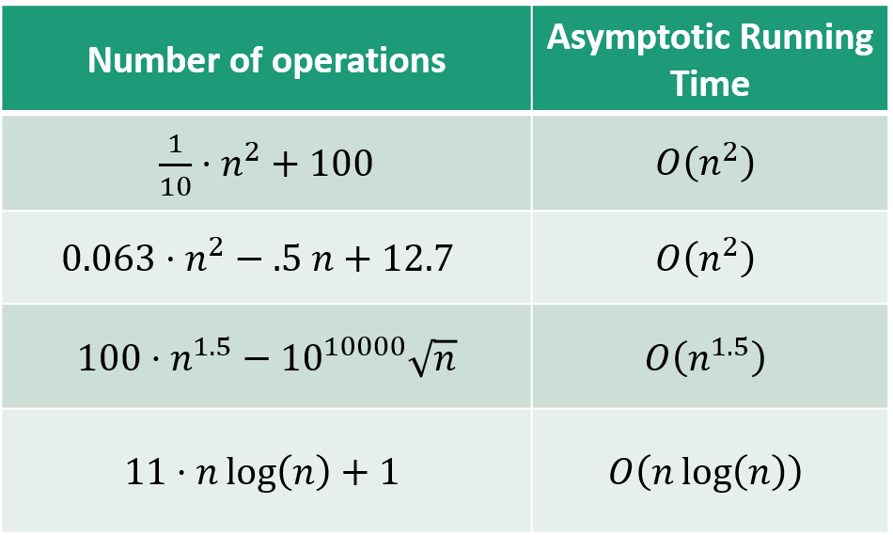

Main idea
Focus on how the runtime scales with $n$ (the input size).
Some examples…
(Heuristically: only pay attention to the largest function of n that appears.)
We say this algorithm is “asymptotically faster” than the others.

Slide 8

Formal definition of O(…)
Let $T\left(n\right)$, $g\left(n\right)$ be functions of positive integers.
Think of 𝑇(𝑛) as a runtime: positive and increasing in n.
Formally,
$$T\left(n\right)=O\left(g\left(n\right)\right)$$
$$⟺$$
$$∃c>0, n_{0} s.t. ∀n≥n_{0},$$
$$T\left(n\right)≤c⋅g(n)$$
Also, review the definitions of $Ω\left(⋯\right), Θ\left(⋯\right)$

Slide 9



For example,
To prove $3n = O(n log n)$ or $n log n=Ω(3n)$
g(n) = 3n
Choose $c = 1/3$
Choose $n0 = 2$
Then
T(n) = nlog(n)
$$∀n≥2,$$
$$\frac{3n}{3}≤n\log_{2}\left(n\right)⁡$$
g(n)/3 = n

Slide 10

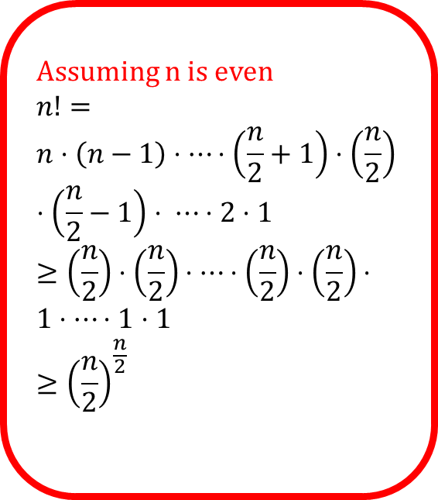
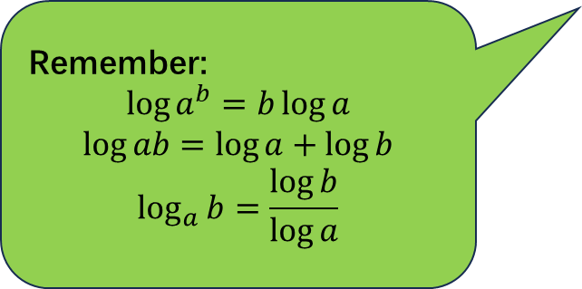
For example,
To prove $log\left(n!\right)=Θ(n log n)$
$$\log{n!}≤\log{n^{n}}=n log n$$
$$\log{n!}≥\log{{\left(\frac{n}{2}\right)}^{\frac{n}{2}}}=\left(\frac{n}{2}\right)⋅\left(log n −1\right)$$
Assuming n is even
$$n!=$$
$$n⋅\left(n−1\right)⋅⋯⋅\left(\frac{n}{2}+1\right)⋅\left(\frac{n}{2}\right)⋅\left(\frac{n}{2}−1\right)⋅ ⋯⋅2⋅1$$
$$≥\left(\frac{n}{2}\right)⋅\left(\frac{n}{2}\right)⋅⋯⋅\left(\frac{n}{2}\right)⋅\left(\frac{n}{2}\right)⋅$$
$$1⋅⋯⋅1⋅1$$
$$≥{\left(\frac{n}{2}\right)}^{\frac{n}{2}}$$
Remember:
$$\log{a^{b}}=b\log{a}$$
$$\log{ab}=\log{a}+\log{b}$$
$$\log_{a}{b}=\frac{\log{b}}{\log{a}}$$

Slide 11
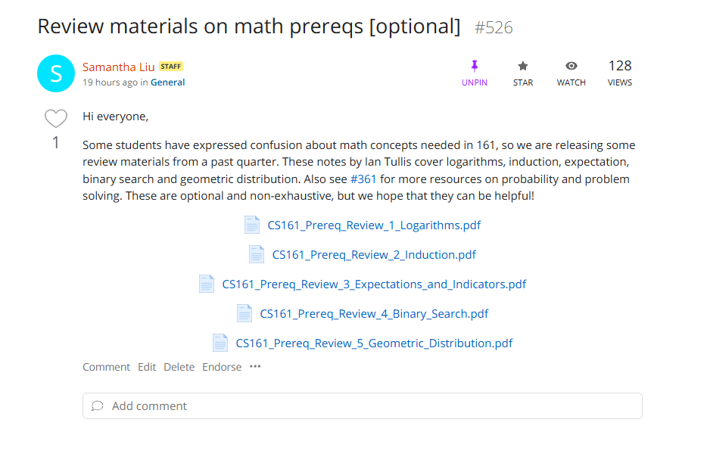

Slide 12

For example,
Note that
$$log f\left(n\right)=O(log g\left(n\right))$$
does not imply
$$f\left(n\right)=O(g\left(n\right))$$
See midterm 2023 Problem 4

Slide 13
Divide and Conquer

Slide 14
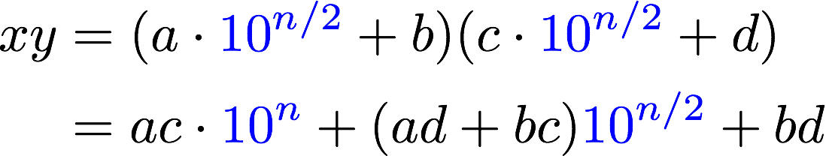
Karatsuba integer multiplication
Recursively compute these THREE things:
ac
bd
(a+b)(c+d)
Assemble the product:
Subtract these off
get this
(a+b)(c+d) = ac + bd + bc + ad

Slide 15



What’s the running time?
1 problem
of size n
If you cut n in half $log2(n)$times, you get down to 1.
So at level
$t= log2(n)$
we get…
$$3^{\log_{2}{n}}=n^{\log_{2}{3}}≈n^{1.6}$$
problems of size 1.
Recursion tree
3 problems
of size n/2
…
3^{t} problems
of size n/2^{t}
Note: this is just a cartoon – I’m not going to draw all 3^{t} circles!
…
$$\sum_{t=1}^{\log\left(n\right)}{3^{t}⋅\frac{n}{2^{t}}}≤n⋅{2\left(\frac{3}{2}\right)}^{\log{n}+1} ≈O\left(n^{1.6}\right)$$
$$n^{1.6}$$
____ problems
of size 1

Slide 16
Solving Recurrence and Master Theorem

Slide 17
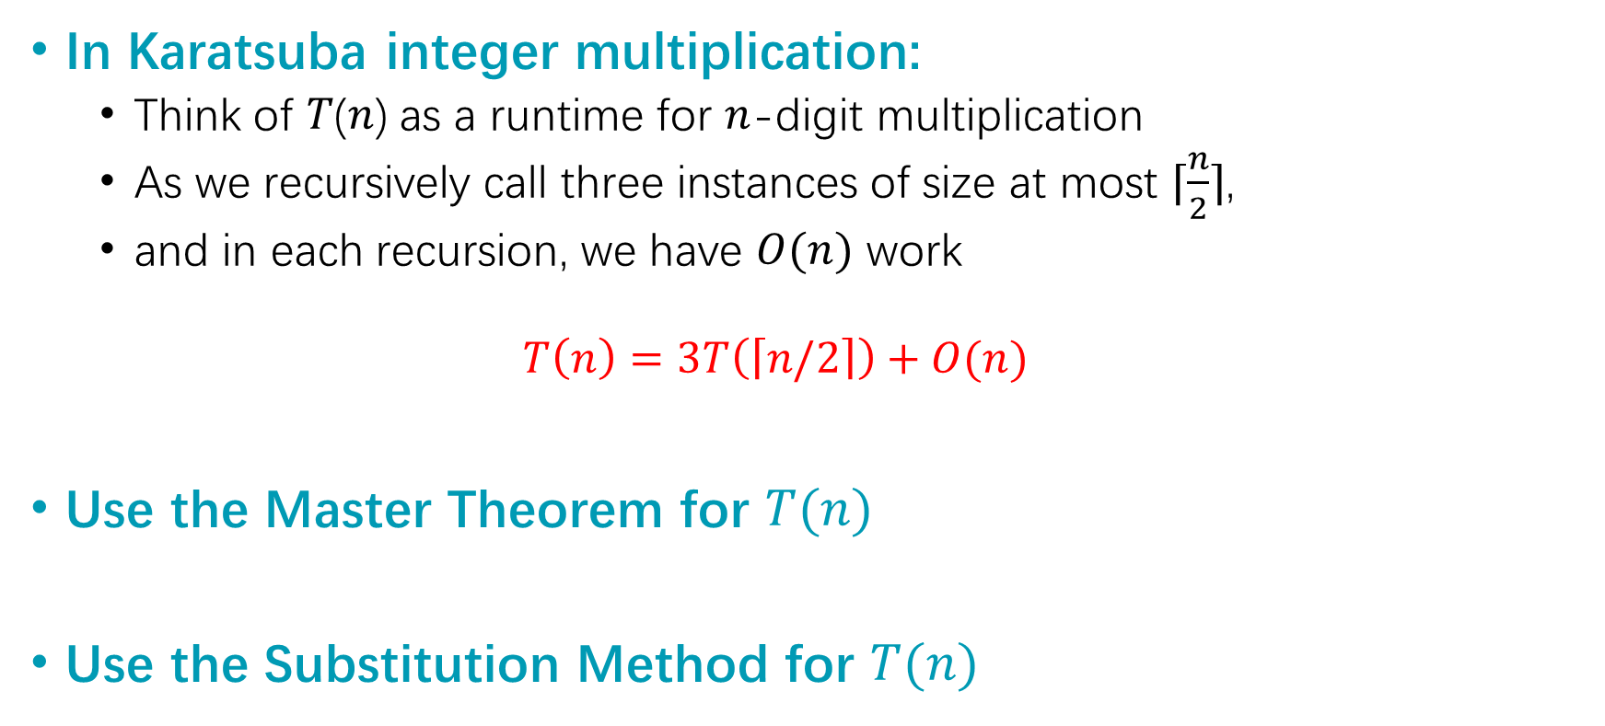

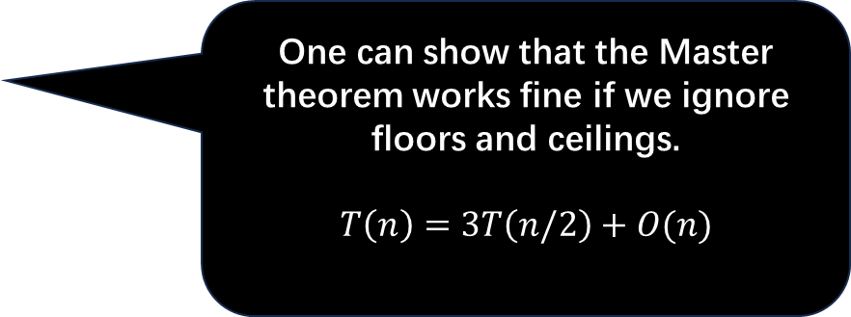
For example,
In Karatsuba integer multiplication:
Think of 𝑇(𝑛) as a runtime for $n$-digit multiplication
As we recursively call three instances of size at most $⌈\frac{n}{2}⌉$,
and in each recursion, we have $O(n)$ work
$$T\left(n\right)=3T\left(\left\lceil n/2\right\rceil \right)+O(n)$$
Use the Master Theorem for $T(n)$
Use the Substitution Method for $T(n)$
Simply, we have $T(1)=O(1)$
One can show that the Master theorem works fine if we ignore floors and ceilings.
$$T\left(n\right)=3T\left(n/2\right)+O(n)$$

Slide 18
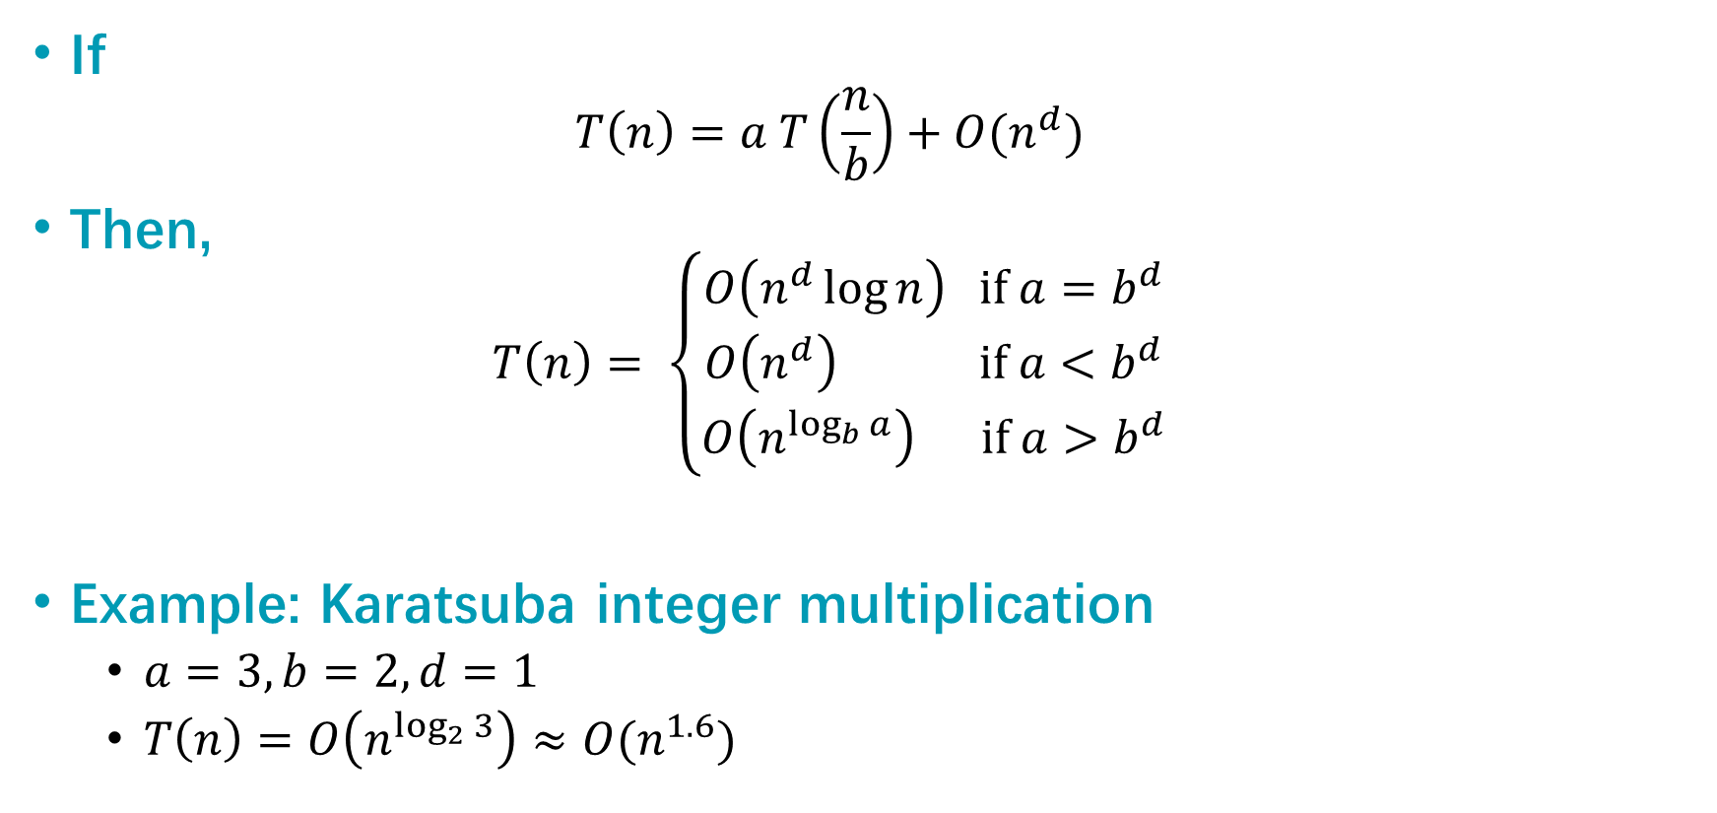
Master Theorem
If
$$T\left(n\right)=a T\left(\frac{n}{b}\right)+O(n^{d})$$
Then,
$$T\left(n\right)= \left\{\begin{aligned}O\left(n^{d}\log{n}\right) if a=b^{d} \\ O\left(n^{d}\right) if a<b^{d} \\ O\left(n^{\log_{b}{a}}\right) if a>b^{d}\end{aligned}\right.$$
Example: Karatsuba integer multiplication
$a=3, b=2, d=1$
$T\left(n\right)=O\left(n^{\log_{2}{3}}\right)≈O(n^{1.6})$

Slide 19
The Substitution Method
Another way to solve recurrence relations.
More general than the master method.
Step 1: Generate a guess at the correct answer.
Step 2: Try to prove that your guess is correct.
(Step 3: Profit.)

Slide 20

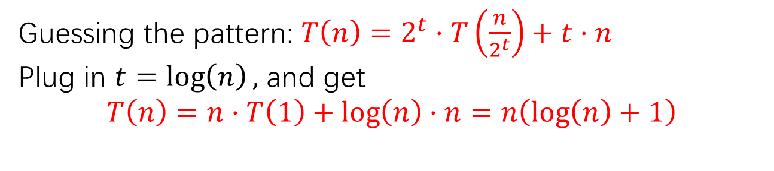


Step 1: Guess the answer
$T\left(n\right)=2⋅T\left(\frac{n}{2}\right)+n$, with $T\left(1\right)=1.$
You can guess the answer however you want: meta-reasoning, a little bird told you, wishful thinking, etc. One useful way is to try to “unroll” the recursion, like we’re doing here.
$T\left(n\right)=2⋅T\left(\frac{n}{2}\right)+n$
$T\left(n\right)=2⋅\left(2⋅T\left(\frac{n}{4}\right)+\frac{n}{2}\right)+n$
$T\left(n\right)=4⋅T\left(\frac{n}{4}\right)+2n$
$T\left(n\right)=4⋅\left(2⋅T\left(\frac{n}{8}\right)+\frac{n}{4}\right)+2n$
$T\left(n\right)=8⋅T\left(\frac{n}{8}\right)+3n$
…
Expand $T\left(\frac{n}{2}\right)$
Simplify
Expand $T\left(\frac{n}{4}\right)$
Simplify
Guessing the pattern: $T\left(n\right)=2^{t}⋅T\left(\frac{n}{2^{t}}\right)+t⋅n$
Plug in $t=\log\left(n\right),$ and get
$$T\left(n\right)=n⋅T\left(1\right)+\log\left(n\right)⋅n=n\left(\log\left(n\right)+1\right)$$

Slide 21
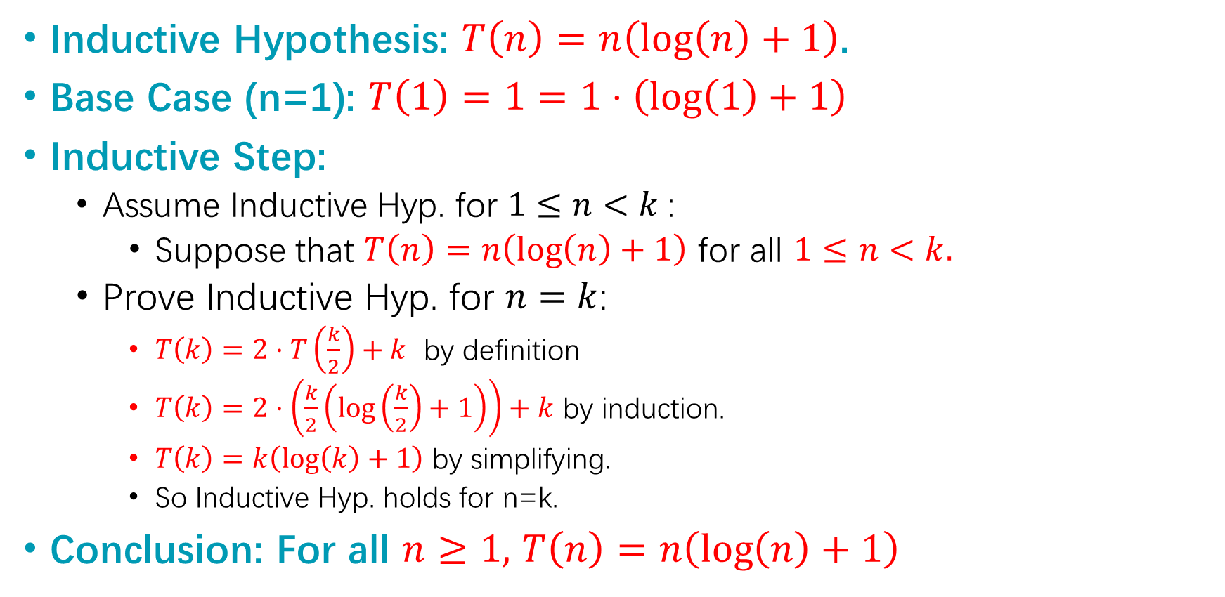
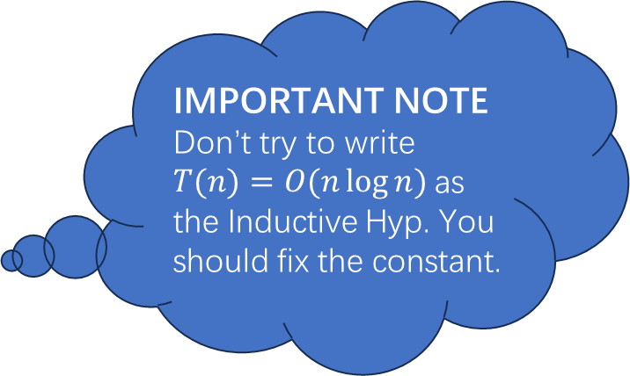
Step 2: Prove the guess is correct.
IMPORTANT NOTE
Don’t try to write $T(n)=O(n\log{n})$as the Inductive Hyp. You should fix the constant.
$T\left(n\right)=2⋅T\left(\frac{n}{2}\right)+n$, with $T\left(1\right)=1.$
Inductive Hypothesis: $T\left(n\right)=n\left(\log\left(n\right)+1\right)$.
Base Case (n=1): $T\left(1\right)=1=1⋅\left(\log\left(1\right)+1\right)$
Inductive Step:
Assume Inductive Hyp. for $1≤n<k$:
Suppose that $T\left(n\right)=n\left(\log\left(n\right)+1\right)$ for all $1≤n<k.$
Prove Inductive Hyp. for $n=k$:
$T\left(k\right)=2⋅T\left(\frac{k}{2}\right)+k$ by definition
$T\left(k\right)=2⋅\left(\frac{k}{2}\left(\log\left(\frac{k}{2}\right)+1\right)\right)+k$ by induction.
$T\left(k\right)=k\left(\log\left(k\right)+1\right)$ by simplifying.
So Inductive Hyp. holds for n=k.
Conclusion: For all $n≥1,$ $T\left(n\right)=n\left(\log\left(n\right)+1\right)$

Slide 22

Step 3: Profit
Pretend like you never did Step 1, and just write down:
Theorem: $T\left(n\right)=O(n\log\left(n\right))$
Proof: [Whatever you wrote in Step 2]

Slide 23
Linear-time Selection

Slide 24
The k-SELECT problem
SELECT(A, k):
Return the k-th smallest element of A.
7
4
3
8
1
5
9
14
SELECT(A, 1) = 1
SELECT(A, 2) = 3
SELECT(A, 3) = 4
SELECT(A, 8) = 14
SELECT(A, 1) = MIN(A)
SELECT(A, n/2) = MEDIAN(A)
SELECT(A, n) = MAX(A)
Note that the definition of Select is 1-indexed…

Slide 25

Goal: An O(n)-time algorithm
Trivial algorithm:
Sort and Select
Time: $O(n\log{n})$
It turns out that we can do better!
In worst-case time

Slide 26
Idea: divide and conquer!
6
3
1
4
2
pivot
9
8
L = array with things smaller than A[pivot]
R = array with things larger than A[pivot]
If k = 5 = len(L) + 1:
We should return A[pivot]
If k < 5:
We should return SELECT(L, k)
If k > 5:
We should return SELECT(R, k – 5)
This suggests a recursive algorithm
(still need to figure out how to pick the pivot…)

Slide 27

The ideal pivot
Imagine we split the input exactly in half:
len(L) = len(R) = (n-1)/2
Let’s pretend that’s the case and use the Master Theorem!
2
1
3
pivot
A bad guy who knows what pivots we will choose gets to come up with A.
$T\left(n\right)≤T\left(\frac{n}{2}\right)+O(n)$
So $a = 1, b = 2, d = 1$
$T\left(n\right)≤O\left(n^{d}\right)=O\left(n\right)$

Slide 28

A good enough pivot
Imagine we split the input not quite in half:
3n/10 < len(L) < 7n/10
3n/10 < len(R) < 7n/10
If we could do that (let’s say, in time O(n)), the Master Theorem would say:
$T\left(n\right)≤T\left(\frac{7n}{10}\right)+O(n)$
So $a = 1, b = 10/7, d = 1$
$T\left(n\right)≤O\left(n^{d}\right)=O\left(n\right)$

Slide 29
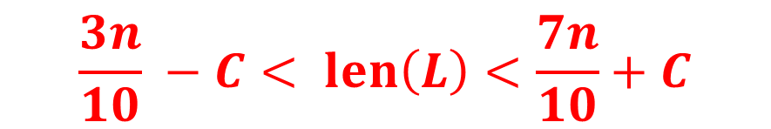
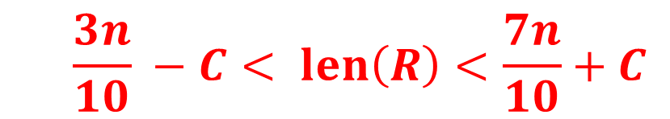
Goal
Efficiently pick the pivot so that
6
3
1
4
2
pivot
9
8
L = array with things smaller than A[pivot]
R = array with things larger than A[pivot]
$$\frac{3n}{10} −C< len\left(L\right)<\frac{7n}{10}+C$$
$$\frac{3n}{10} −C< len\left(R\right)<\frac{7n}{10}+C$$

Slide 30

Another divide-and-conquer Alg.!
We can’t solve SELECT(A,n/2) (yet)
But we can divide and conquer and solve SELECT(B,m/2) for smaller values of m (where len(B) = m).
Lemma*: The median of sub-medians is close to the median.
Ideal pivot
What we’ll use as the pivot
median of sub-medians
median of the whole thing
$$≈$$
sub-median
sub-median
sub-median
sub-median
sub-median
*we will make this a bit more precise.

Slide 31

How to pick the pivot
CHOOSEPIVOT(A):
Split A into m =$\left\lceil \frac{n}{5}\right\rceil$ groups, of size <=5 each.
For i=1, .., m$:$
Find the median within the i’th group, call it p_{i}
p = SELECT( [ p_{1,} p₂, p₃, …, p_{m} ] , m/2 )
return the index of p in A
This takes time O(1) for each group, since each group has size 5. So that’s O(m)=O(n) total in the for loop.

Slide 32

How it works (formally)
Lemma: If we choose the pivots like this, then
$$\left|L\right|≤\frac{7n}{10}+5$$
and
$$\left|R\right|≤\frac{7n}{10}+5$$

Slide 33

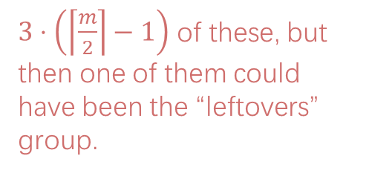
Proof By Picture
$3⋅\left(\left\lceil \frac{m}{2}\right\rceil −1\right)$ of these, but then one of them could have been the “leftovers” group.
2
4
1
2
3
5
6
3
7
5
4
6
7
8
10
13
18
17
9
11
70
35
22
15
12
m
How many of those are there?
at least $3⋅\left(\left\lceil \frac{m}{2}\right\rceil −2\right)$

Slide 34

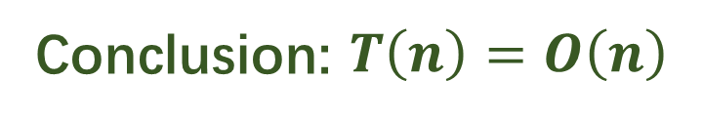
How about the running time?
Recurrence relation:
$T\left(n\right)≤T\left(\frac{n}{5}\right)+T\left(\frac{7n}{10}+5\right)+O\left(n\right)$
The Substitution Method!
Step 1: generate a guess
Step 2: try to prove that your guess is correct
Step 3: profit
Conclusion: $T\left(n\right)=O\left(n\right)$

Slide 35
Exercise – Multiple k-SELECT

Slide 36

Problem Description
Input:
Array $A$ containing $n$ distinct integers
$k$ different ranks $r_{1},…, r_{k}$
Output:
For each $i$, the $r_{i}$-th smallest element in $A$
Requirement:
An $O(n log k)$ time algorithm

Slide 37
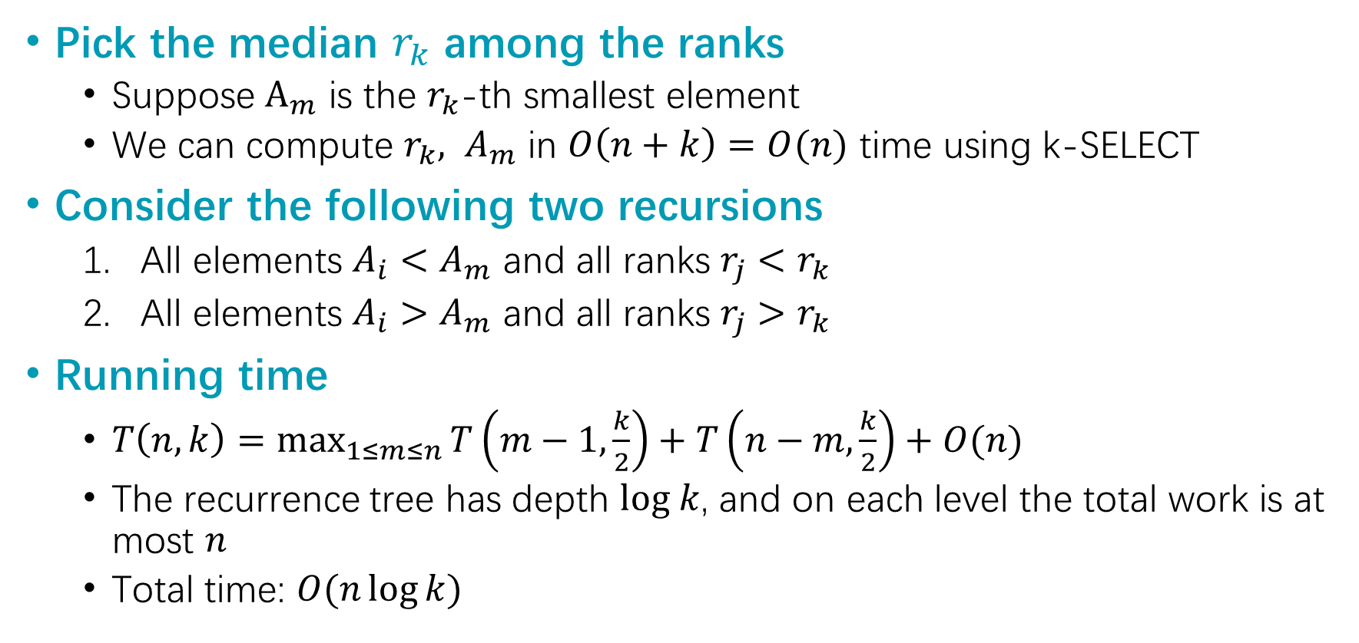
Solution
Pick the median $r_{k}$ among the ranks
Suppose $A_{m}$ is the $r_{k}$-th smallest element
We can compute ${r_{k}, A}_{m}$ in $O\left(n+k\right)=O(n)$ time using k-SELECT
Consider the following two recursions
All elements $A_{i}<A_{m}$ and all ranks $r_{j}<r_{k}$
All elements $A_{i}>A_{m}$ and all ranks $r_{j}>r_{k}$
Running time
$T\left(n,k\right)=\max_{1≤m≤n}{T\left(m−1,\frac{k}{2}\right)+T\left(n−m,\frac{k}{2}\right)+O(n)}$
The recurrence tree has depth $log k$, and on each level the total work is at most $n$
Total time: $O(n\log{k})$

Slide 38
Sorting

Slide 39
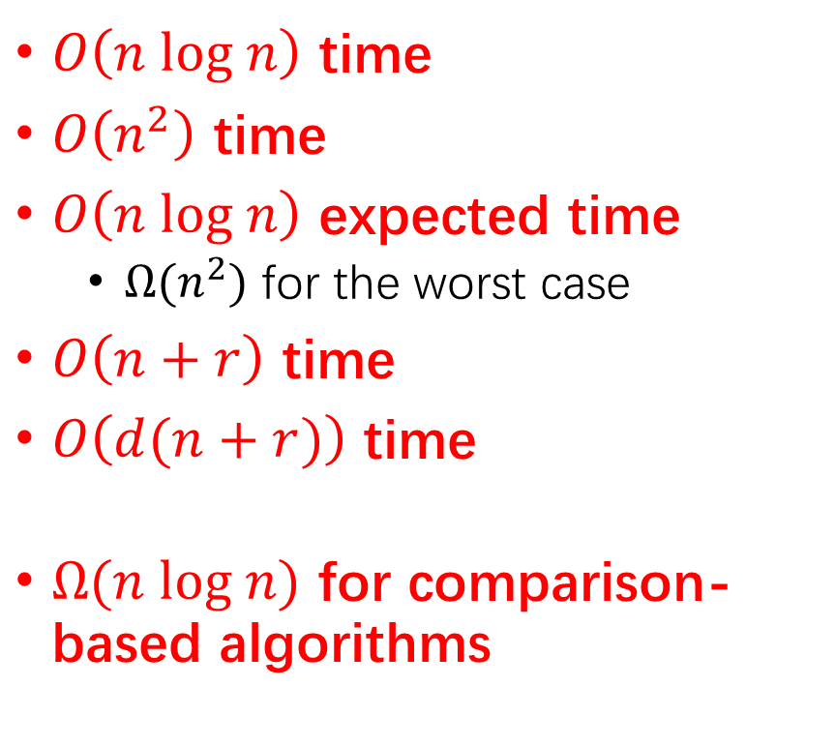
What we have learned for sorting
Merge Sort
Insertion Sort
Quick Sort
A randomized algorithm
Counting Sort
Radix Sort
Sorting lower bound
$O\left(n log n\right)$ time
$O\left(n^{2}\right)$ time
$O\left(n log n\right)$ expected time
$Ω(n^{2})$ for the worst case
$O\left(n+r\right)$ time
$O\left(d(n+r)\right)$ time
$Ω(n log n)$ for comparison-based algorithms

Slide 40
QuickSort vs MergeSort
*What if you want O(n log(n)) worst-case runtime and stability? Check out “Block Sort” on Wikipedia!
 | QuickSort (random pivot) | MergeSort (deterministic)
Running time | Worst-case: O(n²) Expected: O(n log(n)) | Worst-case: O(n log(n))
Used by | Java for primitive types C qsort Unix g++ | Java for objects Perl Python (variant of it called Timsort)
In-Place? (With O(log(n)) extra bits of memory) | Yes, pretty easily | Not easily* if you want to maintain both stability and runtime. (But pretty easily if you can sacrifice runtime).
Stable? | No | Yes
Other Pros | Good cache locality if implemented for arrays | Merge step is really efficient with linked lists
Understand this
These are just for fun. (Not on exam).

Slide 41
Quicksort
.
We want to sort this array.
assume all elements of A are distinct
First, pick a “pivot.”
Do it at random.
7
6
3
5
1
2
4
7
6
3
5
1
2
4
This PARTITION step takes time O(n). (Notice that we don’t sort each half).
[same as in SELECT]
Next, partition the array into “bigger than 5” or “less than 5”
random pivot!
Arrange them like so:
L = array with things smaller than A[pivot]
R = array with things larger than A[pivot]
Recurse on
L and R:
3
1
2
4
5
7
6

Slide 42
Expected Running Time
We will count the number of comparisons that the algorithm does.
This turns out to give us a good idea of the runtime.
How many times are any two items compared?
7
6
3
5
1
2
4
3
1
2
4
5
7
6
3
1
4
2
5
7
6
1
2
3
4
5
6
7
In the example before, everything was compared to 5 once in the first step….and never again.
But not everything was compared to 3.
5 was, and so were 1,2 and 4.
But not 6 or 7.

Slide 43
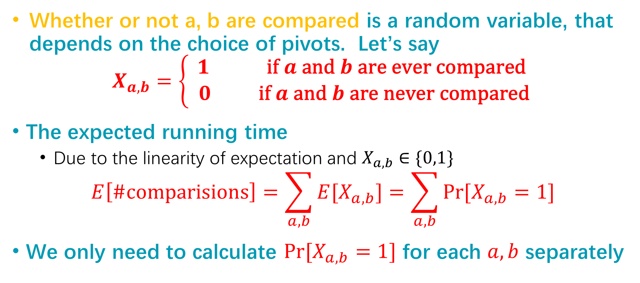
Analysis
Whether or not a, b are compared is a random variable, that depends on the choice of pivots. Let’s say
$$X_{a,b}=\left\{\begin{aligned}1 \text{if} a \text{and} b \text{are} \text{ever} \text{compared} \\ 0 \text{if} a \text{and} b \text{are} \text{never} \text{compared} \end{aligned}\right.$$
The expected running time
Due to the linearity of expectation and $X_{a,b}∈\{0,1\}$
$$E\left[\#comparisions\right]=\sum_{a,b}{E[X_{a,b}]}=\sum_{a,b}{\operatorname{Pr}{[X_{a,b}=1]}}$$
We only need to calculate $\operatorname{Pr}{[X_{a,b}=1]}$ for each $a,b$ separately

Slide 44
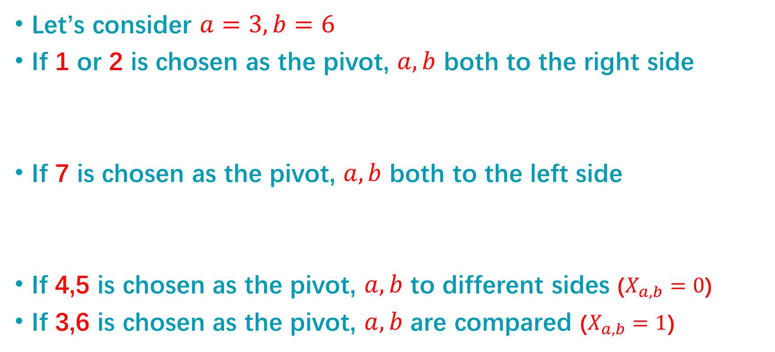
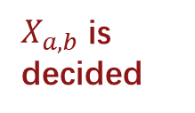
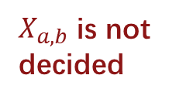


Analysis – cont’d
Let’s consider $a=3, b=6$
If 1 or 2 is chosen as the pivot, $a,b$ both to the right side
If 7 is chosen as the pivot, $a,b$ both to the left side
If 4,5 is chosen as the pivot, $a,b$ to different sides ($X_{a,b}=0$)
If 3,6 is chosen as the pivot, $a,b$ are compared ($X_{a,b}=1$)
7
6
3
5
1
2
4
$$a,b$$
$X_{a,b}$ is not decided
7
6
3
5
1
2
4
$$a,b$$
$X_{a,b}$ is decided

Slide 45

Analysis – cont’d
$Pr\left[X_{a,b}=1\right]=Pr\left[X_{a,b}=1\right|X_{a,b} is decided]$, by the following rules
probability that one of $a,b$are picked first out of all of the $b – a +1$numbers between them.
$$\operatorname{Pr}\left[X_{a,b}=1\right]=\frac{2}{b−a+1}$$
7
6
3
5
1
2
4
Say that a = 3 and b = 6. What is the probability that 3 and 6 are ever compared?
7
6
3
5
1
2
4
This is exactly the probability that either 3 or 6 is first picked to be a pivot out of the highlighted entries.
3
1
2
4
5
7
6
If, say, 5 were picked first, then 3 and 6 would be separated and never see each other again.

Slide 46

Analysis – cont’d
$$\sum_{a=1}^{n}{\sum_{b=a+1}^{n}{E\left[X_{a,b}\right]}}=\sum_{a=1}^{n}{\sum_{b=a+1}^{n}{\frac{2}{b−a+1}}} \\ =\sum_{Δ=1}^{n}{\sum_{b=Δ+1}^{n}{\frac{2}{Δ+1}}} \\ ≤\sum_{Δ=1}^{n}{n⋅\frac{2}{Δ+1}}=O(n log n)$$
Upper-bounded by the harmonic number

Slide 47
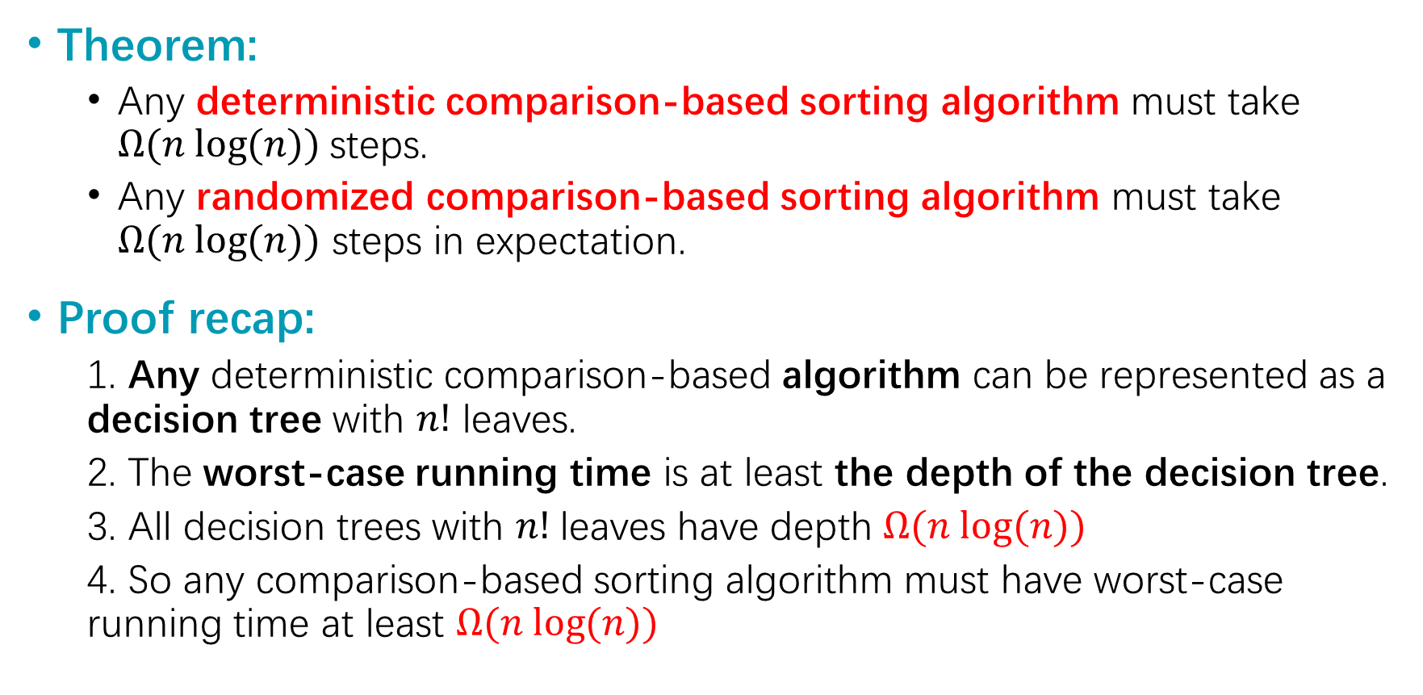
Lower bound
Theorem:
Any deterministic comparison-based sorting algorithm must take $Ω(n log⁡(n))$steps.
Any randomized comparison-based sorting algorithm must take $Ω(n log⁡(n))$ steps in expectation.
Proof recap:
1. Any deterministic comparison-based algorithm can be represented as a decision tree with $n!$ leaves.
2. The worst-case running time is at least the depth of the decision tree.
3. All decision trees with $n!$leaves have depth $Ω(n log⁡(n))$
4. So any comparison-based sorting algorithm must have worst-case running time at least $Ω(n log⁡(n))$
This covers all the sorting algorithms we know!!!

Slide 48
Decision Tree
?
YES
NO
?
?
YES
NO
YES
NO
?
?
?
?
If we take this path through the tree, the runtime is Ω(length of the path)

Slide 49
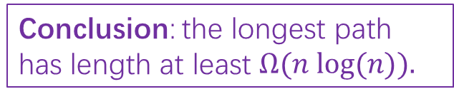
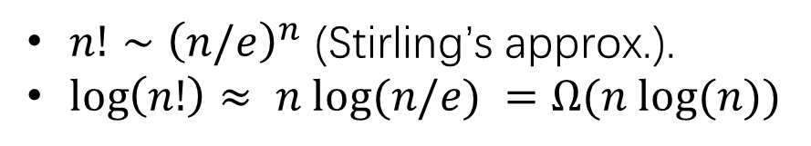
How long is the longest path?
We want a statement: in all such trees, the longest path is at least _____
?
This is a binary tree with at least _____ leaves.
The shallowest tree with n! leaves is the completely balanced one, which has depth ______.
So in all such trees, the longest path is at least log(n!).
YES
NO
n!
?
?
YES
NO
YES
NO
?
?
?
?
log(n!)
$n!∼{\left(n/e\right)}^{n}$ (Stirling’s approx.).
$\log\left(n!\right)≈ n log⁡(n/e) =Ω(n log⁡(n))$
Conclusion: the longest path has length at least $Ω(n log⁡(n)).$

Slide 50
Exercise – Adaptivity for Sorting
Section 3 Problem 3

Slide 51
Adaptivity
Adaptivity
# rounds (depth) of queries
For comparison-based problems (e.g. sorting)
Query = Comparisons
Adaptivity: # rounds of comparisons

Slide 52



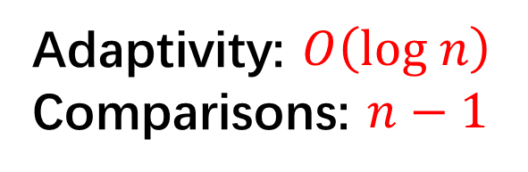
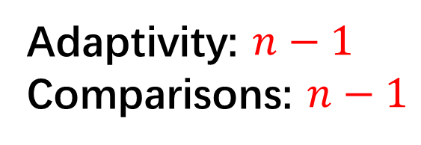
Adaptivity – Warmup Examples
Computing the maximum $\max_{i} A[i]$
5
5
6
6
6
6
3
6
3
8
8
8
8
8
7
8
7
8
8
8
2
$$⋮$$
2
$$⋯$$
8
8
8
8
9
9
6
Adaptivity: $n−1$
Comparisons: $n−1$
6
9
Adaptivity: $O\left(log n\right)$
Comparisons: $n−1$
4
4
9
5
5
5

Slide 53







Adaptivity for Insertion Sort
Insertion Sort
Step $1$
Step $2$
Step $3$
Step $K$
5
1
9
5
5
5
…
1
3
3
9
9
3
3
5
1
3
3
9
5
9
1
1
1
9
$$K=Θ\left(n^{2}\right)$$

Slide 54

Adaptivity for Quick Sort
Quick Sort
Step $1$
Step $2$
Step 3
5
1
9
5
3
1
3
3
9
1
3
5
1
3
5
5
9
1
9
9
$$E[K]=Θ\left(log n\right)$$

Slide 55


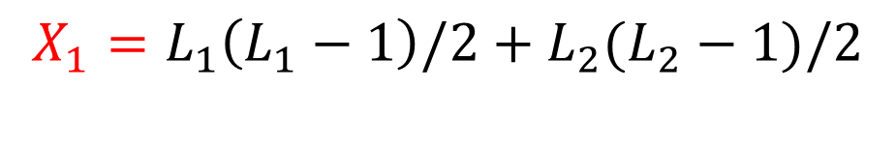





Adaptivity for Quick Sort -Analysis
Number of remaining comparisons
# pairs whose order is unknown
$N$ elements
$$X_{0}=N(N−1)/2$$
$L_{1}$ elements
$L_{2}$ elements
$$X_{1}=L_{1}\left(L_{1}−1\right)/2+L_{2}(L_{2}−1)/2$$
$$X_{2}=⋯$$
Analysis
With probability ½, $L_{1},L_{2}≤ 3N/4$, $X_{1}≤\frac{N\left(3N/4−1\right)}{2}≤\frac{3}{4}X_{0}$
$$E\left[X_{1}\right]≤\frac{1}{2}⋅\frac{3}{4}⋅X_{0}+\frac{1}{2}⋅X_{0}=\frac{7}{8}⋅X_{0}$$
Similarly, we have $E\left[X_{t}|X_{t−1}\right]≤\frac{7}{8}⋅X_{t−1}$ and $E\left[X_{t}\right]=O(1/n)$ for $t=Θ(log n)$
At level t:
A is sorted $⇔X_{t}=0$
A is unsorted $⇔X_{t}≥1$
$$E\left[X_{t}\right]≥\operatorname{Pr}{[A is unsorted]}$$

Slide 56
Binary Search Trees

Slide 57
Binary Search Trees
A BST is a binary tree so that:
Every LEFT descendant of a node has key less than that node.
Every RIGHT descendant of a node has key larger than that node.
5
5
3
7
3
7
2
4
8
2
4
8
1
1
NOT a Binary Search Tree
Binary Search Tree

Slide 58

Operations on BST
In-order Traversal
Output all the elements in sorted order!
Search
Time = $O($height of tree$)$
Height could be $Θ(n)$
Insertion
Deletion
5
Search for 4
3
7
!!!!
2
4
8
1

Slide 59

Red-Black Trees
Every node is colored red or black.
The root node is a black node.
NIL children count as black nodes.
Children of a red node are black nodes.
For all nodes x:
all paths from x to NIL’s have the same number of black nodes on them.
Balanced:
The height of a RB-tree with $n$ non-NIL nodes is at most $2log⁡(n+1)$
5
3
7
2
4
6
8
NIL
NIL
NIL
NIL
NIL
NIL
NIL
NIL

Slide 60

Q&A

