Slide 1
CS 161 – Section 9
CA:

Slide 2
Section 9 Agenda
Stable Matching
Course Review

Slide 3
Stable Matching

Slide 4


Stable Matching
Blocking pair
In a given matching M, (Doctor i, Hospital j) are a blocking pair if they prefer each other to their assignment in M
Stable matching
M is a stable matching if there are no blocking pairs.
n
n

Slide 5
Deferred Acceptance Algorithm
5
Main idea: try to match each doctor to top choice;
if you discover a blocking pair, just switch the matching!
Almost-pseudo-code:
While there is an unmatched doctor i:
Try to match i to next-favorite hospital in her list;
If this hospital doesn’t have a doctor yet:
Both Doctor i and hospital are happy with this new match ☺
Else-if this hospital prefers its current match i’ over i:
Doctor i remains unmatched
Else-if this hospital prefers i over i’:
Unmatch i’; Match (i, hospital)

Slide 6
Example run-through

Slide 7





DA Example Run 1
B, A, C
X, Y, Z
X
Alice
A, B, C
Y, X, Z
Y
Bob
B, C, A
Y, Z, X
Z
Charlie

Slide 8
DA Example Run 1
B, A, C
X, Y, Z
X
Alice
A, B, C
Y, X, Z
Y
Bob
B, C, A
Y, Z, X
Z
Charlie

Slide 9
DA Example Run 1
B, A, C
X, Y, Z
X
Alice
A, B, C
Y, X, Z
Y
Bob
B, C, A
Y, Z, X
Z
Charlie

Slide 10
DA Example Run 1
B, A, C
X, Y, Z
X
Alice
A, B, C
Y, X, Z
Y
Bob
B, C, A
Y, Z, X
Z
Charlie

Slide 11
DA Example Run 1
B, A, C
X, Y, Z
X
Alice
A, B, C
Y, X, Z
Y
Bob
B, C, A
Y, Z, X
Z
Charlie

Slide 12
DA Example Run 1
B, A, C
X, Y, Z
X
Alice
A, B, C
Y, X, Z
Y
Bob
B, C, A
Y, Z, X
Z
Charlie

Slide 13
Another example

Slide 14
DA Example Run 2
B, A, C
X, Y, Z
X
Alice
A, C, B
Y, X, Z
Y
Bob
B, C, A
Y, Z, X
Z
Charlie

Slide 15
DA Example Run 2
B, A, C
X, Y, Z
X
Alice
A, C, B
Y, X, Z
Y
Bob
B, C, A
Y, Z, X
Z
Charlie

Slide 16
DA Example Run 2
B, A, C
X, Y, Z
X
Alice
A, C, B
Y, X, Z
Y
Bob
B, C, A
Y, Z, X
Z
Charlie

Slide 17
DA Example Run 2
B, A, C
X, Y, Z
X
Alice
A, C, B
Y, X, Z
Y
Bob
B, C, A
Y, Z, X
Z
Charlie

Slide 18
DA Example Run 2
B, A, C
X, Y, Z
X
Alice
A, C, B
Y, X, Z
Y
Bob
B, C, A
Y, Z, X
Z
Charlie

Slide 19
DA Example Run 2
B, A, C
X, Y, Z
X
Alice
A, C, B
Y, X, Z
Y
Bob
B, C, A
Y, Z, X
Z
Charlie

Slide 20
DA Example Run 2
B, A, C
X, Y, Z
X
Alice
A, C, B
Y, X, Z
Y
Bob
B, C, A
Y, Z, X
Z
Charlie

Slide 21
DA Example Run 2
B, A, C
X, Y, Z
X
Alice
A, C, B
Y, X, Z
Y
Bob
B, C, A
Y, Z, X
Z
Charlie

Slide 22
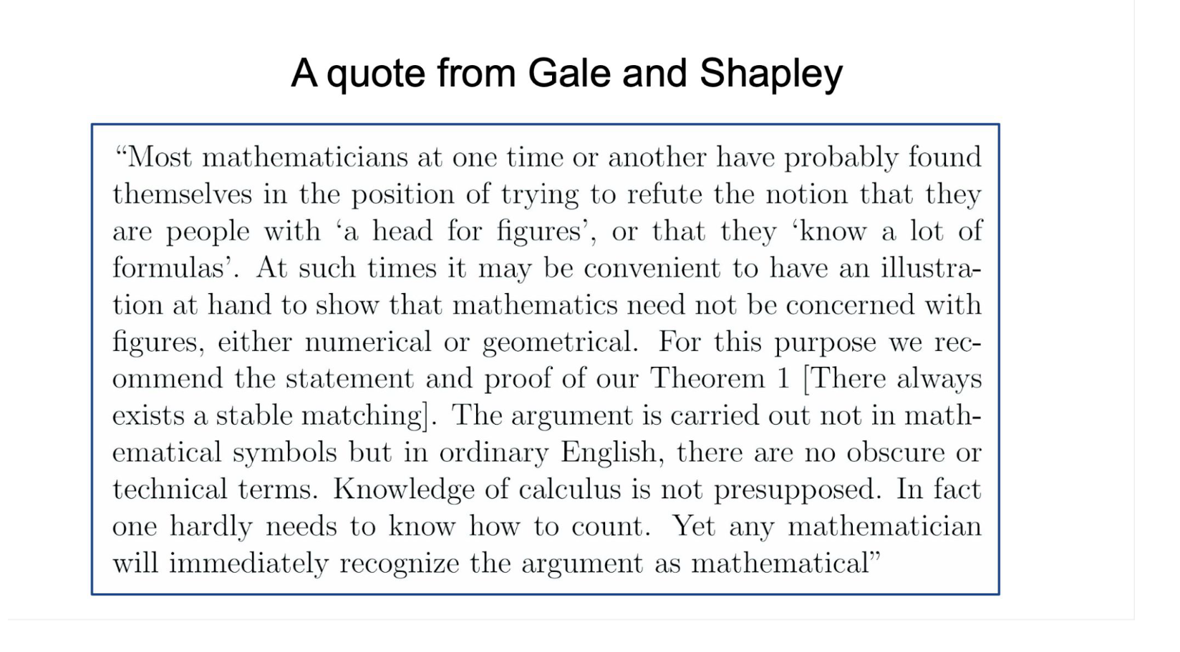

Slide 23
Final Review!

Slide 24
Asymptotics, Runtime Analysis
Big-O Notation O(f(n)) - what does this mean?
O vs. Theta vs. Omega
Expected vs. Worst-Case Analysis

Slide 25
Divide and Conquer
What does it mean to divide and conquer
How do you define subproblems?
How do we analyze
Recurrence (substitution and tree method), Master Theorem

Slide 26
More Algorithm Concepts
Randomized Algorithms
What does it mean for an algorithm to be randomized?
What types of randomized algorithms are there?
Bounds for sorting
How can we prove bounds on complexity?
Binary trees
What are their key properties and uses? Balanced vs. unbalanced?
Hashing
Universal families and universal hash functions

Slide 27
Graphs
BFS, DFS
Complexity, differences?
SCC’s
Definition, how do we find them?
Shortest Path
Bellman Ford, Dijkstra, Floyd-Warshall
Requirements, runtime

Slide 28
Dynamic Programming
Optimization problems
Overlapping subproblems (reuse work)
Top-down vs. bottom-up
Examples:
Bellman Ford, Floyd-Warshall
LCS, Knapsack, Independent Set

Slide 29
Greedy Algorithms
What makes a greedy algorithm?
How do we prove a greedy algorithm is correct?
Greedy and mostly greedy algorithms
Minimum Spanning Tree
Max-Flow, Min-Cut
Stable Matching (not on the final)

Slide 30
Problem-Solving Toolkit
How can you adapt algorithms from lecture for different problems?
Read the problem statement carefully! Are there hints in provided runtimes, inputs, or outputs?
Break down the problem: what could smaller subproblems look like?
Try small test-cases
Good to know: various proof structures, runtime and applicability of algorithms from class
Notes:
Not all strategies will be applicable for all problems

Slide 31
Other Review Resources
2 Practice Finals (Ed #840)
Recommended: practice under timed conditions to develop timing strategies!
2 Review Sections
3/7 and 3/14 – Skilling Auditorium 10:30am-12:00pm, recorded on Canvas
Lectures
Content covered on the exam is cumulative with a focus on materials covered after the midterm
Section Problems – great for extra practice!
Have Questions? Feel free to ask on Ed or in OH!

Slide 32
Questions?
Notes:
Give time to review specific material requested by students!

Slide 33
Good luck preparing for the final!!

