Slide 1
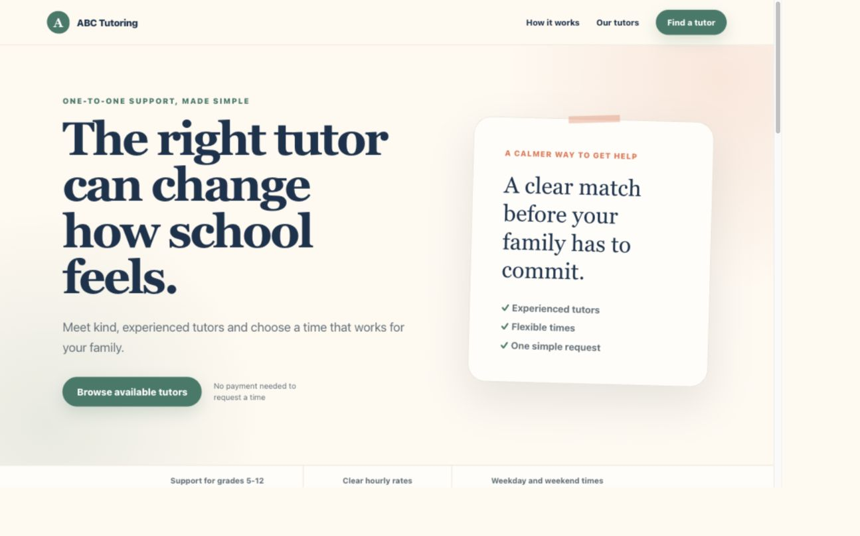
ABC TUTORING / FIRST-VERSION PROTOTYPE
A simpler way for families to find the right tutor
Compare tutors. Choose a time. Request a match.
Prepared for Dana
ABC Tutoring prototype
1
Notes:
[Sources]
- ABC Tutoring prototype static export, captured 2026-09-03.

Slide 2
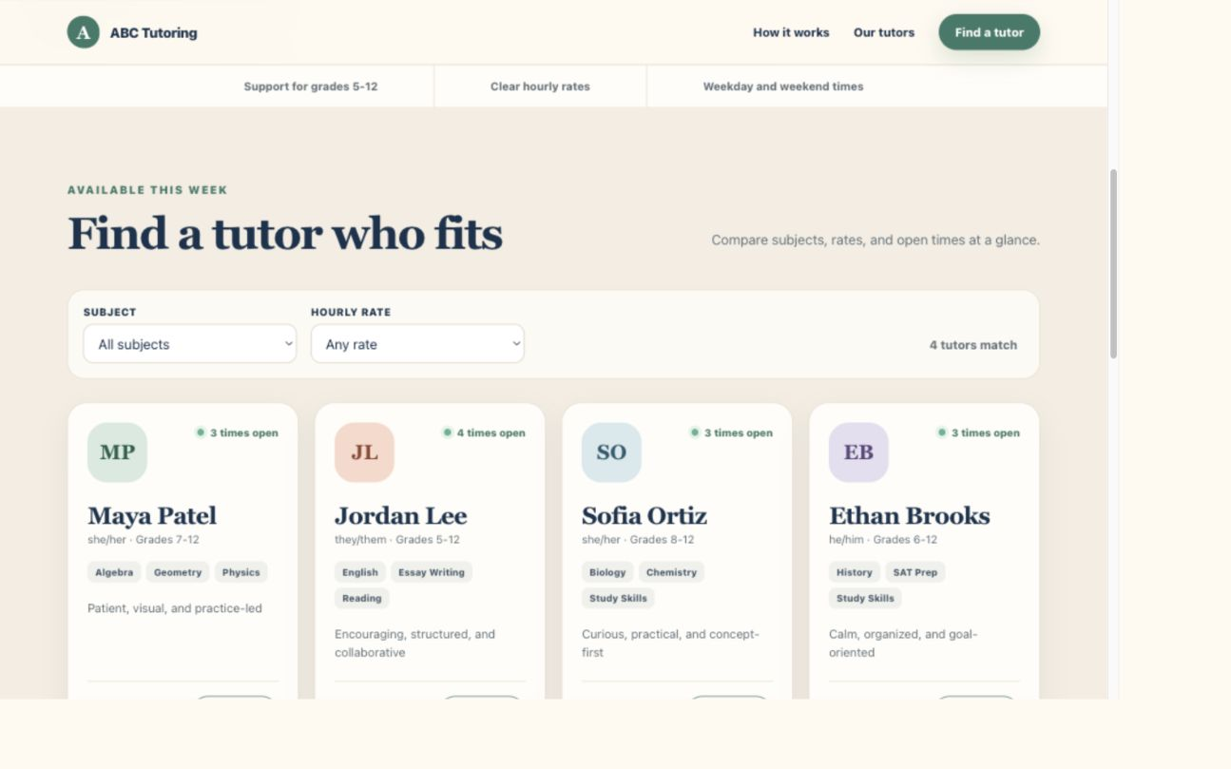
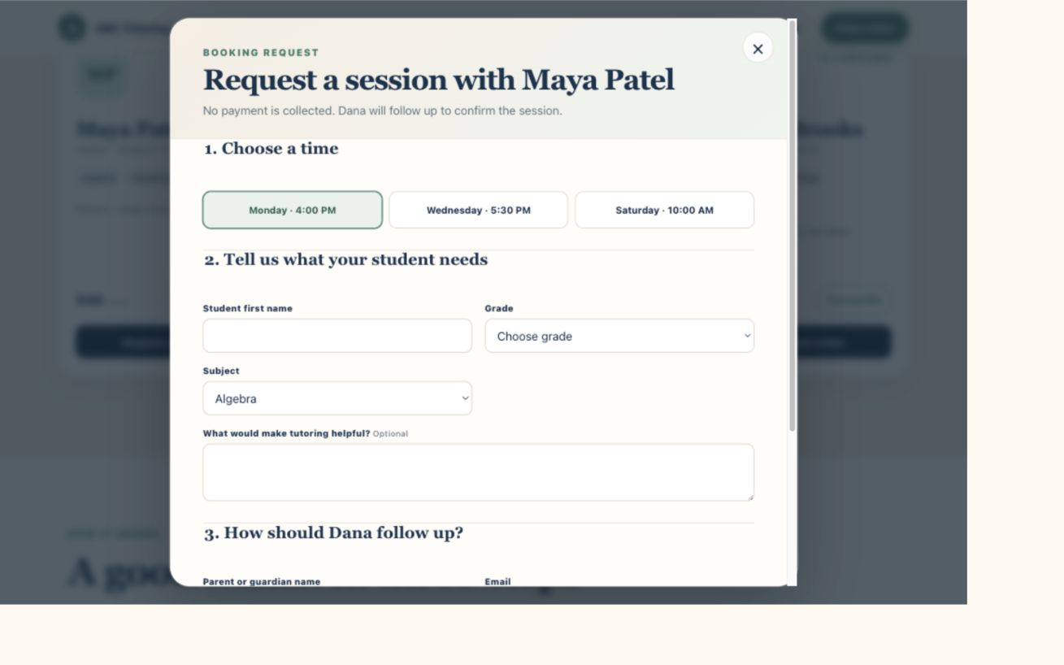
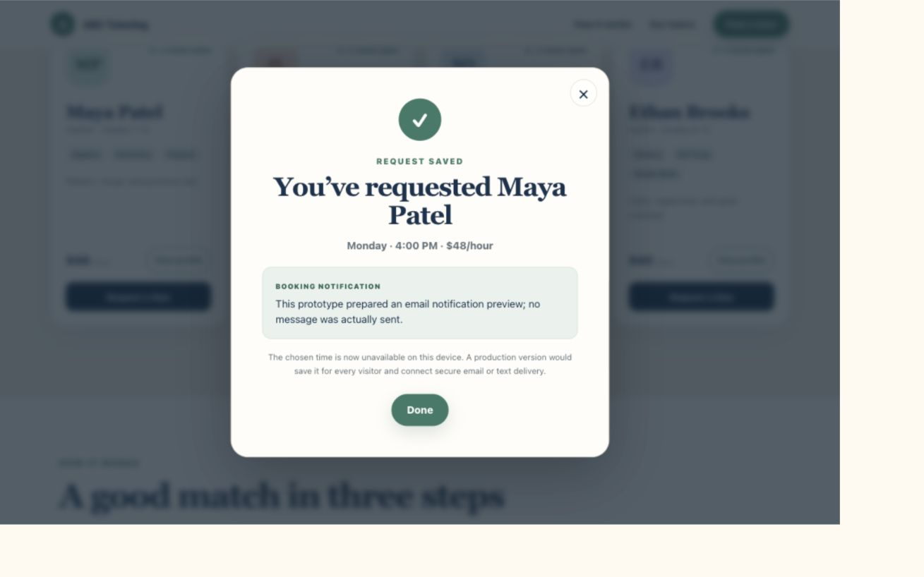
Parents can request a tutor in one clear flow
1 Browse profiles
2 Choose a time
3 Request sent
Private family details are never sent to analytics.
ABC Tutoring prototype
2
Notes:
[Sources]
- Confirmed Dana requirements and implemented ABC Tutoring prototype flow.

Slide 3
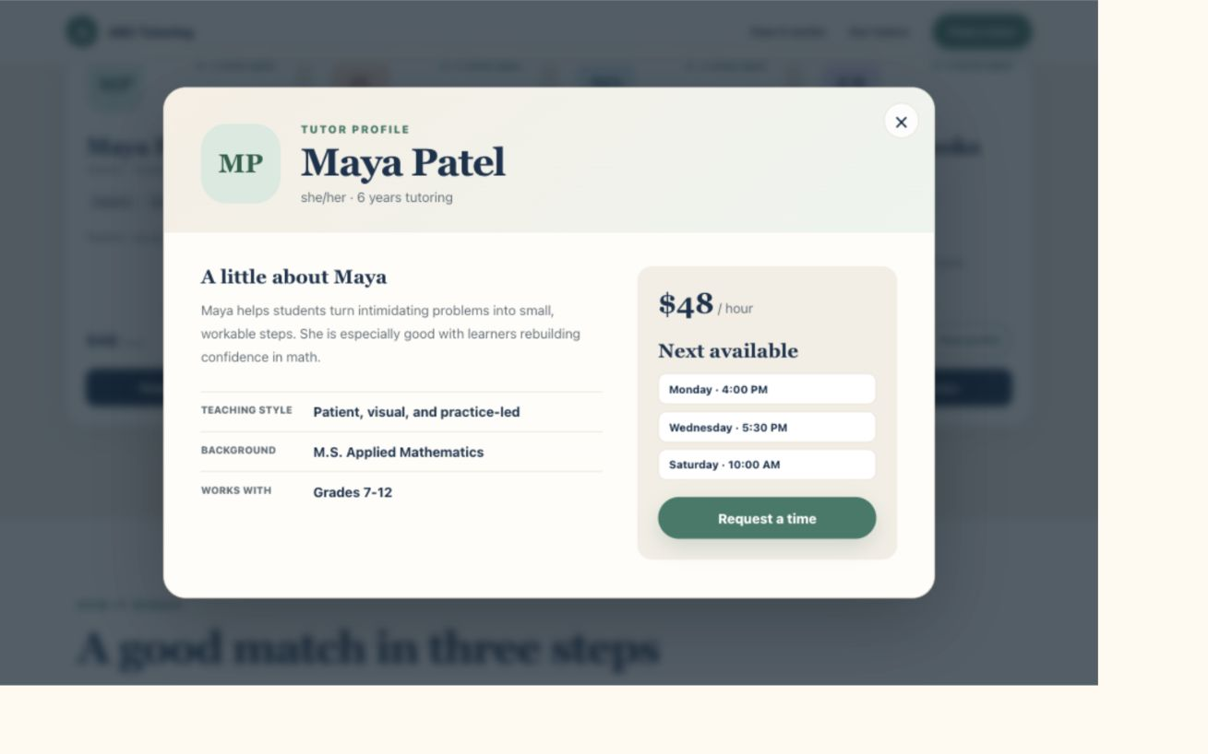
One request, two automatic updates
BEFORE / OPEN TIME
AFTER / TIME CLOSED
Schedule updates
Alert is prepared
Prototype: browser-based availability + notification preview
3
Notes:
[Sources]
- ABC Tutoring prototype booking confirmation, captured 2026-09-03.

Slide 4
Dana can see which tutor interest becomes bookings
DEMO ACTIVITY - 32 SYNTHETIC VISITS
25
profile views
18
booking starts
12
booking requests
Demo activity is labeled and can be filtered in PostHog
4
Notes:
[Sources]
- Synthetic activity from scripts/simulate-traffic.mjs, run 2026-09-03.
- PostHog Funnels: https://posthog.com/docs/product-analytics/funnels
- PostHog Dashboards: https://posthog.com/docs/product-analytics/dashboards

