Slide 1
MS&E 228: Prediction with High-Dimensional Linear Models
Vasilis Syrgkanis
MS&E, Stanford

Slide 2
Causal Inference with Experiments
Prediction with Linear Models
Prediction with High-Dim Linear Models
Inference on Causal and Predictive Effects with High-Dim Linear Models
Potential Outcomes and Conditional Ignorability
Structural Equation Models and Conditional Exogeneity
Directed Acyclic Graphs
Prediction with Non-Linear Models
Inference on Causal Effects with Non-Linear Models
Un-observed Confounding and Instruments
Identification of Causal Effects in Longitudinal Data
Estimation of Heterogeneous Causal Effects
Linear Predictive Models and Statistical Inference
Causal Identification in Observational Data
Non-Linear Predictive Models and Statistical Inference
Topics

Slide 3
Causal Inference with Experiments
Prediction with Linear Models
Prediction with High-Dim Linear Models
Inference on Causal and Predictive Effects with High-Dim Linear Models
Potential Outcomes and Conditional Ignorability
Structural Equation Models and Conditional Exogeneity
Directed Acyclic Graphs
Prediction with Non-Linear Models
Inference on Causal Effects with Non-Linear Models
Un-observed Confounding and Instruments
Identification of Causal Effects in Longitudinal Data
Estimation of Heterogeneous Causal Effects
Linear Predictive Models and Statistical Inference
Causal Identification in Observational Data
Non-Linear Predictive Models and Statistical Inference
Topics

Slide 4
Recap of Previous Lecture

Slide 5

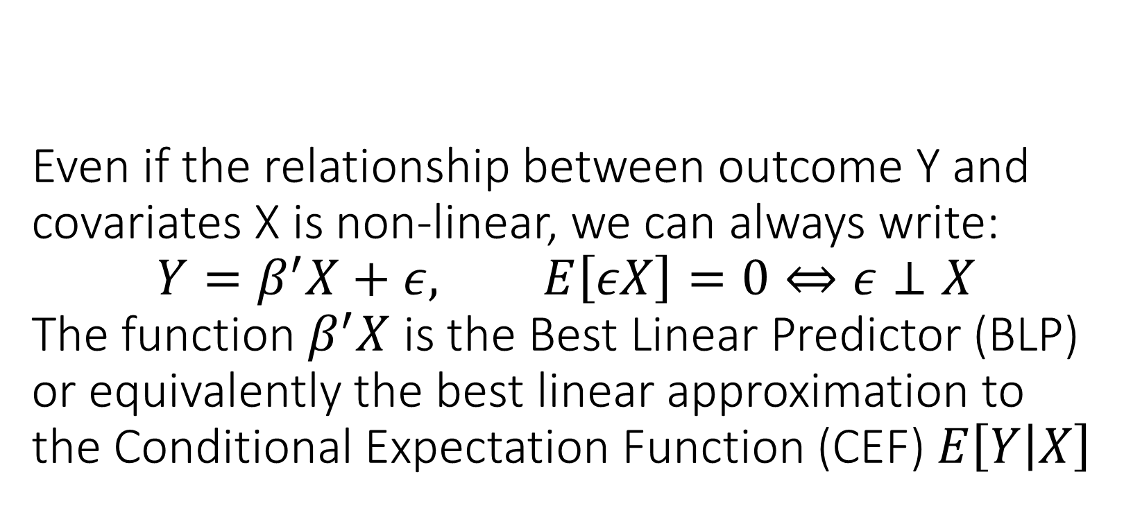
Even if the relationship between outcome Y and covariates X is non-linear, we can always write: $$Y=β^{′}X+ε, E\left[εX\right]=0⇔ε⊥X$$ The function $β^{′}X$ is the Best Linear Predictor (BLP) or equivalently the best linear approximation to the Conditional Expectation Function (CEF) $E\left[Y | X\right]$

Slide 6
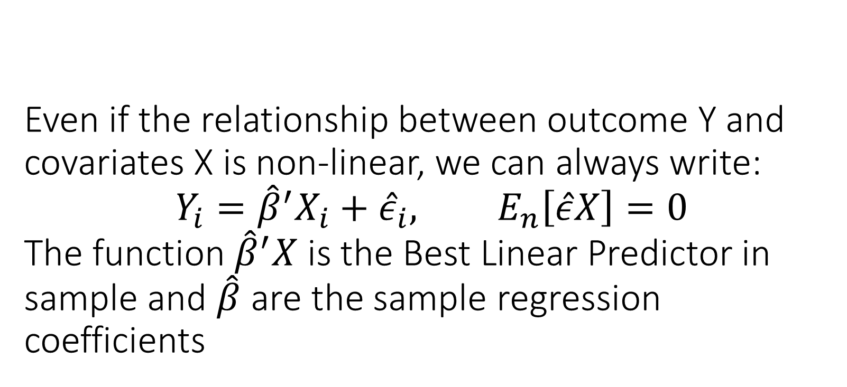
Even if the relationship between outcome Y and covariates X is non-linear, we can always write: $$Y_{i}={\hat{β}}^{′}X_{i}+{\hat{ε}}_{i}, E_{n}\left[\hat{ε}X\right]=0$$ The function ${\hat{β}}^{′}X$ is the Best Linear Predictor in sample and $\hat{β}$ are the sample regression coefficients

Slide 7
You should expect OLS to produce accurate predictions in the worst-case only if the number of variables is small compared to number of samples. Its predictions converge to the predictions of the BLP in the population

Slide 8
Almost always measure predictive performance of your estimated model on a held-out sample

Slide 9
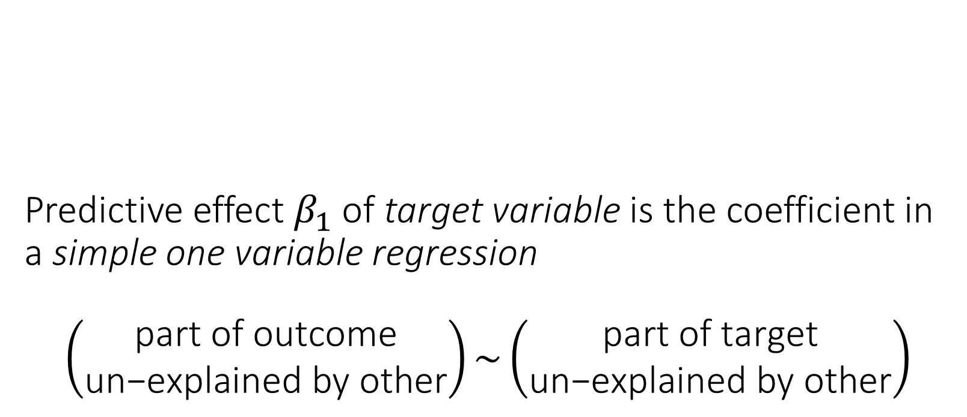
Predictive effect $β_{1}$of target variable is the coefficient in a simple one variable regression $$\left(\begin{matrix}\text{part} \text{of} \text{outcome} \\ \text{un}\text{−}\text{explained} \text{by} \text{other}\end{matrix}\right)\sim \left(\begin{matrix}\text{part} \text{of} \text{target} \\ \text{un}\text{−}\text{explained} \text{by} \text{other}\end{matrix}\right)$$

Slide 10
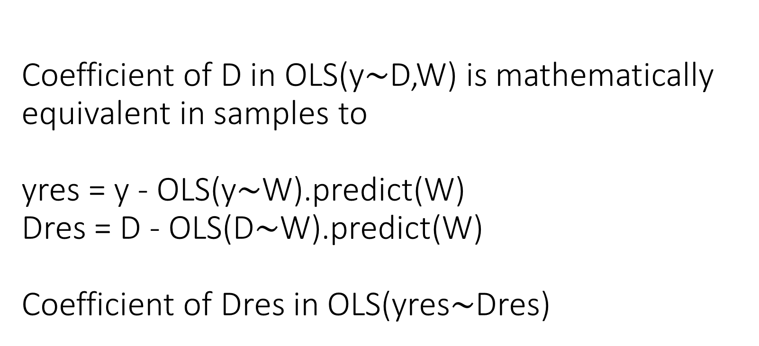
Coefficient of D in OLS(y$∼$D,W) is mathematically equivalent in samples to yres = y - OLS(y$∼$W).predict(W) Dres = D - OLS(D$∼$W).predict(W) Coefficient of Dres in OLS(yres$∼$Dres)

Slide 11
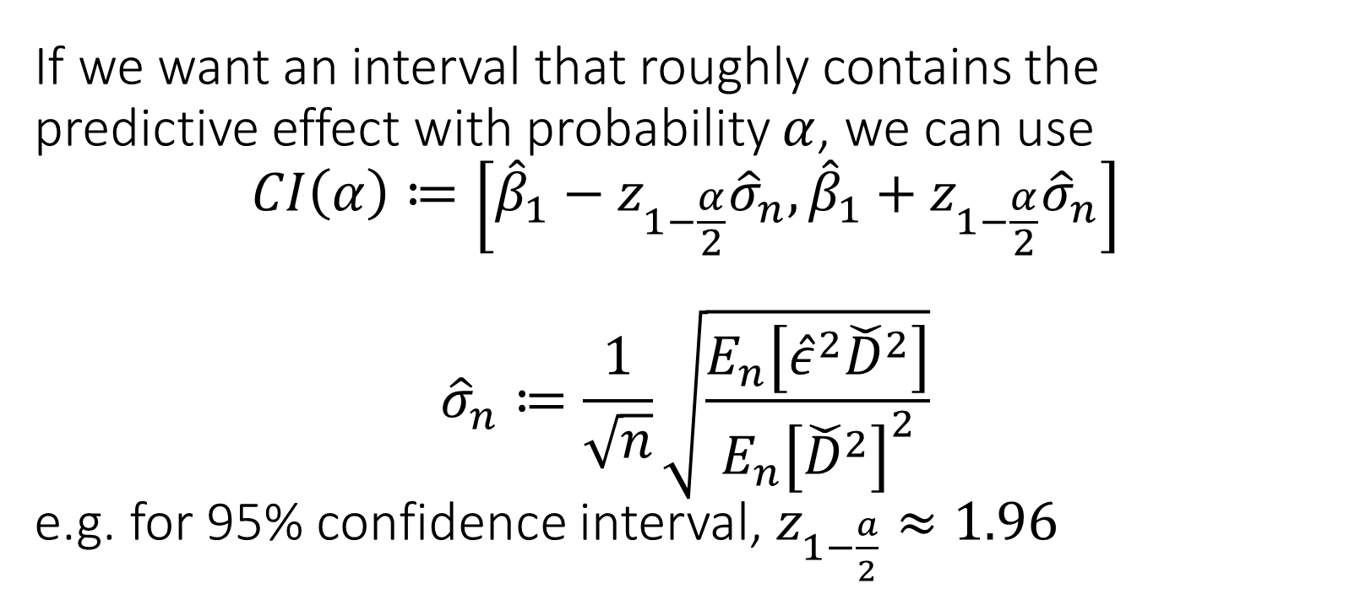
If we want an interval that roughly contains the predictive effect with probability $α$, we can use $$CI\left(α\right)≔\left[{\hat{β}}_{1}−z_{1−\frac{α}{2}}{\hat{σ}}_{n},{\hat{β}}_{1}+z_{1−\frac{α}{2}}{\hat{σ}}_{n}\right]$$ $${\hat{σ}}_{n}≔\frac{1}{\sqrt{n}}\sqrt{\frac{E_{n}\left[{\hat{ε}}^{2}{\check{D}}^{2}\right]}{E_{n}{\left[{\check{D}}^{2}\right]}^{2}}}$$ e.g. for 95% confidence interval, $z_{1−\frac{a}{2}}≈1.96$

Slide 12
The coefficient associated with treatment D in OLS with co-variate adjustment is always consistent for the treatment effect, when run on data from a randomized experiment, as-long-as covariates are de-meaned. The true relationship of outcome with covariates does not need to be linear.

Slide 13
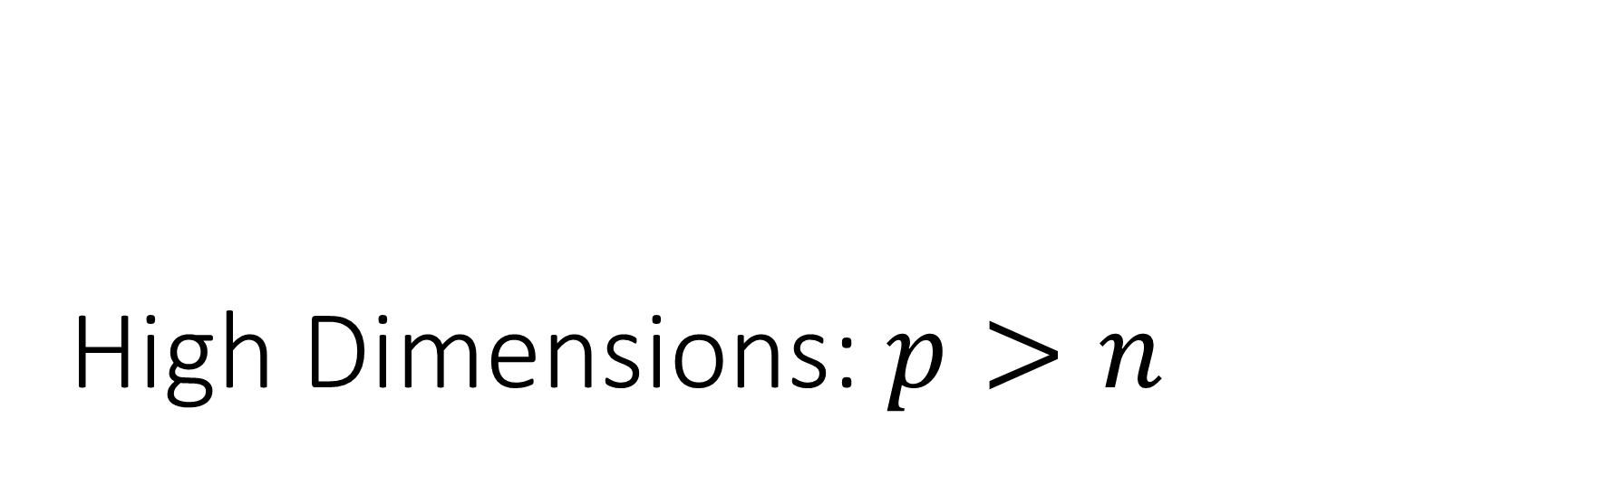
High Dimensions: $p>n$

Slide 14
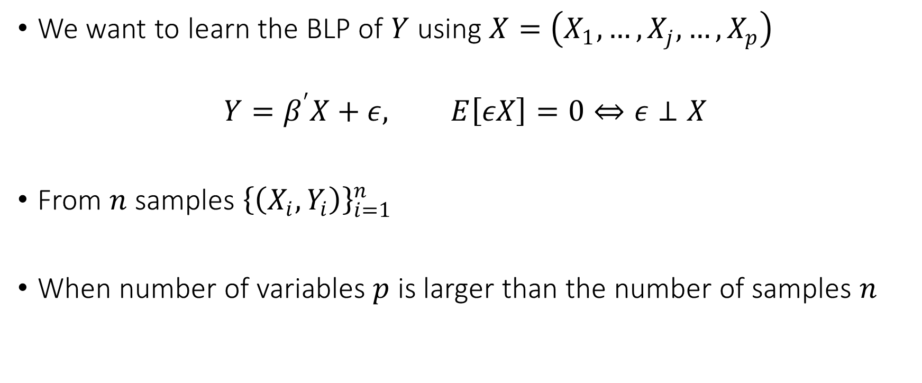
Best Linear Predictor
We want to learn the BLP of $Y$ using $X=\left(X_{1},…,X_{j},…,X_{p}\right)$
$$Y=β^{′}X+ε, E\left[εX\right]=0⇔ε⊥X$$
From $n$ samples ${\left\{\left(X_{i},Y_{i}\right)\right\}}_{i=1}^{n}$
When number of variables $p$ is larger than the number of samples $n$

Slide 15
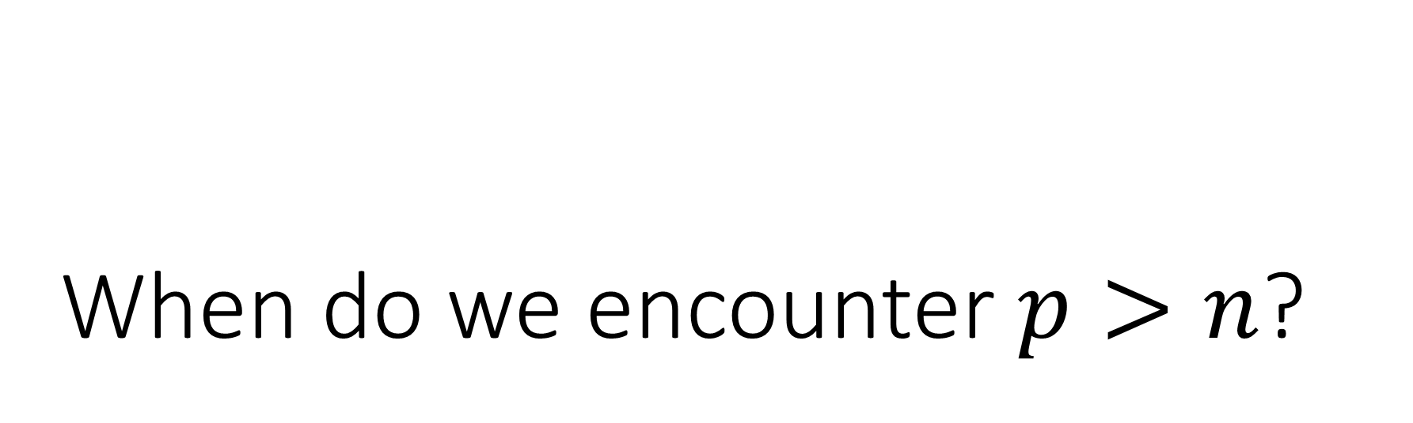
When do we encounter $p>n$?

Slide 16
Inherent High-Dimensionality

Slide 17
Inherent High-Dimensional Data
Rich datasets with many covariates
Country characteristics in cross-country wealth analysis
Housing characteristics in housing pricing/appraisal analysis
Individual electronic health records and claims data
Product characteristics at point of purchase in demand analysis
Customer characteristics in operations management
User characteristics and history in the digital economy

Slide 18
Fabricated High-Dimensionality
As a means for better real-world approximations

Slide 19
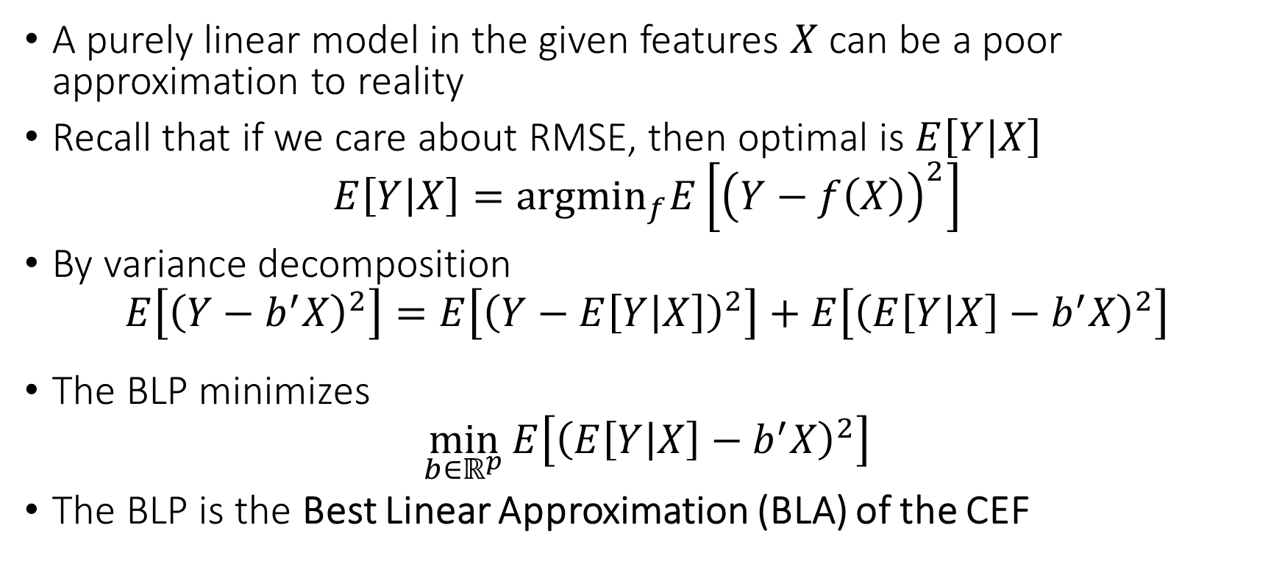
High-Dimensionality from Feature Engineering
A purely linear model in the given features $X$ can be a poor approximation to reality
Recall that if we care about RMSE, then optimal is $E\left[Y | X\right]$
$$E\left[Y | X\right]={argmin}_{f}E\left[{\left(Y−f\left(X\right)\right)}^{2}\right]$$
By variance decomposition
$$E\left[{\left(Y−b^{′}X\right)}^{2}\right]=E\left[{\left(Y−E\left[Y | X\right]\right)}^{2}\right]+E\left[{\left(E\left[Y | X\right]−b^{′}X\right)}^{2}\right]$$
The BLP minimizes
$$\min_{b∈ℝ^{p}}{E\left[{\left(E\left[Y | X\right]−b^{′}X\right)}^{2}\right]}$$
The BLP is the Best Linear Approximation (BLA) of the CEF

Slide 20
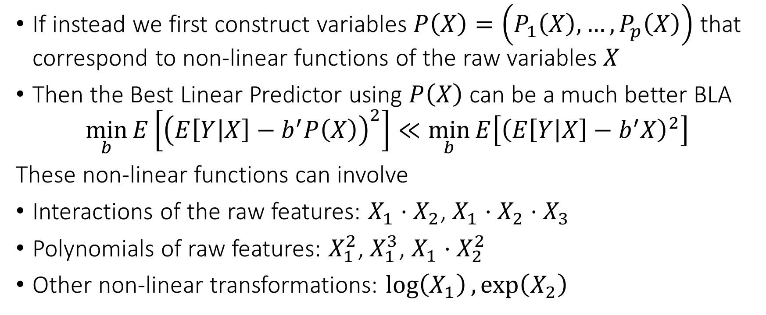
High-Dimensionality from Feature Engineering
If instead we first construct variables $P\left(X\right)=\left(P_{1}\left(X\right),…,P_{p}\left(X\right)\right)$ that correspond to non-linear functions of the raw variables $X$
Then the Best Linear Predictor using $P\left(X\right)$ can be a much better BLA
$$\min_{b}{E\left[{\left(E\left[Y | X\right]−b^{′}P\left(X\right)\right)}^{2}\right]}≪\min_{b}{E\left[{\left(E\left[Y | X\right]−b^{′}X\right)}^{2}\right]}$$
These non-linear functions can involve
Interactions of the raw features: $X_{1}⋅X_{2}$, $X_{1}⋅X_{2}⋅X_{3}$
Polynomials of raw features: $X_{1}^{2}$, $X_{1}^{3}$, $X_{1}⋅X_{2}^{2}$
Other non-linear transformations: $\log\left(X_{1}\right),\exp\left(X_{2}\right)$

Slide 21
Coding Example

Slide 22
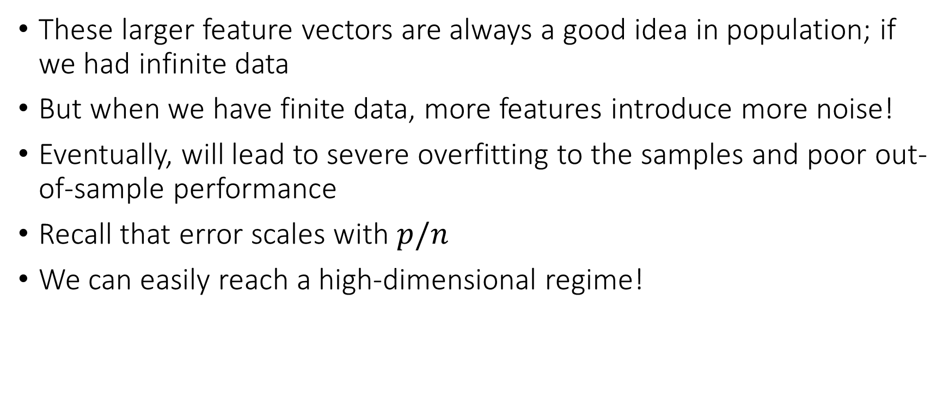
High-Dimensionality from Feature Engineering
These larger feature vectors are always a good idea in population; if we had infinite data
But when we have finite data, more features introduce more noise!
Eventually, will lead to severe overfitting to the samples and poor out-of-sample performance
Recall that error scales with $p/n$
We can easily reach a high-dimensional regime!

Slide 23
Coding Example

Slide 24
Not imposing any restrictions or biases on the parameters can lead to un-stable estimation in finite samples

Slide 25
Solution: add penalty terms to your estimation that induce biases towards solutions we a prior believe are more probable

Slide 26
Sparsity and the Lasso

Slide 27
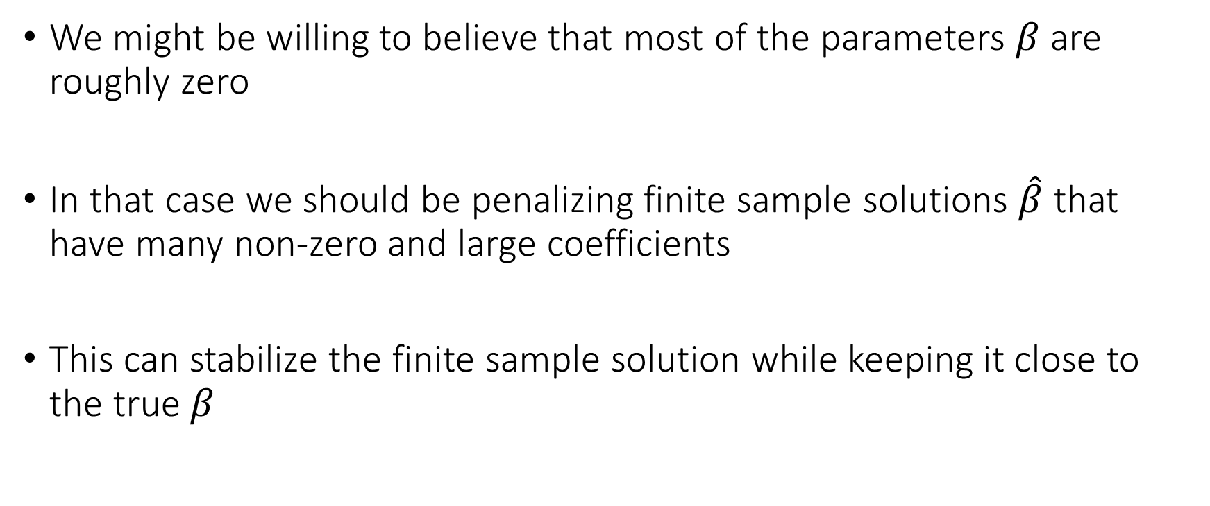
The Premise
We might be willing to believe that most of the parameters $β$ are roughly zero
In that case we should be penalizing finite sample solutions $\hat{β}$ that have many non-zero and large coefficients
This can stabilize the finite sample solution while keeping it close to the true $β$

Slide 28
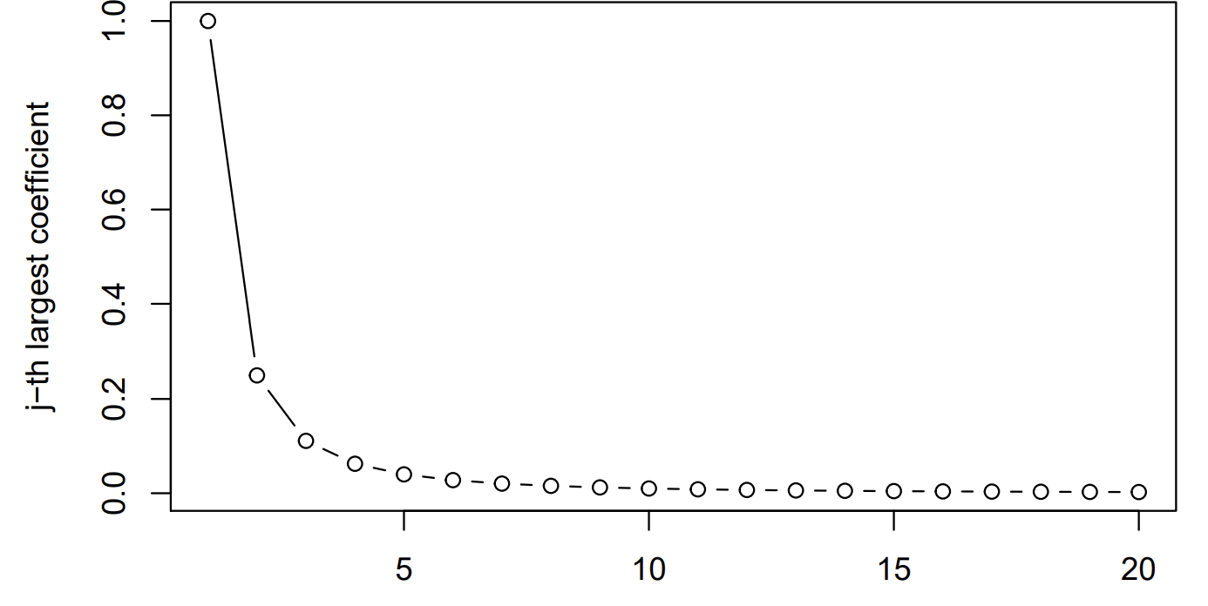
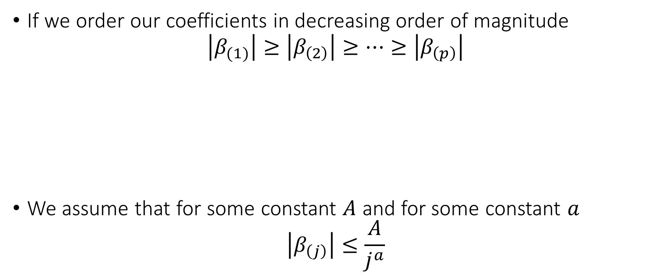
Approximate Sparsity
If we order our coefficients in decreasing order of magnitude
$$\left|β_{(1)}\right|≥\left|β_{\left(2\right)}\right|≥…≥\left|β_{\left(p\right)}\right|$$
We assume that for some constant $A$ and for some constant $a$
$$\left|β_{\left(j\right)}\right|≤\frac{A}{j^{a}}$$

Slide 29
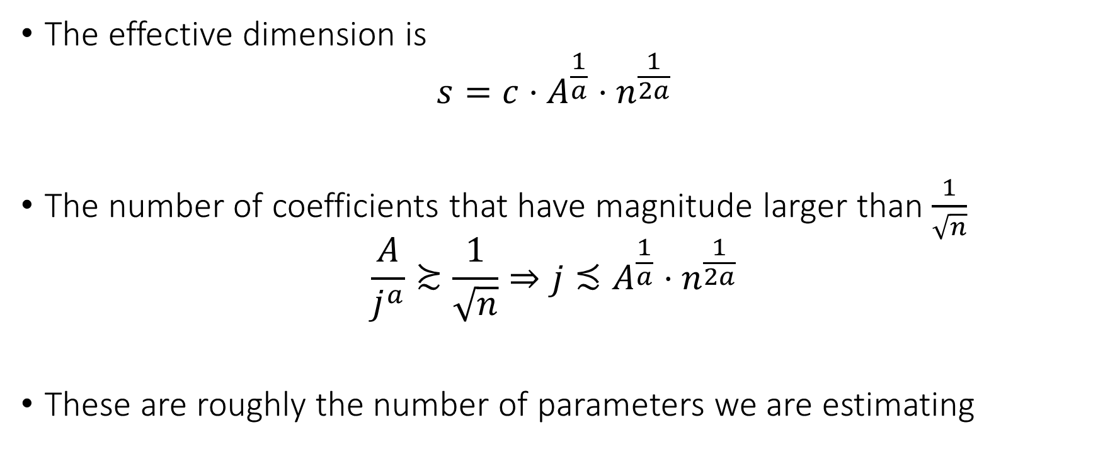
Effective Dimension
The effective dimension is
$$s=c⋅A^{\frac{1}{a}}⋅n^{\frac{1}{2a}}$$
The number of coefficients that have magnitude larger than $\frac{1}{\sqrt{n}}$
$$\frac{A}{j^{a}}≿\frac{1}{\sqrt{n}}⇒j≾A^{\frac{1}{a}}⋅n^{\frac{1}{2a}}$$
These are roughly the number of parameters we are estimating

Slide 30
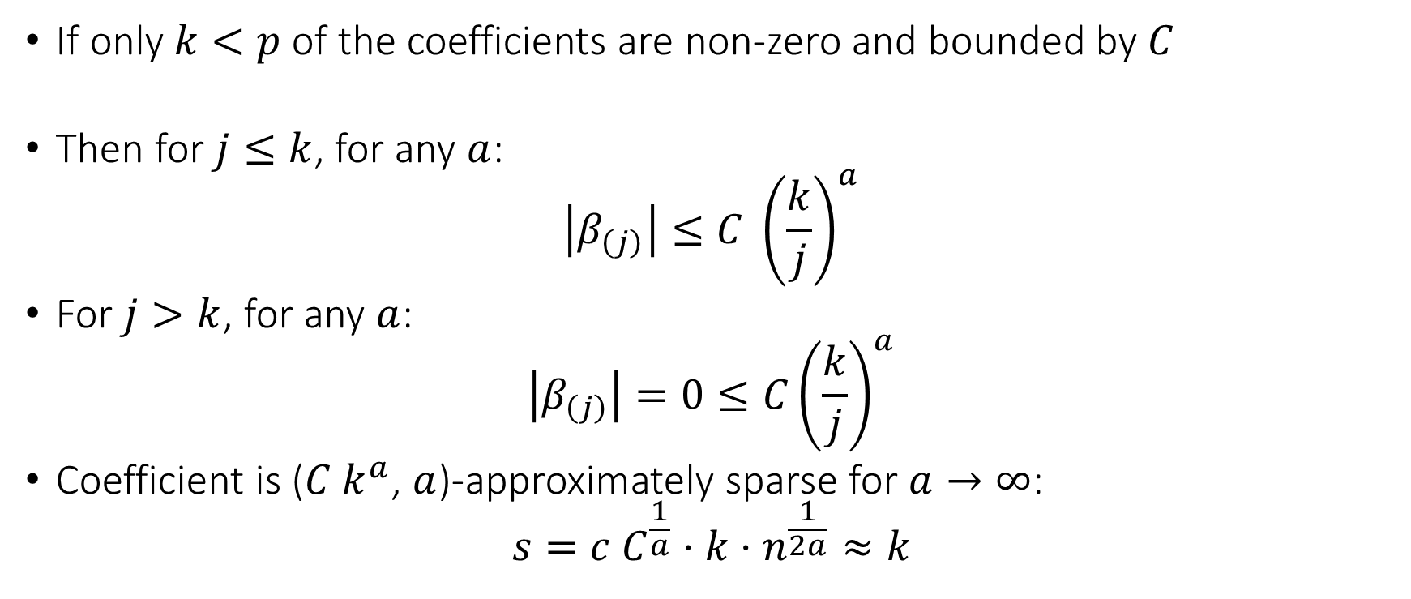
Example: Exact Sparsity
If only $k<p$ of the coefficients are non-zero and bounded by $C$
Then for $j≤k$, for any $a$:
$$\left|β_{\left(j\right)}\right|≤C {\left(\frac{k}{j}\right)}^{a}$$
For $j>k$, for any $a$:
$$\left|β_{\left(j\right)}\right|=0≤C{\left(\frac{k}{j}\right)}^{a}$$
Coefficient is ($C k^{a}$, $a$)-approximately sparse for $a→∞$:
$$s=c C^{\frac{1}{a}}⋅k⋅n^{\frac{1}{2a}}≈k$$

Slide 31
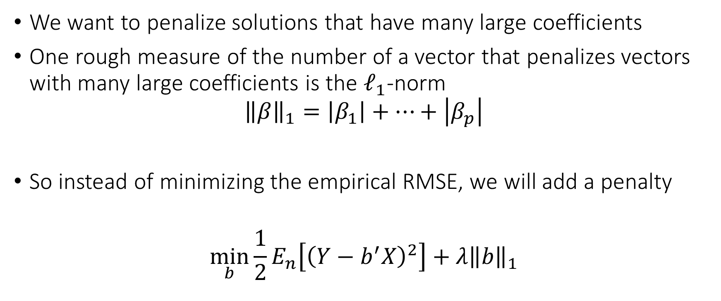
The Method
We want to penalize solutions that have many large coefficients
One rough measure of the number of a vector that penalizes vectors with many large coefficients is the $ℓ_{1}$-norm
$${\left\|β\right\|}_{1}=\left|β_{1}\right|+…+\left|β_{p}\right|$$
So instead of minimizing the empirical RMSE, we will add a penalty
$$\min_{b}{\frac{1}{2}E_{n}\left[{\left(Y−b^{′}X\right)}^{2}\right]+λ{\left\|b\right\|}_{1}}$$

Slide 32
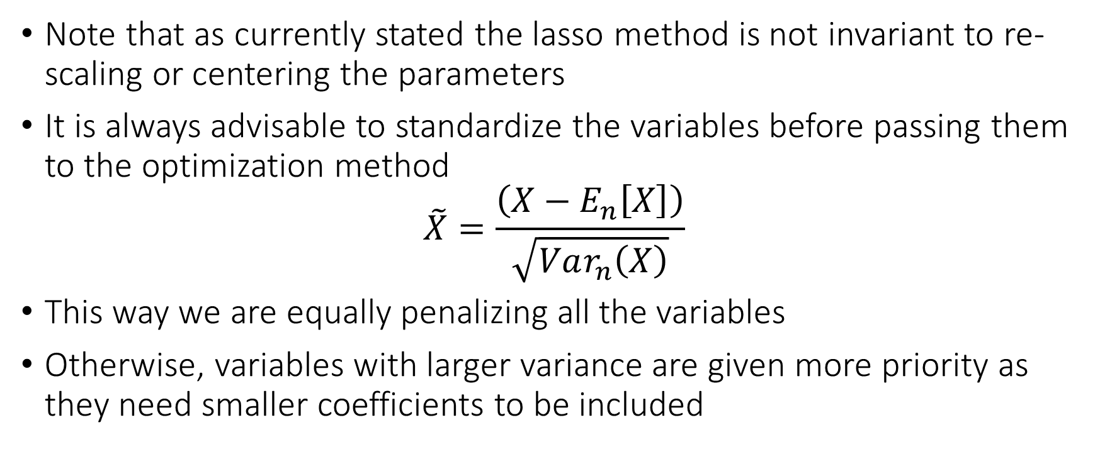
Note: Standardization
Note that as currently stated the lasso method is not invariant to re-scaling or centering the parameters
It is always advisable to standardize the variables before passing them to the optimization method
$$\tilde{X}=\frac{\left(X−E_{n}\left[X\right]\right)}{\sqrt{Var_{n}\left(X\right)}}$$
This way we are equally penalizing all the variables
Otherwise, variables with larger variance are given more priority as they need smaller coefficients to be included

Slide 33
Note: Never Penalize the Intercept
Most packages don’t penalize the intercept of the model by default
But be aware that this is the case
If not, one can always demean the outcome and covariates first before passing to the Lasso package
When evaluating, make sure that you only use the “training based calculated means” and don’t calculate the “means” (of outcome and covariates) on the test set.

Slide 34
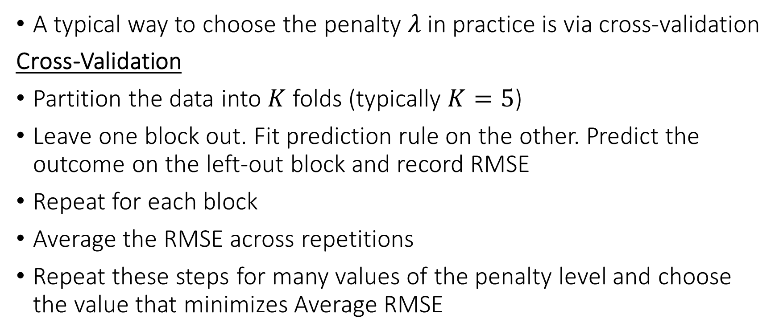
Choosing the Penalty
A typical way to choose the penalty $λ$ in practice is via cross-validation
Cross-Validation
Partition the data into $K$ folds (typically $K=5$)
Leave one block out. Fit prediction rule on the other. Predict the outcome on the left-out block and record RMSE
Repeat for each block
Average the RMSE across repetitions
Repeat these steps for many values of the penalty level and choose the value that minimizes Average RMSE

Slide 35
Coding Example

Slide 36
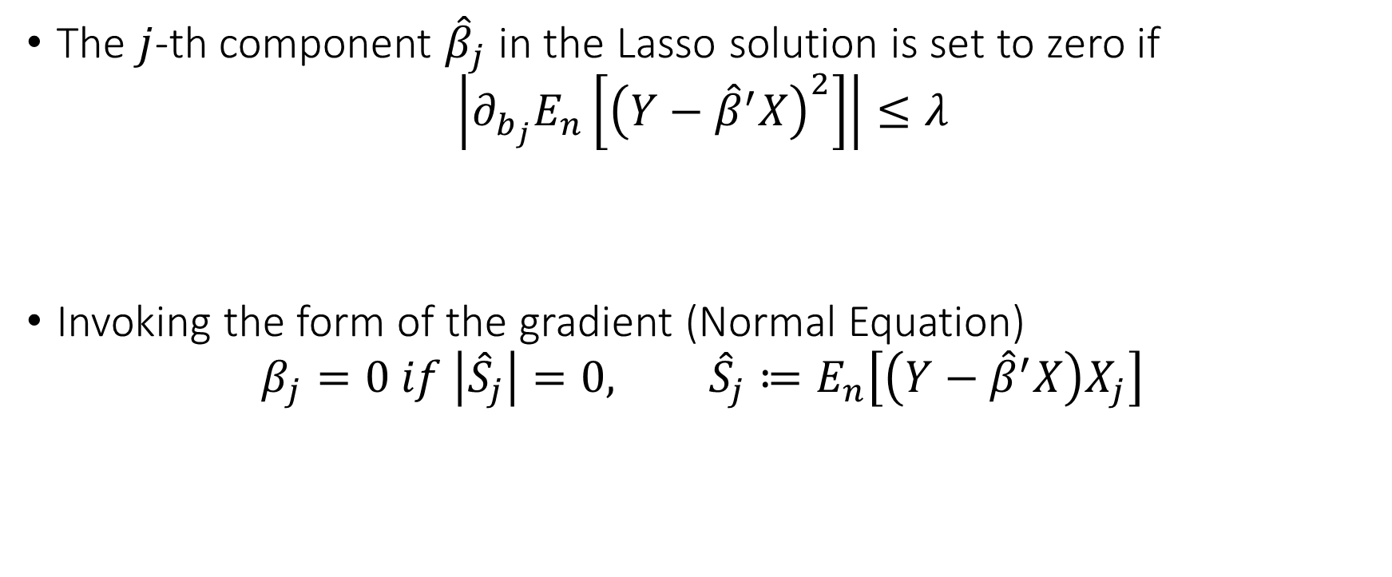
The Intuition
The $j$-th component ${\hat{β}}_{j}$ in the Lasso solution is set to zero if
$$\left|∂_{b_{j}}E_{n}\left[{\left(Y−{\hat{β}}^{′}X\right)}^{2}\right]\right|≤λ$$
Invoking the form of the gradient (Normal Equation)
$$β_{j}=0 if \left|{\hat{S}}_{j}\right|=0, {\hat{S}}_{j}≔E_{n}\left[\left(Y−{\hat{β}}^{′}X\right)X_{j}\right]$$
Marginal benefit in prediction
Marginal increase in penalty

Slide 37
Coding Example

Slide 38
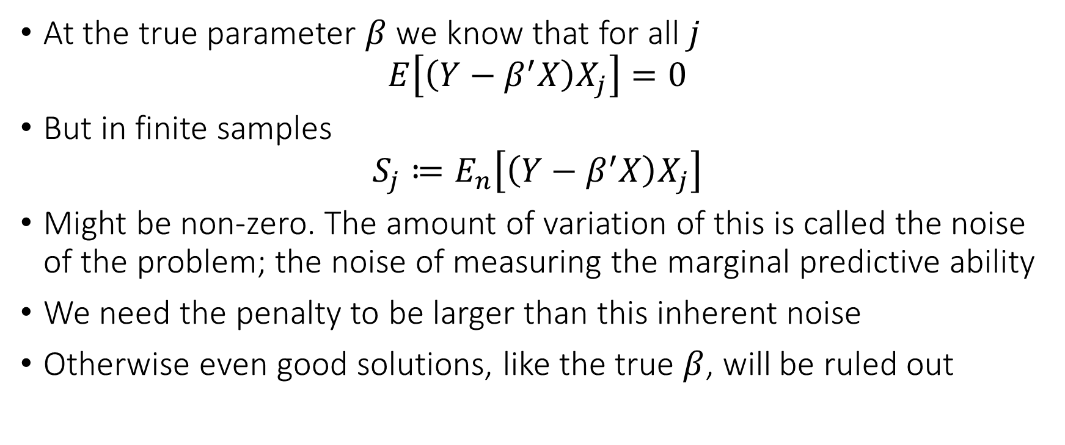
The intuition
At the true parameter $β$ we know that for all $j$
$$E\left[\left(Y−β^{′}X\right)X_{j}\right]=0$$
But in finite samples
$$S_{j}≔E_{n}\left[\left(Y−β^{′}X\right)X_{j}\right]$$
Might be non-zero. The amount of variation of this is called the noise of the problem; the noise of measuring the marginal predictive ability
We need the penalty to be larger than this inherent noise
Otherwise even good solutions, like the true $β$, will be ruled out

Slide 39
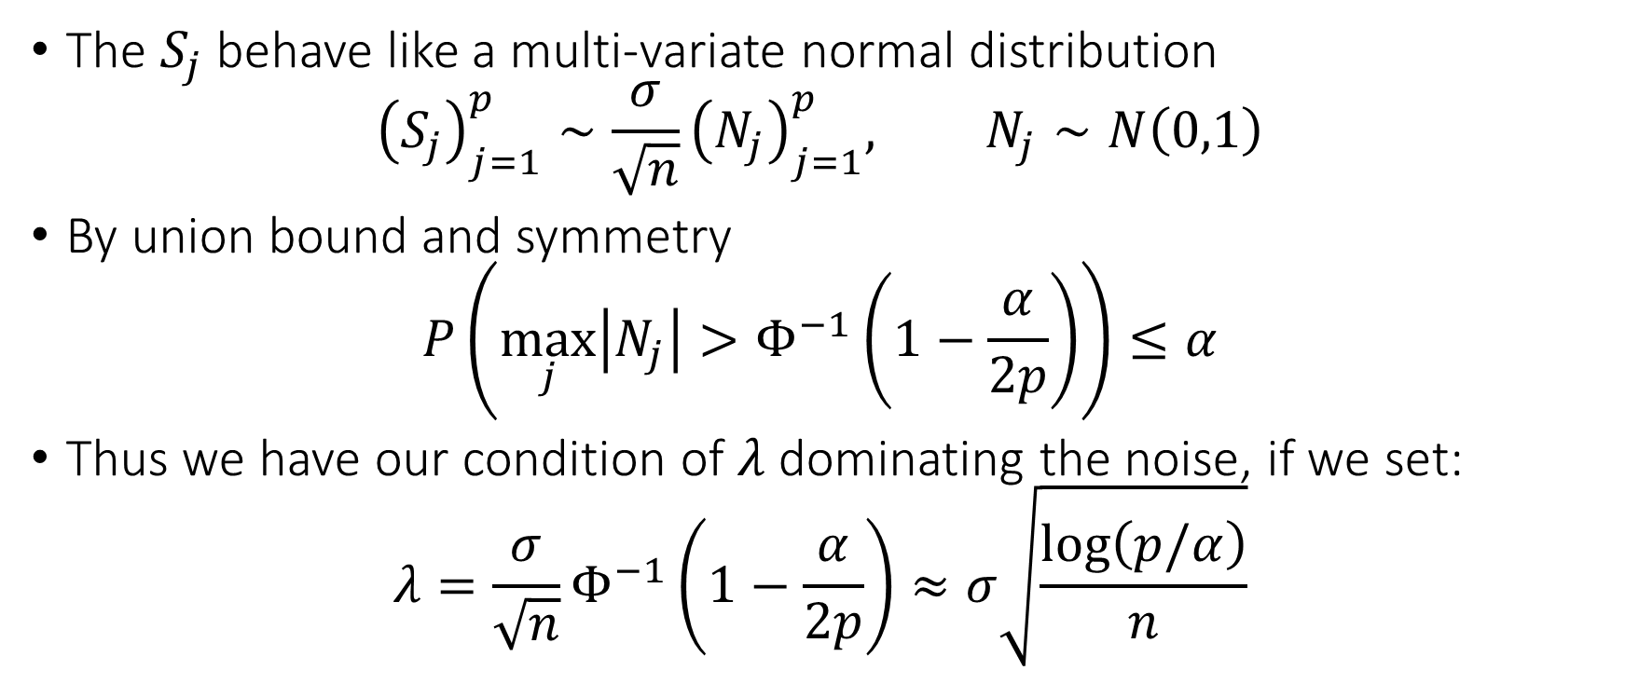
The intuition
The $S_{j}$ behave like a multi-variate normal distribution
$${\left(S_{j}\right)}_{j=1}^{p}∼\frac{σ}{\sqrt{n}}{\left(N_{j}\right)}_{j=1}^{p}, N_{j}∼N\left(0,1\right)$$
By union bound and symmetry
$$P\left(\max_{j}\left|N_{j}\right|>Φ^{−1}\left(1−\frac{α}{2p}\right)\right)≤α$$
Thus we have our condition of $λ$ dominating the noise, if we set:
$$λ=\frac{σ}{\sqrt{n}}Φ^{−1}\left(1−\frac{α}{2p}\right)≈σ\sqrt{\frac{\log\left(p/α\right)}{n}}$$

Slide 40
Coding Example

Slide 41
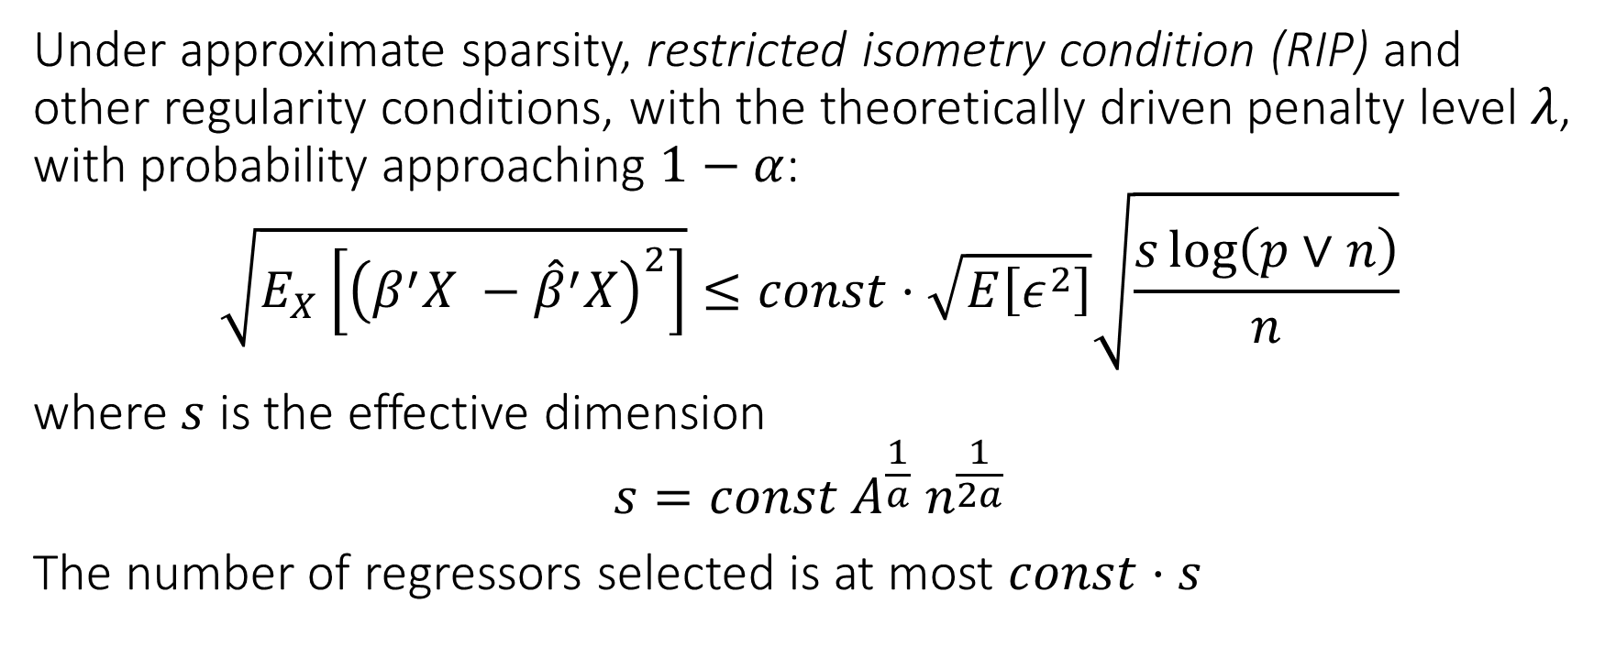
The Theory
Under approximate sparsity, restricted isometry condition (RIP) and other regularity conditions, with the theoretically driven penalty level $λ$, with probability approaching $1−α$:
$$\sqrt{E_{X}\left[{\left(β^{′}X −{\hat{β}}^{′}X\right)}^{2}\right]}≤const⋅\sqrt{E\left[ε^{2}\right]}\sqrt{\frac{s\log\left(p∨n\right)}{n}}$$
where $s$ is the effective dimension
$$s=const A^{\frac{1}{a}} n^{\frac{1}{2a}}$$
The number of regressors selected is at most $const⋅s$

Slide 42
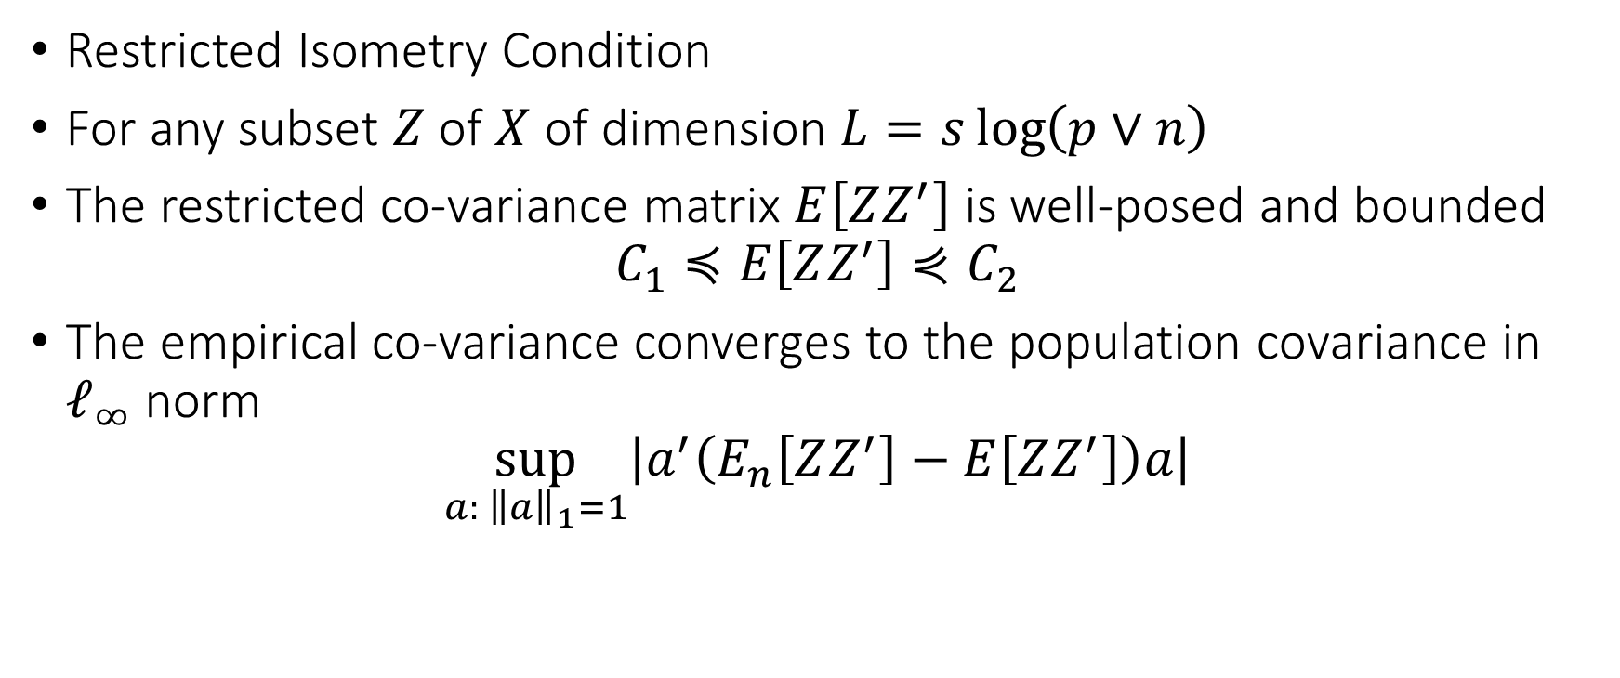
The Technical Assumption
Restricted Isometry Condition
For any subset $Z$ of $X$ of dimension $L=s\log\left(p∨n\right)$
The restricted co-variance matrix $E\left[ZZ^{′}\right]$ is well-posed and bounded
$$C_{1}≼E\left[ZZ^{′}\right]⋞C_{2}$$
The empirical co-variance converges to the population covariance in $ℓ_{∞}$ norm
$$\sup_{a: {\left\|a\right\|}_{1}=1}\left|a^{′}\left(E_{n}\left[ZZ^{′}\right]−E\left[ZZ^{′}\right]\right)a\right|$$

Slide 43
Post-Lasso OLS
It could be beneficial in finite samples to attempt to remove the regularization bias, at least from the chosen coefficients
We can do that by running an OLS step after the Lasso step on the subset of variables with a non-zero coefficient
The method has the same worst-case guarantees as Lasso, so it cannot hurt

Slide 44
Coding Example

Slide 45
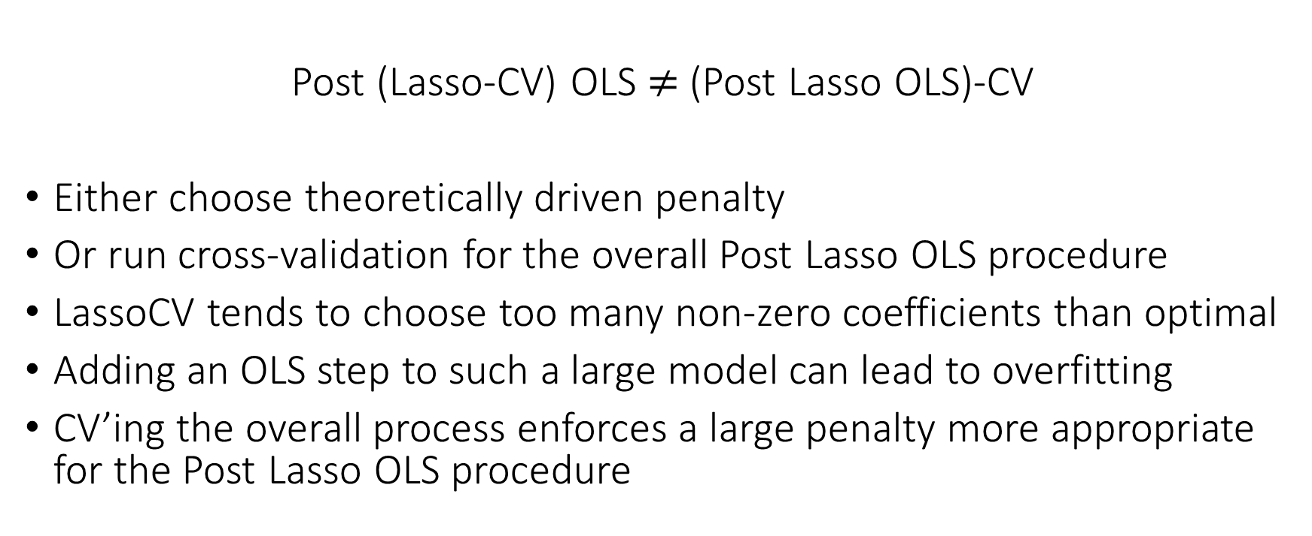
Watch out with regularizing Post Lasso OLS
Post (Lasso-CV) OLS $≠$ (Post Lasso OLS)-CV
Either choose theoretically driven penalty
Or run cross-validation for the overall Post Lasso OLS procedure
LassoCV tends to choose too many non-zero coefficients than optimal
Adding an OLS step to such a large model can lead to overfitting
CV’ing the overall process enforces a large penalty more appropriate for the Post Lasso OLS procedure

Slide 46
Beyond Sparsity

Slide 47
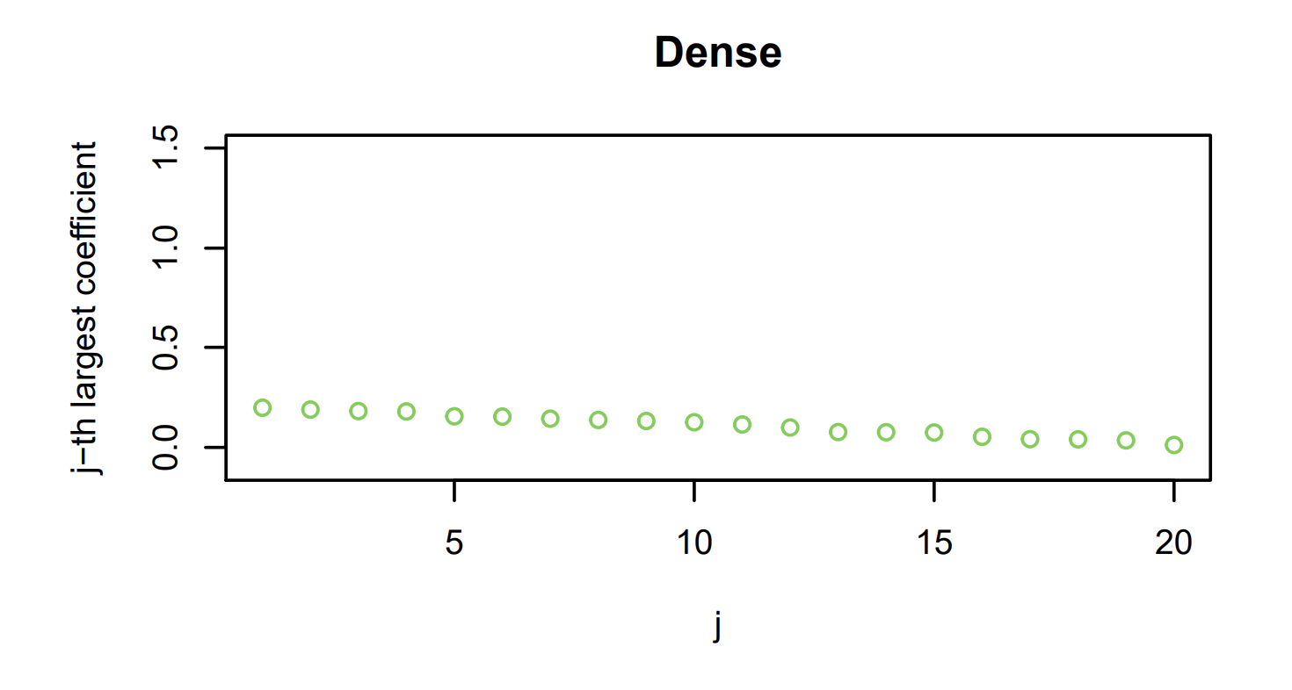

Small Dense Coefficients and Ridge
$$\min_{b}{\frac{1}{2}E_{n}\left[{\left(Y−b^{′}X\right)}^{2}\right]+λ{\left\|β\right\|}_{2}^{2}}$$
$${\left\|β\right\|}_{2}^{2}=β_{1}^{2}+…+β_{p}^{2}$$

Slide 48
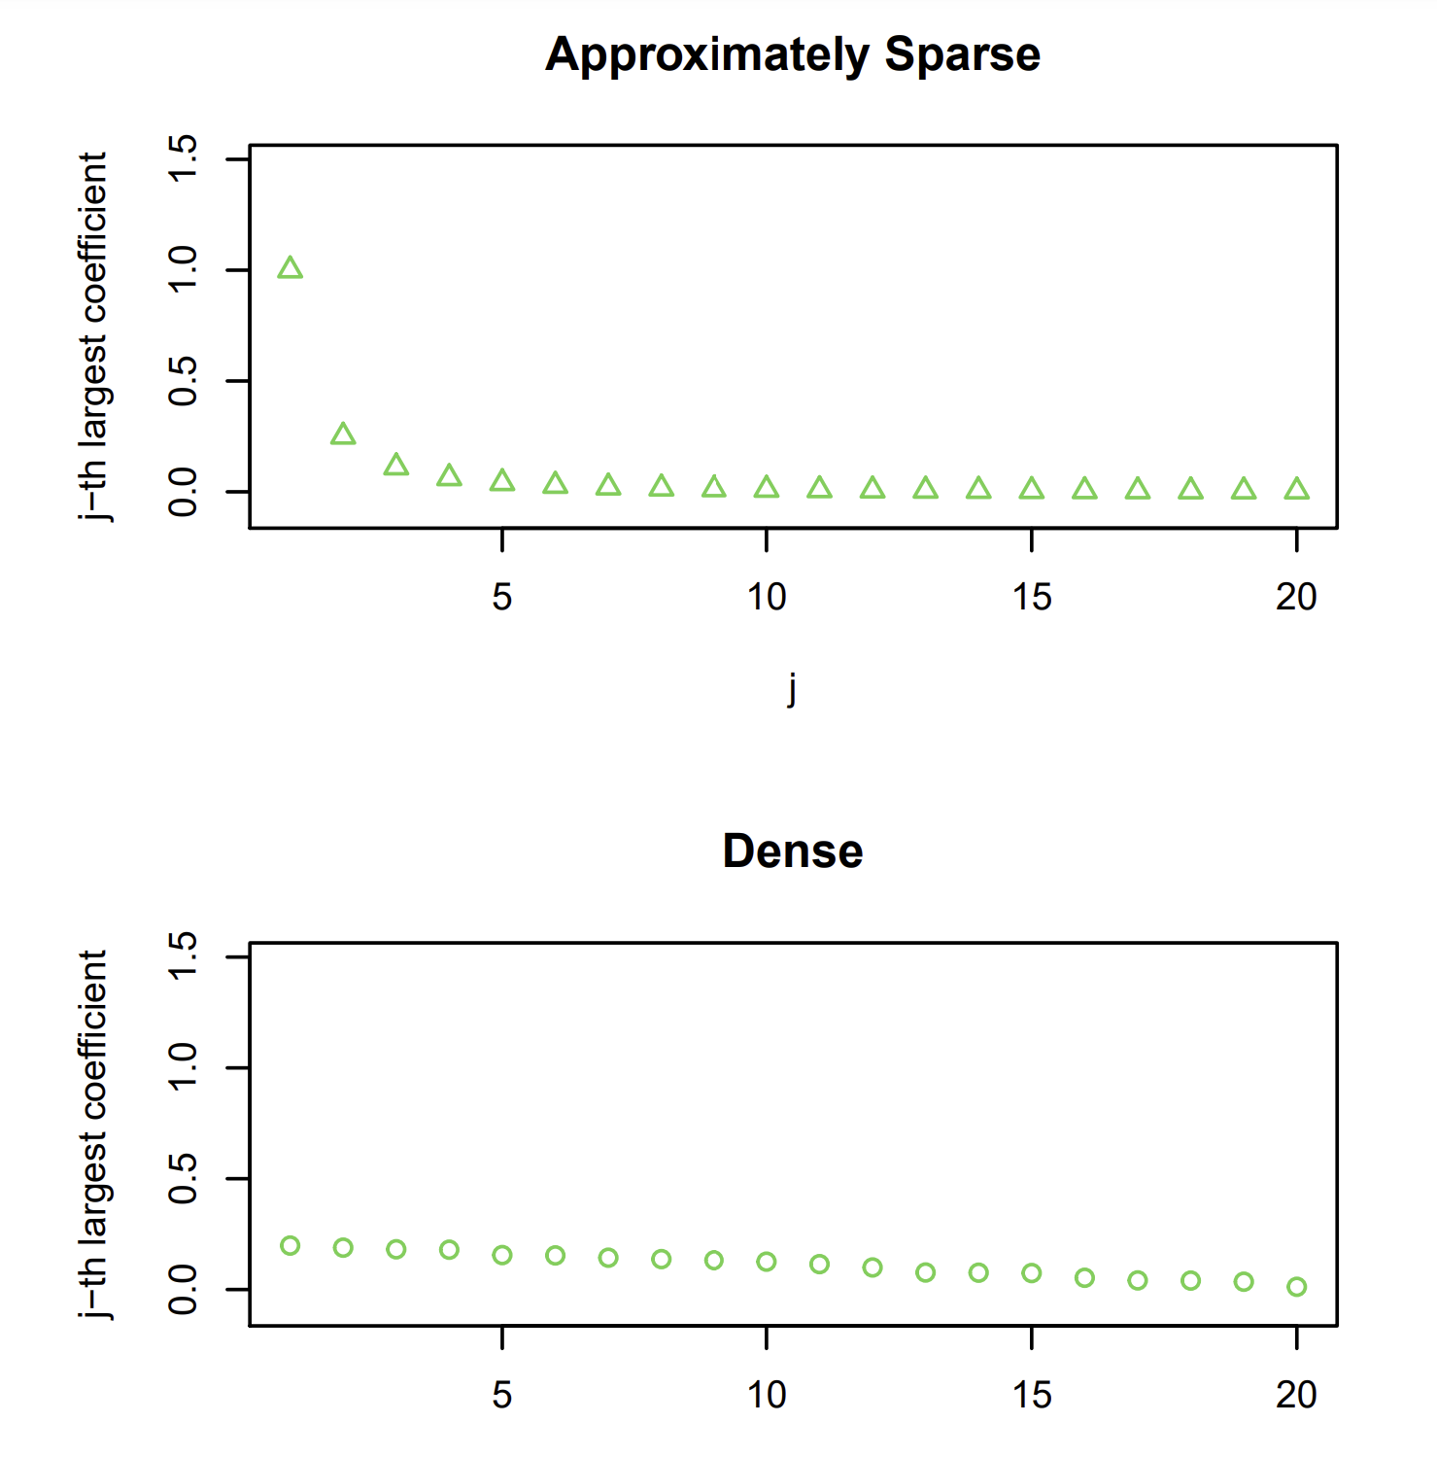

Dense or Sparse and ElasticNet
$$\min_{b}{\frac{1}{2}E_{n}\left[{\left(Y−b^{′}X\right)}^{2}\right]+λ\left(\left(1−α\right){\left\|b\right\|}_{2}^{2}+α{\left\|b\right\|}_{1}\right)}$$

Slide 49
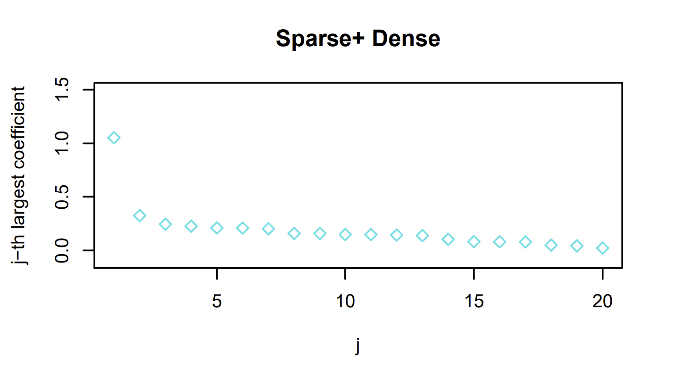

Dense + Sparse and LAVA
$$\min_{b=γ+δ}{\frac{1}{2}E_{n}\left[{\left(Y−b^{′}X\right)}^{2}\right]+λ_{1}{\left\|γ\right\|}_{2}^{2}+λ_{2}{\left\|δ\right\|}_{1}}$$

Slide 50
Coding Example

