Slide 1
MS&E 228: Heterogeneous Treatment Effects
Vasilis Syrgkanis
MS&E, Stanford

Slide 2
Causal Inference with Experiments
Prediction with Linear Models
Prediction with High-Dim Linear Models
Inference on Causal and Predictive Effects with High-Dim Linear Models
Potential Outcomes and Conditional Ignorability
Structural Equation Models and Conditional Exogeneity
Directed Acyclic Graphs
Prediction with Non-Linear Models
Inference on Causal Effects with Non-Linear Models
Un-observed Confounding and Instruments
Estimation of Heterogeneous Causal Effects
Identification of Causal Effects in Longitudinal Data
Linear Predictive Models and Statistical Inference
Causal Identification in Observational Data
Non-Linear Predictive Models and Statistical Inference
Topics

Slide 3
Causal Inference with Experiments
Prediction with Linear Models
Prediction with High-Dim Linear Models
Inference on Causal and Predictive Effects with High-Dim Linear Models
Potential Outcomes and Conditional Ignorability
Structural Equation Models and Conditional Exogeneity
Directed Acyclic Graphs
Prediction with Non-Linear Models
Inference on Causal Effects with Non-Linear Models
Un-observed Confounding and Instruments
Estimation of Heterogeneous Causal Effects
Identification of Causal Effects in Longitudinal Data
Linear Predictive Models and Statistical Inference
Causal Identification in Observational Data
Non-Linear Predictive Models and Statistical Inference
Topics

Slide 4
Recap of Last Lecture

Slide 5








Causal Inference Pipeline
Data Collection
Estimation
(training)
Validation
(testing)
Domain Assumption Elicitation
Identification
Inference (Confidence Intervals)
DAGs/ASEMs
Construct estimate $\hat{g}\left(d,z\right)$ of predictive model
$$E\left[Y ∣ D=d,Z=z\right]$$
Estimate mean counterfactual
$${\hat{a}}_{d}=E_{n}\left[\hat{g}\left(d,Z\right)\right]$$
Theory
$$a_{d}$$
$$E\left[E\left[Y | D=d,Z\right]\right]$$
$$D$$
$$=$$
$$a_{d}∈{\hat{a}}_{d}±2\hat{σ}$$
$$Z$$
$$Y$$
Who should we treat?
Sensitivity Analysis
Practice
$$a_{d}∈{\hat{a}}_{d}±(2\hat{σ}+ε)$$
Adaptive Experiments
Decision
Policy

Slide 6
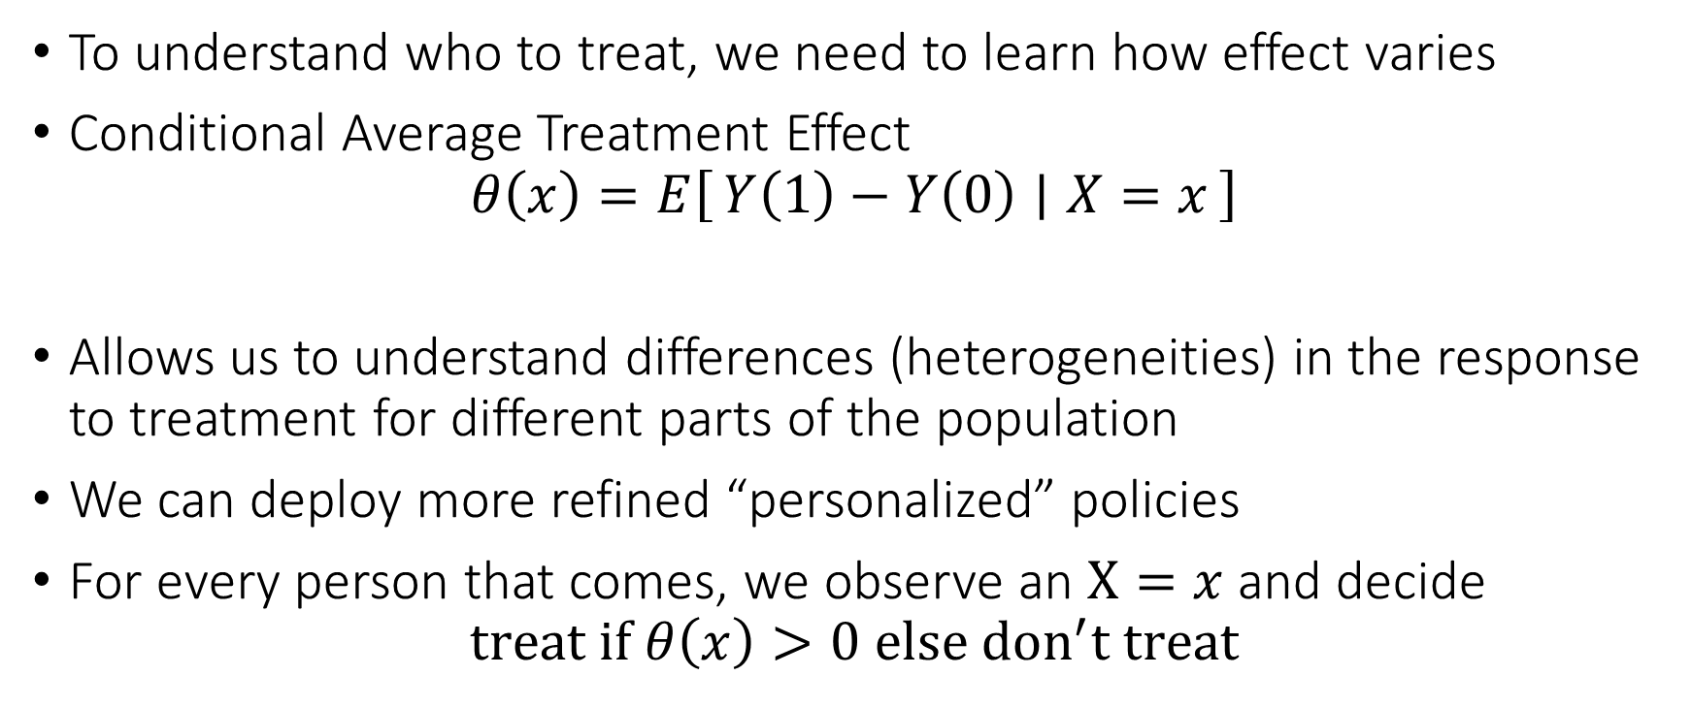
Personalized (Refined) Policies
To understand who to treat, we need to learn how effect varies
Conditional Average Treatment Effect
$$θ\left(x\right)=E\left[Y\left(1\right)−Y\left(0\right) ∣ X=x\right]$$
Allows us to understand differences (heterogeneities) in the response to treatment for different parts of the population
We can deploy more refined “personalized” policies
For every person that comes, we observe an $X=x$ and decide
$$treat if θ\left(x\right)>0 else don^{′}t treat$$

Slide 7
The intrinsic hardness of CATE
Estimating CATE at least as hard as estimating the best prediction rule
Inherently harder than estimating an “average”
So far for our target causal quantities we wanted fast estimation rates and confidence intervals
We were only ok with “decent” estimation rates for the auxiliary (nuisance) predictive models that entered our analysis
We might want to relax our goals…

Slide 8
Different Approaches to Relaxing our Goals
Goal 1: Maybe estimate a simpler projection (e.g. analogue of BLP)
Goal 2: Confidence intervals for predictions of this simple projection
Goal 3: Simultaneous confidence bands for predictions of this simple projection
Goal 4: Estimation error rate for the true CATE
Goal 5: Confidence intervals for the prediction of a CATE model
Goal 6: Simultaneous confidence bands for joint predictions of CATE model
Policy Learning
Goal 7: Go after optimal simple treatment policies; give me a policy with value close to the best
Goal 8: Inference on value of candidate treatment policies
Goal 9: Inference on value of optimal policy
Goal 10: Identify responder or heterogeneous sub-groups; policies with statistical significance;
Linear Doubly Robust Learner
Meta-learner approaches: S-Learner, T-Learner, X-Learner, R-Learner, DR-Learner
Neural Network approaches: TARNet, CFR
Random Forest approaches: BART
Modified (honest) ML methods: Generalized Random Forest, Orthogonal Random Forest, Sub-sampled Nearest Neighbor Regression
?? (only classical non-parametric statistic results on confidence bands of non-parametric functions)
Doubly Robust Policy Learning
Doubly Robust Policy Evaluation

Slide 9
Different Approaches to Relaxing our Goals
Goal 1: Maybe estimate a simpler projection (e.g. analogue of BLP)
Goal 2: Confidence intervals for predictions of this simple projection
Goal 3: Simultaneous confidence bands for predictions of this simple projection
Goal 4: Estimation error rate for the true CATE
Goal 5: Confidence intervals for the prediction of a CATE model
Goal 6: Simultaneous confidence bands for joint predictions of CATE model
Policy Learning
Goal 7: Go after optimal simple treatment policies; give me a policy with value close to the best
Goal 8: Inference on value of candidate treatment policies
Goal 9: Inference on value of optimal policy
Goal 10: Identify responder or heterogeneous sub-groups; policies with statistical significance;
Linear Doubly Robust Learner
Meta-learner approaches: S-Learner, T-Learner, X-Learner, R-Learner, DR-Learner
Neural Network approaches: TARNet, CFR
Random Forest approaches: BART
Modified (honest) ML methods: Generalized Random Forest, Orthogonal Random Forest, Sub-sampled Nearest Neighbor Regression
?? (only classical non-parametric statistic results on confidence bands of non-parametric functions)
Doubly Robust Policy Learning
Doubly Robust Policy Evaluation

Slide 10
Goals for Today
Meta-Learners for Heterogeneous Treatment Effects

Slide 11
Meta-Learning Approaches for CATE

Slide 12
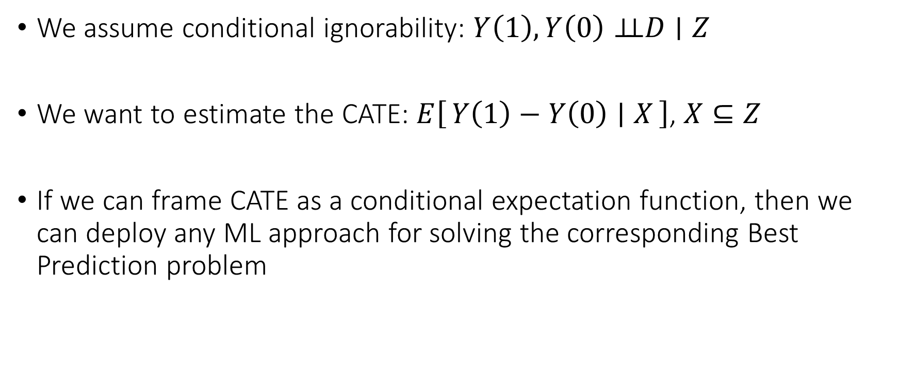
Meta-Learning Idea
We assume conditional ignorability: $Y\left(1\right),Y\left(0\right)⊥⊥D∣Z$
We want to estimate the CATE: $E\left[Y\left(1\right)−Y\left(0\right) ∣ X\right]$, $X⊆Z$
If we can frame CATE as a conditional expectation function, then we can deploy any ML approach for solving the corresponding Best Prediction problem

Slide 13
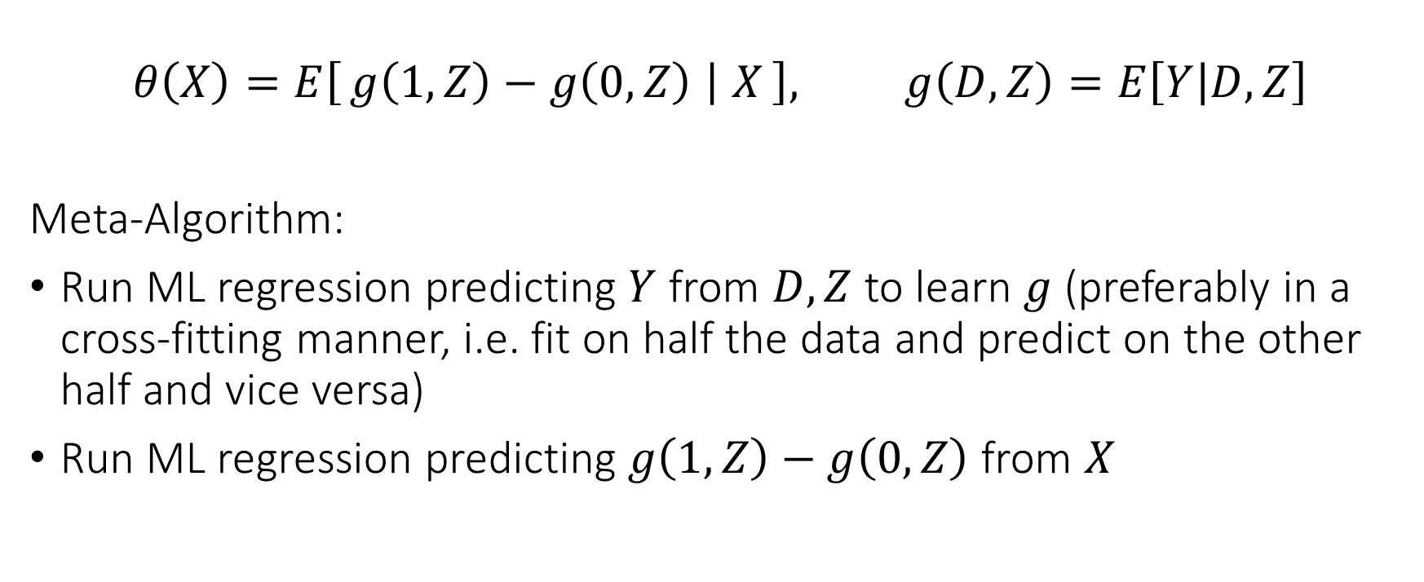
Single Learner (S-Learner)
$$θ\left(X\right)=E\left[g\left(1, Z\right)−g\left(0, Z\right) ∣ X\right], g\left(D,Z\right)=E\left[Y | D,Z\right]$$
Meta-Algorithm:
Run ML regression predicting $Y$ from $D, Z$ to learn $g$ (preferably in a cross-fitting manner, i.e. fit on half the data and predict on the other half and vice versa)
Run ML regression predicting $g\left(1,Z\right)−g\left(0,Z\right)$ from $X$

Slide 14
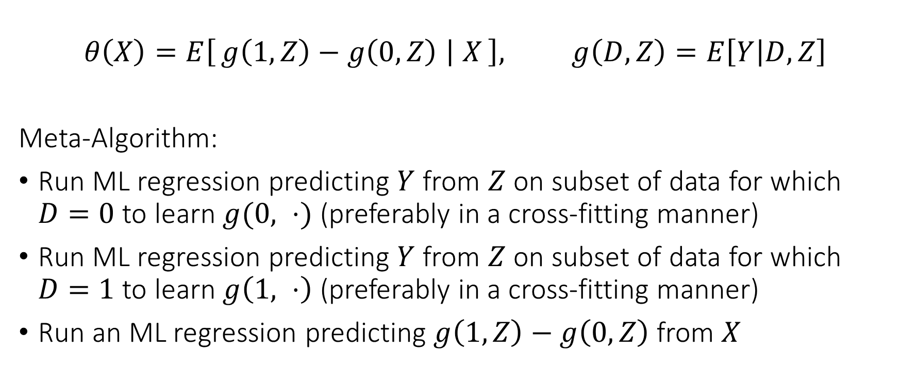
Two Learner (T-Learner)
$$θ\left(X\right)=E\left[g\left(1, Z\right)−g\left(0, Z\right) ∣ X\right], g\left(D,Z\right)=E\left[Y | D,Z\right]$$
Meta-Algorithm:
Run ML regression predicting $Y$ from $Z$ on subset of data for which $D=0$ to learn $g(0, ⋅)$ (preferably in a cross-fitting manner)
Run ML regression predicting $Y$ from $Z$ on subset of data for which $D=1$ to learn $g\left(1, ⋅\right)$ (preferably in a cross-fitting manner)
Run an ML regression predicting $g\left(1, Z\right)−g\left(0,Z\right)$ from $X$

Slide 15
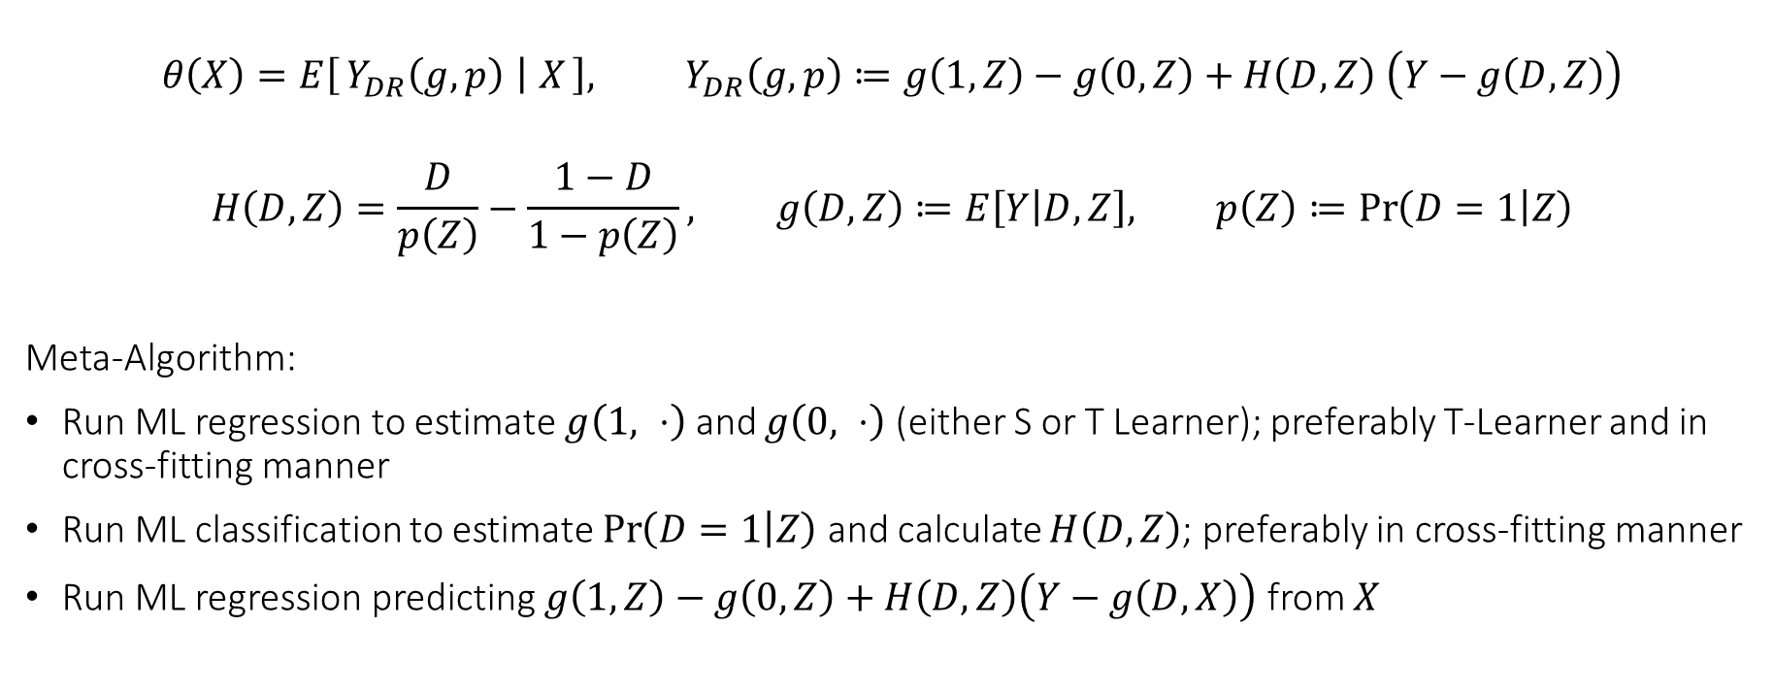
Doubly Robust Learner (DR-Learner)
$$θ\left(X\right)=E\left[Y_{DR}\left(g,p\right) ∣ X\right], Y_{DR}\left(g,p\right)≔g\left(1, Z\right)−g\left(0, Z\right)+H\left(D,Z\right) \left(Y−g\left(D,Z\right)\right)$$
$$H\left(D,Z\right)=\frac{D}{p\left(Z\right)}−\frac{1−D}{1−p\left(Z\right)}, g\left(D,Z\right)≔E\left[Y | D,Z\right], p\left(Z\right)≔\operatorname{Pr}\left(D=1 | Z\right)$$
Meta-Algorithm:
Run ML regression to estimate $g\left(1, ⋅\right)$ and $g\left(0, ⋅\right)$ (either S or T Learner); preferably T-Learner and in cross-fitting manner
Run ML classification to estimate $\operatorname{Pr}\left(D=1 | Z\right)$ and calculate $H\left(D, Z\right)$; preferably in cross-fitting manner
Run ML regression predicting $g\left(1, Z\right)−g\left(0, Z\right)+H\left(D,Z\right)\left(Y−g\left(D,X\right)\right)$ from $X$

Slide 16
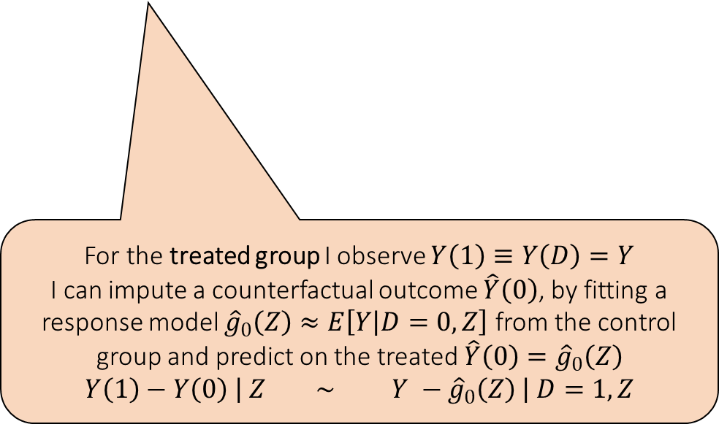

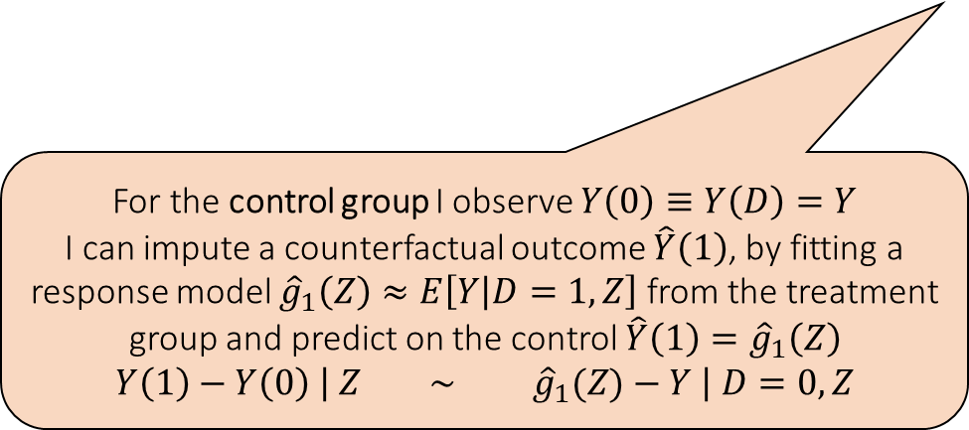
Cross Learner (X-Learner)
$$τ\left(Z\right)=τ_{1}\left(Z\right)≔E\left[Y−E\left[Y ∣ D=0,Z\right] ∣ D=1, Z\right]$$
$$τ\left(Z\right)=τ_{0}\left(Z\right)≔E\left[E\left[Y ∣ D=1,Z\right]−Y ∣ D=0, Z\right]$$
For the control group I observe $Y\left(0\right)≡Y\left(D\right)=Y$
I can impute a counterfactual outcome $\hat{Y}\left(1\right)$, by fitting a response model ${\hat{g}}_{1}\left(Z\right)≈E\left[Y | D=1,Z\right]$ from the treatment group and predict on the control $\hat{Y}\left(1\right)={\hat{g}}_{1}\left(Z\right)$
$$Y\left(1\right)−Y\left(0\right) \left| Z ∼ {\hat{g}}_{1}(Z)−Y \right| D=0, Z$$
For the treated group I observe $Y\left(1\right)≡Y\left(D\right)=Y$
I can impute a counterfactual outcome $\hat{Y}\left(0\right)$, by fitting a response model ${\hat{g}}_{0}\left(Z\right)≈E\left[Y | D=0,Z\right]$ from the control group and predict on the treated $\hat{Y}\left(0\right)={\hat{g}}_{0}\left(Z\right)$
$$Y\left(1\right)−Y\left(0\right) \left| Z ∼ Y −{\hat{g}}_{0}\left(Z\right) \right| D=1, Z$$

Slide 17
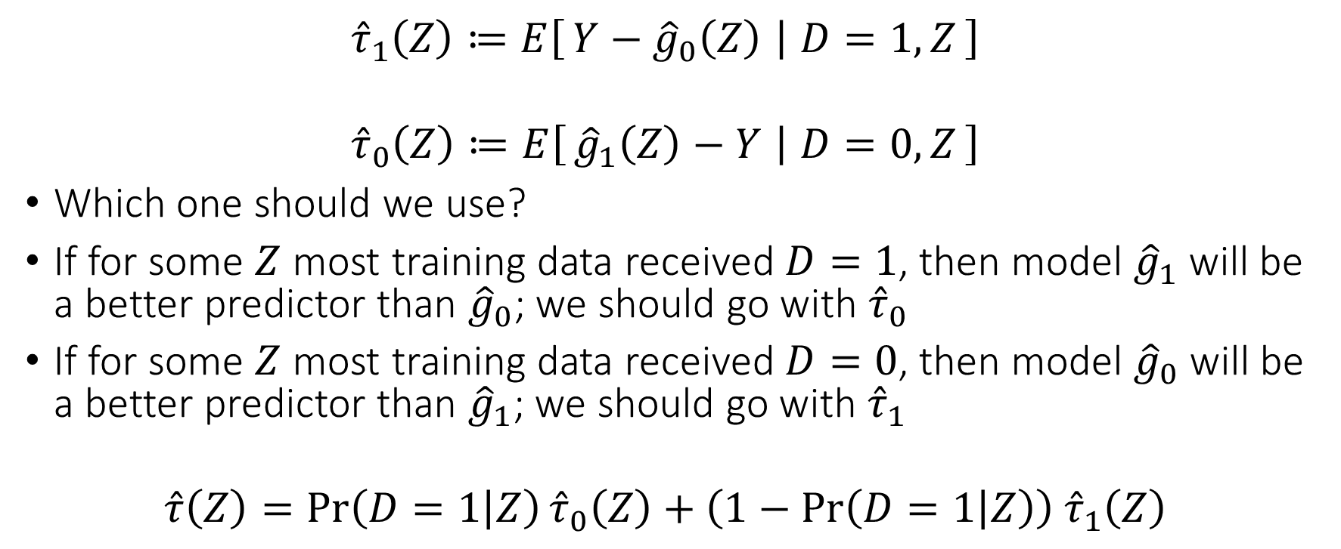
Cross Learner (X-Learner)
$${\hat{τ}}_{1}\left(Z\right)≔E\left[Y−{\hat{g}}_{0}\left(Z\right) ∣ D=1, Z\right]$$
$${\hat{τ}}_{0}\left(Z\right)≔E\left[{\hat{g}}_{1}\left(Z\right)−Y ∣ D=0, Z\right]$$
Which one should we use?
If for some $Z$ most training data received $D=1$, then model ${\hat{g}}_{1}$ will be a better predictor than ${\hat{g}}_{0}$; we should go with ${\hat{τ}}_{0}$
If for some $Z$ most training data received $D=0$, then model ${\hat{g}}_{0}$ will be a better predictor than ${\hat{g}}_{1}$; we should go with ${\hat{τ}}_{1}$
$$\hat{τ}\left(Z\right)=\operatorname{Pr}\left(D=1 | Z\right){\hat{τ}}_{0}\left(Z\right)+\left(1−\operatorname{Pr}\left(D=1 | Z\right)\right) {\hat{τ}}_{1}\left(Z\right)$$

Slide 18
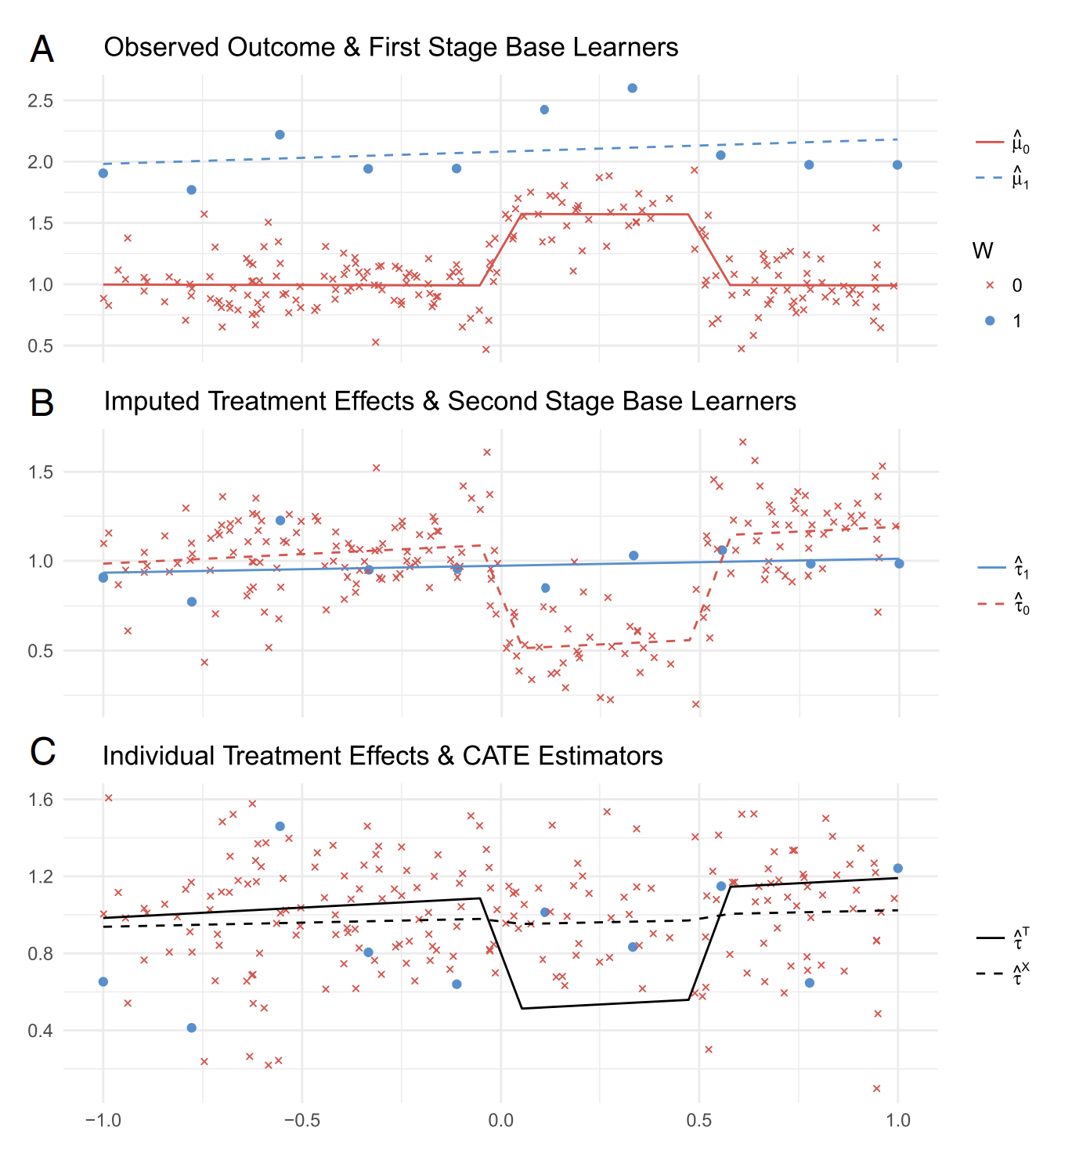
X-Learner Kunzel et al, 2019

Slide 19
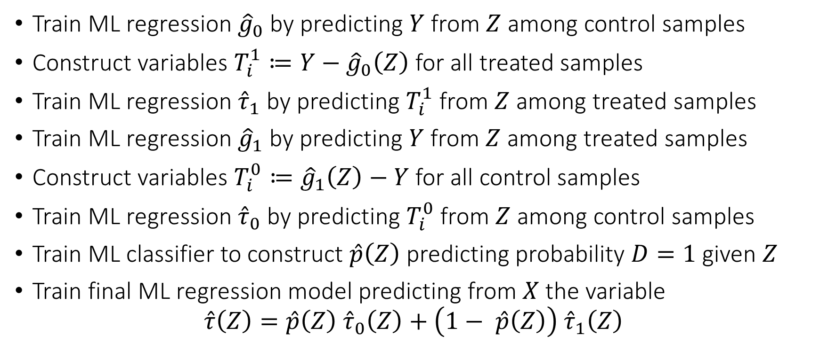
Cross Learner (X-Learner) Meta Algorithm
Train ML regression ${\hat{g}}_{0}$ by predicting $Y$ from $Z$ among control samples
Construct variables $T_{i}^{1}≔Y−{\hat{g}}_{0}\left(Z\right)$ for all treated samples
Train ML regression ${\hat{τ}}_{1}$ by predicting $T_{i}^{1}$ from $Z$ among treated samples
Train ML regression ${\hat{g}}_{1}$ by predicting $Y$ from $Z$ among treated samples
Construct variables $T_{i}^{0}≔{\hat{g}}_{1}\left(Z\right)−Y$ for all control samples
Train ML regression ${\hat{τ}}_{0}$ by predicting $T_{i}^{0}$ from $Z$ among control samples
Train ML classifier to construct $\hat{p}\left(Z\right)$ predicting probability $D=1$ given $Z$
Train final ML regression model predicting from $X$ the variable
$$\hat{τ}\left(Z\right)=\hat{p}\left(Z\right) {\hat{τ}}_{0}\left(Z\right)+\left(1− \hat{p}\left(Z\right)\right) {\hat{τ}}_{1}\left(Z\right)$$

Slide 20
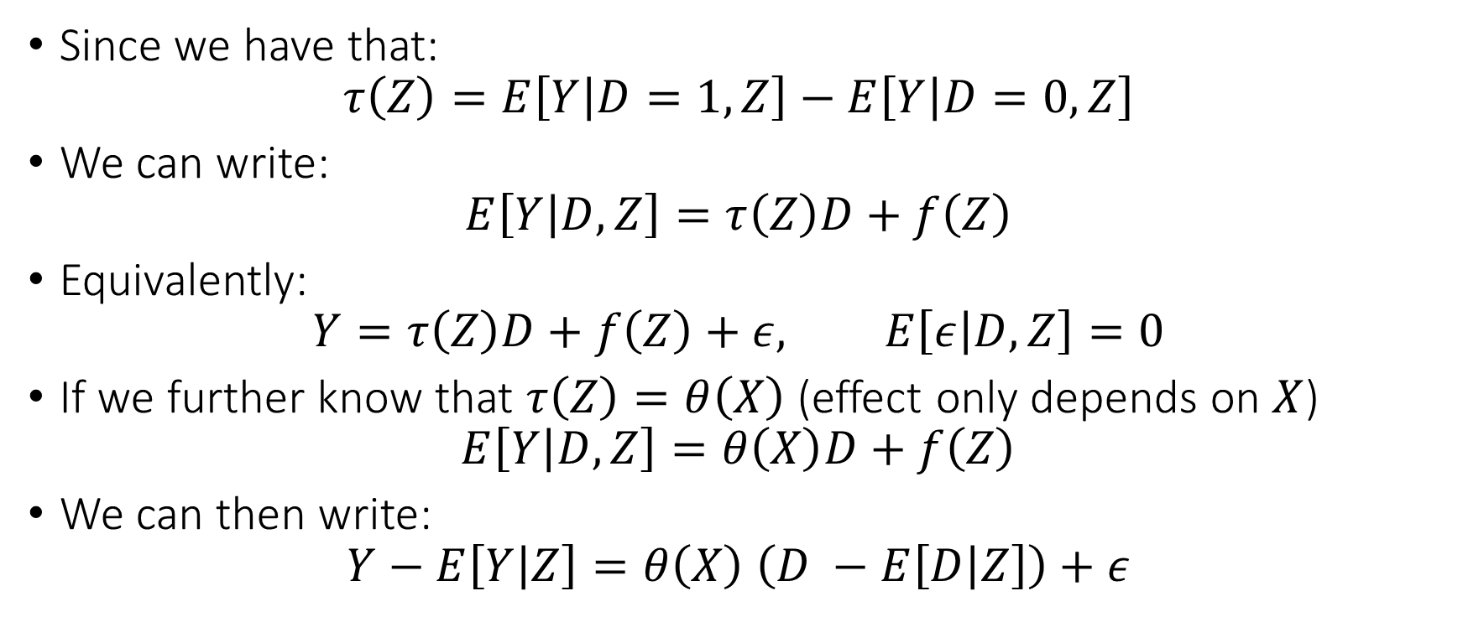
Residual Learner (R-Learner)
Since we have that:
$$τ\left(Z\right)=E\left[Y | D=1,Z\right]−E\left[Y | D=0,Z\right]$$
We can write:
$$E\left[Y | D,Z\right]=τ\left(Z\right)D+f\left(Z\right)$$
Equivalently:
$$Y=τ\left(Z\right)D+f\left(Z\right)+ε, E\left[ε | D,Z\right]=0$$
If we further know that $τ\left(Z\right)=θ\left(X\right)$ (effect only depends on $X$)
$$E\left[Y | D,Z\right]=θ\left(X\right)D+f\left(Z\right)$$
We can then write:
$$Y−E\left[Y | Z\right]=θ\left(X\right) \left(D −E\left[D | Z\right]\right)+ε$$

Slide 21
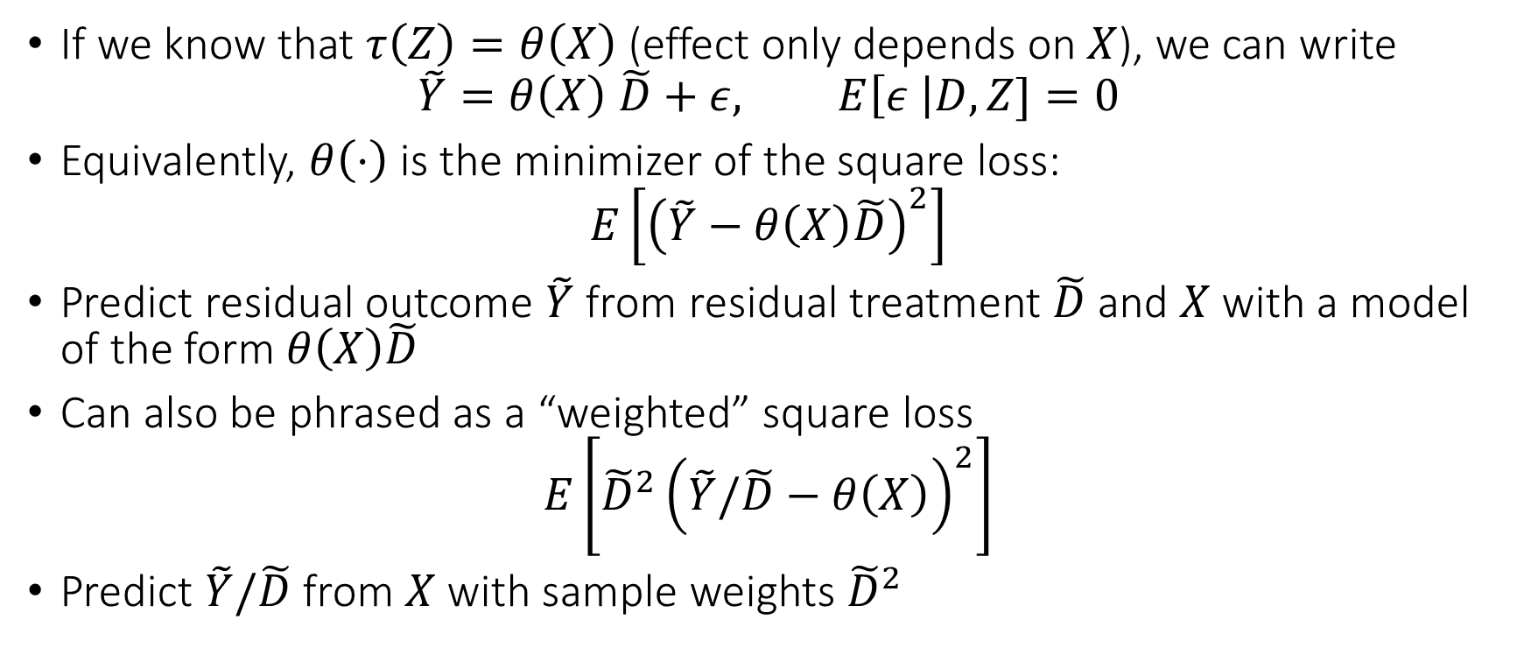
Residual Learner (R-Learner)
If we know that $τ\left(Z\right)=θ\left(X\right)$ (effect only depends on $X$), we can write
$$\tilde{Y}=θ\left(X\right) \tilde{D}+ε, E\left[ε \right|D,Z]=0$$
Equivalently, $θ\left(⋅\right)$ is the minimizer of the square loss:
$$E\left[{\left(\tilde{Y}−θ\left(X\right)\tilde{D}\right)}^{2}\right]$$
Predict residual outcome $\tilde{Y}$ from residual treatment $\tilde{D}$ and $X$ with a model of the form $θ\left(X\right)\tilde{D}$
Can also be phrased as a “weighted” square loss
$$E\left[{\tilde{D}}^{2}{\left(\tilde{Y}/\tilde{D}−θ\left(X\right)\right)}^{2}\right]$$
Predict $\tilde{Y}/\tilde{D}$ from $X$ with sample weights ${\tilde{D}}^{2}$

Slide 22
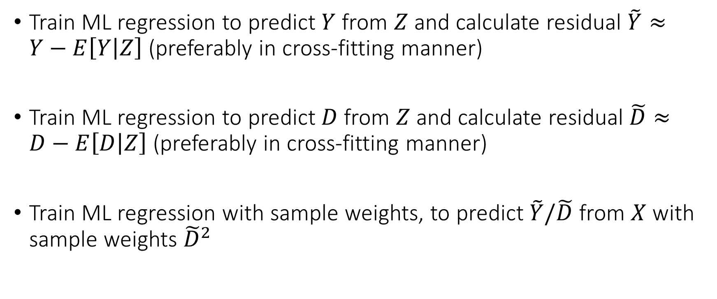
Residual Learner (R-Learner) Meta Algorithm
Train ML regression to predict $Y$ from $Z$ and calculate residual $\tilde{Y}≈Y−E\left[Y | Z\right]$ (preferably in cross-fitting manner)
Train ML regression to predict $D$ from $Z$ and calculate residual $\tilde{D}≈D−E\left[D | Z\right]$ (preferably in cross-fitting manner)
Train ML regression with sample weights, to predict $\tilde{Y}/\tilde{D}$ from $X$ with sample weights ${\tilde{D}}^{2}$

Slide 23
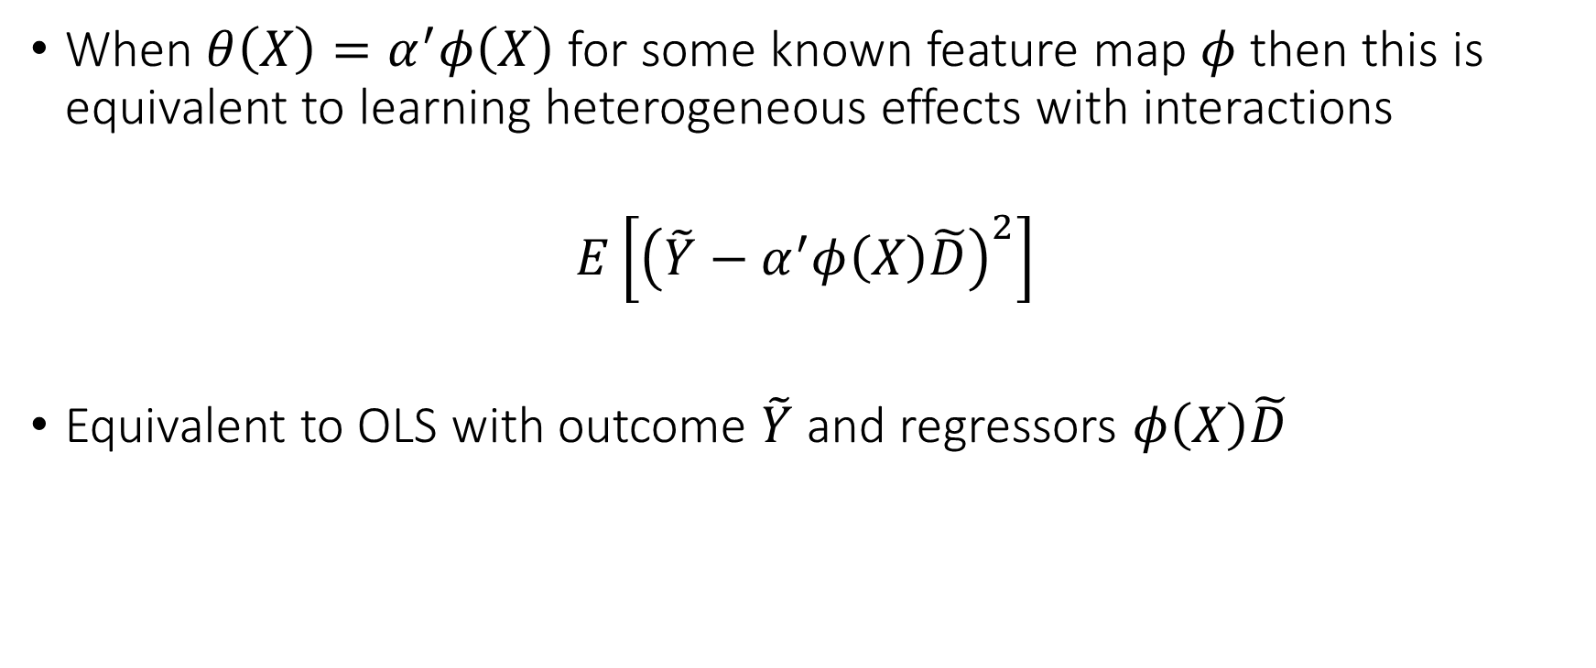
Residual Learner (R-Learner)
When $θ\left(X\right)=α^{′}φ\left(X\right)$ for some known feature map $φ$ then this is equivalent to learning heterogeneous effects with interactions
$$E\left[{\left(\tilde{Y}−α^{′}φ\left(X\right)\tilde{D}\right)}^{2}\right]$$
Equivalent to OLS with outcome $\tilde{Y}$ and regressors $φ\left(X\right)\tilde{D}$

Slide 24
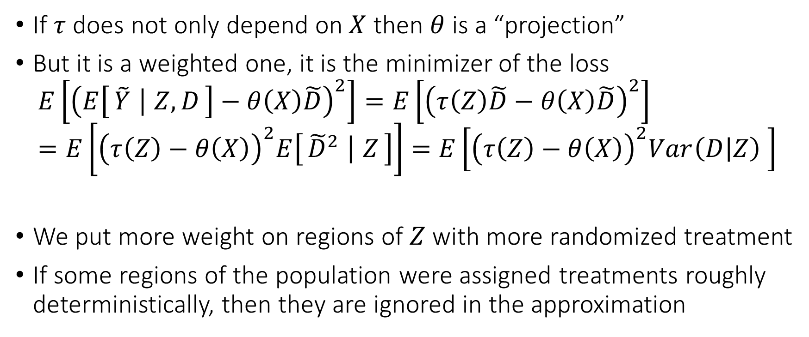
Residual Learner (R-Learner)
If $τ$ does not only depend on $X$ then $θ$ is a “projection”
But it is a weighted one, it is the minimizer of the loss
$$E\left[{\left(E\left[\tilde{Y} ∣ Z,D\right]−θ\left(X\right)\tilde{D}\right)}^{2}\right]=E\left[{\left(τ\left(Z\right)\tilde{D}−θ\left(X\right)\tilde{D}\right)}^{2}\right]=E\left[{\left(τ\left(Z\right)−θ\left(X\right)\right)}^{2}E\left[{\tilde{D}}^{2} ∣ Z\right]\right]=E\left[{\left(τ\left(Z\right)−θ\left(X\right)\right)}^{2}Var\left(D | Z\right) \right]$$
We put more weight on regions of $Z$ with more randomized treatment
If some regions of the population were assigned treatments roughly deterministically, then they are ignored in the approximation

Slide 25
Comparing Meta-Learners
S and T-Learners are typically poor performing as they heavily depend on outcome modelling; among them the T-Learner should be preferred
X-Learner is a better version of S and T as it incorporates propensity knowledge
DR-Learner and R-Learner, both possess “Neyman orthogonality” properties as they carefully combine outcome and treatment assignment modelling
The error of the final cate model is not heavily impacted by the errors in the auxiliary models (Orthogonal Statistical Learning)
DR-Learner estimates un-weighted projection of true CATE on model space, but can be “high-variance” due to inverse propensity
R-Learner estimates variance weighted projection but is much more stable to extreme propensities as it never divides by propensity.

