Slide 1
MS&E 228: Dynamic Treatment Effects
Vasilis Syrgkanis
MS&E, Stanford

Slide 2
Causal Inference with Experiments
Prediction with Linear Models
Prediction with High-Dim Linear Models
Inference on Causal and Predictive Effects with High-Dim Linear Models
Potential Outcomes and Conditional Ignorability
Structural Equation Models and Conditional Exogeneity
Directed Acyclic Graphs
Prediction with Non-Linear Models
Inference on Causal Effects with Non-Linear Models
Un-observed Confounding and Instruments
Estimation of Heterogeneous Causal Effects
Identification of Causal Effects in Longitudinal Data
Linear Predictive Models and Statistical Inference
Causal Identification in Observational Data
Non-Linear Predictive Models and Statistical Inference
Topics

Slide 3
Causal Inference with Experiments
Prediction with Linear Models
Prediction with High-Dim Linear Models
Inference on Causal and Predictive Effects with High-Dim Linear Models
Potential Outcomes and Conditional Ignorability
Structural Equation Models and Conditional Exogeneity
Directed Acyclic Graphs
Prediction with Non-Linear Models
Inference on Causal Effects with Non-Linear Models
Un-observed Confounding and Instruments
Estimation of Heterogeneous Causal Effects
Identification of Causal Effects in Longitudinal Data
Linear Predictive Models and Statistical Inference
Causal Identification in Observational Data
Non-Linear Predictive Models and Statistical Inference
Topics

Slide 4
Longitudinal Data
Longitudinal data refer to datasets where we have multiple observations of the same unit over time
They present a separate set of new problems
Correlation: samples stemming from each unit (or sometimes cluster of units from the same “site”) are correlated
Censoring/Missingness: units typically drop out at (potentially not) random times before the end of the study
Dynamic treatments: units are treated with multiple treatments over time in a manner that is adaptive and auto-correlated

Slide 5
Longitudinal Data
Longitudinal data refer to datasets where we have multiple observations of the same unit over time
They present a separate set of new problems
Correlation: samples stemming from each unit (or sometimes cluster of units from the same “site”) are correlated
Censoring/Missingness: units typically drop out at (potentially not) random times before the end of the study
Dynamic treatments: units are treated with multiple treatments over time in a manner that is adaptive and auto-correlated

Slide 6
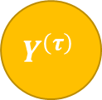
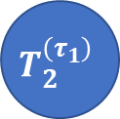




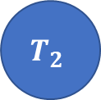

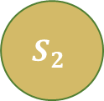
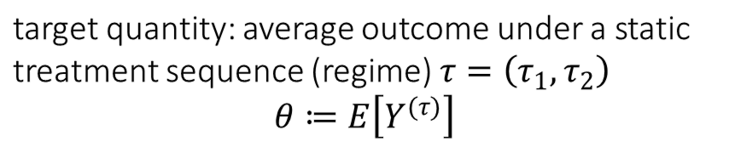

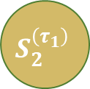

Dynamic Treatment Regime
target quantity: average outcome under a static treatment sequence (regime) $τ=\left(τ_{1},τ_{2}\right)$
$$θ≔E\left[Y^{(τ)}\right]$$
observed data (panel)
$$T_{1}$$
$$T_{2}$$
$$T_{1}$$
$$T_{2}^{\left(τ_{1}\right)}$$
$$τ_{1}$$
$$τ_{2}$$
$$S_{1}$$
$$S_{2}$$
$$Y$$
$$S_{1}$$
$$S_{2}^{\left(τ_{1}\right)}$$
$$Y^{\left(τ\right)}$$
Treatments are offered in an adaptive manner, in response to previous period controls
The surrogate – control feedback precludes viewing this as a one-shot treatment problem
Setting is known as the dynamic treatment regime [Robins’94,’04, Chakraborty-Murphy’14]

Slide 7


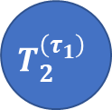

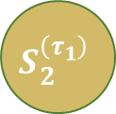
Examples
Healthcare: Patients treated over time and adaptively
observed data (panel)
target quantity
First Line Therapy
Second Line Therapy
$$T_{1}$$
$$T_{2}^{\left(τ_{1}\right)}$$
Immunotherapy
Chemotherapy
Progression+
Genomics
Genomics
Survival
$$S_{1}$$
$$S_{2}^{\left(τ_{1}\right)}$$
$$Y^{\left(τ\right)}$$

Slide 8
Examples
Digital Marketing: Web users shown ads multiple times
observed data (panel)
target quantity
Ad Impression
Ad Impression
$$T_{1}$$
$$T_{2}^{\left(τ_{1}\right)}$$
No impression
No impression
Tracking Data
Tracking Data
Conversion
$$S_{1}$$
$$S_{2}^{\left(τ_{1}\right)}$$
$$Y^{\left(τ\right)}$$

Slide 9





Examples
Business-to-Business (B2B) Operations: Customers offered multiple discount/support interventions over time
observed data (panel)
target quantity
Azure Credits
Sales Specialist
$$T_{1}$$
$$T_{2}^{\left(τ_{1}\right)}$$
No credits
Yes Specialist
Purchase History
Purchase History
Spend
$$S_{1}$$
$$S_{2}^{\left(τ_{1}\right)}$$
$$Y^{\left(τ\right)}$$

Slide 10
Identification in the Dynamic Treatment Regime

Slide 11
Dynamic Treatment Regime
target quantity: average outcome under a static treatment sequence (regime) $τ=\left(τ_{1},τ_{2}\right)$
$$θ≔E\left[Y^{(τ)}\right]$$
observed data (panel)
$$T_{1}$$
$$T_{2}$$
$$T_{1}$$
$$T_{2}^{\left(τ_{1}\right)}$$
$$τ_{1}$$
$$τ_{2}$$
$$S_{1}$$
$$S_{2}$$
$$Y$$
$$S_{1}$$
$$S_{2}^{\left(τ_{1}\right)}$$
$$Y^{\left(τ\right)}$$
Treatments are offered in an adaptive manner, in response to previous period controls
The surrogate – control feedback precludes viewing this as a one-shot treatment problem
Setting is known as the dynamic treatment regime [Robins’94,’04, Chakraborty-Murphy’14]

Slide 12
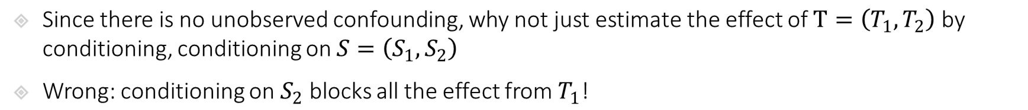
Identification in Dynamic Treatment Regime
target quantity: average outcome under a static treatment sequence (regime) $τ=\left(τ_{1},τ_{2}\right)$
$$θ≔E\left[Y^{(τ)}\right]$$
observed data (panel)
$$T_{1}$$
$$T_{2}$$
$$T_{1}$$
$$T_{2}^{\left(τ_{1}\right)}$$
$$τ_{1}$$
$$τ_{2}$$
$$S_{1}$$
$$S_{2}$$
$$Y$$
$$S_{1}$$
$$S_{2}^{\left(τ_{1}\right)}$$
$$Y^{\left(τ\right)}$$
Since there is no unobserved confounding, why not just estimate the effect of $T=\left(T_{1},T_{2}\right)$ by conditioning, conditioning on $S=\left(S_{1},S_{2}\right)$
Wrong: conditioning on $S_{2}$ blocks all the effect from $T_{1}$!

Slide 13
Identification in Dynamic Treatment Regime
target quantity: average outcome under a static treatment sequence (regime) $τ=\left(τ_{1},τ_{2}\right)$
$$θ≔E\left[Y^{(τ)}\right]$$
observed data (panel)
$$T_{1}$$
$$T_{2}$$
$$T_{1}$$
$$T_{2}^{\left(τ_{1}\right)}$$
$$τ_{1}$$
$$τ_{2}$$
$$S_{1}$$
$$S_{2}$$
$$Y$$
$$S_{1}$$
$$S_{2}^{\left(τ_{1}\right)}$$
$$Y^{\left(τ\right)}$$
Since there is no unobserved confounding, why not just estimate the effect of $T=\left(T_{1},T_{2}\right)$ by conditioning, conditioning on $S=\left(S_{1},S_{2}\right)$
Wrong: conditioning on $S_{2}$ blocks all the effect from $T_{1}$!

Slide 14
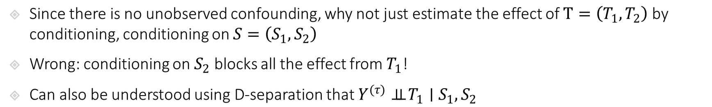
Identification in Dynamic Treatment Regime
target quantity: average outcome under a static treatment sequence (regime) $τ=\left(τ_{1},τ_{2}\right)$
$$θ≔E\left[Y^{(τ)}\right]$$
observed data (panel)
$$T_{1}$$
$$T_{2}$$
$$T_{1}$$
$$T_{2}^{\left(τ_{1}\right)}$$
$$τ_{1}$$
$$τ_{2}$$
$$S_{1}$$
$$S_{2}$$
$$Y$$
$$S_{1}$$
$$S_{2}^{\left(τ_{1}\right)}$$
$$Y^{\left(τ\right)}$$
Since there is no unobserved confounding, why not just estimate the effect of $T=\left(T_{1},T_{2}\right)$ by conditioning, conditioning on $S=\left(S_{1},S_{2}\right)$
Wrong: conditioning on $S_{2}$ blocks all the effect from $T_{1}$!
Can also be understood using D-separation that $Y^{(τ)}⊥⊥ T_{1}∣S_{1},S_{2}$

Slide 15
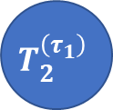



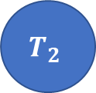

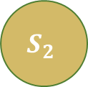
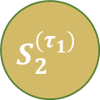

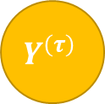

Identification in Dynamic Treatment Regime
$$T_{1}$$
$$τ_{1}$$
$$T_{2}^{\left(τ_{1}\right)}$$
$$τ_{2}$$
Intervention World
$$S_{1}$$
$$S_{2}^{\left(τ_{1}\right)}$$
$$Y^{\left(τ\right)}$$
Two-World Graphs
$$ε_{S_{2}}$$
$$T_{2}$$
Observed World
$$S_{2}$$
$$Y$$
Since there is no unobserved confounding, why not just estimate the effect of $T=\left(T_{1},T_{2}\right)$ by conditioning, conditioning on $S=\left(S_{1},S_{2}\right)$
Wrong: conditioning on $S_{2}$ blocks all the effect from $T_{1}$!
Can also be understood using D-separation that $Y^{(τ)}⊥⊥ T_{1}∣S_{1},S_{2}$

Slide 16

Identification in Dynamic Treatment Regime
target quantity: average outcome under a static treatment sequence (regime) $τ=\left(τ_{1},τ_{2}\right)$
$$θ≔E\left[Y^{(τ)}\right]$$
observed data (panel)
$$T_{1}$$
$$T_{2}$$
$$T_{1}$$
$$T_{2}^{\left(τ_{1}\right)}$$
$$τ_{1}$$
$$τ_{2}$$
$$S_{1}$$
$$S_{2}$$
$$Y$$
$$S_{1}$$
$$S_{2}^{\left(τ_{1}\right)}$$
$$Y^{\left(τ\right)}$$
Then let’s condition only on $S_{1}$, i.e. estimate the effect of $T=\left(T_{1},T_{2}\right)$ by conditioning, conditioning on $S_{1}$
Wrong: conditioning only on $S_{1}$ leaves “unobserved confounding” between $T_{2}$ and $Y$!

Slide 17
Identification in Dynamic Treatment Regime
target quantity: average outcome under a static treatment sequence (regime) $τ=\left(τ_{1},τ_{2}\right)$
$$θ≔E\left[Y^{(τ)}\right]$$
observed data (panel)
$$T_{1}$$
$$T_{2}$$
$$T_{1}$$
$$T_{2}^{\left(τ_{1}\right)}$$
$$τ_{1}$$
$$τ_{2}$$
$$S_{1}$$
$$S_{2}$$
$$Y$$
$$S_{1}$$
$$S_{2}^{\left(τ_{1}\right)}$$
$$Y^{\left(τ\right)}$$
Then let’s condition only on $S_{1}$, i.e. estimate the effect of $T=\left(T_{1},T_{2}\right)$ by conditioning, conditioning on $S_{1}$
Wrong: conditioning only on $S_{1}$ leaves “unobserved confounding” between $T_{2}$ and $Y$!

Slide 18
Identification in Dynamic Treatment Regime
target quantity: average outcome under a static treatment sequence (regime) $τ=\left(τ_{1},τ_{2}\right)$
$$θ≔E\left[Y^{(τ)}\right]$$
observed data (panel)
$$T_{1}$$
$$T_{2}$$
$$T_{1}$$
$$T_{2}^{\left(τ_{1}\right)}$$
$$τ_{1}$$
$$τ_{2}$$
$$S_{1}$$
$$S_{2}$$
$$Y$$
$$S_{1}$$
$$S_{2}^{\left(τ_{1}\right)}$$
$$Y^{\left(τ\right)}$$
Then let’s condition only on $S_{1}$, i.e. estimate the effect of $T=\left(T_{1},T_{2}\right)$ by conditioning, conditioning on $S_{1}$
Wrong: conditioning only on $S_{1}$ leaves “unobserved confounding” between $T_{2}$ and $Y$!

Slide 19
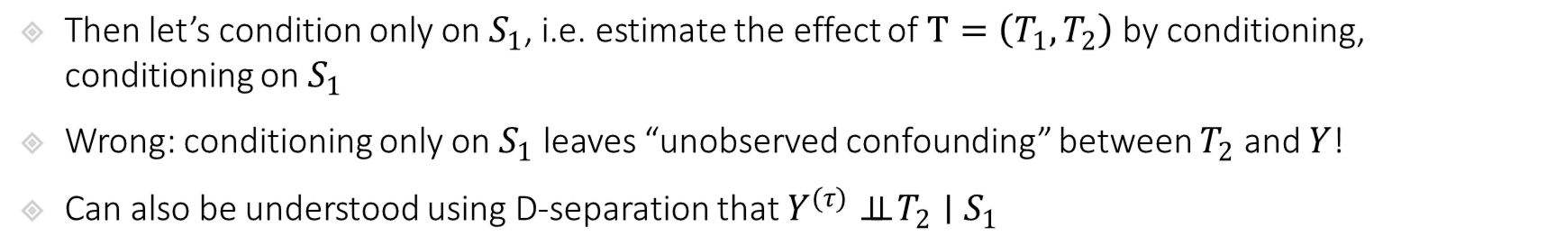
Identification in Dynamic Treatment Regime
$$T_{1}$$
$$τ_{1}$$
$$T_{2}^{\left(τ_{1}\right)}$$
$$τ_{2}$$
Intervention World
$$S_{1}$$
$$S_{2}^{\left(τ_{1}\right)}$$
$$Y^{\left(τ\right)}$$
Two-World Graphs
$$ε_{S_{2}}$$
$$T_{2}$$
Observed World
$$S_{2}$$
$$Y$$
Then let’s condition only on $S_{1}$, i.e. estimate the effect of $T=\left(T_{1},T_{2}\right)$ by conditioning, conditioning on $S_{1}$
Wrong: conditioning only on $S_{1}$ leaves “unobserved confounding” between $T_{2}$ and $Y$!
Can also be understood using D-separation that $Y^{(τ)}⊥⊥ T_{2}∣S_{1}$

Slide 20
Dynamic Treatment Regime
target quantity: average outcome under a static treatment sequence (regime) $τ=\left(τ_{1},τ_{2}\right)$
$$θ≔E\left[Y^{(τ)}\right]$$
observed data (panel)
$$T_{1}$$
$$T_{2}$$
$$T_{1}$$
$$T_{2}^{\left(τ_{1}\right)}$$
$$τ_{1}$$
$$τ_{2}$$
$$S_{1}$$
$$S_{2}$$
$$Y$$
$$S_{1}$$
$$S_{2}^{\left(τ_{1}\right)}$$
$$Y^{\left(τ\right)}$$
We cannot identify this expected potential outcome simply by conditioning!
Let’s take it one step at a time
What can we identify by conditioning?

Slide 21
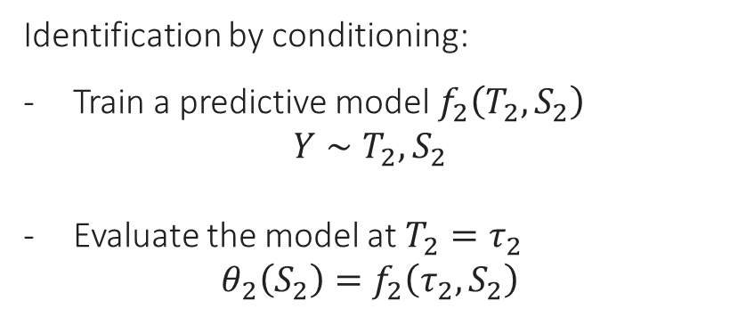
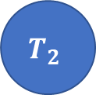
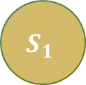


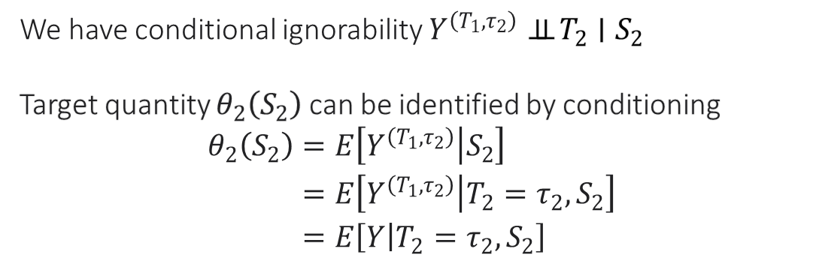
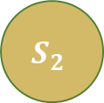
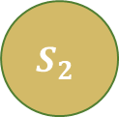

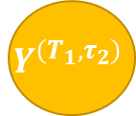

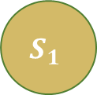

Identification of Last Period Intervention
target quantity: $θ_{2}\left(S_{2}\right)≔E\left[Y^{(T_{1},τ_{2})}|S_{2}\right]$
$$T_{1}$$
$$T_{2}$$
$$T_{1}$$
$$T_{2}$$
$$τ_{2}$$
$$S_{1}$$
$$S_{2}$$
$$Y$$
$$S_{1}$$
$$S_{2}$$
$$Y^{\left(T_{1},τ_{2}\right)}$$
We have conditional ignorability $Y^{\left(T_{1},τ_{2}\right)}⊥⊥ T_{2}∣S_{2}$
Target quantity $θ_{2}\left(S_{2}\right)$ can be identified by conditioning
$$\begin{aligned}θ_{2}\left(S_{2}\right)=&E\left[Y^{\left(T_{1},τ_{2}\right)} | S_{2}\right] \\ =&E\left[Y^{\left(T_{1},τ_{2}\right)} | T_{2}=τ_{2},S_{2}\right] \\ =&E\left[Y | T_{2}=τ_{2},S_{2}\right]\end{aligned}$$
Identification by conditioning:
Train a predictive model $f_{2}\left(T_{2},S_{2}\right)$
$$Y∼T_{2},S_{2}$$
Evaluate the model at $T_{2}=τ_{2}$
$$θ_{2}\left(S_{2}\right)=f_{2}\left(τ_{2},S_{2}\right)$$

Slide 22





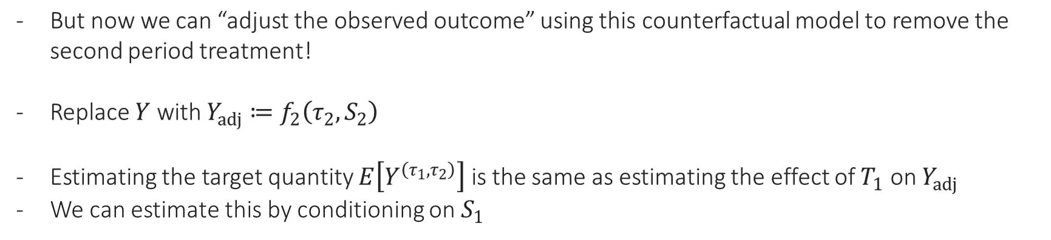


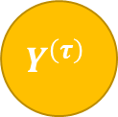



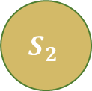

Identification via Backwards Recursion
$$T_{1}$$
$$T_{1}$$
$$T_{2}^{\left(τ_{1}\right)}$$
$$T_{2}$$
$$τ_{2}$$
$$τ_{1}$$
$$τ_{2}$$
$$S_{1}$$
$$S_{2}$$
$$Y^{adj}$$
$$S_{1}$$
$$S_{2}^{\left(τ_{1}\right)}$$
$$Y^{\left(τ\right)}$$
But now we can “adjust the observed outcome” using this counterfactual model to remove the second period treatment!
Replace $Y$ with $Y_{adj}≔f_{2}\left(τ_{2},S_{2}\right)$
Estimating the target quantity $E\left[Y^{\left(τ_{1},τ_{2}\right)}\right]$ is the same as estimating the effect of $T_{1}$ on $Y_{adj}$
We can estimate this by conditioning on $S_{1}$

Slide 23
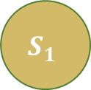


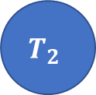

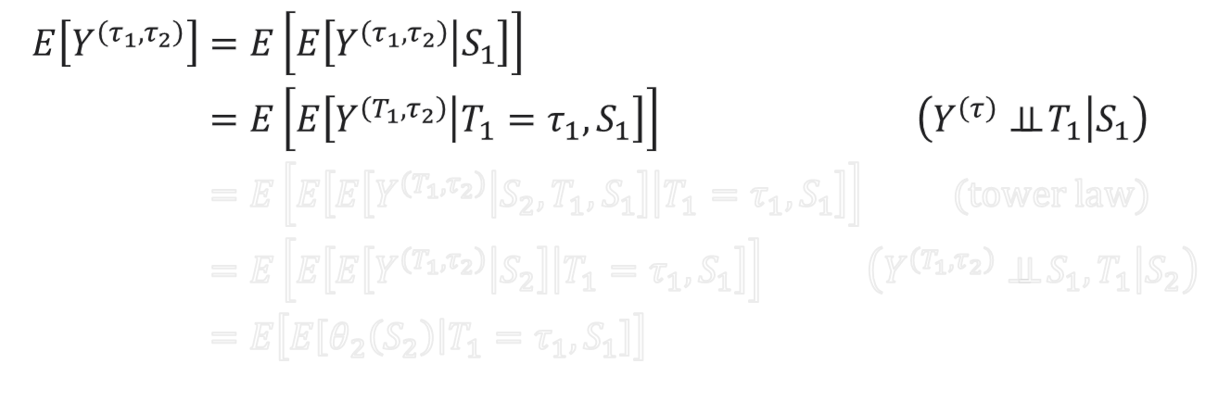




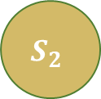
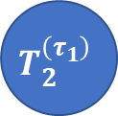
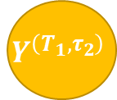

Identification via Backwards Recursion
$$T_{1}$$
$$T_{2}$$
$$T_{1}$$
$$T_{2}^{\left(τ_{1}\right)}$$
$$τ_{1}$$
$$τ_{2}$$
$$S_{1}$$
$$S_{2}$$
$$Y$$
$$S_{1}$$
$$S_{2}^{\left(τ_{1}\right)}$$
$$Y^{\left(τ\right)}$$
$$\begin{aligned}E\left[Y^{\left(τ_{1},τ_{2}\right)}\right]=&E\left[E\left[Y^{\left(τ_{1},τ_{2}\right)} | S_{1}\right]\right]& \\ =&E\left[E\left[Y^{\left(T_{1},τ_{2}\right)} | T_{1}=τ_{1},S_{1}\right]\right]&\left(Y^{\left(τ\right)}⊥⊥ T_{1} | S_{1}\right) \\ =&E\left[E\left[E\left[Y^{\left(T_{1},τ_{2}\right)} | S_{2},T_{1},S_{1}\right] | T_{1}=τ_{1},S_{1}\right]\right]& (tower law) \\ =&E\left[E\left[E\left[Y^{\left(T_{1},τ_{2}\right)} | S_{2}\right] | T_{1}=τ_{1},S_{1}\right]\right]&\left(Y^{\left(T_{1},τ_{2}\right)}⊥⊥ S_{1},T_{1} | S_{2}\right) \\ =&E\left[E\left[θ_{2}\left(S_{2}\right) | T_{1}=τ_{1},S_{1}\right]\right] \\ &\end{aligned}$$
$$T_{1}$$
$$T_{2}$$
$$τ_{2}$$
$$S_{1}$$
$$S_{2}$$
$$Y^{\left(T_{1},τ_{2}\right)}$$

Slide 24
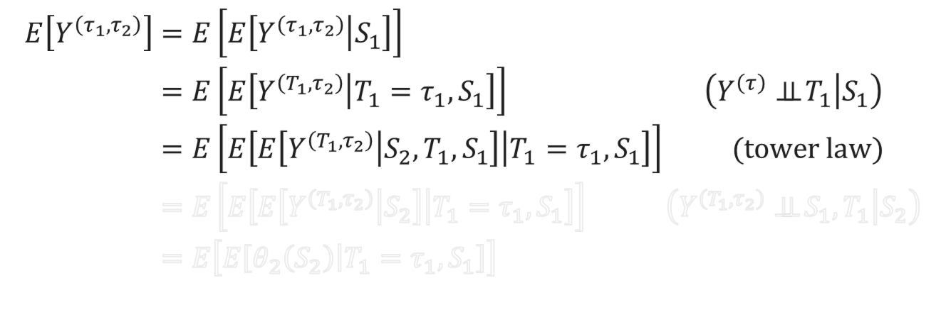
Identification via Backwards Recursion
$$T_{1}$$
$$T_{2}$$
$$T_{1}$$
$$T_{2}^{\left(τ_{1}\right)}$$
$$τ_{1}$$
$$τ_{2}$$
$$S_{1}$$
$$S_{2}$$
$$Y$$
$$S_{1}$$
$$S_{2}^{\left(τ_{1}\right)}$$
$$Y^{\left(τ\right)}$$
$$\begin{aligned}E\left[Y^{\left(τ_{1},τ_{2}\right)}\right]=&E\left[E\left[Y^{\left(τ_{1},τ_{2}\right)} | S_{1}\right]\right]& \\ =&E\left[E\left[Y^{\left(T_{1},τ_{2}\right)} | T_{1}=τ_{1},S_{1}\right]\right]&\left(Y^{\left(τ\right)}⊥⊥ T_{1} | S_{1}\right) \\ =&E\left[E\left[E\left[Y^{\left(T_{1},τ_{2}\right)} | S_{2},T_{1},S_{1}\right] | T_{1}=τ_{1},S_{1}\right]\right]& (tower law) \\ =&E\left[E\left[E\left[Y^{\left(T_{1},τ_{2}\right)} | S_{2}\right] | T_{1}=τ_{1},S_{1}\right]\right]&\left(Y^{\left(T_{1},τ_{2}\right)}⊥⊥ S_{1},T_{1} | S_{2}\right) \\ =&E\left[E\left[θ_{2}\left(S_{2}\right) | T_{1}=τ_{1},S_{1}\right]\right] \\ &\end{aligned}$$
$$T_{1}$$
$$T_{2}$$
$$τ_{2}$$
$$S_{1}$$
$$S_{2}$$
$$Y^{\left(T_{1},τ_{2}\right)}$$

Slide 25



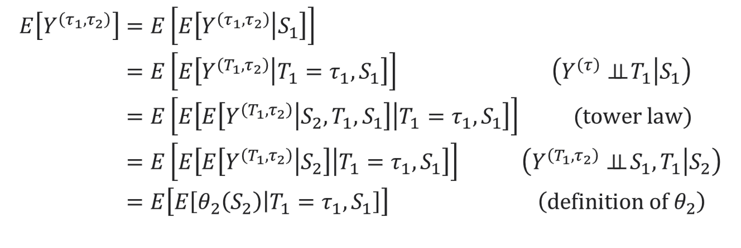



Identification via Backwards Recursion
$$T_{1}$$
$$T_{2}$$
$$T_{1}$$
$$T_{2}^{\left(τ_{1}\right)}$$
$$τ_{1}$$
$$τ_{2}$$
$$S_{1}$$
$$S_{2}$$
$$Y$$
$$S_{1}$$
$$S_{2}^{\left(τ_{1}\right)}$$
$$Y^{\left(τ\right)}$$
$$\begin{aligned}E\left[Y^{\left(τ_{1},τ_{2}\right)}\right]=&E\left[E\left[Y^{\left(τ_{1},τ_{2}\right)} | S_{1}\right]\right]& \\ =&E\left[E\left[Y^{\left(T_{1},τ_{2}\right)} | T_{1}=τ_{1},S_{1}\right]\right]&\left(Y^{\left(τ\right)}⊥⊥ T_{1} | S_{1}\right) \\ =&E\left[E\left[E\left[Y^{\left(T_{1},τ_{2}\right)} | S_{2},T_{1},S_{1}\right] | T_{1}=τ_{1},S_{1}\right]\right]& (tower law) \\ =&E\left[E\left[E\left[Y^{\left(T_{1},τ_{2}\right)} | S_{2}\right] | T_{1}=τ_{1},S_{1}\right]\right]&\left(Y^{\left(T_{1},τ_{2}\right)}⊥⊥ S_{1},T_{1} | S_{2}\right) \\ =&E\left[E\left[θ_{2}\left(S_{2}\right) | T_{1}=τ_{1},S_{1}\right]\right]&\left(definition of θ_{2}\right) \\ &\end{aligned}$$
$$T_{1}$$
$$T_{2}$$
$$τ_{2}$$
$$S_{1}$$
$$S_{2}$$
$$Y^{\left(T_{1},τ_{2}\right)}$$

Slide 26
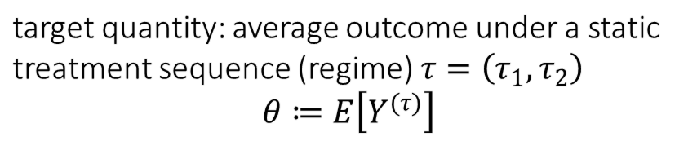


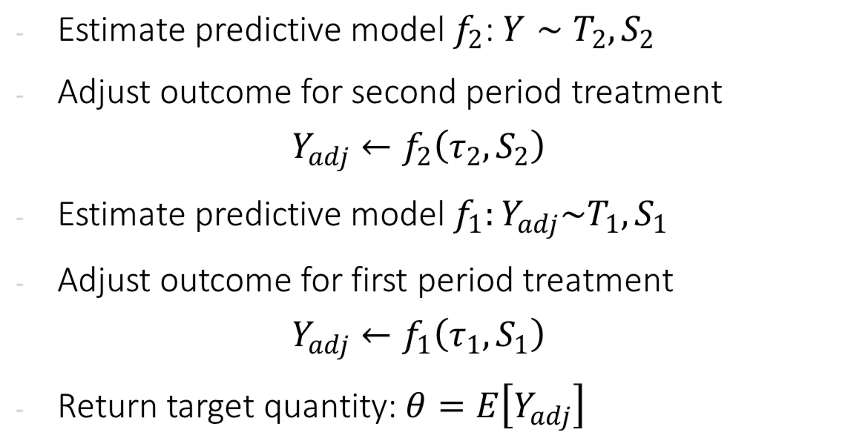



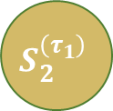
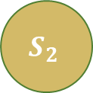




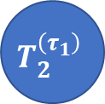
Identification Process
observed data (panel)
$$T_{1}$$
$$T_{2}$$
Estimate predictive model $f_{2}$: $Y∼T_{2},S_{2}$
Adjust outcome for second period treatment
$$Y_{adj}←f_{2}\left(τ_{2},S_{2}\right)$$
Estimate predictive model $f_{1}:Y_{adj}\sim T_{1},S_{1}$
Adjust outcome for first period treatment
$$Y_{adj}←f_{1}\left(τ_{1},S_{1}\right)$$
Return target quantity: $θ=E\left[Y_{adj}\right]$
$$S_{1}$$
$$S_{2}$$
$$Y$$
target quantity: average outcome under a static treatment sequence (regime) $τ=\left(τ_{1},τ_{2}\right)$
$$θ≔E\left[Y^{(τ)}\right]$$
$$T_{1}$$
$$T_{2}^{\left(τ_{1}\right)}$$
$$τ_{1}$$
$$τ_{2}$$
$$S_{1}$$
$$S_{2}^{\left(τ_{1}\right)}$$
$$Y^{\left(τ\right)}$$

Slide 27
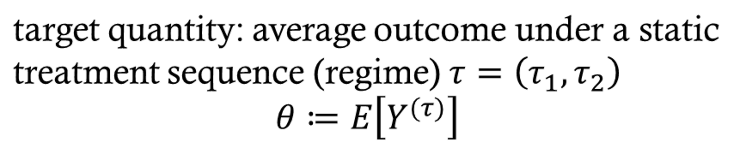


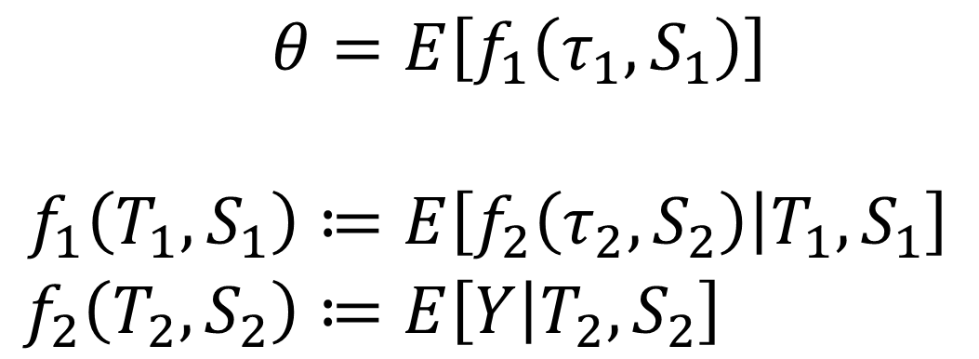





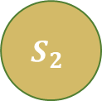

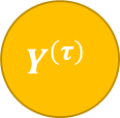


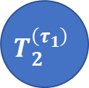
Moment Based Framework
observed data (panel)
$$T_{1}$$
$$T_{2}$$
$$S_{1}$$
$$S_{2}$$
$$Y$$
$$\begin{aligned}θ=&E\left[f_{1}\left(τ_{1},S_{1}\right)\right] \\ \\ f_{1}\left(T_{1},S_{1}\right)≔&E\left[f_{2}\left(τ_{2},S_{2}\right) | T_{1},S_{1}\right] \\ f_{2}\left(T_{2},S_{2}\right)≔&E\left[Y | T_{2},S_{2}\right]\end{aligned}$$
target quantity: average outcome under a static treatment sequence (regime) $τ=\left(τ_{1},τ_{2}\right)$
$$θ≔E\left[Y^{(τ)}\right]$$
$$T_{1}$$
$$T_{2}^{\left(τ_{1}\right)}$$
$$τ_{1}$$
$$τ_{2}$$
These set of equations (and their generalization to many periods) are known as the $g$-formula
$$S_{1}$$
$$S_{2}^{\left(τ_{1}\right)}$$
$$Y^{\left(τ\right)}$$

Slide 28
Estimation in the Dynamic Treatment Regime

Slide 29
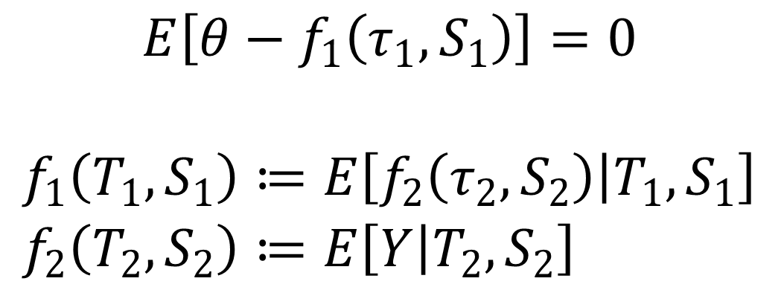

G-computation
observed data (panel)
$$T_{1}$$
$$T_{2}$$
Moment function: $m\left(Z;θ,f\right)$
$$S_{1}$$
$$S_{2}$$
$$Y$$
$$\begin{aligned}E\left[θ−f_{1}\left(τ_{1},S_{1}\right)\right]=0 \\ \\ f_{1}\left(T_{1},S_{1}\right)≔&E\left[f_{2}\left(τ_{2},S_{2}\right) | T_{1},S_{1}\right] \\ f_{2}\left(T_{2},S_{2}\right)≔&E\left[Y | T_{2},S_{2}\right]\end{aligned}$$
target quantity: average outcome under a static treatment sequence (regime) $τ=\left(τ_{1},τ_{2}\right)$
$$θ≔E\left[Y^{(τ)}\right]$$
$$T_{1}$$
$$T_{2}^{\left(τ_{1}\right)}$$
$$τ_{1}$$
$$τ_{2}$$
Nuisance functions
Using parametric models to estimate these functions (e.g. linear or logistic regression) and plug them in the formula is known as the “parametric g computation”
$$S_{1}$$
$$S_{2}^{\left(τ_{1}\right)}$$
$$Y^{\left(τ\right)}$$

Slide 30



ML Based Estimation
observed data (panel)
$$T_{1}$$
$$T_{2}$$
Moment function: $m\left(Z;θ,f\right)$
$$S_{1}$$
$$S_{2}$$
$$Y$$
$$\begin{aligned}E\left[θ−\&f_{1}\left(τ_{1},S_{1}\right)\right]=0 \\ \\ f_{1}\left(T_{1},S_{1}\right)≔&E\left[f_{2}\left(τ_{2},S_{2}\right) | T_{1},S_{1}\right] \\ f_{2}\left(T_{2},S_{2}\right)≔&E\left[Y | T_{2},S_{2}\right]\end{aligned}$$
target quantity: average outcome under a static treatment sequence (regime) $τ=\left(τ_{1},τ_{2}\right)$
$$θ≔E\left[Y^{(τ)}\right]$$
$$T_{1}$$
$$T_{2}^{\left(τ_{1}\right)}$$
$$τ_{1}$$
$$τ_{2}$$
If we use ML for these predictive problems, then we wont be able to construct confidence intervals for $θ$ because moment is not Neyman orthogonal
We can apply the Inverse Propensity based debiasing idea
$$S_{1}$$
$$S_{2}^{\left(τ_{1}\right)}$$
$$Y^{\left(τ\right)}$$

Slide 31



Debiasing Moments and Neyman Orthogonality
Residual of the Regression Problem that defines nuisance function $f_{1}$
Original moment
Inverse Propensity
$$\begin{aligned}E\left[θ−\&f_{1}\left(τ_{1},S_{1}\right)+\frac{1\left\{T_{1}=τ_{1}\right\}}{\operatorname{Pr}\left(T_{1}=τ_{1} | S_{1}\right)}\left(f_{2}\left(τ_{2},S_{2}\right)−f_{1}\left(T_{1},S_{1}\right)\right)\right]=0 \\ \\ f_{1}\left(T_{1},S_{1}\right)≔&E\left[f_{2}\left(τ_{2},S_{2}\right) | T_{1},S_{1}\right] \\ f_{2}\left(T_{2},S_{2}\right)≔&E\left[Y | T_{2},S_{2}\right]\end{aligned}$$
Debiasing correction for nuisance function $f_{1}$
Nuisance functions

Slide 32
Debiasing Moments and Neyman Orthogonality
We are still left with this nuisance, that we have not “debiased”
Original moment
$$\begin{aligned}E\left[θ−\&f_{1}\left(τ_{1},S_{1}\right)+\frac{1\left\{T_{1}=τ_{1}\right\}}{\operatorname{Pr}\left(T_{1}=τ_{1} | S_{1}\right)}\left(f_{2}\left(τ_{2},S_{2}\right)−f_{1}\left(T_{1},S_{1}\right)\right)\right]=0 \\ \\ f_{1}\left(T_{1},S_{1}\right)≔&E\left[f_{2}\left(τ_{2},S_{2}\right) | T_{1},S_{1}\right] \\ f_{2}\left(T_{2},S_{2}\right)≔&E\left[Y | T_{2},S_{2}\right]\end{aligned}$$
Debiasing correction for nuisance function $f_{1}$
Nuisance functions

Slide 33


Debiasing Moments and Neyman Orthogonality
We are still left with this nuisance, that we have not “debiased”
Original moment
$$E\left[θ−f_{1}\left(τ_{1},S_{1}\right)+\frac{1\left\{T_{1}=τ_{1}\right\}}{\operatorname{Pr}\left(T_{1}=τ_{1} | S_{1}\right)}\left(f_{2}\left(τ_{2},S_{2}\right)−f_{1}\left(T_{1},S_{1}\right)\right)\right]=0$$
$$+\frac{1\left\{T_{1}=τ_{1}\right\}}{\operatorname{Pr}\left(T_{1}=τ_{1} | S_{1}\right)}\frac{1\left\{T_{2}=τ_{2}\right\}}{\operatorname{Pr}\left(T_{2}=τ_{2} | S_{2}\right)}\left(y−f_{2}\left(T_{2},S_{2}\right)\right)$$
$$f_{1}\left(T_{1},S_{1}\right)≔E\left[f_{2}\left(τ_{2},S_{2}\right) | T_{1},S_{1}\right]$$
Debiasing correction for nuisance function $f_{2}$
$$f_{2}\left(T_{2},S_{2}\right)≔E\left[Y | T_{2},S_{2}\right]$$
Nuisance functions

Slide 34



Debiasing Moments and Neyman Orthogonality
We are still left with this nuisance, that we have not “debiased”
Original moment
$$E\left[θ−f_{1}\left(τ_{1},S_{1}\right)+\frac{1\left\{T_{1}=τ_{1}\right\}}{\operatorname{Pr}\left(T_{1}=τ_{1} | S_{1}\right)}\left(f_{2}\left(τ_{2},S_{2}\right)−f_{1}\left(T_{1},S_{1}\right)\right)\right]=0$$
IPS term already multiplying $f_{2}$
$$+\frac{1\left\{T_{1}=τ_{1}\right\}}{\operatorname{Pr}\left(T_{1}=τ_{1} | S_{1}\right)}\frac{1\left\{T_{2}=τ_{2}\right\}}{\operatorname{Pr}\left(T_{2}=τ_{2} | S_{2}\right)}\left(y−f_{2}\left(T_{2},S_{2}\right)\right)$$
Residual of the regression problem that defines $f_{2}$
New IPS term for second period treatment introduced to transform
$$f_{2}\left(T_{2},S_{2}\right)→f_{2}\left(τ_{2},S_{2}\right)$$
$$f_{1}\left(T_{1},S_{1}\right)≔E\left[f_{2}\left(τ_{2},S_{2}\right) | T_{1},S_{1}\right]$$
$$f_{2}\left(T_{2},S_{2}\right)≔E\left[Y | T_{2},S_{2}\right]$$
Nuisance functions

Slide 35
Debiasing Moments and Neyman Orthogonality
Original moment
$$E\left[θ−f_{1}\left(τ_{1},S_{1}\right)+\frac{1\left\{T_{1}=τ_{1}\right\}}{\operatorname{Pr}\left(T_{1}=τ_{1} | S_{1}\right)}\left(f_{2}\left(τ_{2},S_{2}\right)−f_{1}\left(T_{1},S_{1}\right)\right)\right]=0$$
$$+\frac{1\left\{T_{1}=τ_{1}\right\}}{\operatorname{Pr}\left(T_{1}=τ_{1} | S_{1}\right)}\frac{1\left\{T_{2}=τ_{2}\right\}}{\operatorname{Pr}\left(T_{2}=τ_{2} | S_{2}\right)}\left(y−f_{2}\left(T_{2},S_{2}\right)\right)$$
$$f_{1}\left(T_{1},S_{1}\right)≔E\left[f_{2}\left(τ_{2},S_{2}\right) | T_{1},S_{1}\right]$$
This moment now satisfies Neyman orthogonality with respect to all the nuisance functions
We need to also estimate the propensity functions via generic ML classification
$$f_{2}\left(T_{2},S_{2}\right)≔E\left[Y | T_{2},S_{2}\right]$$
Nuisance functions

Slide 36
Continuous Treatments and Alternative Approach to Identification and Estimation

Slide 37
What if we have continuous treatments
The propensity based approach to de-biasing does not apply
What is the analogue of the “Residual-on-Residual” or “Partialling-Out” (FWL) approach for the dynamic treatment regime, which is also applicable to continuous treatments?

Slide 38

Identification via “Instantaneous” or “Blip” Effects
target quantity: $θ_{2}\left(S_{2}\right)≔E\left[Y^{(T_{1},τ_{2})}|S_{2}\right]$
$$T_{1}$$
$$T_{2}$$
$$T_{1}$$
$$T_{2}$$
$$τ_{2}$$
$$S_{1}$$
$$S_{2}$$
$$Y$$
$$S_{1}$$
$$S_{2}$$
$$Y^{\left(T_{1},τ_{2}\right)}$$
Instead of estimating the outcome $Y^{\left(T_{1},τ_{2}\right)}$, we will estimate the “effect” of $T_{2}$
$$α_{2}\left(τ_{2}, S_{2}\right)≔E\left[Y^{\left(T_{1},τ_{2}\right)}−Y^{\left(T_{1},0\right)} | S_{2}\right]$$
Adjust outcome by subtracting effect of observed treatment and adding effect of target treatment
$$Y_{adj}≔Y−α_{2}\left(T_{2},S_{2}\right)+α_{2}\left(τ_{2},S_{2}\right)$$

Slide 39

Identification via “Instantaneous” or “Blip” Effects
target quantity: $θ_{2}\left(S_{2}\right)≔E\left[Y^{(T_{1},τ_{2})}|S_{2}\right]$
$$T_{1}$$
$$T_{2}$$
$$T_{1}$$
$$T_{2}$$
$$τ_{2}$$
$$S_{1}$$
$$S_{2}$$
$$Y$$
$$S_{1}$$
$$S_{2}$$
$$Y^{\left(T_{1},τ_{2}\right)}$$
Instead of estimating the outcome $Y^{\left(T_{1},τ_{2}\right)}$, we will estimate the “effect” of $T_{2}$
$$α_{2}\left(τ_{2}, S_{2}\right)≔E\left[Y^{\left(T_{1},τ_{2}\right)}−Y^{\left(T_{1},0\right)} | S_{2}\right]$$
Adjust outcome by subtracting effect of observed treatment and adding effect of target treatment
$$Y_{adj}≔Y−α_{2}\left(T_{2},S_{2}\right)+α_{2}\left(τ_{2},S_{2}\right)$$
If “effect” is assumed to have a simple parametric form, then this approach leverages this simplicity!
Repeat in a backwards manner

Slide 40

Identification Process
observed data (panel)
$$T_{1}$$
$$T_{2}$$
Estimate the “effect” $α_{2}\left(τ_{2}, S_{2}\right)$
$$α_{2}\left(τ_{2}, S_{2}\right)≔E\left[Y^{\left(T_{1},τ_{2}\right)}−Y^{\left(T_{1},0\right)} | S_{2}\right]$$
Adjust outcome for second period treatment
$$Y_{adj}←Y−α_{2}\left(T_{2},S_{2}\right)+α_{2}\left(τ_{2},S_{2}\right)$$
Estimate the effect $α_{1}\left(τ_{1}, S_{1}\right)$
$$E\left[Y^{\left(τ_{1},τ_{2}\right)}−Y^{\left(0,τ_{2}\right)} | S_{1}\right]≈E\left[Y_{adj}^{\left(τ_{1}\right)}−Y_{adj}^{\left(0\right)} ∣ S_{1}\right]$$
Adjust outcome for first period treatment
$$Y_{adj}←Y_{adj}−α_{1}\left(T_{1},S_{1}\right)+α_{1}\left(τ_{1},S_{1}\right)$$
Return target quantity: $θ=E\left[Y_{adj}\right]$
$$S_{1}$$
$$S_{2}$$
$$Y$$
target quantity: average outcome under a static treatment sequence (regime) $τ=\left(τ_{1},τ_{2}\right)$
$$θ≔E\left[Y^{(τ)}\right]$$
$$T_{1}$$
$$T_{2}^{\left(τ_{1}\right)}$$
$$τ_{1}$$
$$τ_{2}$$
$$S_{1}$$
$$S_{2}^{\left(τ_{1}\right)}$$
$$Y^{\left(τ\right)}$$

Slide 41

Partial Linearity: Linear Effects
observed data (panel)
$$T_{1}$$
$$T_{2}$$
If we assume that these effects are partially linear:
$$a_{2}\left(τ_{2},S_{2}\right)=δ_{2}τ_{2}$$
$$a_{1}\left(τ_{1},S_{1}\right)≔δ_{1}τ_{1}$$
$$S_{1}$$
$$S_{2}$$
$$Y$$
target quantity: average outcome under a static treatment sequence (regime) $τ=\left(τ_{1},τ_{2}\right)$
$$θ≔E\left[Y^{(τ)}\right]$$
$$T_{1}$$
$$T_{2}^{\left(τ_{1}\right)}$$
$$τ_{1}$$
$$τ_{2}$$
$$S_{1}$$
$$S_{2}^{\left(τ_{1}\right)}$$
$$Y^{\left(τ\right)}$$

Slide 42

Identification Process
observed data (panel)
$$T_{1}$$
$$T_{2}$$
If we assume that these effects are partially linear:
$$a_{2}\left(τ_{2},S_{2}\right)=δ_{2}τ_{2}$$
$$a_{1}\left(τ_{1},S_{1}\right)≔δ_{1}τ_{1}$$
We can estimate these effects via partialling out!
$$S_{1}$$
$$S_{2}$$
$$Y$$
$$T_{1}$$
$$T_{2}^{\left(τ_{1}\right)}$$
$$τ_{1}$$
$$τ_{2}$$
$$S_{1}$$
$$S_{2}^{\left(τ_{1}\right)}$$
$$Y^{\left(τ\right)}$$

Slide 43

Dynamic DML (Partialling Out)
observed data (panel)
$$T_{1}$$
$$T_{2}$$
Construct residuals
$${\tilde{Y}}_{2}≔Y−E\left[Y | S_{2}\right], {\tilde{T}}_{2}=T_{2}−E\left[T_{2} ∣ S_{2}\right]$$
Run OLS: ${\tilde{Y}}_{2}∼{\tilde{T}}_{2}$ to estimate $δ_{2}$
Adjust outcome $Y_{adj}=Y−δ_{2}T_{2}+δ_{2}τ_{2}$
Construct residuals:
$${\tilde{Y}}_{1}≔Y_{adj}−E\left[Y_{adj} | S_{1}\right], {\tilde{T}}_{1}≔T_{1}−E\left[T_{1} | S_{1}\right]$$
Run OLS: ${\tilde{Y}}_{1}∼{\tilde{T}}_{1}$ to estimate $δ_{1}$
Adjust outcome $Y_{adj}←Y_{adj}−δ_{1}T_{1}+δ_{1}τ_{1}$
Return: $θ≔E\left[Y_{adj}\right]$
$$S_{1}$$
$$S_{2}$$
$$Y$$
$$T_{1}$$
$$T_{2}^{\left(τ_{1}\right)}$$
$$τ_{1}$$
$$τ_{2}$$
$$S_{1}$$
$$S_{2}^{\left(τ_{1}\right)}$$
$$Y^{\left(τ\right)}$$

Slide 44


Moment Based Framework
observed data (panel)
$$T_{1}$$
$$T_{2}$$
$$S_{1}$$
$$S_{2}$$
$$Y$$
$$\begin{aligned}θ≔E\left[Y−δ_{2}T_{2}+δ_{2}τ_{2}−δ_{1}T_{1}+δ_{1}τ_{1}\right]=0 \\ \\ E\left[\left({\tilde{Y}}_{2}−δ_{2}{\tilde{T}}_{2}\right){\tilde{T}}_{2}\right]=0 \\ E\left[\left({\tilde{Y}}_{1}−δ_{1}{\tilde{T}}_{1}\right){\tilde{T}}_{1}\right]=0\end{aligned}$$
$$T_{1}$$
$$T_{2}^{\left(τ_{1}\right)}$$
$$τ_{1}$$
$$τ_{2}$$
$$E\left[Y | S_{2}\right], E\left[T_{2} | S_{2}\right]$$
$$E\left[Y−δ_{2}T_{2}+δ_{2}τ_{2} | S_{1}\right], E\left[T_{1} | S_{1}\right]$$
$$S_{1}$$
$$S_{2}^{\left(τ_{1}\right)}$$
$$Y^{\left(τ\right)}$$
Nuisance functions

Slide 45

Moment Based Framework
observed data (panel)
$$T_{1}$$
$$T_{2}$$
$$S_{1}$$
$$S_{2}$$
$$Y$$
$$\begin{aligned}θ≔E\left[Y−δ_{2}T_{2}+δ_{2}τ_{2}−δ_{1}T_{1}+δ_{1}τ_{1}\right]=0 \\ \\ E\left[\left({\tilde{Y}}_{2}−δ_{2}{\tilde{T}}_{2}\right){\tilde{T}}_{2}\right]=0 \\ E\left[\left({\tilde{Y}}_{1}−δ_{1}{\tilde{T}}_{1}\right){\tilde{T}}_{1}\right]=0\end{aligned}$$
$$T_{1}$$
$$T_{2}^{\left(τ_{1}\right)}$$
$$E\left[Y | S_{2}\right], E\left[T_{2} | S_{2}\right]$$
$$E\left[Y−δ_{2}T_{2}+δ_{2}τ_{2} | S_{1}\right], E\left[T_{1} | S_{1}\right]$$
$$τ_{1}$$
$$τ_{2}$$
For the same reason why the Residual-on-Residual moment was Neyman orthogonal, this estimation process is also orthogonal and we can use ML for these problems
$$S_{1}$$
$$S_{2}^{\left(τ_{1}\right)}$$
$$Y^{\left(τ\right)}$$

Slide 46
An Application from Operations Management
Return on Investment at Microsoft

Slide 47

Estimating Long-Term Returns on Investment
Companies frequently deploys new discount or customer support programs
Which of these programs (“investments”) are more successful than others?
Success is a long-term objective: what is the effect of the program on the two-year customer journey (e.g., effect on two-year revenue)
We cannot wait two years to evaluate a program
Main Question. Can we construct estimates of the values of these programs with short-term data, e.g. after 6 months?

Slide 48




Long-Term Effects from Short-Term Surrogates
Suppose that there are many short-term signals $S$ that are indicative of a customer’s long-term reward $Y$ (e.g. the next 6-month purchase patterns of a customer could be indicative of their long-term spend)
Suppose that investment program $T$ affects long-term rewards if and only if it affects these short-term signals
We will call these short-term signals $S$ surrogates
$T$
$S$
$Y$

Slide 49










Causal Inference with Surrogates 101
(Prentice, 1989; Begg & Leung, 2000; Frangakis & Rubin, 2002; Freedman et al., 1992; Athey et al., 2020)
Since long-term effect goes only through surrogates:
expected effect on long-term reward = effect on projected long-term reward based on surrogates
$$E\left[Y^{\left(τ\right)}\right]=E\left[Y^{\left(τ\right)} | T=τ\right]=E\left[Y | T=τ\right]=E\left[E\left[Y | T=τ, S\right] | T=τ\right]=E\left[E\left[Y | S\right]\right|T=τ]$$
Average reward if intervene and set investment$=τ$
Independence in counterfactual graph
Average reward of samples that received investment=$τ$ in data
Tower Law of Expectations
Forecasted reward from surrogates
$S^{\left(τ\right)}$
$Y^{\left(τ\right)}$
$$T$$
$$τ$$
$T$
$S$
$Y$

Slide 50










Causal Inference with Surrogates 101
historical/long-term (O)
recent/short-term (E)
Contains long-term $Y$ and surrogates $S$
Relationship between $Y$ and $S$ the same as in short-term dataset ($E$)
$$T$$
$$T$$
$$S$$
$$Y$$
$$S$$
$$Y$$
$$g\left(S\right)=E_{o}\left[Y | S\right]$$
Estimate $g\left(S\right)≔E\left[Y | S\right]$ (surrogate index) from ($O$) by regressing $Y∼S$
Impute expected long-term outcomes in (E)
Regress $g\left(S\right)∼T$ to estimate effect of $T$ on $Y$ from (E)

Slide 51





Causal Inference with Surrogates 101
historical/long-term (O)
recent/short-term (E)
Contains long-term $Y$ and surrogates $S$
Relationship between $Y$ and $S$ the same as in short-term dataset ($E$)
$$T$$
$$T$$
$$S_{0}$$
$$S$$
$$Y$$
$$S_{0}$$
$$S$$
$$Y$$
U
$$g\left(S\right)=E_{o}\left[Y | S\right]$$
No un-measured confounders
Estimate $g\left(S\right)≔E\left[Y | S\right]$ (surrogate index) from ($O$) by regressing $Y∼S$
Impute expected long-term outcomes in (E)
Regress $g\left(S\right)∼T$to estimate effect of $T$ on $Y$ from (E)

Slide 52


Key Assumptions
Long-term effect only goes through surrogates
Expected relationship between surrogates and long-term reward is the same long-term setting ($O$) and in short-term setting ($E$)

Slide 53






Key Assumptions can be Easily Violated Investment policies are dynamic and change
historical/long-term (O)
recent/short-term (E)
$$T_{1}$$
$$T_{2}$$
$$T_{1}^{new}$$
$$S$$
$$Y$$
$$S$$
$$Y$$
We deployed older/deprecated investments
In a potentially long-term highly auto-correlated manner
Investments are potentially adaptive
Investment policies change

Slide 54

Bias of Vanilla Surrogate
Illustrative Example

Slide 55












Illustrative Example
Available in O
Want the effect of $T_{1}$ on $Y$, with no future treatments
Available in E
$$T_{2}=κT_{1}+λS+noise$$
$$T_{1}$$
$$T_{2}$$
$$α$$
$$λ$$
$$α_{2}$$
$$S$$
$$Y$$
$$S=αT_{1}+noise$$
$$β$$
$$Y=α_{2}T_{2}+βS+noise$$

Slide 56







Bias of Vanilla Surrogate
What do we want to estimate?
$$Y=β α T_{1}+α_{2} T_{2}+noise$$
$$≔$$
$$θ_{0}$$
$$T_{2}=κT_{1}+λS+noise$$
$$T_{1}$$
$$κ$$
$$T_{2}$$
$$α$$
$$λ$$
$$α_{2}$$
$$S$$
$$Y$$
$$S=αT_{1}+noise$$
$$β$$
$$Y=α_{2}T_{2}+βS+noise$$

Slide 57


Bias of Vanilla Surrogate
What do we want to estimate?
$$Y=β α T_{1}+α_{2} T_{2}+noise$$
What does the surrogate approach estimate?
$$g_{0}\left(S\right)≔E\left[Y | S\right]=β S+α_{2} E\left[T_{2} | S\right]$$
$$≔$$
$$θ_{0}$$
$$T_{2}=κT_{1}+λS+noise$$
$$T_{1}$$
$$κ$$
$$T_{2}$$
$$α$$
$$λ$$
$$α_{2}$$
$$κE\left[T_{1} | S\right]+λS$$
$$S$$
$$Y$$
$$S=αT_{1}+noise$$
$$β$$
$$Y=α_{2}T_{2}+βS+noise$$

Slide 58

Bias of Vanilla Surrogate
What do we want to estimate?
$$Y=β α T_{1}+α_{2} T_{2}+noise$$
What does the surrogate approach estimate?
$$g_{0}\left(S\right)≔E\left[Y | S\right]=β S+α_{2} E\left[T_{2} | S\right]$$
The effect of $T_{1}$ on $g_{0}\left(S\right)$ is:
$$θ_{∗}≔β α+α_{2} κ\frac{E\left[E\left[T_{1} | S\right]⋅T_{1}\right]}{E\left[T_{1}^{2}\right]}+α_{2} λ α$$
$$≔$$
$$θ_{0}$$
$$T_{2}=κT_{1}+λS+noise$$
$$T_{1}$$
$$κ$$
$$T_{2}$$
$$α$$
$$λ$$
$$α_{2}$$
$$κE\left[T_{1} | S\right]+λS$$
$$S$$
$$Y$$
$$S=αT_{1}+noise$$
$$β$$
$$Y=α_{2}T_{2}+βS+noise$$

Slide 59

Bias of Vanilla Surrogate
What do we want to estimate?
$$Y=β α T_{1}+α_{2} T_{2}+noise$$
What does the surrogate approach estimate?
$$g_{0}\left(S\right)≔E\left[Y | S\right]=β S+α_{2} E\left[T_{2} | S\right]$$
The effect of $T_{1}$ on $g_{0}\left(S\right)$ is:
$$θ_{∗}≔β α+α_{2} κ\frac{E\left[E\left[T_{1} | S\right]⋅T_{1}\right]}{E\left[T_{1}^{2}\right]}+α_{2} λ α$$
$$≔$$
$$θ_{0}$$
$$T_{2}=κT_{1}+λS+noise$$
$$T_{1}$$
$$κ$$
$$T_{2}$$
$$α$$
$$λ$$
$$α_{2}$$
$$κE\left[T_{1} | S\right]+λS$$
$$S$$
$$Y$$
$$S=αT_{1}+noise$$
$$β$$
$$Y=α_{2}T_{2}+βS+noise$$
Bias from the fact that policy is auto-correlated violating the “effect only through surrogates” assumption
Bias from the fact that policy is adaptive on past surrogates violating
“relationship of $S$ and $Y$ unchanged”
assumption

Slide 60
Prevalence of Such Violation
Marketing departments frequently deploy new marketing campaigns
In historical data, older campaigns were deployed
Due to targeting, if a customer received an ad, most probably will receive one in the future
Ad display is adaptive to signals of customer behavior
Pharmaceutical companies frequently deploy new drugs
Can we get estimates of long-term effect from short-term trials
Use short-term signals of patient response that correlated with long-term survival
In historical long-term clinical data, patients are treated with multiple treatments over time
Treatments are typically adaptive to signals of patient trajectory

Slide 61

Key Idea 1
Dynamic Adjustment of Surrogate Index
Battocchi, Dillon, Hei, Lewis, Oprescu, Syrgkanis, Estimating the Long-Term Effects of Novel Treatments, NeurIPS’21
https://arxiv.org/abs/2103.08390

Slide 62











Dynamically Adjusted Surrogate Index
historical/long-term (O)
recent/short-term (E)
$$T_{1}$$
$$T_{1}^{new}$$
$$T_{2}$$
$$0$$
$$S$$
$$Y^{\left(0_{2}\right)}$$
$$S$$
$$Y$$
$$g^{adj}\left(S\right)=E_{o}\left[Y^{\left(0_{2}\right)} | S\right]$$
$$=E_{o}\left[Y−γ\left(T_{2},S\right) | S\right]$$
Identification argument
“blip” effect of second treatment conditional on surrogate
effect of $T_{2}$ controlling for 𝑆

Slide 63

Illustrative Example: Dynamically Adjusted Index
Estimate effect $α_{2}$ of $T_{2}$ on $Y$, controlling for $S$
$$E\left[Y | T_{2},S\right]=α_{2}T_{2}+βS$$
$$T_{2}=κT_{1}+λS+noise$$
$$T_{1}$$
$$κ$$
$$T_{2}$$
$$α$$
$$λ$$
$$α_{2}$$
$$S$$
$$Y$$
$$S=αT_{1}+noise$$
$$β$$
$$Y=α_{2}T_{2}+βS+noise$$

Slide 64







Illustrative Example: Dynamically Adjusted Index
Estimate effect $α_{2}$ of $T_{2}$ on $Y$, controlling for $S$
$$E\left[Y | T_{2},S\right]=α_{2}T_{2}+βS$$
Subtract that effect to create the adjusted outcome
$$Y^{adj}≔Y−α_{2}T_{2}$$
$$T_{1}$$
$$κ$$
$$T_{2}$$
$$α$$
$$λ$$
$$α_{2}$$
$$S$$
$$Y^{adj}$$
$$S=αT_{1}+noise$$
$$β$$
$$Y^{adj}=βS+noise$$

Slide 65

Illustrative Example: Dynamically Adjusted Index
Estimate effect $α_{2}$ of $T_{2}$ on $Y$, controlling for $S$
$$E\left[Y | T_{2},S\right]=α_{2}T_{2}+βS$$
Subtract that effect to create the adjusted outcome
$$Y^{adj}≔Y−α_{2}T_{2}$$
Estimate dynamically adjusted index on long-term data
$$g_{0}^{adj}\left(S\right)≔E\left[Y^{adj} | S\right]=β S$$
$$T_{1}$$
$$κ$$
$$T_{2}$$
$$α$$
$$λ$$
$$α_{2}$$
$$S$$
$$Y^{adj}$$
$$S=αT_{1}+noise$$
$$β$$
$$Y^{adj}=βS+noise$$

Slide 66

Illustrative Example: Dynamically Adjusted Index
Estimate effect $α_{2}$ of $T_{2}$ on $Y$, controlling for $S$
$$E\left[Y | T_{2},S\right]=α_{2}T_{2}+βS$$
Subtract that effect to create the adjusted outcome
$$Y^{adj}≔Y−α_{2}T_{2}$$
Estimate dynamically adjusted index on long-term data
$$g_{0}^{adj}\left(S\right)≔E\left[Y^{adj} | S\right]=β S$$
Estimate effect of $T_{1}$ on $g_{0}^{adj}\left(S\right)$ on short-term data
$$θ_{0}≔\frac{E\left[g_{0}^{adj}\left(S\right)⋅T_{1}\right]}{E\left[T_{1}^{2}\right]}=β⋅α$$
$$T_{1}$$
$$κ$$
$$T_{2}$$
$$α$$
$$λ$$
$$α_{2}$$
$$S$$
$$Y^{adj}$$
$$S=αT_{1}+noise$$
$$β$$
$$Y^{adj}=βS+noise$$

Slide 67










Beyond Two Periods
historical/long-term (O)
recent/short-term (E)
$$T_{1}$$
$$T_{2}$$
$$T_{3}$$
$$T_{1}^{new}$$
$$S_{1}$$
$$Y$$
$$S_{0}$$
$$S_{1}$$
$$Y$$
Multiple treatments are offered after the surrogate variable
Easy: estimate their effect controlling for $S_{1}$
Wrong!

Slide 68


Beyond Two Periods
historical/long-term (O)
recent/short-term (E)
$$T_{1}$$
$$T_{2}$$
$$T_{3}$$
$$T_{1}^{new}$$
$$S_{1}$$
$$S_{2}$$
$$Y$$
$$S_{0}$$
$$S_{1}$$
$$Y$$
Treatments are offered in an adaptive manner, in response to previous period surrogate/state
The surrogate – treatment feedback precludes viewing this as a one-shot treatment problem
Setting is known as the dynamic treatment regime [Robins’94,’04, Chakraborty-Murphy’14]

Slide 69









Beyond Two Periods: Target Quantity
historical/long-term (O)
recent/short-term (E)
$$T_{1}$$
$$T_{1}^{new}$$
$$T_{2}$$
$$0$$
$$T_{3}$$
$$0$$
$$S_{1}$$
$$S_{2}^{\left(0_{≥2}\right)}$$
$$Y^{\left(0_{≥2}\right)}$$
$$S_{0}$$
$$S_{1}$$
$$Y$$
$$g^{adj}\left(S_{1}\right)=E_{o}\left[Y^{\left(0_{≥2}\right)} | S_{1}\right]$$
What effect do we subtract from $Y$?
Do we estimate effect of $T_{2},T_{3}$ controlling for $S_{1},S_{2}$? Wrong
Do we estimate effect of $T_{2},T_{3}$ controlling for $S_{1}$? Wrong
$$=E_{o}\left[\left.Y−\sum_{t≥2}{γ_{t}\left(T_{t},S_{t−1}\right)}\right|S_{1}\right]$$
“blip” effect of treatment at period $t$

