Slide 1
MS&E 228: Inference in Linear Models
Vasilis Syrgkanis
MS&E, Stanford

Slide 2
Causal Inference with Experiments
Prediction with Linear Models
Prediction with High-Dim Linear Models
Inference on Causal and Predictive Effects with High-Dim Linear Models
Potential Outcomes and Conditional Ignorability
Structural Equation Models and Conditional Exogeneity
Directed Acyclic Graphs
Prediction with Non-Linear Models
Inference on Causal Effects with Non-Linear Models
Un-observed Confounding and Instruments
Identification of Causal Effects in Longitudinal Data
Estimation of Heterogeneous Causal Effects
Linear Predictive Models and Statistical Inference
Causal Identification in Observational Data
Non-Linear Predictive Models and Statistical Inference
Topics

Slide 3
Causal Inference with Experiments
Prediction with Linear Models
Prediction with High-Dim Linear Models
Inference on Causal and Predictive Effects with High-Dim Linear Models
Potential Outcomes and Conditional Ignorability
Structural Equation Models and Conditional Exogeneity
Directed Acyclic Graphs
Prediction with Non-Linear Models
Inference on Causal Effects with Non-Linear Models
Un-observed Confounding and Instruments
Identification of Causal Effects in Longitudinal Data
Estimation of Heterogeneous Causal Effects
Linear Predictive Models and Statistical Inference
Causal Identification in Observational Data
Non-Linear Predictive Models and Statistical Inference
Topics

Slide 4
Linear Regression and the Best Linear Prediction (BLP) Problem

Slide 5
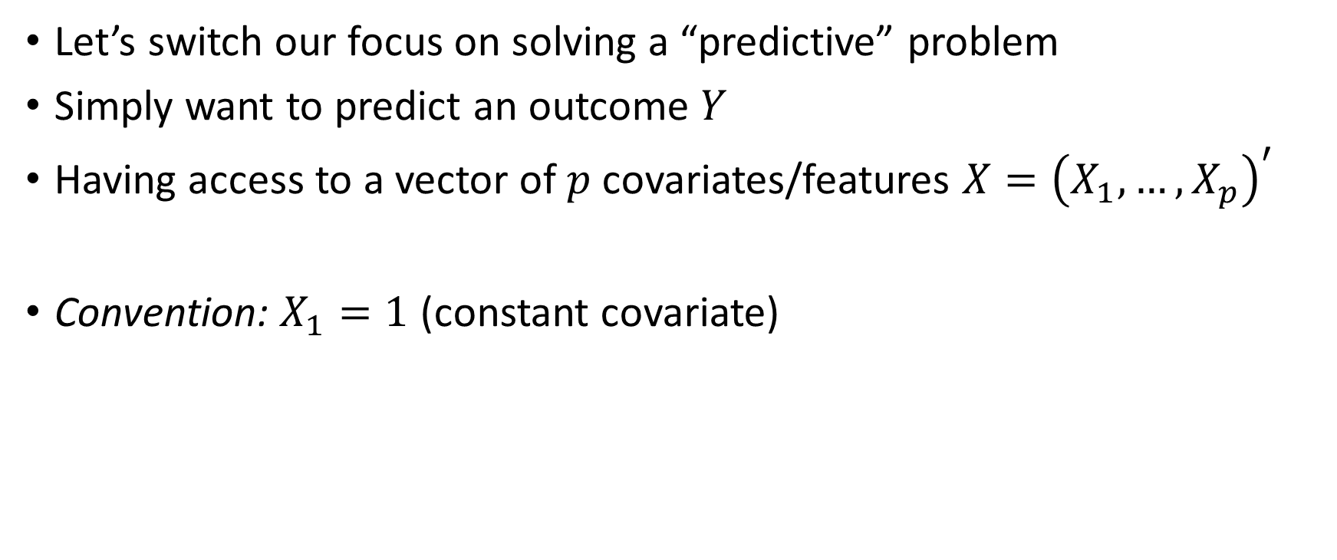
Predictive Modelling
Let’s switch our focus on solving a “predictive” problem
Simply want to predict an outcome $Y$
Having access to a vector of $p$ covariates/features $X={\left(X_{1},…,X_{p}\right)}^{′}$
Convention: $X_{1}=1$ (constant covariate)

Slide 6
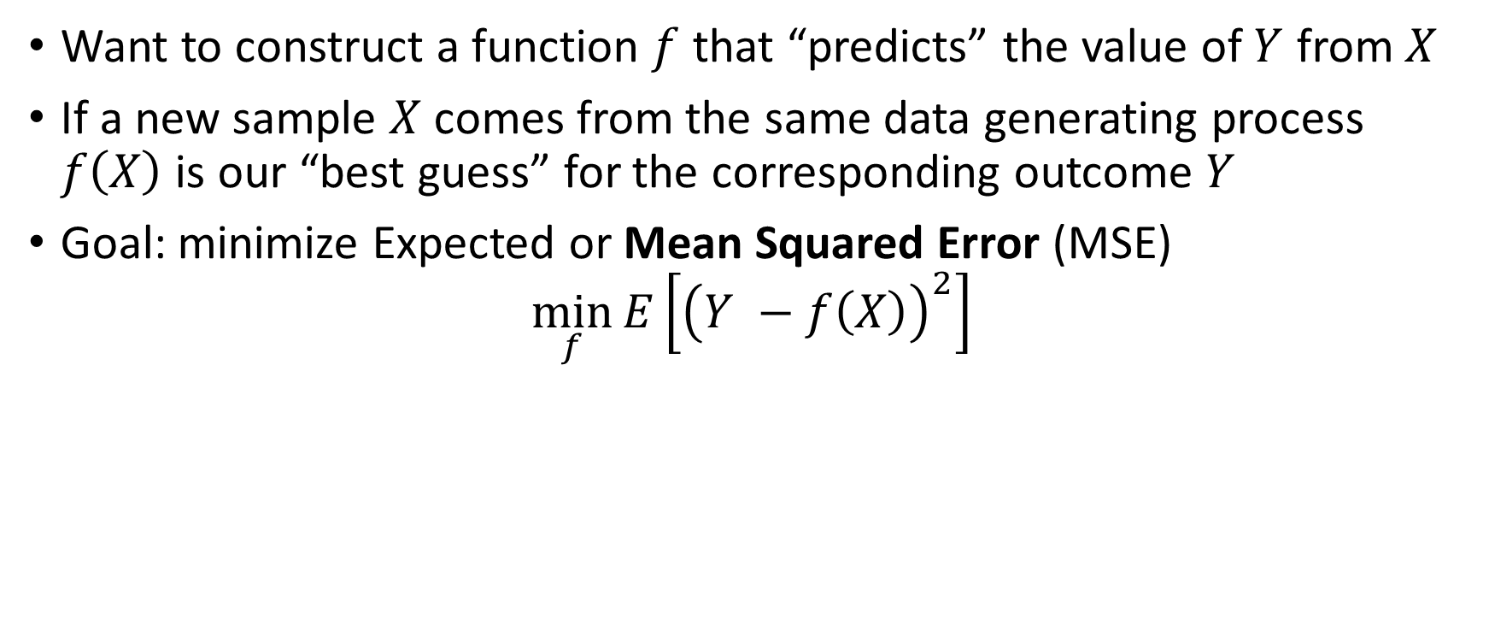
Predictive Modelling: Mean Squared Error
Want to construct a function $f$ that “predicts” the value of $Y$ from $X$
If a new sample $X$ comes from the same data generating process $f\left(X\right)$ is our “best guess” for the corresponding outcome $Y$
Goal: minimize Expected or Mean Squared Error (MSE)
$$\min_{f}{E\left[{\left(Y −f\left(X\right)\right)}^{2}\right]}$$

Slide 7
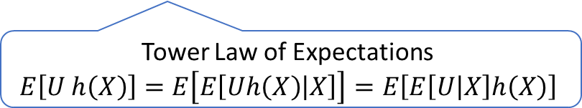
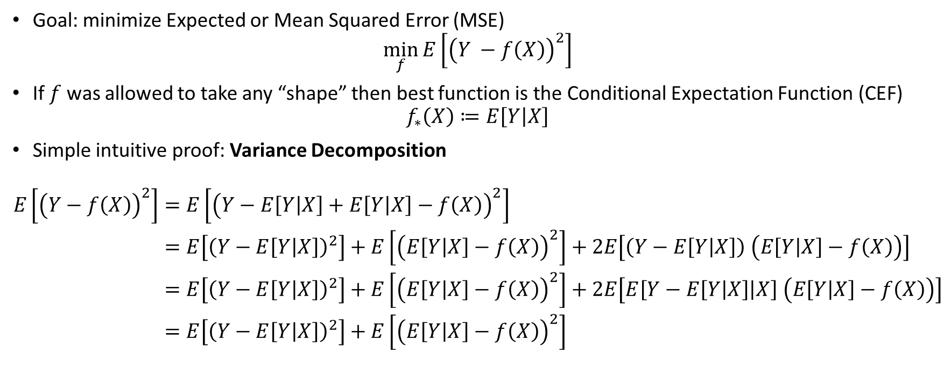
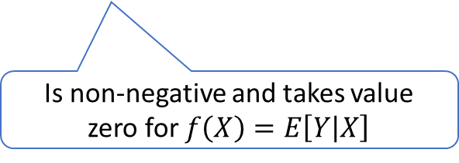
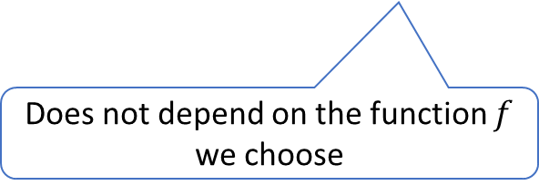
Best Predictive Model
Goal: minimize Expected or Mean Squared Error (MSE)
$$\min_{f}{E\left[{\left(Y −f\left(X\right)\right)}^{2}\right]}$$
If $f$ was allowed to take any “shape” then best function is the Conditional Expectation Function (CEF)
$$f_{∗}\left(X\right)≔E\left[Y | X\right]$$
Simple intuitive proof: Variance Decomposition
$$\begin{aligned}E\left[{\left(Y−f\left(X\right)\right)}^{2}\right]=&E\left[{\left(Y−E\left[Y | X\right]+E\left[Y | X\right]−f\left(X\right)\right)}^{2}\right] \\ =&E\left[{\left(Y−E\left[Y | X\right]\right)}^{2}\right]+E\left[{\left(E\left[Y | X\right]−f\left(X\right)\right)}^{2}\right]+2E\left[\left(Y−E\left[Y | X\right]\right) \left(E\left[Y | X\right]−f\left(X\right)\right)\right] \\ =&E\left[{\left(Y−E\left[Y | X\right]\right)}^{2}\right]+E\left[{\left(E\left[Y | X\right]−f\left(X\right)\right)}^{2}\right]+2E\left[E\left[Y−E\left[Y | X\right] | X\right] \left(E\left[Y | X\right]−f\left(X\right)\right)\right] \\ =&E\left[{\left(Y−E\left[Y | X\right]\right)}^{2}\right]+E\left[{\left(E\left[Y | X\right]−f\left(X\right)\right)}^{2}\right]\end{aligned}$$
Tower Law of Expectations
$$E\left[U h\left(X\right)\right]=E\left[E\left[Uh\left(X\right) | X\right]\right]=E\left[E\left[U | X\right]h\left(X\right)\right]$$
Does not depend on the function $f$ we choose
Is non-negative and takes value zero for $f\left(X\right)=E\left[Y | X\right]$

Slide 8
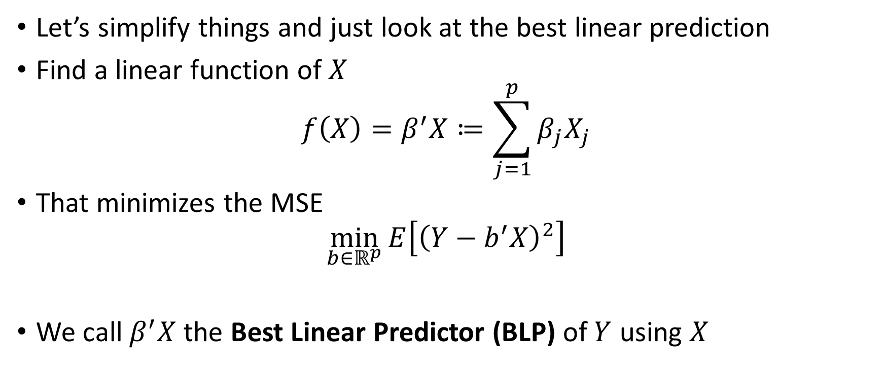
Best Linear Prediction (BLP) Problem
Let’s simplify things and just look at the best linear prediction
Find a linear function of $X$
$$f\left(X\right)=β^{′}X≔\sum_{j=1}^{p}{β_{j}X_{j}}$$
That minimizes the MSE
$$\min_{b∈ℝ^{p}}{E\left[{\left(Y−b^{′}X\right)}^{2}\right]}$$
We call $β^{′}X$ the Best Linear Predictor (BLP) of $Y$ using $X$

Slide 9
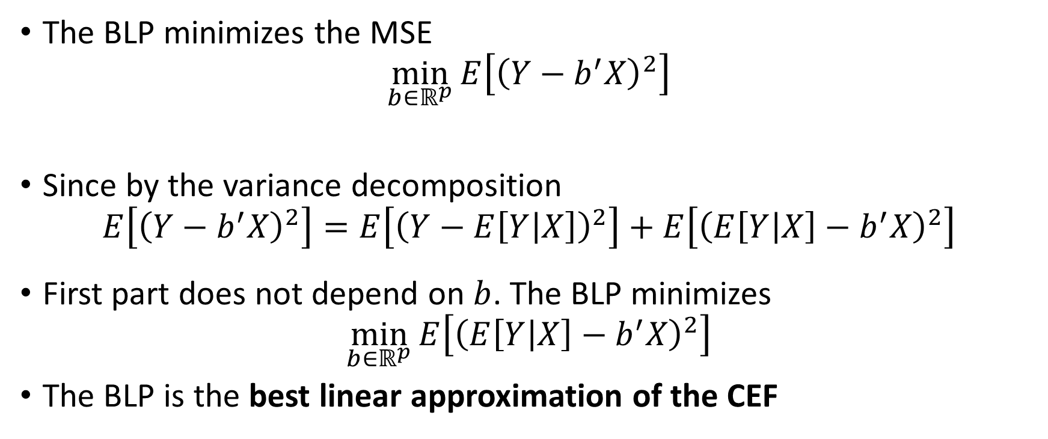
Best Linear Prediction (BLP) Problem
The BLP minimizes the MSE
$$\min_{b∈ℝ^{p}}{E\left[{\left(Y−b^{′}X\right)}^{2}\right]}$$
Since by the variance decomposition
$$E\left[{\left(Y−b^{′}X\right)}^{2}\right]=E\left[{\left(Y−E\left[Y | X\right]\right)}^{2}\right]+E\left[{\left(E\left[Y | X\right]−b^{′}X\right)}^{2}\right]$$
First part does not depend on $b$. The BLP minimizes
$$\min_{b∈ℝ^{p}}{E\left[{\left(E\left[Y | X\right]−b^{′}X\right)}^{2}\right]}$$
The BLP is the best linear approximation of the CEF

Slide 10
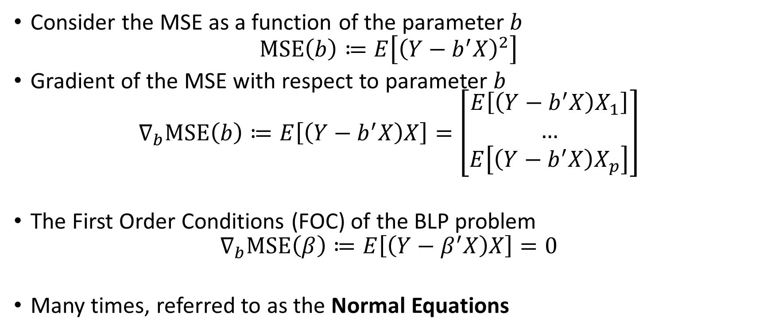
Solving for the BLP
Consider the MSE as a function of the parameter $b$
$$MSE\left(b\right)≔E\left[{\left(Y−b^{′}X\right)}^{2}\right]$$
Gradient of the MSE with respect to parameter $b$
$$∇_{b}MSE\left(b\right)≔E\left[\left(Y−b^{′}X\right)X\right]=\left[\begin{matrix}E\left[\left(Y−b^{′}X\right)X_{1}\right] \\ … \\ E\left[\left(Y−b^{′}X\right)X_{p}\right]\end{matrix}\right]$$
The First Order Conditions (FOC) of the BLP problem
$$∇_{b}MSE\left(β\right)≔E\left[\left(Y−β^{′}X\right)X\right]=0$$
Many times, referred to as the Normal Equations

Slide 11
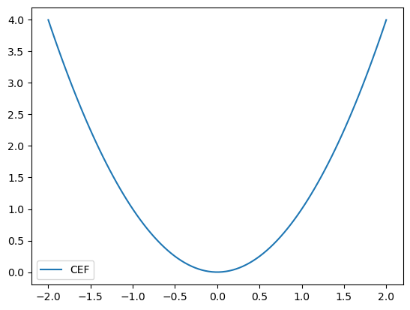
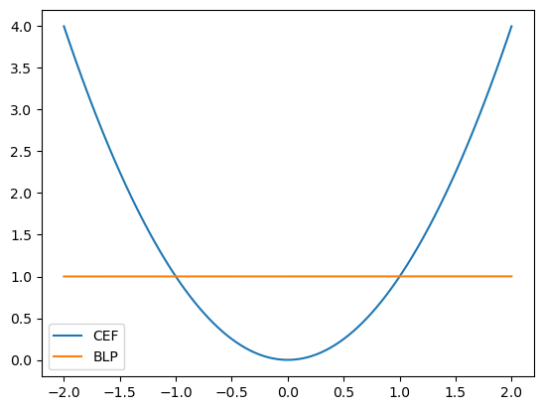

Numerical Example
Suppose $X=\left(1,W\right)$
$$Y=γ W^{2}+η, η∼N\left(0, 1\right), W∼N\left(0, 1\right)$$
The Normal Equations
$$\begin{aligned}E\left[\left(Y −β^{′}X\right) X\right]=&E\left[\left(γW^{2}+η−β^{′}X\right)X\right] \\ =&E\left[\left(γW^{2}−β^{′}X\right)X\right]=0\end{aligned}$$
Since $E\left[W\right]=0, E\left[W^{2}\right]=1, E\left[W^{3}\right]=0$
$$E[\left(γW^{2}−β^{′}X) 1\right]=γ−β_{1}=0$$
$$E\left[\left(γW^{2}−β^{′}X\right)W\right]=γ⋅0−β_{2}=0$$
So $β_{1}=γ, β_{2}=0$ and the BLP takes the form:
$$β^{′}X=γ, (a constant prediction)$$

Slide 12
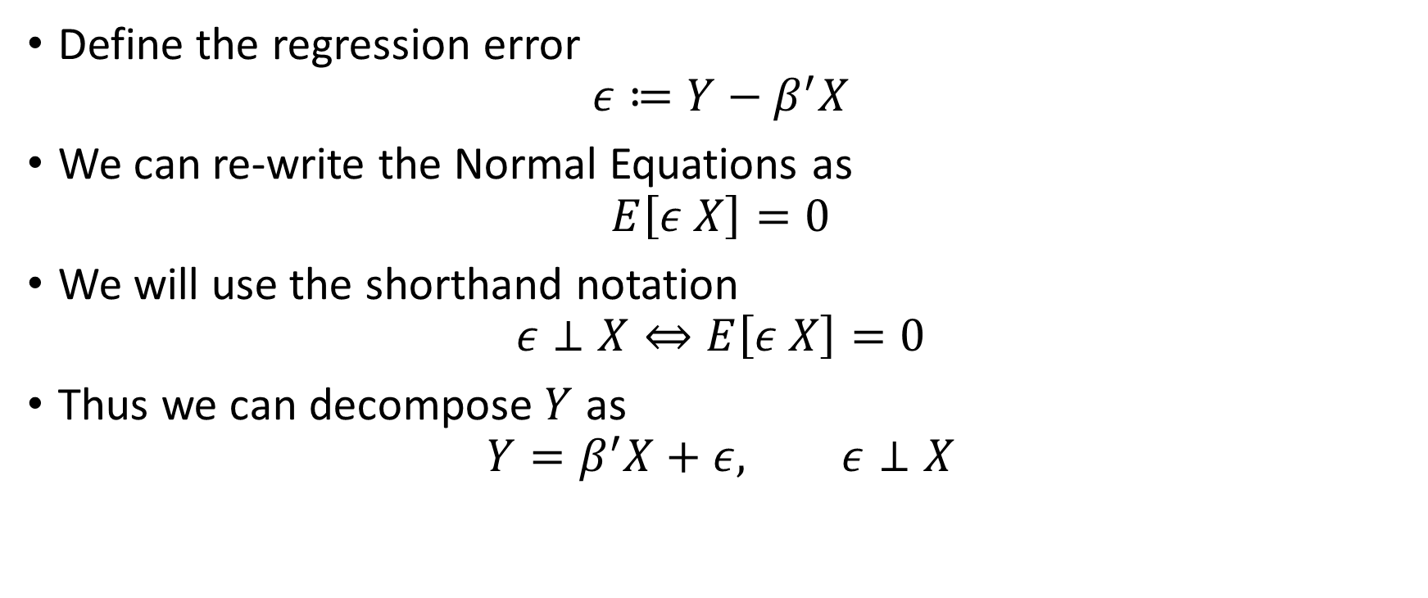

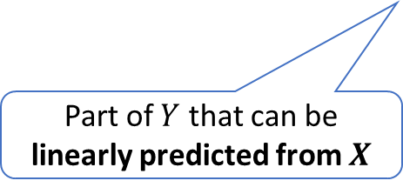
Decomposition of $Y$
Define the regression error
$$ε≔Y−β^{′}X$$
We can re-write the Normal Equations as
$$E\left[ε X\right]=0$$
We will use the shorthand notation
$$ε⊥X⇔E\left[ε X\right]=0$$
Thus we can decompose $Y$ as
$$Y=β^{′}X+ε, ε⊥X$$
Part of $Y$ that can be linearly predicted from $X$
Remaining un-explained or residual part

Slide 13

Numerical Example
Suppose $X=\left(1,W\right)$
$$Y=γ W^{2}+η, η∼N\left(0, 1\right), W∼N\left(0, 1\right)$$
Reminder $β_{1}=γ, β_{2}=0$ and the BLP takes the form:
$$β^{′}X=γ, (a constant prediction)$$
We can decompose $Y$ as
$$Y=γ+ε, ε≔γ\left(W^{2}−1\right)+η$$
Note that
$$E\left[ε\right]=γ\left(E\left[W^{2}\right]−1\right)=0$$
$$E\left[εW\right]=γ\left(E\left[W^{3}\right]−E\left[W\right]\right)=0$$

Slide 14

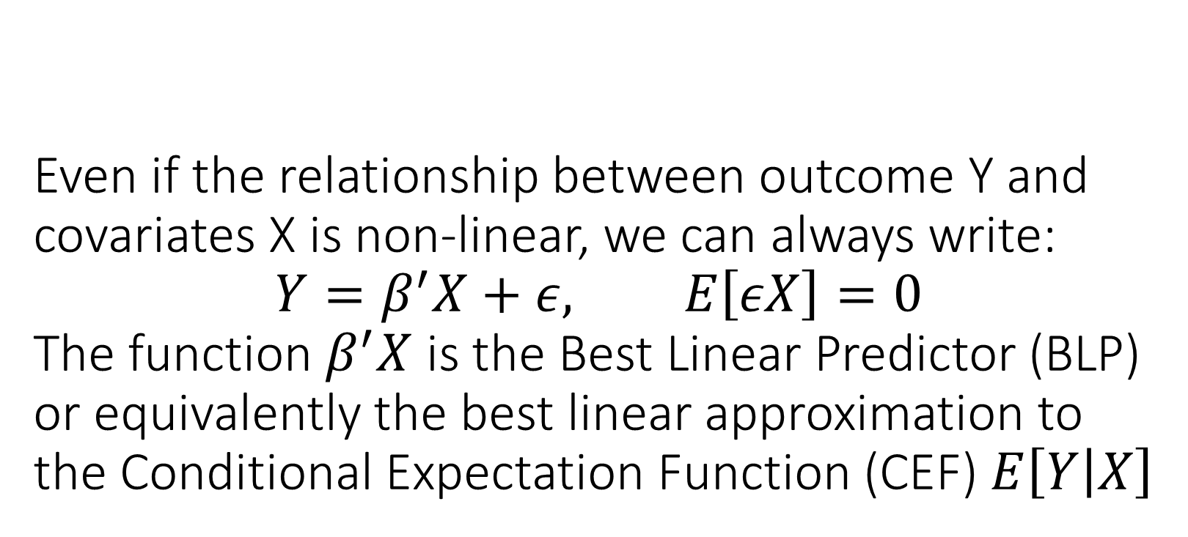
Even if the relationship between outcome Y and covariates X is non-linear, we can always write: $$Y=β^{′}X+ε, E\left[εX\right]=0$$ The function $β^{′}X$ is the Best Linear Predictor (BLP) or equivalently the best linear approximation to the Conditional Expectation Function (CEF) $E\left[Y | X\right]$

Slide 15
Finite Sample Estimation

Slide 16
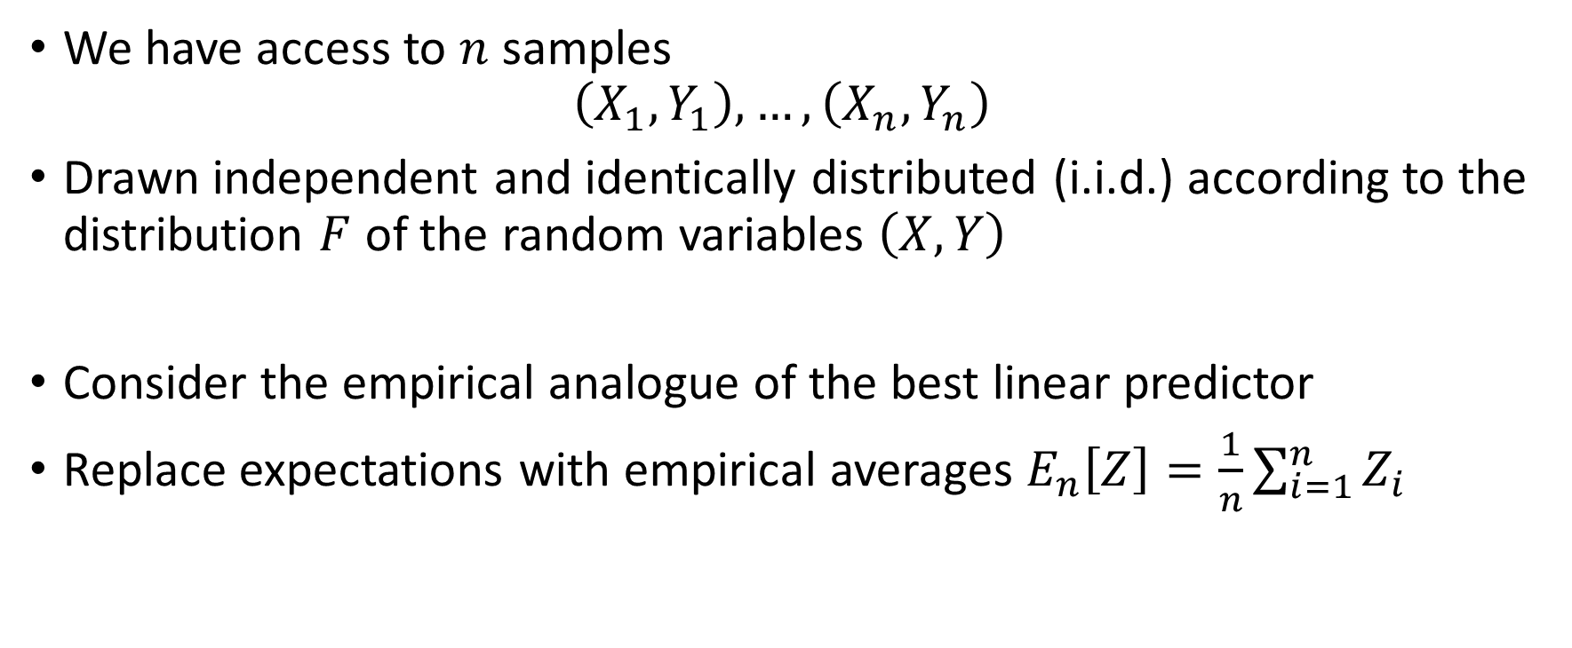
BLP in Sample
We have access to $n$ samples
$$\left(X_{1},Y_{1}\right),…, \left(X_{n},Y_{n}\right)$$
Drawn independent and identically distributed (i.i.d.) according to the distribution $F$ of the random variables $\left(X, Y\right)$
Consider the empirical analogue of the best linear predictor
Replace expectations with empirical averages $E_{n}\left[Z\right]=\frac{1}{n}\sum_{i=1}^{n}{Z_{i}}$

Slide 17
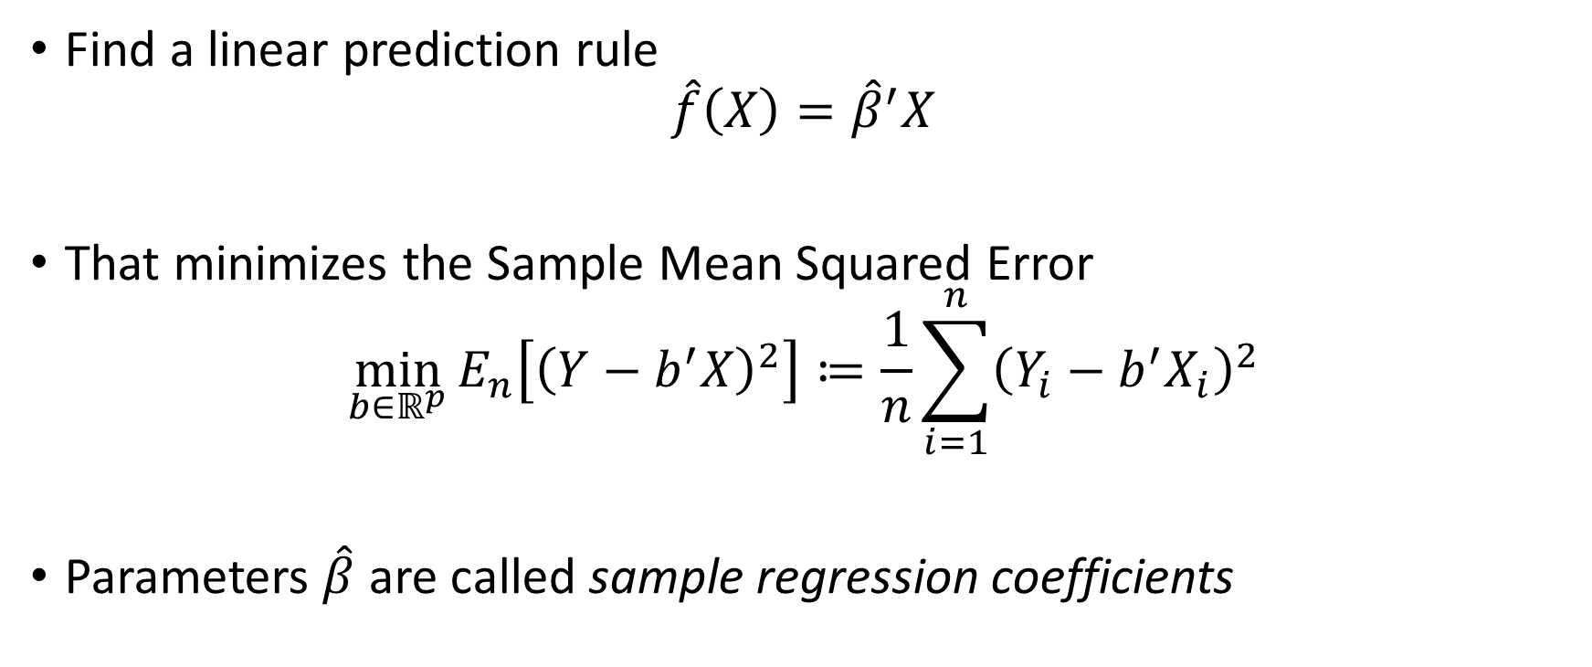
BLP in Sample: Ordinary Least Squares (OLS)
Find a linear prediction rule
$$\hat{f}\left(X\right)={\hat{β}}^{′}X$$
That minimizes the Sample Mean Squared Error
$$\min_{b∈ℝ^{p}}{E_{n}\left[{\left(Y−b^{′}X\right)}^{2}\right]≔\frac{1}{n}\sum_{i=1}^{n}{{\left(Y_{i}−b^{′}X_{i}\right)}^{2}}}$$
Parameters $\hat{β}$ are called sample regression coefficients

Slide 18
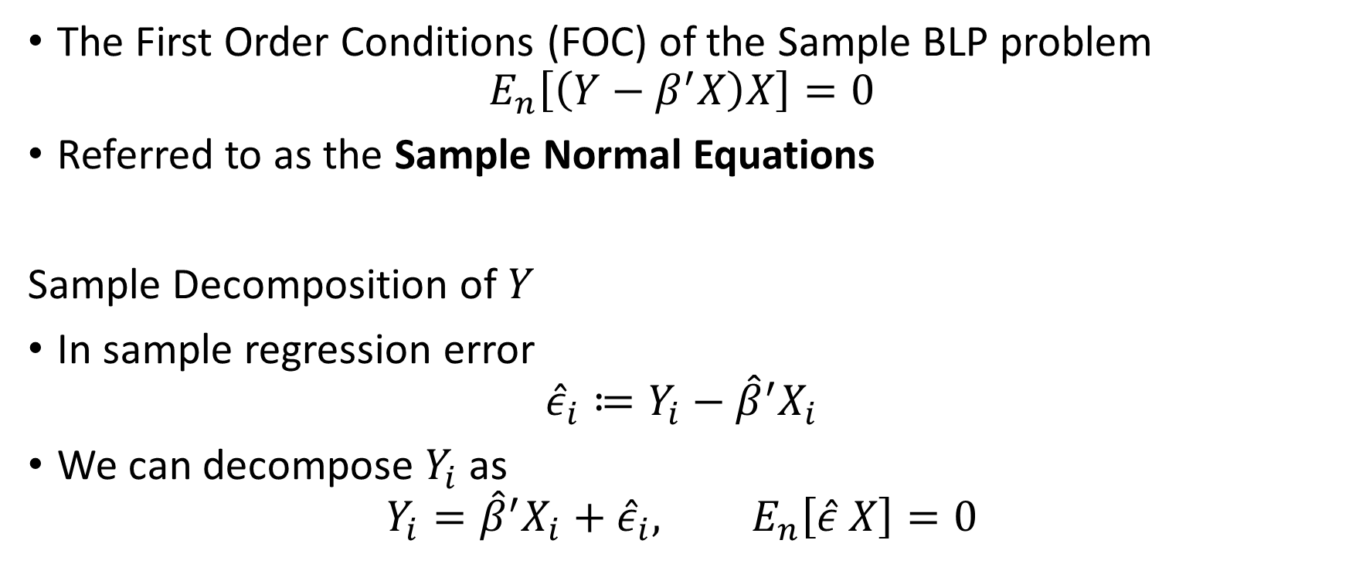
Sample Normal Equations
The First Order Conditions (FOC) of the Sample BLP problem
$$E_{n}\left[\left(Y−β^{′}X\right)X\right]=0$$
Referred to as the Sample Normal Equations
Sample Decomposition of $Y$
In sample regression error
$${\hat{ε}}_{i}≔Y_{i}−{\hat{β}}^{′}X_{i}$$
We can decompose $Y_{i}$ as
$$Y_{i}={\hat{β}}^{′}X_{i}+{\hat{ε}}_{i}, E_{n}\left[\hat{ε} X\right]=0$$

Slide 19
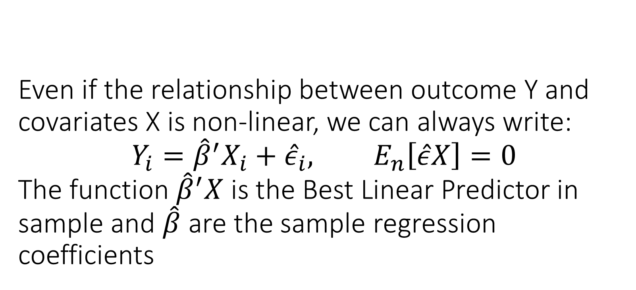
Even if the relationship between outcome Y and covariates X is non-linear, we can always write: $$Y_{i}={\hat{β}}^{′}X_{i}+{\hat{ε}}_{i}, E_{n}\left[\hat{ε}X\right]=0$$ The function ${\hat{β}}^{′}X$ is the Best Linear Predictor in sample and $\hat{β}$ are the sample regression coefficients

Slide 20
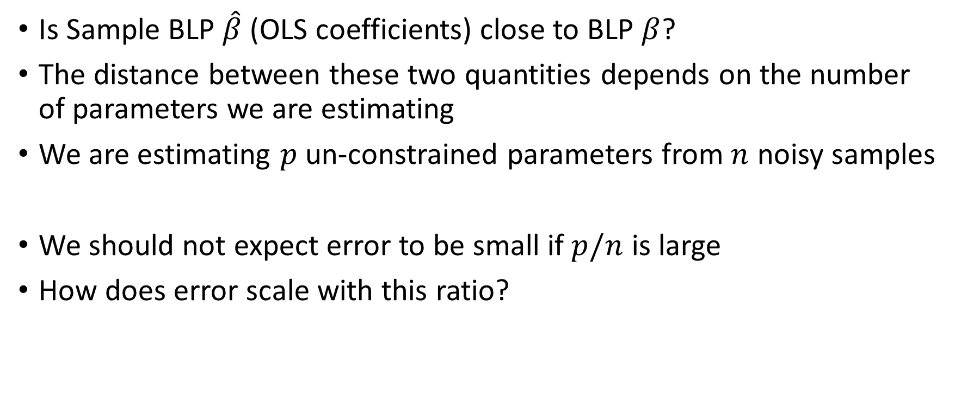
How Good is OLS in Recovering BLP
Is Sample BLP $\hat{β}$ (OLS coefficients) close to BLP $β$?
The distance between these two quantities depends on the number of parameters we are estimating
We are estimating $p$ un-constrained parameters from $n$ noisy samples
We should not expect error to be small if $p/n$ is large
How does error scale with this ratio?

Slide 21

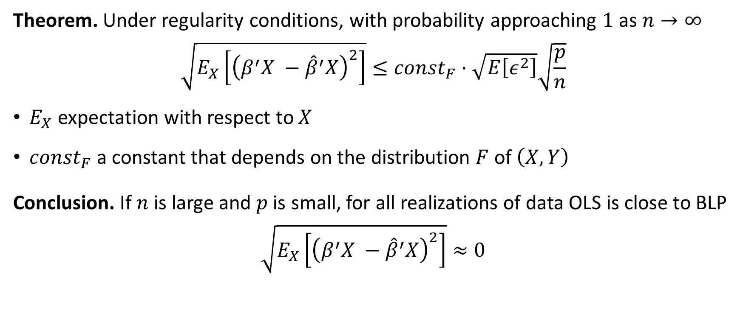
Approximation of BLP by OLS
Theorem. Under regularity conditions, with probability approaching $1$ as $n→∞$
$$\sqrt{E_{X}\left[{\left(β^{′}X −{\hat{β}}^{′}X\right)}^{2}\right]}≤{const}_{F}⋅\sqrt{E\left[ε^{2}\right]}\sqrt{\frac{p}{n}}$$
$E_{X}$ expectation with respect to $X$
$const_{F}$ a constant that depends on the distribution $F$ of $\left(X, Y\right)$
Conclusion. If $n$ is large and $p$ is small, for all realizations of data OLS is close to BLP
$$\sqrt{E_{X}\left[{\left(β^{′}X −{\hat{β}}^{′}X\right)}^{2}\right]}≈0$$
$A_{n}≈B_{n}$ means that distance of $A_{n},B_{n}$ concentrates around $0$for some measure of distance $d$:
$$∀ε>0:\lim_{n→∞}{P\left(d\left(A_{n},B_{n}\right)≤ε\right)=1}$$

Slide 22
You should expect OLS to produce accurate predictions in the worst-case only if the number of variables is small compared to number of samples. Its predictions converge to the predictions of the BLP in the population

Slide 23
Interpretable Performance Measures via Analysis of Variance (ANOVA)

Slide 24
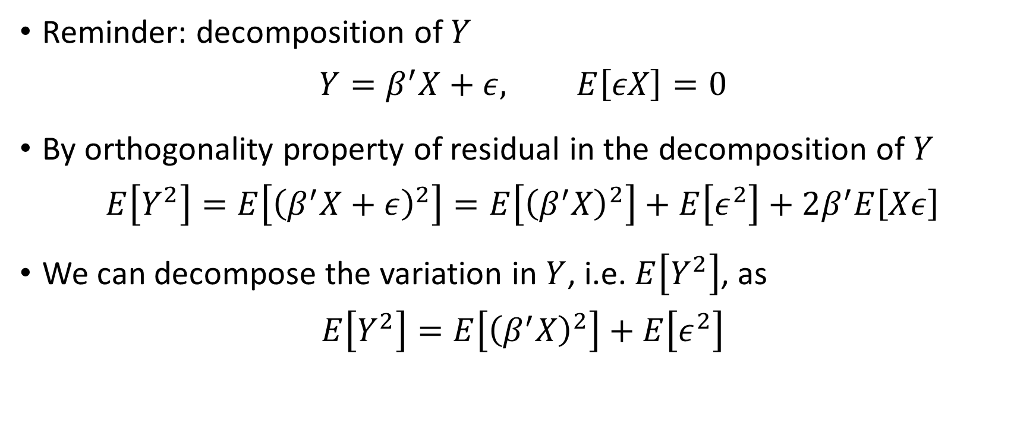
Analysis of Variance (ANOVA)
Reminder: decomposition of $Y$
$$Y=β^{′}X+ε, E\left[εX\right]=0$$
By orthogonality property of residual in the decomposition of $Y$
$$E\left[Y^{2}\right]=E\left[{\left(β^{′}X+ε\right)}^{2}\right]=E\left[{\left(β^{′}X\right)}^{2}\right]+E\left[ε^{2}\right]+2β^{′}E\left[Xε\right]$$
We can decompose the variation in $Y$, i.e. $E\left[Y^{2}\right]$, as
$$E\left[Y^{2}\right]=E\left[{\left(β^{′}X\right)}^{2}\right]+E\left[ε^{2}\right]$$
explained variation
residual variation

Slide 25
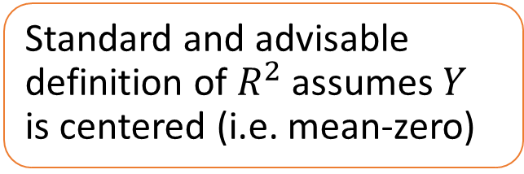
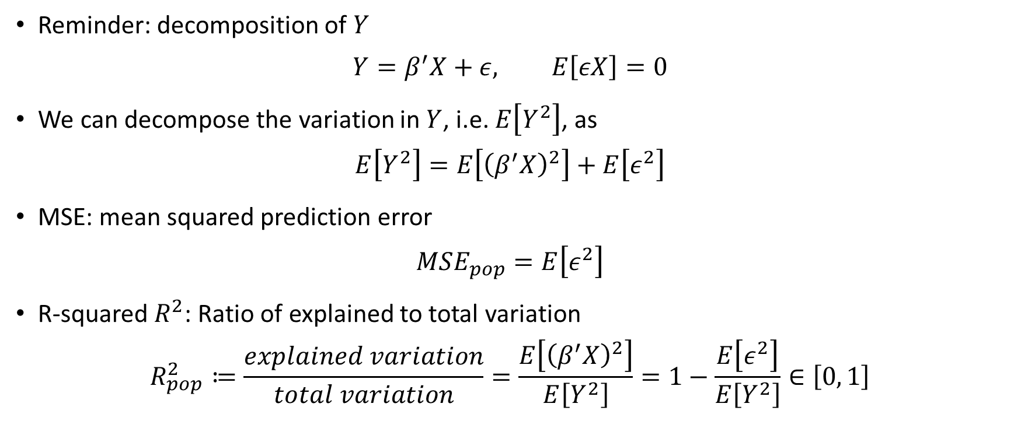
Analysis of Variance (ANOVA)
Reminder: decomposition of $Y$
$$Y=β^{′}X+ε, E\left[εX\right]=0$$
We can decompose the variation in $Y$, i.e. $E\left[Y^{2}\right]$, as
$$E\left[Y^{2}\right]=E\left[{\left(β^{′}X\right)}^{2}\right]+E\left[ε^{2}\right]$$
MSE: mean squared prediction error
$$MSE_{pop}=E\left[ε^{2}\right]$$
R-squared $R^{2}$: Ratio of explained to total variation
$$R_{pop}^{2}≔\frac{explained variation}{total variation}=\frac{E\left[{\left(β^{′}X\right)}^{2}\right]}{E\left[Y^{2}\right]}=1−\frac{E\left[ε^{2}\right]}{E\left[Y^{2}\right]}∈\left[0, 1\right]$$
Standard and advisable definition of $R^{2}$ assumes $Y$ is centered (i.e. mean-zero)

Slide 26
Performance Evaluation

Slide 27
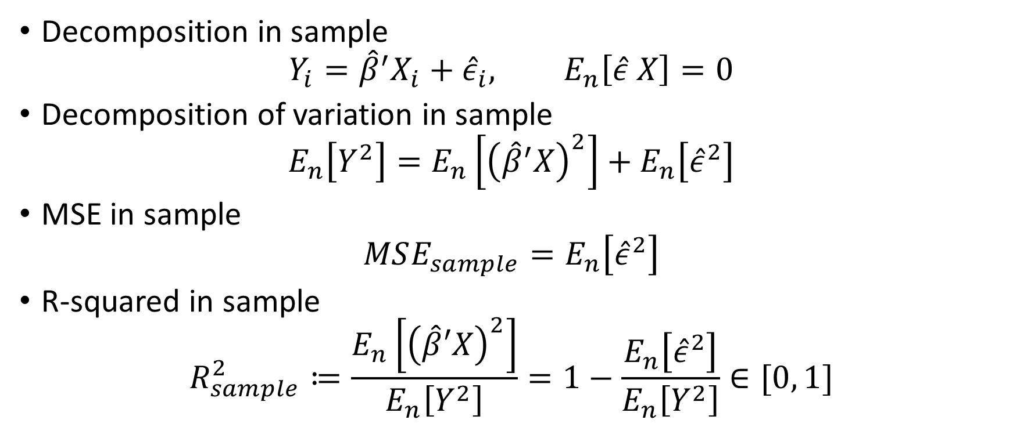
In Sample R-squared and MSE
Decomposition in sample
$$Y_{i}={\hat{β}}^{′}X_{i}+{\hat{ε}}_{i}, E_{n}\left[\hat{ε} X\right]=0$$
Decomposition of variation in sample
$$E_{n}\left[Y^{2}\right]=E_{n}\left[{\left({\hat{β}}^{′}X\right)}^{2}\right]+E_{n}\left[{\hat{ε}}^{2}\right]$$
MSE in sample
$$MSE_{sample}=E_{n}\left[{\hat{ε}}^{2}\right]$$
R-squared in sample
$$R_{sample}^{2}≔\frac{E_{n}\left[{\left(\hat{β}′X\right)}^{2}\right]}{E_{n}\left[Y^{2}\right]}=1−\frac{E_{n}\left[{\hat{ε}}^{2}\right]}{E_{n}\left[Y^{2}\right]}∈[0, 1]$$
Standard and advisable definition of $R^{2}$ assumes $Y$ is centered (i.e. mean-zero)

Slide 28
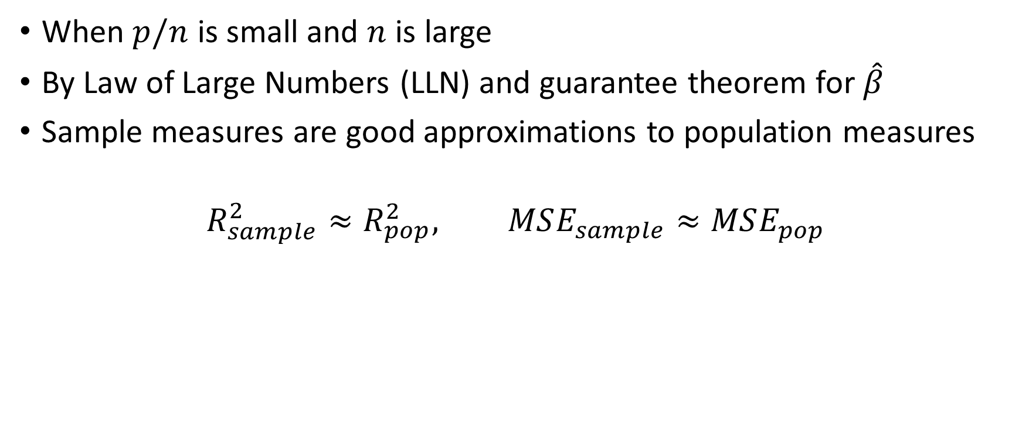
When are these good proxies?
When $p/n$ is small and $n$ is large
By Law of Large Numbers (LLN) and guarantee theorem for $\hat{β}$
Sample measures are good approximations to population measures
$$R_{sample}^{2}≈R_{pop}^{2}, MSE_{sample}≈MSE_{pop}$$

Slide 29
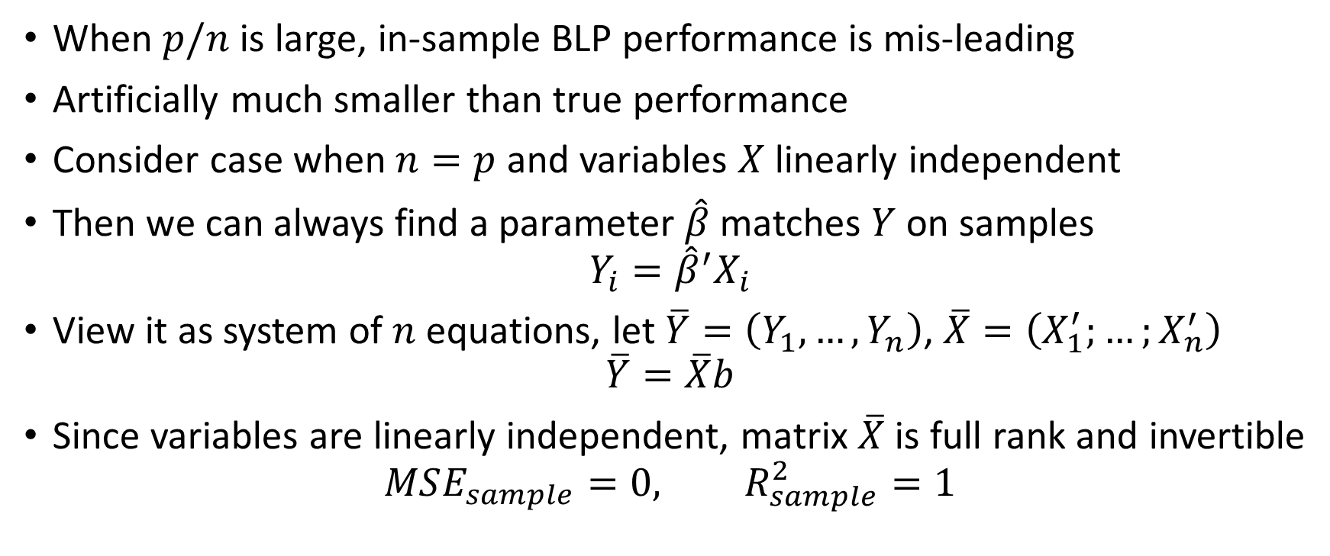

Overfitting: $p/n$ large
When $p/n$ is large, in-sample BLP performance is mis-leading
Artificially much smaller than true performance
Consider case when $n=p$ and variables $X$ linearly independent
Then we can always find a parameter $\hat{β}$ matches $Y$ on samples
$$Y_{i}={\hat{β}}^{′}X_{i}$$
View it as system of $n$ equations, let $\overline{Y}=\left(Y_{1},…,Y_{n}\right)$, $\overline{X}=\left(X_{1}^{′};…;X_{n}^{′}\right)$
$$\overline{Y}=\overline{X}b$$
Since variables are linearly independent, matrix $\overline{X}$ is full rank and invertible
$$MSE_{sample}=0, R_{sample}^{2}=1$$

Slide 30
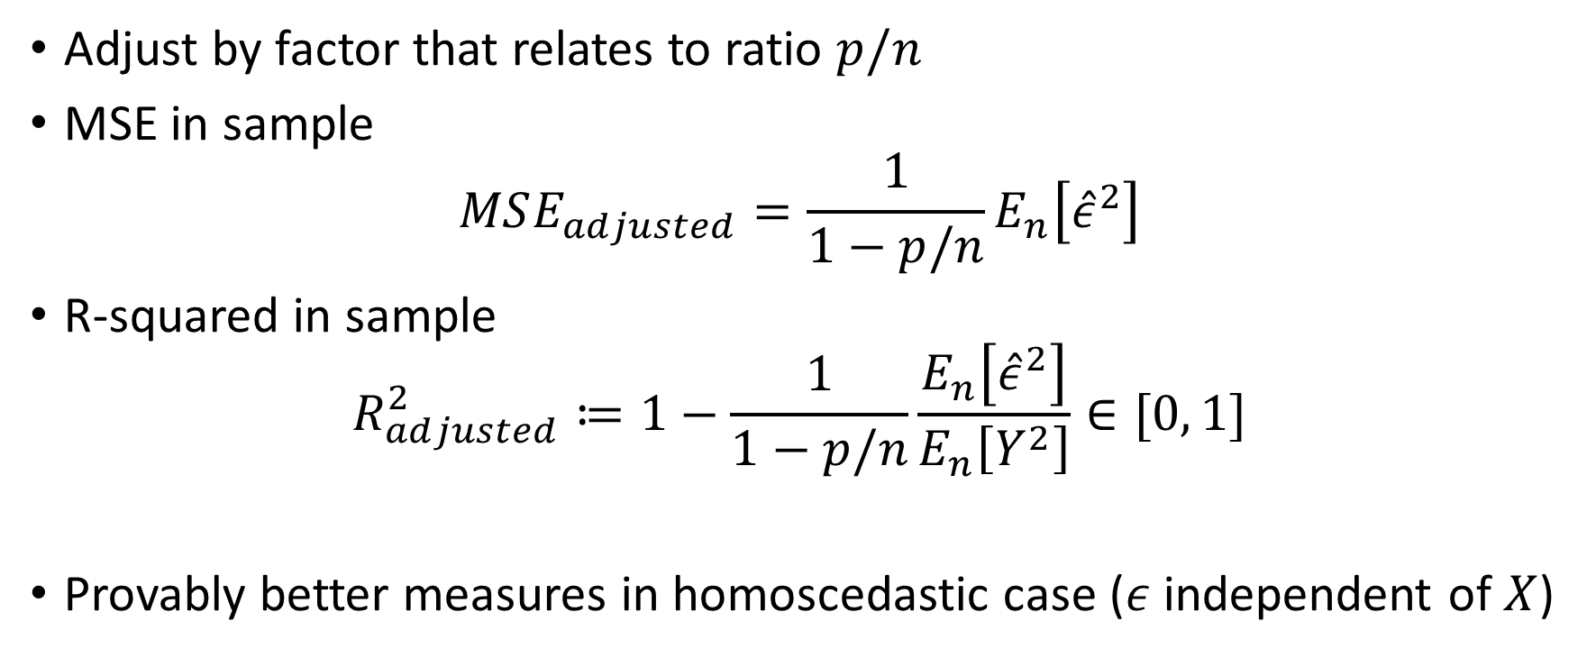
An Improvement: Adjusted Measures
Adjust by factor that relates to ratio $p/n$
MSE in sample
$$MSE_{adjusted}=\frac{1}{1−p/n}E_{n}\left[{\hat{ε}}^{2}\right]$$
R-squared in sample
$$R_{adjusted}^{2}≔1−\frac{1}{1−p/n}\frac{E_{n}\left[{\hat{ε}}^{2}\right]}{E_{n}\left[Y^{2}\right]}∈[0, 1]$$
Provably better measures in homoscedastic case ($ε$ independent of $X$)

Slide 31
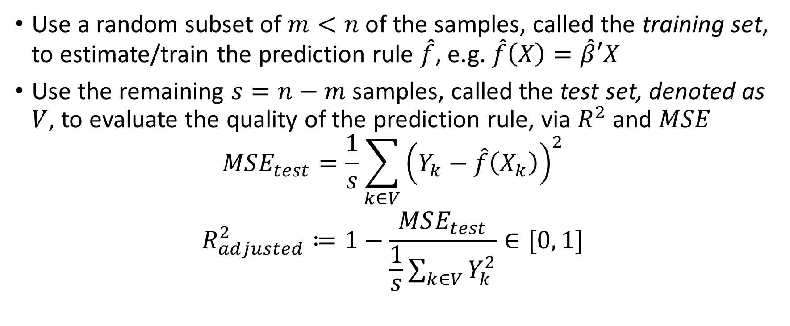
Sample Splitting: Reliable Performance Measure
Use a random subset of $m<n$ of the samples, called the training set, to estimate/train the prediction rule $\hat{f}$, e.g. $\hat{f}\left(X\right)=\hat{β}′X$
Use the remaining $s=n−m$ samples, called the test set, denoted as $V$, to evaluate the quality of the prediction rule, via $R^{2}$ and $MSE$
$$MSE_{test}=\frac{1}{s}\sum_{k∈V}{{\left(Y_{k}−\hat{f}\left(X_{k}\right)\right)}^{2}}$$
$$R_{adjusted}^{2}≔1−\frac{MSE_{test}}{\frac{1}{s}\sum_{k∈V}{Y_{k}^{2}}}∈[0, 1]$$

Slide 32
Stratification
In moderately sized samples it helps to ensure that train and test set are similar
In large samples, randomness will guarantee that
In small samples and with categorical variables, it is advisable to stratify, i.e. split samples in a manner that proportion of samples with each categorical value are similar on each of the two samples

Slide 33
Almost always measure predictive performance of your estimated model on a held-out sample

Slide 34
Inference on Predictive Effects

Slide 35
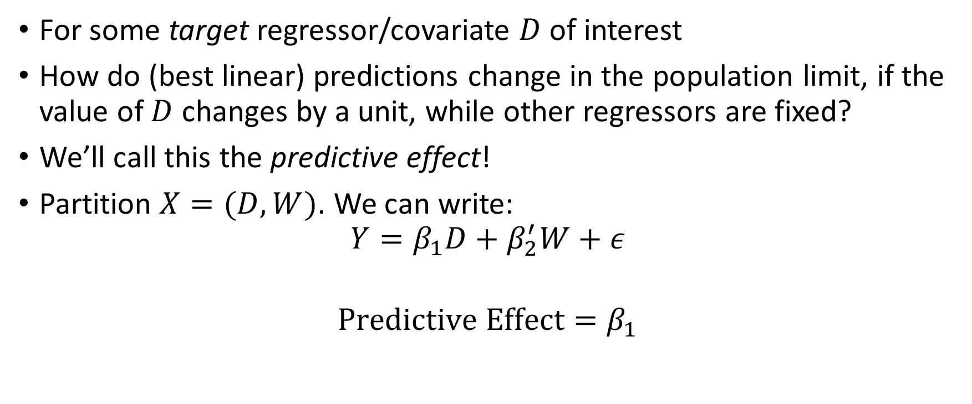
Predictive Effect
For some target regressor/covariate $D$ of interest
How do (best linear) predictions change in the population limit, if the value of $D$ changes by a unit, while other regressors are fixed?
We’ll call this the predictive effect!
Partition $X=(D, W)$. We can write:
$$Y=β_{1}D+β_{2}^{′}W+ε$$
$$Predictive Effect=β_{1}$$

Slide 36
Partialling-Out

Slide 37
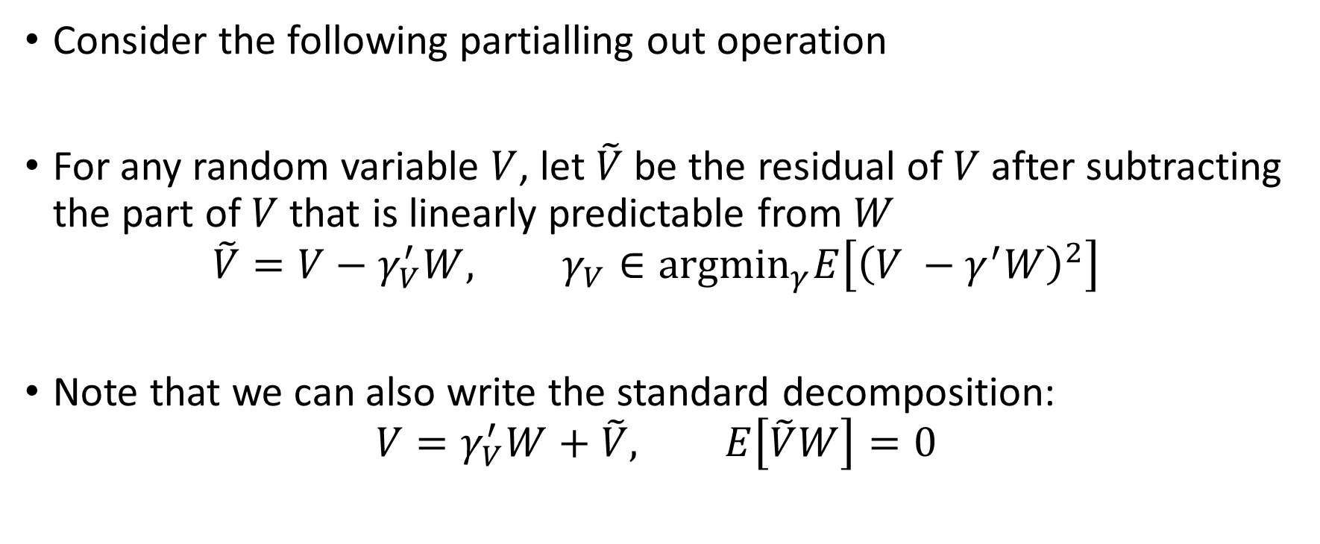

Understanding $β_{1}$
Consider the following partialling out operation
For any random variable $V$, let $\tilde{V}$ be the residual of $V$ after subtracting the part of $V$ that is linearly predictable from $W$
$$\tilde{V}=V−γ_{V}^{′}W, γ_{V}∈{argmin}_{γ}E\left[{\left(V −γ^{′}W\right)}^{2}\right]$$
Note that we can also write the standard decomposition:
$$V=γ_{V}^{′}W+\tilde{V}, E\left[\tilde{V}W\right]=0$$

Slide 38
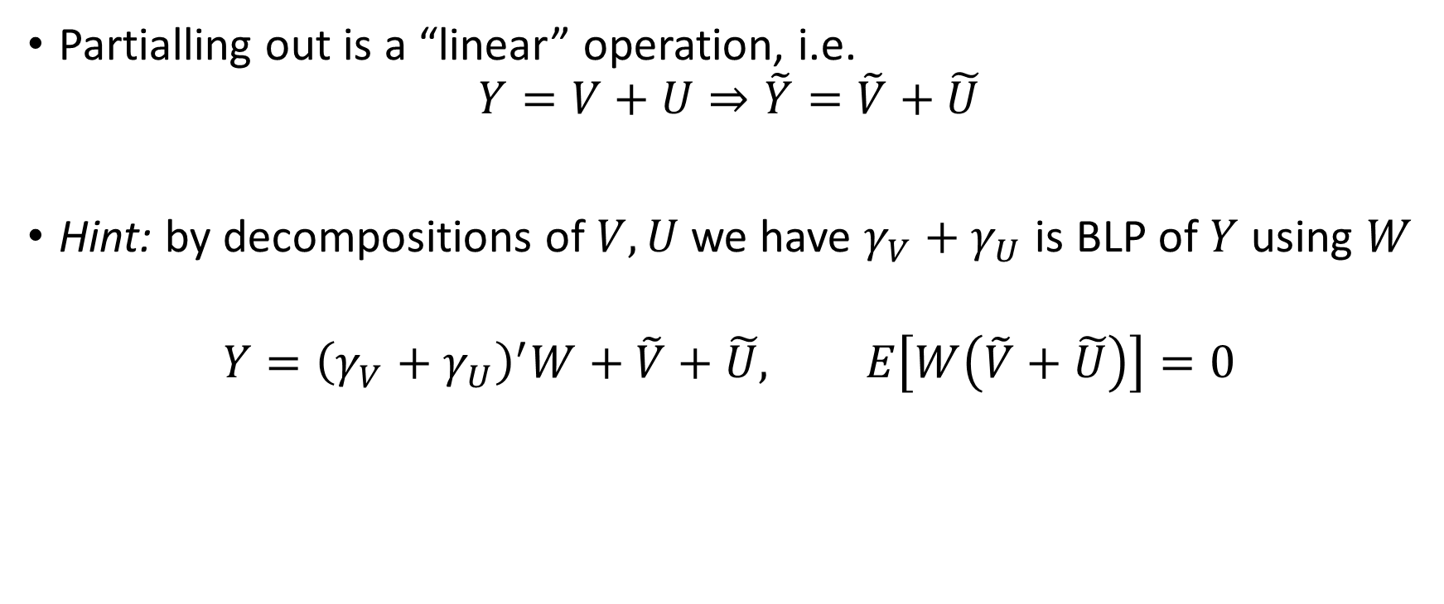
Linearity of Partialling-Out
Partialling out is a “linear” operation, i.e.
$$Y=V+U⇒\tilde{Y}=\tilde{V}+\tilde{U}$$
Hint: by decompositions of $V, U$ we have $γ_{V}+γ_{U}$ is BLP of $Y$ using $W$
$$Y={\left(γ_{V}+γ_{U}\right)}^{′}W+\tilde{V}+\tilde{U}, E\left[W\left(\tilde{V}+\tilde{U}\right)\right]=0$$

Slide 39
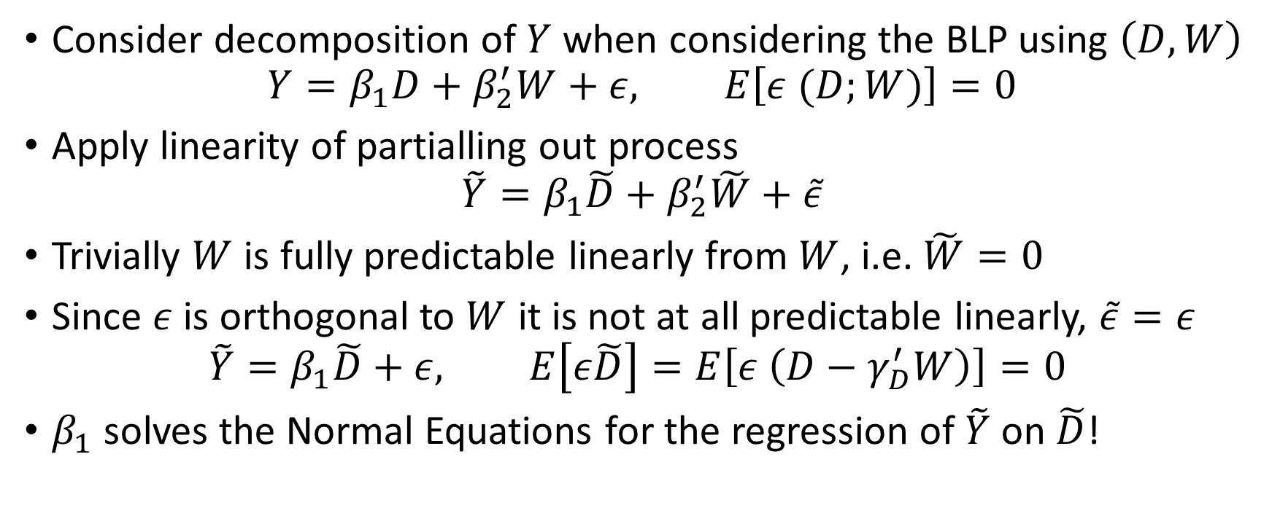
Some Magic
Consider decomposition of $Y$ when considering the BLP using $\left(D, W\right)$
$$Y=β_{1}D+β_{2}^{′}W+ε, E\left[ε (D;W)\right]=0$$
Apply linearity of partialling out process
$$\tilde{Y}=β_{1}\tilde{D}+β_{2}^{′}\tilde{W}+\tilde{ε}$$
Trivially $W$ is fully predictable linearly from $W$, i.e. $\tilde{W}=0$
Since $ε$ is orthogonal to $W$ it is not at all predictable linearly, $\tilde{ε}=ε$
$$\tilde{Y}=β_{1}\tilde{D}+ε, E\left[ε\tilde{D}\right]=E\left[ε \left(D−γ_{D}^{′}W\right)\right]=0$$
$β_{1}$ solves the Normal Equations for the regression of $\tilde{Y}$ on $\tilde{D}$!

Slide 40
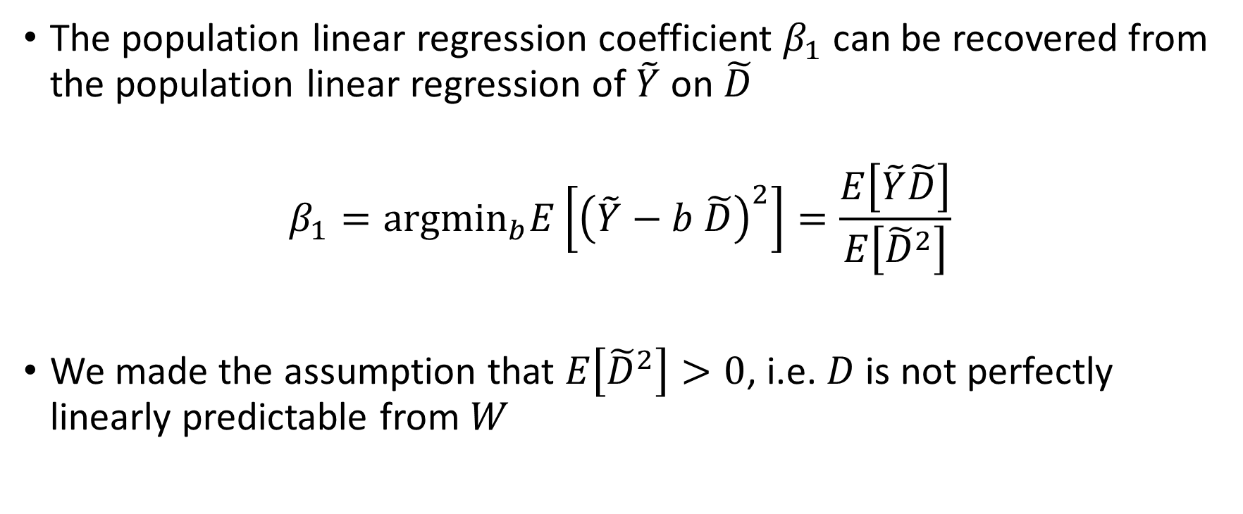
Frisch-Waugh-Lovell (FWL) Theorem!
The population linear regression coefficient $β_{1}$ can be recovered from the population linear regression of $\tilde{Y}$ on $\tilde{D}$
$$β_{1}={argmin}_{b}E\left[{\left(\tilde{Y}−b \tilde{D}\right)}^{2}\right]=\frac{E\left[\tilde{Y}\tilde{D}\right]}{E\left[{\tilde{D}}^{2}\right]}$$
We made the assumption that $E\left[{\tilde{D}}^{2}\right]>0$, i.e. $D$ is not perfectly linearly predictable from $W$

Slide 41
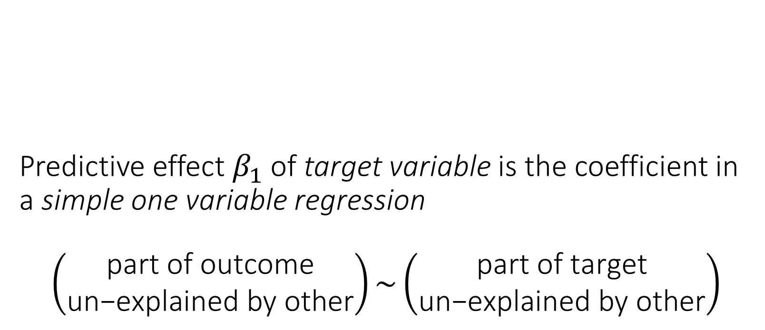
Predictive effect $β_{1}$of target variable is the coefficient in a simple one variable regression $$\left(\begin{matrix}\text{part} \text{of} \text{outcome} \\ \text{un}\text{−}\text{explained} \text{by} \text{other}\end{matrix}\right)\sim \left(\begin{matrix}\text{part} \text{of} \text{target} \\ \text{un}\text{−}\text{explained} \text{by} \text{other}\end{matrix}\right)$$

Slide 42
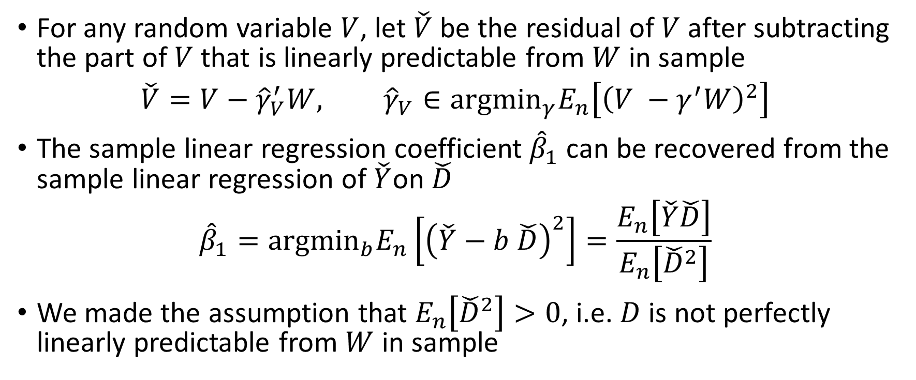
FWL in Sample: Exact same arguments can be repeated in sample
For any random variable $V$, let $\check{V}$ be the residual of $V$ after subtracting the part of $V$ that is linearly predictable from $W$ in sample
$$\check{V}=V−{\hat{γ}}_{V}^{′}W, {\hat{γ}}_{V}∈{argmin}_{γ}E_{n}\left[{\left(V −γ^{′}W\right)}^{2}\right]$$
The sample linear regression coefficient ${\hat{β}}_{1}$ can be recovered from the sample linear regression of $\check{Y}$on $\check{D}$
$${\hat{β}}_{1}={argmin}_{b}E_{n}\left[{\left(\check{Y}−b \check{D}\right)}^{2}\right]=\frac{E_{n}\left[\check{Y}\check{D}\right]}{E_{n}\left[{\check{D}}^{2}\right]}$$
We made the assumption that $E_{n}\left[{\check{D}}^{2}\right]>0$, i.e. $D$ is not perfectly linearly predictable from $W$ in sample

Slide 43
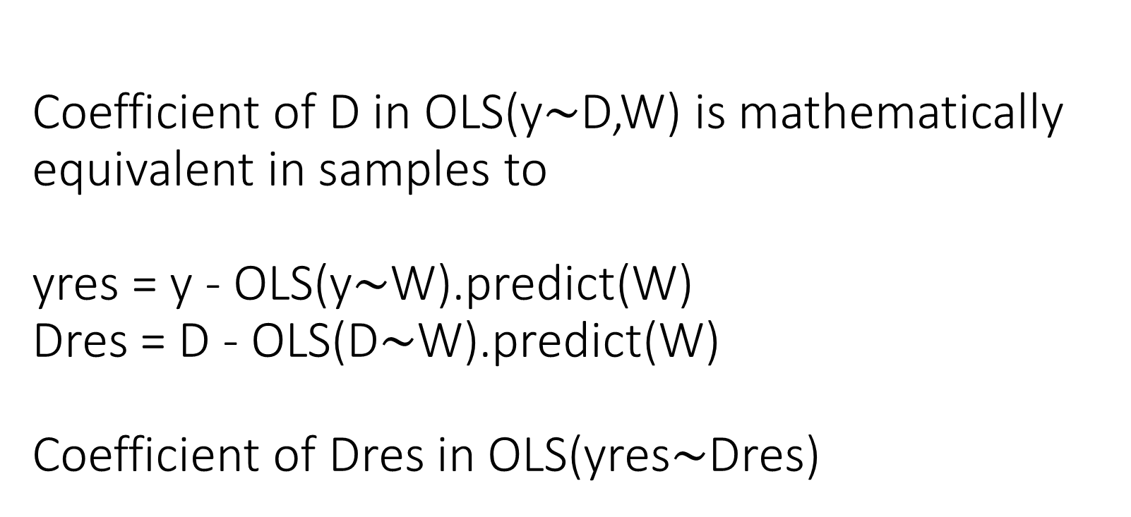
Coefficient of D in OLS(y$∼$D,W) is mathematically equivalent in samples to yres = y - OLS(y$∼$W).predict(W) Dres = D - OLS(D$∼$W).predict(W) Coefficient of Dres in OLS(yres$∼$Dres)

Slide 44
Asymptotic Distribution and Confidence Intervals

Slide 45

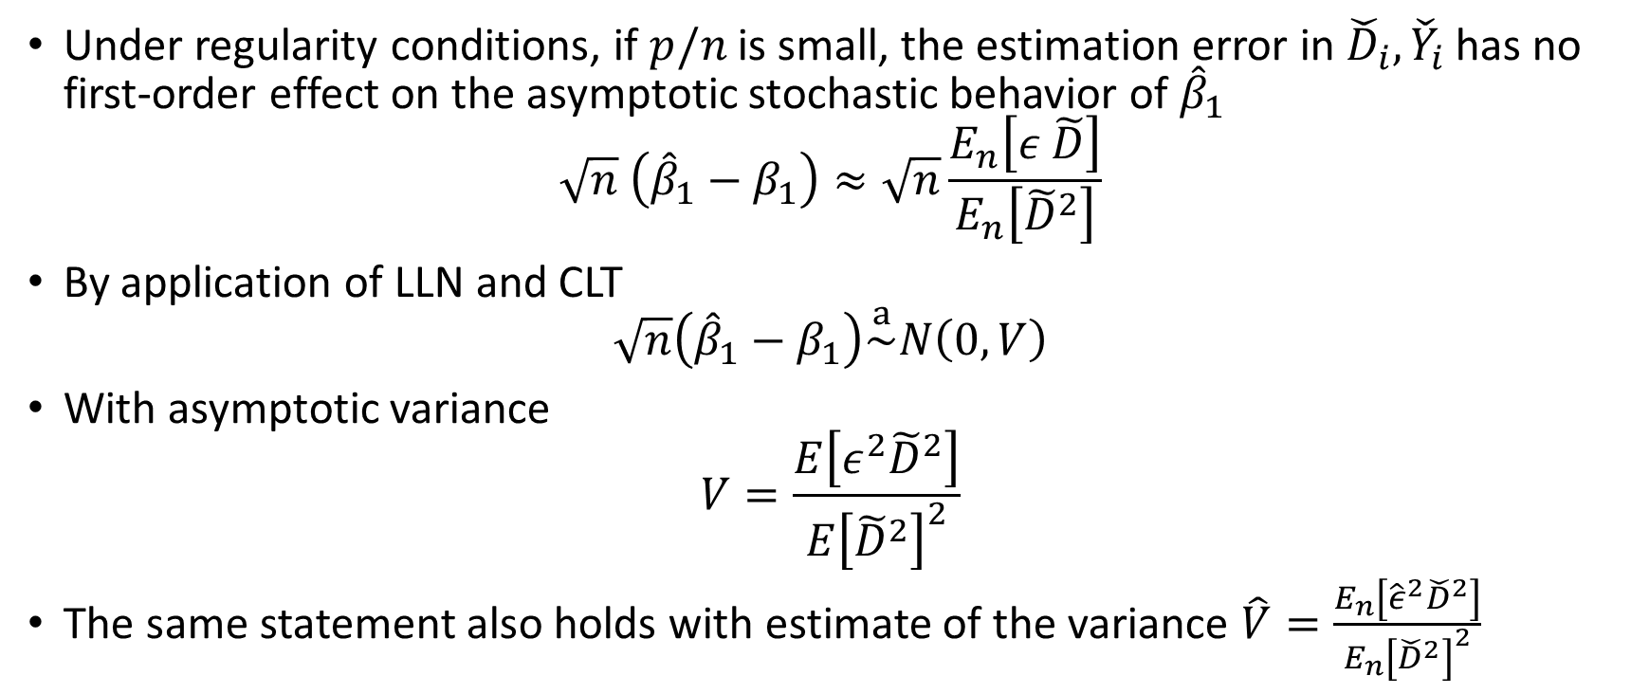
Adaptive Inference
$A_{n}\overset{a}{\sim }N\left(0, V\right)$ means that as $n→∞$:
$$\sup_{R∈ℛ}\left|P\left(A_{n}∈R\right)−P\left(N\left(0,V\right)∈R\right)\right|≈0$$
where $ℛ$ set of all hyper-rectangles
Under regularity conditions, if $p/n$ is small, the estimation error in ${\check{D}}_{i},{\check{Y}}_{i}$ has no first-order effect on the asymptotic stochastic behavior of ${\hat{β}}_{1}$
$$\sqrt{n} \left({\hat{β}}_{1}−β_{1}\right)≈\sqrt{n}\frac{E_{n}\left[ε \tilde{D}\right]}{E_{n}\left[{\tilde{D}}^{2}\right]}$$
By application of LLN and CLT
$$\sqrt{n}\left({\hat{β}}_{1}−β_{1}\right)\overset{a}{\sim }N\left(0,V\right)$$
With asymptotic variance
$$V=\frac{E\left[ε^{2}{\tilde{D}}^{2}\right]}{E{\left[{\tilde{D}}^{2}\right]}^{2}}$$
The same statement also holds with estimate of the variance $\hat{V}=\frac{E_{n}\left[{\hat{ε}}^{2}{\check{D}}^{2}\right]}{E_{n}{\left[{\check{D}}^{2}\right]}^{2}}$

Slide 46
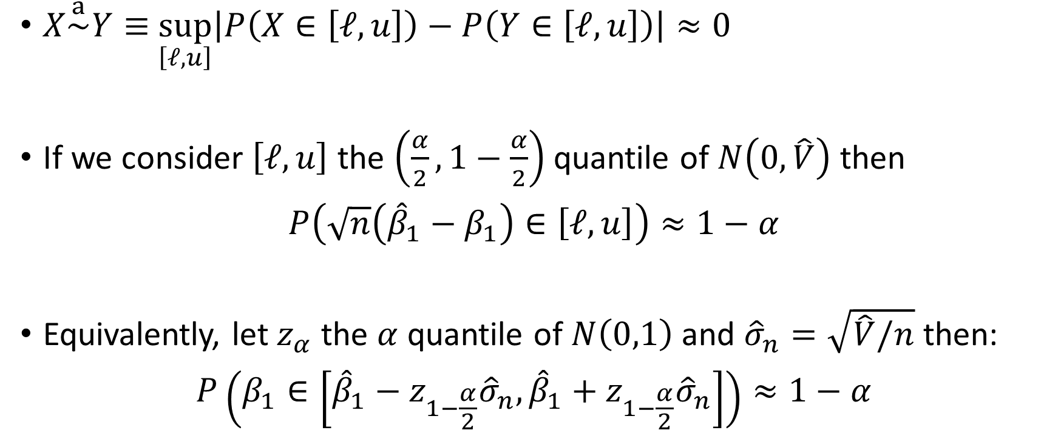
Confidence Interval
$X\overset{a}{\sim }Y≡$ $\sup_{\left[ℓ,u\right]}\left|P\left(X∈\left[ℓ,u\right]\right)−P\left(Y∈\left[ℓ,u\right]\right)\right|≈0$
If we consider $\left[ℓ, u\right]$ the $\left(\frac{α}{2},1−\frac{α}{2}\right)$ quantile of $N\left(0, \hat{V}\right)$ then
$$P\left(\sqrt{n}\left({\hat{β}}_{1}−β_{1}\right)∈\left[ℓ,u\right]\right)≈1−α$$
Equivalently, let $z_{α}$ the $α$ quantile of $N\left(0,1\right)$ and ${\hat{σ}}_{n}=\sqrt{\hat{V}/n}$ then:
$$P\left(β_{1}∈\left[{\hat{β}}_{1}−z_{1−\frac{α}{2}}{\hat{σ}}_{n},{\hat{β}}_{1}+z_{1−\frac{α}{2}}{\hat{σ}}_{n}\right]\right)≈1−α$$
Standard error

Slide 47
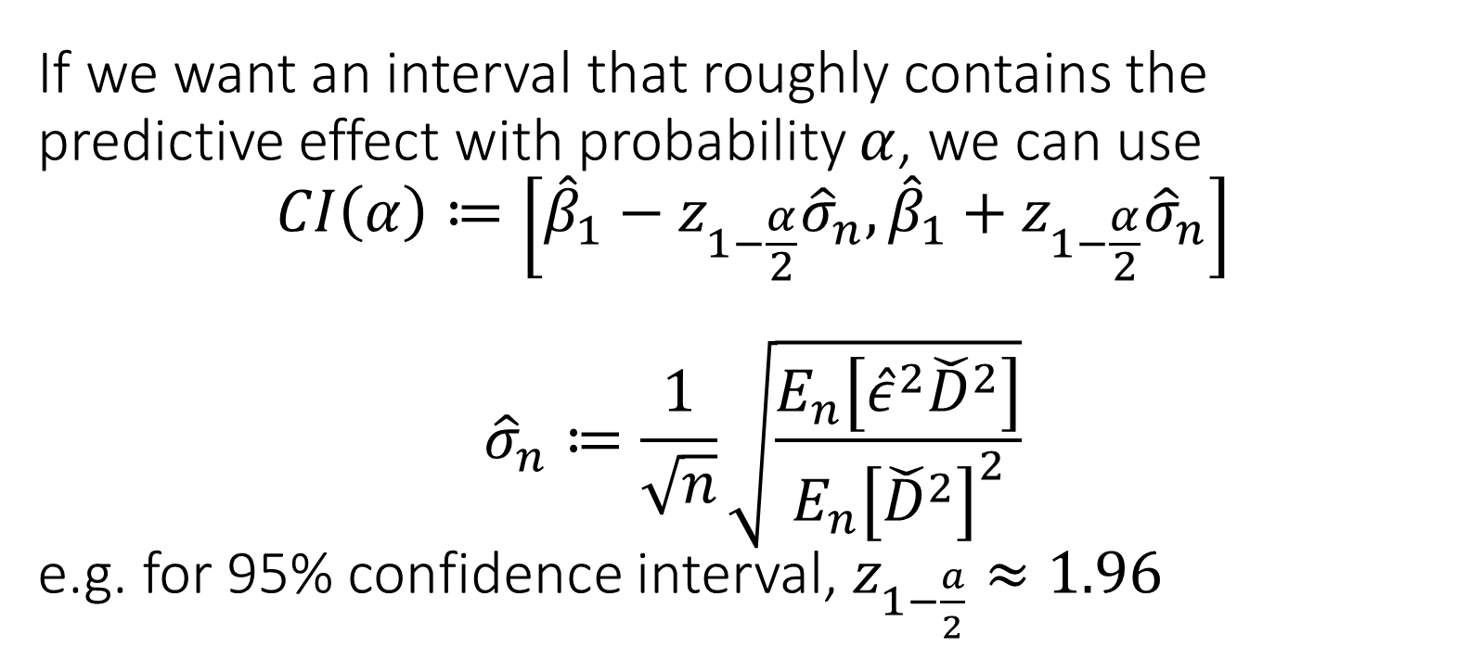
If we want an interval that roughly contains the predictive effect with probability $α$, we can use $$CI\left(α\right)≔\left[{\hat{β}}_{1}−z_{1−\frac{α}{2}}{\hat{σ}}_{n},{\hat{β}}_{1}+z_{1−\frac{α}{2}}{\hat{σ}}_{n}\right]$$ $${\hat{σ}}_{n}≔\frac{1}{\sqrt{n}}\sqrt{\frac{E_{n}\left[{\hat{ε}}^{2}{\check{D}}^{2}\right]}{E_{n}{\left[{\check{D}}^{2}\right]}^{2}}}$$ e.g. for 95% confidence interval, $z_{1−\frac{a}{2}}≈1.96$

Slide 48
Example: Wage Gap based on Sex Indicator

Slide 49
Revisit Covariate Adjustment for Effect Inference in Experiments

Slide 50
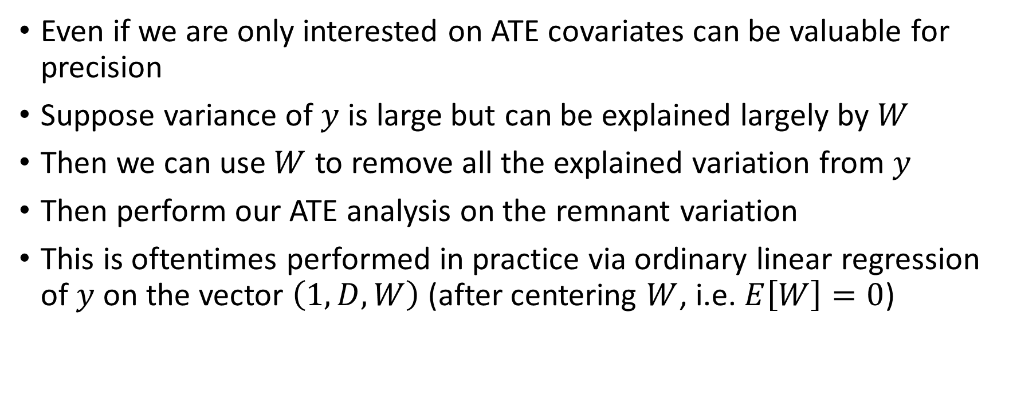
Co-variates for Precision
Even if we are only interested on ATE covariates can be valuable for precision
Suppose variance of $y$ is large but can be explained largely by $W$
Then we can use $W$ to remove all the explained variation from $y$
Then perform our ATE analysis on the remnant variation
This is oftentimes performed in practice via ordinary linear regression of $y$ on the vector $\left(1, D, W\right)$ (after centering $W$, i.e. $E\left[W\right]=0$)

Slide 51
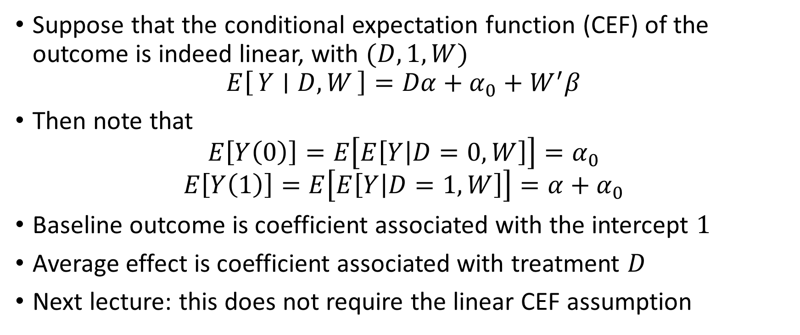
Is this consistent?
Suppose that the conditional expectation function (CEF) of the outcome is indeed linear, with $(D,1,W)$
$$E\left[Y ∣ D, W\right]=Dα+α_{0}+W^{′}β$$
Then note that
$$E\left[Y\left(0\right)\right]=E\left[E\left[Y | D=0,W\right]\right]=α_{0}$$
$$E\left[Y\left(1\right)\right]=E\left[E\left[Y | D=1, W\right]\right]=α+α_{0}$$
Baseline outcome is coefficient associated with the intercept $1$
Average effect is coefficient associated with treatment $D$
Next lecture: this does not require the linear CEF assumption

Slide 52
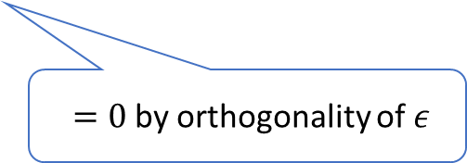
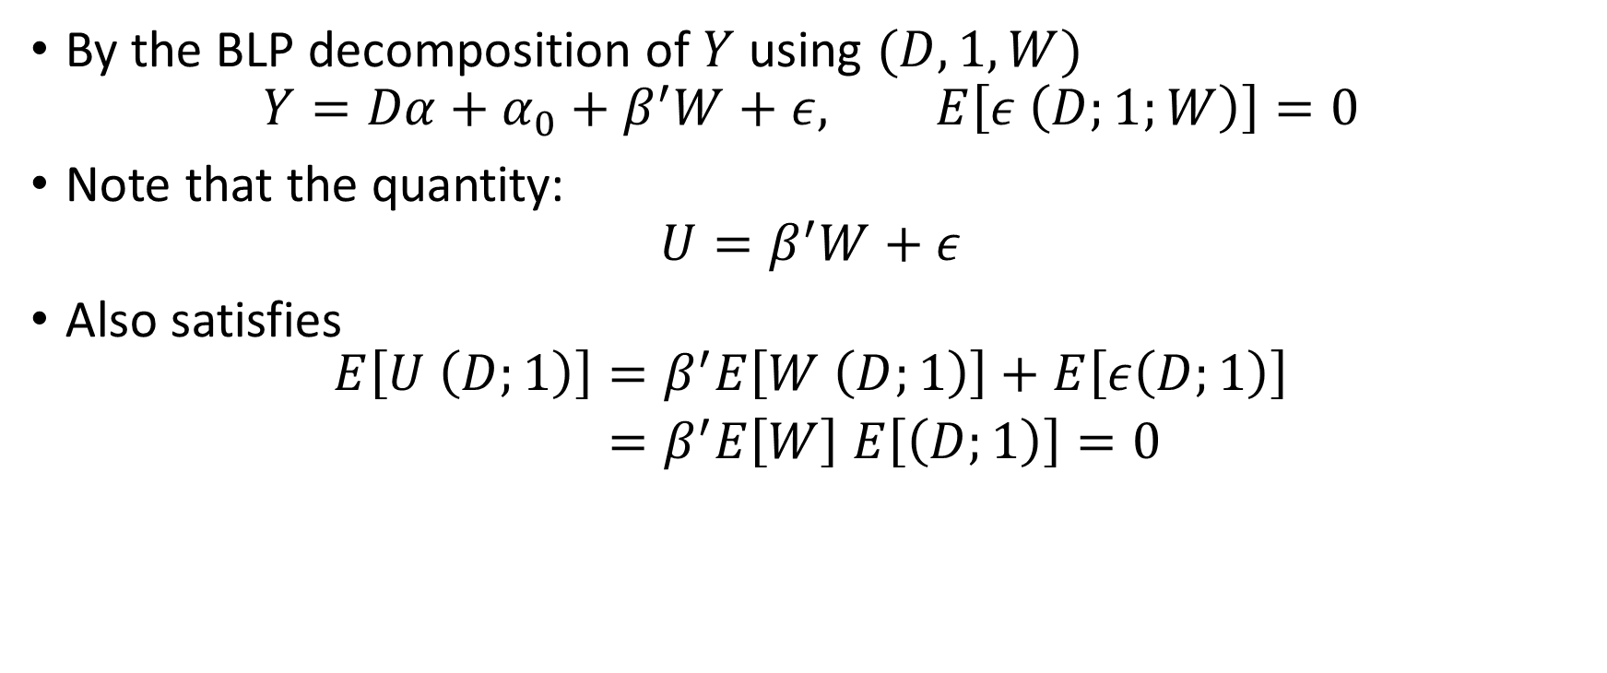
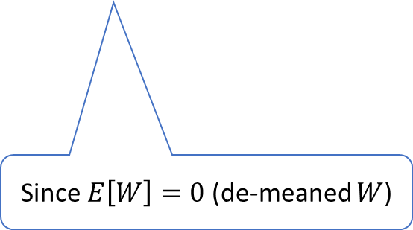
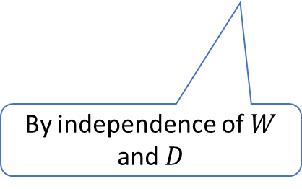
Is this consistent? Beyond Linear CEF
By the BLP decomposition of $Y$ using $(D,1,W)$
$$Y=Dα+α_{0}+β^{′}W+ε, E\left[ε \left(D;1;W\right)\right]=0$$
Note that the quantity:
$$U=β^{′}W+ε$$
Also satisfies
$$\begin{aligned}E\left[U \left(D;1\right)\right]=&β^{′}E\left[W \left(D;1\right)\right]+E\left[ε\left(D;1\right)\right] \\ =&β^{′}E\left[W\right] E\left[\left(D;1\right)\right]=0\end{aligned}$$
$=0$ by orthogonality of $ε$
By independence of $W$ and $D$
Since $E\left[W\right]=0$ (de-meaned $W$)

Slide 53
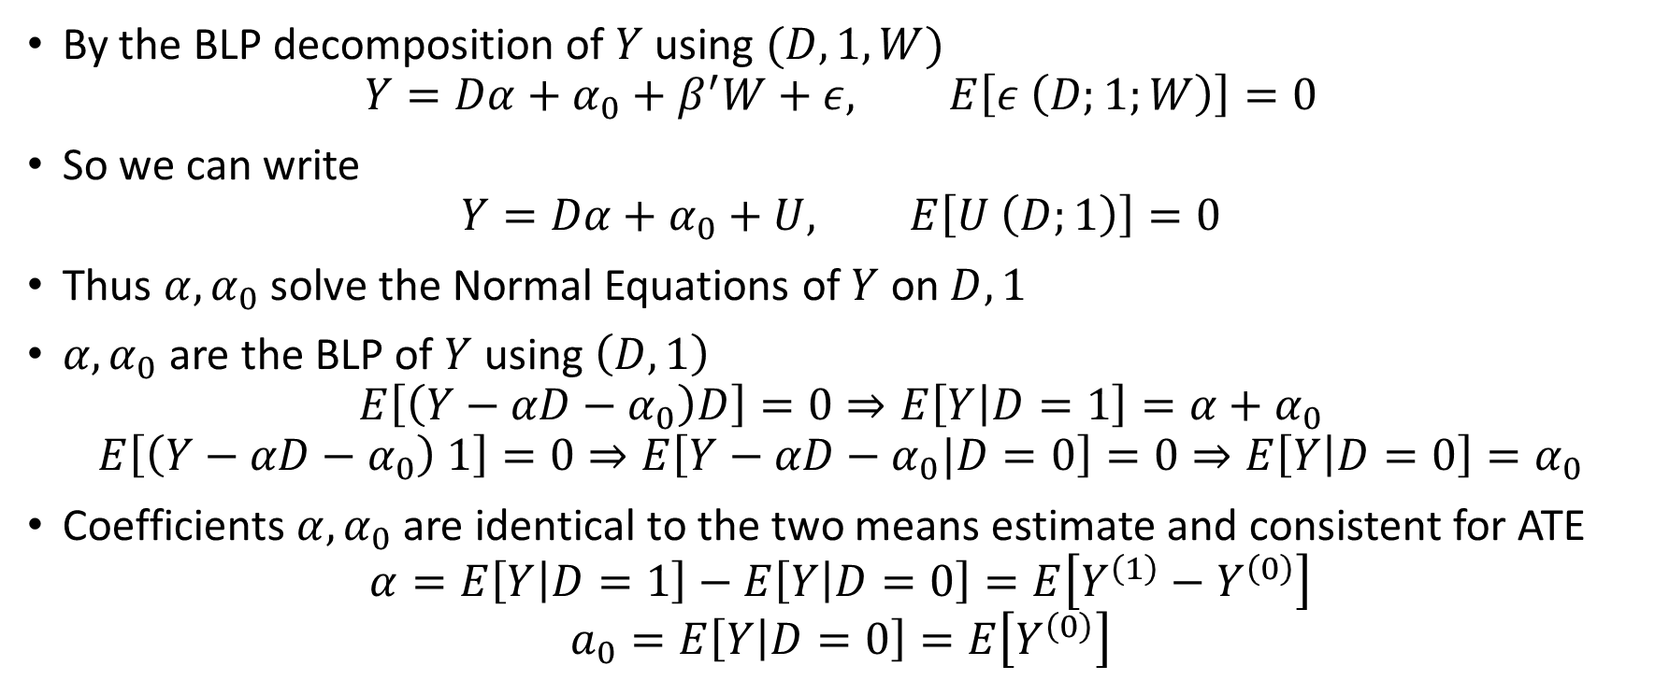
Is this consistent? Beyond Linear CEF
By the BLP decomposition of $Y$ using $(D,1,W)$
$$Y=Dα+α_{0}+β^{′}W+ε, E\left[ε \left(D;1;W\right)\right]=0$$
So we can write
$$Y=Dα+α_{0}+U, E\left[U \left(D;1\right)\right]=0$$
Thus $α,α_{0}$ solve the Normal Equations of $Y$ on $D, 1$
$α,α_{0}$ are the BLP of $Y$ using $\left(D,1\right)$
$$E\left[\left(Y−αD−α_{0}\right)D\right]=0⇒E\left[Y | D=1\right]=α+α_{0}$$
$$E\left[\left(Y−αD−α_{0}\right) 1\right]=0⇒E\left[Y−αD−α_{0}|D=0\right]=0⇒E\left[Y | D=0\right]=α_{0}$$
Coefficients $α,α_{0}$ are identical to the two means estimate and consistent for ATE
$$α=E\left[Y | D=1\right]−E\left[Y | D=0\right]=E\left[Y^{\left(1\right)}−Y^{\left(0\right)}\right]$$
$$a_{0}=E\left[Y | D=0\right]=E\left[Y^{\left(0\right)}\right]$$

Slide 54
The coefficient associated with treatment D in OLS with co-variate adjustment is always consistent for the treatment effect, when run on data from a randomized experiment, as-long-as covariates are de-meaned. The true relationship of outcome with covariates does not need to be linear.

