Slide 1
MS&E 228: Unobserved Confounding and Instruments
Vasilis Syrgkanis
MS&E, Stanford

Slide 2
Causal Inference with Experiments
Prediction with Linear Models
Prediction with High-Dim Linear Models
Inference on Causal and Predictive Effects with High-Dim Linear Models
Potential Outcomes and Conditional Ignorability
Structural Equation Models and Conditional Exogeneity
Directed Acyclic Graphs
Prediction with Non-Linear Models
Inference on Causal Effects with Non-Linear Models
Un-observed Confounding and Instruments
Identification of Causal Effects in Longitudinal Data
Estimation of Heterogeneous Causal Effects
Linear Predictive Models and Statistical Inference
Causal Identification in Observational Data
Non-Linear Predictive Models and Statistical Inference
Topics

Slide 3
Causal Inference with Experiments
Prediction with Linear Models
Prediction with High-Dim Linear Models
Inference on Causal and Predictive Effects with High-Dim Linear Models
Potential Outcomes and Conditional Ignorability
Structural Equation Models and Conditional Exogeneity
Directed Acyclic Graphs
Prediction with Non-Linear Models
Inference on Causal Effects with Non-Linear Models
Un-observed Confounding and Instruments
Identification of Causal Effects in Longitudinal Data
Estimation of Heterogeneous Causal Effects
Linear Predictive Models and Statistical Inference
Causal Identification in Observational Data
Non-Linear Predictive Models and Statistical Inference
Topics

Slide 4
Goals for Today
What can we do when we have un-observed confounding
Omitted variable bias bounds
Introduction to “Instruments”

Slide 5








Causal Inference Pipeline
Data Collection
Estimation
(training)
Validation
(testing)
Domain Assumption Elicitation
Identification
Inference (Confidence Intervals)
DAGs/ASEMs
Construct estimate $\hat{g}\left(d,z\right)$ of predictive model
$$E\left[Y ∣ D=d,Z=z\right]$$
Estimate mean counterfactual
$${\hat{a}}_{d}=E_{n}\left[\hat{g}\left(d,Z\right)\right]$$
Theory
$$a_{d}$$
$$E\left[E\left[Y | D=d,Z\right]\right]$$
$$D$$
$$=$$
$$a_{d}∈{\hat{a}}_{d}±2\hat{σ}$$
$$Z$$
$$Y$$
What if my conditional ignorability assumption was violated? How much would the estimate change?
Sensitivity Analysis
Practice
$$a_{d}∈{\hat{a}}_{d}±(2\hat{σ}+ε)$$
Adaptive Experiments
Decision
Policy

Slide 6
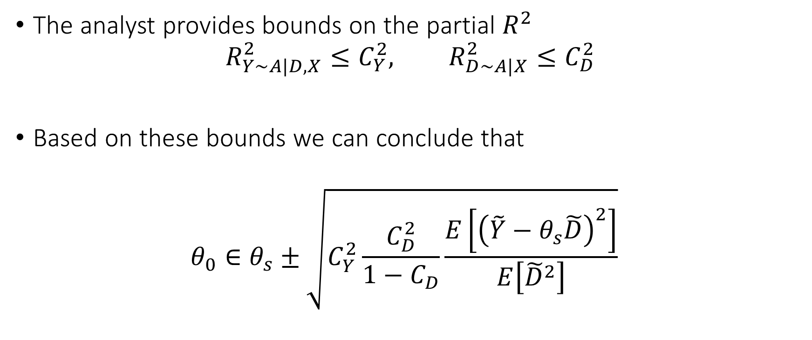
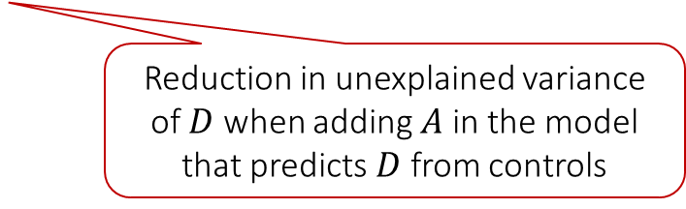
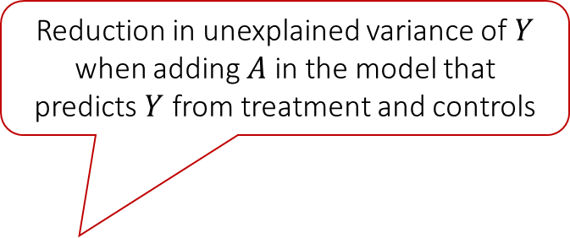
Bias Bounds
Reduction in unexplained variance of $Y$ when adding $A$ in the model that predicts $Y$ from treatment and controls
The analyst provides bounds on the partial $R^{2}$
$$R_{Y\sim A|D,X}^{2}≤C_{Y}^{2}, R_{D∼A|X}^{2}≤C_{D}^{2}$$
Based on these bounds we can conclude that
$$θ_{0}∈θ_{s}±\sqrt{C_{Y}^{2}\frac{C_{D}^{2}}{1−C_{D}}\frac{E\left[{\left(\tilde{Y}−θ_{s}\tilde{D}\right)}^{2}\right]}{E\left[{\tilde{D}}^{2}\right]}}$$
Reduction in unexplained variance of $D$ when adding $A$ in the model that predicts $D$ from controls
For more details:
Making Sense of Sensitivity: Extending Omitted Variable Bias
For more general analysis see:
Long Story Short: Omitted Variable Bias in Causal Machine Learning
Measurable from the data

Slide 7





Causal Inference Pipeline
Data Collection
Estimation
(training)
Validation
(testing)
Domain Assumption Elicitation
Identification
Inference (Confidence Intervals)
DAGs/ASEMs
Estimate approximate residuals $\check{Y}$, $\check{Z}$, $\check{D}$ using cross-fitting
Solve moment restriction
$$E_{n}\left[\left(\check{Y}−\hat{a}\check{D}\right)\check{Z}\right]=0$$
Theory
$$Z$$
$$D$$
$$α=\frac{E\left[\tilde{Y}\tilde{Z}\right]}{E\left[\tilde{D}\tilde{Z}\right]}$$
$$a∈\hat{a}±2\hat{σ}$$
$$X$$
$$Y$$
Instrumental Variable: any random variable Z that affects the treatment (log-price) D but does not affect the outcome (log-demand) Y other than through the treatment
Sensitivity Analysis
Practice
Adaptive Experiments
Decision
Policy

Slide 8

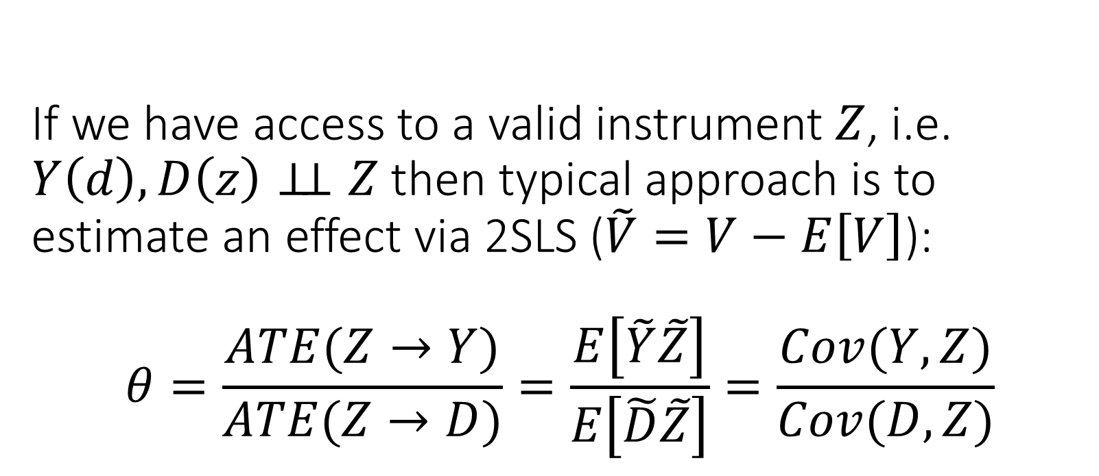
If we have access to a valid instrument $Z$, i.e. $Y\left(d\right),D\left(z\right)⊥⊥ Z$ then typical approach is to estimate an effect via 2SLS ($\tilde{V}=V−E\left[V\right]$): $$θ=\frac{ATE(Z→Y)}{ATE(Z→D)}=\frac{E\left[\tilde{Y}\tilde{Z}\right]}{E\left[\tilde{D}\tilde{Z}\right]}=\frac{Cov(Y,Z)}{Cov(D,Z)}$$
A
unobserved confounder
instrument
treatment
Z
D
Y
outcome

Slide 9
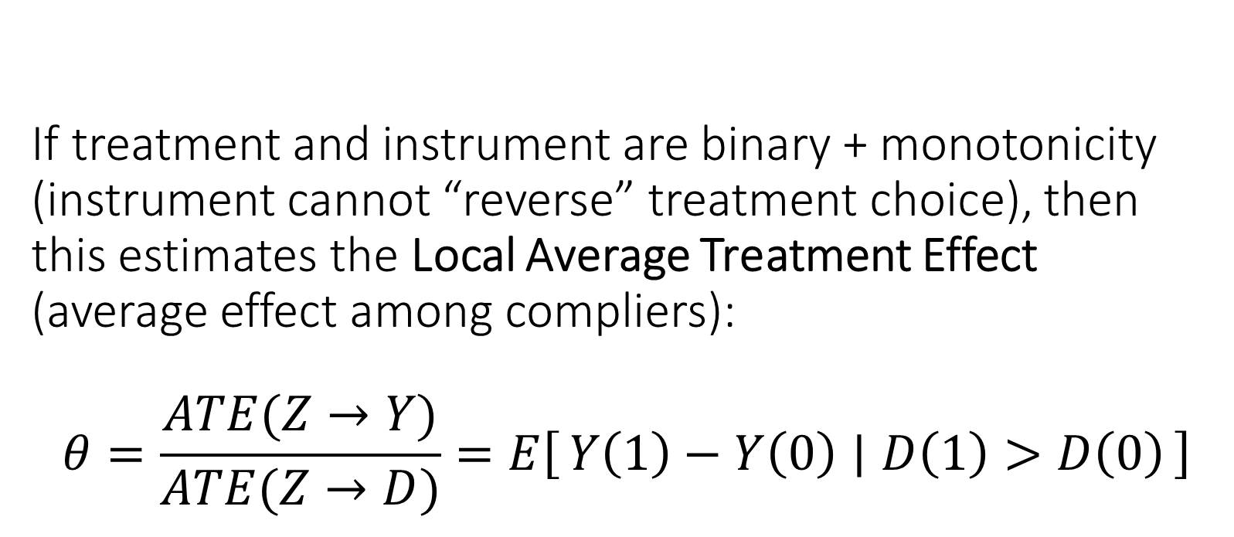
If treatment and instrument are binary + monotonicity (instrument cannot “reverse” treatment choice), then this estimates the Local Average Treatment Effect (average effect among compliers): $$θ=\frac{ATE(Z→Y)}{ATE(Z→D)}=E\left[Y\left(1\right)−Y\left(0\right) ∣ D\left(1\right)>D\left(0\right)\right]$$

Slide 10
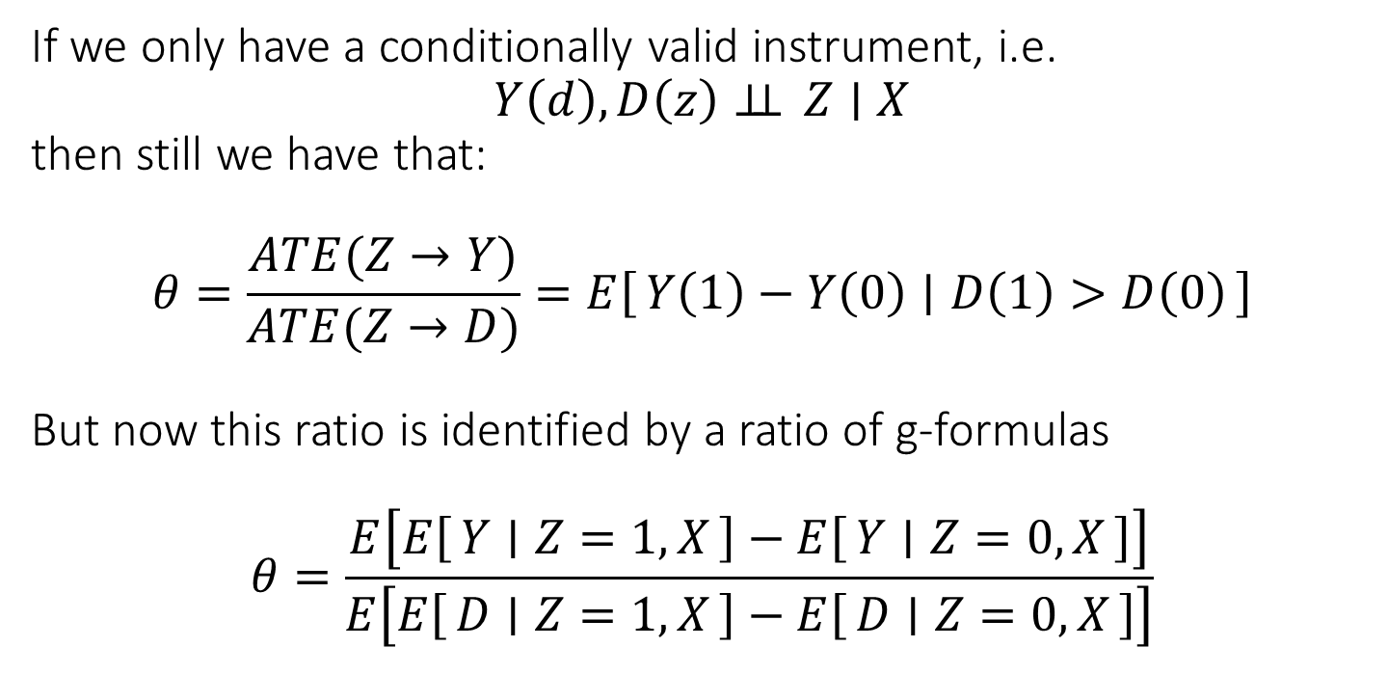
If we only have a conditionally valid instrument, i.e. $$Y\left(d\right),D\left(z\right)⊥⊥ Z∣X$$ then still we have that: $$θ=\frac{ATE(Z→Y)}{ATE(Z→D)}=E\left[Y\left(1\right)−Y\left(0\right) ∣ D\left(1\right)>D\left(0\right)\right]$$ But now this ratio is identified by a ratio of g-formulas $$θ=\frac{E\left[E\left[Y ∣ Z=1,X\right]−E\left[Y ∣ Z=0,X\right]\right]}{E\left[E\left[D ∣ Z=1,X\right]−E\left[D ∣ Z=0,X\right]\right]}$$
A
unobserved confounder
instrument
treatment
Z
D
Y
outcome
X

Slide 11
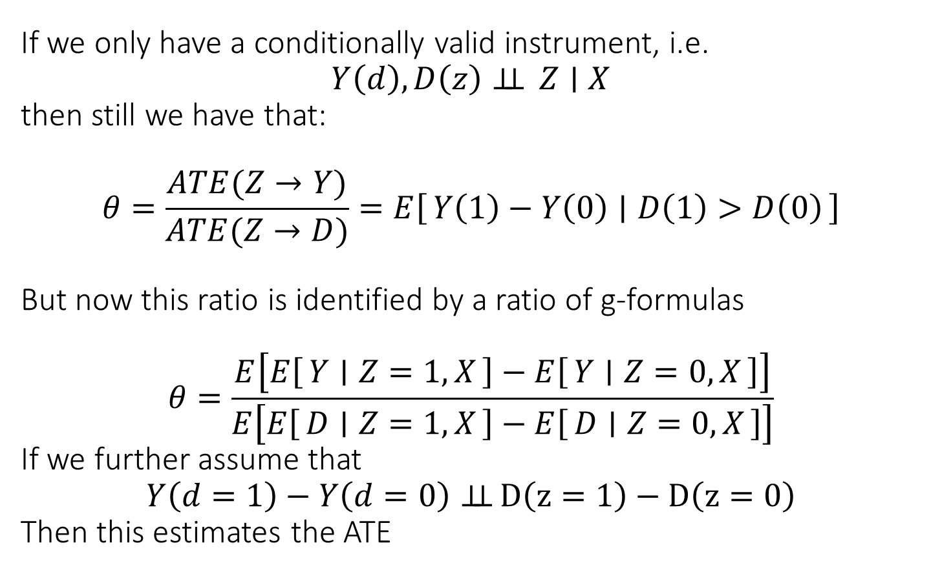
If we only have a conditionally valid instrument, i.e. $$Y\left(d\right),D\left(z\right)⊥⊥ Z∣X$$ then still we have that: $$θ=\frac{ATE(Z→Y)}{ATE(Z→D)}=E\left[Y\left(1\right)−Y\left(0\right) ∣ D\left(1\right)>D\left(0\right)\right]$$ But now this ratio is identified by a ratio of g-formulas $$θ=\frac{E\left[E\left[Y ∣ Z=1,X\right]−E\left[Y ∣ Z=0,X\right]\right]}{E\left[E\left[D ∣ Z=1,X\right]−E\left[D ∣ Z=0,X\right]\right]}$$ If we further assume that $$Y\left(d=1\right)−Y\left(d=0\right)⊥⊥ D\left(z=1\right)−D\left(z=0\right)$$ Then this estimates the ATE
A
unobserved confounder
instrument
treatment
Z
D
Y
outcome
X

Slide 12
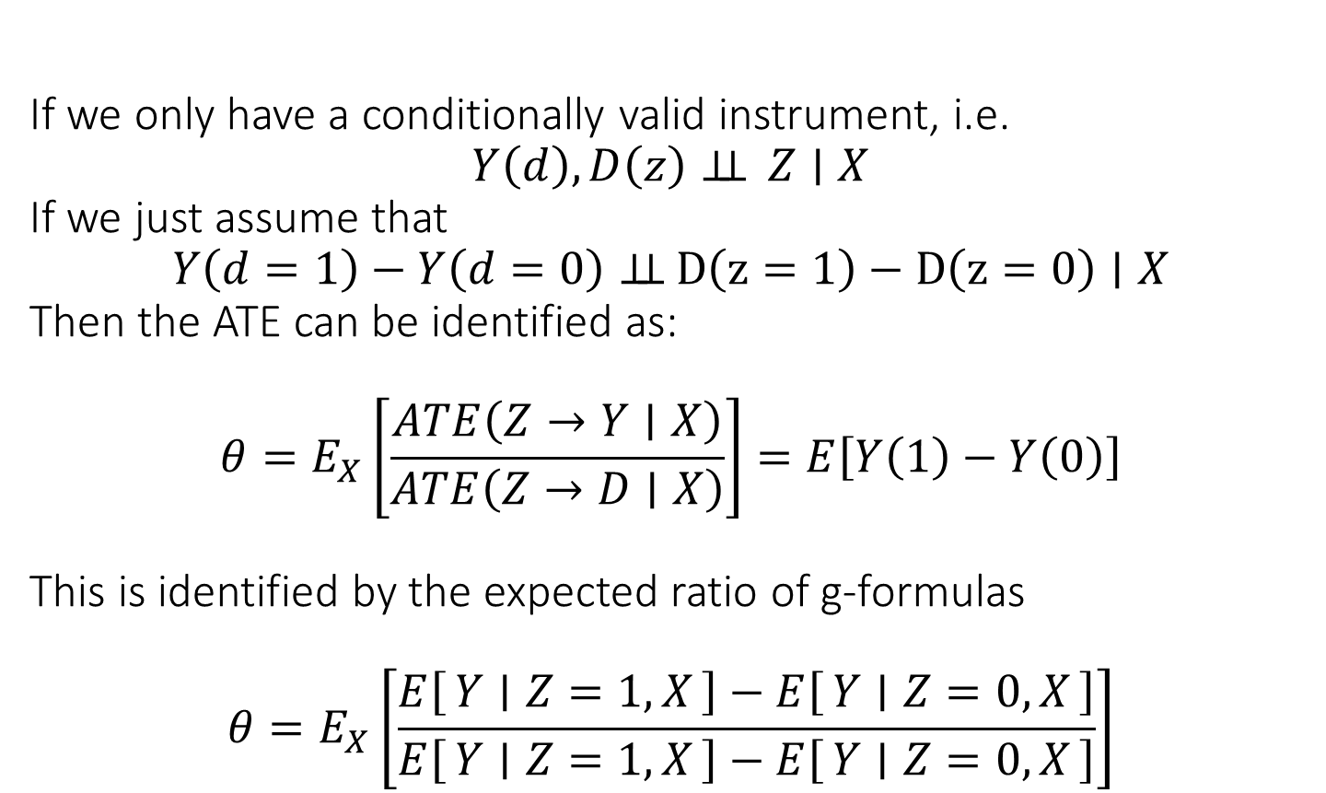
If we only have a conditionally valid instrument, i.e. $$Y\left(d\right),D\left(z\right)⊥⊥ Z∣X$$ If we just assume that $$Y\left(d=1\right)−Y\left(d=0\right)⊥⊥ D\left(z=1\right)−D\left(z=0\right)∣X$$ Then the ATE can be identified as: $$θ=E_{X}\left[\frac{ATE\left(Z→Y∣X\right)}{ATE\left(Z→D∣X\right)}\right]=E\left[Y\left(1\right)−Y\left(0\right)\right]$$ This is identified by the expected ratio of g-formulas $$θ=E_{X}\left[\frac{E\left[Y ∣ Z=1,X\right]−E\left[Y ∣ Z=0,X\right]}{E\left[Y ∣ Z=1,X\right]−E\left[Y ∣ Z=0,X\right]}\right]$$
A
unobserved confounder
instrument
treatment
Z
D
Y
outcome
X

Slide 13
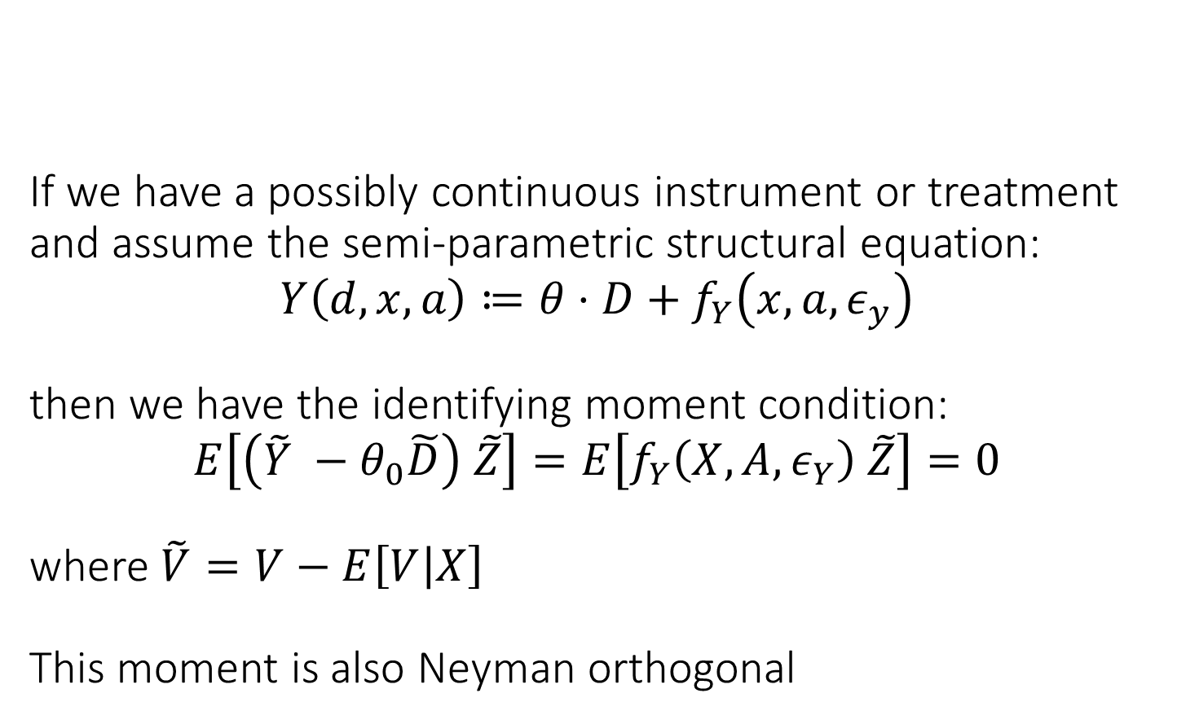
If we have a possibly continuous instrument or treatment and assume the semi-parametric structural equation: $$Y\left(d,x,a\right)≔θ⋅D+f_{Y}\left(x,a, ε_{y}\right)$$ then we have the identifying moment condition: $$E\left[\left(\tilde{Y} −θ_{0}\tilde{D}\right) \tilde{Z}\right]=E\left[f_{Y}\left(X,A,ε_{Y}\right) \tilde{Z}\right]=0$$ where $\tilde{V}=V−E\left[V | X\right]$ This moment is also Neyman orthogonal
A
unobserved confounder
instrument
treatment
Z
D
Y
outcome
X

Slide 14
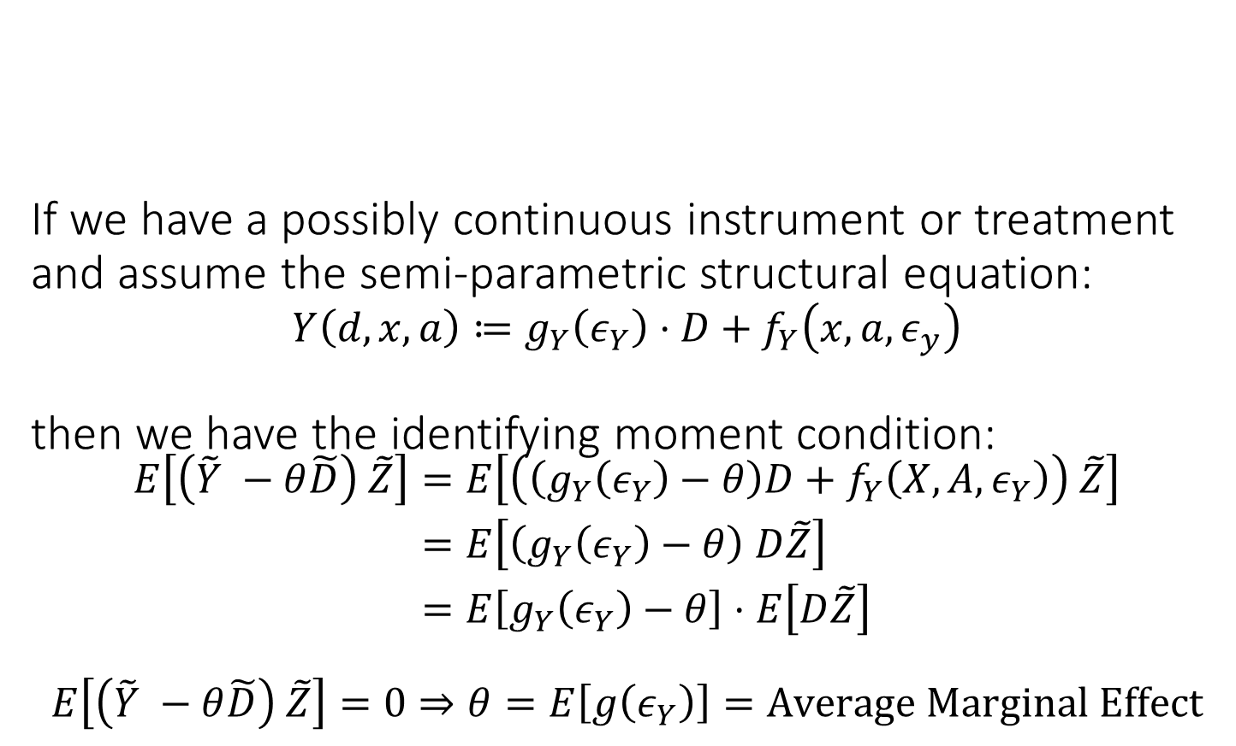
If we have a possibly continuous instrument or treatment and assume the semi-parametric structural equation: $$Y\left(d,x,a\right)≔g_{Y}\left(ε_{Y}\right)⋅D+f_{Y}\left(x,a, ε_{y}\right)$$ then we have the identifying moment condition: $$\begin{aligned}E\left[\left(\tilde{Y} −θ\tilde{D}\right) \tilde{Z}\right]=&E\left[\left(\left(g_{Y}\left(ε_{Y}\right)−θ\right)D+f_{Y}\left(X,A,ε_{Y}\right)\right) \tilde{Z}\right] \\ =&E\left[\left(g_{Y}\left(ε_{Y}\right)−θ\right) D\tilde{Z}\right] \\ =&E\left[g_{Y}\left(ε_{Y}\right)−θ\right]⋅E\left[D\tilde{Z}\right]\end{aligned}$$ $$E\left[\left(\tilde{Y} −θ\tilde{D}\right) \tilde{Z}\right]=0⇒θ=E\left[g\left(ε_{Y}\right)\right]=Average Marginal Effect$$
A
unobserved confounder
instrument
treatment
Z
D
Y
outcome
X

Slide 15
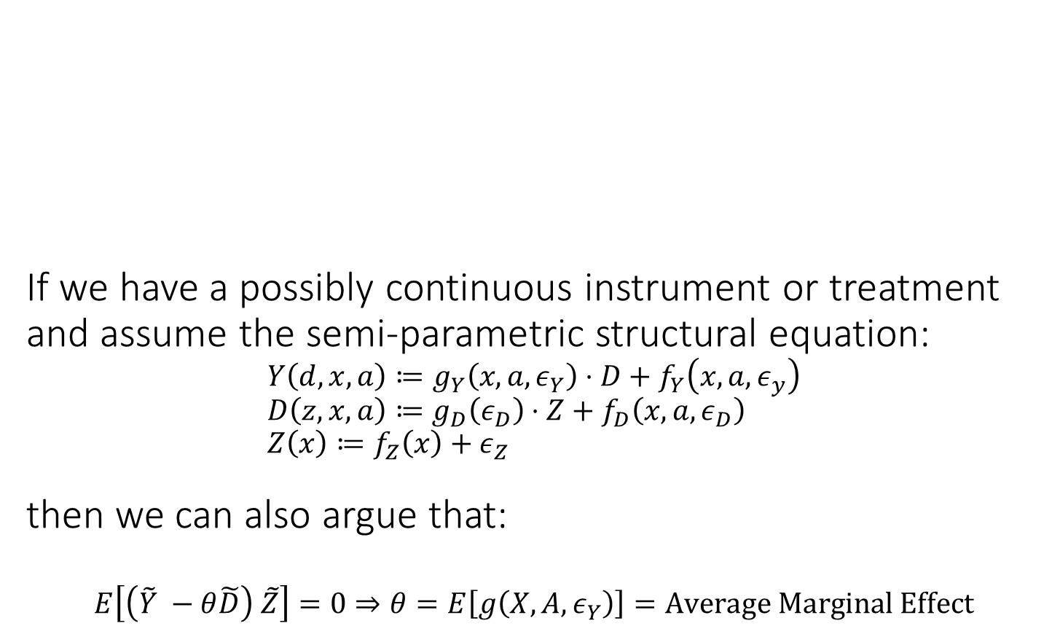
If we have a possibly continuous instrument or treatment and assume the semi-parametric structural equation: $$Y\left(d,x,a\right)≔g_{Y}\left(x,a,ε_{Y}\right)⋅D+f_{Y}\left(x,a, ε_{y}\right) \\ D\left(z,x,a\right)≔g_{D}\left(ε_{D}\right)⋅Z+f_{D}\left(x,a,ε_{D}\right) \\ Z\left(x\right)≔f_{Z}\left(x\right)+ε_{Z}$$ then we can also argue that: $$E\left[\left(\tilde{Y} −θ\tilde{D}\right) \tilde{Z}\right]=0⇒θ=E\left[g\left(X,A,ε_{Y}\right)\right]=Average Marginal Effect$$
A
unobserved confounder
instrument
treatment
Z
D
Y
outcome
X

Slide 16
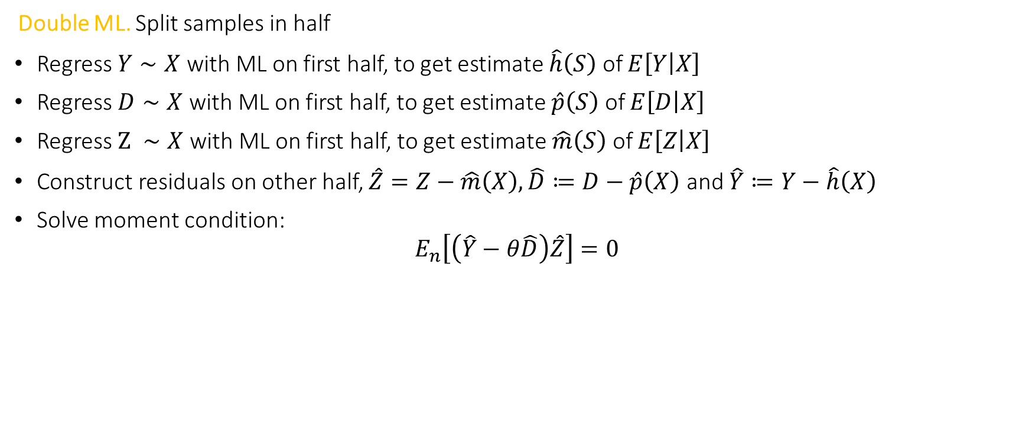
Orthogonal Method: Double ML for IV
Double ML. Split samples in half
Regress $Y∼X$ with ML on first half, to get estimate $\hat{h}\left(S\right)$ of $E\left[Y | X\right]$
Regress $D∼X$ with ML on first half, to get estimate $\hat{p}\left(S\right)$ of $E\left[D | X\right]$
Regress $Z ∼X$ with ML on first half, to get estimate $\hat{m}\left(S\right)$ of $E\left[Z | X\right]$
Construct residuals on other half, $\hat{Z}=Z−\hat{m}\left(X\right),\hat{D}≔D−\hat{p}\left(X\right)$ and $\hat{Y}≔Y−\hat{h}\left(X\right)$
Solve moment condition:
$$E_{n}\left[\left(\hat{Y}−θ\hat{D}\right)\hat{Z}\right]=0$$

Slide 17
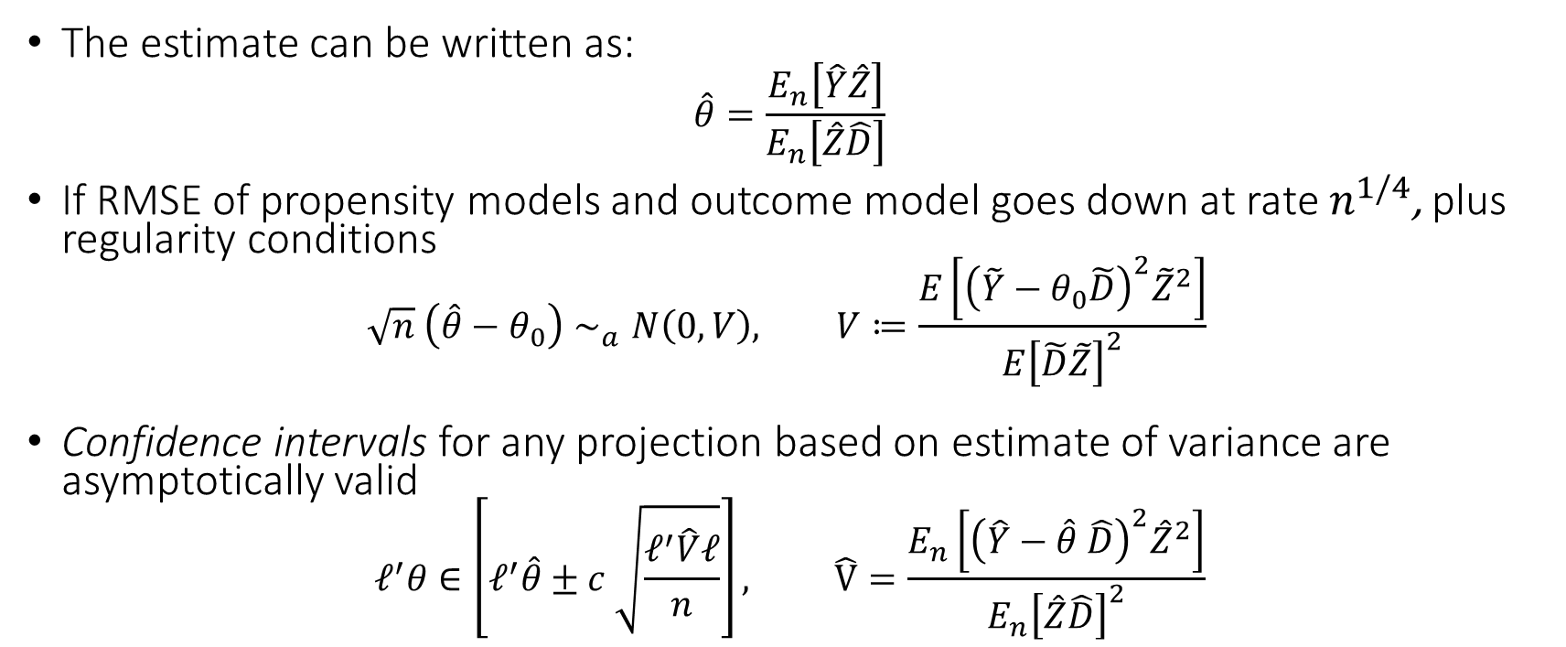
Inference with DML in PLIV Setting
The estimate can be written as:
$$\hat{θ}=\frac{E_{n}\left[\hat{Y}\hat{Z}\right]}{E_{n}\left[\hat{Z}\hat{D}\right]}$$
If RMSE of propensity models and outcome model goes down at rate $n^{1/4}$, plus regularity conditions
$$\sqrt{n} \left(\hat{θ}−θ_{0}\right)∼_{a}N\left(0, V\right), V≔\frac{E\left[{\left(\tilde{Y}−θ_{0}\tilde{D}\right)}^{2}{\tilde{Z}}^{2}\right]}{E{\left[\tilde{D}\tilde{Z}\right]}^{2}}$$
Confidence intervals for any projection based on estimate of variance are asymptotically valid
$$ℓ^{′}θ∈\left[ℓ^{′}\hat{θ}±c \sqrt{\frac{ℓ^{′}\hat{V}ℓ}{n}}\right], \hat{V}=\frac{E_{n}\left[{\left(\hat{Y}−\hat{θ} \hat{D}\right)}^{2}{\hat{Z}}^{2}\right]}{E_{n}{\left[\hat{Z}\hat{D}\right]}^{2}}$$

Slide 18
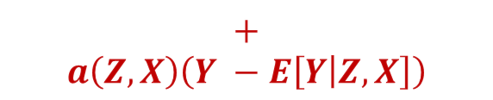
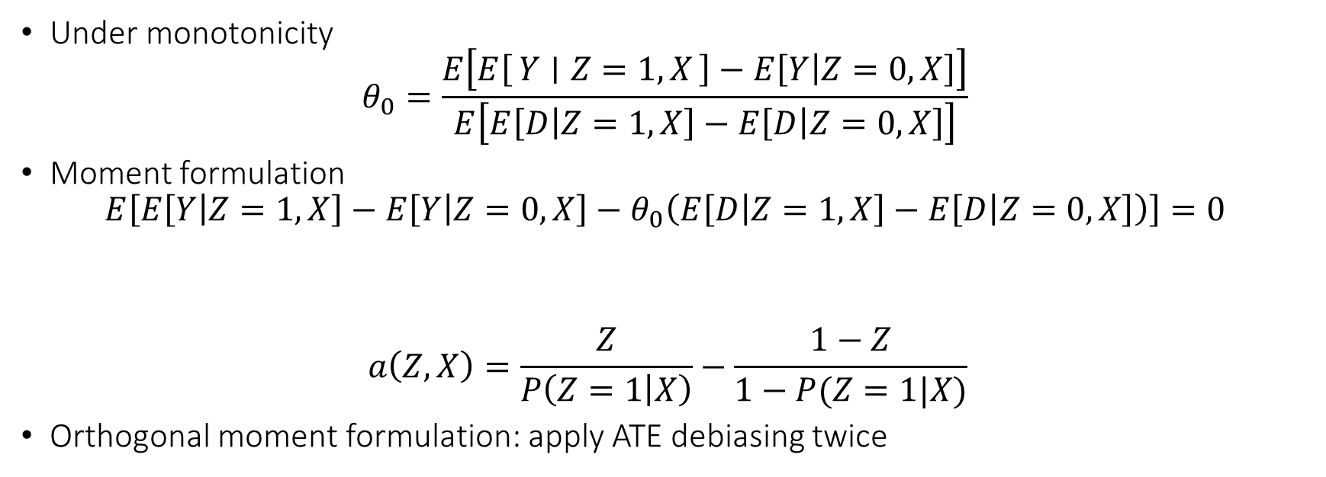
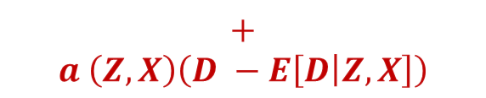
LATE in the Binary Case
Under monotonicity
$$θ_{0}=\frac{E\left[E\left[Y ∣ Z=1,X\right]−E\left[Y | Z=0,X\right]\right]}{E\left[E\left[D | Z=1,X\right]−E\left[D | Z=0,X\right]\right]}$$
Moment formulation
$$E\left[E\left[Y | Z=1,X\right]−E\left[Y | Z=0,X\right]−θ_{0}\left(E\left[D | Z=1,X\right]−E\left[D | Z=0,X\right]\right)\right]=0$$
$$a\left(Z,X\right)=\frac{Z}{P\left(Z=1 | X\right)}−\frac{1−Z}{1−P(Z=1|X)}$$
Orthogonal moment formulation: apply ATE debiasing twice
$$+$$
$$a\left(Z,X\right)\left(Y −E\left[Y | Z,X\right]\right)$$
$$+$$
$$a \left(Z,X\right)\left(D −E\left[D | Z,X\right]\right)$$

Slide 19
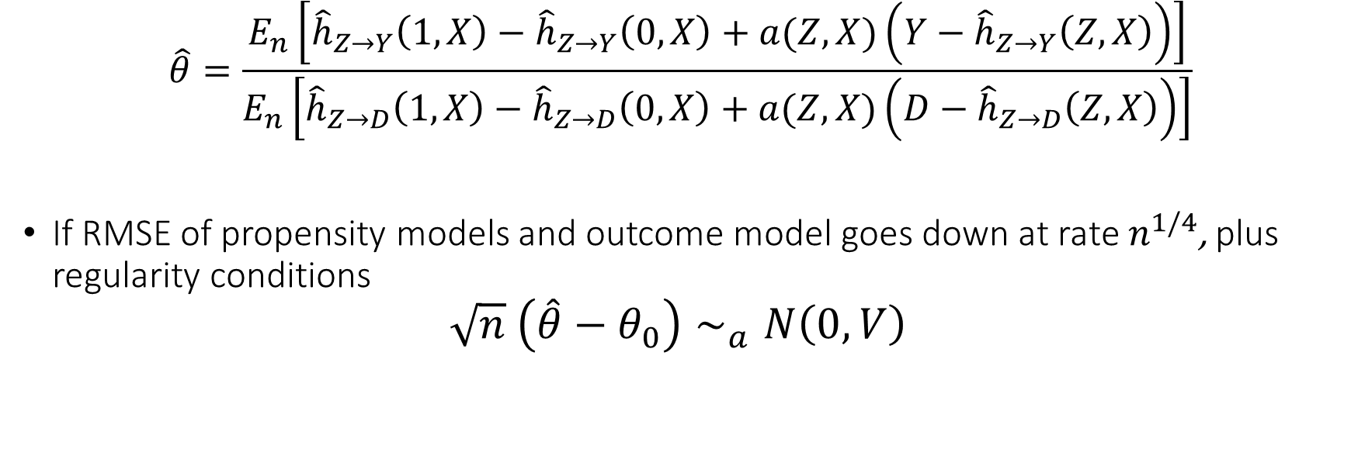
Inference on LATE in the Binary Case
$$\hat{θ}=\frac{E_{n}\left[{\hat{h}}_{Z→Y}\left(1, X\right)−{\hat{h}}_{Z→Y}\left(0, X\right)+a(Z,X)\left(Y−{\hat{h}}_{Z→Y}\left(Z,X\right)\right)\right]}{E_{n}\left[{\hat{h}}_{Z→D}\left(1, X\right)−{\hat{h}}_{Z→D}\left(0, X\right)+a(Z,X)\left(D−{\hat{h}}_{Z→D}\left(Z,X\right)\right)\right]}$$
If RMSE of propensity models and outcome model goes down at rate $n^{1/4}$, plus regularity conditions
$$\sqrt{n} \left(\hat{θ}−θ_{0}\right)∼_{a}N\left(0, V\right)$$

Slide 20
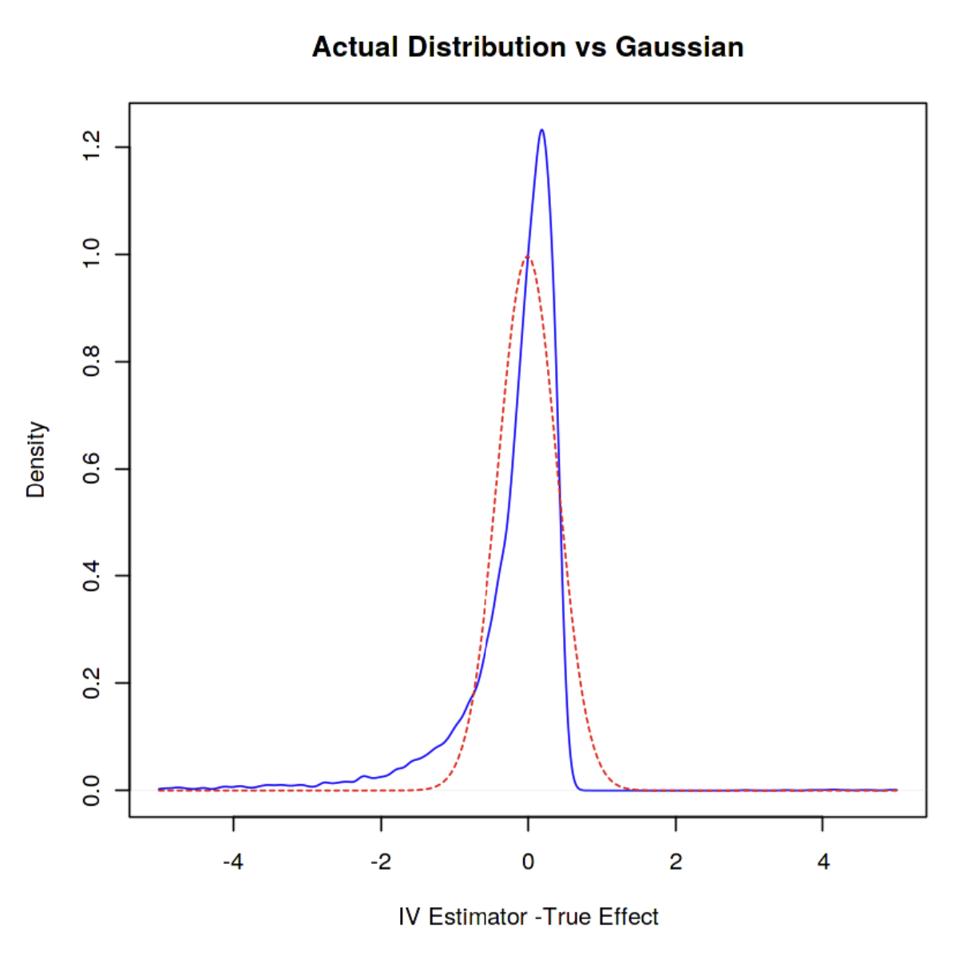

Weak Identification
If $E\left[\tilde{D}\tilde{Z}\right]$ is small and comparable with the sample size, then approximation
$$E_{n}{\left[\tilde{D}\tilde{Z}\right]}^{−1}≈E{\left[\tilde{D}\tilde{Z}\right]}^{−1}$$
Can be inaccurate in finite samples and normal based approximation will yield in-correct confidence intervals

Slide 21
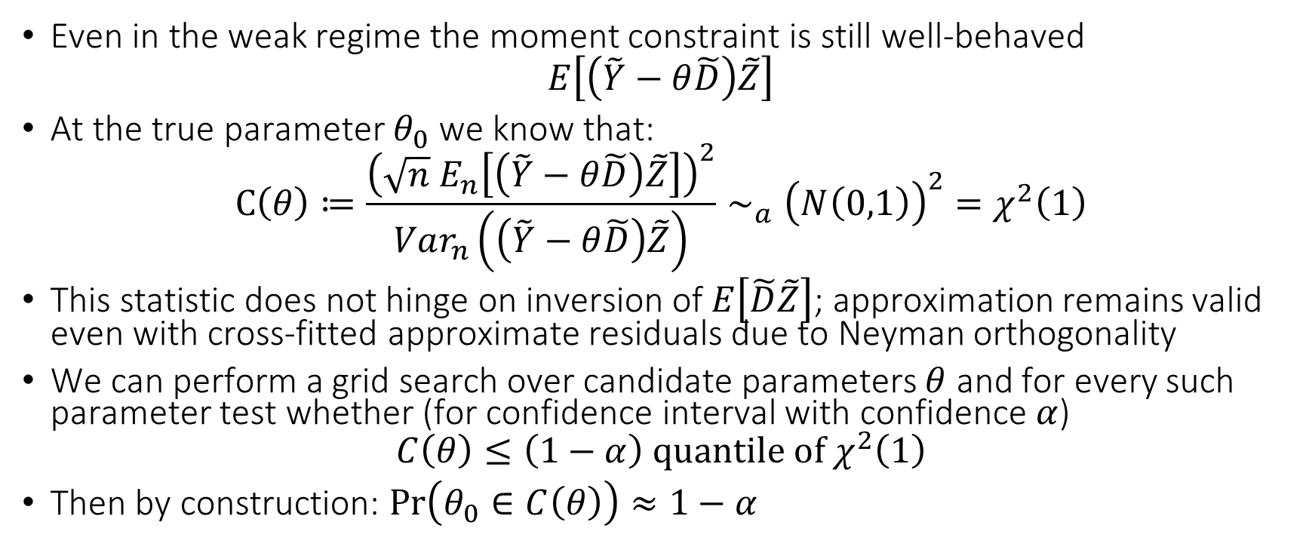
A More Robust Inference Approach
Even in the weak regime the moment constraint is still well-behaved
$$E\left[\left(\tilde{Y}−θ\tilde{D}\right)\tilde{Z}\right]$$
At the true parameter $θ_{0}$ we know that:
$$C\left(θ\right)≔\frac{{\left(\sqrt{n} E_{n}\left[\left(\tilde{Y}−θ\tilde{D}\right)\tilde{Z}\right]\right)}^{2}}{Var_{n}\left(\left(\tilde{Y}−θ\tilde{D}\right)\tilde{Z}\right)}∼_{a}{\left(N\left(0,1\right)\right)}^{2}=χ^{2}\left(1\right)$$
This statistic does not hinge on inversion of $E\left[\tilde{D}\tilde{Z}\right]$; approximation remains valid even with cross-fitted approximate residuals due to Neyman orthogonality
We can perform a grid search over candidate parameters $θ$ and for every such parameter test whether (for confidence interval with confidence $α$)
$$C\left(θ\right)≤\left(1−α\right) quantile of χ^{2}\left(1\right)$$
Then by construction: $\operatorname{Pr}\left(θ_{0}∈C\left(θ\right)\right)≈1−α$

Slide 22
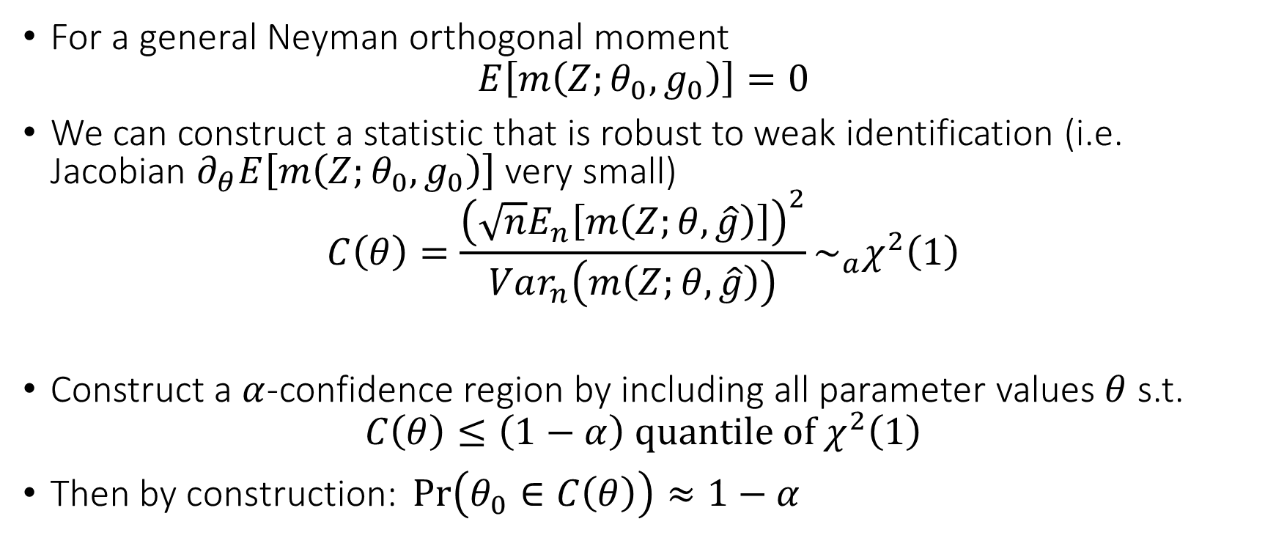
General Moments and Weak Identification
For a general Neyman orthogonal moment
$$E\left[m\left(Z;θ_{0},g_{0}\right)\right]=0$$
We can construct a statistic that is robust to weak identification (i.e. Jacobian $∂_{θ}E\left[m\left(Z;θ_{0},g_{0}\right)\right]$ very small)
$$C\left(θ\right)=\frac{{\left(\sqrt{n}E_{n}\left[m\left(Z;θ,\hat{g}\right)\right]\right)}^{2}}{Var_{n}\left(m\left(Z;θ,\hat{g}\right)\right)}\sim _{a}χ^{2}\left(1\right)$$
Construct a $α$-confidence region by including all parameter values $θ$ s.t.
$$C\left(θ\right)≤\left(1−α\right) quantile of χ^{2}\left(1\right)$$
$\text{Then} \text{by} \text{construction}\text{: }\operatorname{Pr}\left(θ_{0}∈C\left(θ\right)\right)≈1−α$

