Slide 1
MS&E228: Lecture 2 Causality via Experiments
Vasilis Syrgkanis
MS&E, Stanford

Slide 2
Causal Inference with Experiments
Prediction with Linear Models
Prediction with High-Dim Linear Models
Inference on Causal and Predictive Effects with High-Dim Linear Models
Potential Outcomes and Conditional Ignorability
Structural Equation Models and Conditional Exogeneity
Directed Acyclic Graphs
Prediction with Non-Linear Models
Inference on Causal Effects with Non-Linear Models
Un-observed Confounding and Instruments
Identification of Causal Effects in Longitudinal Data
Estimation of Heterogeneous Causal Effects
Linear Predictive Models and Statistical Inference
Causal Identification in Observational Data
Non-Linear Predictive Models and Statistical Inference
Topics

Slide 3
Causal Inference with Experiments
Prediction with Linear Models
Prediction with High-Dim Linear Models
Inference on Causal and Predictive Effects with High-Dim Linear Models
Potential Outcomes and Conditional Ignorability
Structural Equation Models and Conditional Exogeneity
Directed Acyclic Graphs
Prediction with Non-Linear Models
Inference on Causal Effects with Non-Linear Models
Un-observed Confounding and Instruments
Identification of Causal Effects in Longitudinal Data
Estimation of Heterogeneous Causal Effects
Linear Predictive Models and Statistical Inference
Causal Identification in Observational Data
Non-Linear Predictive Models and Statistical Inference
Topics

Slide 4
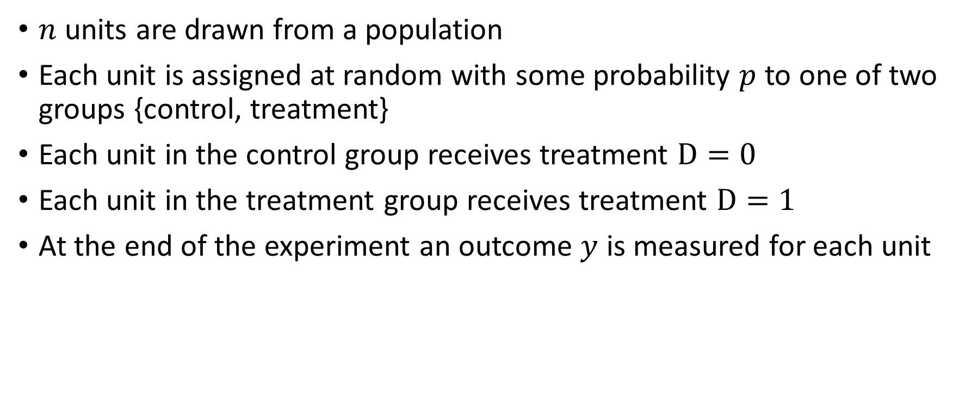
Randomized Control Trial (RCT)
$n$ units are drawn from a population
Each unit is assigned at random with some probability $p$ to one of two groups {control, treatment}
Each unit in the control group receives treatment $D=0$
Each unit in the treatment group receives treatment $D=1$
At the end of the experiment an outcome $y$ is measured for each unit

Slide 5
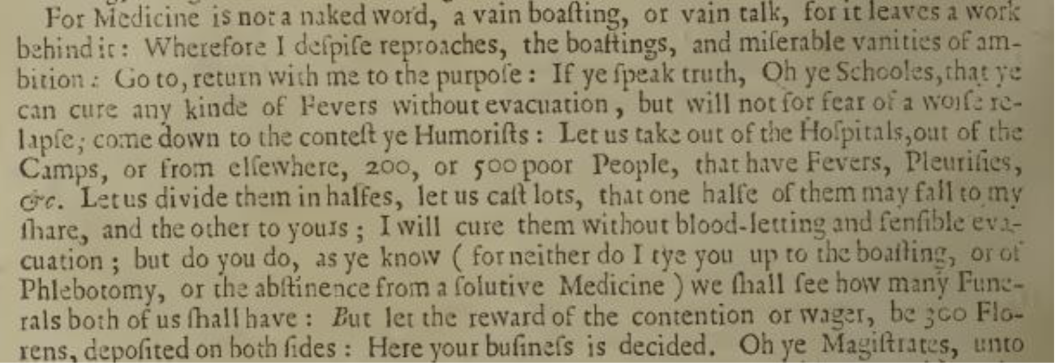
A Brief History of Experimentation
Abhijit Banerjee, Esther Duflo, and
Michael Kremer, popularize the use of RCTs in economics (esp. for policy problems related to poverty).
Neyman publishes “On the Application of Probability Theory to Agricultural Experiments”
Michigan Supreme Court authorizes RCTs as part of medical practice
FDA to prohibit the marketing of any new drug in the absence of “substantial evidence.”
1662
1828
1923
1925
1935
1947
1962
1969
2000-
John Baptista Van Helmont proposes a randomized experiment for the effect of bloodletting
Louis conducts a non-randomized controlled experiment showing strong evidence against bloodletting
Fisher publishes Statistical Methods for Research Workers
Fisher publishes The Design of Experiments
First published medical RCT in Great Britain
FDA: “…partially controlled studies are not acceptable evidence to support claims of effectiveness”
10s of thousands of RCTs run annually by companies like Airbnb, Amazon, Booking.com eBay, Facebook, Google, LinkedIn, Lyft, Microsoft, Netflix, Twitter, Uber, Yahoo! and Yandex
Credit: Ron Kohavi, History of Controlled Experiments

Slide 6
RCTs are the gold standard for measuring the “causal effect” of a “treatment” on an “outcome”

Slide 7
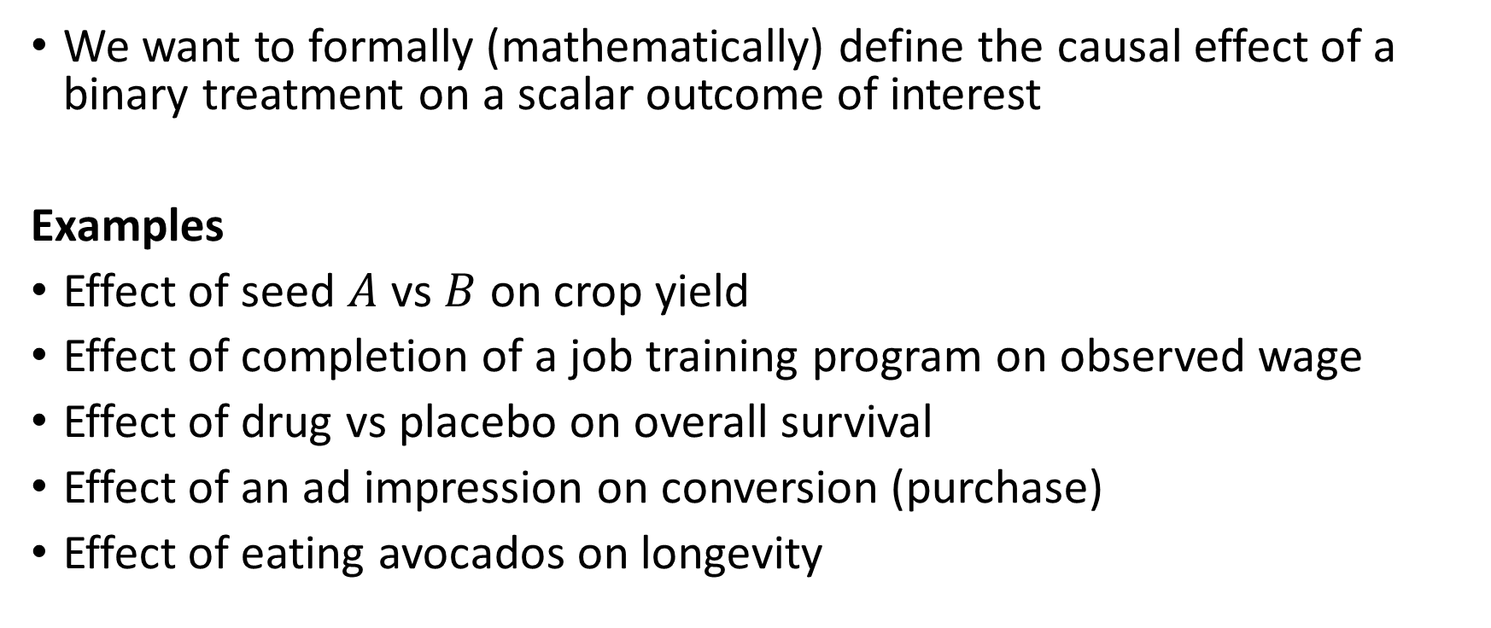
Goal #1: Mathematical Definition of Causality
We want to formally (mathematically) define the causal effect of a binary treatment on a scalar outcome of interest
Examples
Effect of seed $A$ vs $B$ on crop yield
Effect of completion of a job training program on observed wage
Effect of drug vs placebo on overall survival
Effect of an ad impression on conversion (purchase)
Effect of eating avocados on longevity

Slide 8
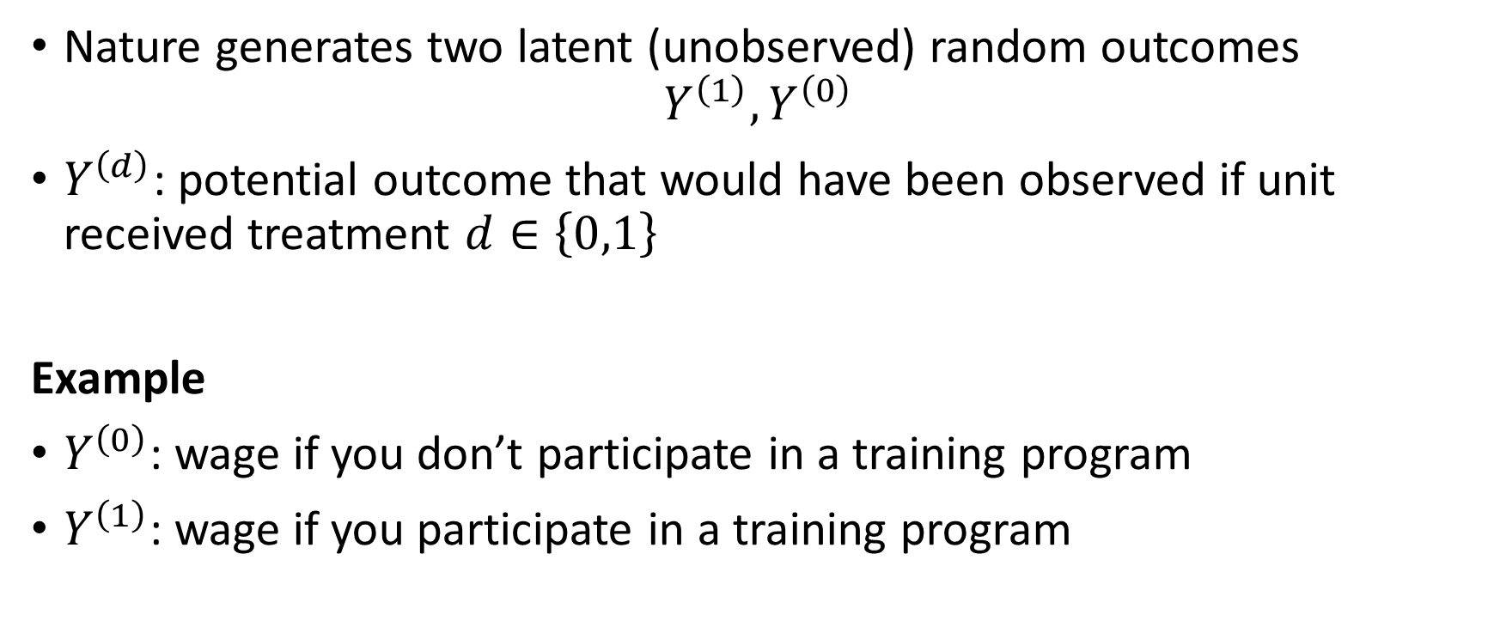
Causality via Potential Outcomes
Nature generates two latent (unobserved) random outcomes
$$Y^{\left(1\right)}, Y^{\left(0\right)}$$
$Y^{\left(d\right)}$: potential outcome that would have been observed if unit received treatment $d∈\left\{0,1\right\}$
Example
$Y^{\left(0\right)}$: wage if you don’t participate in a training program
$Y^{\left(1\right)}$: wage if you participate in a training program

Slide 9
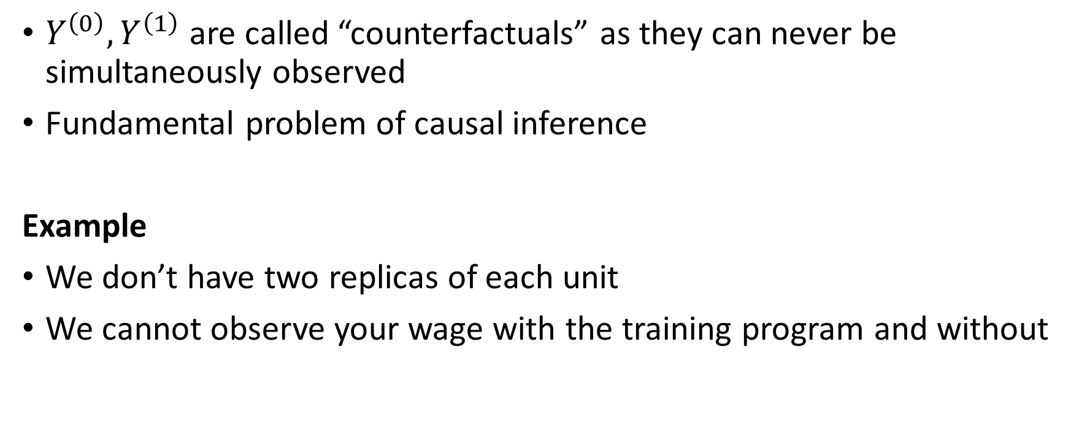
Causality via Potential Outcomes
$Y^{\left(0\right)},Y^{\left(1\right)}$ are called “counterfactuals” as they can never be simultaneously observed
Fundamental problem of causal inference
Example
We don’t have two replicas of each unit
We cannot observe your wage with the training program and without

Slide 10
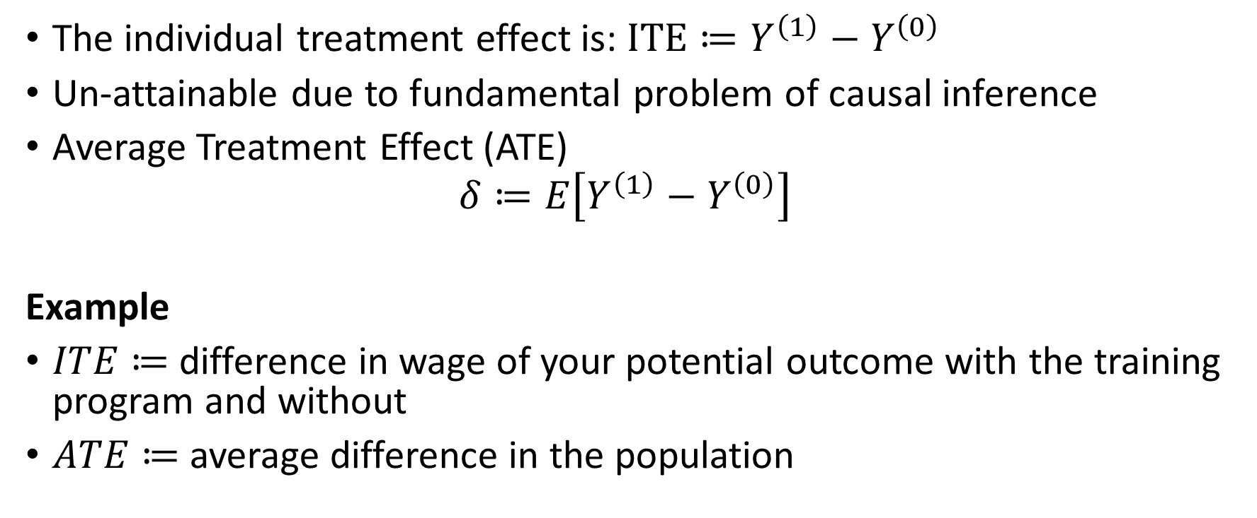
Causality via Potential Outcomes
The individual treatment effect is: $ITE≔Y^{\left(1\right)}−Y^{\left(0\right)}$
Un-attainable due to fundamental problem of causal inference
Average Treatment Effect (ATE)
$$δ≔E\left[Y^{\left(1\right)}−Y^{\left(0\right)}\right]$$
Example
$ITE≔$ difference in wage of your potential outcome with the training program and without
$ATE≔$ average difference in the population

Slide 11
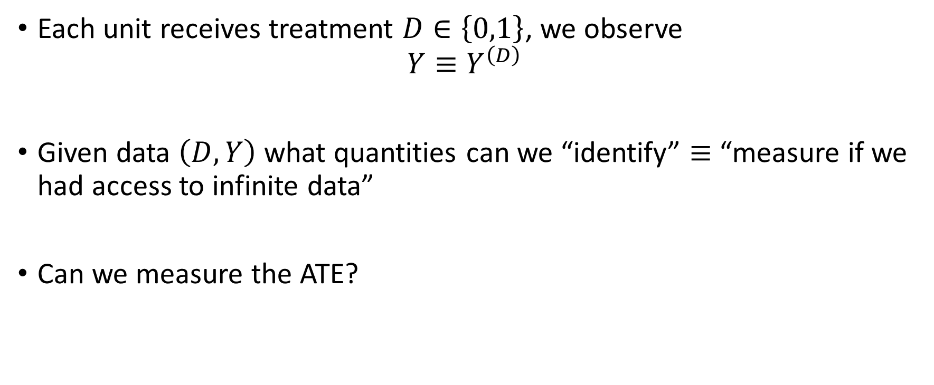
Treatment Assignment and Observed Outcome
Each unit receives treatment $D∈\left\{0,1\right\}$, we observe
$$Y≡Y^{\left(D\right)}$$
Given data $\left(D, Y\right)$ what quantities can we “identify” $≡$ “measure if we had access to infinite data”
Can we measure the ATE?

Slide 12
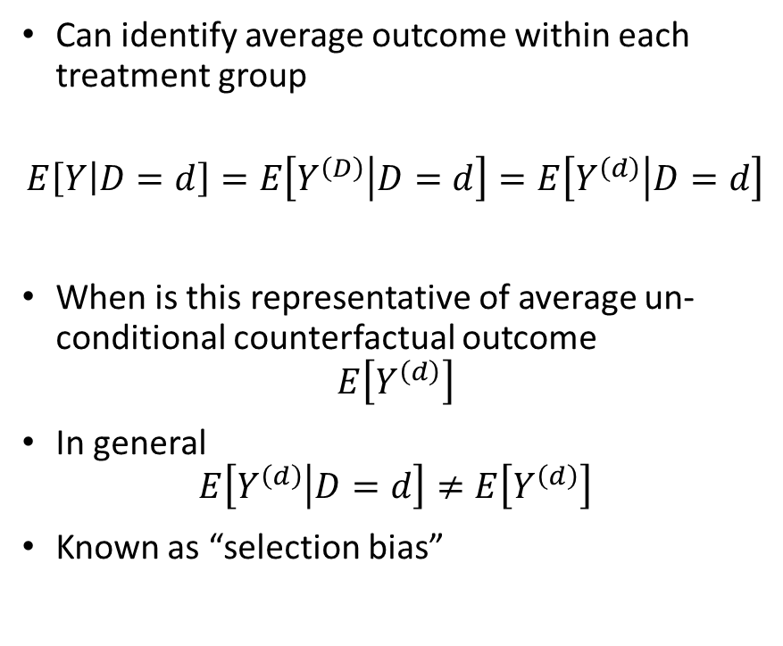
The Effect of Eating Avocados on Health
Can identify average outcome within each treatment group
$$E\left[Y | D=d\right]=E\left[Y^{\left(D\right)} | D=d\right]=E\left[Y^{\left(d\right)} | D=d\right]$$
When is this representative of average un-conditional counterfactual outcome
$$E\left[Y^{\left(d\right)}\right]$$
In general
$$E\left[Y^{\left(d\right)} | D=d\right]≠E\left[Y^{\left(d\right)}\right]$$
Known as “selection bias”
high
Life expectancy
low
Avocado Consumption

Slide 13
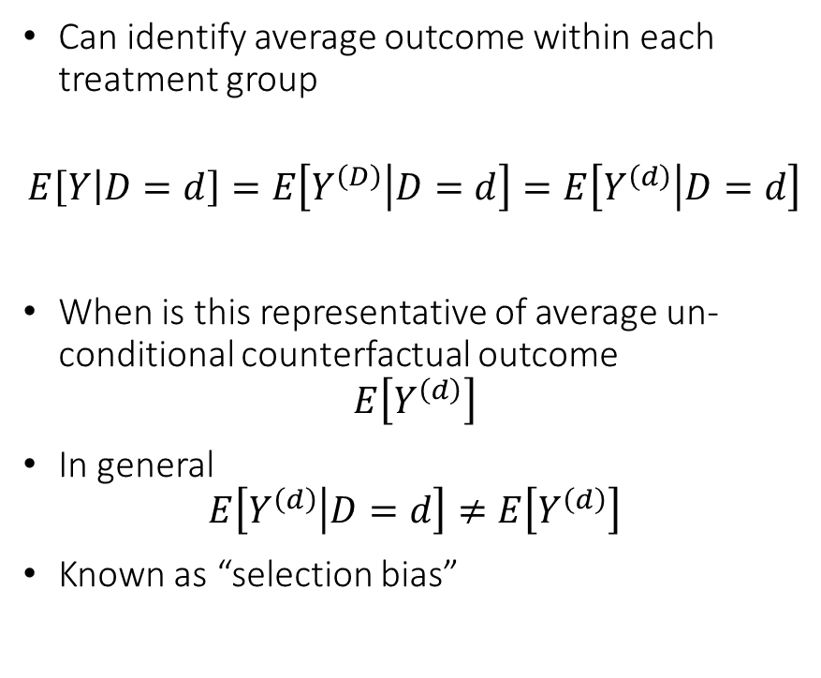


The Effect of Eating Avocados on Health
Can identify average outcome within each treatment group
$$E\left[Y | D=d\right]=E\left[Y^{\left(D\right)} | D=d\right]=E\left[Y^{\left(d\right)} | D=d\right]$$
When is this representative of average un-conditional counterfactual outcome
$$E\left[Y^{\left(d\right)}\right]$$
In general
$$E\left[Y^{\left(d\right)} | D=d\right]≠E\left[Y^{\left(d\right)}\right]$$
Known as “selection bias”
high
Life expectancy
low
$$E\left[Y^{\left(0\right)}\right]$$
$$E\left[Y^{\left(0\right)}|D=0\right]$$
Avocado Consumption

Slide 14
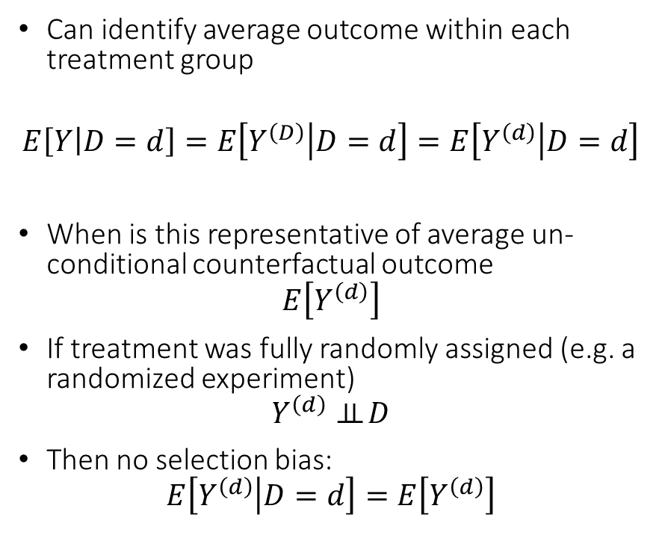

The Effect of Eating Avocados on Health
Can identify average outcome within each treatment group
$$E\left[Y | D=d\right]=E\left[Y^{\left(D\right)} | D=d\right]=E\left[Y^{\left(d\right)} | D=d\right]$$
When is this representative of average un-conditional counterfactual outcome
$$E\left[Y^{\left(d\right)}\right]$$
If treatment was fully randomly assigned (e.g. a randomized experiment)
$$Y^{\left(d\right)}⊥⊥ D$$
Then no selection bias:
$$E\left[Y^{\left(d\right)} | D=d\right]=E\left[Y^{\left(d\right)}\right]$$
high
Life expectancy
low
$$E\left[Y^{\left(0\right)}\right]$$
$$=$$
$$E\left[Y^{\left(0\right)}|D=0\right]$$
Avocado Consumption

Slide 15
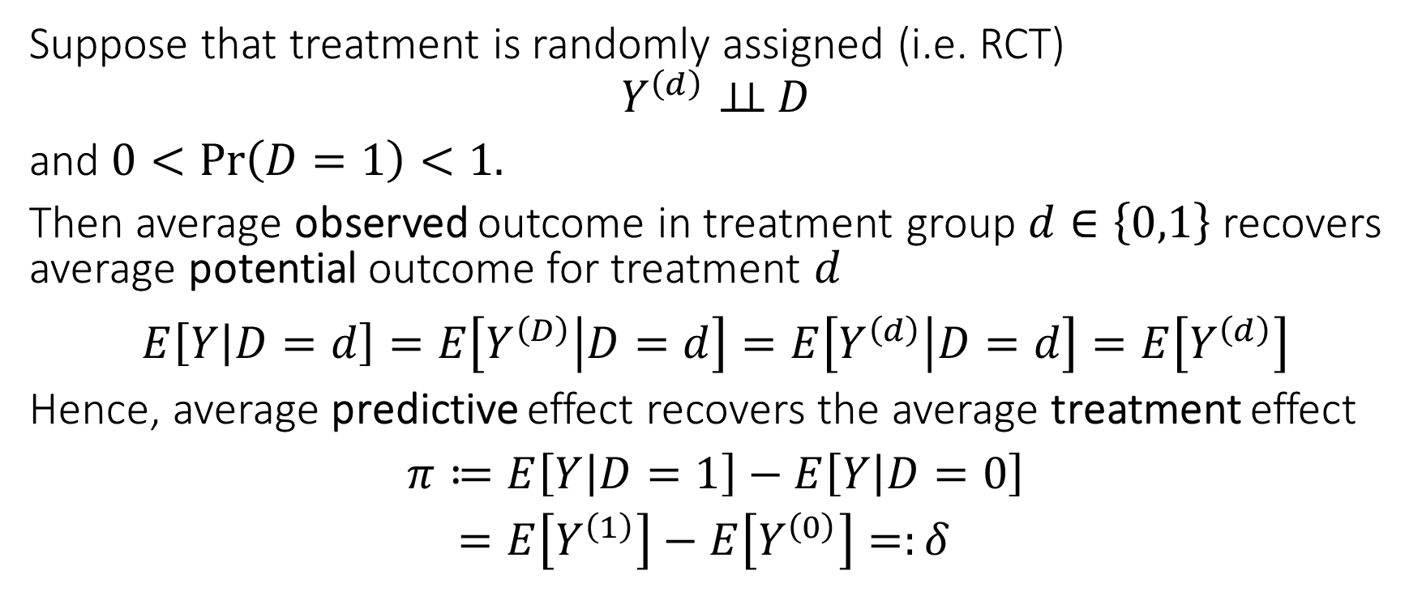
Identification of ATE under Random Assignment
Suppose that treatment is randomly assigned (i.e. RCT)
$$Y^{\left(d\right)}⊥⊥ D$$
and $0<\operatorname{Pr}\left(D=1\right)<1.$
Then average observed outcome in treatment group $d∈\left\{0,1\right\}$ recovers average potential outcome for treatment $d$
$$E\left[Y | D=d\right]=E\left[Y^{\left(D\right)} | D=d\right]=E\left[Y^{\left(d\right)} | D=d\right]=E\left[Y^{\left(d\right)}\right]$$
Hence, average predictive effect recovers the average treatment effect
$$\begin{aligned}π≔&E\left[Y | D=1\right]−E\left[Y | D=0\right] \\ =&E\left[Y^{\left(1\right)}\right]−E\left[Y^{\left(0\right)}\right]=:δ\end{aligned}$$

Slide 16
RCTs and Causal Diagrams

Slide 17








RCTs and Causal Diagrams
Causal diagrams can help visualize how our assumptions imply the identification of a causal effect
First instances in work of Sewall and Philip Wright’28
Pioneered and fully developed by Pearl and Robins [80s-90s]
$$D$$
Easy to visualize that
$$y^{\left(d\right)}⊥D$$
$$D$$
$$d$$
$$W$$
$$y$$
$$W$$
$$y^{\left(d\right)}$$
Causal Diagram (Graph)
Single World Intervention Graph (SWIG)

Slide 18
Limitations of RCTs

Slide 19
Externalities, Stability and Equilibrium Effects
Stable Unit Treatment Value Assumption (SUTVA)
Implicit in our notation the potential outcome of a unit depends only on its own treatment
This can be violated due to what is known as spillover effects, externalities or general equilibrium effects
In vaccine trials: if large fraction of population is treated, then the effect of vaccinating an additional unity changes, due to herd immunity
In labor: if we make an intervention that incentivizes a large fraction of population to attend college, the college-wage premium will likely decrease

Slide 20
Ethical, Practical and Generalizability Concerns
Ethical Concerns: Many potential trials would correctly be judged unethical by a human subject trial review board; Key principles [78 Belmont report]: (i) respect for persons, (ii) beneficence, (iii) justice
Practical Concerns: Practically infeasible due to high cost (e.g. expensive treatment, expensive data collection, low signal regime, long-term outcomes) or inability to directly randomize the treatment
Generalizability: Local population used for RCT might not generalize to broader population

Slide 21
Statistical Inference

Slide 22
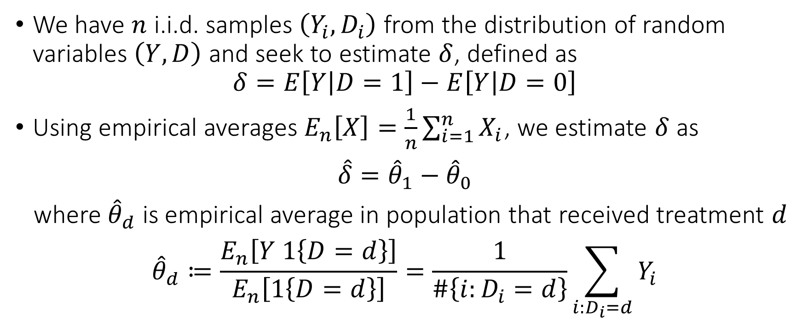
What can we do with finite samples
We have $n$ i.i.d. samples $\left(Y_{i},D_{i}\right)$ from the distribution of random variables $\left(Y, D\right)$ and seek to estimate $δ$, defined as
$$δ=E\left[Y | D=1\right]−E\left[Y | D=0\right]$$
Using empirical averages $E_{n}\left[X\right]=\frac{1}{n}\sum_{i=1}^{n}{X_{i}}$, we estimate $δ$ as
$$\hat{δ}={\hat{θ}}_{1}−{\hat{θ}}_{0}$$
where ${\hat{θ}}_{d}$ is empirical average in population that received treatment $d$
$${\hat{θ}}_{d}≔\frac{E_{n}\left[Y 1\left\{D=d\right\}\right]}{E_{n}\left[1\left\{D=d\right\}\right]}=\frac{1}{\#\left\{i:D_{i}=d\right\}}\sum_{i:D_{i}=d}{Y_{i}}$$

Slide 23
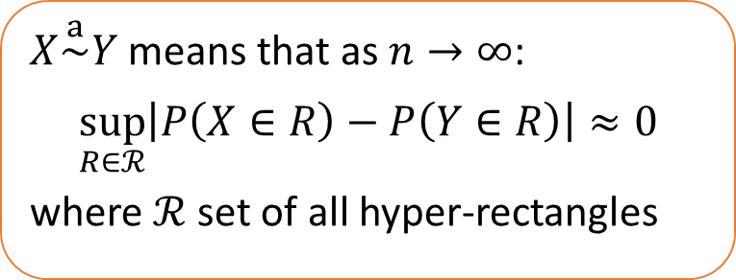
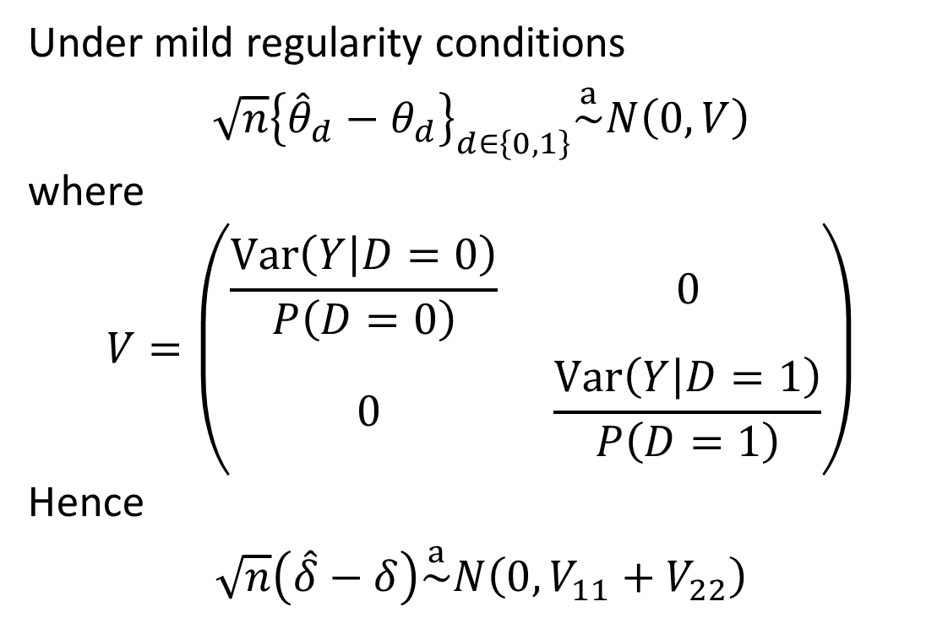
How accurate is the estimate?
Under mild regularity conditions
$$\sqrt{n}{\left\{{\hat{θ}}_{d}−θ_{d}\right\}}_{d∈\left\{0,1\right\}}\overset{a}{\sim }N\left(0, V\right)$$
where
$$V=\left(\begin{matrix}\frac{Var\left(Y | D=0\right)}{P\left(D=0\right)} & 0 \\ 0 & \frac{Var\left(Y | D=1\right)}{P\left(D=1\right)}\end{matrix}\right)$$
Hence
$$\sqrt{n}\left(\hat{δ}−δ\right)\overset{a}{\sim }N\left(0, V_{11}+V_{22}\right)$$
$X\overset{a}{\sim }Y$ means that as $n→∞$:
$$\sup_{R∈ℛ}\left|P\left(X∈R\right)−P\left(Y∈R\right)\right|≈0$$
where $ℛ$ set of all hyper-rectangles

Slide 24
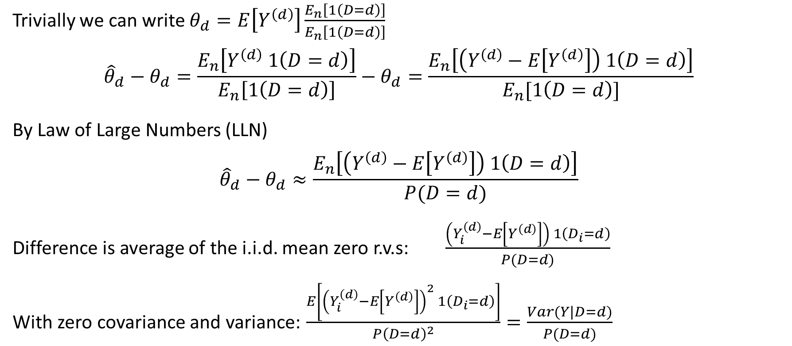
Proof Sketch
Trivially we can write $θ_{d}=E\left[Y^{\left(d\right)}\right]\frac{E_{n}\left[1\left(D=d\right)\right]}{E_{n}\left[1\left(D=d\right)\right]}$
$${\hat{θ}}_{d}−θ_{d}=\frac{E_{n}\left[Y^{\left(d\right)} 1\left(D=d\right)\right]}{E_{n}\left[1\left(D=d\right)\right]}−θ_{d}=\frac{E_{n}\left[\left(Y^{\left(d\right)}−E\left[Y^{\left(d\right)}\right]\right) 1\left(D=d\right)\right]}{E_{n}[1\left(D=d\right)]}$$
By Law of Large Numbers (LLN)
$${\hat{θ}}_{d}−θ_{d}≈\frac{E_{n}\left[\left(Y^{\left(d\right)}−E\left[Y^{\left(d\right)}\right]\right) 1\left(D=d\right)\right]}{P(D=d)}$$
Difference is average of the i.i.d. mean zero r.v.s: $\frac{\left(Y_{i}^{\left(d\right)}−E\left[Y^{\left(d\right)}\right]\right) 1\left(D_{i}=d\right)}{P(D=d)}$
With zero covariance and variance: $\frac{E\left[{\left(Y_{i}^{\left(d\right)}−E\left[Y^{\left(d\right)}\right]\right)}^{2} 1\left(D_{i}=d\right)\right]}{P{\left(D=d\right)}^{2}}=\frac{Var(Y|D=d)}{P(D=d)}$
Statement follows by Central Limit Theorem (CLT)

Slide 25
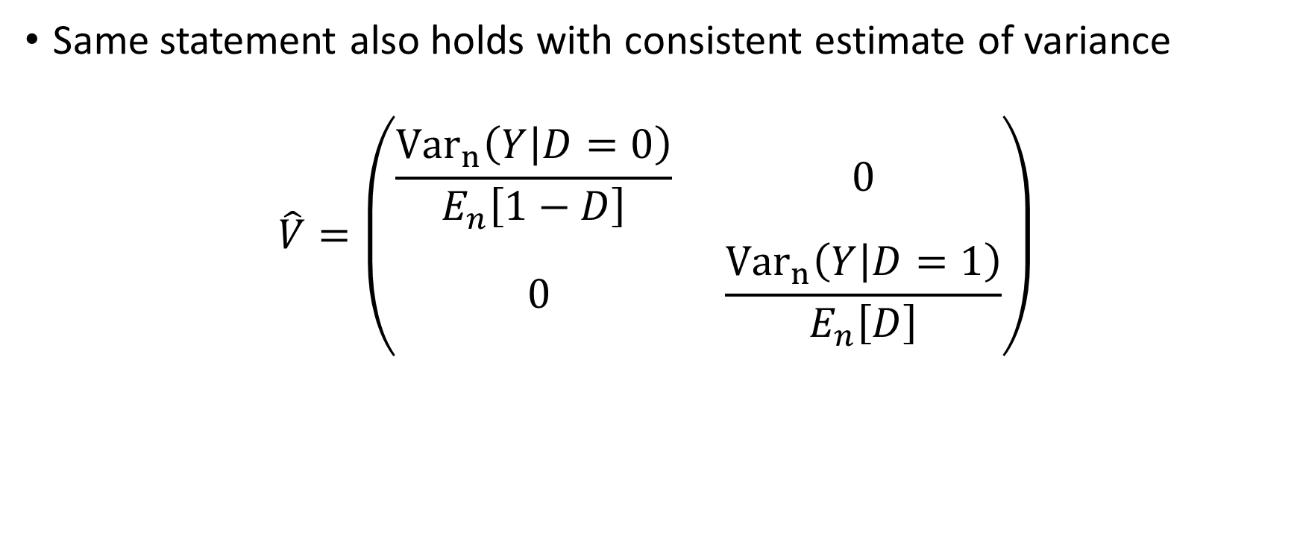
Variance estimate
Same statement also holds with consistent estimate of variance
$$\hat{V}=\left(\begin{matrix}\frac{{Var}_{n}\left(Y | D=0\right)}{E_{n}\left[1−D\right]} & 0 \\ 0 & \frac{{Var}_{n}\left(Y | D=1\right)}{E_{n}\left[D\right]}\end{matrix}\right)$$

Slide 26
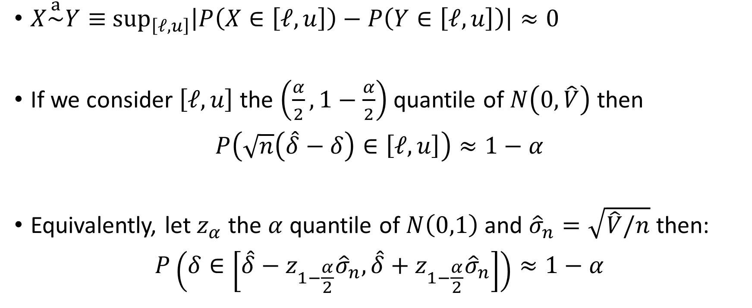
Confidence Interval
$X\overset{a}{\sim }Y≡$ $\sup_{\left[ℓ,u\right]}\left|P\left(X∈\left[ℓ,u\right]\right)−P\left(Y∈\left[ℓ,u\right]\right)\right|≈0$
If we consider $\left[ℓ, u\right]$ the $\left(\frac{α}{2},1−\frac{α}{2}\right)$ quantile of $N\left(0, \hat{V}\right)$ then
$$P\left(\sqrt{n}\left(\hat{δ}−δ\right)∈\left[ℓ,u\right]\right)≈1−α$$
Equivalently, let $z_{α}$ the $α$ quantile of $N\left(0,1\right)$ and ${\hat{σ}}_{n}=\sqrt{\hat{V}/n}$ then:
$$P\left(δ∈\left[\hat{δ}−z_{1−\frac{α}{2}}{\hat{σ}}_{n},\hat{δ}+z_{1−\frac{α}{2}}{\hat{σ}}_{n}\right]\right)≈1−α$$
Standard error

Slide 27
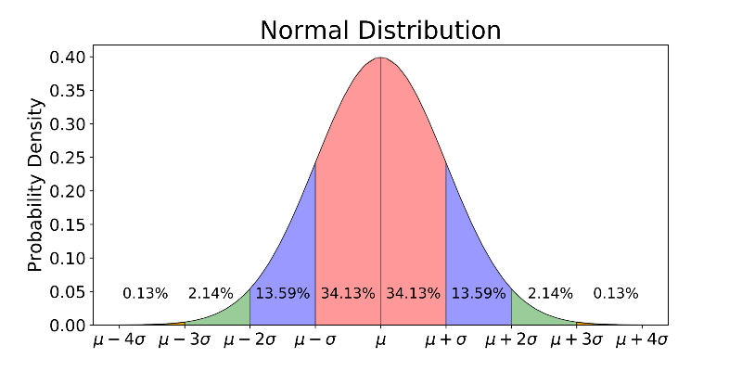









Confidence Interval
$$\hat{δ}−4{\hat{σ}}_{n}$$
$$\hat{δ}−3{\hat{σ}}_{n}$$
$$\hat{δ}−2{\hat{σ}}_{n}$$
$$\hat{δ}−{\hat{σ}}_{n}$$
$$\hat{δ}$$
$$\hat{δ}+{\hat{σ}}_{n}$$
$$\hat{δ}+2{\hat{σ}}_{n}$$
$$\hat{δ}+3{\hat{σ}}_{n}$$
$$\hat{δ}+4{\hat{σ}}_{n}$$
95% CI $≈\left[\hat{δ}−1.96 {\hat{σ}}_{n}, \hat{δ}+1.96 {\hat{σ}}_{n}\right]$
Let’s try it out!

Slide 28

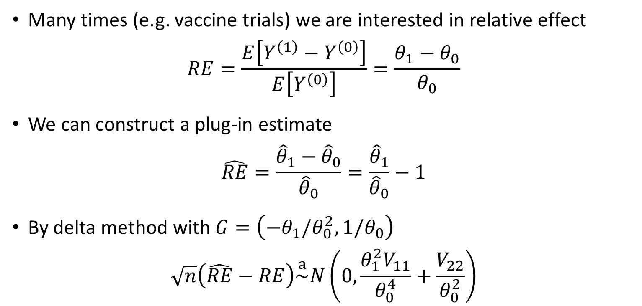
Relative effect
Many times (e.g. vaccine trials) we are interested in relative effect
$$RE=\frac{E\left[Y^{\left(1\right)}−Y^{\left(0\right)}\right]}{E\left[Y^{\left(0\right)}\right]}=\frac{θ_{1}−θ_{0}}{θ_{0}}$$
We can construct a plug-in estimate
$$\hat{RE}=\frac{{\hat{θ}}_{1}−{\hat{θ}}_{0}}{{\hat{θ}}_{0}}=\frac{{\hat{θ}}_{1}}{{\hat{θ}}_{0}}−1$$
By delta method with $G=\left(−θ_{1}/θ_{0}^{2},1/θ_{0}\right)$
$$\sqrt{n}\left(\hat{RE}−RE\right)\overset{a}{\sim }N\left(0,\frac{θ_{1}^{2}V_{11}}{θ_{0}^{4}}+\frac{V_{22}}{θ_{0}^{2}}\right)$$
Delta method: for any function $f$, with $G=∇f\left(θ\right)$
$$\sqrt{n}\left(f\left(\hat{θ}\right)−f\left(θ\right)\right)≈G \sqrt{n}\left(\hat{θ}−θ\right)\overset{a}{\sim }N\left(0, G^{′}VG\right)$$

Slide 29
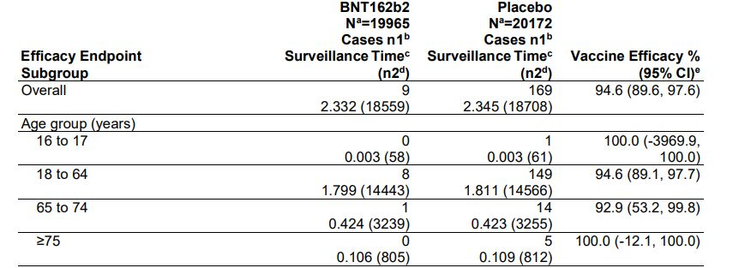
Example: Pfizer Vaccine

Slide 30
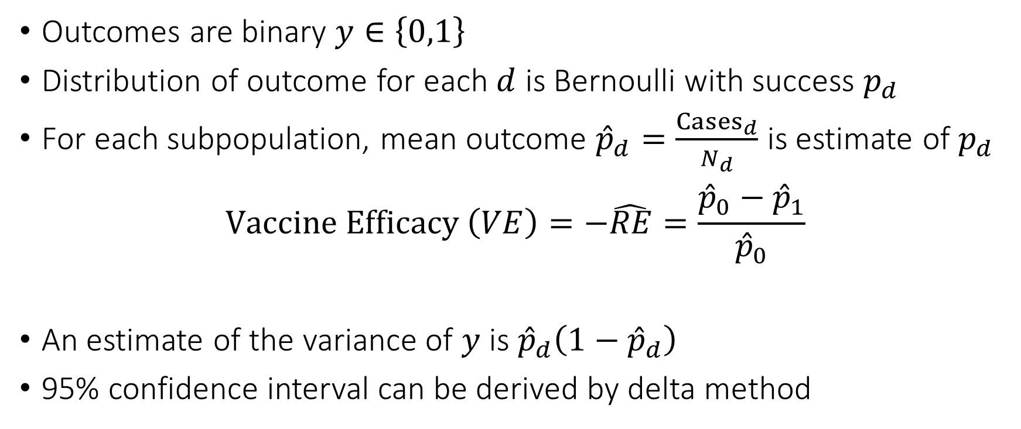
Approximate Confidence Interval
Outcomes are binary $y∈\left\{0,1\right\}$
Distribution of outcome for each $d$ is Bernoulli with success $p_{d}$
For each subpopulation, mean outcome ${\hat{p}}_{d}=\frac{{Cases}_{d}}{N_{d}}$ is estimate of $p_{d}$
$$Vaccine Efficacy \left(VE\right)=−\hat{RE}=\frac{{\hat{p}}_{0}−{\hat{p}}_{1}}{{\hat{p}}_{0}}$$
An estimate of the variance of $y$ is ${\hat{p}}_{d}\left(1−{\hat{p}}_{d}\right)$
95% confidence interval can be derived by delta method
Let’s try it out!

Slide 31
Pre-Treatment Covariates
Heterogeneity, Checks, and Precision

Slide 32
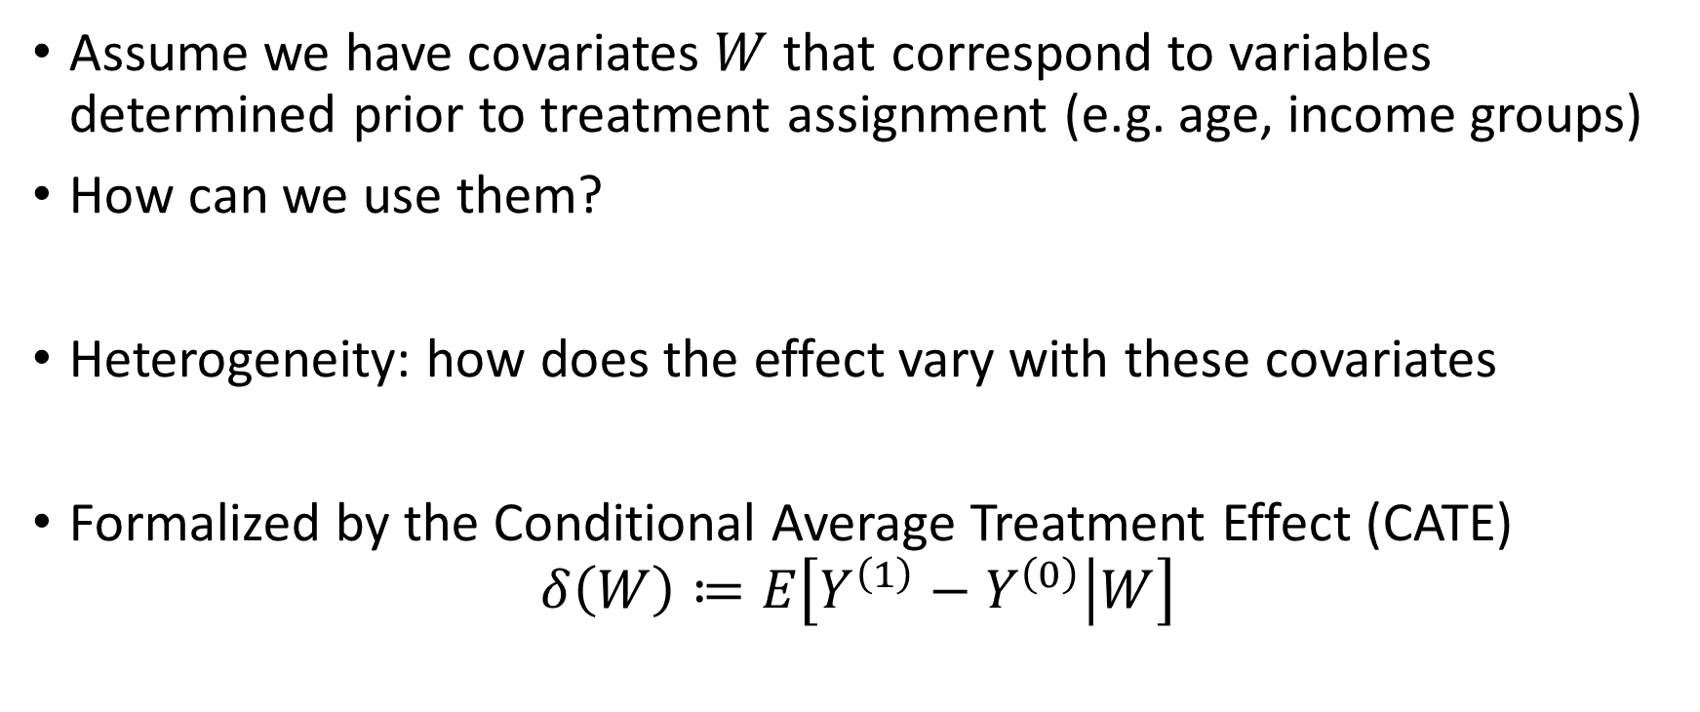
Pre-Treatment Covariates
Assume we have covariates $W$ that correspond to variables determined prior to treatment assignment (e.g. age, income groups)
How can we use them?
Heterogeneity: how does the effect vary with these covariates
Formalized by the Conditional Average Treatment Effect (CATE)
$$δ\left(W\right)≔E\left[Y^{\left(1\right)}−Y^{\left(0\right)} | W\right]$$

Slide 33
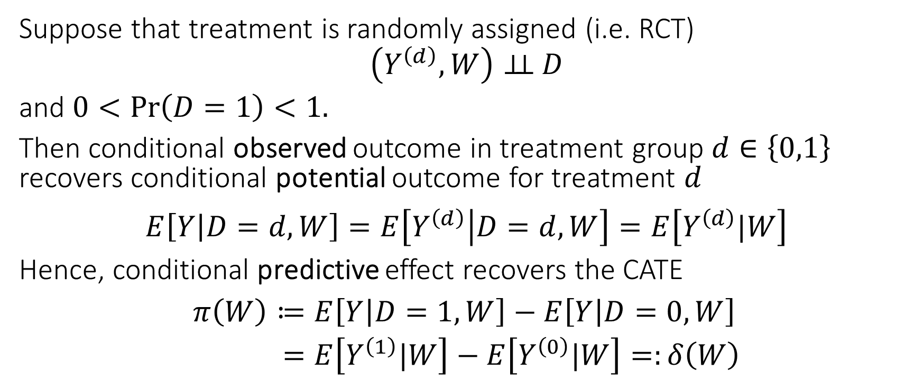
Identification of CATE under Random Assignment
Suppose that treatment is randomly assigned (i.e. RCT)
$$\left(Y^{\left(d\right)},W\right)⊥⊥ D$$
and $0<\operatorname{Pr}\left(D=1\right)<1.$
Then conditional observed outcome in treatment group $d∈\left\{0,1\right\}$ recovers conditional potential outcome for treatment $d$
$$E\left[Y | D=d,W\right]=E\left[Y^{\left(d\right)} | D=d,W\right]=E\left[Y^{\left(d\right)}|W\right]$$
Hence, conditional predictive effect recovers the CATE
$$\begin{aligned}π\left(W\right)≔&E\left[Y | D=1,W\right]−E\left[Y | D=0,W\right] \\ =&E\left[Y^{\left(1\right)}|W\right]−E\left[Y^{\left(0\right)}|W\right]=:δ\left(W\right)\end{aligned}$$

Slide 34
If we only care about ATE are co-variates useful?

Slide 35
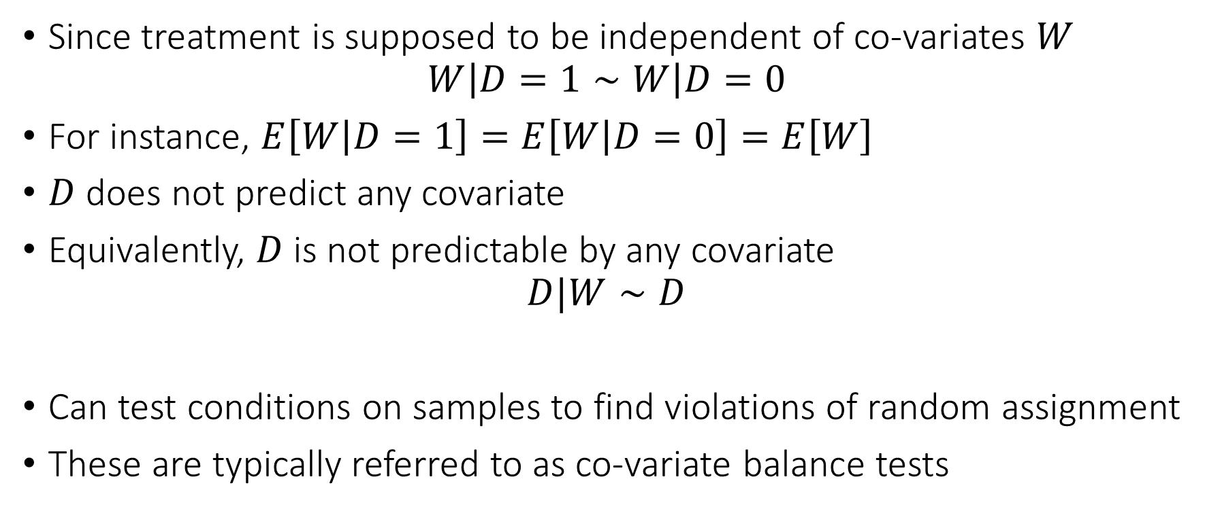
Co-variates for Sanity Check
Since treatment is supposed to be independent of co-variates $W$
$$W\left|D=1∼W\right|D=0$$
For instance, $E\left[W | D=1\right]=E\left[W | D=0\right]=E\left[W\right]$
$D$ does not predict any covariate
Equivalently, $D$ is not predictable by any covariate
$$D|W∼D$$
Can test conditions on samples to find violations of random assignment
These are typically referred to as co-variate balance tests

Slide 36
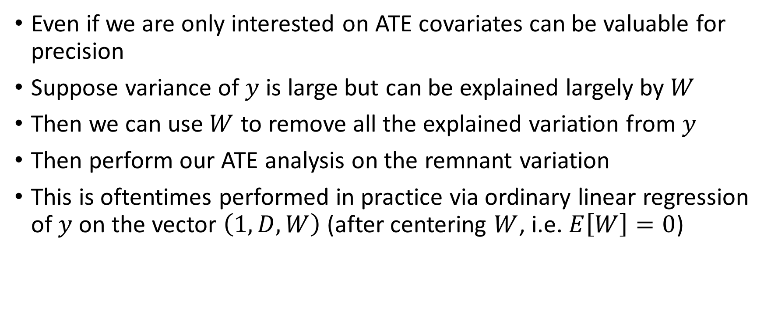
Co-variates for Precision
Even if we are only interested on ATE covariates can be valuable for precision
Suppose variance of $y$ is large but can be explained largely by $W$
Then we can use $W$ to remove all the explained variation from $y$
Then perform our ATE analysis on the remnant variation
This is oftentimes performed in practice via ordinary linear regression of $y$ on the vector $\left(1, D, W\right)$ (after centering $W$, i.e. $E\left[W\right]=0$)

Slide 37
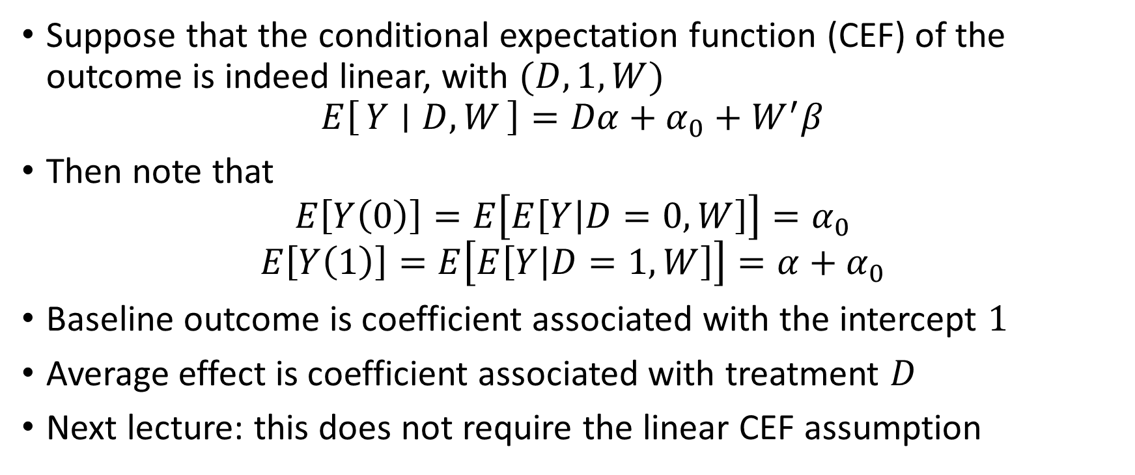
Is this consistent?
Suppose that the conditional expectation function (CEF) of the outcome is indeed linear, with $(D,1,W)$
$$E\left[Y ∣ D, W\right]=Dα+α_{0}+W^{′}β$$
Then note that
$$E\left[Y\left(0\right)\right]=E\left[E\left[Y | D=0,W\right]\right]=α_{0}$$
$$E\left[Y\left(1\right)\right]=E\left[E\left[Y | D=1, W\right]\right]=α+α_{0}$$
Baseline outcome is coefficient associated with the intercept $1$
Average effect is coefficient associated with treatment $D$
Next lecture: this does not require the linear CEF assumption

Slide 38
Analysis of Variance (ANOVA)
Sneak peek into some material from next lecture

Slide 39
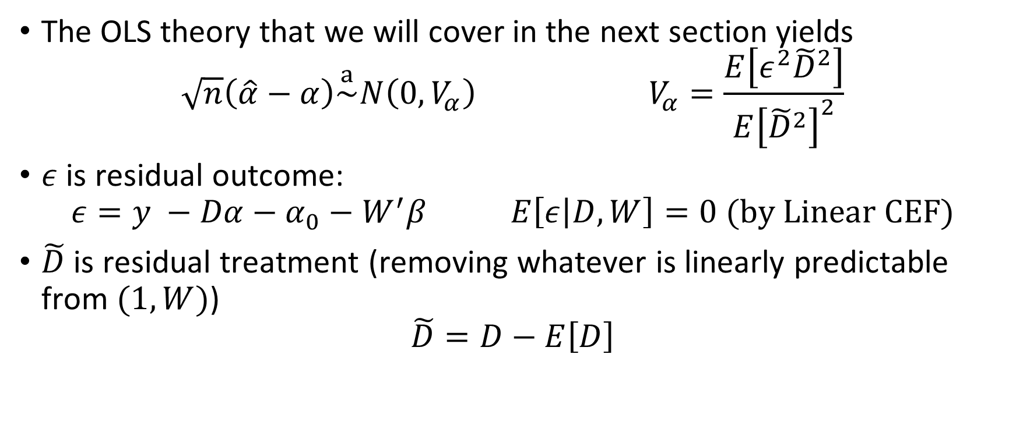
Variance of Estimate
The OLS theory that we will cover in the next section yields
$$\sqrt{n}\left(\hat{α}−α\right)\overset{a}{\sim }N\left(0, V_{α}\right) V_{α}=\frac{E\left[ε^{2}{\tilde{D}}^{2}\right]}{E{\left[{\tilde{D}}^{2}\right]}^{2}}$$
$ε$ is residual outcome:
$$ε=y −Dα−α_{0}−W^{′}β E\left[ε | D,W\right]=0 (by Linear CEF)$$
$\tilde{D}$ is residual treatment (removing whatever is linearly predictable from $(1, W)$)
$$\tilde{D}=D−E\left[D\right]$$

Slide 40

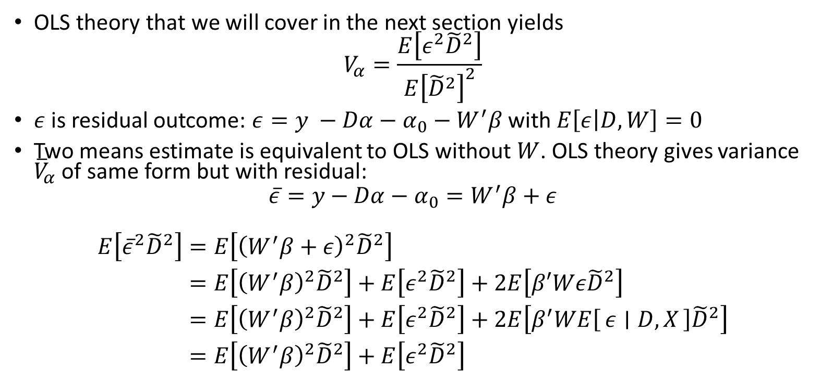
Variance without adjustment
OLS theory that we will cover in the next section yields
$$V_{α}=\frac{E\left[ε^{2}{\tilde{D}}^{2}\right]}{E{\left[{\tilde{D}}^{2}\right]}^{2}}$$
$ε$ is residual outcome: $ε=y −Dα−α_{0}−W^{′}β$ with $E\left[ε | D,W\right]=0$
Two means estimate is equivalent to OLS without $W$. OLS theory gives variance ${\overline{V}}_{α}$ of same form but with residual:
$$\overline{ε}=y−Dα−α_{0}=W^{′}β+ε$$
$$\begin{aligned}E\left[{\overline{ε}}^{2}{\tilde{D}}^{2}\right]=&E\left[{\left(W^{′}β+ε\right)}^{2}{\tilde{D}}^{2}\right] \\ =&E\left[{\left(W^{′}β\right)}^{2}{\tilde{D}}^{2}\right]+E\left[ε^{2}{\tilde{D}}^{2}\right]+2E\left[β′Wε{\tilde{D}}^{2}\right] \\ =&E\left[{\left(W^{′}β\right)}^{2}{\tilde{D}}^{2}\right]+E\left[ε^{2}{\tilde{D}}^{2}\right]+2E\left[β^{′}WE\left[ε ∣ D,X\right]{\tilde{D}}^{2}\right] \\ =&E\left[{\left(W^{′}β\right)}^{2}{\tilde{D}}^{2}\right]+E\left[ε^{2}{\tilde{D}}^{2}\right]\end{aligned}$$
$${\overline{V}}_{α}≥V_{α}$$
Variance of OLS estimate with extra co-variates (adjusted) is weakly smaller than two-means estimate (un-adjusted)

Slide 41
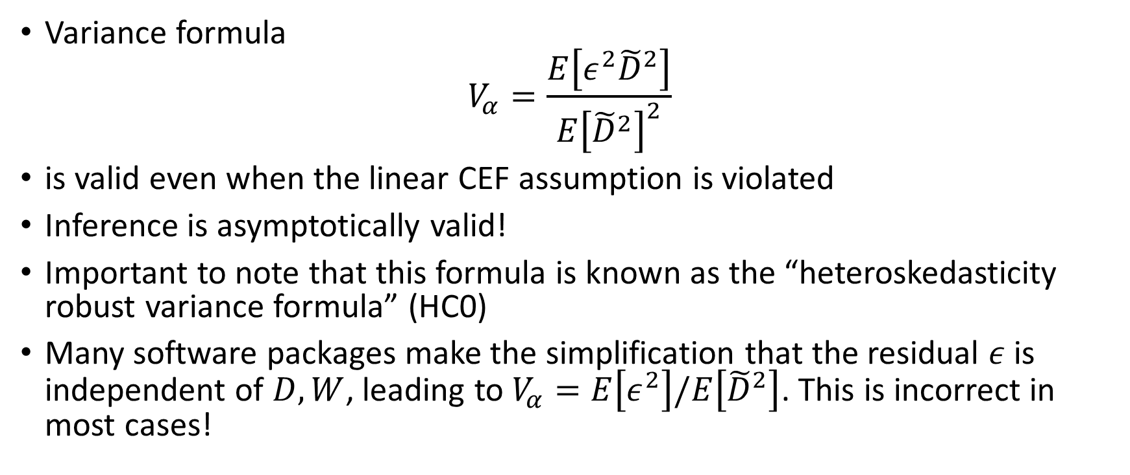

Heteroskedasticity Robust Variance
Variance formula
$$V_{α}=\frac{E\left[ε^{2}{\tilde{D}}^{2}\right]}{E{\left[{\tilde{D}}^{2}\right]}^{2}}$$
is valid even when the linear CEF assumption is violated
Inference is asymptotically valid!
Important to note that this formula is known as the “heteroskedasticity robust variance formula” (HC0)
Many software packages make the simplification that the residual $ε$ is independent of $D,W$, leading to $V_{α}=E\left[ε^{2}\right]/E\left[{\tilde{D}}^{2}\right]$. This is incorrect in most cases!

Slide 42

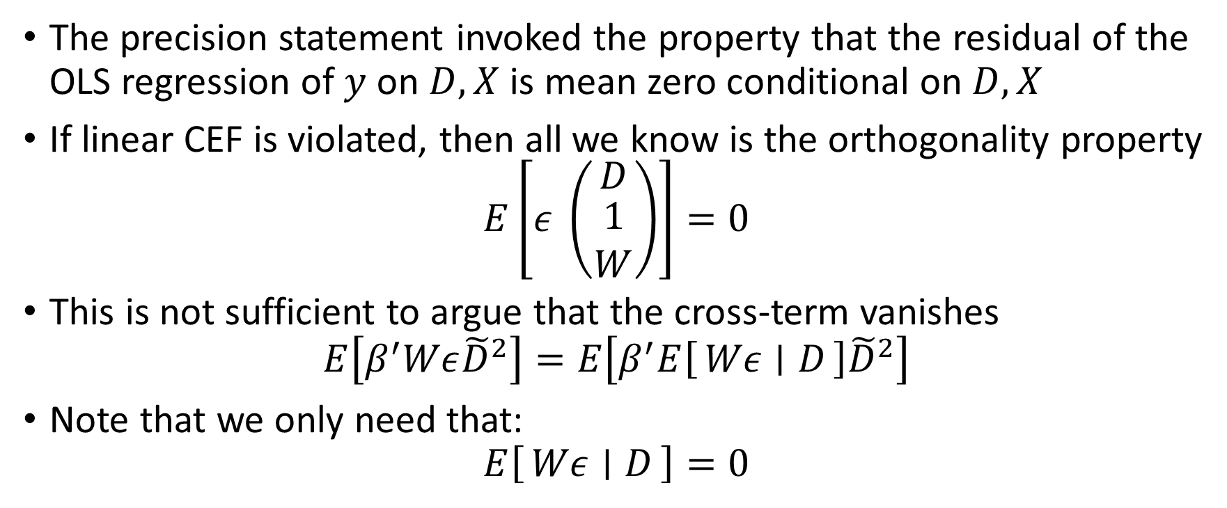

Precision Beyond Linear CEF
The precision statement invoked the property that the residual of the OLS regression of $y$ on $D,X$ is mean zero conditional on $D, X$
If linear CEF is violated, then all we know is the orthogonality property
$$E\left[ε \left(\begin{matrix}D \\ \begin{aligned}1 \\ W\end{aligned}\end{matrix}\right)\right]=0$$
This is not sufficient to argue that the cross-term vanishes
$$E\left[β^{′}Wε{\tilde{D}}^{2}\right]=E\left[β^{′}E\left[Wε ∣ D\right]{\tilde{D}}^{2}\right]$$
Note that we only need that:
$$E\left[Wε ∣ D\right]=0$$
FOC of: $\min_{α,α_{0},β}{E\left[{\left(y−Dα−α_{0}−W^{′}β\right)}^{2}\right]}$
Let’s try it out!

Slide 43
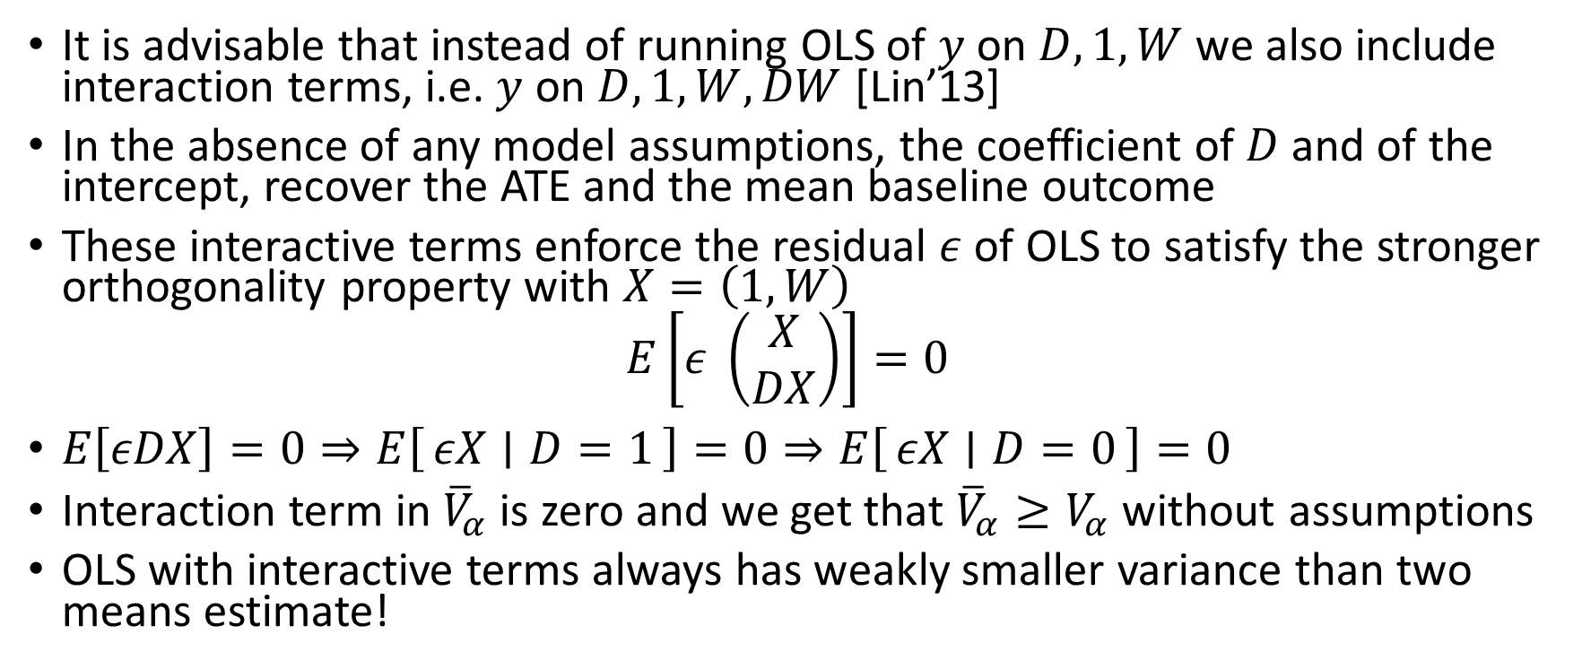
OLS with Interactive Terms
It is advisable that instead of running OLS of $y$ on $D, 1,W$ we also include interaction terms, i.e. $y$ on $D, 1, W,DW$ [Lin’13]
In the absence of any model assumptions, the coefficient of $D$ and of the intercept, recover the ATE and the mean baseline outcome
These interactive terms enforce the residual $ε$ of OLS to satisfy the stronger orthogonality property with $X=\left(1,W\right)$
$$E\left[ε \left(\begin{matrix}X \\ DX\end{matrix}\right)\right]=0$$
$E\left[εDX\right]=0⇒E\left[εX ∣ D=1\right]=0⇒E\left[εX ∣ D=0\right]=0$
Interaction term in ${\overline{V}}_{α}$ is zero and we get that ${\overline{V}}_{α}≥V_{α}$ without assumptions
OLS with interactive terms always has weakly smaller variance than two means estimate!
Let’s try it out!

Slide 44
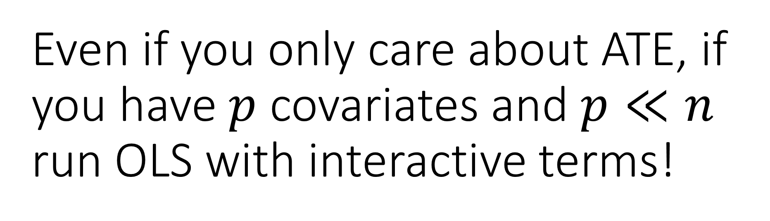
Even if you only care about ATE, if you have $p$ covariates and $p≪n$ run OLS with interactive terms!
Guaranteed improved precision, plus can uncover potential dimensions of heterogeneity

Slide 45
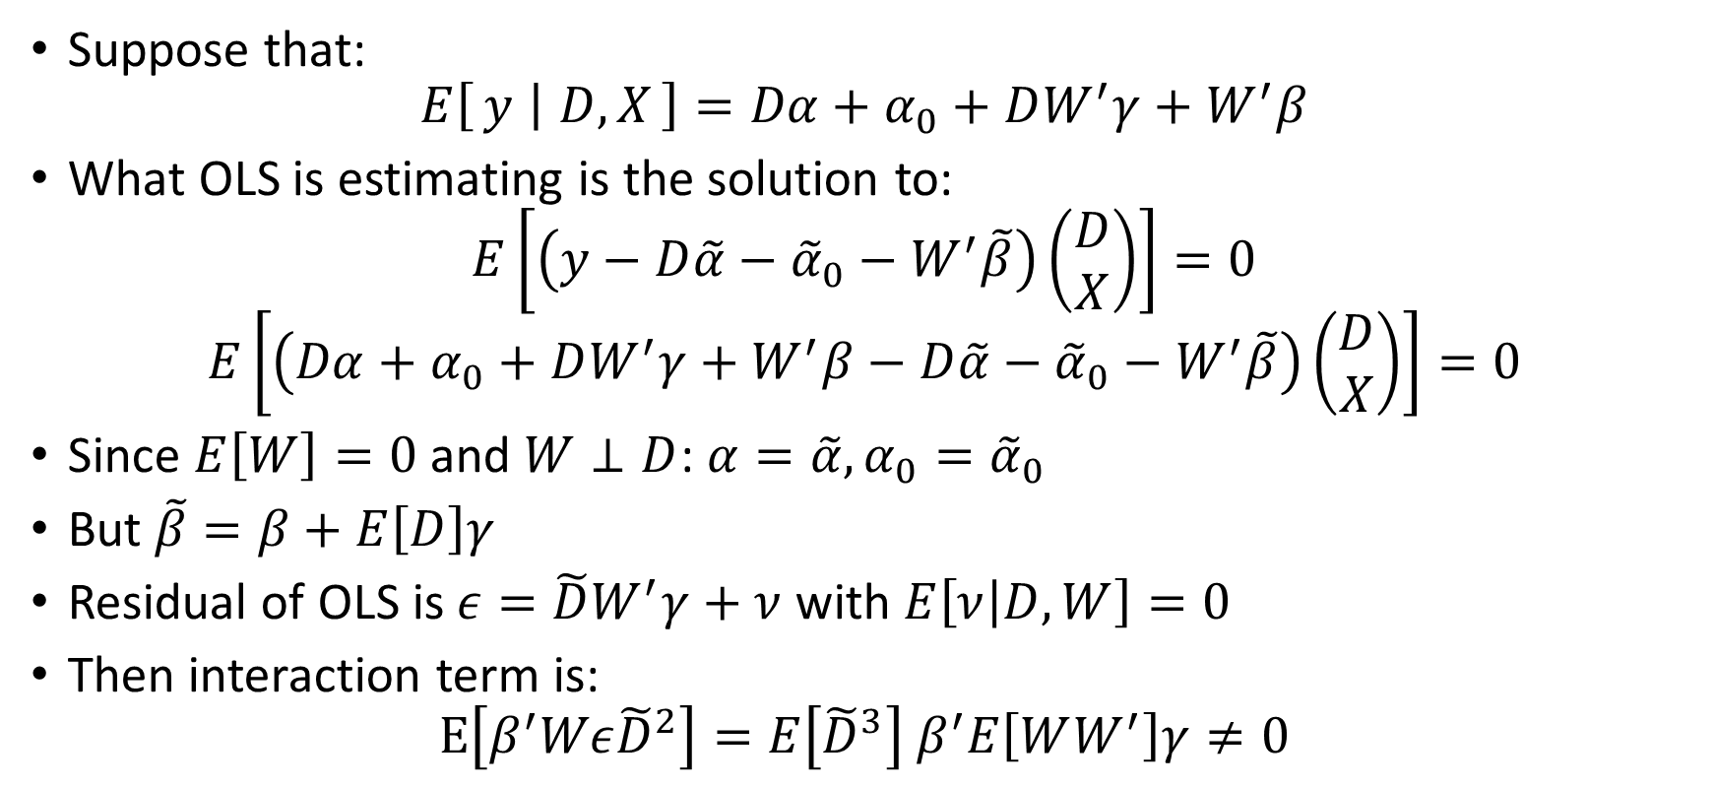
Example: Heterogeneous Effects
effect modifier
ATE
Suppose that:
$$E\left[y ∣ D,X\right]=Dα+α_{0}+DW^{′}γ+W^{′}β$$
What OLS is estimating is the solution to:
$$E\left[\left(y−D\tilde{α}−{\tilde{α}}_{0}−W^{′}\tilde{β}\right)\left(\begin{matrix}D \\ X\end{matrix}\right)\right]=0$$
$$E\left[\left(Dα+α_{0}+DW^{′}γ+W^{′}β−D\tilde{α}−{\tilde{α}}_{0}−W^{′}\tilde{β}\right)\left(\begin{matrix}D \\ X\end{matrix}\right)\right]=0$$
Since $E\left[W\right]=0$ and $W⊥D$: $α=\tilde{α},α_{0}={\tilde{α}}_{0}$
But $\tilde{β}=β+E\left[D\right]γ$
Residual of OLS is $ε=\tilde{D}W^{′}γ+ν$ with $E\left[ν | D,W\right]=0$
Then interaction term is:
$$E\left[β^{′}Wε{\tilde{D}}^{2}\right]=E\left[{\tilde{D}}^{3}\right] β^{′}E\left[WW^{′}\right]γ≠0$$

