Slide 1
MS&E 228: Causality in Observational Data
Vasilis Syrgkanis
MS&E, Stanford

Slide 2
Causal Inference with Experiments
Prediction with Linear Models
Prediction with High-Dim Linear Models
Inference on Causal and Predictive Effects with High-Dim Linear Models
Potential Outcomes and Conditional Ignorability
Structural Equation Models and Conditional Exogeneity
Directed Acyclic Graphs
Prediction with Non-Linear Models
Inference on Causal Effects with Non-Linear Models
Un-observed Confounding and Instruments
Identification of Causal Effects in Longitudinal Data
Estimation of Heterogeneous Causal Effects
Linear Predictive Models and Statistical Inference
Causal Identification in Observational Data
Non-Linear Predictive Models and Statistical Inference
Topics

Slide 3
Causal Inference with Experiments
Prediction with Linear Models
Prediction with High-Dim Linear Models
Inference on Causal and Predictive Effects with High-Dim Linear Models
Potential Outcomes and Conditional Ignorability
Structural Equation Models and Conditional Exogeneity
Directed Acyclic Graphs
Prediction with Non-Linear Models
Inference on Causal Effects with Non-Linear Models
Un-observed Confounding and Instruments
Identification of Causal Effects in Longitudinal Data
Estimation of Heterogeneous Causal Effects
Linear Predictive Models and Statistical Inference
Causal Identification in Observational Data
Non-Linear Predictive Models and Statistical Inference
Topics

Slide 4
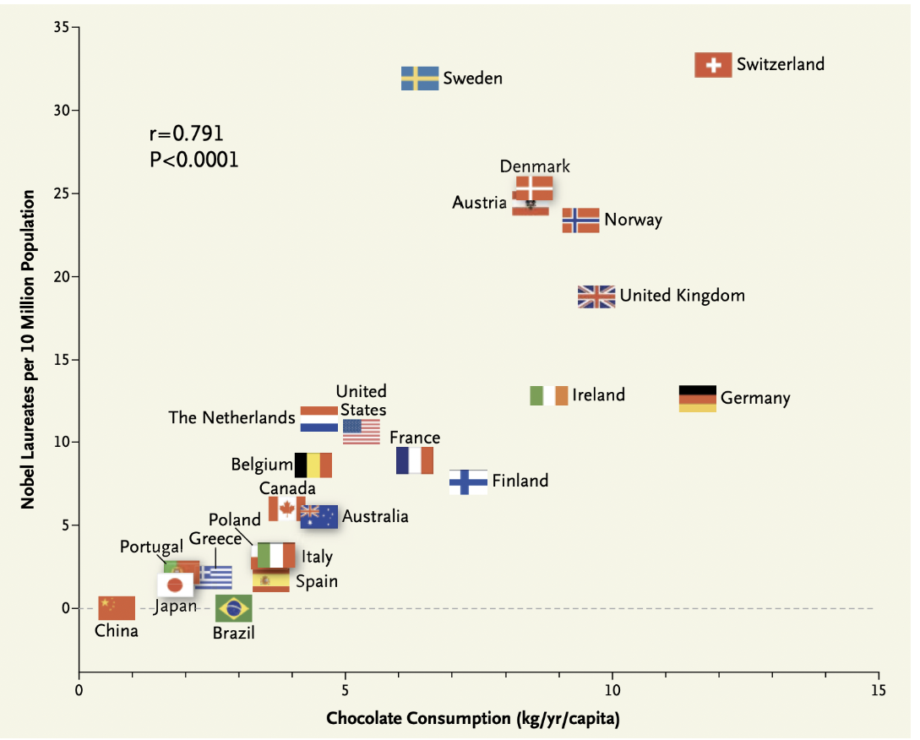

Slide 5
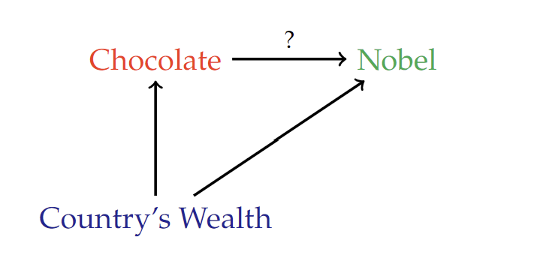

Slide 6
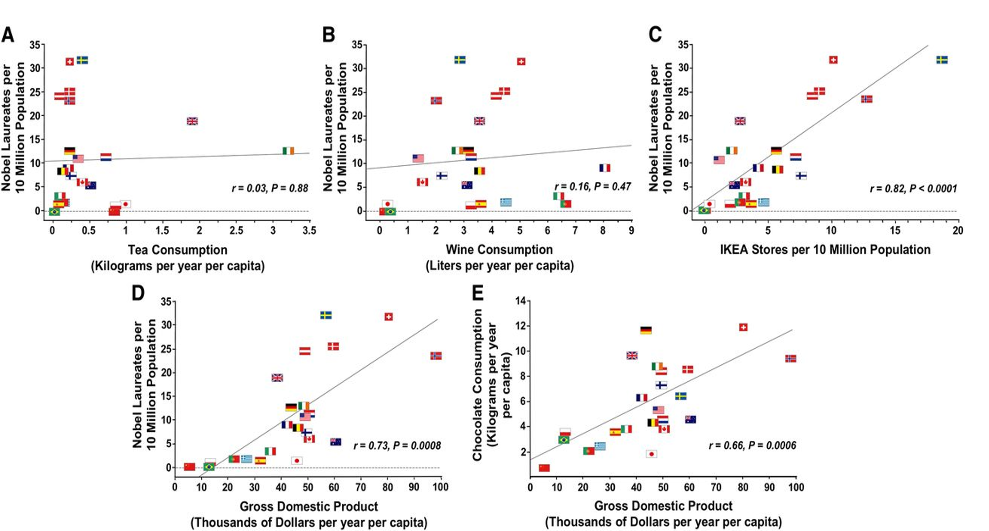

Slide 8
Through the Lens of Potential Outcomes

Slide 9




$$Y^{\left(0\right)}$$
$$Y|D=0$$
$$Y|D=1$$
$$Y^{\left(1\right)}$$
Counterfactual World
Observed World
Counterfactual World

Slide 10










$$X=1$$
$$Y^{\left(0\right)}$$
$$≠$$
$$Y|D=0$$
$$Y|D=1$$
$$≠$$
$$Y^{\left(1\right)}$$
$$X=0$$
$$P\left(D=0 | X=1\right)=1/4$$
$$P\left(D=1 | X=1\right)=3/4$$
$$P\left(D=0 | X\right)$$
$$P\left(D=1 | X\right)$$
Selection based on X
Selection based on X
$$P\left(D=0 | X=1\right)=3/4$$
$$P\left(D=1 | X=1\right)=1/4$$
Counterfactual World
Observed World
Counterfactual World

Slide 11











$$Y^{\left(0\right)}$$
$$Y^{\left(0\right)}|X$$
$$∼$$
$$Y|D=0, X$$
$$Y|D=0$$
$$Y|D=1$$
$$Y|D=1,X$$
$$∼$$
$$Y^{\left(1\right)}|X$$
$$Y^{\left(1\right)}$$
$$P\left(D=0 | X=1\right)=1/4$$
$$P\left(D=1 | X=1\right)=3/4$$
$$X=1$$
$$P\left(D=0 | X\right)$$
$$P\left(D=1 | X\right)$$
Selection based on X
Selection based on X
$$X=0$$
$$P\left(D=0 | X=1\right)=3/4$$
$$P\left(D=1 | X=1\right)=1/4$$
Counterfactual World
Observed World
Counterfactual World

Slide 12



$$Y^{\left(0\right)}$$
$$Y^{\left(0\right)}|X$$
$$\sim$$
$$Y|D=0, X$$
$$Y|D=1,X$$
$$\sim$$
$$Y^{\left(1\right)}|X$$
$$Y^{\left(1\right)}$$
$$P\left(D=0 | X=1\right)=1/4$$
$$P\left(D=1 | X=1\right)=3/4$$
$$X=1$$
$$P\left(D=0 | X\right)$$
$$P\left(D=1 | X\right)$$
Selection based on X
Selection based on X
$$X=0$$
$$P\left(D=0 | X=1\right)=3/4$$
$$P\left(D=1 | X=1\right)=1/4$$
Counterfactual World
Observed World
Counterfactual World

Slide 13

Conditional Ignorability
For sub-populations with the same $X$, treatment is assigned as if RCT
$$Y^{d}⊥⊥ D | X$$

Slide 14
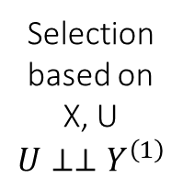
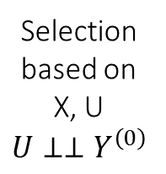
$$Y^{\left(0\right)}$$
$$Y^{\left(0\right)}|X$$
$$\sim$$
$$Y|D=0, X$$
$$Y|D=1,X$$
$$\sim$$
$$Y^{\left(1\right)}|X$$
$$Y^{\left(1\right)}$$
$$X=1$$
Selection based on X, U
$$U⊥⊥Y^{\left(0\right)}$$
Selection based on X, U
$$U⊥⊥Y^{\left(1\right)}$$
$$X=0$$
Counterfactual World
Observed World
Counterfactual World

Slide 15
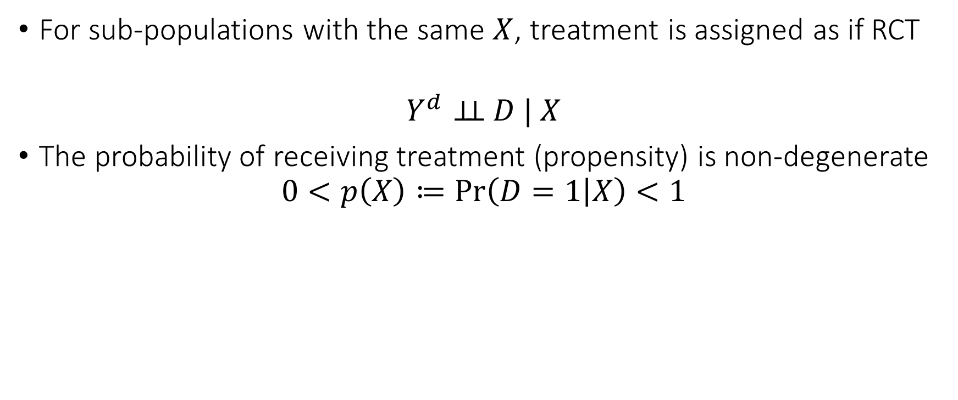
Conditional Ignorability
For sub-populations with the same $X$, treatment is assigned as if RCT
$$Y^{d}⊥⊥ D | X$$
The probability of receiving treatment (propensity) is non-degenerate
$$0<p\left(X\right)≔\operatorname{Pr}\left(D=1 | X\right)<1$$

Slide 16
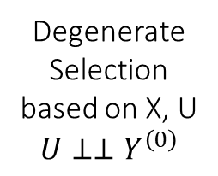
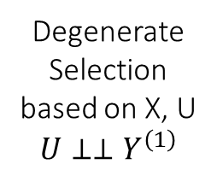
$$Y^{\left(0\right)}$$
$$Y^{\left(0\right)}|X$$
$$\sim$$
$$Y|D=0, X$$
$$Y|D=1,X$$
$$\sim$$
$$Y^{\left(1\right)}|X$$
$$Y^{\left(1\right)}$$
$$X=1$$
Degenerate Selection based on X, U
$$U⊥⊥Y^{\left(0\right)}$$
Degenerate Selection based on X, U
$$U⊥⊥Y^{\left(1\right)}$$
$$X=0$$
Counterfactual World
Observed World
Counterfactual World

Slide 17
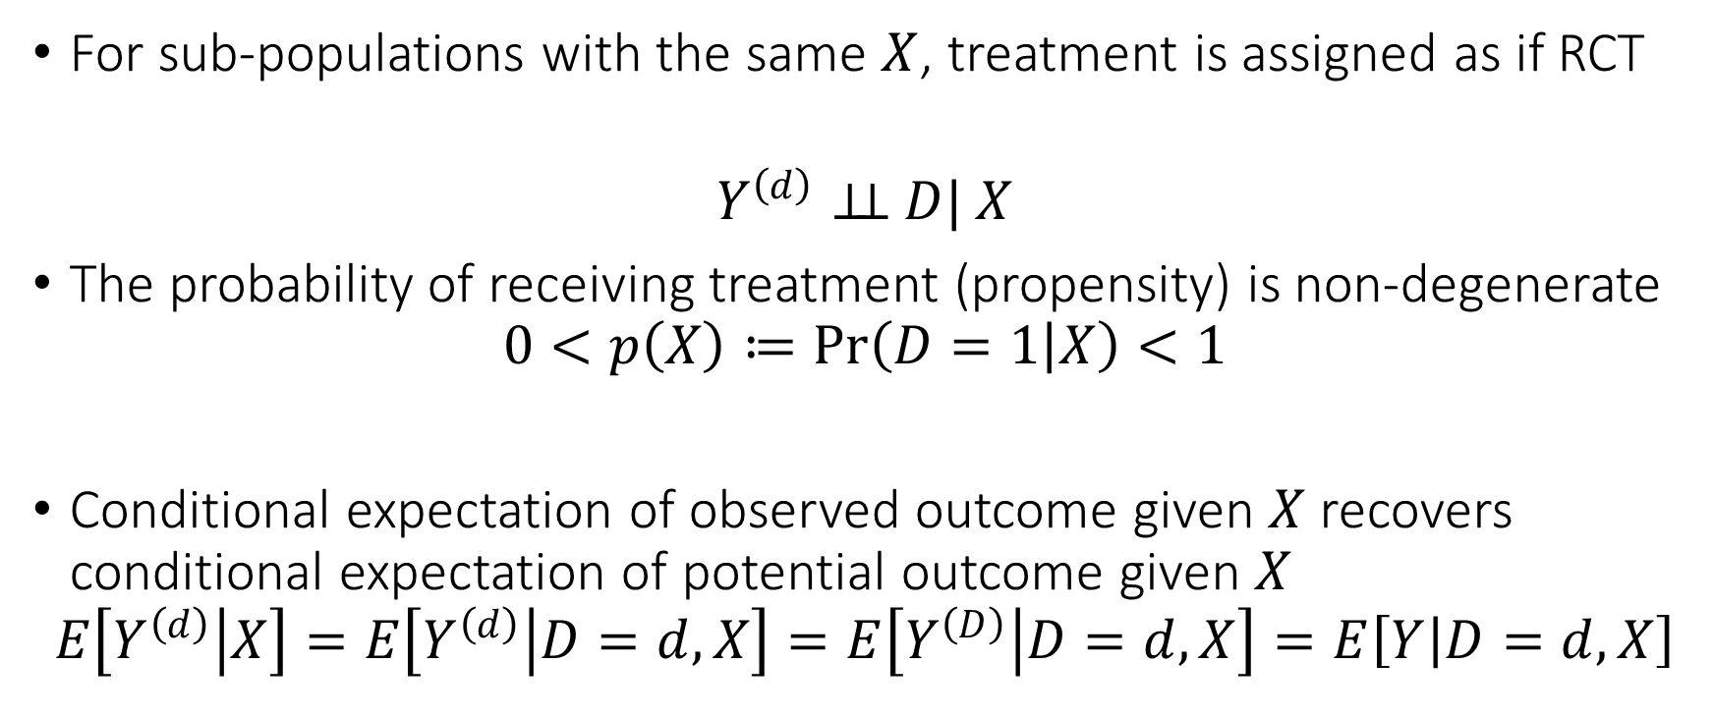
Conditional Ignorability
For sub-populations with the same $X$, treatment is assigned as if RCT
$$Y^{\left(d\right)}⊥⊥ D| X$$
The probability of receiving treatment (propensity) is non-degenerate
$$0<p\left(X\right)≔\operatorname{Pr}\left(D=1 | X\right)<1$$
Conditional expectation of observed outcome given $X$ recovers conditional expectation of potential outcome given $X$
$$E\left[Y^{\left(d\right)} | X\right]=E\left[Y^{\left(d\right)} | D=d,X\right]=E\left[Y^{\left(D\right)} | D=d,X\right]=E\left[Y | D=d,X\right]$$

Slide 18
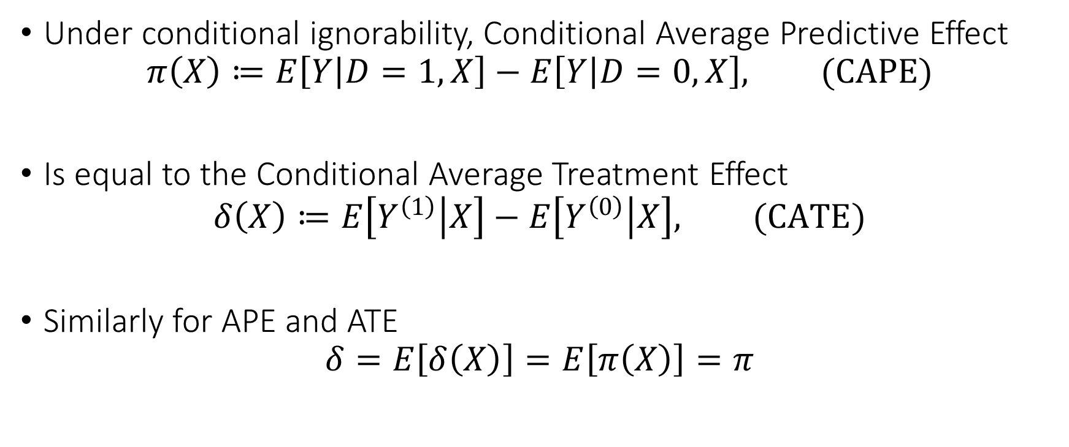
Identification of Conditional Average Treatment Effect
Under conditional ignorability, Conditional Average Predictive Effect
$$π\left(X\right)≔E\left[Y | D=1,X\right]−E\left[Y | D=0,X\right], (CAPE)$$
Is equal to the Conditional Average Treatment Effect
$$δ\left(X\right)≔E\left[Y^{\left(1\right)} | X\right]−E\left[Y^{\left(0\right)} | X\right], (CATE)$$
Similarly for APE and ATE
$$δ=E\left[δ\left(X\right)\right]=E\left[π\left(X\right)\right]=π$$

Slide 19

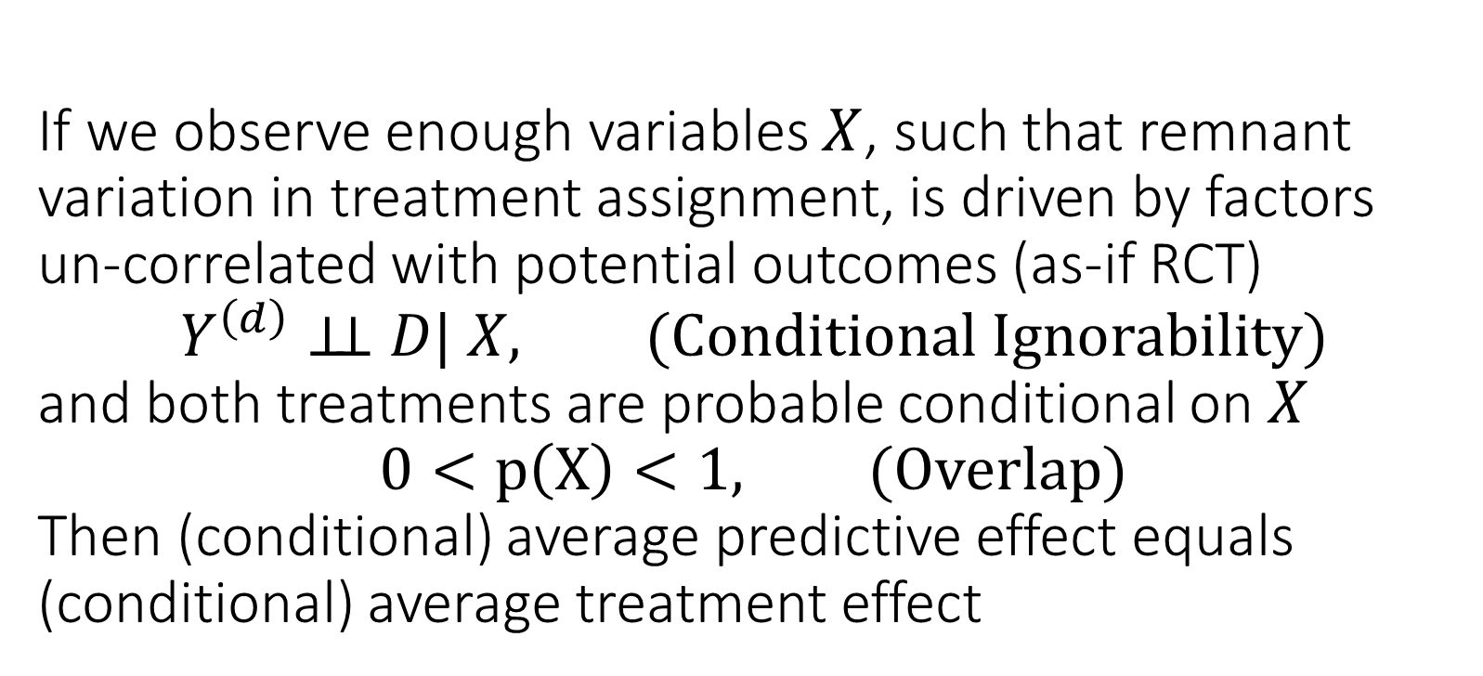
If we observe enough variables $X$, such that remnant variation in treatment assignment, is driven by factors un-correlated with potential outcomes (as-if RCT) $$Y^{\left(d\right)}⊥⊥ D| X, (Conditional Ignorability)$$ and both treatments are probable conditional on $X$ $$0<p\left(X\right)<1, (Overlap)$$ Then (conditional) average predictive effect equals (conditional) average treatment effect

Slide 20

$$E\left[Y^{\left(1\right)}−Y^{\left(0\right)}\right]=E\left[E\left[Y | D=1,X\right]−E\left[Y | D=0,X\right]\right]$$
Identification by Conditioning
Quantity involving variables observed only in the counterfactual worlds
Quantities involving only variables observed in the data
Identification

Slide 21
Causal Diagrams

Slide 22








RCTs and Causal Diagrams
Causal diagrams can help visualize how our assumptions imply the identification of a causal effect
First instances in work of Sewall and Philip Wright’28
Pioneered and fully developed by Pearl and Robins [80s-90s]
$$D$$
Easy to visualize that
$$Y^{\left(d\right)}⊥⊥ D$$
$$D$$
$$d$$
$$X$$
$$Y$$
$$X$$
$$Y^{\left(d\right)}$$
Causal Diagram (Graph)
Single World Intervention Graph (SWIG)

Slide 23

Conditional Ignorability and Causal Diagrams
Causal diagrams can help visualize how our assumptions imply the identification of a causal effect
First instances in work of Sewall and Philip Wright’28
Pioneered and fully developed by Pearl and Robins [80s-90s]
Easy to visualize that
$$Y^{\left(d\right)}⊥⊥ D$$
$$Y^{\left(d\right)}⊥⊥ D|X$$
$$D$$
$$D$$
$$d$$
$$X$$
$$Y$$
$$X$$
$$Y^{\left(d\right)}$$
Causal Diagram (Graph)
Single World Intervention Graph (SWIG)

Slide 24
Causal Diagrams can help us verify the conditional independence assumptions on the potential outcome variables that are used in identification arguments, from easily interpretable, visually, domain assumptions on how observed data were generated.

Slide 25
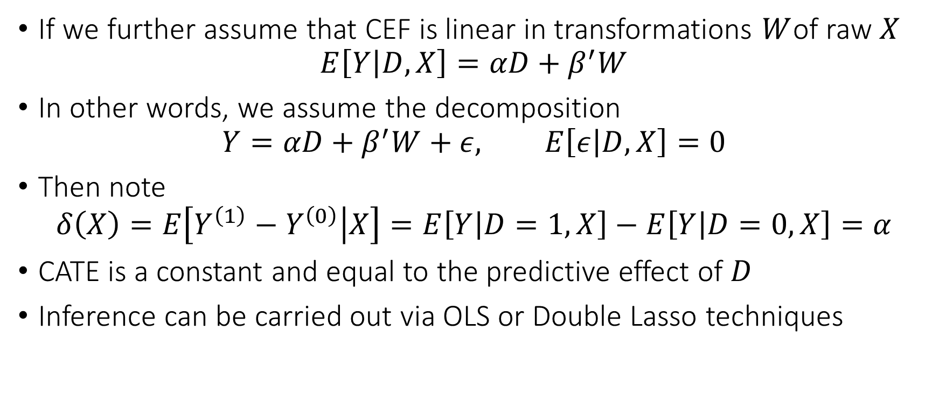
Connection to Linear Regression
If we further assume that CEF is linear in transformations $W$of raw $X$
$$E\left[Y | D,X\right]=αD+β^{′}W$$
In other words, we assume the decomposition
$$Y=αD+β^{′}W+ε, E\left[ε | D, X\right]=0$$
Then note
$$δ\left(X\right)=E\left[Y^{\left(1\right)}−Y^{\left(0\right)} | X\right]=E\left[Y | D=1,X\right]−E\left[Y | D=0,X\right]=α$$
CATE is a constant and equal to the predictive effect of $D$
Inference can be carried out via OLS or Double Lasso techniques

Slide 26
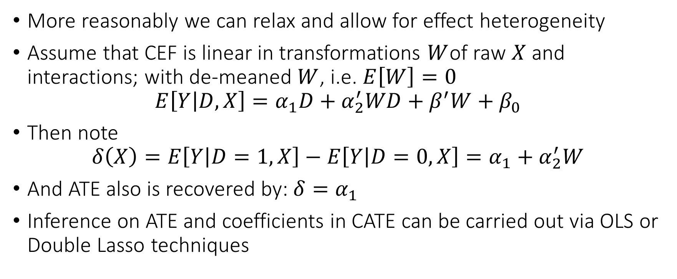
Connection to Linear Regression
More reasonably we can relax and allow for effect heterogeneity
Assume that CEF is linear in transformations $W$of raw $X$ and interactions; with de-meaned $W$, i.e. $E\left[W\right]=0$
$$E\left[Y | D,X\right]=α_{1}D+α_{2}^{′}WD+β^{′}W+β_{0}$$
Then note
$$δ\left(X\right)=E\left[Y | D=1,X\right]−E\left[Y | D=0,X\right]=α_{1}+α_{2}^{′}W$$
And ATE also is recovered by: $δ=α_{1}$
Inference on ATE and coefficients in CATE can be carried out via OLS or Double Lasso techniques

Slide 27
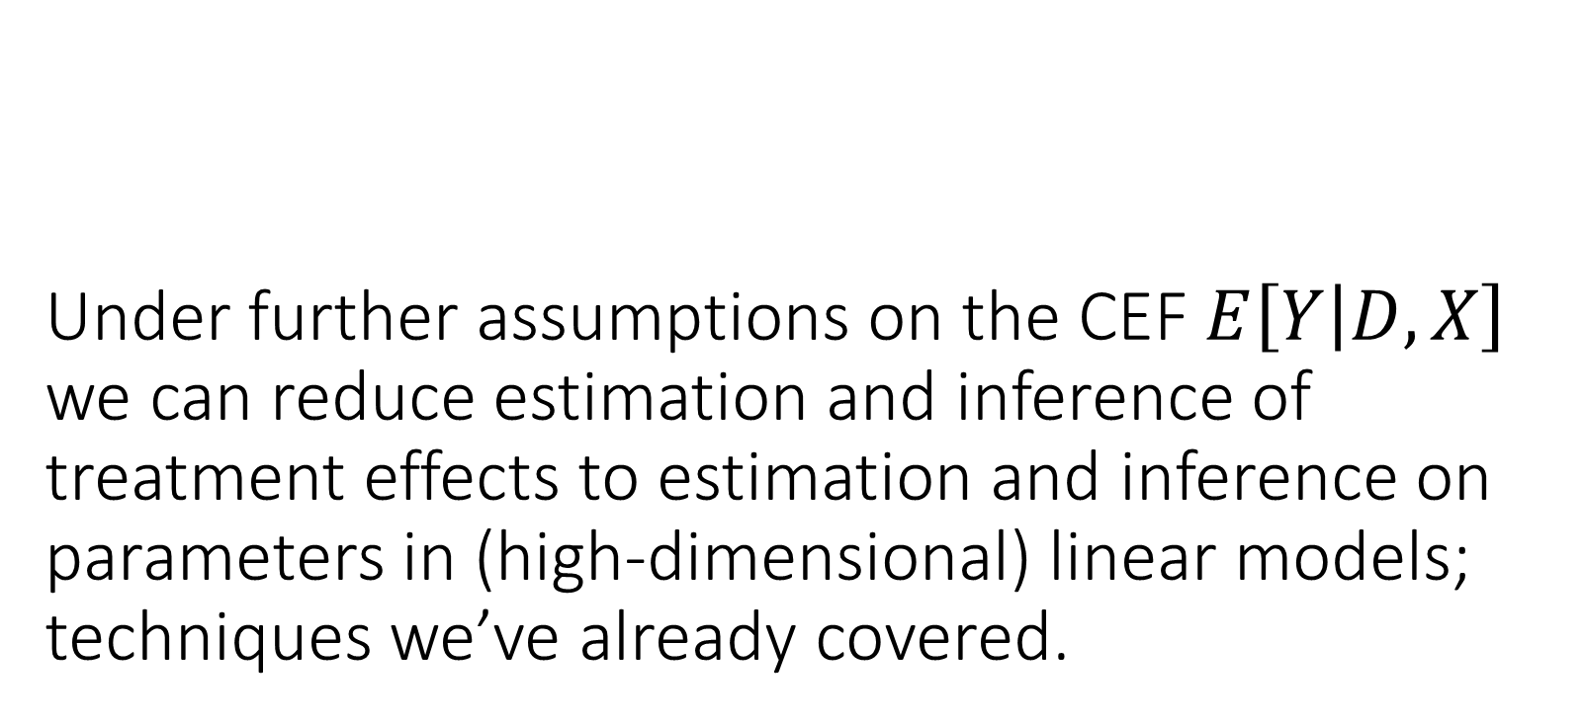
Under further assumptions on the CEF $E\left[Y | D,X\right]$ we can reduce estimation and inference of treatment effects to estimation and inference on parameters in (high-dimensional) linear models; techniques we’ve already covered.

Slide 28
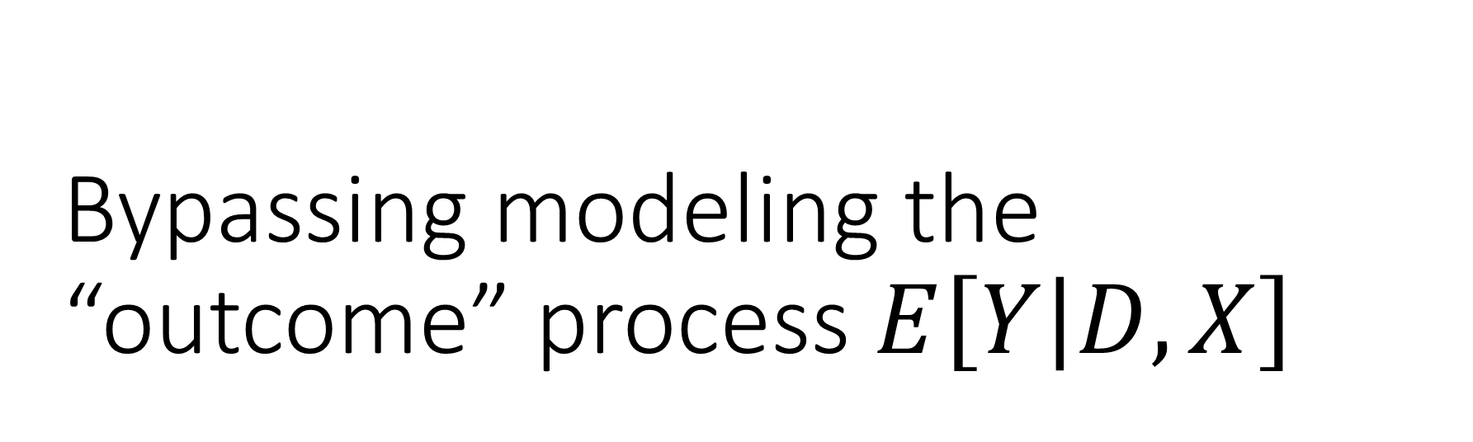
Bypassing modeling the “outcome” process $E\left[Y | D,X\right]$
What if we know the “treatment selection” process (propensity)?

Slide 29
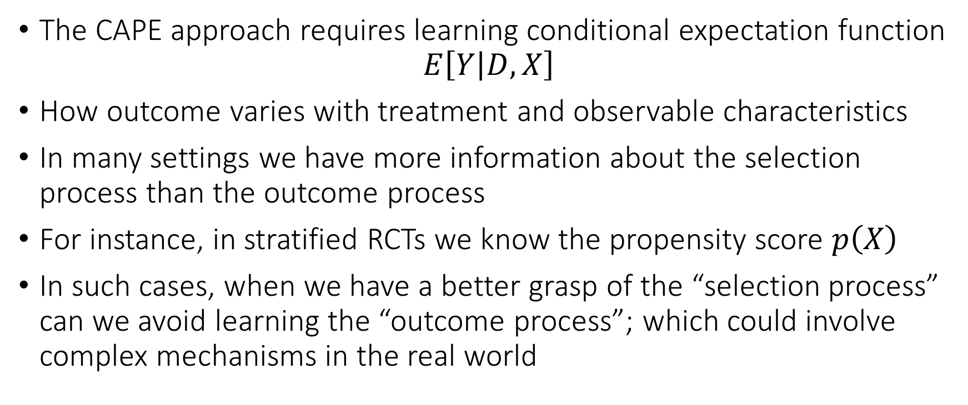
Identification via Propensity Scores
The CAPE approach requires learning conditional expectation function
$$E\left[Y | D,X\right]$$
How outcome varies with treatment and observable characteristics
In many settings we have more information about the selection process than the outcome process
For instance, in stratified RCTs we know the propensity score $p\left(X\right)$
In such cases, when we have a better grasp of the “selection process” can we avoid learning the “outcome process”; which could involve complex mechanisms in the real world

Slide 30


We know we are under-sampling from the blue points
Say we select a blue point with prob 1/4. We can duplicate any blue point four times
$$Y^{\left(0\right)}$$
$$Y^{\left(0\right)}|X$$
$$∼$$
$$Y|D=0, X$$
$$Y|D=0$$
$$Y|D=1$$
$$Y|D=1,X$$
$$∼$$
$$Y^{\left(1\right)}|X$$
$$Y^{\left(1\right)}$$
$$X=1$$
$$P\left(D=0 | X\right)$$
$$P\left(D=1 | X\right)$$
Selection based on X
Selection based on X
$$X=0$$
We know we are over-sampling from the blue points
Say we select an orange point with prob 3/4. We can duplicate any orange point 4/3 times
Counterfactual World
Observed World
Counterfactual World

Slide 31






$$Y^{\left(0\right)}$$
$$HY|D=0$$
$$HY|D=1$$
$$Y^{\left(1\right)}$$
$$P\left(D=0 | X=1\right)=1/4$$
$$P\left(D=1 | X=1\right)=3/4$$
$$P\left(D=0 | X\right)$$
$$P\left(D=1 | X\right)$$
Selection based on X
Selection based on X
$$P\left(D=0 | X=1\right)=3/4$$
$$P\left(D=1 | X=1\right)=1/4$$
Counterfactual World
Observed World
Counterfactual World

Slide 32
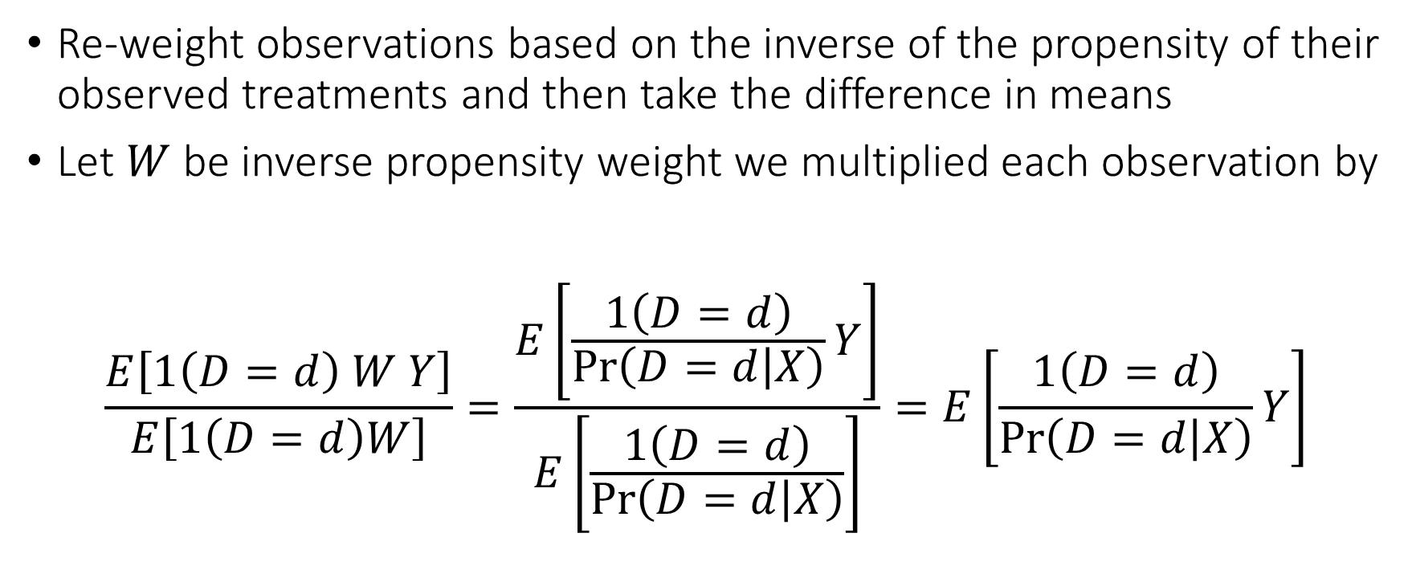
Identification via Propensity Scores
Re-weight observations based on the inverse of the propensity of their observed treatments and then take the difference in means
Let $W$ be inverse propensity weight we multiplied each observation by
$$\frac{E\left[1\left(D=d\right) W Y\right]}{E\left[1\left(D=d\right)W\right]}=\frac{E\left[\frac{1\left(D=d\right)}{\operatorname{Pr}\left(D=d | X\right)}Y\right]}{E\left[\frac{1\left(D=d\right)}{\operatorname{Pr}\left(D=d | X\right)}\right]}=E\left[\frac{1\left(D=d\right)}{\operatorname{Pr}\left(D=d | X\right)}Y\right]$$

Slide 33
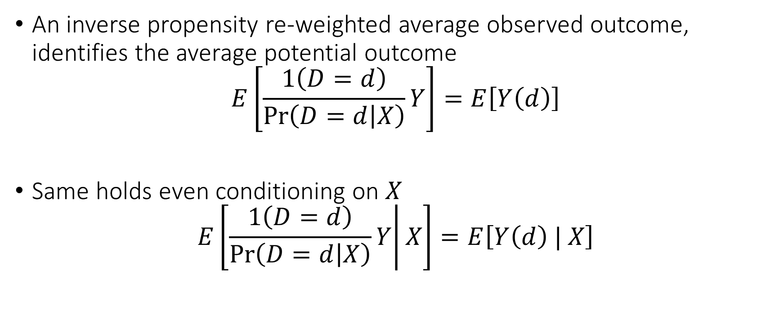
Horvitz-Thompson Reweighting
An inverse propensity re-weighted average observed outcome, identifies the average potential outcome
$$E\left[\frac{1\left(D=d\right)}{\operatorname{Pr}\left(D=d | X\right)}Y\right]=E\left[Y\left(d\right)\right]$$
Same holds even conditioning on $X$
$$E\left[\left.\frac{1\left(D=d\right)}{\operatorname{Pr}\left(D=d | X\right)}Y\right|X\right]=E\left[Y\left(d\right) | X\right]$$

Slide 34

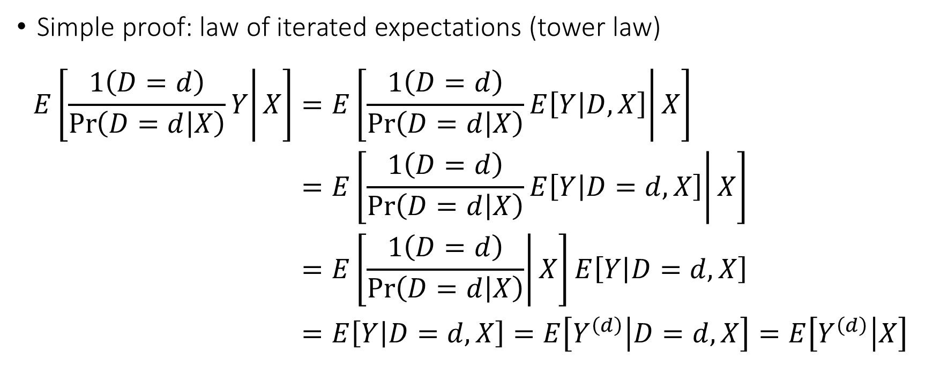
Horvitz-Thompson Reweighting
Tower Law. For any random variables $Z, V, U$
$$E\left[Z|V\right]=E\left[\left.E\left[Z | U,V\right]\right|V\right]$$
Simple proof: law of iterated expectations (tower law)
$$\begin{aligned}E\left[\left.\frac{1\left(D=d\right)}{\operatorname{Pr}\left(D=d | X\right)}Y\right|X\right]=&E\left[\left.\frac{1\left(D=d\right)}{\operatorname{Pr}\left(D=d | X\right)}E\left[Y | D,X\right]\right|X\right] \\ =&E\left[\left.\frac{1\left(D=d\right)}{\operatorname{Pr}\left(D=d | X\right)}E\left[Y | D=d,X\right]\right|X\right] \\ =&E\left[\left.\frac{1\left(D=d\right)}{\operatorname{Pr}\left(D=d | X\right)}\right|X\right]E\left[Y | D=d,X\right] \\ =&E\left[Y | D=d,X\right]=E\left[Y^{\left(d\right)} | D=d,X\right]=E\left[Y^{\left(d\right)} | X\right]\end{aligned}$$

Slide 35
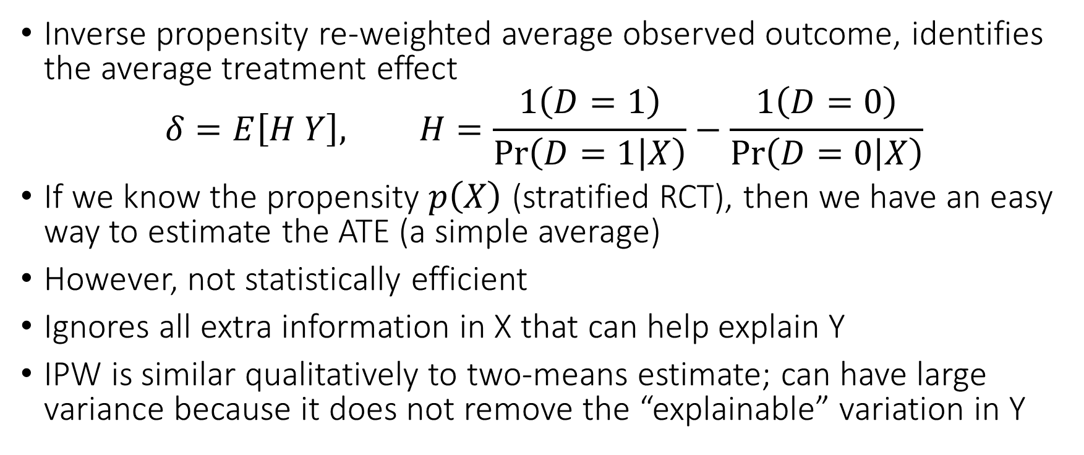
Horvitz-Thompson Reweighting
Inverse propensity re-weighted average observed outcome, identifies the average treatment effect
$$δ=E\left[H Y\right], H=\frac{1\left(D=1\right)}{\operatorname{Pr}\left(D=1 | X\right)}−\frac{1\left(D=0\right)}{\operatorname{Pr}\left(D=0 | X\right)}$$
If we know the propensity $p\left(X\right)$ (stratified RCT), then we have an easy way to estimate the ATE (a simple average)
However, not statistically efficient
Ignores all extra information in X that can help explain Y
IPW is similar qualitatively to two-means estimate; can have large variance because it does not remove the “explainable” variation in Y

Slide 36
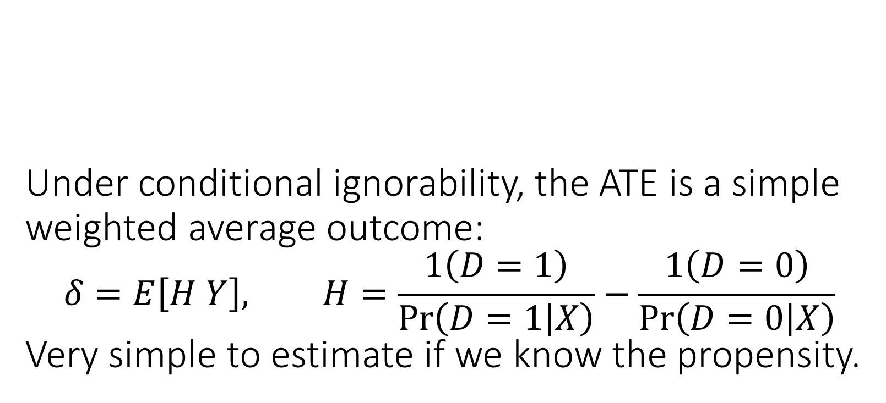
Under conditional ignorability, the ATE is a simple weighted average outcome: $$δ=E\left[H Y\right], H=\frac{1\left(D=1\right)}{\operatorname{Pr}\left(D=1 | X\right)}−\frac{1\left(D=0\right)}{\operatorname{Pr}\left(D=0 | X\right)}$$ Very simple to estimate if we know the propensity.

Slide 37
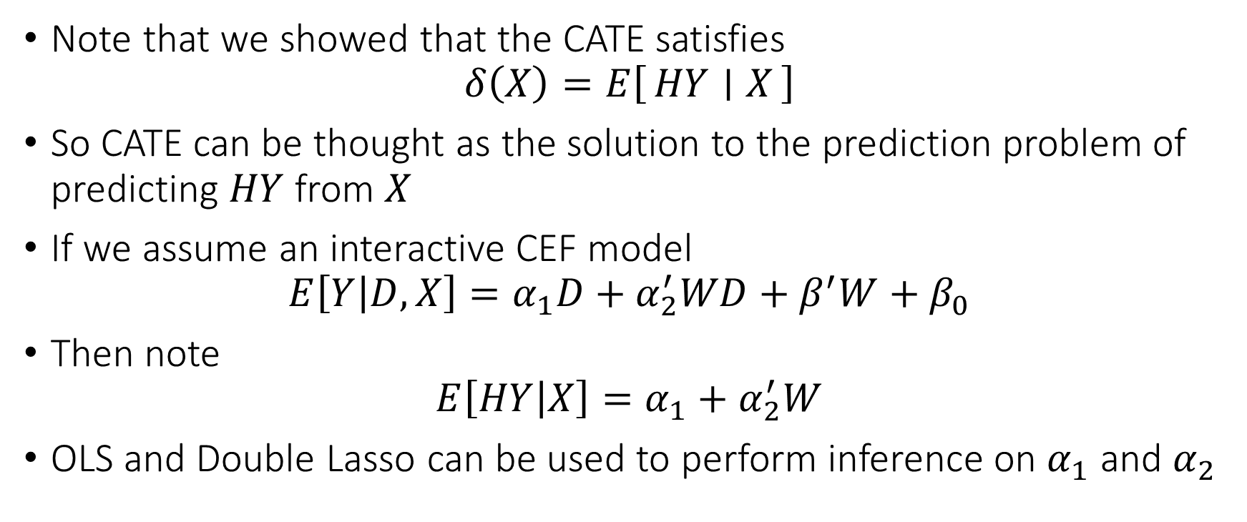
Clever Target Outcome Approach for CATE
Note that we showed that the CATE satisfies
$$δ\left(X\right)=E\left[HY ∣ X\right]$$
So CATE can be thought as the solution to the prediction problem of predicting $HY$ from $X$
If we assume an interactive CEF model
$$E\left[Y | D,X\right]=α_{1}D+α_{2}^{′}WD+β^{′}W+β_{0}$$
Then note
$$E\left[HY | X\right]=α_{1}+α_{2}^{′}W$$
OLS and Double Lasso can be used to perform inference on $α_{1}$ and $α_{2}$

Slide 38
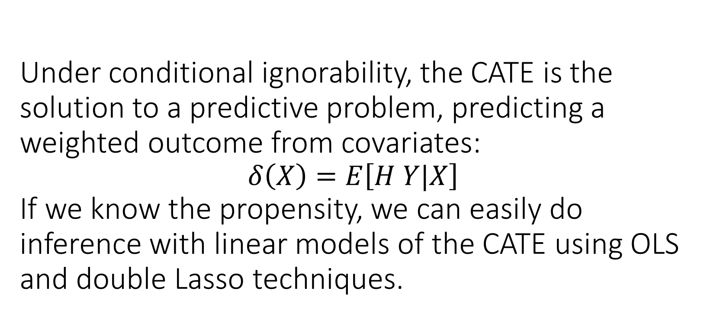
Under conditional ignorability, the CATE is the solution to a predictive problem, predicting a weighted outcome from covariates: $$δ\left(X\right)=E\left[H Y|X\right]$$ If we know the propensity, we can easily do inference with linear models of the CATE using OLS and double Lasso techniques.

Slide 39
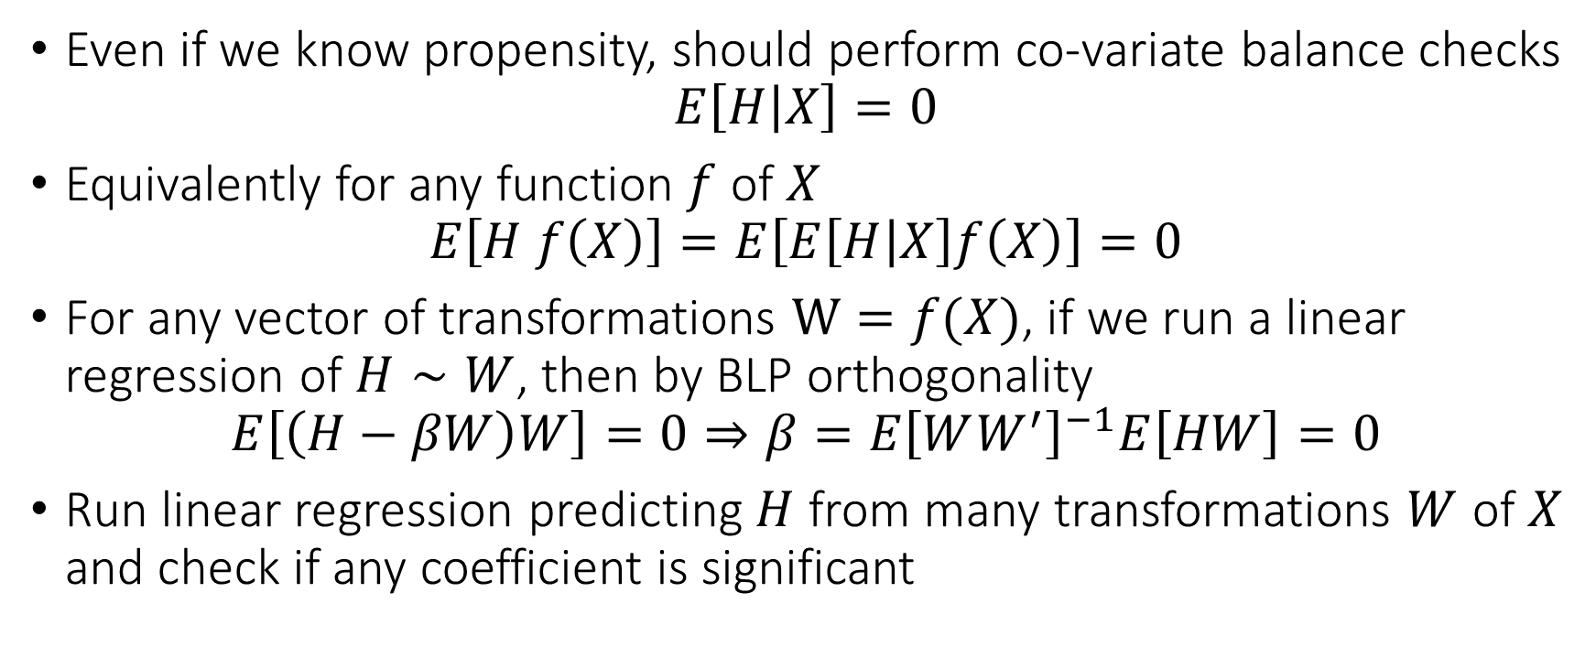
Sensitive to Violations of Randomization
Even if we know propensity, should perform co-variate balance checks
$$E\left[H | X\right]=0$$
Equivalently for any function $f$ of $X$
$$E\left[H f\left(X\right)\right]=E\left[E\left[H | X\right]f\left(X\right)\right]=0$$
For any vector of transformations $W=f(X)$, if we run a linear regression of $H∼W$, then by BLP orthogonality
$$E\left[\left(H−βW\right)W\right]=0⇒β=E{\left[WW^{′}\right]}^{−1}E\left[HW\right]=0$$
Run linear regression predicting $H$ from many transformations $W$ of $X$ and check if any coefficient is significant

Slide 40
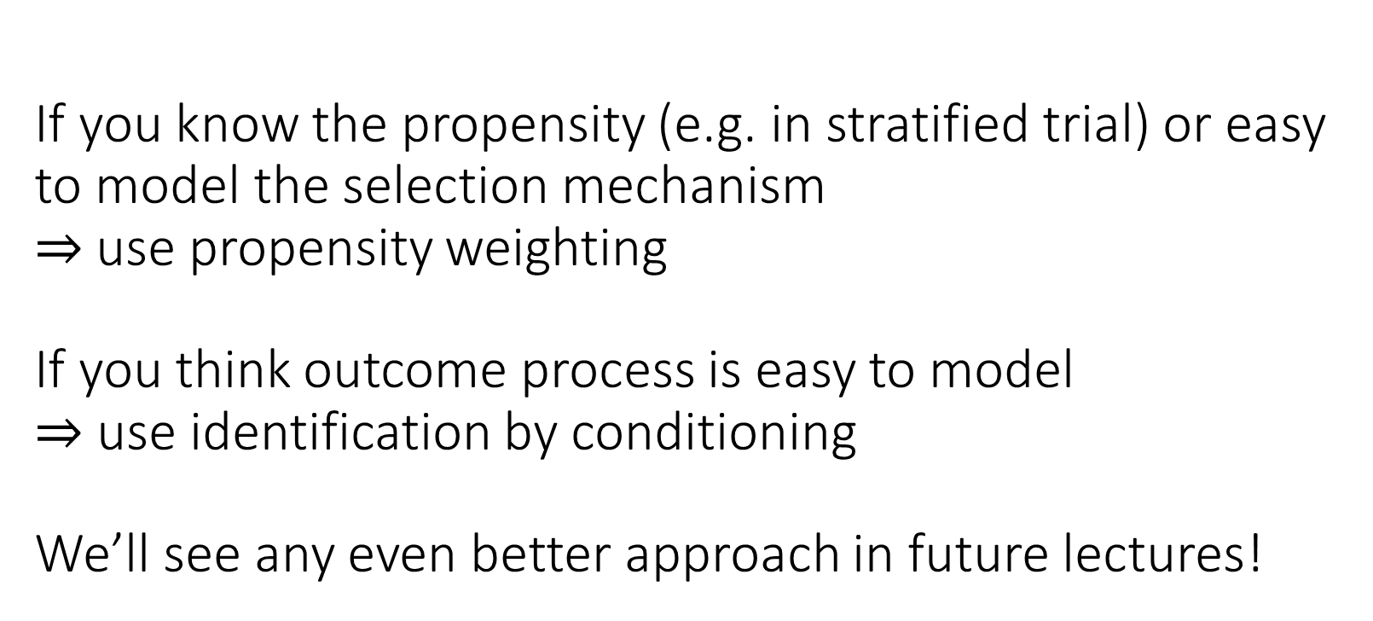
If you know the propensity (e.g. in stratified trial) or easy to model the selection mechanism $⇒$use propensity weighting If you think outcome process is easy to model $⇒$ use identification by conditioning We’ll see any even better approach in future lectures!

Slide 41
Simplifying Identification by Conditioning: Sufficient Statistic
Suffices to control/adjust for propensity

Slide 42
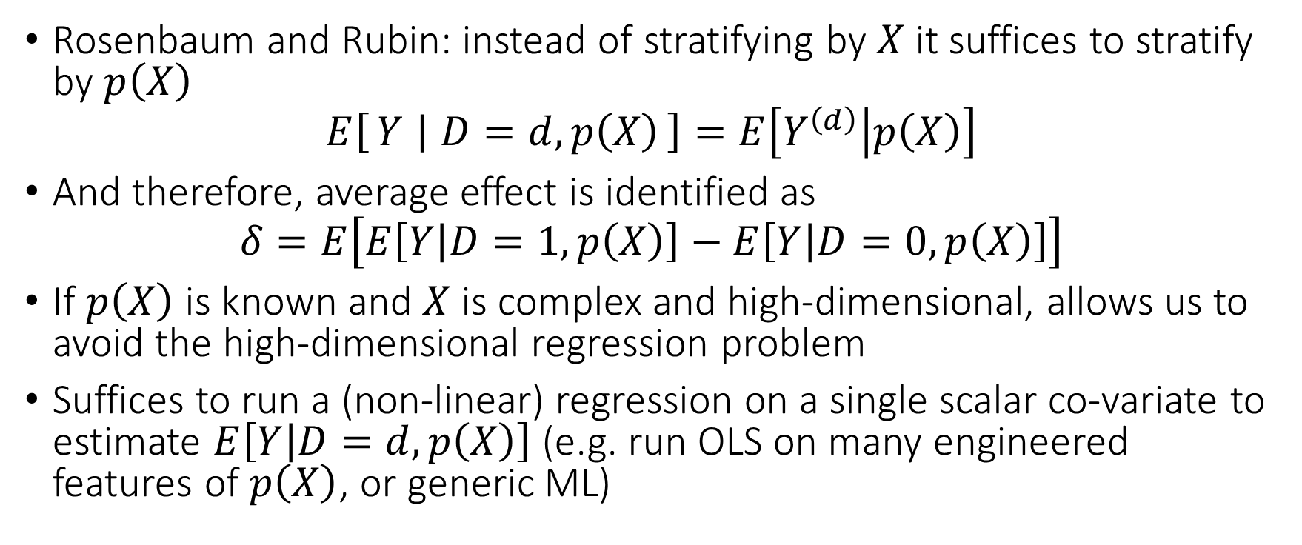
Conditioning on Propensity Suffices
Rosenbaum and Rubin: instead of stratifying by $X$ it suffices to stratify by $p\left(X\right)$
$$E\left[Y ∣ D=d,p\left(X\right)\right]=E\left[Y^{\left(d\right)} | p\left(X\right)\right]$$
And therefore, average effect is identified as
$$δ=E\left[E\left[Y | D=1,p\left(X\right)\right]−E\left[Y | D=0,p\left(X\right)\right]\right]$$
If $p\left(X\right)$ is known and $X$ is complex and high-dimensional, allows us to avoid the high-dimensional regression problem
Suffices to run a (non-linear) regression on a single scalar co-variate to estimate $E\left[Y | D=d,p\left(X\right)\right]$ (e.g. run OLS on many engineered features of $p\left(X\right)$, or generic ML)

Slide 43
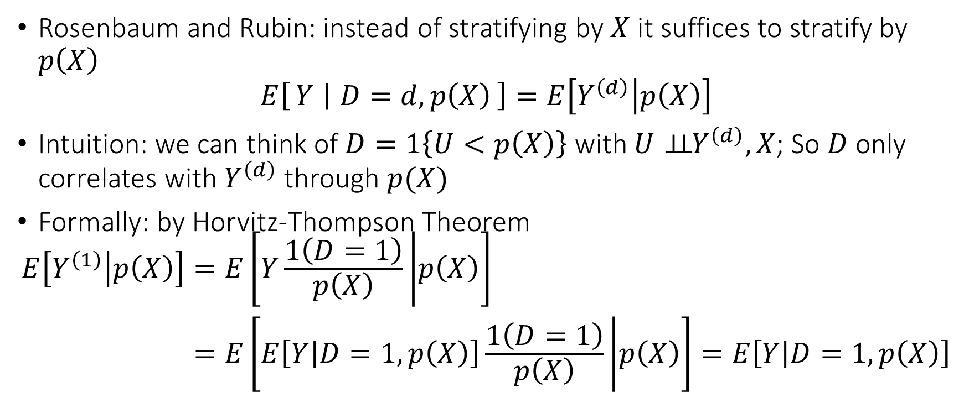
Conditioning on Propensity Suffices
Rosenbaum and Rubin: instead of stratifying by $X$ it suffices to stratify by $p\left(X\right)$
$$E\left[Y ∣ D=d,p\left(X\right)\right]=E\left[Y^{\left(d\right)} | p\left(X\right)\right]$$
Intuition: we can think of $D=1\left\{U<p\left(X\right)\right\}$ with $U⊥⊥{ Y}^{\left(d\right)},X$; So $D$ only correlates with $Y^{\left(d\right)}$ through $p(X)$
Formally: by Horvitz-Thompson Theorem
$$\begin{aligned}E\left[Y^{\left(1\right)} | p\left(X\right)\right]=&E\left[Y\frac{1\left(D=1\right)}{p\left(X\right)} | p\left(X\right)\right] \\ =&E\left[E\left[Y | D=1,p\left(X\right)\right]\frac{1\left(D=1\right)}{p\left(X\right)} | p\left(X\right)\right]=E\left[Y | D=1,p\left(X\right)\right]\end{aligned}$$

Slide 44
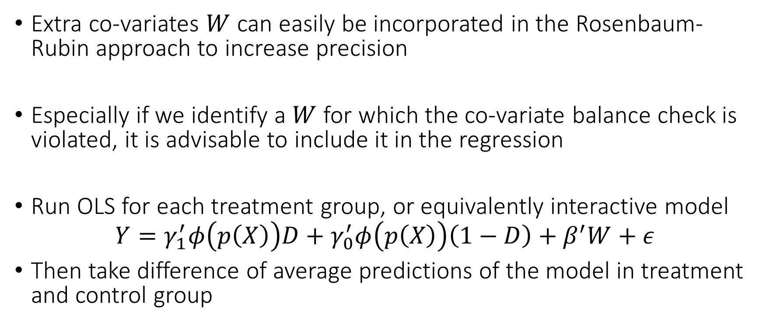
Improving precision
Extra co-variates $W$ can easily be incorporated in the Rosenbaum-Rubin approach to increase precision
Especially if we identify a $W$ for which the co-variate balance check is violated, it is advisable to include it in the regression
Run OLS for each treatment group, or equivalently interactive model
$$Y=γ_{1}^{′}φ\left(p\left(X\right)\right)D+γ_{0}^{′}φ\left(p\left(X\right)\right)\left(1−D\right)+β^{′}W+ε$$
Then take difference of average predictions of the model in treatment and control group

Slide 45
Relaxing Assumptions when we only want Effect on the Treated

Slide 46
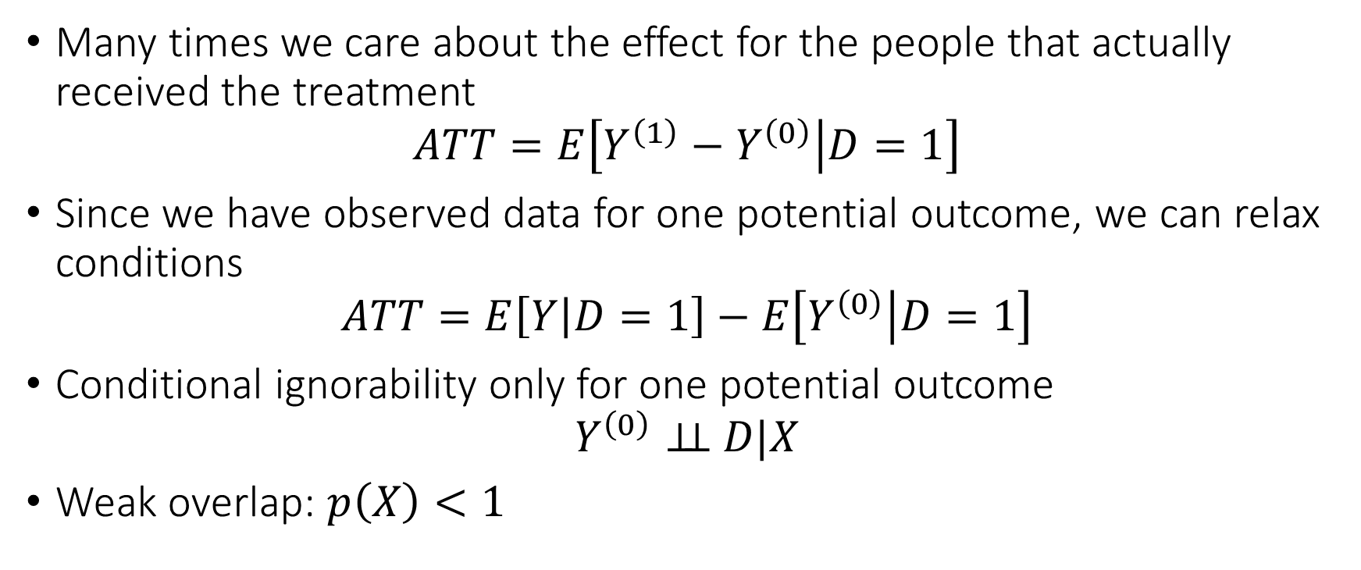
Average Treatment Effect on the Treated ATT
Many times we care about the effect for the people that actually received the treatment
$$ATT=E\left[Y^{\left(1\right)}−Y^{\left(0\right)} | D=1\right]$$
Since we have observed data for one potential outcome, we can relax conditions
$$ATT=E\left[Y | D=1\right]−E\left[Y^{\left(0\right)} | D=1\right]$$
Conditional ignorability only for one potential outcome
$$Y^{\left(0\right)}⊥⊥ D|X$$
Weak overlap: $p\left(X\right)<1$

Slide 47
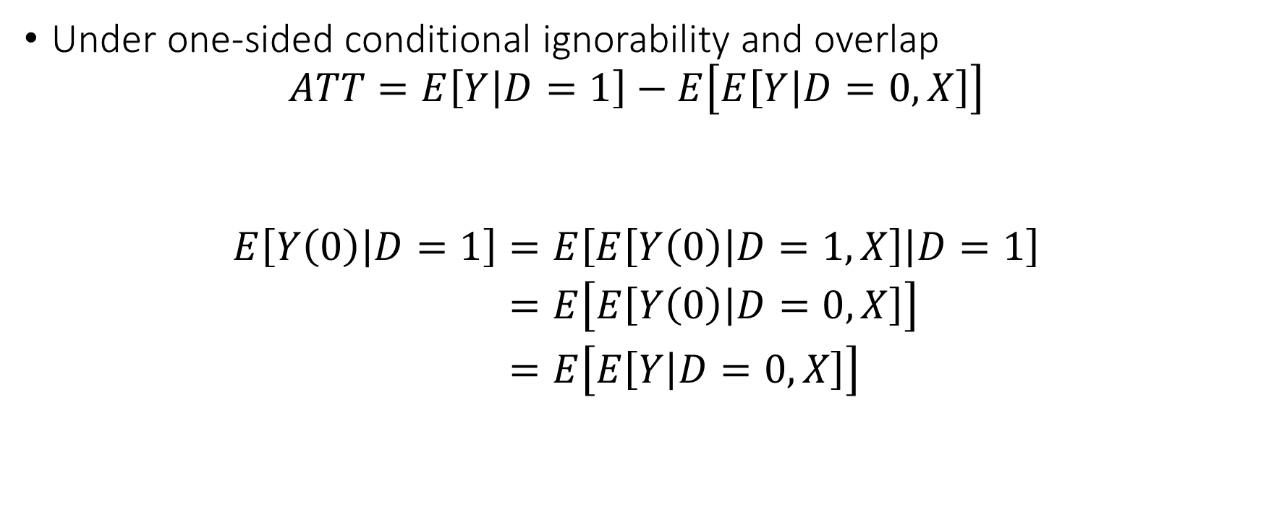
Identification of ATT
Under one-sided conditional ignorability and overlap
$$ATT=E\left[Y | D=1\right]−E\left[E\left[Y | D=0,X\right]\right]$$
$$\begin{aligned}E\left[Y\left(0\right) | D=1\right]=&E\left[E\left[Y\left(0\right) | D=1,X\right] | D=1\right] \\ =&E\left[E\left[Y\left(0\right) | D=0,X\right]\right] \\ =&E\left[E\left[Y | D=0,X\right]\right]\end{aligned}$$

Slide 48
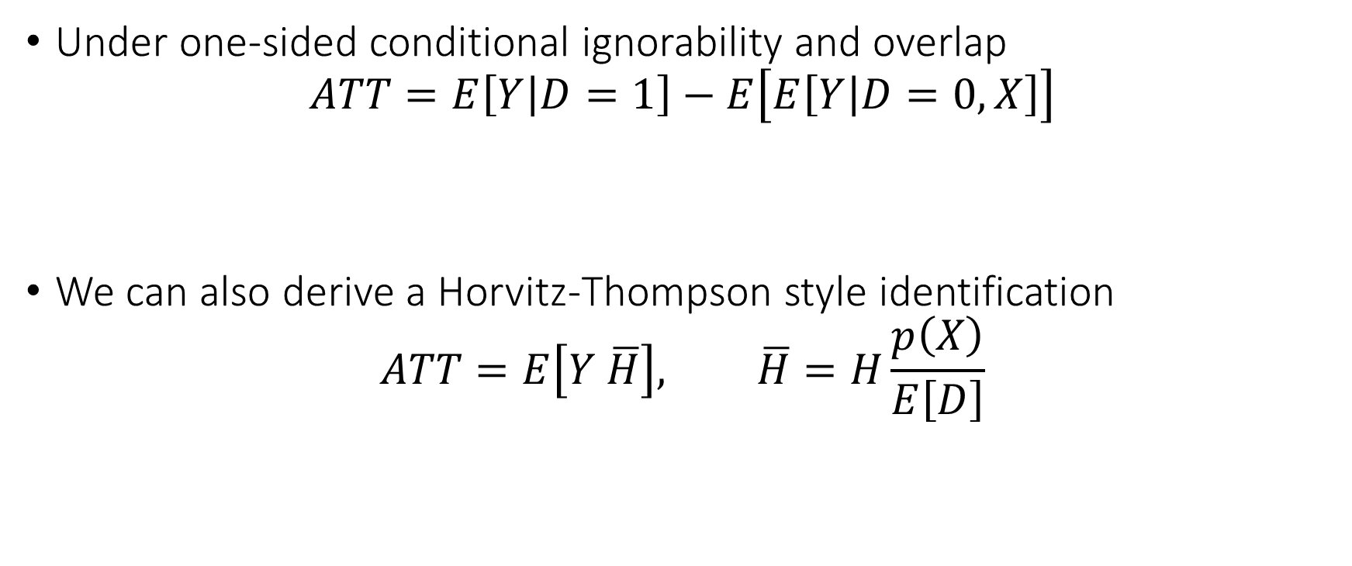
Identification of ATT
Under one-sided conditional ignorability and overlap
$$ATT=E\left[Y | D=1\right]−E\left[E\left[Y | D=0,X\right]\right]$$
We can also derive a Horvitz-Thompson style identification
$$ATT=E\left[Y \overline{H}\right], \overline{H}=H\frac{p\left(X\right)}{E\left[D\right]}$$

Slide 49
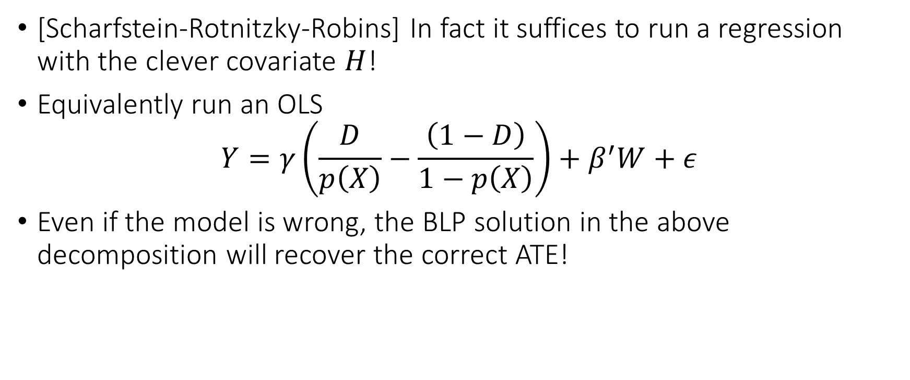
Bonus: Clever Co-Variate Approach
[Scharfstein-Rotnitzky-Robins] In fact it suffices to run a regression with the clever covariate $H$!
Equivalently run an OLS
$$Y=γ\left(\frac{D}{p\left(X\right)}−\frac{\left(1−D\right)}{1−p\left(X\right)}\right)+β^{′}W+ε$$
Even if the model is wrong, the BLP solution in the above decomposition will recover the correct ATE!

Slide 50
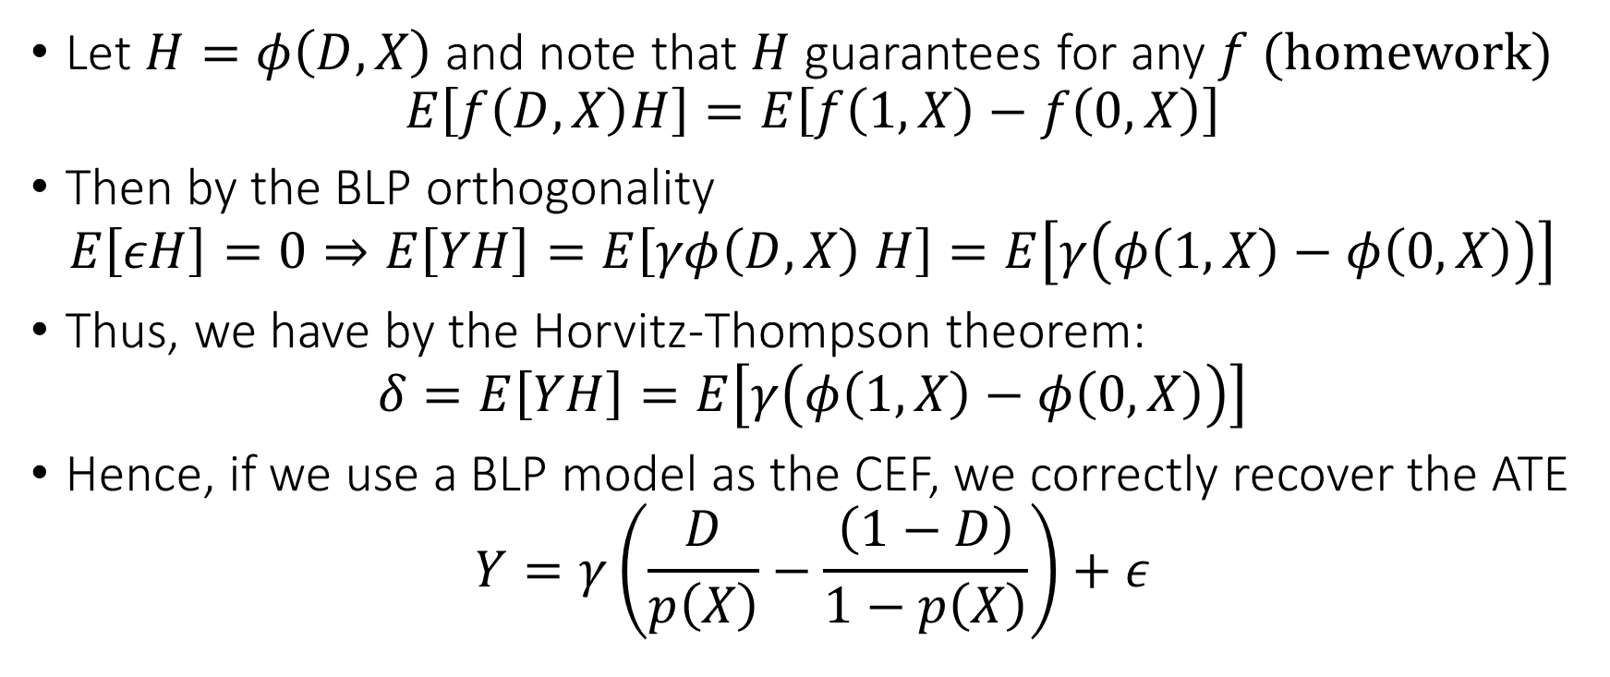
Clever Co-Variate Approach
Let $H=φ\left(D,X\right)$ and note that $H$ guarantees for any $f$ (homework)
$$E\left[f\left(D,X\right)H\right]=E\left[f\left(1,X\right)−f\left(0,X\right)\right]$$
Then by the BLP orthogonality
$$E\left[εH\right]=0⇒E\left[YH\right]=E\left[γφ\left(D,X\right) H\right]=E\left[γ\left(φ\left(1,X\right)−φ\left(0,X\right)\right)\right]$$
Thus, we have by the Horvitz-Thompson theorem:
$$δ=E\left[YH\right]=E\left[γ\left(φ\left(1,X\right)−φ\left(0,X\right)\right)\right]$$
Hence, if we use a BLP model as the CEF, we correctly recover the ATE
$$Y=γ\left(\frac{D}{p\left(X\right)}−\frac{\left(1−D\right)}{1−p\left(X\right)}\right)+ε$$

