Slide 1
MS&E 228: Directed Acyclic Graphs and Non-Linear SEMs
Vasilis Syrgkanis
MS&E, Stanford

Slide 2
Causal Inference with Experiments
Prediction with Linear Models
Prediction with High-Dim Linear Models
Inference on Causal and Predictive Effects with High-Dim Linear Models
Potential Outcomes and Conditional Ignorability
Structural Equation Models and Conditional Exogeneity
Directed Acyclic Graphs
Prediction with Non-Linear Models
Inference on Causal Effects with Non-Linear Models
Un-observed Confounding and Instruments
Identification of Causal Effects in Longitudinal Data
Estimation of Heterogeneous Causal Effects
Linear Predictive Models and Statistical Inference
Causal Identification in Observational Data
Non-Linear Predictive Models and Statistical Inference
Topics

Slide 3
Causal Inference with Experiments
Prediction with Linear Models
Prediction with High-Dim Linear Models
Inference on Causal and Predictive Effects with High-Dim Linear Models
Potential Outcomes and Conditional Ignorability
Structural Equation Models and Conditional Exogeneity
Directed Acyclic Graphs
Prediction with Non-Linear Models
Inference on Causal Effects with Non-Linear Models
Un-observed Confounding and Instruments
Identification of Causal Effects in Longitudinal Data
Estimation of Heterogeneous Causal Effects
Linear Predictive Models and Statistical Inference
Causal Identification in Observational Data
Non-Linear Predictive Models and Statistical Inference
Topics

Slide 4
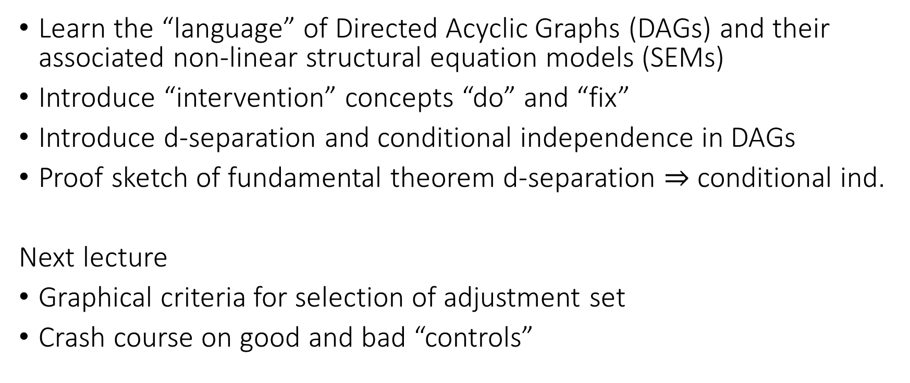
Goals for Today
Learn the “language” of Directed Acyclic Graphs (DAGs) and their associated non-linear structural equation models (SEMs)
Introduce “intervention” concepts “do” and “fix”
Introduce d-separation and conditional independence in DAGs
Proof sketch of fundamental theorem d-separation $⇒$ conditional ind.
Next lecture
Graphical criteria for selection of adjustment set
Crash course on good and bad “controls”

Slide 5
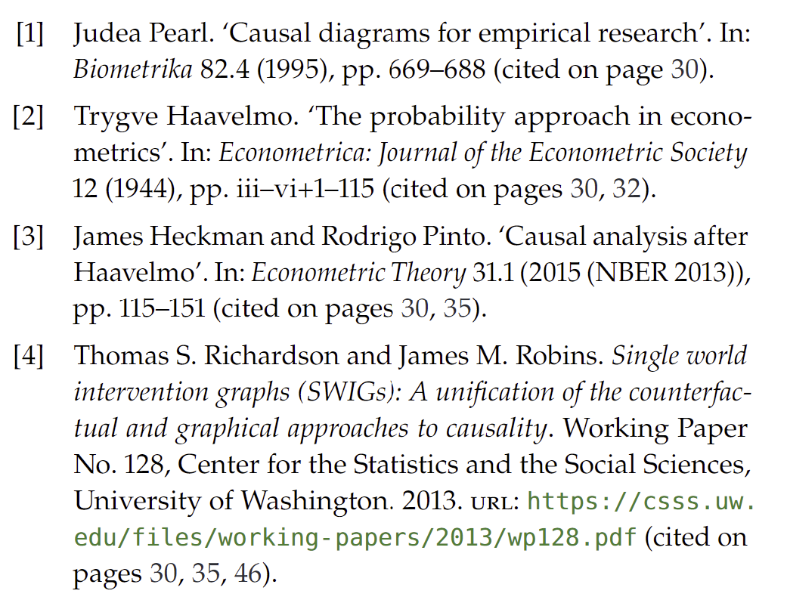
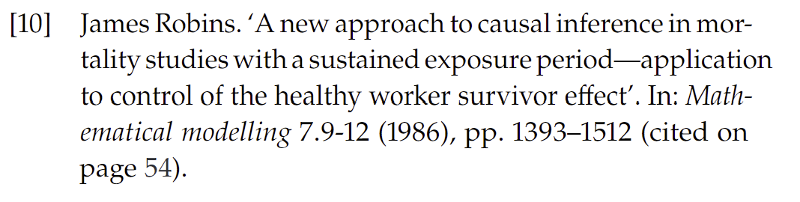
DAGs

Slide 6
Non-Linear SEMs

Slide 7
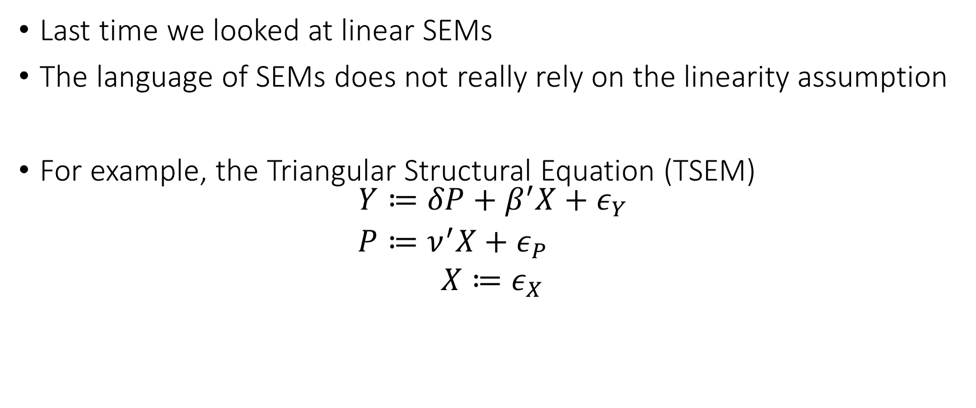
Non-Linear SEMs
Last time we looked at linear SEMs
The language of SEMs does not really rely on the linearity assumption
For example, the Triangular Structural Equation (TSEM)
$$\begin{aligned}Y≔&δP+β^{′}X+ε_{Y} \\ P≔&ν^{′}X+ε_{P} \\ X≔ε_{X}\end{aligned}$$

Slide 8
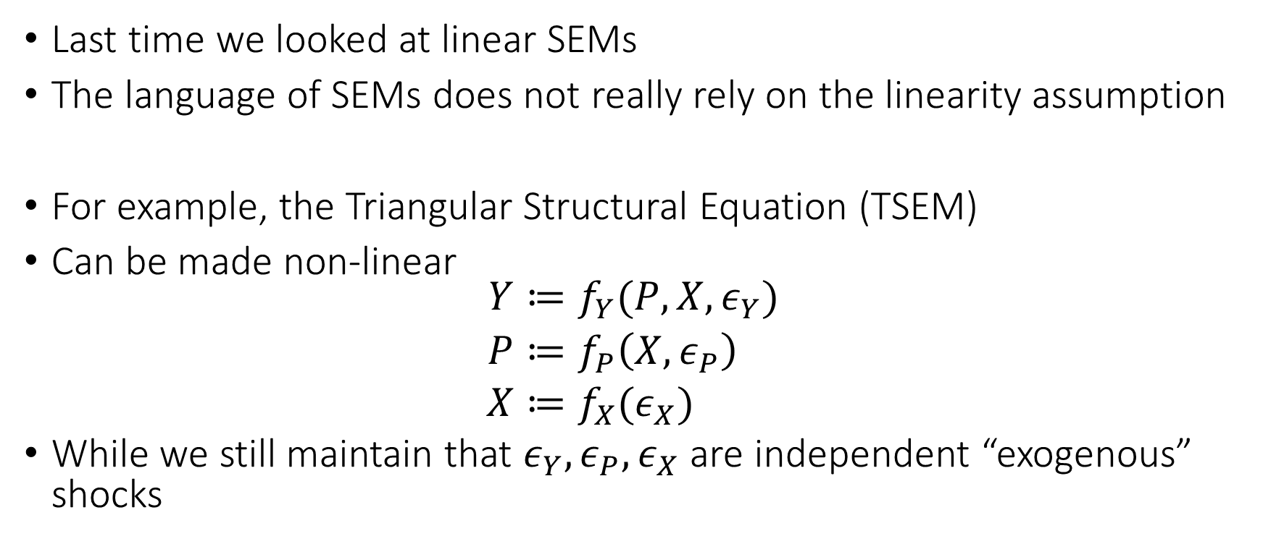
Non-Linear SEMs
Last time we looked at linear SEMs
The language of SEMs does not really rely on the linearity assumption
For example, the Triangular Structural Equation (TSEM)
Can be made non-linear
$$\begin{aligned}Y≔&f_{Y}(P,X,ε_{Y}) \\ P≔&f_{P}\left(X, ε_{P}\right) \\ X≔&f_{X}(ε_{X})\end{aligned}$$
While we still maintain that $ε_{Y},ε_{P},ε_{X}$ are independent “exogenous” shocks

Slide 9
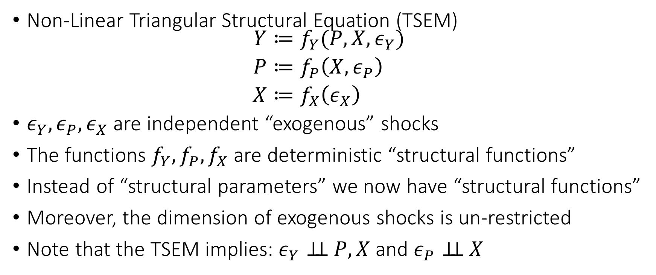
Non-Linear SEMs
Non-Linear Triangular Structural Equation (TSEM)
$$\begin{aligned}Y≔&f_{Y}(P,X,ε_{Y}) \\ P≔&f_{P}\left(X, ε_{P}\right) \\ X≔&f_{X}\left(ε_{X}\right)\end{aligned}$$
$ε_{Y},ε_{P},ε_{X}$ are independent “exogenous” shocks
The functions $f_{Y},f_{P},f_{X}$ are deterministic “structural functions”
Instead of “structural parameters” we now have “structural functions”
Moreover, the dimension of exogenous shocks is un-restricted
Note that the TSEM implies: $ε_{Y}⊥⊥ P,X$ and $ε_{P}⊥⊥ X$
Endogenously determined by the structural model
Exogenously determined “outside” of the model

Slide 10







Non-Linear SEMs
Non-Linear Triangular Structural Equation (TSEM)
$$\begin{aligned}Y≔&f_{Y}(P,X,ε_{Y}) \\ P≔&f_{P}\left(X, ε_{P}\right) \\ X≔&f_{X}\left(ε_{X}\right)\end{aligned}$$
$ε_{Y},ε_{P},ε_{X}$ are independent “exogenous” shocks
Endogenously determined by the structural model
Exogenously determined “outside” of the model
$$ε_{P}$$
$$P$$
$$ε_{P}$$
$$X$$
$$Y$$
$$ε_{Y}$$

Slide 11
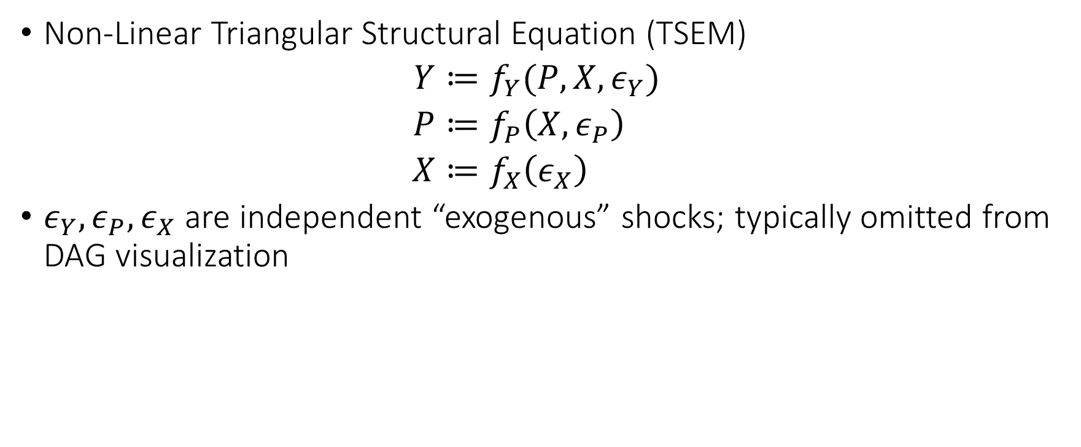
Non-Linear SEMs
Non-Linear Triangular Structural Equation (TSEM)
$$\begin{aligned}Y≔&f_{Y}(P,X,ε_{Y}) \\ P≔&f_{P}\left(X, ε_{P}\right) \\ X≔&f_{X}\left(ε_{X}\right)\end{aligned}$$
$ε_{Y},ε_{P},ε_{X}$ are independent “exogenous” shocks; typically omitted from DAG visualization
Endogenously determined by the structural model
Exogenously determined “outside” of the model
$$P$$
$$X$$
$$Y$$

Slide 12
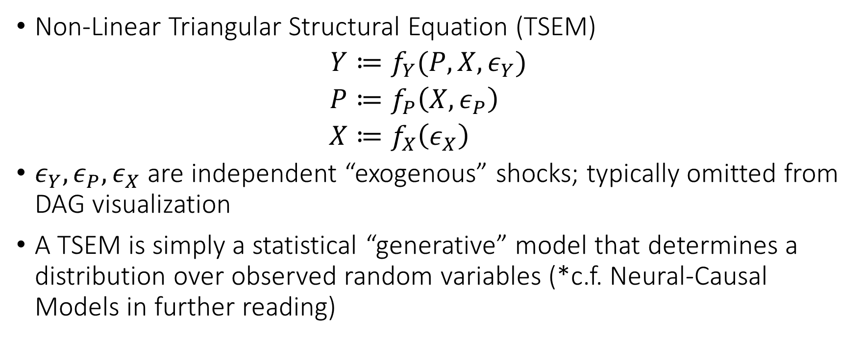
Non-Linear SEMs
Non-Linear Triangular Structural Equation (TSEM)
$$\begin{aligned}Y≔&f_{Y}(P,X,ε_{Y}) \\ P≔&f_{P}\left(X, ε_{P}\right) \\ X≔&f_{X}\left(ε_{X}\right)\end{aligned}$$
$ε_{Y},ε_{P},ε_{X}$ are independent “exogenous” shocks; typically omitted from DAG visualization
A TSEM is simply a statistical “generative” model that determines a distribution over observed random variables (*c.f. Neural-Causal Models in further reading)
Endogenously determined by the structural model
Exogenously determined “outside” of the model

Slide 13
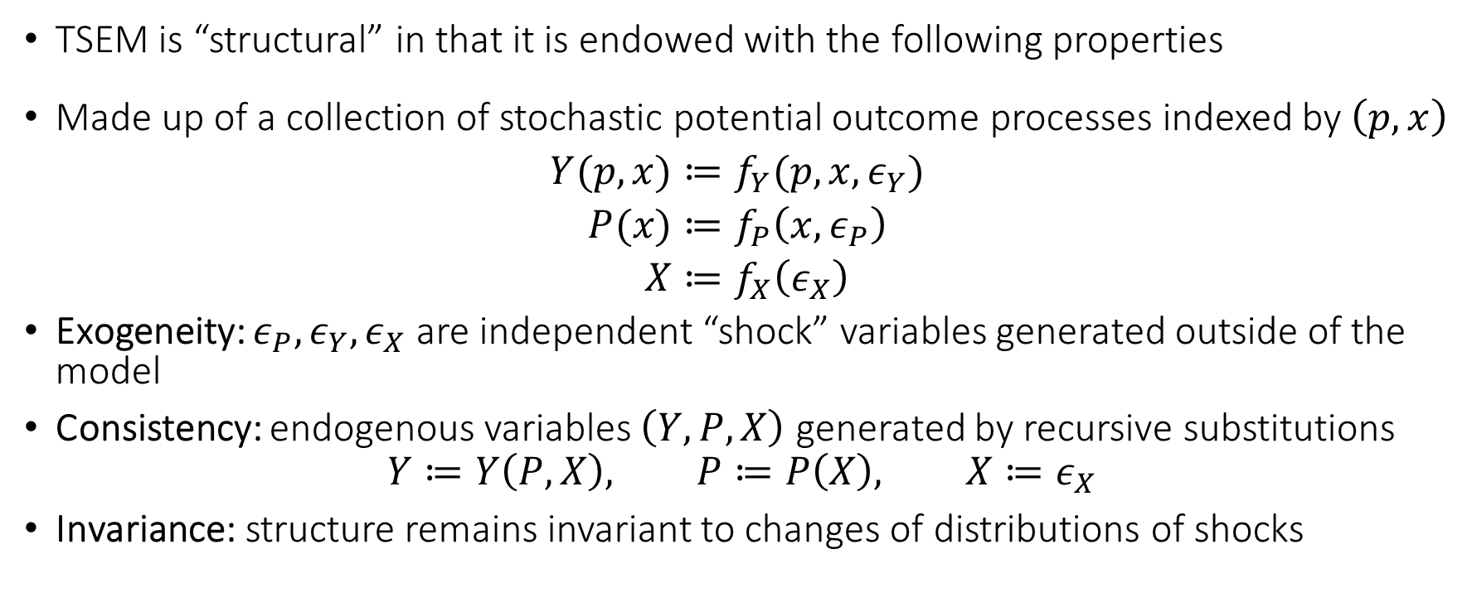
Structural Form
TSEM is “structural” in that it is endowed with the following properties
Made up of a collection of stochastic potential outcome processes indexed by $\left(p,x\right)$
$$\begin{aligned}Y(p,x)≔&f_{Y}(p,x,ε_{Y}) \\ P(x)≔&f_{P}\left(x, ε_{P}\right) \\ X≔&f_{X}\left(ε_{X}\right)\end{aligned}$$
Exogeneity: $ε_{P},ε_{Y},ε_{X}$ are independent “shock” variables generated outside of the model
Consistency: endogenous variables $\left(Y, P, X\right)$ generated by recursive substitutions
$$Y≔Y\left(P,X\right), P≔P\left(X\right), X≔ε_{X}$$
Invariance: structure remains invariant to changes of distributions of shocks

Slide 14
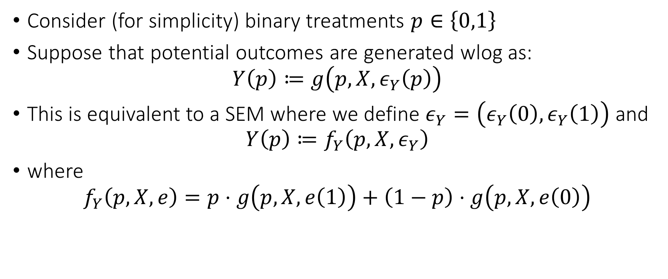
Link to Potential Outcomes
Consider (for simplicity) binary treatments $p∈\left\{0,1\right\}$
Suppose that potential outcomes are generated wlog as:
$$Y\left(p\right)≔g\left(p, X,ε_{Y}\left(p\right)\right)$$
This is equivalent to a SEM where we define $ε_{Y}=\left(ε_{Y}\left(0\right),ε_{Y}\left(1\right)\right)$ and
$$Y\left(p\right)≔f_{Y}\left(p, X, ε_{Y}\right)$$
where
$$f_{Y}\left(p, X, e\right)=p⋅g\left(p,X,e\left(1\right)\right)+\left(1−p\right)⋅g\left(p,X,e\left(0\right)\right)$$

Slide 15
Identification of Structural Responses

Slide 16





Identification by Regression Revisited
If we condition on $X=x$ it’s as if we’re altering the graph and SEM
$$Y=f_{Y}\left(P\left(x\right),x,ε_{Y}\right), ε_{Y}⊥⊥ P\left(x\right)$$
Notice that remnant variation in $P\left(x\right)$, is $ε_{P}$, which is exogenous
As if driven by a randomized trial process
$$ε_{P}$$
$$P(x)$$
$$x$$
$$Y(x)$$

Slide 17
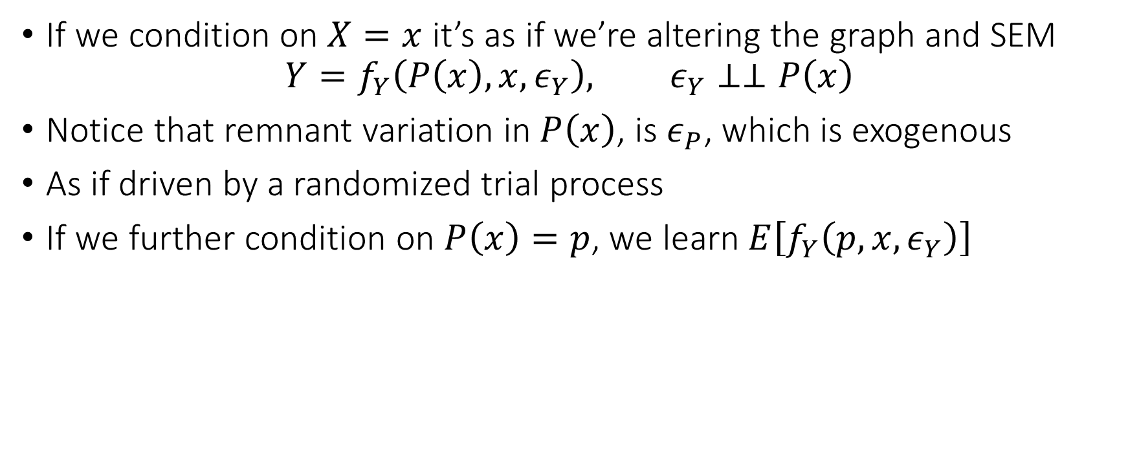
Identification by Regression Revisited
If we condition on $X=x$ it’s as if we’re altering the graph and SEM
$$Y=f_{Y}\left(P\left(x\right),x,ε_{Y}\right), ε_{Y}⊥⊥P\left(x\right)$$
Notice that remnant variation in $P\left(x\right)$, is $ε_{P}$, which is exogenous
As if driven by a randomized trial process
If we further condition on $P\left(x\right)=p$, we learn $E\left[f_{Y}\left(p,x,ε_{Y}\right)\right]$
$$ε_{P}$$
$$P(x)$$
$$x$$
$$Y(x)$$

Slide 18
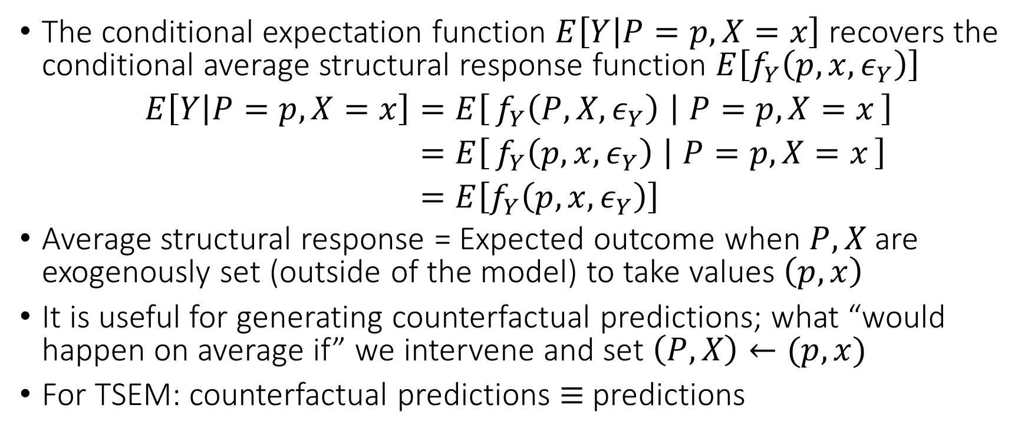
Identification by Regression Revisited
The conditional expectation function $E\left[Y | P=p, X=x\right]$ recovers the conditional average structural response function $E\left[f_{Y}\left(p, x, ε_{Y}\right)\right]$
$$\begin{aligned}E\left[Y | P=p,X=x\right]=&E\left[f_{Y}\left(P,X,ε_{Y}\right) ∣ P=p,X=x\right] \\ =&E\left[f_{Y}\left(p,x,ε_{Y}\right) ∣ P=p,X=x\right] \\ =&E\left[f_{Y}\left(p,x,ε_{Y}\right)\right]\end{aligned}$$
Average structural response = Expected outcome when $P,X$ are exogenously set (outside of the model) to take values $\left(p,x\right)$
It is useful for generating counterfactual predictions; what “would happen on average if” we intervene and set $\left(P,X\right)←(p,x)$
For TSEM: counterfactual predictions $≡$ predictions

Slide 19
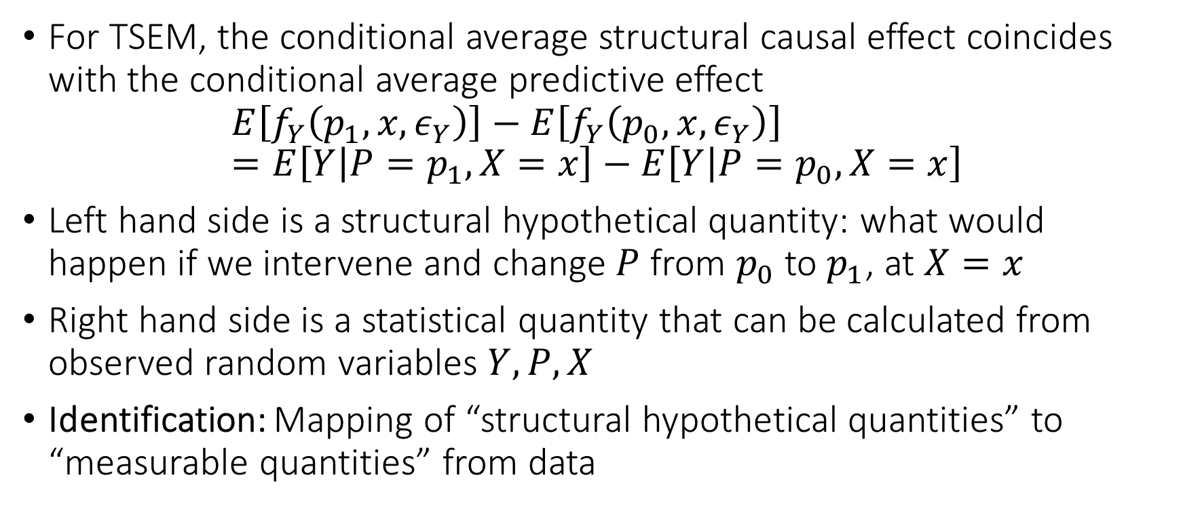
Identification by Regression Re-stated
For TSEM, the conditional average structural causal effect coincides with the conditional average predictive effect
$$E\left[f_{Y}\left(p_{1},x,ε_{Y}\right)\right]−E\left[f_{Y}\left(p_{0},x, ε_{Y}\right)\right]=E\left[Y | P=p_{1},X=x\right]−E\left[Y | P=p_{0},X=x\right]$$
Left hand side is a structural hypothetical quantity: what would happen if we intervene and change $P$ from $p_{0}$ to $p_{1}$, at $X=x$
Right hand side is a statistical quantity that can be calculated from observed random variables $Y, P, X$
Identification: Mapping of “structural hypothetical quantities” to “measurable quantities” from data

Slide 20
Formalizing the Language of Interventions

Slide 21








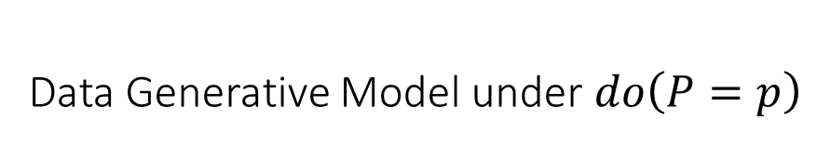

Do Interventions: $do\left(P=p\right)$
Original Data Generative Model
Data Generative Model under $do\left(P=p\right)$
$$\begin{aligned}Y≔&f_{Y}(P,X,ε_{Y}) \\ P≔&f_{P}\left(X, ε_{P}\right) \\ X≔&ε_{X}\end{aligned}$$
$$\left.\begin{matrix}Y \\ P \\ X\end{matrix}\right|do\left(P=p\right)\begin{aligned}≔&f_{Y}(p,X,ε_{Y}) \\ ≔ p \\ ≔&ε_{X}\end{aligned}$$
$$P$$
$$p$$
$$X$$
$$Y$$
$$X$$
$$Y\left(p\right)$$

Slide 22
Interventions
Do-interventions is only one way of defining counterfactuals
We can define any type of counterfactual by simply changing one of the equations to something else
Wright in his seminal work in ‘28 defined an intervention where the demand equation was replaced by another one that reflects a tax hike
We can also define “soft-interventions”: increase price by 10% of its current value
Another useful variant of do-interventions does not replace the treatment equation are “fix” interventions

Slide 23




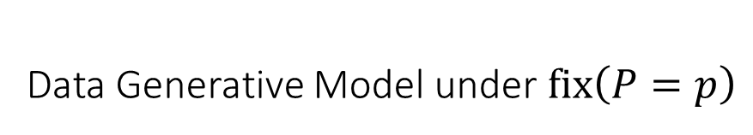
Fix Interventions: $fix\left(P=p\right)$
Original Data Generative Model
Data Generative Model under $fix\left(P=p\right)$
$$\begin{aligned}Y≔&f_{Y}(P,X,ε_{Y}) \\ P≔&f_{P}\left(X, ε_{P}\right) \\ X≔&ε_{X}\end{aligned}$$
$$\left.\begin{matrix}Y \\ P \\ X\end{matrix}\right|fix\left(P=p\right)\begin{aligned}≔&f_{Y}(p,X,ε_{Y}) \\ ≔ f_{P}\left(X, ε_{P}\right) \\ ≔&ε_{X}\end{aligned}$$
$$P$$
$$P$$
$$p$$
$$X$$
$$Y$$
$$X$$
$$Y\left(p\right)$$

Slide 24
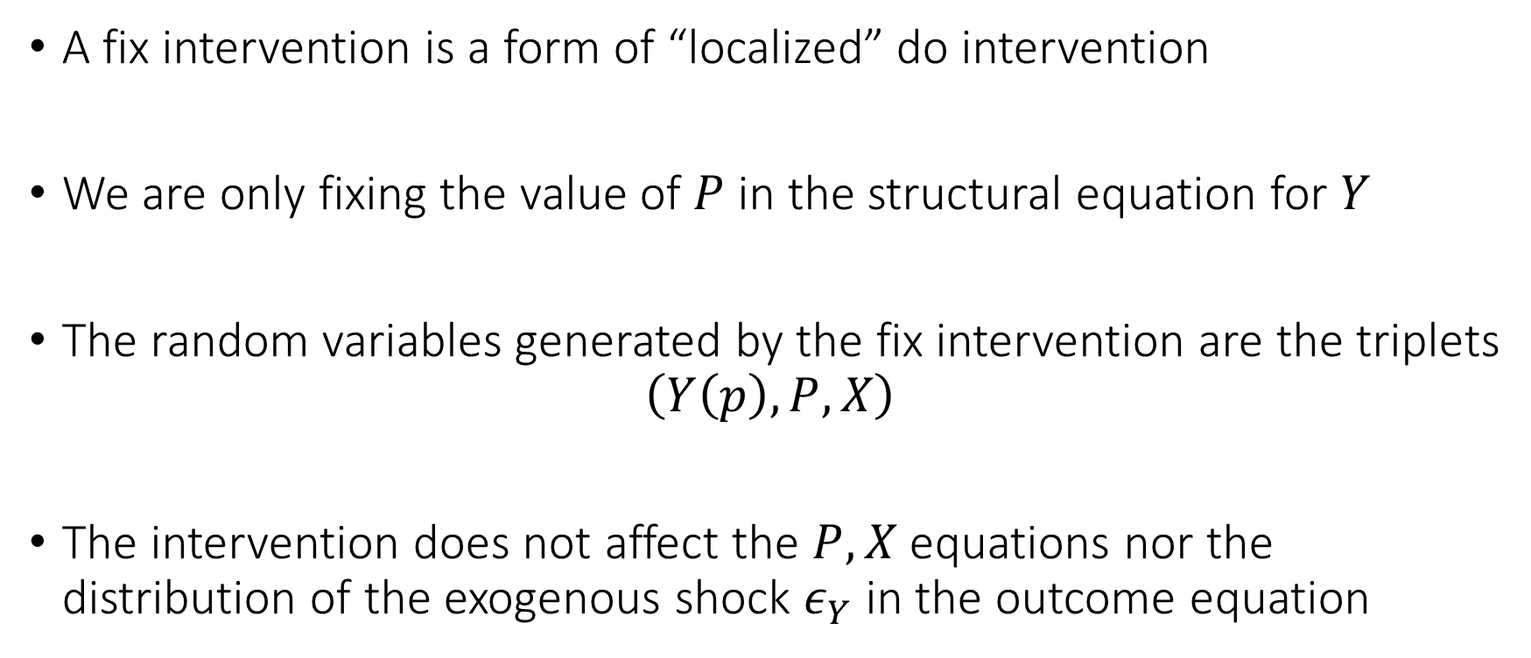
Fix Interventions
A fix intervention is a form of “localized” do intervention
We are only fixing the value of $P$ in the structural equation for $Y$
The random variables generated by the fix intervention are the triplets
$$\left(Y\left(p\right),P,X\right)$$
The intervention does not affect the $P,X$ equations nor the distribution of the exogenous shock $ε_{Y}$ in the outcome equation

Slide 25
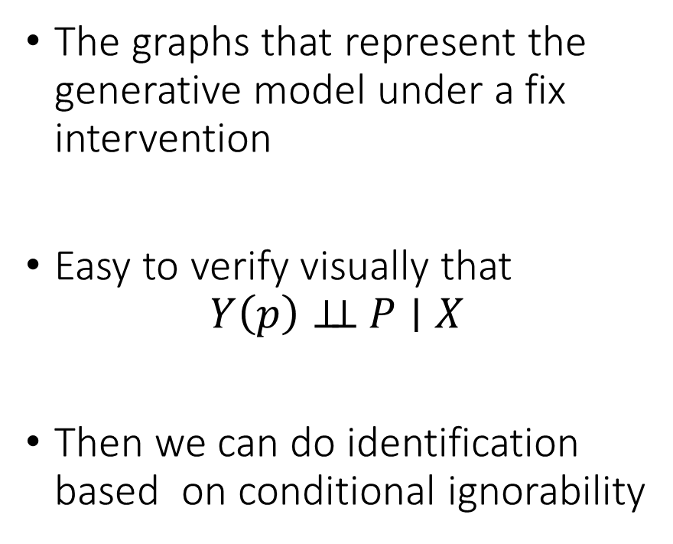

Single World Intervention Graphs
Data Generative Model under $fix\left(P=p\right)$
The graphs that represent the generative model under a fix intervention
Easy to verify visually that
$$Y\left(p\right)⊥⊥ P∣X$$
Then we can do identification based on conditional ignorability
$$\left.\begin{matrix}Y \\ P \\ X\end{matrix}\right|fix\left(P=p\right)\begin{aligned}≔&f_{Y}(p,X,ε_{Y}) \\ f_{P}\left(X, ε_{P}\right) \\ ≔&ε_{X}\end{aligned}$$
$$P$$
$$p$$
$$X$$
$$Y\left(p\right)$$
Single World Intervention Graph

Slide 26
Testable Implications of a DAG
D-Separation and Conditional Independence

Slide 27
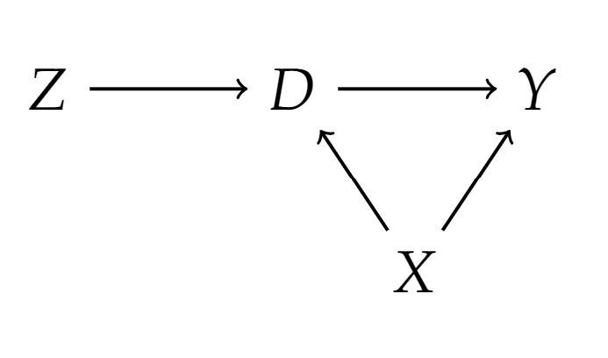
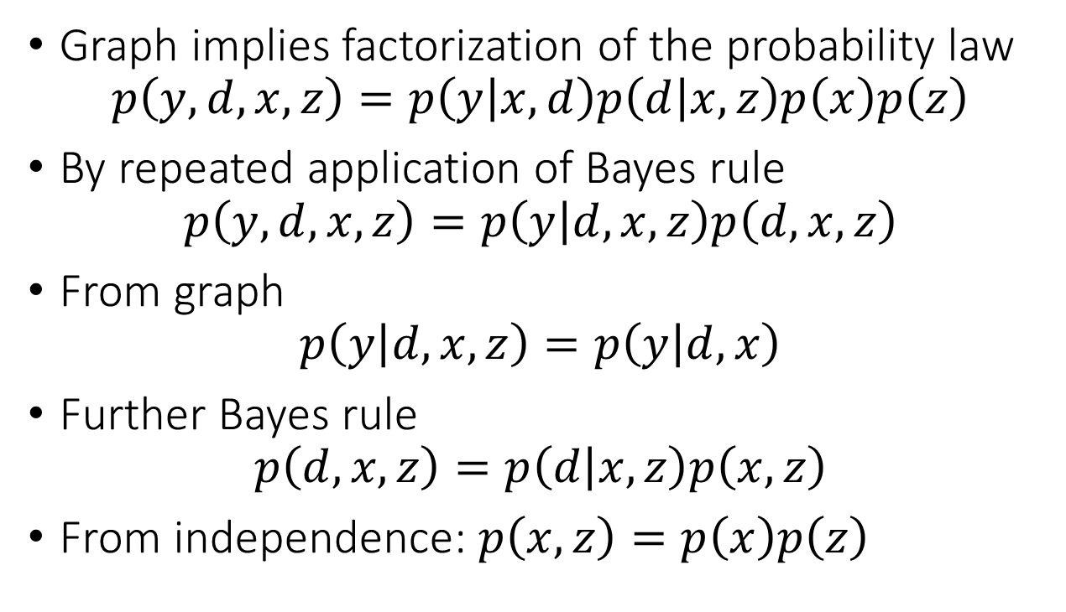
DAGs Encode Factorization of Probability
Graph implies factorization of the probability law
$$p\left(y,d,x,z\right)=p\left(y | x,d\right)p\left(d | x,z\right)p\left(x\right)p\left(z\right)$$
By repeated application of Bayes rule
$$p\left(y,d,x,z\right)=p\left(y | d,x,z\right)p\left(d,x,z\right)$$
From graph
$$p\left(y | d,x,z\right)=p\left(y | d,x\right)$$
Further Bayes rule
$$p\left(d, x,z\right)=p\left(d | x,z\right)p\left(x,z\right)$$
From independence: $p\left(x,z\right)=p\left(x\right)p\left(z\right)$

Slide 28
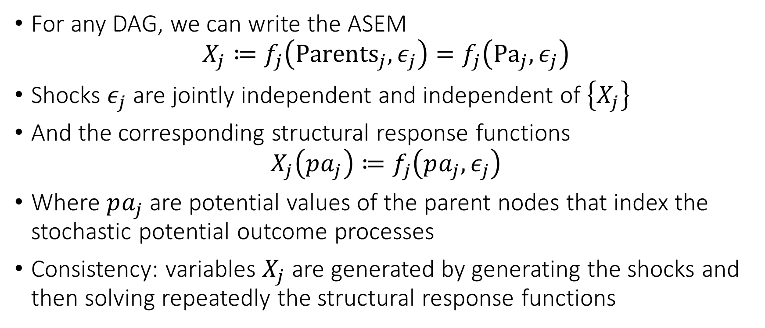
General DAGs
For any DAG, we can write the ASEM
$$X_{j}≔f_{j}\left({Parents}_{j}, ε_{j}\right)=f_{j}\left({Pa}_{j},ε_{j}\right)$$
Shocks $ε_{j}$ are jointly independent and independent of $\left\{X_{j}\right\}$
And the corresponding structural response functions
$$X_{j}\left(pa_{j}\right)≔f_{j}\left(pa_{j},ε_{j}\right)$$
Where $pa_{j}$ are potential values of the parent nodes that index the stochastic potential outcome processes
Consistency: variables $X_{j}$ are generated by generating the shocks and then solving repeatedly the structural response functions

Slide 29

General DAGs and Factorization
The probability law factorizes as:
$$p\left({\left\{x_{ℓ}\right\}}_{ℓ∈V}\right)=\prod_{ℓ∈V}{p\left(x_{ℓ} | pa_{ℓ}\right)}$$

Slide 30

DAGs Encode Conditional Independencies
Any two variables $X, Y$ are independent conditional on a set $S$ if they are D(irected)-separated in the graph
$${\left(X⊥⊥_{ _d}Y ∣ S\right)}_{G} ⇒ X⊥⊥Y∣S$$
Need to define the concept of D-separation

Slide 31
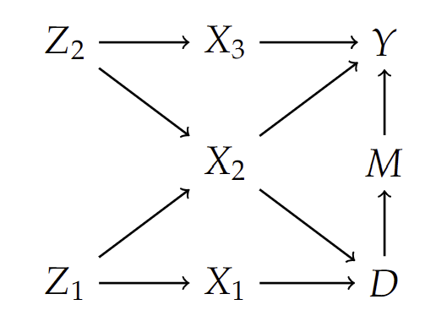
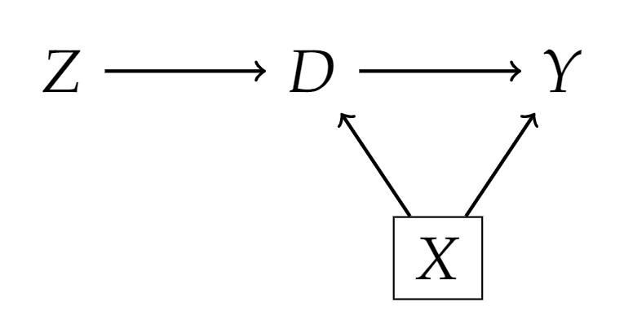
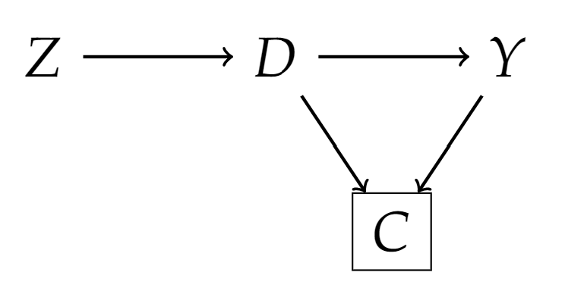

Some Graph Definitions
A path $π$ in a graph is blocked by a set of nodes $S$ if
Either $π$ contains a chain $i→m→j$ or a fork $i←m→j$ and $m∈S$
Or $π$ contains a collider $i→m←j$ and neither $m$ nor its descendants are in $S$

Slide 32

D-Separation
In a DAG $G$, two nodes $X, Y$ are D-separated by s set of nodes $S$ if $S$ blocks all paths between $X$ and $Y$
We denote it as:
$${\left(X⊥⊥_{ _d}Y ∣ S\right)}_{G}$$

Slide 33

D-separation implies conditional independency
$${\left(X⊥⊥_{ _d}Y ∣ S\right)}_{G} ⇒ X⊥⊥Y∣S,$$
$$(Verma, Pearl,^{′}88)$$

Slide 34
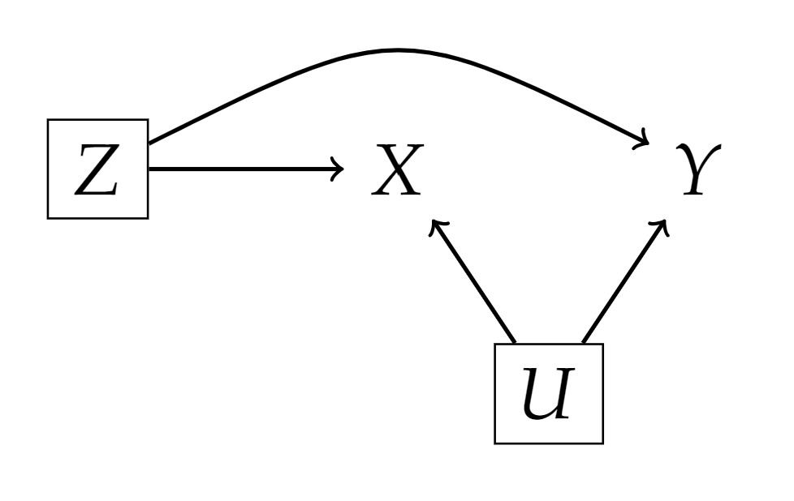

Examples
By factorization property and Bayes rule
$$p\left(y,x | z,u\right)=p\left(y | x,z,u\right) p\left(x | z,u\right)=p\left(y | z,u\right) p\left(x | z,u\right)$$

Slide 35
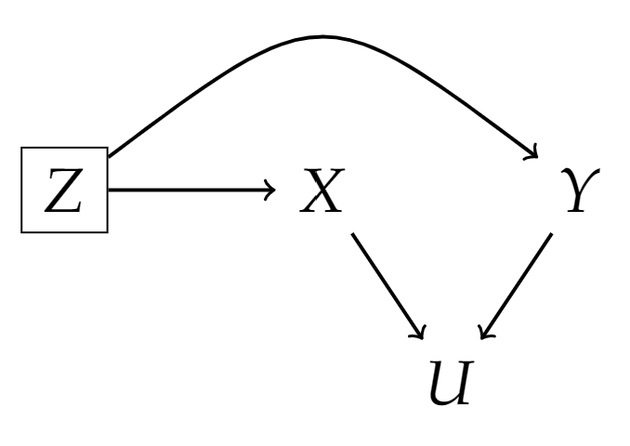
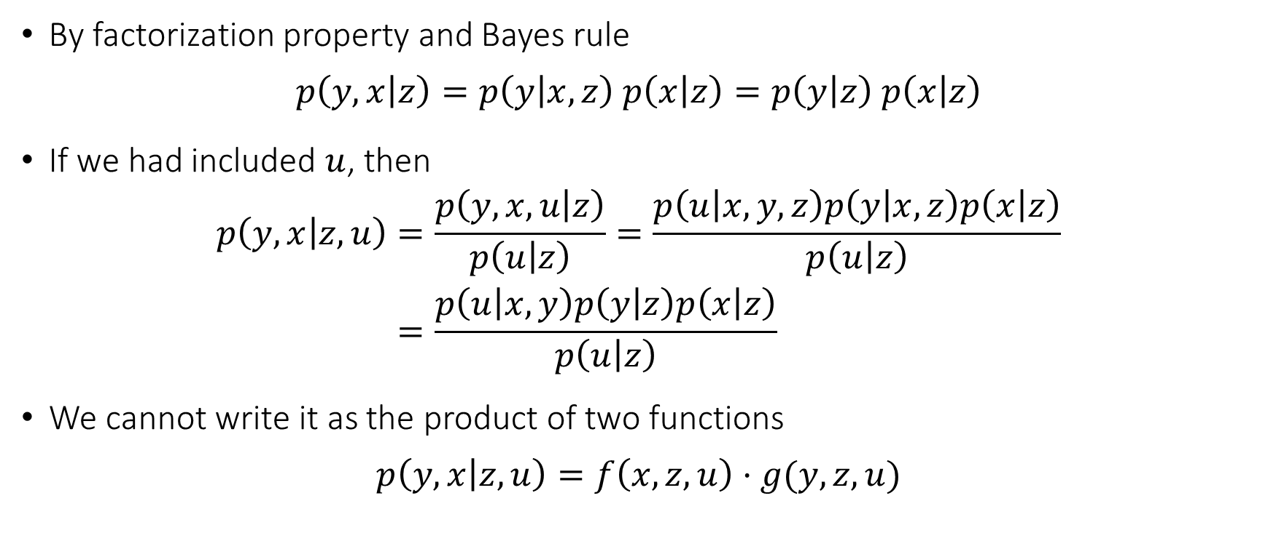
Examples
By factorization property and Bayes rule
$$p\left(y,x | z\right)=p\left(y | x,z\right) p\left(x | z\right)=p\left(y | z\right) p\left(x | z\right)$$
If we had included $u$, then
$$\begin{aligned}p\left(y,x | z,u\right)=&\frac{p\left(y,x,u | z\right)}{p\left(u | z\right)}=\frac{p\left(u | x,y,z\right)p\left(y | x,z\right)p\left(x | z\right)}{p\left(u | z\right)} \\ =&\frac{p\left(u | x,y\right)p\left(y | z\right)p\left(x | z\right)}{p\left(u | z\right)}\end{aligned}$$
We cannot write it as the product of two functions
$$p\left(y,x | z,u\right)=f\left(x,z,u\right)⋅g(y,z,u)$$

Slide 36
Proving the Main Theorem!

Slide 37
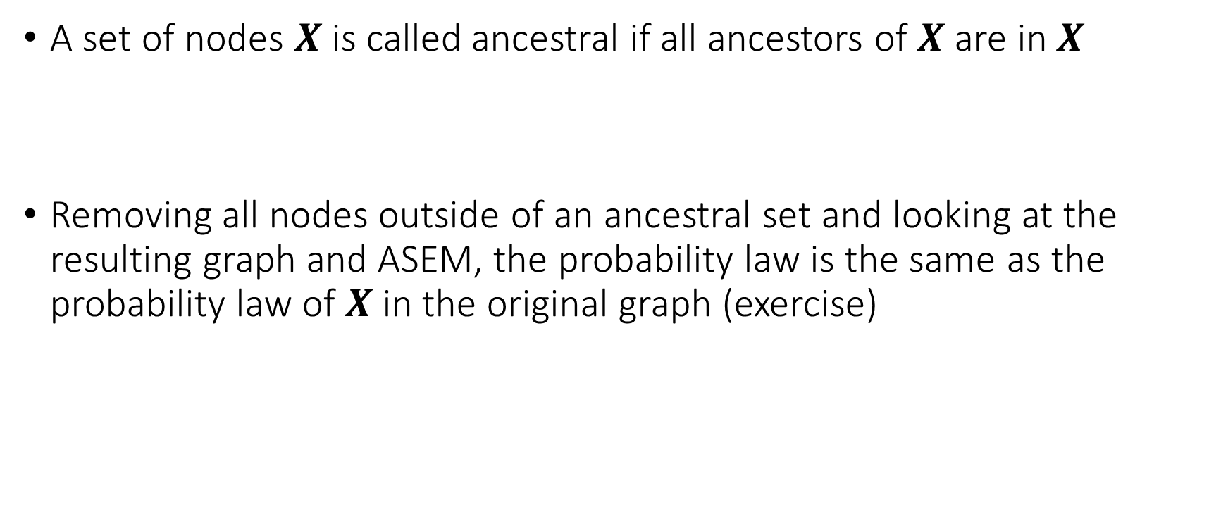
Proof Step 1
A set of nodes $X$ is called ancestral if all ancestors of $X$ are in $X$
Removing all nodes outside of an ancestral set and looking at the resulting graph and ASEM, the probability law is the same as the probability law of $X$ in the original graph (exercise)

Slide 38





Proof Step 2
Suppose that a set of nodes $X$ is D-separated from a set of nodes $Y$ by a set of nodes $S$
And that $X∪Y∪S$ is the set of all nodes
$$X$$
$$X$$
$$S$$
$$Y$$

Slide 39



Proof Step 2
Let $S_{1}$ the subset of $S$ that has a parent in $X$. Let $S_{2}$ the remainder.
It has to be that $Pa\left(X∪S_{1}\right)∈X∪S$
It has to be that $Pa\left(Y∪S_{2}\right)∈Y∪S$
$$X$$
$$S_{2}$$
$$X$$
$$Y$$
$$S_{1}$$

Slide 40

Proof Step 2
We can factorize:
$$p\left(x,y,s\right)=\prod_{W∈X∪S_{1}}{p\left(w | pa_{W}\right)}\prod_{W∈Y∪S_{2}}{p\left(w | pa_{W}\right)}=f\left(x,s_{1}\right)g\left(y,s_{2}\right)$$
$$X$$
$$S_{2}$$
$$X$$
$$Y$$
$$S_{1}$$

Slide 41

Proof Step 2
We can factorize:
$$p\left(x,y,s\right)=\prod_{W∈X∪S_{1}}{p\left(w | pa_{W}\right)}\prod_{W∈Y∪S_{2}}{p\left(w | pa_{W}\right)}=f\left(x,s_{1}\right)g\left(y,s_{2}\right)$$
Implies that:
$$X⊥⊥ Y∣S$$

Slide 42






Final Step
By first step, we can restrict to ancestral set of $X∪Y∪S$
Does not change conditional independence relations (exercise)
Does not change d-separation relations (exercise)
Define $X$ nodes in ancestral set of $X∪Y∪S$ not d-separated from X
Define $Y$ the remainder of nodes in ancestral set not in $X, S$.
$$X$$
$$S$$
$$X$$
$$Y$$
$$X$$

Slide 43






Final Step
By definition of d-separation, $S$ must d-separate $X$ from $Y$ (exercise)
We can invoke previous critical lemma
$$X$$
$$S$$
$$X$$
$$Y$$
$$X$$

Slide 44
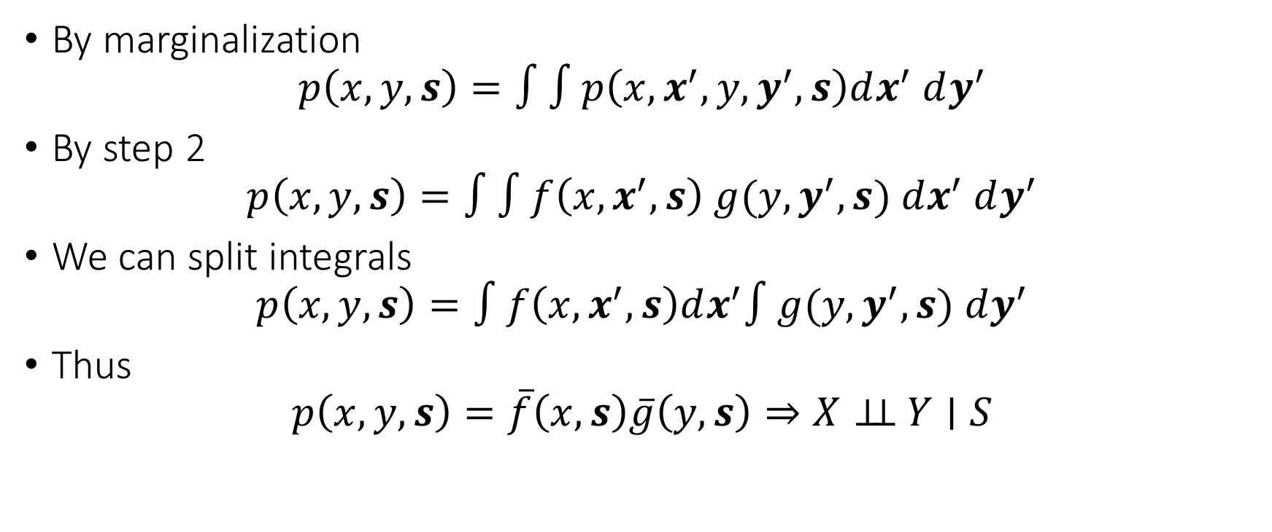
Final Step
By marginalization
$$p\left(x,y,s\right)=∫∫p\left(x, x^{′},y, y^{′},s\right)dx^{′} dy^{′}$$
By step 2
$$p\left(x,y,s\right)=∫∫f\left(x,x^{′},s\right) g(y,y^{′},s) dx^{′} dy^{′}$$
We can split integrals
$$p\left(x,y,s\right)=∫f\left(x,x^{′},s\right)dx^{′}∫g(y,y^{′},s) dy^{′}$$
Thus
$$p\left(x,y,s\right)=\overline{f}\left(x,s\right)\overline{g}\left(y, s\right)⇒X⊥⊥ Y∣S$$

