Slide 1
MS&E 228: Heterogeneous Treatment Effects
Vasilis Syrgkanis
MS&E, Stanford

Slide 2
Causal Inference with Experiments
Prediction with Linear Models
Prediction with High-Dim Linear Models
Inference on Causal and Predictive Effects with High-Dim Linear Models
Potential Outcomes and Conditional Ignorability
Structural Equation Models and Conditional Exogeneity
Directed Acyclic Graphs
Prediction with Non-Linear Models
Inference on Causal Effects with Non-Linear Models
Un-observed Confounding and Instruments
Estimation of Heterogeneous Causal Effects
Identification of Causal Effects in Longitudinal Data
Linear Predictive Models and Statistical Inference
Causal Identification in Observational Data
Non-Linear Predictive Models and Statistical Inference
Topics

Slide 3
Causal Inference with Experiments
Prediction with Linear Models
Prediction with High-Dim Linear Models
Inference on Causal and Predictive Effects with High-Dim Linear Models
Potential Outcomes and Conditional Ignorability
Structural Equation Models and Conditional Exogeneity
Directed Acyclic Graphs
Prediction with Non-Linear Models
Inference on Causal Effects with Non-Linear Models
Un-observed Confounding and Instruments
Estimation of Heterogeneous Causal Effects
Identification of Causal Effects in Longitudinal Data
Linear Predictive Models and Statistical Inference
Causal Identification in Observational Data
Non-Linear Predictive Models and Statistical Inference
Topics

Slide 4
Recap of Last Lecture

Slide 5








Causal Inference Pipeline
Data Collection
Estimation
(training)
Validation
(testing)
Domain Assumption Elicitation
Identification
Inference (Confidence Intervals)
DAGs/ASEMs
Construct estimate $\hat{g}\left(d,z\right)$ of predictive model
$$E\left[Y ∣ D=d,Z=z\right]$$
Estimate mean counterfactual
$${\hat{a}}_{d}=E_{n}\left[\hat{g}\left(d,Z\right)\right]$$
Theory
$$a_{d}$$
$$E\left[E\left[Y | D=d,Z\right]\right]$$
$$D$$
$$=$$
$$a_{d}∈{\hat{a}}_{d}±2\hat{σ}$$
$$Z$$
$$Y$$
Who should we treat?
Sensitivity Analysis
Practice
$$a_{d}∈{\hat{a}}_{d}±(2\hat{σ}+ε)$$
Adaptive Experiments
Decision
Policy

Slide 6
Different Approaches to Relaxing our Goals
Goal 1: Maybe estimate a simpler projection (e.g. analogue of BLP)
Goal 2: Confidence intervals for predictions of this simple projection
Goal 3: Simultaneous confidence bands for predictions of this simple projection
Goal 4: Estimation error rate for the true CATE
Goal 5: Confidence intervals for the prediction of a CATE model
Goal 6: Simultaneous confidence bands for joint predictions of CATE model
Policy Learning
Goal 7: Go after optimal simple treatment policies; give me a policy with value close to the best
Goal 8: Inference on value of candidate treatment policies
Goal 9: Inference on value of optimal policy
Goal 10: Identify responder or heterogeneous sub-groups; policies with statistical significance;
Linear Doubly Robust Learner
Meta-learner approaches: S-Learner, T-Learner, X-Learner, R-Learner, DR-Learner
Neural Network approaches: TARNet, CFR
Random Forest approaches: BART
Modified (honest) ML methods: Generalized Random Forest, Orthogonal Random Forest, Sub-sampled Nearest Neighbor Regression
?? (only classical non-parametric statistic results on confidence bands of non-parametric functions)
Doubly Robust Policy Learning
Doubly Robust Policy Evaluation

Slide 7
Goals for Today
Meta-Learners for Heterogeneous Treatment Effects

Slide 8
Comparing Meta-Learners
S and T-Learners are typically poor performing as they heavily depend on outcome modelling; among them the T-Learner should be preferred
X-Learner is a better version of S and T as it incorporates propensity knowledge
DR-Learner and R-Learner, both possess “Neyman orthogonality” properties as they carefully combine outcome and treatment assignment modelling
The error of the final cate model is not heavily impacted by the errors in the auxiliary models (Orthogonal Statistical Learning)
DR-Learner estimates un-weighted projection of true CATE on model space, but can be “high-variance” due to inverse propensity
R-Learner estimates variance weighted projection but is much more stable to extreme propensities as it never divides by propensity.

Slide 9
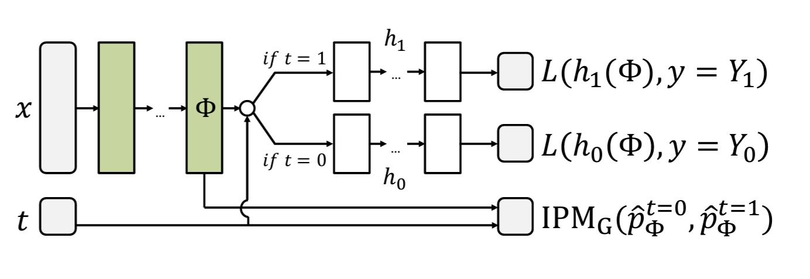
Neural Network CATE Learners (CFR Net) Shalit et al. 17

Slide 10
Model Selection and Evaluation

Slide 11
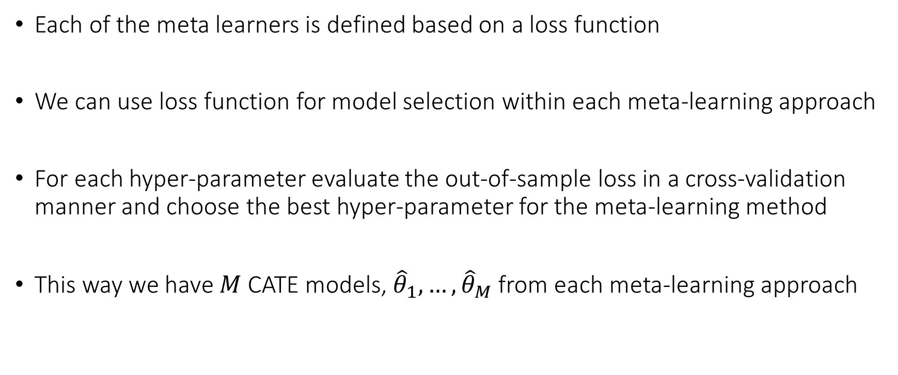
Model Selection within Method
Each of the meta learners is defined based on a loss function
We can use loss function for model selection within each meta-learning approach
For each hyper-parameter evaluate the out-of-sample loss in a cross-validation manner and choose the best hyper-parameter for the meta-learning method
This way we have $M$ CATE models, ${\hat{θ}}_{1}, …,{\hat{θ}}_{M}$ from each meta-learning approach

Slide 12
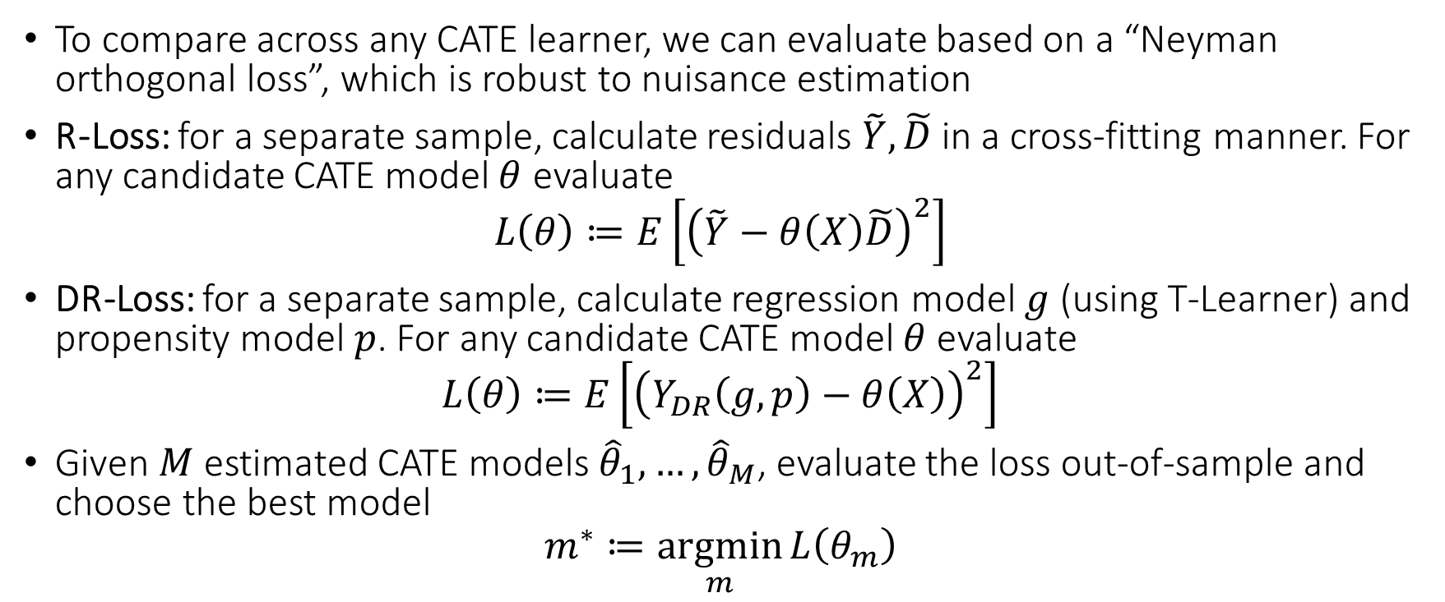
Model Selection Across Methods
To compare across any CATE learner, we can evaluate based on a “Neyman orthogonal loss”, which is robust to nuisance estimation
R-Loss: for a separate sample, calculate residuals $\tilde{Y},\tilde{D}$ in a cross-fitting manner. For any candidate CATE model $θ$ evaluate
$$L\left(θ\right)≔E\left[{\left(\tilde{Y}−θ\left(X\right)\tilde{D}\right)}^{2}\right]$$
DR-Loss: for a separate sample, calculate regression model $g$ (using T-Learner) and propensity model $p$. For any candidate CATE model $θ$ evaluate
$$L\left(θ\right)≔E\left[{\left(Y_{DR}\left(g,p\right)−θ\left(X\right)\right)}^{2}\right]$$
Given $M$ estimated CATE models ${\hat{θ}}_{1}, …,{\hat{θ}}_{M}$, evaluate the loss out-of-sample and choose the best model
$$m^{∗}≔\underset{m}{argmin}{L\left(θ_{m}\right)}$$

Slide 13
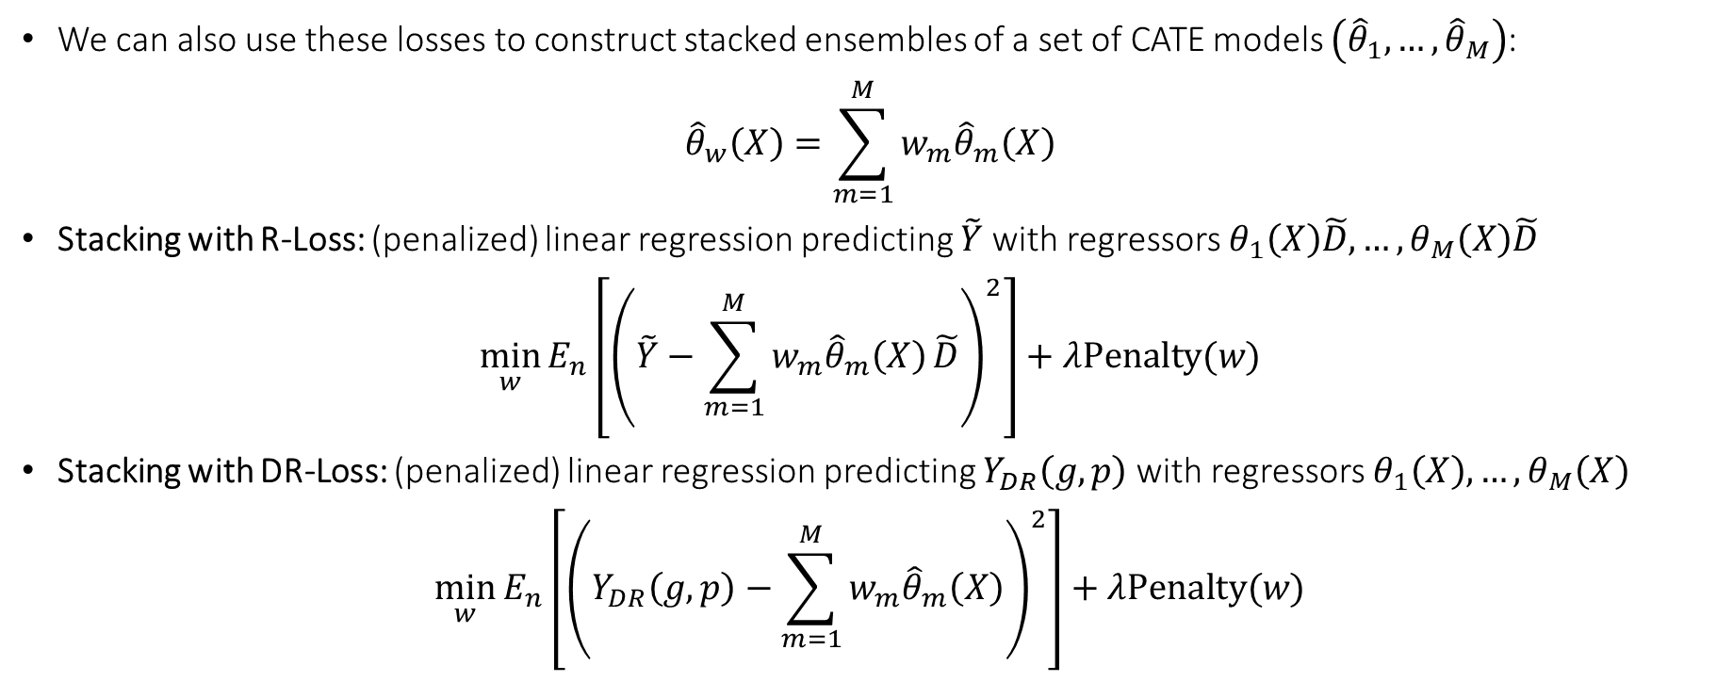
Ensembling and Stacking
We can also use these losses to construct stacked ensembles of a set of CATE models $\left({\hat{θ}}_{1},…,{\hat{θ}}_{M}\right)$:
$${\hat{θ}}_{w}\left(X\right)=\sum_{m=1}^{M}{w_{m}{\hat{θ}}_{m}\left(X\right)}$$
Stacking with R-Loss: (penalized) linear regression predicting $\tilde{Y}$ with regressors $θ_{1}\left(X\right)\tilde{D},…,θ_{M}\left(X\right)\tilde{D}$
$$\min_{w}{E_{n}\left[{\left(\tilde{Y}−\sum_{m=1}^{M}{w_{m}{\hat{θ}}_{m}\left(X\right)}\tilde{D}\right)}^{2}\right]+λPenalty(w)}$$
Stacking with DR-Loss: (penalized) linear regression predicting $Y_{DR}\left(g,p\right)$with regressors $θ_{1}\left(X\right),…,θ_{M}\left(X\right)$
$$\min_{w}{E_{n}\left[{\left(Y_{DR}\left(g,p\right)−\sum_{m=1}^{M}{w_{m}{\hat{θ}}_{m}\left(X\right)}\right)}^{2}\right]+λPenalty(w)}$$

Slide 14
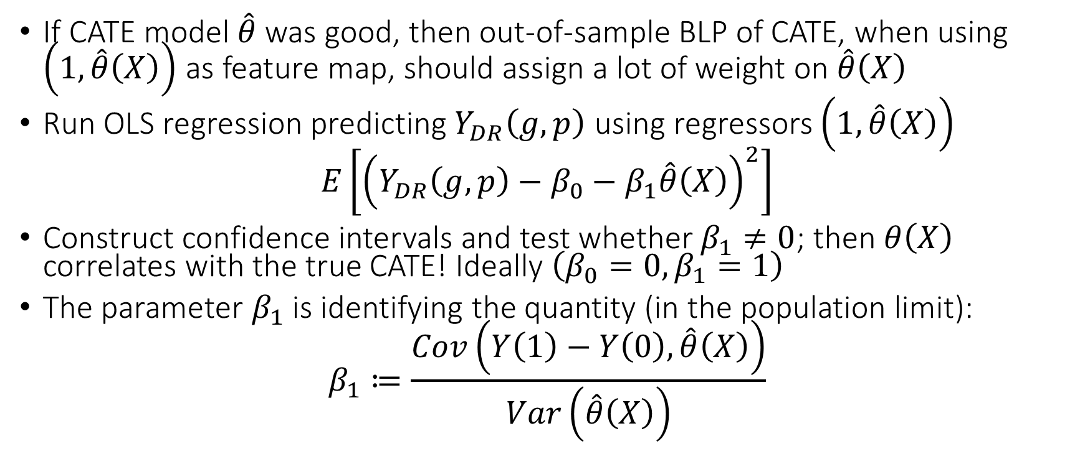
Evaluation via Testing Approaches
If CATE model $\hat{θ}$ was good, then out-of-sample BLP of CATE, when using $\left(1, \hat{θ}\left(X\right)\right)$ as feature map, should assign a lot of weight on $\hat{θ}\left(X\right)$
Run OLS regression predicting$Y_{DR}\left(g,p\right)$ using regressors $\left(1, \hat{θ}\left(X\right)\right)$
$$E\left[{\left(Y_{DR}\left(g,p\right)−β_{0}−β_{1}\hat{θ}\left(X\right)\right)}^{2}\right]$$
Construct confidence intervals and test whether $β_{1}≠0$; then $θ\left(X\right)$ correlates with the true CATE! Ideally $\left(β_{0}=0,β_{1}=1\right)$
The parameter $β_{1}$ is identifying the quantity (in the population limit):
$$β_{1}≔\frac{Cov\left(Y\left(1\right)−Y\left(0\right), \hat{θ}\left(X\right)\right)}{Var\left(\hat{θ}\left(X\right)\right)}$$

Slide 15
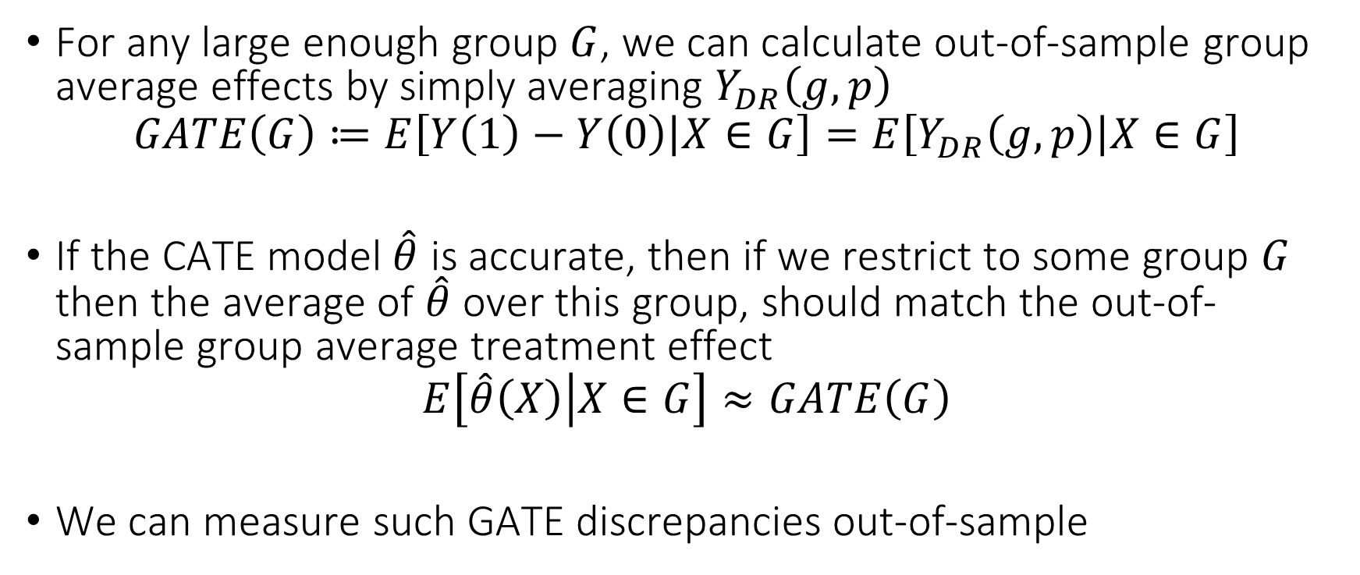
Validation via GATEs
For any large enough group $G$, we can calculate out-of-sample group average effects by simply averaging $Y_{DR}\left(g,p\right)$
$$GATE\left(G\right)≔E\left[Y\left(1\right)−Y\left(0\right) | X∈G\right]=E\left[Y_{DR}\left(g,p\right) | X∈G\right]$$
If the CATE model $\hat{θ}$ is accurate, then if we restrict to some group $G$ then the average of $\hat{θ}$ over this group, should match the out-of-sample group average treatment effect
$$E\left[\hat{θ}\left(X\right) | X∈G\right]≈GATE\left(G\right)$$
We can measure such GATE discrepancies out-of-sample

Slide 16
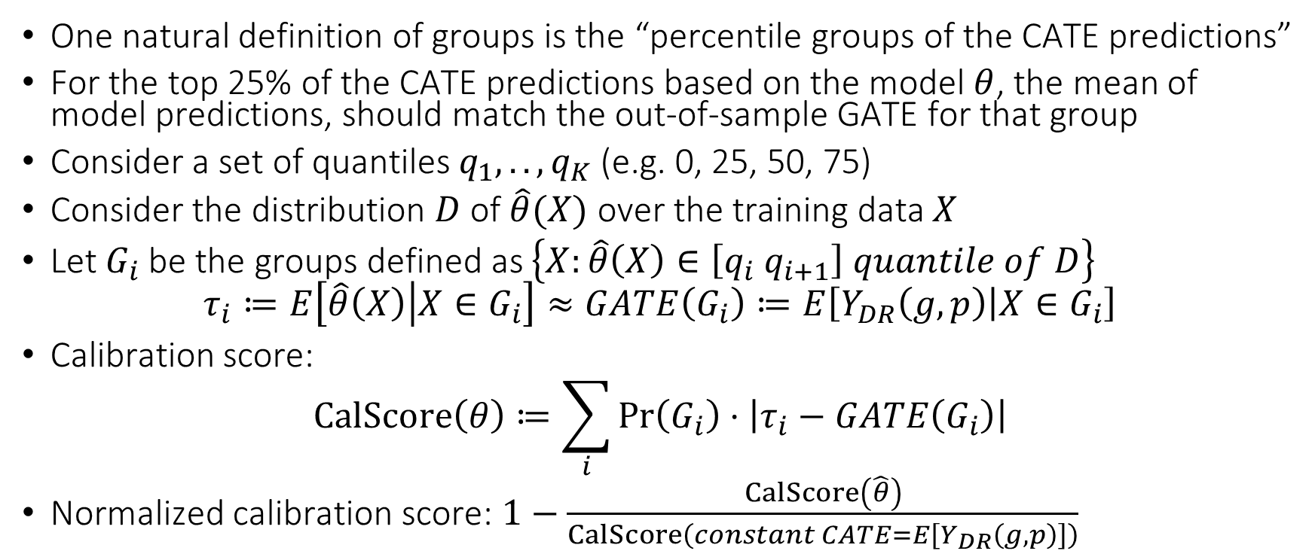
Validation via Calibration
One natural definition of groups is the “percentile groups of the CATE predictions”
For the top 25% of the CATE predictions based on the model $θ$, the mean of model predictions, should match the out-of-sample GATE for that group
Consider a set of quantiles $q_{1},..,q_{K}$ (e.g. 0, 25, 50, 75)
Consider the distribution $D$ of $\hat{θ}(X)$ over the training data $X$
Let $G_{i}$ be the groups defined as $\left\{X:\hat{θ}\left(X\right)∈\left[q_{i} q_{i+1}\right] quantile of D\right\}$
$$τ_{i}≔E\left[\hat{θ}\left(X\right) | X∈G_{i}\right]≈GATE\left(G_{i}\right)≔E\left[Y_{DR}\left(g,p\right) | X∈G_{i}\right]$$
Calibration score:
$$CalScore\left(θ\right)≔\sum_{i}{\operatorname{Pr}\left(G_{i}\right)⋅\left|τ_{i}−GATE\left(G_{i}\right)\right|}$$
Normalized calibration score: $1−\frac{CalScore\left(\hat{θ}\right)}{CalScore\left(constant CATE=E\left[Y_{DR}\left(g,p\right)\right]\right)}$

Slide 17
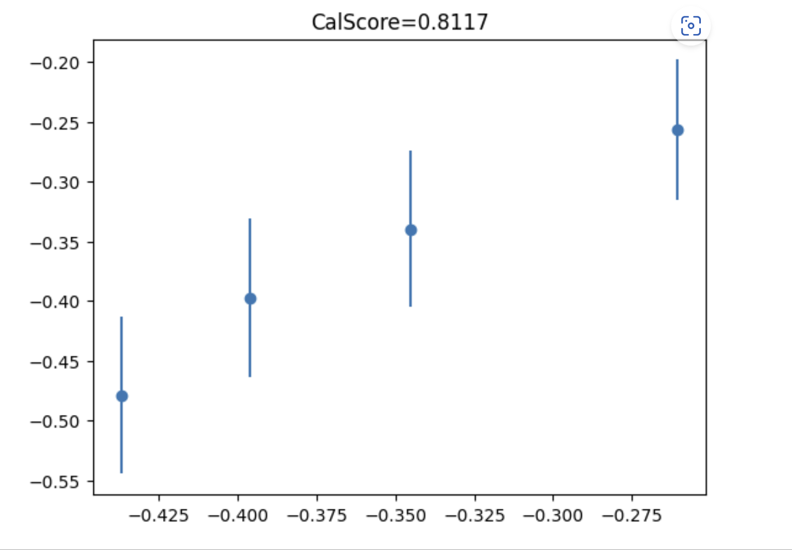

Testing for Heterogeneity
We can easily construct joint confidence intervals for all the GATEs
GATEs are the coefficients in the BLP of CATE using group one-hot-encoding as features
$$E\left[{\left(Y_{DR}\left(g,p\right)−β^{′}\left(1\left\{X∈G_{1}\right\},…, 1\left\{X∈G_{K}\right\}\right)\right)}^{2}\right]$$
We can use joint confidence intervals for BLP via the DR-Learner
If there was heterogeneity, then we should have that there are GATEs whose confidence intervals are non-overlapping

Slide 18
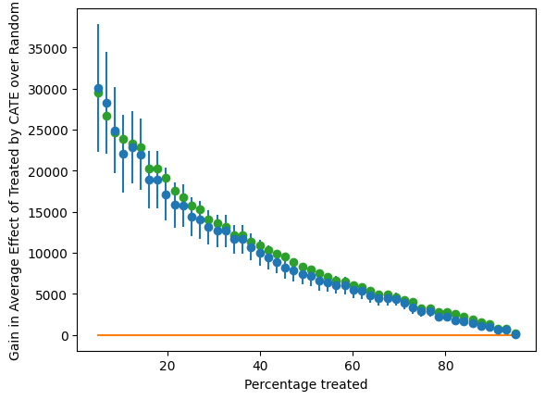

Stratification Motivated Evaluation
If we were to “prioritize” into treatment based on $\hat{θ}$ with a target to treat around q-percent of population then what would be the GATE of the treated group
Consider distribution $D_{n}$ of $θ(X)$ over training data $X$
We can define the groups:
$$G_{q}≔\left\{X:θ\left(X\right)≥\left(1−q\right)−th quantile of D_{n}\right\}$$
$$τ\left(q\right)=E\left[Y_{DR}\left(g,p\right) ∣ X∈G_{q}\right]−E\left[Y_{DR}\left(g,p\right)\right]$$
Ideally, $τ\left(q\right)$ should be always positive and increasing!
AUTOC $≈$ the area under the curve $τ\left(q\right)$

Slide 19
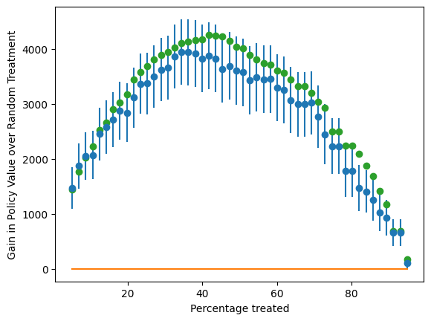

Stratification Motivated Evaluation
If we were “prioritize” into treatment based on $\hat{θ}$ with a target to treat around q-percent of the population then what would be the policy value we would get over treating $q$ percentage at random
Consider distribution $D_{n}$ of $\hat{θ}(X)$ over the training data $X$
We can define the group:
$$G_{q}≔\left\{X:\hat{θ}\left(X\right)≥\left(1−q\right)−th quantile of D_{n}\right\}$$
$$τ_{Q}\left(q\right)=\operatorname{Pr}\left(X∈G_{q}\right) \left(E\left[Y_{DR}\left(g,p\right) ∣ X∈G_{q}\right]−E\left[Y_{DR}\left(g,p\right)\right]\right)$$
Ideally, $τ_{Q}\left(q\right)$ should be large positive for some values!
QINI $≈$ the area under the curve $τ_{Q}\left(q\right)$

Slide 20
Policy Learning

Slide 21
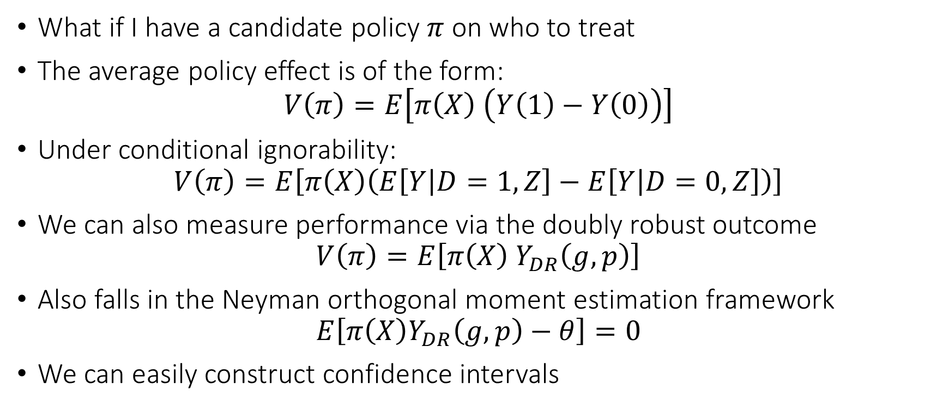
Candidate Policy
What if I have a candidate policy $π$ on who to treat
The average policy effect is of the form:
$$V\left(π\right)=E\left[π\left(X\right) \left(Y\left(1\right)−Y\left(0\right)\right)\right]$$
Under conditional ignorability:
$$V\left(π\right)=E\left[π\left(X\right)\left(E\left[Y | D=1,Z\right]−E\left[Y | D=0,Z\right]\right)\right]$$
We can also measure performance via the doubly robust outcome
$$V\left(π\right)=E\left[π\left(X\right) Y_{DR}\left(g,p\right)\right]$$
Also falls in the Neyman orthogonal moment estimation framework
$$E\left[π\left(X\right)Y_{DR}\left(g,p\right)−θ\right]=0$$
We can easily construct confidence intervals

Slide 22
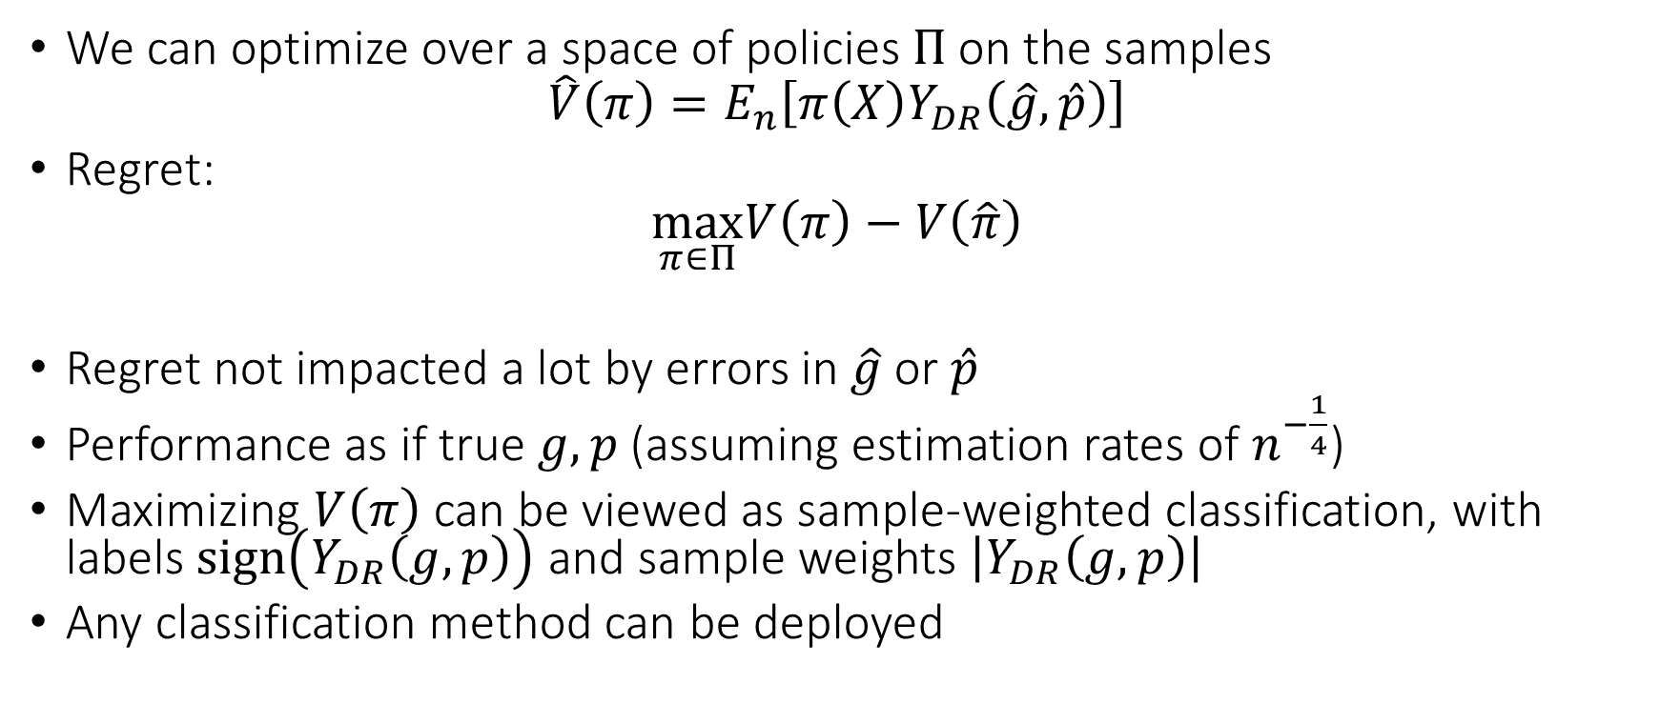
Policy Optimization
We can optimize over a space of policies $Π$ on the samples
$$\hat{V}\left(π\right)=E_{n}\left[π\left(X\right)Y_{DR}\left(\hat{g},\hat{p}\right)\right]$$
Regret:
$$\max_{π∈Π}V\left(π\right)−V\left(\hat{π}\right)$$
Regret not impacted a lot by errors in $\hat{g}$ or $\hat{p}$
Performance as if true $g,p$ (assuming estimation rates of $n^{−\frac{1}{4}}$)
Maximizing $V\left(π\right)$ can be viewed as sample-weighted classification, with labels $sign\left(Y_{DR}\left(g,p\right)\right)$ and sample weights $\left|Y_{DR}\left(g,p\right)\right|$
Any classification method can be deployed

Slide 23
Non-Parametric Confidence Intervals

Slide 24
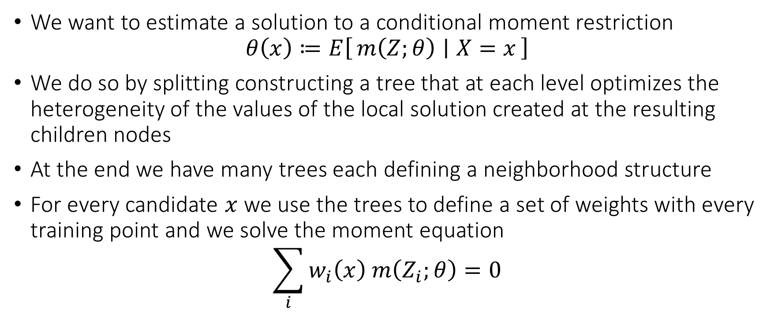
Generalized Random Forest
We want to estimate a solution to a conditional moment restriction
$$θ\left(x\right)≔E\left[m\left(Z;θ\right) ∣ X=x\right]$$
We do so by splitting constructing a tree that at each level optimizes the heterogeneity of the values of the local solution created at the resulting children nodes
At the end we have many trees each defining a neighborhood structure
For every candidate $x$ we use the trees to define a set of weights with every training point and we solve the moment equation
$$\sum_{i}{w_{i}\left(x\right) m\left(Z_{i};θ\right)}=0$$

Slide 25
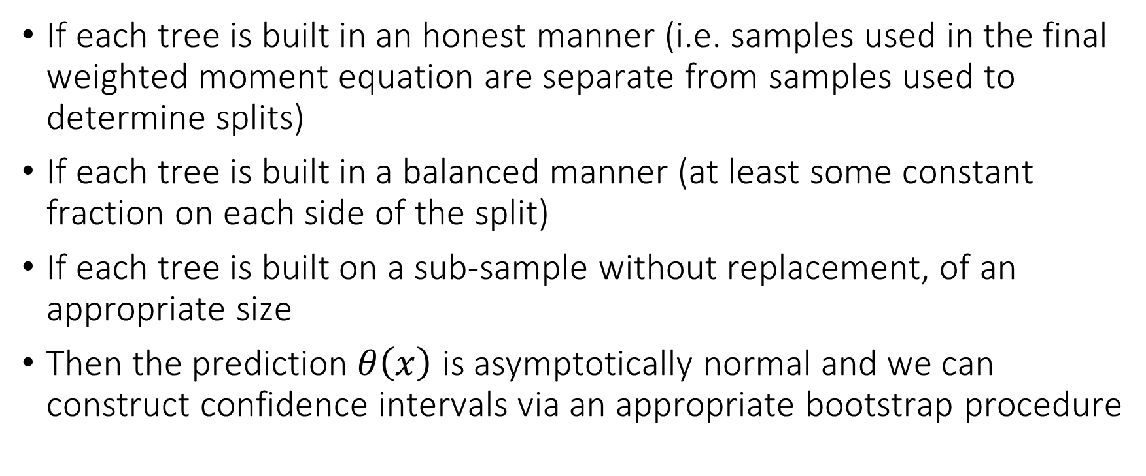
Generalized Random Forest
If each tree is built in an honest manner (i.e. samples used in the final weighted moment equation are separate from samples used to determine splits)
If each tree is built in a balanced manner (at least some constant fraction on each side of the split)
If each tree is built on a sub-sample without replacement, of an appropriate size
Then the prediction $θ\left(x\right)$ is asymptotically normal and we can construct confidence intervals via an appropriate bootstrap procedure

Slide 26
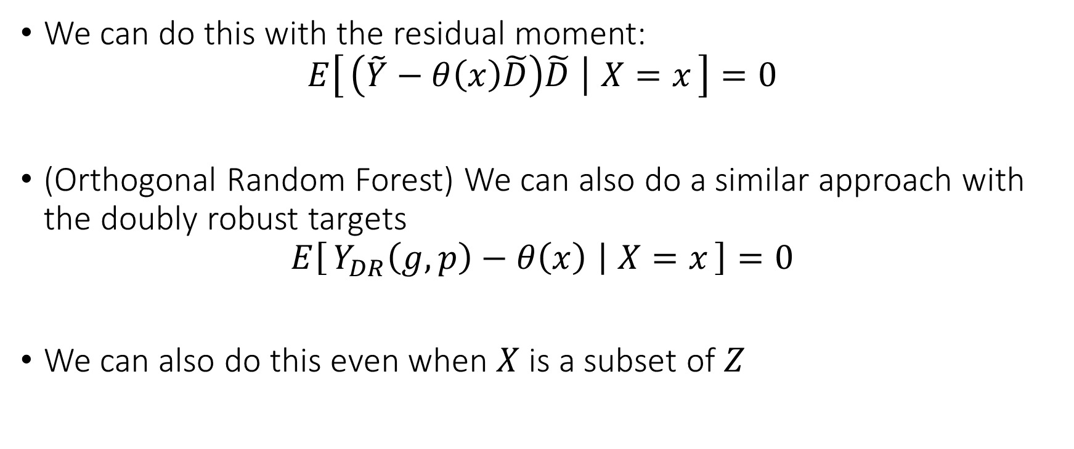
GRF for CATE
We can do this with the residual moment:
$$E\left[\left(\tilde{Y}−θ\left(x\right)\tilde{D}\right)\tilde{D} ∣ X=x\right]=0$$
(Orthogonal Random Forest) We can also do a similar approach with the doubly robust targets
$$E\left[Y_{DR}\left(g,p\right)−θ\left(x\right) ∣ X=x\right]=0$$
We can also do this even when $X$ is a subset of $Z$

