Slide 1
MS&E 228: Directed Acyclic Graphs and Non-Linear SEMs
Vasilis Syrgkanis
MS&E, Stanford

Slide 2
Causal Inference with Experiments
Prediction with Linear Models
Prediction with High-Dim Linear Models
Inference on Causal and Predictive Effects with High-Dim Linear Models
Potential Outcomes and Conditional Ignorability
Structural Equation Models and Conditional Exogeneity
Directed Acyclic Graphs
Prediction with Non-Linear Models
Inference on Causal Effects with Non-Linear Models
Un-observed Confounding and Instruments
Identification of Causal Effects in Longitudinal Data
Estimation of Heterogeneous Causal Effects
Linear Predictive Models and Statistical Inference
Causal Identification in Observational Data
Non-Linear Predictive Models and Statistical Inference
Topics

Slide 3
Causal Inference with Experiments
Prediction with Linear Models
Prediction with High-Dim Linear Models
Inference on Causal and Predictive Effects with High-Dim Linear Models
Potential Outcomes and Conditional Ignorability
Structural Equation Models and Conditional Exogeneity
Directed Acyclic Graphs
Prediction with Non-Linear Models
Inference on Causal Effects with Non-Linear Models
Un-observed Confounding and Instruments
Identification of Causal Effects in Longitudinal Data
Estimation of Heterogeneous Causal Effects
Linear Predictive Models and Statistical Inference
Causal Identification in Observational Data
Non-Linear Predictive Models and Statistical Inference
Topics

Slide 4
Goals for Today
Graphical criteria for selection of adjustment set
Crash course on good and bad “controls”

Slide 5
Recap of Last Lecture

Slide 6

Non-Linear versions of structural equation models are equivalent to Directed Acyclic Graphs

Slide 7


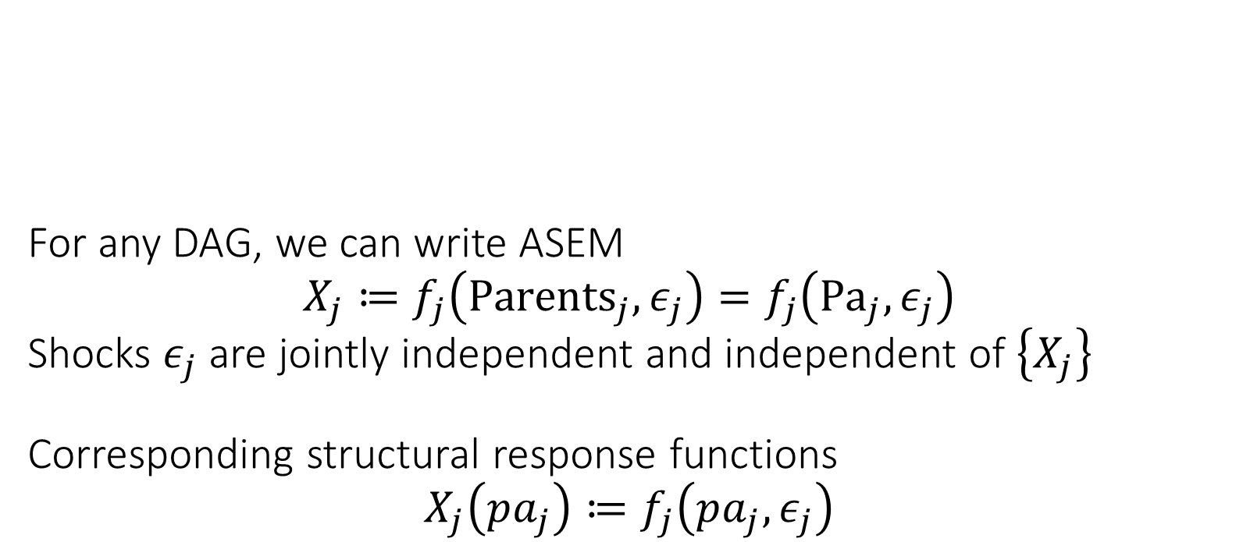




For any DAG, we can write ASEM $$X_{j}≔f_{j}\left({Parents}_{j}, ε_{j}\right)=f_{j}\left({Pa}_{j},ε_{j}\right)$$ Shocks $ε_{j}$ are jointly independent and independent of $\left\{X_{j}\right\}$ Corresponding structural response functions $$X_{j}\left(pa_{j}\right)≔f_{j}\left(pa_{j},ε_{j}\right)$$
$$ε_{D}$$
$$D$$
$$ε_{P}$$
$$X$$
$$Y$$
$$ε_{Y}$$
Exogenously determined “outside” of the model
Endogenously determined by the structural model
Shocks can be multi-dimensional e.g. separate shock variable per parental value
Potential/Counterfactual Outcome Processes
Structural Response Function
Potential values of parents

Slide 8

DAGs encode conditions on factorization of probability law $$p\left({\left\{x_{ℓ}\right\}}_{ℓ∈V}\right)=\prod_{ℓ∈V}{p\left(x_{ℓ} | pa_{ℓ}\right)}$$

Slide 9
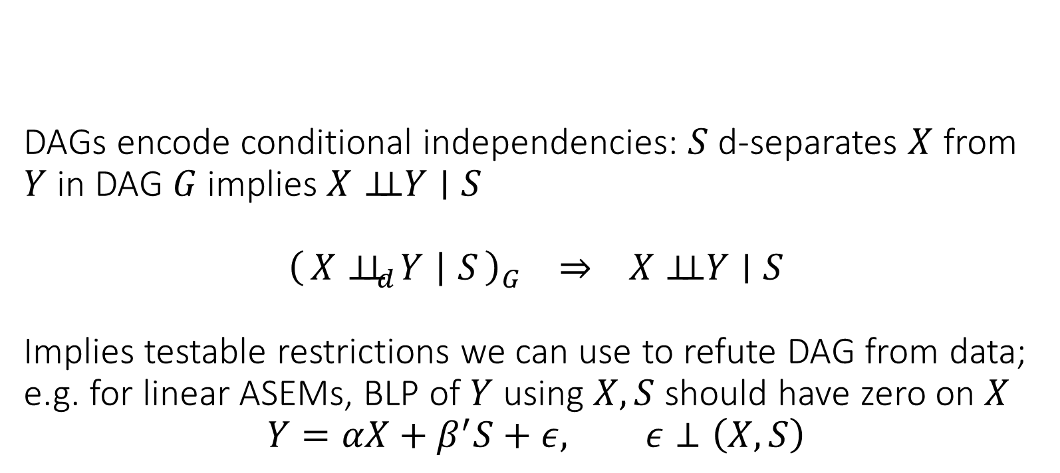
DAGs encode conditional independencies: $S$ d-separates $X$ from $Y$ in DAG $G$ implies $X⊥⊥Y∣S$ $${\left(X⊥⊥_{d}Y ∣ S\right)}_{G} ⇒ X⊥⊥Y∣S$$ Implies testable restrictions we can use to refute DAG from data; e.g. for linear ASEMs, BLP of $Y$ using $X, S$ should have zero on $X$ $$Y=αX+β^{′}S+ε, ε⊥\left(X,S\right)$$
Test whether it is non-zero!

Slide 10




$X$ is d-separated from $Y$ by $S$ if every path from $X$ to $Y$ is blocked. $S$ blocks a path if one of the following holds: - path contains chain $X→M→Y$ or fork $X←M→Y$ and $M∈S$ - path contains collider $X→M←Y$ and neither $M$ nor its descendants are in $S$
unblocked chain
unblocked fork
$$S$$
$$X$$
opened collider path
blocked chain
$$Y$$
blocked fork
collider path

Slide 11

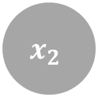
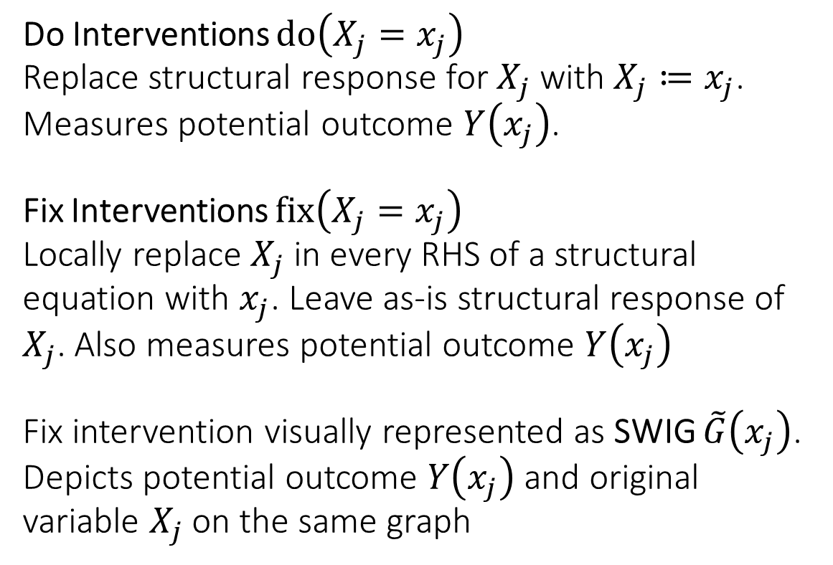
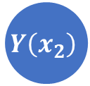
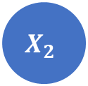

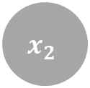
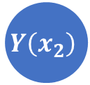
Do Interventions $do\left(X_{j}=x_{j}\right)$ Replace structural response for $X_{j}$ with $X_{j}≔x_{j}$. Measures potential outcome $Y\left(x_{j}\right)$. Fix Interventions $fix\left(X_{j}=x_{j}\right)$ Locally replace $X_{j}$ in every RHS of a structural equation with $x_{j}$. Leave as-is structural response of $X_{j}$. Also measures potential outcome $Y\left(x_{j}\right)$ Fix intervention visually represented as SWIG $\tilde{G}\left(x_{j}\right)$. Depicts potential outcome $Y\left(x_{j}\right)$ and original variable $X_{j}$ on the same graph
$$x_{2}$$
$$X_{1}$$
$$Y\left(x_{2}\right)$$
$$X_{2}$$
$$x_{2}$$
$$X_{1}$$
$$Y\left(x_{2}\right)$$

Slide 12
Graphical Criteria for Valid Adjustment Sets

Slide 13
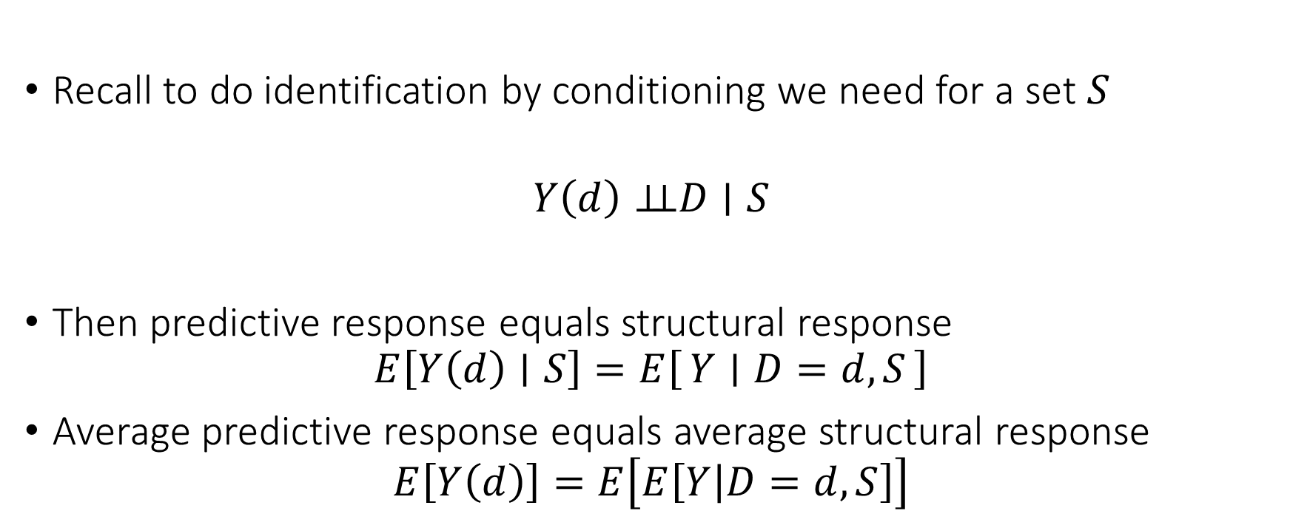
Conditional Ignorability
Recall to do identification by conditioning we need for a set $S$
$$Y\left(d\right)⊥⊥D∣S$$
Then predictive response equals structural response
$$E\left[Y\left(d\right)∣S\right]=E\left[Y ∣ D=d,S\right]$$
Average predictive response equals average structural response
$$E\left[Y\left(d\right)\right]=E\left[E\left[Y | D=d,S\right]\right]$$

Slide 14

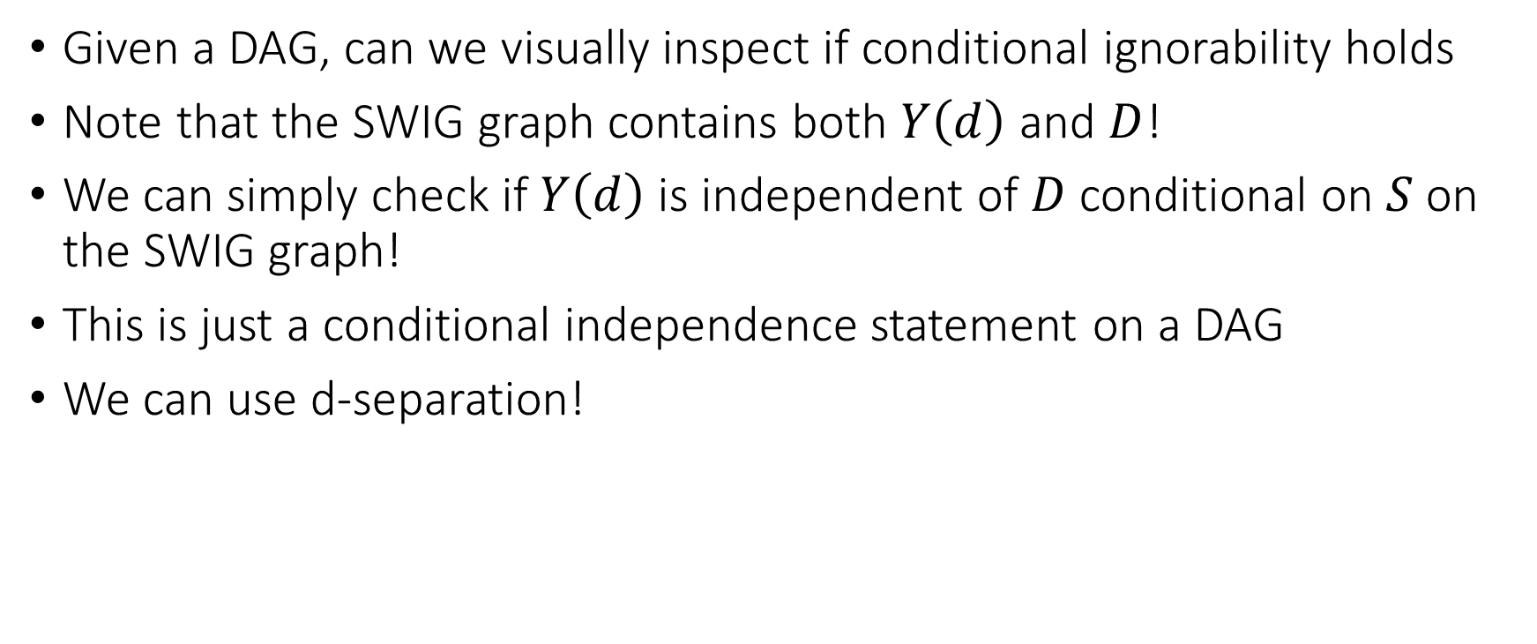


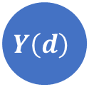
How can we check Conditional Ignorability
Given a DAG, can we visually inspect if conditional ignorability holds
Note that the SWIG graph contains both $Y\left(d\right)$ and $D$!
We can simply check if $Y\left(d\right)$ is independent of $D$ conditional on $S$ on the SWIG graph!
This is just a conditional independence statement on a DAG
We can use d-separation!
$$D$$
$$d$$
$$X$$
$$Y\left(d\right)$$

Slide 15



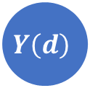


Conditional ignorability between treatment $D$ and outcome $Y$ conditional on set $S$ holds if $Y\left(d\right)$ is d-separated from $D$ on SWIG $\tilde{G}(d)$ induced by $fix\left(D=d\right)$ by the set $S$
$$D$$
$$d$$
$$X$$
$$Y\left(d\right)$$
$$S$$

Slide 16
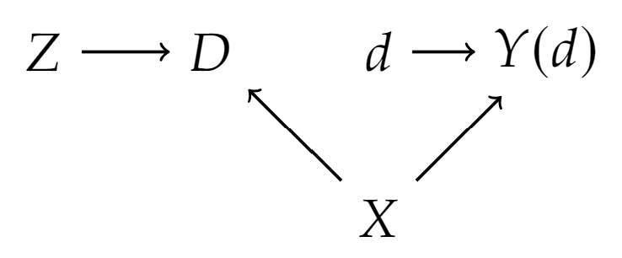
Example

Slide 17
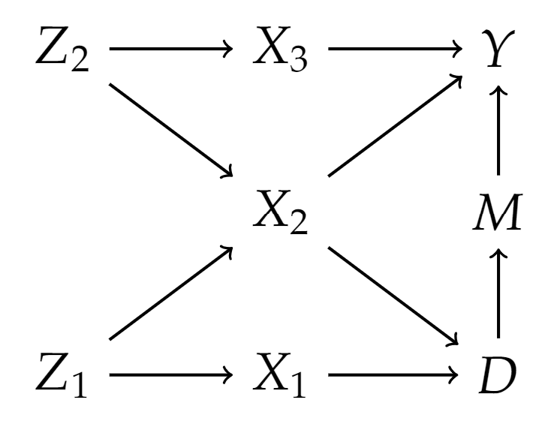
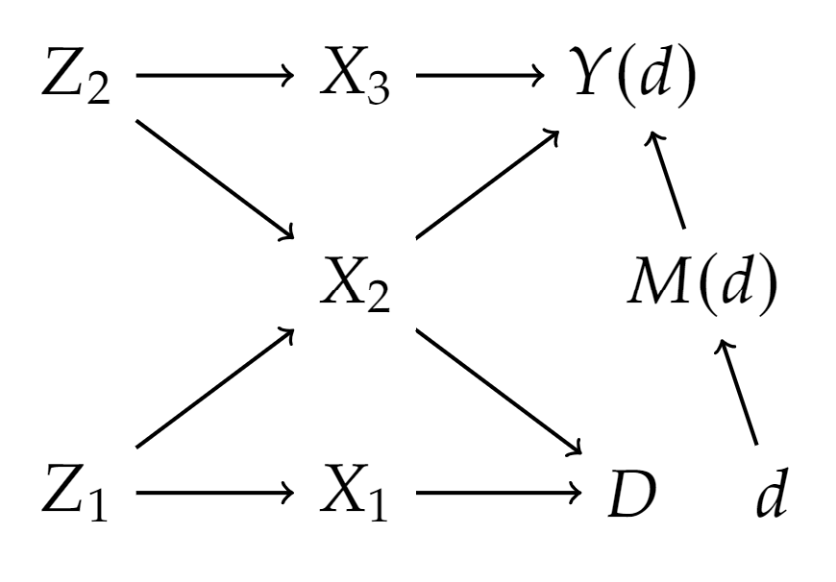
Example

Slide 18
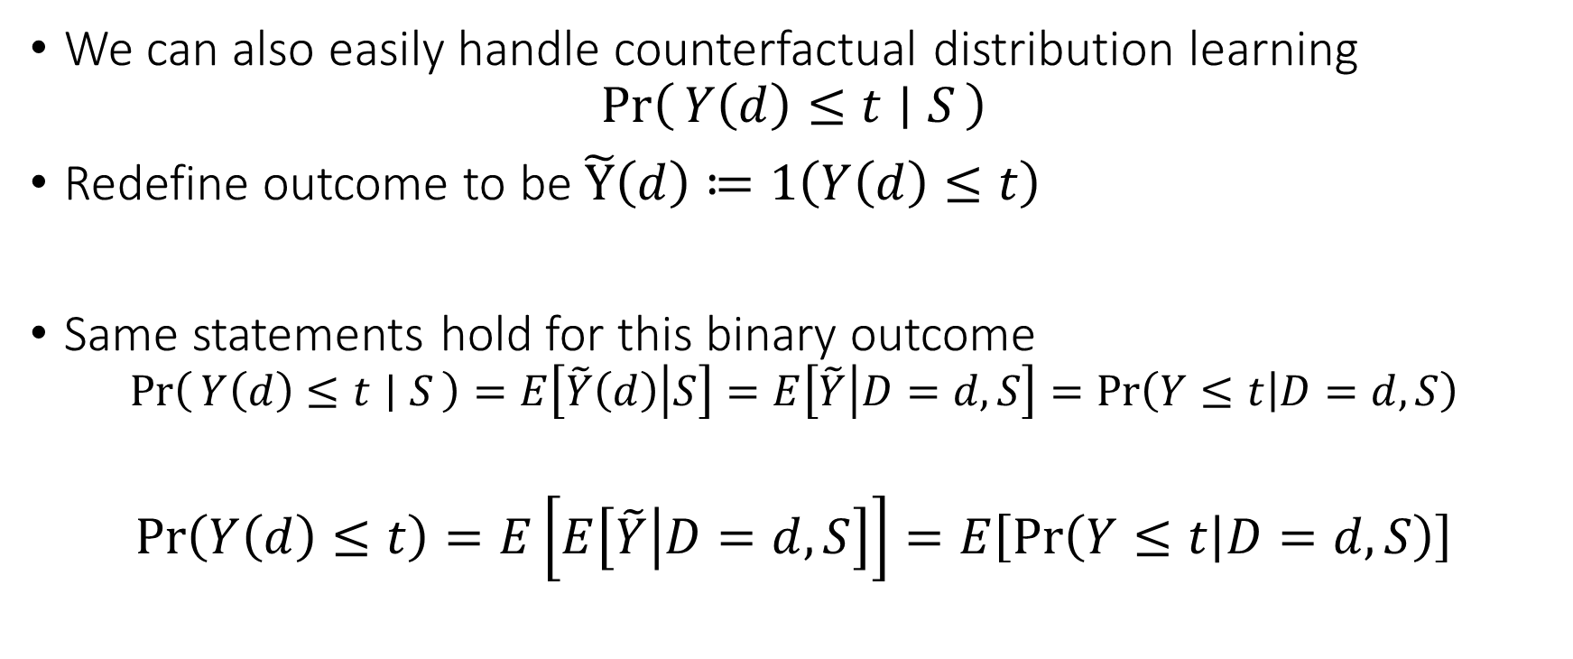
Side Note: Counterfactual Distributions
We can also easily handle counterfactual distribution learning
$$\operatorname{Pr}\left(Y\left(d\right)≤t ∣ S\right)$$
Redefine outcome to be $\tilde{Y}\left(d\right)≔1\left(Y\left(d\right)≤t\right)$
Same statements hold for this binary outcome
$$\operatorname{Pr}\left(Y\left(d\right)≤t ∣ S\right)=E\left[\tilde{Y}\left(d\right) | S\right]=E\left[\tilde{Y} | D=d, S\right]=\operatorname{Pr}\left(Y≤t | D=d, S\right)$$
$$\operatorname{Pr}\left(Y\left(d\right)≤t\right)=E\left[E\left[\tilde{Y} | D=d, S\right]\right]=E\left[\operatorname{Pr}\left(Y≤t | D=d,S\right)\right]$$

Slide 19
Useful Adjustment Strategies

Slide 20
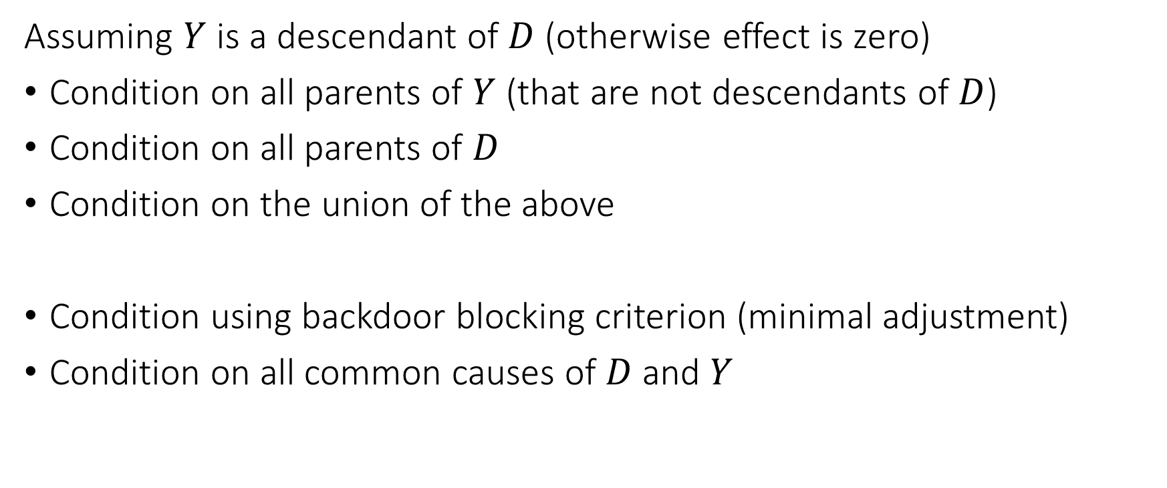
Adjustment Strategies
Assuming $Y$ is a descendant of $D$ (otherwise effect is zero)
Condition on all parents of $Y$ (that are not descendants of $D$)
Condition on all parents of $D$
Condition on the union of the above
Condition using backdoor blocking criterion (minimal adjustment)
Condition on all common causes of $D$ and $Y$

Slide 21

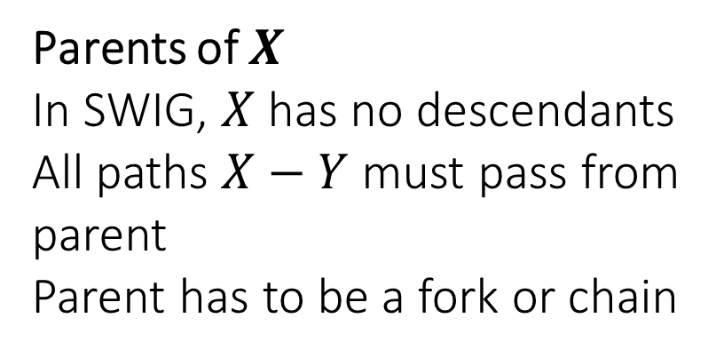




Conditioning on Parents
Empirically widely used strategy
Requires only partial knowledge of the graph
If we only know the parents of $D$ or the parents of $Y$ we are ok
Adding any further set to the parent strategy maintains validity
$$S$$
Parents of $X$
In SWIG, $X$ has no descendants
All paths $X−Y$ must pass from parent
Parent has to be a fork or chain
$$X$$
$$Y$$
SWIG
$$x$$

Slide 22
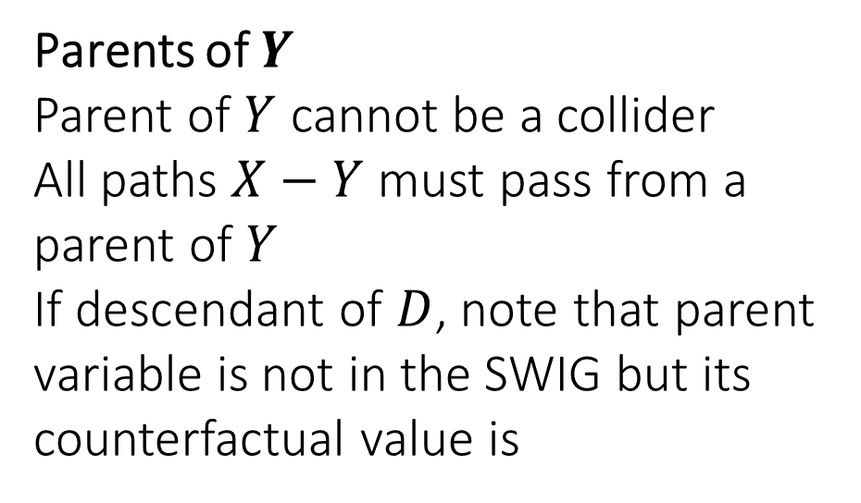
Conditioning on Parents
Empirically widely used strategy
Requires only partial knowledge of the graph
If we only know the parents of $D$ or the parents of $Y$ we are ok
Adding any further set to the parent strategy maintains validity
Parents of $Y$
Parent of $Y$ cannot be a collider
All paths $X−Y$ must pass from a parent of $Y$
If descendant of $D$, note that parent variable is not in the SWIG but its counterfactual value is
$$S$$
$$X$$
$$Y$$
SWIG
$$x$$

Slide 23
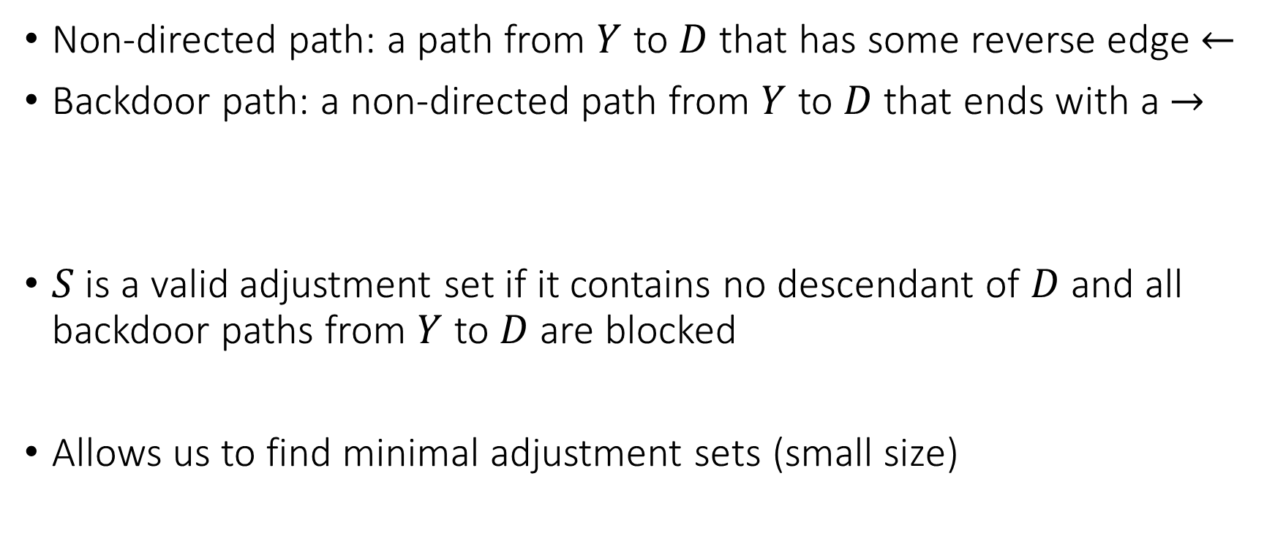
Backdoor Blocking
Non-directed path: a path from $Y$ to $D$ that has some reverse edge $←$
Backdoor path: a non-directed path from $Y$ to $D$ that ends with a $→$
$S$ is a valid adjustment set if it contains no descendant of $D$ and all backdoor paths from $Y$ to $D$ are blocked
Allows us to find minimal adjustment sets (small size)

Slide 24
Example

Slide 25
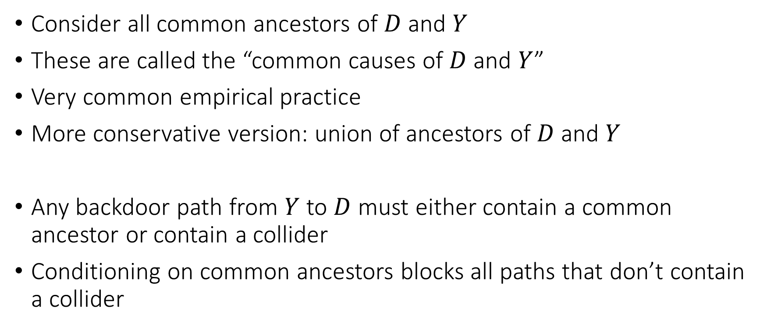
All Common Causes
Consider all common ancestors of $D$ and $Y$
These are called the “common causes of $D$ and $Y$”
Very common empirical practice
More conservative version: union of ancestors of $D$ and $Y$
Any backdoor path from $Y$ to $D$ must either contain a common ancestor or contain a collider
Conditioning on common ancestors blocks all paths that don’t contain a collider

Slide 26
Good and Bad Controls

Slide 27
High Level Categorization of Variables
Pre-treatment variables: variables whose value is determined before the assignment of the treatment
Post-treatment variables: variables whose value is determined after the assignment of the treatment

Slide 28
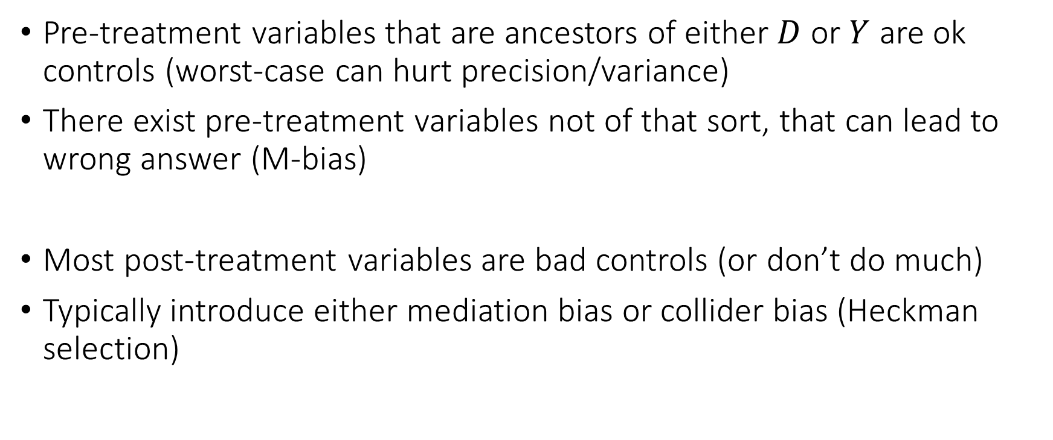
Good and Bad Controls: High Level
Pre-treatment variables that are ancestors of either $D$ or $Y$ are ok controls (worst-case can hurt precision/variance)
There exist pre-treatment variables not of that sort, that can lead to wrong answer (M-bias)
Most post-treatment variables are bad controls (or don’t do much)
Typically introduce either mediation bias or collider bias (Heckman selection)

Slide 29
“Pre-Treatment Variables”

Slide 30
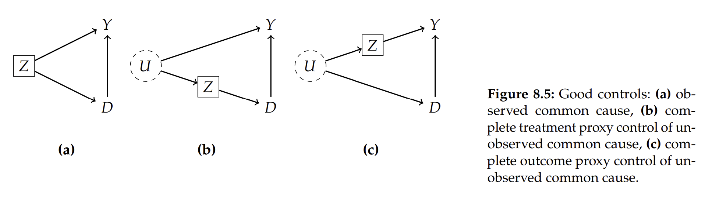
Examples: Good Controls

Slide 31
Example of Proxy
Effect of Prenatal Multivitamin consumption (D) on birth defects (Y)
Prior family history of birth defects (Z) can influence mother’s decision for multivitamin consumption
Unmeasured genetic factors (U) cause family history (Z) of birth defects
Unmeasured genetic factors (U) have direct influence on birth defects (Y)
Family history of birth defects is a good proxy control for unmeasured genetic factors

Slide 32
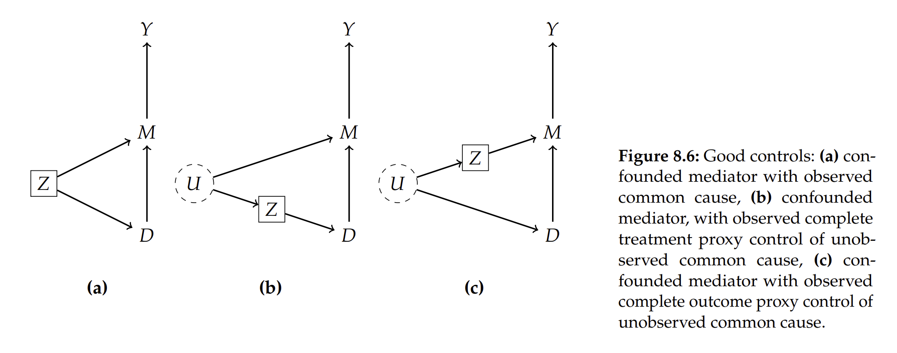
Examples: Good Controls

Slide 33
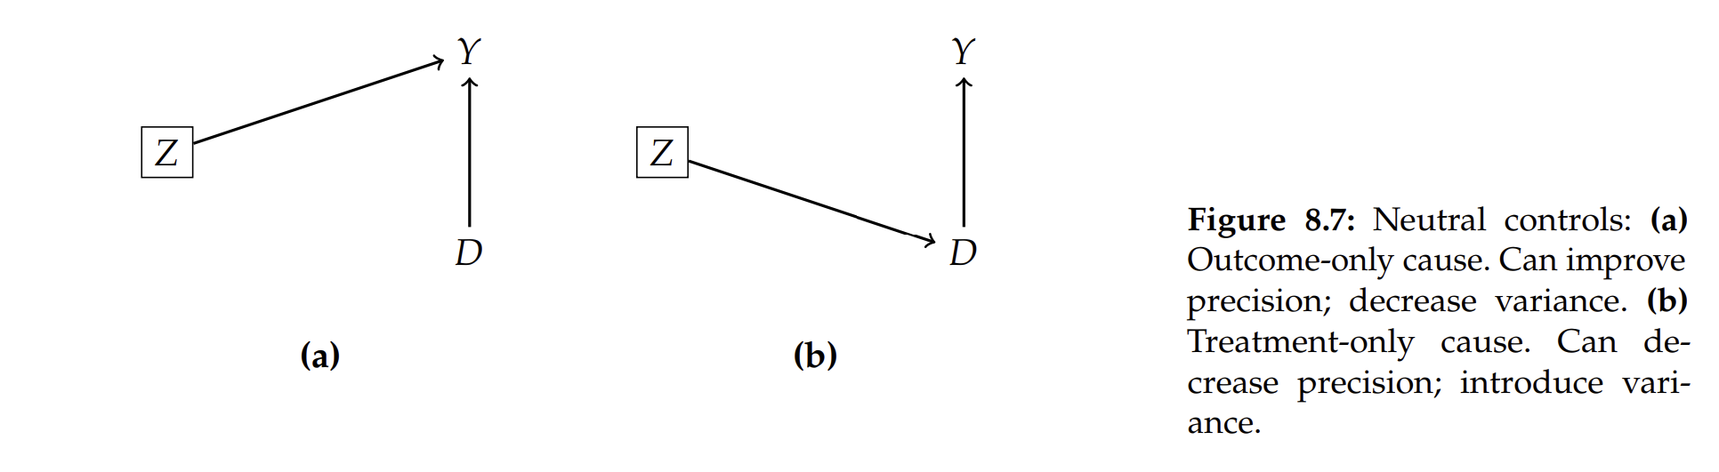
Examples: Neutral Controls

Slide 34
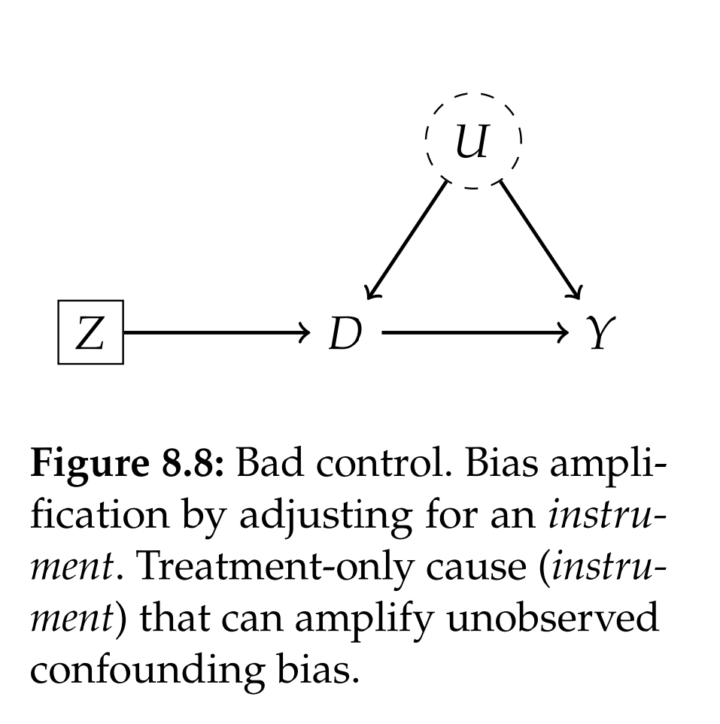
Examples: Pre-Treatment Variable that is Bad Control

Slide 35
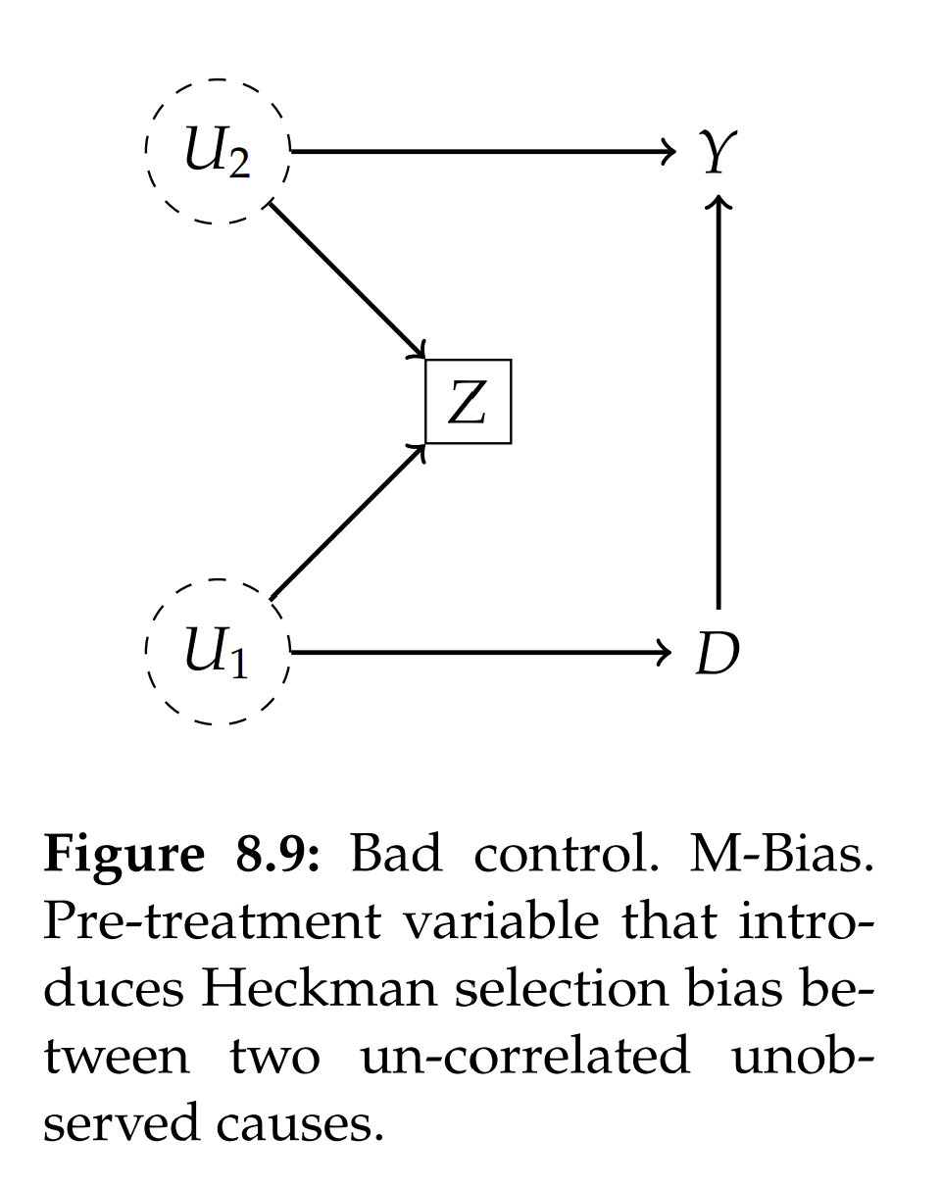
Example: Pre-Treatment Variable that is Bad Control

Slide 36
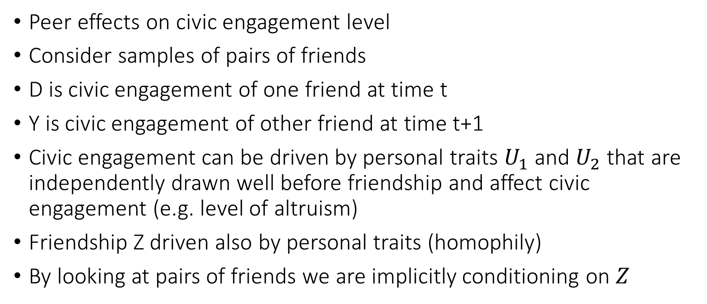
Example: Homophily Bias in Peer Effects
Peer effects on civic engagement level
Consider samples of pairs of friends
D is civic engagement of one friend at time t
Y is civic engagement of other friend at time t+1
Civic engagement can be driven by personal traits $U_{1}$ and $U_{2}$ that are independently drawn well before friendship and affect civic engagement (e.g. level of altruism)
Friendship Z driven also by personal traits (homophily)
By looking at pairs of friends we are implicitly conditioning on $Z$

Slide 37
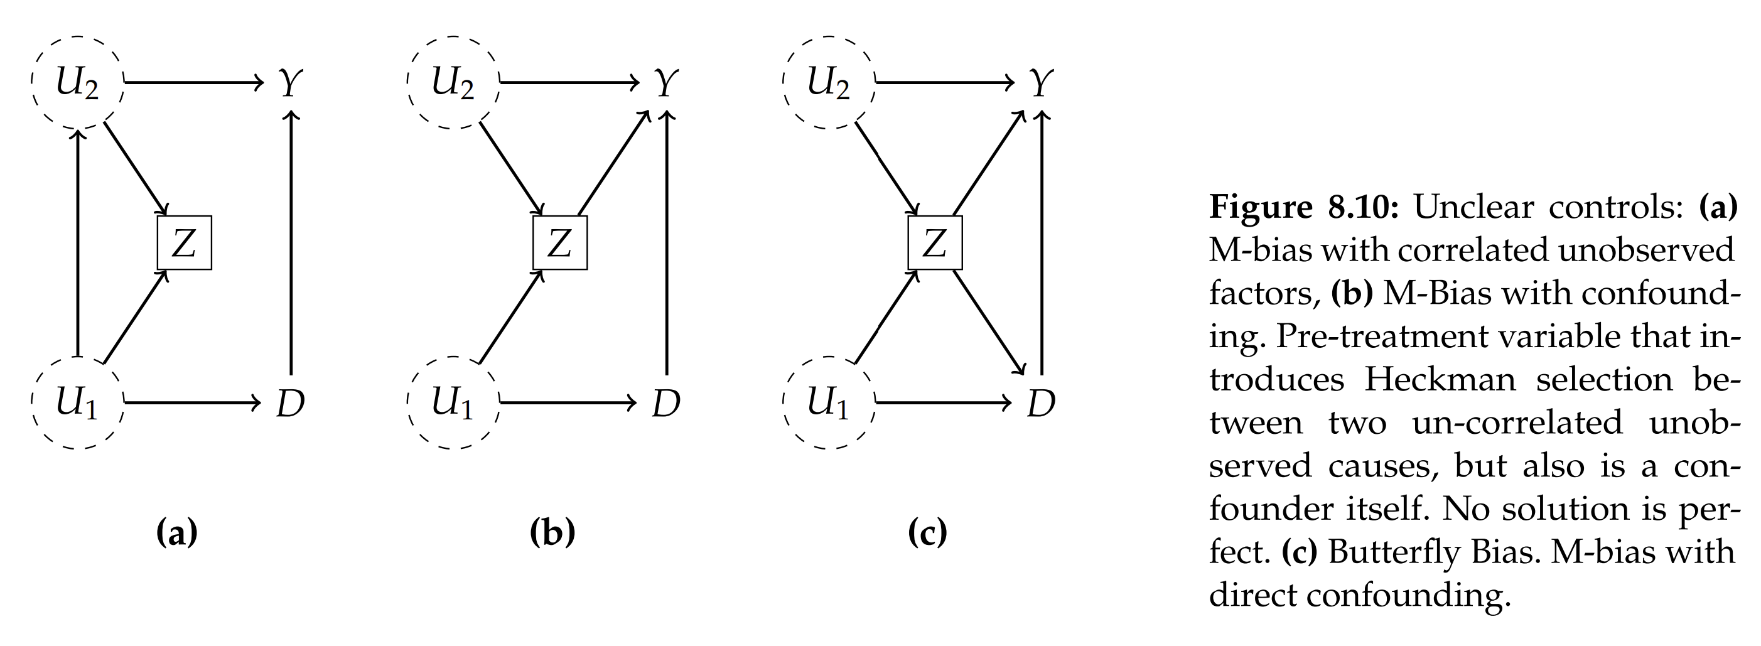
Example: M-Bias not robust to perturbation

Slide 38
“Post-Treatment Variables”

Slide 39
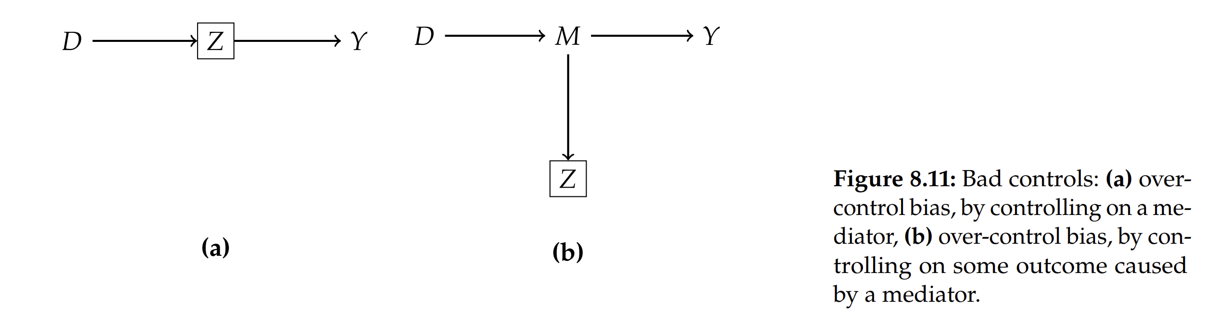
Example: Bad Controls, Mediation Bias

Slide 40
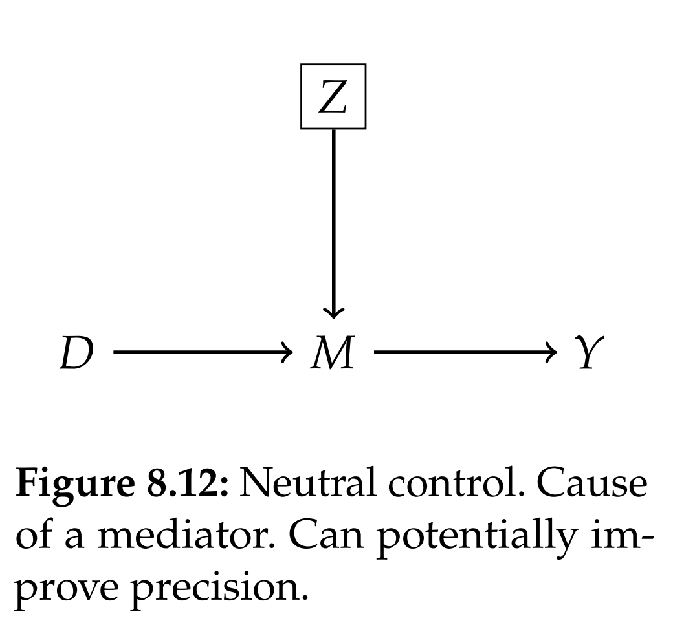
Example: Exception to Mediation Bias

Slide 41
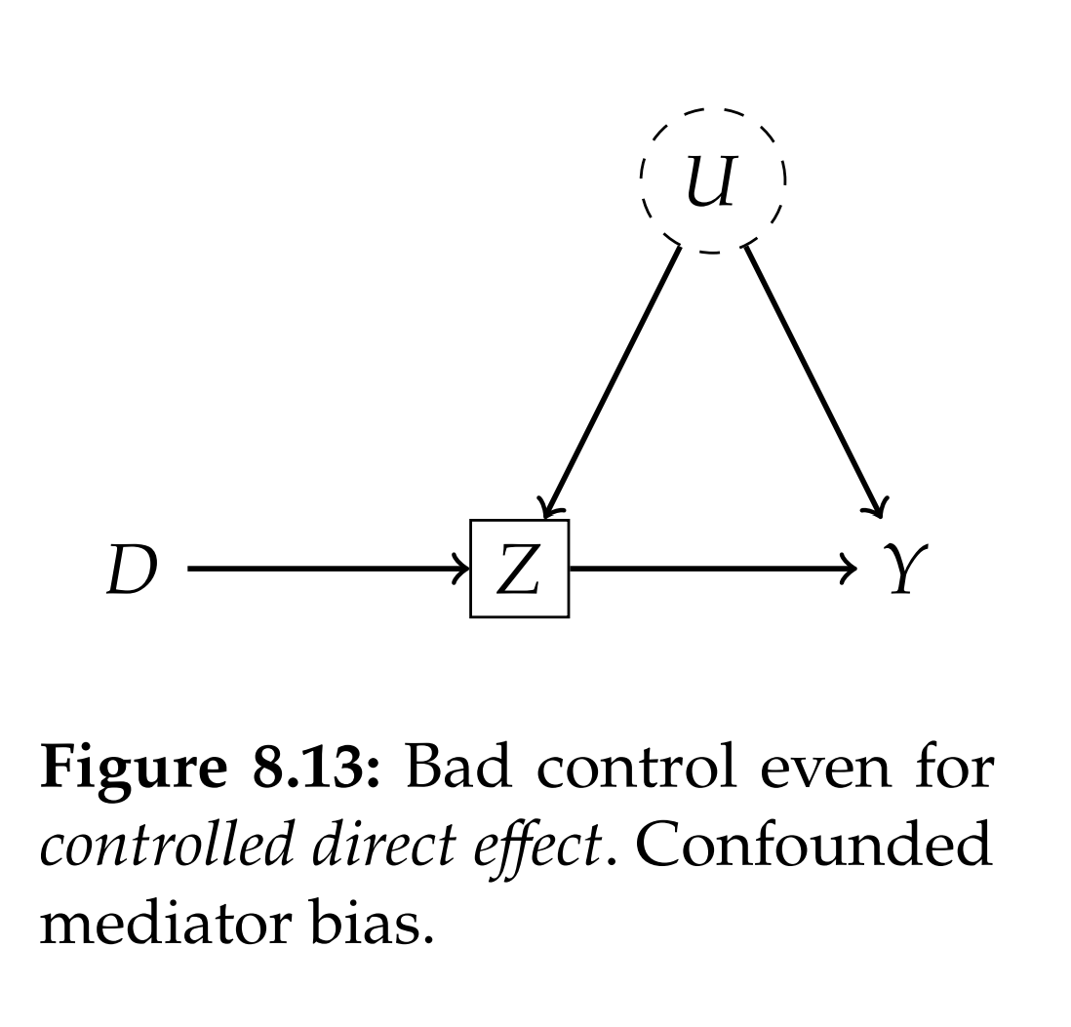
Example: Controlled Direct Effect Gone Wrong

Slide 42
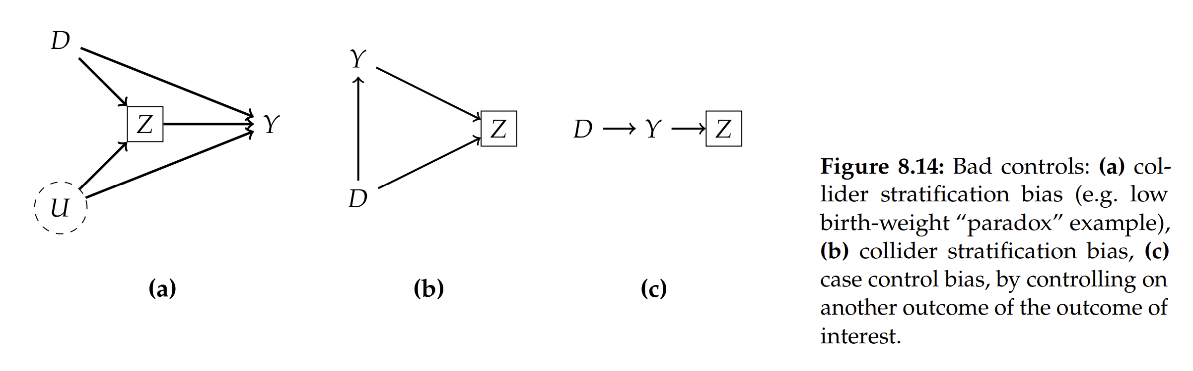
Example: Bad Controls, Collider (Heckman Selection) bias

Slide 43
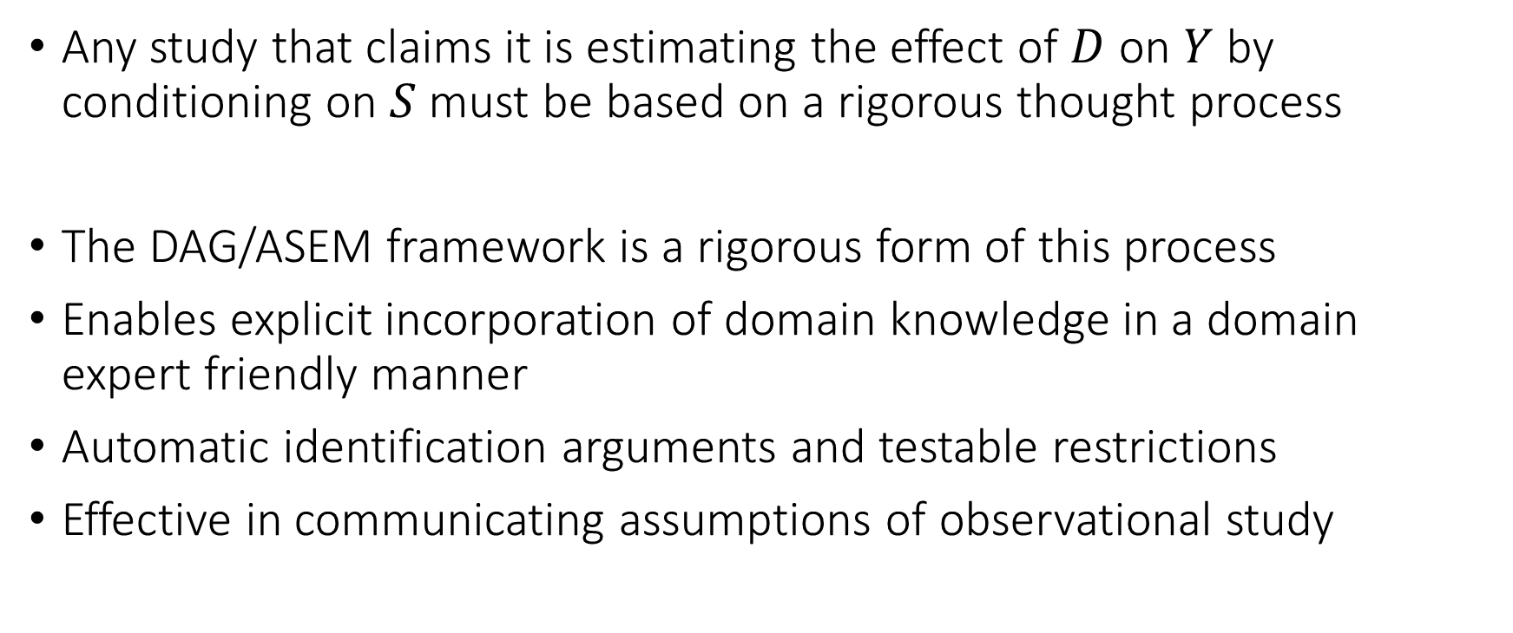
Concluding Remarks
Any study that claims it is estimating the effect of $D$ on $Y$ by conditioning on $S$ must be based on a rigorous thought process
The DAG/ASEM framework is a rigorous form of this process
Enables explicit incorporation of domain knowledge in a domain expert friendly manner
Automatic identification arguments and testable restrictions
Effective in communicating assumptions of observational study

