Slide 1
MS&E 228: Inference with Modern Non-Linear Prediction
Vasilis Syrgkanis
MS&E, Stanford

Slide 2
Causal Inference with Experiments
Prediction with Linear Models
Prediction with High-Dim Linear Models
Inference on Causal and Predictive Effects with High-Dim Linear Models
Potential Outcomes and Conditional Ignorability
Structural Equation Models and Conditional Exogeneity
Directed Acyclic Graphs
Prediction with Non-Linear Models
Inference on Causal Effects with Non-Linear Models
Un-observed Confounding and Instruments
Identification of Causal Effects in Longitudinal Data
Estimation of Heterogeneous Causal Effects
Linear Predictive Models and Statistical Inference
Causal Identification in Observational Data
Non-Linear Predictive Models and Statistical Inference
Topics

Slide 3
Causal Inference with Experiments
Prediction with Linear Models
Prediction with High-Dim Linear Models
Inference on Causal and Predictive Effects with High-Dim Linear Models
Potential Outcomes and Conditional Ignorability
Structural Equation Models and Conditional Exogeneity
Directed Acyclic Graphs
Prediction with Non-Linear Models
Inference on Causal Effects with Non-Linear Models
Un-observed Confounding and Instruments
Identification of Causal Effects in Longitudinal Data
Estimation of Heterogeneous Causal Effects
Linear Predictive Models and Statistical Inference
Causal Identification in Observational Data
Non-Linear Predictive Models and Statistical Inference
Topics

Slide 4
Goals for Today
Revisiting and expanding on theory from last time
Sample-splitting and cross-fitting
Example application

Slide 5
Recap of Last Lecture

Slide 6





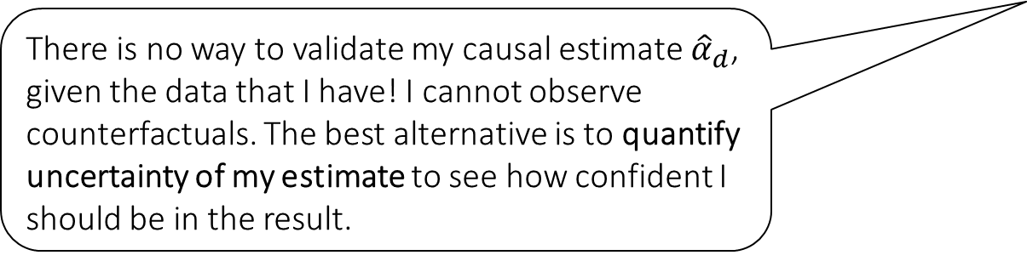



Causal Inference Pipeline
Data Collection
Estimation
(training)
Validation
(testing)
Domain Assumption Elicitation
Identification
Inference (Confidence Intervals)
DAGs/ASEMs
Construct estimate $\hat{g}\left(d,z\right)$ of predictive model
$$E\left[Y ∣ D=d,Z=z\right]$$
Estimate mean counterfactual
$${\hat{a}}_{d}=E_{n}\left[\hat{g}\left(d,Z\right)\right]$$
Theory
$$a_{d}$$
$$E\left[E\left[Y | D=d,Z\right]\right]$$
$$D$$
$$=$$
$$a_{d}∈{\hat{a}}_{d}±2\hat{σ}$$
$$Z$$
$$Y$$
There is no way to validate my causal estimate ${\hat{α}}_{d}$, given the data that I have! I cannot observe counterfactuals. The best alternative is to quantify uncertainty of my estimate to see how confident I should be in the result.
Sensitivity Analysis
Practice
$$a_{d}∈{\hat{a}}_{d}±(2\hat{σ}+ε)$$
Adaptive Experiments
Decision
Policy

Slide 7
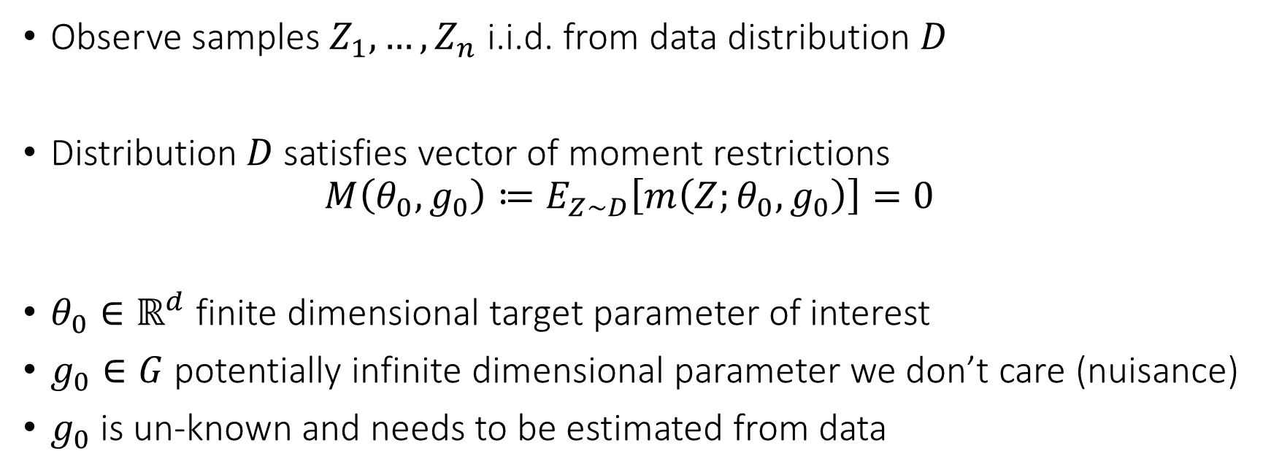
Semi-Parametric Moment Restrictions
Observe samples $Z_{1},…,Z_{n}$ i.i.d. from data distribution $D$
Distribution $D$ satisfies vector of moment restrictions
$$M\left(θ_{0},g_{0}\right)≔E_{Z∼D}\left[m\left(Z;θ_{0},g_{0}\right)\right]=0$$
$θ_{0}∈ℝ^{d}$ finite dimensional target parameter of interest
$g_{0}∈G$ potentially infinite dimensional parameter we don’t care (nuisance)
$g_{0}$ is un-known and needs to be estimated from data

Slide 8
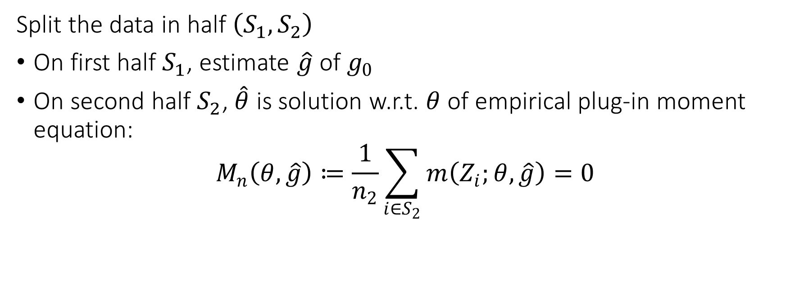
Natural Estimation Algorithm (sample-splitting)
Split the data in half $\left(S_{1},S_{2}\right)$
On first half $S_{1}$, estimate $\hat{g}$ of $g_{0}$
On second half $S_{2}$, $\hat{θ}$ is solution w.r.t. $θ$ of empirical plug-in moment equation:
$$M_{n}\left(θ,\hat{g}\right)≔\frac{1}{n_{2}}\sum_{i∈S_{2}}{m\left(Z_{i};θ, \hat{g}\right)}=0$$

Slide 9
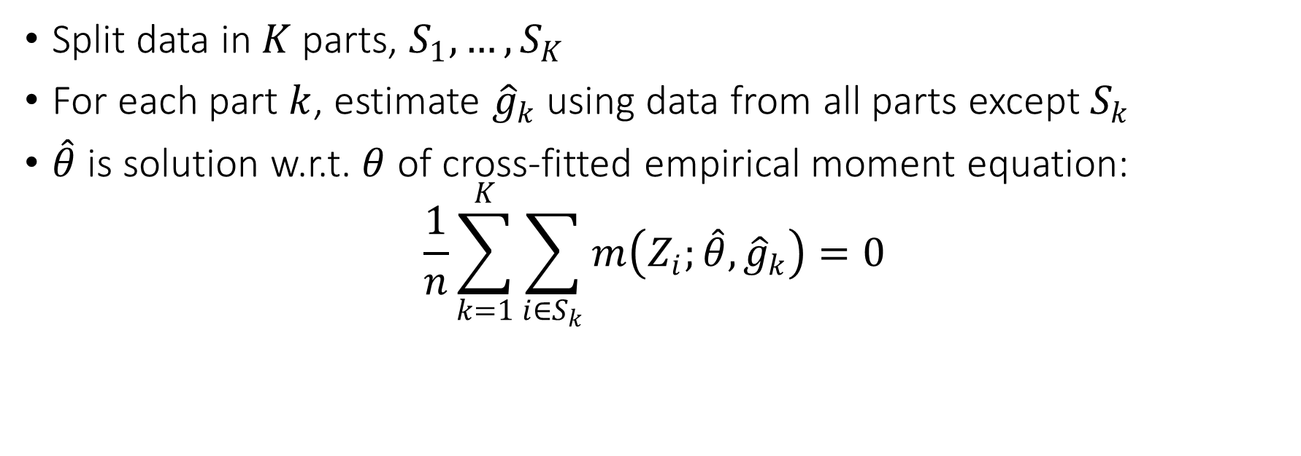
Natural Estimation Algorithm (cross-fitting)
Split data in $K$ parts, $S_{1},…, S_{K}$
For each part $k$, estimate ${\hat{g}}_{k}$ using data from all parts except $S_{k}$
$\hat{θ}$ is solution w.r.t. $θ$ of cross-fitted empirical moment equation:
$$\frac{1}{n}\sum_{k=1}^{K}{\sum_{i∈S_{k}}{m\left(Z_{i};\hat{θ}, {\hat{g}}_{k}\right)}}=0$$

Slide 10

Neyman Orthogonality
Moment $M\left(θ, g\right)$ is Neyman orthogonal if for any $ν∈G−g_{0}$:
$${D_{g}M\left(θ_{0},g_{0}\right)\left[ν\right]≔\left.\frac{∂}{∂t}M\left(θ_{0},g_{0}+t ν\right)\right|}_{t=0}=0$$

Slide 11

Main Theorem
If moment is Neyman orthogonal and RMSE of $\hat{g}$ is $o_{p}\left(n^{−1/4}\right)$, plus regularity conditions
$$\sqrt{n} \left(\hat{θ}−θ_{0}\right)→N\left(0,J_{0}^{−1}Σ{\left(J_{0}^{−1}\right)}^{⊤}\right)$$
where $J_{0}≔∇_{θ}M\left(θ_{0},g_{0}\right)$ and $Σ≔E\left[m\left(Z;θ_{0},g_{0}\right) m{\left(Z;θ_{0},g_{0}\right)}^{⊤}\right]$

Slide 12
Two Main Applications
Average Treatment Effect in identification by conditioning and a binary treatment
Doubly robust moment which combines identification by regression and identification via propensity scores
Average Treatment Effect in identification by conditioning under a partially linear model; response linear in treatment
Residual-on-residual moment which generalizes the partialling out approach (FWL) to non-linear models

Slide 13
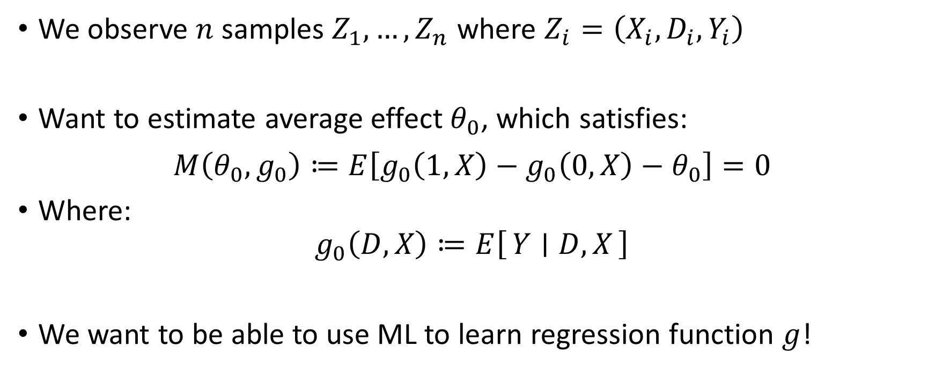
ATE under Conditional Exogeneity
We observe $n$ samples $Z_{1},…, Z_{n}$ where $Z_{i}=\left(X_{i},D_{i},Y_{i}\right)$
Want to estimate average effect $θ_{0}$, which satisfies:
$$M\left(θ_{0},g_{0}\right)≔E\left[g_{0}\left(1, X\right)−g_{0}\left(0,X\right)−θ_{0}\right]=0$$
Where:
$$g_{0}\left(D,X\right)≔E\left[Y ∣ D, X\right]$$
We want to be able to use ML to learn regression function $g$!

Slide 14
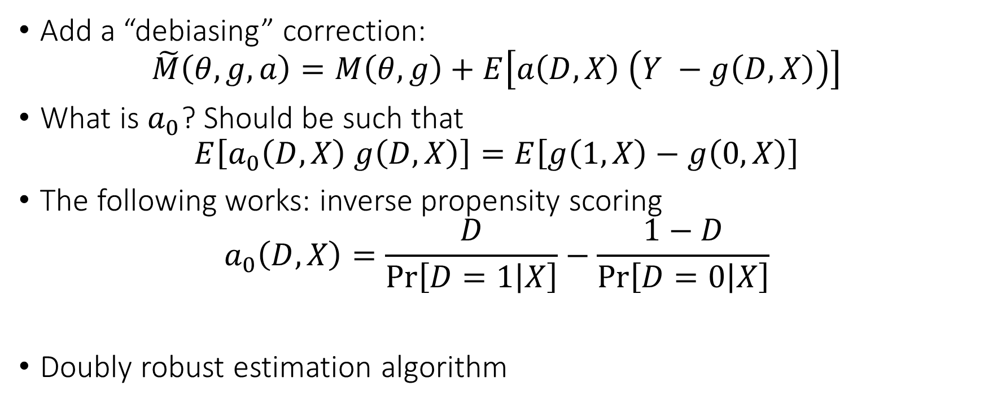
Better Moment for ATE
Add a “debiasing” correction:
$$\tilde{M}\left(θ, g, a\right)=M\left(θ, g\right)+E\left[a\left(D, X\right) \left(Y −g\left(D, X\right)\right)\right]$$
What is $a_{0}$? Should be such that
$$E\left[a_{0}\left(D,X\right) g\left(D,X\right)\right]=E\left[g\left(1,X\right)−g\left(0, X\right)\right]$$
The following works: inverse propensity scoring
$$a_{0}\left(D,X\right)=\frac{D}{\operatorname{Pr}\left[D=1 | X\right]}−\frac{1−D}{\operatorname{Pr}\left[D=0 | X\right]}$$
Doubly robust estimation algorithm

Slide 15
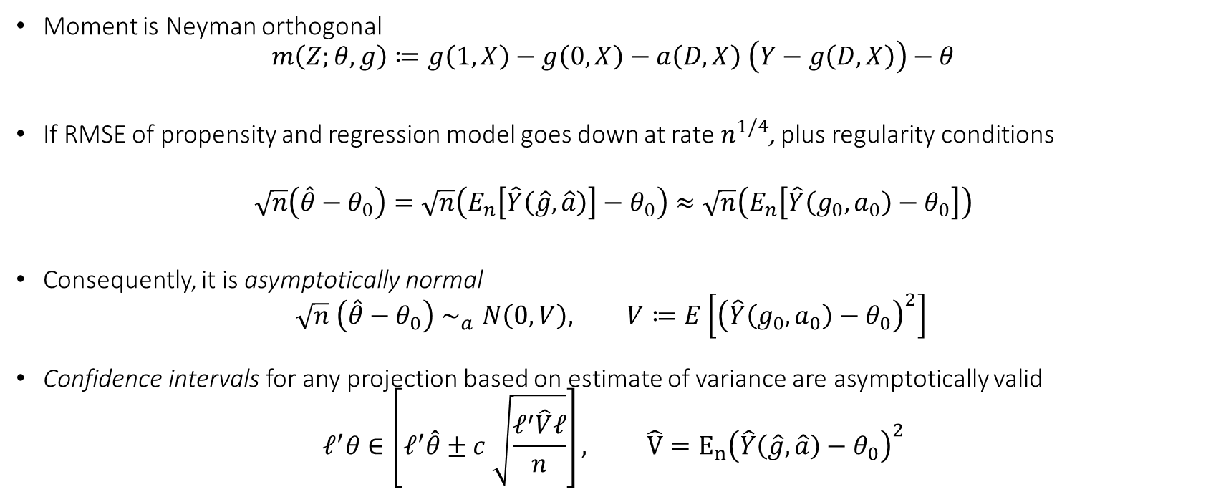
Inference with Doubly Robust Algorithm
Moment is Neyman orthogonal
$$m\left(Z;θ,g\right)≔g\left(1,X\right)−g\left(0,X\right)−a\left(D,X\right) \left(Y−g\left(D,X\right)\right)−θ$$
If RMSE of propensity and regression model goes down at rate $n^{1/4}$, plus regularity conditions
$$\sqrt{n}\left(\hat{θ}−θ_{0}\right)=\sqrt{n}\left(E_{n}\left[\hat{Y}\left(\hat{g},\hat{a}\right)\right]−θ_{0}\right)≈\sqrt{n}\left(E_{n}\left[\hat{Y}\left(g_{0},a_{0}\right)−θ_{0}\right]\right)$$
Consequently, it is asymptotically normal
$$\sqrt{n} \left(\hat{θ}−θ_{0}\right)∼_{a}N\left(0, V\right), V≔E\left[{\left(\hat{Y}\left(g_{0},a_{0}\right)−θ_{0}\right)}^{2}\right]$$
Confidence intervals for any projection based on estimate of variance are asymptotically valid
$$ℓ^{′}θ∈\left[ℓ^{′}\hat{θ}±c \sqrt{\frac{ℓ^{′}\hat{V}ℓ}{n}}\right], \hat{V}=E_{n}{\left(\hat{Y}\left(\hat{g},\hat{a}\right)−θ_{0}\right)}^{2}$$
$$\hat{Y}\left(g,a\right)$$

Slide 16
Python Pseudocode
cv = KFold(n_splits=nfolds, shuffle=True, random_state=123)
yhat0, yhat1 = np.zeros(y.shape), np.zeros(y.shape)
# we will fit a model E[Y| D, X] by fitting a separate model for D==0
# and a separate model for D==1.
for train, test in cv.split(X, y):
# train a model on training data that received zero and predict on all test data
yhat0[test] = modely.fit(X[train][D[train]==0], y[train][D[train]==0]).predict(X[test])
# train a model on training data that received one and predict on all test data
yhat1[test] = modely.fit(X[train][D[train]==1], y[train][D[train]==1]).predict(X[test])
# prediction for observed treatment
yhat = yhat0 * (1 - D) + yhat1 * D
# propensity scores
Dhat = cross_val_predict(modeld, X, D, cv=cv, method='predict_proba', n_jobs=-1)[:, 1]
Dhat = np.clip(Dhat, trimming, 1 - trimming)
# doubly robust quantity for every sample
drhat = yhat1 - yhat0 + (y - yhat) * (D/Dhat - (1 - D)/(1 - Dhat))
point = np.mean(drhat)
var = np.var(drhat)
stderr = np.sqrt(var / X.shape[0])
return point, stderr, yhat, Dhat, y - yhat, D - Dhat, drhat

Slide 17
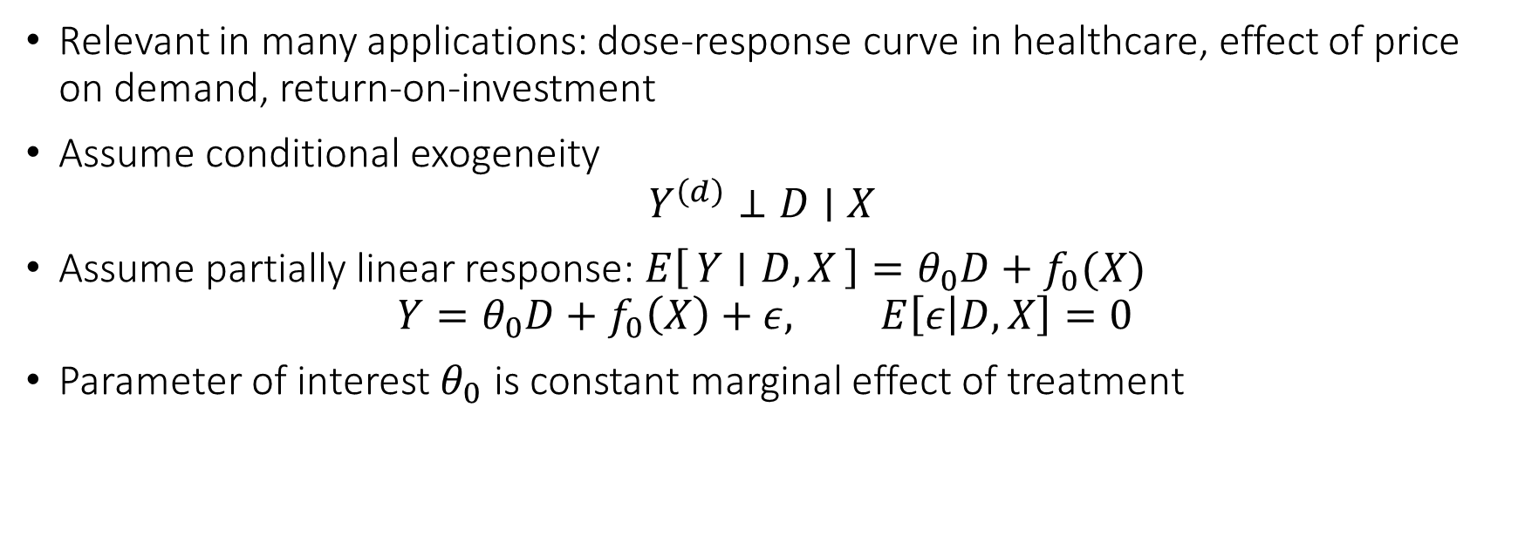
Partially Linear Model
Relevant in many applications: dose-response curve in healthcare, effect of price on demand, return-on-investment
Assume conditional exogeneity
$$Y^{\left(d\right)}⊥D∣X$$
Assume partially linear response: $E\left[Y ∣ D,X\right]=θ_{0}D+f_{0}(X)$
$$Y=θ_{0}D+f_{0}\left(X\right)+ε, E\left[ε | D,X\right]=0$$
Parameter of interest $θ_{0}$ is constant marginal effect of treatment

Slide 18

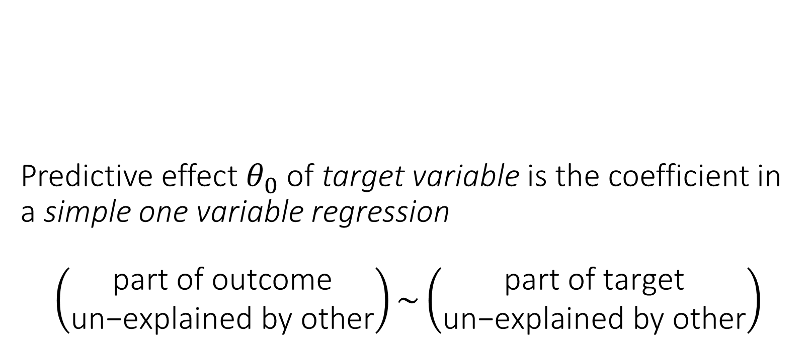
Predictive effect $θ_{0}$ of target variable is the coefficient in a simple one variable regression $$\left(\begin{matrix}\text{part} \text{of} \text{outcome} \\ \text{un}\text{−}\text{explained} \text{by} \text{other}\end{matrix}\right)\sim \left(\begin{matrix}\text{part} \text{of} \text{target} \\ \text{un}\text{−}\text{explained} \text{by} \text{other}\end{matrix}\right)$$

Slide 19
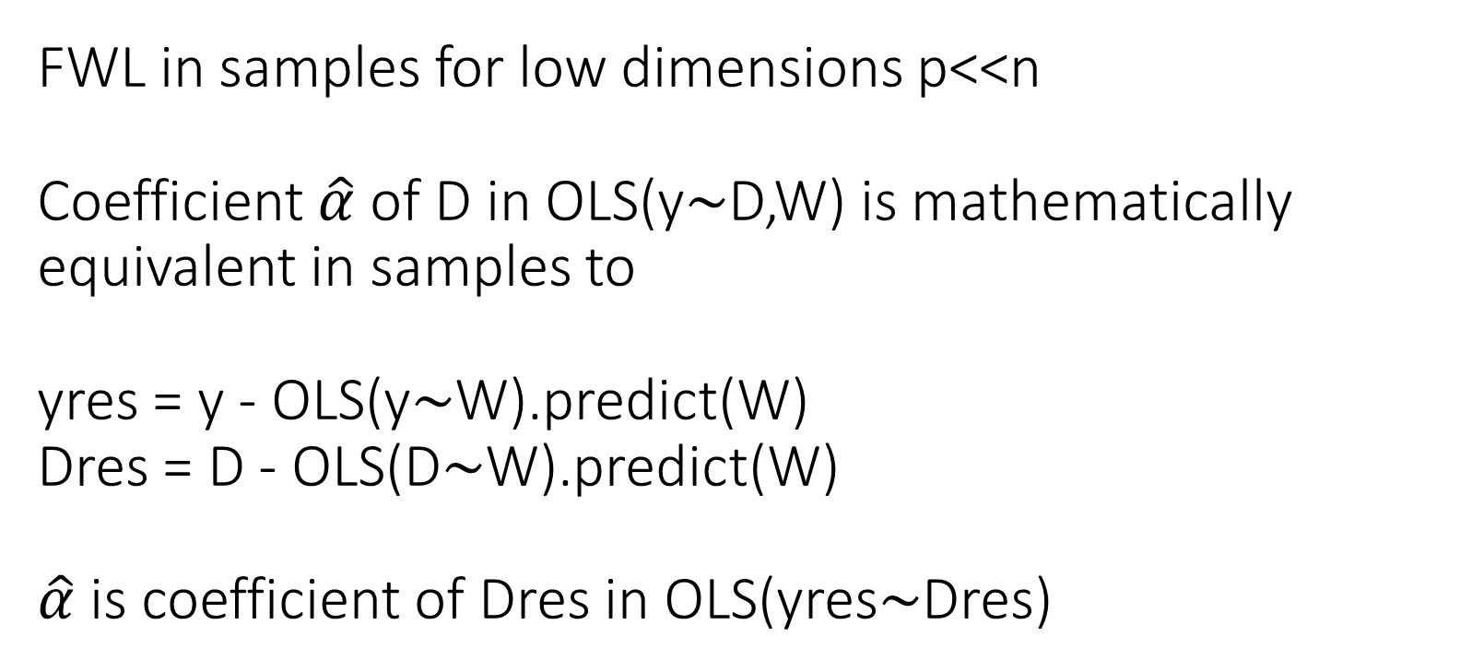
FWL in samples for low dimensions p<<n Coefficient $\hat{α}$ of D in OLS(y$∼$D,W) is mathematically equivalent in samples to yres = y - OLS(y$∼$W).predict(W) Dres = D - OLS(D$∼$W).predict(W) $\hat{α}$ is coefficient of Dres in OLS(yres$∼$Dres)

Slide 20
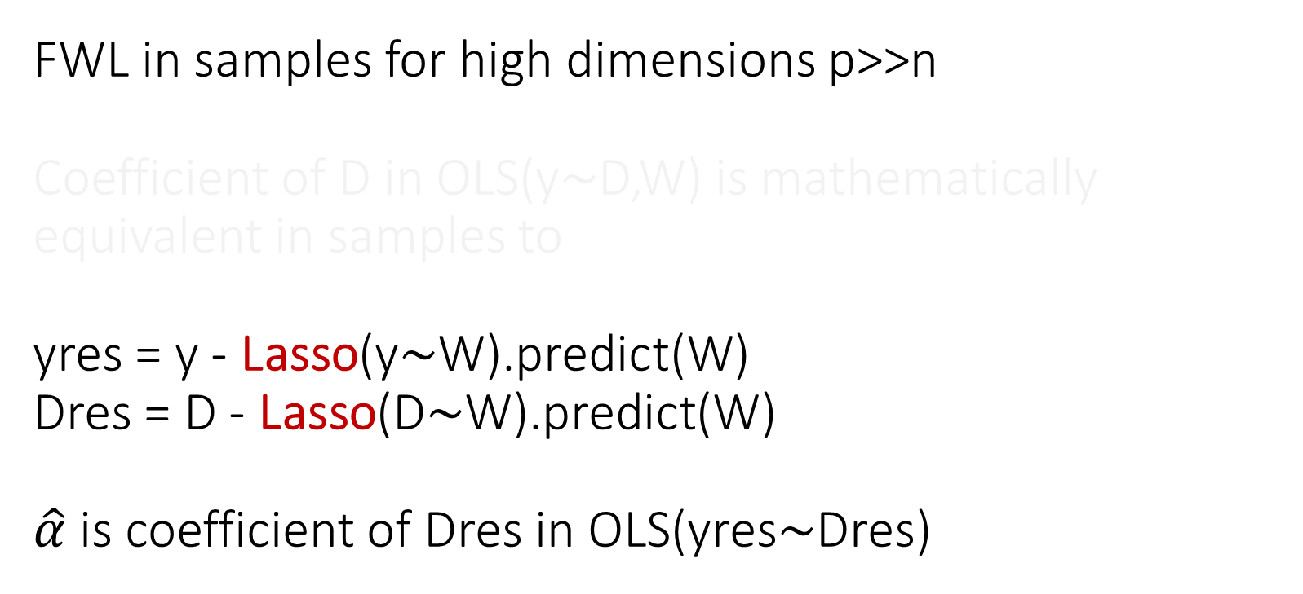
FWL in samples for high dimensions p>>n Coefficient of D in OLS(y$∼$D,W) is mathematically equivalent in samples to yres = y - Lasso(y$∼$W).predict(W) Dres = D - Lasso(D$∼$W).predict(W) $\hat{α}$ is coefficient of Dres in OLS(yres$∼$Dres)
Double Lasso

Slide 21
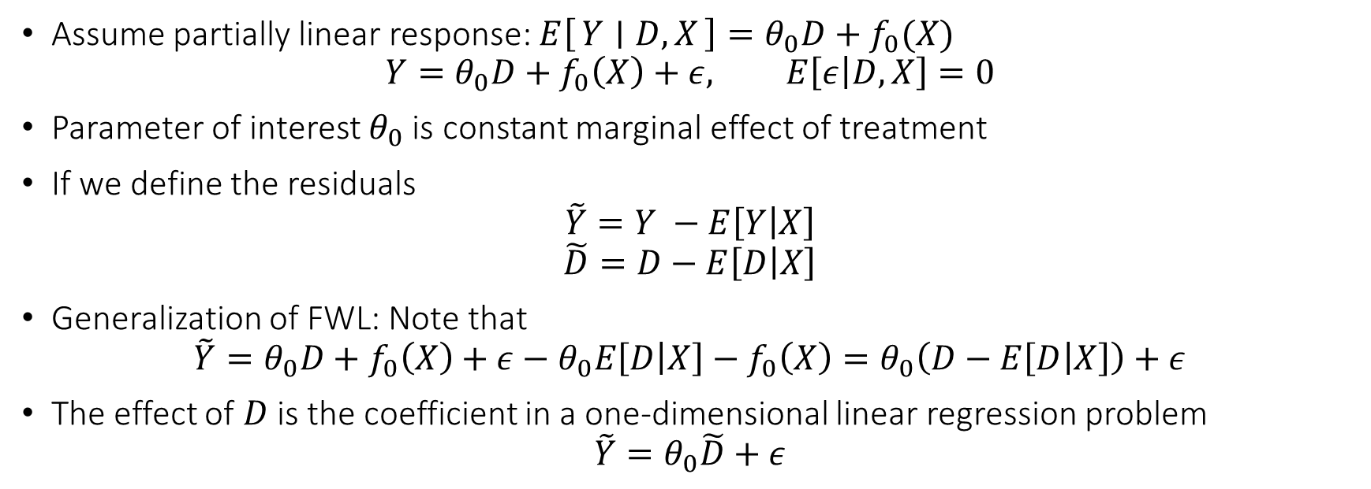
Partially Linear Model
Assume partially linear response: $E\left[Y ∣ D,X\right]=θ_{0}D+f_{0}(X)$
$$Y=θ_{0}D+f_{0}\left(X\right)+ε, E\left[ε | D,X\right]=0$$
Parameter of interest $θ_{0}$ is constant marginal effect of treatment
If we define the residuals
$$\tilde{Y}=Y −E\left[Y | X\right]$$
$$\tilde{D}=D−E\left[D | X\right]$$
Generalization of FWL: Note that
$$\tilde{Y}=θ_{0}D+f_{0}\left(X\right)+ε−θ_{0}E\left[D | X\right]−f_{0}\left(X\right)=θ_{0}\left(D−E\left[D | X\right]\right)+ε$$
The effect of $D$ is the coefficient in a one-dimensional linear regression problem
$$\tilde{Y}=θ_{0}\tilde{D}+ε$$

Slide 22



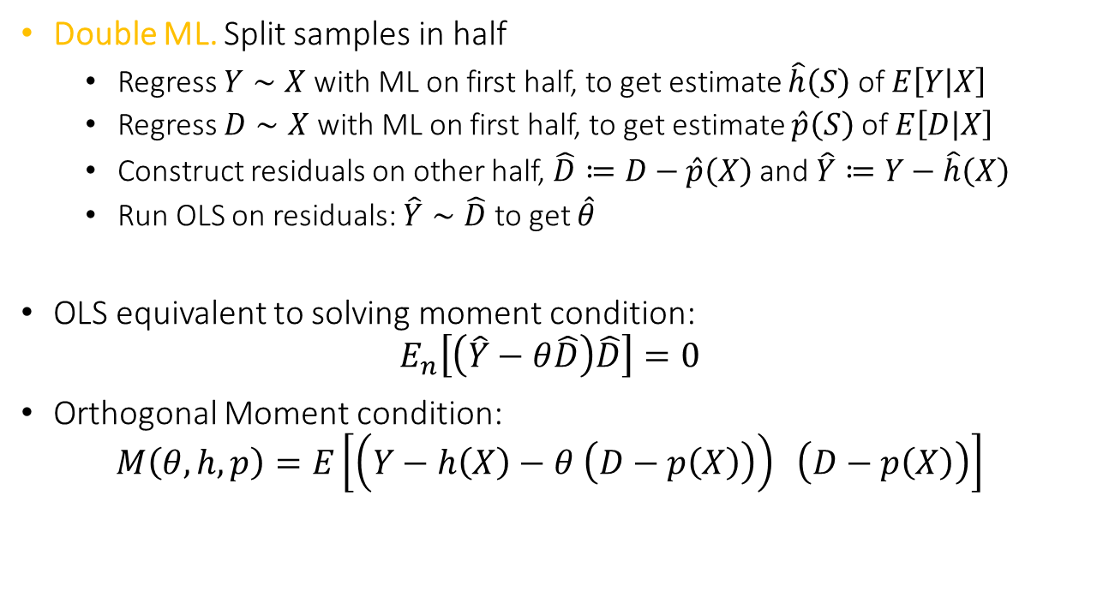



Orthogonal Method: Double ML
Double ML. Split samples in half
Regress $Y∼X$ with ML on first half, to get estimate $\hat{h}\left(S\right)$ of $E\left[Y | X\right]$
Regress $D∼X$ with ML on first half, to get estimate $\hat{p}\left(S\right)$ of $E\left[D | X\right]$
Construct residuals on other half, $\hat{D}≔D−\hat{p}\left(X\right)$ and $\hat{Y}≔Y−\hat{h}\left(X\right)$
Run OLS on residuals: $\hat{Y}∼\hat{D}$ to get $\hat{θ}$
OLS equivalent to solving moment condition:
$$E_{n}\left[\left(\hat{Y}−θ\hat{D}\right)\hat{D}\right]=0$$
Orthogonal Moment condition:
$$M\left(θ, h, p\right)=E\left[\left(Y−h\left(X\right)−θ \left(D−p\left(X\right)\right)\right) \left(D−p\left(X\right)\right)\right]$$
$$\tilde{D}≈noise$$
$$\tilde{D}$$
$$θ$$
$$X$$
$$\tilde{Y}$$
$$\tilde{Y}≈θ\tilde{D}+noise$$

Slide 23



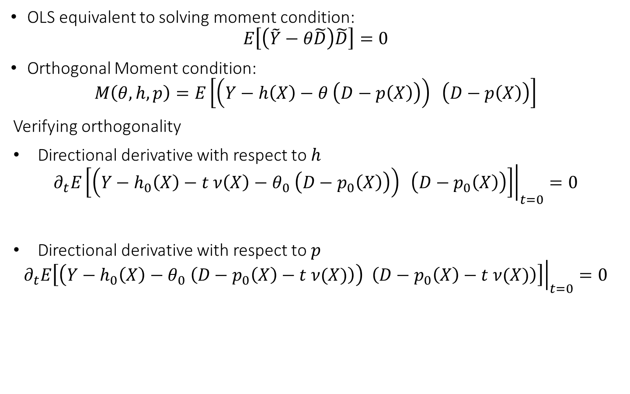



Orthogonal Method: Double ML
$$\tilde{D}≈noise$$
OLS equivalent to solving moment condition:
$$E\left[\left(\tilde{Y}−θ\tilde{D}\right)\tilde{D}\right]=0$$
Orthogonal Moment condition:
$$M\left(θ, h, p\right)=E\left[\left(Y−h\left(X\right)−θ \left(D−p\left(X\right)\right)\right) \left(D−p\left(X\right)\right)\right]$$
Verifying orthogonality
Directional derivative with respect to $h$
$${\left.∂_{t}E\left[\left(Y−h_{0}\left(X\right)−t ν\left(X\right)−θ_{0} \left(D−p_{0}\left(X\right)\right)\right) \left(D−p_{0}\left(X\right)\right)\right]\right|}_{t=0}=0$$
Directional derivative with respect to $p$
$${\left.∂_{t}E\left[\left(Y−h_{0}\left(X\right)−θ_{0} \left(D−p_{0}\left(X\right)−t ν(X)\right)\right) \left(D−p_{0}\left(X\right)−t ν(X)\right)\right]\right|}_{t=0}=0$$
$$\tilde{D}$$
$$θ$$
$$X$$
$$\tilde{Y}$$
$$\tilde{Y}≈θ\tilde{D}+noise$$

Slide 24
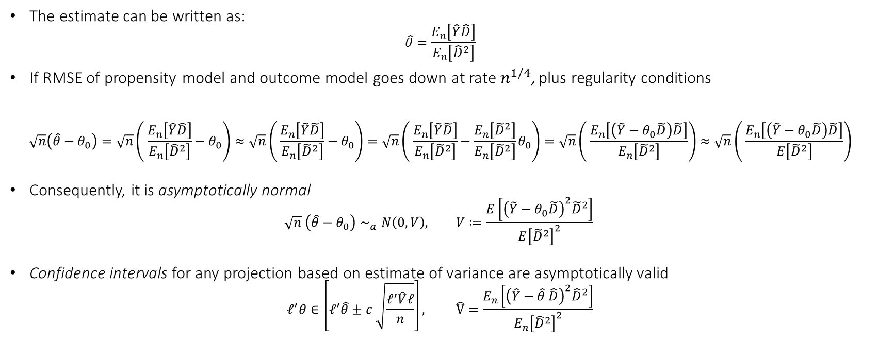
Inference with DML in PLR Setting
The estimate can be written as:
$$\hat{θ}=\frac{E_{n}\left[\hat{Y}\hat{D}\right]}{E_{n}\left[{\hat{D}}^{2}\right]}$$
If RMSE of propensity model and outcome model goes down at rate $n^{1/4}$, plus regularity conditions
$$\sqrt{n}\left(\hat{θ}−θ_{0}\right)=\sqrt{n}\left( \frac{E_{n}\left[\hat{Y}\hat{D}\right]}{E_{n}\left[{\hat{D}}^{2}\right]}−θ_{0}\right)≈\sqrt{n}\left( \frac{E_{n}\left[\tilde{Y}\tilde{D}\right]}{E_{n}\left[{\tilde{D}}^{2}\right]}−θ_{0}\right)=\sqrt{n}\left( \frac{E_{n}\left[\tilde{Y}\tilde{D}\right]}{E_{n}\left[{\tilde{D}}^{2}\right]}−\frac{E_{n}\left[{\tilde{D}}^{2}\right]}{E_{n}\left[{\tilde{D}}^{2}\right]}θ_{0}\right)=\sqrt{n}\left( \frac{E_{n}\left[\left(\tilde{Y}−θ_{0}\tilde{D}\right)\tilde{D}\right]}{E_{n}\left[{\tilde{D}}^{2}\right]}\right)≈\sqrt{n}\left( \frac{E_{n}\left[\left(\tilde{Y}−θ_{0}\tilde{D}\right)\tilde{D}\right]}{E\left[{\tilde{D}}^{2}\right]}\right)$$
Consequently, it is asymptotically normal
$$\sqrt{n} \left(\hat{θ}−θ_{0}\right)∼_{a}N\left(0, V\right), V≔\frac{E\left[{\left(\tilde{Y}−θ_{0}\tilde{D}\right)}^{2}{\tilde{D}}^{2}\right]}{E{\left[{\tilde{D}}^{2}\right]}^{2}}$$
Confidence intervals for any projection based on estimate of variance are asymptotically valid
$$ℓ^{′}θ∈\left[ℓ^{′}\hat{θ}±c \sqrt{\frac{ℓ^{′}\hat{V}ℓ}{n}}\right], \hat{V}=\frac{E_{n}\left[{\left(\hat{Y}−\hat{θ} \hat{D}\right)}^{2}{\hat{D}}^{2}\right]}{E_{n}{\left[{\hat{D}}^{2}\right]}^{2}}$$

Slide 25
Python Pseudocode
cv = KFold(n_splits=nfolds, shuffle=True, random_state=123)
# out-of-fold predictions for y
yhat = cross_val_predict(modely, X, y, cv=cv, n_jobs=-1)
# out-of-fold predictions for D
Dhat = cross_val_predict(modeld, X, D, cv=cv, n_jobs=-1)
# calculate outcome and treatment residuals
resy = y - yhat
resD = D - Dhat
# final stage ols based point estimate and standard error
point = np.mean(resy * resD) / np.mean(resD**2)
epsilon = resy - point * resD
var = np.mean(epsilon**2 * resD**2) / np.mean(resD**2)**2
stderr = np.sqrt(var / X.shape[0])
return point, stderr

Slide 26
Expanding More on Theory

Slide 27
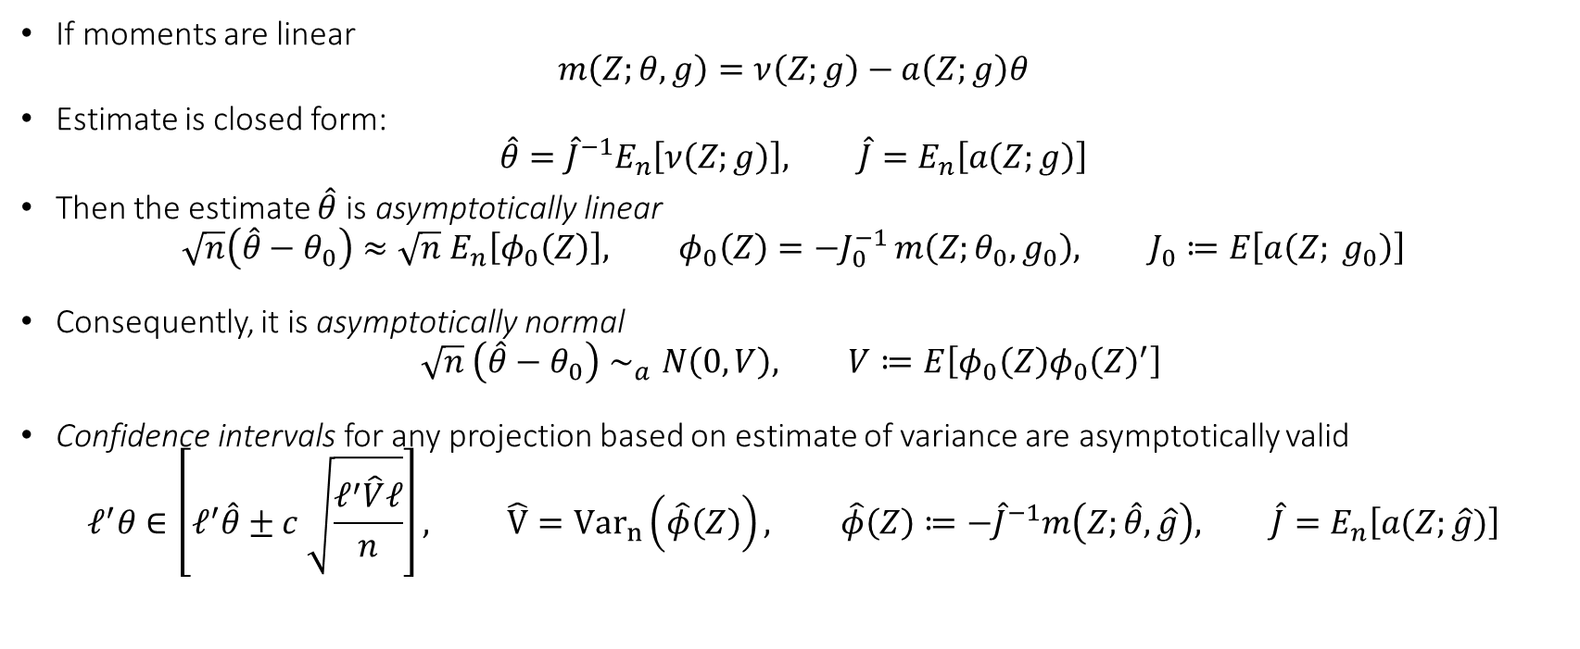
Main Theorem (linear moments)
If moments are linear
$$m\left(Z;θ,g\right)=ν\left(Z;g\right)−a\left(Z;g\right)θ$$
Estimate is closed form:
$$\hat{θ}={\hat{J}}^{−1}E_{n}\left[ν\left(Z;g\right)\right], \hat{J}=E_{n}\left[a\left(Z;g\right)\right]$$
Then the estimate $\hat{θ}$ is asymptotically linear
$$\sqrt{n}\left(\hat{θ}−θ_{0}\right)≈\sqrt{n} E_{n}\left[φ_{0}\left(Z\right)\right], φ_{0}\left(Z\right)=−J_{0}^{−1 }m\left(Z;θ_{0},g_{0}\right), J_{0}≔E\left[a\left(Z; g_{0}\right)\right]$$
Consequently, it is asymptotically normal
$$\sqrt{n} \left(\hat{θ}−θ_{0}\right)∼_{a}N\left(0, V\right), V≔E\left[φ_{0}\left(Z\right)φ_{0}{\left(Z\right)}^{′}\right]$$
Confidence intervals for any projection based on estimate of variance are asymptotically valid
$$ℓ^{′}θ∈\left[ℓ^{′}\hat{θ}±c \sqrt{\frac{ℓ^{′}\hat{V}ℓ}{n}}\right], \hat{V}={Var}_{n}\left(\hat{φ}\left(Z\right)\right), \hat{φ}\left(Z\right)≔−{\hat{J}}^{−1}m\left(Z;\hat{θ},\hat{g}\right), \hat{J}=E_{n}\left[a(Z;\hat{g})\right]$$

Slide 28
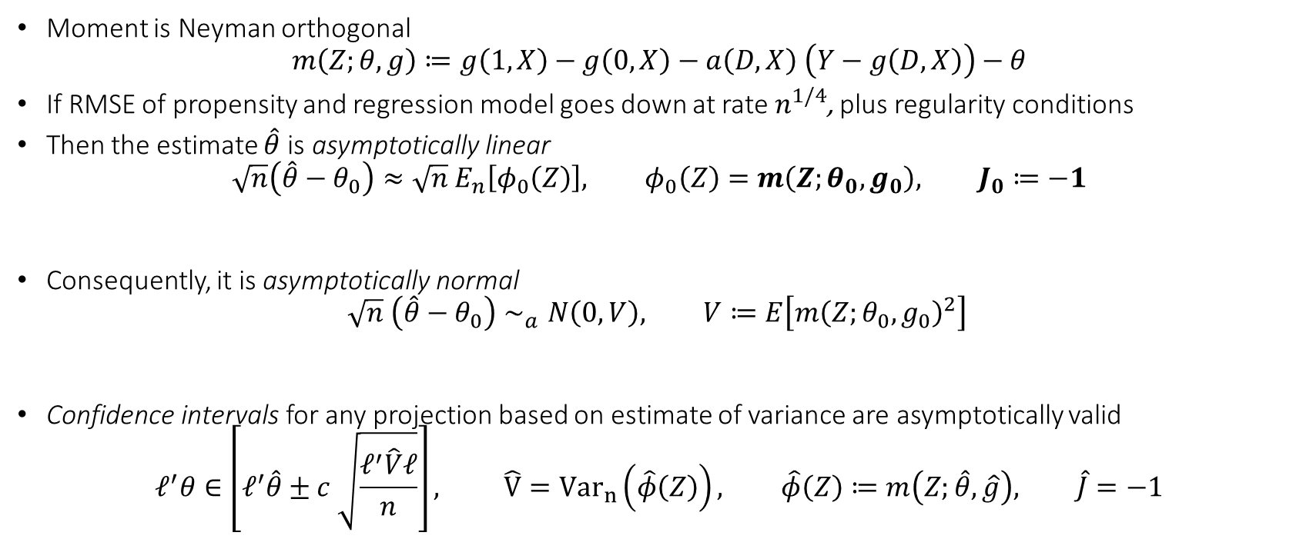
Inference with Doubly Robust Algorithm
Moment is Neyman orthogonal
$$m\left(Z;θ,g\right)≔g\left(1,X\right)−g\left(0,X\right)−a\left(D,X\right) \left(Y−g\left(D,X\right)\right)−θ$$
If RMSE of propensity and regression model goes down at rate $n^{1/4}$, plus regularity conditions
Then the estimate $\hat{θ}$ is asymptotically linear
$$\sqrt{n}\left(\hat{θ}−θ_{0}\right)≈\sqrt{n} E_{n}\left[φ_{0}\left(Z\right)\right], φ_{0}\left(Z\right)=m\left(Z;θ_{0},g_{0}\right), J_{0}≔−1$$
Consequently, it is asymptotically normal
$$\sqrt{n} \left(\hat{θ}−θ_{0}\right)∼_{a}N\left(0, V\right), V≔E\left[m{\left(Z;θ_{0},g_{0}\right)}^{2}\right]$$
Confidence intervals for any projection based on estimate of variance are asymptotically valid
$$ℓ^{′}θ∈\left[ℓ^{′}\hat{θ}±c \sqrt{\frac{ℓ^{′}\hat{V}ℓ}{n}}\right], \hat{V}={Var}_{n}\left(\hat{φ}\left(Z\right)\right), \hat{φ}\left(Z\right)≔m\left(Z;\hat{θ},\hat{g}\right), \hat{J}=−1$$

Slide 29

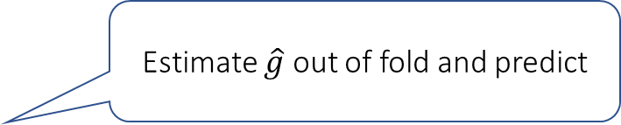
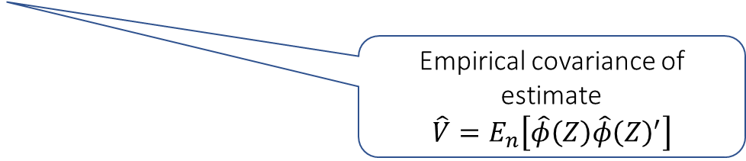
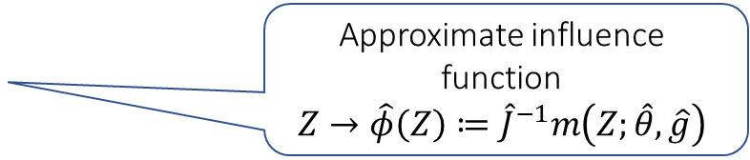

Python Pseudocode
# General DML pseudocode for linear moments: m(Z; theta, g) = nu(Z;g) - alpha(Z;g) theta
def general_dml_linear_moment(Z, ell, nfolds, alpha, nu, jacobian, nuisance_estimator):
# construct out-of-fold predictions from the nuisance estimator
ghat = cross_val_predict(nuisance_estimator, Z, cv=nfolds)
# use these predictions to define the empirical moment equation
# and solve explicitly with respect to theta
Jhat = np.mean(alpha(Z, ghat), axis=0)
avg_nu = np.mean(nu(Z, ghat), axis=0)
# solve for the empirical moment equation equals zero
invJhat = np.linalg.pinv(Jhat)
thetahat = invJhat @ avg_nu
# construct approximate influence function for each sample
phihat = - (nu(Z, ghat) - alpha(Z, ghat) @ thetahat) @ invJhat.T
# variance estimate
var = phihat.T @ phihat / phihat.shape[0]
# estimate and standard error for any projection ell of the parameters
point = ell @ thetahat
stderr_ell = np.sqrt(ell.T @ var @ ell / phihat.shape[0])
return point, stderr_ell
Estimate $\hat{g}$ out of fold and predict
cross-fitted jacobian $\hat{J}≔E_{n}\left[a\left(Z;\hat{g}\right)\right]$
cross-fitted offset $E_{n}\left[ν\left(Z;\hat{g}\right)\right]$
Closed form solution: $θ={\hat{J}}^{−1}E_{n}\left[ν\left(Z;\hat{g}\right)\right]$
Approximate influence function
$$Z→\hat{φ}\left(Z\right)≔{\hat{J}}^{−1}m\left(Z;\hat{θ},\hat{g}\right)$$
Empirical covariance of estimate
$$\hat{V}=E_{n}\left[\hat{φ}\left(Z\right)\hat{φ}{\left(Z\right)}^{′}\right]$$

Slide 30
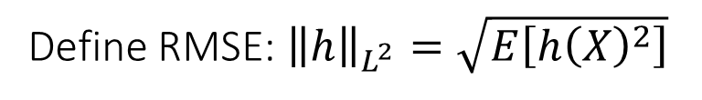
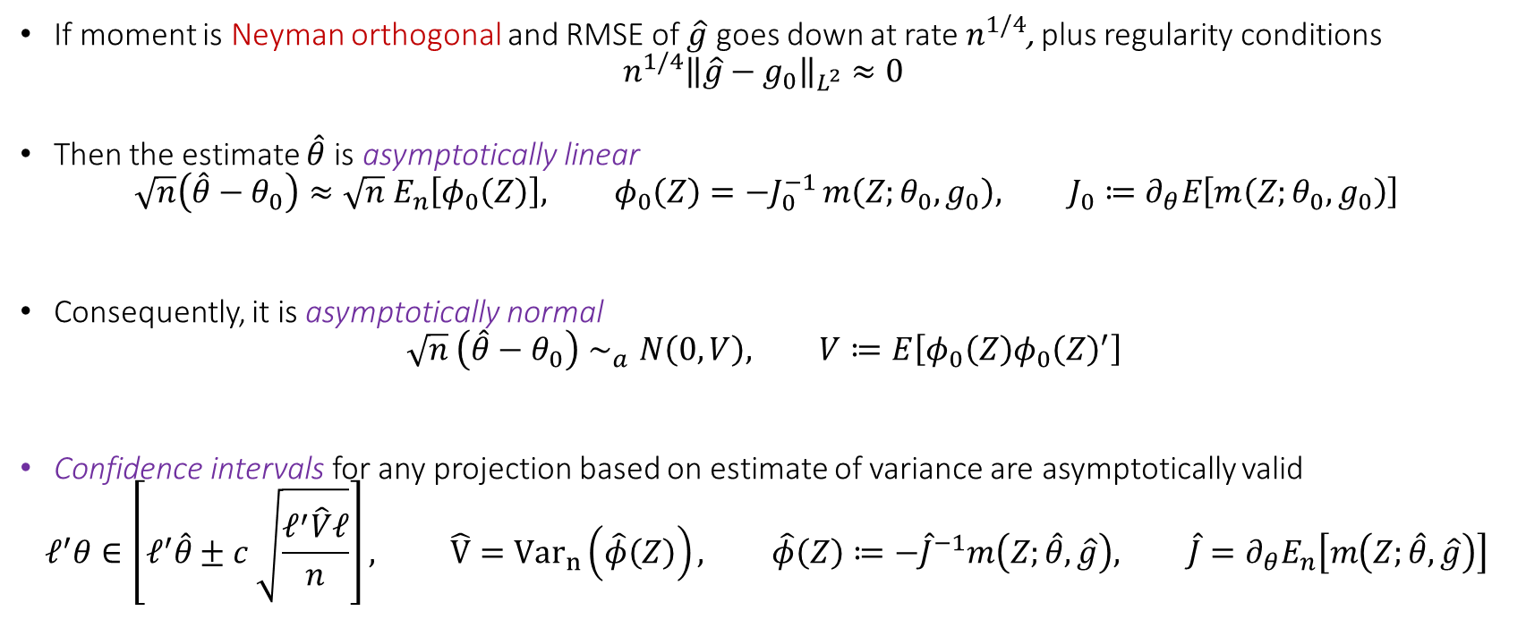
Main Theorem (expanded)
Define RMSE: ${\left\|h\right\|}_{L^{2}}=\sqrt{E\left[h{\left(X\right)}^{2}\right]}$
If moment is Neyman orthogonal and RMSE of $\hat{g}$ goes down at rate $n^{1/4}$, plus regularity conditions
$$n^{1/4}{\left\|\hat{g}−g_{0}\right\|}_{L^{2}}≈0$$
Then the estimate $\hat{θ}$ is asymptotically linear
$$\sqrt{n}\left(\hat{θ}−θ_{0}\right)≈\sqrt{n} E_{n}\left[φ_{0}\left(Z\right)\right], φ_{0}\left(Z\right)=−J_{0}^{−1 }m\left(Z;θ_{0},g_{0}\right), J_{0}≔∂_{θ}E\left[m\left(Z;θ_{0},g_{0}\right)\right]$$
Consequently, it is asymptotically normal
$$\sqrt{n} \left(\hat{θ}−θ_{0}\right)∼_{a}N\left(0, V\right), V≔E\left[φ_{0}\left(Z\right)φ_{0}{\left(Z\right)}^{′}\right]$$
Confidence intervals for any projection based on estimate of variance are asymptotically valid
$$ℓ^{′}θ∈\left[ℓ^{′}\hat{θ}±c \sqrt{\frac{ℓ^{′}\hat{V}ℓ}{n}}\right], \hat{V}={Var}_{n}\left(\hat{φ}\left(Z\right)\right), \hat{φ}\left(Z\right)≔−{\hat{J}}^{−1}m\left(Z;\hat{θ},\hat{g}\right), \hat{J}=∂_{θ}E_{n}\left[m\left(Z;\hat{θ},\hat{g}\right)\right]$$
Jacobian of moments with respect to parameter; relates to identification strength
influence function
influence is a linear transformation of the moment; transforming from “moment space” to “parameter space”
Covariance of the influence function
Empirical variance of approximate influence
Approximate influence function
Empirical average of jacobian

Slide 31
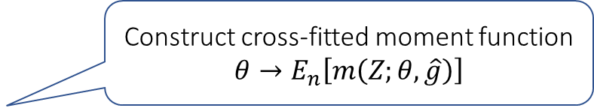
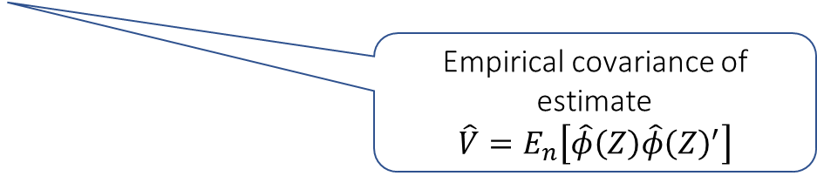

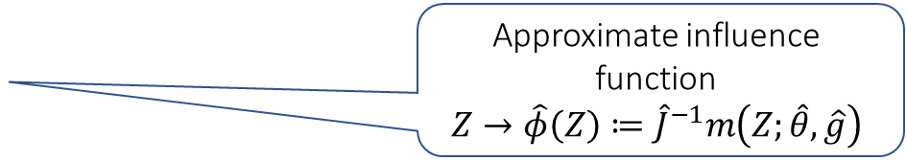
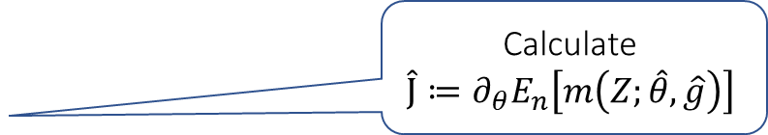
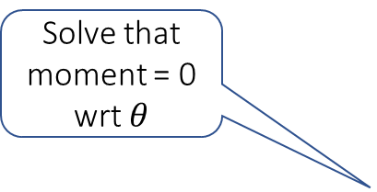
Python Pseudocode
# General DML pseudocode
def general_dml(Z, ell, nfolds, moment, jacobian, nuisance_estimator): # construct out-of-fold predictions from the nuisance estimator
ghat = cross_val_predict(nuisance_estimator, Z, cv=nfolds)
# use these predictions to define the empirical moment equation
# with respect to theta
avg_moment = lambda theta: np.mean(moment(Z, theta, ghat), axis=0)
# solve for the empirical moment equation equals zero
thetahat = fsolve(avg_moment)
# calculate empirical jacobian with respect to theta, evaluated
# at the estimates thetahat and ghat
Jhat = np.mean(jacobian(Z, thetahat, ghat), axis=0)
# construct approximate influence function for each sample
phihat = - moment(Z, thetahat, ghat) @ np.linalg.pinv(Jhat).T
# variance estimate
var = phihat.T @ phihat / phihat.shape[0]
# estimate and standard error for any projection ell of the parameters
point = ell @ thetahat
stderr_ell = np.sqrt(ell.T @ var @ ell / phihat.shape[0]) return point, stderr_ell
Estimate $\hat{g}$ out of fold and predict
Construct cross-fitted moment function
$$θ→E_{n}\left[m\left(Z;θ, \hat{g}\right)\right]$$
Solve that moment = 0 wrt $θ$
Calculate
$$\hat{J}≔∂_{θ}E_{n}\left[m\left(Z;\hat{θ},\hat{g}\right)\right]$$
Approximate influence function
$$Z→\hat{φ}\left(Z\right)≔{\hat{J}}^{−1}m\left(Z;\hat{θ},\hat{g}\right)$$
Empirical covariance of estimate
$$\hat{V}=E_{n}\left[\hat{φ}\left(Z\right)\hat{φ}{\left(Z\right)}^{′}\right]$$

Slide 32
Practical Variants of Sample-Splitting
Cross-fitting and semi-cross-fitting

Slide 33
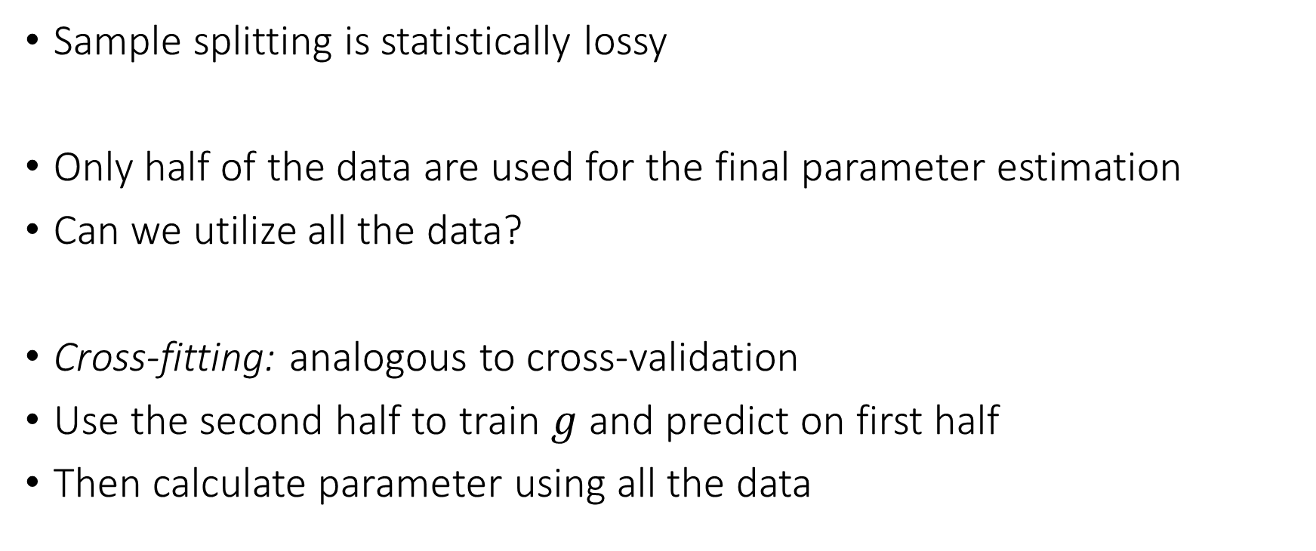
Cross-fitting
Sample splitting is statistically lossy
Only half of the data are used for the final parameter estimation
Can we utilize all the data?
Cross-fitting: analogous to cross-validation
Use the second half to train $g$ and predict on first half
Then calculate parameter using all the data

Slide 34
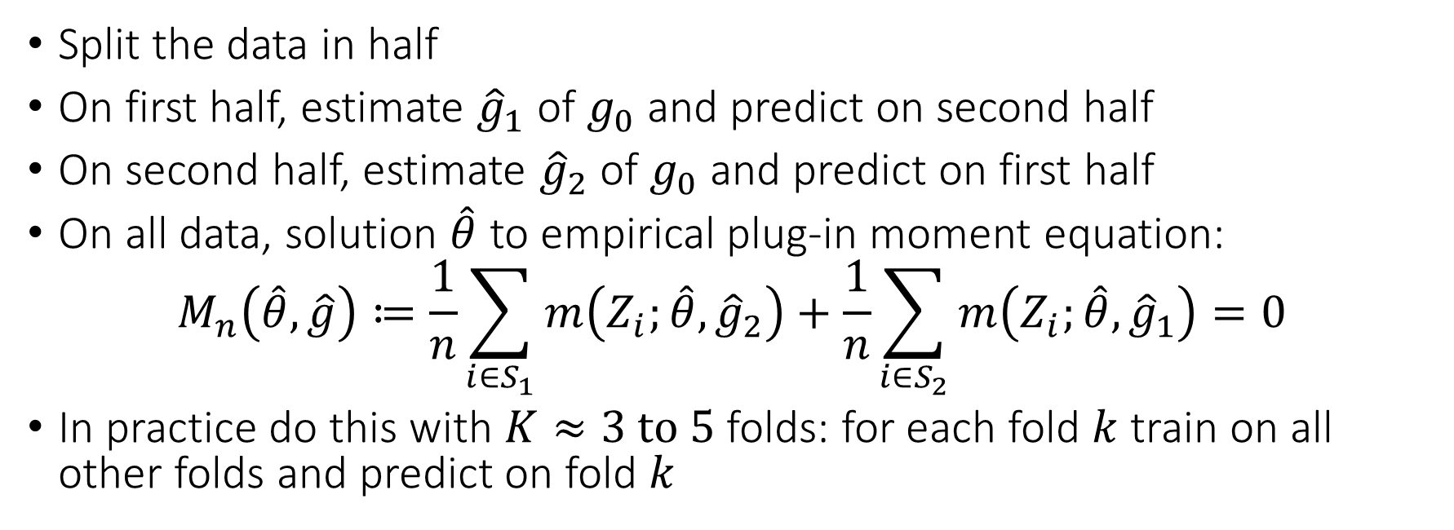
Cross-fitting Estimation Algorithm
Split the data in half
On first half, estimate ${\hat{g}}_{1}$ of $g_{0}$ and predict on second half
On second half, estimate ${\hat{g}}_{2}$ of $g_{0}$ and predict on first half
On all data, solution $\hat{θ}$ to empirical plug-in moment equation:
$$M_{n}\left(\hat{θ},\hat{g}\right)≔\frac{1}{n}\sum_{i∈S_{1}}{m\left(Z_{i};\hat{θ}, {\hat{g}}_{2}\right)}+\frac{1}{n}\sum_{i∈S_{2}}{m\left(Z_{i};\hat{θ}, {\hat{g}}_{1}\right)}=0$$
In practice do this with $K≈3 to 5$ folds: for each fold $k$ train on all other folds and predict on fold $k$

Slide 35
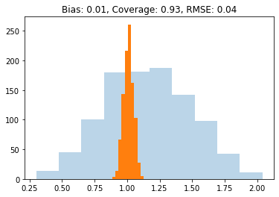
Natural Algorithm (Draft 3) Gone Right
def dml2(X, D, y): # orthogonal dml with sample-splitting
est_y = RandomForestRegressor(min_samples_leaf=20)
yres = y - cross_val_predict(est_y, X, y, cv=3)
est_t = RandomForestRegressor(min_samples_leaf=20)
Dres = D - cross_val_predict(est_t, X, D, cv=3)
theta = np.mean(yres * Dres) / np.mean(Dres**2)
var = np.mean((Dres**2) * (yres - theta*Dres)**2) / np.mean(Dres**2)
stderr = np.sqrt(var / X.shape[0])
return theta, stderr

Slide 36
Natural Algorithm (Draft 3) Gone Right
from econml.dml import LinearDML
dml = LinearDML(model_y=RandomForestRegressor(min_samples_leaf=20),
model_t=RandomForestRegressor(min_samples_leaf=20))
est.fit(y, D, W=X).effect_inference()

Slide 37
Stacking and Model Selection
If we want to choose among many models or perform stacking, we can just use a stacked or automl model in place of each ML model

Slide 38
Stacking ML Models
def dml2(X, D, y): # orthogonal dml with sample-splitting
est_y = StackingRegressor([rf, nnet, gbf, lasso])
yres = y - cross_val_predict(est_y, X, y, cv=3)
est_t = StackingRegressor([rf, nnet, gbf, lasso])
Dres = D - cross_val_predict(est_t, X, D, cv=3)
theta = np.mean(yres * Dres) / np.mean(Dres**2)
var = np.mean((Dres**2) * (yres - theta*Dres)**2) / np.mean(Dres**2)
stderr = np.sqrt(var / X.shape[0])
return theta, stderr

Slide 39
AutoML Models
from flaml import AutoML
def dml2(X, D, y): # orthogonal dml with sample-splitting
est_y = AutoML()
yres = y - cross_val_predict(est_y, X, y, cv=3)
est_t = AutoML()
Dres = D - cross_val_predict(est_t, X, D, cv=3)
theta = np.mean(yres * Dres) / np.mean(Dres**2)
var = np.mean((Dres**2) * (yres - theta*Dres)**2) / np.mean(Dres**2)
stderr = np.sqrt(var / X.shape[0])
return theta, stderr

Slide 40
Stacking and Model Selection
If we want to choose among many models or perform stacking, we can just use a stacked or automl model in place of each ML model
Model selection or stacking done many times within each training fold
Computationally expensive and statistically lossy
Can we use all the data to at least select among models?

Slide 41
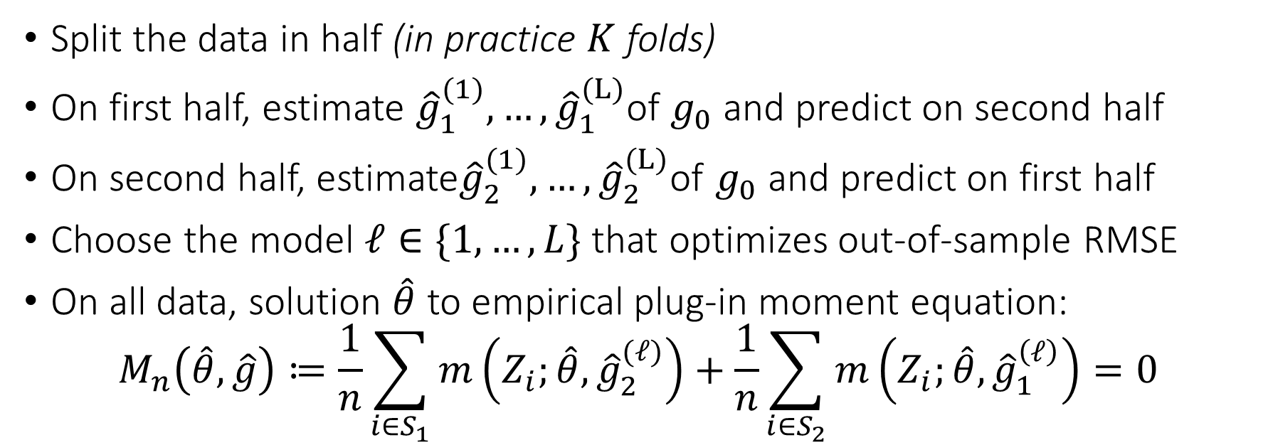
Semi-Cross-fitting Estimation Algorithm
Split the data in half (in practice $K$ folds)
On first half, estimate ${\hat{g}}_{1}^{(1)}, …,{\hat{g}}_{1}^{(L)}$of $g_{0}$ and predict on second half
On second half, estimate${\hat{g}}_{2}^{(1)}, …,{\hat{g}}_{2}^{(L)}$of $g_{0}$ and predict on first half
Choose the model $ℓ∈\{1,…,L\}$ that optimizes out-of-sample RMSE
On all data, solution $\hat{θ}$ to empirical plug-in moment equation:
$$M_{n}\left(\hat{θ},\hat{g}\right)≔\frac{1}{n}\sum_{i∈S_{1}}{m\left(Z_{i};\hat{θ}, {\hat{g}}_{2}^{(ℓ)}\right)}+\frac{1}{n}\sum_{i∈S_{2}}{m\left(Z_{i};\hat{θ}, {\hat{g}}_{1}^{\left(ℓ\right)}\right)}=0$$

Slide 42
Semi-Crossfitting
def dml2(X, D, y): # orthogonal dml with semi-crossfitting
# cross val predict with many models
est_y = [rf, gbf, lasso]
yres = np.array([y - cross_val_predict(est, X, y, cv=3) for est in est_y])
est_d = [rf, gbf, lasso]
Dres = np.array([D - cross_val_predict(est, X, D, cv=3) for est in est_d])
# select models with best out of fold performance
best_y = np.argmin(np.mean(yres**2, axis=1))
best_d = np.argmin(np.mean(Dres**2, axis=1))
yres = yres[best_y]
Dres = Dres[best_d]
# go with their corresponding residuals
theta = np.mean(yres * Dres) / np.mean(Dres**2)
var = np.mean((Dres**2) * (yres - theta*Dres)**2) / np.mean(Dres**2)
stderr = np.sqrt(var / X.shape[0])
return theta, stderr

Slide 43

Semi-Crossfitting
If the number of models $L$ is small, then “spillover” is ok and approach still works. For practical purposes $L$ should be thought as constant.
Under further regularity, provably asymptotic normality holds if
$$\sqrt{\log\left(L\right)}=o\left(n^{1/4}\right)$$

Slide 44
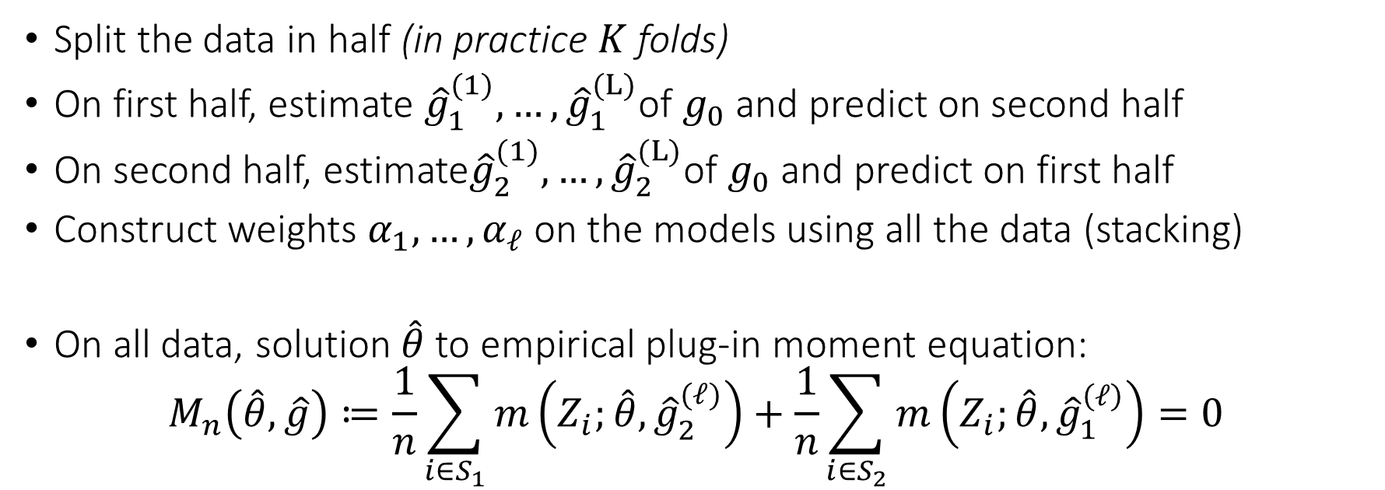
Semi-Cross-fitting with Stacking
Split the data in half (in practice $K$ folds)
On first half, estimate ${\hat{g}}_{1}^{(1)}, …,{\hat{g}}_{1}^{(L)}$of $g_{0}$ and predict on second half
On second half, estimate${\hat{g}}_{2}^{(1)}, …,{\hat{g}}_{2}^{(L)}$of $g_{0}$ and predict on first half
Construct weights $α_{1},…,α_{ℓ}$ on the models using all the data (stacking)
On all data, solution $\hat{θ}$ to empirical plug-in moment equation:
$$M_{n}\left(\hat{θ},\hat{g}\right)≔\frac{1}{n}\sum_{i∈S_{1}}{m\left(Z_{i};\hat{θ}, {\hat{g}}_{2}^{(ℓ)}\right)}+\frac{1}{n}\sum_{i∈S_{2}}{m\left(Z_{i};\hat{θ}, {\hat{g}}_{1}^{\left(ℓ\right)}\right)}=0$$

Slide 45
Semi-Crossfitting with Stacking
def dml2(X, D, y): # orthogonal dml with semi-crossfitting and stacking
# cross val predict with many models
est_y = [rf, gbf, lasso]
ypreds = np.array([cross_val_predict(est, X, y, cv=3) for est in est_y]).T
est_d = [rf, gbf, lasso]
Dpreds = np.array([cross_val_predict(est, X, D, cv=3) for est in est_d]).T
# calculate stacked residuals by finding optimal coefficients
# and weigthing out-of-sample predictions by these coefficients
yres = y - LinearRegression().fit(ypreds, y).predict(ypreds)
Dres = D - LinearRegression().fit(Dpreds, D).predict(Dpreds)
# go with the stacked residuals
theta = np.mean(yres * Dres) / np.mean(Dres**2)
var = np.mean((Dres**2) * (yres - theta*Dres)**2) / np.mean(Dres**2)
stderr = np.sqrt(var / X.shape[0])
return theta, stderr

Slide 46
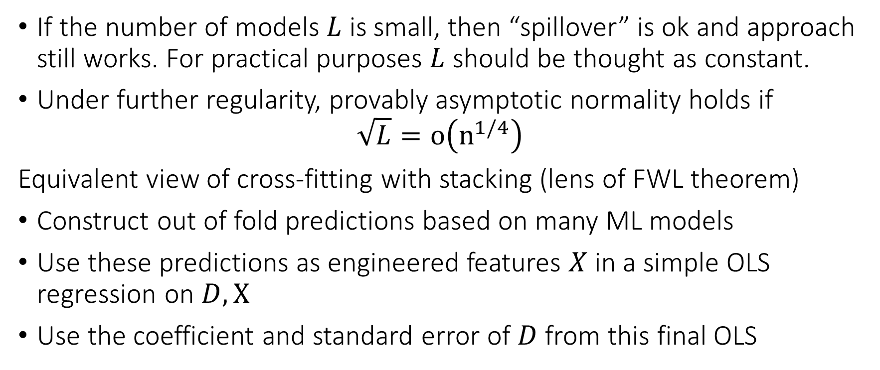
Semi-Crossfitting
If the number of models $L$ is small, then “spillover” is ok and approach still works. For practical purposes $L$ should be thought as constant.
Under further regularity, provably asymptotic normality holds if
$$\sqrt{L}=o\left(n^{1/4}\right)$$
Equivalent view of cross-fitting with stacking (lens of FWL theorem)
Construct out of fold predictions based on many ML models
Use these predictions as engineered features $X$ in a simple OLS regression on $D,X$
Use the coefficient and standard error of $D$ from this final OLS

Slide 47
Application: Effect of 401k

Slide 48
Problem
Impact of 401k eligibility on financial assets
Working for a firm that offers access to 401k eligibility not randomly assigned
After conditioning on important characteristics of the worker and job, assignment can be thought as exogenous
Most important: income
At least around 1991 (early in 401k deployment), workers would not really base their employment decision on 401k eligibility

Slide 49
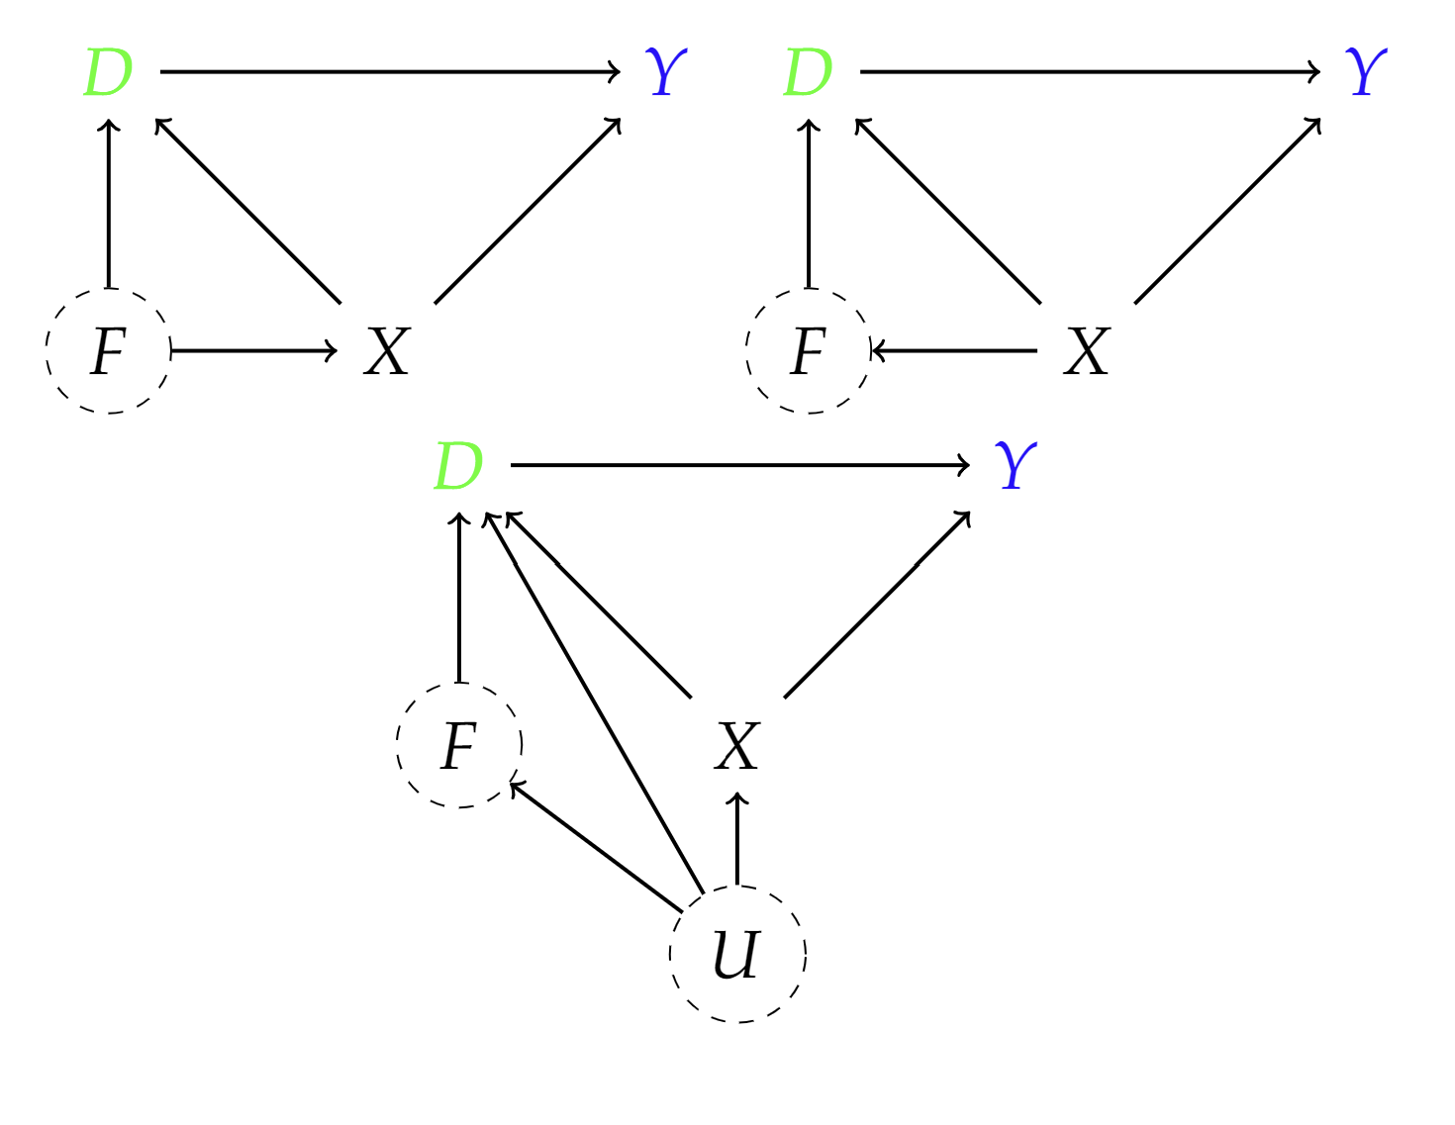
Causal Diagrams
F: firm characteristics
D: eligibility for 401k
Y: net financial assets
X: age, income, family size, years of education, a married indicator, a two-earner status indicator, a defined benefit pension status indicator, an IRA participation indicator, and a home ownership indicator
Let’s try it out!

Slide 50
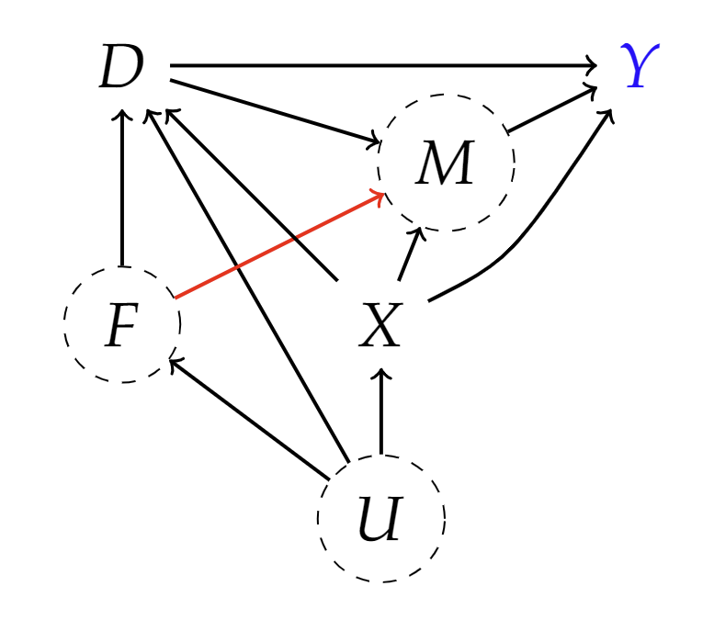
Possible Violations
F: firm characteristics
D: eligibility for 401k
Y: net financial assets
X: age, income, family size, years of education, a married indicator, a two-earner status indicator, a defined benefit pension status indicator, an IRA participation indicator, and a home ownership indicator
M: match amount

