Slide 1
MS&E 228: Topics on Longitudinal Data and Causal Machine Learning Difference-in-Difference
Vasilis Syrgkanis
MS&E, Stanford

Slide 2
Causal Inference with Experiments
Prediction with Linear Models
Prediction with High-Dim Linear Models
Inference on Causal and Predictive Effects with High-Dim Linear Models
Potential Outcomes and Conditional Ignorability
Structural Equation Models and Conditional Exogeneity
Directed Acyclic Graphs
Prediction with Non-Linear Models
Inference on Causal Effects with Non-Linear Models
Un-observed Confounding and Instruments
Estimation of Heterogeneous Causal Effects
Identification of Causal Effects in Longitudinal Data
Linear Predictive Models and Statistical Inference
Causal Identification in Observational Data
Non-Linear Predictive Models and Statistical Inference
Topics

Slide 3
Causal Inference with Experiments
Prediction with Linear Models
Prediction with High-Dim Linear Models
Inference on Causal and Predictive Effects with High-Dim Linear Models
Potential Outcomes and Conditional Ignorability
Structural Equation Models and Conditional Exogeneity
Directed Acyclic Graphs
Prediction with Non-Linear Models
Inference on Causal Effects with Non-Linear Models
Un-observed Confounding and Instruments
Estimation of Heterogeneous Causal Effects
Identification of Causal Effects in Longitudinal Data
Linear Predictive Models and Statistical Inference
Causal Identification in Observational Data
Non-Linear Predictive Models and Statistical Inference
Topics

Slide 4
Longitudinal Data
Longitudinal data refer to datasets where we have multiple observations of the same unit over time
They present a separate set of new problems
Correlation: samples stemming from each unit (or sometimes cluster of units from the same “site”) are correlated
Censoring/Missingness: units typically drop out at (potentially not) random times before the end of the study
Dynamic treatments: units are treated with multiple treatments over time in a manner that is adaptive and auto-correlated

Slide 5
Longitudinal Data
Longitudinal data refer to datasets where we have multiple observations of the same unit over time
They present a separate set but also opportunities for causal identification strategies
Differences-in-Differences: assumption of treatment not being chosen based on potential “growth” trajectory of unit under control
Synthetic Controls: assumption that trajectory of a treated unit under control, can be well approximated as some combination of trajectories of un-treated units

Slide 6
Differences-in-Differences

Slide 7
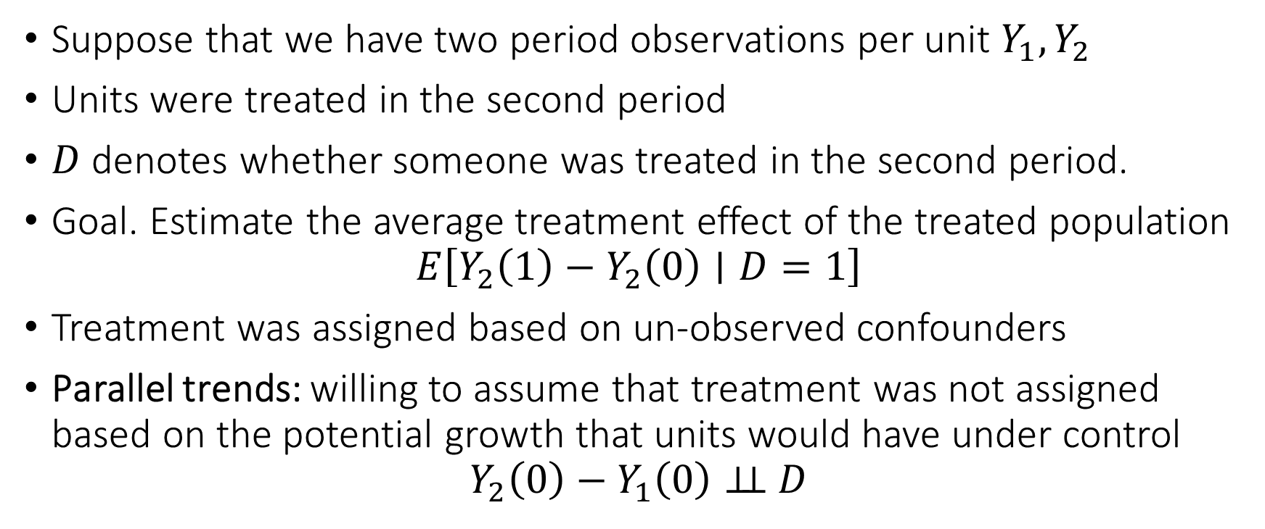
Differences-in-Differences
Suppose that we have two period observations per unit $Y_{1},Y_{2}$
Units were treated in the second period
$D$ denotes whether someone was treated in the second period.
Goal. Estimate the average treatment effect of the treated population
$$E\left[Y_{2}\left(1\right)−Y_{2}\left(0\right)∣D=1\right]$$
Treatment was assigned based on un-observed confounders
Parallel trends: willing to assume that treatment was not assigned based on the potential growth that units would have under control
$$Y_{2}\left(0\right)−Y_{1}\left(0\right)⊥⊥ D$$

Slide 8




Visually
$$D=1$$
Counterfactual post-treatment outcomes under control
$$D=0$$
$$Y_{1}$$
$$Y_{2}$$
Pre-treatment
Post-treatment

Slide 9
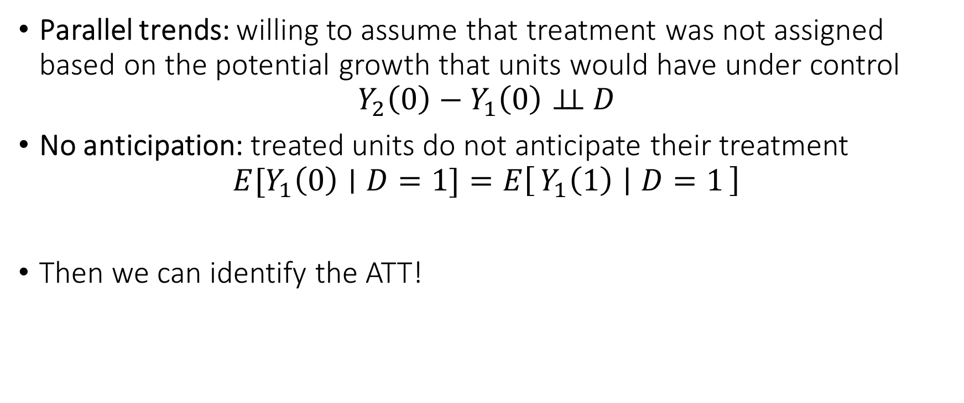
Differences-in-Differences
Parallel trends: willing to assume that treatment was not assigned based on the potential growth that units would have under control
$$Y_{2}\left(0\right)−Y_{1}\left(0\right)⊥⊥ D$$
No anticipation: treated units do not anticipate their treatment
$$E[Y_{1}\left(0\right)∣D=1]=E\left[Y_{1}\left(1\right) ∣ D=1\right]$$
Then we can identify the ATT!

Slide 10
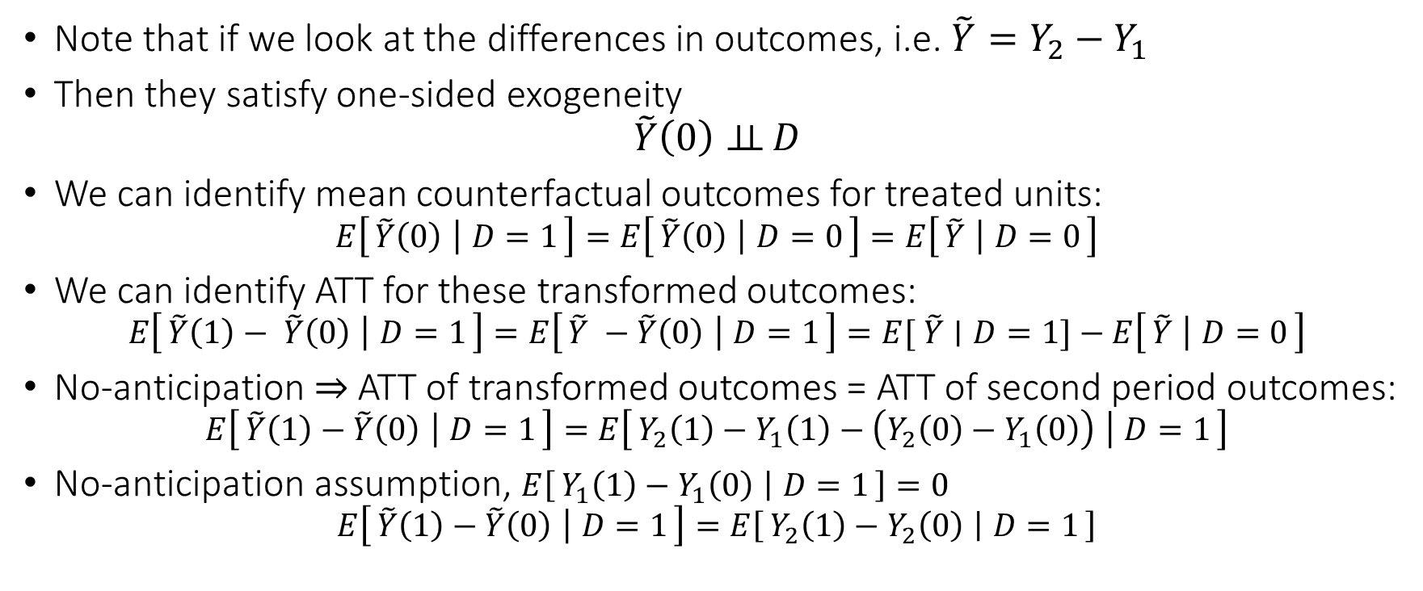
Identification of ATT
Note that if we look at the differences in outcomes, i.e. $\tilde{Y}=Y_{2}−Y_{1}$
Then they satisfy one-sided exogeneity
$$\tilde{Y}\left(0\right)⊥⊥ D$$
We can identify mean counterfactual outcomes for treated units:
$$E\left[\tilde{Y}\left(0\right) ∣ D=1\right]=E\left[\tilde{Y}\left(0\right) ∣ D=0\right]=E\left[\tilde{Y} ∣ D=0\right]$$
We can identify ATT for these transformed outcomes:
$$E\left[\tilde{Y}\left(1\right)− \tilde{Y}\left(0\right) ∣ D=1\right]=E\left[\tilde{Y} −\tilde{Y}\left(0\right) ∣ D=1\right]=E[ \tilde{Y}∣D=1]−E\left[\tilde{Y} ∣ D=0\right]$$
No-anticipation $⇒$ ATT of transformed outcomes = ATT of second period outcomes:
$$E\left[\tilde{Y}\left(1\right)−\tilde{Y}\left(0\right) ∣ D=1\right]=E\left[Y_{2}\left(1\right)−Y_{1}\left(1\right)−\left(Y_{2}\left(0\right)−Y_{1}\left(0\right)\right) ∣ D=1\right]$$
No-anticipation assumption, $E\left[Y_{1}\left(1\right)−Y_{1}\left(0\right) ∣ D=1\right]=0$
$$E\left[\tilde{Y}\left(1\right)−\tilde{Y}\left(0\right) ∣ D=1\right]=E\left[Y_{2}\left(1\right)−Y_{2}\left(0\right) ∣ D=1\right]$$

Slide 11
Conditional Parallel Trends
Parallel trends can be quite strong of an assumption
Much more plausible once we match on observable characteristics

Slide 12






Visually
$$X=x_{1}$$
$$D=1$$
Counterfactual post-treatment outcomes under control
$$X=x_{2}$$
$$X=x_{1}$$
$$D=0$$
$$X=x_{2}$$
$$Y_{1}$$
$$Y_{2}$$
Pre-treatment
Post-treatment

Slide 13
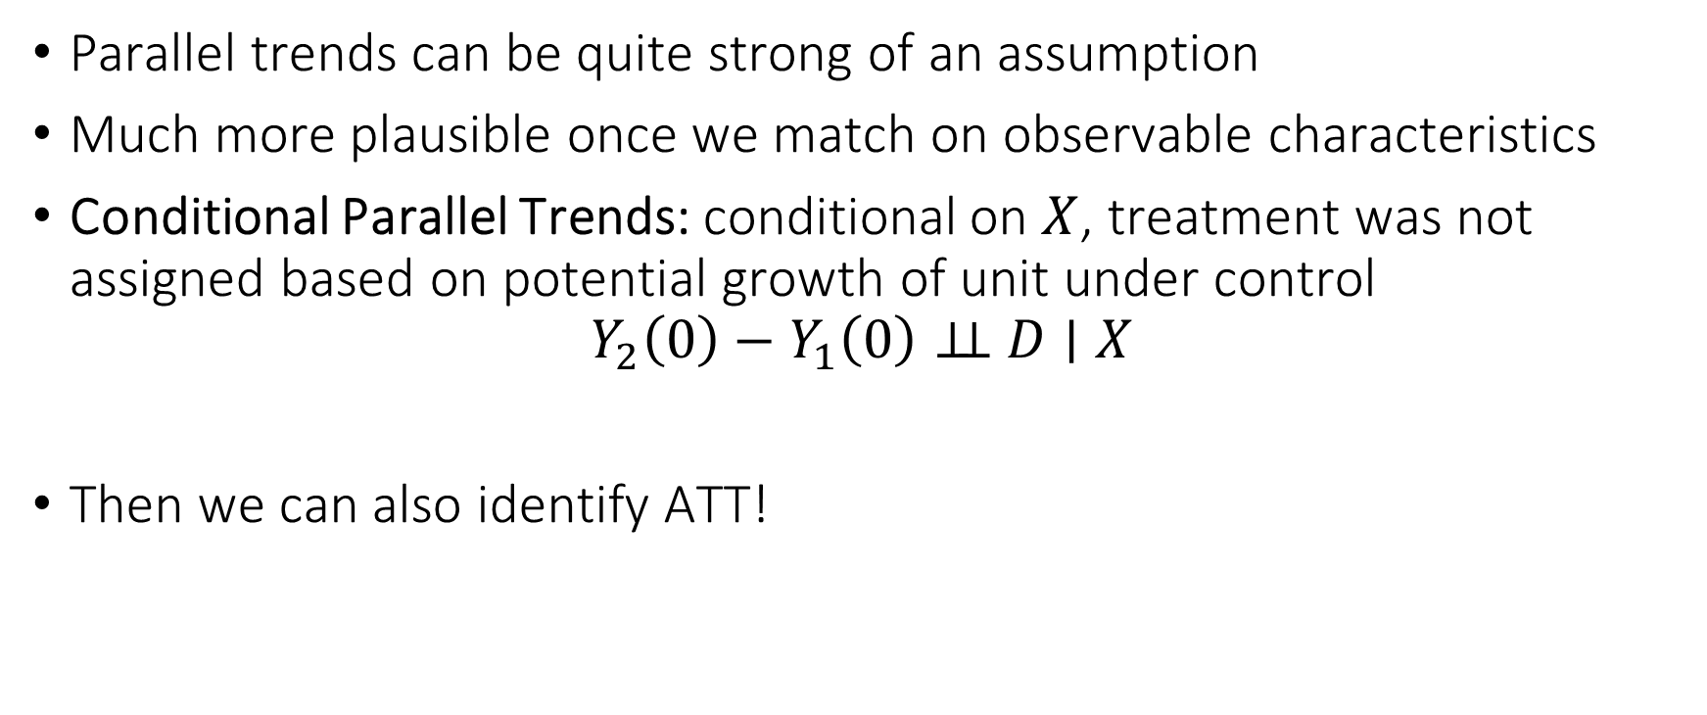
Conditional Parallel Trends
Parallel trends can be quite strong of an assumption
Much more plausible once we match on observable characteristics
Conditional Parallel Trends: conditional on $X$, treatment was not assigned based on potential growth of unit under control
$$Y_{2}\left(0\right)−Y_{1}\left(0\right)⊥⊥ D∣X$$
Then we can also identify ATT!

Slide 14
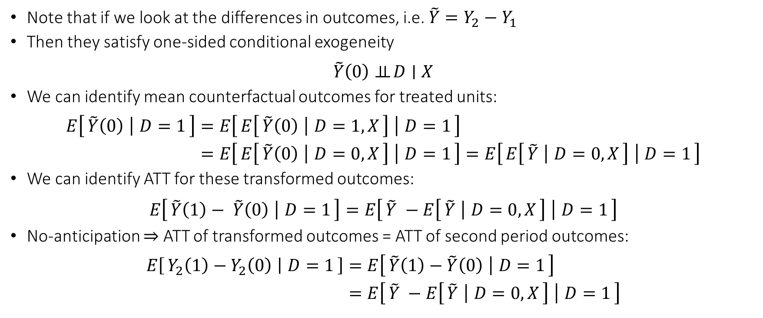
ATT under Conditional Parallel Trends
Note that if we look at the differences in outcomes, i.e. $\tilde{Y}=Y_{2}−Y_{1}$
Then they satisfy one-sided conditional exogeneity
$$\tilde{Y}\left(0\right)⊥⊥ D∣X$$
We can identify mean counterfactual outcomes for treated units:
$$\begin{aligned}E\left[\tilde{Y}\left(0\right) ∣ D=1\right]=&E\left[E\left[\tilde{Y}\left(0\right) ∣ D=1,X\right] ∣ D=1\right] \\ =&E\left[E\left[\tilde{Y}\left(0\right) ∣ D=0,X\right] ∣ D=1\right]=E\left[E\left[\tilde{Y} ∣ D=0,X\right] ∣ D=1\right]\end{aligned}$$
We can identify ATT for these transformed outcomes:
$$E\left[\tilde{Y}\left(1\right)− \tilde{Y}\left(0\right) ∣ D=1\right]=E\left[\tilde{Y} −E\left[\tilde{Y} ∣ D=0,X\right] ∣ D=1\right]$$
No-anticipation $⇒$ ATT of transformed outcomes = ATT of second period outcomes:
$$\begin{aligned}E\left[Y_{2}\left(1\right)−Y_{2}\left(0\right) ∣ D=1\right]=&E\left[\tilde{Y}\left(1\right)−\tilde{Y}\left(0\right) ∣ D=1\right] \\ =&E\left[\tilde{Y} −E\left[\tilde{Y} ∣ D=0,X\right] ∣ D=1\right]\end{aligned}$$

Slide 15
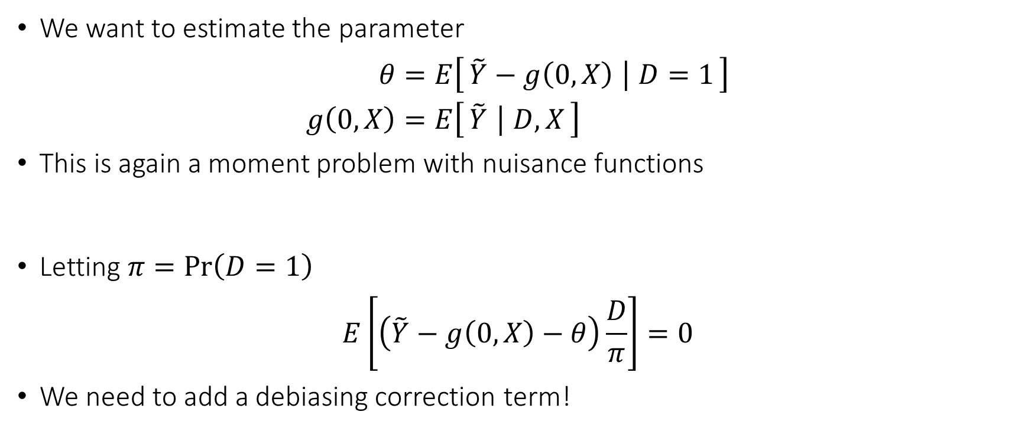
Debiased ML Estimation
We want to estimate the parameter
$$\begin{aligned}θ=&E\left[\tilde{Y}−g\left(0,X\right) ∣ D=1\right] \\ g\left(0,X\right)=&E\left[\tilde{Y} ∣ D,X\right]\end{aligned}$$
This is again a moment problem with nuisance functions
Letting $π=\operatorname{Pr}\left(D=1\right)$
$$E\left[\left(\tilde{Y}−g\left(0,X\right)−θ\right)\frac{D}{π}\right]=0$$
We need to add a debiasing correction term!

Slide 16
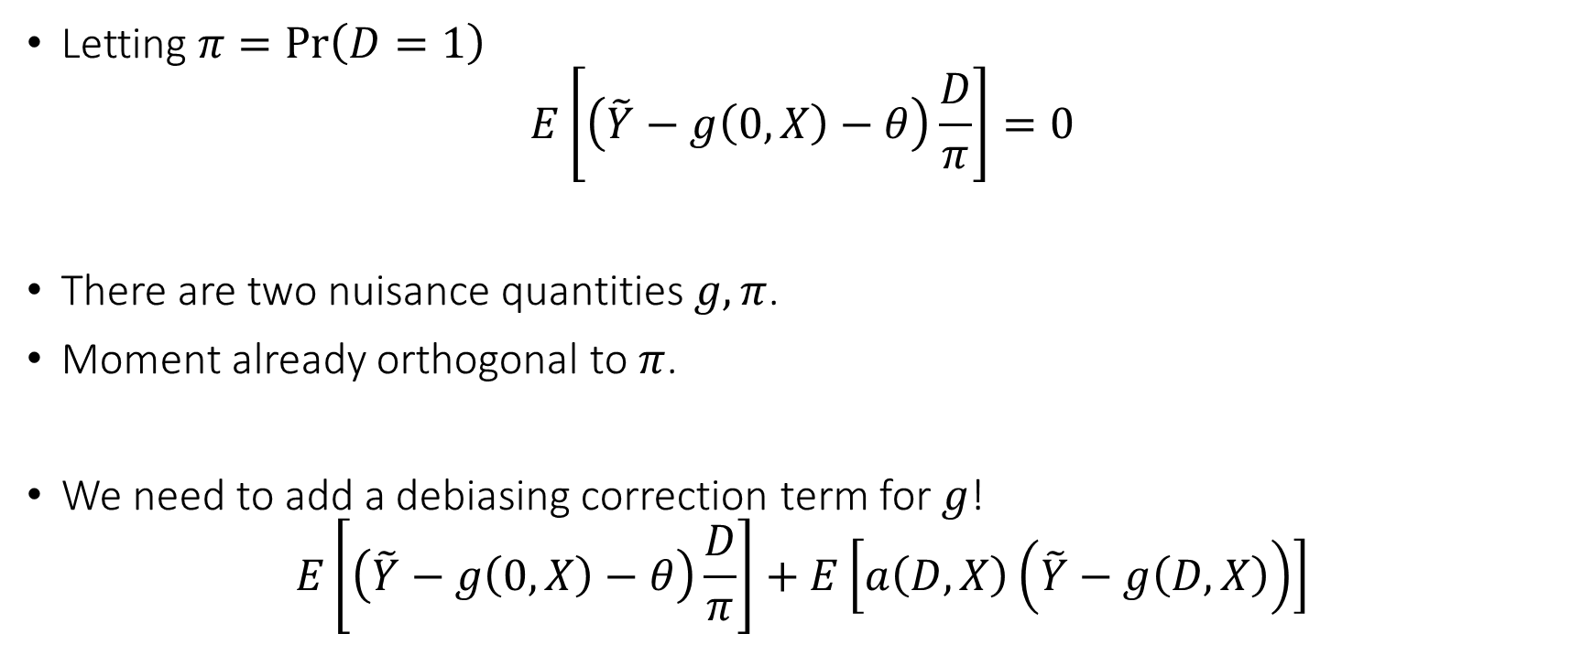
Debiased ML for ATT
Letting $π=\operatorname{Pr}\left(D=1\right)$
$$E\left[\left(\tilde{Y}−g\left(0,X\right)−θ\right)\frac{D}{π}\right]=0$$
There are two nuisance quantities $g,π$.
Moment already orthogonal to $π$.
We need to add a debiasing correction term for $g$!
$$E\left[\left(\tilde{Y}−g\left(0,X\right)−θ\right)\frac{D}{π}\right]+E\left[a\left(D,X\right)\left(\tilde{Y}−g\left(D,X\right)\right)\right]$$

Slide 17
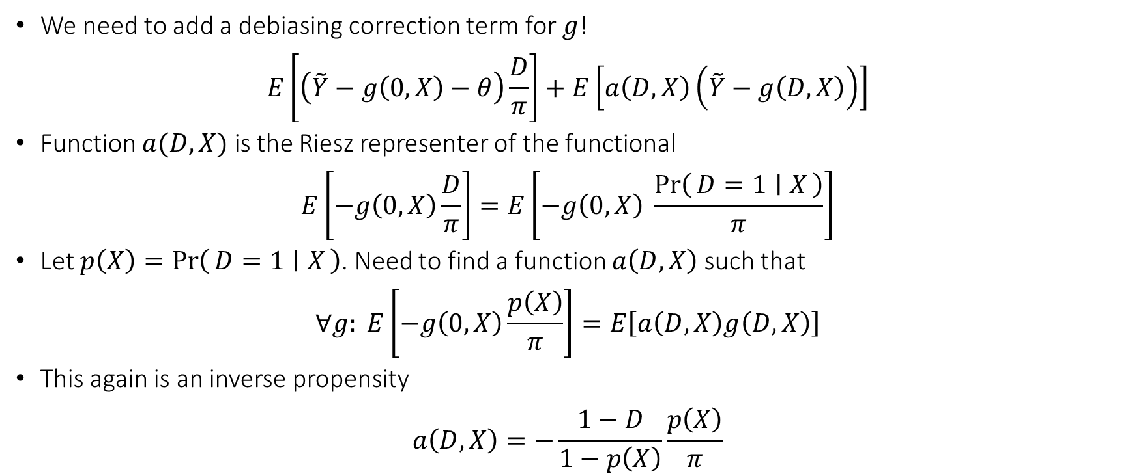
Debiased ML for ATT
We need to add a debiasing correction term for $g$!
$$E\left[\left(\tilde{Y}−g\left(0,X\right)−θ\right)\frac{D}{π}\right]+E\left[a\left(D,X\right)\left(\tilde{Y}−g\left(D,X\right)\right)\right]$$
Function $a(D,X)$ is the Riesz representer of the functional
$$E\left[−g\left(0,X\right)\frac{D}{π}\right]=E\left[−g\left(0,X\right) \frac{\operatorname{Pr}\left(D=1 ∣ X\right)}{π}\right]$$
Let $p\left(X\right)=\operatorname{Pr}\left(D=1 ∣ X\right)$. Need to find a function $a\left(D,X\right)$ such that
$$∀g: E\left[−g\left(0,X\right)\frac{p\left(X\right)}{π}\right]=E\left[a\left(D,X\right)g\left(D,X\right)\right]$$
This again is an inverse propensity
$$a\left(D,X\right)=−\frac{1−D}{1−p\left(X\right)}\frac{p\left(X\right)}{π}$$

Slide 18
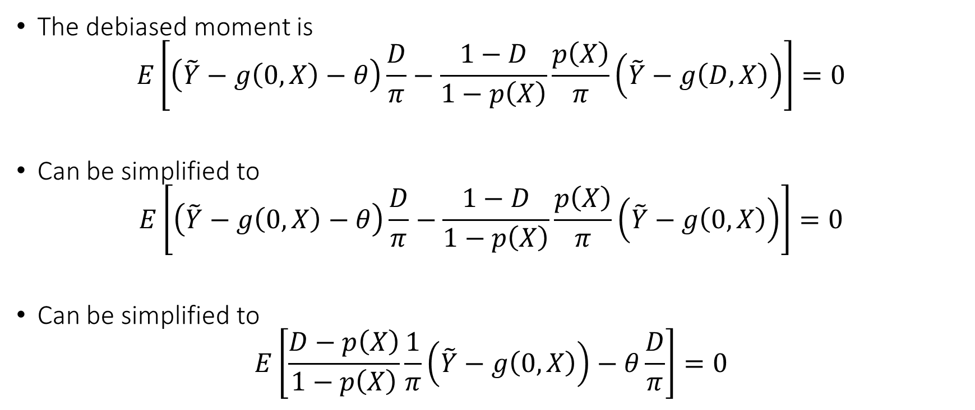
Debiased Moment
The debiased moment is
$$E\left[\left(\tilde{Y}−g\left(0,X\right)−θ\right)\frac{D}{π}−\frac{1−D}{1−p\left(X\right)}\frac{p\left(X\right)}{π}\left(\tilde{Y}−g\left(D,X\right)\right)\right]=0$$
Can be simplified to
$$E\left[\left(\tilde{Y}−g\left(0,X\right)−θ\right)\frac{D}{π}−\frac{1−D}{1−p\left(X\right)}\frac{p\left(X\right)}{π}\left(\tilde{Y}−g\left(0,X\right)\right)\right]=0$$
Can be simplified to
$$E\left[\frac{D−p\left(X\right)}{1−p\left(X\right)}\frac{1}{π}\left(\tilde{Y}−g\left(0,X\right)\right)−θ\frac{D}{π}\right]=0$$

Slide 19
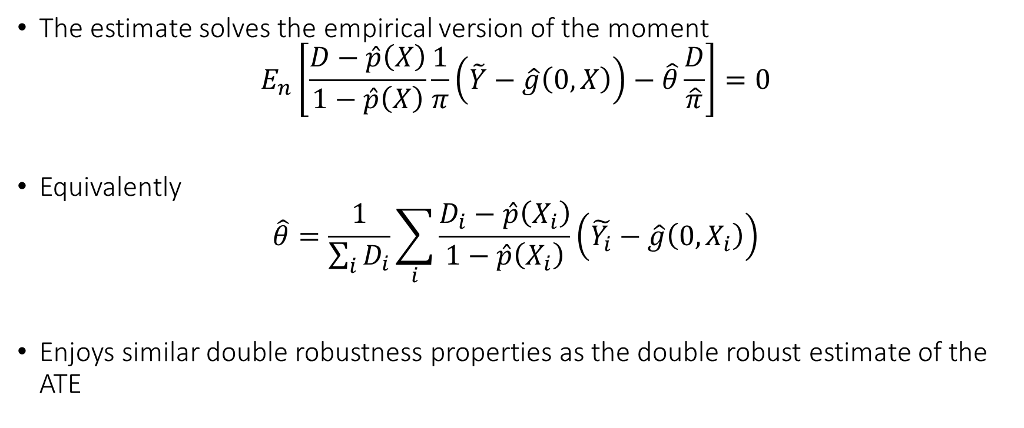
Doubly Robust Estimate
The estimate solves the empirical version of the moment
$$E_{n}\left[\frac{D−\hat{p}\left(X\right)}{1−\hat{p}\left(X\right)}\frac{1}{π}\left(\tilde{Y}−\hat{g}\left(0,X\right)\right)−\hat{θ}\frac{D}{\hat{π}}\right]=0$$
Equivalently
$$\hat{θ}=\frac{1}{\sum_{i}{D_{i}}}\sum_{i}{\frac{D_{i}−\hat{p}\left(X_{i}\right)}{1−\hat{p}\left(X_{i}\right)}\left(\tilde{Y_{i}}−\hat{g}\left(0,X_{i}\right)\right)}$$
Enjoys similar double robustness properties as the double robust estimate of the ATE

Slide 20
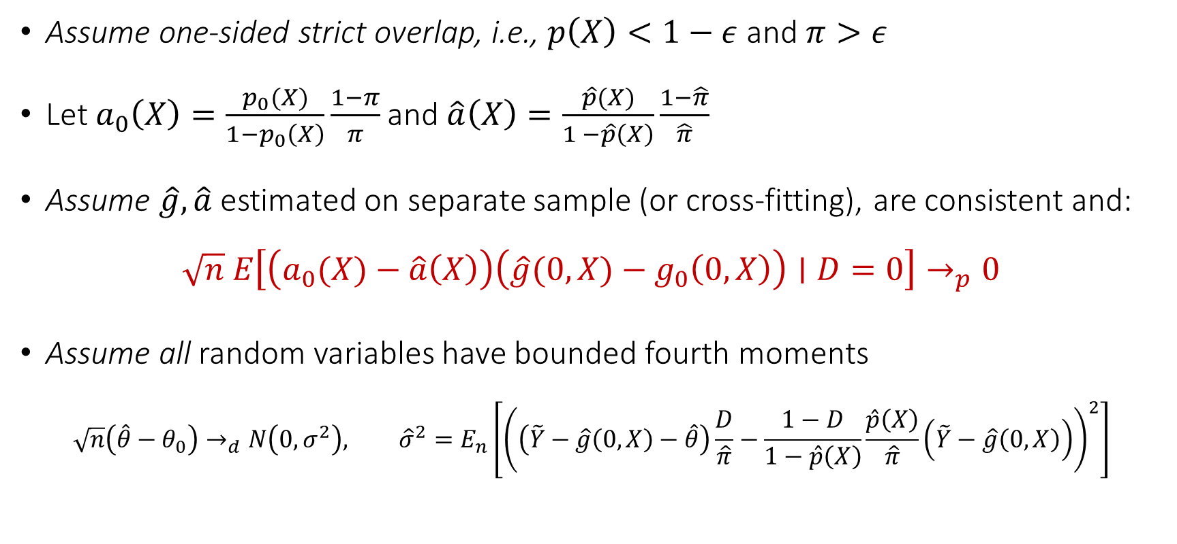
Asymptotic Normality of De-biased Estimate
Assume one-sided strict overlap, i.e., $p\left(X\right)<1−ε$ and $π>ε$
Let $a_{0}\left(X\right)=\frac{p_{0}(X)}{1−p_{0}\left(X\right)}\frac{1−π}{π}$ and $\hat{a}\left(X\right)=\frac{\hat{p}(X)}{1 −\hat{p}\left(X\right)}\frac{1−\hat{π}}{\hat{π}}$
Assume $\hat{g},\hat{a}$ estimated on separate sample (or cross-fitting), are consistent and:
$$\sqrt{n} E\left[\left(a_{0}(X)−\hat{a}\left(X\right)\right)\left(\hat{g}(0,X)−g_{0}\left(0,X\right)\right)∣D=0\right]→_{p}0$$
Assume all random variables have bounded fourth moments
$$\sqrt{n}\left(\hat{θ}−θ_{0}\right)→_{d}N\left(0,σ^{2}\right), {\hat{σ}}^{2}=E_{n}\left[{\left(\left(\tilde{Y}−\hat{g}\left(0,X\right)−\hat{θ}\right)\frac{D}{\hat{π}}−\frac{1−D}{1−\hat{p}\left(X\right)}\frac{\hat{p}\left(X\right)}{\hat{π}}\left(\tilde{Y}−\hat{g}\left(0,X\right)\right)\right)}^{2}\right]$$

Slide 21
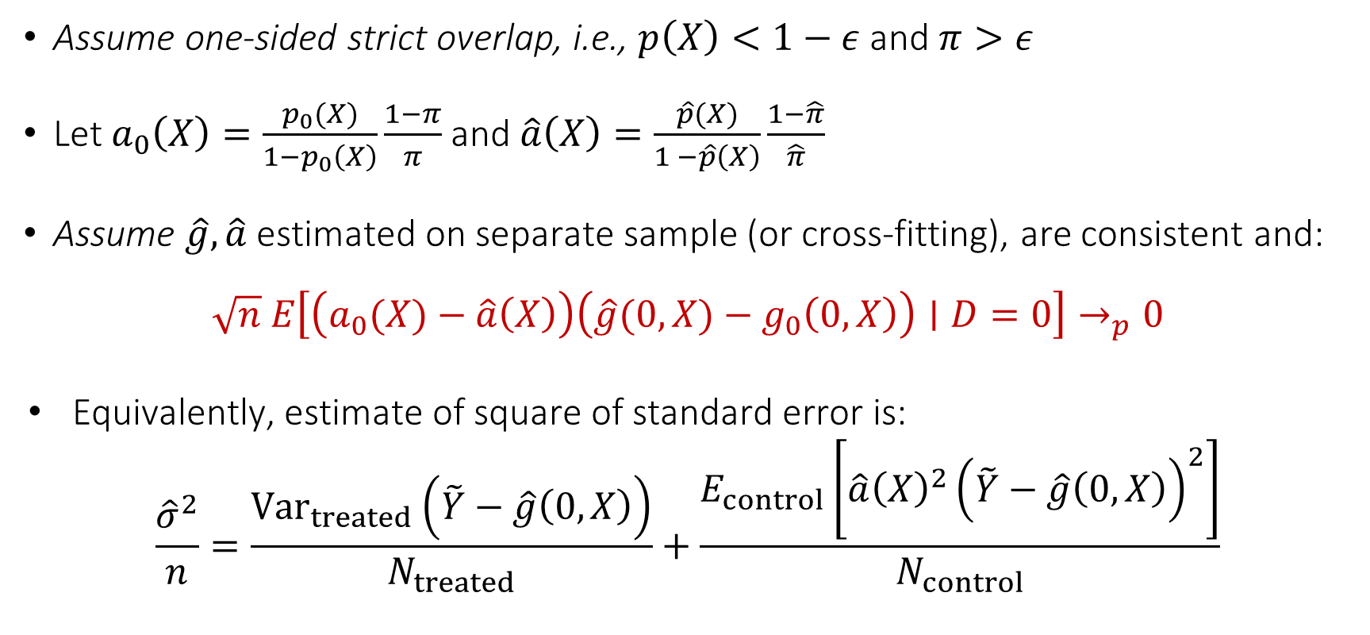
Asymptotic Normality of De-biased Estimate
Assume one-sided strict overlap, i.e., $p\left(X\right)<1−ε$ and $π>ε$
Let $a_{0}\left(X\right)=\frac{p_{0}(X)}{1−p_{0}\left(X\right)}\frac{1−π}{π}$ and $\hat{a}\left(X\right)=\frac{\hat{p}(X)}{1 −\hat{p}\left(X\right)}\frac{1−\hat{π}}{\hat{π}}$
Assume $\hat{g},\hat{a}$ estimated on separate sample (or cross-fitting), are consistent and:
$$\sqrt{n} E\left[\left(a_{0}(X)−\hat{a}\left(X\right)\right)\left(\hat{g}(0,X)−g_{0}\left(0,X\right)\right)∣D=0\right]→_{p}0$$
Equivalently, estimate of square of standard error is:
$$\frac{{\hat{σ}}^{2}}{n}=\frac{{Var}_{treated}\left(\tilde{Y}−\hat{g}\left(0,X\right)\right)}{N_{treated}}+\frac{E_{control}\left[\hat{a}{\left(X\right)}^{2}{\left(\tilde{Y}−\hat{g}\left(0,X\right)\right)}^{2}\right]}{N_{control}}$$

Slide 22
Data with Multiple Periods
If we have data with multiple periods where different units were treated at different periods then it is an active area of research
Typical empirical practice is what is known as two-way-fixed-effects
Can be problematic when there is heterogeneity of the effect across periods and cannot incorporate relaxed conditional parallel trends

Slide 23
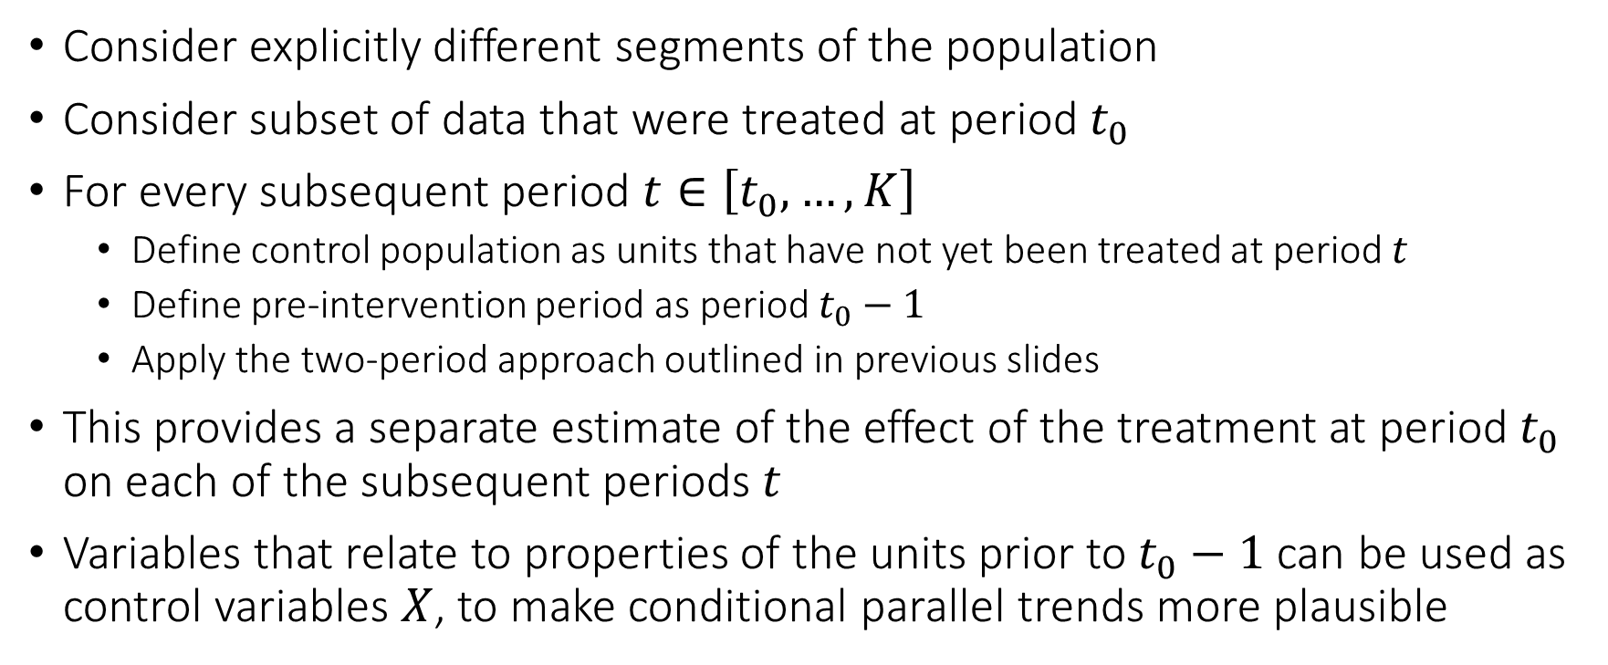
One Approach
Consider explicitly different segments of the population
Consider subset of data that were treated at period $t_{0}$
For every subsequent period $t∈\left[t_{0},…,K\right]$
Define control population as units that have not yet been treated at period $t$
Define pre-intervention period as period $t_{0}−1$
Apply the two-period approach outlined in previous slides
This provides a separate estimate of the effect of the treatment at period $t_{0}$ on each of the subsequent periods $t$
Variables that relate to properties of the units prior to $t_{0}−1$ can be used as control variables $X$, to make conditional parallel trends more plausible

Slide 24
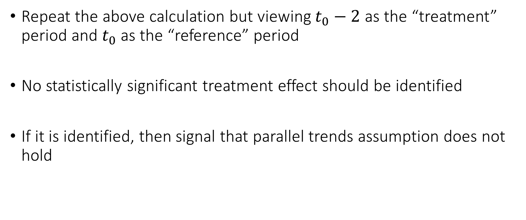
Sanity Checks: Pre-Trends
Repeat the above calculation but viewing $t_{0}−2$ as the “treatment” period and $t_{0}$ as the “reference” period
No statistically significant treatment effect should be identified
If it is identified, then signal that parallel trends assumption does not hold

Slide 25
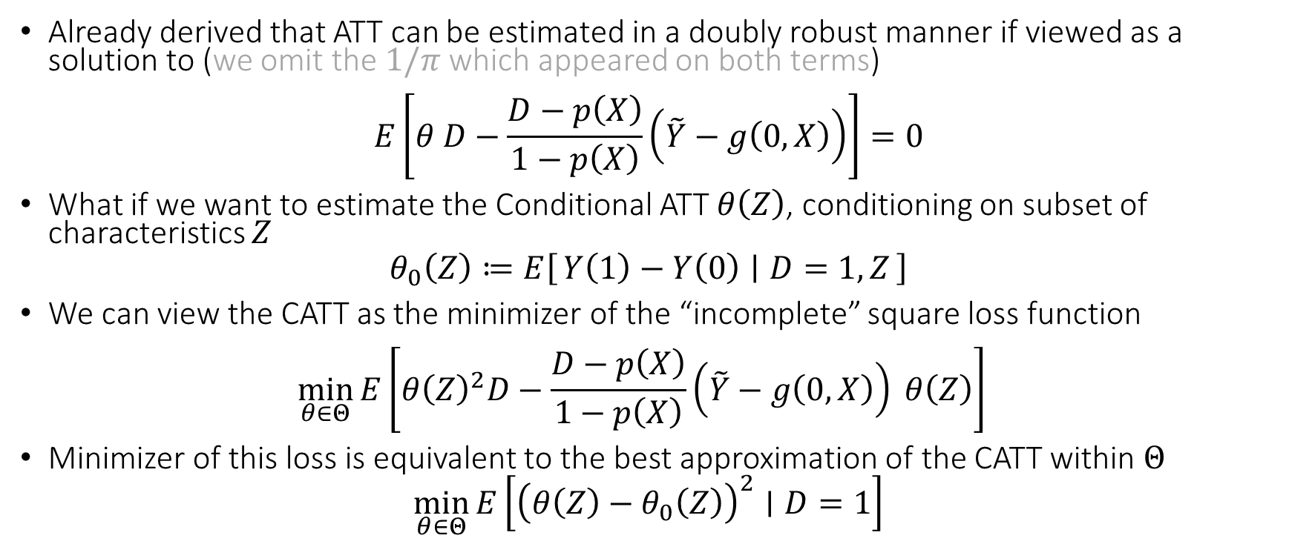
Heterogeneous Effects on the Treated
Already derived that ATT can be estimated in a doubly robust manner if viewed as a solution to (we omit the $1/π$ which appeared on both terms)
$$E\left[θ D−\frac{D−p\left(X\right)}{1−p\left(X\right)}\left(\tilde{Y}−g\left(0,X\right)\right)\right]=0$$
What if we want to estimate the Conditional ATT $θ\left(Z\right)$, conditioning on subset of characteristics $Z$
$$θ_{0}\left(Z\right)≔E\left[Y\left(1\right)−Y\left(0\right) ∣ D=1, Z\right]$$
We can view the CATT as the minimizer of the “incomplete” square loss function
$$\min_{θ∈Θ}{E\left[θ{\left(Z\right)}^{2}D−\frac{D−p\left(X\right)}{1−p\left(X\right)}\left(\tilde{Y}−g\left(0,X\right)\right) θ\left(Z\right)\right] }$$
Minimizer of this loss is equivalent to the best approximation of the CATT within $Θ$
$$\min_{θ∈Θ}{E\left[{\left(θ\left(Z\right)−θ_{0}\left(Z\right)\right)}^{2}∣D=1\right]}$$
[2502.04699] A Meta-learner for Heterogeneous Effects in Difference-in-Differences

