Slide 1
MS&E 228: Topics on Longitudinal Data and Causal Machine Learning
Vasilis Syrgkanis
MS&E, Stanford

Slide 2
Causal Inference with Experiments
Prediction with Linear Models
Prediction with High-Dim Linear Models
Inference on Causal and Predictive Effects with High-Dim Linear Models
Potential Outcomes and Conditional Ignorability
Structural Equation Models and Conditional Exogeneity
Directed Acyclic Graphs
Prediction with Non-Linear Models
Inference on Causal Effects with Non-Linear Models
Un-observed Confounding and Instruments
Estimation of Heterogeneous Causal Effects
Identification of Causal Effects in Longitudinal Data
Linear Predictive Models and Statistical Inference
Causal Identification in Observational Data
Non-Linear Predictive Models and Statistical Inference
Topics

Slide 3
Causal Inference with Experiments
Prediction with Linear Models
Prediction with High-Dim Linear Models
Inference on Causal and Predictive Effects with High-Dim Linear Models
Potential Outcomes and Conditional Ignorability
Structural Equation Models and Conditional Exogeneity
Directed Acyclic Graphs
Prediction with Non-Linear Models
Inference on Causal Effects with Non-Linear Models
Un-observed Confounding and Instruments
Estimation of Heterogeneous Causal Effects
Identification of Causal Effects in Longitudinal Data
Linear Predictive Models and Statistical Inference
Causal Identification in Observational Data
Non-Linear Predictive Models and Statistical Inference
Topics

Slide 4
Longitudinal Data
Longitudinal data refer to datasets where we have multiple observations of the same unit over time
They present a separate set of new problems
Correlation: samples stemming from each unit (or sometimes cluster of units from the same “site”) are correlated
Censoring/Missingness: units typically drop out at (potentially not) random times before the end of the study
Dynamic treatments: units are treated with multiple treatments over time in a manner that is adaptive and auto-correlated

Slide 5
Longitudinal Data
Longitudinal data refer to datasets where we have multiple observations of the same unit over time
They present a separate set of new problems
Correlation: samples stemming from each unit (or sometimes cluster of units from the same “site”) are correlated
Censoring/Missingness: units typically drop out at (potentially not) random times before the end of the study
Dynamic treatments: units are treated with multiple treatments over time in a manner that is adaptive and auto-correlated

Slide 6
Dynamic Treatment Regime

Slide 7
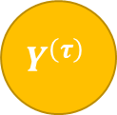
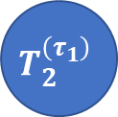




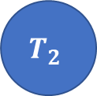

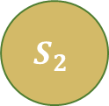
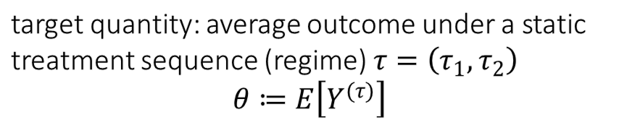

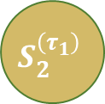

Dynamic Treatment Regime
target quantity: average outcome under a static treatment sequence (regime) $τ=\left(τ_{1},τ_{2}\right)$
$$θ≔E\left[Y^{(τ)}\right]$$
observed data (panel)
$$T_{1}$$
$$T_{2}$$
$$T_{1}$$
$$T_{2}^{\left(τ_{1}\right)}$$
$$τ_{1}$$
$$τ_{2}$$
$$S_{1}$$
$$S_{2}$$
$$Y$$
$$S_{1}$$
$$S_{2}^{\left(τ_{1}\right)}$$
$$Y^{\left(τ\right)}$$
Treatments are offered in an adaptive manner, in response to previous period controls
The surrogate – control feedback precludes viewing this as a one-shot treatment problem
Setting is known as the dynamic treatment regime [Robins’94,’04, Chakraborty-Murphy’14]

Slide 8


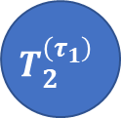

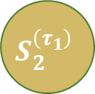
Examples
Healthcare: Patients treated over time and adaptively
observed data (panel)
target quantity
First Line Therapy
Second Line Therapy
$$T_{1}$$
$$T_{2}^{\left(τ_{1}\right)}$$
Immunotherapy
Chemotherapy
Progression+
Genomics
Genomics
Survival
$$S_{1}$$
$$S_{2}^{\left(τ_{1}\right)}$$
$$Y^{\left(τ\right)}$$

Slide 9
Examples
Digital Marketing: Web users shown ads multiple times
observed data (panel)
target quantity
Ad Impression
Ad Impression
$$T_{1}$$
$$T_{2}^{\left(τ_{1}\right)}$$
No impression
No impression
Tracking Data
Tracking Data
Conversion
$$S_{1}$$
$$S_{2}^{\left(τ_{1}\right)}$$
$$Y^{\left(τ\right)}$$

Slide 10





Examples
Business-to-Business (B2B) Operations: Customers offered multiple discount/support interventions over time
observed data (panel)
target quantity
Azure Credits
Sales Specialist
$$T_{1}$$
$$T_{2}^{\left(τ_{1}\right)}$$
No credits
Yes Specialist
Purchase History
Purchase History
Spend
$$S_{1}$$
$$S_{2}^{\left(τ_{1}\right)}$$
$$Y^{\left(τ\right)}$$

Slide 11
Identification in the Dynamic Treatment Regime

Slide 12
Dynamic Treatment Regime
target quantity: average outcome under a static treatment sequence (regime) $τ=\left(τ_{1},τ_{2}\right)$
$$θ≔E\left[Y^{(τ)}\right]$$
observed data (panel)
$$T_{1}$$
$$T_{2}$$
$$T_{1}$$
$$T_{2}^{\left(τ_{1}\right)}$$
$$τ_{1}$$
$$τ_{2}$$
$$S_{1}$$
$$S_{2}$$
$$Y$$
$$S_{1}$$
$$S_{2}^{\left(τ_{1}\right)}$$
$$Y^{\left(τ\right)}$$
Treatments are offered in an adaptive manner, in response to previous period controls
The surrogate – control feedback precludes viewing this as a one-shot treatment problem
Setting is known as the dynamic treatment regime [Robins’94,’04, Chakraborty-Murphy’14]

Slide 13
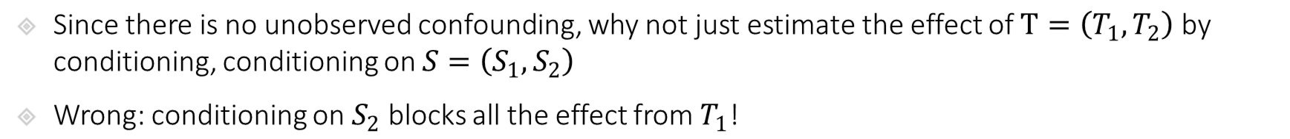
Identification in Dynamic Treatment Regime
target quantity: average outcome under a static treatment sequence (regime) $τ=\left(τ_{1},τ_{2}\right)$
$$θ≔E\left[Y^{(τ)}\right]$$
observed data (panel)
$$T_{1}$$
$$T_{2}$$
$$T_{1}$$
$$T_{2}^{\left(τ_{1}\right)}$$
$$τ_{1}$$
$$τ_{2}$$
$$S_{1}$$
$$S_{2}$$
$$Y$$
$$S_{1}$$
$$S_{2}^{\left(τ_{1}\right)}$$
$$Y^{\left(τ\right)}$$
Since there is no unobserved confounding, why not just estimate the effect of $T=\left(T_{1},T_{2}\right)$ by conditioning, conditioning on $S=\left(S_{1},S_{2}\right)$
Wrong: conditioning on $S_{2}$ blocks all the effect from $T_{1}$!

Slide 14
Identification in Dynamic Treatment Regime
target quantity: average outcome under a static treatment sequence (regime) $τ=\left(τ_{1},τ_{2}\right)$
$$θ≔E\left[Y^{(τ)}\right]$$
observed data (panel)
$$T_{1}$$
$$T_{2}$$
$$T_{1}$$
$$T_{2}^{\left(τ_{1}\right)}$$
$$τ_{1}$$
$$τ_{2}$$
$$S_{1}$$
$$S_{2}$$
$$Y$$
$$S_{1}$$
$$S_{2}^{\left(τ_{1}\right)}$$
$$Y^{\left(τ\right)}$$
Since there is no unobserved confounding, why not just estimate the effect of $T=\left(T_{1},T_{2}\right)$ by conditioning, conditioning on $S=\left(S_{1},S_{2}\right)$
Wrong: conditioning on $S_{2}$ blocks all the effect from $T_{1}$!

Slide 15
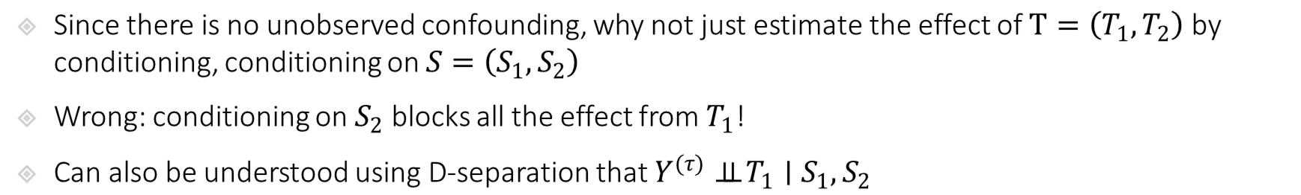
Identification in Dynamic Treatment Regime
target quantity: average outcome under a static treatment sequence (regime) $τ=\left(τ_{1},τ_{2}\right)$
$$θ≔E\left[Y^{(τ)}\right]$$
observed data (panel)
$$T_{1}$$
$$T_{2}$$
$$T_{1}$$
$$T_{2}^{\left(τ_{1}\right)}$$
$$τ_{1}$$
$$τ_{2}$$
$$S_{1}$$
$$S_{2}$$
$$Y$$
$$S_{1}$$
$$S_{2}^{\left(τ_{1}\right)}$$
$$Y^{\left(τ\right)}$$
Since there is no unobserved confounding, why not just estimate the effect of $T=\left(T_{1},T_{2}\right)$ by conditioning, conditioning on $S=\left(S_{1},S_{2}\right)$
Wrong: conditioning on $S_{2}$ blocks all the effect from $T_{1}$!
Can also be understood using D-separation that $Y^{(τ)}⊥⊥ T_{1}∣S_{1},S_{2}$

Slide 16
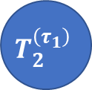



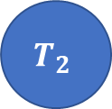

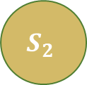
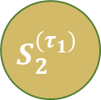

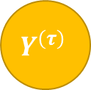

Identification in Dynamic Treatment Regime
$$T_{1}$$
$$τ_{1}$$
$$T_{2}^{\left(τ_{1}\right)}$$
$$τ_{2}$$
Intervention World
$$S_{1}$$
$$S_{2}^{\left(τ_{1}\right)}$$
$$Y^{\left(τ\right)}$$
Two-World Graphs
$$ε_{S_{2}}$$
$$T_{2}$$
Observed World
$$S_{2}$$
$$Y$$
Since there is no unobserved confounding, why not just estimate the effect of $T=\left(T_{1},T_{2}\right)$ by conditioning, conditioning on $S=\left(S_{1},S_{2}\right)$
Wrong: conditioning on $S_{2}$ blocks all the effect from $T_{1}$!
Can also be understood using D-separation that $Y^{(τ)}⊥⊥ T_{1}∣S_{1},S_{2}$

Slide 17

Identification in Dynamic Treatment Regime
target quantity: average outcome under a static treatment sequence (regime) $τ=\left(τ_{1},τ_{2}\right)$
$$θ≔E\left[Y^{(τ)}\right]$$
observed data (panel)
$$T_{1}$$
$$T_{2}$$
$$T_{1}$$
$$T_{2}^{\left(τ_{1}\right)}$$
$$τ_{1}$$
$$τ_{2}$$
$$S_{1}$$
$$S_{2}$$
$$Y$$
$$S_{1}$$
$$S_{2}^{\left(τ_{1}\right)}$$
$$Y^{\left(τ\right)}$$
Then let’s condition only on $S_{1}$, i.e. estimate the effect of $T=\left(T_{1},T_{2}\right)$ by conditioning, conditioning on $S_{1}$
Wrong: conditioning only on $S_{1}$ leaves “unobserved confounding” between $T_{2}$ and $Y$!

Slide 18
Identification in Dynamic Treatment Regime
target quantity: average outcome under a static treatment sequence (regime) $τ=\left(τ_{1},τ_{2}\right)$
$$θ≔E\left[Y^{(τ)}\right]$$
observed data (panel)
$$T_{1}$$
$$T_{2}$$
$$T_{1}$$
$$T_{2}^{\left(τ_{1}\right)}$$
$$τ_{1}$$
$$τ_{2}$$
$$S_{1}$$
$$S_{2}$$
$$Y$$
$$S_{1}$$
$$S_{2}^{\left(τ_{1}\right)}$$
$$Y^{\left(τ\right)}$$
Then let’s condition only on $S_{1}$, i.e. estimate the effect of $T=\left(T_{1},T_{2}\right)$ by conditioning, conditioning on $S_{1}$
Wrong: conditioning only on $S_{1}$ leaves “unobserved confounding” between $T_{2}$ and $Y$!

Slide 19
Identification in Dynamic Treatment Regime
target quantity: average outcome under a static treatment sequence (regime) $τ=\left(τ_{1},τ_{2}\right)$
$$θ≔E\left[Y^{(τ)}\right]$$
observed data (panel)
$$T_{1}$$
$$T_{2}$$
$$T_{1}$$
$$T_{2}^{\left(τ_{1}\right)}$$
$$τ_{1}$$
$$τ_{2}$$
$$S_{1}$$
$$S_{2}$$
$$Y$$
$$S_{1}$$
$$S_{2}^{\left(τ_{1}\right)}$$
$$Y^{\left(τ\right)}$$
Then let’s condition only on $S_{1}$, i.e. estimate the effect of $T=\left(T_{1},T_{2}\right)$ by conditioning, conditioning on $S_{1}$
Wrong: conditioning only on $S_{1}$ leaves “unobserved confounding” between $T_{2}$ and $Y$!

Slide 20
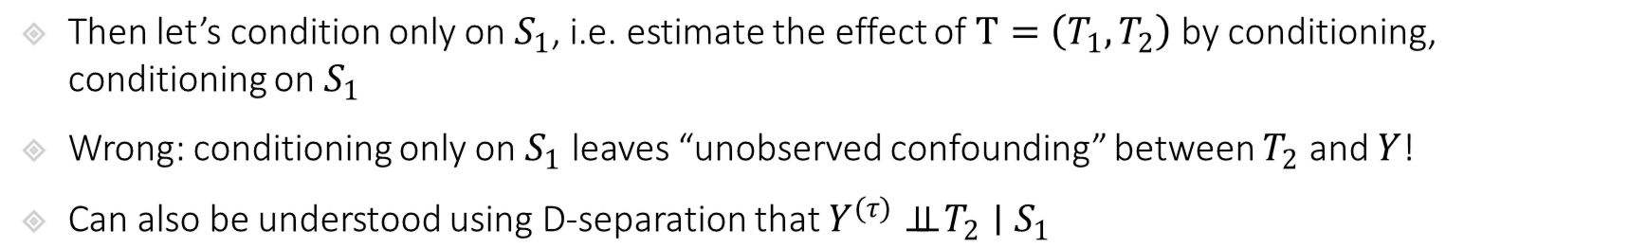
Identification in Dynamic Treatment Regime
$$T_{1}$$
$$τ_{1}$$
$$T_{2}^{\left(τ_{1}\right)}$$
$$τ_{2}$$
Intervention World
$$S_{1}$$
$$S_{2}^{\left(τ_{1}\right)}$$
$$Y^{\left(τ\right)}$$
Two-World Graphs
$$ε_{S_{2}}$$
$$T_{2}$$
Observed World
$$S_{2}$$
$$Y$$
Then let’s condition only on $S_{1}$, i.e. estimate the effect of $T=\left(T_{1},T_{2}\right)$ by conditioning, conditioning on $S_{1}$
Wrong: conditioning only on $S_{1}$ leaves “unobserved confounding” between $T_{2}$ and $Y$!
Can also be understood using D-separation that $Y^{(τ)}⊥⊥ T_{2}∣S_{1}$

Slide 21
Dynamic Treatment Regime
target quantity: average outcome under a static treatment sequence (regime) $τ=\left(τ_{1},τ_{2}\right)$
$$θ≔E\left[Y^{(τ)}\right]$$
observed data (panel)
$$T_{1}$$
$$T_{2}$$
$$T_{1}$$
$$T_{2}^{\left(τ_{1}\right)}$$
$$τ_{1}$$
$$τ_{2}$$
$$S_{1}$$
$$S_{2}$$
$$Y$$
$$S_{1}$$
$$S_{2}^{\left(τ_{1}\right)}$$
$$Y^{\left(τ\right)}$$
We cannot identify this expected potential outcome simply by conditioning!
Let’s take it one step at a time
What can we identify by conditioning?

Slide 22
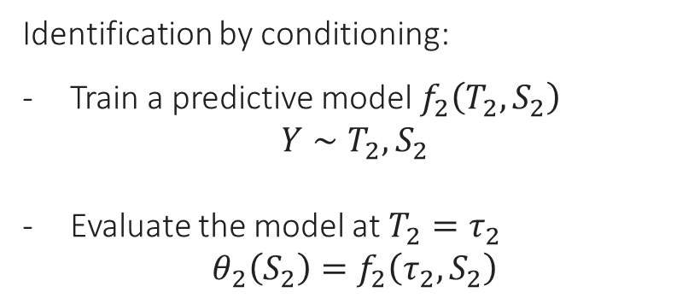
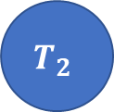
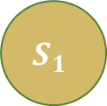


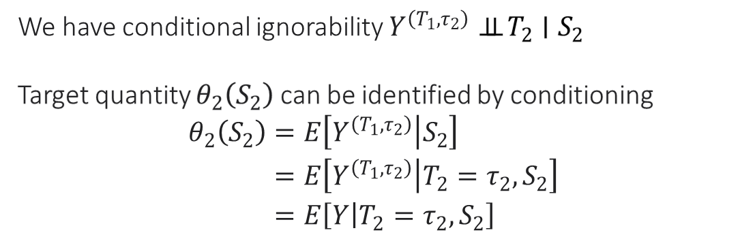
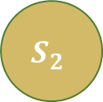
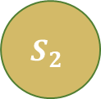

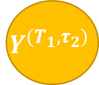

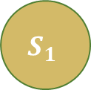

Identification of Last Period Intervention
target quantity: $θ_{2}\left(S_{2}\right)≔E\left[Y^{(T_{1},τ_{2})}|S_{2}\right]$
$$T_{1}$$
$$T_{2}$$
$$T_{1}$$
$$T_{2}$$
$$τ_{2}$$
$$S_{1}$$
$$S_{2}$$
$$Y$$
$$S_{1}$$
$$S_{2}$$
$$Y^{\left(T_{1},τ_{2}\right)}$$
We have conditional ignorability $Y^{\left(T_{1},τ_{2}\right)}⊥⊥ T_{2}∣S_{2}$
Target quantity $θ_{2}\left(S_{2}\right)$ can be identified by conditioning
$$\begin{aligned}θ_{2}\left(S_{2}\right)=&E\left[Y^{\left(T_{1},τ_{2}\right)} | S_{2}\right] \\ =&E\left[Y^{\left(T_{1},τ_{2}\right)} | T_{2}=τ_{2},S_{2}\right] \\ =&E\left[Y | T_{2}=τ_{2},S_{2}\right]\end{aligned}$$
Identification by conditioning:
Train a predictive model $f_{2}\left(T_{2},S_{2}\right)$
$$Y∼T_{2},S_{2}$$
Evaluate the model at $T_{2}=τ_{2}$
$$θ_{2}\left(S_{2}\right)=f_{2}\left(τ_{2},S_{2}\right)$$

Slide 23





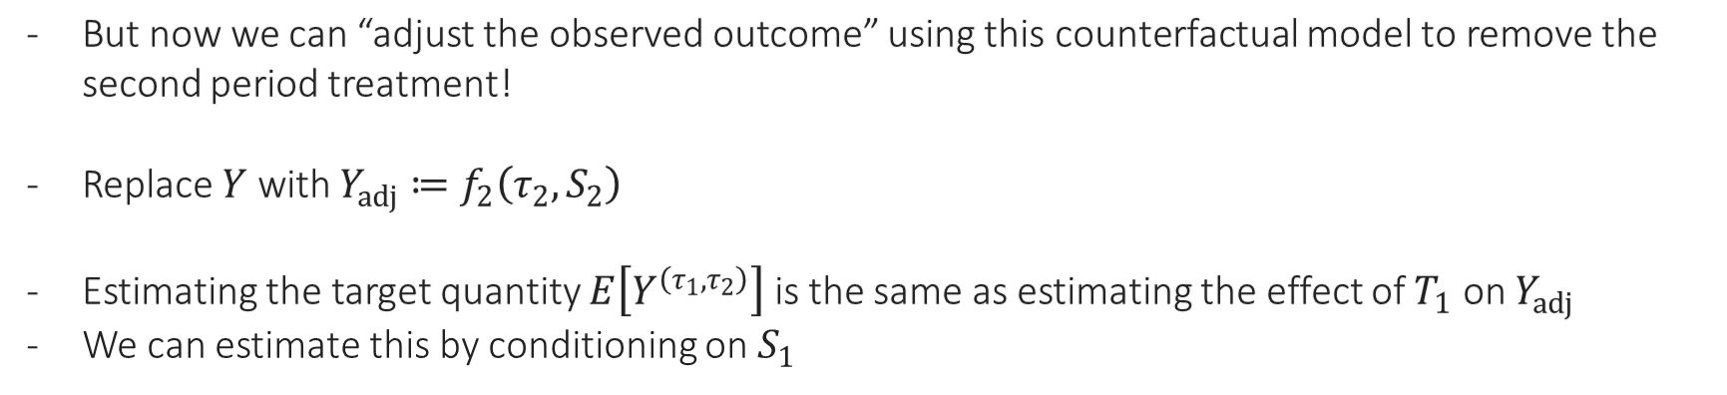


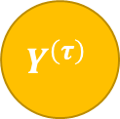



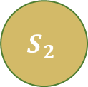

Identification via Backwards Recursion
$$T_{1}$$
$$T_{1}$$
$$T_{2}^{\left(τ_{1}\right)}$$
$$T_{2}$$
$$τ_{2}$$
$$τ_{1}$$
$$τ_{2}$$
$$S_{1}$$
$$S_{2}$$
$$Y^{adj}$$
$$S_{1}$$
$$S_{2}^{\left(τ_{1}\right)}$$
$$Y^{\left(τ\right)}$$
But now we can “adjust the observed outcome” using this counterfactual model to remove the second period treatment!
Replace $Y$ with $Y_{adj}≔f_{2}\left(τ_{2},S_{2}\right)$
Estimating the target quantity $E\left[Y^{\left(τ_{1},τ_{2}\right)}\right]$ is the same as estimating the effect of $T_{1}$ on $Y_{adj}$
We can estimate this by conditioning on $S_{1}$

Slide 24
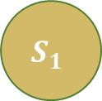


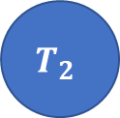

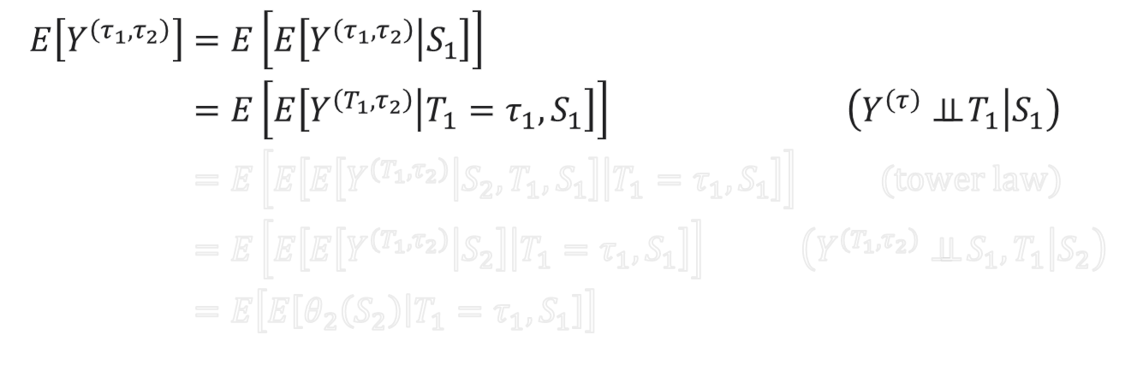




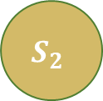
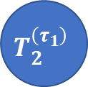
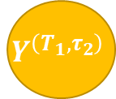

Identification via Backwards Recursion
$$T_{1}$$
$$T_{2}$$
$$T_{1}$$
$$T_{2}^{\left(τ_{1}\right)}$$
$$τ_{1}$$
$$τ_{2}$$
$$S_{1}$$
$$S_{2}$$
$$Y$$
$$S_{1}$$
$$S_{2}^{\left(τ_{1}\right)}$$
$$Y^{\left(τ\right)}$$
$$\begin{aligned}E\left[Y^{\left(τ_{1},τ_{2}\right)}\right]=&E\left[E\left[Y^{\left(τ_{1},τ_{2}\right)} | S_{1}\right]\right]& \\ =&E\left[E\left[Y^{\left(T_{1},τ_{2}\right)} | T_{1}=τ_{1},S_{1}\right]\right]&\left(Y^{\left(τ\right)}⊥⊥ T_{1} | S_{1}\right) \\ =&E\left[E\left[E\left[Y^{\left(T_{1},τ_{2}\right)} | S_{2},T_{1},S_{1}\right] | T_{1}=τ_{1},S_{1}\right]\right]& (tower law) \\ =&E\left[E\left[E\left[Y^{\left(T_{1},τ_{2}\right)} | S_{2}\right] | T_{1}=τ_{1},S_{1}\right]\right]&\left(Y^{\left(T_{1},τ_{2}\right)}⊥⊥ S_{1},T_{1} | S_{2}\right) \\ =&E\left[E\left[θ_{2}\left(S_{2}\right) | T_{1}=τ_{1},S_{1}\right]\right] \\ &\end{aligned}$$
$$T_{1}$$
$$T_{2}$$
$$τ_{2}$$
$$S_{1}$$
$$S_{2}$$
$$Y^{\left(T_{1},τ_{2}\right)}$$

Slide 25
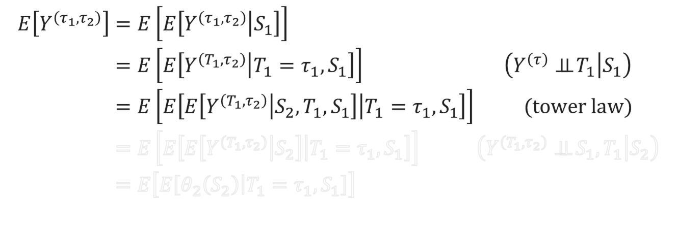
Identification via Backwards Recursion
$$T_{1}$$
$$T_{2}$$
$$T_{1}$$
$$T_{2}^{\left(τ_{1}\right)}$$
$$τ_{1}$$
$$τ_{2}$$
$$S_{1}$$
$$S_{2}$$
$$Y$$
$$S_{1}$$
$$S_{2}^{\left(τ_{1}\right)}$$
$$Y^{\left(τ\right)}$$
$$\begin{aligned}E\left[Y^{\left(τ_{1},τ_{2}\right)}\right]=&E\left[E\left[Y^{\left(τ_{1},τ_{2}\right)} | S_{1}\right]\right]& \\ =&E\left[E\left[Y^{\left(T_{1},τ_{2}\right)} | T_{1}=τ_{1},S_{1}\right]\right]&\left(Y^{\left(τ\right)}⊥⊥ T_{1} | S_{1}\right) \\ =&E\left[E\left[E\left[Y^{\left(T_{1},τ_{2}\right)} | S_{2},T_{1},S_{1}\right] | T_{1}=τ_{1},S_{1}\right]\right]& (tower law) \\ =&E\left[E\left[E\left[Y^{\left(T_{1},τ_{2}\right)} | S_{2}\right] | T_{1}=τ_{1},S_{1}\right]\right]&\left(Y^{\left(T_{1},τ_{2}\right)}⊥⊥ S_{1},T_{1} | S_{2}\right) \\ =&E\left[E\left[θ_{2}\left(S_{2}\right) | T_{1}=τ_{1},S_{1}\right]\right] \\ &\end{aligned}$$
$$T_{1}$$
$$T_{2}$$
$$τ_{2}$$
$$S_{1}$$
$$S_{2}$$
$$Y^{\left(T_{1},τ_{2}\right)}$$

Slide 26



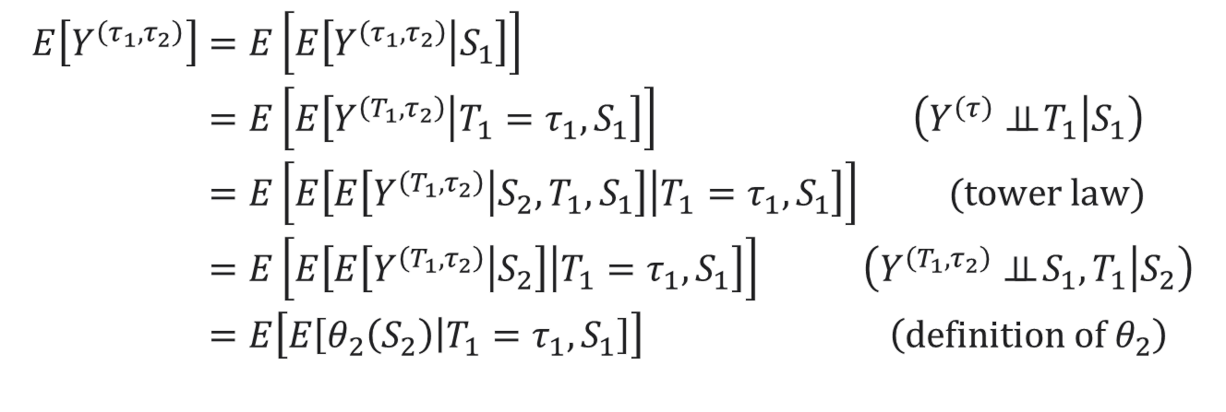



Identification via Backwards Recursion
$$T_{1}$$
$$T_{2}$$
$$T_{1}$$
$$T_{2}^{\left(τ_{1}\right)}$$
$$τ_{1}$$
$$τ_{2}$$
$$S_{1}$$
$$S_{2}$$
$$Y$$
$$S_{1}$$
$$S_{2}^{\left(τ_{1}\right)}$$
$$Y^{\left(τ\right)}$$
$$\begin{aligned}E\left[Y^{\left(τ_{1},τ_{2}\right)}\right]=&E\left[E\left[Y^{\left(τ_{1},τ_{2}\right)} | S_{1}\right]\right]& \\ =&E\left[E\left[Y^{\left(T_{1},τ_{2}\right)} | T_{1}=τ_{1},S_{1}\right]\right]&\left(Y^{\left(τ\right)}⊥⊥ T_{1} | S_{1}\right) \\ =&E\left[E\left[E\left[Y^{\left(T_{1},τ_{2}\right)} | S_{2},T_{1},S_{1}\right] | T_{1}=τ_{1},S_{1}\right]\right]& (tower law) \\ =&E\left[E\left[E\left[Y^{\left(T_{1},τ_{2}\right)} | S_{2}\right] | T_{1}=τ_{1},S_{1}\right]\right]&\left(Y^{\left(T_{1},τ_{2}\right)}⊥⊥ S_{1},T_{1} | S_{2}\right) \\ =&E\left[E\left[θ_{2}\left(S_{2}\right) | T_{1}=τ_{1},S_{1}\right]\right]&\left(definition of θ_{2}\right) \\ &\end{aligned}$$
$$T_{1}$$
$$T_{2}$$
$$τ_{2}$$
$$S_{1}$$
$$S_{2}$$
$$Y^{\left(T_{1},τ_{2}\right)}$$

Slide 27
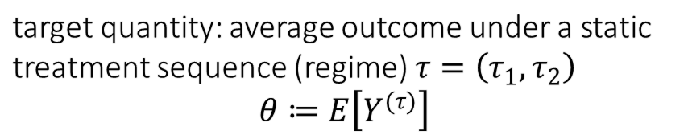


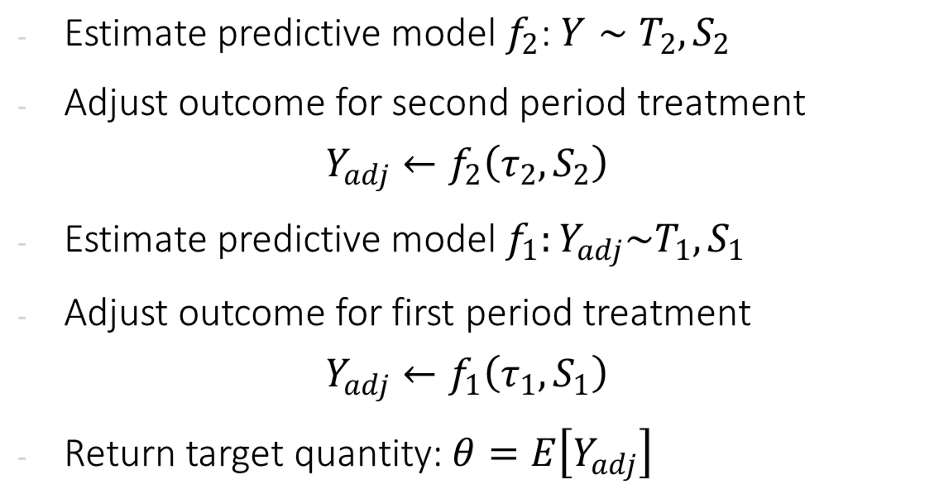



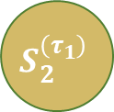
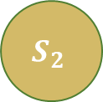




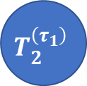
Identification Process
observed data (panel)
$$T_{1}$$
$$T_{2}$$
Estimate predictive model $f_{2}$: $Y∼T_{2},S_{2}$
Adjust outcome for second period treatment
$$Y_{adj}←f_{2}\left(τ_{2},S_{2}\right)$$
Estimate predictive model $f_{1}:Y_{adj}\sim T_{1},S_{1}$
Adjust outcome for first period treatment
$$Y_{adj}←f_{1}\left(τ_{1},S_{1}\right)$$
Return target quantity: $θ=E\left[Y_{adj}\right]$
$$S_{1}$$
$$S_{2}$$
$$Y$$
target quantity: average outcome under a static treatment sequence (regime) $τ=\left(τ_{1},τ_{2}\right)$
$$θ≔E\left[Y^{(τ)}\right]$$
$$T_{1}$$
$$T_{2}^{\left(τ_{1}\right)}$$
$$τ_{1}$$
$$τ_{2}$$
$$S_{1}$$
$$S_{2}^{\left(τ_{1}\right)}$$
$$Y^{\left(τ\right)}$$

Slide 28
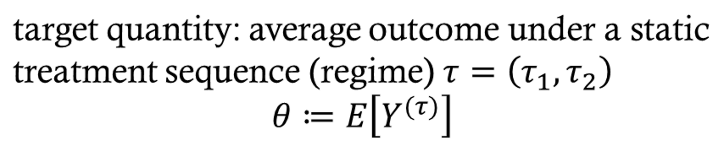


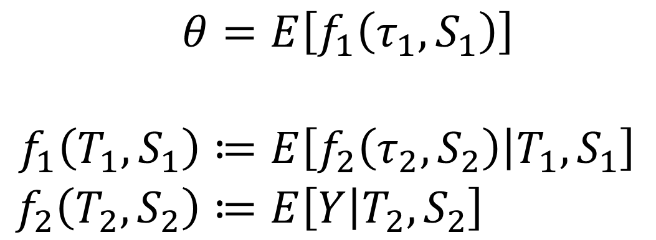





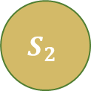

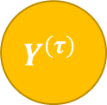


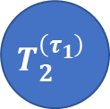
Moment Based Framework
observed data (panel)
$$T_{1}$$
$$T_{2}$$
$$S_{1}$$
$$S_{2}$$
$$Y$$
$$\begin{aligned}θ=&E\left[f_{1}\left(τ_{1},S_{1}\right)\right] \\ \\ f_{1}\left(T_{1},S_{1}\right)≔&E\left[f_{2}\left(τ_{2},S_{2}\right) | T_{1},S_{1}\right] \\ f_{2}\left(T_{2},S_{2}\right)≔&E\left[Y | T_{2},S_{2}\right]\end{aligned}$$
target quantity: average outcome under a static treatment sequence (regime) $τ=\left(τ_{1},τ_{2}\right)$
$$θ≔E\left[Y^{(τ)}\right]$$
$$T_{1}$$
$$T_{2}^{\left(τ_{1}\right)}$$
$$τ_{1}$$
$$τ_{2}$$
These set of equations (and their generalization to many periods) are known as the $g$-formula
$$S_{1}$$
$$S_{2}^{\left(τ_{1}\right)}$$
$$Y^{\left(τ\right)}$$

Slide 29
Estimation in the Dynamic Treatment Regime

Slide 30
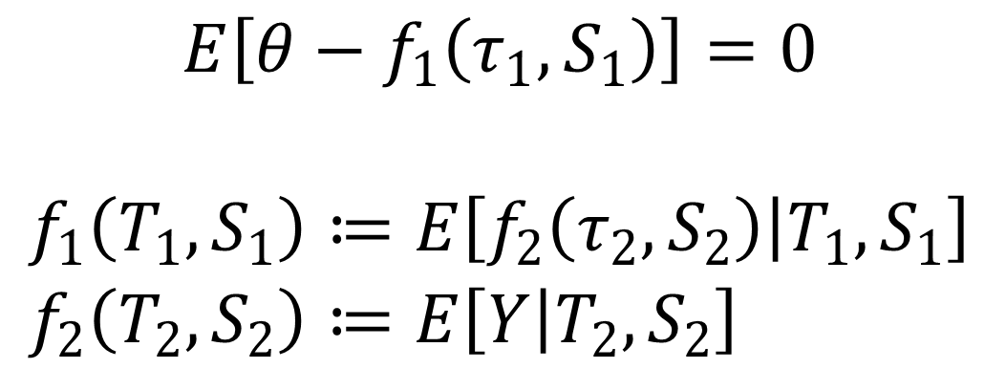

G-computation
observed data (panel)
$$T_{1}$$
$$T_{2}$$
Moment function: $m\left(Z;θ,f\right)$
$$S_{1}$$
$$S_{2}$$
$$Y$$
$$\begin{aligned}E\left[θ−f_{1}\left(τ_{1},S_{1}\right)\right]=0 \\ \\ f_{1}\left(T_{1},S_{1}\right)≔&E\left[f_{2}\left(τ_{2},S_{2}\right) | T_{1},S_{1}\right] \\ f_{2}\left(T_{2},S_{2}\right)≔&E\left[Y | T_{2},S_{2}\right]\end{aligned}$$
target quantity: average outcome under a static treatment sequence (regime) $τ=\left(τ_{1},τ_{2}\right)$
$$θ≔E\left[Y^{(τ)}\right]$$
$$T_{1}$$
$$T_{2}^{\left(τ_{1}\right)}$$
$$τ_{1}$$
$$τ_{2}$$
Nuisance functions
Using parametric models to estimate these functions (e.g. linear or logistic regression) and plug them in the formula is known as the “parametric g computation”
$$S_{1}$$
$$S_{2}^{\left(τ_{1}\right)}$$
$$Y^{\left(τ\right)}$$

Slide 31



ML Based Estimation
observed data (panel)
$$T_{1}$$
$$T_{2}$$
Moment function: $m\left(Z;θ,f\right)$
$$S_{1}$$
$$S_{2}$$
$$Y$$
$$\begin{aligned}E\left[θ−\&f_{1}\left(τ_{1},S_{1}\right)\right]=0 \\ \\ f_{1}\left(T_{1},S_{1}\right)≔&E\left[f_{2}\left(τ_{2},S_{2}\right) | T_{1},S_{1}\right] \\ f_{2}\left(T_{2},S_{2}\right)≔&E\left[Y | T_{2},S_{2}\right]\end{aligned}$$
target quantity: average outcome under a static treatment sequence (regime) $τ=\left(τ_{1},τ_{2}\right)$
$$θ≔E\left[Y^{(τ)}\right]$$
$$T_{1}$$
$$T_{2}^{\left(τ_{1}\right)}$$
$$τ_{1}$$
$$τ_{2}$$
If we use ML for these predictive problems, then we wont be able to construct confidence intervals for $θ$ because moment is not Neyman orthogonal
We can apply the Inverse Propensity based debiasing idea
$$S_{1}$$
$$S_{2}^{\left(τ_{1}\right)}$$
$$Y^{\left(τ\right)}$$

Slide 32



Debiasing Moments and Neyman Orthogonality
Residual of the Regression Problem that defines nuisance function $f_{1}$
Original moment
Inverse Propensity
$$\begin{aligned}E\left[θ−\&f_{1}\left(τ_{1},S_{1}\right)+\frac{1\left\{T_{1}=τ_{1}\right\}}{\operatorname{Pr}\left(T_{1}=τ_{1} | S_{1}\right)}\left(f_{2}\left(τ_{2},S_{2}\right)−f_{1}\left(T_{1},S_{1}\right)\right)\right]=0 \\ \\ f_{1}\left(T_{1},S_{1}\right)≔&E\left[f_{2}\left(τ_{2},S_{2}\right) | T_{1},S_{1}\right] \\ f_{2}\left(T_{2},S_{2}\right)≔&E\left[Y | T_{2},S_{2}\right]\end{aligned}$$
Debiasing correction for nuisance function $f_{1}$
Nuisance functions

Slide 33
Debiasing Moments and Neyman Orthogonality
We are still left with this nuisance, that we have not “debiased”
Original moment
$$\begin{aligned}E\left[θ−\&f_{1}\left(τ_{1},S_{1}\right)+\frac{1\left\{T_{1}=τ_{1}\right\}}{\operatorname{Pr}\left(T_{1}=τ_{1} | S_{1}\right)}\left(f_{2}\left(τ_{2},S_{2}\right)−f_{1}\left(T_{1},S_{1}\right)\right)\right]=0 \\ \\ f_{1}\left(T_{1},S_{1}\right)≔&E\left[f_{2}\left(τ_{2},S_{2}\right) | T_{1},S_{1}\right] \\ f_{2}\left(T_{2},S_{2}\right)≔&E\left[Y | T_{2},S_{2}\right]\end{aligned}$$
Debiasing correction for nuisance function $f_{1}$
Nuisance functions

Slide 34


Debiasing Moments and Neyman Orthogonality
We are still left with this nuisance, that we have not “debiased”
Original moment
$$E\left[θ−f_{1}\left(τ_{1},S_{1}\right)+\frac{1\left\{T_{1}=τ_{1}\right\}}{\operatorname{Pr}\left(T_{1}=τ_{1} | S_{1}\right)}\left(f_{2}\left(τ_{2},S_{2}\right)−f_{1}\left(T_{1},S_{1}\right)\right)\right]=0$$
$$+\frac{1\left\{T_{1}=τ_{1}\right\}}{\operatorname{Pr}\left(T_{1}=τ_{1} | S_{1}\right)}\frac{1\left\{T_{2}=τ_{2}\right\}}{\operatorname{Pr}\left(T_{2}=τ_{2} | S_{2}\right)}\left(Y−f_{2}\left(T_{2},S_{2}\right)\right)$$
$$f_{1}\left(T_{1},S_{1}\right)≔E\left[f_{2}\left(τ_{2},S_{2}\right) | T_{1},S_{1}\right]$$
Debiasing correction for nuisance function $f_{2}$
$$f_{2}\left(T_{2},S_{2}\right)≔E\left[Y | T_{2},S_{2}\right]$$
Nuisance functions

Slide 35



Debiasing Moments and Neyman Orthogonality
We are still left with this nuisance, that we have not “debiased”
Original moment
$$E\left[θ−f_{1}\left(τ_{1},S_{1}\right)+\frac{1\left\{T_{1}=τ_{1}\right\}}{\operatorname{Pr}\left(T_{1}=τ_{1} | S_{1}\right)}\left(f_{2}\left(τ_{2},S_{2}\right)−f_{1}\left(T_{1},S_{1}\right)\right)\right]=0$$
IPS term already multiplying $f_{2}$
$$+\frac{1\left\{T_{1}=τ_{1}\right\}}{\operatorname{Pr}\left(T_{1}=τ_{1} | S_{1}\right)}\frac{1\left\{T_{2}=τ_{2}\right\}}{\operatorname{Pr}\left(T_{2}=τ_{2} | S_{2}\right)}\left(Y−f_{2}\left(T_{2},S_{2}\right)\right)$$
Residual of the regression problem that defines $f_{2}$
New IPS term for second period treatment introduced to transform
$$f_{2}\left(T_{2},S_{2}\right)→f_{2}\left(τ_{2},S_{2}\right)$$
$$f_{1}\left(T_{1},S_{1}\right)≔E\left[f_{2}\left(τ_{2},S_{2}\right) | T_{1},S_{1}\right]$$
$$f_{2}\left(T_{2},S_{2}\right)≔E\left[Y | T_{2},S_{2}\right]$$
Nuisance functions

Slide 36
Debiasing Moments and Neyman Orthogonality
Original moment
$$E\left[θ−f_{1}\left(τ_{1},S_{1}\right)+\frac{1\left\{T_{1}=τ_{1}\right\}}{\operatorname{Pr}\left(T_{1}=τ_{1} | S_{1}\right)}\left(f_{2}\left(τ_{2},S_{2}\right)−f_{1}\left(T_{1},S_{1}\right)\right)\right]=0$$
$$+\frac{1\left\{T_{1}=τ_{1}\right\}}{\operatorname{Pr}\left(T_{1}=τ_{1} | S_{1}\right)}\frac{1\left\{T_{2}=τ_{2}\right\}}{\operatorname{Pr}\left(T_{2}=τ_{2} | S_{2}\right)}\left(Y−f_{2}\left(T_{2},S_{2}\right)\right)$$
$$f_{1}\left(T_{1},S_{1}\right)≔E\left[f_{2}\left(τ_{2},S_{2}\right) | T_{1},S_{1}\right]$$
This moment now satisfies Neyman orthogonality with respect to all the nuisance functions
We need to also estimate the propensity functions via generic ML classification
$$f_{2}\left(T_{2},S_{2}\right)≔E\left[Y | T_{2},S_{2}\right]$$
Nuisance functions

Slide 37
Continuous Treatments and Alternative Approach to Identification and Estimation

Slide 38
What if we have continuous treatments
The propensity based approach to de-biasing does not apply
What is the analogue of the “Residual-on-Residual” or “Partialling-Out” (FWL) approach for the dynamic treatment regime, which is also applicable to continuous treatments?

Slide 39

Identification via “Instantaneous” or “Blip” Effects
target quantity: $θ_{2}\left(S_{2}\right)≔E\left[Y^{(T_{1},τ_{2})}|S_{2}\right]$
$$T_{1}$$
$$T_{2}$$
$$T_{1}$$
$$T_{2}$$
$$τ_{2}$$
$$S_{1}$$
$$S_{2}$$
$$Y$$
$$S_{1}$$
$$S_{2}$$
$$Y^{\left(T_{1},τ_{2}\right)}$$
Instead of estimating the outcome $Y^{\left(T_{1},τ_{2}\right)}$, we will estimate the “effect” of $T_{2}$
$$α_{2}\left(τ_{2}, S_{2}\right)≔E\left[Y^{\left(T_{1},τ_{2}\right)}−Y^{\left(T_{1},0\right)} | S_{2}\right]$$
Adjust outcome by subtracting effect of observed treatment and adding effect of target treatment
$$Y_{adj}≔Y−α_{2}\left(T_{2},S_{2}\right)+α_{2}\left(τ_{2},S_{2}\right)$$

Slide 40

Identification via “Instantaneous” or “Blip” Effects
target quantity: $θ_{2}\left(S_{2}\right)≔E\left[Y^{(T_{1},τ_{2})}|S_{2}\right]$
$$T_{1}$$
$$T_{2}$$
$$T_{1}$$
$$T_{2}$$
$$τ_{2}$$
$$S_{1}$$
$$S_{2}$$
$$Y$$
$$S_{1}$$
$$S_{2}$$
$$Y^{\left(T_{1},τ_{2}\right)}$$
Instead of estimating the outcome $Y^{\left(T_{1},τ_{2}\right)}$, we will estimate the “effect” of $T_{2}$
$$α_{2}\left(τ_{2}, S_{2}\right)≔E\left[Y^{\left(T_{1},τ_{2}\right)}−Y^{\left(T_{1},0\right)} | S_{2}\right]$$
Adjust outcome by subtracting effect of observed treatment and adding effect of target treatment
$$Y_{adj}≔Y−α_{2}\left(T_{2},S_{2}\right)+α_{2}\left(τ_{2},S_{2}\right)$$
If “effect” is assumed to have a simple parametric form, then this approach leverages this simplicity!
Repeat in a backwards manner

Slide 41

Identification Process
observed data (panel)
$$T_{1}$$
$$T_{2}$$
Estimate the “effect” $α_{2}\left(τ_{2}, S_{2}\right)$
$$α_{2}\left(τ_{2}, S_{2}\right)≔E\left[Y^{\left(T_{1},τ_{2}\right)}−Y^{\left(T_{1},0\right)} | S_{2}\right]$$
Adjust outcome for second period treatment
$$Y_{adj}←Y−α_{2}\left(T_{2},S_{2}\right)+α_{2}\left(τ_{2},S_{2}\right)$$
Estimate the effect $α_{1}\left(τ_{1}, S_{1}\right)$
$$E\left[Y^{\left(τ_{1},τ_{2}\right)}−Y^{\left(0,τ_{2}\right)} | S_{1}\right]≈E\left[Y_{adj}^{\left(τ_{1}\right)}−Y_{adj}^{\left(0\right)} ∣ S_{1}\right]$$
Adjust outcome for first period treatment
$$Y_{adj}←Y_{adj}−α_{1}\left(T_{1},S_{1}\right)+α_{1}\left(τ_{1},S_{1}\right)$$
Return target quantity: $θ=E\left[Y_{adj}\right]$
$$S_{1}$$
$$S_{2}$$
$$Y$$
target quantity: average outcome under a static treatment sequence (regime) $τ=\left(τ_{1},τ_{2}\right)$
$$θ≔E\left[Y^{(τ)}\right]$$
$$T_{1}$$
$$T_{2}^{\left(τ_{1}\right)}$$
$$τ_{1}$$
$$τ_{2}$$
$$S_{1}$$
$$S_{2}^{\left(τ_{1}\right)}$$
$$Y^{\left(τ\right)}$$

Slide 42

Partial Linearity: Linear Effects
observed data (panel)
$$T_{1}$$
$$T_{2}$$
If we assume that these effects are partially linear:
$$a_{2}\left(τ_{2},S_{2}\right)=δ_{2}τ_{2}$$
$$a_{1}\left(τ_{1},S_{1}\right)≔δ_{1}τ_{1}$$
$$S_{1}$$
$$S_{2}$$
$$Y$$
target quantity: average outcome under a static treatment sequence (regime) $τ=\left(τ_{1},τ_{2}\right)$
$$θ≔E\left[Y^{(τ)}\right]$$
$$T_{1}$$
$$T_{2}^{\left(τ_{1}\right)}$$
$$τ_{1}$$
$$τ_{2}$$
$$S_{1}$$
$$S_{2}^{\left(τ_{1}\right)}$$
$$Y^{\left(τ\right)}$$

Slide 43

Identification Process
observed data (panel)
$$T_{1}$$
$$T_{2}$$
If we assume that these effects are partially linear:
$$a_{2}\left(τ_{2},S_{2}\right)=δ_{2}τ_{2}$$
$$a_{1}\left(τ_{1},S_{1}\right)≔δ_{1}τ_{1}$$
We can estimate these effects via partialling out!
$$S_{1}$$
$$S_{2}$$
$$Y$$
$$T_{1}$$
$$T_{2}^{\left(τ_{1}\right)}$$
$$τ_{1}$$
$$τ_{2}$$
$$S_{1}$$
$$S_{2}^{\left(τ_{1}\right)}$$
$$Y^{\left(τ\right)}$$

Slide 44

Dynamic DML (Partialling Out)
observed data (panel)
$$T_{1}$$
$$T_{2}$$
Construct residuals
$${\tilde{Y}}_{2}≔Y−E\left[Y | S_{2}\right], {\tilde{T}}_{2}=T_{2}−E\left[T_{2} ∣ S_{2}\right]$$
Run OLS: ${\tilde{Y}}_{2}∼{\tilde{T}}_{2}$ to estimate $δ_{2}$
Adjust outcome $Y_{adj}=Y−δ_{2}T_{2}+δ_{2}τ_{2}$
Construct residuals:
$${\tilde{Y}}_{1}≔Y_{adj}−E\left[Y_{adj} | S_{1}\right], {\tilde{T}}_{1}≔T_{1}−E\left[T_{1} | S_{1}\right]$$
Run OLS: ${\tilde{Y}}_{1}∼{\tilde{T}}_{1}$ to estimate $δ_{1}$
Adjust outcome $Y_{adj}←Y_{adj}−δ_{1}T_{1}+δ_{1}τ_{1}$
Return: $θ≔E\left[Y_{adj}\right]$
$$S_{1}$$
$$S_{2}$$
$$Y$$
$$T_{1}$$
$$T_{2}^{\left(τ_{1}\right)}$$
$$τ_{1}$$
$$τ_{2}$$
$$S_{1}$$
$$S_{2}^{\left(τ_{1}\right)}$$
$$Y^{\left(τ\right)}$$

Slide 45


Moment Based Framework
observed data (panel)
$$T_{1}$$
$$T_{2}$$
$$S_{1}$$
$$S_{2}$$
$$Y$$
$$\begin{aligned}θ≔E\left[Y−δ_{2}T_{2}+δ_{2}τ_{2}−δ_{1}T_{1}+δ_{1}τ_{1}\right]=0 \\ \\ E\left[\left({\tilde{Y}}_{2}−δ_{2}{\tilde{T}}_{2}\right){\tilde{T}}_{2}\right]=0 \\ E\left[\left({\tilde{Y}}_{1}−δ_{1}{\tilde{T}}_{1}\right){\tilde{T}}_{1}\right]=0\end{aligned}$$
$$T_{1}$$
$$T_{2}^{\left(τ_{1}\right)}$$
$$τ_{1}$$
$$τ_{2}$$
$$E\left[Y | S_{2}\right], E\left[T_{2} | S_{2}\right]$$
$$E\left[Y−δ_{2}T_{2}+δ_{2}τ_{2} | S_{1}\right], E\left[T_{1} | S_{1}\right]$$
$$S_{1}$$
$$S_{2}^{\left(τ_{1}\right)}$$
$$Y^{\left(τ\right)}$$
Nuisance functions

Slide 46

Moment Based Framework
observed data (panel)
$$T_{1}$$
$$T_{2}$$
$$S_{1}$$
$$S_{2}$$
$$Y$$
$$\begin{aligned}θ≔E\left[Y−δ_{2}T_{2}+δ_{2}τ_{2}−δ_{1}T_{1}+δ_{1}τ_{1}\right]=0 \\ \\ E\left[\left({\tilde{Y}}_{2}−δ_{2}{\tilde{T}}_{2}\right){\tilde{T}}_{2}\right]=0 \\ E\left[\left({\tilde{Y}}_{1}−δ_{1}{\tilde{T}}_{1}\right){\tilde{T}}_{1}\right]=0\end{aligned}$$
$$T_{1}$$
$$T_{2}^{\left(τ_{1}\right)}$$
$$E\left[Y | S_{2}\right], E\left[T_{2} | S_{2}\right]$$
$$E\left[Y−δ_{2}T_{2}+δ_{2}τ_{2} | S_{1}\right], E\left[T_{1} | S_{1}\right]$$
$$τ_{1}$$
$$τ_{2}$$
For the same reason why the Residual-on-Residual moment was Neyman orthogonal, this estimation process is also orthogonal and we can use ML for these problems
$$S_{1}$$
$$S_{2}^{\left(τ_{1}\right)}$$
$$Y^{\left(τ\right)}$$

Slide 47
Long-Term Causal Inference from Short-Term Data with Surrogates

Slide 48

Estimating Long-Term Returns on Investment
Companies frequently deploys new discount or customer support programs
Which of these programs (“investments”) are more successful than others?
Success is a long-term objective: what is the effect of the program on the two-year customer journey (e.g., effect on two-year revenue)
We cannot wait two years to evaluate a program
Main Question. Can we construct estimates of the values of these programs with short-term data, e.g. after 6 months?

Slide 49




Long-Term Effects from Short-Term Surrogates
Suppose that there are many short-term signals $S$ that are indicative of a customer’s long-term reward $Y$ (e.g. the next 6-month purchase patterns of a customer could be indicative of their long-term spend)
Suppose that investment program $T$ affects long-term rewards if and only if it affects these short-term signals
We will call these short-term signals $S$ surrogates
$T$
$S$
$Y$

Slide 50










Causal Inference with Surrogates 101
(Prentice, 1989; Begg & Leung, 2000; Frangakis & Rubin, 2002; Freedman et al., 1992; Athey et al., 2020)
Since long-term effect goes only through surrogates:
expected effect on long-term reward = effect on projected long-term reward based on surrogates
$$E\left[Y^{\left(τ\right)}\right]=E\left[Y^{\left(τ\right)} | T=τ\right]=E\left[Y | T=τ\right]=E\left[E\left[Y | T=τ, S\right] | T=τ\right]=E\left[E\left[Y | S\right]\right|T=τ]$$
Average reward if intervene and set investment$=τ$
Independence in counterfactual graph
Average reward of samples that received investment=$τ$ in data
Tower Law of Expectations
Forecasted reward from surrogates
$S^{\left(τ\right)}$
$Y^{\left(τ\right)}$
$$T$$
$$τ$$
$T$
$S$
$Y$

Slide 51










Causal Inference with Surrogates 101
historical/long-term (O)
recent/short-term (E)
Contains long-term $Y$ and surrogates $S$
Relationship between $Y$ and $S$ the same as in short-term dataset ($E$)
$$T$$
$$T$$
$$S$$
$$Y$$
$$S$$
$$Y$$
$$g\left(S\right)=E_{o}\left[Y | S\right]$$
Estimate $g\left(S\right)≔E\left[Y | S\right]$ (surrogate index) from ($O$) by regressing $Y∼S$
Impute expected long-term outcomes in (E)
Regress $g\left(S\right)∼T$ to estimate effect of $T$ on $Y$ from (E)

Slide 52













Causal Inference with Surrogates
long-term data ($ℓ$)
short-term data ($s$)
$$T$$
$$T$$
$$X$$
$$S$$
$$Y$$
$$X$$
$$S$$
$$Y$$
$$h\left(S,X\right)=E_{ℓ}\left[Y | S,X\right]$$
Estimate $h\left(S,X\right)≔E\left[Y | S,X\right]$ (surrogate index) by regressing $Y∼S,X$
Impute expected long-term outcomes
Estimate effect of $T$ on imputed outcomes
(Athey et al., 2020)

Slide 53










Causal Inference with Surrogates 102
Reminder: $θ_{0}≔E\left[Y^{\left(τ\right)}\right]=E\left[E\left[Y | T=τ,X\right]\right], (\text{g}\text{−}\text{formula}\text{)}$
Surrogacy assumption implies:
$$E\left[Y | T=τ,X\right]=E\left[E\left[Y | S,X\right] ∣ T=τ,X\right]$$
Surrogacy based g-formula
$$θ_{0}=E\left[E\left[h\left(S,X\right) | T=τ,X\right]\right]$$
$$T$$
$$T$$
$$τ$$
$$X$$
$$S$$
$$Y$$
$$X$$
$S^{\left(τ\right)}$
$Y^{\left(τ\right)}$

Slide 54

Nested Regression Estimand
(Prentice, 1989; Begg & Leung, 2000; Frangakis & Rubin, 2002; Freedman et al., 1992; Athey et al., 2020)
Surrogacy based g-formula
$$θ_{0}=E_{s}\left[g\left(τ,X\right)\right]$$
$$g\left(T,X\right)=E_{s}\left[h\left(S,X\right) | T,X\right]$$
$$h\left(S,X\right)=E_{ℓ}\left[Y | S,X\right]$$
$g$ regression function is trained on the outputs of the $h$ regression function
Surrogate Index Model $h$ is trained on long-term data distribution
Target parameter is averaged over short-term data distribution

Slide 55

Automatic Debiased Machine Learning
Surrogacy based g-formula
$$θ_{0}=E_{s}\left[g\left(τ ,X\right)\right]$$
$$g\left(T,X\right)=E_{s}\left[h\left(S,X\right) | T,X\right]$$
$$h\left(S,X\right)=E_{ℓ}\left[Y | S,X\right]$$
Automatic debiased formula
$$θ_{0}=E_{s}\left[g\left(τ, X\right)+a_{1}\left(T,X\right) \left(h\left(S,X\right)−g\left(T,X\right)\right)\right]$$

Slide 56



Recursive Automatic Debiasing
Surrogacy based g-formula
$$θ_{0}=E_{s}\left[g\left(τ ,X\right)\right]$$
$$g\left(T,X\right)=E_{s}\left[h\left(S,X\right) | T,X\right]$$
$$h\left(S,X\right)=E_{ℓ}\left[Y | S,X\right]$$
Automatic debiased formula
$$θ_{0}=E_{s}\left[g\left(τ, X\right)+a_{1}\left(T,X\right) \left(h\left(S,X\right)−g\left(D,X\right)\right)\right]+E_{ℓ}\left[a_{2}\left(S,X\right)\left(Y −h\left(S,X\right)\right)\right]$$
Surrogate Score$(S,X)$ * $E\left[a_{1}\left(T,X\right) ∣ S,X\right]$
Surrogate score: (density ratio of S,X between $ℓ$ and $s$ “environment”)
$$\frac{p\left(S,X ∣ E=s\right)}{p\left(S,X ∣ E=ℓ\right)}=\frac{\operatorname{Pr}\left(E=s ∣ S,X\right)\operatorname{Pr}\left(E=ℓ\right)}{\operatorname{Pr}\left(E=ℓ ∣ S,X\right) Pr(E=s)}$$
Multiplied by
$$E\left[a_{1}\left(T,X\right) ∣ S,X\right]=\frac{\operatorname{Pr}\left(T=t ∣ S,X\right)}{Pr⁡(T=t∣X)}$$
Inverse Propensity ratio
$$\frac{1\{T=τ\}}{Pr⁡(T=τ∣X)}$$

Slide 57
An Application from Operations Management
Return on Investment at Microsoft using Surrogates and Dynamic Treatment Effects

Slide 58
Estimating Long-Term Returns on Investment
Companies frequently deploys new discount or customer support programs
Which of these programs (“investments”) are more successful than others?
Success is a long-term objective: what is the effect of the program on the two-year customer journey (e.g., effect on two-year revenue)
We cannot wait two years to evaluate a program
Main Question. Can we construct estimates of the values of these programs with short-term data, e.g. after 6 months?

Slide 59


Key Assumptions
Long-term effect only goes through surrogates
Expected relationship between surrogates and long-term reward is the same long-term setting ($O$) and in short-term setting ($E$)

Slide 60






Key Assumptions can be Easily Violated Investment policies are dynamic and change
historical/long-term (O)
recent/short-term (E)
$$T_{1}$$
$$T_{2}$$
$$T_{1}^{new}$$
$$S$$
$$Y$$
$$S$$
$$Y$$
We deployed older/deprecated investments
In a potentially long-term highly auto-correlated manner
Investments are potentially adaptive
Investment policies change

Slide 61

Bias of Vanilla Surrogate
Illustrative Example

Slide 62












Illustrative Example
Available in O
Want the effect of $T_{1}$ on $Y$, with no future treatments
Available in E
$$T_{2}=κT_{1}+λS+noise$$
$$T_{1}$$
$$T_{2}$$
$$α$$
$$λ$$
$$α_{2}$$
$$S$$
$$Y$$
$$S=αT_{1}+noise$$
$$β$$
$$Y=α_{2}T_{2}+βS+noise$$

Slide 63







Bias of Vanilla Surrogate
What do we want to estimate?
$$Y=β α T_{1}+α_{2} T_{2}+noise$$
$$≔$$
$$θ_{0}$$
$$T_{2}=κT_{1}+λS+noise$$
$$T_{1}$$
$$κ$$
$$T_{2}$$
$$α$$
$$λ$$
$$α_{2}$$
$$S$$
$$Y$$
$$S=αT_{1}+noise$$
$$β$$
$$Y=α_{2}T_{2}+βS+noise$$

Slide 64


Bias of Vanilla Surrogate
What do we want to estimate?
$$Y=β α T_{1}+α_{2} T_{2}+noise$$
What does the surrogate approach estimate?
$$g_{0}\left(S\right)≔E\left[Y | S\right]=β S+α_{2} E\left[T_{2} | S\right]$$
$$≔$$
$$θ_{0}$$
$$T_{2}=κT_{1}+λS+noise$$
$$T_{1}$$
$$κ$$
$$T_{2}$$
$$α$$
$$λ$$
$$α_{2}$$
$$S$$
$$Y$$
$$S=αT_{1}+noise$$
$$β$$
$$κE\left[T_{1} | S\right]+λS$$
$$Y=α_{2}T_{2}+βS+noise$$

Slide 65


Bias of Vanilla Surrogate
What do we want to estimate?
$$Y=β α T_{1}+α_{2} T_{2}+noise$$
What does the surrogate approach estimate?
$$g_{0}\left(S\right)≔E\left[Y | S\right]=β S+α_{2} E\left[T_{2} | S\right]$$
The effect of $T_{1}$ on $g_{0}\left(S\right)$ is:
$$θ_{∗}≔β α+α_{2} κ\frac{E\left[E\left[T_{1} | S\right]⋅T_{1}\right]}{E\left[T_{1}^{2}\right]}+α_{2} λ α$$
$$≔$$
$$θ_{0}$$
$$T_{2}=κT_{1}+λS+noise$$
$$T_{1}$$
$$κ$$
$$T_{2}$$
$$α$$
$$λ$$
$$α_{2}$$
$$κE\left[T_{1} | S\right]+λS$$
$$S$$
$$Y$$
$$S=αT_{1}+noise$$
$$β$$
$$Y=α_{2}T_{2}+βS+noise$$

Slide 66


Bias of Vanilla Surrogate
What do we want to estimate?
$$Y=β α T_{1}+α_{2} T_{2}+noise$$
What does the surrogate approach estimate?
$$g_{0}\left(S\right)≔E\left[Y | S\right]=β S+α_{2} E\left[T_{2} | S\right]$$
The effect of $T_{1}$ on $g_{0}\left(S\right)$ is:
$$θ_{∗}≔β α+α_{2} κ\frac{E\left[E\left[T_{1} | S\right]⋅T_{1}\right]}{E\left[T_{1}^{2}\right]}+α_{2} λ α$$
$$≔$$
$$θ_{0}$$
$$T_{2}=κT_{1}+λS+noise$$
$$T_{1}$$
$$κ$$
$$T_{2}$$
$$α$$
$$λ$$
$$α_{2}$$
$$κE\left[T_{1} | S\right]+λS$$
$$S$$
$$Y$$
$$S=αT_{1}+noise$$
$$β$$
$$Y=α_{2}T_{2}+βS+noise$$
Bias from the fact that policy is auto-correlated violating the “effect only through surrogates” assumption
Bias from the fact that policy is adaptive on past surrogates violating
“relationship of $S$ and $Y$ unchanged”
assumption

Slide 67
Prevalence of Such Violation
Marketing departments frequently deploy new marketing campaigns
In historical data, older campaigns were deployed
Due to targeting, if a customer received an ad, most probably will receive one in the future
Ad display is adaptive to signals of customer behavior
Pharmaceutical companies frequently deploy new drugs
Can we get estimates of long-term effect from short-term trials
Use short-term signals of patient response that correlated with long-term survival
In historical long-term clinical data, patients are treated with multiple treatments over time
Treatments are typically adaptive to signals of patient trajectory

Slide 68

Key Idea 1
Dynamic Adjustment of Surrogate Index
Battocchi, Dillon, Hei, Lewis, Oprescu, Syrgkanis, Estimating the Long-Term Effects of Novel Treatments, NeurIPS’21
https://arxiv.org/abs/2103.08390

Slide 69











Dynamically Adjusted Surrogate Index
historical/long-term (O)
recent/short-term (E)
$$T_{1}$$
$$T_{1}^{new}$$
$$T_{2}$$
$$0$$
$$S$$
$$Y^{\left(0_{2}\right)}$$
$$S$$
$$Y$$
$$g^{adj}\left(S\right)=E_{o}\left[Y^{\left(0_{2}\right)} | S\right]$$
$$=E_{o}\left[Y−γ\left(T_{2},S\right) | S\right]$$
Identification argument
“blip” effect of second treatment conditional on surrogate
effect of $T_{2}$ controlling for 𝑆

Slide 70

Illustrative Example: Dynamically Adjusted Index
Estimate effect $α_{2}$ of $T_{2}$ on $Y$, controlling for $S$
$$E\left[Y | T_{2},S\right]=α_{2}T_{2}+βS$$
$$T_{2}=κT_{1}+λS+noise$$
$$T_{1}$$
$$κ$$
$$T_{2}$$
$$α$$
$$λ$$
$$α_{2}$$
$$S$$
$$Y$$
$$S=αT_{1}+noise$$
$$β$$
$$Y=α_{2}T_{2}+βS+noise$$

Slide 71



Illustrative Example: Dynamically Adjusted Index
Estimate effect $α_{2}$ of $T_{2}$ on $Y$, controlling for $S$
$$E\left[Y | T_{2},S\right]=α_{2}T_{2}+βS$$
Subtract that effect to create the adjusted outcome
$$Y^{adj}≔Y−α_{2}T_{2}$$
$$T_{1}$$
$$α$$
$$S$$
$$Y^{adj}$$
$$S=αT_{1}+noise$$
$$β$$
$$Y^{adj}=βS+noise$$

Slide 72


Illustrative Example: Dynamically Adjusted Index
Estimate effect $α_{2}$ of $T_{2}$ on $Y$, controlling for $S$
$$E\left[Y | T_{2},S\right]=α_{2}T_{2}+βS$$
Subtract that effect to create the adjusted outcome
$$Y^{adj}≔Y−α_{2}T_{2}$$
Estimate dynamically adjusted index on long-term data
$$g_{0}^{adj}\left(S\right)≔E\left[Y^{adj} | S\right]=β S$$
$$T_{1}$$
$$α$$
$$S$$
$$Y^{adj}$$
$$S=αT_{1}+noise$$
$$β$$
$$Y^{adj}=βS+noise$$

Slide 73

Illustrative Example: Dynamically Adjusted Index
Estimate effect $α_{2}$ of $T_{2}$ on $Y$, controlling for $S$
$$E\left[Y | T_{2},S\right]=α_{2}T_{2}+βS$$
Subtract that effect to create the adjusted outcome
$$Y^{adj}≔Y−α_{2}T_{2}$$
Estimate dynamically adjusted index on long-term data
$$g_{0}^{adj}\left(S\right)≔E\left[Y^{adj} | S\right]=β S$$
Estimate effect of $T_{1}$ on $g_{0}^{adj}\left(S\right)$ on short-term data
$$θ_{0}≔\frac{E\left[g_{0}^{adj}\left(S\right)⋅T_{1}\right]}{E\left[T_{1}^{2}\right]}=β⋅α$$
$$T_{1}$$
$$α$$
$$S$$
$$Y^{adj}$$
$$S=αT_{1}+noise$$
$$β$$
$$Y^{adj}=βS+noise$$

Slide 74










Beyond Two Periods
historical/long-term (O)
recent/short-term (E)
$$T_{1}$$
$$T_{2}$$
$$T_{3}$$
$$T_{1}^{new}$$
$$S_{1}$$
$$Y$$
$$S_{0}$$
$$S_{1}$$
$$Y$$
Multiple treatments are offered after the surrogate variable
Easy: estimate their effect controlling for $S_{1}$
Wrong!

Slide 75


Beyond Two Periods
historical/long-term (O)
recent/short-term (E)
$$T_{1}$$
$$T_{2}$$
$$T_{3}$$
$$T_{1}^{new}$$
$$S_{1}$$
$$S_{2}$$
$$Y$$
$$S_{0}$$
$$S_{1}$$
$$Y$$
Treatments are offered in an adaptive manner, in response to previous period surrogate/state
The surrogate – treatment feedback precludes viewing this as a one-shot treatment problem
Setting is known as the dynamic treatment regime [Robins’94,’04, Chakraborty-Murphy’14]

Slide 76









Beyond Two Periods: Target Quantity
historical/long-term (O)
recent/short-term (E)
$$T_{1}$$
$$T_{1}^{new}$$
$$T_{2}$$
$$0$$
$$T_{3}$$
$$0$$
$$S_{1}$$
$$S_{2}^{\left(0_{≥2}\right)}$$
$$Y^{\left(0_{≥2}\right)}$$
$$S_{0}$$
$$S_{1}$$
$$Y$$
$$g^{adj}\left(S_{1}\right)=E_{o}\left[Y^{\left(0_{≥2}\right)} | S_{1}\right]$$
What effect do we subtract from $Y$?
Do we estimate effect of $T_{2},T_{3}$ controlling for $S_{1},S_{2}$? Wrong
Do we estimate effect of $T_{2},T_{3}$ controlling for $S_{1}$? Wrong
$$=E_{o}\left[\left.Y−\sum_{t≥2}{γ_{t}\left(T_{t},S_{t−1}\right)}\right|S_{1}\right]$$
“blip” effect of treatment at period $t$

