Slide 1
MS&E 228: Inference with Modern Non-Linear Prediction
Vasilis Syrgkanis
MS&E, Stanford

Slide 2
Causal Inference with Experiments
Prediction with Linear Models
Prediction with High-Dim Linear Models
Inference on Causal and Predictive Effects with High-Dim Linear Models
Potential Outcomes and Conditional Ignorability
Structural Equation Models and Conditional Exogeneity
Directed Acyclic Graphs
Prediction with Non-Linear Models
Inference on Causal Effects with Non-Linear Models
Un-observed Confounding and Instruments
Identification of Causal Effects in Longitudinal Data
Estimation of Heterogeneous Causal Effects
Linear Predictive Models and Statistical Inference
Causal Identification in Observational Data
Non-Linear Predictive Models and Statistical Inference
Topics

Slide 3
Causal Inference with Experiments
Prediction with Linear Models
Prediction with High-Dim Linear Models
Inference on Causal and Predictive Effects with High-Dim Linear Models
Potential Outcomes and Conditional Ignorability
Structural Equation Models and Conditional Exogeneity
Directed Acyclic Graphs
Prediction with Non-Linear Models
Inference on Causal Effects with Non-Linear Models
Un-observed Confounding and Instruments
Identification of Causal Effects in Longitudinal Data
Estimation of Heterogeneous Causal Effects
Linear Predictive Models and Statistical Inference
Causal Identification in Observational Data
Non-Linear Predictive Models and Statistical Inference
Topics

Slide 4
Recap of Last Lecture

Slide 5





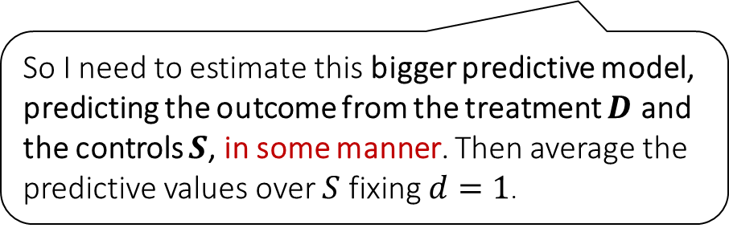



Causal Inference Pipeline
Data Collection
Estimation
(training)
Validation
(testing)
Domain Assumption Elicitation
Identification
Inference (Confidence Intervals)
DAGs/ASEMs
Construct estimate $\hat{g}\left(d,z\right)$ of predictive model
$$E\left[Y ∣ D=d,Z=z\right]$$
Estimate mean counterfactual
$${\hat{a}}_{d}=E_{n}\left[\hat{g}\left(d,Z\right)\right]$$
Theory
$$a_{d}$$
$$E\left[E\left[Y | D=d,Z\right]\right]$$
$$D$$
$$=$$
$$a_{d}∈{\hat{a}}_{d}±2\hat{σ}$$
$$Z$$
$$Y$$
So I need to estimate this bigger predictive model, predicting the outcome from the treatment $D$ and the controls $S$, in some manner. Then average the predictive values over $S$ fixing $d=1$.
Sensitivity Analysis
Practice
$$a_{d}∈{\hat{a}}_{d}±(2\hat{σ}+ε)$$
Adaptive Experiments
Decision
Policy

Slide 6
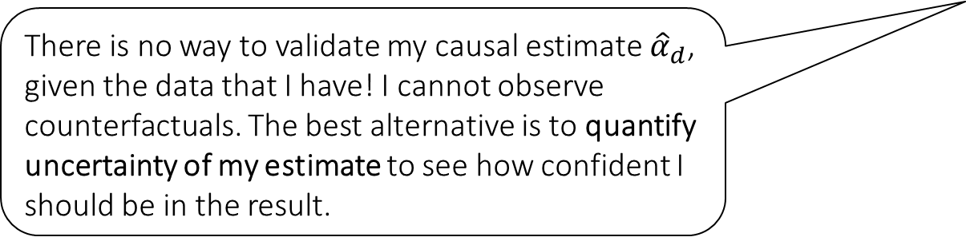
Causal Inference Pipeline
Data Collection
Estimation
(training)
Validation
(testing)
Domain Assumption Elicitation
Identification
Inference (Confidence Intervals)
DAGs/ASEMs
Construct estimate $\hat{g}\left(d,z\right)$ of predictive model
$$E\left[Y ∣ D=d,Z=z\right]$$
Estimate mean counterfactual
$${\hat{a}}_{d}=E_{n}\left[\hat{g}\left(d,Z\right)\right]$$
Theory
$$a_{d}$$
$$E\left[E\left[Y | D=d,Z\right]\right]$$
$$D$$
$$=$$
$$a_{d}∈{\hat{a}}_{d}±2\hat{σ}$$
$$Z$$
$$Y$$
There is no way to validate my causal estimate ${\hat{α}}_{d}$, given the data that I have! I cannot observe counterfactuals. The best alternative is to quantify uncertainty of my estimate to see how confident I should be in the result.
Sensitivity Analysis
Practice
$$a_{d}∈{\hat{a}}_{d}±(2\hat{σ}+ε)$$
Adaptive Experiments
Decision
Policy

Slide 7
Goals for Today
Methods for Confidence Intervals for ATE with non-linear models
General Neyman Orthogonality Framework (Double/Debiased ML)
Methods for Confidence Intervals for ATE in a partially-linear model
Sample-splitting and cross-fitting
Proof sketch of main theorem*

Slide 8
The Example Problem

Slide 9
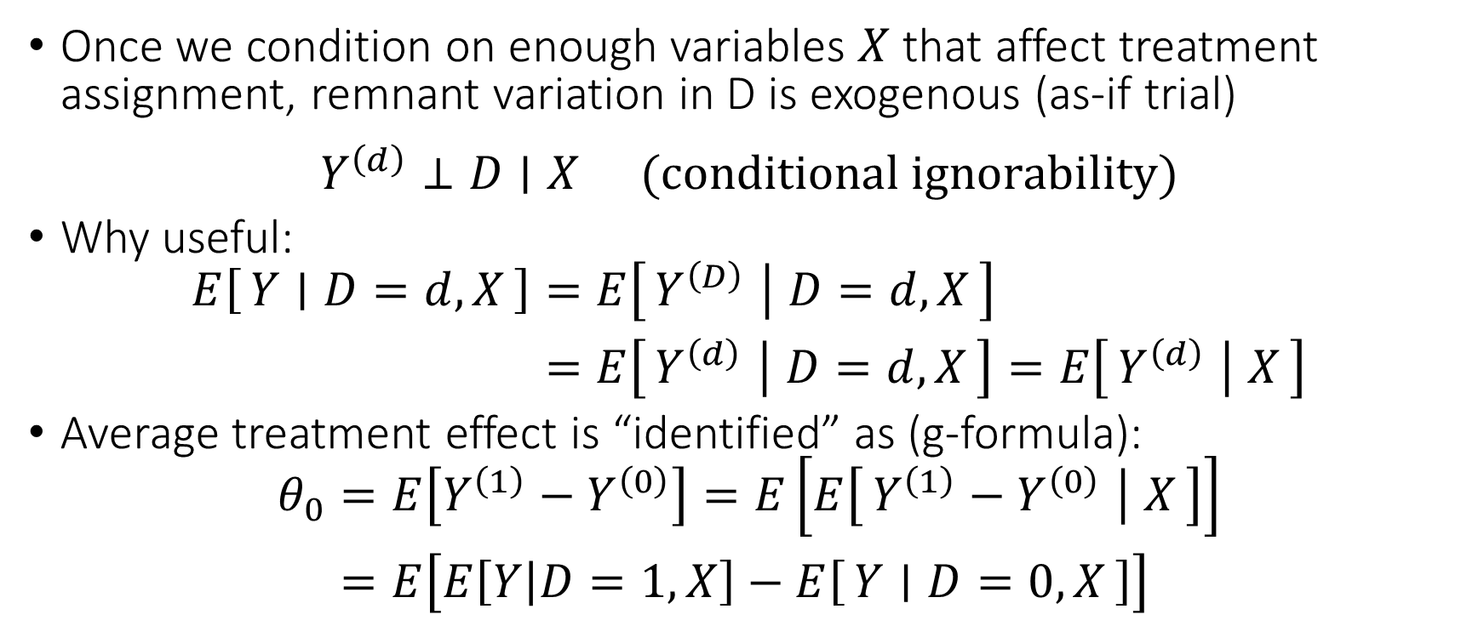
Identification under Conditional Ignorability
Once we condition on enough variables $X$ that affect treatment assignment, remnant variation in D is exogenous (as-if trial)
$$\begin{matrix}Y^{\left(d\right)}⊥D∣X & (conditional ignorability)\end{matrix}$$
Why useful:
$$\begin{aligned}E\left[Y ∣ D=d,X\right]=&E\left[Y^{\left(D\right)} ∣ D=d,X\right] \\ =&E\left[Y^{\left(d\right)} ∣ D=d,X\right]=E\left[Y^{\left(d\right)} ∣ X\right]\end{aligned}$$
Average treatment effect is “identified” as (g-formula):
$$\begin{aligned}θ_{0}=&E\left[Y^{\left(1\right)}−Y^{\left(0\right)}\right]=E\left[E\left[Y^{\left(1\right)}−Y^{\left(0\right)} ∣ X\right]\right] \\ =&E\left[E\left[Y | D=1,X\right]−E\left[Y ∣ D=0,X\right]\right]\end{aligned}$$

Slide 10
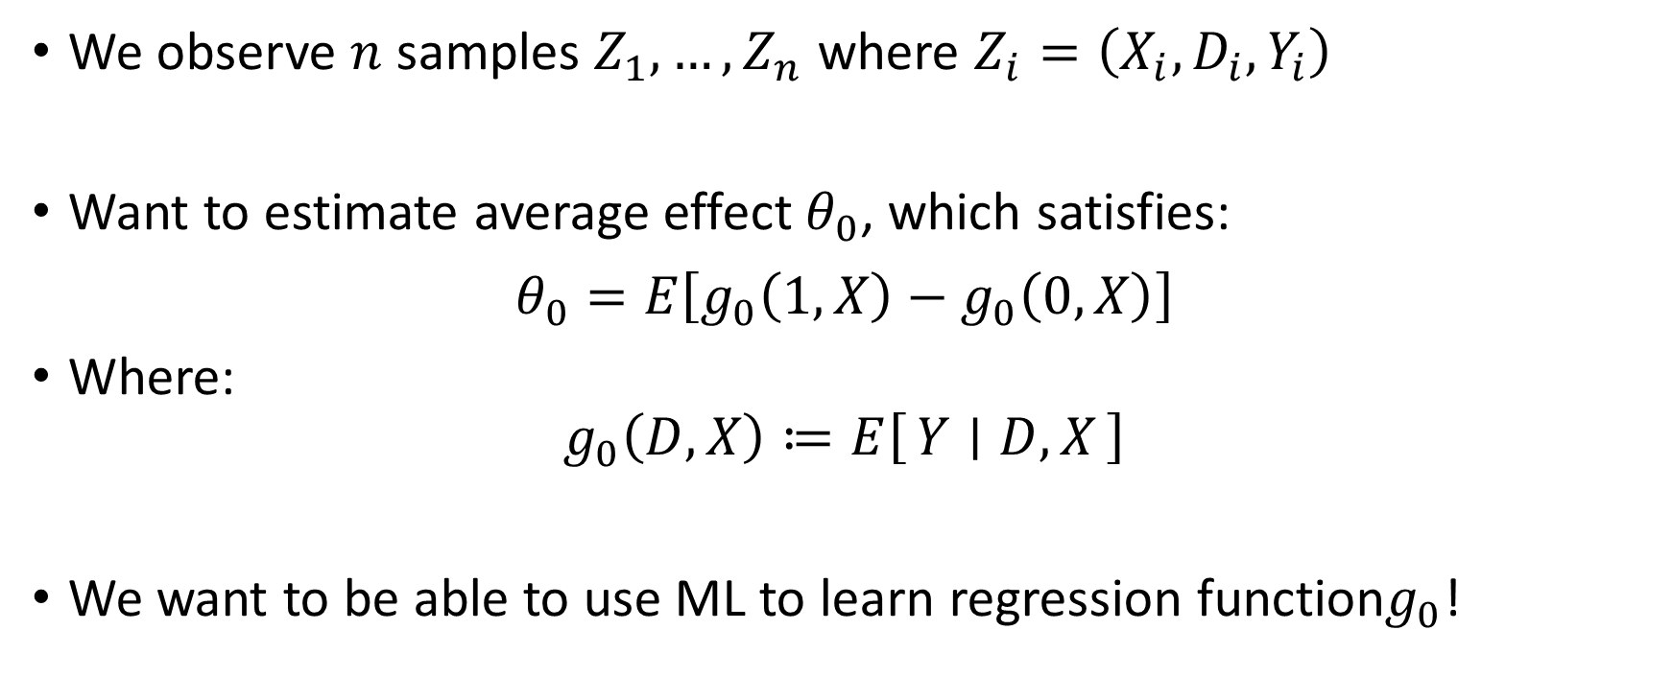
Let’s take it to data
We observe $n$ samples $Z_{1},…, Z_{n}$ where $Z_{i}=\left(X_{i},D_{i},Y_{i}\right)$
Want to estimate average effect $θ_{0}$, which satisfies:
$$θ_{0}=E\left[g_{0}\left(1, X\right)−g_{0}\left(0,X\right)\right]$$
Where:
$$g_{0}\left(D,X\right)≔E\left[Y ∣ D, X\right]$$
We want to be able to use ML to learn regression function$g_{0}$!

Slide 11
What do we want from $\hat{θ}$?
Ideally parametric rates for $θ_{0}$ even when we have slower rates for $g_{0}$
Ideally construction of confidence intervals for $θ_{0}$
One approach. Asymptotic normality
$$\sqrt{n}\left(\hat{θ}−θ_{0}\right)→_{d}N\left(0,σ^{2}\right)$$
Implies construction of approximately correct confidence intervals
with prob. $≈$ 95%: $θ_{0}∈\left[\hat{θ}±1.96\hat{σ}/\sqrt{n}\right]$

Slide 12
Natural Estimation Algorithm
Estimate $\hat{g}$ of $g_{0}$ from data
Calculate empirical plug-in average:
$$\hat{θ}≔\frac{1}{n}\sum_{i=1}^{n}{\hat{g}\left(1,X\right)−\hat{g}(0,X) }$$

Slide 13
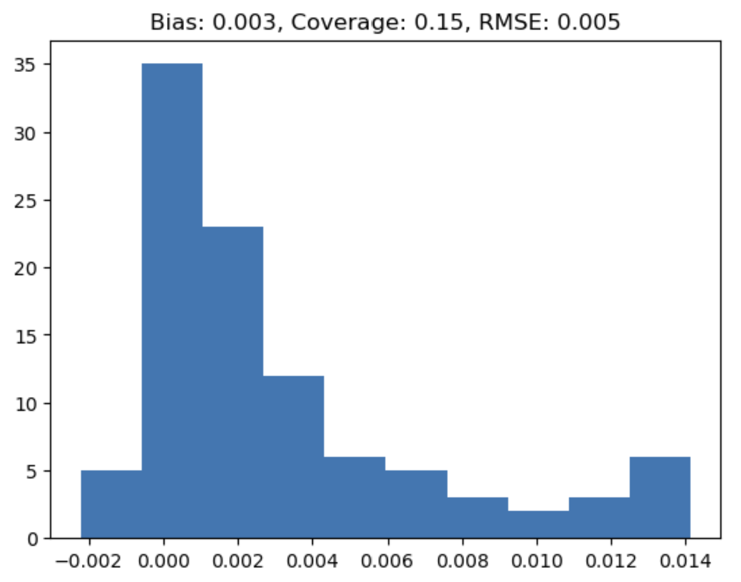
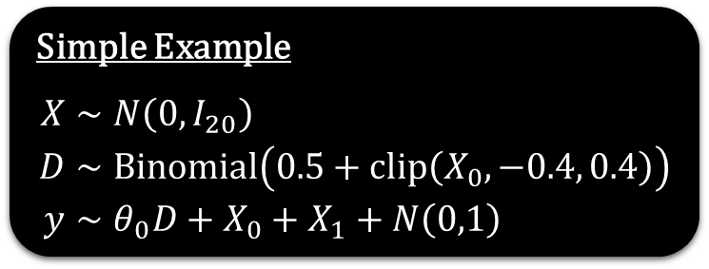
Natural Algorithm Gone Wrong
def est(X, D, y): # direct non-orthogonal estimator of average effect
est = RandomForestRegressor(min_samples_leaf=20)
est.fit(np.hstack([D.reshape(-1, 1), X]), y)
ones = np.hstack([np.ones((X.shape[0], 1)), X])
zeros = np.hstack([np.zeros((X.shape[0], 1)), X])
preds = est.predict(ones) - est.predict(zeros)
return np.mean(preds), np.std(preds)/np.sqrt(X.shape[0])
Simple Example
$$\begin{aligned}X∼&N\left(0,I_{20}\right) \\ D∼&Binomial\left(0.5+clip\left(X_{0},−0.4, 0.4\right)\right) \\ y∼&θ_{0}D+X_{0}+X_{1}+N\left(0,1\right)\end{aligned}$$

Slide 14
Natural Estimation Algorithm (Draft 2)
Split the data in half $S_{1},S_{2}$
On first half $S_{1}$, estimate $\hat{g}$ of $g_{0}$
Calculate empirical plug-in average on second half $S_{2}$:
$$\hat{θ}≔\frac{1}{\left|S_{2}\right|}\sum_{i∈S_{2}}{\hat{g}\left(1,X\right)−\hat{g}(0,X)}$$

Slide 15
Natural Estimation Algorithm (Draft 3)
Split data in $K$ parts, $S_{1},…, S_{K}$
For each part $k$, estimate ${\hat{g}}_{k}$ using data from all parts except $S_{k}$
Calculate average over all data:
$$\hat{θ}=\frac{1}{n}\sum_{k=1}^{K}{\sum_{i∈S_{k}}{{\hat{g}}_{k}\left(1,X\right)−{\hat{g}}_{k}\left(0,X\right)}}$$

Slide 16
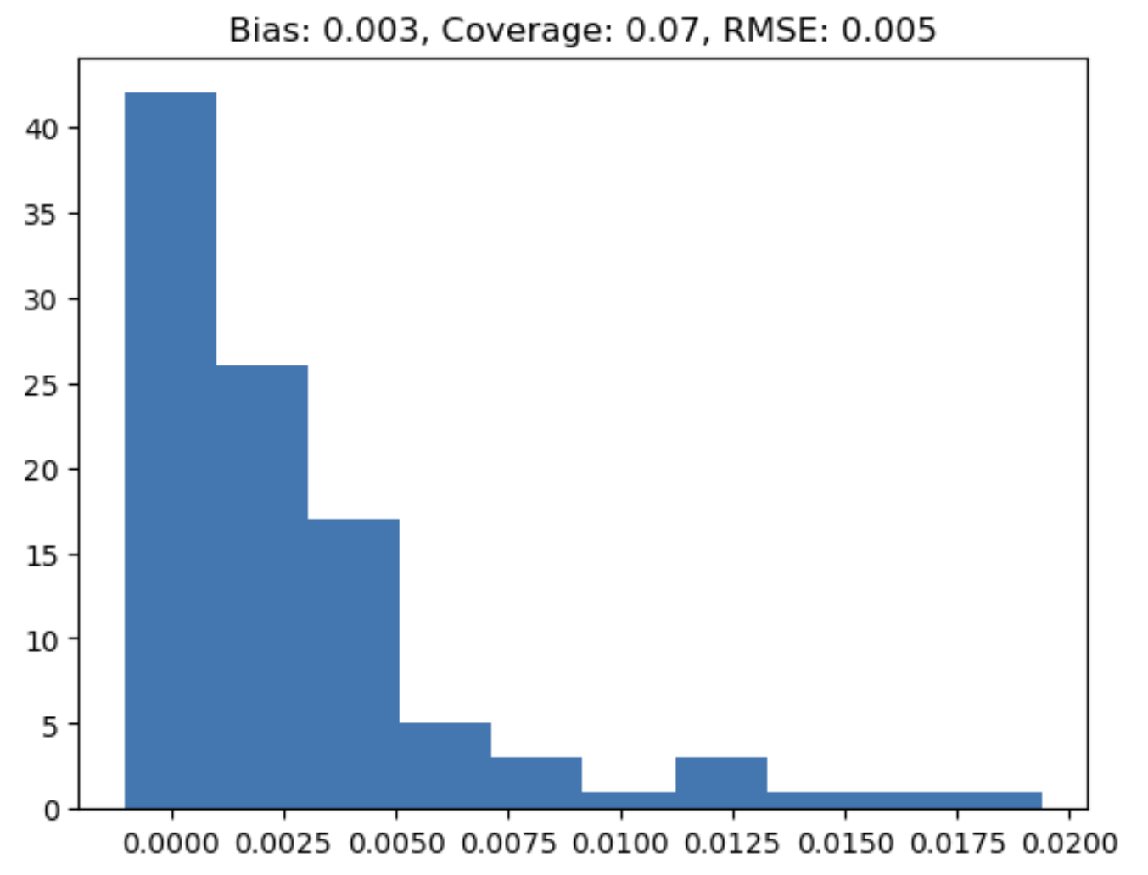
Natural Algorithm (Draft 3) Gone Wrong
def est2(X, D, y): # direct non-orthogonal estimator with sample splitting
effects = np.zeros(X.shape[0])
for train, test in KFold(n_splits=3).split(X):
est = RandomForestRegressor(min_samples_leaf=20)
est.fit(np.hstack([D[train].reshape(-1, 1), X[train]]), y[train])
ones = np.hstack([np.ones((X[test].shape[0], 1)), X[test]])
zeros = np.hstack([np.zeros((X[test].shape[0], 1)), X[test]])
effects[test] = est.predict(ones) - est.predict(zeros)
return np.mean(effects), np.std(effects)/np.sqrt(X.shape[0])
Simple Example
$$\begin{aligned}X∼&N\left(0,I_{20}\right) \\ D∼&Binomial\left(0.5+clip\left(X_{0},−0.4, 0.4\right)\right) \\ y∼&θ_{0}D+X_{0}+X_{1}+N\left(0,1\right)\end{aligned}$$

Slide 17

When is estimate $\hat{θ}$ $\sqrt{n}$-asymptotically normal?

Slide 18

When is estimate $\hat{θ}$ $\sqrt{n}$-asymptotically normal? We need to change the moment we use

Slide 19
Debiased Machine Learning

Slide 20
Average Causal Effect Example
We observe $n$ samples $Z_{1},…, Z_{n}$ where $Z_{i}=\left(X_{i},D_{i},Y_{i}\right)$
Want to estimate average effect $θ_{0}$, which satisfies:
$$θ_{0}≔E\left[g_{0}\left(1, X\right)−g_{0}\left(0,X\right)\right]$$
Where:
$$g_{0}\left(D,X\right)≔E\left[Y ∣ D, X\right]$$
The identification formula for $θ_{0}$ is sensitive to variations in $g$
Any bias or error in $g$ propagates to bias or error in moment and $\hat{θ}$
Can we add a correction that corrects the biases of $\hat{g}$

Slide 21
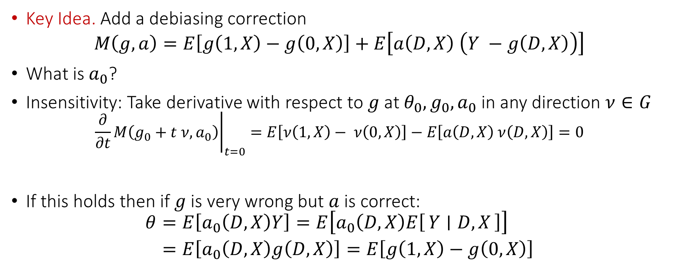
Better Formula for ATE
Regression residual is a proxy that g is biased
Key Idea. Add a debiasing correction
$$M\left(g,a\right)=E\left[g\left(1,X\right)−g\left(0,X\right)\right]+E\left[a\left(D, X\right) \left(Y −g\left(D, X\right)\right)\right]$$
What is $a_{0}$?
Insensitivity: Take derivative with respect to $g$ at $θ_{0},g_{0},a_{0}$ in any direction $ν∈G$
$${\left.\frac{∂}{∂t}M\left(g_{0}+t ν,a_{0}\right)\right|}_{t=0}=E\left[ν\left(1,X\right)− ν\left(0,X\right)\right]−E\left[a\left(D,X\right) ν\left(D,X\right)\right]=0$$
If this holds then if $g$ is very wrong but $a$ is correct:
$$\begin{aligned}θ=&E\left[a_{0}\left(D,X\right)Y\right]=E\left[a_{0}\left(D,X\right)E\left[Y ∣ D,X\right]\right] \\ =&E\left[a_{0}\left(D,X\right)g\left(D,X\right)\right]=E\left[g\left(1,X\right)−g\left(0,X\right)\right]\end{aligned}$$

Slide 22
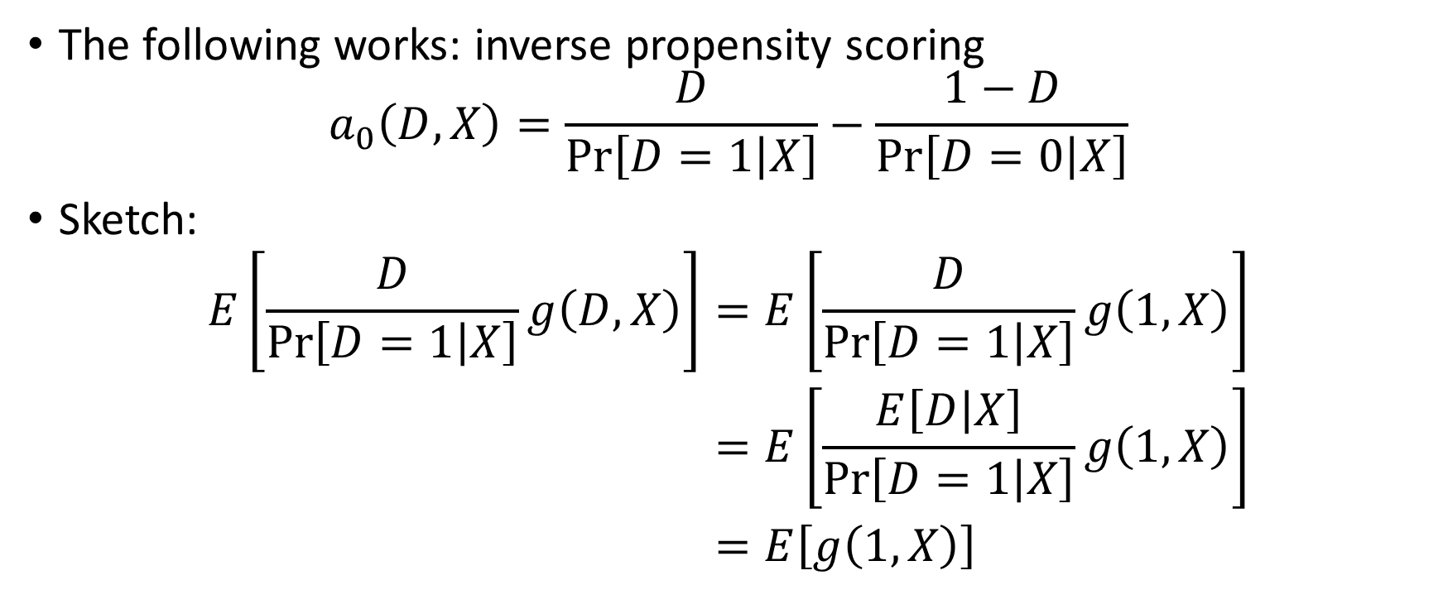
Inverse Propensity Weighting (IPW)
The following works: inverse propensity scoring
$$a_{0}\left(D,X\right)=\frac{D}{\operatorname{Pr}\left[D=1 | X\right]}−\frac{1−D}{\operatorname{Pr}\left[D=0 | X\right]}$$
Sketch:
$$\begin{aligned}E\left[\frac{D}{\operatorname{Pr}\left[D=1 | X\right]}g\left(D,X\right)\right]=&E\left[\frac{D}{\operatorname{Pr}\left[D=1 | X\right]}g\left(1,X\right)\right] \\ =&E\left[\frac{E\left[D | X\right]}{\operatorname{Pr}\left[D=1 | X\right]}g\left(1,X\right)\right] \\ =&E\left[g\left(1,X\right)\right]\end{aligned}$$

Slide 23
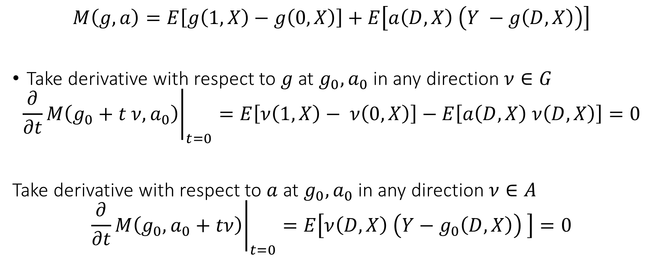
New Formula is Insensitive
$$M\left(g,a\right)=E\left[g\left(1,X\right)−g\left(0,X\right)\right]+E\left[a\left(D, X\right) \left(Y −g\left(D, X\right)\right)\right]$$
Take derivative with respect to $g$ at $g_{0},a_{0}$ in any direction $ν∈G$
$${\left.\frac{∂}{∂t}M\left(g_{0}+t ν,a_{0}\right)\right|}_{t=0}=E\left[ν\left(1,X\right)− ν\left(0,X\right)\right]−E\left[a\left(D,X\right) ν\left(D,X\right)\right]=0$$
Take derivative with respect to $a$ at $g_{0},a_{0}$ in any direction $ν∈A$
$${\left.\frac{∂}{∂t}M\left(g_{0},a_{0}+tν\right)\right|}_{t=0}=E\left[ν\left(D,X\right) \left(Y−g_{0}\left(D,X\right)\right) \right]=0$$

Slide 24
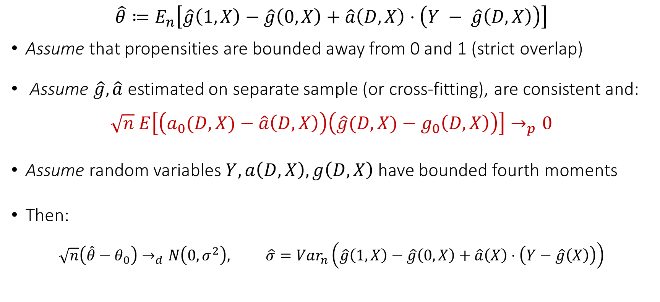
Asymptotic Normality of De-biased Estimate
$$\hat{θ}≔E_{n}\left[\hat{g}\left(1,X\right)−\hat{g}\left(0,X\right)+\hat{a}\left(D,X\right)⋅\left(Y − \hat{g}\left(D,X\right)\right)\right]$$
Assume that propensities are bounded away from 0 and 1 (strict overlap)
Assume $\hat{g},\hat{a}$ estimated on separate sample (or cross-fitting), are consistent and:
$$\sqrt{n} E\left[\left(a_{0}(D,X)−\hat{a}\left(D,X\right)\right)\left(\hat{g}(D,X)−g_{0}\left(D,X\right)\right)\right]→_{p}0$$
Assume random variables $Y,a\left(D,X\right), g\left(D,X\right)$ have bounded fourth moments
Then:
$$\sqrt{n}\left(\hat{θ}−θ_{0}\right)→_{d}N\left(0,σ^{2}\right), \hat{σ}=Var_{n}\left(\hat{g}\left(1,X\right)−\hat{g}\left(0,X\right)+\hat{a}\left(X\right)⋅\left(Y−\hat{g}\left(X\right)\right)\right)$$

Slide 25
Python Pseudocode
cv = KFold(n_splits=nfolds, shuffle=True, random_state=123)
yhat0, yhat1 = np.zeros(y.shape), np.zeros(y.shape)
# we will fit a model E[Y| D, X] by fitting a separate model for D==0
# and a separate model for D==1.
for train, test in cv.split(X, y):
# train a model on training data that received zero and predict on all test data
yhat0[test] = modely.fit(X[train][D[train]==0], y[train][D[train]==0]).predict(X[test])
# train a model on training data that received one and predict on all test data
yhat1[test] = modely.fit(X[train][D[train]==1], y[train][D[train]==1]).predict(X[test])
# prediction for observed treatment
yhat = yhat0 * (1 - D) + yhat1 * D
# propensity scores
Dhat = cross_val_predict(modeld, X, D, cv=cv, method='predict_proba', n_jobs=-1)[:, 1]
Dhat = np.clip(Dhat, trimming, 1 - trimming)
# doubly robust quantity for every sample
drhat = yhat1 - yhat0 + (y - yhat) * (D/Dhat - (1 - D)/(1 - Dhat))
point = np.mean(drhat)
var = np.var(drhat)
stderr = np.sqrt(var / X.shape[0])
return point, stderr, yhat, Dhat, y - yhat, D - Dhat, drhat

Slide 26
Continuous Treatments under Partial Linearity

Slide 27
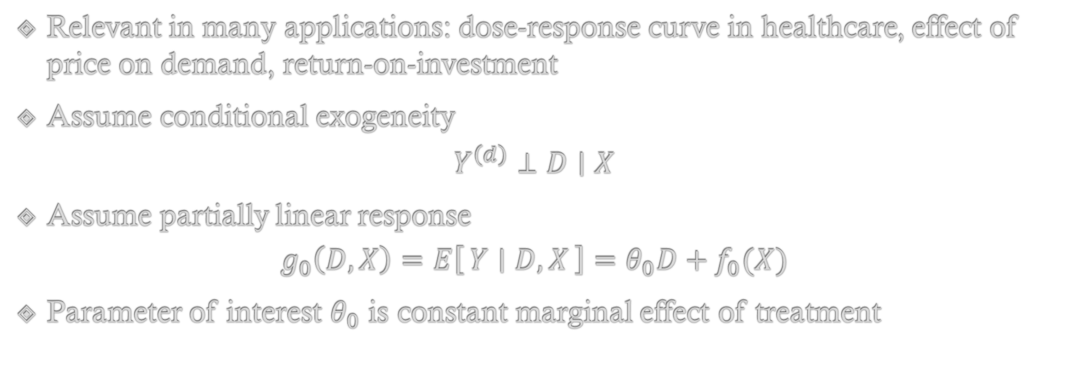
Partially Linear Model
Relevant in many applications: dose-response curve in healthcare, effect of price on demand, return-on-investment
Assume conditional exogeneity
$$Y^{\left(d\right)}⊥D∣X$$
Assume partially linear response
$$g_{0}\left(D,X\right)=E\left[Y ∣ D,X\right]=θ_{0}D+f_{0}(X)$$
Parameter of interest $θ_{0}$ is constant marginal effect of treatment

Slide 28
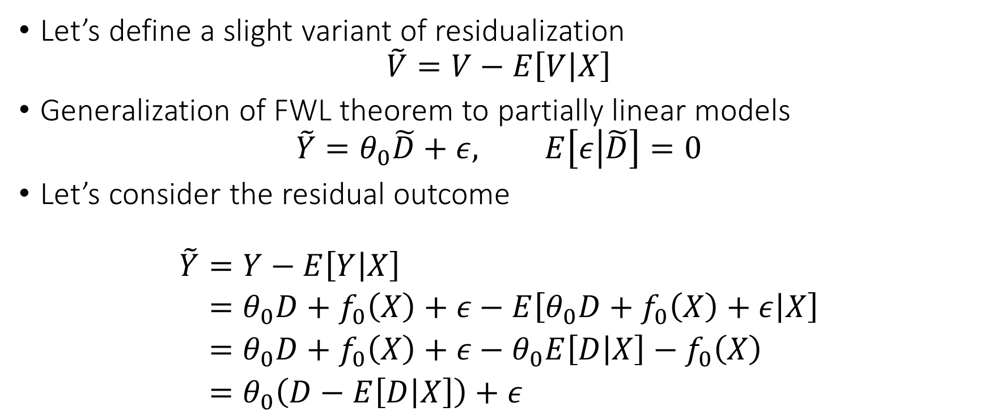
Generalization of FWL Theorem
Let’s define a slight variant of residualization
$$\tilde{V}=V−E\left[V | X\right]$$
Generalization of FWL theorem to partially linear models
$$\tilde{Y}=θ_{0}\tilde{D}+ε, E\left[ε | \tilde{D}\right]=0$$
Let’s consider the residual outcome
$$\begin{aligned}\tilde{Y}=&Y−E\left[Y | X\right] \\ =&θ_{0}D+f_{0}\left(X\right)+ε−E\left[θ_{0}D+f_{0}\left(X\right)+ε | X\right] \\ =&θ_{0}D+f_{0}\left(X\right)+ε−θ_{0}E\left[D | X\right]−f_{0}\left(X\right) \\ =&θ_{0}\left(D−E\left[D | X\right]\right)+ε\end{aligned}$$

Slide 29



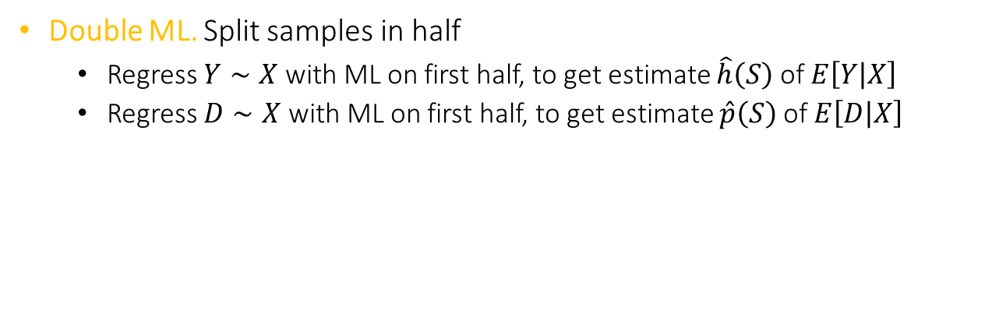






Orthogonal Method: Double ML
Double ML. Split samples in half
Regress $Y∼X$ with ML on first half, to get estimate $\hat{h}\left(S\right)$ of $E\left[Y | X\right]$
Regress $D∼X$ with ML on first half, to get estimate $\hat{p}\left(S\right)$ of $E\left[D | X\right]$
$$D=p\left(X\right)+noise$$
$$D$$
$$p$$
$$θ$$
$$X$$
$$Y$$
$$h$$
$$f$$
$$Y=θD+f(X)+noise$$

Slide 30


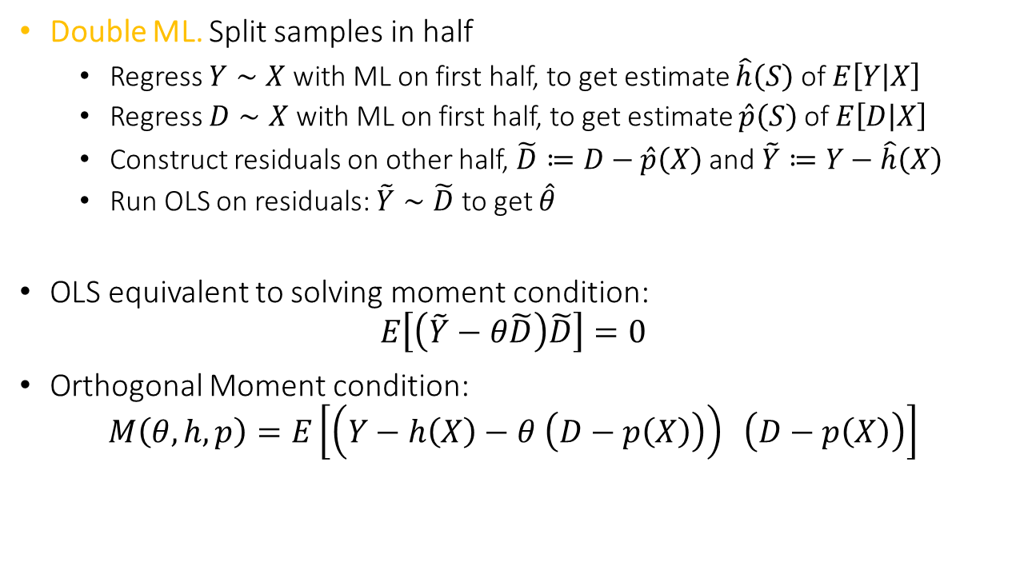



Orthogonal Method: Double ML
Double ML. Split samples in half
Regress $Y∼X$ with ML on first half, to get estimate $\hat{h}\left(S\right)$ of $E\left[Y | X\right]$
Regress $D∼X$ with ML on first half, to get estimate $\hat{p}\left(S\right)$ of $E\left[D | X\right]$
Construct residuals on other half, $\tilde{D}≔D−\hat{p}\left(X\right)$ and $\tilde{Y}≔Y−\hat{h}\left(X\right)$
Run OLS on residuals: $\tilde{Y}∼\tilde{D}$ to get $\hat{θ}$
OLS equivalent to solving moment condition:
$$E\left[\left(\tilde{Y}−θ\tilde{D}\right)\tilde{D}\right]=0$$
Orthogonal Moment condition:
$$M\left(θ, h, p\right)=E\left[\left(Y−h\left(X\right)−θ \left(D−p\left(X\right)\right)\right) \left(D−p\left(X\right)\right)\right]$$
$$\tilde{D}≈noise$$
$$\tilde{D}$$
$$θ$$
$$X$$
$$\tilde{Y}$$
$$\tilde{Y}≈θ\tilde{D}+noise$$

Slide 31
General Theory

Slide 32
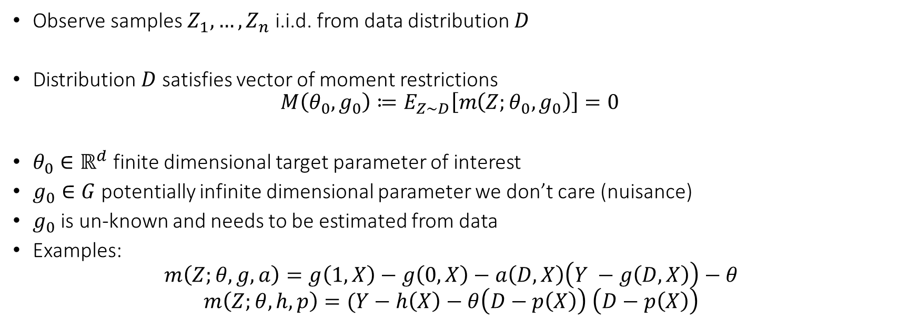
Semi-Parametric Moment Restrictions
Observe samples $Z_{1},…,Z_{n}$ i.i.d. from data distribution $D$
Distribution $D$ satisfies vector of moment restrictions
$$M\left(θ_{0},g_{0}\right)≔E_{Z∼D}\left[m\left(Z;θ_{0},g_{0}\right)\right]=0$$
$θ_{0}∈ℝ^{d}$ finite dimensional target parameter of interest
$g_{0}∈G$ potentially infinite dimensional parameter we don’t care (nuisance)
$g_{0}$ is un-known and needs to be estimated from data
Examples:
$$m\left(Z;θ, g,a\right)=g\left(1, X\right)−g\left(0,X\right)−a\left(D,X\right)\left(Y −g\left(D,X\right)\right)−θ$$
$$m\left(Z;θ, h,p\right)=(Y−h\left(X\right)−θ\left(D−p\left(X\right)\right) \left(D−p\left(X\right)\right)$$

Slide 33
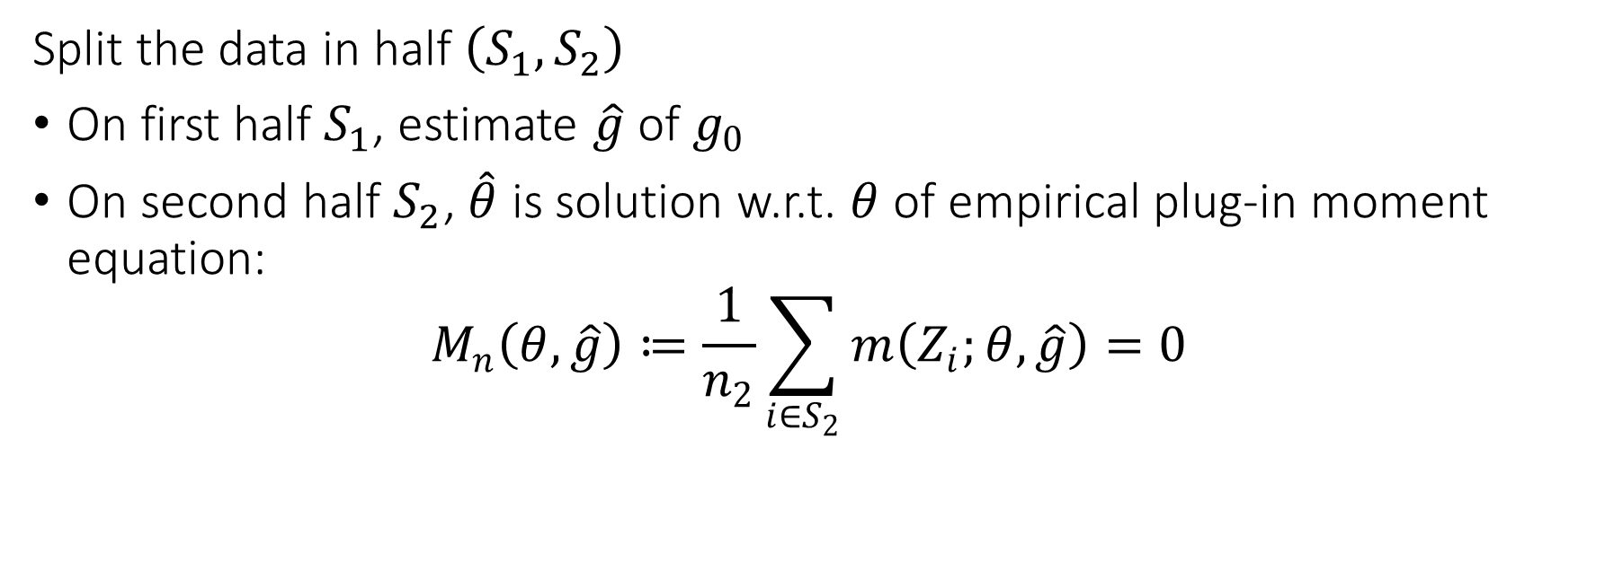
Natural Estimation Algorithm (sample-splitting)
Split the data in half $\left(S_{1},S_{2}\right)$
On first half $S_{1}$, estimate $\hat{g}$ of $g_{0}$
On second half $S_{2}$, $\hat{θ}$ is solution w.r.t. $θ$ of empirical plug-in moment equation:
$$M_{n}\left(θ,\hat{g}\right)≔\frac{1}{n_{2}}\sum_{i∈S_{2}}{m\left(Z_{i};θ, \hat{g}\right)}=0$$

Slide 34

Neyman Orthogonality
Moment $M\left(θ, g\right)$ is Neyman orthogonal if for any $ν∈G−g_{0}$:
$${D_{g}M\left(θ_{0},g_{0}\right)\left[ν\right]≔\left.\frac{∂}{∂t}M\left(θ_{0},g_{0}+t ν\right)\right|}_{t=0}=0$$

Slide 35

Main Theorem
If moment is Neyman orthogonal and RMSE of $\hat{g}$ is $o_{p}\left(n^{−1/4}\right)$, plus regularity conditions
$$\sqrt{n} \left(\hat{θ}−θ_{0}\right)→N\left(0,J_{0}^{−1}Σ{\left(J_{0}^{−1}\right)}^{⊤}\right)$$
where $J_{0}≔∇_{θ}M\left(θ_{0},g_{0}\right)$ and $Σ≔E\left[m\left(Z;θ_{0},g_{0}\right) m{\left(Z;θ_{0},g_{0}\right)}^{⊤}\right]$

Slide 36
Practical Variants of Sample-Splitting
Cross-fitting and semi-cross-fitting

Slide 37
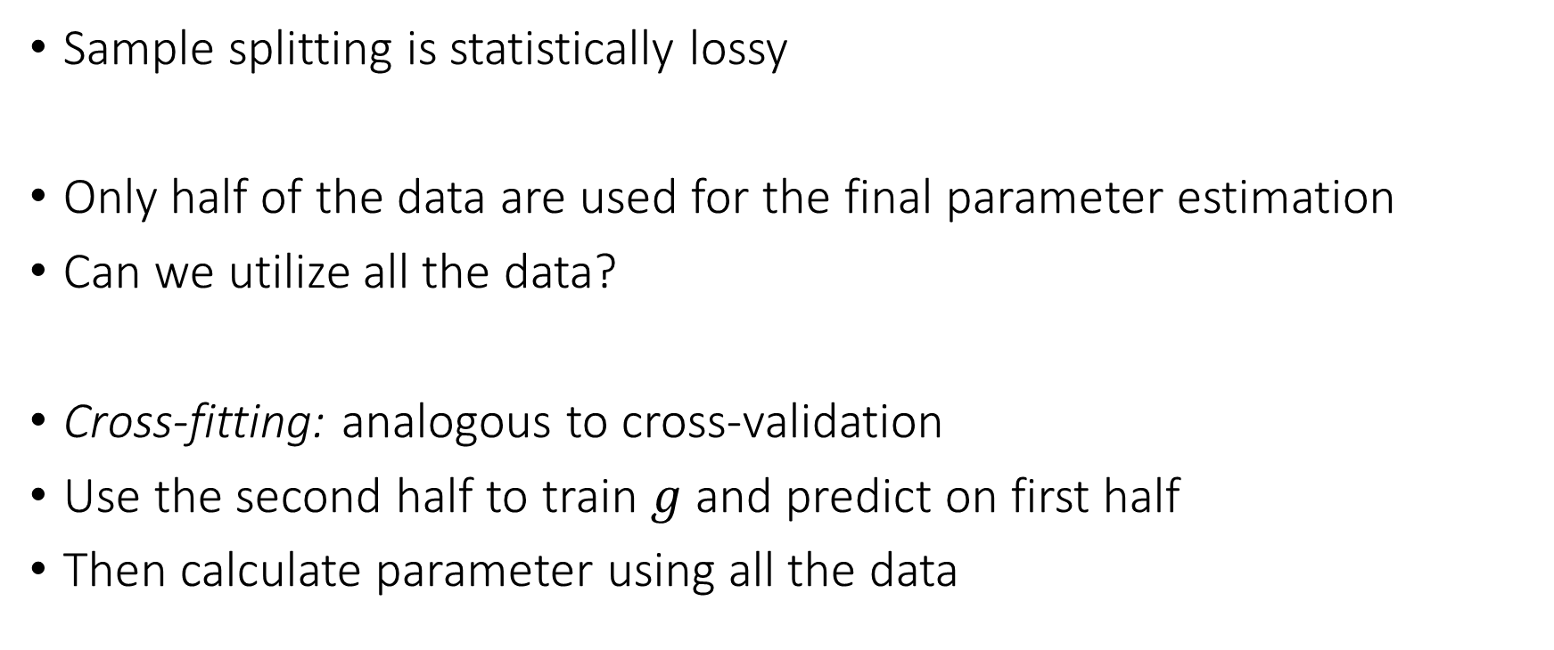
Cross-fitting
Sample splitting is statistically lossy
Only half of the data are used for the final parameter estimation
Can we utilize all the data?
Cross-fitting: analogous to cross-validation
Use the second half to train $g$ and predict on first half
Then calculate parameter using all the data

Slide 38
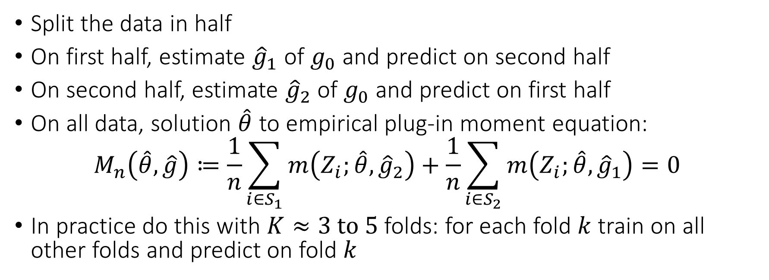
Cross-fitting Estimation Algorithm
Split the data in half
On first half, estimate ${\hat{g}}_{1}$ of $g_{0}$ and predict on second half
On second half, estimate ${\hat{g}}_{2}$ of $g_{0}$ and predict on first half
On all data, solution $\hat{θ}$ to empirical plug-in moment equation:
$$M_{n}\left(\hat{θ},\hat{g}\right)≔\frac{1}{n}\sum_{i∈S_{1}}{m\left(Z_{i};\hat{θ}, {\hat{g}}_{2}\right)}+\frac{1}{n}\sum_{i∈S_{2}}{m\left(Z_{i};\hat{θ}, {\hat{g}}_{1}\right)}=0$$
In practice do this with $K≈3 to 5$ folds: for each fold $k$ train on all other folds and predict on fold $k$

Slide 39
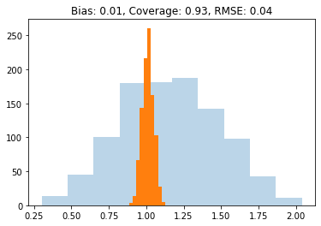
Natural Algorithm (Draft 3) Gone Right
def dml2(X, D, y): # orthogonal dml with sample-splitting
est_y = RandomForestRegressor(min_samples_leaf=20)
yres = y - cross_val_predict(est_y, X, y, cv=3)
est_t = RandomForestRegressor(min_samples_leaf=20)
Dres = D - cross_val_predict(est_t, X, D, cv=3)
theta = np.mean(yres * Dres) / np.mean(Dres**2)
var = np.mean((Dres**2) * (yres - theta*Dres)**2) / np.mean(Dres**2)
stderr = np.sqrt(var / X.shape[0])
return theta, stderr

Slide 40
Natural Algorithm (Draft 3) Gone Right
from econml.dml import LinearDML
dml = LinearDML(model_y=RandomForestRegressor(min_samples_leaf=20),
model_t=RandomForestRegressor(min_samples_leaf=20))
est.fit(y, D, W=X).effect_inference()

Slide 41
Stacking and Model Selection
If we want to choose among many models or perform stacking, we can just use a stacked or automl model in place of each ML model

Slide 42
Stacking ML Models
def dml2(X, D, y): # orthogonal dml with sample-splitting
est_y = StackingRegressor([rf, nnet, gbf, lasso])
yres = y - cross_val_predict(est_y, X, y, cv=3)
est_t = StackingRegressor([rf, nnet, gbf, lasso])
Dres = D - cross_val_predict(est_t, X, D, cv=3)
theta = np.mean(yres * Dres) / np.mean(Dres**2)
var = np.mean((Dres**2) * (yres - theta*Dres)**2) / np.mean(Dres**2)
stderr = np.sqrt(var / X.shape[0])
return theta, stderr

Slide 43
AutoML Models
from flaml import AutoML
def dml2(X, D, y): # orthogonal dml with sample-splitting
est_y = AutoML()
yres = y - cross_val_predict(est_y, X, y, cv=3)
est_t = AutoML()
Dres = D - cross_val_predict(est_t, X, D, cv=3)
theta = np.mean(yres * Dres) / np.mean(Dres**2)
var = np.mean((Dres**2) * (yres - theta*Dres)**2) / np.mean(Dres**2)
stderr = np.sqrt(var / X.shape[0])
return theta, stderr

Slide 44
Stacking and Model Selection
If we want to choose among many models or perform stacking, we can just use a stacked or automl model in place of each ML model
Model selection or stacking done many times within each training fold
Computationally expensive and statistically lossy
Can we use all the data to at least select among models?

Slide 45
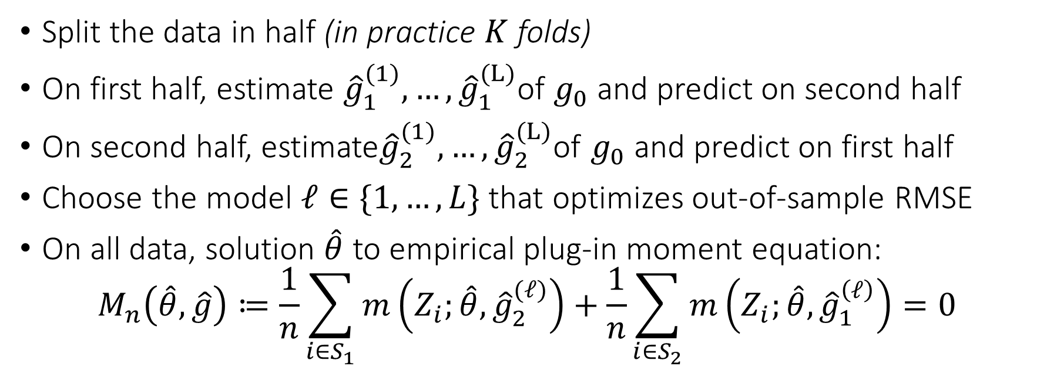
Semi-Cross-fitting Estimation Algorithm
Split the data in half (in practice $K$ folds)
On first half, estimate ${\hat{g}}_{1}^{(1)}, …,{\hat{g}}_{1}^{(L)}$of $g_{0}$ and predict on second half
On second half, estimate${\hat{g}}_{2}^{(1)}, …,{\hat{g}}_{2}^{(L)}$of $g_{0}$ and predict on first half
Choose the model $ℓ∈\{1,…,L\}$ that optimizes out-of-sample RMSE
On all data, solution $\hat{θ}$ to empirical plug-in moment equation:
$$M_{n}\left(\hat{θ},\hat{g}\right)≔\frac{1}{n}\sum_{i∈S_{1}}{m\left(Z_{i};\hat{θ}, {\hat{g}}_{2}^{(ℓ)}\right)}+\frac{1}{n}\sum_{i∈S_{2}}{m\left(Z_{i};\hat{θ}, {\hat{g}}_{1}^{\left(ℓ\right)}\right)}=0$$

Slide 46
Semi-Crossfitting
def dml2(X, D, y): # orthogonal dml with semi-crossfitting
# cross val predict with many models
est_y = [rf, gbf, lasso]
yres = np.array([y - cross_val_predict(est, X, y, cv=3) for est in est_y])
est_d = [rf, gbf, lasso]
Dres = np.array([D - cross_val_predict(est, X, D, cv=3) for est in est_d])
# select models with best out of fold performance
best_y = np.argmin(np.mean(yres**2, axis=1))
best_d = np.argmin(np.mean(Dres**2, axis=1))
yres = yres[best_y]
Dres = Dres[best_d]
# go with their corresponding residuals
theta = np.mean(yres * Dres) / np.mean(Dres**2)
var = np.mean((Dres**2) * (yres - theta*Dres)**2) / np.mean(Dres**2)
stderr = np.sqrt(var / X.shape[0])
return theta, stderr

Slide 47

Semi-Crossfitting
If the number of models $L$ is small, then “spillover” is ok and approach still works. For practical purposes $L$ should be thought as constant.
Under further regularity, provably asymptotic normality holds if
$$\sqrt{\log\left(L\right)}=o\left(n^{1/4}\right)$$

Slide 48
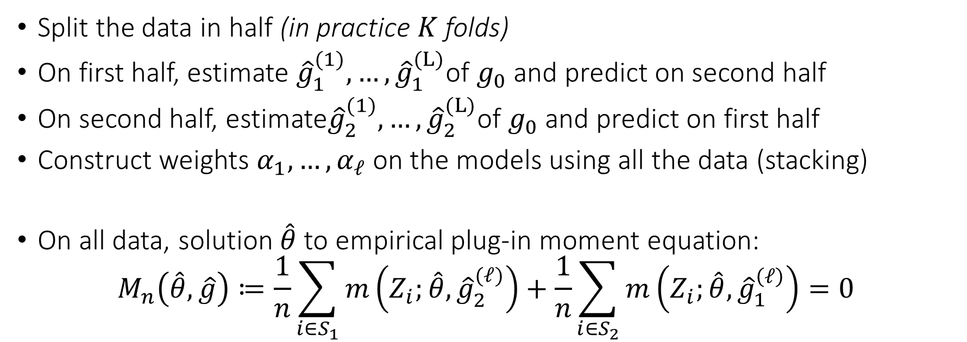
Semi-Cross-fitting with Stacking
Split the data in half (in practice $K$ folds)
On first half, estimate ${\hat{g}}_{1}^{(1)}, …,{\hat{g}}_{1}^{(L)}$of $g_{0}$ and predict on second half
On second half, estimate${\hat{g}}_{2}^{(1)}, …,{\hat{g}}_{2}^{(L)}$of $g_{0}$ and predict on first half
Construct weights $α_{1},…,α_{ℓ}$ on the models using all the data (stacking)
On all data, solution $\hat{θ}$ to empirical plug-in moment equation:
$$M_{n}\left(\hat{θ},\hat{g}\right)≔\frac{1}{n}\sum_{i∈S_{1}}{m\left(Z_{i};\hat{θ}, {\hat{g}}_{2}^{(ℓ)}\right)}+\frac{1}{n}\sum_{i∈S_{2}}{m\left(Z_{i};\hat{θ}, {\hat{g}}_{1}^{\left(ℓ\right)}\right)}=0$$

Slide 49
Semi-Crossfitting with Stacking
def dml2(X, D, y): # orthogonal dml with semi-crossfitting and stacking
# cross val predict with many models
est_y = [rf, gbf, lasso]
ypreds = np.array([cross_val_predict(est, X, y, cv=3) for est in est_y]).T
est_d = [rf, gbf, lasso]
Dpreds = np.array([cross_val_predict(est, X, D, cv=3) for est in est_d]).T
# calculate stacked residuals by finding optimal coefficients
# and weigthing out-of-sample predictions by these coefficients
yres = y - LinearRegression().fit(ypreds, y).predict(ypreds)
Dres = D - LinearRegression().fit(Dpreds, D).predict(Dpreds)
# go with the stacked residuals
theta = np.mean(yres * Dres) / np.mean(Dres**2)
var = np.mean((Dres**2) * (yres - theta*Dres)**2) / np.mean(Dres**2)
stderr = np.sqrt(var / X.shape[0])
return theta, stderr

Slide 50
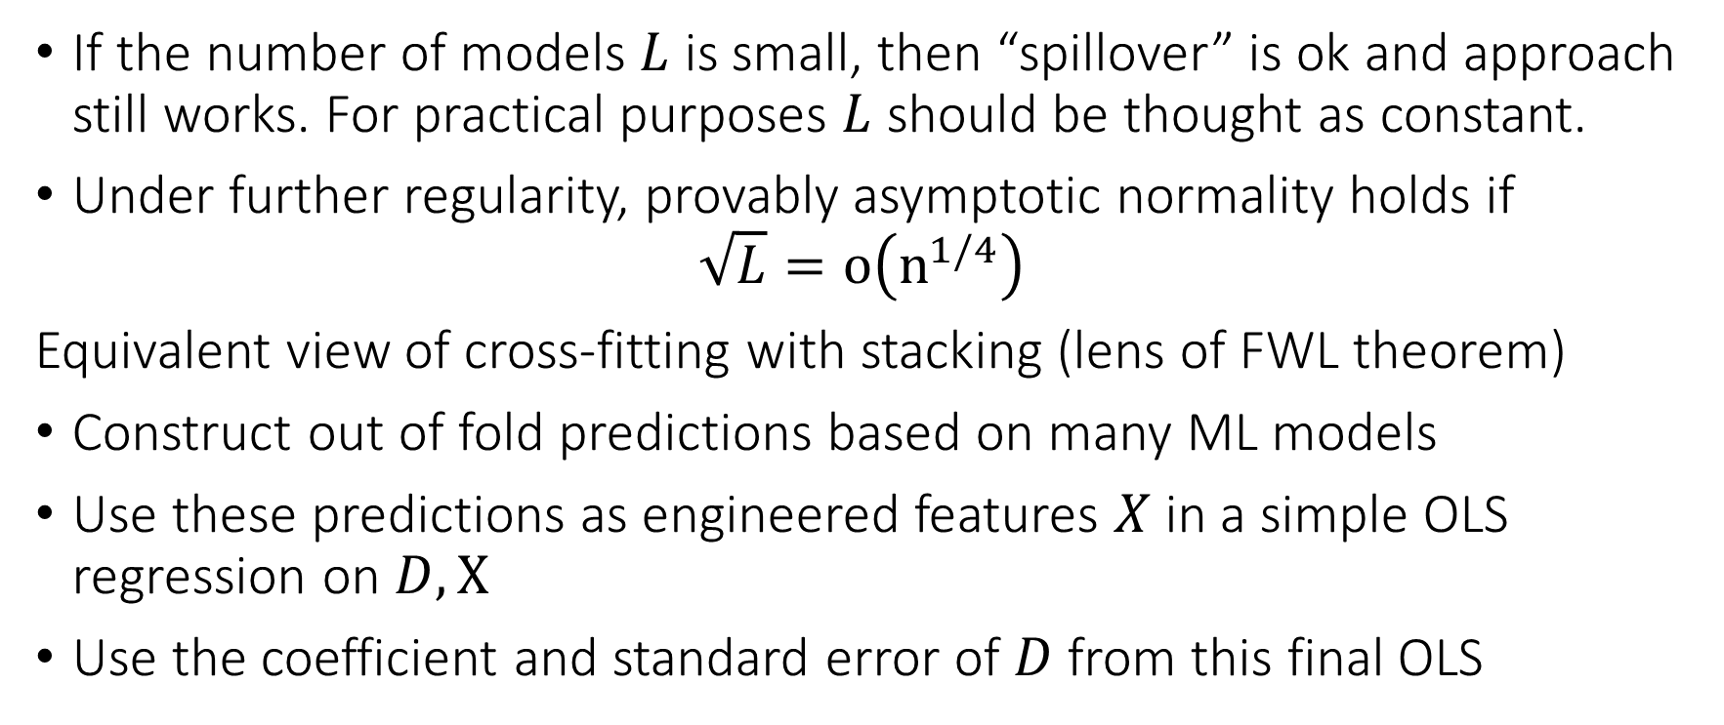
Semi-Crossfitting
If the number of models $L$ is small, then “spillover” is ok and approach still works. For practical purposes $L$ should be thought as constant.
Under further regularity, provably asymptotic normality holds if
$$\sqrt{L}=o\left(n^{1/4}\right)$$
Equivalent view of cross-fitting with stacking (lens of FWL theorem)
Construct out of fold predictions based on many ML models
Use these predictions as engineered features $X$ in a simple OLS regression on $D,X$
Use the coefficient and standard error of $D$ from this final OLS

