Slide 1
MS&E 228: Topics on Longitudinal Data and Causal Machine Learning
Vasilis Syrgkanis
MS&E, Stanford

Slide 2
Causal Inference with Experiments
Prediction with Linear Models
Prediction with High-Dim Linear Models
Inference on Causal and Predictive Effects with High-Dim Linear Models
Potential Outcomes and Conditional Ignorability
Structural Equation Models and Conditional Exogeneity
Directed Acyclic Graphs
Prediction with Non-Linear Models
Inference on Causal Effects with Non-Linear Models
Un-observed Confounding and Instruments
Estimation of Heterogeneous Causal Effects
Identification of Causal Effects in Longitudinal Data
Linear Predictive Models and Statistical Inference
Causal Identification in Observational Data
Non-Linear Predictive Models and Statistical Inference
Topics

Slide 3
Causal Inference with Experiments
Prediction with Linear Models
Prediction with High-Dim Linear Models
Inference on Causal and Predictive Effects with High-Dim Linear Models
Potential Outcomes and Conditional Ignorability
Structural Equation Models and Conditional Exogeneity
Directed Acyclic Graphs
Prediction with Non-Linear Models
Inference on Causal Effects with Non-Linear Models
Un-observed Confounding and Instruments
Estimation of Heterogeneous Causal Effects
Identification of Causal Effects in Longitudinal Data
Linear Predictive Models and Statistical Inference
Causal Identification in Observational Data
Non-Linear Predictive Models and Statistical Inference
Topics

Slide 4
Longitudinal Data
Longitudinal data refer to datasets where we have multiple observations of the same unit over time
They present a separate set of new problems
Correlation: samples stemming from each unit (or sometimes cluster of units from the same “site”) are correlated
Censoring/Missingness: units typically drop out at (potentially not) random times before the end of the study
Dynamic treatments: units are treated with multiple treatments over time in a manner that is adaptive and auto-correlated

Slide 5
Longitudinal Data
Longitudinal data refer to datasets where we have multiple observations of the same unit over time
They present a separate set but also opportunities for causal identification strategies
Differences-in-Differences: assumption of treatment not being chosen based on potential “growth” trajectory of unit under control
Synthetic Controls: assumption that trajectory of a treated unit under control, can be well approximated as some combination of trajectories of un-treated units

Slide 6
Differences-in-Differences

Slide 7
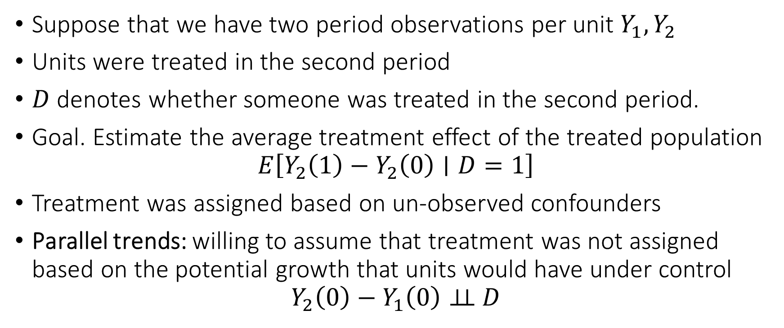
Differences-in-Differences
Suppose that we have two period observations per unit $Y_{1},Y_{2}$
Units were treated in the second period
$D$ denotes whether someone was treated in the second period.
Goal. Estimate the average treatment effect of the treated population
$$E\left[Y_{2}\left(1\right)−Y_{2}\left(0\right)∣D=1\right]$$
Treatment was assigned based on un-observed confounders
Parallel trends: willing to assume that treatment was not assigned based on the potential growth that units would have under control
$$Y_{2}\left(0\right)−Y_{1}\left(0\right)⊥⊥ D$$

Slide 8




Visually
$$D=1$$
Counterfactual post-treatment outcomes under control
$$D=0$$
$$Y_{1}$$
$$Y_{2}$$
Pre-treatment
Post-treatment

Slide 9
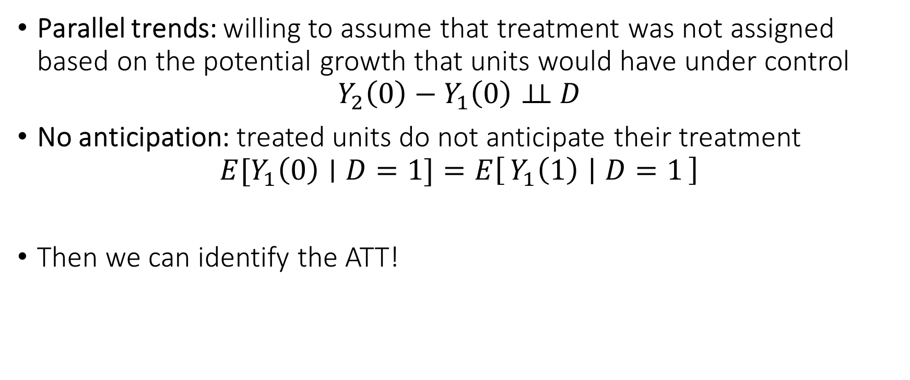
Differences-in-Differences
Parallel trends: willing to assume that treatment was not assigned based on the potential growth that units would have under control
$$Y_{2}\left(0\right)−Y_{1}\left(0\right)⊥⊥ D$$
No anticipation: treated units do not anticipate their treatment
$$E[Y_{1}\left(0\right)∣D=1]=E\left[Y_{1}\left(1\right) ∣ D=1\right]$$
Then we can identify the ATT!

Slide 10
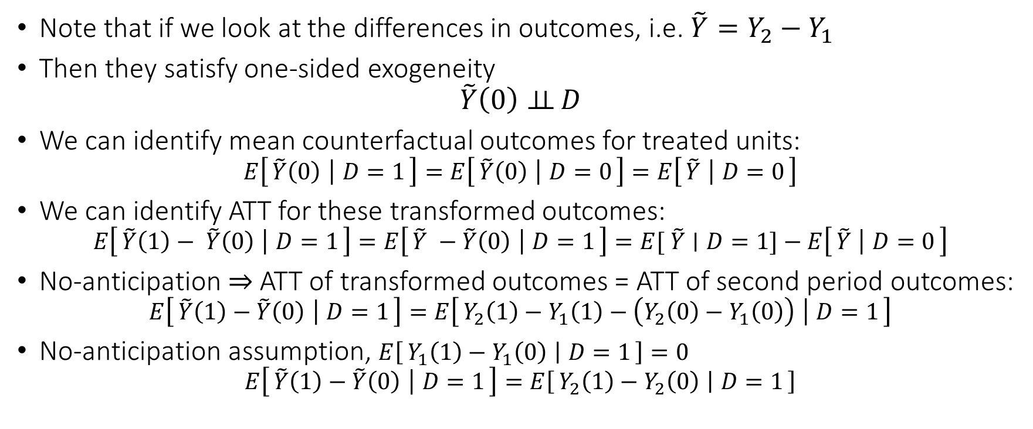
Identification of ATT
Note that if we look at the differences in outcomes, i.e. $\tilde{Y}=Y_{2}−Y_{1}$
Then they satisfy one-sided exogeneity
$$\tilde{Y}\left(0\right)⊥⊥ D$$
We can identify mean counterfactual outcomes for treated units:
$$E\left[\tilde{Y}\left(0\right) ∣ D=1\right]=E\left[\tilde{Y}\left(0\right) ∣ D=0\right]=E\left[\tilde{Y} ∣ D=0\right]$$
We can identify ATT for these transformed outcomes:
$$E\left[\tilde{Y}\left(1\right)− \tilde{Y}\left(0\right) ∣ D=1\right]=E\left[\tilde{Y} −\tilde{Y}\left(0\right) ∣ D=1\right]=E[ \tilde{Y}∣D=1]−E\left[\tilde{Y} ∣ D=0\right]$$
No-anticipation $⇒$ ATT of transformed outcomes = ATT of second period outcomes:
$$E\left[\tilde{Y}\left(1\right)−\tilde{Y}\left(0\right) ∣ D=1\right]=E\left[Y_{2}\left(1\right)−Y_{1}\left(1\right)−\left(Y_{2}\left(0\right)−Y_{1}\left(0\right)\right) ∣ D=1\right]$$
No-anticipation assumption, $E\left[Y_{1}\left(1\right)−Y_{1}\left(0\right) ∣ D=1\right]=0$
$$E\left[\tilde{Y}\left(1\right)−\tilde{Y}\left(0\right) ∣ D=1\right]=E\left[Y_{2}\left(1\right)−Y_{2}\left(0\right) ∣ D=1\right]$$

Slide 11
Conditional Parallel Trends
Parallel trends can be quite strong of an assumption
Much more plausible once we match on observable characteristics

Slide 12






Visually
$$X=x_{1}$$
$$D=1$$
Counterfactual post-treatment outcomes under control
$$X=x_{2}$$
$$X=x_{1}$$
$$D=0$$
$$X=x_{2}$$
$$Y_{1}$$
$$Y_{2}$$
Pre-treatment
Post-treatment

Slide 13
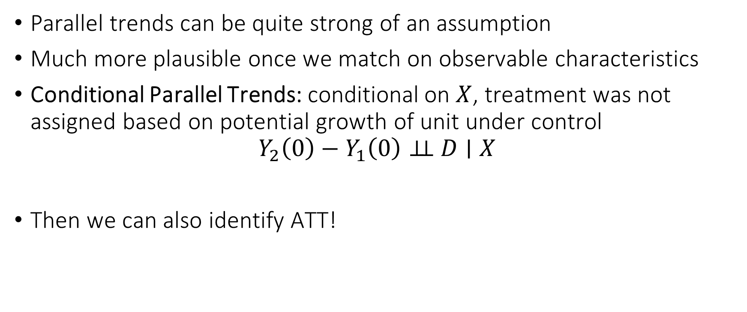
Conditional Parallel Trends
Parallel trends can be quite strong of an assumption
Much more plausible once we match on observable characteristics
Conditional Parallel Trends: conditional on $X$, treatment was not assigned based on potential growth of unit under control
$$Y_{2}\left(0\right)−Y_{1}\left(0\right)⊥⊥ D∣X$$
Then we can also identify ATT!

Slide 14
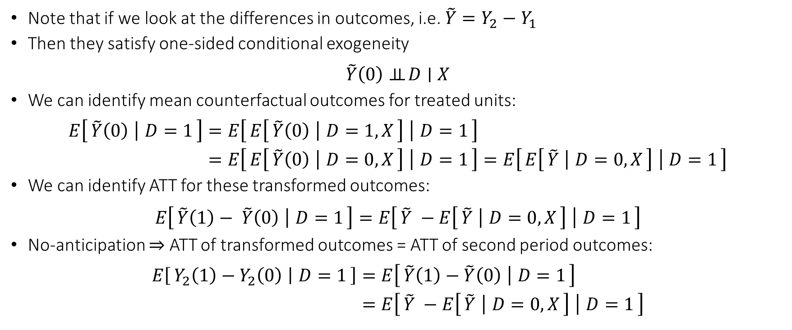
ATT under Conditional Parallel Trends
Note that if we look at the differences in outcomes, i.e. $\tilde{Y}=Y_{2}−Y_{1}$
Then they satisfy one-sided conditional exogeneity
$$\tilde{Y}\left(0\right)⊥⊥ D∣X$$
We can identify mean counterfactual outcomes for treated units:
$$\begin{aligned}E\left[\tilde{Y}\left(0\right) ∣ D=1\right]=&E\left[E\left[\tilde{Y}\left(0\right) ∣ D=1,X\right] ∣ D=1\right] \\ =&E\left[E\left[\tilde{Y}\left(0\right) ∣ D=0,X\right] ∣ D=1\right]=E\left[E\left[\tilde{Y} ∣ D=0,X\right] ∣ D=1\right]\end{aligned}$$
We can identify ATT for these transformed outcomes:
$$E\left[\tilde{Y}\left(1\right)− \tilde{Y}\left(0\right) ∣ D=1\right]=E\left[\tilde{Y} −E\left[\tilde{Y} ∣ D=0,X\right] ∣ D=1\right]$$
No-anticipation $⇒$ ATT of transformed outcomes = ATT of second period outcomes:
$$\begin{aligned}E\left[Y_{2}\left(1\right)−Y_{2}\left(0\right) ∣ D=1\right]=&E\left[\tilde{Y}\left(1\right)−\tilde{Y}\left(0\right) ∣ D=1\right] \\ =&E\left[\tilde{Y} −E\left[\tilde{Y} ∣ D=0,X\right] ∣ D=1\right]\end{aligned}$$

Slide 15
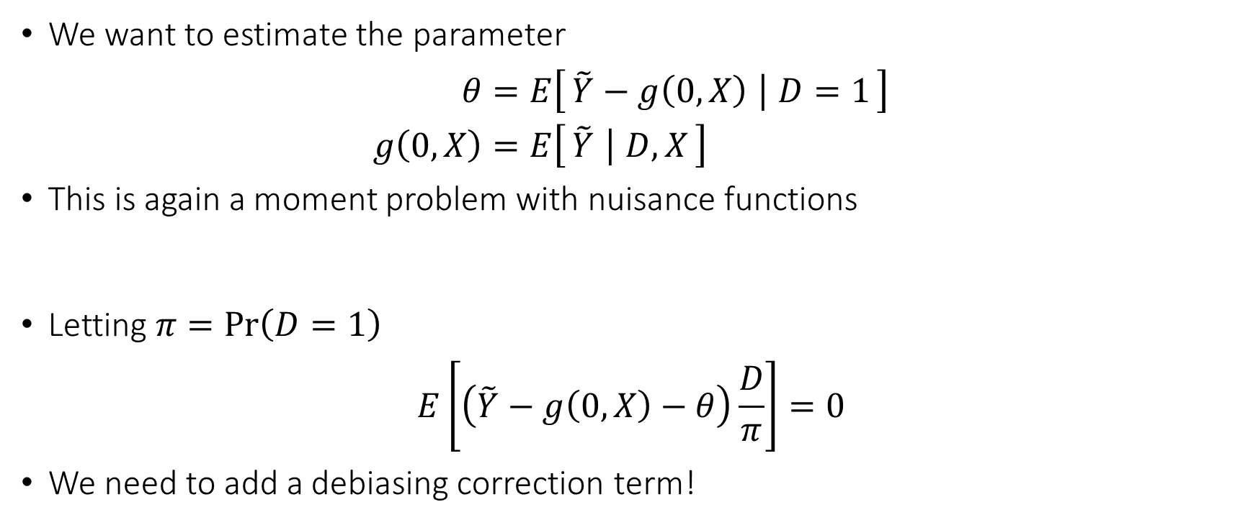
Debiased ML Estimation
We want to estimate the parameter
$$\begin{aligned}θ=&E\left[\tilde{Y}−g\left(0,X\right) ∣ D=1\right] \\ g\left(0,X\right)=&E\left[\tilde{Y} ∣ D,X\right]\end{aligned}$$
This is again a moment problem with nuisance functions
Letting $π=\operatorname{Pr}\left(D=1\right)$
$$E\left[\left(\tilde{Y}−g\left(0,X\right)−θ\right)\frac{D}{π}\right]=0$$
We need to add a debiasing correction term!

Slide 16
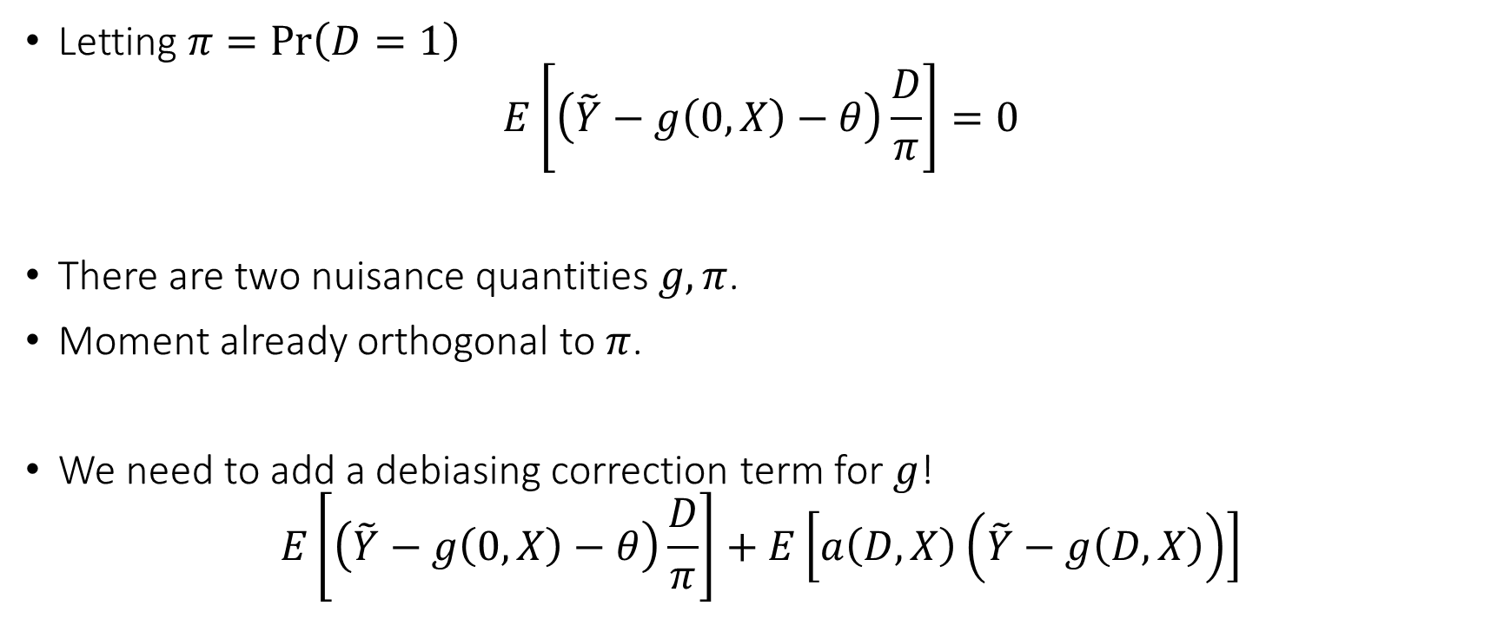
Debiased ML for ATT
Letting $π=\operatorname{Pr}\left(D=1\right)$
$$E\left[\left(\tilde{Y}−g\left(0,X\right)−θ\right)\frac{D}{π}\right]=0$$
There are two nuisance quantities $g,π$.
Moment already orthogonal to $π$.
We need to add a debiasing correction term for $g$!
$$E\left[\left(\tilde{Y}−g\left(0,X\right)−θ\right)\frac{D}{π}\right]+E\left[a\left(D,X\right)\left(\tilde{Y}−g\left(D,X\right)\right)\right]$$

Slide 17
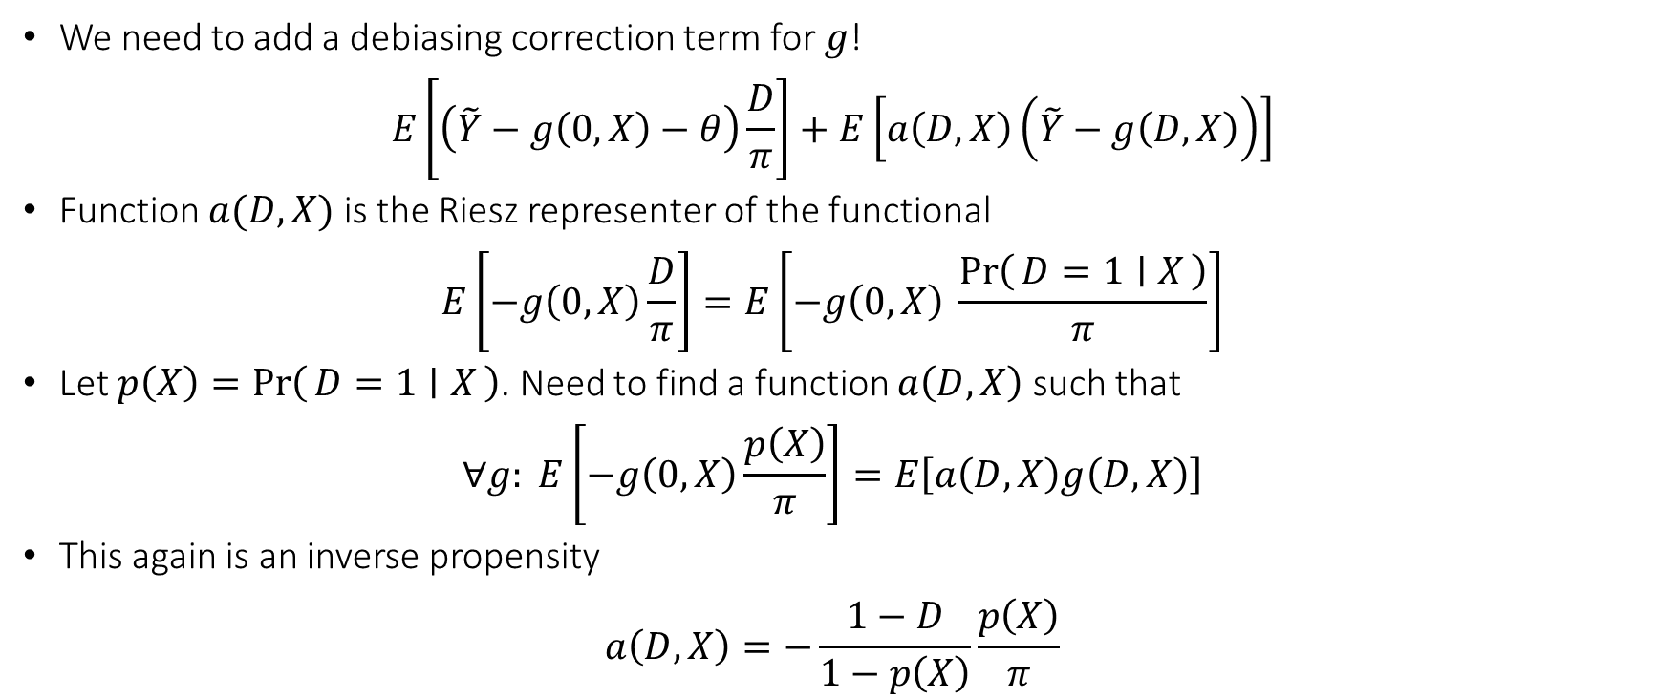
Debiased ML for ATT
We need to add a debiasing correction term for $g$!
$$E\left[\left(\tilde{Y}−g\left(0,X\right)−θ\right)\frac{D}{π}\right]+E\left[a\left(D,X\right)\left(\tilde{Y}−g\left(D,X\right)\right)\right]$$
Function $a(D,X)$ is the Riesz representer of the functional
$$E\left[−g\left(0,X\right)\frac{D}{π}\right]=E\left[−g\left(0,X\right) \frac{\operatorname{Pr}\left(D=1 ∣ X\right)}{π}\right]$$
Let $p\left(X\right)=\operatorname{Pr}\left(D=1 ∣ X\right)$. Need to find a function $a\left(D,X\right)$ such that
$$∀g: E\left[−g\left(0,X\right)\frac{p\left(X\right)}{π}\right]=E\left[a\left(D,X\right)g\left(D,X\right)\right]$$
This again is an inverse propensity
$$a\left(D,X\right)=−\frac{1−D}{1−p\left(X\right)}\frac{p\left(X\right)}{π}$$

Slide 18
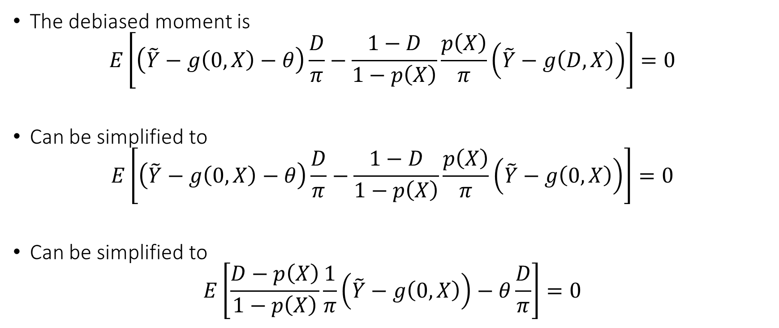
Debiased Moment
The debiased moment is
$$E\left[\left(\tilde{Y}−g\left(0,X\right)−θ\right)\frac{D}{π}−\frac{1−D}{1−p\left(X\right)}\frac{p\left(X\right)}{π}\left(\tilde{Y}−g\left(D,X\right)\right)\right]=0$$
Can be simplified to
$$E\left[\left(\tilde{Y}−g\left(0,X\right)−θ\right)\frac{D}{π}−\frac{1−D}{1−p\left(X\right)}\frac{p\left(X\right)}{π}\left(\tilde{Y}−g\left(0,X\right)\right)\right]=0$$
Can be simplified to
$$E\left[\frac{D−p\left(X\right)}{1−p\left(X\right)}\frac{1}{π}\left(\tilde{Y}−g\left(0,X\right)\right)−θ\frac{D}{π}\right]=0$$

Slide 19
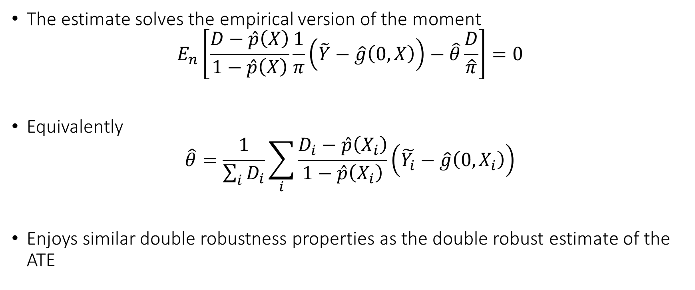
Doubly Robust Estimate
The estimate solves the empirical version of the moment
$$E_{n}\left[\frac{D−\hat{p}\left(X\right)}{1−\hat{p}\left(X\right)}\frac{1}{π}\left(\tilde{Y}−\hat{g}\left(0,X\right)\right)−\hat{θ}\frac{D}{\hat{π}}\right]=0$$
Equivalently
$$\hat{θ}=\frac{1}{\sum_{i}{D_{i}}}\sum_{i}{\frac{D_{i}−\hat{p}\left(X_{i}\right)}{1−\hat{p}\left(X_{i}\right)}\left(\tilde{Y_{i}}−\hat{g}\left(0,X_{i}\right)\right)}$$
Enjoys similar double robustness properties as the double robust estimate of the ATE

Slide 20
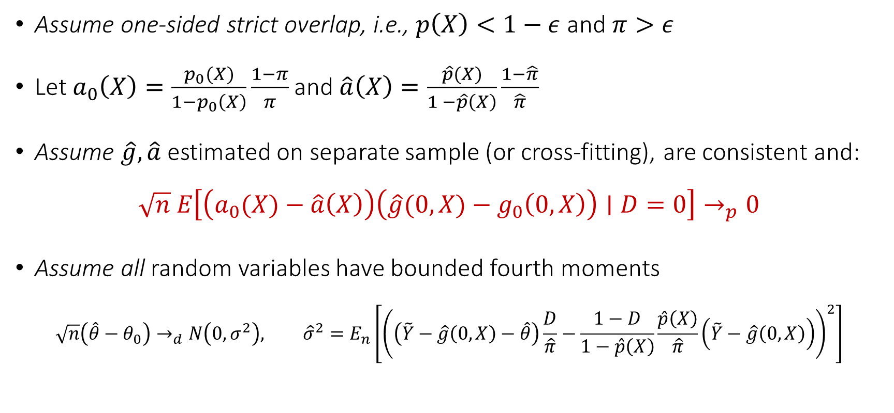
Asymptotic Normality of De-biased Estimate
Assume one-sided strict overlap, i.e., $p\left(X\right)<1−ε$ and $π>ε$
Let $a_{0}\left(X\right)=\frac{p_{0}(X)}{1−p_{0}\left(X\right)}\frac{1−π}{π}$ and $\hat{a}\left(X\right)=\frac{\hat{p}(X)}{1 −\hat{p}\left(X\right)}\frac{1−\hat{π}}{\hat{π}}$
Assume $\hat{g},\hat{a}$ estimated on separate sample (or cross-fitting), are consistent and:
$$\sqrt{n} E\left[\left(a_{0}(X)−\hat{a}\left(X\right)\right)\left(\hat{g}(0,X)−g_{0}\left(0,X\right)\right)∣D=0\right]→_{p}0$$
Assume all random variables have bounded fourth moments
$$\sqrt{n}\left(\hat{θ}−θ_{0}\right)→_{d}N\left(0,σ^{2}\right), {\hat{σ}}^{2}=E_{n}\left[{\left(\left(\tilde{Y}−\hat{g}\left(0,X\right)−\hat{θ}\right)\frac{D}{\hat{π}}−\frac{1−D}{1−\hat{p}\left(X\right)}\frac{\hat{p}\left(X\right)}{\hat{π}}\left(\tilde{Y}−\hat{g}\left(0,X\right)\right)\right)}^{2}\right]$$

Slide 21
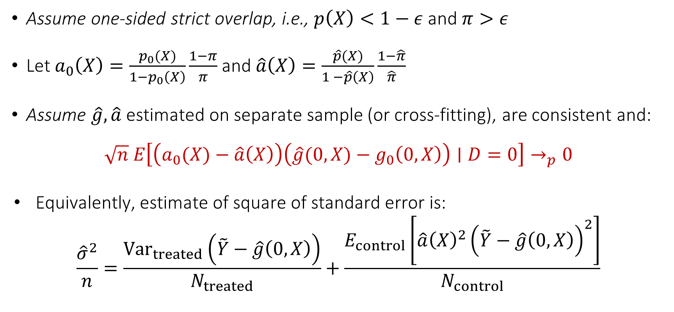
Asymptotic Normality of De-biased Estimate
Assume one-sided strict overlap, i.e., $p\left(X\right)<1−ε$ and $π>ε$
Let $a_{0}\left(X\right)=\frac{p_{0}(X)}{1−p_{0}\left(X\right)}\frac{1−π}{π}$ and $\hat{a}\left(X\right)=\frac{\hat{p}(X)}{1 −\hat{p}\left(X\right)}\frac{1−\hat{π}}{\hat{π}}$
Assume $\hat{g},\hat{a}$ estimated on separate sample (or cross-fitting), are consistent and:
$$\sqrt{n} E\left[\left(a_{0}(X)−\hat{a}\left(X\right)\right)\left(\hat{g}(0,X)−g_{0}\left(0,X\right)\right)∣D=0\right]→_{p}0$$
Equivalently, estimate of square of standard error is:
$$\frac{{\hat{σ}}^{2}}{n}=\frac{{Var}_{treated}\left(\tilde{Y}−\hat{g}\left(0,X\right)\right)}{N_{treated}}+\frac{E_{control}\left[\hat{a}{\left(X\right)}^{2}{\left(\tilde{Y}−\hat{g}\left(0,X\right)\right)}^{2}\right]}{N_{control}}$$

Slide 22
Data with Multiple Periods
If we have data with multiple periods where different units were treated at different periods then it is an active area of research
Typical empirical practice is what is known as two-way-fixed-effects
Can be problematic when there is heterogeneity of the effect across periods and cannot incorporate relaxed conditional parallel trends

Slide 23
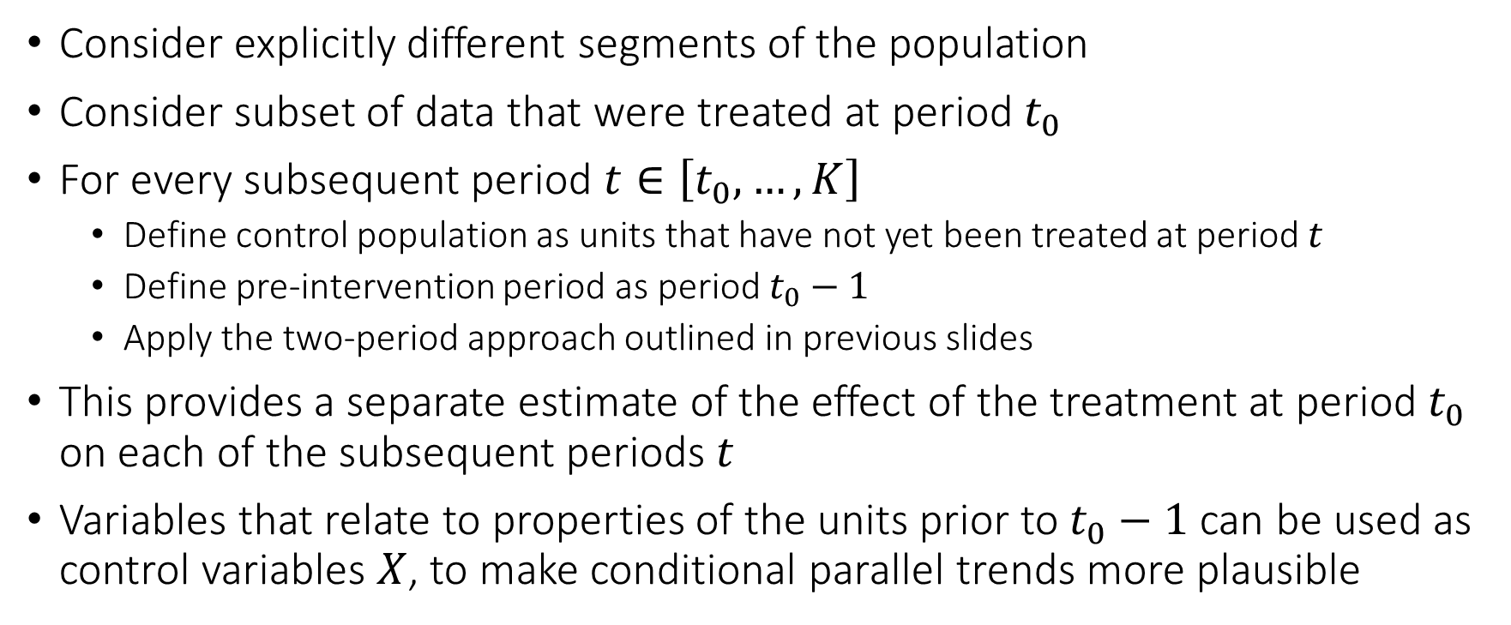
One Approach
Consider explicitly different segments of the population
Consider subset of data that were treated at period $t_{0}$
For every subsequent period $t∈\left[t_{0},…,K\right]$
Define control population as units that have not yet been treated at period $t$
Define pre-intervention period as period $t_{0}−1$
Apply the two-period approach outlined in previous slides
This provides a separate estimate of the effect of the treatment at period $t_{0}$ on each of the subsequent periods $t$
Variables that relate to properties of the units prior to $t_{0}−1$ can be used as control variables $X$, to make conditional parallel trends more plausible

Slide 24
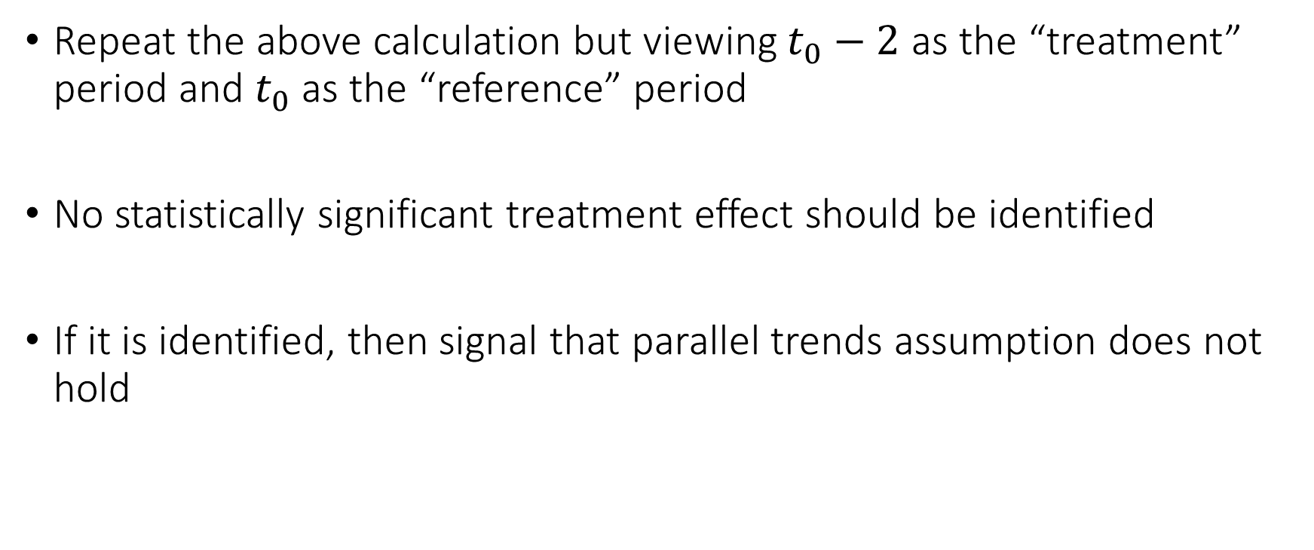
Sanity Checks: Pre-Trends
Repeat the above calculation but viewing $t_{0}−2$ as the “treatment” period and $t_{0}$ as the “reference” period
No statistically significant treatment effect should be identified
If it is identified, then signal that parallel trends assumption does not hold

Slide 25
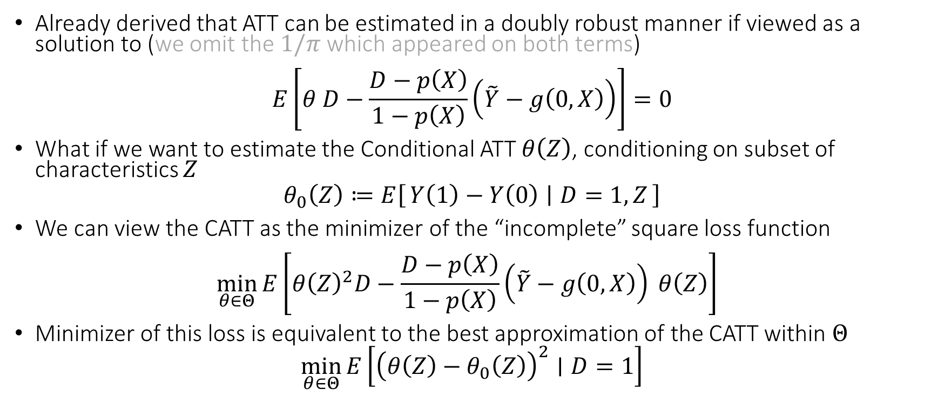
Heterogeneous Effects on the Treated
Already derived that ATT can be estimated in a doubly robust manner if viewed as a solution to (we omit the $1/π$ which appeared on both terms)
$$E\left[θ D−\frac{D−p\left(X\right)}{1−p\left(X\right)}\left(\tilde{Y}−g\left(0,X\right)\right)\right]=0$$
What if we want to estimate the Conditional ATT $θ\left(Z\right)$, conditioning on subset of characteristics $Z$
$$θ_{0}\left(Z\right)≔E\left[Y\left(1\right)−Y\left(0\right) ∣ D=1, Z\right]$$
We can view the CATT as the minimizer of the “incomplete” square loss function
$$\min_{θ∈Θ}{E\left[θ{\left(Z\right)}^{2}D−\frac{D−p\left(X\right)}{1−p\left(X\right)}\left(\tilde{Y}−g\left(0,X\right)\right) θ\left(Z\right)\right] }$$
Minimizer of this loss is equivalent to the best approximation of the CATT within $Θ$
$$\min_{θ∈Θ}{E\left[{\left(θ\left(Z\right)−θ_{0}\left(Z\right)\right)}^{2}∣D=1\right]}$$
[2502.04699] A Meta-learner for Heterogeneous Effects in Difference-in-Differences

Slide 26
Longitudinal Data
Longitudinal data refer to datasets where we have multiple observations of the same unit over time
They present a separate set of new problems
Correlation: samples stemming from each unit (or sometimes cluster of units from the same “site”) are correlated
Censoring/Missingness: units typically drop out at (potentially not) random times before the end of the study
Dynamic treatments: units are treated with multiple treatments over time in a manner that is adaptive and auto-correlated

Slide 27
Dynamic Treatment Regime

Slide 28
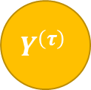
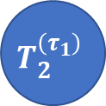




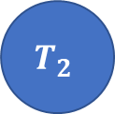

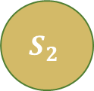
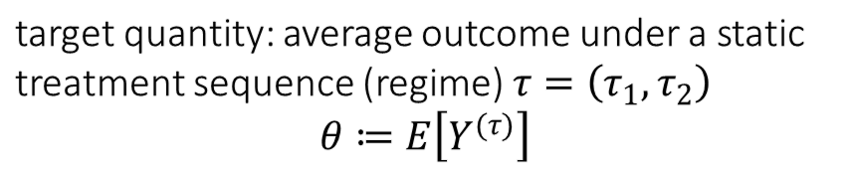

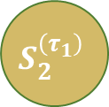

Dynamic Treatment Regime
target quantity: average outcome under a static treatment sequence (regime) $τ=\left(τ_{1},τ_{2}\right)$
$$θ≔E\left[Y^{(τ)}\right]$$
observed data (panel)
$$T_{1}$$
$$T_{2}$$
$$T_{1}$$
$$T_{2}^{\left(τ_{1}\right)}$$
$$τ_{1}$$
$$τ_{2}$$
$$S_{1}$$
$$S_{2}$$
$$Y$$
$$S_{1}$$
$$S_{2}^{\left(τ_{1}\right)}$$
$$Y^{\left(τ\right)}$$
Treatments are offered in an adaptive manner, in response to previous period controls
The surrogate – control feedback precludes viewing this as a one-shot treatment problem
Setting is known as the dynamic treatment regime [Robins’94,’04, Chakraborty-Murphy’14]

Slide 29


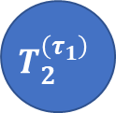

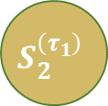
Examples
Healthcare: Patients treated over time and adaptively
observed data (panel)
target quantity
First Line Therapy
Second Line Therapy
$$T_{1}$$
$$T_{2}^{\left(τ_{1}\right)}$$
Immunotherapy
Chemotherapy
Progression+
Genomics
Genomics
Survival
$$S_{1}$$
$$S_{2}^{\left(τ_{1}\right)}$$
$$Y^{\left(τ\right)}$$

Slide 30
Examples
Digital Marketing: Web users shown ads multiple times
observed data (panel)
target quantity
Ad Impression
Ad Impression
$$T_{1}$$
$$T_{2}^{\left(τ_{1}\right)}$$
No impression
No impression
Tracking Data
Tracking Data
Conversion
$$S_{1}$$
$$S_{2}^{\left(τ_{1}\right)}$$
$$Y^{\left(τ\right)}$$

Slide 31





Examples
Business-to-Business (B2B) Operations: Customers offered multiple discount/support interventions over time
observed data (panel)
target quantity
Azure Credits
Sales Specialist
$$T_{1}$$
$$T_{2}^{\left(τ_{1}\right)}$$
No credits
Yes Specialist
Purchase History
Purchase History
Spend
$$S_{1}$$
$$S_{2}^{\left(τ_{1}\right)}$$
$$Y^{\left(τ\right)}$$

Slide 32
Identification in the Dynamic Treatment Regime

Slide 33
Dynamic Treatment Regime
target quantity: average outcome under a static treatment sequence (regime) $τ=\left(τ_{1},τ_{2}\right)$
$$θ≔E\left[Y^{(τ)}\right]$$
observed data (panel)
$$T_{1}$$
$$T_{2}$$
$$T_{1}$$
$$T_{2}^{\left(τ_{1}\right)}$$
$$τ_{1}$$
$$τ_{2}$$
$$S_{1}$$
$$S_{2}$$
$$Y$$
$$S_{1}$$
$$S_{2}^{\left(τ_{1}\right)}$$
$$Y^{\left(τ\right)}$$
Treatments are offered in an adaptive manner, in response to previous period controls
The surrogate – control feedback precludes viewing this as a one-shot treatment problem
Setting is known as the dynamic treatment regime [Robins’94,’04, Chakraborty-Murphy’14]

Slide 34
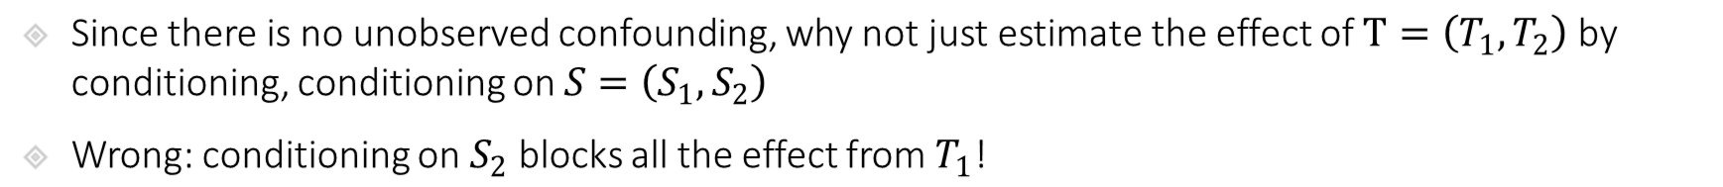
Identification in Dynamic Treatment Regime
target quantity: average outcome under a static treatment sequence (regime) $τ=\left(τ_{1},τ_{2}\right)$
$$θ≔E\left[Y^{(τ)}\right]$$
observed data (panel)
$$T_{1}$$
$$T_{2}$$
$$T_{1}$$
$$T_{2}^{\left(τ_{1}\right)}$$
$$τ_{1}$$
$$τ_{2}$$
$$S_{1}$$
$$S_{2}$$
$$Y$$
$$S_{1}$$
$$S_{2}^{\left(τ_{1}\right)}$$
$$Y^{\left(τ\right)}$$
Since there is no unobserved confounding, why not just estimate the effect of $T=\left(T_{1},T_{2}\right)$ by conditioning, conditioning on $S=\left(S_{1},S_{2}\right)$
Wrong: conditioning on $S_{2}$ blocks all the effect from $T_{1}$!

Slide 35
Identification in Dynamic Treatment Regime
target quantity: average outcome under a static treatment sequence (regime) $τ=\left(τ_{1},τ_{2}\right)$
$$θ≔E\left[Y^{(τ)}\right]$$
observed data (panel)
$$T_{1}$$
$$T_{2}$$
$$T_{1}$$
$$T_{2}^{\left(τ_{1}\right)}$$
$$τ_{1}$$
$$τ_{2}$$
$$S_{1}$$
$$S_{2}$$
$$Y$$
$$S_{1}$$
$$S_{2}^{\left(τ_{1}\right)}$$
$$Y^{\left(τ\right)}$$
Since there is no unobserved confounding, why not just estimate the effect of $T=\left(T_{1},T_{2}\right)$ by conditioning, conditioning on $S=\left(S_{1},S_{2}\right)$
Wrong: conditioning on $S_{2}$ blocks all the effect from $T_{1}$!

Slide 36
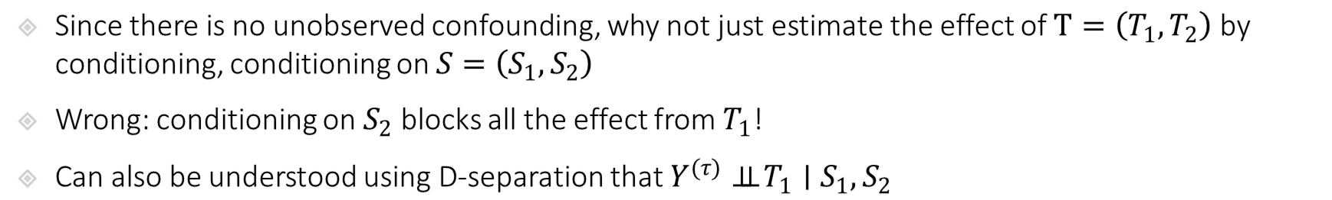
Identification in Dynamic Treatment Regime
target quantity: average outcome under a static treatment sequence (regime) $τ=\left(τ_{1},τ_{2}\right)$
$$θ≔E\left[Y^{(τ)}\right]$$
observed data (panel)
$$T_{1}$$
$$T_{2}$$
$$T_{1}$$
$$T_{2}^{\left(τ_{1}\right)}$$
$$τ_{1}$$
$$τ_{2}$$
$$S_{1}$$
$$S_{2}$$
$$Y$$
$$S_{1}$$
$$S_{2}^{\left(τ_{1}\right)}$$
$$Y^{\left(τ\right)}$$
Since there is no unobserved confounding, why not just estimate the effect of $T=\left(T_{1},T_{2}\right)$ by conditioning, conditioning on $S=\left(S_{1},S_{2}\right)$
Wrong: conditioning on $S_{2}$ blocks all the effect from $T_{1}$!
Can also be understood using D-separation that $Y^{(τ)}⊥⊥ T_{1}∣S_{1},S_{2}$

Slide 37
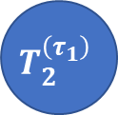



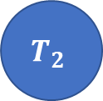

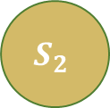
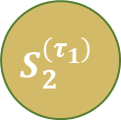

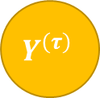

Identification in Dynamic Treatment Regime
$$T_{1}$$
$$τ_{1}$$
$$T_{2}^{\left(τ_{1}\right)}$$
$$τ_{2}$$
Intervention World
$$S_{1}$$
$$S_{2}^{\left(τ_{1}\right)}$$
$$Y^{\left(τ\right)}$$
Two-World Graphs
$$ε_{S_{2}}$$
$$T_{2}$$
Observed World
$$S_{2}$$
$$Y$$
Since there is no unobserved confounding, why not just estimate the effect of $T=\left(T_{1},T_{2}\right)$ by conditioning, conditioning on $S=\left(S_{1},S_{2}\right)$
Wrong: conditioning on $S_{2}$ blocks all the effect from $T_{1}$!
Can also be understood using D-separation that $Y^{(τ)}⊥⊥ T_{1}∣S_{1},S_{2}$

Slide 38

Identification in Dynamic Treatment Regime
target quantity: average outcome under a static treatment sequence (regime) $τ=\left(τ_{1},τ_{2}\right)$
$$θ≔E\left[Y^{(τ)}\right]$$
observed data (panel)
$$T_{1}$$
$$T_{2}$$
$$T_{1}$$
$$T_{2}^{\left(τ_{1}\right)}$$
$$τ_{1}$$
$$τ_{2}$$
$$S_{1}$$
$$S_{2}$$
$$Y$$
$$S_{1}$$
$$S_{2}^{\left(τ_{1}\right)}$$
$$Y^{\left(τ\right)}$$
Then let’s condition only on $S_{1}$, i.e. estimate the effect of $T=\left(T_{1},T_{2}\right)$ by conditioning, conditioning on $S_{1}$
Wrong: conditioning only on $S_{1}$ leaves “unobserved confounding” between $T_{2}$ and $Y$!

Slide 39
Identification in Dynamic Treatment Regime
target quantity: average outcome under a static treatment sequence (regime) $τ=\left(τ_{1},τ_{2}\right)$
$$θ≔E\left[Y^{(τ)}\right]$$
observed data (panel)
$$T_{1}$$
$$T_{2}$$
$$T_{1}$$
$$T_{2}^{\left(τ_{1}\right)}$$
$$τ_{1}$$
$$τ_{2}$$
$$S_{1}$$
$$S_{2}$$
$$Y$$
$$S_{1}$$
$$S_{2}^{\left(τ_{1}\right)}$$
$$Y^{\left(τ\right)}$$
Then let’s condition only on $S_{1}$, i.e. estimate the effect of $T=\left(T_{1},T_{2}\right)$ by conditioning, conditioning on $S_{1}$
Wrong: conditioning only on $S_{1}$ leaves “unobserved confounding” between $T_{2}$ and $Y$!

Slide 40
Identification in Dynamic Treatment Regime
target quantity: average outcome under a static treatment sequence (regime) $τ=\left(τ_{1},τ_{2}\right)$
$$θ≔E\left[Y^{(τ)}\right]$$
observed data (panel)
$$T_{1}$$
$$T_{2}$$
$$T_{1}$$
$$T_{2}^{\left(τ_{1}\right)}$$
$$τ_{1}$$
$$τ_{2}$$
$$S_{1}$$
$$S_{2}$$
$$Y$$
$$S_{1}$$
$$S_{2}^{\left(τ_{1}\right)}$$
$$Y^{\left(τ\right)}$$
Then let’s condition only on $S_{1}$, i.e. estimate the effect of $T=\left(T_{1},T_{2}\right)$ by conditioning, conditioning on $S_{1}$
Wrong: conditioning only on $S_{1}$ leaves “unobserved confounding” between $T_{2}$ and $Y$!

Slide 41
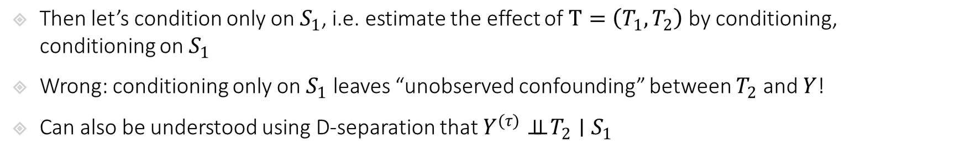
Identification in Dynamic Treatment Regime
$$T_{1}$$
$$τ_{1}$$
$$T_{2}^{\left(τ_{1}\right)}$$
$$τ_{2}$$
Intervention World
$$S_{1}$$
$$S_{2}^{\left(τ_{1}\right)}$$
$$Y^{\left(τ\right)}$$
Two-World Graphs
$$ε_{S_{2}}$$
$$T_{2}$$
Observed World
$$S_{2}$$
$$Y$$
Then let’s condition only on $S_{1}$, i.e. estimate the effect of $T=\left(T_{1},T_{2}\right)$ by conditioning, conditioning on $S_{1}$
Wrong: conditioning only on $S_{1}$ leaves “unobserved confounding” between $T_{2}$ and $Y$!
Can also be understood using D-separation that $Y^{(τ)}⊥⊥ T_{2}∣S_{1}$

Slide 42
Dynamic Treatment Regime
target quantity: average outcome under a static treatment sequence (regime) $τ=\left(τ_{1},τ_{2}\right)$
$$θ≔E\left[Y^{(τ)}\right]$$
observed data (panel)
$$T_{1}$$
$$T_{2}$$
$$T_{1}$$
$$T_{2}^{\left(τ_{1}\right)}$$
$$τ_{1}$$
$$τ_{2}$$
$$S_{1}$$
$$S_{2}$$
$$Y$$
$$S_{1}$$
$$S_{2}^{\left(τ_{1}\right)}$$
$$Y^{\left(τ\right)}$$
We cannot identify this expected potential outcome simply by conditioning!
Let’s take it one step at a time
What can we identify by conditioning?

Slide 43
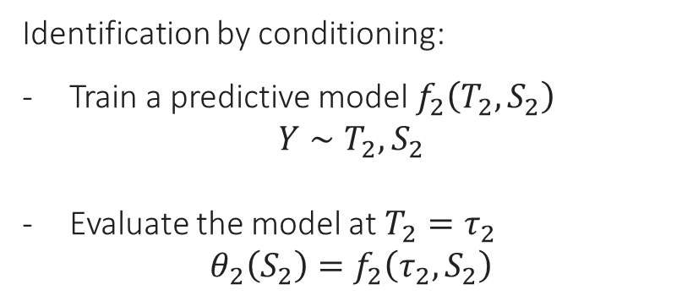
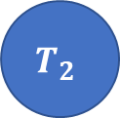



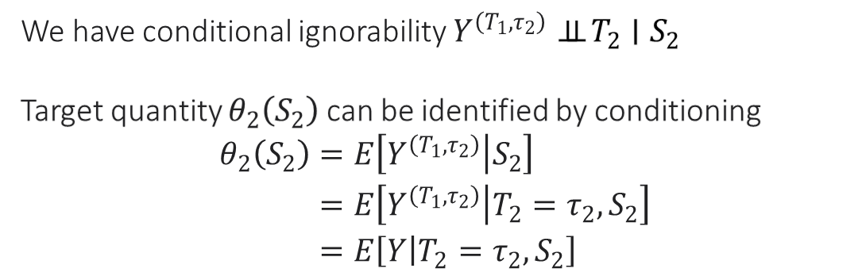
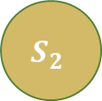
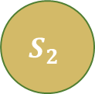

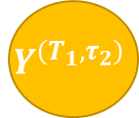



Identification of Last Period Intervention
target quantity: $θ_{2}\left(S_{2}\right)≔E\left[Y^{(T_{1},τ_{2})}|S_{2}\right]$
$$T_{1}$$
$$T_{2}$$
$$T_{1}$$
$$T_{2}$$
$$τ_{2}$$
$$S_{1}$$
$$S_{2}$$
$$Y$$
$$S_{1}$$
$$S_{2}$$
$$Y^{\left(T_{1},τ_{2}\right)}$$
We have conditional ignorability $Y^{\left(T_{1},τ_{2}\right)}⊥⊥ T_{2}∣S_{2}$
Target quantity $θ_{2}\left(S_{2}\right)$ can be identified by conditioning
$$\begin{aligned}θ_{2}\left(S_{2}\right)=&E\left[Y^{\left(T_{1},τ_{2}\right)} | S_{2}\right] \\ =&E\left[Y^{\left(T_{1},τ_{2}\right)} | T_{2}=τ_{2},S_{2}\right] \\ =&E\left[Y | T_{2}=τ_{2},S_{2}\right]\end{aligned}$$
Identification by conditioning:
Train a predictive model $f_{2}\left(T_{2},S_{2}\right)$
$$Y∼T_{2},S_{2}$$
Evaluate the model at $T_{2}=τ_{2}$
$$θ_{2}\left(S_{2}\right)=f_{2}\left(τ_{2},S_{2}\right)$$

Slide 44





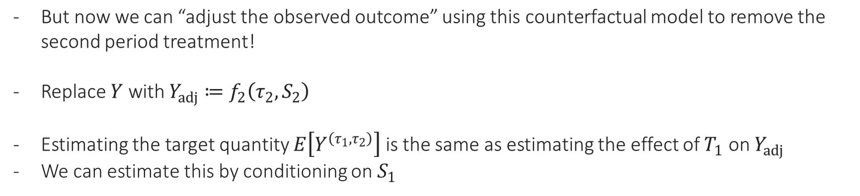


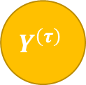



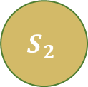

Identification via Backwards Recursion
$$T_{1}$$
$$T_{1}$$
$$T_{2}^{\left(τ_{1}\right)}$$
$$T_{2}$$
$$τ_{2}$$
$$τ_{1}$$
$$τ_{2}$$
$$S_{1}$$
$$S_{2}$$
$$Y^{adj}$$
$$S_{1}$$
$$S_{2}^{\left(τ_{1}\right)}$$
$$Y^{\left(τ\right)}$$
But now we can “adjust the observed outcome” using this counterfactual model to remove the second period treatment!
Replace $Y$ with $Y_{adj}≔f_{2}\left(τ_{2},S_{2}\right)$
Estimating the target quantity $E\left[Y^{\left(τ_{1},τ_{2}\right)}\right]$ is the same as estimating the effect of $T_{1}$ on $Y_{adj}$
We can estimate this by conditioning on $S_{1}$

Slide 45



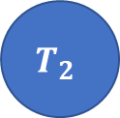

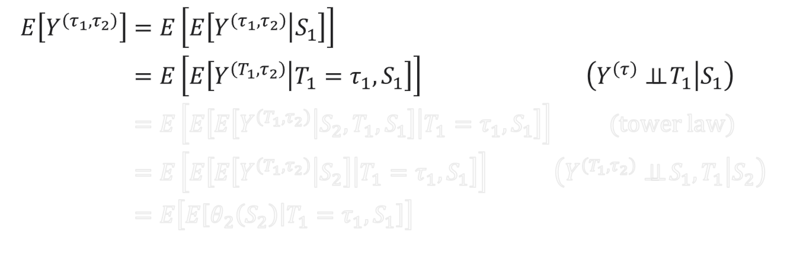




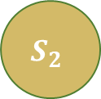
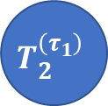
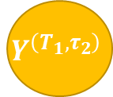

Identification via Backwards Recursion
$$T_{1}$$
$$T_{2}$$
$$T_{1}$$
$$T_{2}^{\left(τ_{1}\right)}$$
$$τ_{1}$$
$$τ_{2}$$
$$S_{1}$$
$$S_{2}$$
$$Y$$
$$S_{1}$$
$$S_{2}^{\left(τ_{1}\right)}$$
$$Y^{\left(τ\right)}$$
$$\begin{aligned}E\left[Y^{\left(τ_{1},τ_{2}\right)}\right]=&E\left[E\left[Y^{\left(τ_{1},τ_{2}\right)} | S_{1}\right]\right]& \\ =&E\left[E\left[Y^{\left(T_{1},τ_{2}\right)} | T_{1}=τ_{1},S_{1}\right]\right]&\left(Y^{\left(τ\right)}⊥⊥ T_{1} | S_{1}\right) \\ =&E\left[E\left[E\left[Y^{\left(T_{1},τ_{2}\right)} | S_{2},T_{1},S_{1}\right] | T_{1}=τ_{1},S_{1}\right]\right]& (tower law) \\ =&E\left[E\left[E\left[Y^{\left(T_{1},τ_{2}\right)} | S_{2}\right] | T_{1}=τ_{1},S_{1}\right]\right]&\left(Y^{\left(T_{1},τ_{2}\right)}⊥⊥ S_{1},T_{1} | S_{2}\right) \\ =&E\left[E\left[θ_{2}\left(S_{2}\right) | T_{1}=τ_{1},S_{1}\right]\right] \\ &\end{aligned}$$
$$T_{1}$$
$$T_{2}$$
$$τ_{2}$$
$$S_{1}$$
$$S_{2}$$
$$Y^{\left(T_{1},τ_{2}\right)}$$

Slide 46
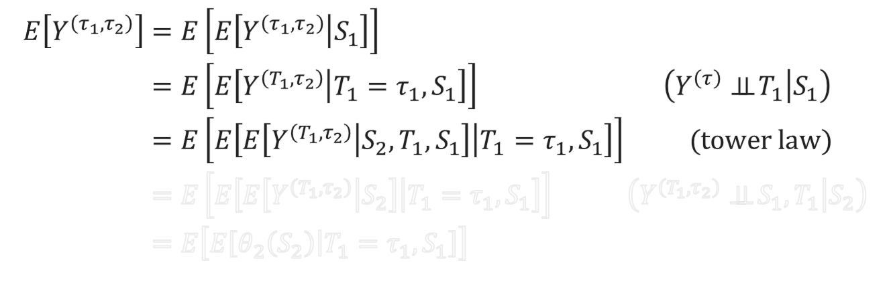
Identification via Backwards Recursion
$$T_{1}$$
$$T_{2}$$
$$T_{1}$$
$$T_{2}^{\left(τ_{1}\right)}$$
$$τ_{1}$$
$$τ_{2}$$
$$S_{1}$$
$$S_{2}$$
$$Y$$
$$S_{1}$$
$$S_{2}^{\left(τ_{1}\right)}$$
$$Y^{\left(τ\right)}$$
$$\begin{aligned}E\left[Y^{\left(τ_{1},τ_{2}\right)}\right]=&E\left[E\left[Y^{\left(τ_{1},τ_{2}\right)} | S_{1}\right]\right]& \\ =&E\left[E\left[Y^{\left(T_{1},τ_{2}\right)} | T_{1}=τ_{1},S_{1}\right]\right]&\left(Y^{\left(τ\right)}⊥⊥ T_{1} | S_{1}\right) \\ =&E\left[E\left[E\left[Y^{\left(T_{1},τ_{2}\right)} | S_{2},T_{1},S_{1}\right] | T_{1}=τ_{1},S_{1}\right]\right]& (tower law) \\ =&E\left[E\left[E\left[Y^{\left(T_{1},τ_{2}\right)} | S_{2}\right] | T_{1}=τ_{1},S_{1}\right]\right]&\left(Y^{\left(T_{1},τ_{2}\right)}⊥⊥ S_{1},T_{1} | S_{2}\right) \\ =&E\left[E\left[θ_{2}\left(S_{2}\right) | T_{1}=τ_{1},S_{1}\right]\right] \\ &\end{aligned}$$
$$T_{1}$$
$$T_{2}$$
$$τ_{2}$$
$$S_{1}$$
$$S_{2}$$
$$Y^{\left(T_{1},τ_{2}\right)}$$

Slide 47



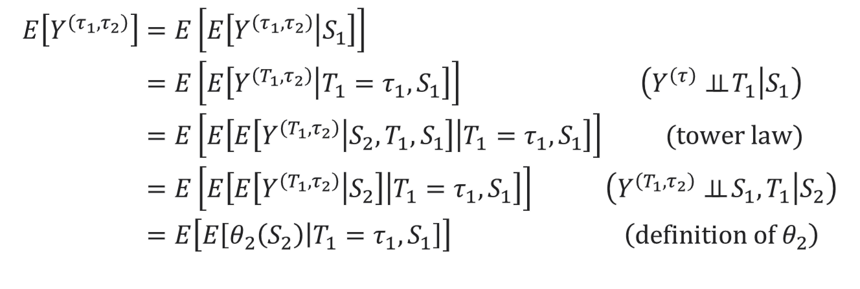



Identification via Backwards Recursion
$$T_{1}$$
$$T_{2}$$
$$T_{1}$$
$$T_{2}^{\left(τ_{1}\right)}$$
$$τ_{1}$$
$$τ_{2}$$
$$S_{1}$$
$$S_{2}$$
$$Y$$
$$S_{1}$$
$$S_{2}^{\left(τ_{1}\right)}$$
$$Y^{\left(τ\right)}$$
$$\begin{aligned}E\left[Y^{\left(τ_{1},τ_{2}\right)}\right]=&E\left[E\left[Y^{\left(τ_{1},τ_{2}\right)} | S_{1}\right]\right]& \\ =&E\left[E\left[Y^{\left(T_{1},τ_{2}\right)} | T_{1}=τ_{1},S_{1}\right]\right]&\left(Y^{\left(τ\right)}⊥⊥ T_{1} | S_{1}\right) \\ =&E\left[E\left[E\left[Y^{\left(T_{1},τ_{2}\right)} | S_{2},T_{1},S_{1}\right] | T_{1}=τ_{1},S_{1}\right]\right]& (tower law) \\ =&E\left[E\left[E\left[Y^{\left(T_{1},τ_{2}\right)} | S_{2}\right] | T_{1}=τ_{1},S_{1}\right]\right]&\left(Y^{\left(T_{1},τ_{2}\right)}⊥⊥ S_{1},T_{1} | S_{2}\right) \\ =&E\left[E\left[θ_{2}\left(S_{2}\right) | T_{1}=τ_{1},S_{1}\right]\right]&\left(definition of θ_{2}\right) \\ &\end{aligned}$$
$$T_{1}$$
$$T_{2}$$
$$τ_{2}$$
$$S_{1}$$
$$S_{2}$$
$$Y^{\left(T_{1},τ_{2}\right)}$$

Slide 48














Identification Process
observed data (panel)
$$T_{1}$$
$$T_{2}$$
Estimate predictive model $f_{2}$: $Y∼T_{2},S_{2}$
Adjust outcome for second period treatment
$$Y_{adj}←f_{2}\left(τ_{2},S_{2}\right)$$
Estimate predictive model $f_{1}:Y_{adj}\sim T_{1},S_{1}$
Adjust outcome for first period treatment
$$Y_{adj}←f_{1}\left(τ_{1},S_{1}\right)$$
Return target quantity: $θ=E\left[Y_{adj}\right]$
$$S_{1}$$
$$S_{2}$$
$$Y$$
target quantity: average outcome under a static treatment sequence (regime) $τ=\left(τ_{1},τ_{2}\right)$
$$θ≔E\left[Y^{(τ)}\right]$$
$$T_{1}$$
$$T_{2}^{\left(τ_{1}\right)}$$
$$τ_{1}$$
$$τ_{2}$$
$$S_{1}$$
$$S_{2}^{\left(τ_{1}\right)}$$
$$Y^{\left(τ\right)}$$

Slide 49















Moment Based Framework
observed data (panel)
$$T_{1}$$
$$T_{2}$$
$$S_{1}$$
$$S_{2}$$
$$Y$$
$$\begin{aligned}θ=&E\left[f_{1}\left(τ_{1},S_{1}\right)\right] \\ \\ f_{1}\left(T_{1},S_{1}\right)≔&E\left[f_{2}\left(τ_{2},S_{2}\right) | T_{1},S_{1}\right] \\ f_{2}\left(T_{2},S_{2}\right)≔&E\left[Y | T_{2},S_{2}\right]\end{aligned}$$
target quantity: average outcome under a static treatment sequence (regime) $τ=\left(τ_{1},τ_{2}\right)$
$$θ≔E\left[Y^{(τ)}\right]$$
$$T_{1}$$
$$T_{2}^{\left(τ_{1}\right)}$$
$$τ_{1}$$
$$τ_{2}$$
These set of equations (and their generalization to many periods) are known as the $g$-formula
$$S_{1}$$
$$S_{2}^{\left(τ_{1}\right)}$$
$$Y^{\left(τ\right)}$$

Slide 50
Estimation in the Dynamic Treatment Regime

Slide 51


G-computation
observed data (panel)
$$T_{1}$$
$$T_{2}$$
Moment function: $m\left(Z;θ,f\right)$
$$S_{1}$$
$$S_{2}$$
$$Y$$
$$\begin{aligned}E\left[θ−f_{1}\left(τ_{1},S_{1}\right)\right]=0 \\ \\ f_{1}\left(T_{1},S_{1}\right)≔&E\left[f_{2}\left(τ_{2},S_{2}\right) | T_{1},S_{1}\right] \\ f_{2}\left(T_{2},S_{2}\right)≔&E\left[Y | T_{2},S_{2}\right]\end{aligned}$$
target quantity: average outcome under a static treatment sequence (regime) $τ=\left(τ_{1},τ_{2}\right)$
$$θ≔E\left[Y^{(τ)}\right]$$
$$T_{1}$$
$$T_{2}^{\left(τ_{1}\right)}$$
$$τ_{1}$$
$$τ_{2}$$
Nuisance functions
Using parametric models to estimate these functions (e.g. linear or logistic regression) and plug them in the formula is known as the “parametric g computation”
$$S_{1}$$
$$S_{2}^{\left(τ_{1}\right)}$$
$$Y^{\left(τ\right)}$$

Slide 52



ML Based Estimation
observed data (panel)
$$T_{1}$$
$$T_{2}$$
Moment function: $m\left(Z;θ,f\right)$
$$S_{1}$$
$$S_{2}$$
$$Y$$
$$\begin{aligned}E\left[θ−\&f_{1}\left(τ_{1},S_{1}\right)\right]=0 \\ \\ f_{1}\left(T_{1},S_{1}\right)≔&E\left[f_{2}\left(τ_{2},S_{2}\right) | T_{1},S_{1}\right] \\ f_{2}\left(T_{2},S_{2}\right)≔&E\left[Y | T_{2},S_{2}\right]\end{aligned}$$
target quantity: average outcome under a static treatment sequence (regime) $τ=\left(τ_{1},τ_{2}\right)$
$$θ≔E\left[Y^{(τ)}\right]$$
$$T_{1}$$
$$T_{2}^{\left(τ_{1}\right)}$$
$$τ_{1}$$
$$τ_{2}$$
If we use ML for these predictive problems, then we wont be able to construct confidence intervals for $θ$ because moment is not Neyman orthogonal
We can apply the Inverse Propensity based debiasing idea
$$S_{1}$$
$$S_{2}^{\left(τ_{1}\right)}$$
$$Y^{\left(τ\right)}$$

Slide 53



Debiasing Moments and Neyman Orthogonality
Residual of the Regression Problem that defines nuisance function $f_{1}$
Original moment
Inverse Propensity
$$\begin{aligned}E\left[θ−\&f_{1}\left(τ_{1},S_{1}\right)+\frac{1\left\{T_{1}=τ_{1}\right\}}{\operatorname{Pr}\left(T_{1}=τ_{1} | S_{1}\right)}\left(f_{2}\left(τ_{2},S_{2}\right)−f_{1}\left(T_{1},S_{1}\right)\right)\right]=0 \\ \\ f_{1}\left(T_{1},S_{1}\right)≔&E\left[f_{2}\left(τ_{2},S_{2}\right) | T_{1},S_{1}\right] \\ f_{2}\left(T_{2},S_{2}\right)≔&E\left[Y | T_{2},S_{2}\right]\end{aligned}$$
Debiasing correction for nuisance function $f_{1}$
Nuisance functions

Slide 54
Debiasing Moments and Neyman Orthogonality
We are still left with this nuisance, that we have not “debiased”
Original moment
$$\begin{aligned}E\left[θ−\&f_{1}\left(τ_{1},S_{1}\right)+\frac{1\left\{T_{1}=τ_{1}\right\}}{\operatorname{Pr}\left(T_{1}=τ_{1} | S_{1}\right)}\left(f_{2}\left(τ_{2},S_{2}\right)−f_{1}\left(T_{1},S_{1}\right)\right)\right]=0 \\ \\ f_{1}\left(T_{1},S_{1}\right)≔&E\left[f_{2}\left(τ_{2},S_{2}\right) | T_{1},S_{1}\right] \\ f_{2}\left(T_{2},S_{2}\right)≔&E\left[Y | T_{2},S_{2}\right]\end{aligned}$$
Debiasing correction for nuisance function $f_{1}$
Nuisance functions

Slide 55


Debiasing Moments and Neyman Orthogonality
We are still left with this nuisance, that we have not “debiased”
Original moment
$$E\left[θ−f_{1}\left(τ_{1},S_{1}\right)+\frac{1\left\{T_{1}=τ_{1}\right\}}{\operatorname{Pr}\left(T_{1}=τ_{1} | S_{1}\right)}\left(f_{2}\left(τ_{2},S_{2}\right)−f_{1}\left(T_{1},S_{1}\right)\right)\right]=0$$
$$+\frac{1\left\{T_{1}=τ_{1}\right\}}{\operatorname{Pr}\left(T_{1}=τ_{1} | S_{1}\right)}\frac{1\left\{T_{2}=τ_{2}\right\}}{\operatorname{Pr}\left(T_{2}=τ_{2} | S_{2}\right)}\left(y−f_{2}\left(T_{2},S_{2}\right)\right)$$
$$f_{1}\left(T_{1},S_{1}\right)≔E\left[f_{2}\left(τ_{2},S_{2}\right) | T_{1},S_{1}\right]$$
Debiasing correction for nuisance function $f_{2}$
$$f_{2}\left(T_{2},S_{2}\right)≔E\left[Y | T_{2},S_{2}\right]$$
Nuisance functions

Slide 56



Debiasing Moments and Neyman Orthogonality
We are still left with this nuisance, that we have not “debiased”
Original moment
$$E\left[θ−f_{1}\left(τ_{1},S_{1}\right)+\frac{1\left\{T_{1}=τ_{1}\right\}}{\operatorname{Pr}\left(T_{1}=τ_{1} | S_{1}\right)}\left(f_{2}\left(τ_{2},S_{2}\right)−f_{1}\left(T_{1},S_{1}\right)\right)\right]=0$$
IPS term already multiplying $f_{2}$
$$+\frac{1\left\{T_{1}=τ_{1}\right\}}{\operatorname{Pr}\left(T_{1}=τ_{1} | S_{1}\right)}\frac{1\left\{T_{2}=τ_{2}\right\}}{\operatorname{Pr}\left(T_{2}=τ_{2} | S_{2}\right)}\left(y−f_{2}\left(T_{2},S_{2}\right)\right)$$
Residual of the regression problem that defines $f_{2}$
New IPS term for second period treatment introduced to transform
$$f_{2}\left(T_{2},S_{2}\right)→f_{2}\left(τ_{2},S_{2}\right)$$
$$f_{1}\left(T_{1},S_{1}\right)≔E\left[f_{2}\left(τ_{2},S_{2}\right) | T_{1},S_{1}\right]$$
$$f_{2}\left(T_{2},S_{2}\right)≔E\left[Y | T_{2},S_{2}\right]$$
Nuisance functions

Slide 57
Debiasing Moments and Neyman Orthogonality
Original moment
$$E\left[θ−f_{1}\left(τ_{1},S_{1}\right)+\frac{1\left\{T_{1}=τ_{1}\right\}}{\operatorname{Pr}\left(T_{1}=τ_{1} | S_{1}\right)}\left(f_{2}\left(τ_{2},S_{2}\right)−f_{1}\left(T_{1},S_{1}\right)\right)\right]=0$$
$$+\frac{1\left\{T_{1}=τ_{1}\right\}}{\operatorname{Pr}\left(T_{1}=τ_{1} | S_{1}\right)}\frac{1\left\{T_{2}=τ_{2}\right\}}{\operatorname{Pr}\left(T_{2}=τ_{2} | S_{2}\right)}\left(y−f_{2}\left(T_{2},S_{2}\right)\right)$$
$$f_{1}\left(T_{1},S_{1}\right)≔E\left[f_{2}\left(τ_{2},S_{2}\right) | T_{1},S_{1}\right]$$
This moment now satisfies Neyman orthogonality with respect to all the nuisance functions
We need to also estimate the propensity functions via generic ML classification
$$f_{2}\left(T_{2},S_{2}\right)≔E\left[Y | T_{2},S_{2}\right]$$
Nuisance functions

Slide 58
Continuous Treatments and Alternative Approach to Identification and Estimation

Slide 59
What if we have continuous treatments
The propensity based approach to de-biasing does not apply
What is the analogue of the “Residual-on-Residual” or “Partialling-Out” (FWL) approach for the dynamic treatment regime, which is also applicable to continuous treatments?

Slide 60

Identification via “Instantaneous” or “Blip” Effects
target quantity: $θ_{2}\left(S_{2}\right)≔E\left[Y^{(T_{1},τ_{2})}|S_{2}\right]$
$$T_{1}$$
$$T_{2}$$
$$T_{1}$$
$$T_{2}$$
$$τ_{2}$$
$$S_{1}$$
$$S_{2}$$
$$Y$$
$$S_{1}$$
$$S_{2}$$
$$Y^{\left(T_{1},τ_{2}\right)}$$
Instead of estimating the outcome $Y^{\left(T_{1},τ_{2}\right)}$, we will estimate the “effect” of $T_{2}$
$$α_{2}\left(τ_{2}, S_{2}\right)≔E\left[Y^{\left(T_{1},τ_{2}\right)}−Y^{\left(T_{1},0\right)} | S_{2}\right]$$
Adjust outcome by subtracting effect of observed treatment and adding effect of target treatment
$$Y_{adj}≔Y−α_{2}\left(T_{2},S_{2}\right)+α_{2}\left(τ_{2},S_{2}\right)$$

Slide 61

Identification via “Instantaneous” or “Blip” Effects
target quantity: $θ_{2}\left(S_{2}\right)≔E\left[Y^{(T_{1},τ_{2})}|S_{2}\right]$
$$T_{1}$$
$$T_{2}$$
$$T_{1}$$
$$T_{2}$$
$$τ_{2}$$
$$S_{1}$$
$$S_{2}$$
$$Y$$
$$S_{1}$$
$$S_{2}$$
$$Y^{\left(T_{1},τ_{2}\right)}$$
Instead of estimating the outcome $Y^{\left(T_{1},τ_{2}\right)}$, we will estimate the “effect” of $T_{2}$
$$α_{2}\left(τ_{2}, S_{2}\right)≔E\left[Y^{\left(T_{1},τ_{2}\right)}−Y^{\left(T_{1},0\right)} | S_{2}\right]$$
Adjust outcome by subtracting effect of observed treatment and adding effect of target treatment
$$Y_{adj}≔Y−α_{2}\left(T_{2},S_{2}\right)+α_{2}\left(τ_{2},S_{2}\right)$$
If “effect” is assumed to have a simple parametric form, then this approach leverages this simplicity!
Repeat in a backwards manner

Slide 62

Identification Process
observed data (panel)
$$T_{1}$$
$$T_{2}$$
Estimate the “effect” $α_{2}\left(τ_{2}, S_{2}\right)$
$$α_{2}\left(τ_{2}, S_{2}\right)≔E\left[Y^{\left(T_{1},τ_{2}\right)}−Y^{\left(T_{1},0\right)} | S_{2}\right]$$
Adjust outcome for second period treatment
$$Y_{adj}←Y−α_{2}\left(T_{2},S_{2}\right)+α_{2}\left(τ_{2},S_{2}\right)$$
Estimate the effect $α_{1}\left(τ_{1}, S_{1}\right)$
$$E\left[Y^{\left(τ_{1},τ_{2}\right)}−Y^{\left(0,τ_{2}\right)} | S_{1}\right]≈E\left[Y_{adj}^{\left(τ_{1}\right)}−Y_{adj}^{\left(0\right)} ∣ S_{1}\right]$$
Adjust outcome for first period treatment
$$Y_{adj}←Y_{adj}−α_{1}\left(T_{1},S_{1}\right)+α_{1}\left(τ_{1},S_{1}\right)$$
Return target quantity: $θ=E\left[Y_{adj}\right]$
$$S_{1}$$
$$S_{2}$$
$$Y$$
target quantity: average outcome under a static treatment sequence (regime) $τ=\left(τ_{1},τ_{2}\right)$
$$θ≔E\left[Y^{(τ)}\right]$$
$$T_{1}$$
$$T_{2}^{\left(τ_{1}\right)}$$
$$τ_{1}$$
$$τ_{2}$$
$$S_{1}$$
$$S_{2}^{\left(τ_{1}\right)}$$
$$Y^{\left(τ\right)}$$

Slide 63

Partial Linearity: Linear Effects
observed data (panel)
$$T_{1}$$
$$T_{2}$$
If we assume that these effects are partially linear:
$$a_{2}\left(τ_{2},S_{2}\right)=δ_{2}τ_{2}$$
$$a_{1}\left(τ_{1},S_{1}\right)≔δ_{1}τ_{1}$$
$$S_{1}$$
$$S_{2}$$
$$Y$$
target quantity: average outcome under a static treatment sequence (regime) $τ=\left(τ_{1},τ_{2}\right)$
$$θ≔E\left[Y^{(τ)}\right]$$
$$T_{1}$$
$$T_{2}^{\left(τ_{1}\right)}$$
$$τ_{1}$$
$$τ_{2}$$
$$S_{1}$$
$$S_{2}^{\left(τ_{1}\right)}$$
$$Y^{\left(τ\right)}$$

Slide 64

Identification Process
observed data (panel)
$$T_{1}$$
$$T_{2}$$
If we assume that these effects are partially linear:
$$a_{2}\left(τ_{2},S_{2}\right)=δ_{2}τ_{2}$$
$$a_{1}\left(τ_{1},S_{1}\right)≔δ_{1}τ_{1}$$
We can estimate these effects via partialling out!
$$S_{1}$$
$$S_{2}$$
$$Y$$
$$T_{1}$$
$$T_{2}^{\left(τ_{1}\right)}$$
$$τ_{1}$$
$$τ_{2}$$
$$S_{1}$$
$$S_{2}^{\left(τ_{1}\right)}$$
$$Y^{\left(τ\right)}$$

Slide 65

Dynamic DML (Partialling Out)
observed data (panel)
$$T_{1}$$
$$T_{2}$$
Construct residuals
$${\tilde{Y}}_{2}≔Y−E\left[Y | S_{2}\right], {\tilde{T}}_{2}=T_{2}−E\left[T_{2} ∣ S_{2}\right]$$
Run OLS: ${\tilde{Y}}_{2}∼{\tilde{T}}_{2}$ to estimate $δ_{2}$
Adjust outcome $Y_{adj}=Y−δ_{2}T_{2}+δ_{2}τ_{2}$
Construct residuals:
$${\tilde{Y}}_{1}≔Y_{adj}−E\left[Y_{adj} | S_{1}\right], {\tilde{T}}_{1}≔T_{1}−E\left[T_{1} | S_{1}\right]$$
Run OLS: ${\tilde{Y}}_{1}∼{\tilde{T}}_{1}$ to estimate $δ_{1}$
Adjust outcome $Y_{adj}←Y_{adj}−δ_{1}T_{1}+δ_{1}τ_{1}$
Return: $θ≔E\left[Y_{adj}\right]$
$$S_{1}$$
$$S_{2}$$
$$Y$$
$$T_{1}$$
$$T_{2}^{\left(τ_{1}\right)}$$
$$τ_{1}$$
$$τ_{2}$$
$$S_{1}$$
$$S_{2}^{\left(τ_{1}\right)}$$
$$Y^{\left(τ\right)}$$

Slide 66


Moment Based Framework
observed data (panel)
$$T_{1}$$
$$T_{2}$$
$$S_{1}$$
$$S_{2}$$
$$Y$$
$$\begin{aligned}θ≔E\left[Y−δ_{2}T_{2}+δ_{2}τ_{2}−δ_{1}T_{1}+δ_{1}τ_{1}\right]=0 \\ \\ E\left[\left({\tilde{Y}}_{2}−δ_{2}{\tilde{T}}_{2}\right){\tilde{T}}_{2}\right]=0 \\ E\left[\left({\tilde{Y}}_{1}−δ_{1}{\tilde{T}}_{1}\right){\tilde{T}}_{1}\right]=0\end{aligned}$$
$$T_{1}$$
$$T_{2}^{\left(τ_{1}\right)}$$
$$τ_{1}$$
$$τ_{2}$$
$$E\left[Y | S_{2}\right], E\left[T_{2} | S_{2}\right]$$
$$E\left[Y−δ_{2}T_{2}+δ_{2}τ_{2} | S_{1}\right], E\left[T_{1} | S_{1}\right]$$
$$S_{1}$$
$$S_{2}^{\left(τ_{1}\right)}$$
$$Y^{\left(τ\right)}$$
Nuisance functions

Slide 67

Moment Based Framework
observed data (panel)
$$T_{1}$$
$$T_{2}$$
$$S_{1}$$
$$S_{2}$$
$$Y$$
$$\begin{aligned}θ≔E\left[Y−δ_{2}T_{2}+δ_{2}τ_{2}−δ_{1}T_{1}+δ_{1}τ_{1}\right]=0 \\ \\ E\left[\left({\tilde{Y}}_{2}−δ_{2}{\tilde{T}}_{2}\right){\tilde{T}}_{2}\right]=0 \\ E\left[\left({\tilde{Y}}_{1}−δ_{1}{\tilde{T}}_{1}\right){\tilde{T}}_{1}\right]=0\end{aligned}$$
$$T_{1}$$
$$T_{2}^{\left(τ_{1}\right)}$$
$$E\left[Y | S_{2}\right], E\left[T_{2} | S_{2}\right]$$
$$E\left[Y−δ_{2}T_{2}+δ_{2}τ_{2} | S_{1}\right], E\left[T_{1} | S_{1}\right]$$
$$τ_{1}$$
$$τ_{2}$$
For the same reason why the Residual-on-Residual moment was Neyman orthogonal, this estimation process is also orthogonal and we can use ML for these problems
$$S_{1}$$
$$S_{2}^{\left(τ_{1}\right)}$$
$$Y^{\left(τ\right)}$$

Slide 68
An Application from Operations Management
Return on Investment at Microsoft

Slide 69

Estimating Long-Term Returns on Investment
Companies frequently deploys new discount or customer support programs
Which of these programs (“investments”) are more successful than others?
Success is a long-term objective: what is the effect of the program on the two-year customer journey (e.g., effect on two-year revenue)
We cannot wait two years to evaluate a program
Main Question. Can we construct estimates of the values of these programs with short-term data, e.g. after 6 months?

Slide 70




Long-Term Effects from Short-Term Surrogates
Suppose that there are many short-term signals $S$ that are indicative of a customer’s long-term reward $Y$ (e.g. the next 6-month purchase patterns of a customer could be indicative of their long-term spend)
Suppose that investment program $T$ affects long-term rewards if and only if it affects these short-term signals
We will call these short-term signals $S$ surrogates
$T$
$S$
$Y$

Slide 71










Causal Inference with Surrogates 101
(Prentice, 1989; Begg & Leung, 2000; Frangakis & Rubin, 2002; Freedman et al., 1992; Athey et al., 2020)
Since long-term effect goes only through surrogates:
expected effect on long-term reward = effect on projected long-term reward based on surrogates
$$E\left[Y^{\left(τ\right)}\right]=E\left[Y^{\left(τ\right)} | T=τ\right]=E\left[Y | T=τ\right]=E\left[E\left[Y | T=τ, S\right] | T=τ\right]=E\left[E\left[Y | S\right]\right|T=τ]$$
Average reward if intervene and set investment$=τ$
Independence in counterfactual graph
Average reward of samples that received investment=$τ$ in data
Tower Law of Expectations
Forecasted reward from surrogates
$S^{\left(τ\right)}$
$Y^{\left(τ\right)}$
$$T$$
$$τ$$
$T$
$S$
$Y$

Slide 72










Causal Inference with Surrogates 101
historical/long-term (O)
recent/short-term (E)
Contains long-term $Y$ and surrogates $S$
Relationship between $Y$ and $S$ the same as in short-term dataset ($E$)
$$T$$
$$T$$
$$S$$
$$Y$$
$$S$$
$$Y$$
$$g\left(S\right)=E_{o}\left[Y | S\right]$$
Estimate $g\left(S\right)≔E\left[Y | S\right]$ (surrogate index) from ($O$) by regressing $Y∼S$
Impute expected long-term outcomes in (E)
Regress $g\left(S\right)∼T$ to estimate effect of $T$ on $Y$ from (E)

Slide 73





Causal Inference with Surrogates 101
historical/long-term (O)
recent/short-term (E)
Contains long-term $Y$ and surrogates $S$
Relationship between $Y$ and $S$ the same as in short-term dataset ($E$)
$$T$$
$$T$$
$$S_{0}$$
$$S$$
$$Y$$
$$S_{0}$$
$$S$$
$$Y$$
U
$$g\left(S\right)=E_{o}\left[Y | S\right]$$
No un-measured confounders
Estimate $g\left(S\right)≔E\left[Y | S\right]$ (surrogate index) from ($O$) by regressing $Y∼S$
Impute expected long-term outcomes in (E)
Regress $g\left(S\right)∼T$to estimate effect of $T$ on $Y$ from (E)

Slide 74


Key Assumptions
Long-term effect only goes through surrogates
Expected relationship between surrogates and long-term reward is the same long-term setting ($O$) and in short-term setting ($E$)

Slide 75






Key Assumptions can be Easily Violated Investment policies are dynamic and change
historical/long-term (O)
recent/short-term (E)
$$T_{1}$$
$$T_{2}$$
$$T_{1}^{new}$$
$$S$$
$$Y$$
$$S$$
$$Y$$
We deployed older/deprecated investments
In a potentially long-term highly auto-correlated manner
Investments are potentially adaptive
Investment policies change

Slide 76

Bias of Vanilla Surrogate
Illustrative Example

Slide 77












Illustrative Example
Available in O
Want the effect of $T_{1}$ on $Y$, with no future treatments
Available in E
$$T_{2}=κT_{1}+λS+noise$$
$$T_{1}$$
$$T_{2}$$
$$α$$
$$λ$$
$$α_{2}$$
$$S$$
$$Y$$
$$S=αT_{1}+noise$$
$$β$$
$$Y=α_{2}T_{2}+βS+noise$$

Slide 78







Bias of Vanilla Surrogate
What do we want to estimate?
$$Y=β α T_{1}+α_{2} T_{2}+noise$$
$$≔$$
$$θ_{0}$$
$$T_{2}=κT_{1}+λS+noise$$
$$T_{1}$$
$$κ$$
$$T_{2}$$
$$α$$
$$λ$$
$$α_{2}$$
$$S$$
$$Y$$
$$S=αT_{1}+noise$$
$$β$$
$$Y=α_{2}T_{2}+βS+noise$$

Slide 79


Bias of Vanilla Surrogate
What do we want to estimate?
$$Y=β α T_{1}+α_{2} T_{2}+noise$$
What does the surrogate approach estimate?
$$g_{0}\left(S\right)≔E\left[Y | S\right]=β S+α_{2} E\left[T_{2} | S\right]$$
$$≔$$
$$θ_{0}$$
$$T_{2}=κT_{1}+λS+noise$$
$$T_{1}$$
$$κ$$
$$T_{2}$$
$$α$$
$$λ$$
$$α_{2}$$
$$κE\left[T_{1} | S\right]+λS$$
$$S$$
$$Y$$
$$S=αT_{1}+noise$$
$$β$$
$$Y=α_{2}T_{2}+βS+noise$$

Slide 80

Bias of Vanilla Surrogate
What do we want to estimate?
$$Y=β α T_{1}+α_{2} T_{2}+noise$$
What does the surrogate approach estimate?
$$g_{0}\left(S\right)≔E\left[Y | S\right]=β S+α_{2} E\left[T_{2} | S\right]$$
The effect of $T_{1}$ on $g_{0}\left(S\right)$ is:
$$θ_{∗}≔β α+α_{2} κ\frac{E\left[E\left[T_{1} | S\right]⋅T_{1}\right]}{E\left[T_{1}^{2}\right]}+α_{2} λ α$$
$$≔$$
$$θ_{0}$$
$$T_{2}=κT_{1}+λS+noise$$
$$T_{1}$$
$$κ$$
$$T_{2}$$
$$α$$
$$λ$$
$$α_{2}$$
$$κE\left[T_{1} | S\right]+λS$$
$$S$$
$$Y$$
$$S=αT_{1}+noise$$
$$β$$
$$Y=α_{2}T_{2}+βS+noise$$

Slide 81

Bias of Vanilla Surrogate
What do we want to estimate?
$$Y=β α T_{1}+α_{2} T_{2}+noise$$
What does the surrogate approach estimate?
$$g_{0}\left(S\right)≔E\left[Y | S\right]=β S+α_{2} E\left[T_{2} | S\right]$$
The effect of $T_{1}$ on $g_{0}\left(S\right)$ is:
$$θ_{∗}≔β α+α_{2} κ\frac{E\left[E\left[T_{1} | S\right]⋅T_{1}\right]}{E\left[T_{1}^{2}\right]}+α_{2} λ α$$
$$≔$$
$$θ_{0}$$
$$T_{2}=κT_{1}+λS+noise$$
$$T_{1}$$
$$κ$$
$$T_{2}$$
$$α$$
$$λ$$
$$α_{2}$$
$$κE\left[T_{1} | S\right]+λS$$
$$S$$
$$Y$$
$$S=αT_{1}+noise$$
$$β$$
$$Y=α_{2}T_{2}+βS+noise$$
Bias from the fact that policy is auto-correlated violating the “effect only through surrogates” assumption
Bias from the fact that policy is adaptive on past surrogates violating
“relationship of $S$ and $Y$ unchanged”
assumption

Slide 82
Prevalence of Such Violation
Marketing departments frequently deploy new marketing campaigns
In historical data, older campaigns were deployed
Due to targeting, if a customer received an ad, most probably will receive one in the future
Ad display is adaptive to signals of customer behavior
Pharmaceutical companies frequently deploy new drugs
Can we get estimates of long-term effect from short-term trials
Use short-term signals of patient response that correlated with long-term survival
In historical long-term clinical data, patients are treated with multiple treatments over time
Treatments are typically adaptive to signals of patient trajectory

Slide 83

Key Idea 1
Dynamic Adjustment of Surrogate Index
Battocchi, Dillon, Hei, Lewis, Oprescu, Syrgkanis, Estimating the Long-Term Effects of Novel Treatments, NeurIPS’21
https://arxiv.org/abs/2103.08390

Slide 84











Dynamically Adjusted Surrogate Index
historical/long-term (O)
recent/short-term (E)
$$T_{1}$$
$$T_{1}^{new}$$
$$T_{2}$$
$$0$$
$$S$$
$$Y^{\left(0_{2}\right)}$$
$$S$$
$$Y$$
$$g^{adj}\left(S\right)=E_{o}\left[Y^{\left(0_{2}\right)} | S\right]$$
$$=E_{o}\left[Y−γ\left(T_{2},S\right) | S\right]$$
Identification argument
“blip” effect of second treatment conditional on surrogate
effect of $T_{2}$ controlling for 𝑆

Slide 85

Illustrative Example: Dynamically Adjusted Index
Estimate effect $α_{2}$ of $T_{2}$ on $Y$, controlling for $S$
$$E\left[Y | T_{2},S\right]=α_{2}T_{2}+βS$$
$$T_{2}=κT_{1}+λS+noise$$
$$T_{1}$$
$$κ$$
$$T_{2}$$
$$α$$
$$λ$$
$$α_{2}$$
$$S$$
$$Y$$
$$S=αT_{1}+noise$$
$$β$$
$$Y=α_{2}T_{2}+βS+noise$$

Slide 86







Illustrative Example: Dynamically Adjusted Index
Estimate effect $α_{2}$ of $T_{2}$ on $Y$, controlling for $S$
$$E\left[Y | T_{2},S\right]=α_{2}T_{2}+βS$$
Subtract that effect to create the adjusted outcome
$$Y^{adj}≔Y−α_{2}T_{2}$$
$$T_{1}$$
$$κ$$
$$T_{2}$$
$$α$$
$$λ$$
$$α_{2}$$
$$S$$
$$Y^{adj}$$
$$S=αT_{1}+noise$$
$$β$$
$$Y^{adj}=βS+noise$$

Slide 87

Illustrative Example: Dynamically Adjusted Index
Estimate effect $α_{2}$ of $T_{2}$ on $Y$, controlling for $S$
$$E\left[Y | T_{2},S\right]=α_{2}T_{2}+βS$$
Subtract that effect to create the adjusted outcome
$$Y^{adj}≔Y−α_{2}T_{2}$$
Estimate dynamically adjusted index on long-term data
$$g_{0}^{adj}\left(S\right)≔E\left[Y^{adj} | S\right]=β S$$
$$T_{1}$$
$$κ$$
$$T_{2}$$
$$α$$
$$λ$$
$$α_{2}$$
$$S$$
$$Y^{adj}$$
$$S=αT_{1}+noise$$
$$β$$
$$Y^{adj}=βS+noise$$

Slide 88

Illustrative Example: Dynamically Adjusted Index
Estimate effect $α_{2}$ of $T_{2}$ on $Y$, controlling for $S$
$$E\left[Y | T_{2},S\right]=α_{2}T_{2}+βS$$
Subtract that effect to create the adjusted outcome
$$Y^{adj}≔Y−α_{2}T_{2}$$
Estimate dynamically adjusted index on long-term data
$$g_{0}^{adj}\left(S\right)≔E\left[Y^{adj} | S\right]=β S$$
Estimate effect of $T_{1}$ on $g_{0}^{adj}\left(S\right)$ on short-term data
$$θ_{0}≔\frac{E\left[g_{0}^{adj}\left(S\right)⋅T_{1}\right]}{E\left[T_{1}^{2}\right]}=β⋅α$$
$$T_{1}$$
$$κ$$
$$T_{2}$$
$$α$$
$$λ$$
$$α_{2}$$
$$S$$
$$Y^{adj}$$
$$S=αT_{1}+noise$$
$$β$$
$$Y^{adj}=βS+noise$$

Slide 89










Beyond Two Periods
historical/long-term (O)
recent/short-term (E)
$$T_{1}$$
$$T_{2}$$
$$T_{3}$$
$$T_{1}^{new}$$
$$S_{1}$$
$$Y$$
$$S_{0}$$
$$S_{1}$$
$$Y$$
Multiple treatments are offered after the surrogate variable
Easy: estimate their effect controlling for $S_{1}$
Wrong!

Slide 90


Beyond Two Periods
historical/long-term (O)
recent/short-term (E)
$$T_{1}$$
$$T_{2}$$
$$T_{3}$$
$$T_{1}^{new}$$
$$S_{1}$$
$$S_{2}$$
$$Y$$
$$S_{0}$$
$$S_{1}$$
$$Y$$
Treatments are offered in an adaptive manner, in response to previous period surrogate/state
The surrogate – treatment feedback precludes viewing this as a one-shot treatment problem
Setting is known as the dynamic treatment regime [Robins’94,’04, Chakraborty-Murphy’14]

Slide 91









Beyond Two Periods: Target Quantity
historical/long-term (O)
recent/short-term (E)
$$T_{1}$$
$$T_{1}^{new}$$
$$T_{2}$$
$$0$$
$$T_{3}$$
$$0$$
$$S_{1}$$
$$S_{2}^{\left(0_{≥2}\right)}$$
$$Y^{\left(0_{≥2}\right)}$$
$$S_{0}$$
$$S_{1}$$
$$Y$$
$$g^{adj}\left(S_{1}\right)=E_{o}\left[Y^{\left(0_{≥2}\right)} | S_{1}\right]$$
What effect do we subtract from $Y$?
Do we estimate effect of $T_{2},T_{3}$ controlling for $S_{1},S_{2}$? Wrong
Do we estimate effect of $T_{2},T_{3}$ controlling for $S_{1}$? Wrong
$$=E_{o}\left[\left.Y−\sum_{t≥2}{γ_{t}\left(T_{t},S_{t−1}\right)}\right|S_{1}\right]$$
“blip” effect of treatment at period $t$

