Slide 1
MS&E 228: Unobserved Confounding
Vasilis Syrgkanis
MS&E, Stanford

Slide 2
Causal Inference with Experiments
Prediction with Linear Models
Prediction with High-Dim Linear Models
Inference on Causal and Predictive Effects with High-Dim Linear Models
Potential Outcomes and Conditional Ignorability
Structural Equation Models and Conditional Exogeneity
Directed Acyclic Graphs
Prediction with Non-Linear Models
Inference on Causal Effects with Non-Linear Models
Un-observed Confounding and Instruments
Identification of Causal Effects in Longitudinal Data
Estimation of Heterogeneous Causal Effects
Linear Predictive Models and Statistical Inference
Causal Identification in Observational Data
Non-Linear Predictive Models and Statistical Inference
Topics

Slide 3
Causal Inference with Experiments
Prediction with Linear Models
Prediction with High-Dim Linear Models
Inference on Causal and Predictive Effects with High-Dim Linear Models
Potential Outcomes and Conditional Ignorability
Structural Equation Models and Conditional Exogeneity
Directed Acyclic Graphs
Prediction with Non-Linear Models
Inference on Causal Effects with Non-Linear Models
Un-observed Confounding and Instruments
Identification of Causal Effects in Longitudinal Data
Estimation of Heterogeneous Causal Effects
Linear Predictive Models and Statistical Inference
Causal Identification in Observational Data
Non-Linear Predictive Models and Statistical Inference
Topics

Slide 4
Goals for Today
What can we do when we have un-observed confounding
Omitted variable bias bounds
Introduction to “Instruments”

Slide 5





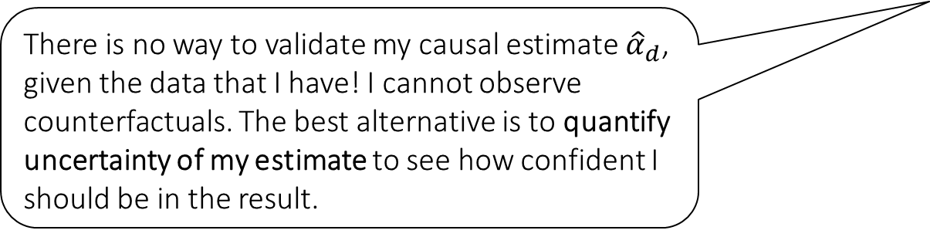



Causal Inference Pipeline
Data Collection
Estimation
(training)
Validation
(testing)
Domain Assumption Elicitation
Identification
Inference (Confidence Intervals)
DAGs/ASEMs
Construct estimate $\hat{g}\left(d,z\right)$ of predictive model
$$E\left[Y ∣ D=d,Z=z\right]$$
Estimate mean counterfactual
$${\hat{a}}_{d}=E_{n}\left[\hat{g}\left(d,Z\right)\right]$$
Theory
$$a_{d}$$
$$E\left[E\left[Y | D=d,Z\right]\right]$$
$$D$$
$$=$$
$$a_{d}∈{\hat{a}}_{d}±2\hat{σ}$$
$$Z$$
$$Y$$
There is no way to validate my causal estimate ${\hat{α}}_{d}$, given the data that I have! I cannot observe counterfactuals. The best alternative is to quantify uncertainty of my estimate to see how confident I should be in the result.
Sensitivity Analysis
Practice
$$a_{d}∈{\hat{a}}_{d}±(2\hat{σ}+ε)$$
Adaptive Experiments
Decision
Policy

Slide 6
Causal Inference Pipeline
Data Collection
Estimation
(training)
Validation
(testing)
Domain Assumption Elicitation
Identification
Inference (Confidence Intervals)
DAGs/ASEMs
Construct estimate $\hat{g}\left(d,z\right)$ of predictive model
$$E\left[Y ∣ D=d,Z=z\right]$$
Estimate mean counterfactual
$${\hat{a}}_{d}=E_{n}\left[\hat{g}\left(d,Z\right)\right]$$
Theory
$$a_{d}$$
$$E\left[E\left[Y | D=d,Z\right]\right]$$
$$D$$
$$=$$
$$a_{d}∈{\hat{a}}_{d}±2\hat{σ}$$
$$Z$$
$$Y$$
What if my conditional ignorability assumption was violated? How much would the estimate change?
Sensitivity Analysis
Practice
$$a_{d}∈{\hat{a}}_{d}±(2\hat{σ}+ε)$$
Adaptive Experiments
Decision
Policy

Slide 7
Causal Inference Pipeline
Data Collection
Estimation
(training)
Validation
(testing)
Domain Assumption Elicitation
Identification
Inference (Confidence Intervals)
DAGs/ASEMs
Construct estimate $\hat{g}\left(d,z\right)$ of predictive model
$$E\left[Y ∣ D=d,Z=z\right]$$
Estimate mean counterfactual
$${\hat{a}}_{d}=E_{n}\left[\hat{g}\left(d,Z\right)\right]$$
Theory
$$a_{d}$$
$$E\left[E\left[Y | D=d,Z\right]\right]$$
$$D$$
$$=$$
$$a_{d}∈{\hat{a}}_{d}±2\hat{σ}$$
$$Z$$
$$Y$$
Are there other ways of identifying the treatment effect I care about (other than identification by conditioning) when I have un-observed confounding?
Sensitivity Analysis
Practice
$$a_{d}∈{\hat{a}}_{d}±(2\hat{σ}+ε)$$
Adaptive Experiments
Decision
Policy

Slide 8
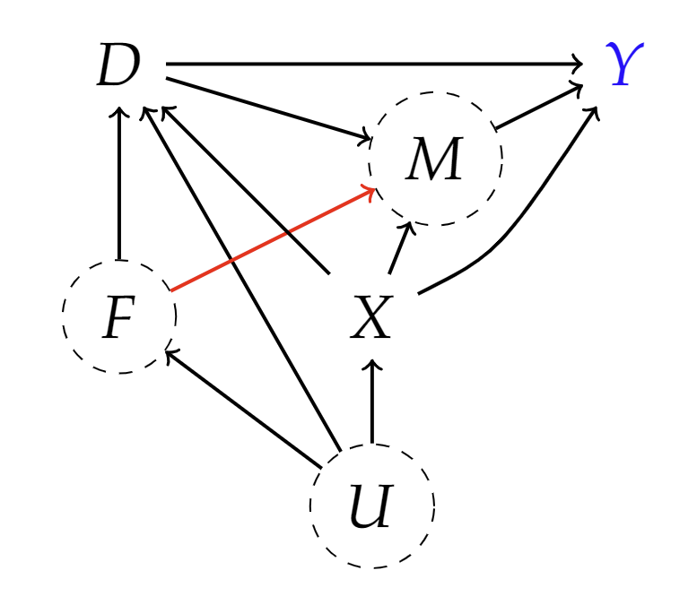
Possible Violations
F: firm characteristics
D: eligibility for 401k
Y: net financial assets
X: age, income, family size, years of education, a married indicator, a two-earner status indicator, a defined benefit pension status indicator, an IRA participation indicator, and a home ownership indicator
M: match amount

Slide 9
Unobserved Confounding: Overview of Today’s Content

Slide 10
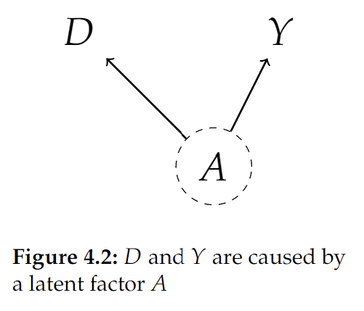
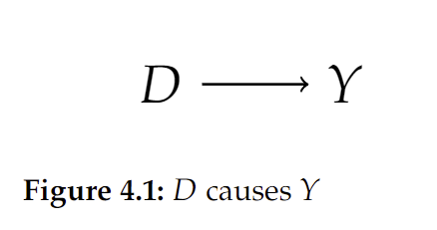
Unobserved Confounding
If there are confounding factors that are un-observed, we cannot distinguish between an effect and a spurious correlation, without further structure

Slide 11
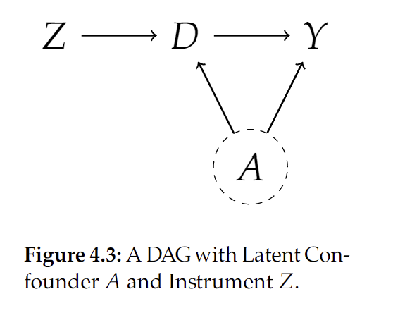
One Type of Structure: Instruments
We already saw one example of more structure in the assignments (which one?)
The structure we will investigate today are instruments

Slide 12
Bias Bounds

Slide 13

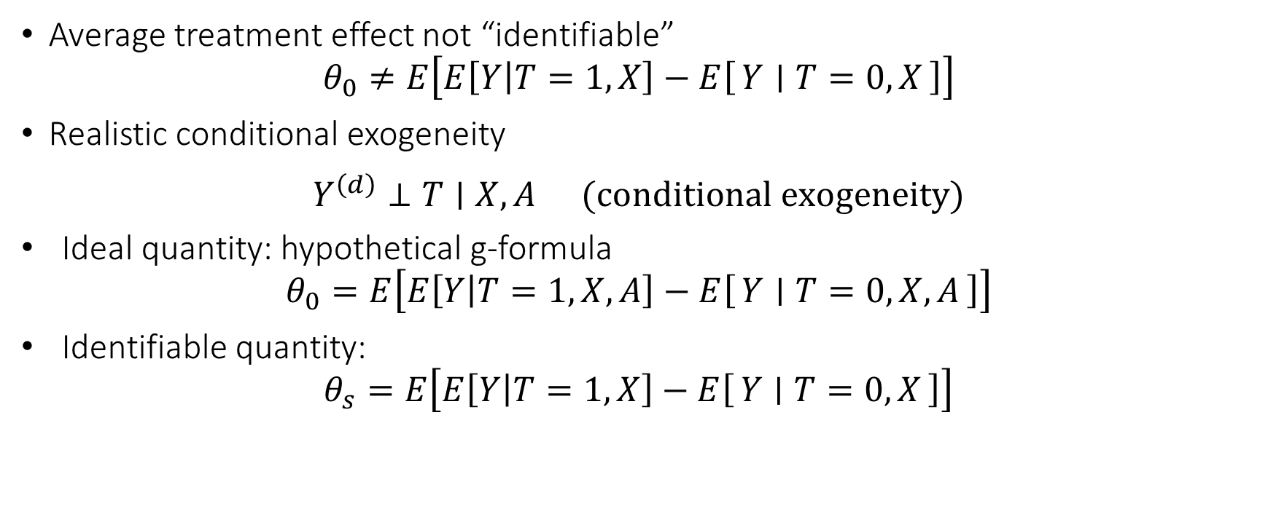


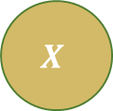
Very Frequently Unobserved Confounders
Average treatment effect not “identifiable”
$$θ_{0}≠E\left[E\left[Y | T=1,X\right]−E\left[Y ∣ T=0,X\right]\right]$$
Realistic conditional exogeneity
$$\begin{matrix}Y^{\left(d\right)}⊥T∣X,A & (conditional exogeneity)\end{matrix}$$
Ideal quantity: hypothetical g-formula
$$θ_{0}=E\left[E\left[Y | T=1,X,A\right]−E\left[Y ∣ T=0,X,A\right]\right]$$
Identifiable quantity:
$$θ_{s}=E\left[E\left[Y | T=1,X\right]−E\left[Y ∣ T=0,X\right]\right]$$
$$T$$
$$X$$
$$Y$$
$$A$$

Slide 14

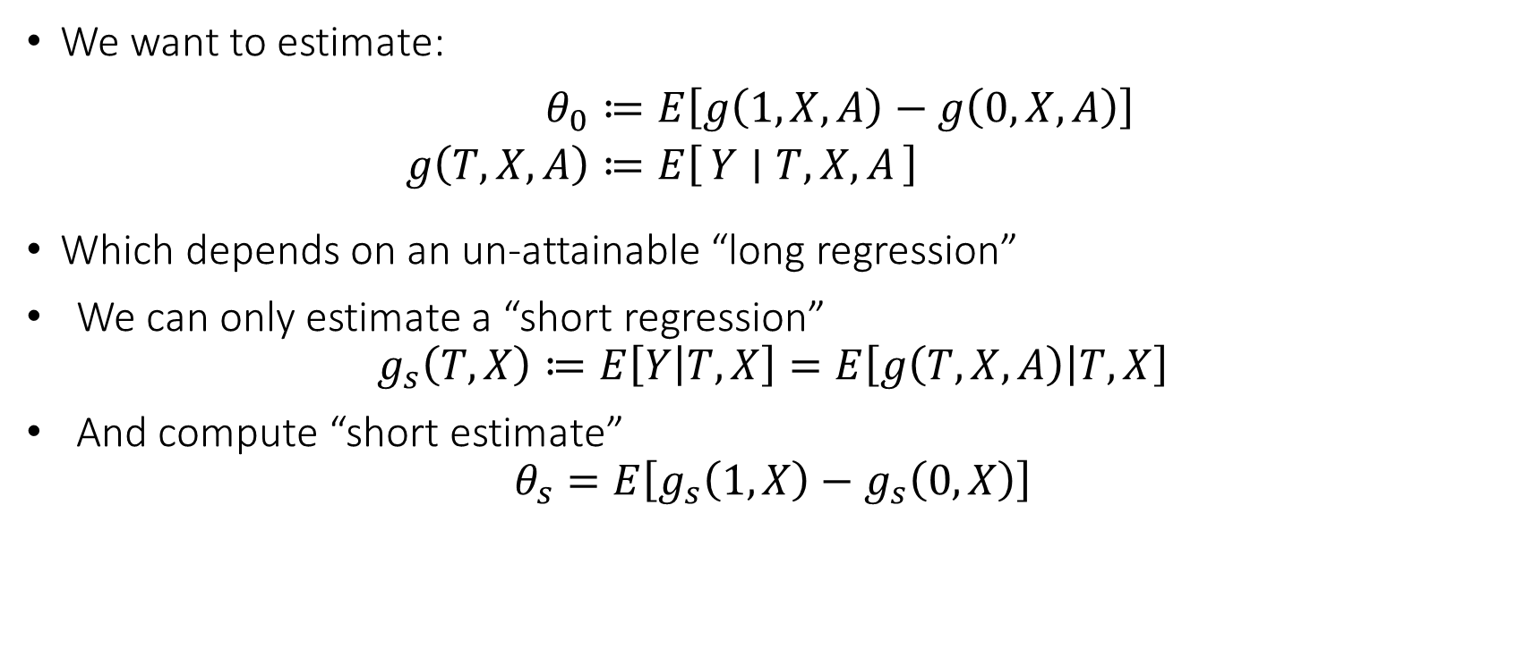



Omitted Variable Bias
We want to estimate:
$$\begin{aligned}θ_{0}≔&E\left[g\left(1,X,A\right)−g\left(0,X,A\right)\right] \\ g\left(T,X,A\right)≔&E\left[Y ∣ T,X,A\right]\end{aligned}$$
Which depends on an un-attainable “long regression”
We can only estimate a “short regression”
$$g_{s}\left(T,X\right)≔E\left[Y | T,X\right]=E\left[g\left(T,X,A\right) | T,X\right]$$
And compute “short estimate”
$$θ_{s}=E\left[g_{s}\left(1,X\right)−g_{s}\left(0,X\right)\right]$$
$$T$$
$$X$$
$$Y$$
$$A$$

Slide 15
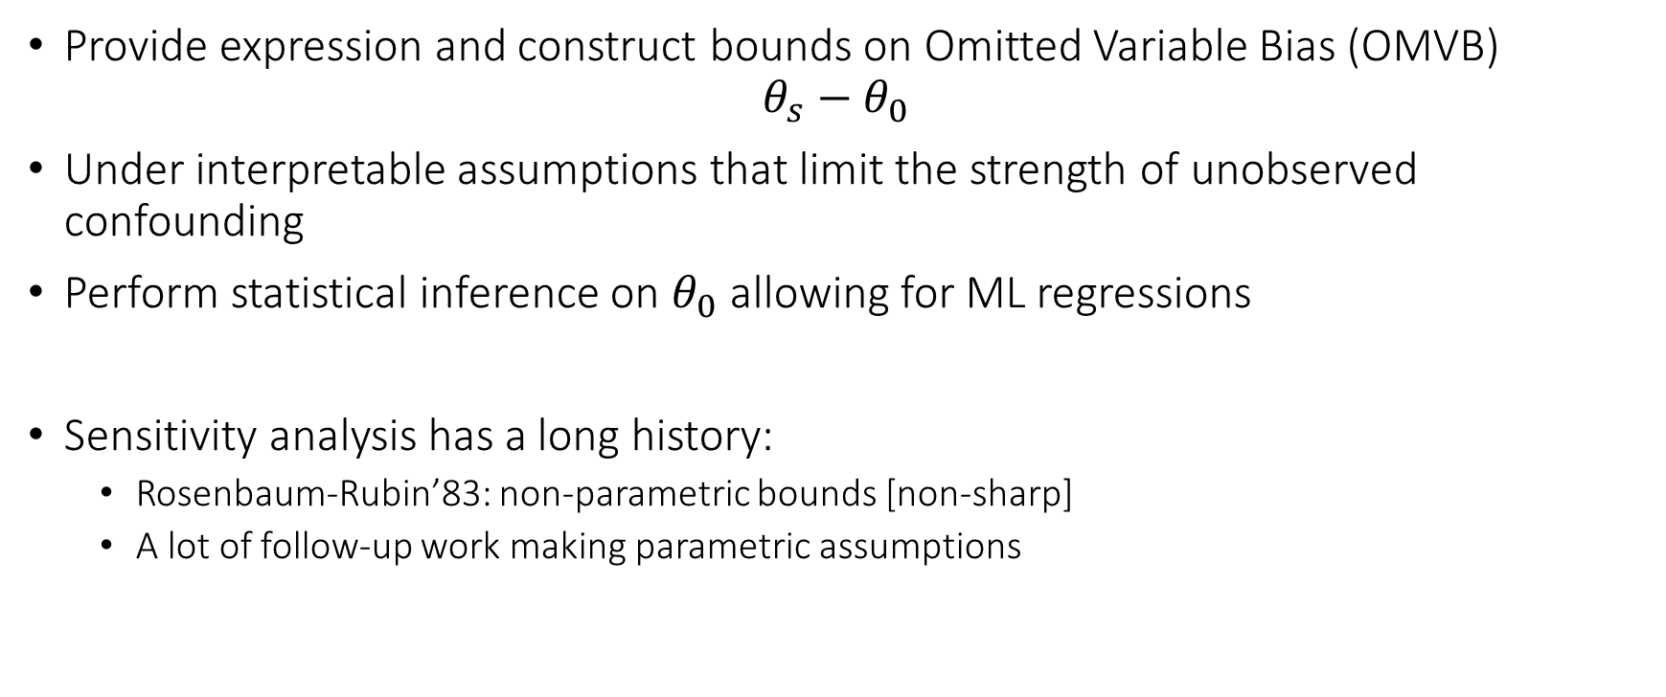
Omitted Variable Bias Bounds
Provide expression and construct bounds on Omitted Variable Bias (OMVB)
$$θ_{s}−θ_{0}$$
Under interpretable assumptions that limit the strength of unobserved confounding
Perform statistical inference on $θ_{0}$ allowing for ML regressions
Sensitivity analysis has a long history:
Rosenbaum-Rubin’83: non-parametric bounds [non-sharp]
A lot of follow-up work making parametric assumptions

Slide 16


Slide 17
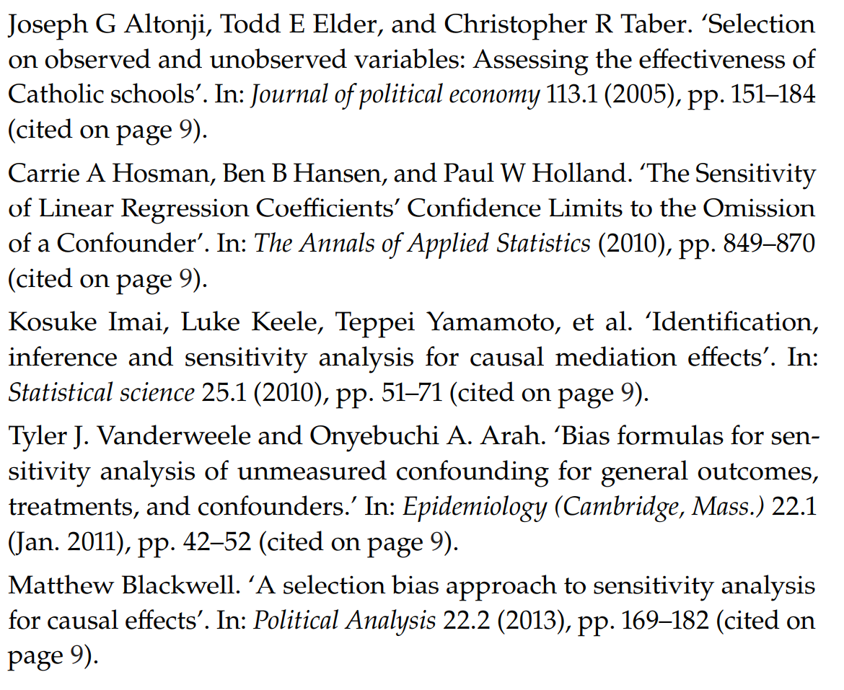

Slide 18
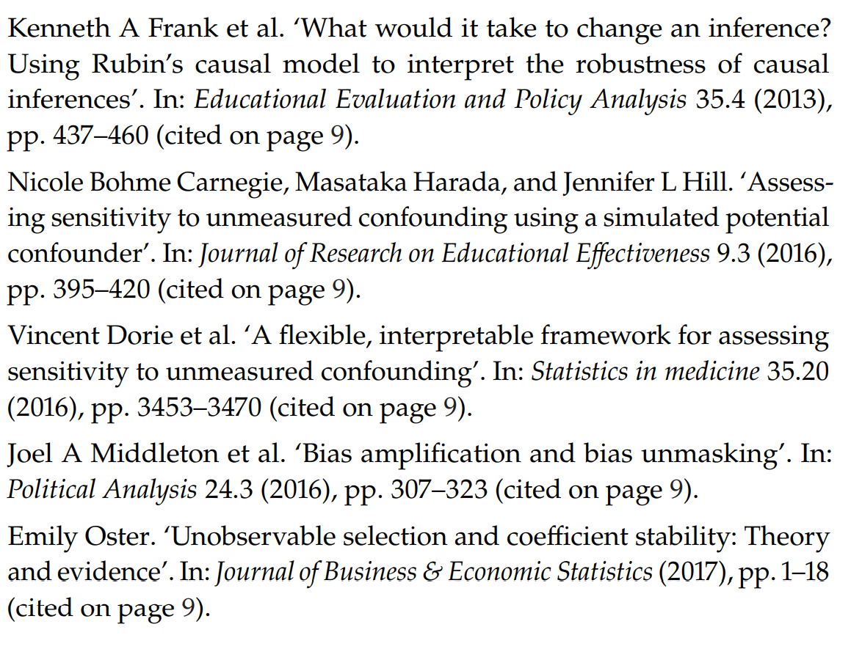

Slide 19
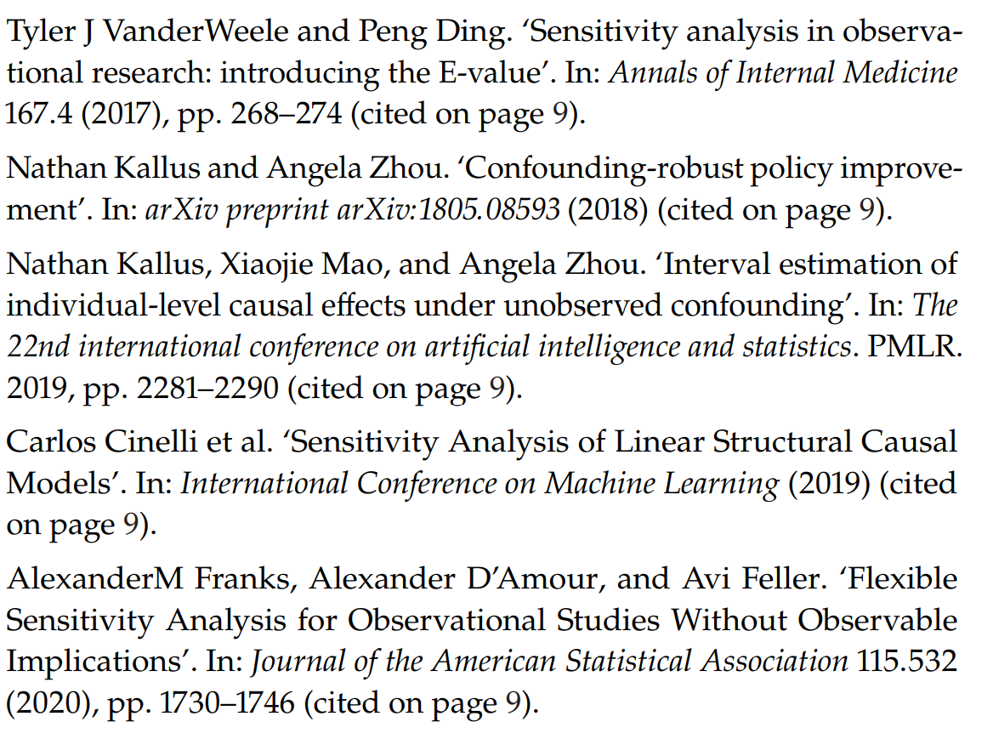

Slide 20
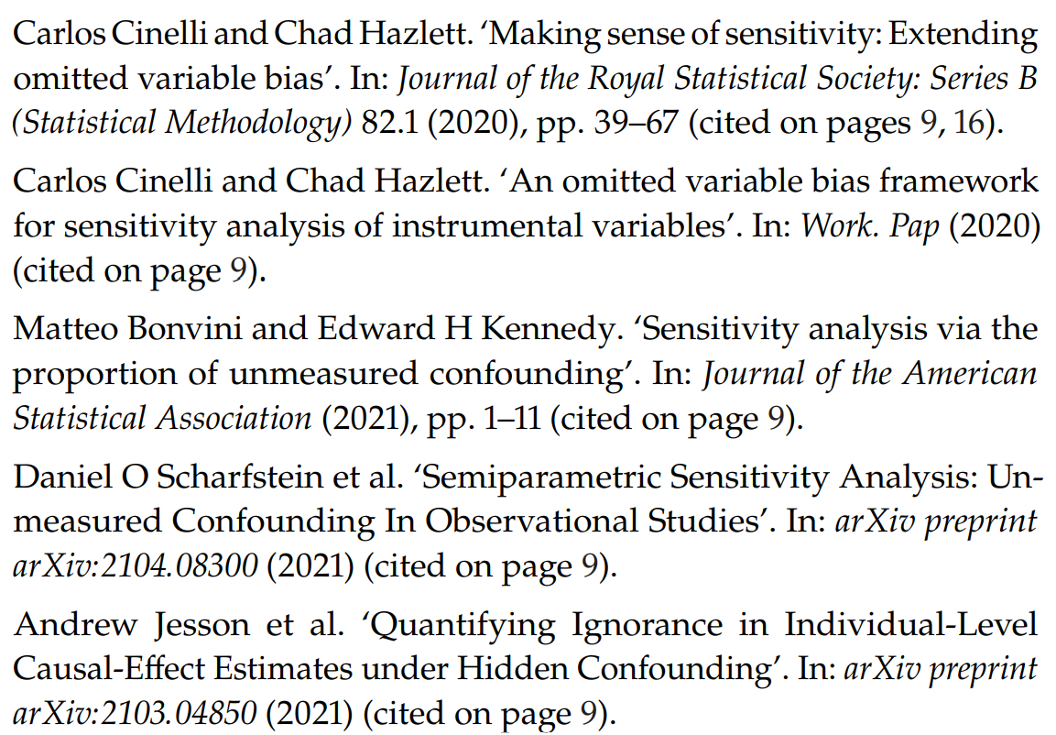

Slide 21
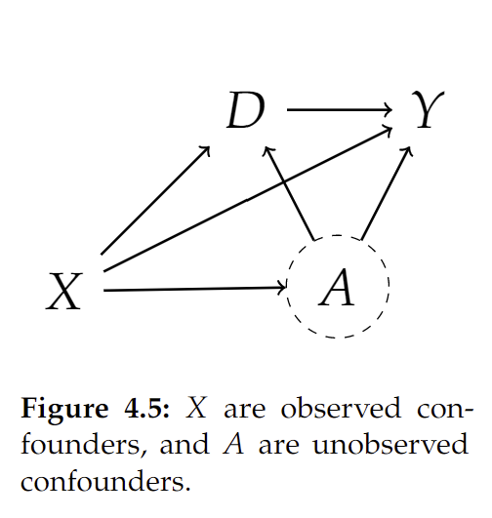

Omitted Variable Bias: Partially Linear Models
Let’s consider a simpler structural equation model
$$\begin{aligned}Y≔&aD+δA+f_{Y}\left(X\right)+ε_{Y} \\ D≔&γA+f_{D}\left(X\right)+ε_{D} \\ A≔&f_{A}\left(X\right)+ε_{A} \\ X≔&ε_{X}\end{aligned}$$

Slide 22
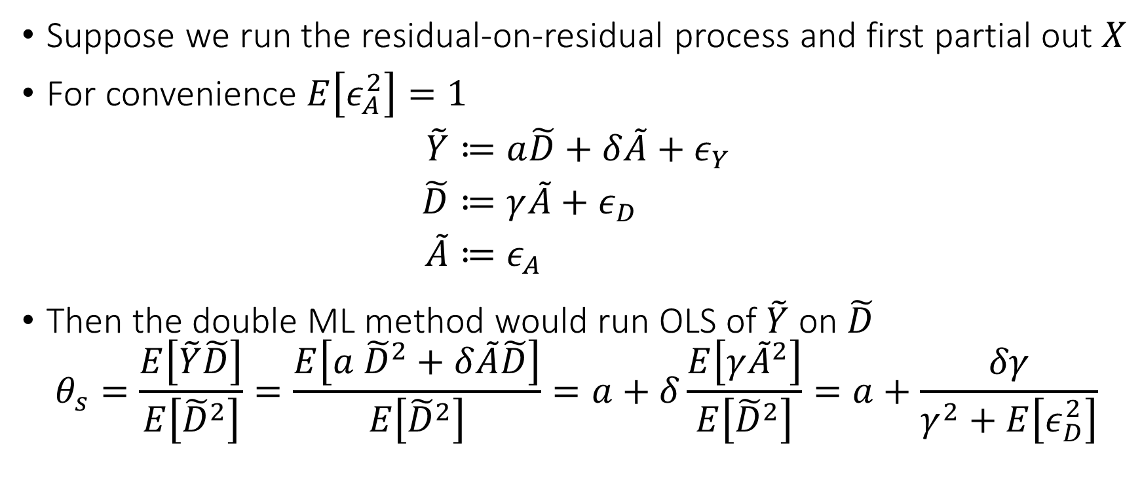
Omitted Variable Bias: Partially Linear Models
Suppose we run the residual-on-residual process and first partial out $X$
For convenience $E\left[ε_{A}^{2}\right]=1$
$$\begin{aligned}\tilde{Y}≔&a\tilde{D}+δ\tilde{A}+ε_{Y} \\ \tilde{D}≔&γ\tilde{A}+ε_{D} \\ \tilde{A}≔&ε_{A}\end{aligned}$$
Then the double ML method would run OLS of $\tilde{Y}$ on $\tilde{D}$
$$θ_{s}=\frac{E\left[\tilde{Y}\tilde{D}\right]}{E\left[{\tilde{D}}^{2}\right]}=\frac{E\left[a {\tilde{D}}^{2}+δ\tilde{A}\tilde{D}\right]}{E\left[{\tilde{D}}^{2}\right]}=a+δ\frac{E\left[γ{\tilde{A}}^{2}\right]}{E\left[{\tilde{D}}^{2}\right]}=a+\frac{δγ}{γ^{2}+E\left[ε_{D}^{2}\right]}$$

Slide 23
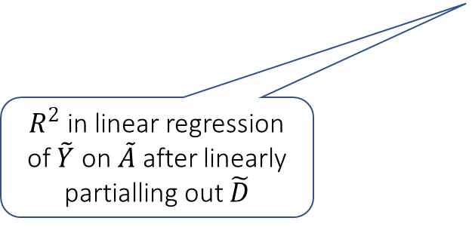
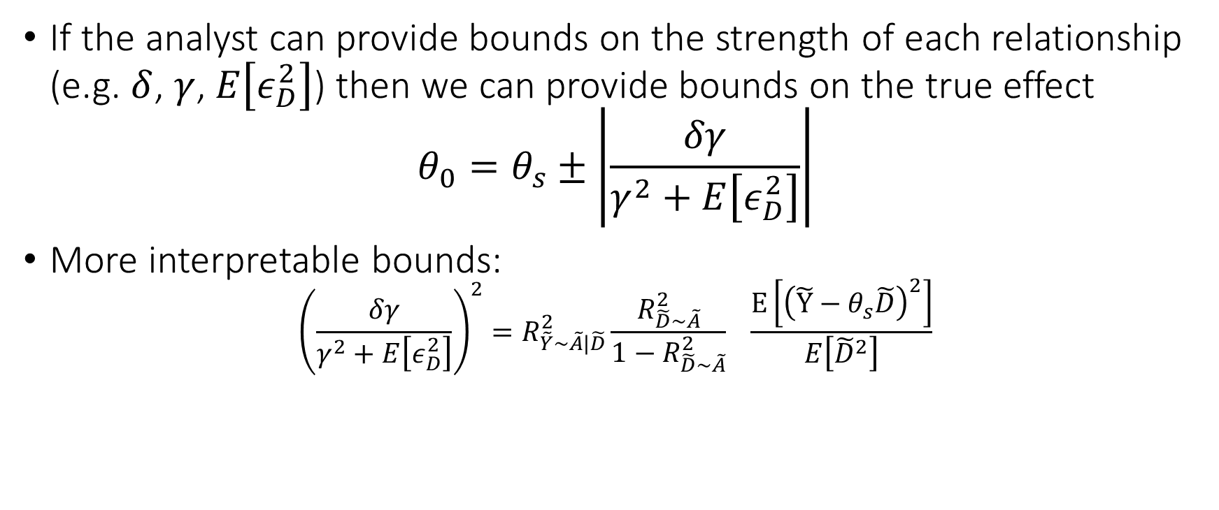
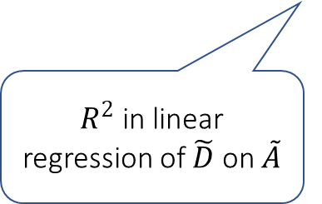
Bias Bounds
If the analyst can provide bounds on the strength of each relationship (e.g. $δ$, $γ$, $E\left[ε_{D}^{2}\right]$) then we can provide bounds on the true effect
$$θ_{0}=θ_{s}±\left|\frac{δγ}{γ^{2}+E\left[ε_{D}^{2}\right]}\right|$$
More interpretable bounds:
$${\left(\frac{δγ}{γ^{2}+E\left[ε_{D}^{2}\right]}\right)}^{2}=R_{\tilde{Y}\sim \tilde{A}|\tilde{D}}^{2}\frac{R_{\tilde{D}\sim \tilde{A}}^{2}}{1−R_{\tilde{D}\sim \tilde{A}}^{2}} \frac{E\left[{\left(\tilde{Y}−θ_{s}\tilde{D}\right)}^{2}\right]}{E\left[{\tilde{D}}^{2}\right]}$$
Measurable from the data
$R^{2}$ in linear regression of $\tilde{Y}$ on $\tilde{A}$ after linearly partialling out $\tilde{D}$
$R^{2}$ in linear regression of $\tilde{D}$ on $\tilde{A}$

Slide 24
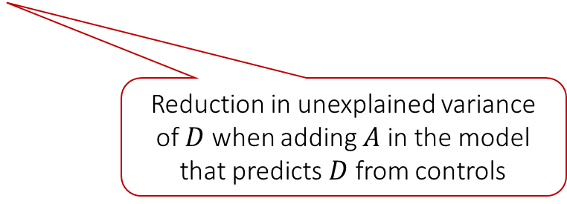
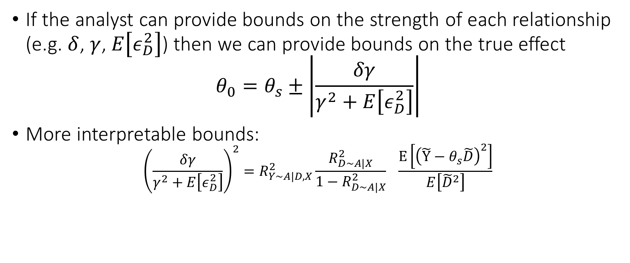
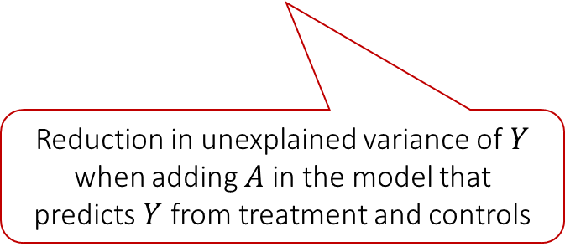
Bias Bounds
If the analyst can provide bounds on the strength of each relationship (e.g. $δ$, $γ$, $E\left[ε_{D}^{2}\right]$) then we can provide bounds on the true effect
$$θ_{0}=θ_{s}±\left|\frac{δγ}{γ^{2}+E\left[ε_{D}^{2}\right]}\right|$$
More interpretable bounds:
$${\left(\frac{δγ}{γ^{2}+E\left[ε_{D}^{2}\right]}\right)}^{2}=R_{Y\sim A|D,X}^{2}\frac{R_{D\sim A|X}^{2}}{1−R_{D∼A|X}^{2}} \frac{E\left[{\left(\tilde{Y}−θ_{s}\tilde{D}\right)}^{2}\right]}{E\left[{\tilde{D}}^{2}\right]}$$
Measurable from the data
For more details:
Making Sense of Sensitivity: Extending Omitted Variable Bias
For more general analysis see:
Long Story Short: Omitted Variable Bias in Causal Machine Learning
Reduction in unexplained variance of $Y$ when adding $A$ in the model that predicts $Y$ from treatment and controls
Reduction in unexplained variance of $D$ when adding $A$ in the model that predicts $D$ from controls

Slide 25
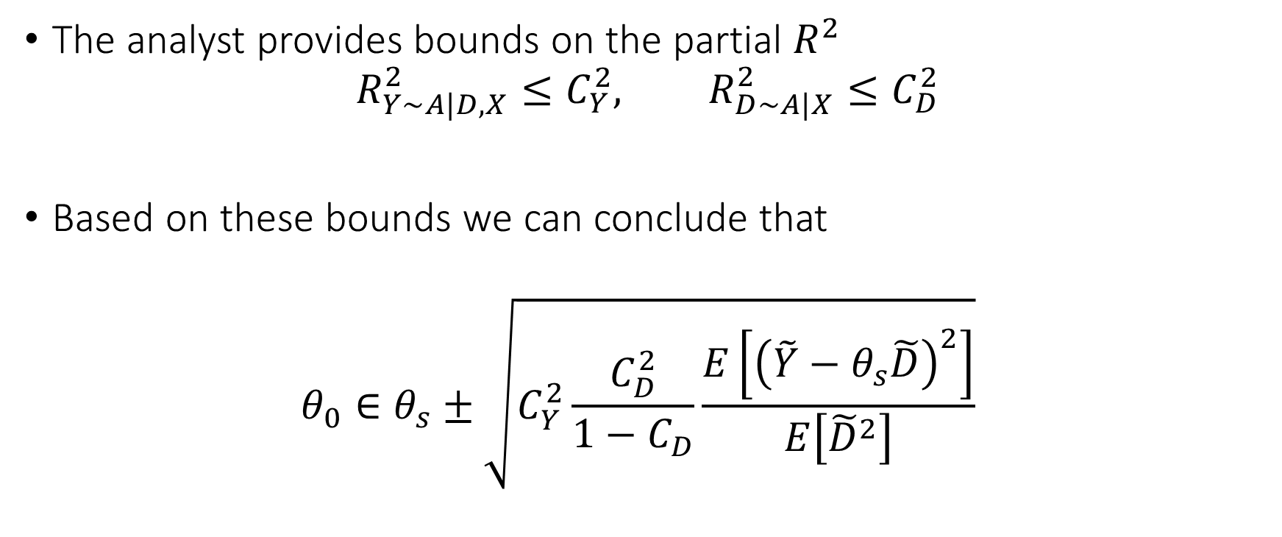
Bias Bounds
The analyst provides bounds on the partial $R^{2}$
$$R_{Y\sim A|D,X}^{2}≤C_{Y}^{2}, R_{D∼A|X}^{2}≤C_{D}^{2}$$
Based on these bounds we can conclude that
$$θ_{0}∈θ_{s}±\sqrt{C_{Y}^{2}\frac{C_{D}^{2}}{1−C_{D}}\frac{E\left[{\left(\tilde{Y}−θ_{s}\tilde{D}\right)}^{2}\right]}{E\left[{\tilde{D}}^{2}\right]}}$$

Slide 26
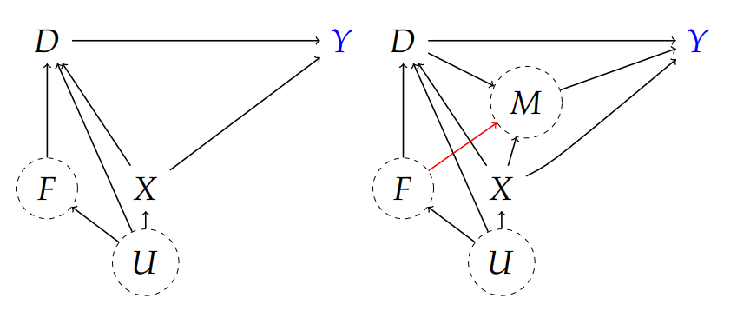
Application: 401k eligibility
Y=net financial assets
D=eligibility to enroll in 401(k) program
X=pre-treatment worker-level covariates (observed)
F=pre-treatment firm-level covariates (unobserved)
M=amount of contribution matched by employer
U=general latent factors
Controlling for X is sufficient in top figure but not bottom

Slide 27
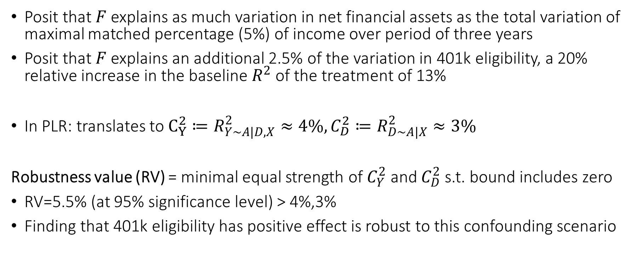
Confounding Scenario
Posit that $F$ explains as much variation in net financial assets as the total variation of maximal matched percentage (5%) of income over period of three years
Posit that $F$ explains an additional 2.5% of the variation in 401k eligibility, a 20% relative increase in the baseline $R^{2}$ of the treatment of 13%
In PLR: translates to $C_{Y}^{2}≔R_{Y\sim A|D,X}^{2}≈4\%, C_{D}^{2}≔R_{D∼A|X}^{2}≈3\%$
Robustness value (RV) = minimal equal strength of $C_{Y}^{2}$ and $C_{D}^{2}$ s.t. bound includes zero
RV=5.5% (at 95% significance level) > 4%,3%
Finding that 401k eligibility has positive effect is robust to this confounding scenario

Slide 28
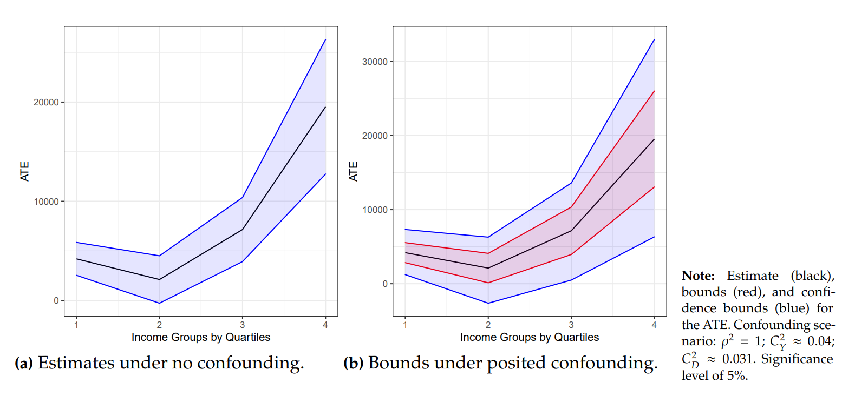

Slide 29
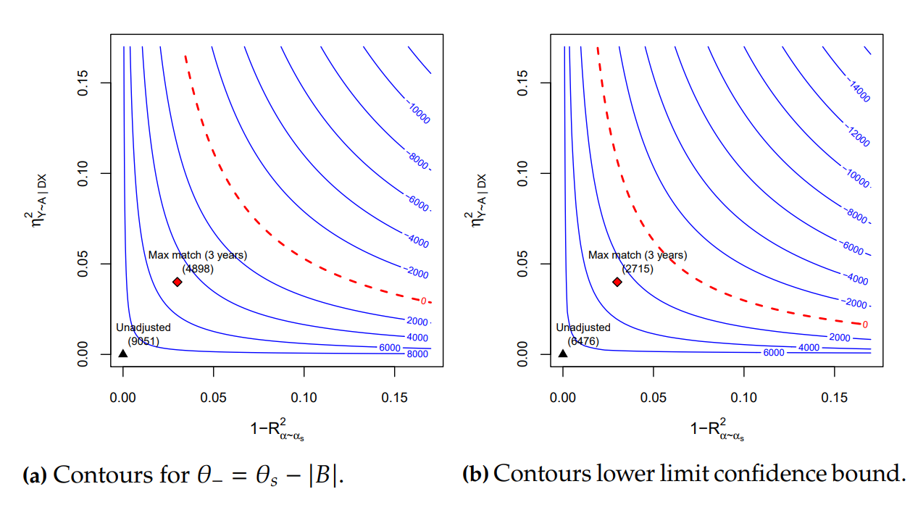




$$R_{Y∼A|D,X}^{2}$$
$$R_{Y∼A|D,X}^{2}$$
$$R_{D∼A|X}^{2}$$
$$R_{D∼A|X}^{2}$$

Slide 30
Can we recover the true effect? Instrumental Variables

Slide 31
Instrumental Variables and 2SLS
U
unobserved confounder
Instrumental Variable: any random variable Z that affects the treatment (log-price) D but does not affect the outcome (log-demand) Y other than through the treatment [Wright’28, Bowden-Turkington’90, Angrist-Krueger’91, Imbens-Angrist’94]
instrument
treatment
Z
D
Y
outcome
causal
model
predictive
model
Z= lenient approver
demand
demand
Z= strict approver
mean demand
with strict approver
price
mean price
with strict approver
price

Slide 32
Instrumental Variables and 2SLS
Instruments are widely used
In the discount example (see also [Kling AER06] for effects of incarceration)
Discounts are sent to an approver desk
Approver assignment is random and different approvers are more or less “lenient”
Approver leniency is an instrument
In healthcare [Doyle et al., JPE15]
Random assignment to ambulance companies of nearby patients is an instrument for measuring hospital quality
In Tech [S., NeurIPS19]
Recommendation A/B tests as instruments for the effects of downstream actions
U
unobserved confounder
instrument
treatment
Z
T
Y
outcome

Slide 33
Returns to Education
A
unobserved confounder
instrument
treatment
Z
D
Y
outcome
D: years of college, Y: income
X: observable characteristics of a student (e.g. test scores)
A: unobserved “ability”
Z: distance to college
X
causal
model
A = high ability
predictive
model
Z= far from college
income
income
Z= near college
A = low ability
mean income
for people that lived near a college
education
mean education
for people that lived near a college
education

Slide 34
Demand Estimation
A
unobserved confounder
instrument
treatment
Z
D
Y
outcome
D: price (e.g. of coffee), Y: demand (e.g. of coffee in US)
X: observable characteristics of a market (e.g. holidays)
A: unobserved “demand shocks” (e.g. local event)
Z: supply shifters (e.g. weather in brazil)
X
causal
model
A = local event
predictive
model
Z= good weather in Brazil
demand
demand
Z= bad weather in Brazil
A = no local event
mean demand
for years when weather in Brazil was bad
price
mean price
for years when weather in Brazil was bad
price

Slide 35
Clinical Trials with Non-Compliance
A
unobserved confounder
instrument
treatment
Z
D
Y
D: drug treatment, Y: survival
X: observable characteristics of a patient
A: unobserved “compliance factors” (e.g. health habits)
Z: randomized cohort assignment
outcome
X
causal
model
Z= assigned to control
A = good habits
predictive
model
survival
survival
Z= assigned to treatment
A = bad habits
mean survival
for patients assigned to treatment
Drug uptake
Prob. of treatment
for patients assigned to treatment
Drug uptake

Slide 36
Digital Recommendation A/B tests
A
unobserved confounder
instrument
treatment
Z
D
Y
D: action taken by user (e.g. membership), Y: spend
X: observable characteristics of a user
A: unobserved confounding factors (e.g. interest in platform)
Z: randomized nudge to take action (e.g. one-click sign-up pop-up)
outcome
X
causal
model
A = interested in platform
predictive
model
Z= did not receive nudge
spend
spend
Z= received nudge to take action
A = not interested
mean spend for users that received nudge
membership
Prob. of membership
for users who received the nudge
membership

Slide 37
Identification of Causal Effects via Instruments
U
unobserved confounder
Phillip Wright’s idea (1928): the first causal path diagram analysis
We can estimate effect of $Z$ on $y$ via a regression
$$γ=\frac{𝔼\left[\tilde{Z}\tilde{y}\right]}{𝔼\left[{\tilde{Z}}^{2}\right]}$$
We can estimate the effect of $Z$ on $D$ via a regression
$$δ=\frac{𝔼\left[\tilde{Z}\tilde{D}\right]}{𝔼\left[{\tilde{Z}}^{2}\right]}$$
The effect of $Z$ on $Y$ ($γ$) is the product of the effect of $Z$ on $T$ ($δ$) multiplied by the effect of $T$ on $y$ ($θ$)
$$θ=\frac{γ}{δ}=\frac{𝔼\left[\tilde{Z}\tilde{y}\right]}{𝔼\left[\tilde{Z}\tilde{D}\right]}$$
instrument
treatment
Z
D
Y
outcome

Slide 38
Partially Linear Instrumental Variable Model
Typically for continuous treatment/instrument a partially linear structural equation assumed
$$Y≔θ_{0}D+f_{Y}\left(X\right)+δA+ε_{Y}$$
$$D≔βZ+f_{D}\left(X\right)+γA+ε_{D}$$
$$Z≔f_{Z}\left(X\right)+ε_{Z}$$
$$A≔f_{A}\left(X\right)+ε_{A}$$
All errors are exogenous and un-correlated

Slide 39
Partially Linear Instrumental Variable Model
After partialling out the observed controls $X$
$$\tilde{Y}≔θ_{0}\tilde{D}+δ\tilde{A}+ε_{Y}$$
$$\tilde{D}≔β\tilde{Z}+γ\tilde{A}+ε_{D}$$
$$\tilde{Z}≔ε_{Z}$$
$$\tilde{A}≔ε_{A}$$
We see immediately that:
$$\tilde{Y}≔θ_{0}\tilde{D}+U, U≔δ\tilde{A}+ε_{Y}⊥\tilde{Z}$$
Since $ε_{A},ε_{Y},ε_{Z}$ are un-correlated: $E\left[\left(δ\tilde{A}+ε_{Y}\right)\tilde{Z}\right]=0$
Thus we have the moment restriction: $E\left[\left(\tilde{Y}−θ_{0}\tilde{D}\right)\tilde{Z}\right]=0$
Notes:
,

Slide 40
Partially Linear Instrumental Variable Model
After partialling out the observed controls $X$
$$\tilde{Y}≔θ_{0}\tilde{D}+δ\tilde{A}+ε_{Y}$$
$$\tilde{D}≔β\tilde{Z}+γ\tilde{A}+ε_{D}$$
$$\tilde{Z}≔ε_{Z}$$
$$\tilde{A}≔ε_{A}$$
Thus we have the moment restriction: $E\left[\left(\tilde{Y}−θ_{0}\tilde{D}\right)\tilde{Z}\right]=0$
We re-derive a generalization of Wright’s formula
$$θ_{0}=\frac{E\left[\tilde{Y}\tilde{Z}\right]}{E\left[\tilde{D}\tilde{Z}\right]}$$

Slide 41
Partially Linear Instrumental Variable Model
After partialling out the observed controls $X$
$$\tilde{Y}≔θ_{0}\tilde{D}+\tilde{A}+ε_{Y}$$
$$\tilde{D}≔β\tilde{Z}+γ\tilde{A}+ε_{D}$$
$$\tilde{Z}≔ε_{Z}$$
$$\tilde{A}≔ε_{A}$$
Setting falls into the general moment estimation framework
$$M\left(θ, h, p,m\right)=E\left[\left(Y−h\left(X\right)−θ \left(D−p\left(X\right)\right)\right) \left(Z−m\left(X\right)\right)\right]=0$$
Where $h\left(X\right)=E\left[Y | X\right]$, $p\left(X\right)=E\left[D | X\right]$, $m\left(Z\right)=E\left[Z | X\right]$

Slide 42
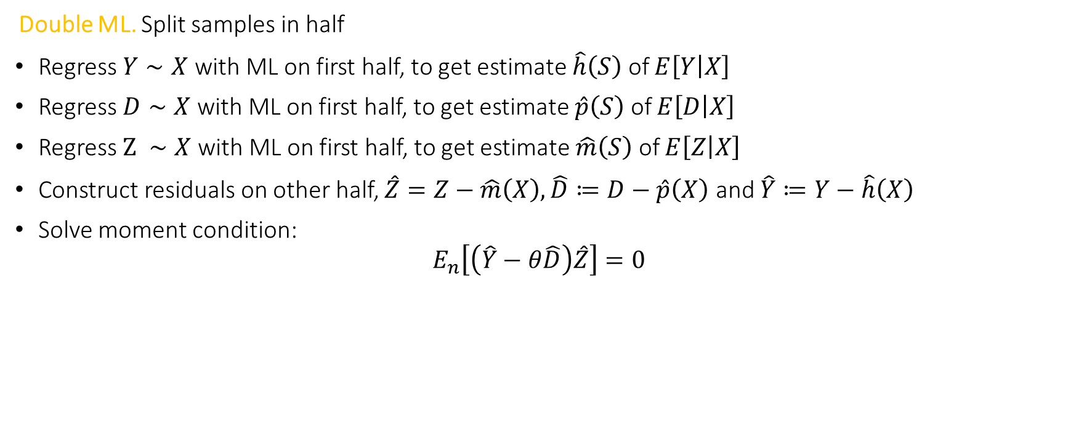
Orthogonal Method: Double ML for IV
Double ML. Split samples in half
Regress $Y∼X$ with ML on first half, to get estimate $\hat{h}\left(S\right)$ of $E\left[Y | X\right]$
Regress $D∼X$ with ML on first half, to get estimate $\hat{p}\left(S\right)$ of $E\left[D | X\right]$
Regress $Z ∼X$ with ML on first half, to get estimate $\hat{m}\left(S\right)$ of $E\left[Z | X\right]$
Construct residuals on other half, $\hat{Z}=Z−\hat{m}\left(X\right),\hat{D}≔D−\hat{p}\left(X\right)$ and $\hat{Y}≔Y−\hat{h}\left(X\right)$
Solve moment condition:
$$E_{n}\left[\left(\hat{Y}−θ\hat{D}\right)\hat{Z}\right]=0$$
from econml.iv.dml import OrthoIV orthoiv = OrthoIV()
orthoiv.fit(y, D, Z, W=X).effect_inference()

Slide 43

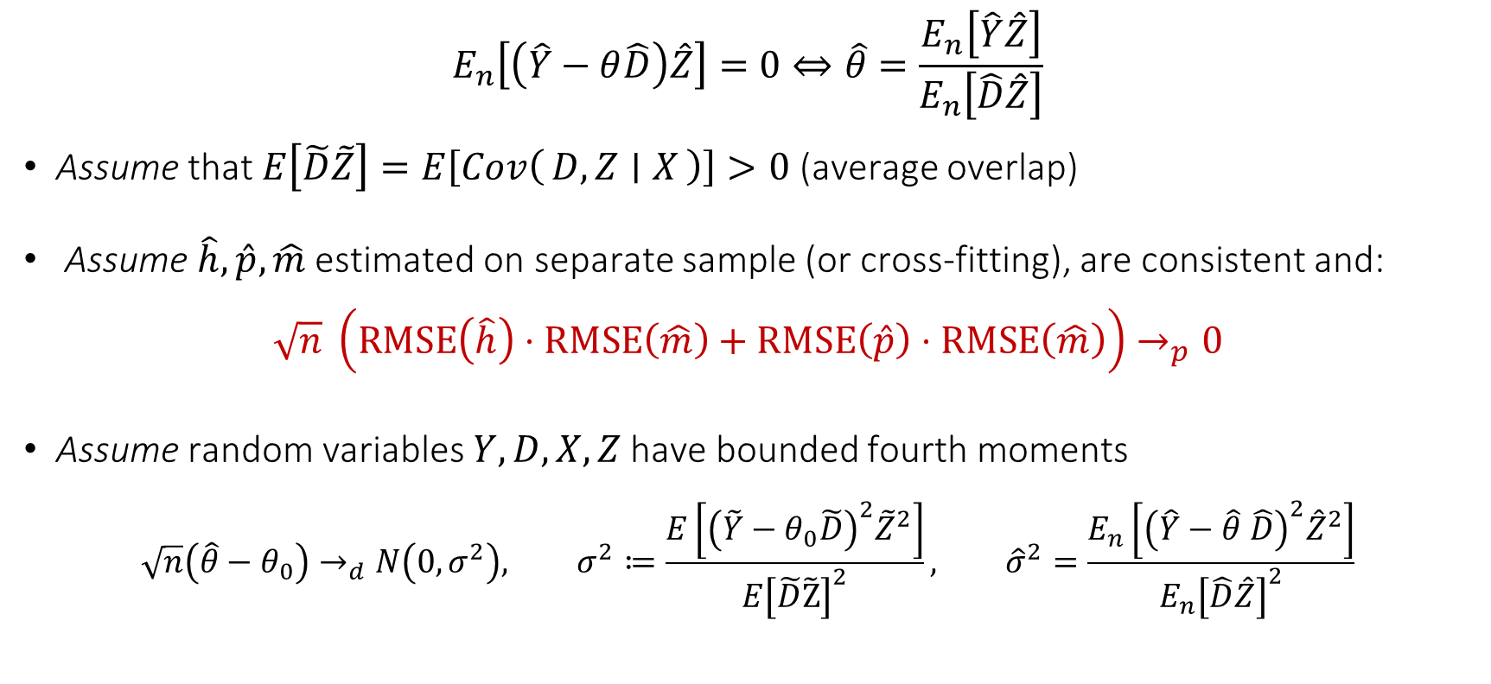
Asymptotic Normality of DoubleML Estimate
$$E_{n}\left[\left(\hat{Y}−θ\hat{D}\right)\hat{Z}\right]=0⇔\hat{θ}=\frac{E_{n}\left[\hat{Y}\hat{Z}\right]}{E_{n}\left[\hat{D}\hat{Z}\right]}$$
Assume that $E\left[\tilde{D}\tilde{Z}\right]=E\left[Cov\left(D,Z ∣ X\right)\right]>0$ (average overlap)
Assume $\hat{h},\hat{p},\hat{m}$ estimated on separate sample (or cross-fitting), are consistent and:
$$\sqrt{n} \left(RMSE\left(\hat{h}\right)⋅RMSE\left(\hat{m}\right)+RMSE\left(\hat{p}\right)⋅RMSE\left(\hat{m}\right)\right)→_{p}0$$
Assume random variables $Y,D,X,Z$ have bounded fourth moments
$$\sqrt{n}\left(\hat{θ}−θ_{0}\right)→_{d}N\left(0,σ^{2}\right), σ^{2}≔\frac{E\left[{\left(\tilde{Y}−θ_{0}\tilde{D}\right)}^{2}{\tilde{Z}}^{2}\right]}{E{\left[\tilde{D}\tilde{\text{Z}}\right]}^{2}}, {\hat{σ}}^{2}=\frac{E_{n}\left[{\left(\hat{Y}−\hat{θ} \hat{D}\right)}^{2}{\hat{Z}}^{2}\right]}{E_{n}{\left[\hat{D}\hat{Z}\right]}^{2}}$$
Estimate asymptotically normal
Estimate of variance $⇒$ 95% CI $\left[θ±1.96\frac{\hat{σ}}{\sqrt{n}}\right]$
Asymptotic variance

Slide 44
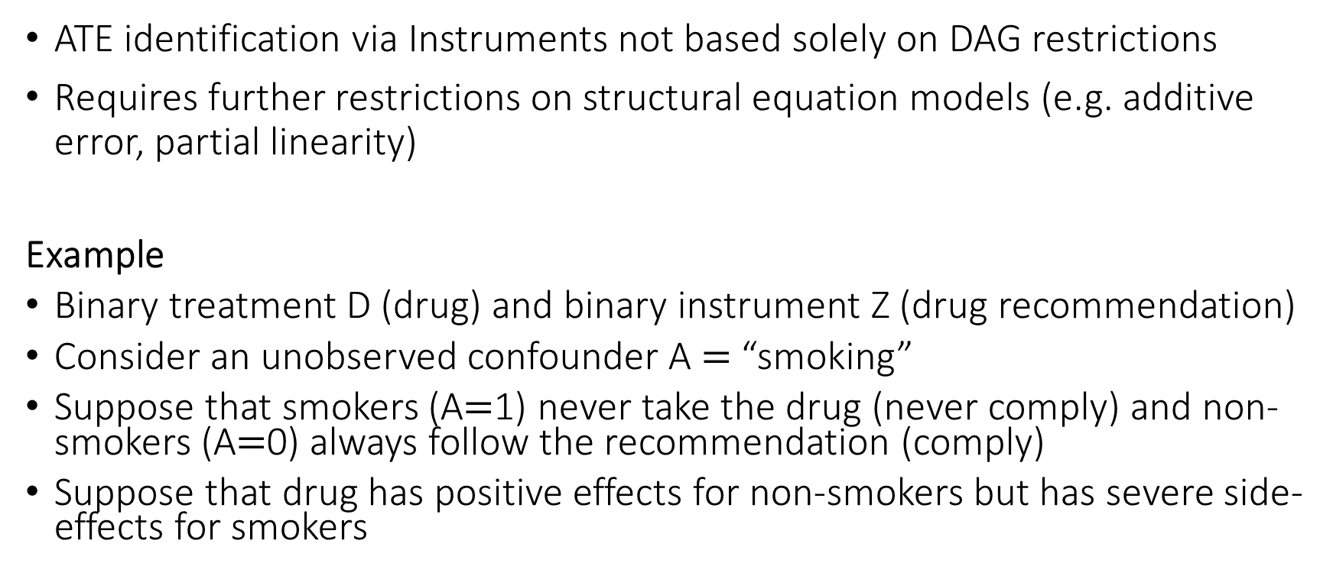
Limits of Identification via Instruments
ATE identification via Instruments not based solely on DAG restrictions
Requires further restrictions on structural equation models (e.g. additive error, partial linearity)
Example
Binary treatment D (drug) and binary instrument Z (drug recommendation)
Consider an unobserved confounder A $=$ “smoking”
Suppose that smokers (A$=$1) never take the drug (never comply) and non-smokers (A$=$0) always follow the recommendation (comply)
Suppose that drug has positive effects for non-smokers but has severe side-effects for smokers

Slide 45
Clinical Trials with Non-Compliance
A
unobserved confounder
instrument
treatment
Z
D
Y
D: drug treatment, Y: survival
X: observable characteristics of a patient
A: unobserved “compliance factors” (e.g. health habits)
Z: randomized cohort assignment
outcome
X
Z= assigned to treatment
A = non-smoking
predictive
model
survival
survival
causal
model
A = non-smoking
Z= assigned to control
mean survival
for patients assigned to treatment
A = smoking
Drug uptake
Prob. of treatment
for patients assigned to treatment
Drug uptake

Slide 46
Limits of Identification via Instruments
ATE identification via Instruments not based solely on DAG restrictions
Requires further restrictions on structural equation models
Example
IV regression will never be able to uncover the side effects of drug treatment on smokers
Nothing in the data is informative of that
Effect will be biased as compared to average effect in whole population

Slide 47
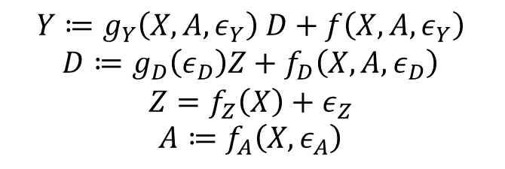
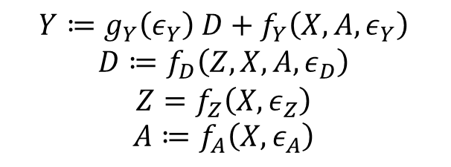
What do we need for ATE
Either the compliance behavior (effect of instrument on treatment) does not vary with A (or X)
Or the treatment effect (effect of treatment on outcome) does not vary with A (or X)
$$Y≔g_{Y}\left(ε_{Y}\right) D+f_{Y}\left(X, A,ε_{Y}\right)$$
$$D≔f_{D}\left(Z, X,A, ε_{D}\right)$$
$$Z=f_{Z}\left(X, ε_{Z}\right)$$
$$A≔f_{A}\left(X,ε_{A}\right)$$
$$Y≔g_{Y}\left(X,A,ε_{Y}\right) D+f\left(X, A,ε_{Y}\right)$$
$$D≔g_{D}\left(ε_{D}\right)Z+f_{D}\left(X,A, ε_{D}\right)$$
$$Z=f_{Z}\left(X\right)+ε_{Z}$$
$$A≔f_{A}\left(X,ε_{A}\right)$$

Slide 48
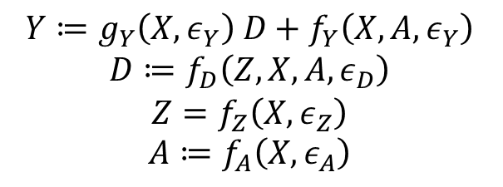
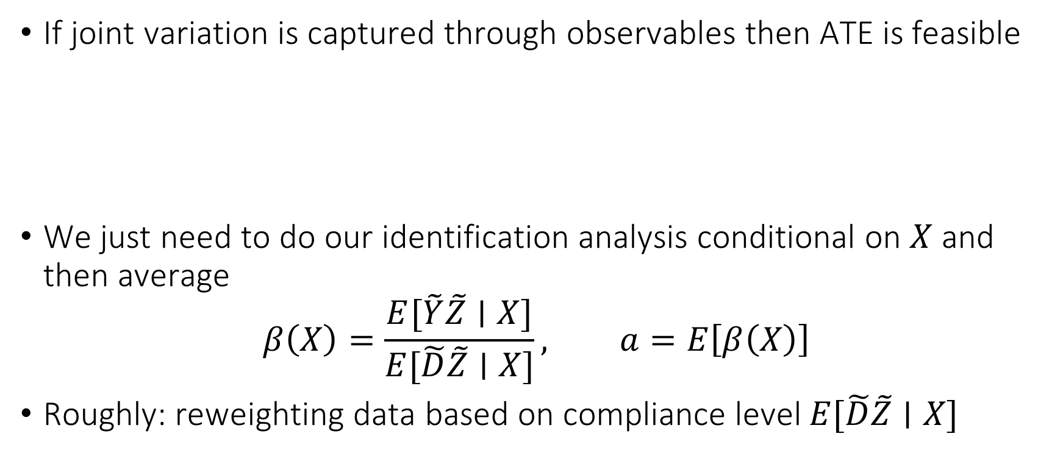
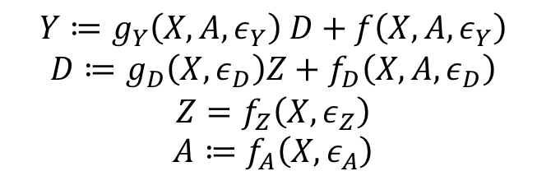
Joint Variation on Observables
If joint variation is captured through observables then ATE is feasible
We just need to do our identification analysis conditional on $X$ and then average
$$β\left(X\right)=\frac{E[\tilde{Y}\tilde{Z}∣X]}{E[\tilde{D}\tilde{Z}∣X]}, a=E\left[β\left(X\right)\right]$$
Roughly: reweighting data based on compliance level $E[\tilde{D}\tilde{Z}∣X]$
$$Y≔g_{Y}\left(X,ε_{Y}\right) D+f_{Y}\left(X, A,ε_{Y}\right)$$
$$D≔f_{D}\left(Z, X,A, ε_{D}\right)$$
$$Z=f_{Z}\left(X, ε_{Z}\right)$$
$$A≔f_{A}\left(X,ε_{A}\right)$$
$$Y≔g_{Y}\left(X,A,ε_{Y}\right) D+f\left(X, A,ε_{Y}\right)$$
$$D≔g_{D}\left(X,ε_{D}\right)Z+f_{D}\left(X,A, ε_{D}\right)$$
$$Z=f_{Z}\left(X,ε_{Z}\right)$$
$$A≔f_{A}\left(X,ε_{A}\right)$$

Slide 49

What if joint variation happens through unobservables?
$$Y≔f_{Y}\left(D,X, A,ε_{Y}\right)$$
$$D≔f_{D}\left(Z, X,A, ε_{D}\right)$$
$$Z=f_{Z}\left(X, ε_{Z}\right)$$
$$A≔f_{A}\left(X,ε_{A}\right)$$

Slide 50


Clinical Trials with Non-Compliance
A
unobserved confounder
instrument
treatment
Z
D
Y
D: drug treatment, Y: survival
X: observable characteristics of a patient
A: unobserved “compliance factors” (e.g. health habits)
Z: randomized cohort assignment
outcome
X
Z= assigned to treatment
A = non-smoking
predictive
model
survival
survival
causal
model
A = non-smoking
Z= assigned to control
Effect of $Z$ on $Y$
A = smoking
Drug uptake
Drug uptake
Effect of $Z$ on $D$

Slide 51
Does the IV estimate coincide with the average effect for some sub-population?

Slide 52
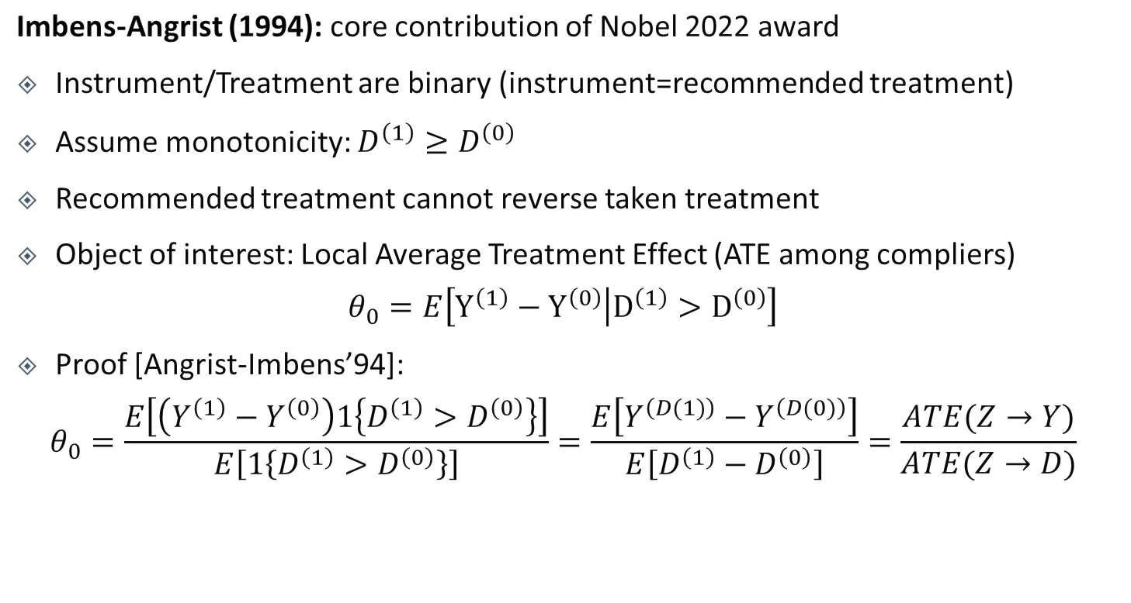


The Binary Case
U
unobserved confounder
instrument
treatment
Z
D
Y
outcome
Imbens-Angrist (1994): core contribution of Nobel 2022 award
Instrument/Treatment are binary (instrument=recommended treatment)
Assume monotonicity: $D^{\left(1\right)}≥D^{\left(0\right)}$
Recommended treatment cannot reverse taken treatment
Object of interest: Local Average Treatment Effect (ATE among compliers)
$$θ_{0}=E\left[Y^{\left(1\right)}−Y^{\left(0\right)} | D^{\left(1\right)}>D^{\left(0\right)}\right]$$
Proof [Angrist-Imbens’94]:
$$θ_{0}=\frac{E\left[\left(Y^{\left(1\right)}−Y^{\left(0\right)}\right)1\left\{D^{\left(1\right)}>D^{\left(0\right)}\right\}\right]}{E\left[1\left\{D^{\left(1\right)}>D^{\left(0\right)}\right\}\right]}=\frac{E\left[Y^{\left(D(1)\right)}−Y^{\left(D(0)\right)}\right]}{E\left[D^{\left(1\right)}−D^{\left(0\right)}\right]}=\frac{ATE(Z→Y)}{ATE(Z→D)}$$
$$γ=\frac{𝔼\left[\tilde{Z}\tilde{y}\right]}{𝔼\left[{\tilde{Z}}^{2}\right]}$$
$$δ=\frac{𝔼\left[\tilde{Z}\tilde{D}\right]}{𝔼\left[{\tilde{Z}}^{2}\right]}$$

Slide 53
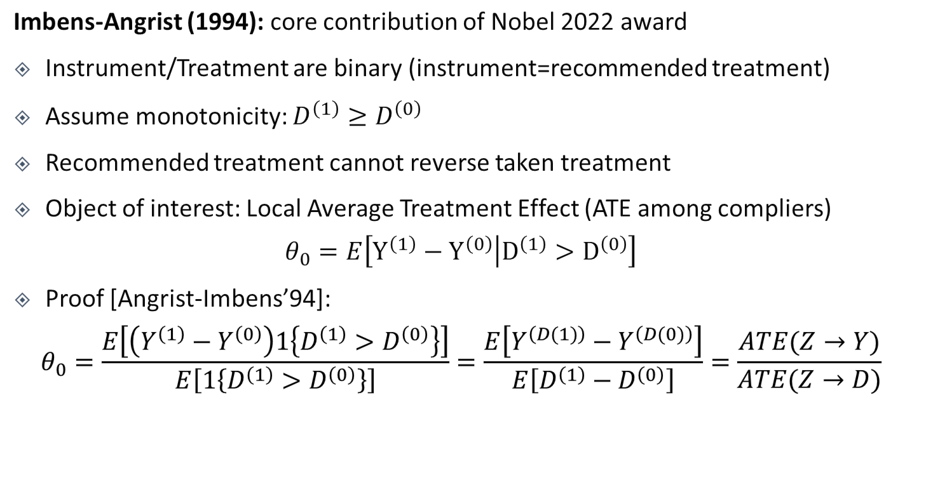


The Binary Case
U
unobserved confounder
instrument
treatment
Z
D
Y
outcome
Imbens-Angrist (1994): core contribution of Nobel 2022 award
Instrument/Treatment are binary (instrument=recommended treatment)
Assume monotonicity: $D^{\left(1\right)}≥D^{\left(0\right)}$
Recommended treatment cannot reverse taken treatment
Object of interest: Local Average Treatment Effect (ATE among compliers)
$$θ_{0}=E\left[Y^{\left(1\right)}−Y^{\left(0\right)} | D^{\left(1\right)}>D^{\left(0\right)}\right]$$
Proof [Angrist-Imbens’94]:
$$θ_{0}=\frac{E\left[\left(Y^{\left(1\right)}−Y^{\left(0\right)}\right)1\left\{D^{\left(1\right)}>D^{\left(0\right)}\right\}\right]}{E\left[1\left\{D^{\left(1\right)}>D^{\left(0\right)}\right\}\right]}=\frac{E\left[Y^{\left(D(1)\right)}−Y^{\left(D(0)\right)}\right]}{E\left[D^{\left(1\right)}−D^{\left(0\right)}\right]}=\frac{ATE(Z→Y)}{ATE(Z→D)}$$
X
$$E\left[E\left[Y | Z=1,X\right]−E\left[Y | Z=0,X\right]\right]$$
$$E\left[E\left[D | Z=1,X\right]−E\left[D | Z=0,X\right]\right]$$

Slide 54
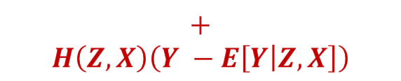
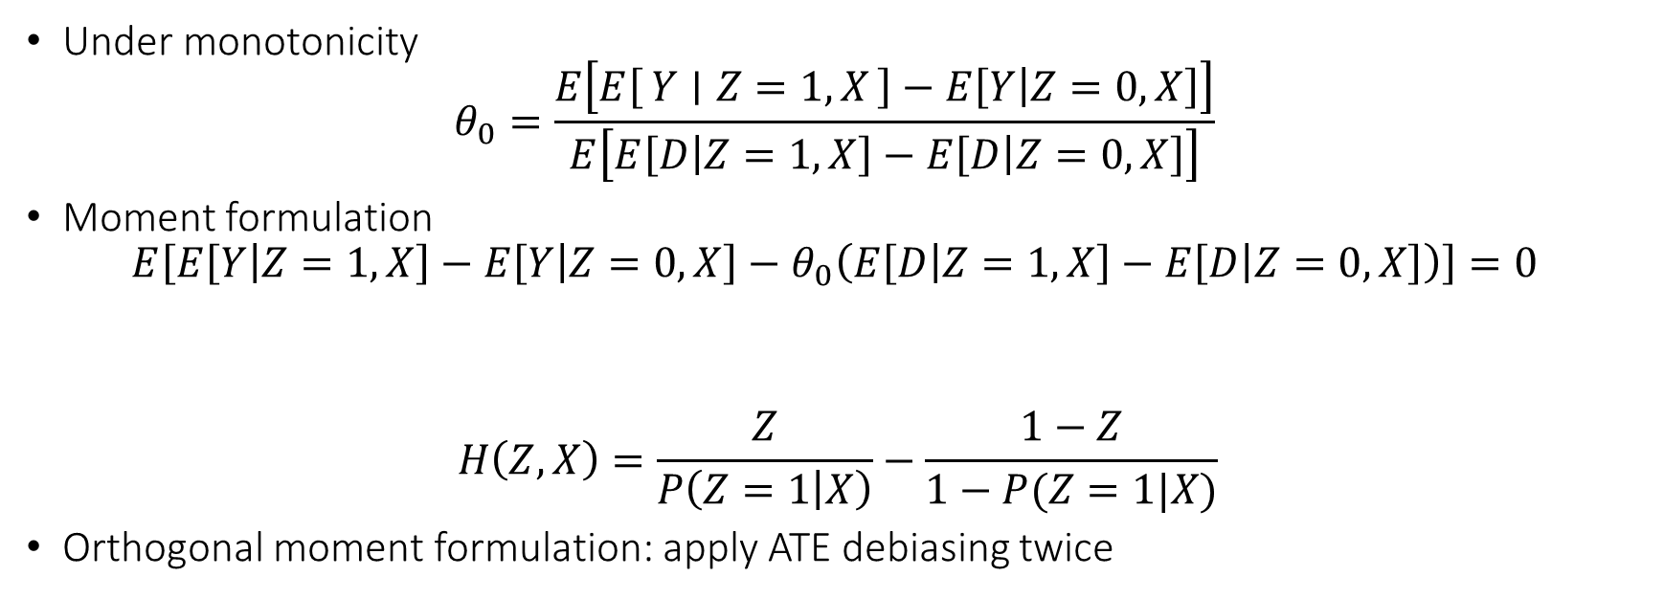
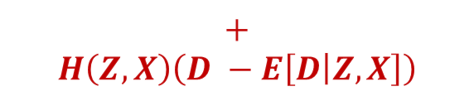
LATE in the Binary Case
Under monotonicity
$$θ_{0}=\frac{E\left[E\left[Y ∣ Z=1,X\right]−E\left[Y | Z=0,X\right]\right]}{E\left[E\left[D | Z=1,X\right]−E\left[D | Z=0,X\right]\right]}$$
Moment formulation
$$E\left[E\left[Y | Z=1,X\right]−E\left[Y | Z=0,X\right]−θ_{0}\left(E\left[D | Z=1,X\right]−E\left[D | Z=0,X\right]\right)\right]=0$$
$$H\left(Z,X\right)=\frac{Z}{P\left(Z=1 | X\right)}−\frac{1−Z}{1−P(Z=1|X)}$$
Orthogonal moment formulation: apply ATE debiasing twice
$$+$$
$$H\left(Z,X\right)\left(Y −E\left[Y | Z,X\right]\right)$$
$$+$$
$$H\left(Z,X\right)\left(D −E\left[D | Z,X\right]\right)$$

Slide 55
Weak-IV Robust Confidence Intervals

Slide 56

Asymptotic Normality of DoubleML Estimate
$$E_{n}\left[\left(\hat{Y}−θ\hat{D}\right)\hat{Z}\right]=0⇔\hat{θ}=\frac{E_{n}\left[\hat{Y}\hat{Z}\right]}{E_{n}\left[\hat{D}\hat{Z}\right]}$$
Assume that $E\left[\tilde{D}\tilde{Z}\right]=E\left[Cov\left(D,Z ∣ X\right)\right]>0$ (average overlap)
Assume $\hat{h},\hat{p},\hat{m}$ estimated on separate sample (or cross-fitting), are consistent and:
$$\sqrt{n} \left(RMSE\left(\hat{h}\right)⋅RMSE\left(\hat{m}\right)+RMSE\left(\hat{p}\right)⋅RMSE\left(\hat{m}\right)\right)→_{p}0$$
Assume random variables $Y,D,X,Z$ have bounded fourth moments
$$\sqrt{n}\left(\hat{θ}−θ_{0}\right)→_{d}N\left(0,σ^{2}\right), σ^{2}≔\frac{E\left[{\left(\tilde{Y}−θ_{0}\tilde{D}\right)}^{2}{\tilde{Z}}^{2}\right]}{E{\left[\tilde{D}\tilde{\text{Z}}\right]}^{2}}, {\hat{σ}}^{2}=\frac{E_{n}\left[{\left(\hat{Y}−\hat{θ} \hat{D}\right)}^{2}{\hat{Z}}^{2}\right]}{E_{n}{\left[\hat{D}\hat{Z}\right]}^{2}}$$
Estimate asymptotically normal
Estimate of variance $⇒$ 95% CI $\left[θ±1.96\frac{\hat{σ}}{\sqrt{n}}\right]$
Asymptotic variance

Slide 57
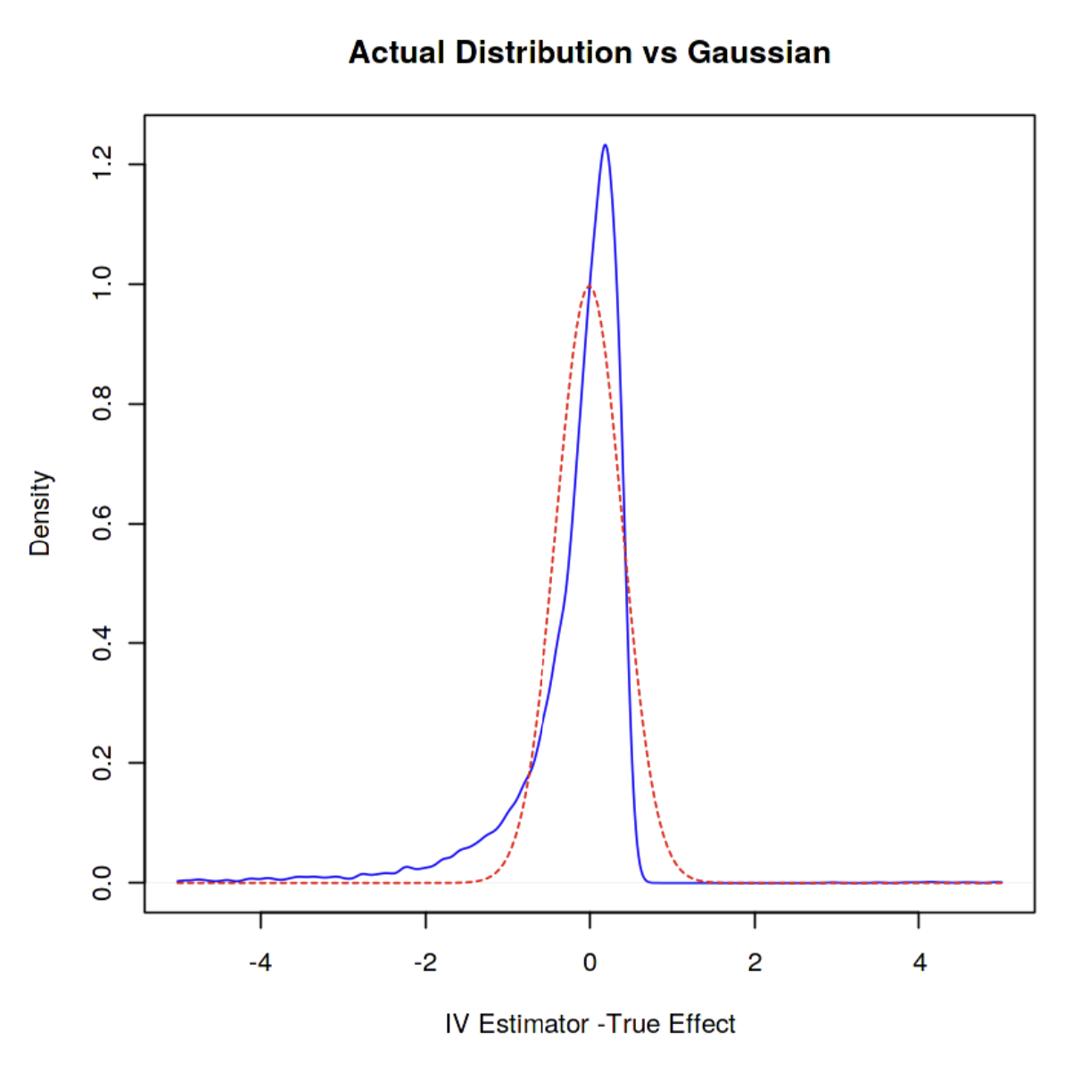

Weak Identification
If $E\left[\tilde{D}\tilde{Z}\right]$ is small and comparable with the sample size, then approximation
$$E_{n}{\left[\tilde{D}\tilde{Z}\right]}^{−1}≈E{\left[\tilde{D}\tilde{Z}\right]}^{−1}$$
Can be inaccurate in finite samples and normal based approximation will yield in-correct confidence intervals

Slide 58
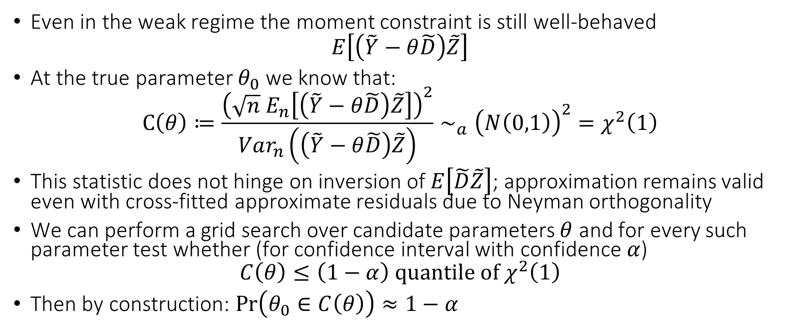
A More Robust Inference Approach
Even in the weak regime the moment constraint is still well-behaved
$$E\left[\left(\tilde{Y}−θ\tilde{D}\right)\tilde{Z}\right]$$
At the true parameter $θ_{0}$ we know that:
$$C\left(θ\right)≔\frac{{\left(\sqrt{n} E_{n}\left[\left(\tilde{Y}−θ\tilde{D}\right)\tilde{Z}\right]\right)}^{2}}{Var_{n}\left(\left(\tilde{Y}−θ\tilde{D}\right)\tilde{Z}\right)}∼_{a}{\left(N\left(0,1\right)\right)}^{2}=χ^{2}\left(1\right)$$
This statistic does not hinge on inversion of $E\left[\tilde{D}\tilde{Z}\right]$; approximation remains valid even with cross-fitted approximate residuals due to Neyman orthogonality
We can perform a grid search over candidate parameters $θ$ and for every such parameter test whether (for confidence interval with confidence $α$)
$$C\left(θ\right)≤\left(1−α\right) quantile of χ^{2}\left(1\right)$$
Then by construction: $\operatorname{Pr}\left(θ_{0}∈C\left(θ\right)\right)≈1−α$

Slide 59
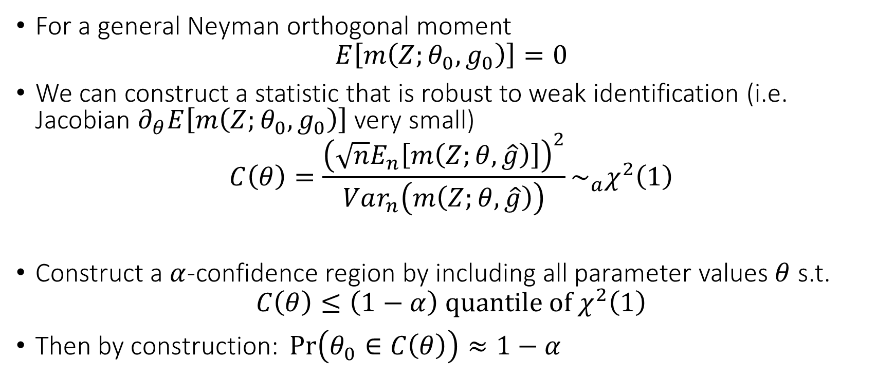
General Moments and Weak Identification
For a general Neyman orthogonal moment
$$E\left[m\left(Z;θ_{0},g_{0}\right)\right]=0$$
We can construct a statistic that is robust to weak identification (i.e. Jacobian $∂_{θ}E\left[m\left(Z;θ_{0},g_{0}\right)\right]$ very small)
$$C\left(θ\right)=\frac{{\left(\sqrt{n}E_{n}\left[m\left(Z;θ,\hat{g}\right)\right]\right)}^{2}}{Var_{n}\left(m\left(Z;θ,\hat{g}\right)\right)}\sim _{a}χ^{2}\left(1\right)$$
Construct a $α$-confidence region by including all parameter values $θ$ s.t.
$$C\left(θ\right)≤\left(1−α\right) quantile of χ^{2}\left(1\right)$$
$\text{Then} \text{by} \text{construction}\text{: }\operatorname{Pr}\left(θ_{0}∈C\left(θ\right)\right)≈1−α$

