Slide 1
MS&E 228: Directed Acyclic Graphs and Non-Linear SEMs
Vasilis Syrgkanis
MS&E, Stanford

Slide 2
Causal Inference with Experiments
Prediction with Linear Models
Prediction with High-Dim Linear Models
Inference on Causal and Predictive Effects with High-Dim Linear Models
Potential Outcomes and Conditional Ignorability
Structural Equation Models and Conditional Exogeneity
Directed Acyclic Graphs
Prediction with Non-Linear Models
Inference on Causal Effects with Non-Linear Models
Un-observed Confounding and Instruments
Identification of Causal Effects in Longitudinal Data
Estimation of Heterogeneous Causal Effects
Linear Predictive Models and Statistical Inference
Causal Identification in Observational Data
Non-Linear Predictive Models and Statistical Inference
Topics

Slide 3
Causal Inference with Experiments
Prediction with Linear Models
Prediction with High-Dim Linear Models
Inference on Causal and Predictive Effects with High-Dim Linear Models
Potential Outcomes and Conditional Ignorability
Structural Equation Models and Conditional Exogeneity
Directed Acyclic Graphs
Prediction with Non-Linear Models
Inference on Causal Effects with Non-Linear Models
Un-observed Confounding and Instruments
Identification of Causal Effects in Longitudinal Data
Estimation of Heterogeneous Causal Effects
Linear Predictive Models and Statistical Inference
Causal Identification in Observational Data
Non-Linear Predictive Models and Statistical Inference
Topics

Slide 4
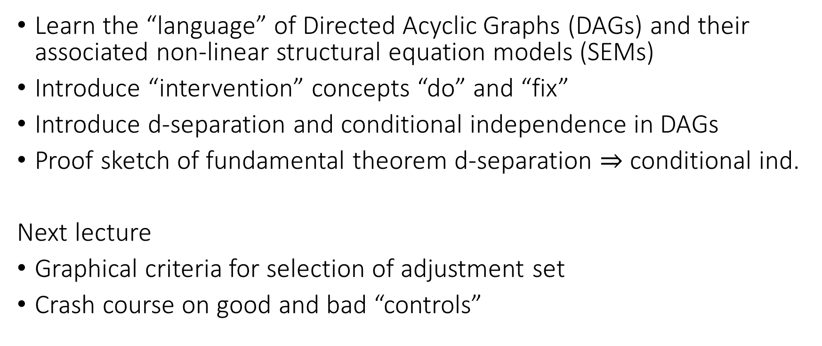
Goals for Today
Learn the “language” of Directed Acyclic Graphs (DAGs) and their associated non-linear structural equation models (SEMs)
Introduce “intervention” concepts “do” and “fix”
Introduce d-separation and conditional independence in DAGs
Proof sketch of fundamental theorem d-separation $⇒$ conditional ind.
Next lecture
Graphical criteria for selection of adjustment set
Crash course on good and bad “controls”

Slide 5
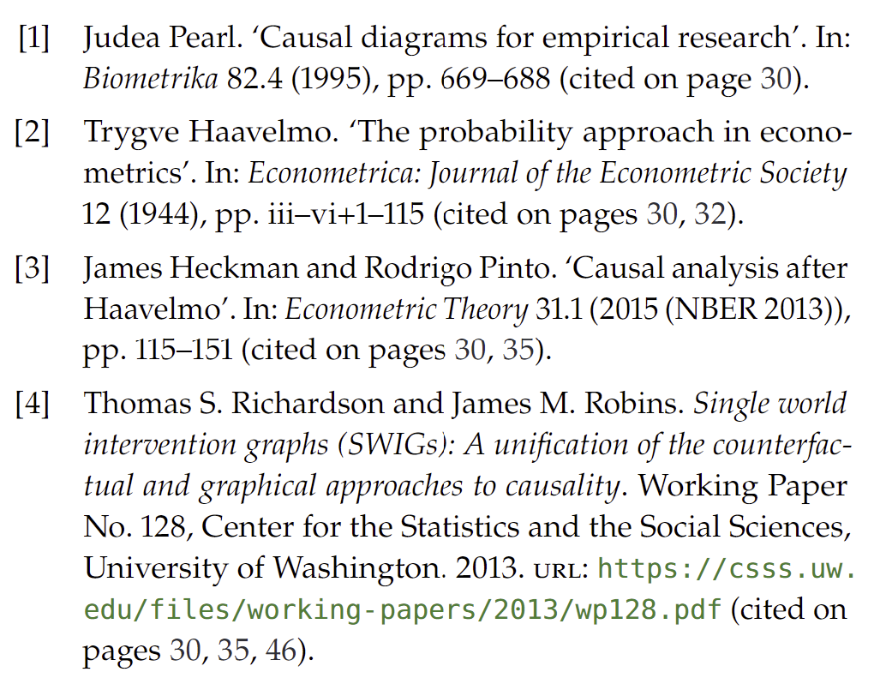
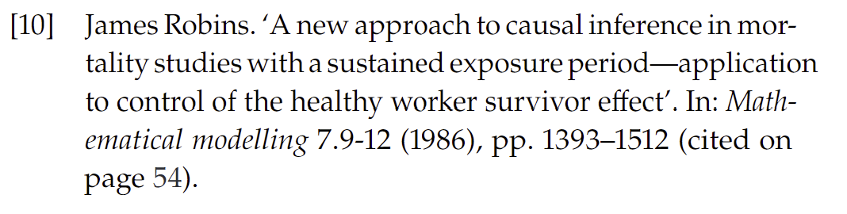
DAGs

Slide 6
Non-Linear SEMs

Slide 7
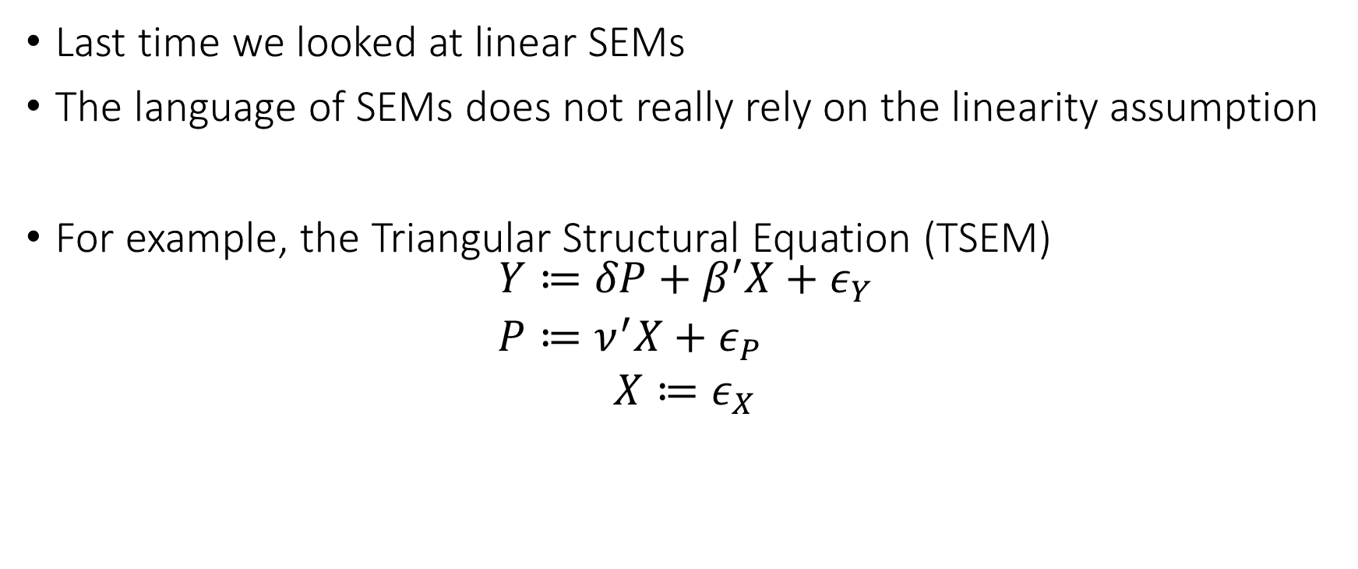
Non-Linear SEMs
Last time we looked at linear SEMs
The language of SEMs does not really rely on the linearity assumption
For example, the Triangular Structural Equation (TSEM)
$$\begin{aligned}Y≔&δP+β^{′}X+ε_{Y} \\ P≔&ν^{′}X+ε_{P} \\ X≔ε_{X}\end{aligned}$$

Slide 8
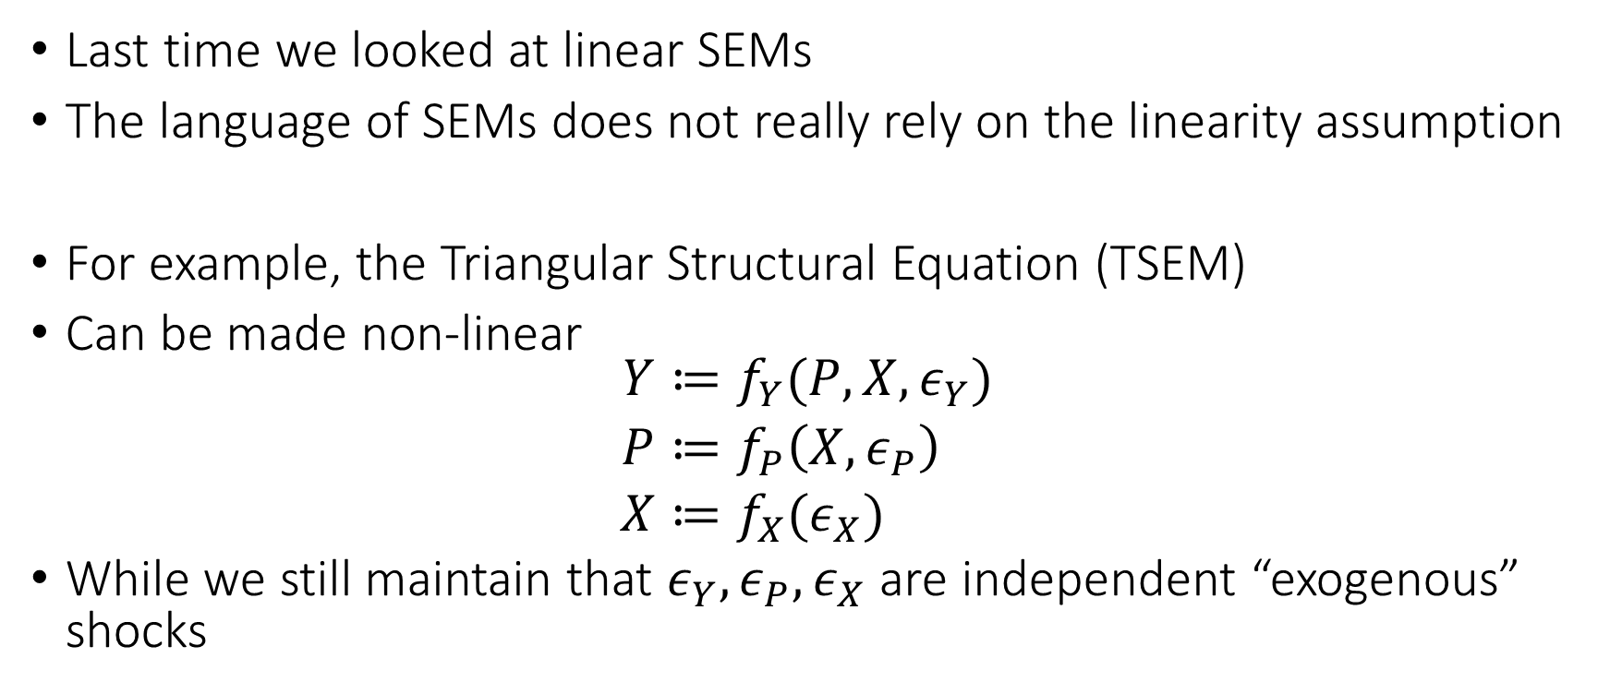
Non-Linear SEMs
Last time we looked at linear SEMs
The language of SEMs does not really rely on the linearity assumption
For example, the Triangular Structural Equation (TSEM)
Can be made non-linear
$$\begin{aligned}Y≔&f_{Y}(P,X,ε_{Y}) \\ P≔&f_{P}\left(X, ε_{P}\right) \\ X≔&f_{X}(ε_{X})\end{aligned}$$
While we still maintain that $ε_{Y},ε_{P},ε_{X}$ are independent “exogenous” shocks

Slide 9
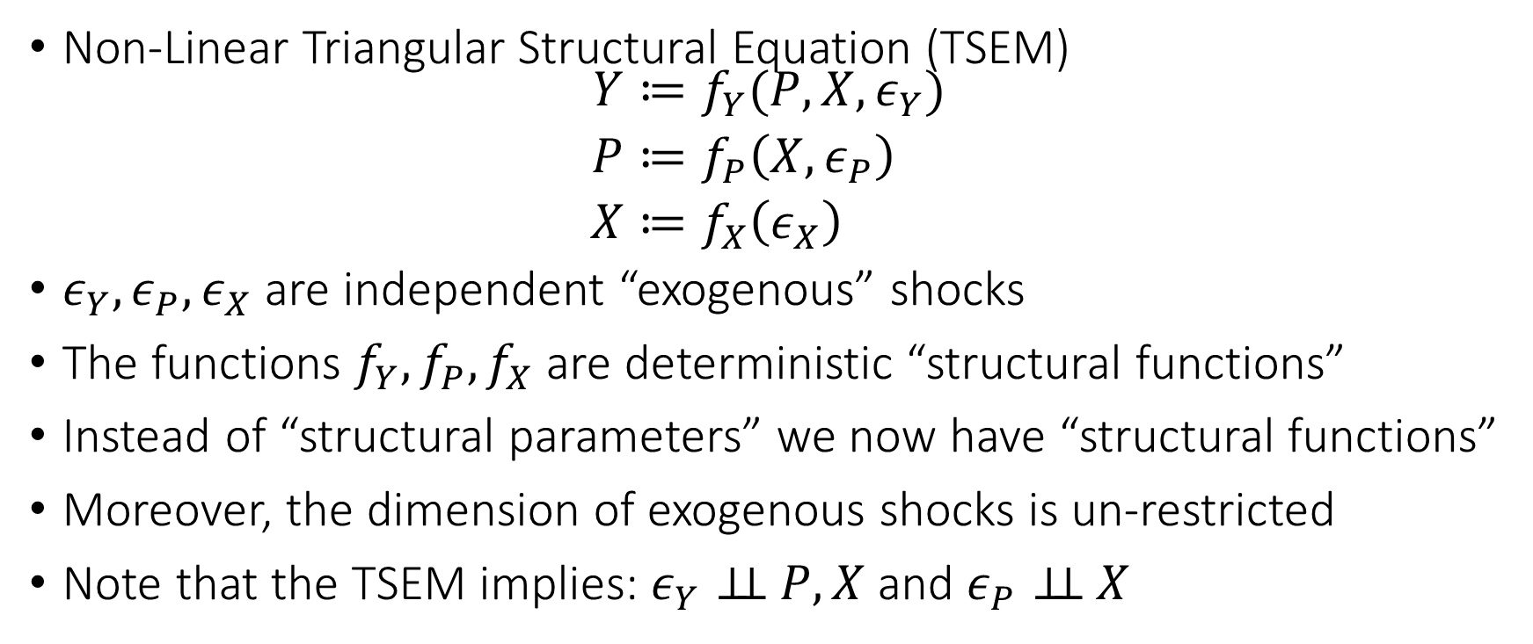
Non-Linear SEMs
Non-Linear Triangular Structural Equation (TSEM)
$$\begin{aligned}Y≔&f_{Y}(P,X,ε_{Y}) \\ P≔&f_{P}\left(X, ε_{P}\right) \\ X≔&f_{X}\left(ε_{X}\right)\end{aligned}$$
$ε_{Y},ε_{P},ε_{X}$ are independent “exogenous” shocks
The functions $f_{Y},f_{P},f_{X}$ are deterministic “structural functions”
Instead of “structural parameters” we now have “structural functions”
Moreover, the dimension of exogenous shocks is un-restricted
Note that the TSEM implies: $ε_{Y}⊥⊥ P,X$ and $ε_{P}⊥⊥ X$
Endogenously determined by the structural model
Exogenously determined “outside” of the model

Slide 10







Non-Linear SEMs
Non-Linear Triangular Structural Equation (TSEM)
$$\begin{aligned}Y≔&f_{Y}(P,X,ε_{Y}) \\ P≔&f_{P}\left(X, ε_{P}\right) \\ X≔&f_{X}\left(ε_{X}\right)\end{aligned}$$
$ε_{Y},ε_{P},ε_{X}$ are independent “exogenous” shocks
Endogenously determined by the structural model
Exogenously determined “outside” of the model
$$ε_{P}$$
$$P$$
$$ε_{P}$$
$$X$$
$$Y$$
$$ε_{Y}$$

Slide 11
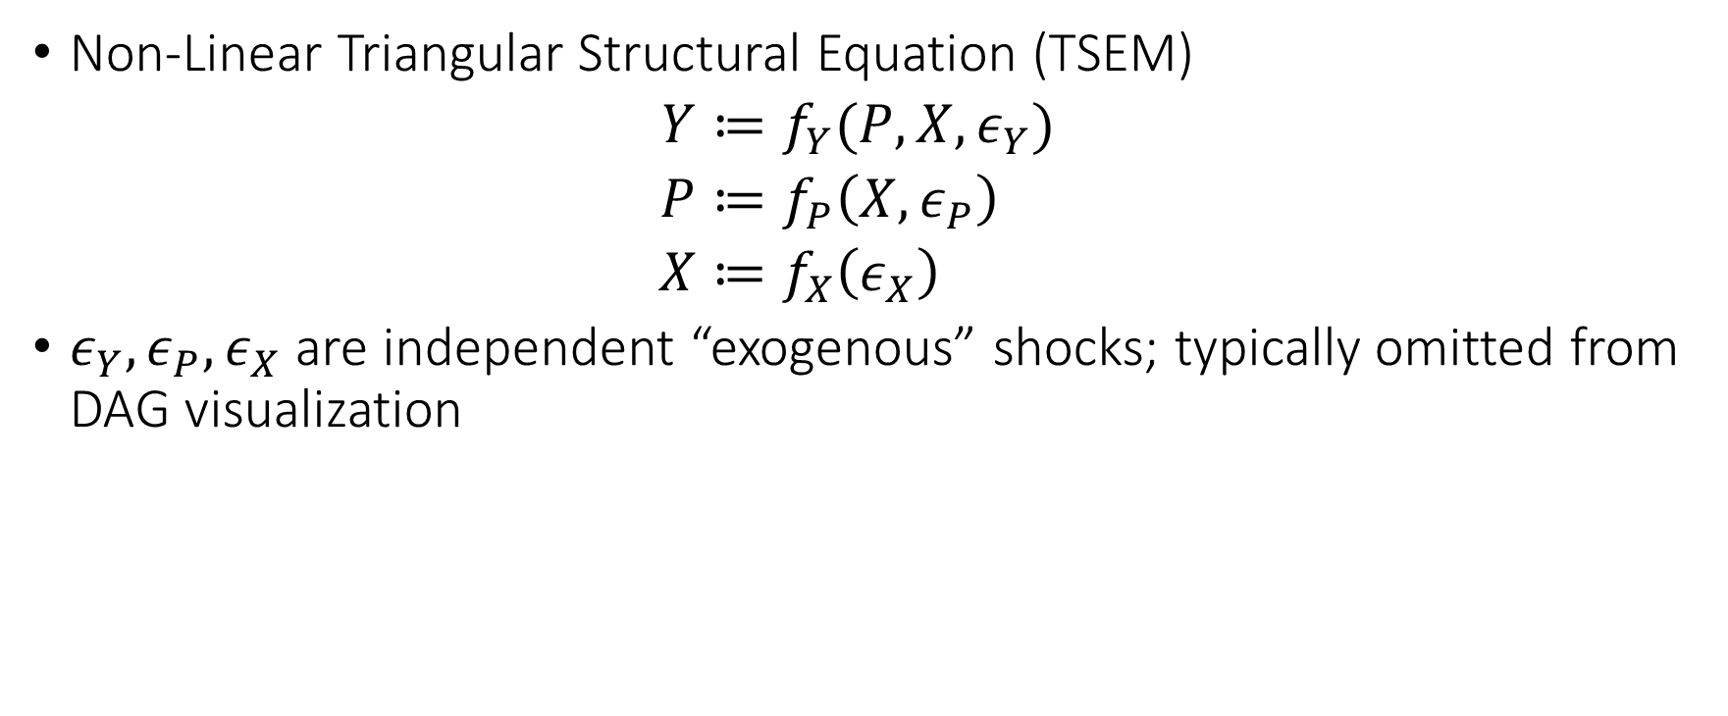
Non-Linear SEMs
Non-Linear Triangular Structural Equation (TSEM)
$$\begin{aligned}Y≔&f_{Y}(P,X,ε_{Y}) \\ P≔&f_{P}\left(X, ε_{P}\right) \\ X≔&f_{X}\left(ε_{X}\right)\end{aligned}$$
$ε_{Y},ε_{P},ε_{X}$ are independent “exogenous” shocks; typically omitted from DAG visualization
Endogenously determined by the structural model
Exogenously determined “outside” of the model
$$P$$
$$X$$
$$Y$$

Slide 12
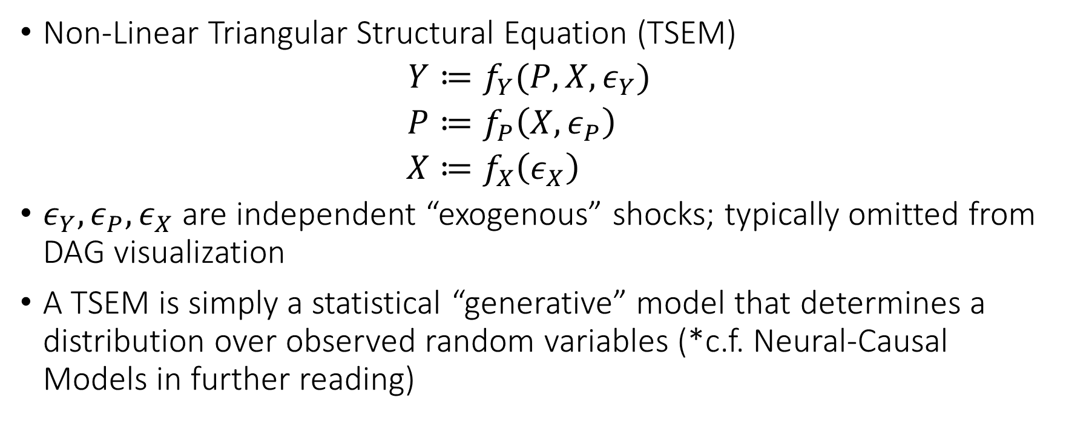
Non-Linear SEMs
Non-Linear Triangular Structural Equation (TSEM)
$$\begin{aligned}Y≔&f_{Y}(P,X,ε_{Y}) \\ P≔&f_{P}\left(X, ε_{P}\right) \\ X≔&f_{X}\left(ε_{X}\right)\end{aligned}$$
$ε_{Y},ε_{P},ε_{X}$ are independent “exogenous” shocks; typically omitted from DAG visualization
A TSEM is simply a statistical “generative” model that determines a distribution over observed random variables (*c.f. Neural-Causal Models in further reading)
Endogenously determined by the structural model
Exogenously determined “outside” of the model

Slide 13
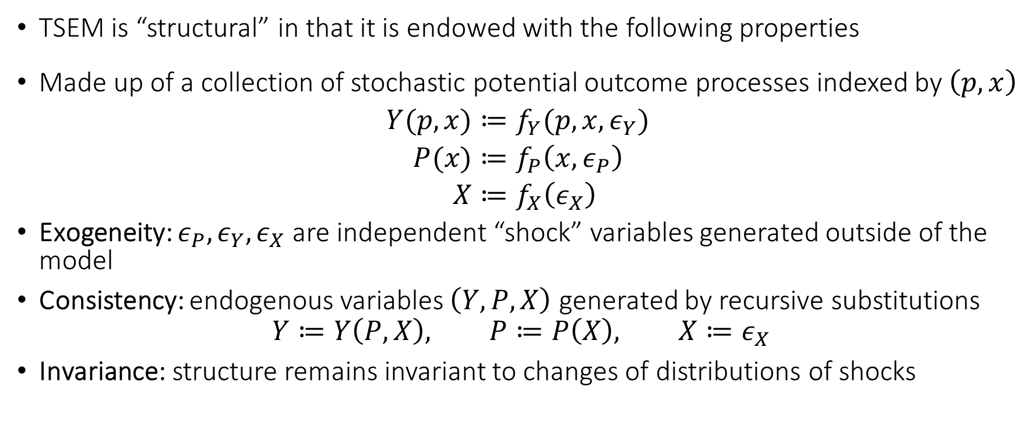
Structural Form
TSEM is “structural” in that it is endowed with the following properties
Made up of a collection of stochastic potential outcome processes indexed by $\left(p,x\right)$
$$\begin{aligned}Y(p,x)≔&f_{Y}(p,x,ε_{Y}) \\ P(x)≔&f_{P}\left(x, ε_{P}\right) \\ X≔&f_{X}\left(ε_{X}\right)\end{aligned}$$
Exogeneity: $ε_{P},ε_{Y},ε_{X}$ are independent “shock” variables generated outside of the model
Consistency: endogenous variables $\left(Y, P, X\right)$ generated by recursive substitutions
$$Y≔Y\left(P,X\right), P≔P\left(X\right), X≔ε_{X}$$
Invariance: structure remains invariant to changes of distributions of shocks

Slide 14
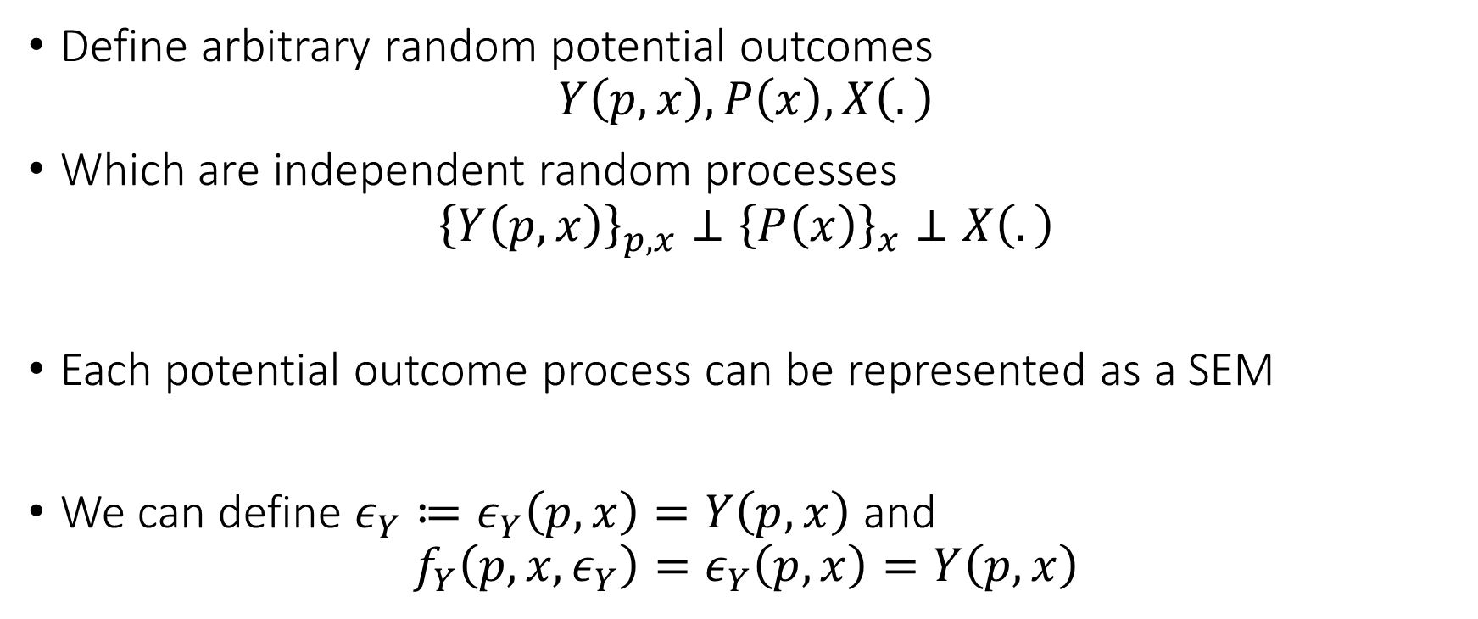
Link to Potential Outcomes
Define arbitrary random potential outcomes
$$Y\left(p,x\right),P\left(x\right), X\left(.\right)$$
Which are independent random processes
$${\left\{Y\left(p,x\right)\right\}}_{p,x}⊥{\left\{P\left(x\right)\right\}}_{x}⊥X\left(.\right)$$
Each potential outcome process can be represented as a SEM
We can define $ε_{Y}≔ε_{Y}\left(p,x\right)=Y\left(p,x\right)$ and
$$f_{Y}\left(p, x, ε_{Y}\right)=ε_{Y}\left(p,x\right)=Y\left(p,x\right)$$

Slide 15
The Language of Interventions and Intervention Counterfactuals

Slide 16








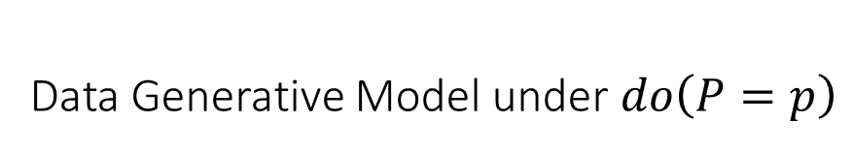

Do Interventions: $do\left(P=p\right)$
Original Data Generative Model
Data Generative Model under $do\left(P=p\right)$
$$\begin{aligned}Y≔&f_{Y}(P,X,ε_{Y}) \\ P≔&f_{P}\left(X, ε_{P}\right) \\ X≔&ε_{X}\end{aligned}$$
$$\left.\begin{matrix}Y \\ P \\ X\end{matrix}\right|do\left(P=p\right)\begin{aligned}≔&f_{Y}(p,X,ε_{Y}) \\ ≔ p \\ ≔&ε_{X}\end{aligned}$$
$$P$$
$$p$$
$$X$$
$$Y$$
$$X$$
$$Y\left(p\right)$$

Slide 17
Interventions
Do-interventions is only one way of defining counterfactuals
We can define any type of counterfactual by simply changing one of the equations to something else
Wright in his seminal work in ‘28 defined an intervention where the demand equation was replaced by another one that reflects a tax hike
We can also define “soft-interventions”: increase price by 10% of its current value
Another useful variant of do-interventions does not replace the treatment equation are “fix” interventions

Slide 18




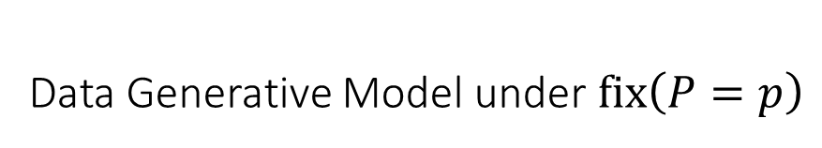
Fix Interventions: $fix\left(P=p\right)$
Original Data Generative Model
Data Generative Model under $fix\left(P=p\right)$
$$\begin{aligned}Y≔&f_{Y}(P,X,ε_{Y}) \\ P≔&f_{P}\left(X, ε_{P}\right) \\ X≔&ε_{X}\end{aligned}$$
$$\left.\begin{matrix}Y \\ P \\ X\end{matrix}\right|fix\left(P=p\right)\begin{aligned}≔&f_{Y}(p,X,ε_{Y}) \\ ≔ f_{P}\left(X, ε_{P}\right) \\ ≔&ε_{X}\end{aligned}$$
$$P$$
$$P$$
$$p$$
$$X$$
$$Y$$
$$X$$
$$Y\left(p\right)$$

Slide 19
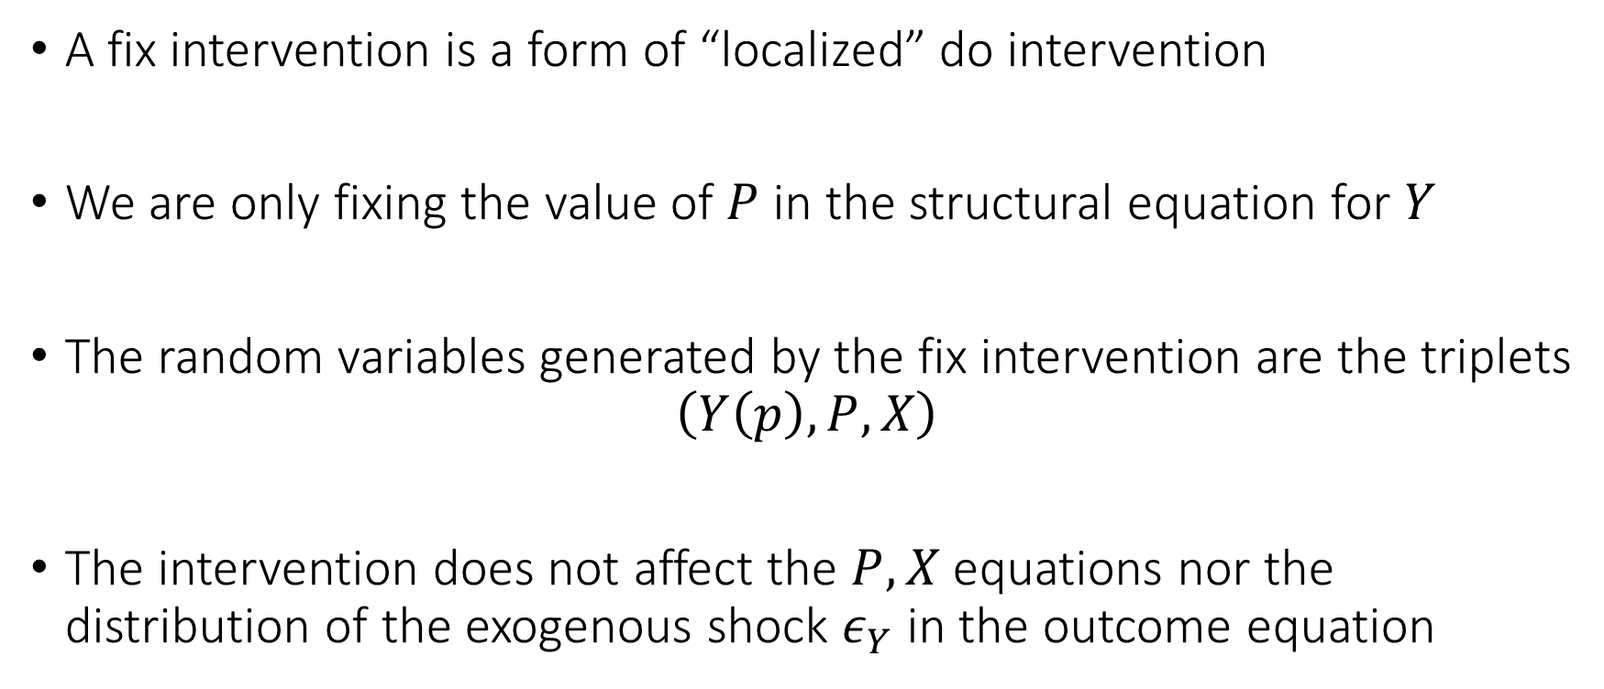
Fix Interventions
A fix intervention is a form of “localized” do intervention
We are only fixing the value of $P$ in the structural equation for $Y$
The random variables generated by the fix intervention are the triplets
$$\left(Y\left(p\right),P,X\right)$$
The intervention does not affect the $P,X$ equations nor the distribution of the exogenous shock $ε_{Y}$ in the outcome equation

Slide 20
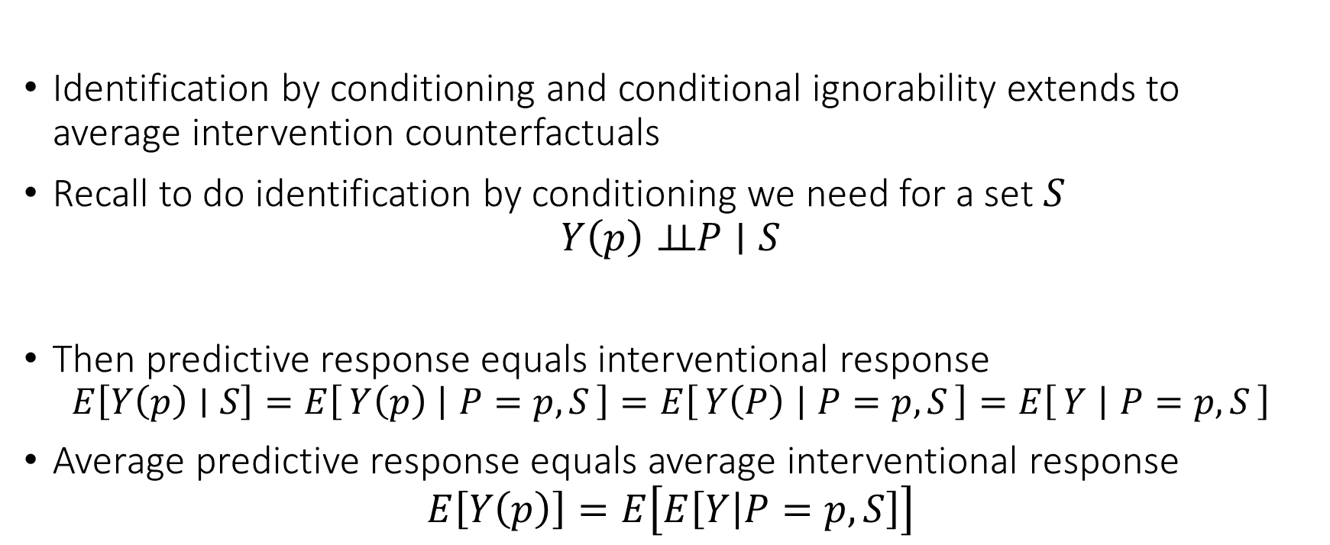
Conditional Ignorability and Mean Intervention Counterfactuals
Identification by conditioning and conditional ignorability extends to average intervention counterfactuals
Recall to do identification by conditioning we need for a set $S$
$$Y\left(p\right)⊥⊥P∣S$$
Then predictive response equals interventional response
$$E\left[Y\left(p\right)∣S\right]=E\left[Y\left(p\right) ∣ P=p,S\right]=E\left[Y\left(P\right) ∣ P=p, S\right]=E\left[Y ∣ P=p,S\right]$$
Average predictive response equals average interventional response
$$E\left[Y\left(p\right)\right]=E\left[E\left[Y | P=p,S\right]\right]$$

Slide 21
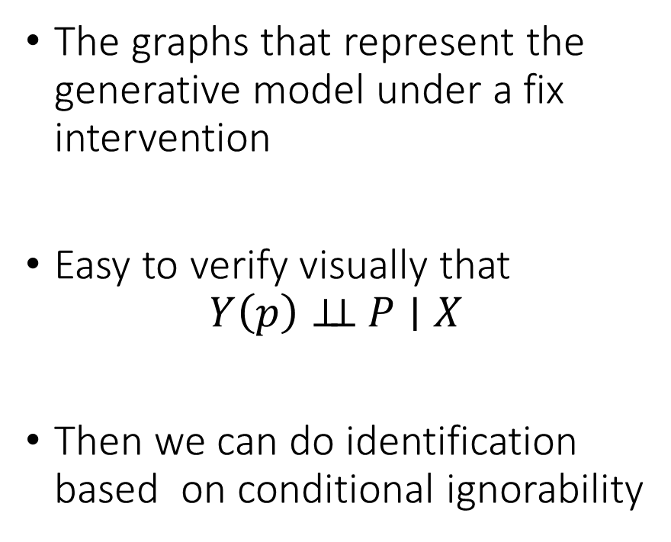

Single World Intervention Graphs
Data Generative Model under $fix\left(P=p\right)$
The graphs that represent the generative model under a fix intervention
Easy to verify visually that
$$Y\left(p\right)⊥⊥ P∣X$$
Then we can do identification based on conditional ignorability
$$\left.\begin{matrix}Y \\ P \\ X\end{matrix}\right|fix\left(P=p\right)\begin{aligned}≔&f_{Y}(p,X,ε_{Y}) \\ f_{P}\left(X, ε_{P}\right) \\ ≔&ε_{X}\end{aligned}$$
$$P$$
$$p$$
$$X$$
$$Y\left(p\right)$$
Single World Intervention Graph

Slide 22

Non-Linear versions of structural equation models are equivalent to Directed Acyclic Graphs

Slide 23


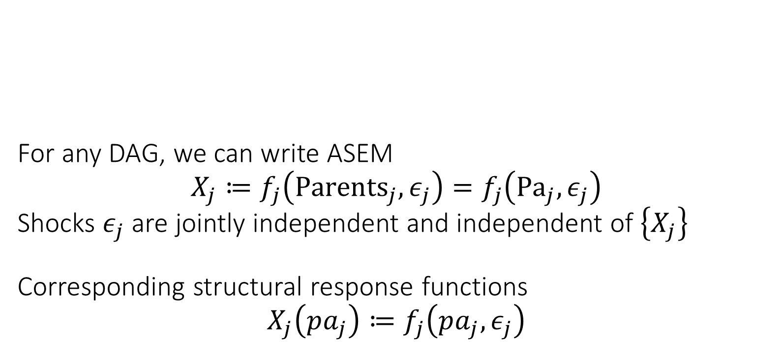




For any DAG, we can write ASEM $$X_{j}≔f_{j}\left({Parents}_{j}, ε_{j}\right)=f_{j}\left({Pa}_{j},ε_{j}\right)$$ Shocks $ε_{j}$ are jointly independent and independent of $\left\{X_{j}\right\}$ Corresponding structural response functions $$X_{j}\left(pa_{j}\right)≔f_{j}\left(pa_{j},ε_{j}\right)$$
$$ε_{D}$$
$$D$$
$$ε_{P}$$
$$X$$
$$Y$$
$$ε_{Y}$$
Exogenously determined “outside” of the model
Endogenously determined by the structural model
Shocks can be multi-dimensional e.g. separate shock variable per parental value
Potential/Counterfactual Outcome Processes
Structural Response Function
Potential values of parents

Slide 24


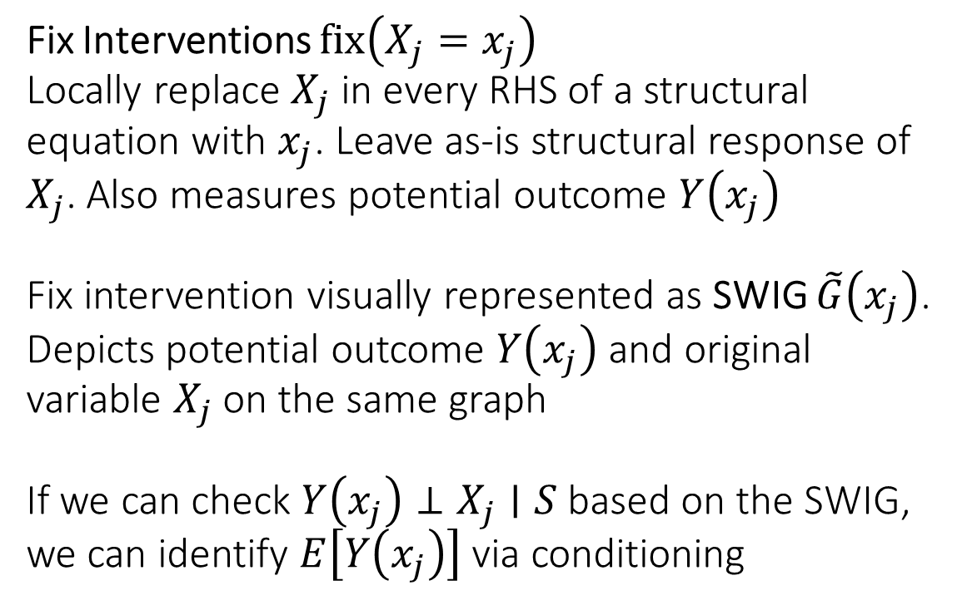
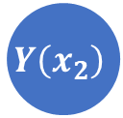
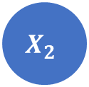


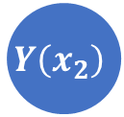
Fix Interventions $fix\left(X_{j}=x_{j}\right)$ Locally replace $X_{j}$ in every RHS of a structural equation with $x_{j}$. Leave as-is structural response of $X_{j}$. Also measures potential outcome $Y\left(x_{j}\right)$ Fix intervention visually represented as SWIG $\tilde{G}\left(x_{j}\right)$. Depicts potential outcome $Y\left(x_{j}\right)$ and original variable $X_{j}$ on the same graph If we can check $Y\left(x_{j}\right)⊥X_{j}∣S$ based on the SWIG, we can identify $E\left[Y\left(x_{j}\right)\right]$ via conditioning
$$x_{2}$$
$$X_{1}$$
$$Y\left(x_{2}\right)$$
$$X_{2}$$
$$x_{2}$$
$$X_{1}$$
$$Y\left(x_{2}\right)$$

Slide 25
Graphical Criteria for Conditional Independence

Slide 26
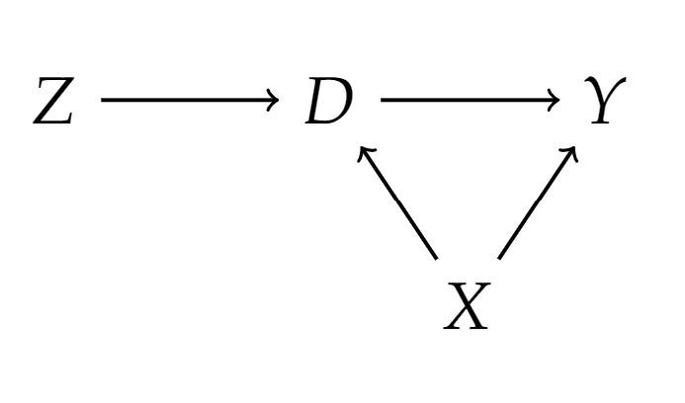
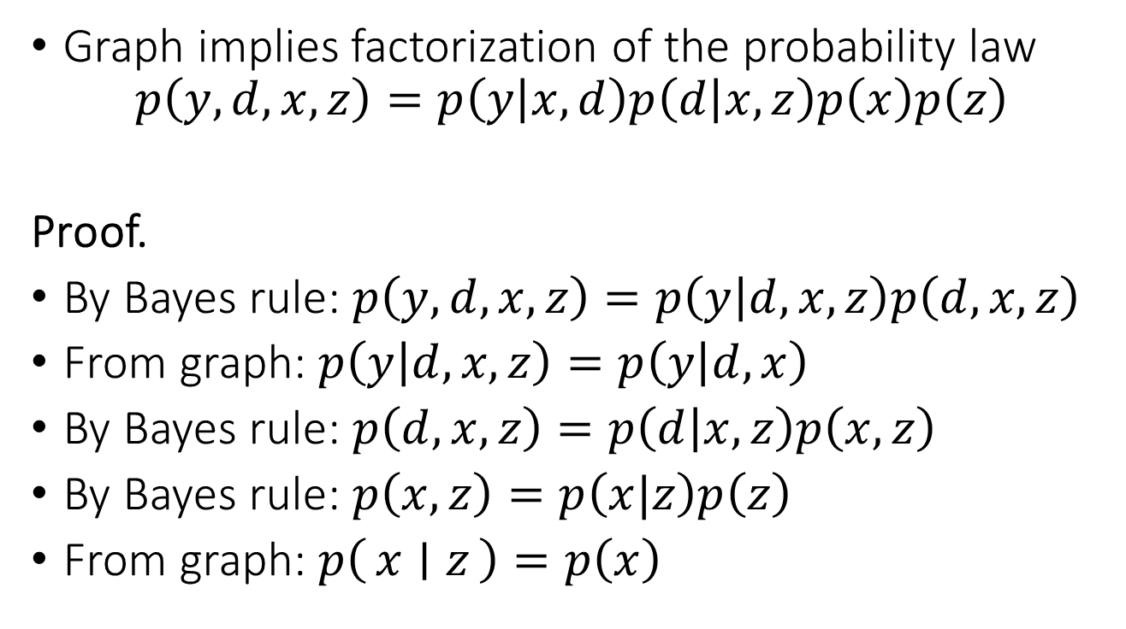
DAGs Encode Factorization of Probability
Graph implies factorization of the probability law
$$p\left(y,d,x,z\right)=p\left(y | x,d\right)p\left(d | x,z\right)p\left(x\right)p\left(z\right)$$
Proof.
By Bayes rule: $p\left(y,d,x,z\right)=p\left(y | d,x,z\right)p\left(d,x,z\right)$
From graph: $p\left(y | d,x,z\right)=p\left(y | d,x\right)$
By Bayes rule: $p\left(d, x,z\right)=p\left(d | x,z\right)p\left(x,z\right)$
By Bayes rule: $p\left(x,z\right)=p\left(x|z\right)p\left(z\right)$
From graph: $p\left(x ∣ z\right)=p\left(x\right)$

Slide 27

General DAGs and Factorization
The probability law factorizes as:
$$p\left({\left\{x_{ℓ}\right\}}_{ℓ∈V}\right)=\prod_{ℓ∈V}{p\left(x_{ℓ} | pa_{ℓ}\right)}$$

Slide 28

DAGs Encode Conditional Independencies
Any two variables $X, Y$ are independent conditional on a set $S$ if they are D(irected)-separated in the graph
$${\left(X⊥⊥_{ _d}Y ∣ S\right)}_{G} ⇒ X⊥⊥Y∣S$$
Need to define the concept of D-separation

Slide 29




Graph Separation and Conditional Independence
Looking at a graph, when can we conclude that
$$X⊥⊥ Y∣Z$$
Case 1:
Z is common cause
Case 2:
Z is mediator
Case 3:
Z is collider
X
Z
X
Z
X
Z
Y
Y
Y
$$\begin{aligned}p\left(x,y,z\right)=&p\left(x ∣ z\right)⋅p\left(y ∣ z\right)⋅p\left(z\right) \\ =&f\left(x,z\right)⋅g\left(y,z\right)\end{aligned}$$
$$\begin{aligned}p\left(x,y,z\right)=&p\left(z ∣ x\right)⋅p\left(x\right)⋅p\left(y∣z\right) \\ =&f\left(x,z\right)⋅g\left(y,z\right)\end{aligned}$$
$$\begin{aligned}p\left(x,y,z\right)=&p\left(z ∣ x,y\right)⋅p\left(x\right)⋅p\left(y\right) \\ ≠&f\left(x,z\right)⋅g\left(y,z\right)\end{aligned}$$

Slide 30
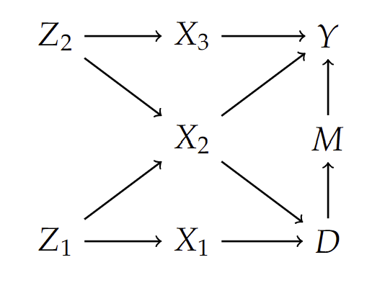
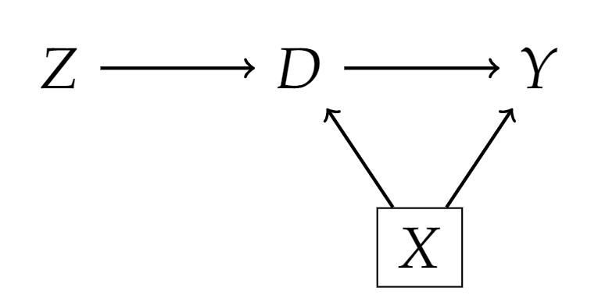
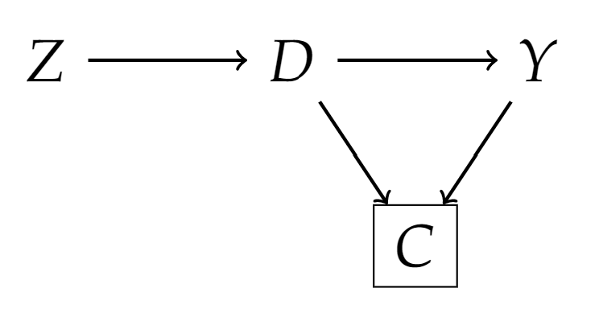

Some Graph Definitions
A path $π$ in a graph is blocked by a set of nodes $S$ if
Either $π$ contains a chain $i→m→j$ or a fork $i←m→j$ and $m∈S$
Or $π$ contains a collider $i→m←j$ and neither $m$ nor its descendants are in $S$

Slide 31

D-Separation
In a DAG $G$, two nodes $X, Y$ are D-separated by s set of nodes $S$ if $S$ blocks all paths between $X$ and $Y$
We denote it as:
$${\left(X⊥⊥_{ _d}Y ∣ S\right)}_{G}$$

Slide 32

D-separation implies conditional independency
$${\left(X⊥⊥_{ _d}Y ∣ S\right)}_{G} ⇒ X⊥⊥Y∣S,$$
$$(Verma, Pearl,^{′}88)$$

Slide 33
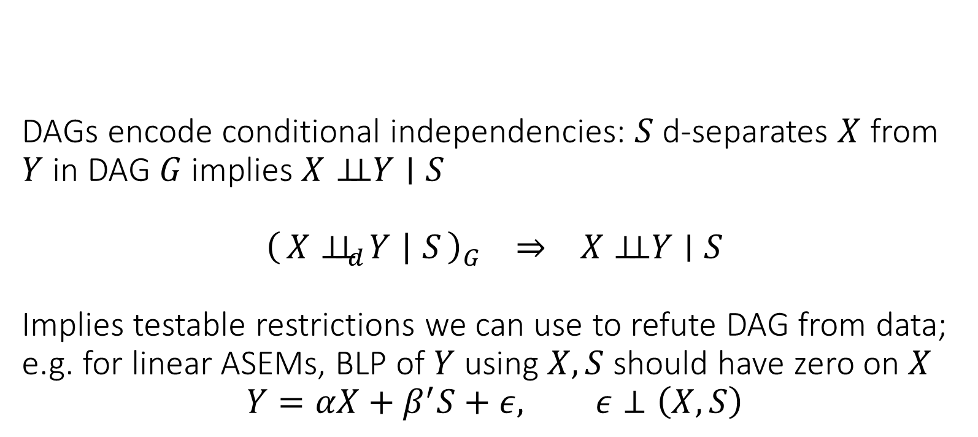
DAGs encode conditional independencies: $S$ d-separates $X$ from $Y$ in DAG $G$ implies $X⊥⊥Y∣S$ $${\left(X⊥⊥_{d}Y ∣ S\right)}_{G} ⇒ X⊥⊥Y∣S$$ Implies testable restrictions we can use to refute DAG from data; e.g. for linear ASEMs, BLP of $Y$ using $X, S$ should have zero on $X$ $$Y=αX+β^{′}S+ε, ε⊥\left(X,S\right)$$
Test whether it is non-zero!

Slide 34




$X$ is d-separated from $Y$ by $S$ if every path from $X$ to $Y$ is blocked. $S$ blocks a path if one of the following holds: - path contains chain $X→M→Y$ or fork $X←M→Y$ and $M∈S$ - path contains collider $X→M←Y$ and neither $M$ nor its descendants are in $S$
unblocked chain
unblocked fork
$$S$$
$$X$$
opened collider path
blocked chain
$$Y$$
blocked fork
collider path

Slide 35
Graphical Criteria for Valid Adjustment Sets

Slide 36
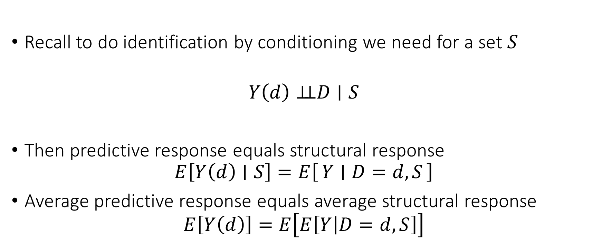
Conditional Ignorability
Recall to do identification by conditioning we need for a set $S$
$$Y\left(d\right)⊥⊥D∣S$$
Then predictive response equals structural response
$$E\left[Y\left(d\right)∣S\right]=E\left[Y ∣ D=d,S\right]$$
Average predictive response equals average structural response
$$E\left[Y\left(d\right)\right]=E\left[E\left[Y | D=d,S\right]\right]$$

Slide 37

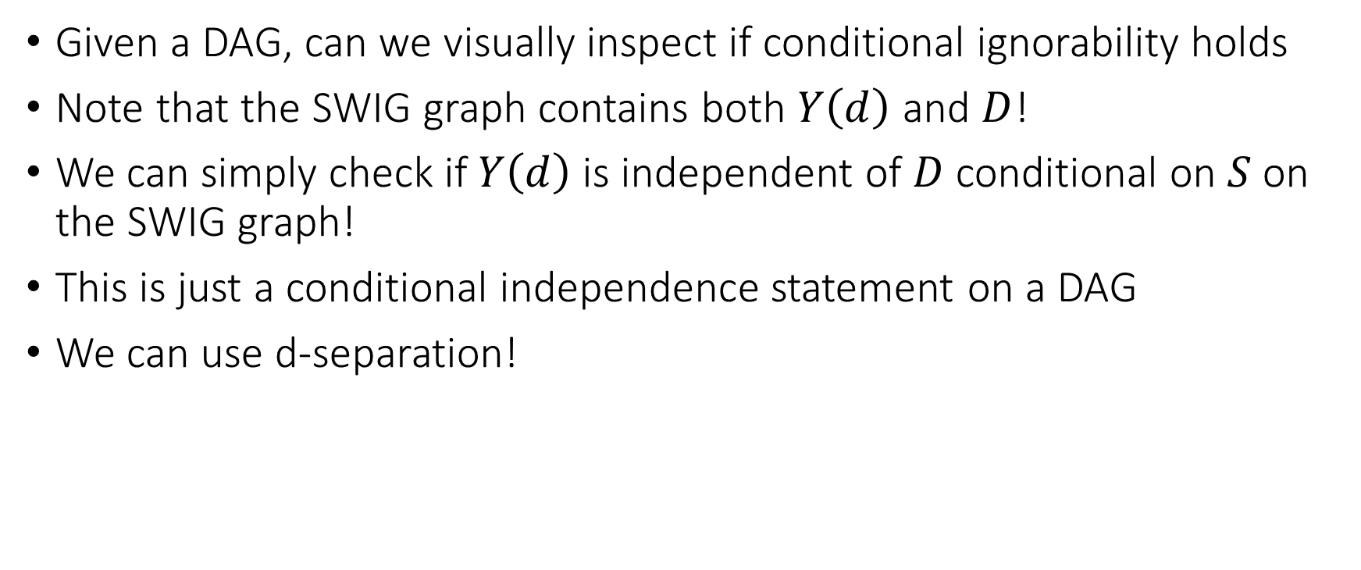


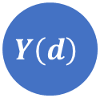
How can we check Conditional Ignorability
Given a DAG, can we visually inspect if conditional ignorability holds
Note that the SWIG graph contains both $Y\left(d\right)$ and $D$!
We can simply check if $Y\left(d\right)$ is independent of $D$ conditional on $S$ on the SWIG graph!
This is just a conditional independence statement on a DAG
We can use d-separation!
$$D$$
$$d$$
$$X$$
$$Y\left(d\right)$$

Slide 38



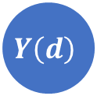


Conditional ignorability between treatment $D$ and outcome $Y$ conditional on set $S$ holds if $Y\left(d\right)$ is d-separated from $D$ on SWIG $\tilde{G}(d)$ induced by $fix\left(D=d\right)$ by the set $S$
$$D$$
$$d$$
$$X$$
$$Y\left(d\right)$$
$$S$$

Slide 39
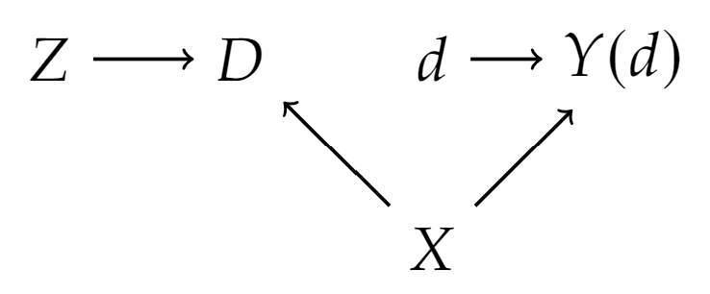
Example

Slide 40
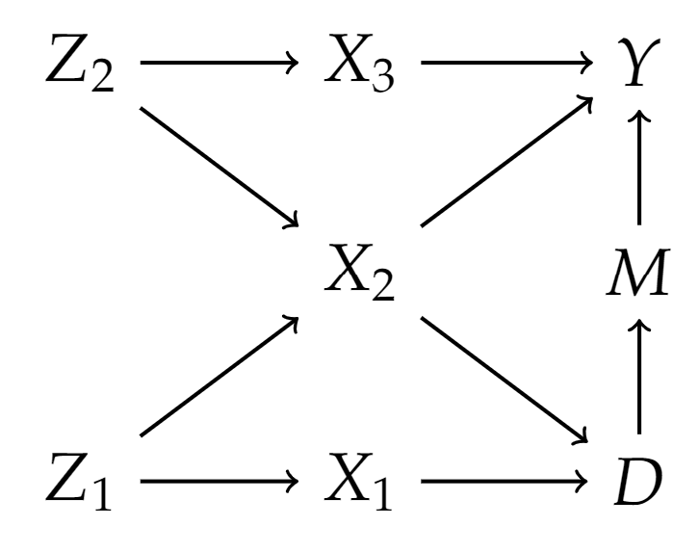
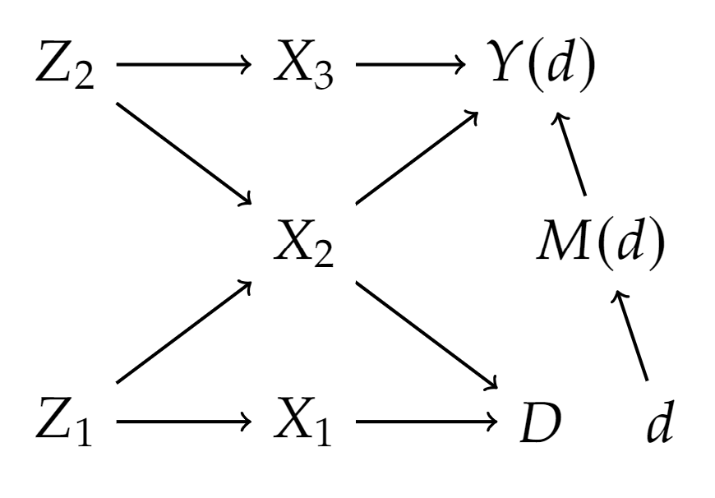
Example

Slide 41
Useful Adjustment Strategies

Slide 42
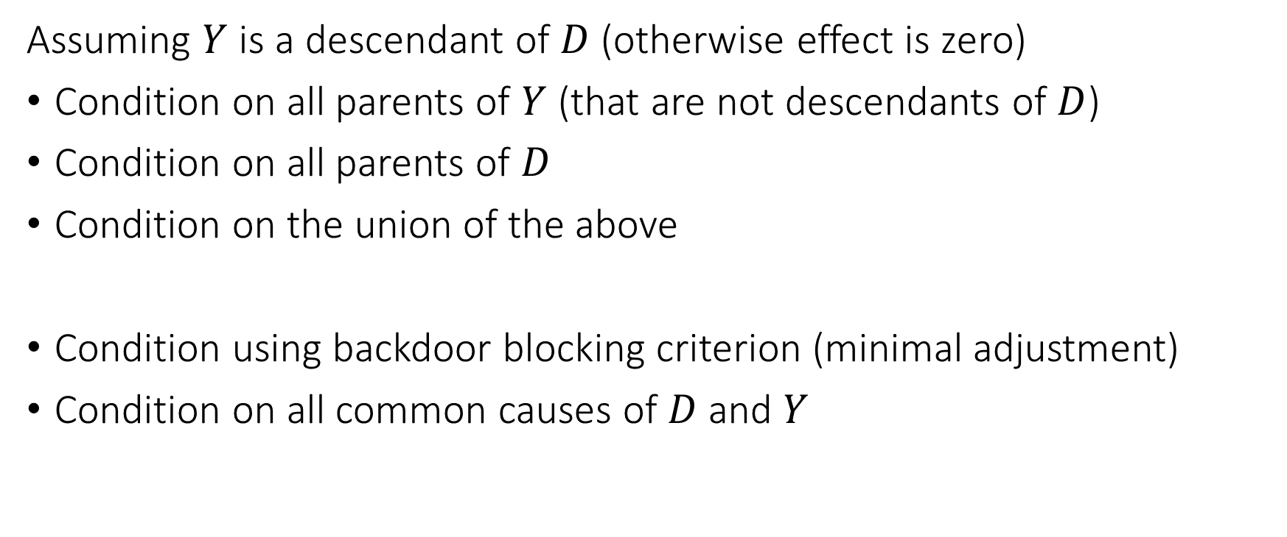
Adjustment Strategies
Assuming $Y$ is a descendant of $D$ (otherwise effect is zero)
Condition on all parents of $Y$ (that are not descendants of $D$)
Condition on all parents of $D$
Condition on the union of the above
Condition using backdoor blocking criterion (minimal adjustment)
Condition on all common causes of $D$ and $Y$

Slide 43

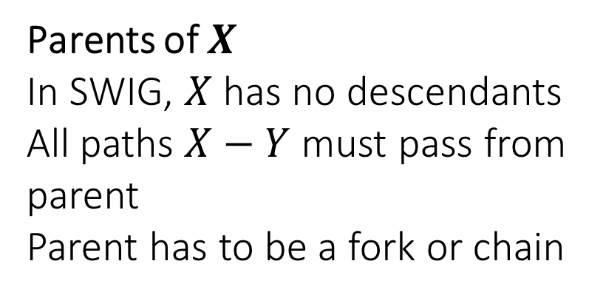




Conditioning on Parents
Empirically widely used strategy
Requires only partial knowledge of the graph
If we only know the parents of $D$ or the parents of $Y$ we are ok
Adding any further set to the parent strategy maintains validity
$$S$$
Parents of $X$
In SWIG, $X$ has no descendants
All paths $X−Y$ must pass from parent
Parent has to be a fork or chain
$$X$$
$$Y$$
SWIG
$$x$$

Slide 44

Backdoor Blocking
Non-directed path: a path from $Y$ to $D$ that has some reverse edge $←$
Backdoor path: a non-directed path from $Y$ to $D$ that ends with a $→$
$S$ is a valid adjustment set if it contains no descendant of $D$ and all backdoor paths from $Y$ to $D$ are blocked
Allows us to find minimal adjustment sets (small size)

Slide 45
Example

Slide 46

All Common Causes
Consider all common ancestors of $D$ and $Y$
These are called the “common causes of $D$ and $Y$”
Very common empirical practice
More conservative version: union of ancestors of $D$ and $Y$
Any backdoor path from $Y$ to $D$ must either contain a common ancestor or contain a collider
Conditioning on common ancestors blocks all paths that don’t contain a collider

Slide 47
Good and Bad Controls

Slide 48
High Level Categorization of Variables
Pre-treatment variables: variables whose value is determined before the assignment of the treatment
Post-treatment variables: variables whose value is determined after the assignment of the treatment

Slide 49

Good and Bad Controls: High Level
Pre-treatment variables that are ancestors of either $D$ or $Y$ are ok controls (worst-case can hurt precision/variance)
There exist pre-treatment variables not of that sort, that can lead to wrong answer (M-bias)
Most post-treatment variables are bad controls (or don’t do much)
Typically introduce either mediation bias or collider bias (Heckman selection)

Slide 50
“Pre-Treatment Variables”

Slide 51

Examples: Good Controls
Notes:
-

Slide 52
Example of Proxy
Effect of Prenatal Multivitamin consumption (D) on birth defects (Y)
Prior family history of birth defects (Z) can influence mother’s decision for multivitamin consumption
Unmeasured genetic factors (U) cause family history (Z) of birth defects
Unmeasured genetic factors (U) have direct influence on birth defects (Y)
Family history of birth defects is a good proxy control for unmeasured genetic factors

Slide 53

Examples: Good Controls

Slide 54

Examples: Neutral Controls

Slide 55

Examples: Pre-Treatment Variable that is Bad Control

Slide 56

Example: Pre-Treatment Variable that is Bad Control

Slide 57

Example: Homophily Bias in Peer Effects
Peer effects on civic engagement level
Consider samples of pairs of friends
D is civic engagement of one friend at time t
Y is civic engagement of other friend at time t+1
Civic engagement can be driven by personal traits $U_{1}$ and $U_{2}$ that are independently drawn well before friendship and affect civic engagement (e.g. level of altruism)
Friendship Z driven also by personal traits (homophily)
By looking at pairs of friends we are implicitly conditioning on $Z$

Slide 58

Example: M-Bias not robust to perturbation

Slide 59
“Post-Treatment Variables”

Slide 60

Example: Bad Controls, Mediation Bias

Slide 61

Example: Exception to Mediation Bias

Slide 62

Example: Controlled Direct Effect Gone Wrong

Slide 63

Example: Bad Controls, Collider (Heckman Selection) bias

Slide 64

Concluding Remarks
Any study that claims it is estimating the effect of $D$ on $Y$ by conditioning on $S$ must be based on a rigorous thought process
The DAG/ASEM framework is a rigorous form of this process
Enables explicit incorporation of domain knowledge in a domain expert friendly manner
Automatic identification arguments and testable restrictions
Effective in communicating assumptions of observational study

Slide 65
Proving the Main Theorem!

Slide 66

Proof Step 1
A set of nodes $X$ is called ancestral if all ancestors of $X$ are in $X$
Removing all nodes outside of an ancestral set and looking at the resulting graph and ASEM, the probability law is the same as the probability law of $X$ in the original graph (exercise)

Slide 67





Proof Step 2
Suppose that a set of nodes $X$ is D-separated from a set of nodes $Y$ by a set of nodes $S$
And that $X∪Y∪S$ is the set of all nodes
$$X$$
$$X$$
$$S$$
$$Y$$

Slide 68



Proof Step 2
Let $S_{1}$ the subset of $S$ that has a parent in $X$. Let $S_{2}$ the remainder.
It has to be that $Pa\left(X∪S_{1}\right)∈X∪S$
It has to be that $Pa\left(Y∪S_{2}\right)∈Y∪S$
$$X$$
$$S_{2}$$
$$X$$
$$Y$$
$$S_{1}$$

Slide 69

Proof Step 2
We can factorize:
$$p\left(x,y,s\right)=\prod_{W∈X∪S_{1}}{p\left(w | pa_{W}\right)}\prod_{W∈Y∪S_{2}}{p\left(w | pa_{W}\right)}=f\left(x,s_{1}\right)g\left(y,s_{2}\right)$$
$$X$$
$$S_{2}$$
$$X$$
$$Y$$
$$S_{1}$$

Slide 70

Proof Step 2
We can factorize:
$$p\left(x,y,s\right)=\prod_{W∈X∪S_{1}}{p\left(w | pa_{W}\right)}\prod_{W∈Y∪S_{2}}{p\left(w | pa_{W}\right)}=f\left(x,s_{1}\right)g\left(y,s_{2}\right)$$
Implies that:
$$X⊥⊥ Y∣S$$

Slide 71






Final Step
By first step, we can restrict to ancestral set of $X∪Y∪S$
Does not change conditional independence relations (exercise)
Does not change d-separation relations (exercise)
Define $X$ nodes in ancestral set of $X∪Y∪S$ not d-separated from X
Define $Y$ the remainder of nodes in ancestral set not in $X, S$.
$$X$$
$$S$$
$$X$$
$$Y$$
$$X$$

Slide 72






Final Step
By definition of d-separation, $S$ must d-separate $X$ from $Y$ (exercise)
We can invoke previous critical lemma
$$X$$
$$S$$
$$X$$
$$Y$$
$$X$$

Slide 73

Final Step
By marginalization
$$p\left(x,y,s\right)=∫∫p\left(x, x^{′},y, y^{′},s\right)dx^{′} dy^{′}$$
By step 2
$$p\left(x,y,s\right)=∫∫f\left(x,x^{′},s\right) g(y,y^{′},s) dx^{′} dy^{′}$$
We can split integrals
$$p\left(x,y,s\right)=∫f\left(x,x^{′},s\right)dx^{′}∫g(y,y^{′},s) dy^{′}$$
Thus
$$p\left(x,y,s\right)=\overline{f}\left(x,s\right)\overline{g}\left(y, s\right)⇒X⊥⊥ Y∣S$$

