Slide 1
MS&E 228: Directed Acyclic Graphs and Non-Linear SEMs
Vasilis Syrgkanis
MS&E, Stanford

Slide 2
Causal Inference with Experiments
Prediction with Linear Models
Prediction with High-Dim Linear Models
Inference on Causal and Predictive Effects with High-Dim Linear Models
Potential Outcomes and Conditional Ignorability
Structural Equation Models and Conditional Exogeneity
Directed Acyclic Graphs
Prediction with Non-Linear Models
Inference on Causal Effects with Non-Linear Models
Un-observed Confounding and Instruments
Identification of Causal Effects in Longitudinal Data
Estimation of Heterogeneous Causal Effects
Linear Predictive Models and Statistical Inference
Causal Identification in Observational Data
Non-Linear Predictive Models and Statistical Inference
Topics

Slide 3
Causal Inference with Experiments
Prediction with Linear Models
Prediction with High-Dim Linear Models
Inference on Causal and Predictive Effects with High-Dim Linear Models
Potential Outcomes and Conditional Ignorability
Structural Equation Models and Conditional Exogeneity
Directed Acyclic Graphs
Prediction with Non-Linear Models
Inference on Causal Effects with Non-Linear Models
Un-observed Confounding and Instruments
Identification of Causal Effects in Longitudinal Data
Estimation of Heterogeneous Causal Effects
Linear Predictive Models and Statistical Inference
Causal Identification in Observational Data
Non-Linear Predictive Models and Statistical Inference
Topics

Slide 4
Goals for Today
Graphical criteria for selection of adjustment set
Crash course on good and bad “controls”

Slide 5
Recap of Last Lecture

Slide 6

Non-Linear versions of structural equation models are equivalent to Directed Acyclic Graphs

Slide 7


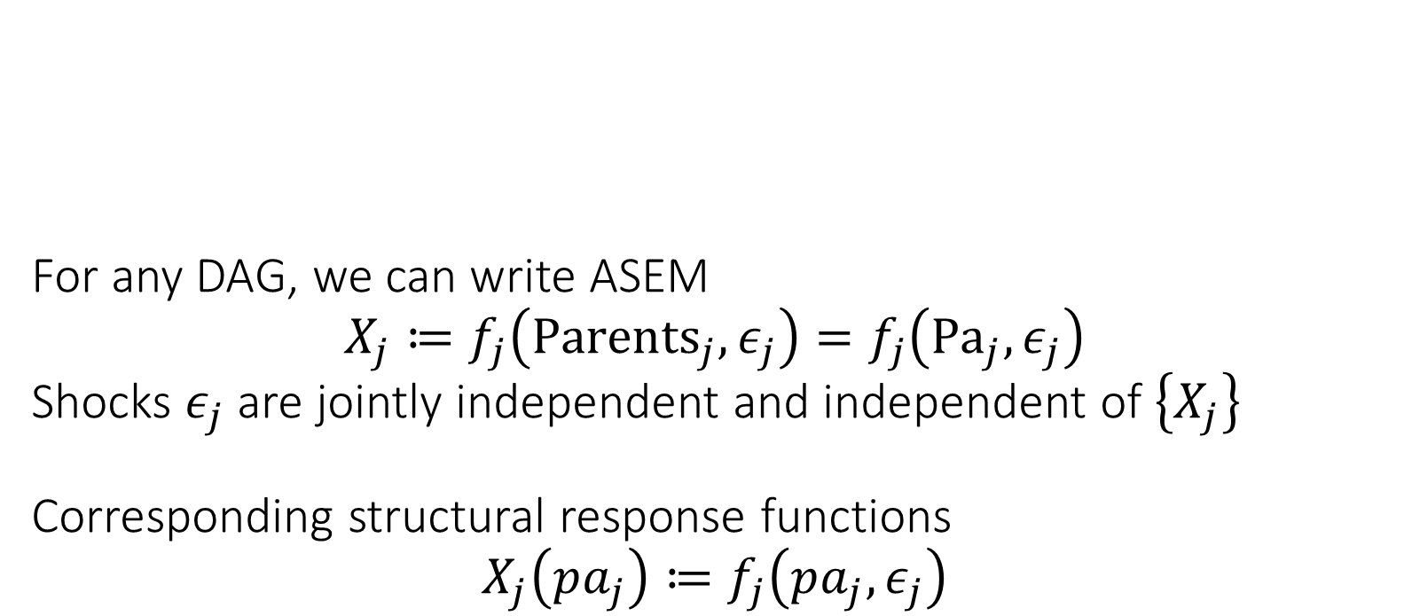




For any DAG, we can write ASEM $$X_{j}≔f_{j}\left({Parents}_{j}, ε_{j}\right)=f_{j}\left({Pa}_{j},ε_{j}\right)$$ Shocks $ε_{j}$ are jointly independent and independent of $\left\{X_{j}\right\}$ Corresponding structural response functions $$X_{j}\left(pa_{j}\right)≔f_{j}\left(pa_{j},ε_{j}\right)$$
$$ε_{D}$$
$$D$$
$$ε_{P}$$
$$X$$
$$Y$$
$$ε_{Y}$$
Exogenously determined “outside” of the model
Endogenously determined by the structural model
Shocks can be multi-dimensional e.g. separate shock variable per parental value
Potential/Counterfactual Outcome Processes
Structural Response Function
Potential values of parents

Slide 8

DAGs encode conditions on factorization of probability law $$p\left({\left\{x_{ℓ}\right\}}_{ℓ∈V}\right)=\prod_{ℓ∈V}{p\left(x_{ℓ} | pa_{ℓ}\right)}$$

Slide 9
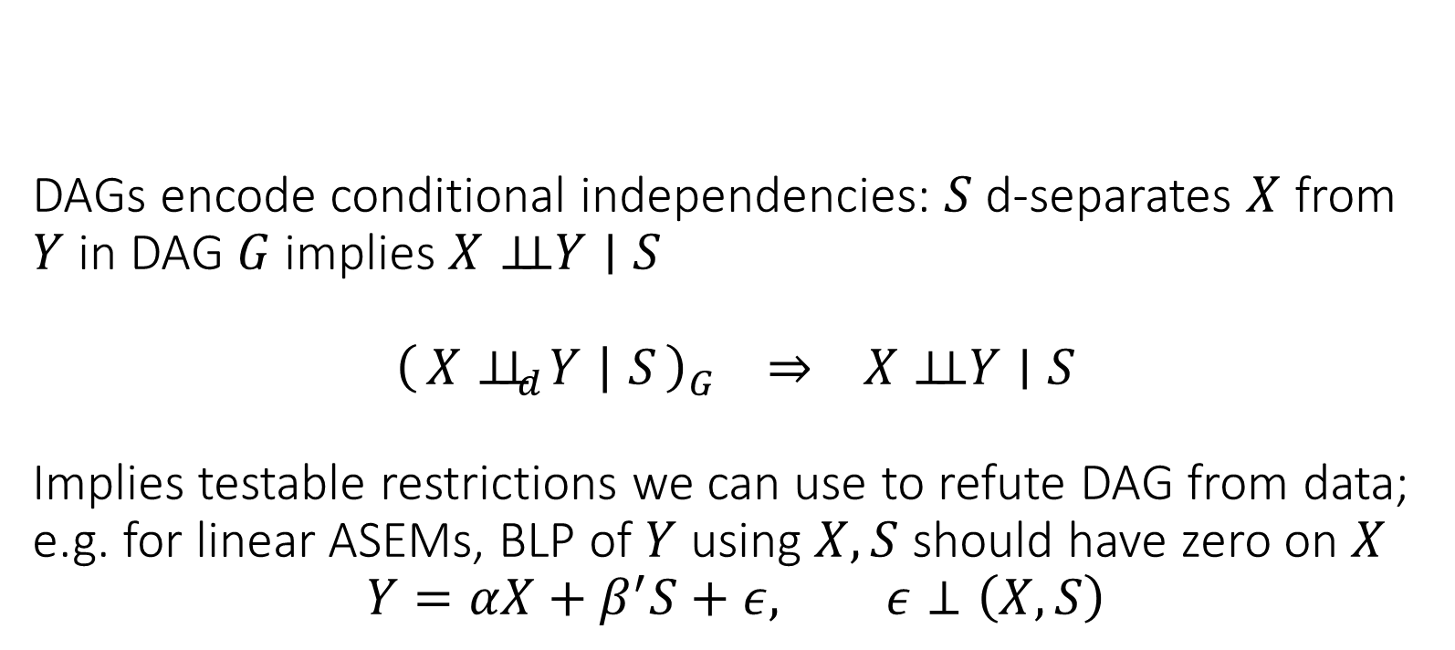
DAGs encode conditional independencies: $S$ d-separates $X$ from $Y$ in DAG $G$ implies $X⊥⊥Y∣S$ $${\left(X⊥⊥_{d}Y ∣ S\right)}_{G} ⇒ X⊥⊥Y∣S$$ Implies testable restrictions we can use to refute DAG from data; e.g. for linear ASEMs, BLP of $Y$ using $X, S$ should have zero on $X$ $$Y=αX+β^{′}S+ε, ε⊥\left(X,S\right)$$
Test whether it is non-zero!

Slide 10




$X$ is d-separated from $Y$ by $S$ if every path from $X$ to $Y$ is blocked. $S$ blocks a path if one of the following holds: - path contains chain $X→M→Y$ or fork $X←M→Y$ and $M∈S$ - path contains collider $X→M←Y$ and neither $M$ nor its descendants are in $S$
unblocked chain
unblocked fork
$$S$$
$$X$$
opened collider path
blocked chain
$$Y$$
blocked fork
collider path

Slide 11
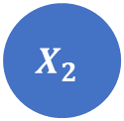

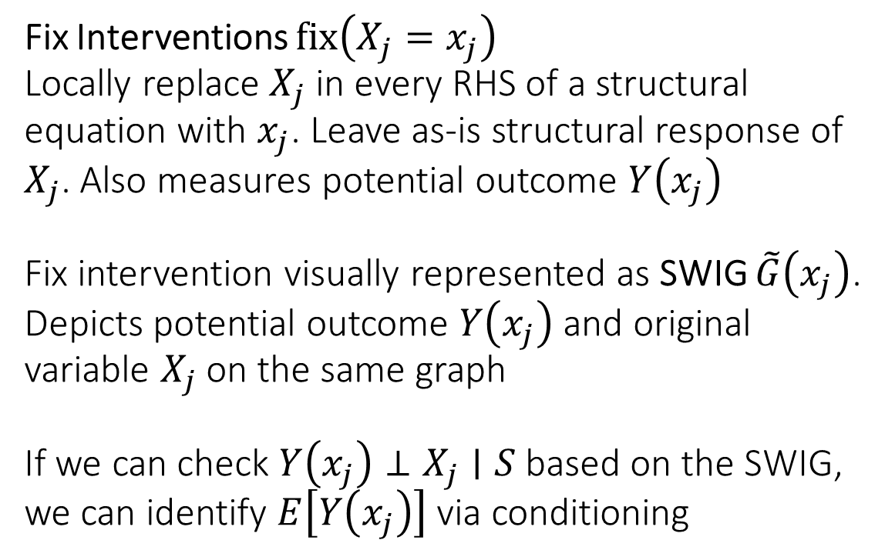
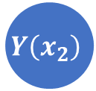

Fix Interventions $fix\left(X_{j}=x_{j}\right)$ Locally replace $X_{j}$ in every RHS of a structural equation with $x_{j}$. Leave as-is structural response of $X_{j}$. Also measures potential outcome $Y\left(x_{j}\right)$ Fix intervention visually represented as SWIG $\tilde{G}\left(x_{j}\right)$. Depicts potential outcome $Y\left(x_{j}\right)$ and original variable $X_{j}$ on the same graph If we can check $Y\left(x_{j}\right)⊥X_{j}∣S$ based on the SWIG, we can identify $E\left[Y\left(x_{j}\right)\right]$ via conditioning
$$X_{2}$$
$$x_{2}$$
$$X_{1}$$
$$Y\left(x_{2}\right)$$

Slide 12



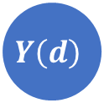


Conditional ignorability between treatment $D$ and outcome $Y$ conditional on set $S$ holds if $Y\left(d\right)$ is d-separated from $D$ on SWIG $\tilde{G}(d)$ induced by $fix\left(D=d\right)$ by the set $S$
$$D$$
$$d$$
$$X$$
$$Y\left(d\right)$$
$$S$$

Slide 13
Useful Adjustment Strategies

Slide 14
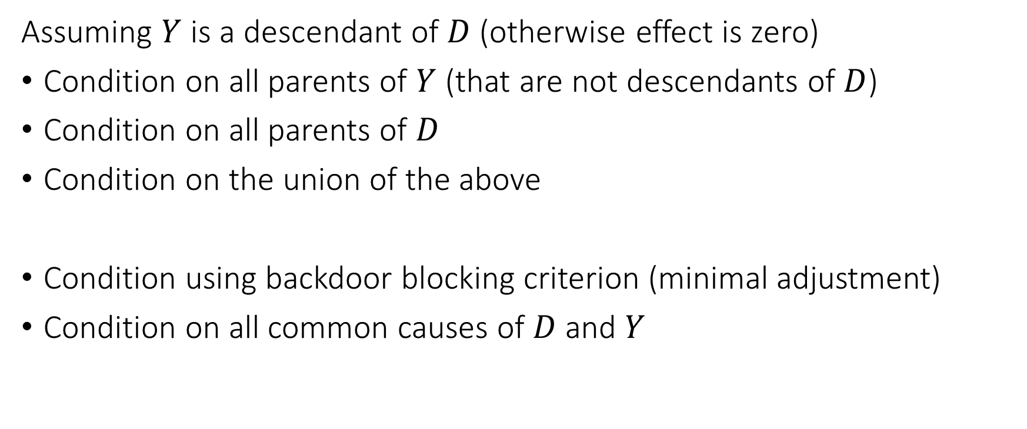
Adjustment Strategies
Assuming $Y$ is a descendant of $D$ (otherwise effect is zero)
Condition on all parents of $Y$ (that are not descendants of $D$)
Condition on all parents of $D$
Condition on the union of the above
Condition using backdoor blocking criterion (minimal adjustment)
Condition on all common causes of $D$ and $Y$

Slide 15

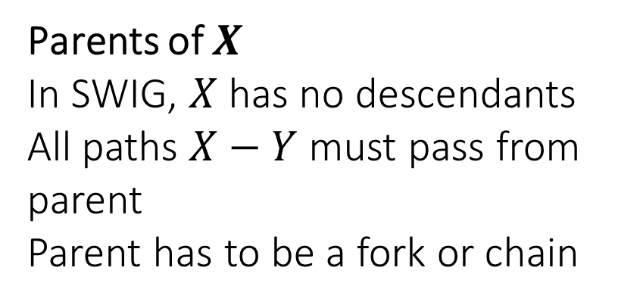




Conditioning on Parents
Empirically widely used strategy
Requires only partial knowledge of the graph
If we only know the parents of $D$ or the parents of $Y$ we are ok
Adding any further set to the parent strategy maintains validity
$$S$$
Parents of $X$
In SWIG, $X$ has no descendants
All paths $X−Y$ must pass from parent
Parent has to be a fork or chain
$$X$$
$$Y$$
SWIG
$$x$$

Slide 16
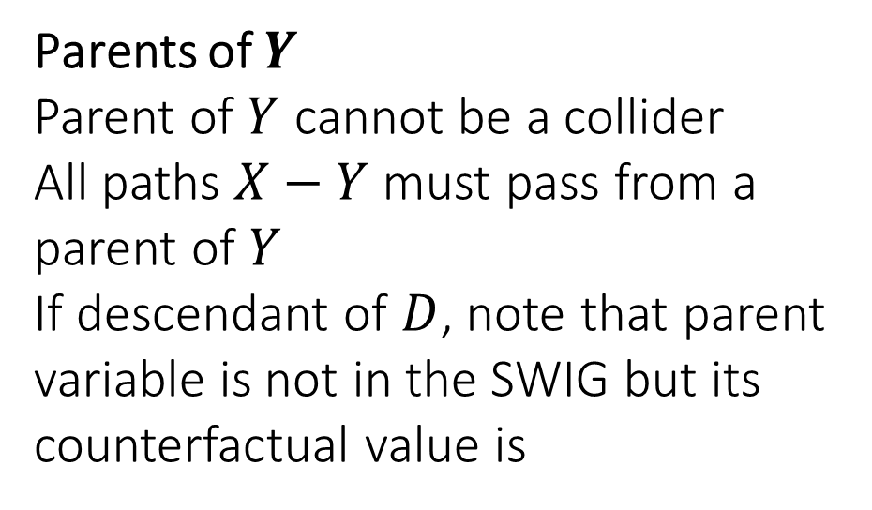
Conditioning on Parents
Empirically widely used strategy
Requires only partial knowledge of the graph
If we only know the parents of $D$ or the parents of $Y$ we are ok
Adding any further set to the parent strategy maintains validity
Parents of $Y$
Parent of $Y$ cannot be a collider
All paths $X−Y$ must pass from a parent of $Y$
If descendant of $D$, note that parent variable is not in the SWIG but its counterfactual value is
$$S$$
$$X$$
$$Y$$
SWIG
$$x$$

Slide 17
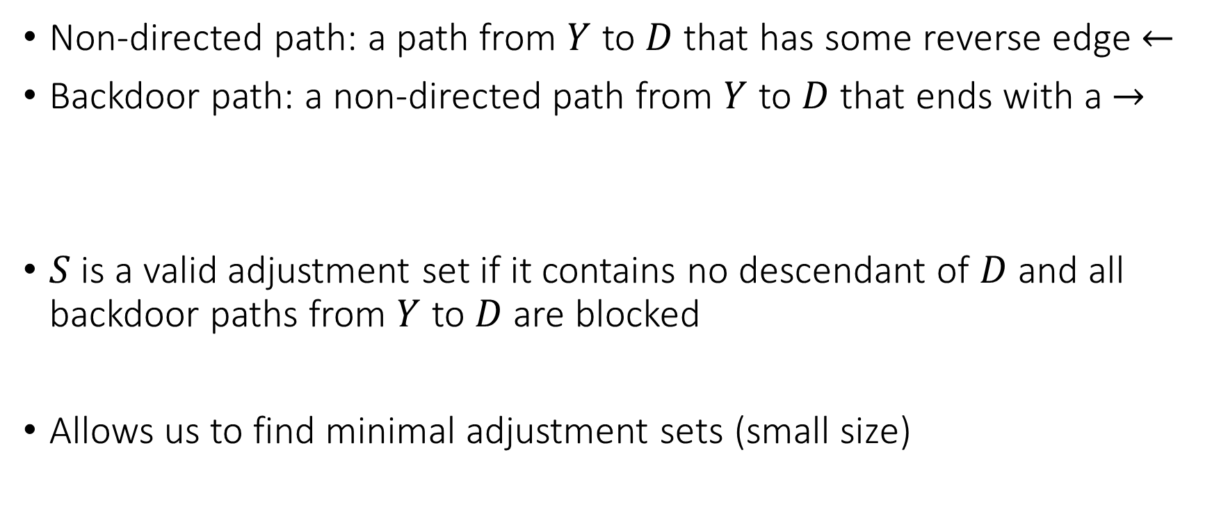
Backdoor Blocking
Non-directed path: a path from $Y$ to $D$ that has some reverse edge $←$
Backdoor path: a non-directed path from $Y$ to $D$ that ends with a $→$
$S$ is a valid adjustment set if it contains no descendant of $D$ and all backdoor paths from $Y$ to $D$ are blocked
Allows us to find minimal adjustment sets (small size)

Slide 18
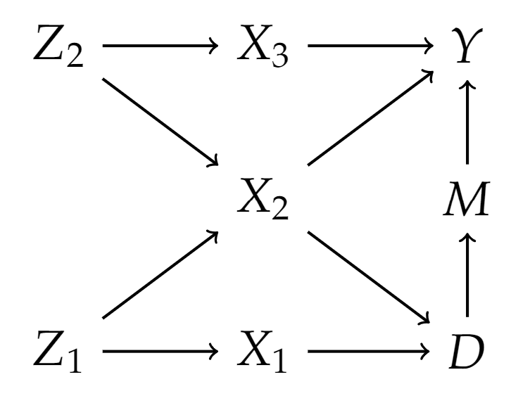
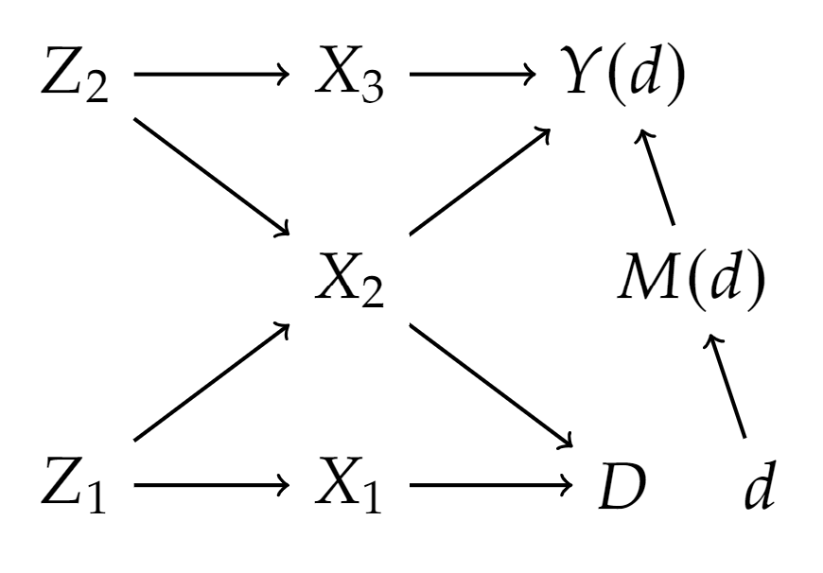
Example

Slide 19
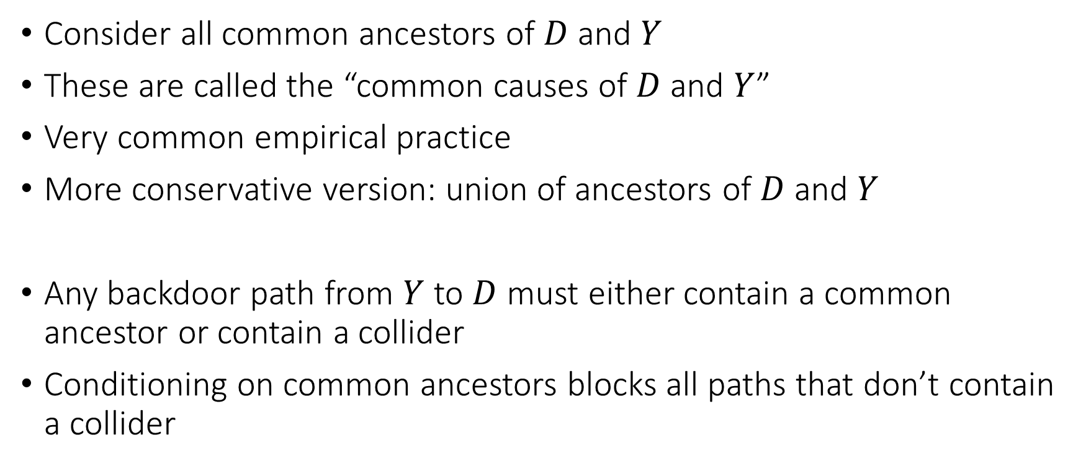
All Common Causes
Consider all common ancestors of $D$ and $Y$
These are called the “common causes of $D$ and $Y$”
Very common empirical practice
More conservative version: union of ancestors of $D$ and $Y$
Any backdoor path from $Y$ to $D$ must either contain a common ancestor or contain a collider
Conditioning on common ancestors blocks all paths that don’t contain a collider

Slide 20
Good and Bad Controls

Slide 21
High Level Categorization of Variables
Pre-treatment variables: variables whose value is determined before the assignment of the treatment
Post-treatment variables: variables whose value is determined after the assignment of the treatment

Slide 22
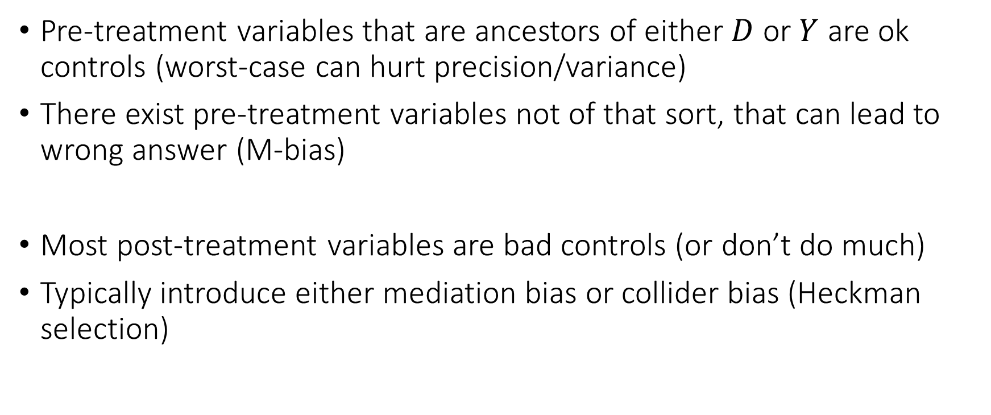
Good and Bad Controls: High Level
Pre-treatment variables that are ancestors of either $D$ or $Y$ are ok controls (worst-case can hurt precision/variance)
There exist pre-treatment variables not of that sort, that can lead to wrong answer (M-bias)
Most post-treatment variables are bad controls (or don’t do much)
Typically introduce either mediation bias or collider bias (Heckman selection)

Slide 23
“Pre-Treatment Variables”

Slide 24
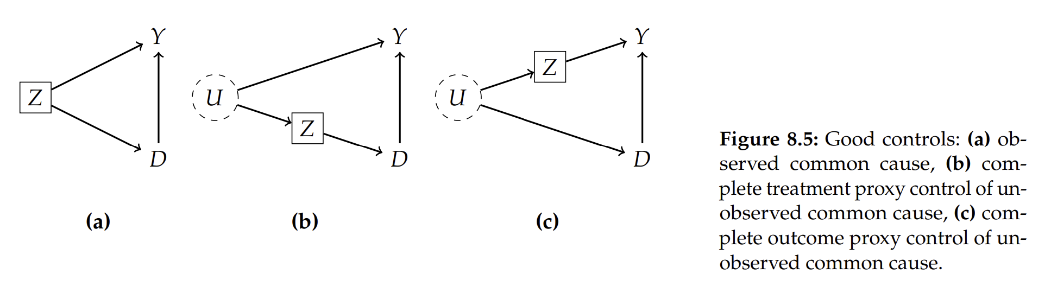
Examples: Good Controls
Notes:
-

Slide 25
Example of Proxy
Effect of Prenatal Multivitamin consumption (D) on birth defects (Y)
Prior family history of birth defects (Z) can influence mother’s decision for multivitamin consumption
Unmeasured genetic factors (U) cause family history (Z) of birth defects
Unmeasured genetic factors (U) have direct influence on birth defects (Y)
Family history of birth defects is a good proxy control for unmeasured genetic factors

Slide 26
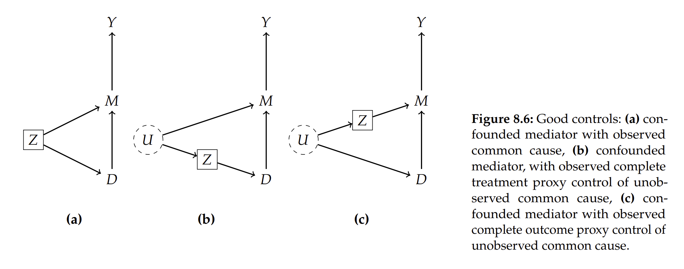
Examples: Good Controls

Slide 27
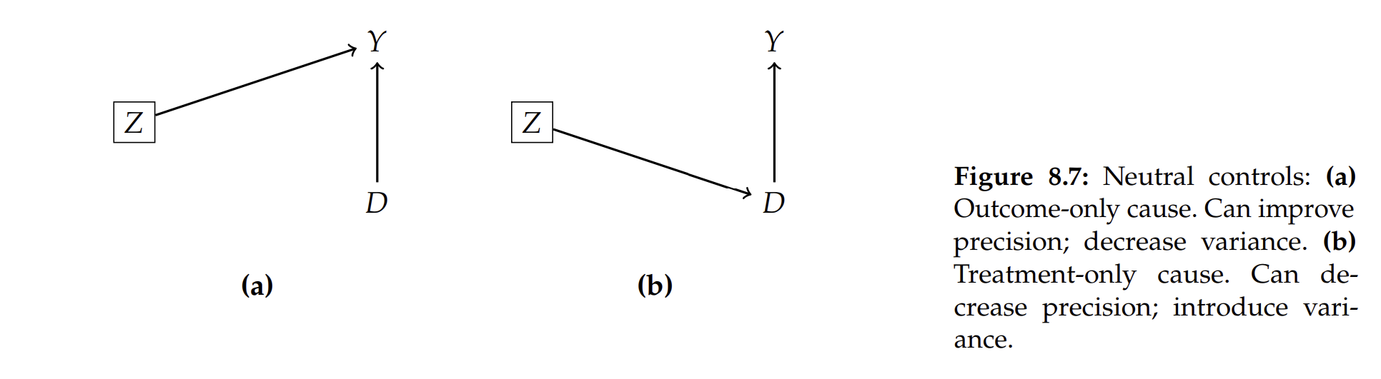
Examples: Neutral Controls

Slide 28
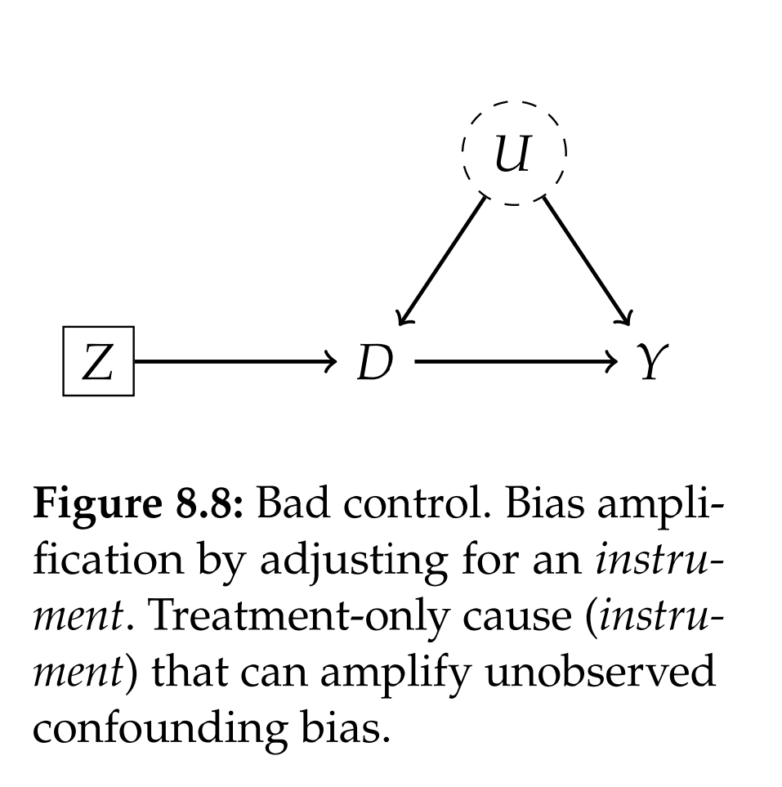
Examples: Pre-Treatment Variable that is Bad Control

Slide 29
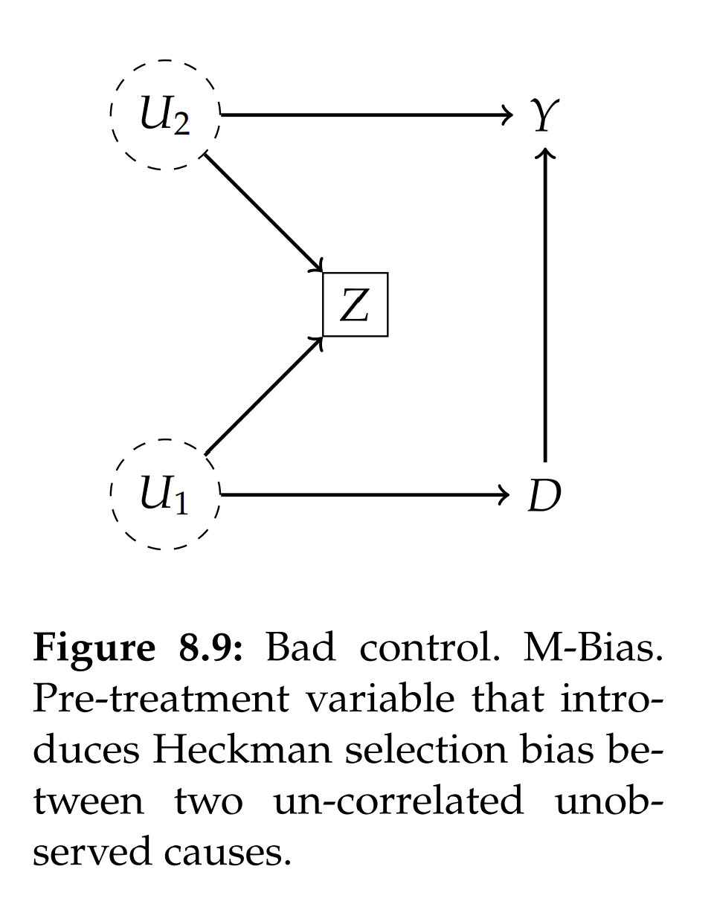
Example: Pre-Treatment Variable that is Bad Control

Slide 30
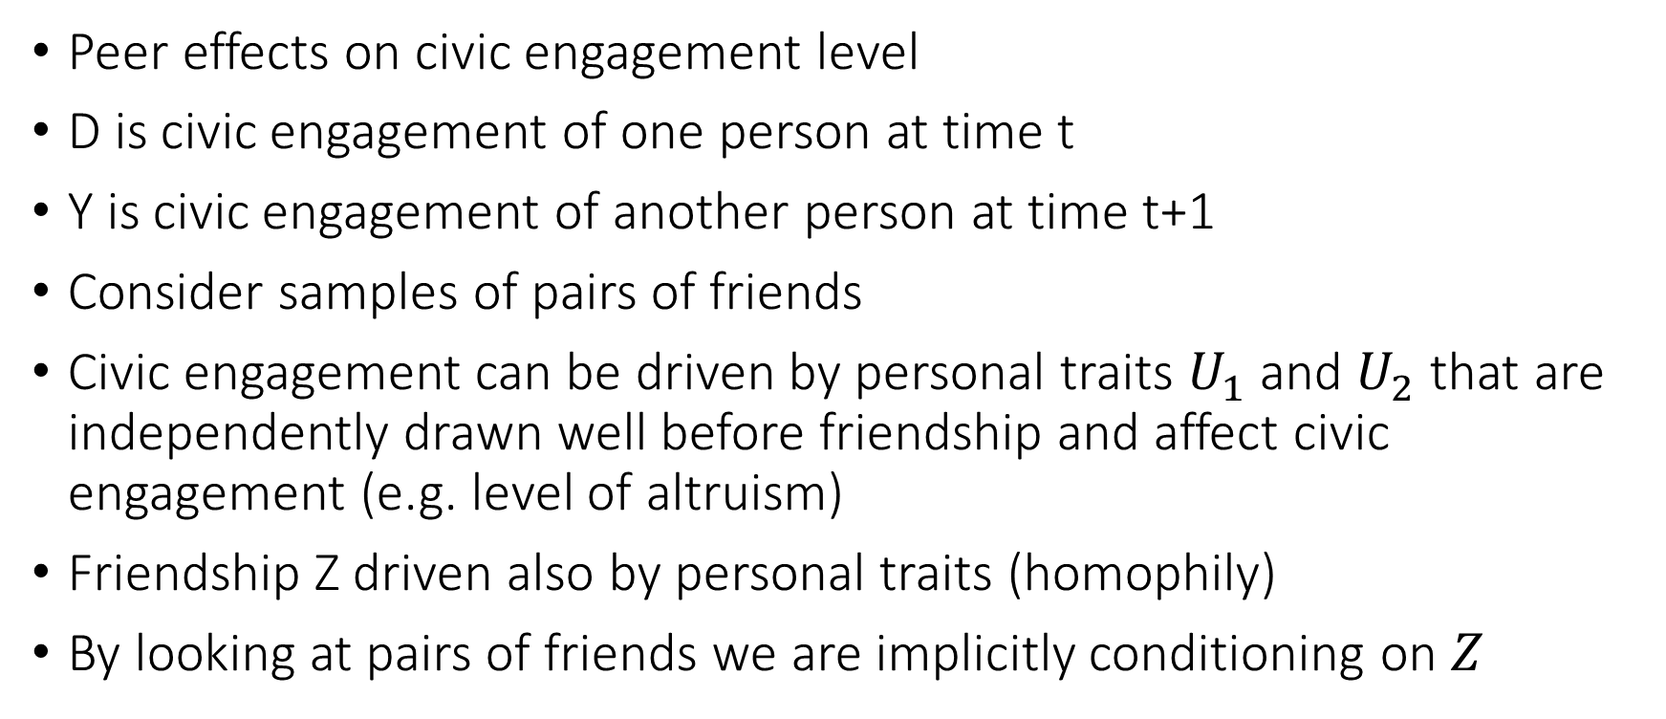
Example: Homophily Bias in Peer Effects
Peer effects on civic engagement level
D is civic engagement of one person at time t
Y is civic engagement of another person at time t+1
Consider samples of pairs of friends
Civic engagement can be driven by personal traits $U_{1}$ and $U_{2}$ that are independently drawn well before friendship and affect civic engagement (e.g. level of altruism)
Friendship Z driven also by personal traits (homophily)
By looking at pairs of friends we are implicitly conditioning on $Z$

Slide 31
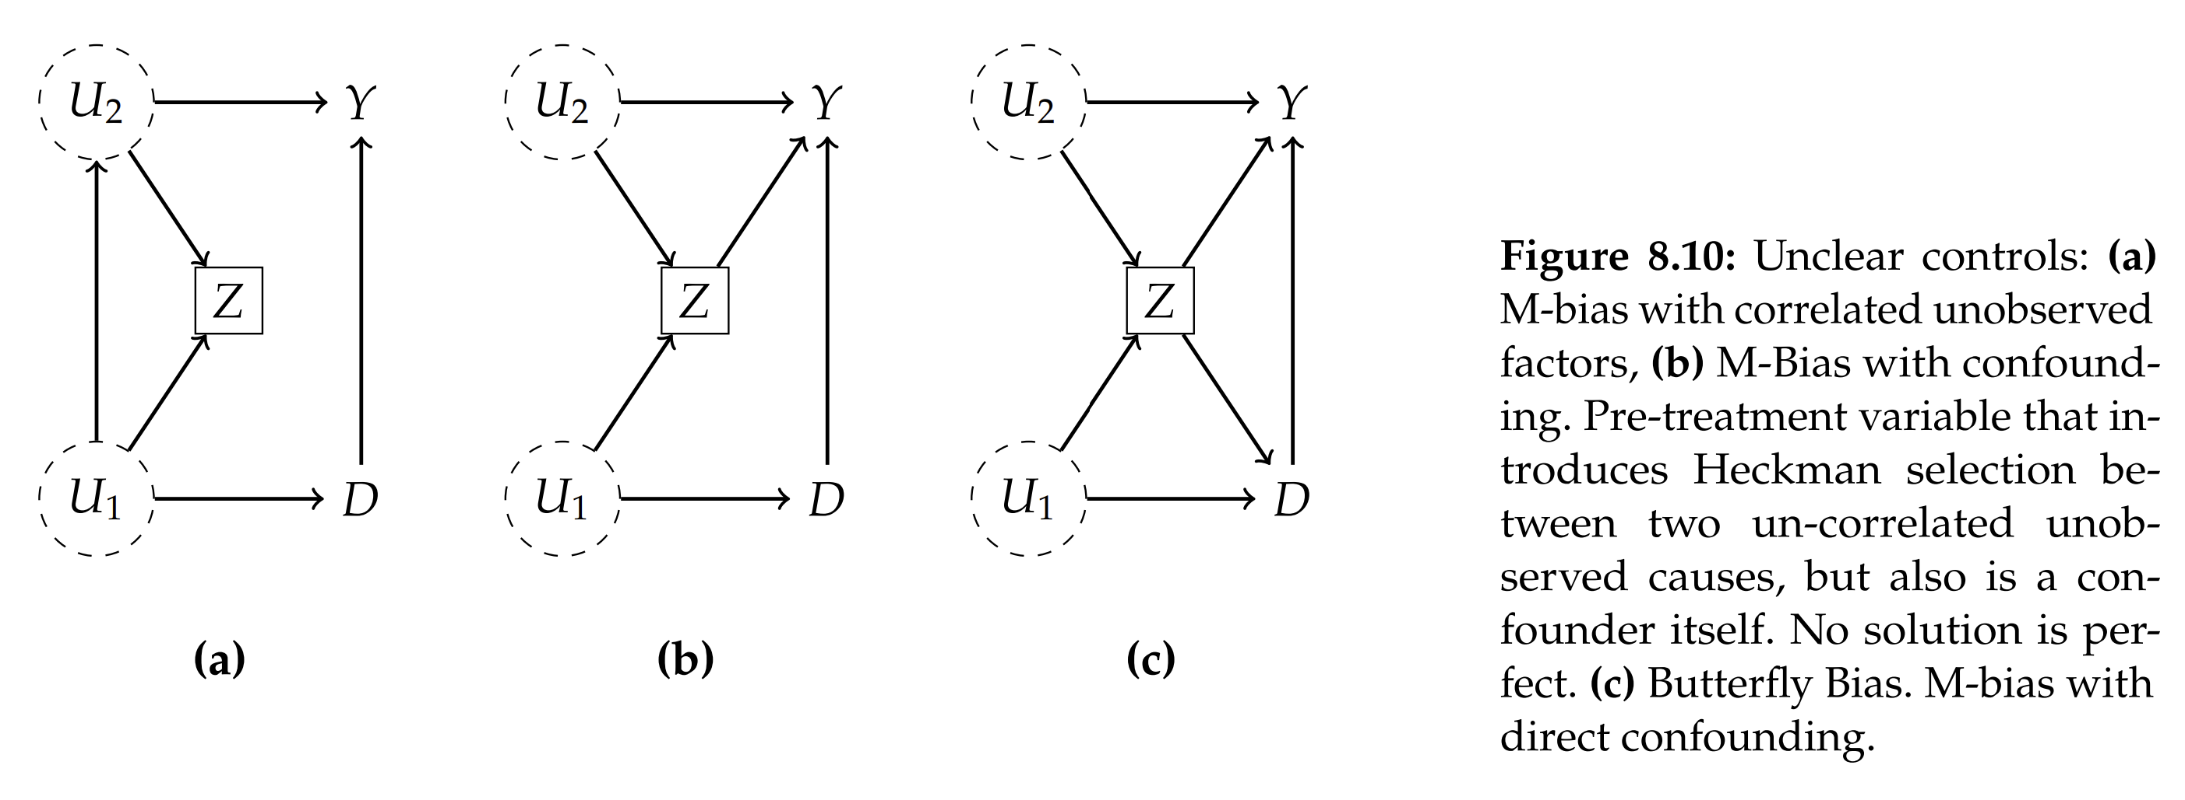
Example: M-Bias not robust to perturbation

Slide 32
“Post-Treatment Variables”

Slide 33
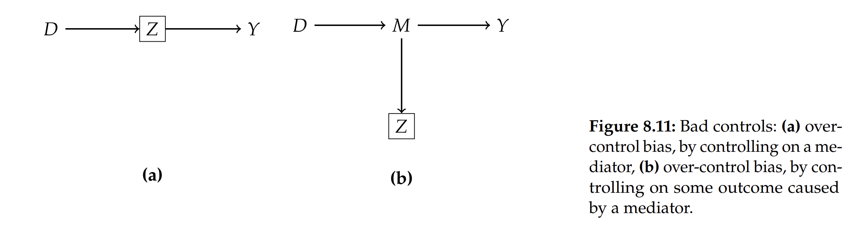
Example: Bad Controls, Mediation Bias

Slide 34
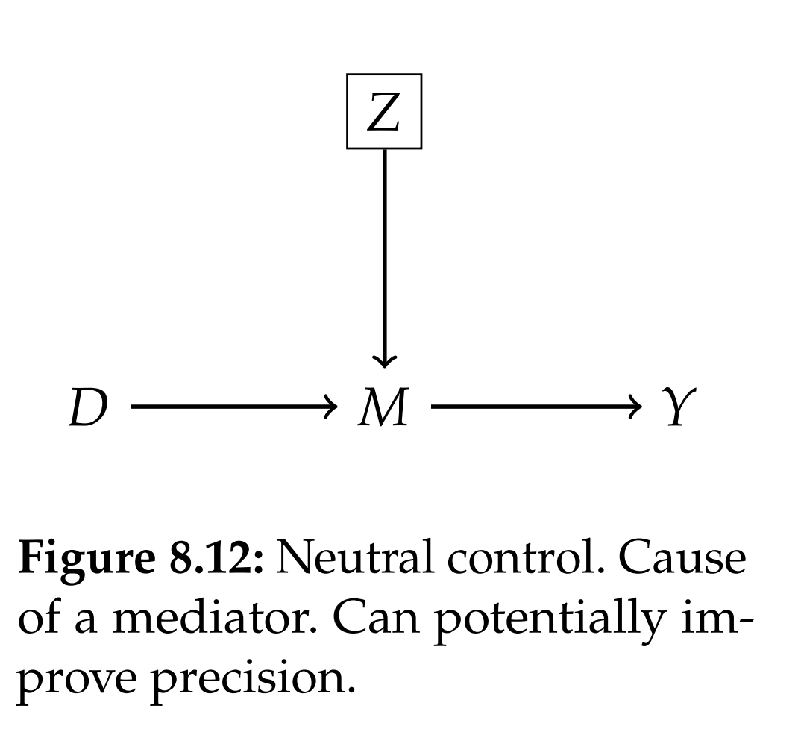
Example: Exception to Mediation Bias

Slide 35
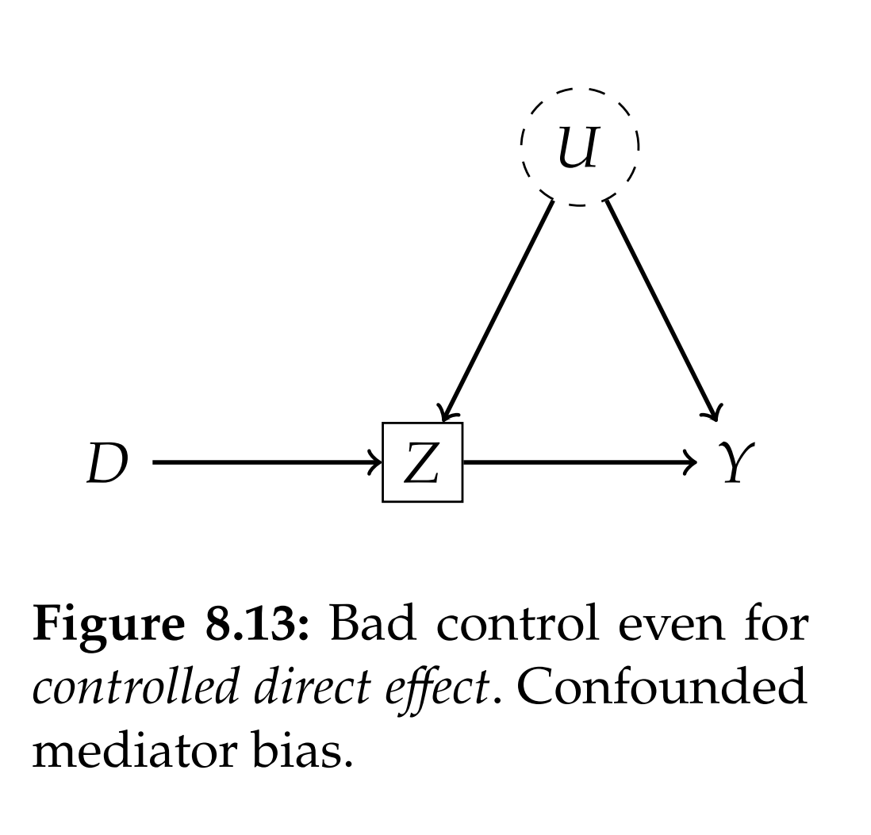
Example: Controlled Direct Effect Gone Wrong

Slide 36
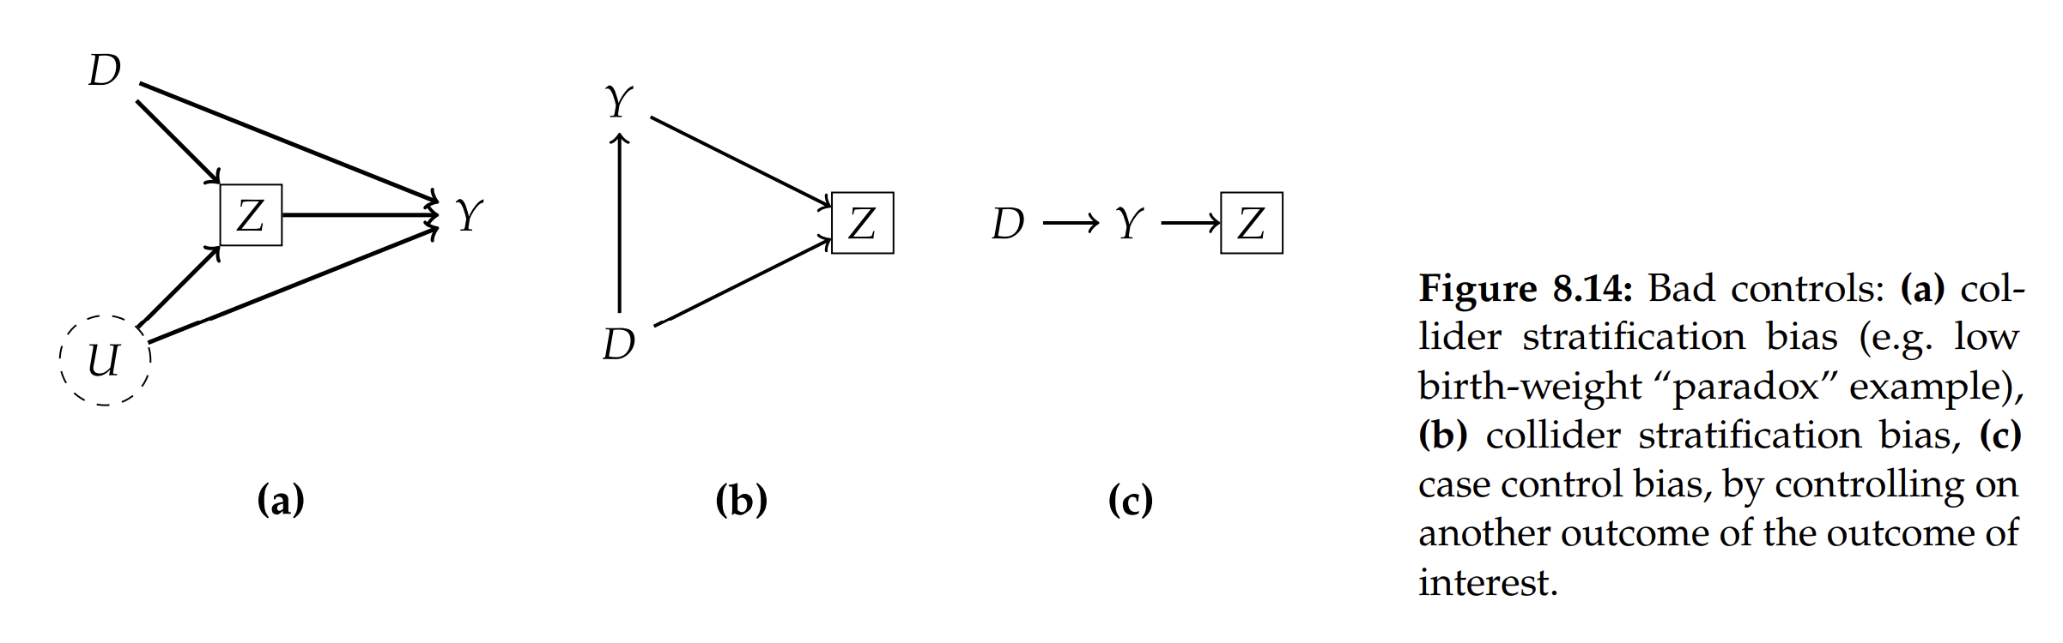
Example: Bad Controls, Collider (Heckman Selection) bias

Slide 37
Direct and Indirect Effects for Analysis of Wage Discrimination

Slide 38
A Structural Equation Model of Wage Discrimination
Absence of arrow $G→Y$ indicates there is no inherent differentiation in productivity level driven by $G$; only due to discrimination or differences in human capital
$$Y≔κD_{w}+θH+ε_{Y}$$
$$D_{w}≔G+δH+ε_{D_{w}}$$
$$H≔γG+λD_{h}+ε_{H}$$
$$D_{h}≔G+ε_{D_{h}}$$
$$G,$$
Abstraction Variable of “Discriminatory Behavior” for wage determination
$$D_{w}$$
Sensitive Group Attribute (e.g. sex, race)
$$κ$$
$$δ$$
$$G$$
$$Y$$
Existence of arrow $G→H$ indicates there is potential heterogeneity in preferences for human capital acquisition (e.g. inherent preferences over different occupations)
$$γ$$
Wage
$$θ$$
$$H$$
$$D_{h}$$
$$λ$$
Human capital (education, skills, prior experience, etc); labor-relevant characteristics
Abstraction Variable of “Discriminatory Behavior” for human capital acquisition

Slide 39
A Structural Equation Model of Wage Discrimination
Absence of arrow $G→Y$ indicates there is no inherent differentiation in productivity level driven by $G$; only due to discrimination or differences in human capital
Wage discrimination = $κ$
$Y∼G, H$ recovers $κ$ as coef on $G$
$Y∼G$ and no heterogeneity in preferences, i.e. $γ=0$, we learn total discrimination effect
$$κ+λ\left(δκ+θ\right)$$
Abstraction Variable of “Discriminatory Behavior” for wage determination
$$D_{w}$$
Sensitive Group Attribute (e.g. sex, race)
$$κ$$
$$δ$$
$$G$$
$$Y$$
Existence of arrow $G→H$ indicates there is potential heterogeneity in preferences for human capital acquisition (e.g. inherent preferences over different occupations)
$$γ$$
Wage
$$θ$$
$$H$$
$$D_{h}$$
$$λ$$
Human capital (education, skills, prior experience, etc); labor-relevant characteristics
Abstraction Variable of “Discriminatory Behavior” for human capital acquisition

Slide 40
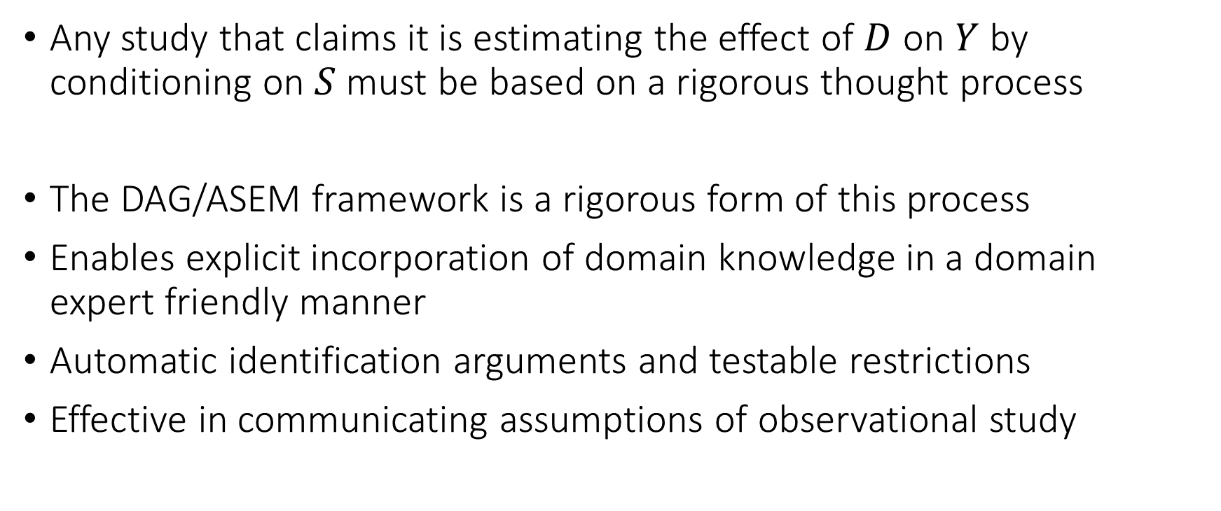
Concluding Remarks
Any study that claims it is estimating the effect of $D$ on $Y$ by conditioning on $S$ must be based on a rigorous thought process
The DAG/ASEM framework is a rigorous form of this process
Enables explicit incorporation of domain knowledge in a domain expert friendly manner
Automatic identification arguments and testable restrictions
Effective in communicating assumptions of observational study

Slide 41
Proving the Main Theorem!

Slide 42
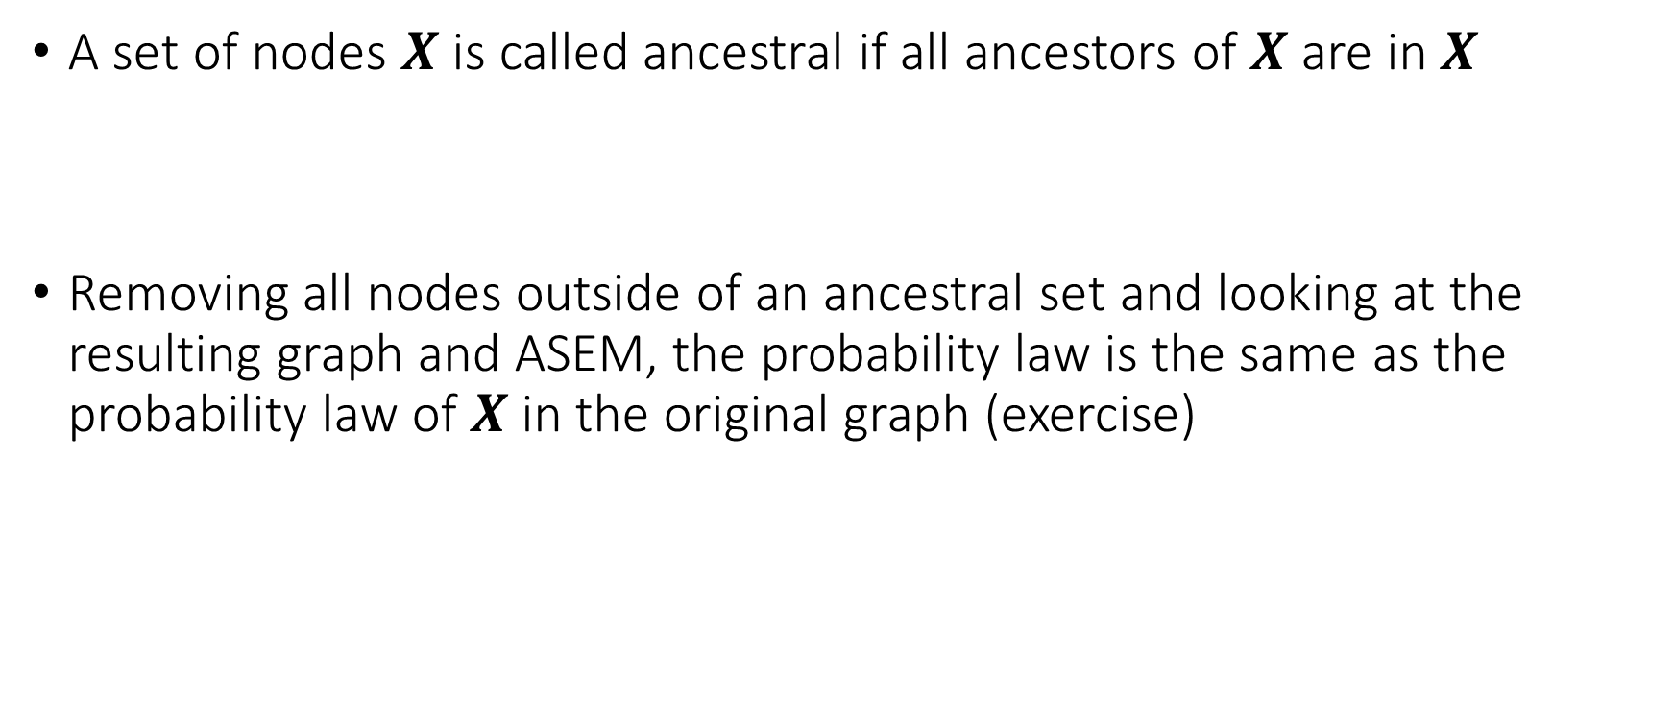
Proof Step 1
A set of nodes $X$ is called ancestral if all ancestors of $X$ are in $X$
Removing all nodes outside of an ancestral set and looking at the resulting graph and ASEM, the probability law is the same as the probability law of $X$ in the original graph (exercise)

Slide 43





Proof Step 2
Suppose that a set of nodes $X$ is D-separated from a set of nodes $Y$ by a set of nodes $S$
And that $X∪Y∪S$ is the set of all nodes
$$X$$
$$X$$
$$S$$
$$Y$$

Slide 44



Proof Step 2
Let $S_{1}$ the subset of $S$ that has a parent in $X$. Let $S_{2}$ the remainder.
It has to be that $Pa\left(X∪S_{1}\right)∈X∪S$
It has to be that $Pa\left(Y∪S_{2}\right)∈Y∪S$
$$X$$
$$S_{2}$$
$$X$$
$$Y$$
$$S_{1}$$

Slide 45

Proof Step 2
We can factorize:
$$p\left(x,y,s\right)=\prod_{W∈X∪S_{1}}{p\left(w | pa_{W}\right)}\prod_{W∈Y∪S_{2}}{p\left(w | pa_{W}\right)}=f\left(x,s_{1}\right)g\left(y,s_{2}\right)$$
$$X$$
$$S_{2}$$
$$X$$
$$Y$$
$$S_{1}$$

Slide 46

Proof Step 2
We can factorize:
$$p\left(x,y,s\right)=\prod_{W∈X∪S_{1}}{p\left(w | pa_{W}\right)}\prod_{W∈Y∪S_{2}}{p\left(w | pa_{W}\right)}=f\left(x,s_{1}\right)g\left(y,s_{2}\right)$$
Implies that:
$$X⊥⊥ Y∣S$$

Slide 47






Final Step
By first step, we can restrict to ancestral set of $X∪Y∪S$
Does not change conditional independence relations (exercise)
Does not change d-separation relations (exercise)
Define $X$ nodes in ancestral set of $X∪Y∪S$ not d-separated from X
Define $Y$ the remainder of nodes in ancestral set not in $X, S$.
$$X$$
$$S$$
$$X$$
$$Y$$
$$X$$

Slide 48






Final Step
By definition of d-separation, $S$ must d-separate $X$ from $Y$ (exercise)
We can invoke previous critical lemma
$$X$$
$$S$$
$$X$$
$$Y$$
$$X$$

Slide 49
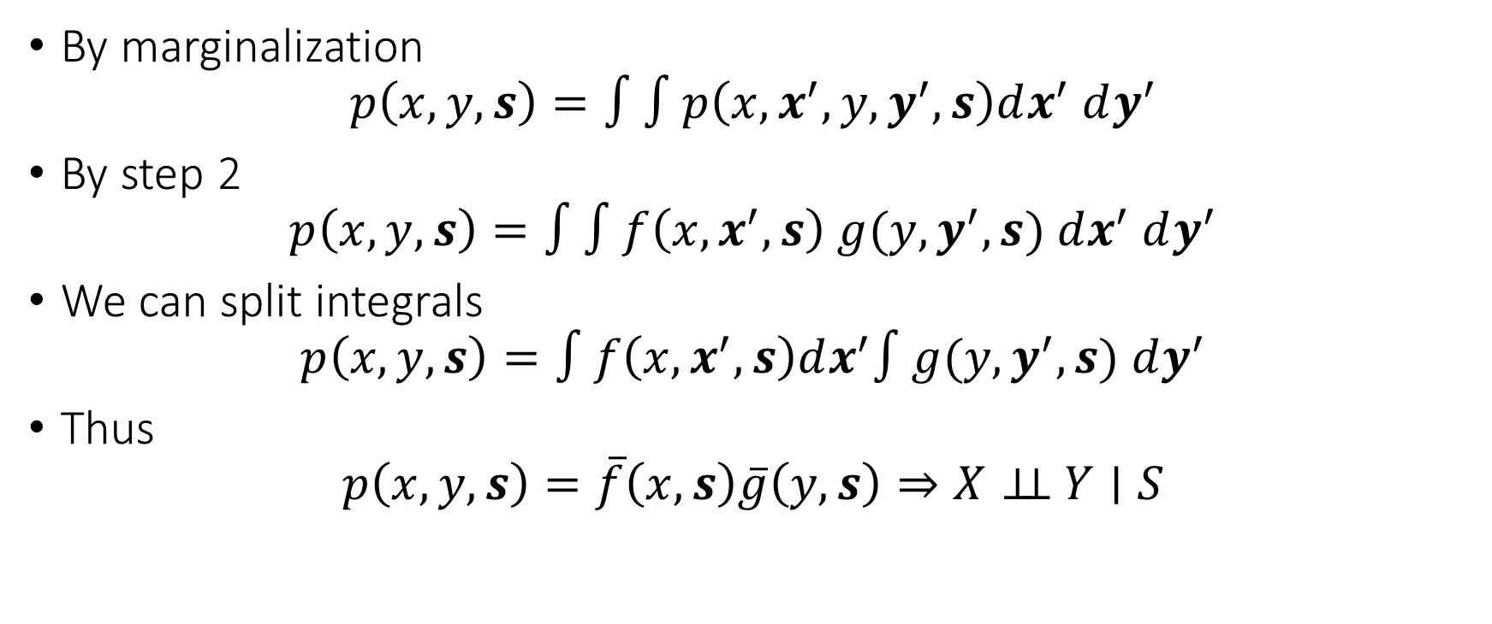
Final Step
By marginalization
$$p\left(x,y,s\right)=∫∫p\left(x, x^{′},y, y^{′},s\right)dx^{′} dy^{′}$$
By step 2
$$p\left(x,y,s\right)=∫∫f\left(x,x^{′},s\right) g(y,y^{′},s) dx^{′} dy^{′}$$
We can split integrals
$$p\left(x,y,s\right)=∫f\left(x,x^{′},s\right)dx^{′}∫g(y,y^{′},s) dy^{′}$$
Thus
$$p\left(x,y,s\right)=\overline{f}\left(x,s\right)\overline{g}\left(y, s\right)⇒X⊥⊥ Y∣S$$

