Slide 1
MS&E 228: Analyzing Experiments with Linear Regression
Vasilis Syrgkanis
MS&E, Stanford

Slide 2
Causal Inference with Experiments
Prediction with Linear Models
Prediction with High-Dim Linear Models
Inference on Causal and Predictive Effects with High-Dim Linear Models
Potential Outcomes and Conditional Ignorability
Structural Equation Models and Conditional Exogeneity
Directed Acyclic Graphs
Prediction with Non-Linear Models
Inference on Causal Effects with Non-Linear Models
Un-observed Confounding and Instruments
Identification of Causal Effects in Longitudinal Data
Estimation of Heterogeneous Causal Effects
Linear Predictive Models and Statistical Inference
Causal Identification in Observational Data
Non-Linear Predictive Models and Statistical Inference
Topics

Slide 3
Causal Inference with Experiments
Prediction with Linear Models
Prediction with High-Dim Linear Models
Inference on Causal and Predictive Effects with High-Dim Linear Models
Potential Outcomes and Conditional Ignorability
Structural Equation Models and Conditional Exogeneity
Directed Acyclic Graphs
Prediction with Non-Linear Models
Inference on Causal Effects with Non-Linear Models
Un-observed Confounding and Instruments
Identification of Causal Effects in Longitudinal Data
Estimation of Heterogeneous Causal Effects
Linear Predictive Models and Statistical Inference
Causal Identification in Observational Data
Non-Linear Predictive Models and Statistical Inference
Topics

Slide 4

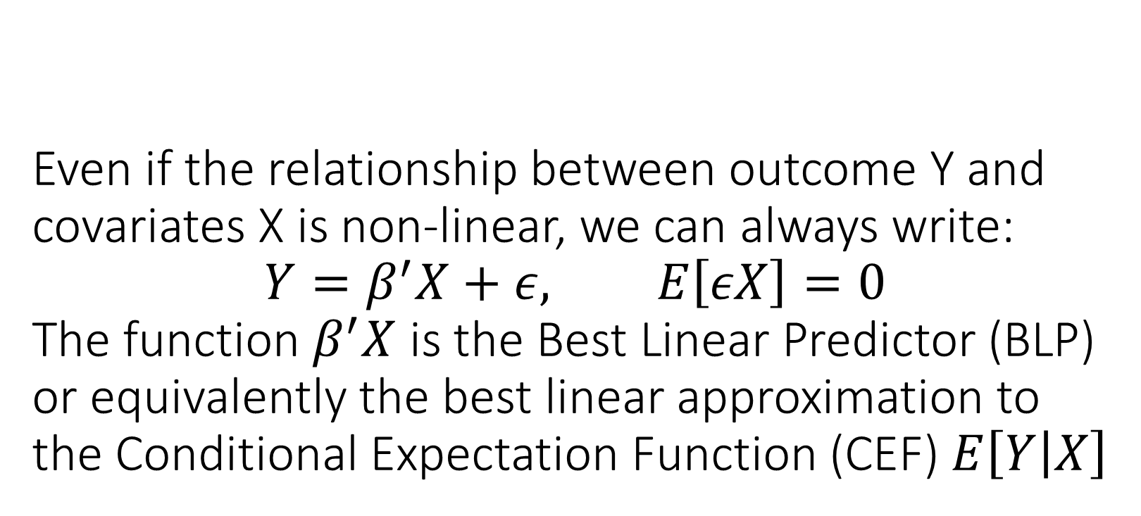
Even if the relationship between outcome Y and covariates X is non-linear, we can always write: $$Y=β^{′}X+ε, E\left[εX\right]=0$$ The function $β^{′}X$ is the Best Linear Predictor (BLP) or equivalently the best linear approximation to the Conditional Expectation Function (CEF) $E\left[Y | X\right]$

Slide 5
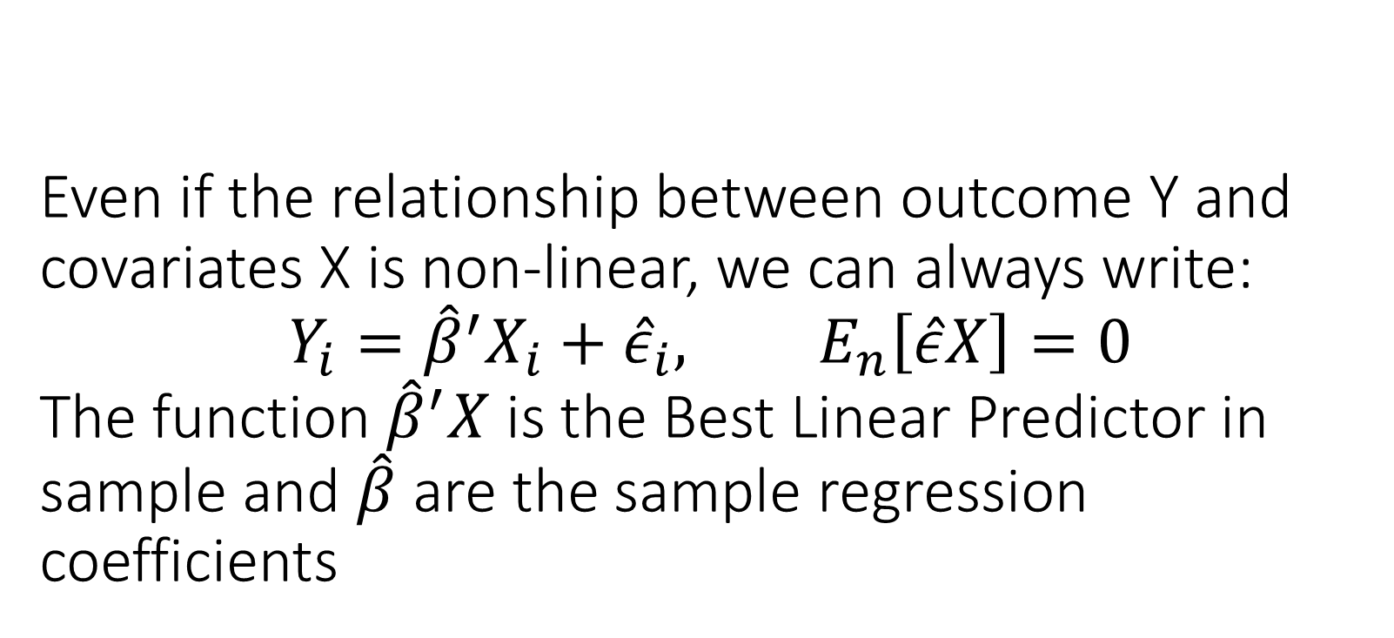
Even if the relationship between outcome Y and covariates X is non-linear, we can always write: $$Y_{i}={\hat{β}}^{′}X_{i}+{\hat{ε}}_{i}, E_{n}\left[\hat{ε}X\right]=0$$ The function ${\hat{β}}^{′}X$ is the Best Linear Predictor in sample and $\hat{β}$ are the sample regression coefficients

Slide 6
You should expect OLS to produce accurate predictions in the worst-case if the number of variables is small compared to number of samples. Its predictions converge to the predictions of the BLP in the population

Slide 7
Almost always measure predictive performance of your estimated model on a held-out sample

Slide 8
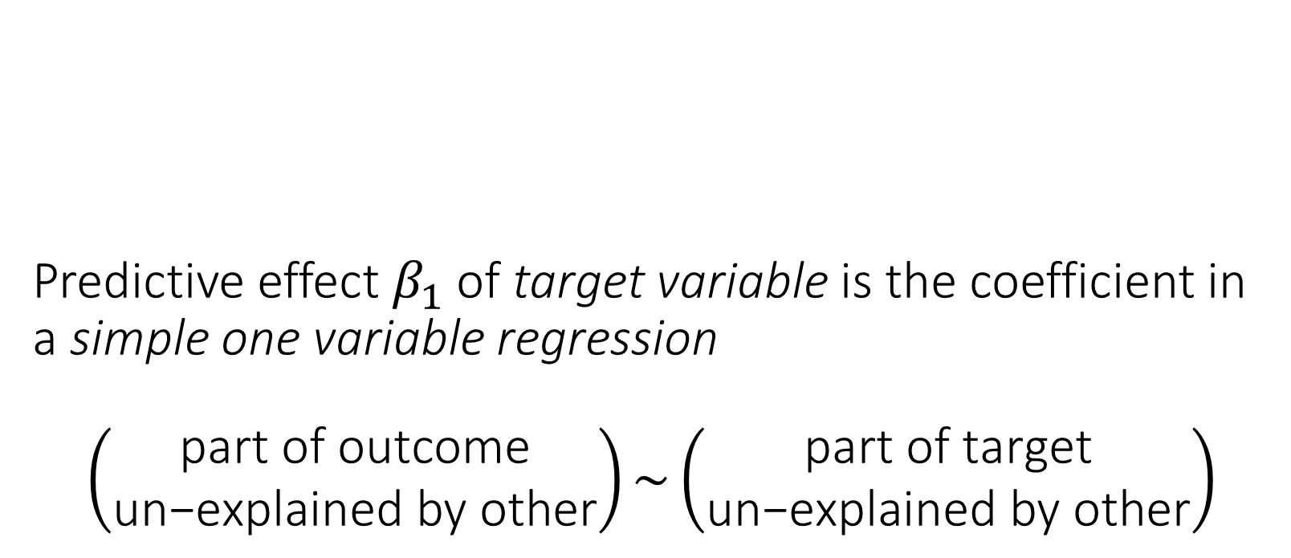
Predictive effect $β_{1}$of target variable is the coefficient in a simple one variable regression $$\left(\begin{matrix}\text{part} \text{of} \text{outcome} \\ \text{un}\text{−}\text{explained} \text{by} \text{other}\end{matrix}\right)\sim \left(\begin{matrix}\text{part} \text{of} \text{target} \\ \text{un}\text{−}\text{explained} \text{by} \text{other}\end{matrix}\right)$$

Slide 9
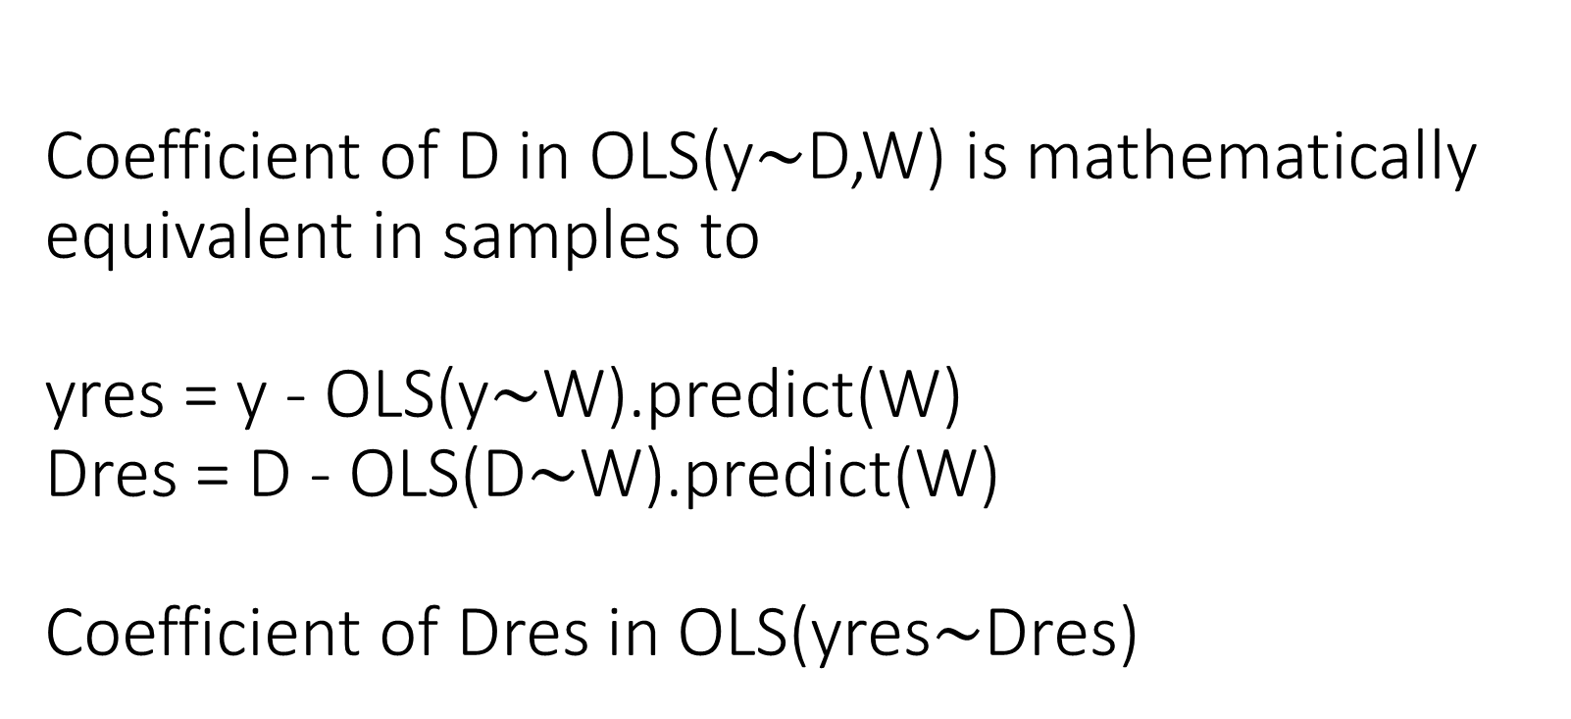
Coefficient of D in OLS(y$∼$D,W) is mathematically equivalent in samples to yres = y - OLS(y$∼$W).predict(W) Dres = D - OLS(D$∼$W).predict(W) Coefficient of Dres in OLS(yres$∼$Dres)

Slide 10
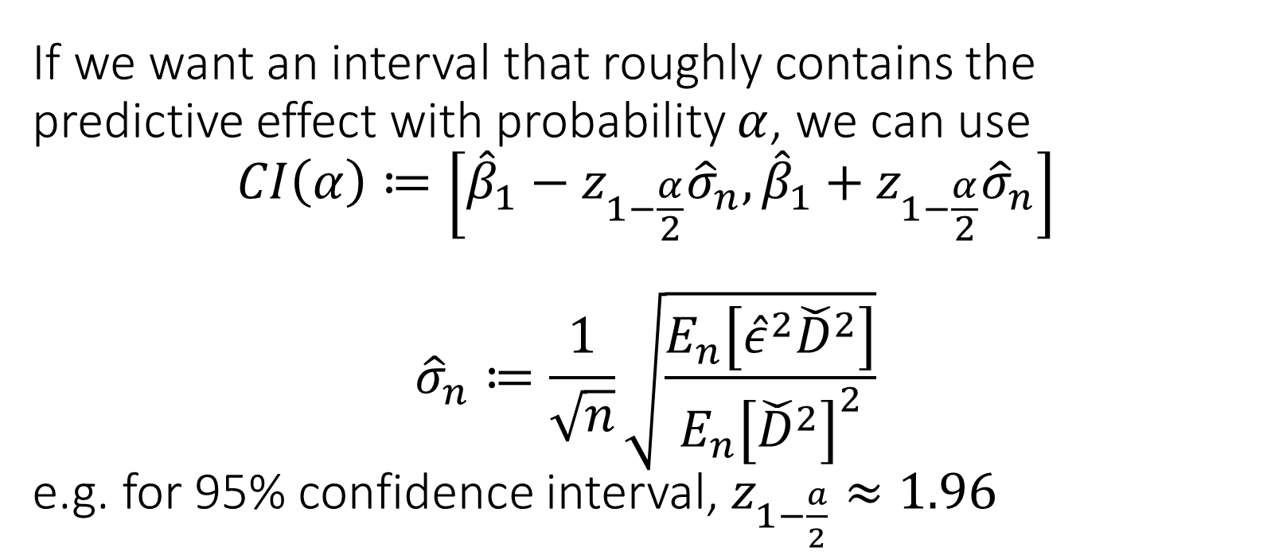
If we want an interval that roughly contains the predictive effect with probability $α$, we can use $$CI\left(α\right)≔\left[{\hat{β}}_{1}−z_{1−\frac{α}{2}}{\hat{σ}}_{n},{\hat{β}}_{1}+z_{1−\frac{α}{2}}{\hat{σ}}_{n}\right]$$ $${\hat{σ}}_{n}≔\frac{1}{\sqrt{n}}\sqrt{\frac{E_{n}\left[{\hat{ε}}^{2}{\check{D}}^{2}\right]}{E_{n}{\left[{\check{D}}^{2}\right]}^{2}}}$$ e.g. for 95% confidence interval, $z_{1−\frac{a}{2}}≈1.96$

Slide 11
Revisit Covariate Adjustment for Effect Inference in Experiments

Slide 12
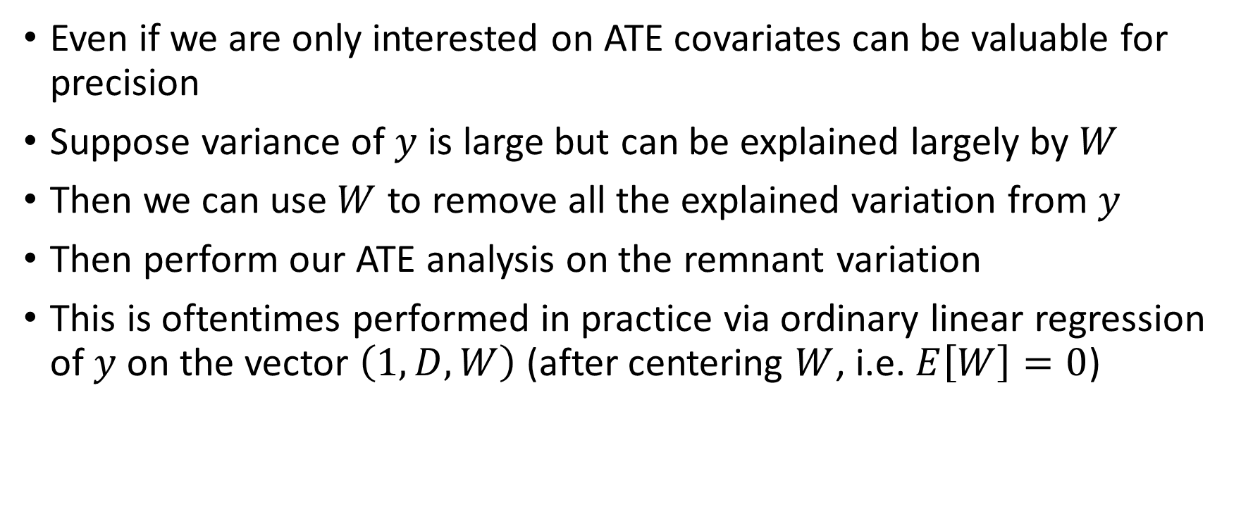
Co-variates for Precision
Even if we are only interested on ATE covariates can be valuable for precision
Suppose variance of $y$ is large but can be explained largely by $W$
Then we can use $W$ to remove all the explained variation from $y$
Then perform our ATE analysis on the remnant variation
This is oftentimes performed in practice via ordinary linear regression of $y$ on the vector $\left(1, D, W\right)$ (after centering $W$, i.e. $E\left[W\right]=0$)

Slide 13
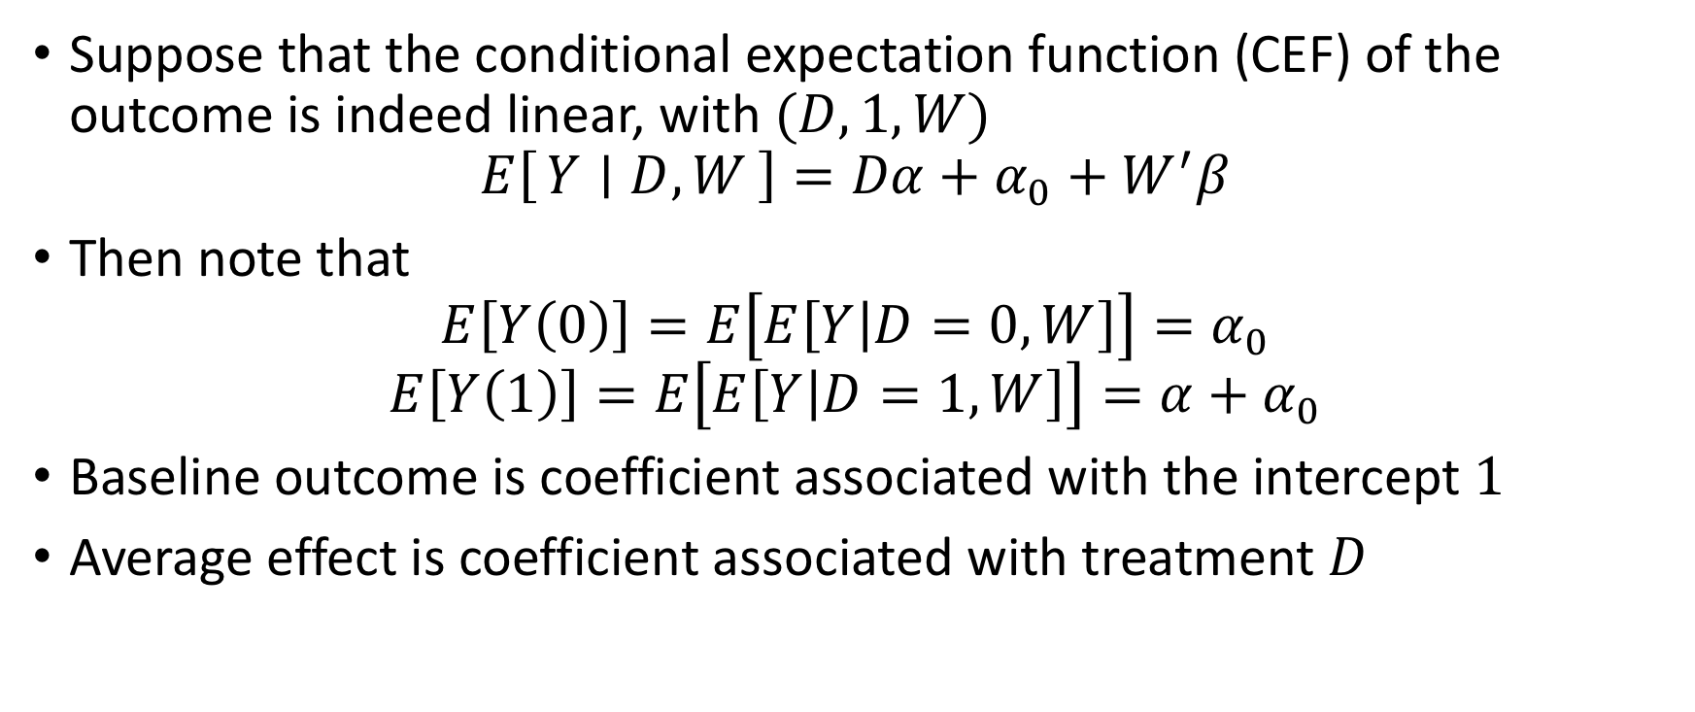
Is this consistent?
Suppose that the conditional expectation function (CEF) of the outcome is indeed linear, with $(D,1,W)$
$$E\left[Y ∣ D, W\right]=Dα+α_{0}+W^{′}β$$
Then note that
$$E\left[Y\left(0\right)\right]=E\left[E\left[Y | D=0,W\right]\right]=α_{0}$$
$$E\left[Y\left(1\right)\right]=E\left[E\left[Y | D=1, W\right]\right]=α+α_{0}$$
Baseline outcome is coefficient associated with the intercept $1$
Average effect is coefficient associated with treatment $D$

Slide 14
Is it consistent if E[Y|D, W] is not linear?

Slide 15
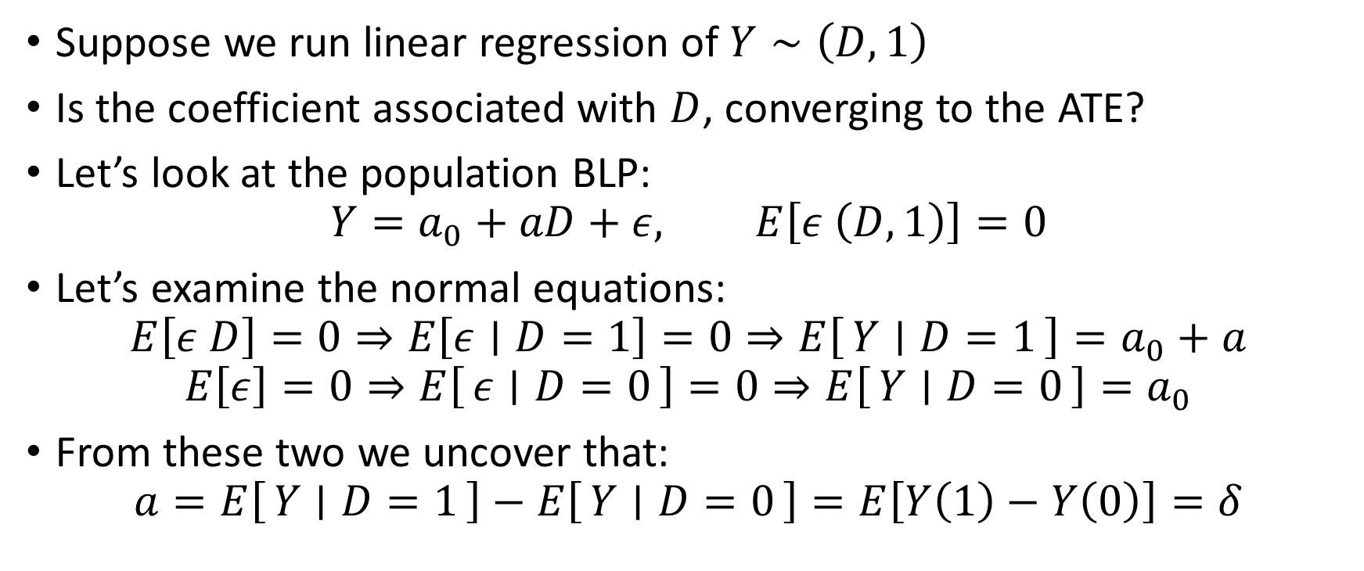
Simple Case
Suppose we run linear regression of $Y∼\left(D,1\right)$
Is the coefficient associated with $D$, converging to the ATE?
Let’s look at the population BLP:
$$Y=a_{0}+aD+ε, E\left[ε \left(D,1\right)\right]=0$$
Let’s examine the normal equations:
$$E\left[ε D\right]=0⇒E\left[ε∣D=1\right]=0⇒E\left[Y ∣ D=1\right]=a_{0}+a$$
$$E\left[ε\right]=0⇒E\left[ε ∣ D=0\right]=0⇒E\left[Y ∣ D=0\right]=a_{0}$$
From these two we uncover that:
$$a=E\left[Y ∣ D=1\right]−E\left[Y ∣ D=0\right]=E\left[Y\left(1\right)−Y\left(0\right)\right]=δ$$

Slide 16
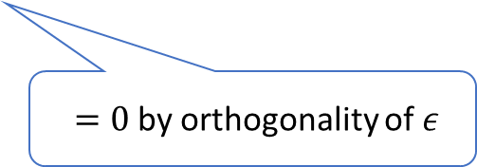
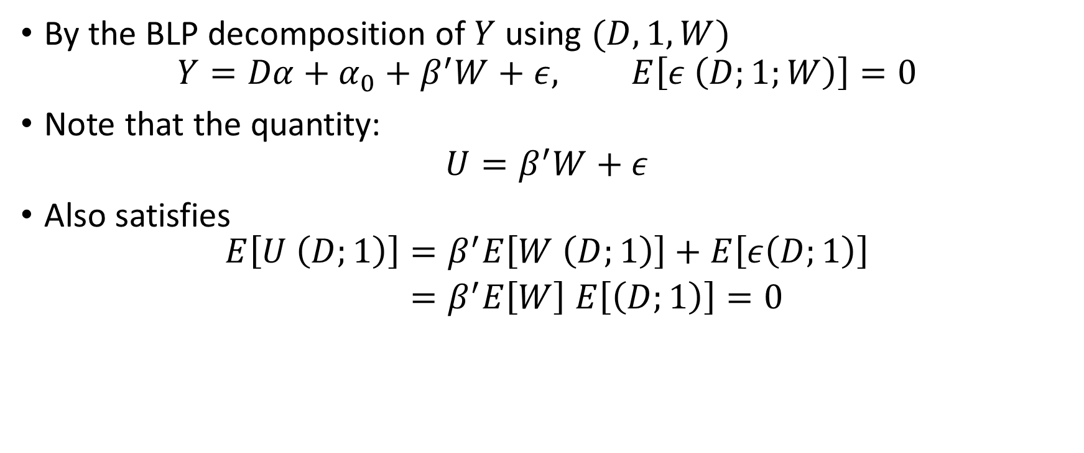
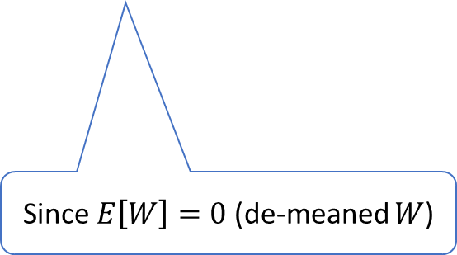
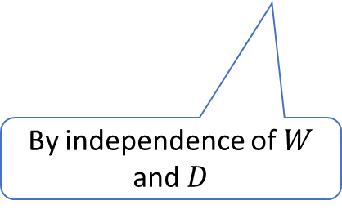
What if we add covariates?
By the BLP decomposition of $Y$ using $(D,1,W)$
$$Y=Dα+α_{0}+β^{′}W+ε, E\left[ε \left(D;1;W\right)\right]=0$$
Note that the quantity:
$$U=β^{′}W+ε$$
Also satisfies
$$\begin{aligned}E\left[U \left(D;1\right)\right]=&β^{′}E\left[W \left(D;1\right)\right]+E\left[ε\left(D;1\right)\right] \\ =&β^{′}E\left[W\right] E\left[\left(D;1\right)\right]=0\end{aligned}$$
$=0$ by orthogonality of $ε$
By independence of $W$ and $D$
Since $E\left[W\right]=0$ (de-meaned $W$)

Slide 17
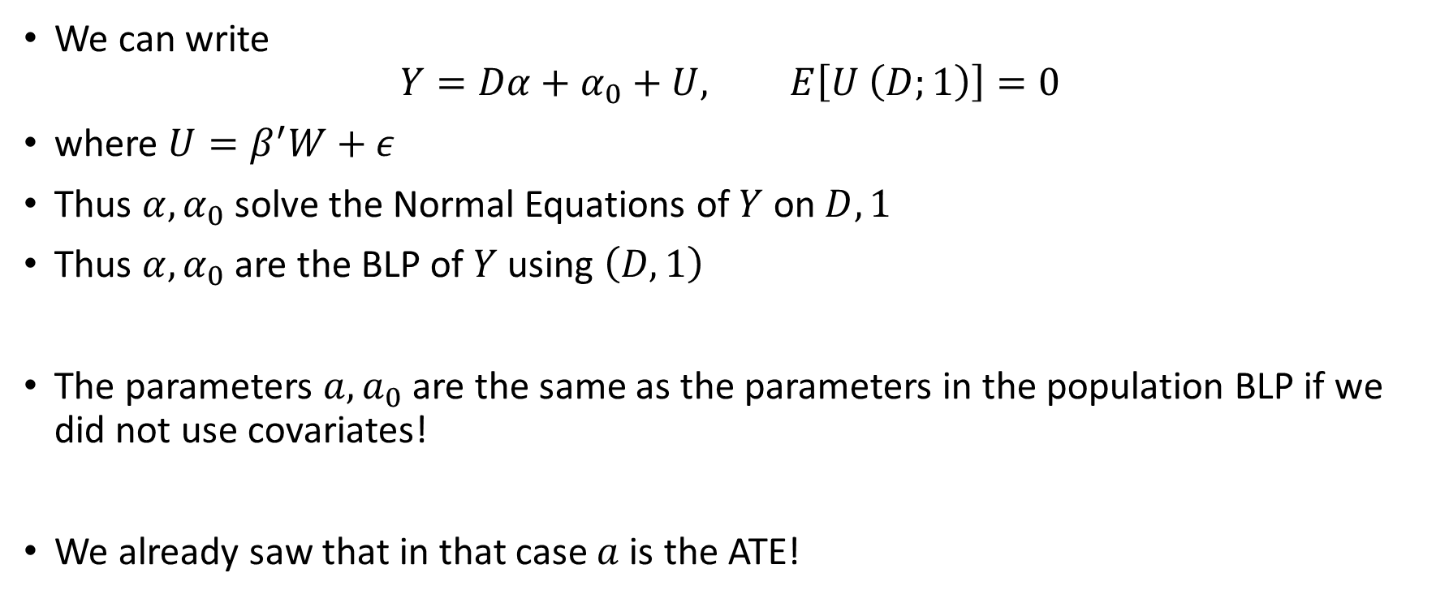
Is this consistent? Beyond Linear CEF
We can write
$$Y=Dα+α_{0}+U, E\left[U \left(D;1\right)\right]=0$$
where $U=β^{′}W+ε$
Thus $α,α_{0}$ solve the Normal Equations of $Y$ on $D, 1$
Thus $α,α_{0}$ are the BLP of $Y$ using $\left(D,1\right)$
The parameters $a, a_{0}$ are the same as the parameters in the population BLP if we did not use covariates!
We already saw that in that case $a$ is the ATE!

Slide 18
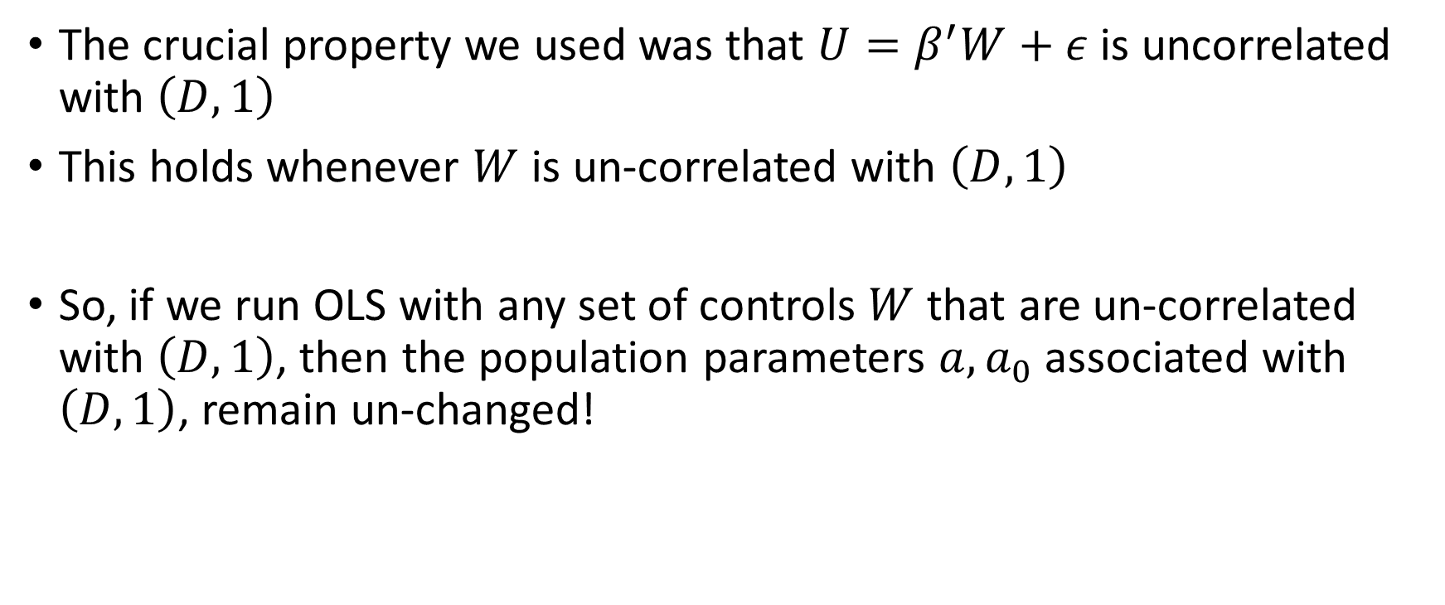
Is this consistent? Beyond Linear CEF
The crucial property we used was that $U=β^{′}W+ε$ is uncorrelated with $\left(D,1\right)$
This holds whenever $W$ is un-correlated with $\left(D,1\right)$
So, if we run OLS with any set of controls $W$ that are un-correlated with $\left(D,1\right)$, then the population parameters $a,a_{0}$ associated with $\left(D,1\right)$, remain un-changed!

Slide 19
The coefficient associated with treatment D in OLS with co-variate adjustment is always consistent for the treatment effect, when run on data from a randomized experiment, as-long-as covariates are de-meaned. The true relationship of outcome with covariates does not need to be linear.

Slide 20
Analysis of Variance (ANOVA)

Slide 21
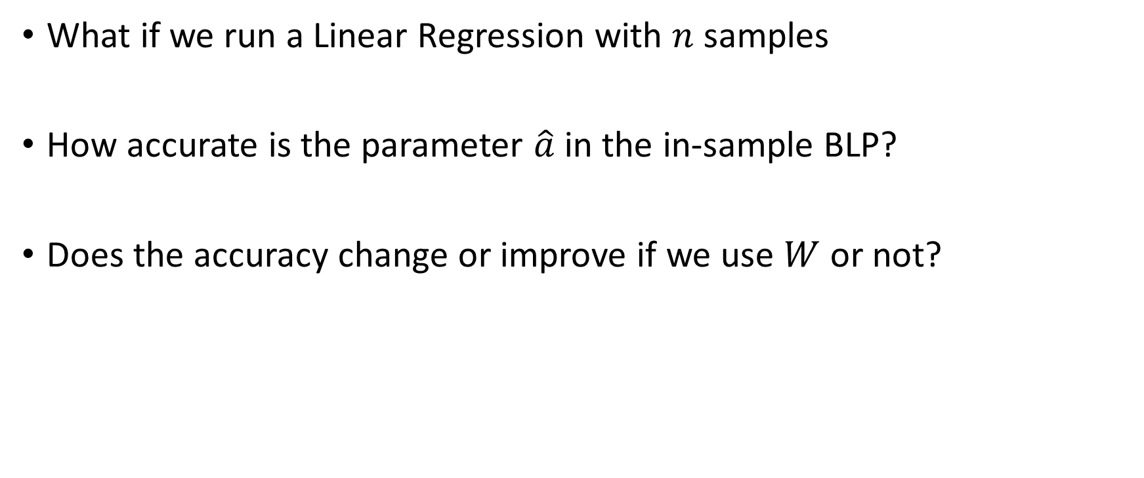
Quality of In-Sample Estimate
What if we run a Linear Regression with $n$ samples
How accurate is the parameter $\hat{a}$ in the in-sample BLP?
Does the accuracy change or improve if we use $W$ or not?

Slide 22
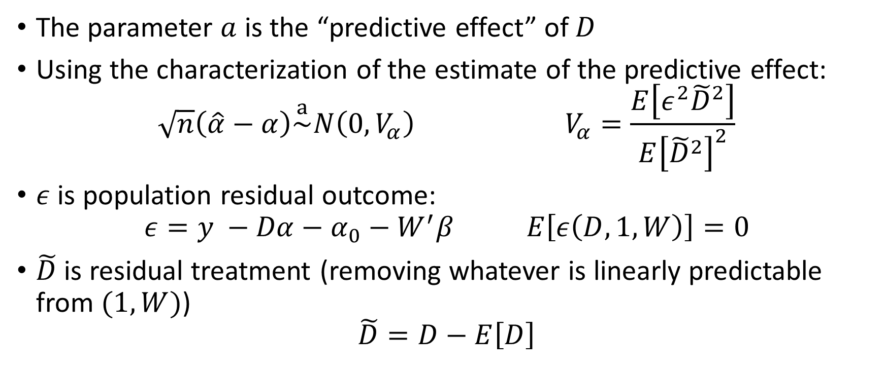
Variance of Estimate
The parameter $a$ is the “predictive effect” of $D$
Using the characterization of the estimate of the predictive effect:
$$\sqrt{n}\left(\hat{α}−α\right)\overset{a}{\sim }N\left(0, V_{α}\right) V_{α}=\frac{E\left[ε^{2}{\tilde{D}}^{2}\right]}{E{\left[{\tilde{D}}^{2}\right]}^{2}}$$
$ε$ is population residual outcome:
$$ε=y −Dα−α_{0}−W^{′}β E\left[ε\left(D,1,W\right)\right]=0$$
$\tilde{D}$ is residual treatment (removing whatever is linearly predictable from $(1, W)$)
$$\tilde{D}=D−E\left[D\right]$$

Slide 23
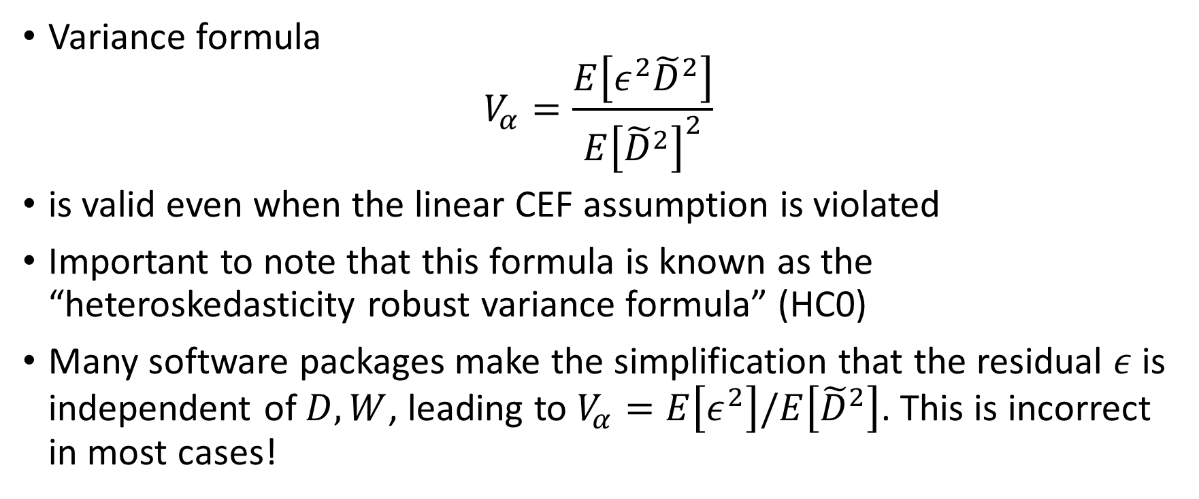
Heteroskedasticity Robust Variance
Variance formula
$$V_{α}=\frac{E\left[ε^{2}{\tilde{D}}^{2}\right]}{E{\left[{\tilde{D}}^{2}\right]}^{2}}$$
is valid even when the linear CEF assumption is violated
Important to note that this formula is known as the “heteroskedasticity robust variance formula” (HC0)
Many software packages make the simplification that the residual $ε$ is independent of $D,W$, leading to $V_{α}=E\left[ε^{2}\right]/E\left[{\tilde{D}}^{2}\right]$. This is incorrect in most cases!

Slide 24
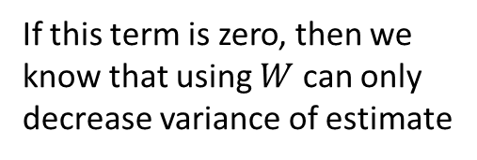
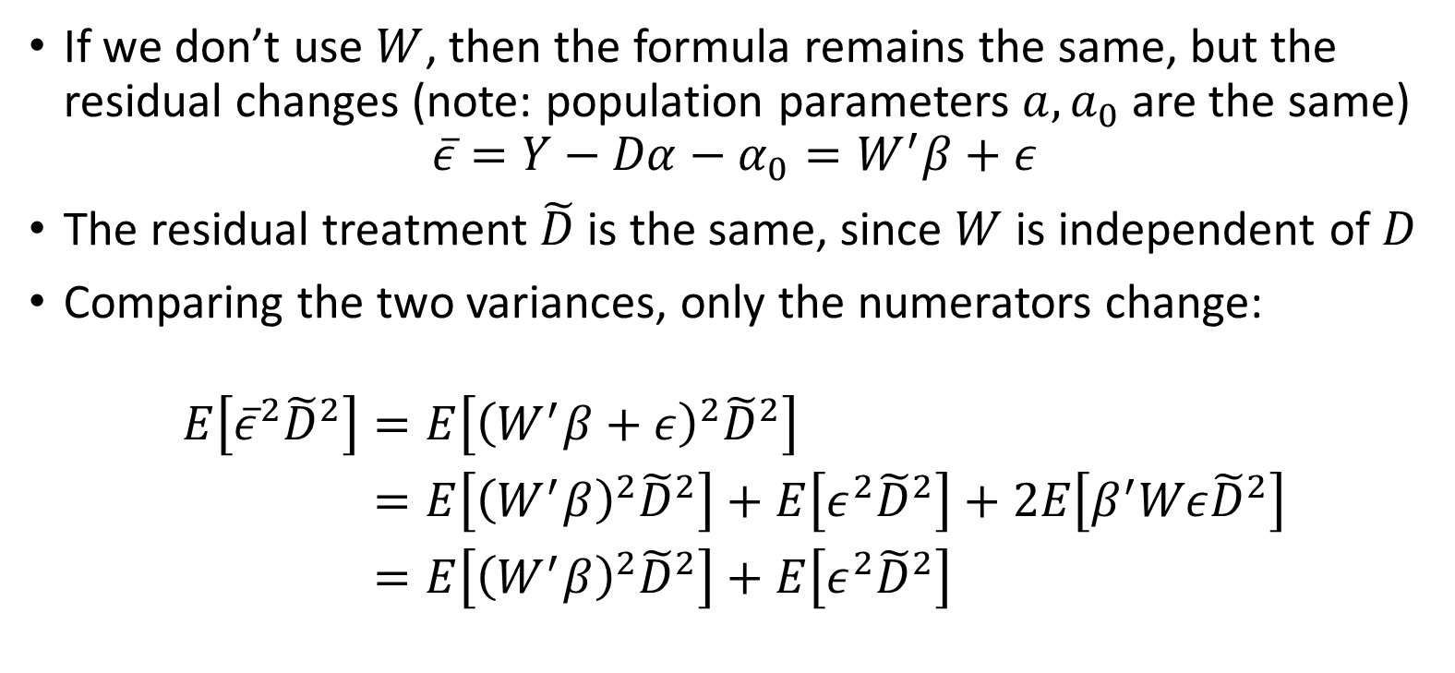
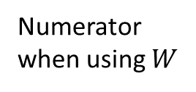
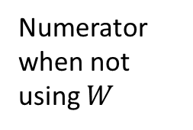
Variance without adjustment
If we don’t use $W$, then the formula remains the same, but the residual changes (note: population parameters $a,a_{0}$ are the same)
$$\overline{ε}=Y−Dα−α_{0}=W^{′}β+ε$$
The residual treatment $\tilde{D}$ is the same, since $W$ is independent of $D$
Comparing the two variances, only the numerators change:
$$\begin{aligned}E\left[{\overline{ε}}^{2}{\tilde{D}}^{2}\right]=&E\left[{\left(W^{′}β+ε\right)}^{2}{\tilde{D}}^{2}\right] \\ =&E\left[{\left(W^{′}β\right)}^{2}{\tilde{D}}^{2}\right]+E\left[ε^{2}{\tilde{D}}^{2}\right]+2E\left[β^{′}Wε{\tilde{D}}^{2}\right] \\ =&E\left[{\left(W^{′}β\right)}^{2}{\tilde{D}}^{2}\right]+E\left[ε^{2}{\tilde{D}}^{2}\right]\end{aligned}$$
Numerator when not using $W$
If this term is zero, then we know that using $W$ can only decrease variance of estimate
Numerator when using $W$

Slide 25

When can we claim that interaction term is zero? $$E\left[εW{\tilde{D}}^{2}\right]=0$$

Slide 26
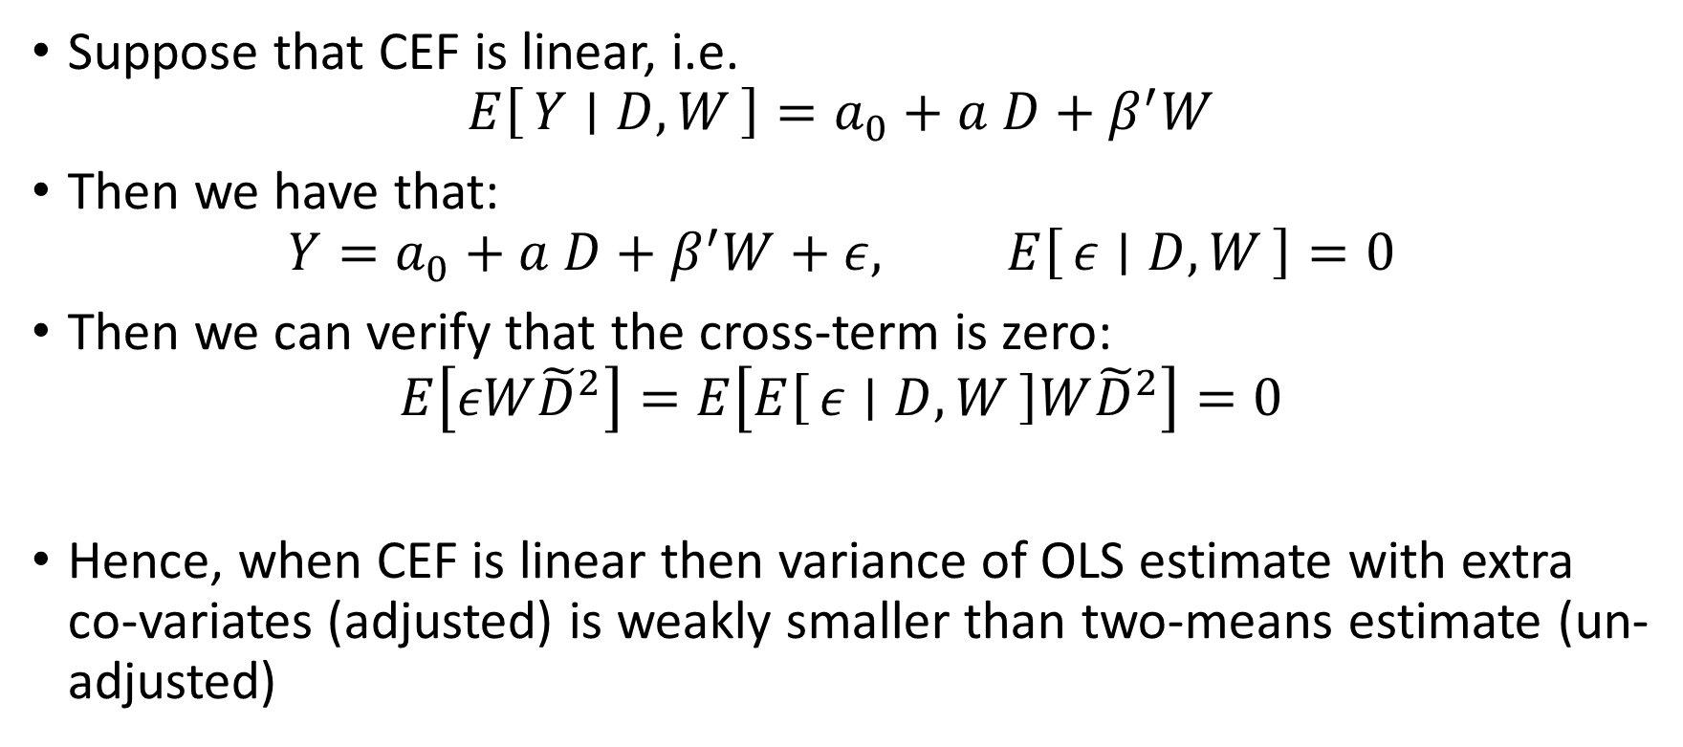
One Case: Strong Assumption
Suppose that CEF is linear, i.e.
$$E\left[Y ∣ D,W\right]=a_{0}+a D+β^{′}W$$
Then we have that:
$$Y=a_{0}+a D+β^{′}W+ε, E\left[ε ∣ D,W\right]=0$$
Then we can verify that the cross-term is zero:
$$E\left[εW{\tilde{D}}^{2}\right]=E\left[E\left[ε ∣ D,W\right]W{\tilde{D}}^{2}\right]=0$$
Hence, when CEF is linear then variance of OLS estimate with extra co-variates (adjusted) is weakly smaller than two-means estimate (un-adjusted)

Slide 27
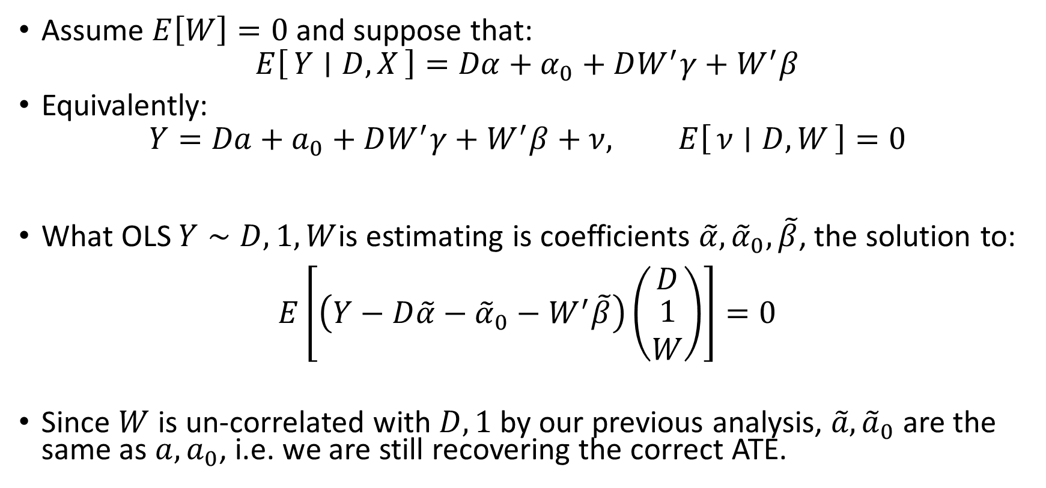
What if CEF is Non-Linear? Example: Heterogeneous Effects
effect modifier
Assume $E\left[W\right]=0$ and suppose that:
$$E\left[Y ∣ D,X\right]=Dα+α_{0}+DW^{′}γ+W^{′}β$$
Equivalently:
$$Y=Da+a_{0}+DW^{′}γ+W^{′}β+ν, E\left[ν ∣ D,W\right]=0$$
What OLS $Y∼D, 1,W$is estimating is coefficients $\tilde{α},{\tilde{α}}_{0},\tilde{β}$, the solution to:
$$E\left[\left(Y−D\tilde{α}−{\tilde{α}}_{0}−W^{′}\tilde{β}\right)\left(\begin{matrix}D \\ \begin{aligned}1 \\ W\end{aligned}\end{matrix}\right)\right]=0$$
Since $W$ is un-correlated with $D,1$ by our previous analysis, $\tilde{a},{\tilde{a}}_{0}$ are the same as $a,a_{0}$, i.e. we are still recovering the correct ATE.
ATE

Slide 28
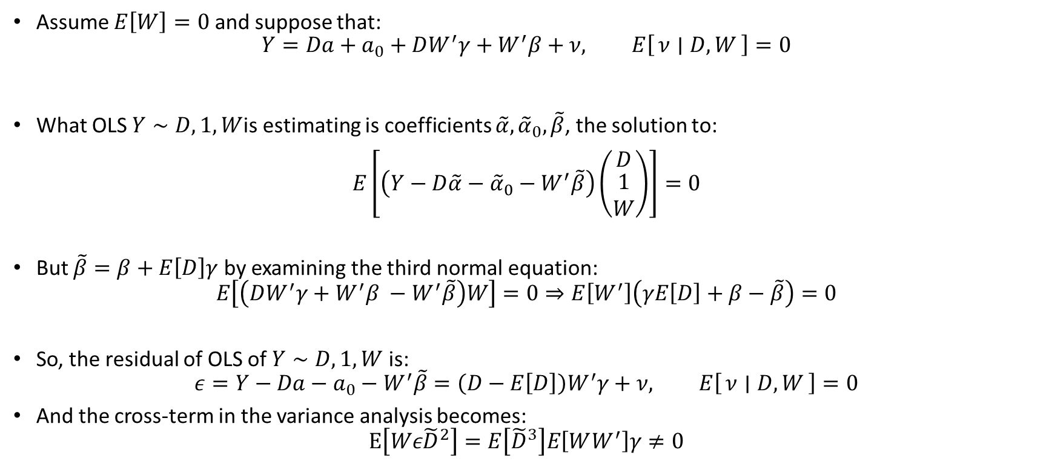
What if CEF is Non-Linear? Example: Heterogeneous Effects
Assume $E\left[W\right]=0$ and suppose that:
$$Y=Da+a_{0}+DW^{′}γ+W^{′}β+ν, E\left[ν ∣ D,W\right]=0$$
What OLS $Y∼D, 1,W$is estimating is coefficients $\tilde{α},{\tilde{α}}_{0},\tilde{β}$, the solution to:
$$E\left[\left(Y−D\tilde{α}−{\tilde{α}}_{0}−W^{′}\tilde{β}\right)\left(\begin{matrix}D \\ \begin{aligned}1 \\ W\end{aligned}\end{matrix}\right)\right]=0$$
But $\tilde{β}=β+E\left[D\right]γ$ by examining the third normal equation:
$$E\left[\left(DW^{′}γ+W^{′}β −W^{′}\tilde{β}\right)W\right]=0⇒E\left[W^{′}\right]\left(γE\left[D\right]+β−\tilde{β}\right)=0$$
So, the residual of OLS of $Y∼D, 1, W$ is:
$$ε=Y−Da−a_{0}−W^{′}\tilde{β}=\left(D−E\left[D\right]\right)W^{′}γ+ν, E\left[ν ∣ D,W\right]=0$$
And the cross-term in the variance analysis becomes:
$$E\left[Wε{\tilde{D}}^{2}\right]=E\left[{\tilde{D}}^{3}\right]E\left[WW^{′}\right]γ≠0$$

Slide 29
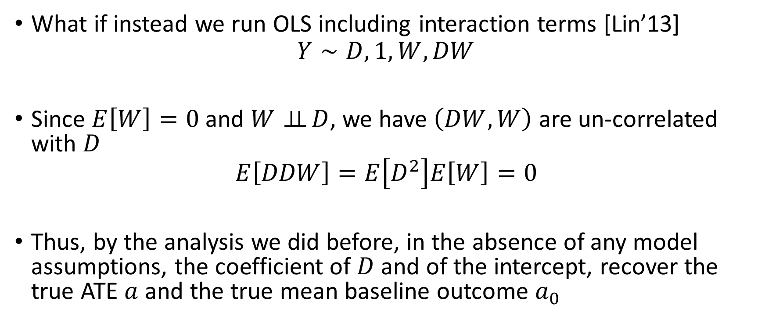
OLS with Interactive Terms
What if instead we run OLS including interaction terms [Lin’13]
$$Y∼D, 1, W, DW$$
Since $E\left[W\right]=0$ and $W⊥⊥ D$, we have $\left(DW, W\right)$ are un-correlated with $D$
$$E\left[DDW\right]=E\left[D^{2}\right]E\left[W\right]=0$$
Thus, by the analysis we did before, in the absence of any model assumptions, the coefficient of $D$ and of the intercept, recover the true ATE $a$and the true mean baseline outcome $a_{0}$
Let’s try it out!

Slide 30
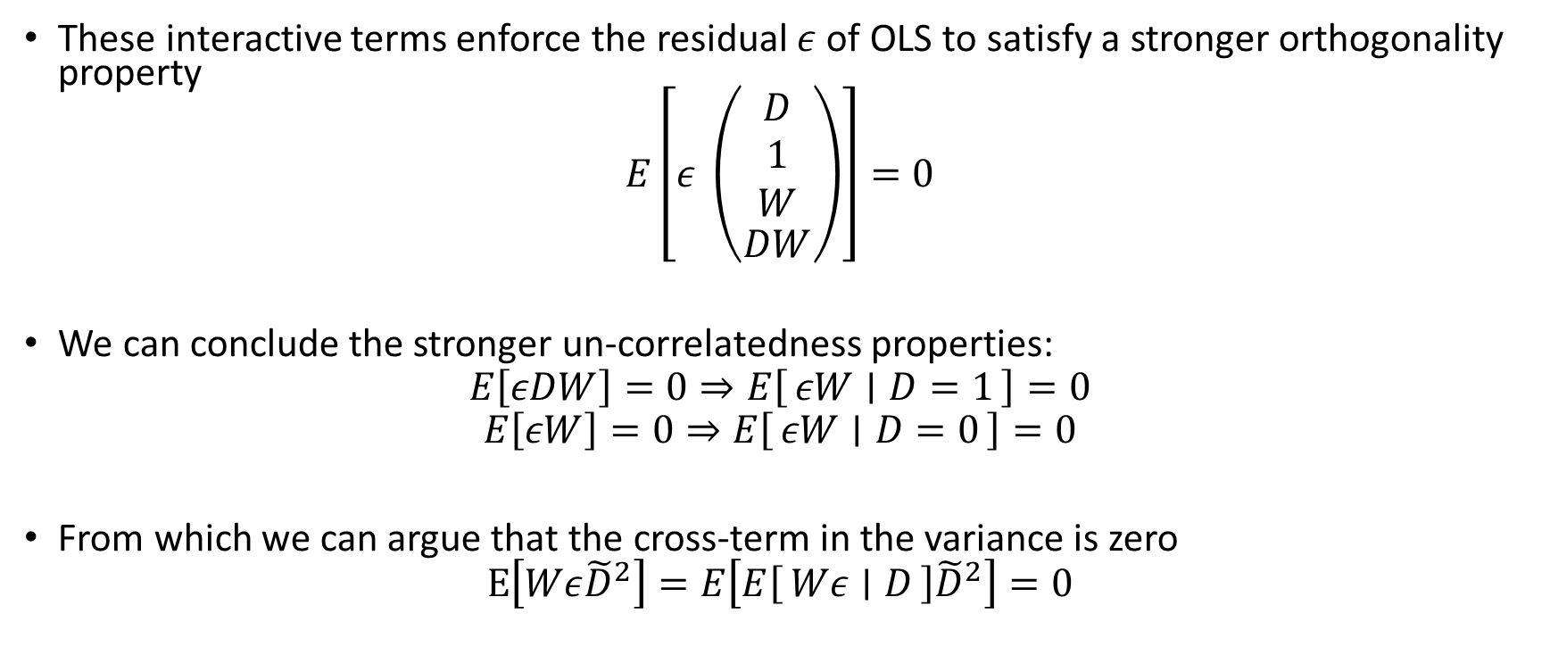
OLS with Interactive Terms
These interactive terms enforce the residual $ε$ of OLS to satisfy a stronger orthogonality property
$$E\left[ε \left(\begin{matrix}\begin{aligned}D \\ 1 \\ W\end{aligned} \\ DW\end{matrix}\right)\right]=0$$
We can conclude the stronger un-correlatedness properties:
$$E\left[εDW\right]=0⇒E\left[εW ∣ D=1\right]=0$$
$$E\left[εW\right]=0⇒E\left[εW ∣ D=0\right]=0$$
From which we can argue that the cross-term in the variance is zero
$$E\left[Wε{\tilde{D}}^{2}\right]=E\left[E\left[Wε ∣ D\right]{\tilde{D}}^{2}\right]=0$$

Slide 31
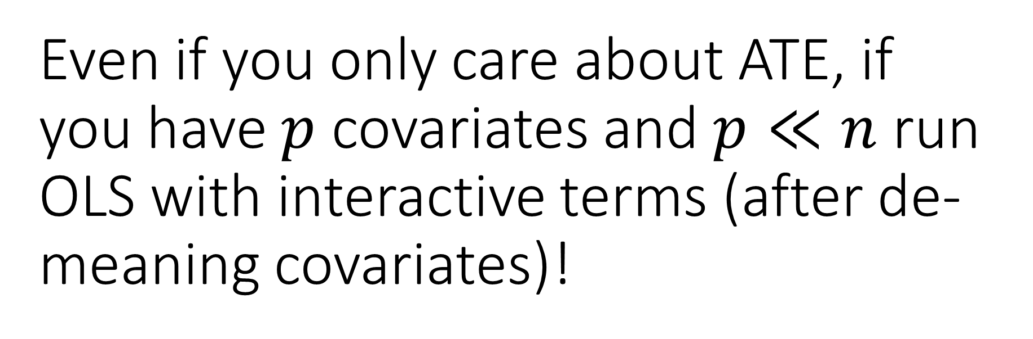
Even if you only care about ATE, if you have $p$ covariates and $p≪n$ run OLS with interactive terms (after de-meaning covariates)!
Guaranteed improved precision

