Slide 1
MS&E 228: Structural Equation Models
Vasilis Syrgkanis
MS&E, Stanford

Slide 2
Causal Inference with Experiments
Prediction with Linear Models
Prediction with High-Dim Linear Models
Inference on Causal and Predictive Effects with High-Dim Linear Models
Potential Outcomes and Conditional Ignorability
Structural Equation Models and Conditional Exogeneity
Directed Acyclic Graphs
Prediction with Non-Linear Models
Inference on Causal Effects with Non-Linear Models
Un-observed Confounding and Instruments
Identification of Causal Effects in Longitudinal Data
Estimation of Heterogeneous Causal Effects
Linear Predictive Models and Statistical Inference
Causal Identification in Observational Data
Non-Linear Predictive Models and Statistical Inference
Topics

Slide 3
Causal Inference with Experiments
Prediction with Linear Models
Prediction with High-Dim Linear Models
Inference on Causal and Predictive Effects with High-Dim Linear Models
Potential Outcomes and Conditional Ignorability
Structural Equation Models and Conditional Exogeneity
Directed Acyclic Graphs
Prediction with Non-Linear Models
Inference on Causal Effects with Non-Linear Models
Un-observed Confounding and Instruments
Identification of Causal Effects in Longitudinal Data
Estimation of Heterogeneous Causal Effects
Linear Predictive Models and Statistical Inference
Causal Identification in Observational Data
Non-Linear Predictive Models and Statistical Inference
Topics

Slide 4
Goals for Today
Learn the “language” of (linear) structural equation models (SEMs)
Connect to “potential outcome” and the “causal diagram” language
Introduce “intervention” concepts
Introduce some causal diagram concepts
Examples of how to use SEMs (direct/indirect effects, collider bias, wage discrimination)

Slide 5
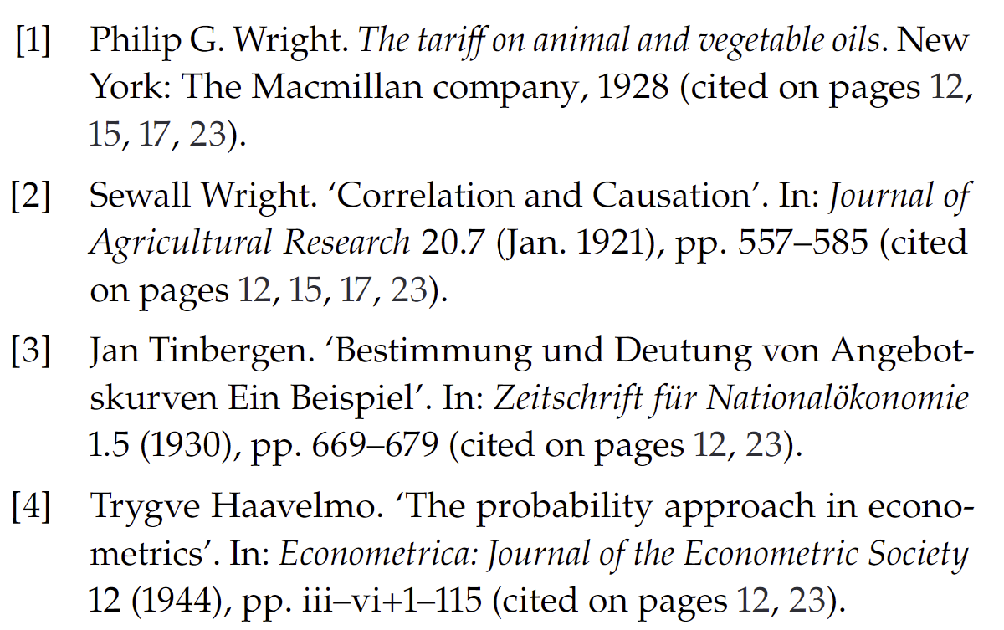
Structural Equation Models

Slide 6
The Language of SEMs

Slide 7
Structural Equation Models (SEMs)
A more “mechanistic” definition of causality
Mathematically equivalent to potential outcomes
SEMs define “mechanisms” or “structures” of how the world works
These “mechanisms” allow one to understand what would be the effects of “interventions”; the causal effect
Parameters that go into these mechanisms are “structural” parameters
Goal: identify “structural” parameters from observed data

Slide 8
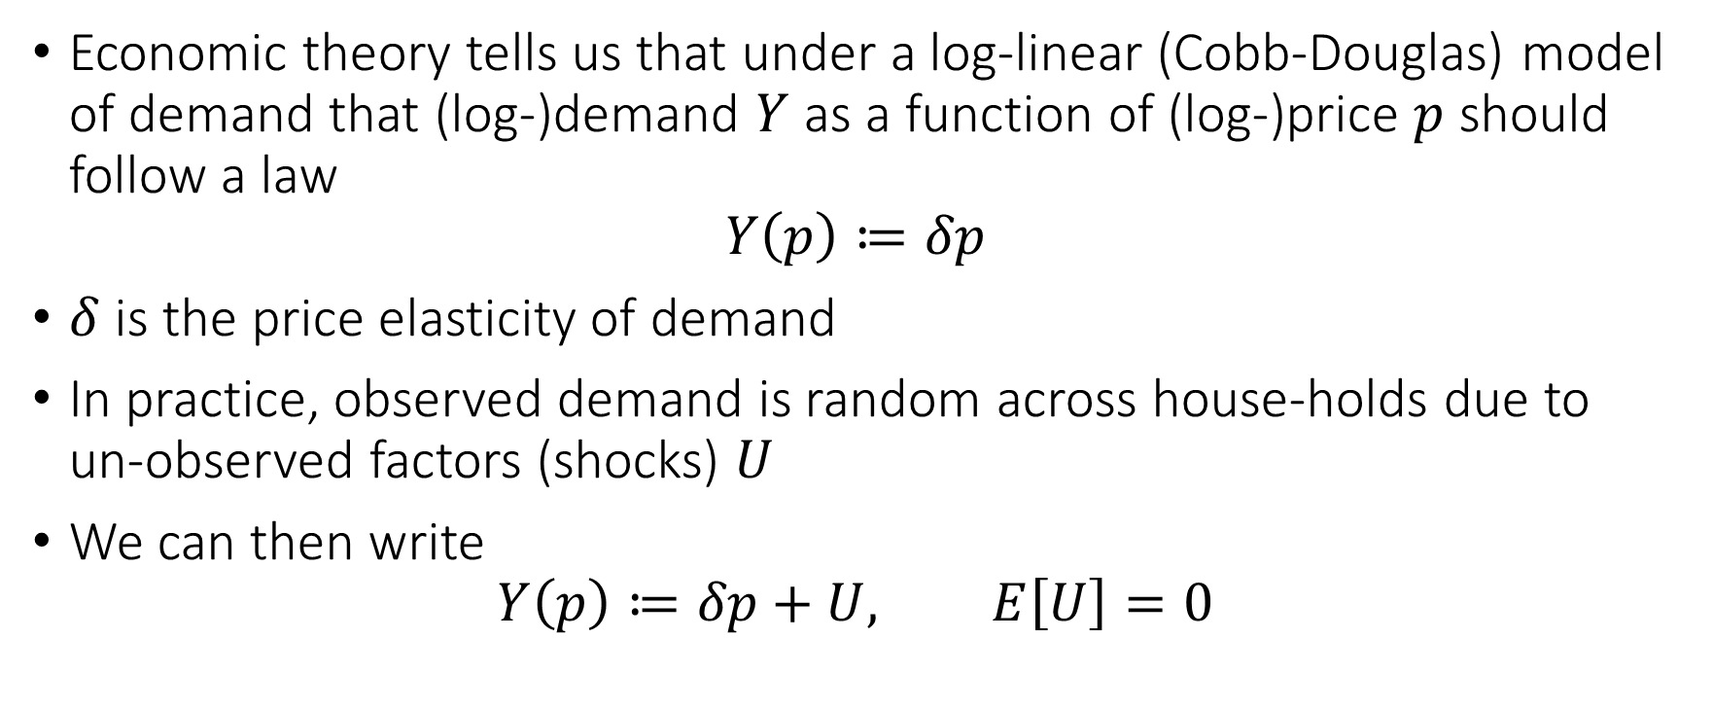
Example: Demand for Gasoline
Economic theory tells us that under a log-linear (Cobb-Douglas) model of demand that (log-)demand $Y$ as a function of (log-)price $p$ should follow a law
$$Y\left(p\right)≔δp$$
$δ$ is the price elasticity of demand
In practice, observed demand is random across house-holds due to un-observed factors (shocks) $U$
We can then write
$$Y\left(p\right)≔δp+U, E\left[U\right]=0$$

Slide 9
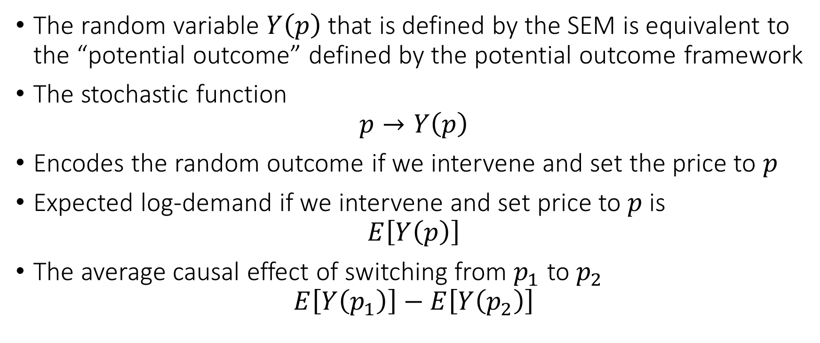
SEMs and Potential Outcomes
The random variable $Y\left(p\right)$ that is defined by the SEM is equivalent to the “potential outcome” defined by the potential outcome framework
The stochastic function
$$p→Y\left(p\right)$$
Encodes the random outcome if we intervene and set the price to $p$
Expected log-demand if we intervene and set price to $p$ is
$$E\left[Y\left(p\right)\right]$$
The average causal effect of switching from $p_{1}$ to $p_{2}$
$$E\left[Y\left(p_{1}\right)\right]−E\left[Y\left(p_{2}\right)\right]$$

Slide 10
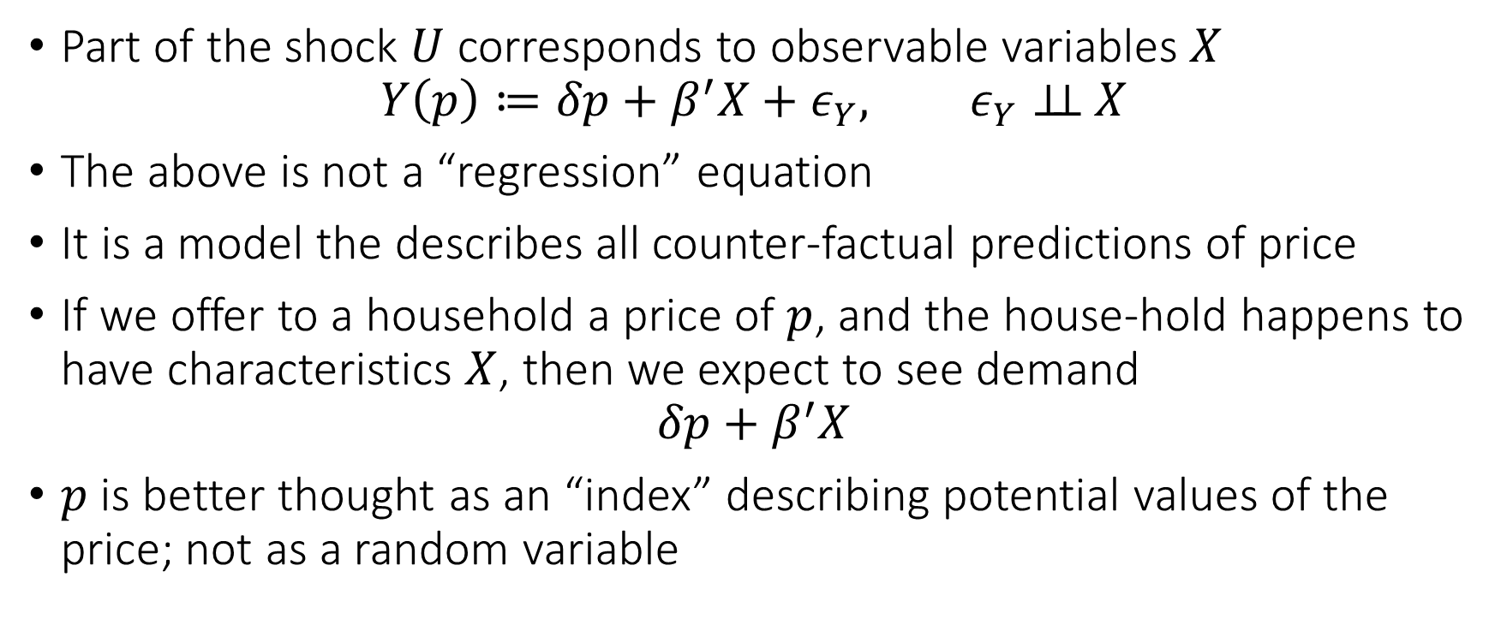
More Reasonable SEM
Part of the shock $U$ corresponds to observable variables $X$
$$Y\left(p\right)≔δp+β^{′}X+ε_{Y}, ε_{Y}⊥⊥ X$$
The above is not a “regression” equation
It is a model the describes all counter-factual predictions of price
If we offer to a household a price of $p$, and the house-hold happens to have characteristics $X$, then we expect to see demand
$$δp+β^{′}X$$
$p$ is better thought as an “index” describing potential values of the price; not as a random variable

Slide 11

Identification Question
What data $(Y, P, X)$ of quantities, prices and characteristics should we collect to allow us to learn the structural parameter $δ$?

Slide 12
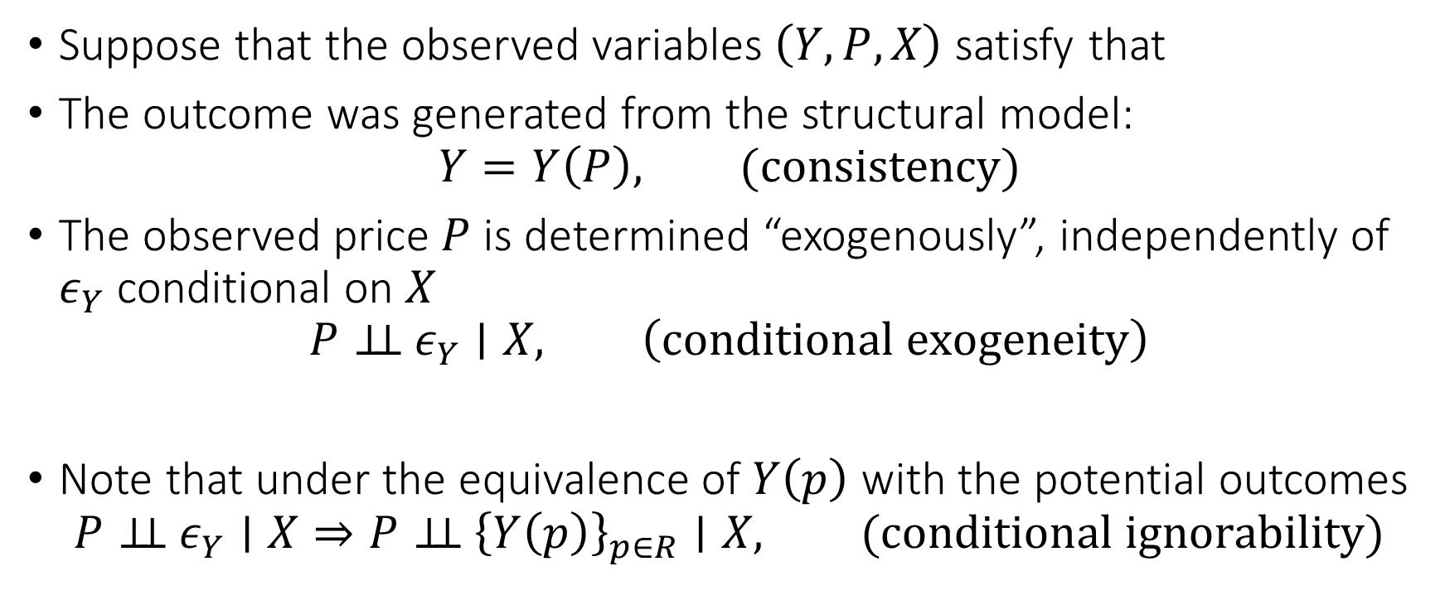
Conditional Exogeneity
Suppose that the observed variables $\left(Y, P, X\right)$ satisfy that
The outcome was generated from the structural model:
$$Y=Y\left(P\right), (consistency)$$
The observed price $P$ is determined “exogenously”, independently of $ε_{Y}$ conditional on $X$
$$P⊥⊥ ε_{Y}∣X, \left(conditional exogeneity\right)$$
Note that under the equivalence of $Y\left(p\right)$ with the potential outcomes
$$P⊥⊥ ε_{Y}∣X⇒P⊥⊥ {\left\{Y\left(p\right)\right\}}_{p∈R}∣X, (conditional ignorability)$$

Slide 13
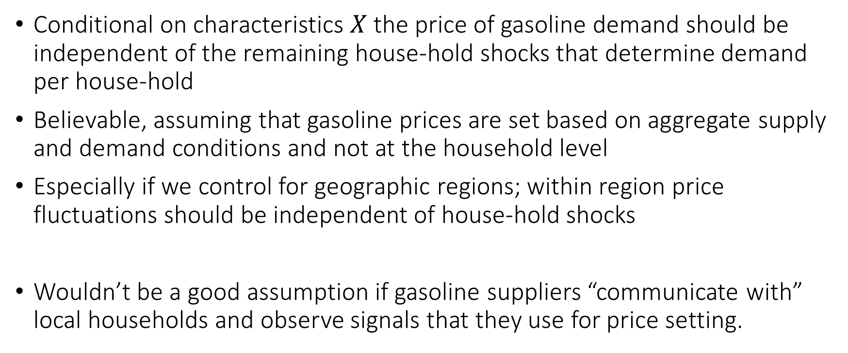
Conditional Exogeneity Interpretation
Conditional on characteristics $X$ the price of gasoline demand should be independent of the remaining house-hold shocks that determine demand per house-hold
Believable, assuming that gasoline prices are set based on aggregate supply and demand conditions and not at the household level
Especially if we control for geographic regions; within region price fluctuations should be independent of house-hold shocks
Wouldn’t be a good assumption if gasoline suppliers “communicate with” local households and observe signals that they use for price setting.

Slide 14

Identification under Conditional Exogeneity
Under conditional exogeneity we have
$$Y=Y\left(P\right)=δP+β^{′}X+ε_{Y}, ε_{Y}⊥\left(P,X\right)$$
Structural parameters $δ,β$ can be identified as the BLP parameters of $Y$ using $\left(P, X\right)$

Slide 15
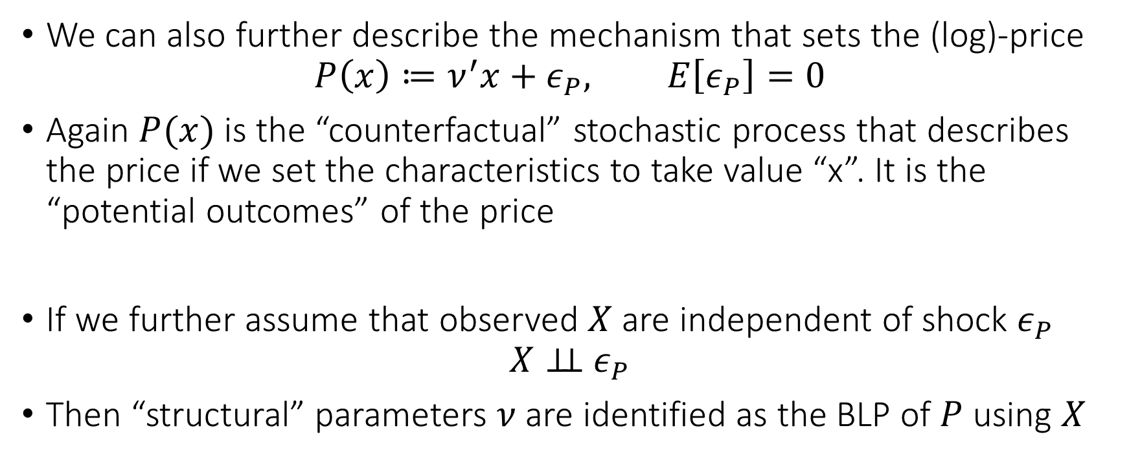
Structural Model of Price
We can also further describe the mechanism that sets the (log)-price
$$P\left(x\right)≔ν^{′}x+ε_{P}, E\left[ε_{P}\right]=0$$
Again $P(x)$ is the “counterfactual” stochastic process that describes the price if we set the characteristics to take value “x”. It is the “potential outcomes” of the price
If we further assume that observed $X$ are independent of shock $ε_{P}$
$$X⊥⊥ ε_{P}$$
Then “structural” parameters $ν$ are identified as the BLP of $P$ using $X$

Slide 16
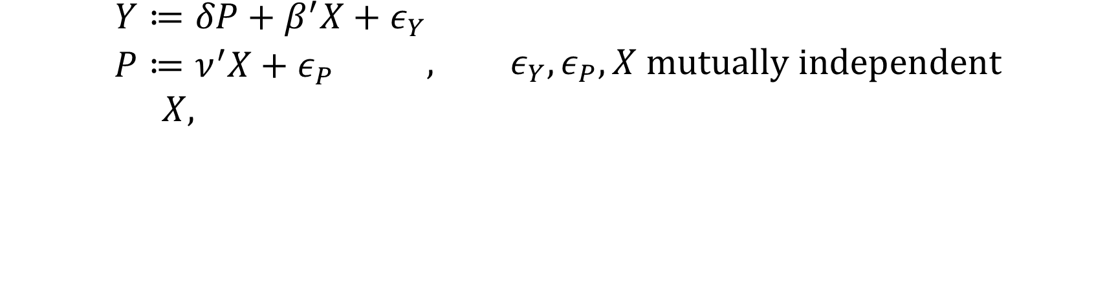
Triangular Structural Equation Model (TSEM)
$$\begin{aligned}Y≔&δP+β^{′}X+ε_{Y} \\ P≔&ν^{′}X+ε_{P} \\ X,&\end{aligned}, ε_{Y},ε_{P},X mutually independent$$
Endogenously determined by the structural model
Exogenously determined “outside” of the model

Slide 17
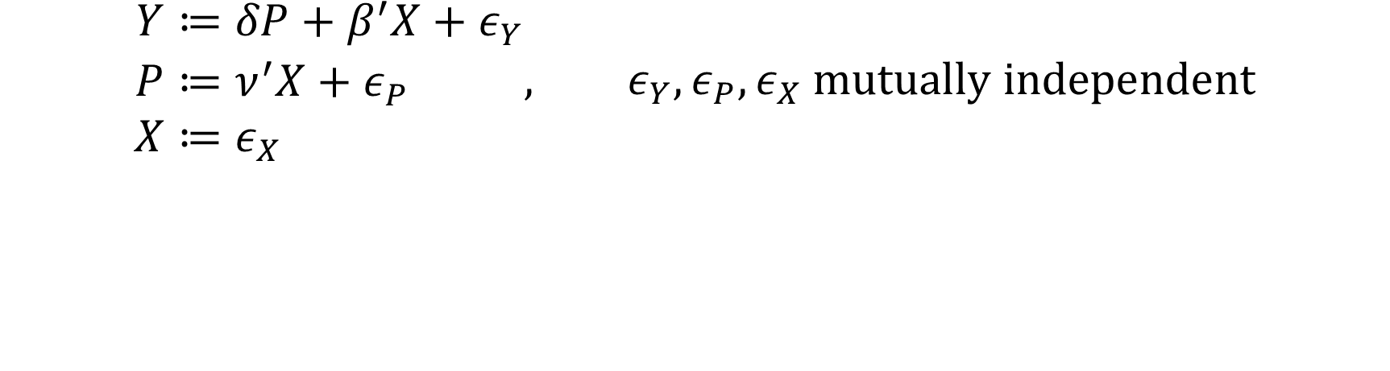
Triangular Structural Equation Model (TSEM)
$$\begin{aligned}Y≔&δP+β^{′}X+ε_{Y} \\ P≔&ν^{′}X+ε_{P} \\ X≔&ε_{X}&\end{aligned}, ε_{Y},ε_{P},ε_{X} mutually independent$$
Endogenously determined by the structural model
Exogenously determined “outside” of the model

Slide 18
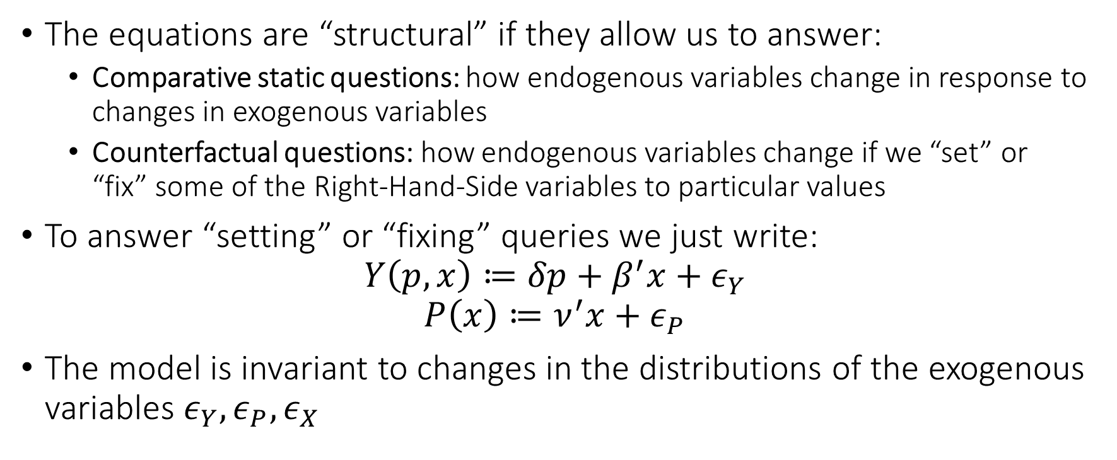
What do we mean by Structural
The equations are “structural” if they allow us to answer:
Comparative static questions: how endogenous variables change in response to changes in exogenous variables
Counterfactual questions: how endogenous variables change if we “set” or “fix” some of the Right-Hand-Side variables to particular values
To answer “setting” or “fixing” queries we just write:
$$Y\left(p,x\right)≔δp+β^{′}x+ε_{Y}$$
$$P\left(x\right)≔ν^{′}x+ε_{P}$$
The model is invariant to changes in the distributions of the exogenous variables $ε_{Y}, ε_{P},ε_{X}$

Slide 19

SEMs: more “mechanistic” version of potential outcomes Allow us to determine the explicit structural mechanisms that give rise to the stochastic potential outcomes.

Slide 20
Parse out which parts of the generative process is endogenous and which part is exogenously driven. Structural component motivated by a “model” and invariant to shifts in the exogenous components Structural component allows to answer counterfactual queries, under interventions on endogenous variables

Slide 21
Visualizing SEMs

Slide 22




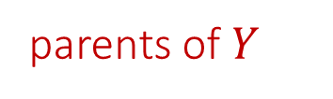
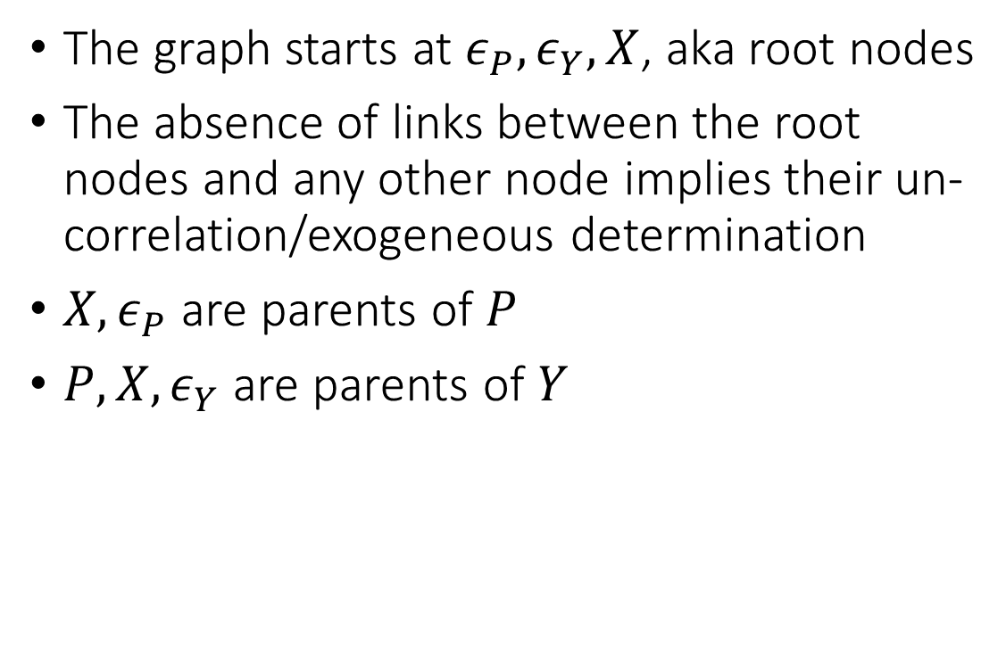

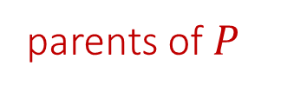




SEMs as Causal Diagrams
root nodes
Mediator
Mediator
The graph starts at $ε_{P},ε_{Y},X$, aka root nodes
The absence of links between the root nodes and any other node implies their un-correlation/exogeneous determination
$X,ε_{P}$ are parents of $P$
$P, X, ε_{Y}$ are parents of $Y$
parents of $Y$
$$ε_{P}$$
$$P$$
$$ν$$
$$δ$$
$$ε_{Y}$$
$$ε_{X}$$
$$X$$
$$Y$$
$$β$$
parents of $P$

Slide 23
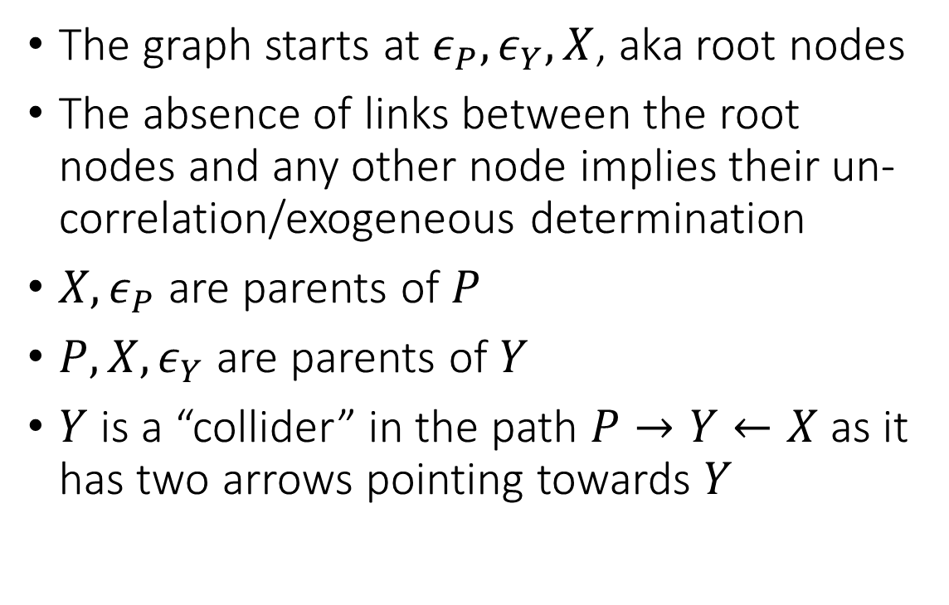
SEMs as Causal Diagrams
The graph starts at $ε_{P},ε_{Y},X$, aka root nodes
The absence of links between the root nodes and any other node implies their un-correlation/exogeneous determination
$X,ε_{P}$ are parents of $P$
$P, X, ε_{Y}$ are parents of $Y$
$Y$ is a “collider” in the path $P→Y←X$ as it has two arrows pointing towards $Y$
$$ε_{P}$$
$$P$$
$$ν$$
$$δ$$
$$ε_{Y}$$
$$ε_{X}$$
$$X$$
$$Y$$
$$β$$

Slide 24
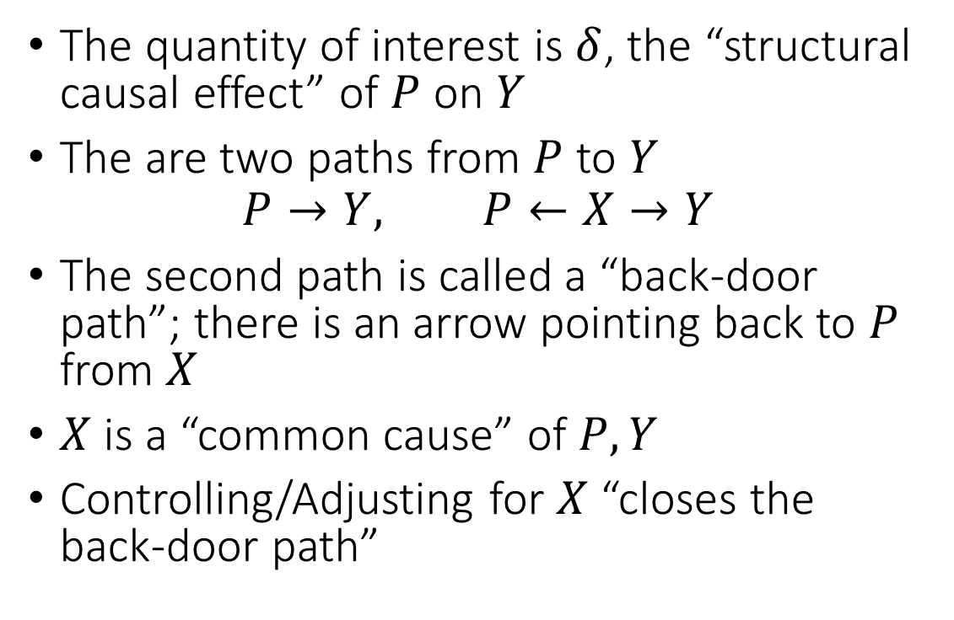
Back-door paths
The quantity of interest is $δ$, the “structural causal effect” of $P$ on $Y$
The are two paths from $P$ to $Y$
$$P→Y, P←X→Y$$
The second path is called a “back-door path”; there is an arrow pointing back to $P$ from $X$
$X$ is a “common cause” of $P,Y$
Controlling/Adjusting for $X$ “closes the back-door path”
$$ε_{P}$$
$$P$$
$$ν$$
$$δ$$
$$ε_{Y}$$
$$ε_{X}$$
$$X$$
$$Y$$
$$β$$

Slide 25
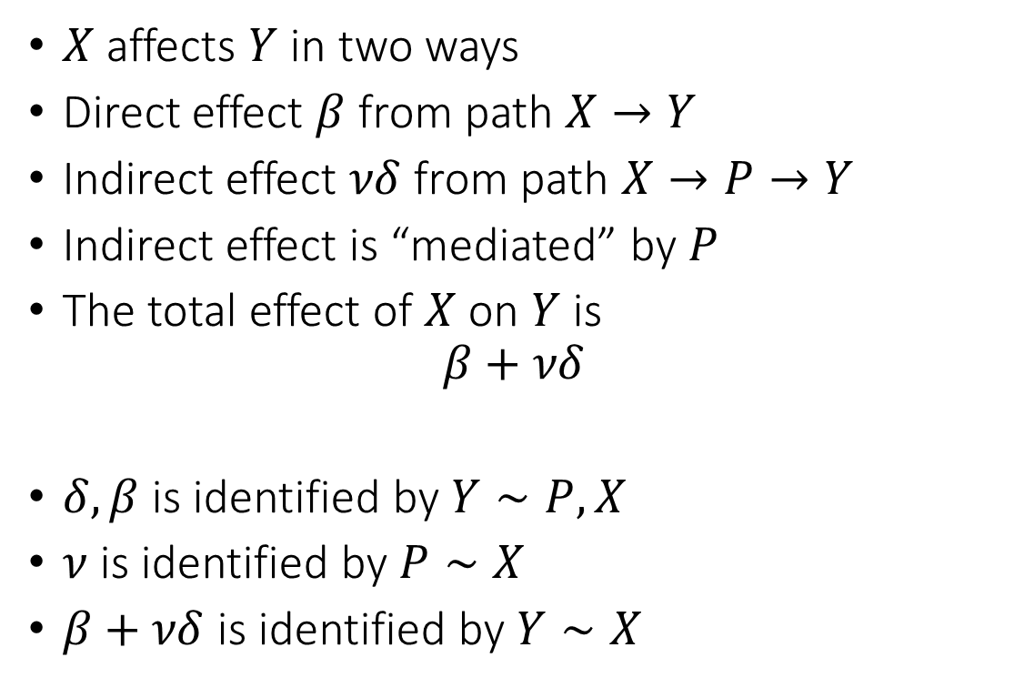
Direct and Indirect Effects
Mediator
$X$ affects $Y$ in two ways
Direct effect $β$ from path $X→Y$
Indirect effect $νδ$ from path $X→P→Y$
Indirect effect is “mediated” by $P$
The total effect of $X$ on $Y$ is
$$β+νδ$$
$δ,β$ is identified by $Y∼P,X$
$ν$ is identified by $P∼X$
$β+νδ$ is identified by $Y∼X$
Indirect
$$ε_{P}$$
$$P$$
$$ν$$
$$δ$$
$$ε_{Y}$$
$$ε_{X}$$
$$X$$
$$Y$$
$$β$$
Direct

Slide 26
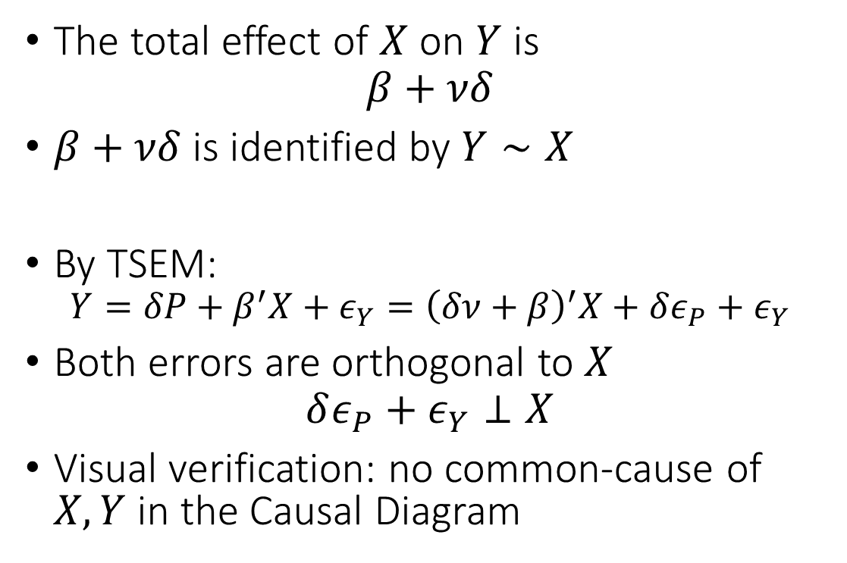
Direct and Indirect Effects
The total effect of $X$ on $Y$ is
$$β+νδ$$
$β+νδ$ is identified by $Y∼X$
By TSEM:
$$Y=δP+β^{′}X+ε_{Y}={\left(δν+β\right)}^{′}X+δε_{P}+ε_{Y}$$
Both errors are orthogonal to $X$
$$δε_{P}+ε_{Y}⊥X$$
Visual verification: no common-cause of $X,Y$ in the Causal Diagram
$$ε_{P}$$
$$P$$
$$ν$$
$$δ$$
$$ε_{Y}$$
$$ε_{X}$$
$$X$$
$$Y$$
$$β$$

Slide 27
Causal Diagram representations of a SEM allow us to understand the different “paths of influence”, and how to identify different structural parameters

Slide 28
Conditioning Gone Wrong

Slide 29




Colliders
$$X$$
$$1$$
$$ε_{P}$$
$$P$$
$$1$$
$$δ$$
$$ε_{Y}$$
$$Y$$

Slide 30

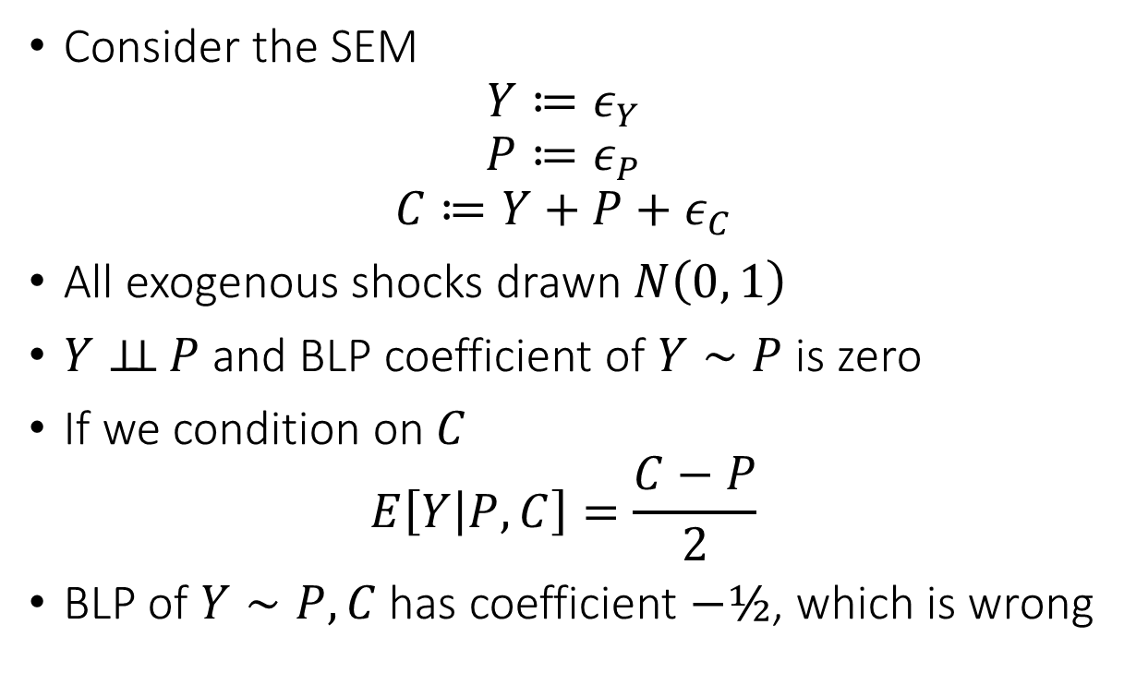
Colliders
Consider the SEM
$$Y≔ε_{Y}$$
$$P≔ε_{P}$$
$$C≔Y+P+ε_{C}$$
All exogenous shocks drawn $N\left(0, 1\right)$
$Y⊥⊥ P$ and BLP coefficient of $Y∼P$ is zero
If we condition on $C$
$$E\left[Y | P,C\right]=\frac{C−P}{2}$$
BLP of $Y∼P,C$ has coefficient $−½$, which is wrong
$$C$$
$$1$$
$$ε_{P}$$
$$P$$
$$1$$
$$ε_{Y}$$
$$Y$$

Slide 31
Birth Length Paradox
Infants born to smokers have higher infant mortality than non-smokers
If one conditions on infants with low birth-weight, effect is reversed!
Many controversies in epidemiology [Hernandez et al, Am. J. of Epidemiology, 06]
Let’s look at it from a SEM/Causal Diagram perspective

Slide 32



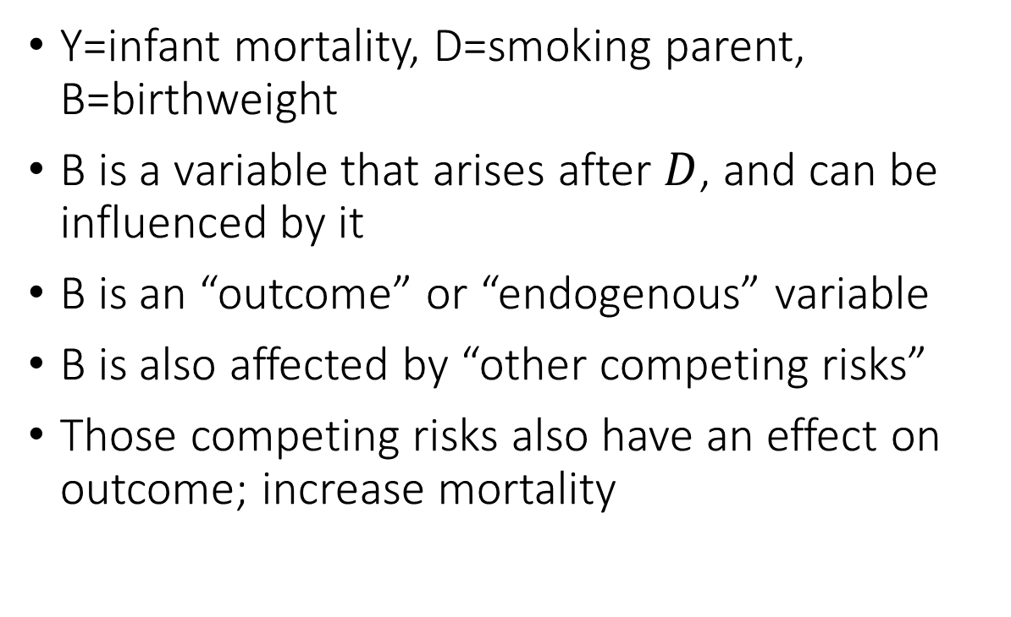



Birth Length Paradox
Y=infant mortality, D=smoking parent, B=birthweight
B is a variable that arises after $D$, and can be influenced by it
B is an “outcome” or “endogenous” variable
B is also affected by “other competing risks”
Those competing risks also have an effect on outcome; increase mortality
$$ε_{D}$$
$$D$$
$$ε_{Y}$$
$$B$$
$$Y$$
$$U$$

Slide 33
Birth Length Paradox
Y=infant mortality, D=smoking parent, B=birthweight
If B is low and D is smoking, then most probably U does not occur (i.e. there are no other competing risks that lead to low birthweight)
But if B is low and D is non-smoking, then most probably U occurs (i.e. the low birthweight was most probably caused by competing risks)
Conditioning on B=low, is as if we are comparing infants from smokers with no other competing risks, to infants from non-smokers with competing risks
$$ε_{D}$$
$$D$$
$$ε_{Y}$$
$$B$$
$$Y$$
$$U$$

Slide 34
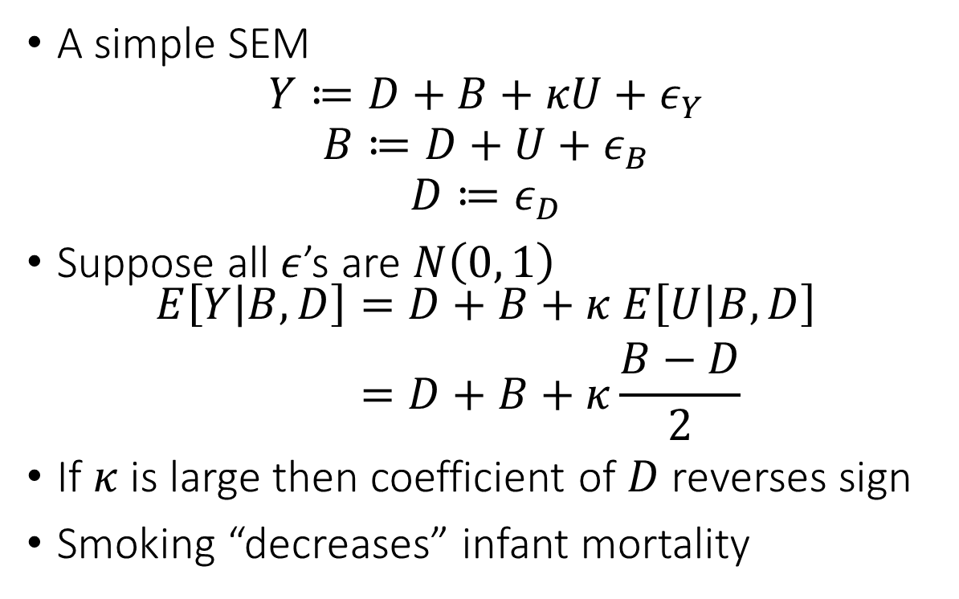
Birth Length Paradox
A simple SEM
$$Y≔D+B+κU+ε_{Y}$$
$$B≔D+U+ε_{B}$$
$$D≔ε_{D}$$
Suppose all $ε$’s are $N\left(0, 1\right)$
$$\begin{aligned}E\left[Y | B,D\right]=&D+B+κ E\left[U | B,D\right] \\ =&D+B+κ\frac{B−D}{2}\end{aligned}$$
If $κ$ is large then coefficient of $D$ reverses sign
Smoking “decreases” infant mortality
$$ε_{D}$$
$$D$$
$$ε_{Y}$$
$$B$$
$$Y$$
$$U$$

Slide 35
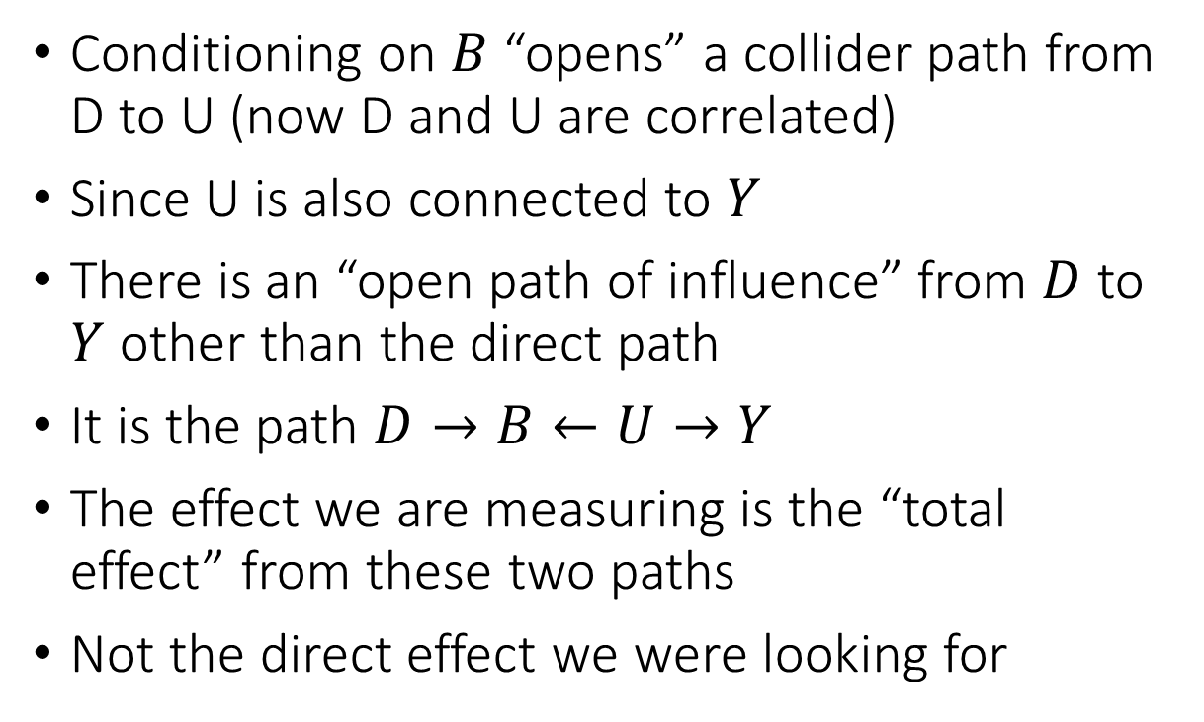
Birth Length Paradox: Visually
Conditioning on $B$ “opens” a collider path from D to U (now D and U are correlated)
Since U is also connected to $Y$
There is an “open path of influence” from $D$ to $Y$ other than the direct path
It is the path $D→B←U→Y$
The effect we are measuring is the “total effect” from these two paths
Not the direct effect we were looking for
$$ε_{D}$$
$$D$$
$$ε_{Y}$$
$$B$$
$$Y$$
$$U$$

Slide 36
We should not always be conditioning/adjusting for any variable that we have access to. Some variables (especially those that are “outcomes”) can introduce heavy biases SEMs and Causal Diagrams is the tool that lets us deduce what is the right adjustment set

Slide 37
Direct and Indirect Effects for Analysis of Wage Discrimination

Slide 38
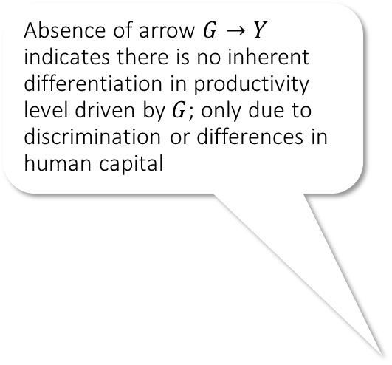


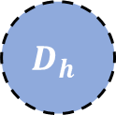

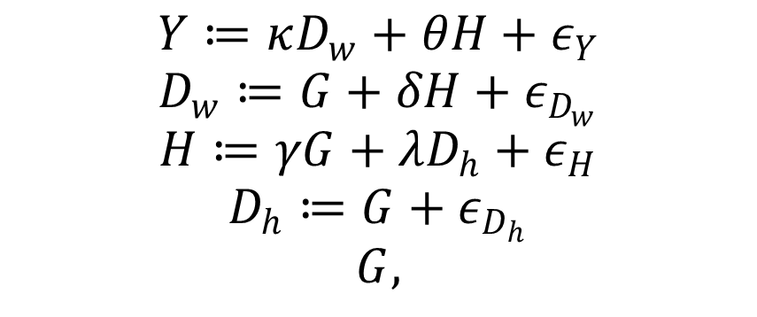






A Structural Equation Model of Wage Discrimination
Absence of arrow $G→Y$ indicates there is no inherent differentiation in productivity level driven by $G$; only due to discrimination or differences in human capital
$$Y≔κD_{w}+θH+ε_{Y}$$
$$D_{w}≔G+δH+ε_{D_{w}}$$
$$H≔γG+λD_{h}+ε_{H}$$
$$D_{h}≔G+ε_{D_{h}}$$
$$G,$$
Abstraction Variable of “Discriminatory Behavior” for wage determination
$$D_{w}$$
Sensitive Group Attribute (e.g. sex, race)
$$κ$$
$$δ$$
$$G$$
$$Y$$
Existence of arrow $G→H$ indicates there is potential heterogeneity in preferences for human capital acquisition (e.g. inherent preferences over different occupations)
$$γ$$
Wage
$$θ$$
$$H$$
$$D_{h}$$
$$λ$$
Human capital (education, skills, prior experience, etc); labor-relevant characteristics
Abstraction Variable of “Discriminatory Behavior” for human capital acquisition

Slide 39
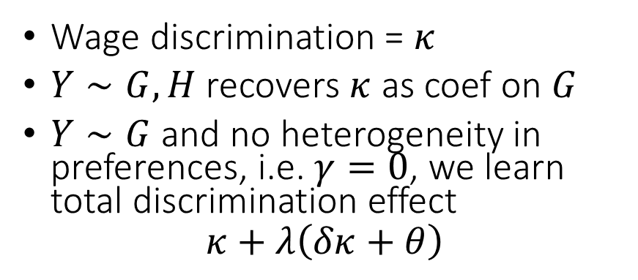
A Structural Equation Model of Wage Discrimination
Absence of arrow $G→Y$ indicates there is no inherent differentiation in productivity level driven by $G$; only due to discrimination or differences in human capital
Wage discrimination = $κ$
$Y∼G, H$ recovers $κ$ as coef on $G$
$Y∼G$ and no heterogeneity in preferences, i.e. $γ=0$, we learn total discrimination effect
$$κ+λ\left(δκ+θ\right)$$
Abstraction Variable of “Discriminatory Behavior” for wage determination
$$D_{w}$$
Sensitive Group Attribute (e.g. sex, race)
$$κ$$
$$δ$$
$$G$$
$$Y$$
Existence of arrow $G→H$ indicates there is potential heterogeneity in preferences for human capital acquisition (e.g. inherent preferences over different occupations)
$$γ$$
Wage
$$θ$$
$$H$$
$$D_{h}$$
$$λ$$
Human capital (education, skills, prior experience, etc); labor-relevant characteristics
Abstraction Variable of “Discriminatory Behavior” for human capital acquisition

Slide 40
SEMs and Causal Diagrams let us disentangle the different flows of “causal influence” and focus on the ones that we care to identify.

