Slide 1
MS&E 228: Prediction with High-Dimensional Linear Models
Vasilis Syrgkanis
MS&E, Stanford

Slide 2
Causal Inference with Experiments
Prediction with Linear Models
Prediction with High-Dim Linear Models
Inference on Causal and Predictive Effects with High-Dim Linear Models
Potential Outcomes and Conditional Ignorability
Structural Equation Models and Conditional Exogeneity
Directed Acyclic Graphs
Prediction with Non-Linear Models
Inference on Causal Effects with Non-Linear Models
Un-observed Confounding and Instruments
Identification of Causal Effects in Longitudinal Data
Estimation of Heterogeneous Causal Effects
Linear Predictive Models and Statistical Inference
Causal Identification in Observational Data
Non-Linear Predictive Models and Statistical Inference
Topics

Slide 3
Causal Inference with Experiments
Prediction with Linear Models
Prediction with High-Dim Linear Models
Inference on Causal and Predictive Effects with High-Dim Linear Models
Potential Outcomes and Conditional Ignorability
Structural Equation Models and Conditional Exogeneity
Directed Acyclic Graphs
Prediction with Non-Linear Models
Inference on Causal Effects with Non-Linear Models
Un-observed Confounding and Instruments
Identification of Causal Effects in Longitudinal Data
Estimation of Heterogeneous Causal Effects
Linear Predictive Models and Statistical Inference
Causal Identification in Observational Data
Non-Linear Predictive Models and Statistical Inference
Topics

Slide 4
Recap of Previous Lecture

Slide 5

The coefficient associated with treatment D in OLS with co-variate adjustment (with or without interactions) is always consistent for the treatment effect, when run on data from a randomized experiment, as-long-as covariates are de-meaned. The true relationship of outcome with covariates does not need to be linear.

Slide 6
The standard error for the coefficient associated with treatment D in OLS with co-variate adjustment can be larger than the standard error of the simple two-means estimate, if we don’t also adjust for interactions of these co-variates with the treatment.

Slide 7
The standard error is weakly smaller for the coefficient associated with treatment D in OLS with co-variate adjustment if interaction terms of these co-variates with the treatment are also included.

Slide 8
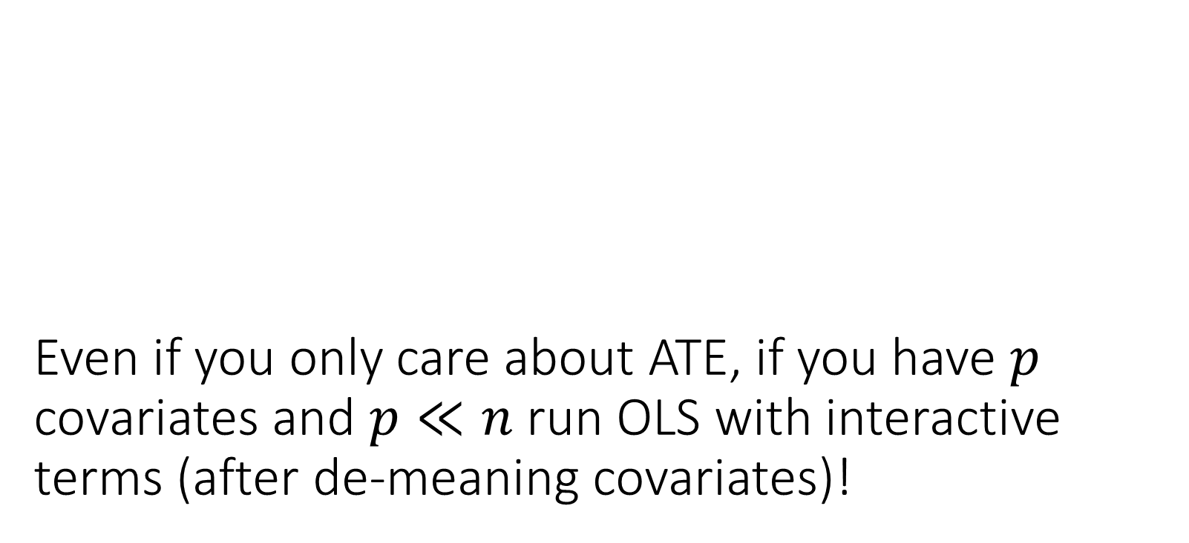
Even if you only care about ATE, if you have $p$ covariates and $p≪n$ run OLS with interactive terms (after de-meaning covariates)!

Slide 9

High Dimensions: $p>n$

Slide 10
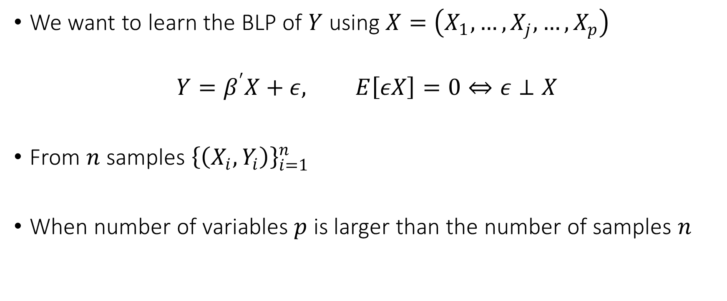
Best Linear Predictor
We want to learn the BLP of $Y$ using $X=\left(X_{1},…,X_{j},…,X_{p}\right)$
$$Y=β^{′}X+ε, E\left[εX\right]=0⇔ε⊥X$$
From $n$ samples ${\left\{\left(X_{i},Y_{i}\right)\right\}}_{i=1}^{n}$
When number of variables $p$ is larger than the number of samples $n$

Slide 11
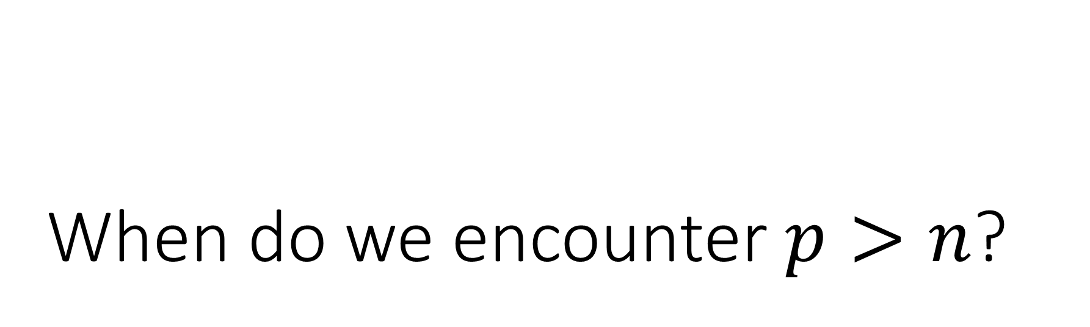
When do we encounter $p>n$?

Slide 12
Inherent High-Dimensionality

Slide 13
Inherent High-Dimensional Data
Rich datasets with many covariates
Country characteristics in cross-country wealth analysis
Housing characteristics in housing pricing/appraisal analysis
Individual electronic health records and claims data
Product characteristics at point of purchase in demand analysis
Customer characteristics in operations management
User characteristics and history in the digital economy

Slide 14
Fabricated High-Dimensionality
As a means for better real-world approximations

Slide 15
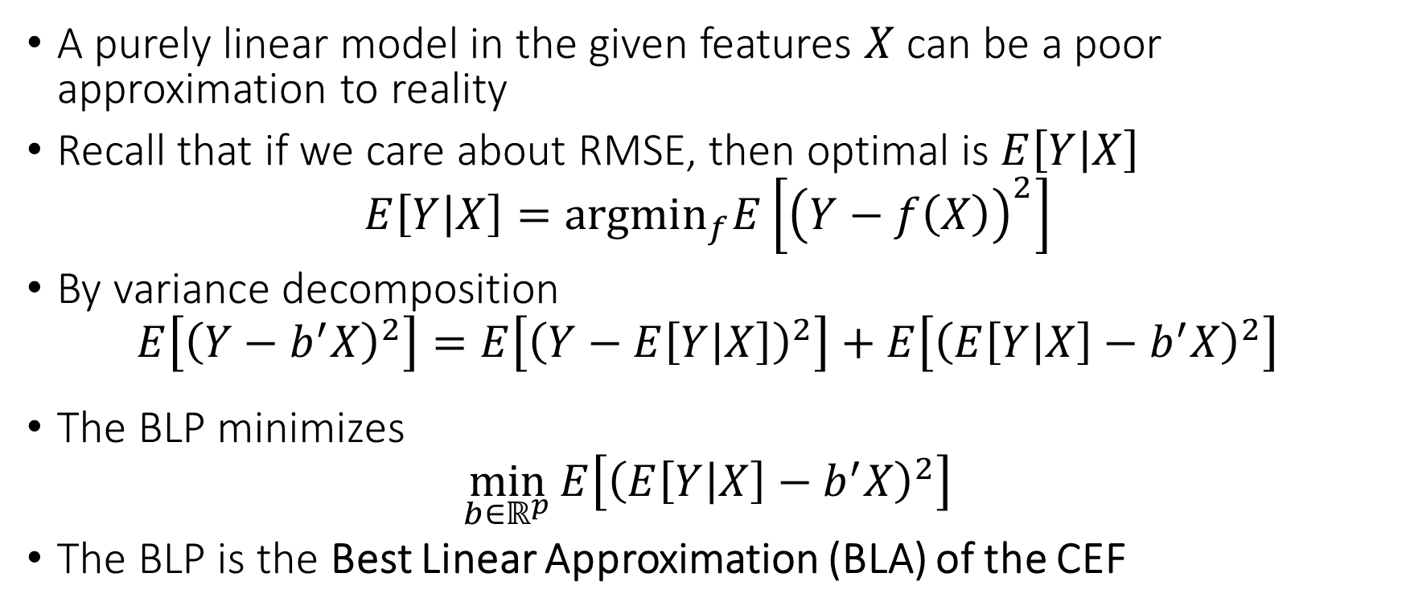
High-Dimensionality from Feature Engineering
A purely linear model in the given features $X$ can be a poor approximation to reality
Recall that if we care about RMSE, then optimal is $E\left[Y | X\right]$
$$E\left[Y | X\right]={argmin}_{f}E\left[{\left(Y−f\left(X\right)\right)}^{2}\right]$$
By variance decomposition
$$E\left[{\left(Y−b^{′}X\right)}^{2}\right]=E\left[{\left(Y−E\left[Y | X\right]\right)}^{2}\right]+E\left[{\left(E\left[Y | X\right]−b^{′}X\right)}^{2}\right]$$
The BLP minimizes
$$\min_{b∈ℝ^{p}}{E\left[{\left(E\left[Y | X\right]−b^{′}X\right)}^{2}\right]}$$
The BLP is the Best Linear Approximation (BLA) of the CEF

Slide 16
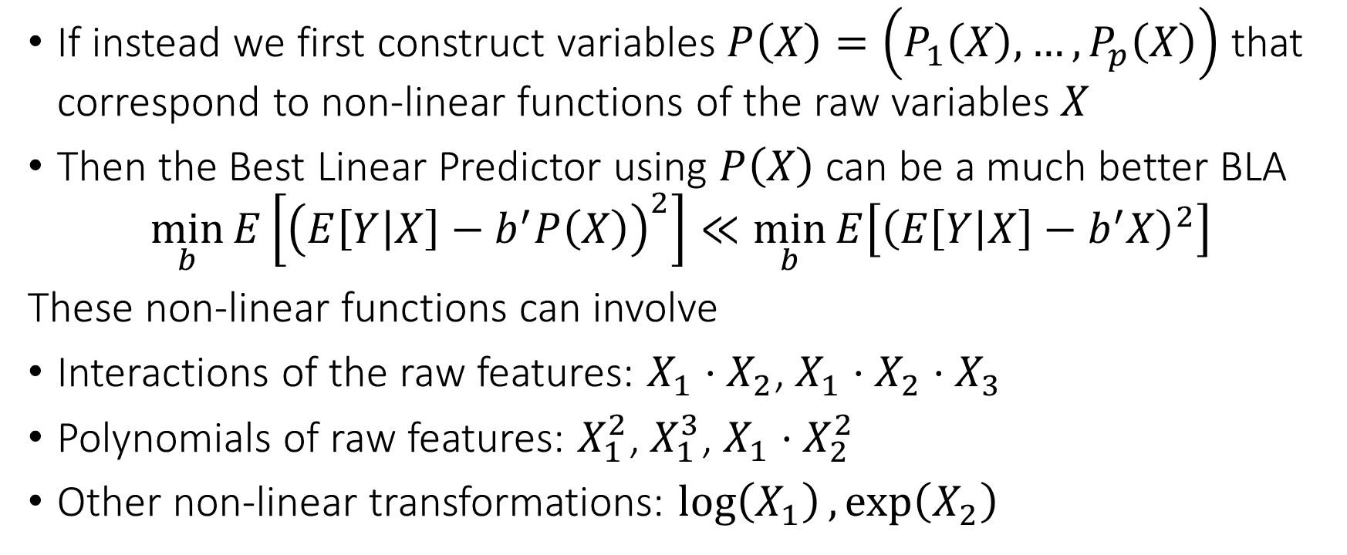
High-Dimensionality from Feature Engineering
If instead we first construct variables $P\left(X\right)=\left(P_{1}\left(X\right),…,P_{p}\left(X\right)\right)$ that correspond to non-linear functions of the raw variables $X$
Then the Best Linear Predictor using $P\left(X\right)$ can be a much better BLA
$$\min_{b}{E\left[{\left(E\left[Y | X\right]−b^{′}P\left(X\right)\right)}^{2}\right]}≪\min_{b}{E\left[{\left(E\left[Y | X\right]−b^{′}X\right)}^{2}\right]}$$
These non-linear functions can involve
Interactions of the raw features: $X_{1}⋅X_{2}$, $X_{1}⋅X_{2}⋅X_{3}$
Polynomials of raw features: $X_{1}^{2}$, $X_{1}^{3}$, $X_{1}⋅X_{2}^{2}$
Other non-linear transformations: $\log\left(X_{1}\right),\exp\left(X_{2}\right)$

Slide 17
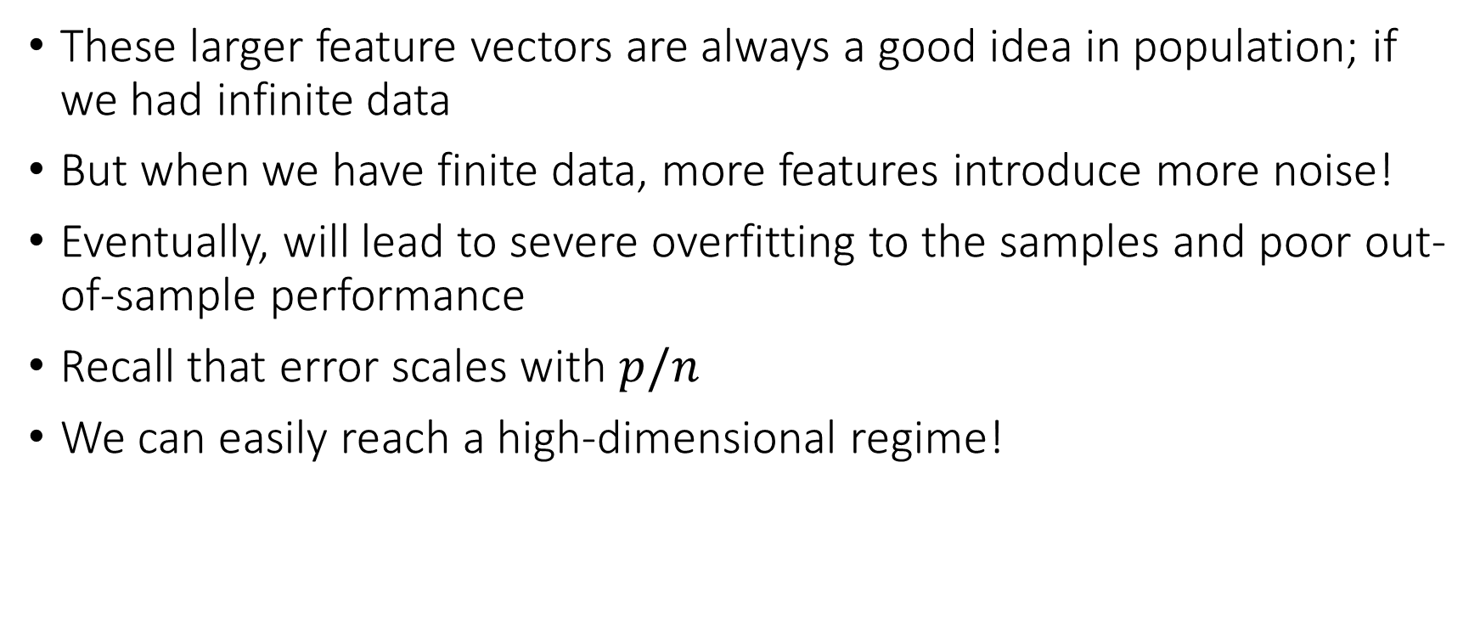
High-Dimensionality from Feature Engineering
These larger feature vectors are always a good idea in population; if we had infinite data
But when we have finite data, more features introduce more noise!
Eventually, will lead to severe overfitting to the samples and poor out-of-sample performance
Recall that error scales with $p/n$
We can easily reach a high-dimensional regime!

Slide 18
Coding Example

Slide 19
Not imposing any restrictions or biases on the parameters can lead to un-stable estimation in finite samples

Slide 20
Solution: add penalty terms to your estimation that induce biases towards solutions we a prior believe are more probable

Slide 21
Sparsity and the Lasso

Slide 22
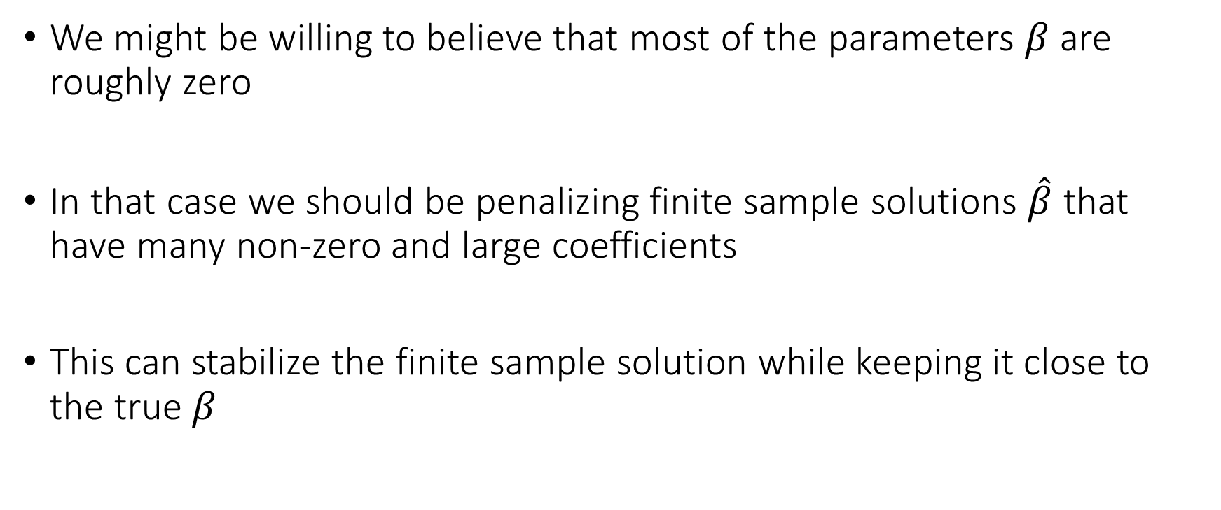
The Premise
We might be willing to believe that most of the parameters $β$ are roughly zero
In that case we should be penalizing finite sample solutions $\hat{β}$ that have many non-zero and large coefficients
This can stabilize the finite sample solution while keeping it close to the true $β$

Slide 23
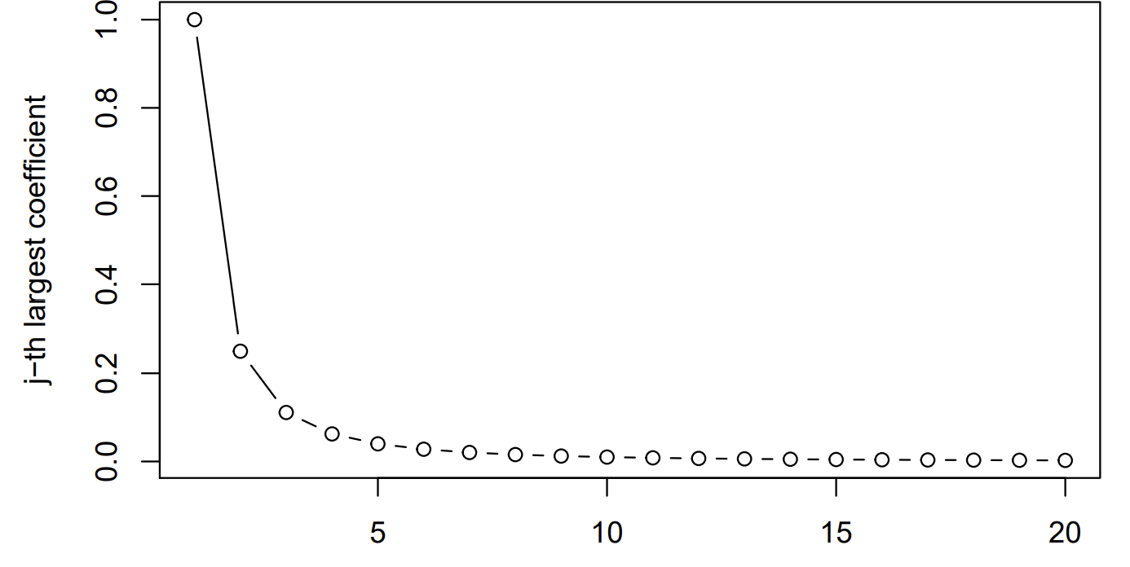
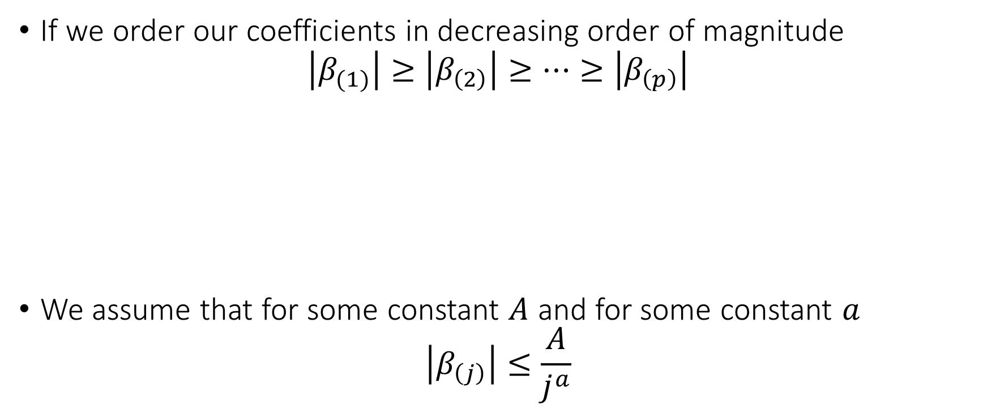
Approximate Sparsity
If we order our coefficients in decreasing order of magnitude
$$\left|β_{(1)}\right|≥\left|β_{\left(2\right)}\right|≥…≥\left|β_{\left(p\right)}\right|$$
We assume that for some constant $A$ and for some constant $a$
$$\left|β_{\left(j\right)}\right|≤\frac{A}{j^{a}}$$

Slide 24
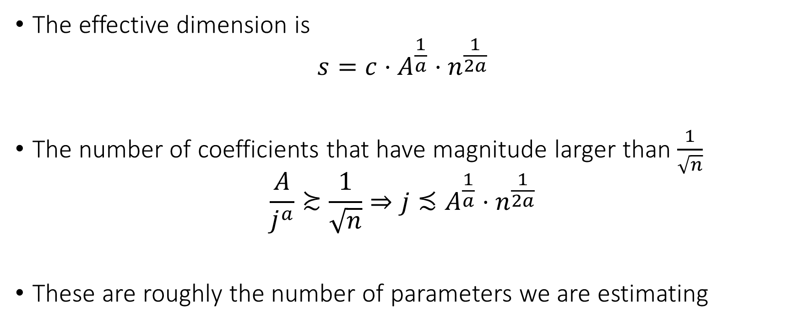
Effective Dimension
The effective dimension is
$$s=c⋅A^{\frac{1}{a}}⋅n^{\frac{1}{2a}}$$
The number of coefficients that have magnitude larger than $\frac{1}{\sqrt{n}}$
$$\frac{A}{j^{a}}≿\frac{1}{\sqrt{n}}⇒j≾A^{\frac{1}{a}}⋅n^{\frac{1}{2a}}$$
These are roughly the number of parameters we are estimating

Slide 25
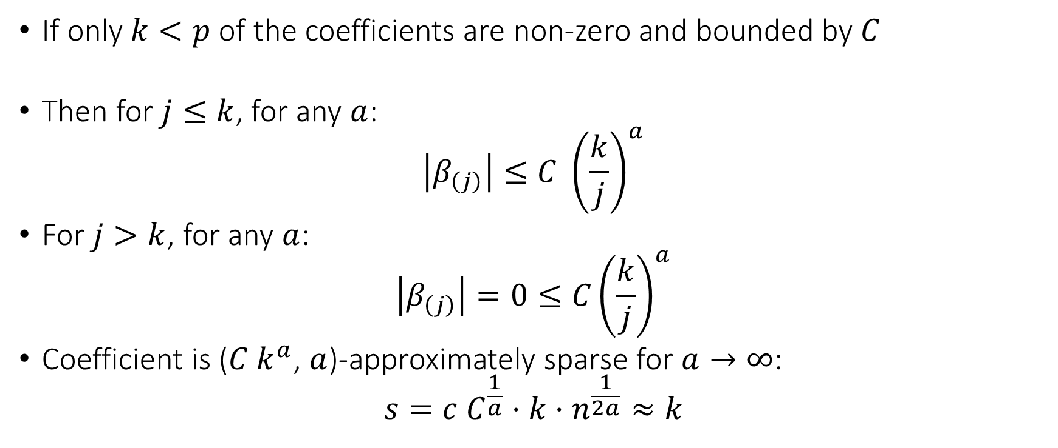
Example: Exact Sparsity
If only $k<p$ of the coefficients are non-zero and bounded by $C$
Then for $j≤k$, for any $a$:
$$\left|β_{\left(j\right)}\right|≤C {\left(\frac{k}{j}\right)}^{a}$$
For $j>k$, for any $a$:
$$\left|β_{\left(j\right)}\right|=0≤C{\left(\frac{k}{j}\right)}^{a}$$
Coefficient is ($C k^{a}$, $a$)-approximately sparse for $a→∞$:
$$s=c C^{\frac{1}{a}}⋅k⋅n^{\frac{1}{2a}}≈k$$

Slide 26
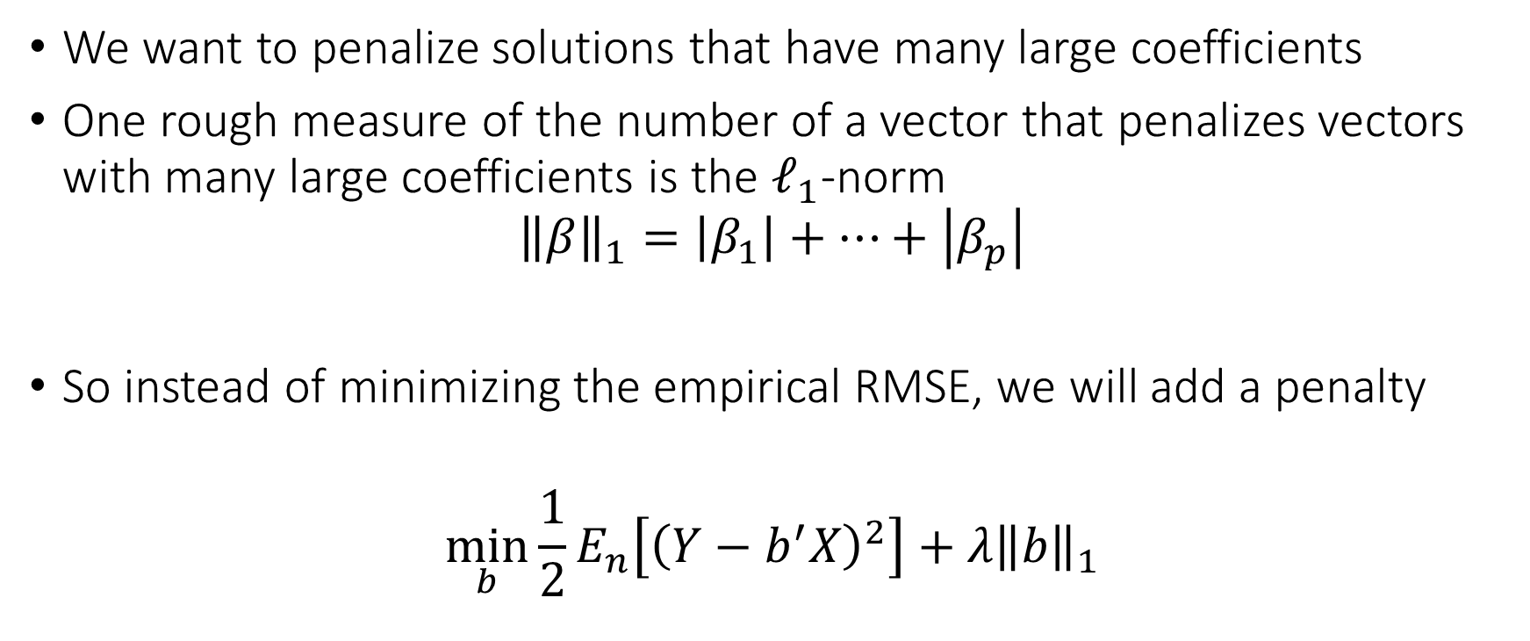
The Method
We want to penalize solutions that have many large coefficients
One rough measure of the number of a vector that penalizes vectors with many large coefficients is the $ℓ_{1}$-norm
$${\left\|β\right\|}_{1}=\left|β_{1}\right|+…+\left|β_{p}\right|$$
So instead of minimizing the empirical RMSE, we will add a penalty
$$\min_{b}{\frac{1}{2}E_{n}\left[{\left(Y−b^{′}X\right)}^{2}\right]+λ{\left\|b\right\|}_{1}}$$

Slide 27
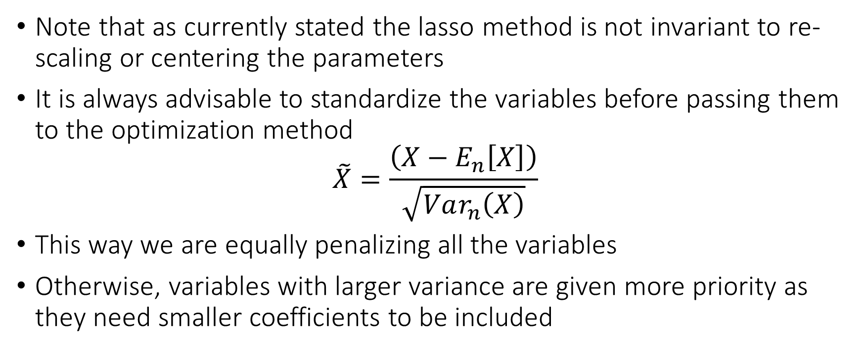
Note: Standardization
Note that as currently stated the lasso method is not invariant to re-scaling or centering the parameters
It is always advisable to standardize the variables before passing them to the optimization method
$$\tilde{X}=\frac{\left(X−E_{n}\left[X\right]\right)}{\sqrt{Var_{n}\left(X\right)}}$$
This way we are equally penalizing all the variables
Otherwise, variables with larger variance are given more priority as they need smaller coefficients to be included

Slide 28
Note: Never Penalize the Intercept
Most packages don’t penalize the intercept of the model by default
But be aware that this is the case
If not, one can always demean the outcome and covariates first before passing to the Lasso package
When evaluating, make sure that you only use the “training based calculated means” and don’t calculate the “means” (of outcome and covariates) on the test set.

Slide 29
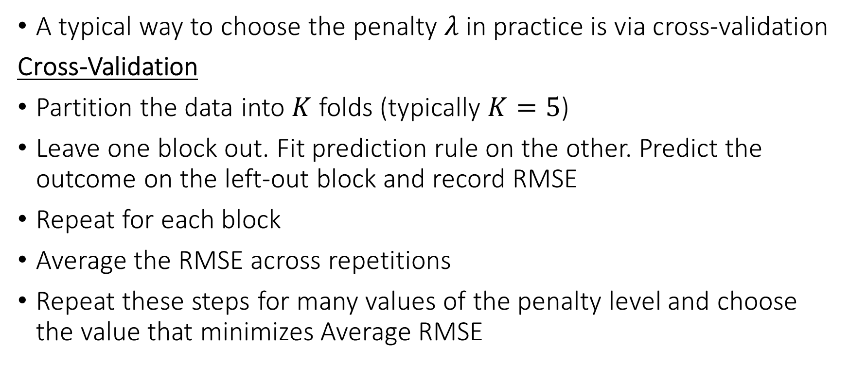
Choosing the Penalty
A typical way to choose the penalty $λ$ in practice is via cross-validation
Cross-Validation
Partition the data into $K$ folds (typically $K=5$)
Leave one block out. Fit prediction rule on the other. Predict the outcome on the left-out block and record RMSE
Repeat for each block
Average the RMSE across repetitions
Repeat these steps for many values of the penalty level and choose the value that minimizes Average RMSE

Slide 30
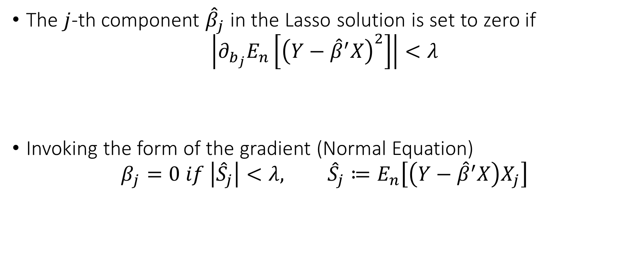
The Intuition
The $j$-th component ${\hat{β}}_{j}$ in the Lasso solution is set to zero if
$$\left|∂_{b_{j}}E_{n}\left[{\left(Y−{\hat{β}}^{′}X\right)}^{2}\right]\right|<λ$$
Invoking the form of the gradient (Normal Equation)
$$β_{j}=0 if \left|{\hat{S}}_{j}\right|<λ, {\hat{S}}_{j}≔E_{n}\left[\left(Y−{\hat{β}}^{′}X\right)X_{j}\right]$$
Marginal benefit in prediction
Marginal increase in penalty

Slide 31
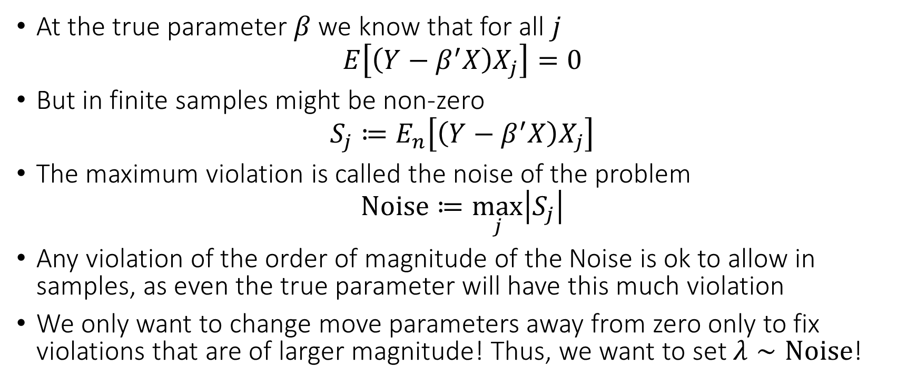
The intuition
At the true parameter $β$ we know that for all $j$
$$E\left[\left(Y−β^{′}X\right)X_{j}\right]=0$$
But in finite samples might be non-zero
$$S_{j}≔E_{n}\left[\left(Y−β^{′}X\right)X_{j}\right]$$
The maximum violation is called the noise of the problem
$$Noise≔\max_{j}\left|S_{j}\right|$$
Any violation of the order of magnitude of the Noise is ok to allow in samples, as even the true parameter will have this much violation
We only want to change move parameters away from zero only to fix violations that are of larger magnitude! Thus, we want to set $λ∼Noise$!

Slide 32
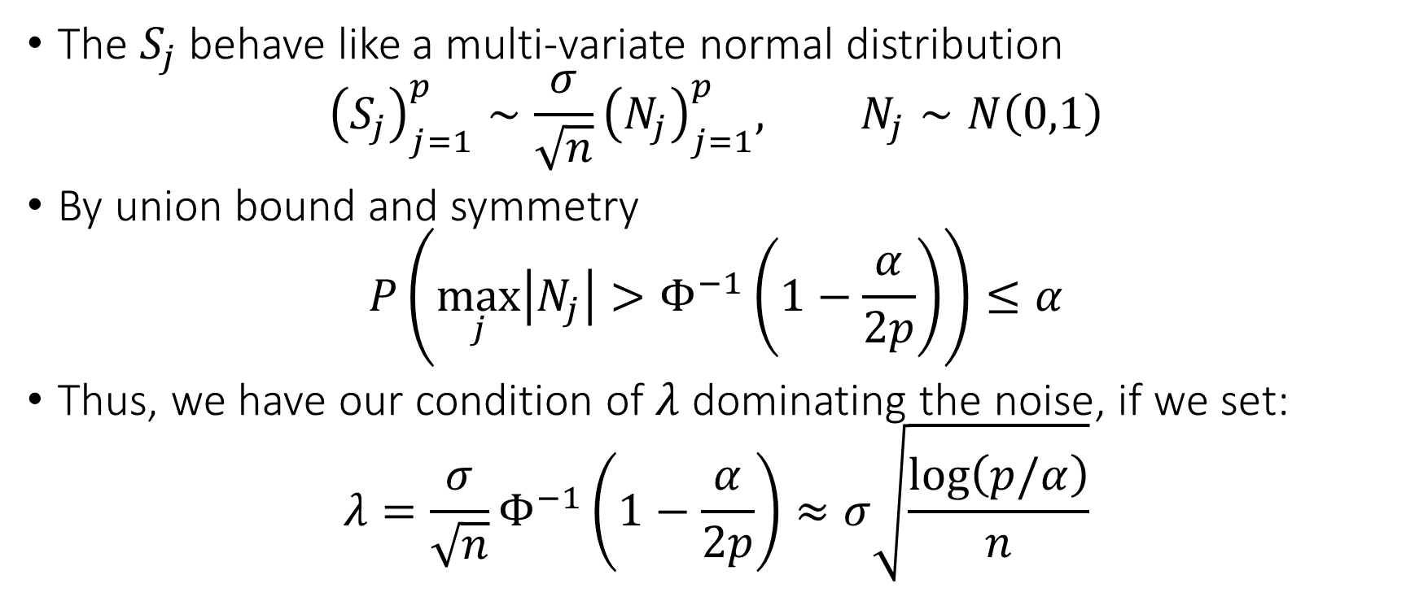
The intuition
The $S_{j}$ behave like a multi-variate normal distribution
$${\left(S_{j}\right)}_{j=1}^{p}∼\frac{σ}{\sqrt{n}}{\left(N_{j}\right)}_{j=1}^{p}, N_{j}∼N\left(0,1\right)$$
By union bound and symmetry
$$P\left(\max_{j}\left|N_{j}\right|>Φ^{−1}\left(1−\frac{α}{2p}\right)\right)≤α$$
Thus, we have our condition of $λ$ dominating the noise, if we set:
$$λ=\frac{σ}{\sqrt{n}}Φ^{−1}\left(1−\frac{α}{2p}\right)≈σ\sqrt{\frac{\log\left(p/α\right)}{n}}$$

Slide 33
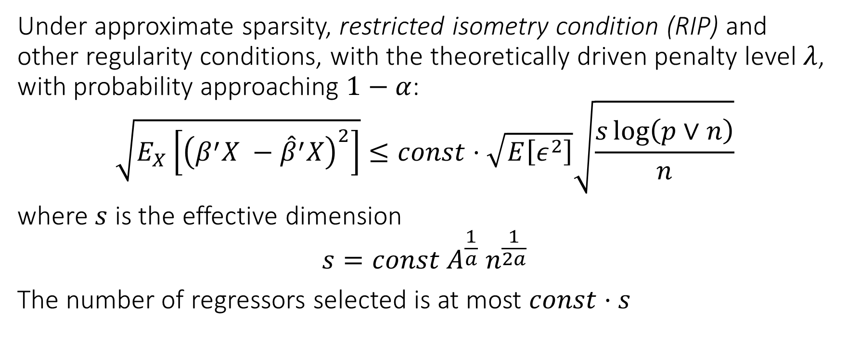
The Theory
Under approximate sparsity, restricted isometry condition (RIP) and other regularity conditions, with the theoretically driven penalty level $λ$, with probability approaching $1−α$:
$$\sqrt{E_{X}\left[{\left(β^{′}X −{\hat{β}}^{′}X\right)}^{2}\right]}≤const⋅\sqrt{E\left[ε^{2}\right]}\sqrt{\frac{s\log\left(p∨n\right)}{n}}$$
where $s$ is the effective dimension
$$s=const A^{\frac{1}{a}} n^{\frac{1}{2a}}$$
The number of regressors selected is at most $const⋅s$

Slide 34
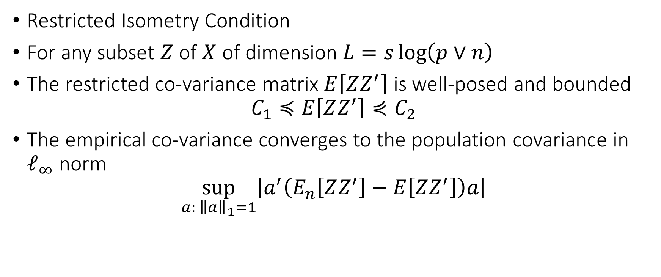
The Technical Assumption
Restricted Isometry Condition
For any subset $Z$ of $X$ of dimension $L=s\log\left(p∨n\right)$
The restricted co-variance matrix $E\left[ZZ^{′}\right]$ is well-posed and bounded
$$C_{1}≼E\left[ZZ^{′}\right]⋞C_{2}$$
The empirical co-variance converges to the population covariance in $ℓ_{∞}$ norm
$$\sup_{a: {\left\|a\right\|}_{1}=1}\left|a^{′}\left(E_{n}\left[ZZ^{′}\right]−E\left[ZZ^{′}\right]\right)a\right|$$

Slide 35
Post-Lasso OLS
It could be beneficial in finite samples to attempt to remove the regularization bias, at least from the chosen coefficients
We can do that by running an OLS step after the Lasso step on the subset of variables with a non-zero coefficient
The method has the same worst-case guarantees as Lasso, so it cannot hurt

Slide 36
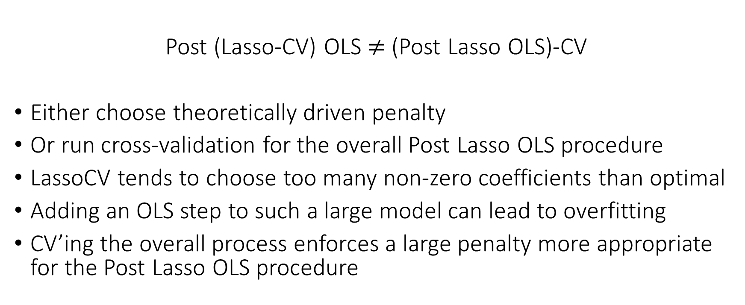
Watch out with regularizing Post Lasso OLS
Post (Lasso-CV) OLS $≠$ (Post Lasso OLS)-CV
Either choose theoretically driven penalty
Or run cross-validation for the overall Post Lasso OLS procedure
LassoCV tends to choose too many non-zero coefficients than optimal
Adding an OLS step to such a large model can lead to overfitting
CV’ing the overall process enforces a large penalty more appropriate for the Post Lasso OLS procedure

Slide 37
Beyond Sparsity

Slide 38
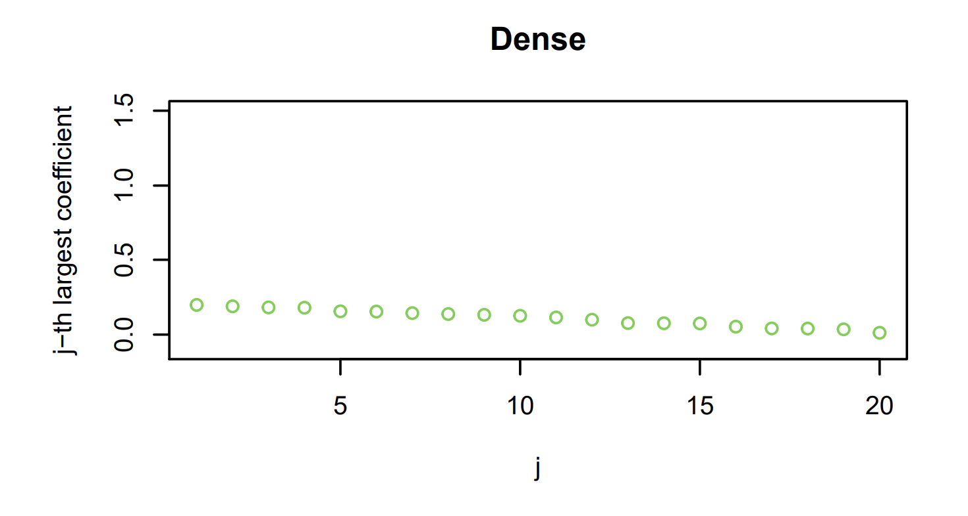

Small Dense Coefficients and Ridge
$$\min_{b}{\frac{1}{2}E_{n}\left[{\left(Y−b^{′}X\right)}^{2}\right]+λ{\left\|β\right\|}_{2}^{2}}$$
$${\left\|β\right\|}_{2}^{2}=β_{1}^{2}+…+β_{p}^{2}$$

Slide 39
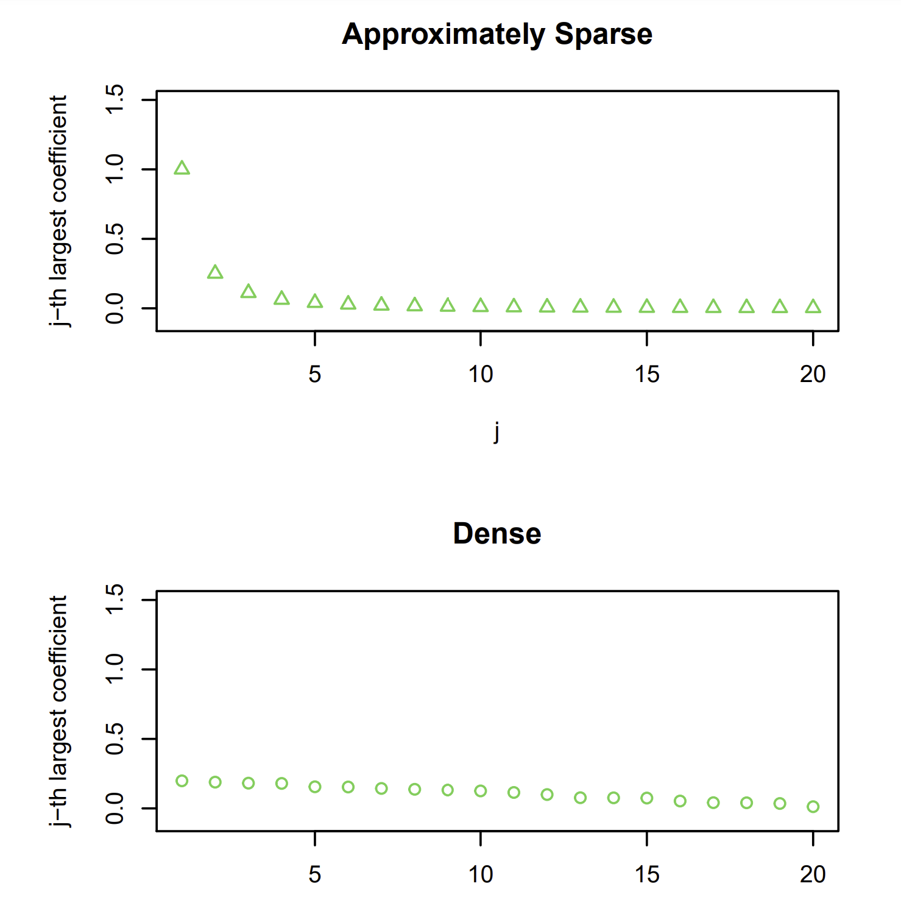

Dense or Sparse and ElasticNet
$$\min_{b}{\frac{1}{2}E_{n}\left[{\left(Y−b^{′}X\right)}^{2}\right]+λ\left(\left(1−α\right){\left\|b\right\|}_{2}^{2}+α{\left\|b\right\|}_{1}\right)}$$

Slide 40
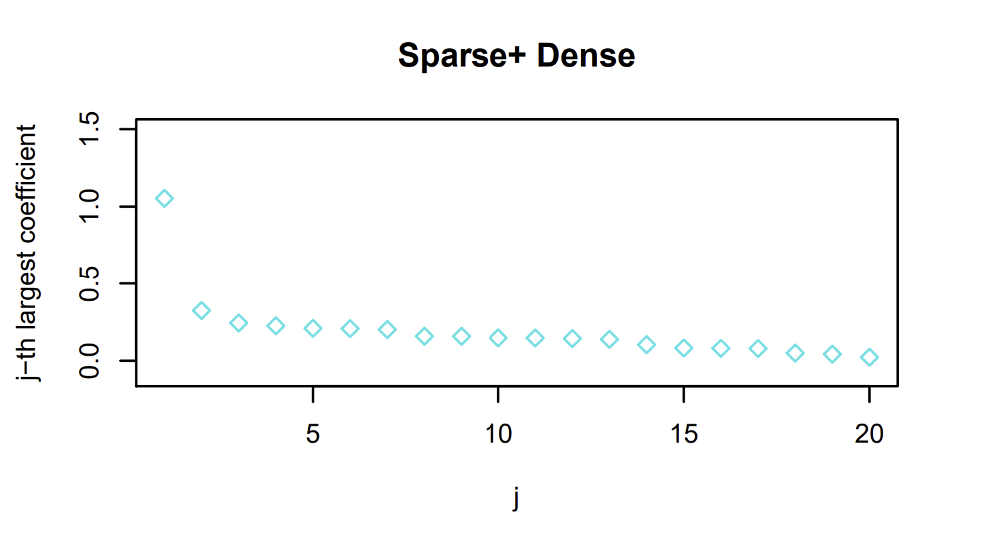

Dense + Sparse and LAVA
$$\min_{b=γ+δ}{\frac{1}{2}E_{n}\left[{\left(Y−b^{′}X\right)}^{2}\right]+λ_{1}{\left\|γ\right\|}_{2}^{2}+λ_{2}{\left\|δ\right\|}_{1}}$$

