Slide 1
Causal Inference I
Prediction Is Not Causation
Correlation, counterfactuals, and the first language of causal graphs
MSE 125

Slide 2
From prediction to intervention
Prediction
What outcome should we expect?
A model can predict who is high risk. That does not automatically tell us which action would reduce risk.
Causation
What would happen if we changed X?
MSE 125 | Lecture 18

Slide 3
Two kinds of questions
Prediction question | Causal question
Which students are likely to earn more? | Would attending Stanford increase earnings?
Which users are likely to churn? | Would a retention email reduce churn?
Which hospitals have high readmission rates? | Would a discharge protocol reduce readmissions?
Which patients are high risk? | Would a treatment improve outcomes?
Prediction helps identify risk. Causal inference helps choose actions.
MSE 125 | Lecture 18

Slide 4
The minimal vocabulary
Term | Meaning | Example
Unit | The object we compare | student, user, patient, school
Treatment / exposure | The thing we might change | tutoring, email, Stanford attendance
Outcome | The result we care about | score, churn, earnings
Comparison group | The substitute for the missing counterfactual | similar students without tutoring
MSE 125 | Lecture 18

Slide 5
DISCUSSION
Classify each question:
Which users are likely to churn?
2. Would a discount reduce churn?
3. Which colleges have high-earning graduates?
4. Would attending Stanford increase earnings?
Lecture 18
6
Notes:
Prediction, causal, prediction/description, causal.

Slide 6
Lecture 18 map
1
2
3
4
5
Three suspicious correlations
Why each causal story can fail
Potential outcomes: missing half the data
Stanford premium: real association, hard causality
DAGs: first graphical language
MSE 125 | Lecture 18

Slide 7
A correlation can be true and still not causal
Correlation question: Do X and Y move together?
Causal question: If we intervened to change X, would Y change?
Thinking: Some intuitions why these two are different?
MSE 125 | Lecture 18

Slide 8
Three suspicious correlations
MSE 125 | Lecture 18

Slide 9
Three correlations to question
Observed relationship | Naive causal question
Ice cream production and drowning deaths move together | Does ice cream increase drowning?
Places with more crime also have more police activity | Does police activity increase crime?
Selected groups sometimes have worse outcomes than non-selected groups | Did the treatment/selection make outcomes worse?
MSE 125 | Lecture 18

Slide 10
Case 1: confounding
A third variable can create a real association.
MSE 125 | Lecture 18

Slide 11
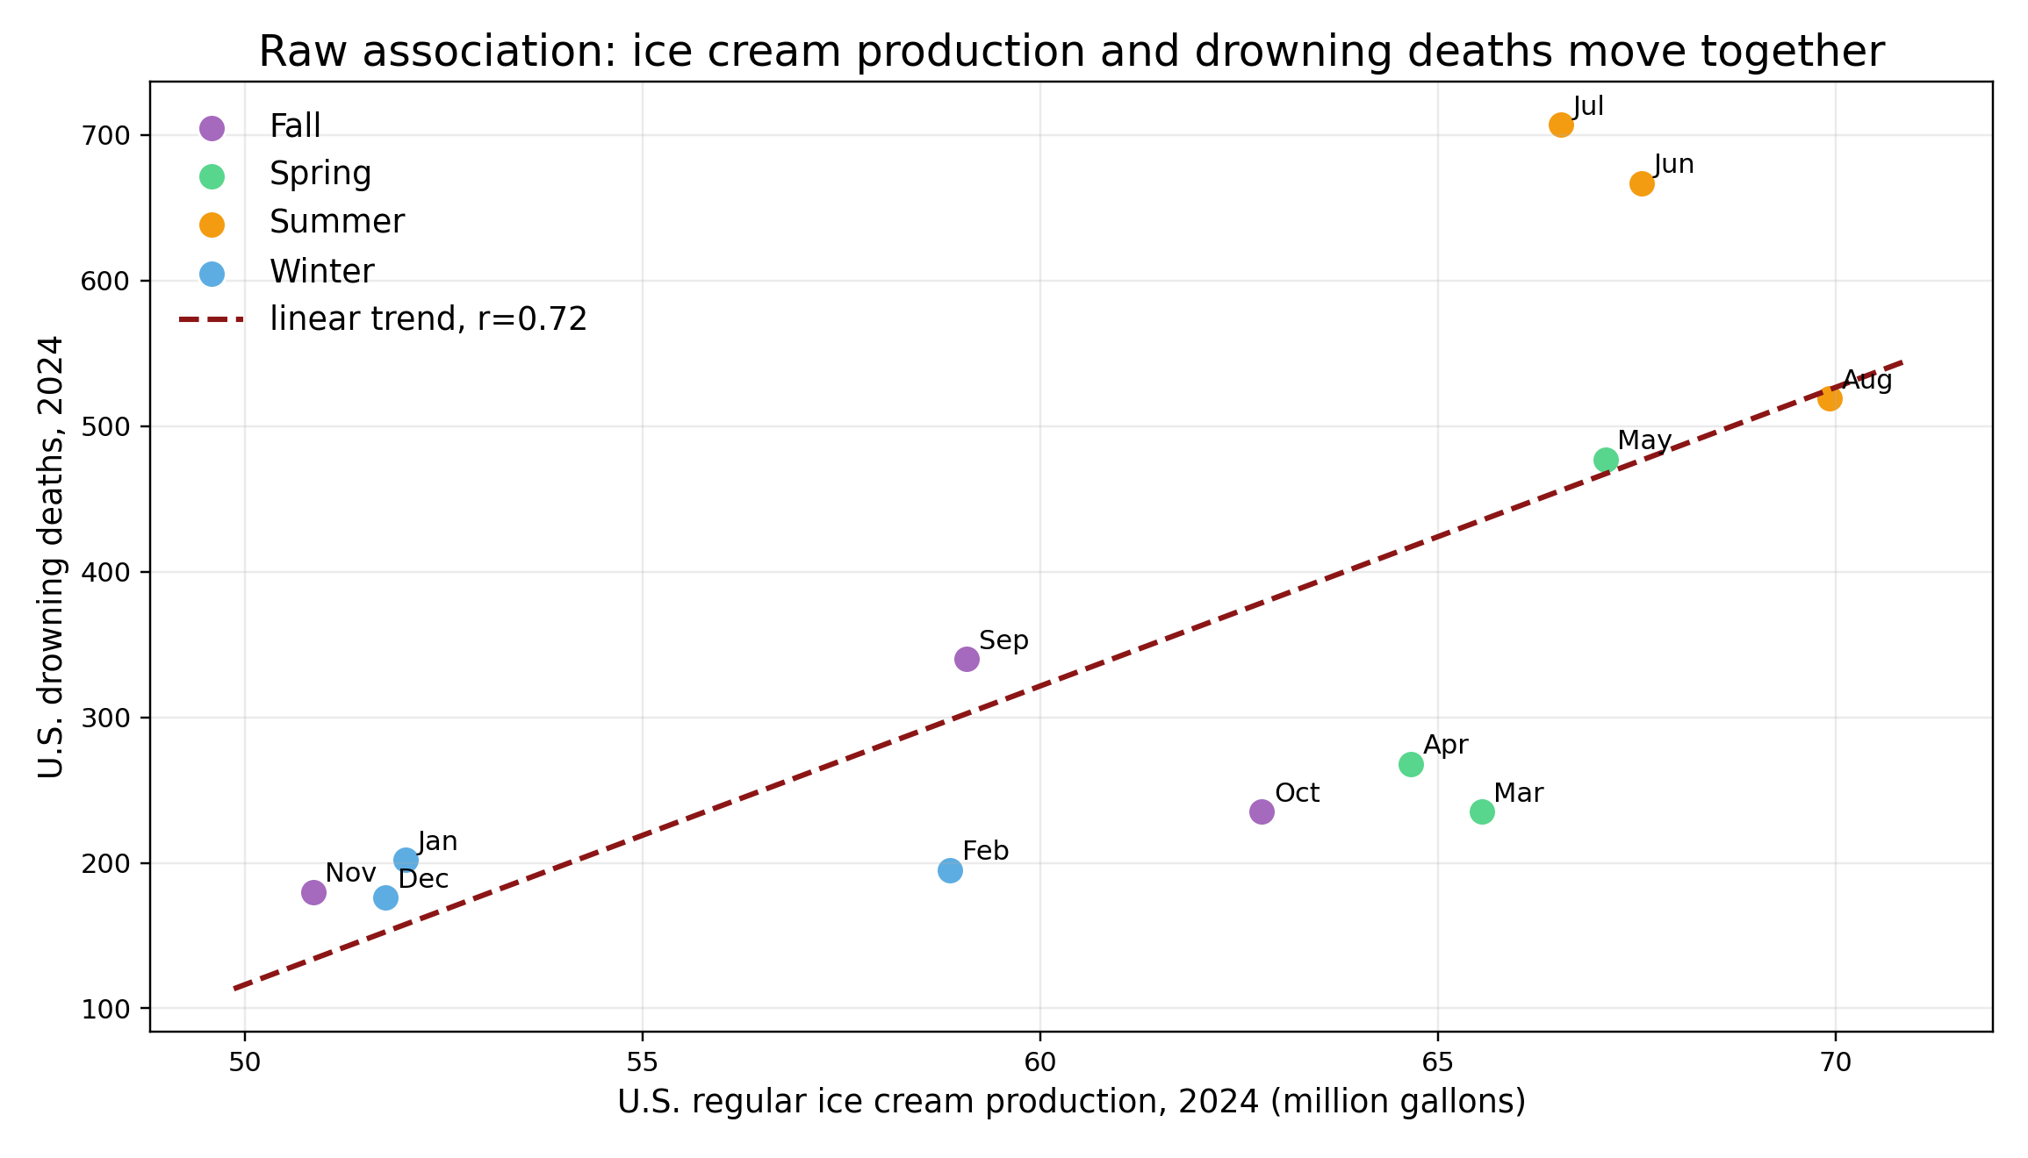
Case 1: ice cream and drowning
Ice cream production is higher in months with more drowning deaths. Does ice cream cause drowning?
From a correlation perspective, the pattern is real.
MSE 125 | Lecture 18

Slide 12
Notation:
Role | In this example
Exposure X | Ice cream production
Outcome Y | Drowning deaths
Other factors Z | ?
What else changes between winter and summer besides ice cream production?
MSE 125 | Lecture 18

Slide 13
Notation:
Role | In this example
Exposure X | Ice cream production
Outcome Y | Drowning deaths
Other factors Z | Season / temperature / swimming exposure
What else changes between winter and summer besides ice cream production?
MSE 125 | Lecture 18

Slide 14
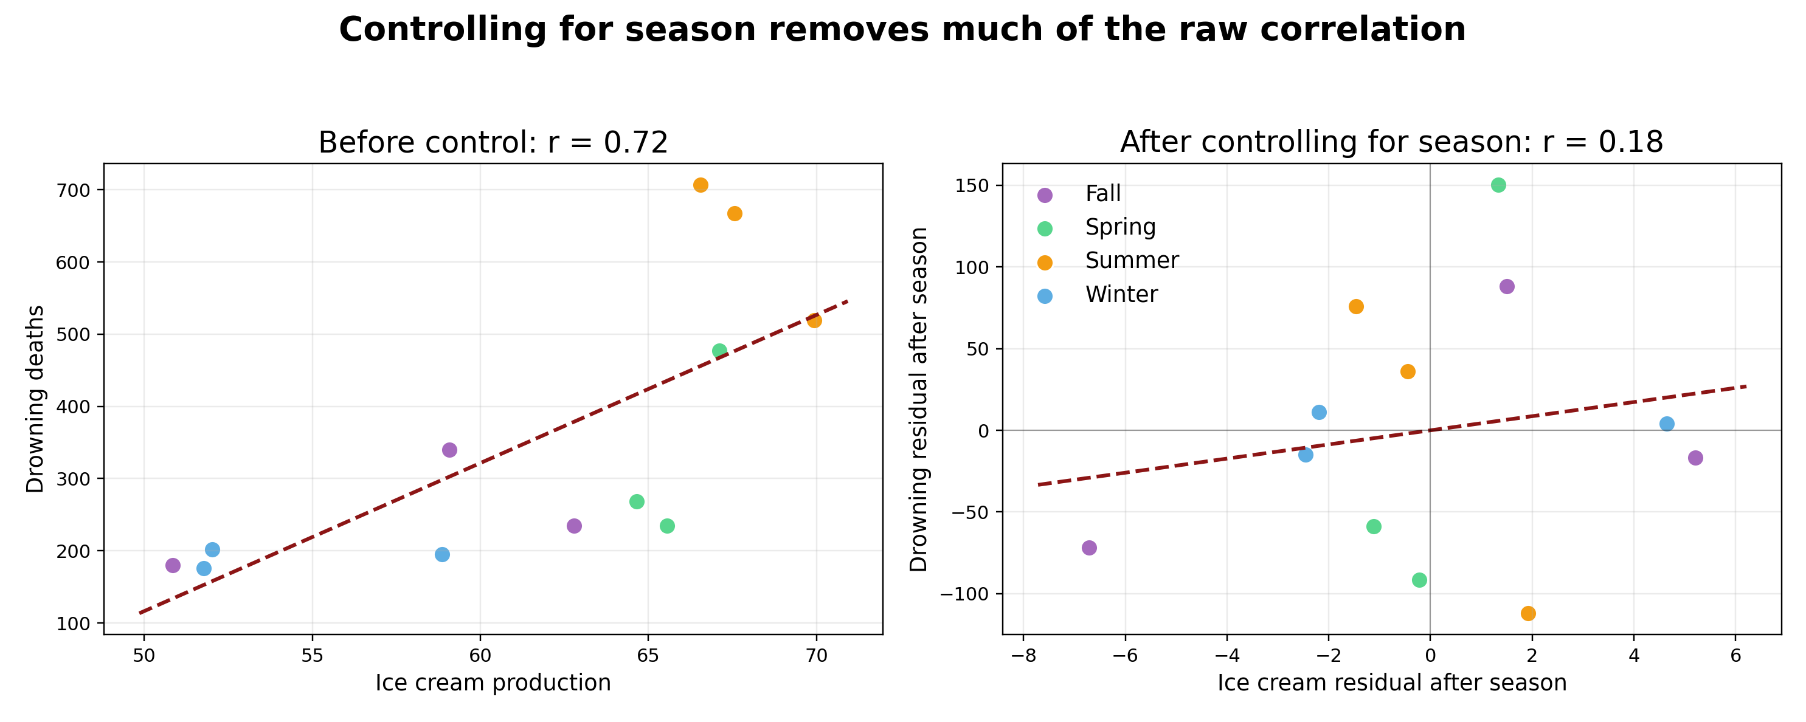
Control for season: the relationship shrinks
After removing season-level differences, the correlation drops sharply. The original pattern was mostly about season/temperature, not ice cream itself.
MSE 125 | Lecture 18

Slide 15
Confounding: a common cause creates the association
Ice cream production
Warm weather / summer
Swimming exposure
Drowning risk
A confounder is a common cause of the exposure and the outcome. It creates an association that is not the causal effect of X on Y.
MSE 125 | Lecture 18

Slide 16
Confounding is everywhere
Observed association | Possible confounder | Why it matters
Bigger shoe size → better reading | Age | Older children have bigger feet and read better.
Coffee drinking → heart disease | Smoking, lifestyle | Coffee drinkers may differ in other risk factors.
Selective college → higher earnings | Family background / preparation | Students differ before college begins.
Question for any correlation: what common cause might affect both sides?
MSE 125 | Lecture 18

Slide 17
Case 2: reverse causality
The direction of the arrow may be the opposite of the naive story.
MSE 125 | Lecture 18

Slide 18
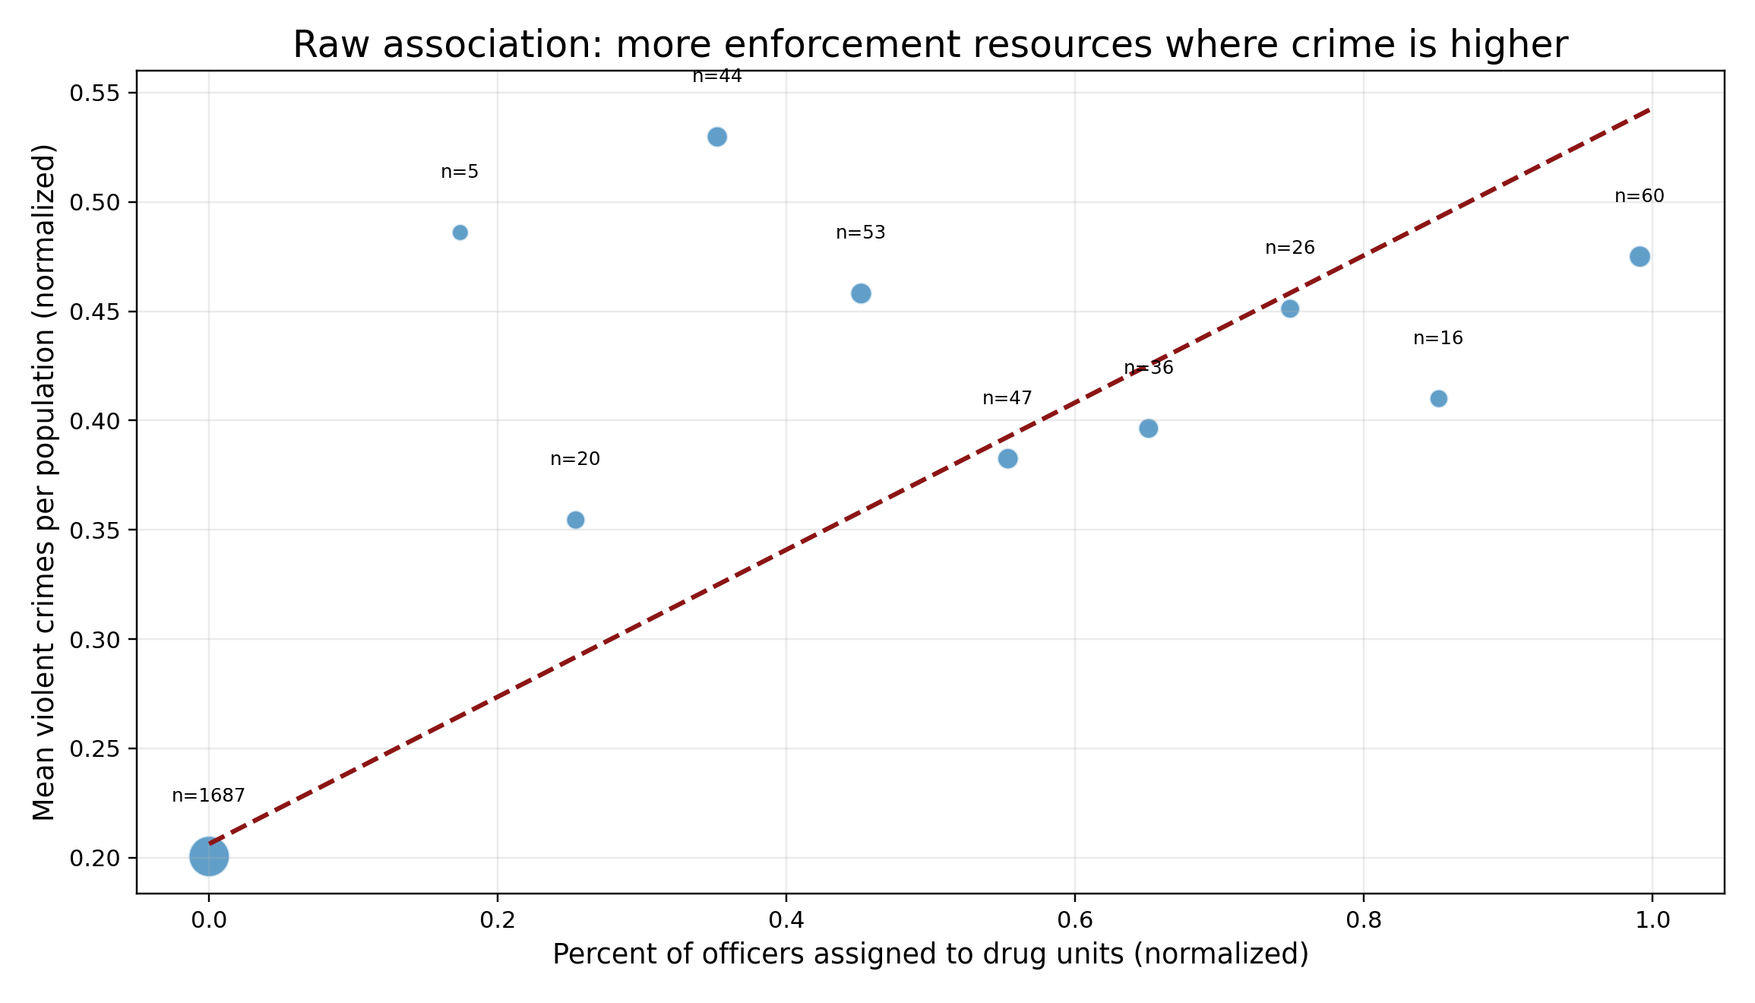
Case 2: crime and enforcement activity
The positive association does not settle the causal direction.
Communities with more crime also report more enforcement activity. Does enforcement activity increase crime?
Correlation alone cannot decide which arrow is correct.
MSE 125 | Lecture 18

Slide 19
Reverse causality: the same correlation can fit different arrows
Naive causal reading
The correlation can be correct in both stories.
Causal inference asks what would happen under an intervention, not just which variables move together.
Police action
Crime
Alternative causal reading
Crime risk
Police assigned
MSE 125 | Lecture 18

Slide 20
Reverse causality: more examples
Observed relationship | Naive claim | Alternative direction
More medicine, worse health | Medicine makes people sick | Sicker people take more medicine
More consultants, poor firm performance | Consultants hurt firms | Struggling firms hire consultants
More hospital care, higher mortality | Hospitals harm patients | Sicker patients receive more care
MSE 125 | Lecture 18

Slide 21
How do we handle reverse causality?
Use timing: cause must precede effect.
Use interventions: what happens if we change X directly?
Use research designs (next lecture): randomization or external shocks can create a direction.
Use DAGs (more on this latter): write down which arrows we believe before interpreting a coefficient.
The data pattern alone is not enough; we need a causal story plus a credible comparison.
MSE 125 | Lecture 18

Slide 22
Case 3: selection and Simpson’s paradox
The comparison groups may have been formed in systematically different ways.
MSE 125 | Lecture 18

Slide 23
Selection bias is about group formation
The treated group is often not a random group.
People may select into treatment, or be selected into treatment, because they are already higher-risk, higher-need, or different on background variables.
Example | Who selects into treatment?
Tutoring | Students who are already struggling
Retention emails | Users predicted to be likely to churn
Insurance | People expecting higher medical costs
MSE 125 | Lecture 18

Slide 24
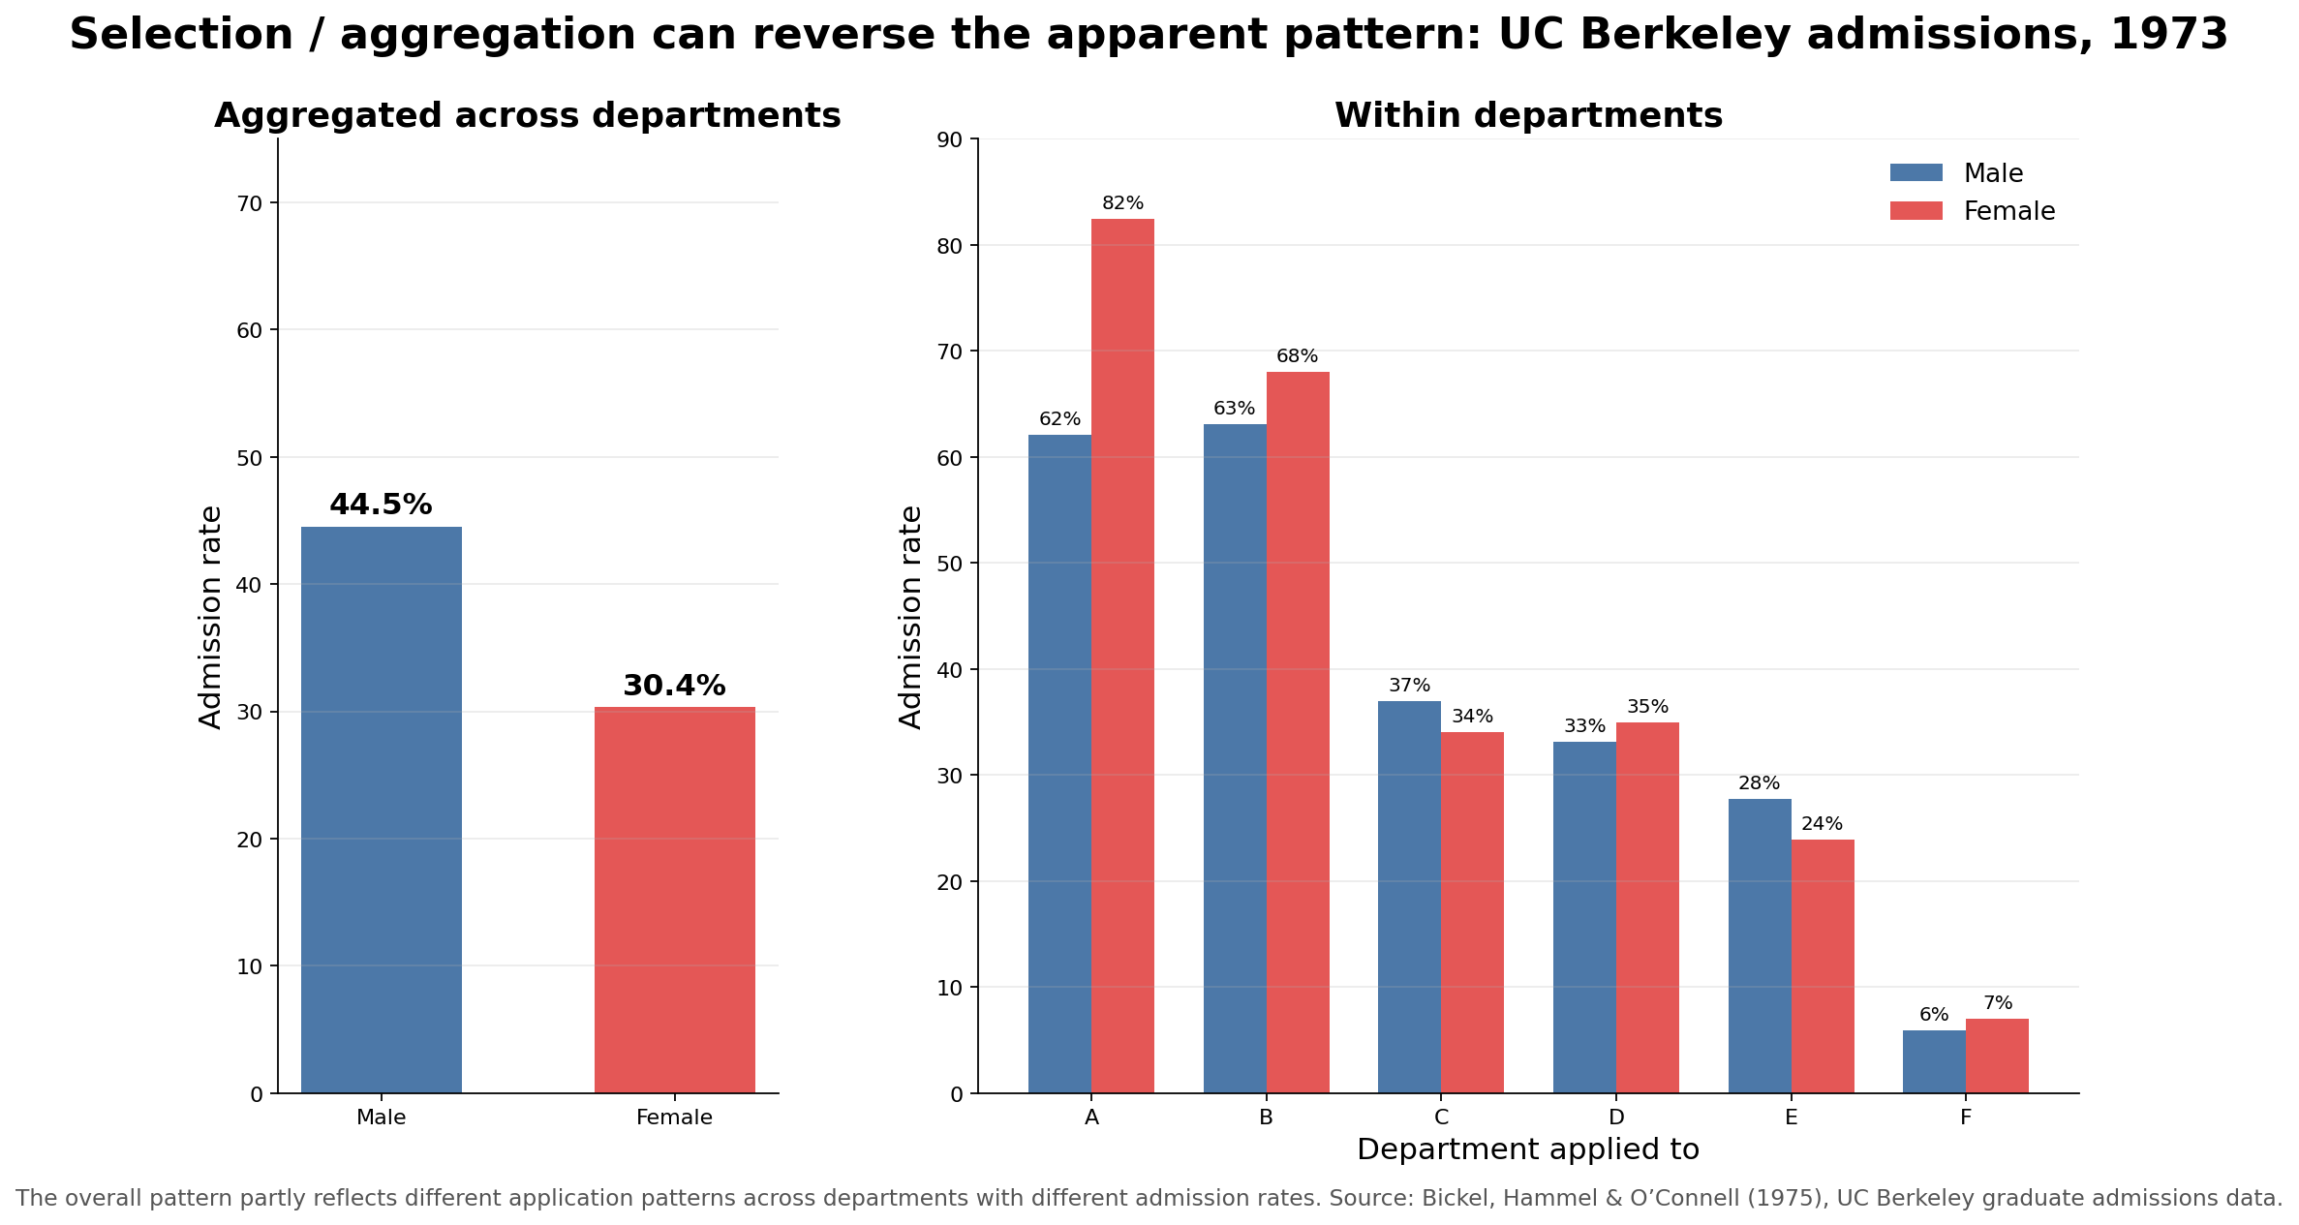
Simpson’s paradox: aggregation can reverse the story
If the overall admission rates differ sharply, does the aggregate comparison alone explain the mechanism?
The aggregate combines groups with different baseline admission rates.
MSE 125 | Lecture 18

Slide 25
Selection example: tutoring looks harmful overall
Group | Average score
Received tutoring | 76
No tutoring | 84
Naive causal question: Does tutoring lower scores by 8 points?
But who was most likely to receive tutoring in the first place?
MSE 125 | Lecture 18

Slide 26
Within comparable groups, the story can reverse
Student group | Tutored | Not tutored | Within-group difference
Struggling students | 72 | 68 | +4
Strong students | 92 | 88 | +4
Overall, tutored students looked worse because they were more likely to be struggling students. Within each preparation group, tutoring helped.
MSE 125 | Lecture 18

Slide 27
So… What happened?
Student group | Tutored | Not tutored | Proportion
Struggling students | x | 1-x | 100%
Strong students | y | 1-y | 100%
Tutored group: 72x + 92y = 78
No tutored group: 68(1-x) + 88(1-y) =84
(x, y) = (0.8, 0.2)
MSE 125 | Lecture 18

Slide 28
So… What happened?
Student group | Tutored | Not tutored | Proportion
Struggling students | 0.8 | 0.2 | 100%
Strong students | 0.2 | 0.8 | 100%
Simple aggregation can be misleading!
Struggling students tend to join the tutoring, which makes tutoring harmful.
MSE 125 | Lecture 18

Slide 29
Selection bias as a DAG
Receives tutoring
Prior preparation
Exam score
Selection bias is often a form of confounding. The emphasis is not just “third variable,” but how the treatment group was formed before the comparison.
MSE 125 | Lecture 18

Slide 30
Three failure modes: summary
Failure mode | Core issue | Question to ask
Confounding | A third variable causes both X and Y | What common cause could explain this?
Reverse causality | The arrow may run from Y to X | Which direction is plausible?
Selection bias | Groups differ before comparison | How were units selected into groups?
MSE 125 | Lecture 18

Slide 31
Potential outcomes
Causal inference is hard because half the data are missing.
MSE 125 | Lecture 18

Slide 32
Potential outcomes: the missing half of the data
Student | Score if tutored Y(1) | Score if not tutored Y(0) | Observed status
Maya | 82 | ? | Tutored
Diego | ? | 75 | Not tutored
Aisha | 91 | ? | Tutored
Noah | ? | 70 | Not tutored
Individual causal effect = Y(1) − Y(0)
MSE 125 | Lecture 18

Slide 33
The fundamental problem of causal inference
For each unit, we observe one potential outcome and do not observe the other.
Every causal method tries to construct a credible substitute for the missing outcome.
Same unit under treatment
Observed
Same unit without treatment
Missing
MSE 125 | Lecture 18

Slide 34
Raw difference is not automatically a causal effect
Observed difference = causal effect + pre-existing group differences
Question | What we need
Are treated and untreated groups different? | A descriptive comparison
Would treatment change the outcome? | A counterfactual comparison
Are the groups comparable before treatment? | A causal design or assumptions
MSE 125 | Lecture 18

Slide 35
Four ways to approximate the missing outcome
Strategy | Basic idea | Preview
Randomized experiment | Create comparable groups by random assignment | Lecture 19
Natural experiment | Find external as-if-random variation | Lecture 19
Difference-in-differences | Use a comparison group to subtract background trends | Lecture 19
DAG + adjustment | Use assumptions to compare similar units | Starts today; deepens next lecture
MSE 125 | Lecture 18

Slide 36
The Stanford premium
MSE 125 | Lecture 18

Slide 37
The Stanford premium: the question
Suppose Stanford costs substantially more than a state school. Stanford graduates have high earnings.
However, is the earnings difference caused by Stanford?
Prediction version | Causal version
Which schools have high-earning graduates? | Would this student earn more if they attended Stanford?
Uses observed patterns across schools. | Requires a missing counterfactual for the same student.
MSE 125 | Lecture 18

Slide 38
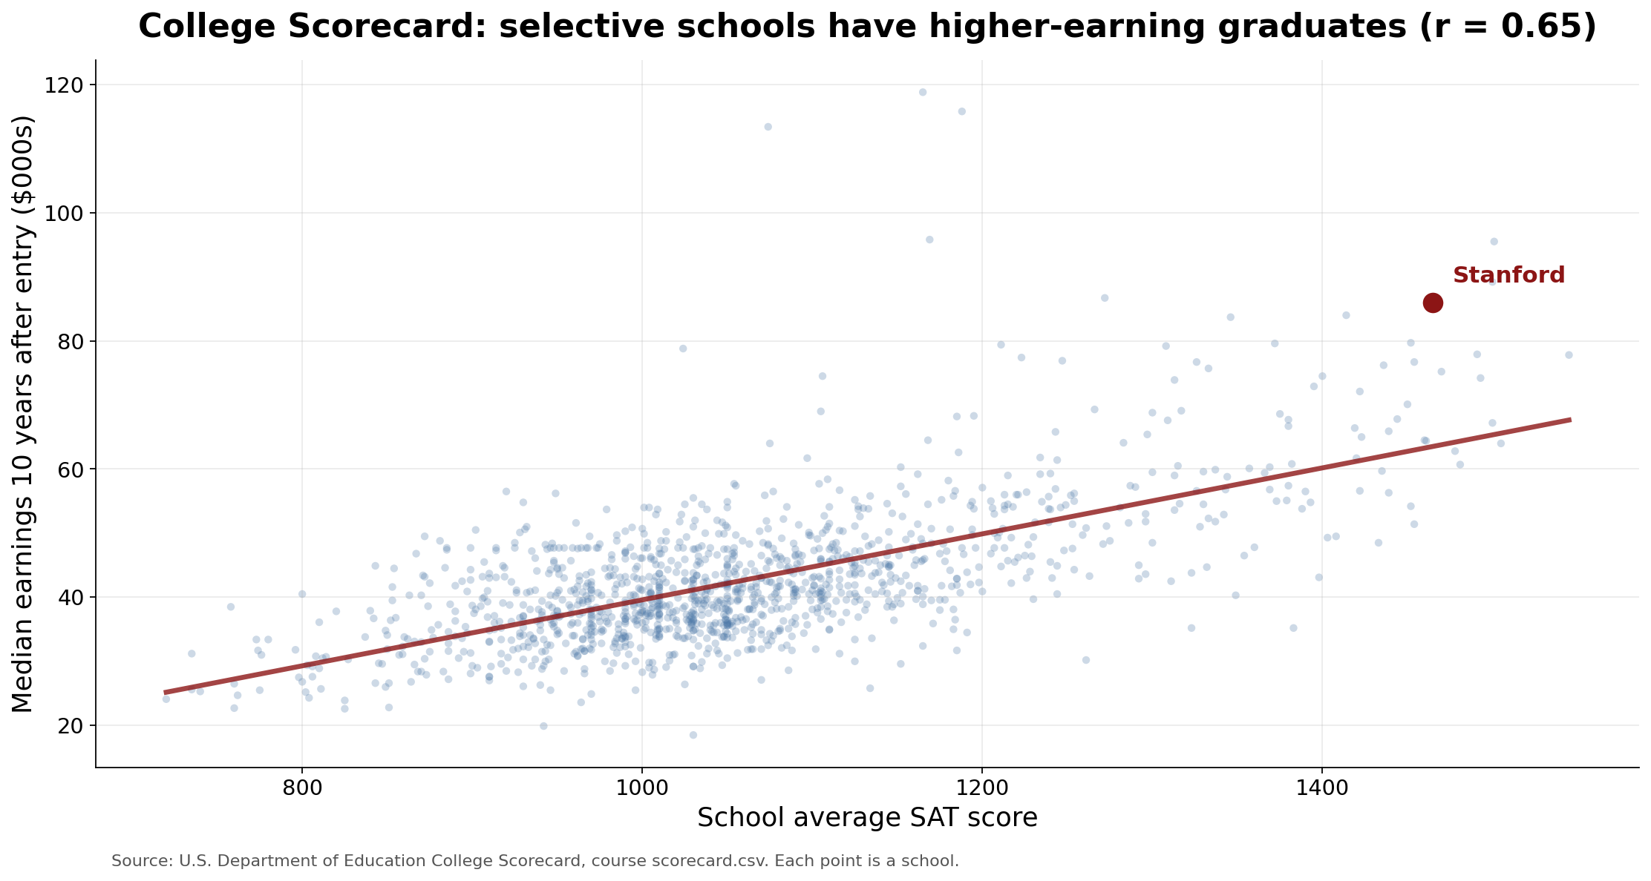
Stanford premium: the association is real
From a prediction perspective, the pattern is informative. But the plot compares different schools with different students.
The graph does not show what the same student would have earned elsewhere.
MSE 125 | Lecture 18

Slide 39
The Stanford counterfactual
Student | Earnings if attends Stanford Y(1) | Earnings if attends state school Y(0) | Observed?
Student A | ? | $80K | State school
Student B | $130K | ? | Stanford
Student C | $105K | ? | Stanford
The causal question compares the same student under two possible college choices.
The observed graph compares different students at different schools.
MSE 125 | Lecture 18

Slide 40
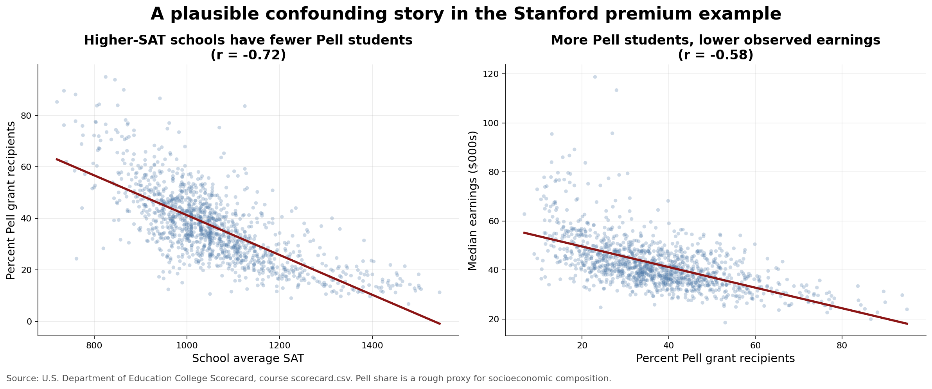
Why the counterfactual is hard
Selective colleges do not enroll a random sample of students.
Students differ before college: preparation, family resources, geography, networks, intended majors.
Any comparison of earnings mixes school effects with pre-existing differences.
MSE 125 | Lecture 18

Slide 41
DAGs: first graphical language
MSE 125 | Lecture 18

Slide 42
What is a DAG?
Term | Meaning
Directed | Arrows have direction: A causes B.
Acyclic | No causal loops inside the graph.
Graph | Variables are nodes; arrows are assumed direct causal links.
A DAG is a causal story drawn with arrows. It is a statement of assumptions, not something the data automatically gives us.
MSE 125 | Lecture 18

Slide 43
How to draw a DAG: a practical recipe
Step | What to do
1. Start with the causal question | Identify treatment X and outcome Y.
2. List variables that occur before treatment | These can confound the comparison.
3. Add arrows for causal influence | Do not draw arrows just because variables are correlated.
4. Mark variables after treatment | These may be mediators or colliders.
5. Ask what comparison the DAG implies | Which groups are comparable?
MSE 125 | Lecture 18

Slide 44
DAG example: Stanford and earnings
Attend selective college
Family background / preparation
Future earnings
The DAG separates the causal path we care about from the noncausal path through background differences.
MSE 125 | Lecture 18

Slide 45
What a DAG can and cannot do
DAGs can help us... | DAGs cannot...
Make assumptions explicit. | Prove the assumptions are true.
Separate causal paths from spurious paths. | Automatically estimate effects.
Discuss what to adjust for. | Save a bad research design.
Communicate the comparison we want. | Replace domain knowledge.
MSE 125 | Lecture 18

Slide 46
Three DAG motifs to recognize
Motif | Shape | First intuition
Confounder | X ← Z → Y | Z makes X and Y move together.
Mediator | X → M → Y | M is part of how X affects Y.
Collider | X → C ← Y | Conditioning on C can create a fake association.
Today: recognize the patterns. Lecture 19: use them to decide what to control for.
MSE 125 | Lecture 18

Slide 47
Motif 1: confounder
X treatment
Z common cause
Y outcome
A confounder Z is a common cause for both treatment X and outcome Y.
Example: preparation affects both tutoring and exam scores. This is the pattern behind many misleading treatment comparisons.
MSE 125 | Lecture 18

Slide 48
Motif 2: mediator
X treatment
M mechanism
Y outcome
A mediator X is a captures how the treatment X effect outcome Y.
Example: college may affect alumni network, which may affect earnings. A mediator is part of the causal pathway, not a pre-treatment common cause.
MSE 125 | Lecture 18

Slide 49
Motif 2: mediator
X treatment
M mechanism
Y outcome
A mediator X is a captures how the treatment X effect outcome Y.
Example: college may affect alumni network, which may affect earnings. A mediator is part of the causal pathway, not a pre-treatment common cause.
MSE 125 | Lecture 18

Slide 50
Motif 2: mediator
❌
X treatment
M mechanism
Y outcome
A mediator X is a captures how the treatment X effect outcome Y.
Example: college may affect alumni network, which may affect earnings. A mediator is part of the causal pathway, not a pre-treatment common cause.
MSE 125 | Lecture 18

Slide 51
Motif 3: collider
X
C selected sample
Y
A collider measures the common effect of X and Y.
Example: if we only look at people hired by a top firm, talent and connections may become related inside that selected group even if they were unrelated in the full population.
MSE 125 | Lecture 18

Slide 52
More about these in next lecture
Which variables should we control for?
Why can controlling for a mediator change the causal question?
Why can conditioning on a collider create bias?
How do DAGs connect to RCTs, natural experiments, and difference-in-differences?
MSE 125 | Lecture 18

Slide 53
Preview: how can we make causal comparisons credible?
Strategy | What it tries to do
Randomized experiment / A-B test | Create comparable groups by random assignment.
Natural experiment | Use external variation that is plausibly as-if random.
Difference-in-differences | Use a comparison group to remove background trends.
DAGs + adjustment | Make assumptions explicit and compare similar units.
MSE 125 | Lecture 18

Slide 54
Lecture 18 takeaways
Prediction and causation answer different questions.
Correlation can be real but causally misleading.
Three common failures: confounding, reverse causality, and selection/aggregation.
The fundamental problem: for each unit, one potential outcome is missing.
DAGs are a compact language for causal assumptions.
Causal inference is about constructing a credible comparison to the missing counterfactual.
MSE 125 | Lecture 18

Slide 55
More thinkings:
Give one example where a correlation is real but the causal interpretation is wrong.
Explain the “missing half of the data” in one sentence.
Draw a simple DAG for the tutoring example.
What would make the Stanford premium question easier to answer causally?
MSE 125 | Lecture 18

