Slide 1
Lecture 19: Causal Wrap-Up + Final Review
MS&E 125 — Applied Statistics

Slide 2
Today’s structure
Part 1: Causal wrap-up
Part 2: Cumulative review
DAG patterns
RCT / A-B tests
Natural experiments
Difference-in-differences
Recap
Practice questions

Slide 3
Causal inference wrap-up

Slide 4
The causal question
Prediction asks:
Causal inference asks:
What is likely to happen?
What would happen if we changed something?
Fundamental problem
For each unit, we want both potential outcomes: Y(1) and Y(0). But we only observe one of them.

Slide 5
Motif 1: confounder
X treatment
Z common cause
Y outcome
A confounder Z is a common cause for both treatment X and outcome Y.
Example: preparation affects both tutoring and exam scores. This is the pattern behind many misleading treatment comparisons.
MSE 125 | Lecture 18

Slide 6
Motif 1: confounder
X treatment
Z common cause
Y outcome
A confounder Z is a common cause for both treatment X and outcome Y.
Example: preparation affects both tutoring and exam scores. This is the pattern behind many misleading treatment comparisons.
MSE 125 | Lecture 18

Slide 7
Motif 2: mediator
X treatment
M mechanism
Y outcome
A mediator X is a captures how the treatment X effect outcome Y.
Example: college may affect alumni network, which may affect earnings. A mediator is part of the causal pathway, not a pre-treatment common cause.
MSE 125 | Lecture 18

Slide 8
Motif 2: mediator
❌
X treatment
M mechanism
Y outcome
A mediator X is a captures how the treatment X effect outcome Y.
Example: college may affect alumni network, which may affect earnings. A mediator is part of the causal pathway, not a pre-treatment common cause.
MSE 125 | Lecture 18

Slide 9
Motif 3: collider
X
C selected sample
Y
A collider measures the common effect of X and Y.
Example: if we only look at people hired by a top firm, talent and connections may become related inside that selected group even if they were unrelated in the full population.
MSE 125 | Lecture 18

Slide 10
Causal designs: what creates the comparison?
RCT / A-B test
Natural experiment
Difference-in-differences
External process creates near-random treatment variation. Example: different water companies in Snow’s cholera study.
Compare before/after changes in treated and control groups. Key assumption: parallel trends.
Researcher randomizes treatment. Best defense against confounding.

Slide 11
In an RCT, the comparison is built by design
Group | Observed outcome | Why credible?
Treatment group | Y(1) | Randomization makes the group comparable to control before treatment
Control group | Y(0) | Control outcomes estimate the missing untreated outcomes for treated units
Average treatment effect ≈ mean(treated outcomes) − mean(control outcomes)
MSE 125 | Lecture 19

Slide 12
Why natural experiments?
Many causal questions cannot be randomized for ethical, legal, or practical reasons.
Sometimes the world creates variation that resembles random assignment.
The analyst’s job is to argue why the treated and comparison groups are comparable.
Natural experiment logic: not “we controlled for everything,” but “the assignment mechanism created a fair comparison.”
MSE 125 | Lecture 19

Slide 13
Before/after alone is not enough
A hospital introduces a new discharge protocol. Readmissions fall from 20% to 15%.
Question:
Did the protocol cause the drop, or were readmissions falling everywhere?
We need a control group to estimate the background trend.
MSE 125 | Lecture 19

Slide 14
Treated/control after treatment is not enough either
Comparison | Problem
Before/after among treated units | Time trends may explain the change.
Treated/control after treatment | Groups may have differed before treatment.
Difference-in-differences | Uses both before/after and treated/control comparisons.
MSE 125 | Lecture 19

Slide 15
The 2×2 difference-in-differences table
Hospital | Before | After | Change
Treated hospital | 20% | 15% | −5 pp
Control hospital | 18% | 16% | −2 pp
Difference-in-differences |  |  | −3 pp
DiD = (15 − 20) − (16 − 18) = −3 percentage points
MSE 125 | Lecture 19

Slide 16
The 2×2 difference-in-differences table
Hospital | Before | After | Change
Treated hospital | 20% | 15% | −5 pp
Control hospital | 18% | 16% | −2 pp
Difference-in-differences |  |  | −3 pp
DiD = (15 − 20) − (16 − 18) = −3 percentage points
MSE 125 | Lecture 19

Slide 17
Parallel trends is the causal assumption
It does not require the treated and control groups to have the same level.
It requires that, absent treatment, their changes over time would have been similar.
Good sign | Warning sign
Pre-treatment trends look similar. | Trends diverge before treatment.
Control group faces same background shocks. | Control group affected by different shocks.
Treatment timing is clearly defined. | Treatment adoption is gradual or anticipatory.
MSE 125 | Lecture 19

Slide 18
Final review

Slide 19
Course map
Act 1: Build Models
Act 2: Trust Models
Act 3: See Further
1. Applied statistics
2. EDA
3. Data munging
4. Regression
5. Multiple regression
6. Validation
7. Classification
8. Bootstrap / CLT
9. Permutation tests
10. Hypothesis tests
11. Multiple testing
12. Regression inference + classification inference
13. Trees / forests
14. PCA
15. Clustering
16. Deployment validation
17. Working with AI
18–19. Causal inference

Slide 20
About practice final
Tool literacy
Interpretation / EDA
Diagnose + supervise
Choose the right method.
Compute some quantities.
Know formulas and definitions.
Read plots.
Interpret coefficients.
Critique missingness, confounding, and design.
Read/Audit AI code.
Spot leakage, shift, metric gaming.
State what to check next.

Slide 21
Act 1: Build Models
Data, features, regression, validation, classification

Slide 22
Ch 1: Introduction to applied statistics
Keep in mind
Summary: describe what happened
Prediction: forecast what will happen
Inference: quantify uncertainty about a conclusion
Causation: determine what would happen under an intervention

Slide 23
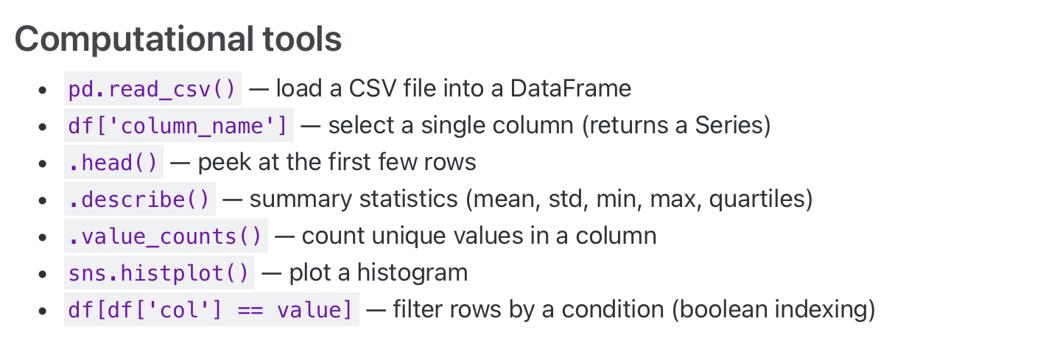
Ch 1: Introduction to applied statistics

Slide 24
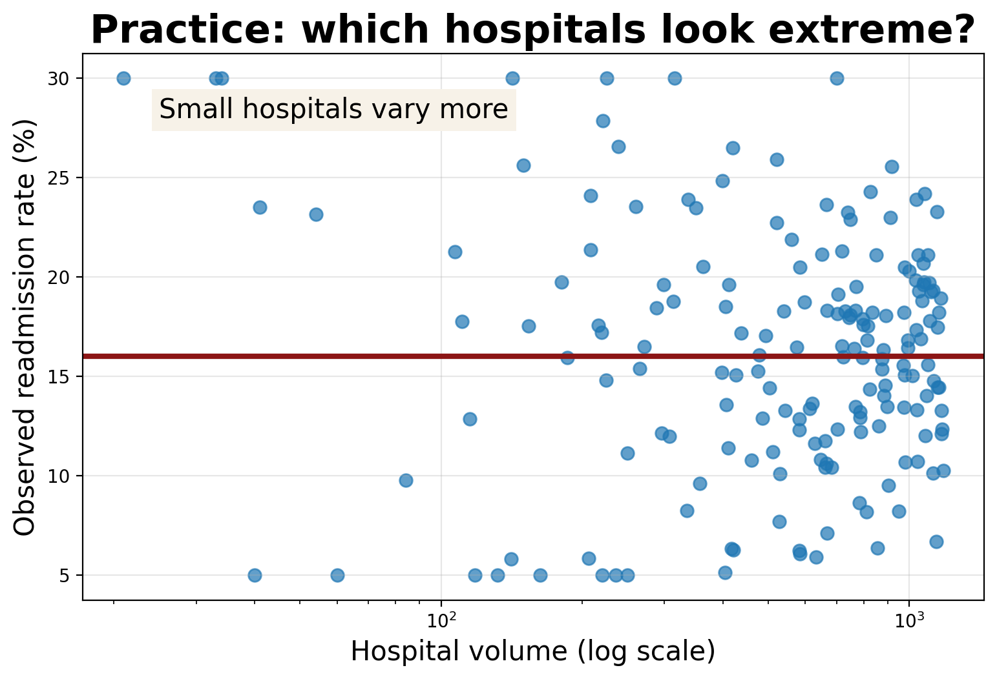
Ch 1: Introduction to applied statistics
Question
A small hospital has the highest observed readmission rate. Should we conclude the worst hospital?

Slide 25
Practice 1 answer
Answer
No. Small denominators create noisy rates. The graph shows wider variation among low-volume hospitals. Before ranking, quantify uncertainty and check whether the apparent extreme could be sampling noise.

Slide 26
Ch 2: Exploratory Data Analysis
Main idea
Core methods
Keep in mind
Plot choice depends on variable types. Always check what the plotting function dropped.
Before modeling, understand what the data looks like.
Distributions shift?
Missingness?
Outliers?
Skewness?
Other patterns?
Histograms,
Boxplots,
- Scatter plots,
Density plots,
- Summary statistics,

Slide 27
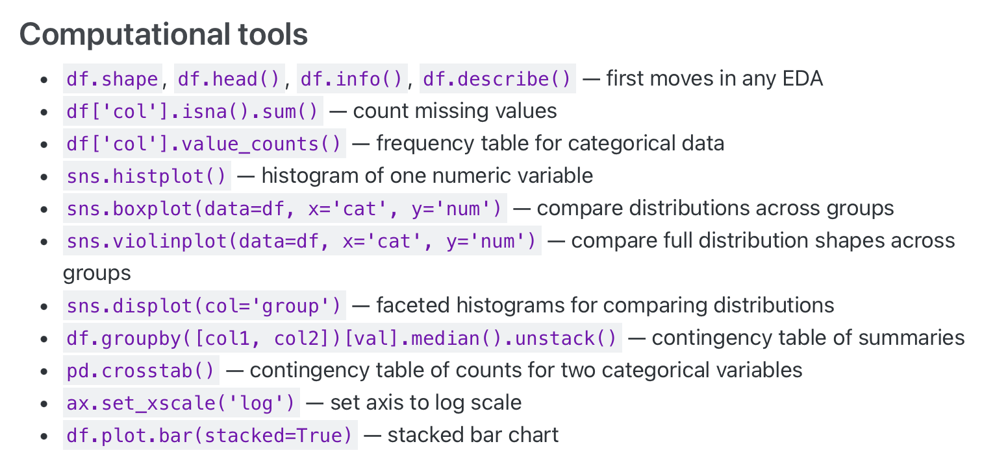
Ch 2: Exploratory Data Analysis

Slide 28
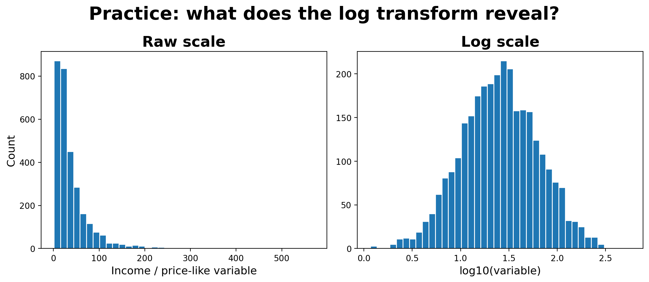
Practice 2: skew and log scale
Question
What changes when we plot the variable on a log scale? What would be misleading on the raw scale?

Slide 29
Practice 2 answer
Answer
The raw-scale histogram hides most observations near zero and exaggerates a long right tail. The log scale reveals the body of the distribution and makes multiplicative differences easier to see.

Slide 30
Ch 3: Data munging
Keep in mind
Data munging:
The process of cleaning, transforming, and preparing raw data for analysis. Every cleaning choice is a decision that changes your conclusions — there is no “neutral” default.
Missingness encodings:
MCAR (unrelated to any variable),
MAR (depends on observed variables only),
MNAR (depends on the unobserved value itself)
Missingness can be informative.
How to deal with missingness?

Slide 31
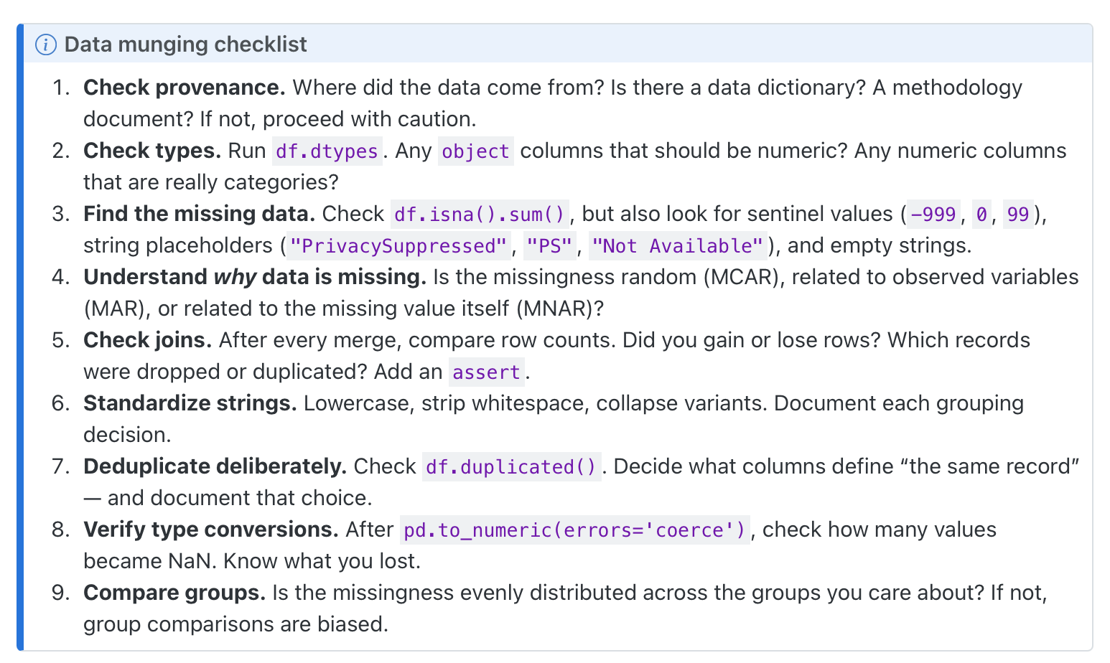
Ch 3: Data munging

Slide 32
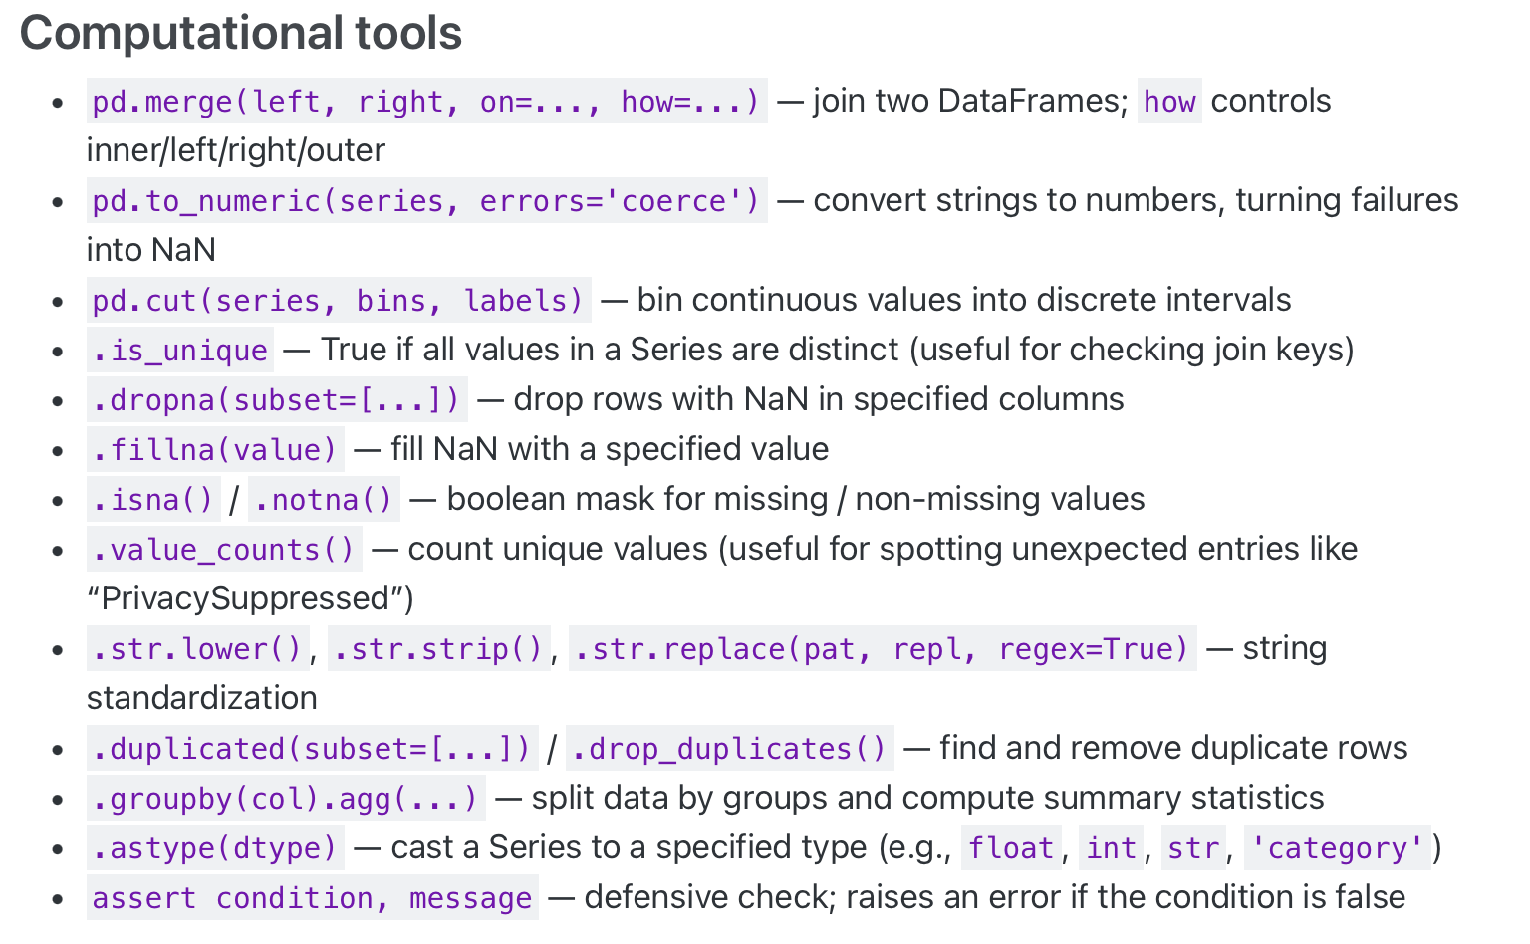
Ch 3: Data munging

Slide 33
Practice 3: missingness audit
Question
Think about
A dataset has 10,000 schools. Only 1,200 have SAT and earnings data. An analyst drops the other 8,800 rows and fits a model. What should you ask before trusting the result?
Are the missing rows random? Which school types disappear? Does the target population change?

Slide 34
Practice 3 answer
Answer
Ask whether complete cases represent the population you care about. If missingness excludes community colleges, for-profit schools, or less selective schools, the model describes a selected subset, not all institutions.

Slide 35
Ch 4: From the mean to simple regression
Main idea
Core methods
Keep in mind
Correlation,
least squares,
residuals,
R²,
projection,
regression to the mean.
A slope is an association unless the design justifies causality
Regression projects y onto a linear space built from x. The residuals are what the line misses.
Assumptions behind the linear regression ?
(more in regression diagnosis)

Slide 36
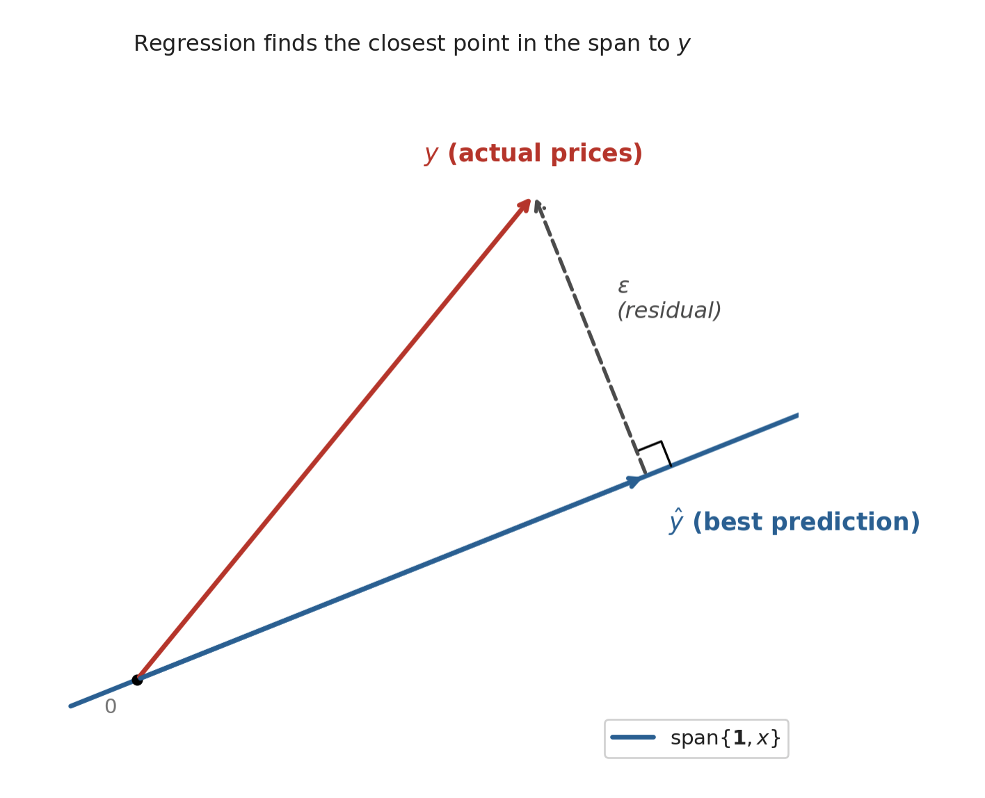
Ch 4: From the mean to simple regression
Geometric interpretation of linear regression?

Slide 37
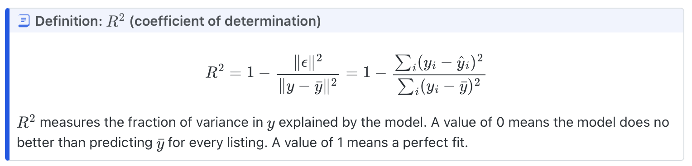
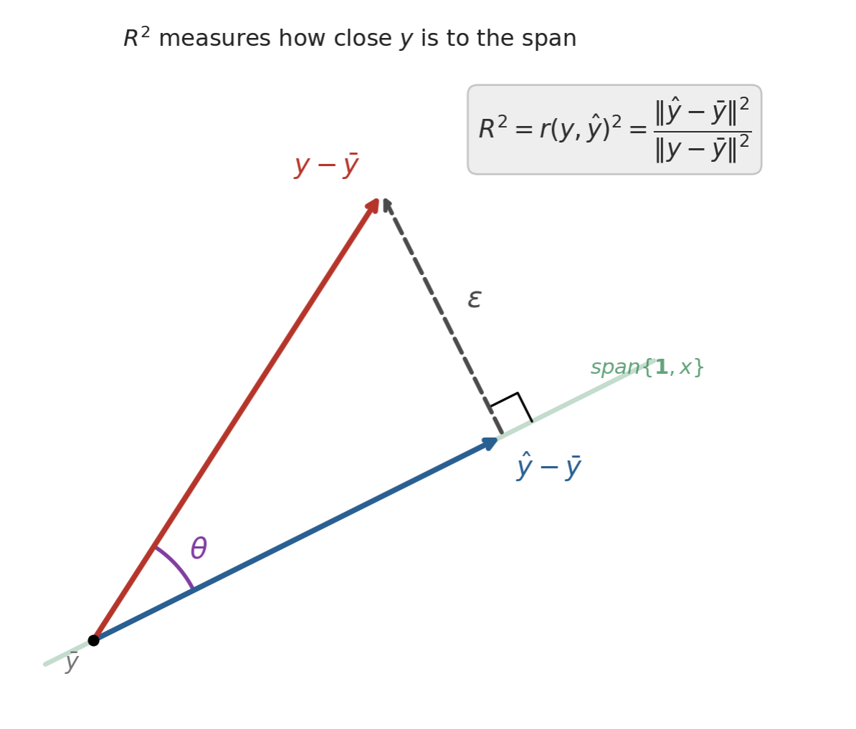
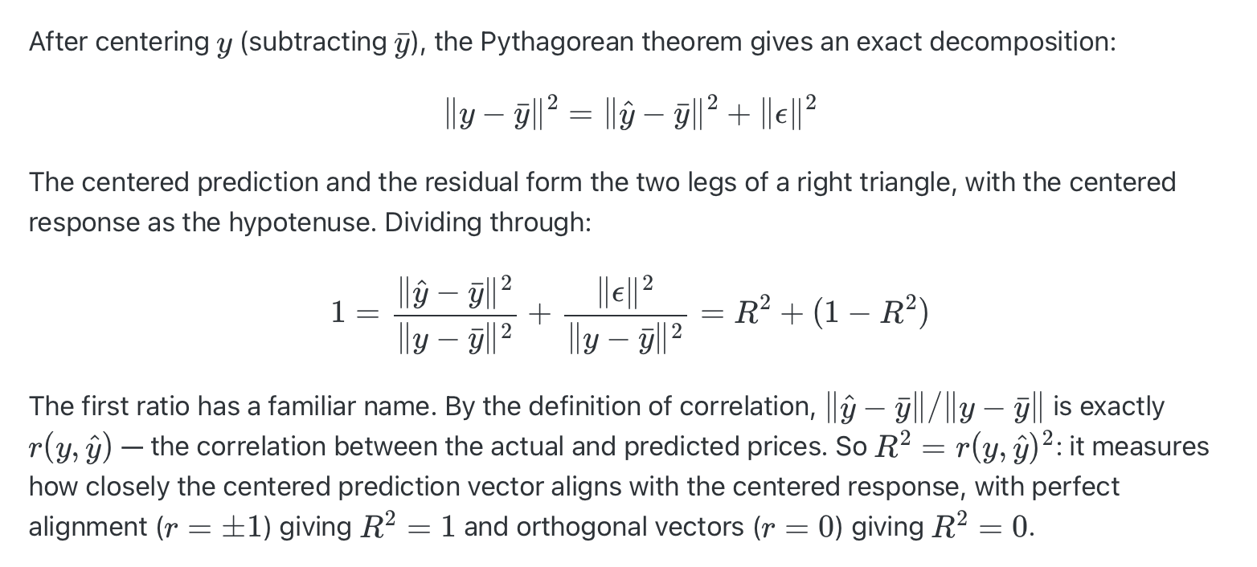
Ch 4: From the mean to simple regression
Geometric interpretation of linear regression?

Slide 38
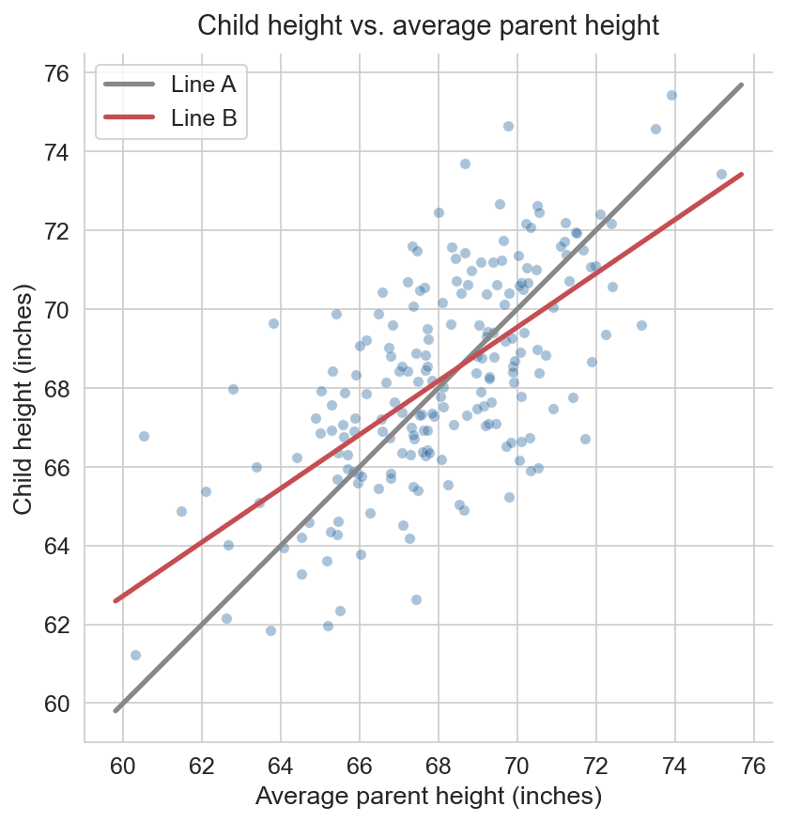
Practice 4: regression to the mean
Question
The plot below shows child height vs. average parent height for a sample of families. Two lines are overlaid: Line A (gray) and Line B (red).
Which line is the regression line of child on parent, and which is y = x ?
What does the relative slope of the two lines reveal about heights across generations?

Slide 39
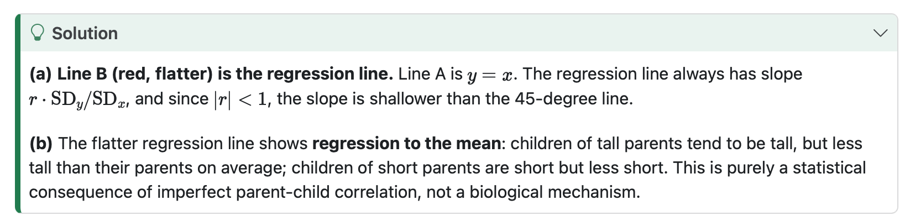
Practice 4 answer

Slide 40
Ch 5: Multiple regression + feature engineering
Main idea
Core methods
Keep in mind
Coefficients are conditional: “holding the other model variables fixed.”
One-hot encoding,
Interactions,
Transformations,
log outcomes,
adjusted R².
Feature engineering changes the question. Interactions say one effect depends on another variable.

Slide 41
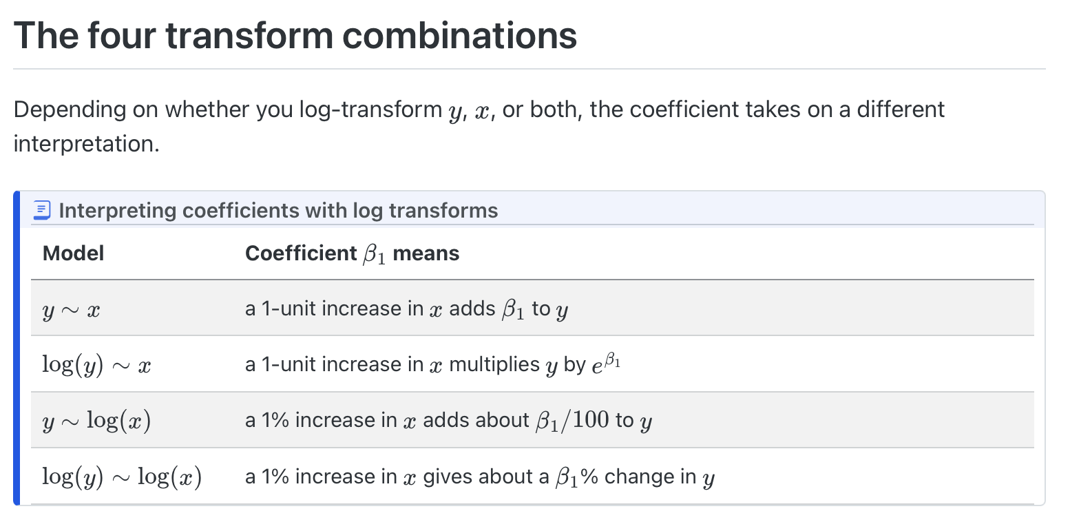
Ch 5: Multiple regression + feature engineering
Transformation:

Slide 42
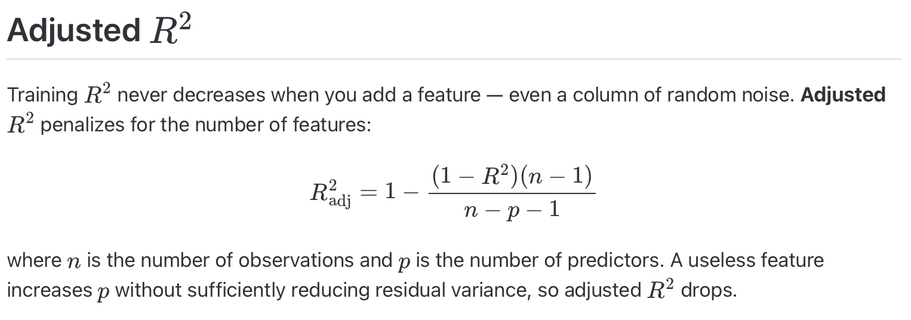
Ch 5: Multiple regression + feature engineering
Adding more features?
What can go wrong if we ignore the intercept?
Adjusted R square?

Slide 43
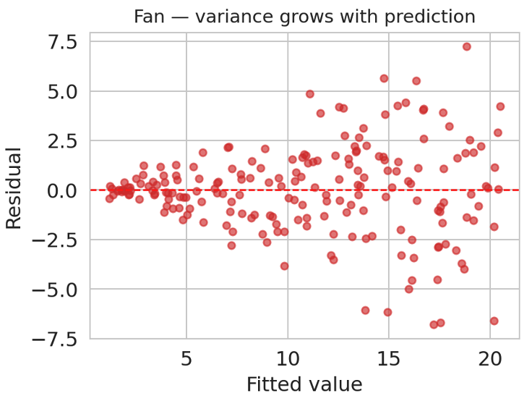
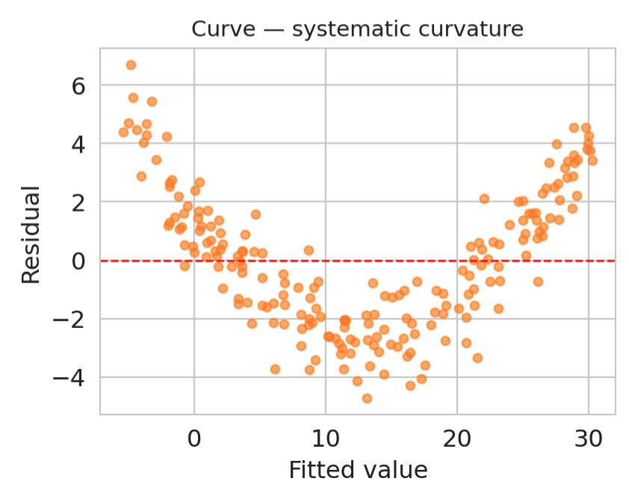
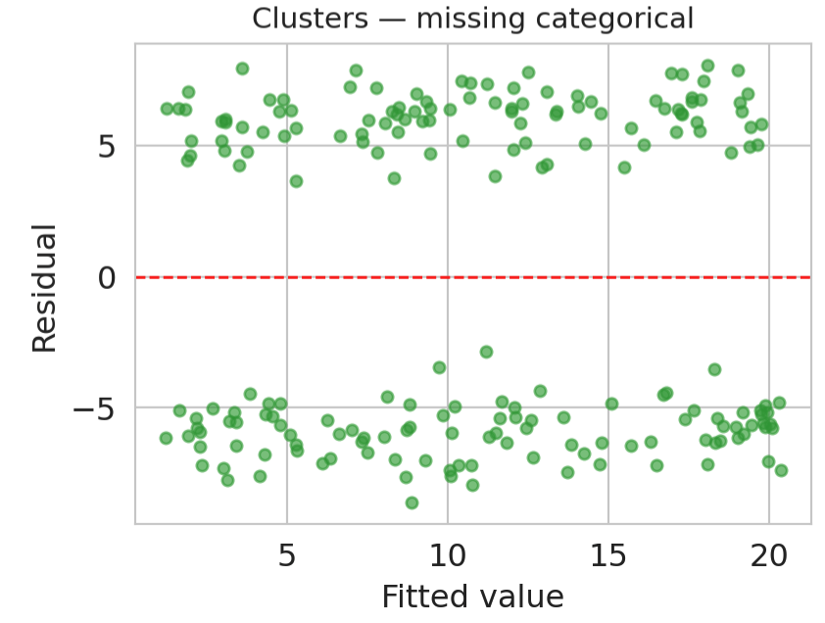
Ch 5: Multiple regression + feature engineering
Residual diagnosis?

Slide 44
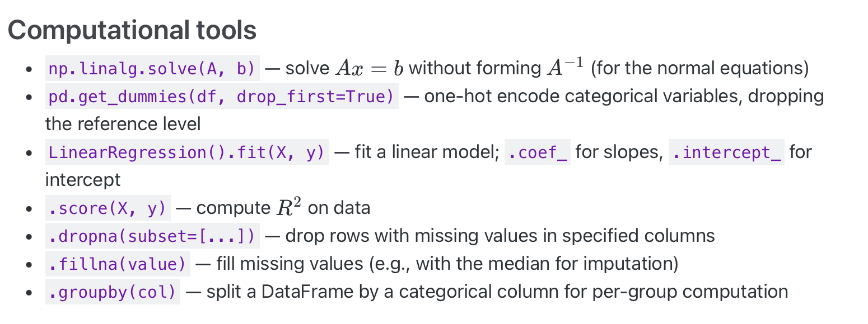
Ch 5: Multiple regression + feature engineering

Slide 45
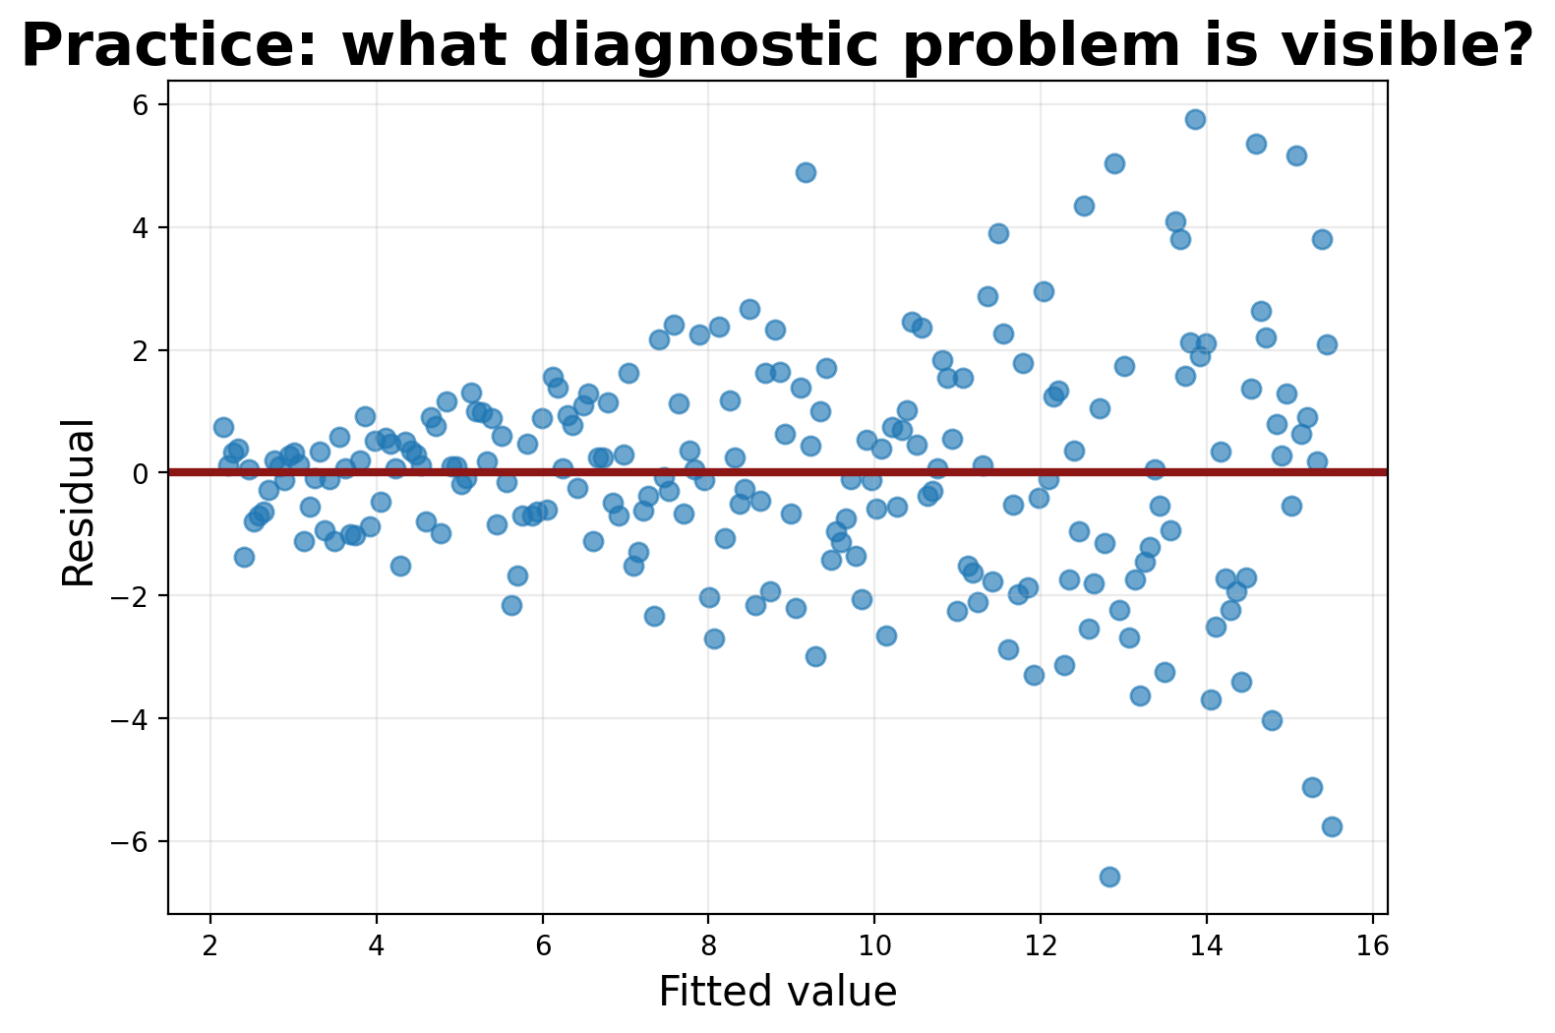
Practice 5: residual diagnostics
Question
The residuals widen as fitted values grow. Which assumption is questionable? What might you try next?

Slide 46
Practice 5 answer
Answer
The equal-variance assumption is questionable: residual spread grows with the fitted value. Possible fixes: transform the outcome, use robust standard errors, model variance, or check whether important subgroups are missing.

Slide 47
Ch 6: Validation and bias–variance
Main idea
Core methods
Keep in mind
Training performance is not deployment performance. Validation estimates generalization.
Train/test split,
validation sets,
k-fold CV,
regularization,
ridge/lasso,
bias–variance tradeoff.
Never use the test set for tuning. Random splits do not protect against distribution shift.

Slide 48
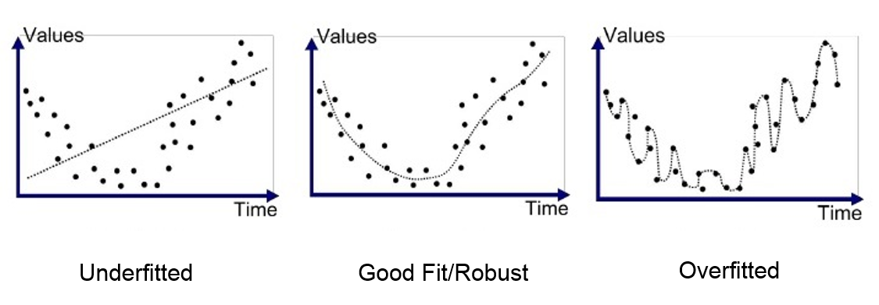
Ch 6: Validation and bias–variance
What is underfitting, and what is overfitting?

Slide 49
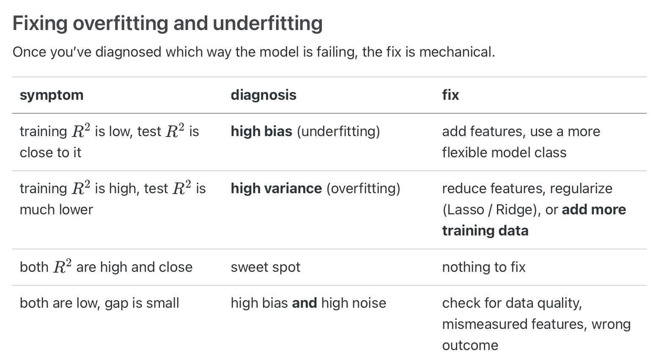
Ch 6: Validation and bias–variance
How to fix them?

Slide 50
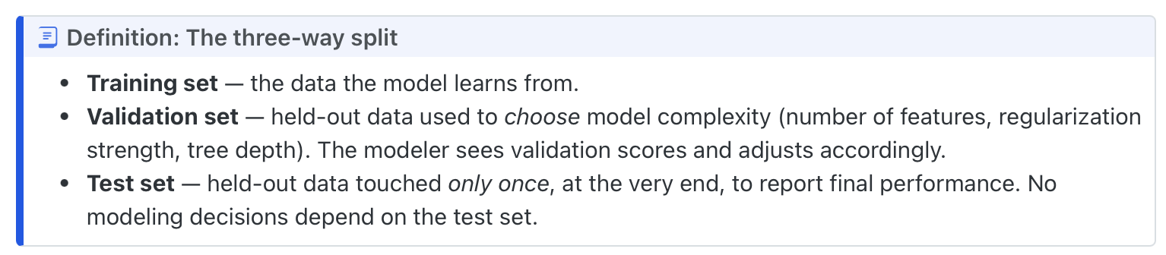
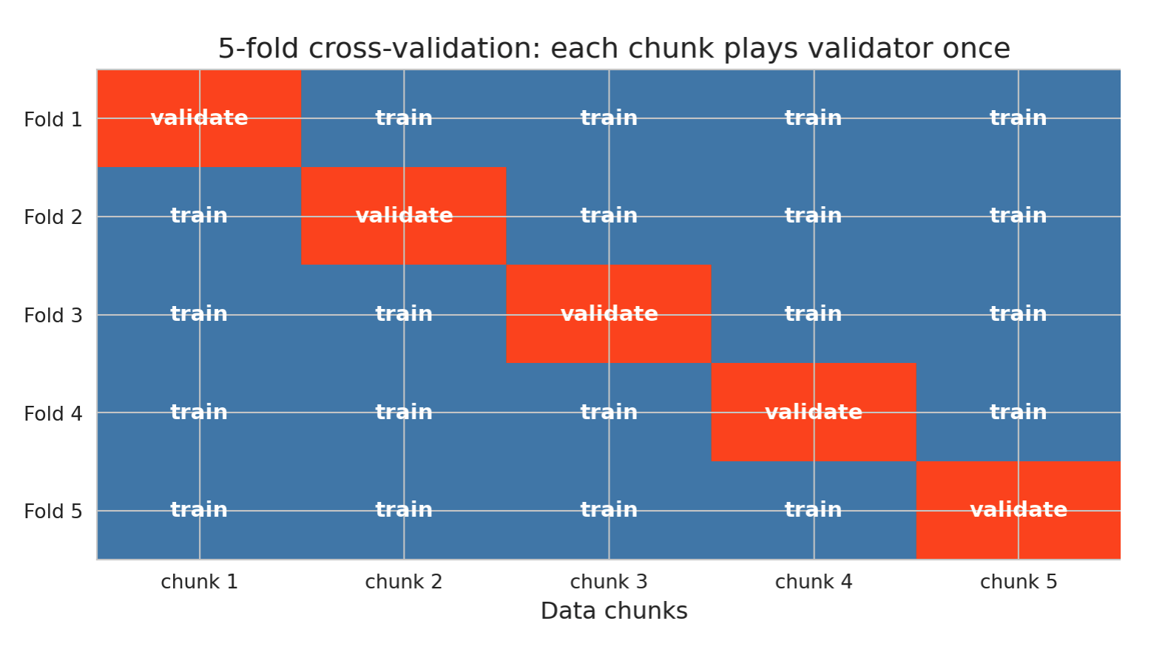
Ch 6: Validation and bias–variance
Train, Validation, Test set?
Examples of data leakage?
Doing standardization?
Cross-validation, but why?

Slide 51
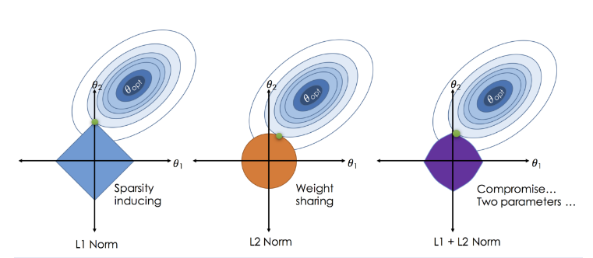
Ch 6: Validation and bias–variance
Regularization?

Slide 52
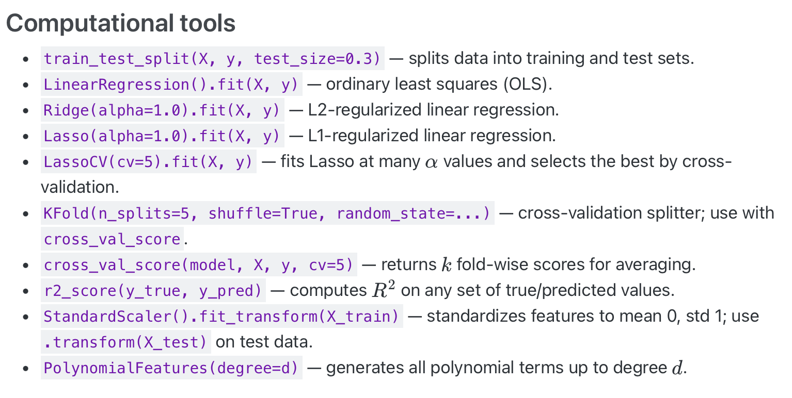
Ch 6: Validation and bias–variance

Slide 53
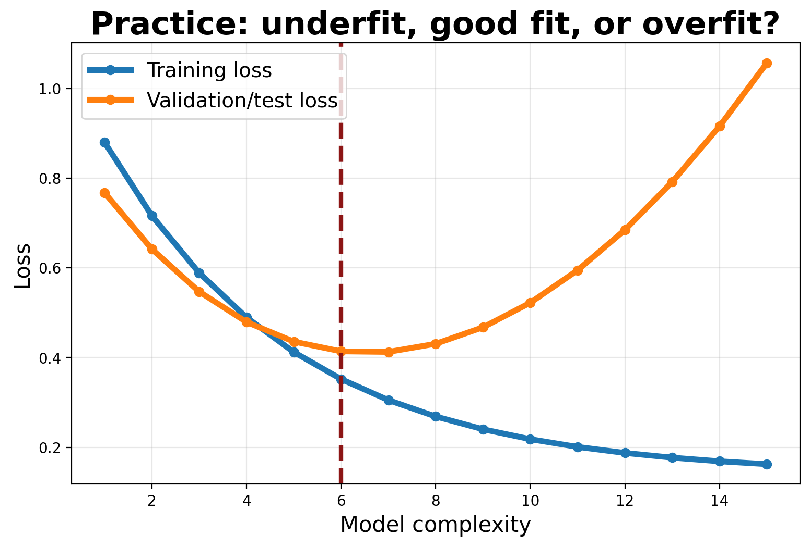
Practice 6: validation curve
Question
Where is the model underfitting?
Where is it overfitting?
Which complexity would you choose?

Slide 54
Practice 6 answer
Answer
Low complexity underfits: both losses are high. High complexity overfits: training loss keeps falling while validation loss rises. Choose near the minimum validation loss, not the minimum training loss.

Slide 55
Ch 7: Classification
Main idea
Core methods
Keep in mind
Classification converts features into probabilities, then decisions depend on thresholds and costs.
Logistic regression,
odds ratios,
confusion matrix,
precision/recall,
ROC/AUC,
calibration.
Accuracy can be misleading under imbalance. Threshold choice is a policy decision.

Slide 56
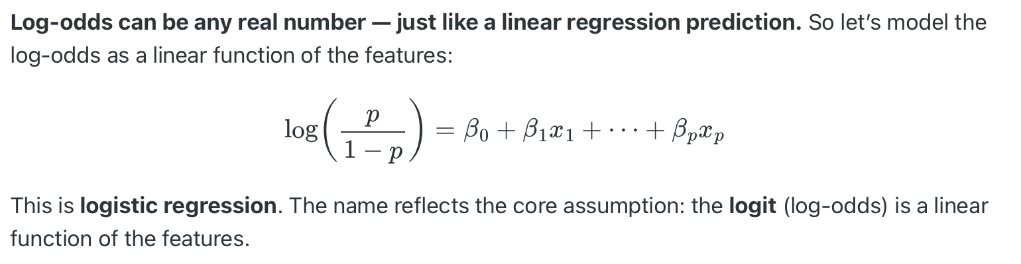
Ch 7: Classification
What is a classification task, why this is different from regression?
What is logistic regression?
What is the problem of logistic regression when the data is perfectly linear separable?
How to solve logistic regression, why can’t just solve like linear regression?
How to interpret the coefficient from the logistic regression?

Slide 57
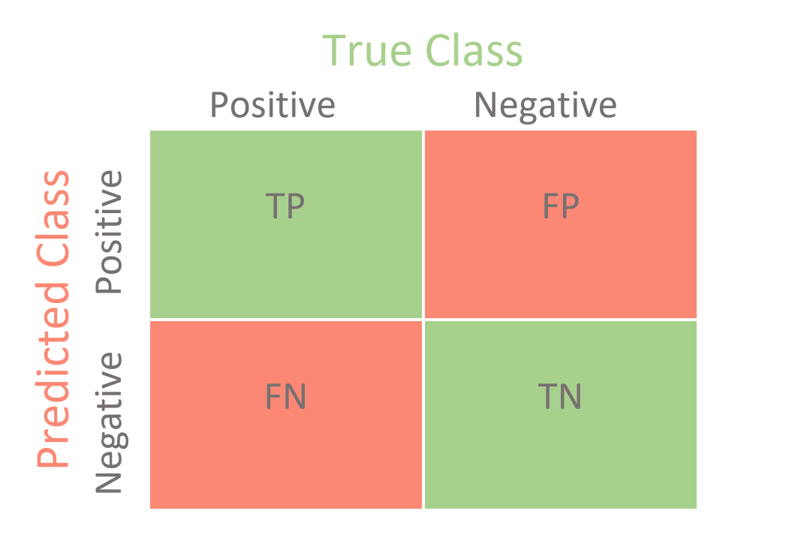
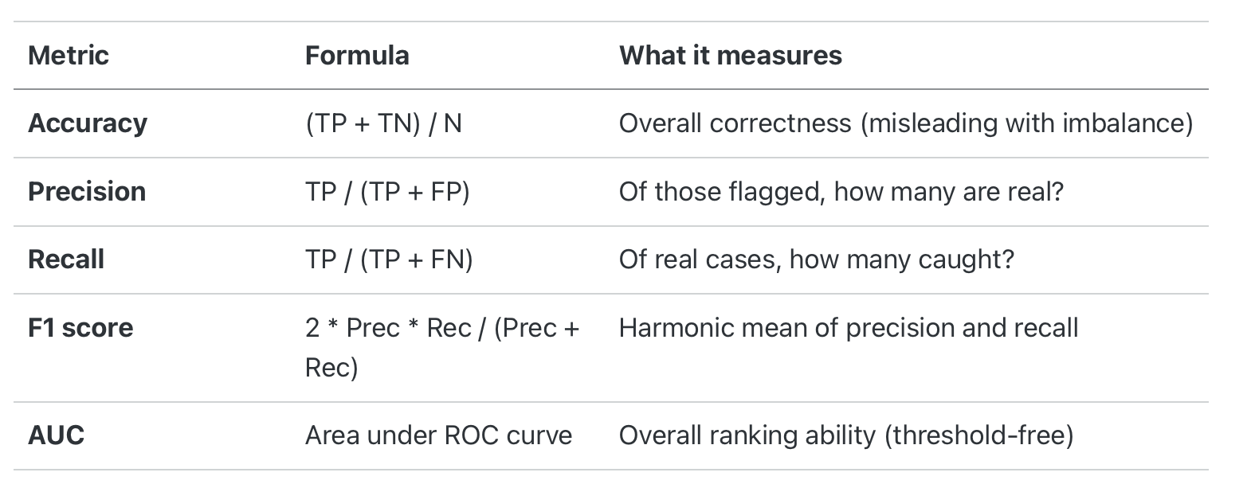
Ch 7: Classification
What is the problem of imbalance class?
Any metric to use when imbalance class exists?
How to solve class imbalance?

Slide 58
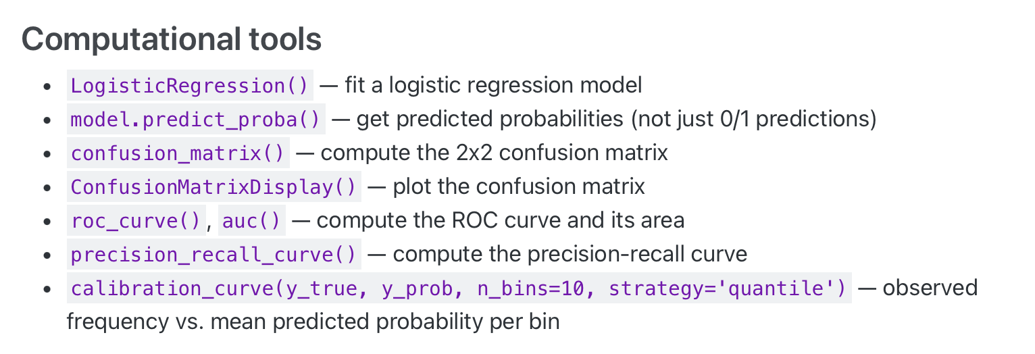
Ch 7: Classification

Slide 59
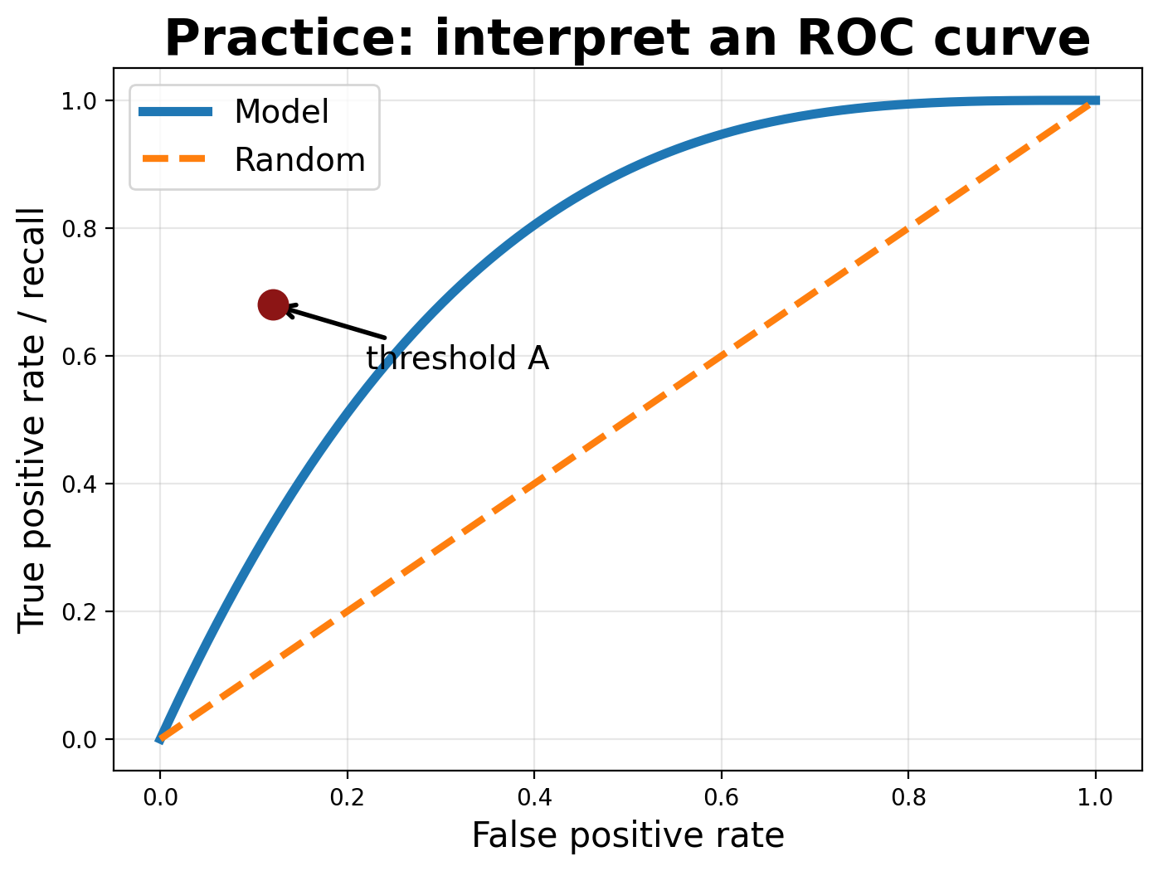
Practice 7: ROC interpretation
Question
At threshold A, what is high and what is low? Why might a hospital prefer a different threshold than a marketing team?

Slide 60
Practice 7 answer
Answer
Threshold A has high recall but nonzero false-positive rate. Different contexts have different costs: missing cancer may be worse than extra follow-up, while spamming customers may be costly.

Slide 61
Act 2: Trust Models
Uncertainty, tests, multiple comparisons, and diagnostics

Slide 62
Ch 8: Bootstrap and normal approximation
Main idea
Core methods
Keep in mind
Estimates vary across samples. We use sampling distributions to quantify uncertainty.
Bootstrap resampling
standard error,
confidence interval,
CLT,
normal approximation.
A CI quantifies sampling uncertainty, not confounding, selection bias, or distribution shift.

Slide 63
Ch 8: Bootstrap and normal approximation
What is bootstrap?
Why bootstrap?
What does bootstrap give us?
When bootstrap fails?
What is Law of Large Number (LLN)?
What is Central Limit Theorem (CLT)?

Slide 64
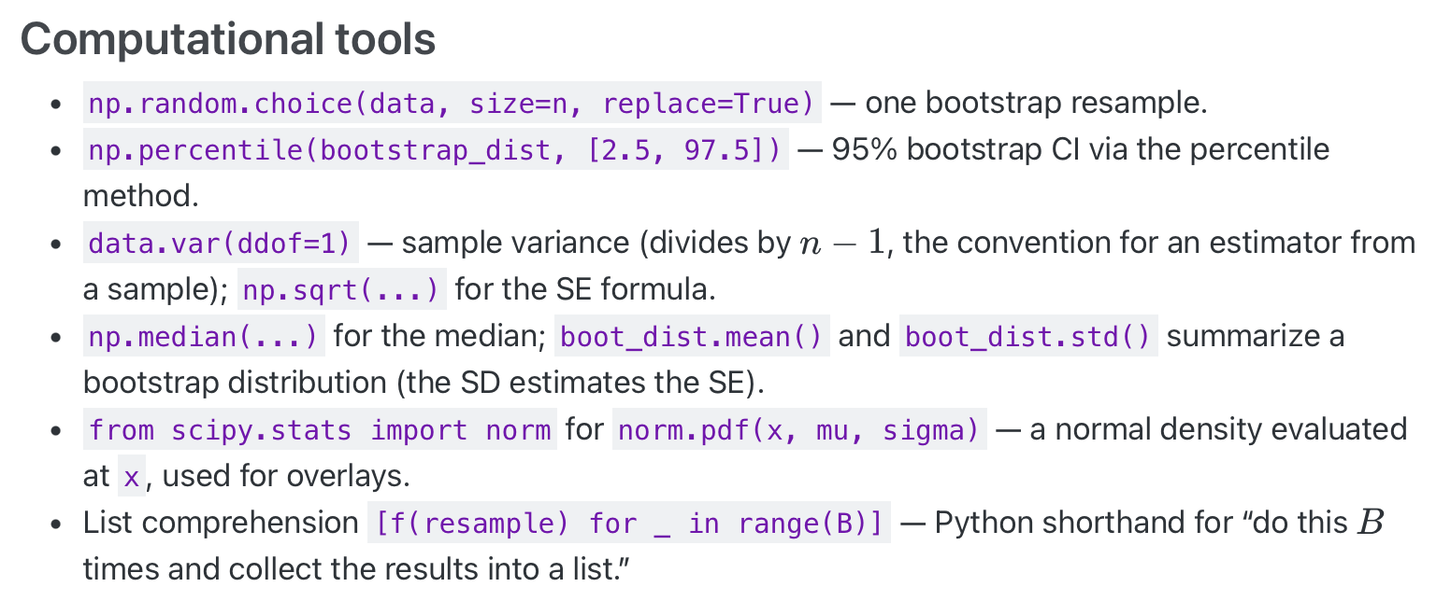
Ch 8: Bootstrap and normal approximation

Slide 65
Ch 9: Permutation tests
Main idea
Core methods
Keep in mind
A permutation test asks: how unusual is this statistic if labels were exchangeable?
Choose a statistic, shuffle labels under H0, compare observed statistic to null distribution.
Validity depends on exchangeability. Bootstrap estimates uncertainty; permutation tests a null.

Slide 66
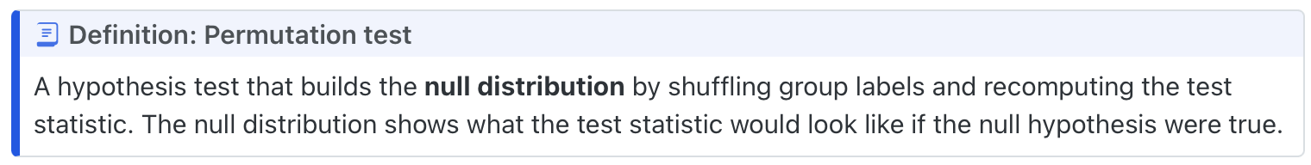
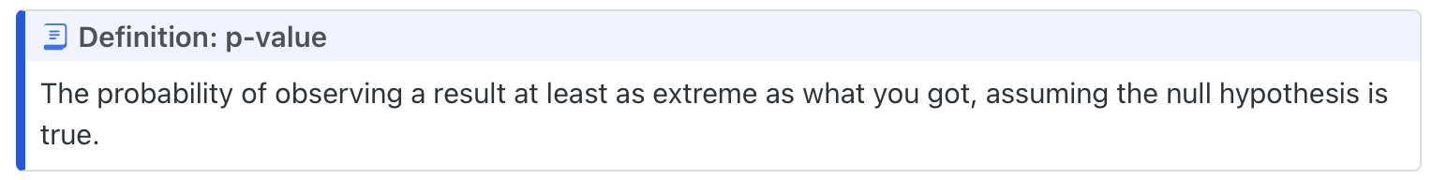
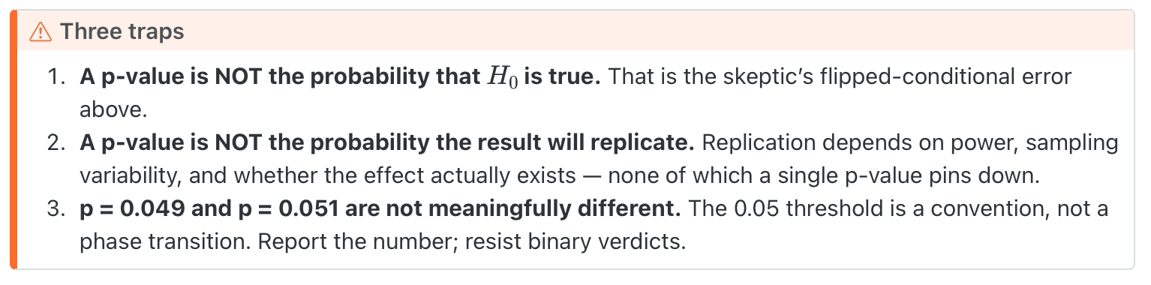
Ch 9: Permutation tests
- What is a permutation test?
- What is a p-value?

Slide 67
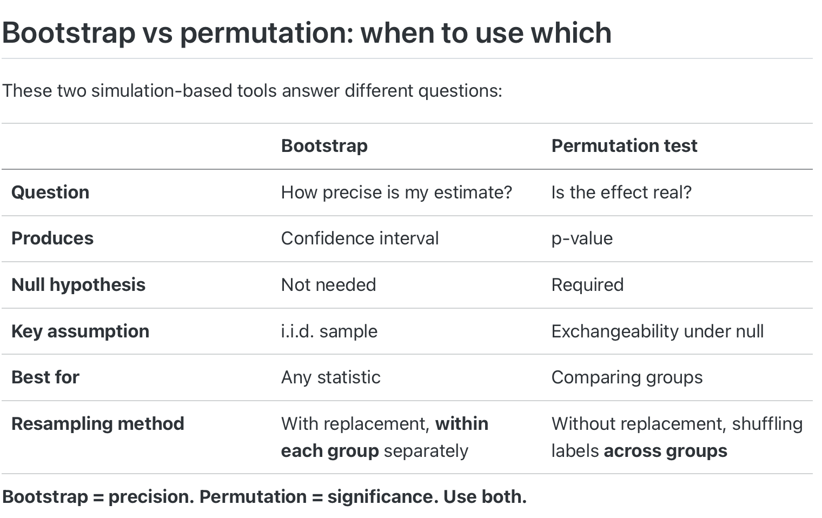
Ch 9: Permutation tests
- Bootstrap v.s. Permutation test?

Slide 68
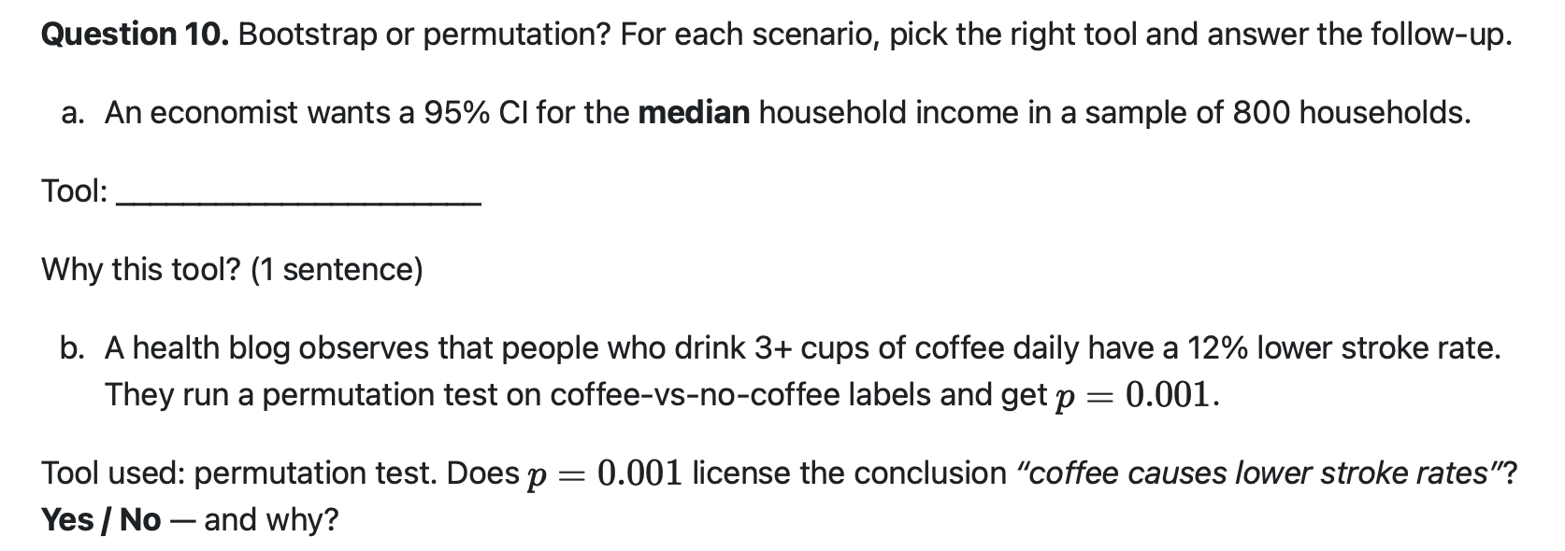
Practice 9

Slide 69
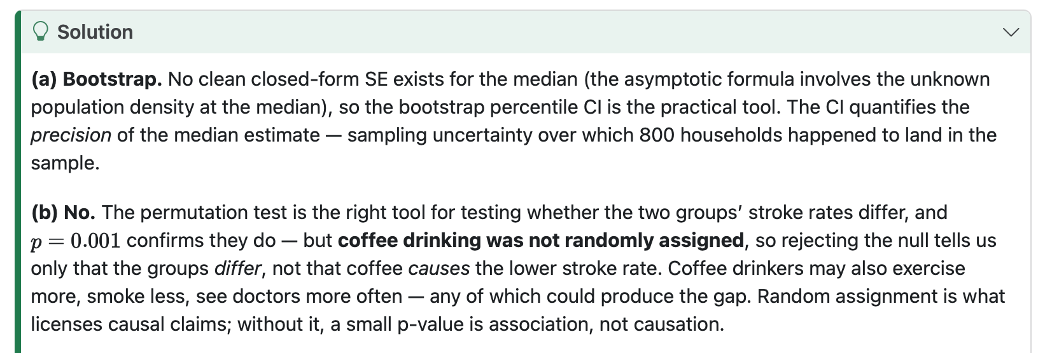
Practice 9

Slide 70
Ch 10: Hypothesis testing framework
Main idea
Core methods
Keep in mind
Hypothesis tests formalize evidence against a null model.
H0/H1,
p-values,
α,
Type I/II error,
power,
CI/test duality.
Fail to reject does not mean the null is true. Statistical significance is not practical importance.

Slide 71
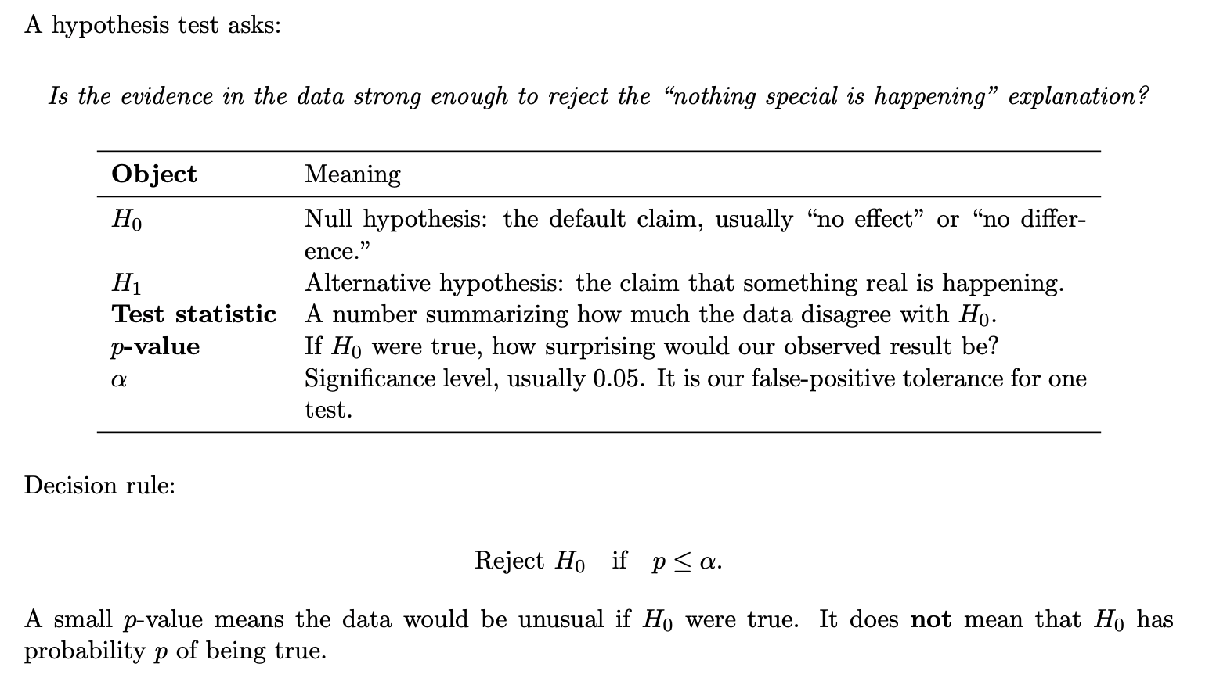
Ch 10: Hypothesis testing framework

Slide 72
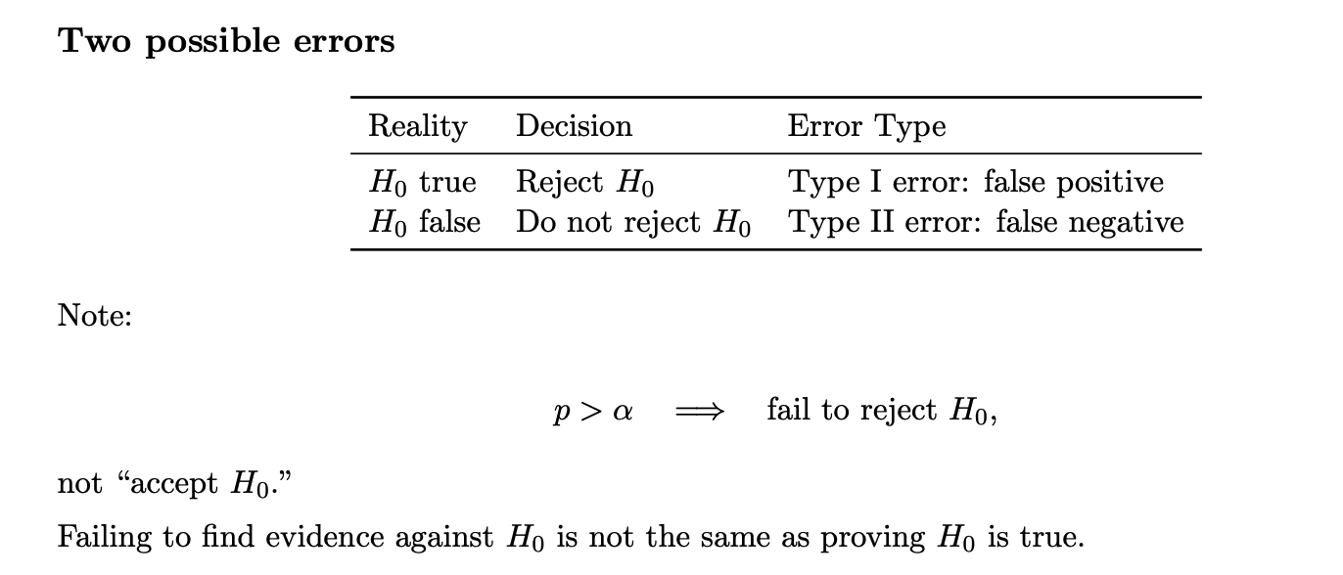
Ch 10: Hypothesis testing framework
Power: The probability to reject the null when the null is false.

Slide 73
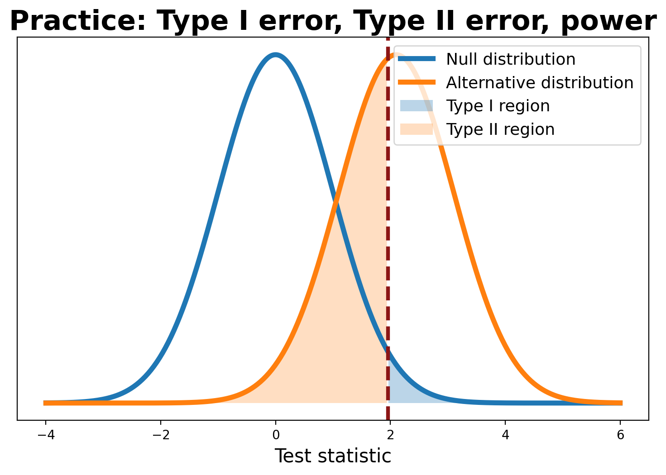
Practice 10: power and errors
Question
Which shaded region is Type I error? Which is Type II error? How would increasing sample size affect power?

Slide 74
Practice 10 answer
Answer
Right tail under the null = Type I error. Left side under the alternative = Type II error. Increasing sample size usually separates the distributions more, reducing Type II error and increasing power.

Slide 75
Ch 11: Multiple testing (see notes on Canvas)
Main idea
Core methods
Keep in mind
Many tests create false discoveries even when every null is true.
FWER,
Bonferroni,
FDR,
Benjamini–Hochberg,
p-value histograms.
Correction is not optional when the search process creates many chances to be fooled.

Slide 76
Ch 12: Regression inference + diagnostics
Main idea
Core methods
Keep in mind
Regression tables are conditional claims; diagnostics ask whether the model assumptions are plausible.
t-tests for coefficients, confidence intervals, residual plots, Q-Q plots, LINE assumptions.
Small p-values do not rescue a bad model. Diagnose before over-interpreting coefficients.

Slide 77
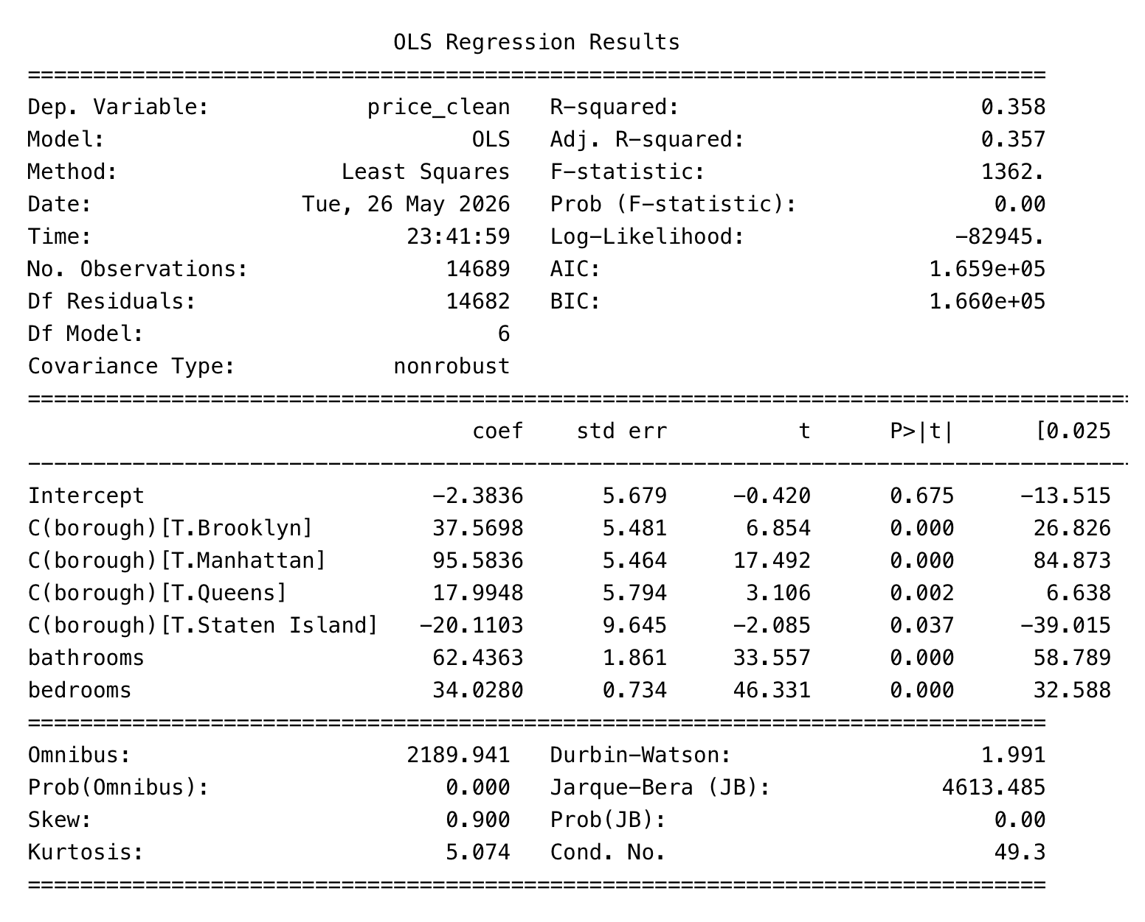
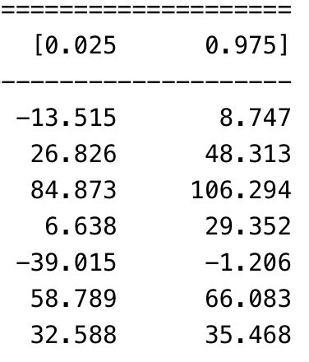

Slide 78
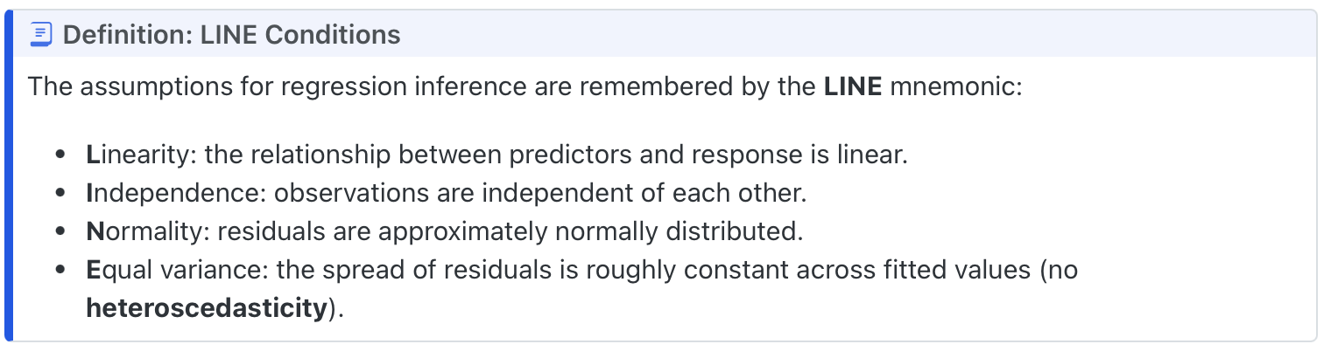
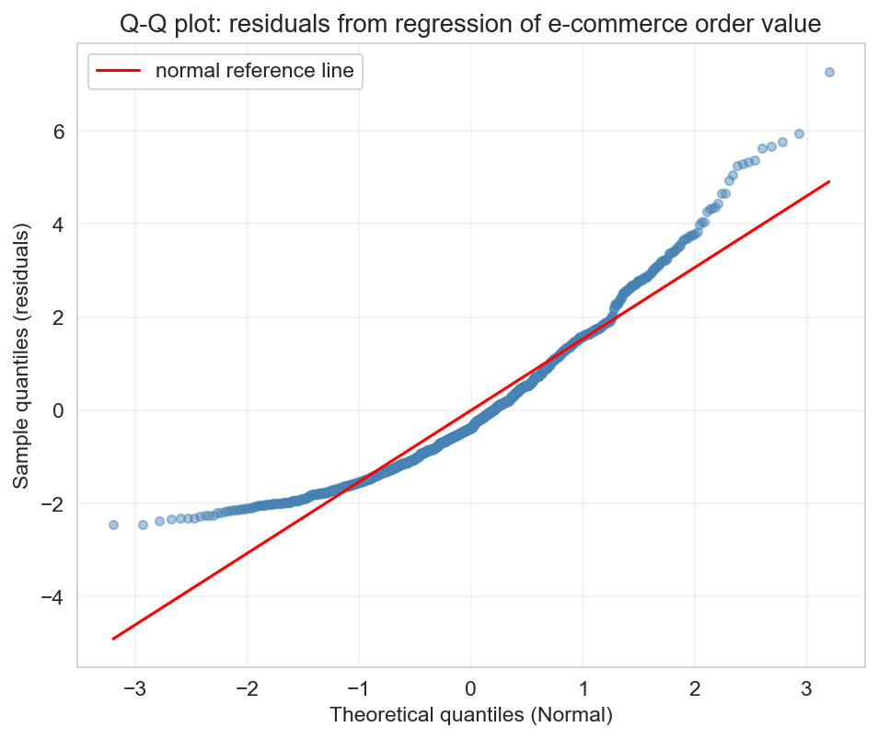

Slide 79
Act 3: See Further
Flexible models, dimension reduction, unsupervised learning, deployment, and AI

Slide 80
Ch 13: Decision trees and random forests
Main idea
Core methods
Keep in mind
Trees learn if/then partitions. Forests average many noisy trees to reduce variance.
Splits,
leaves,
Gini/SSE,
max_depth,
bagging,
random feature subsets,
feature importance.
Deep single trees overfit. More trees in a forest usually stabilize; depth controls overfitting more directly.

Slide 81
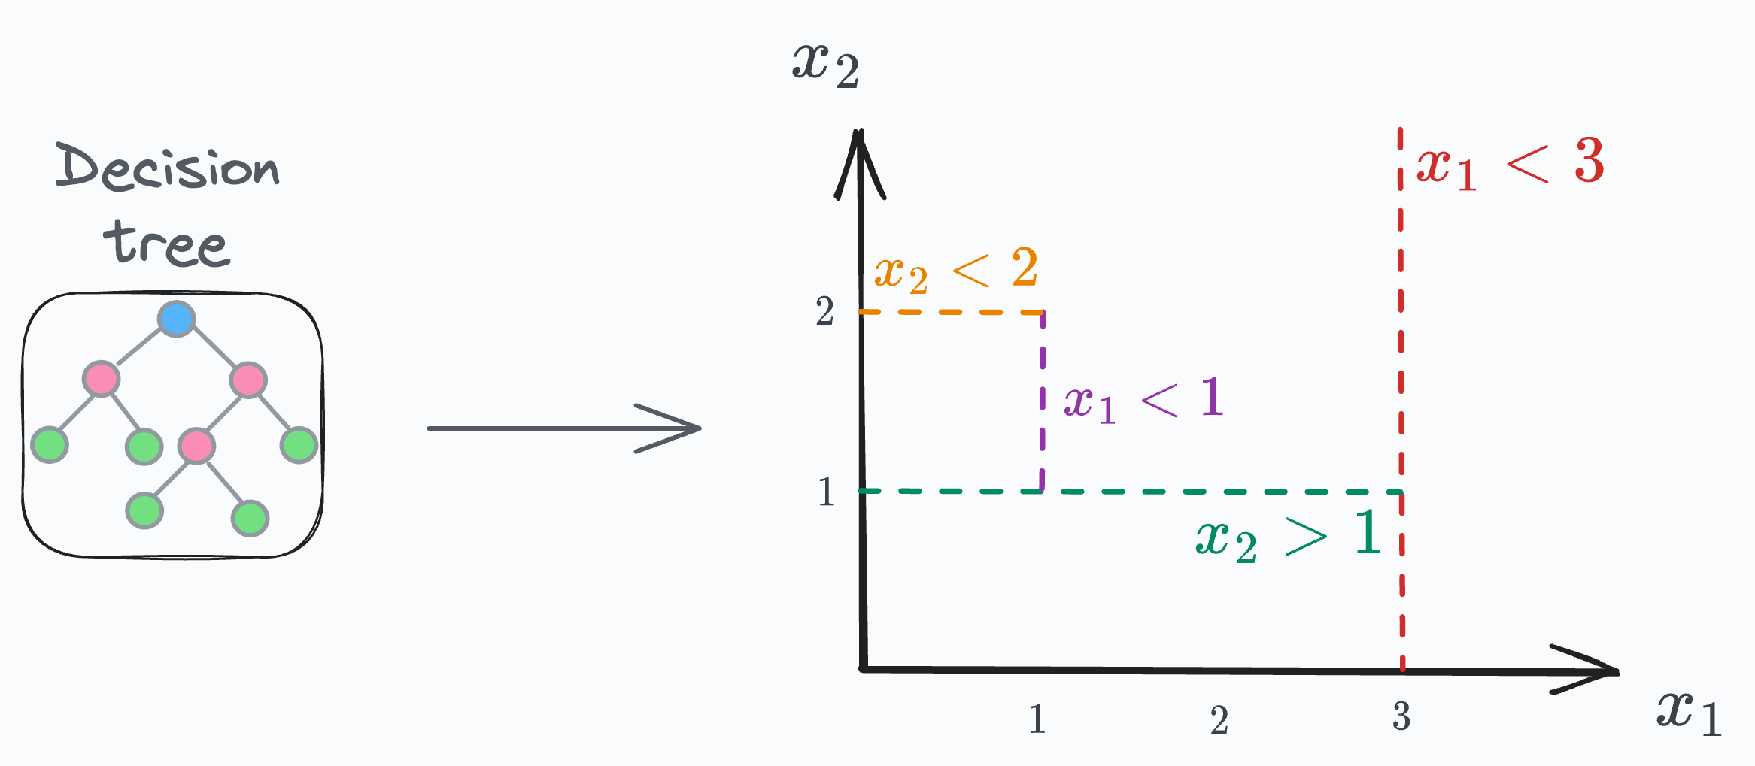
Ch 13: Decision trees and random forests
Trees are doing partitions.

Slide 82
Ch 13: Decision trees and random forests
What are ensemble methods?
Bagging?
Boosting?
What are the benefits of ensemble methods, how about the cost?
What are the advantage of tree-based methods compare to linear method
How about disadvantages?
How to choose depth?

Slide 83
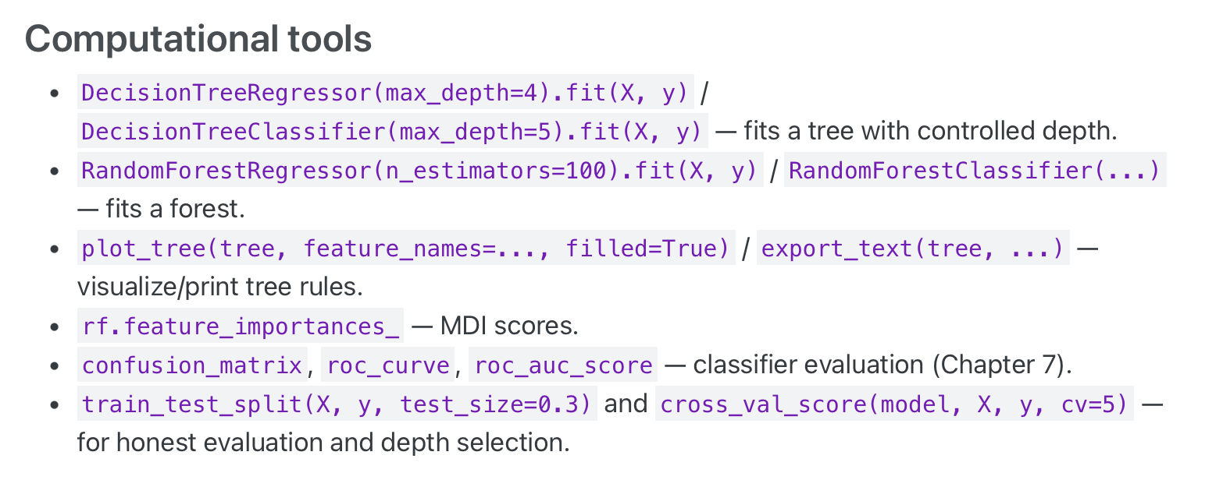
Ch 13: Decision trees and random forests

Slide 84
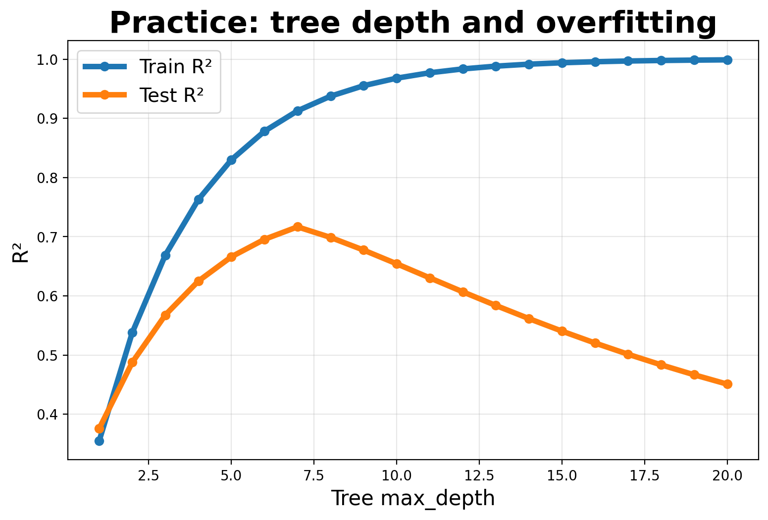
Practice 13: tree depth
Question
What happens as max_depth increases? Why can train R² keep rising while test R² falls?

Slide 85
Practice 13 answer
Answer
Deeper trees memorize idiosyncrasies in the training data. Train R² rises because the model fits noise; test R² falls because the learned splits do not generalize.

Slide 86
Ch 14: PCA
Main idea
Core methods
Keep in mind
PCA finds low-dimensional linear summaries that capture maximum variance.
Standardization,
PC scores,
loadings,
explained variance,
scree plots,
SVD.
Interpret loadings. PCA creates new combined features; it does not select original variables like lasso.

Slide 87
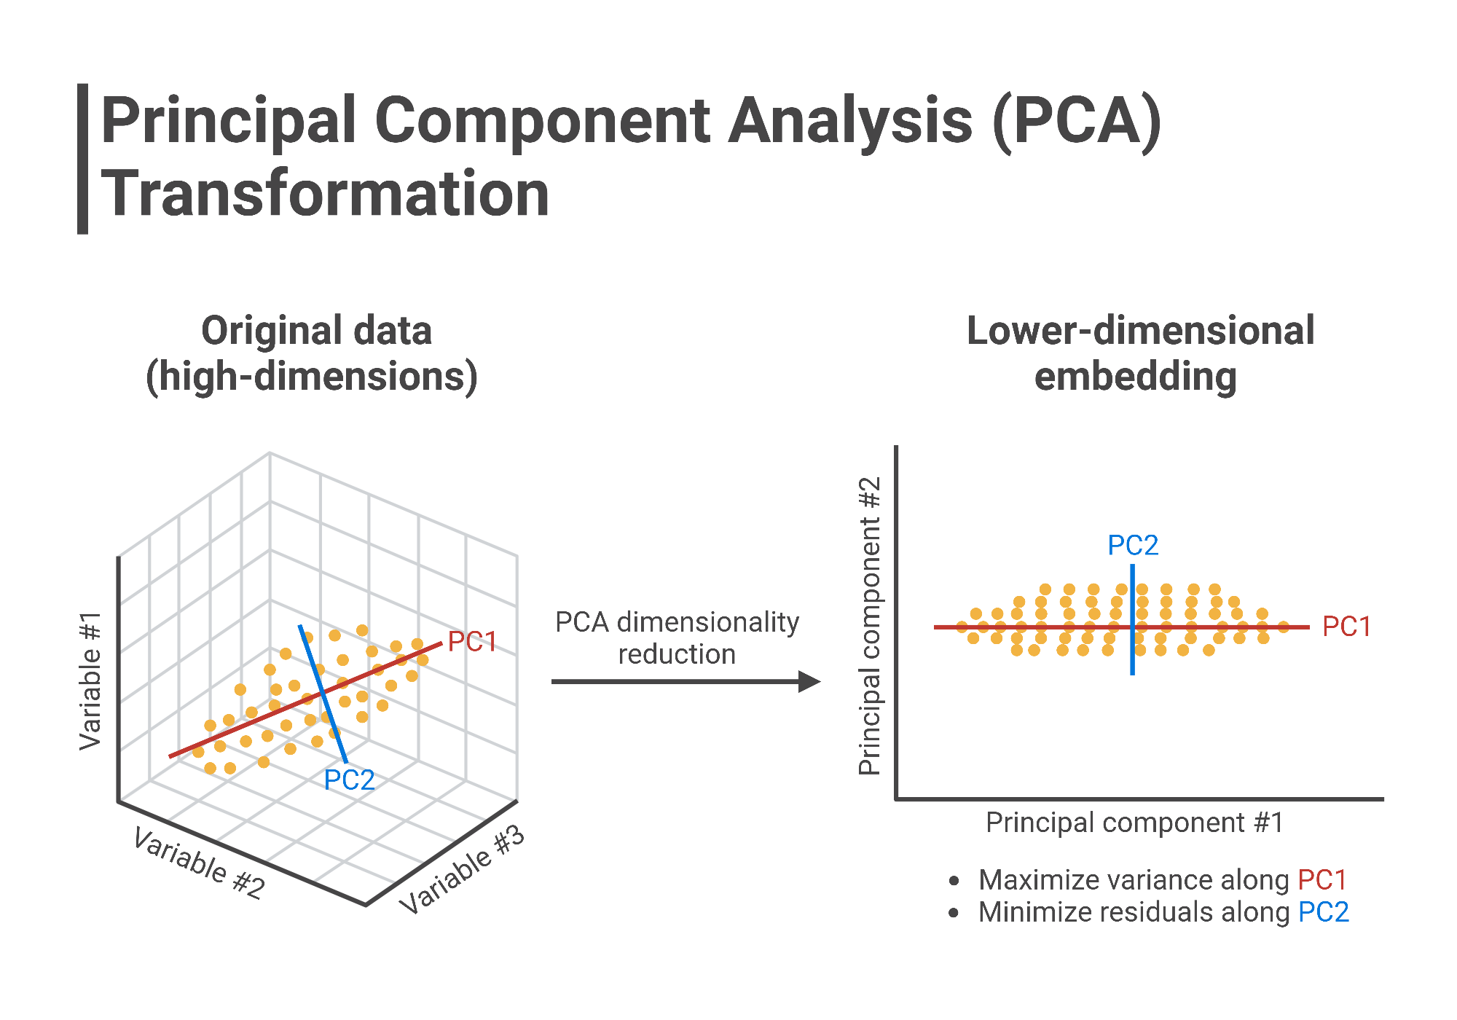
Ch 14: PCA

Slide 88
Ch 14: PCA
What is PCA doing?
How PCA differs from feature selection?
Name some cases PCA might have better interpretation than feature selections?
How to interpret the PCs?
How to choose how many PCs we need?
Why we need to do standardization before doing PCA?

Slide 89
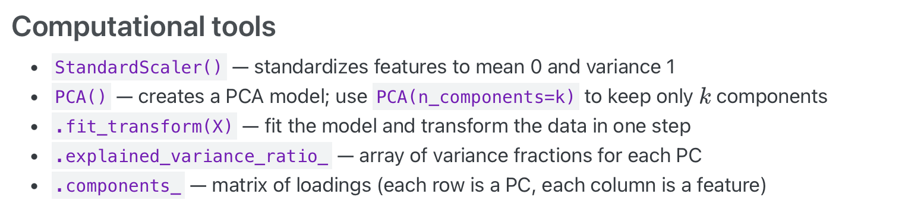
Ch 14: PCA

Slide 90

Practice 14: scree plot
Question
How many PCs capture about 70% of variance? Where is the elbow? Why standardize first?

Slide 91
Practice 14 answer
Answer
About 4 PCs capture roughly 70% here. The elbow is around PC3 or PC4. Standardize first so PCA is not dominated by variables with large measurement units.

Slide 92
Ch 15: Clustering
Main idea
Core methods
Keep in mind
Clustering finds groups without labels, but the algorithm will always return groups.
K-means,
centroids,
SSE/inertia,
elbow plot,
initialization,
ARI.
Feature choice defines similarity. Validate clusters using external evidence or downstream use.

Slide 93

Ch 15: Clustering
How to measure similarity between different units?
What is supervised learning and unsupervised learning?
What is K-means algorithm?

Slide 94


Ch 15: Clustering
K-means can be sensitive to initialization.
Different choice of K can return very different clustering results.
Your feature decide the clustering.
When K-means fail:

Slide 95

Ch 15: Clustering

Slide 96
Ch 16: Validation beyond the random split
Main idea
Core methods
Keep in mind
Deployment changes the validation question: will this model work in the world where it is used?
Temporal split, grouped split, walk-forward validation, leakage audit, distribution shift, feedback loops, Goodhart.
Split along the axis of generalization. Historical accuracy may fail after intervention or policy change.

Slide 97

Ch 16: Validation beyond the random split

