Slide 1
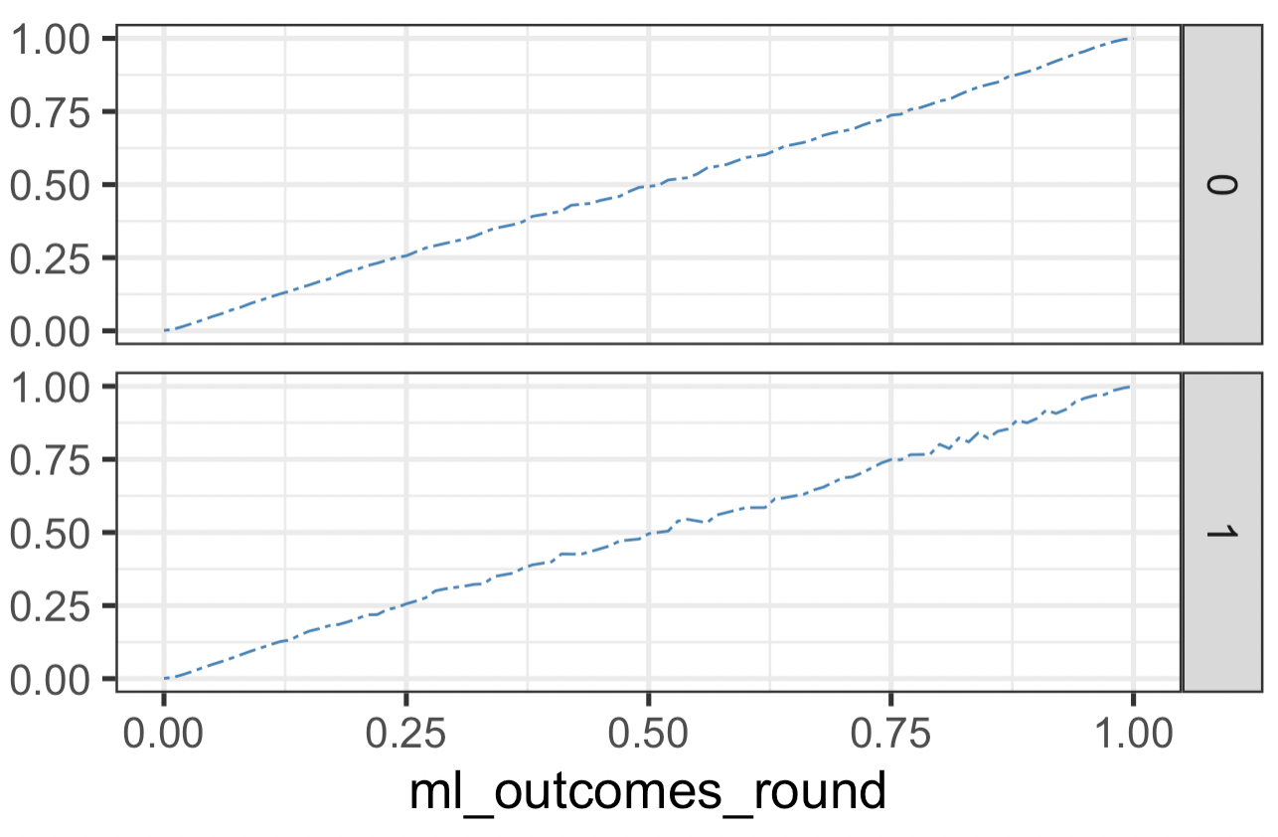
Actual % Who Pass Boards
White
Black
Predicted Likelihood of Boards Passage E[Y_{i} |T, R]

Slide 2
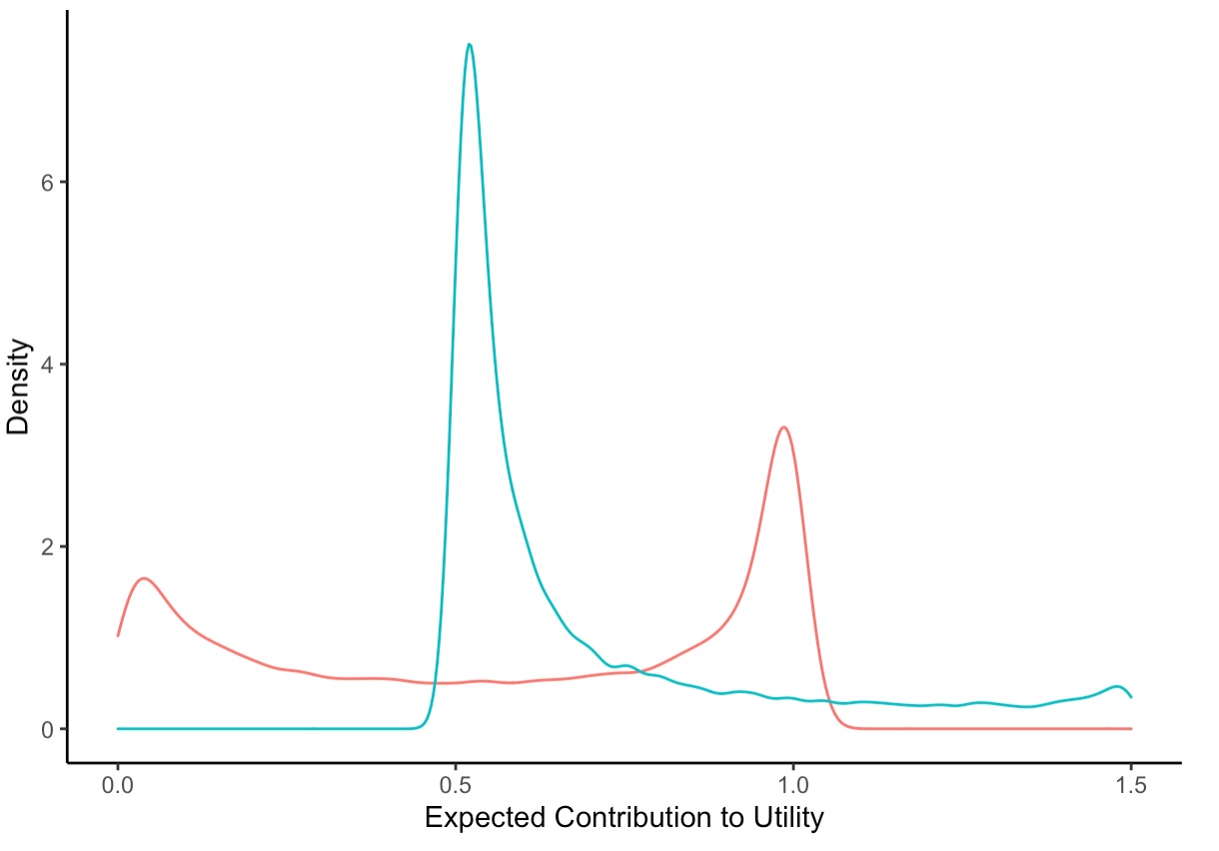

White
Black

Slide 3
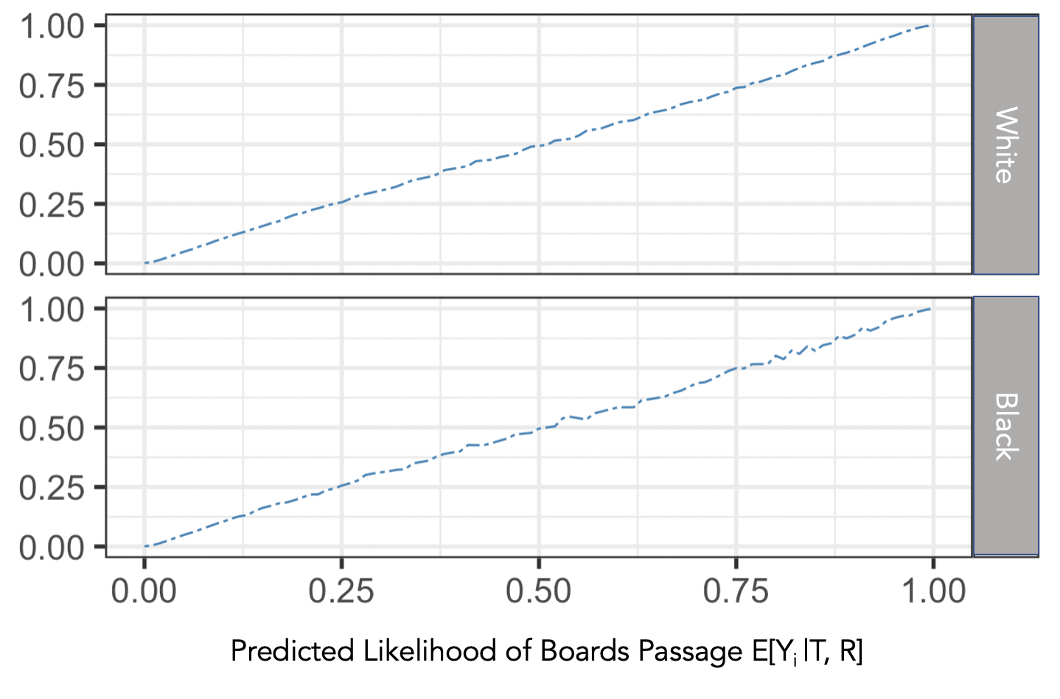
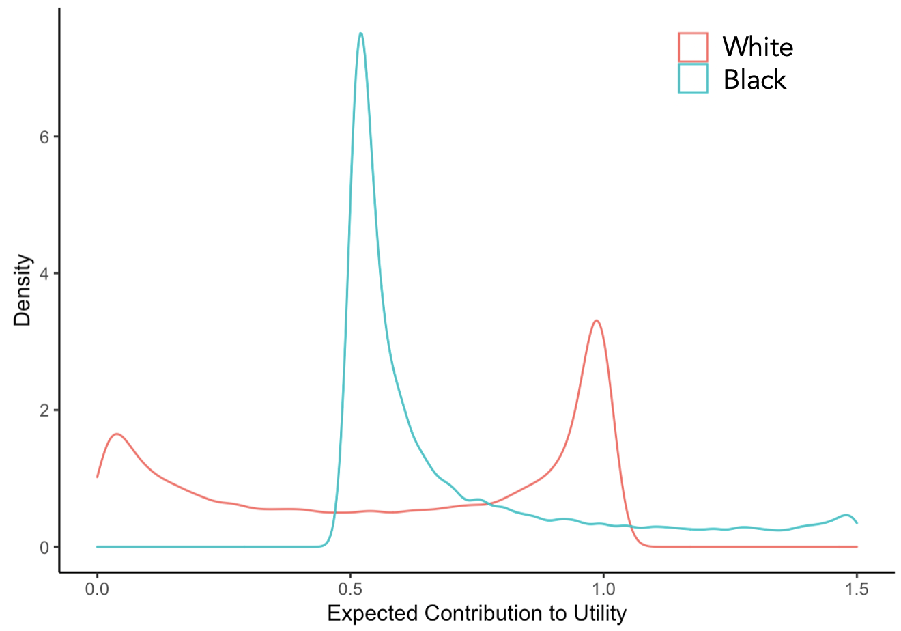
E[U_{i} |T, R]

