Slide 1



Liszt: A DSL for Building Portable
Mesh-based PDE Solvers
Zachary DeVito, Niels Joubert, Francisco Palacios,
Stephen Oakley, Montserrat Medina,
Mike Barrientos, Erich Elsen, Frank Ham,
Alex Aiken, Karthik Duraisamy, Eric Darve,
Juan Alonso, Pat Hanrahan

Slide 2
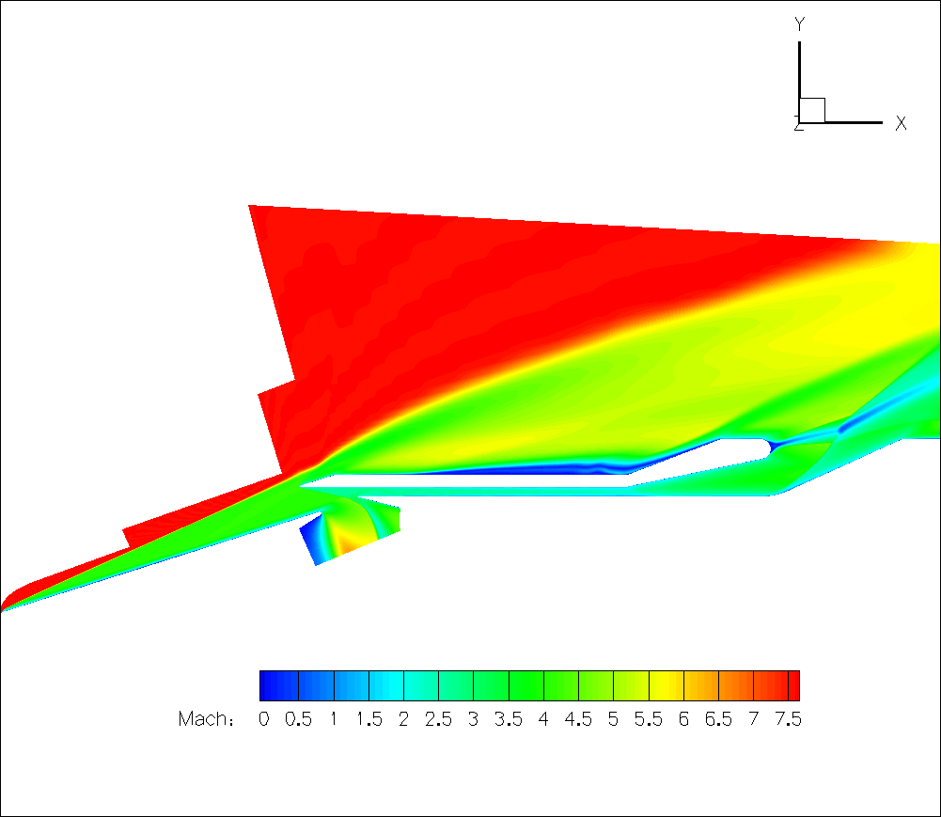
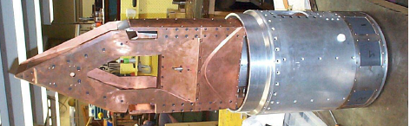
Scientists Need Performance
  Example: PSAAP’s simulation of fluid flow in a hypersonic scramjet
Combustion
Turbulence
Fuel injection
Transition
Thermal
Turbulence
Notes:
At conference like supercomputing, It should be no surprise that scientists need high performance for doing accurate physical simulation.
For example, Our collaborators Stanford’s Predictive Science

Slide 3
Scientists Need Performance
  Example: PSAAP’s simulation of fluid flow in a hypersonic scramjet
  State-of-the-art unstructured Reynolds-averaged Navier Stokes (RANS) solver
  Solving discretized PDEs on a 3D mesh
  Large Meshes (100 million cells)
  Arbitrary polyhedra for complex geometry
  MPI implementation

Slide 4
Scientists Want Portability
  Tried porting to Cell in 2006
  Wish to port to GPU in 2011
  Worried about porting to ??? In 201X
Notes:
The desire for faster turnaround let them to be interested in the increased efficiency of new architectures like GPUs

Slide 5
Programming Models In Flux
Cluster
  Message Passing – MPI
SMPs
  Threads and Locks – pthreads, OpenMP
Hybrid CMPs
  GPU cores – CUDA/OpenCL?
  Cores with vector instructions – ArBB??
  Task queues for scheduling CPU/GPU – AMD FSAIL???

Slide 6
Scientists should not deal with this complexity!

Slide 7
Our Contribution: Liszt
Write code at higher level of abstraction:
  Data stored on a 3D mesh of discrete elements
Liszt code is portable:
  Uses different strategies to parallelize programs for clusters, SMPs, and GPUs
Liszt code is efficient:
  Performance comparable to best hand-written code
Notes:
Our solution to this problem is the programming language list Liszt.
In liszt, Scientists express PDE at a higher level of abstraction.
In particular they express computation in terms of data stored on a 3D mesh of discrete elements.
Writing at this level makes it possible for the code to be both portable and efficient.
We demonstrate that liszt is portable by showing that we can translate the same code to two different execution strategies
We demonstrate that liszt is efficient by comparing our generated code to handwritten code for different parallel programming models

Slide 8
Example: Heat Conduction on Grid
Fields (data)
Mesh Elements
Sets
Parallel for
Topology Functions
Reductions (assoc.)
val Position = FieldWithLabel[Vertex,Double3](“position”)
val Temperature = FieldWithLabel[Vertex,Double](“init_temp”)
val Flux = FieldWithConst[Vertex,Double](0.0)
val JacobiStep = FieldWithConst[Vertex,Double](0.0)
var i = 0
while (i < 1000) {
val all_edges = edges(mesh)
for (e <- all_edges) {
val v1 = head(e)
val v2 = tail(e)
val dP = Position(v1) - Position(v2)
val dT = Temperature(v1) - Temperature(v2)
val step = 1.0/(length(dP))
Flux(v1) += dT*step
Flux(v2) -= dT*step
JacobiStep(v1) += step
JacobiStep(v2) += step
}
for (p <- vertices(mesh)) {
Temperature(p) += 0.01*Flux(p)/JacobiStep(p)
}
for (p <- vertices(mesh)) {
Flux(p) = 0.0; JacobiStep(p) = 0.0;
}
i += 1
}
Vertex
Edge
Face
Cell
Notes:
Fields hold initial problem setup and then temporaries to hold intermediate results
Mesh elements at which fields store data are ADTs, in addition to the verts/edges in this example we have 2d/3d types/arbitrary polyhedra
Iterate to get to a solution
Sets to select portions of mesh elements
Parallel for statements to express computation of each part of mesh
Nested-for
Extra local neighborhood of data around element via topological functions. In addition to head/tail we have a full set of functions: example faces around a cell
Writes to fields can be reductions which are associative and will run atomically eventhough the for-stmt is parallel
second phase of algorithm then updates Temperature with calculated flux

Slide 9
Properties of PDE Code: Parallel
val Position = FieldWithLabel[Vertex,Double3](“position”)
val Temperature = FieldWithLabel[Vertex,Double](“init_temp”)
val Flux = FieldWithConst[Vertex,Double](0.0)
val JacobiStep = FieldWithConst[Vertex,Double](0.0)
var i = 0
while (i < 1000) {
val all_edges = edges(mesh)
for (e <- all_edges) {
val v1 = head(e)
val v2 = tail(e)
val dP = Position(v1) - Position(v2)
val dT = Temperature(v1) - Temperature(v2)
val step = 1.0/(length(dP))
Flux(v1) += dT*step
Flux(v2) -= dT*step
JacobiStep(v1) += step
JacobiStep(v2) += step
}
for (p <- vertices(mesh)) {
Temperature(p) += 0.01*Flux(p)/JacobiStep(p)
}
for (p <- vertices(mesh)) {
Flux(p) = 0.0; JacobiStep(p) = 0.0;
}
i += 1
}
Independent computation per edge
followed by reductions
Notes:
This parallel is expressed implicitly in liszt through the semenatics of the for-stmts, which runs each body idependenly apart from parallel for comprehensions

Slide 10
Properties of PDE Code: Stencil
val Position = FieldWithLabel[Vertex,Double3](“position”)
val Temperature = FieldWithLabel[Vertex,Double](“init_temp”)
val Flux = FieldWithConst[Vertex,Double](0.0)
val JacobiStep = FieldWithConst[Vertex,Double](0.0)
var i = 0
while (i < 1000) {
val all_edges = edges(mesh)
for (e <- all_edges) {
val v1 = head(e)
val v2 = tail(e)
val dP = Position(v1) - Position(v2)
val dT = Temperature(v1) - Temperature(v2)
val step = 1.0/(length(dP))
Flux(v1) += dT*step
Flux(v2) -= dT*step
JacobiStep(v1) += step
JacobiStep(v2) += step
}
for (p <- vertices(mesh)) {
Temperature(p) += 0.01*Flux(p)/JacobiStep(p)
}
for (p <- vertices(mesh)) {
Flux(p) = 0.0; JacobiStep(p) = 0.0;
}
i += 1
}
Stencil is local
and bounded
Notes:
The local data around element that is used to calculated a new value at an eleemnt is the PDE’s stencil
In regular grids you frequently might have 4- or 9- point stencils
Unstructured problems have stencils as well based on local topological relationships
Most formulations use a bounded stencil

Slide 11
Liszt’s Approach
Abstract interface to data using mesh elements and fields
Reason about data-dependencies to infer the PDE’s stencil
Stencil enables program analyses used to parallelize code
  Detection of ghost cells/halos
  Writer conflicts in reductions
Notes:
Liszt’s compiler can retarget this code to different parallel runtimes. We take the following approach…

Slide 12
Liszt’s Abstraction Simplifies
Dependency Analysis
“What data does this value depend on?”
Difficult in general:
    Must reason about f(i), a general function
  Simple in Liszt:
  Must reason about head(e), a built-in function on mesh topology
  double a = B[f(i)]
  val a = Temperature(head(e))

Slide 13
Implementation
Translation to Parallel Code
Notes:
Now that you have an overview of the approach, let’s get into the details of how it works

Slide 14
Stencil Inference
Stencil-driven transforms
  Partitioning for MPI
  Coloring for CUDA

Slide 15
Inferring the Stencil
Code
for (e <- edges(mesh)) {
val v1 = head(e)
val v2 = tail(e)
val dP = Position(v1) - Position(v2)
val dT = Temperature(v1) - Temperature(v2)
val step = 1.0f/(length(dP))
Flux(v1) += dT*step
Flux(v2) -= dT*step
JacobiStep(v1) += step
JacobiStep(v2) += step
}
Environment
Given an edge what field values will this code read/write?
e =

Slide 16
Inferring the Stencil
Code
for (e <- edges(mesh)) {
val v1 = head(e)
val v2 = tail(e)
val dP = Position(v1) - Position(v2)
val dT = Temperature(v1) - Temperature(v2)
val step = 1.0f/(length(dP))
Flux(v1) += dT*step
Flux(v2) -= dT*step
JacobiStep(v1) += step
JacobiStep(v2) += step
}
Stencil
Reads:
Position(A)
Position(B)
Temperature(A)
Temperature(B)
Writes:
Flux(A)
Flux(B)
JacobiStep(A)
JacobiStep(B)
Environment
v1 = head(e) = A
e =
v2 = tail(e) = B

Slide 17
Handling Branches
for (e <- edges(mesh)) {
<...>
if(foo()) {
JacobiStep(head(e)) += 1
}
}
Stencil
Reads:
Writes:
JacobiStep(A)
Conservatively assume that
if-statement runs
v1 = head(e) = A
e =
v2 = tail(e) = B

Slide 18
Handling Loops
for (e <- edges(mesh)) {
val v = head(e)
while(foo()) {
JacobiStep(v) += 1
v = tail(e)
}
}
Stencil
Reads:
Writes:
JacobiStep(A)
/*Error*/
Liszt enforces:
  Mesh variables are constant
  No recursion
∴ Interpret loop once
v = head(e) = A
e =

Slide 19
Formalizing Stencil Inference
By defining a program transformation
Details are in the paper

Slide 20
Using the stencil to transform Liszt programs

Slide 22
MPI: Partitioning with Ghosts

Slide 23
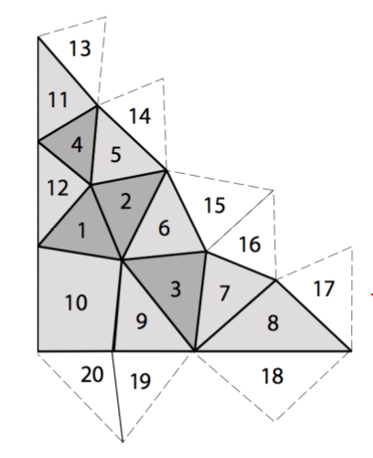
MPI: Partitioning with Ghosts
Ghost Cell
Border Cell
Interior Cell

Slide 24
MPI: Partitioning with Ghosts
Decompose into threads of execution:
Partition Mesh (ParMETIS, G. Karypis)

Slide 25
MPI: Partitioning with Ghosts
2. Resolve dependencies using the stencil
Given a partition, determine its ghosts elements by running the stencil over the local topology
Flux(head(e)) += dT*step
Flux(tail(e)) -= dT*step
non-local !

Slide 26
MPI: Partitioning with Ghosts
3. Execute using a parallel programming model
SPMD with communication between for-statements
for (e <- edges(mesh)) {
<...>
Flux(head(e)) += dT*step
Flux(tail(e)) -= dT*step
<...>
}
transferFlux()
for (p <- vertices(mesh)) {
val a = Flux(p)
}

Slide 28
CUDA: Partitioning With Ghosts?
But!
  20,000+ parallel threads of execution
  Small memory (~2 GB)
  Surface area vs. volume: most elements need ghosts

Slide 29
CUDA: Partitioning With Ghosts?
Coloring to Avoid Conflicts
Use shared memory to handle reads
Resolve writes (i.e. reductions) by launching batches of non-interfering work

Slide 30
CUDA: Coloring to Avoid Conflicts
Decompose into threads of execution:
Assign each edge to a thread
Flux(head(e)) += dT*step
Flux(tail(e)) -= dT*step
...

Slide 31
CUDA: Coloring to Avoid Conflicts
2. Resolve dependencies using the stencil
Use stencil to create a graph
connecting each thread to the
memory it writes
Flux(head(e)) += dT*step
Flux(tail(e)) -= dT*step

Slide 32
CUDA: Coloring to Avoid Conflicts
2. Resolve dependencies using the stencil
Color the graph s.t. 2 threads which
write to the same memory have
different colors
Flux(head(e)) += dT*step
Flux(tail(e)) -= dT*step

Slide 33
CUDA: Coloring to Avoid Conflicts
3. Execute using a parallel programming model
Launch batches of independent threads
fluxCalc(color0)
sync()
fluxCalc(color1)
sync()
fluxCalc(color2)
sync()
fluxCalc(color3)
sync()
def fluxCalc(color : Set[Edge]) {
for (e <- color) {
<...>
Flux(head(e)) += dT*step
Flux(tail(e)) -= dT*step
<...>
}
}

Slide 34
Results
Notes:
Now that we have shown how the code is parallelized, let’s examine its performance

Slide 35
PSAAP’s Code Ported to Liszt
Combustion
Turbulence
Fuel injection
Transition
Thermal
Turbulence
Notes:
We ported the fluid-flow solver used as inspiration for this work

Slide 36
PSAAP’s Code Ported to Liszt
Full system scramjet simulation [Pecnik et al.]
~2,000 lines of Liszt code
Ported from ~40,000 lines of MPI/C++ code
Two Versions
  Euler: Inviscid Only
  Navier-Stokes (NS): Viscous + Inviscid
To test different working sets (ported from scalar C++)
  Simple FEM code
  Shallow Water (SW) simulator

Slide 37
Liszt Performs as well as C++ Code
Single-core Performance
8-core Intel Nehalem E5520 2.26Ghz, 8GB RAM
All performance results use double precision

Slide 38
Liszt Scales on Large Clusters
Speedup
~20 Millions cells/mesh
Knee at 20k cells/core @ 1024 cores (SA vs Volume)
Liszt optimized away a message in Euler Code
256 boards, 2 Nehalem X5650 processors/board , 4 cores/processor, OpenMPI
Notes:
Show graphs first without comparison to C++

Slide 39
Liszt runs on GPUs
NVidia Tesla C2050 GPU
NS speedups from 7x to 28x in literature
[Corrigan et al., Kampolis et al., Giles et al.]

Slide 40
Liszt also runs on SMPs
NVidia Tesla C2050 GPU
8-core Intel Nehalem E5520 2.26Ghz, 8GB RAM

Slide 41
Liszt also runs on SMPs
NVidia Tesla C2050 GPU
8-core Intel Nehalem E5520 2.26Ghz, 8GB RAM
32-core Intel Nehalem-EX X7560 2.26GHz, 128GB RAM

Slide 42
Summary
Write at a high level: fields defined on a mesh
Portable to clusters, SMPs, and GPUs without modification
Performance equivalent to handwritten code
Prototype/Docs: liszt.stanford.edu
Notes:
HACKATHON transisiton

Slide 43
Limitations
Not all PDE solvers can be expressed
  Want adaptive (e.g. AMR) and regular meshes
  Want sparse matrix libraries/solvers
No combination of runtimes (e.g. MPI + CUDA)
Notes:
HACKATHON

Slide 44
Future Work on Liszt
Language extensions for sparse matrices
  Interface to external sparse matrix solvers
  Potential to optimize solver per program
Composable runtimes
  Including a cluster with GPU nodes

Slide 45
Building DSLs
Domain-specific abstractions enabled portable performance
Applicable to a range of problems
  Machine learning
  Graph algorithms
  Statistical computation
Create tools to make DSLs as easy to build as libraries
Notes:
Our vision is that with a appropriate tools, we can make DSLs as easy to build as library are today

Slide 46
liszt.stanford.edu
zdevito@stanford.edu

