Slide 1
Inheritance

Slide 2
Syntax for Inheritance
class ExampleParent:
def __init__(self):
[...]
def funcA(self):
[...]
Start by creating a class, as we’ve seen before. This will be our Parent Class.
Let’s say we have a simple class here with an __init__() method and some function funcA.

Slide 3
Syntax for Inheritance
class ExampleParent:
def __init__(self):
[...]
def funcA(self):
[...]
########################################
class ExampleChild(ExampleParent):
def __init__(self):
super().__init__(self)
def funcB(self):
[...]
We can create a class called the Child class that will inherit properties from the Parent class.

Slide 4
Syntax for Inheritance
class ExampleParent:
def __init__(self):
[...]
def funcA(self):
[...]
########################################
class ExampleChild(ExampleParent):
def __init__(self):
super().__init__(self)
def funcB(self):
[...]
To inherit the Parent class, we simply place the name of our Parent class in parentheses here.

Slide 5
Syntax for Inheritance
class ExampleParent:
def __init__(self):
[...]
def funcA(self):
[...]
########################################
class ExampleChild(ExampleParent):
def __init__(self):
super().__init__(self)
def funcB(self):
[...]
We can also use the __init__() function of the Parent class to help initialize our Child class. We do this by using super(). In this case, super() refers to the ExampleParent class.

Slide 6
Syntax for Inheritance
class ExampleParent:
def __init__(self):
[...]
def funcA(self):
[...]
########################################
class ExampleChild(ExampleParent):
def __init__(self):
super().__init__(self)
def funcB(self):
[...]
Both the Parent and the Child class will be able to call funcA().

Slide 7
Syntax for Inheritance
class ExampleParent:
def __init__(self):
[...]
def funcA(self):
[...]
########################################
class ExampleChild(ExampleParent):
def __init__(self):
super().__init__(self)
def funcB(self):
[...]
However, only the Child class will be able to call funcB.

Slide 8
Example time!

Slide 9
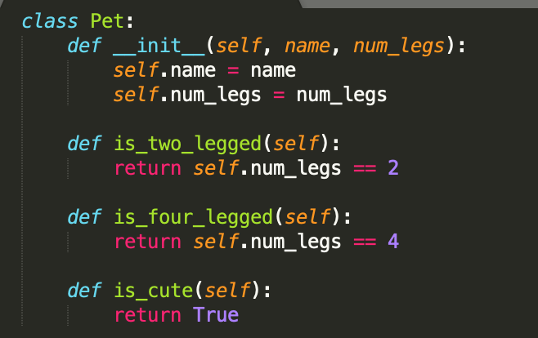
Pet class (Parent)
Our Pet class comes with an __init__() function and three other functions.

Slide 10
Pet class (Parent)
We can write child classes for specific types of pets! (Dogs, cats, etc).

Slide 11
Pet class (Parent)
Let’s write a class called Dog that inherits the Pet class, but also has some dog-specific functionality.

Slide 12
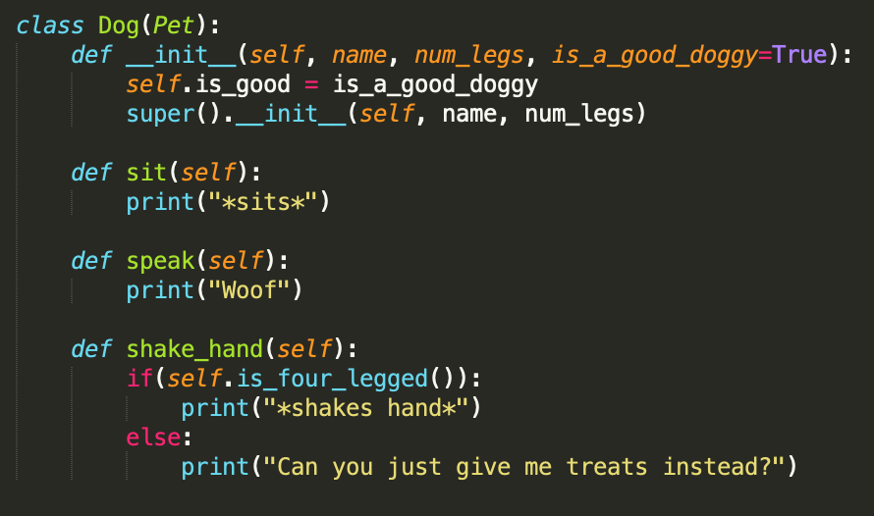
Dog class (Child)
Great! So here’s what our classes look like.

Slide 13
Dog class (Child)
The class on the left is our original Pet class. The class on the right is our Dog class, which inherits the Pet class.

Slide 14
Dog class (Child)
Notice that in our Dog class, our __init__() function takes on a few more parameters than the Pet class’s init function. This is okay! We can simply initialize our Dog-specific properties (namely, self.is_good), and then we can initialize the properties that all Pets would have (namely, num_legs and name).

Slide 15
Dog class (Child)
Notice also that in our Dog class, we can call functions from our Pet class. More specifically, in the shake_hand() function, we call the Pet class’s is_four_legged() function. Dogs with fewer than four legs (like mine!) have a hard time shaking hands, so it’s good that we can call our Pet class’s functions as helpers for our Dog class’s functions.

Slide 16
Using our Examples

Slide 17
# Let’s create a new Pet. We don’t know if this pet is a dog, cat, unicorn, or anything in between. All we know is that this pet has four legs and is named “Firestar”.
>>> import Dog, Pet
>>> firestar = Pet(“Firestar”, 4)
>>> firestar.is_two_legged()
False
>>> firestar.is_four_legged()
True
>>> firestar.is_cute()
True
>>>firestar.sit()
AttributeError: ‘Pet’ object has no attribute ‘sit’

Slide 18
# Let’s create a Dog now. This Dog is named Floof.
>>> import Dog, Pet
>>> floof = Dog(“Floof”, 4)
>>> floof.is_two_legged()
False
>>> floof.is_four_legged()
True
>>> floof.is_cute()
True
>>> floof.sit()
*sits*
>>> floof.speak()
Woof
>>> floof.shake_hand()
*shakes hand*

Slide 19
# Finally, let’s create an object to represent my dog, Oreo. He has three legs, so we have to specify that.
>>> oreo = Dog(“Oreo”, 3)
>>> oreo.is_two_legged(), oreo.is_four_legged()
(False, False)
>>> oreo.is_cute()
True
>>> oreo.sit()
*sits*
>>> oreo.speak()
Woof
>>>oreo.shake_hand()
Can you just give me treats instead?

