Slide 1
GraphQL
A na co to komu??

Slide 2
GraphQL – cold hard facts
GraphQL was developed internally by Facebook in 2012 before being publicly released in 2015. On 7 November 2018, the GraphQL project was moved from Facebook to the newly-established GraphQL Foundation, hosted by the non-profit Linux Foundation.
GraphQL servers are available for multiple languages, including Haskell, JavaScript, Perl, Python, Ruby, Java, C#, Scala, Go, Elixir, Erlang, PHP, R, and Clojure.
https://en.wikipedia.org/wiki/GraphQL
Notes:
1 grudnia 2018 - relese graphql dla springa

Slide 3

GraphQL – cold hard facts
Who’s using GraphQL?
Facebook's mobile apps have been powered by GraphQL since 2012.
More GraphQL users can be found on https://graphql.org/users/

Slide 4
What is GraphQL
GraphQL is an open-source data query and manipulation language for APIs, and a runtime for fulfilling queries with existing data. Query language for API

Slide 5
Ask for what you need, get exactly that
Send a GraphQL query to your API and get exactly what you need, nothing more and nothing less.
No over/under fetch issue.
GraphQL queries always return predictable results.
Notes:
Główna cecha, zapytaj o konkretne dane i otrzymaj tylko te dane.

Slide 6
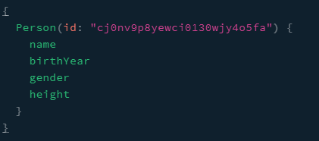
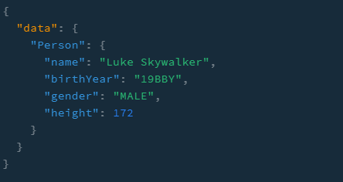
Ask for what you need, get exactly that

Slide 7
Get many resources in a single request
GraphQL queries access not just the properties of one resource but also smoothly follow references between them.
While typical REST APIs require loading from multiple URLs, GraphQL APIs get all the data your app needs in a single request.
Apps using GraphQL can be quick even on slow mobile network connections.

Slide 8
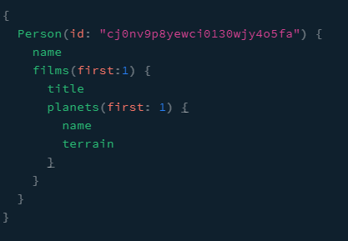
Ask for what you need, get exactly that
Possibility to fetch nested structures

Slide 9
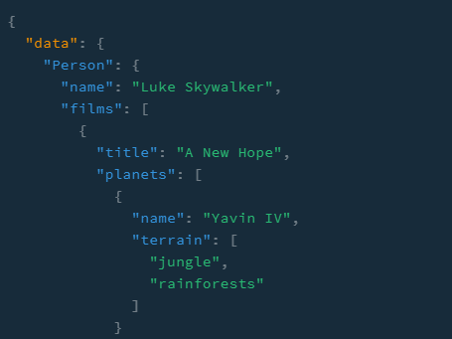
Ask for what you need, get exactly that
Possibility to fetch nested structures

Slide 10
Describe what’s possible with a type system
GraphQL APIs are organized in terms of types and fields, not endpoints.
GraphQL uses types to ensure Apps only ask for what’s possible and provide clear and helpful error messages.

Slide 11
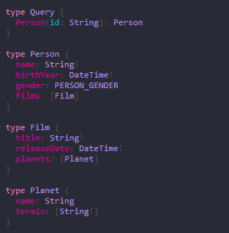
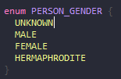
Describe what’s possible with a type system

Slide 12
Move faster with powerful developer tools
Know exactly what data you can request from your API without leaving your editor, highlight potential issues before sending a query, and take advantage of improved code intelligence. GraphQL makes it easy to build powerful tools like GraphiQL by leveraging your API’s type system.
https://graphql.org/

Slide 13
Introspection
Consumer need only information about one endpoint.
No additional documentation

Slide 14
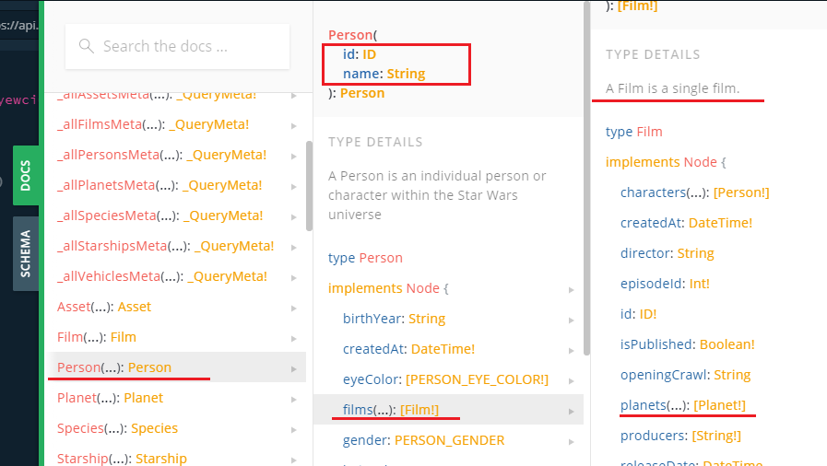
Introspection

Slide 15
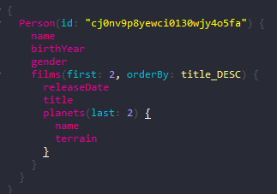
REST vs GraphQL

Slide 16
REST vs GraphQL
/person/1
/film/1
/film/1/planet
/film/2
/film/2/planet
Expand:
/person/1?expand=films
/person/1?expand=films(title,planets,id)
Custom endpoints:
/person/1/with_films_and_planets
/person/1/with_films_v2_and_planets
/person/1/with_films_v2_and_planets_without_smth
/person/1/mobile_device

Slide 17
Some links
https://graphql.org/
https://www.graphql-java.com/documentation/
GraphQL public servers:
https://graphql.org/swapi-graphql
https://api.graphcms.com/simple/v1/swapi
YouTube
Moving beyond REST: GraphQL and Java & Spring by Pratik Patel @ Spring I/O 2019
GraphQL in Java World, let's go for a dive - Vladimir Dejanović @Devoxx 2019
GitHub
GraphQL projects
GraphQL pet clinic
SPQR - GraphQL library for rapid development of GraphQL APIs in Java.

Slide 18
Show us some code samples ☺

Slide 19
Questions ???

Slide 20
Thank you….

