Slide 1
Patent war dynamics 5.4.2024
Valo Hallman, Jenny-Rosa Mattila, Stanislav Andreev

Slide 2
Recap from last time
Data visualization
Data filtering (merging duplicates etc)
Constructing networks
Defining main clusters of companies participating in patent wars (pharma companies and electronics)
Analysis of network size dynamic in 20 years

Slide 3
Next steps for the project
Biggest players by year
In the last weeks we defined possible next steps for the project and discussed possible broader goals
Backbone extraction
Looking into interesting wars between 2 companies
Network Stats by years -> finding trends
Better visualization (possibly using gephi?)
How is the pharma sector different? (possibly more aggressive?)

Slide 4
Themes we decided to pursue for this meeting
Network Stats by years -> finding trends?
Looking into interesting wars between 2 companies
Biggest players by year
Better visualization (possibly using gephi?)

Slide 5
Network Stats by years

Slide 6
Network stats by years
Filtered data was used, but same calculations could be done for the raw data to compare the results
The nodes are the companies/individuals and edges are cases between them and weights are the number of lawsuits
Number of nodes, edge density, average clustering, average degree, average weight, degree distribution and weight distribution were calculated for the network for each year

Slide 7
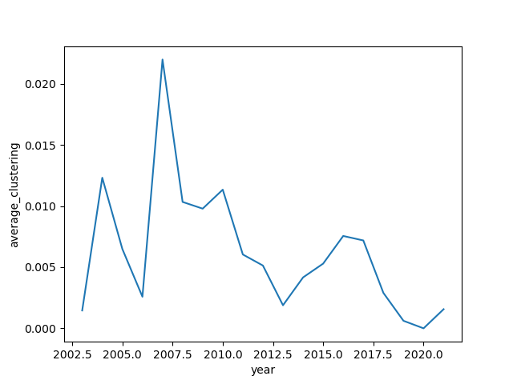
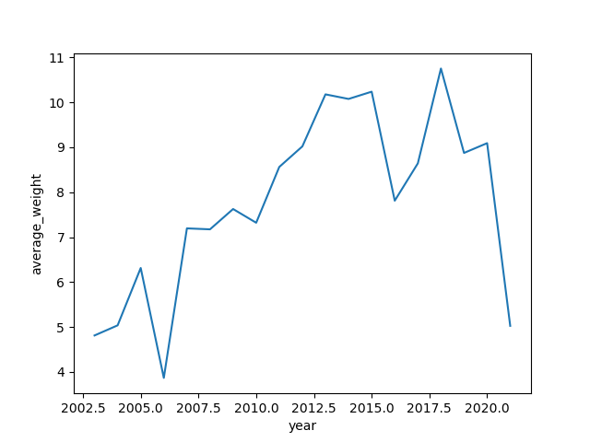
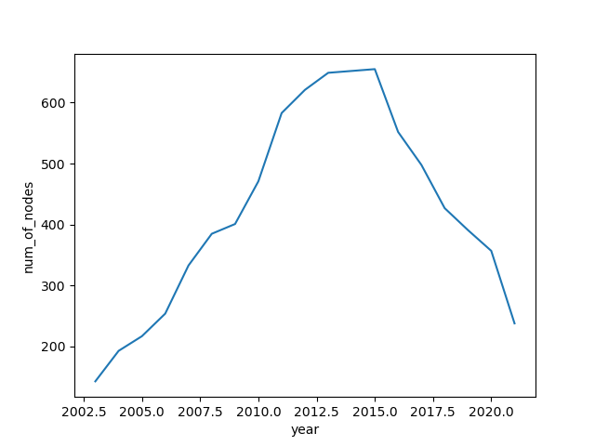
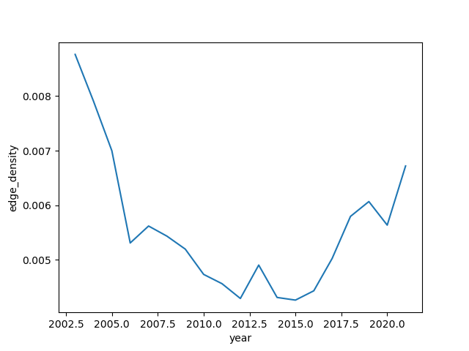
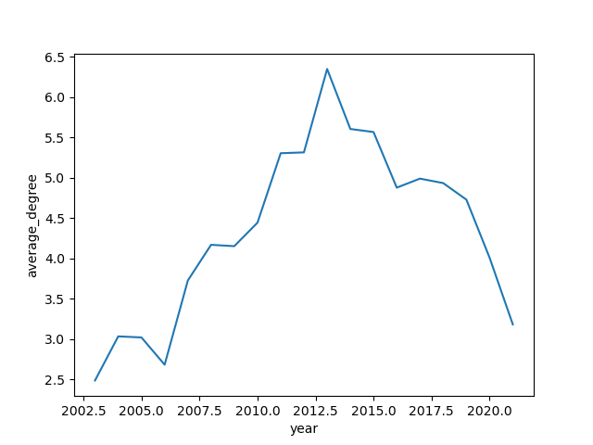

Slide 8
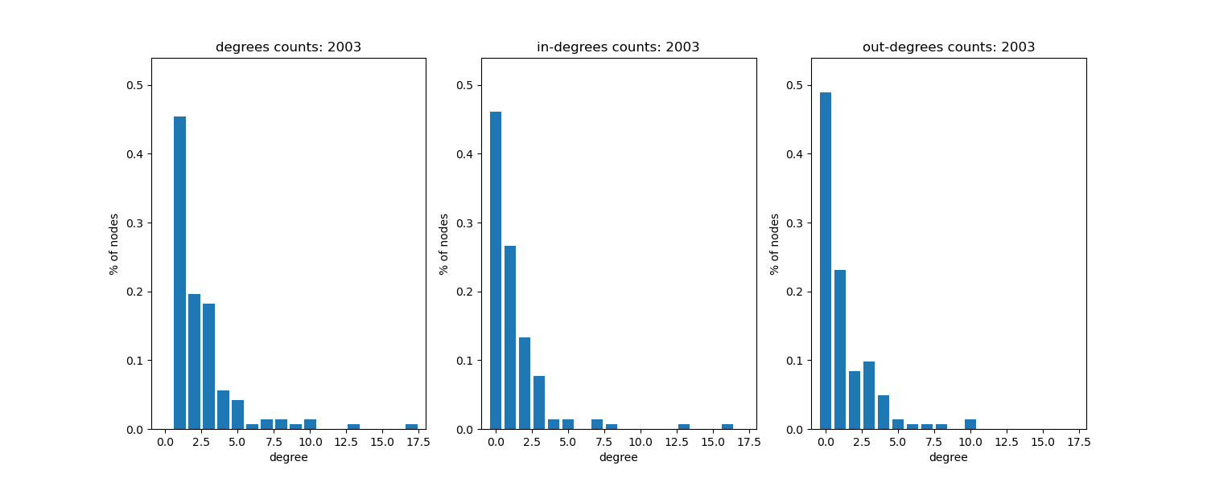
Degree and weight distributions
In-degree = edges going to the node -> someone sues them
Out-degree = edges coming out of node -> they sue someone
The 3 plots within a year have the same axis-scales, but the scales differ for different years

Slide 9
Degree distribution

Slide 10
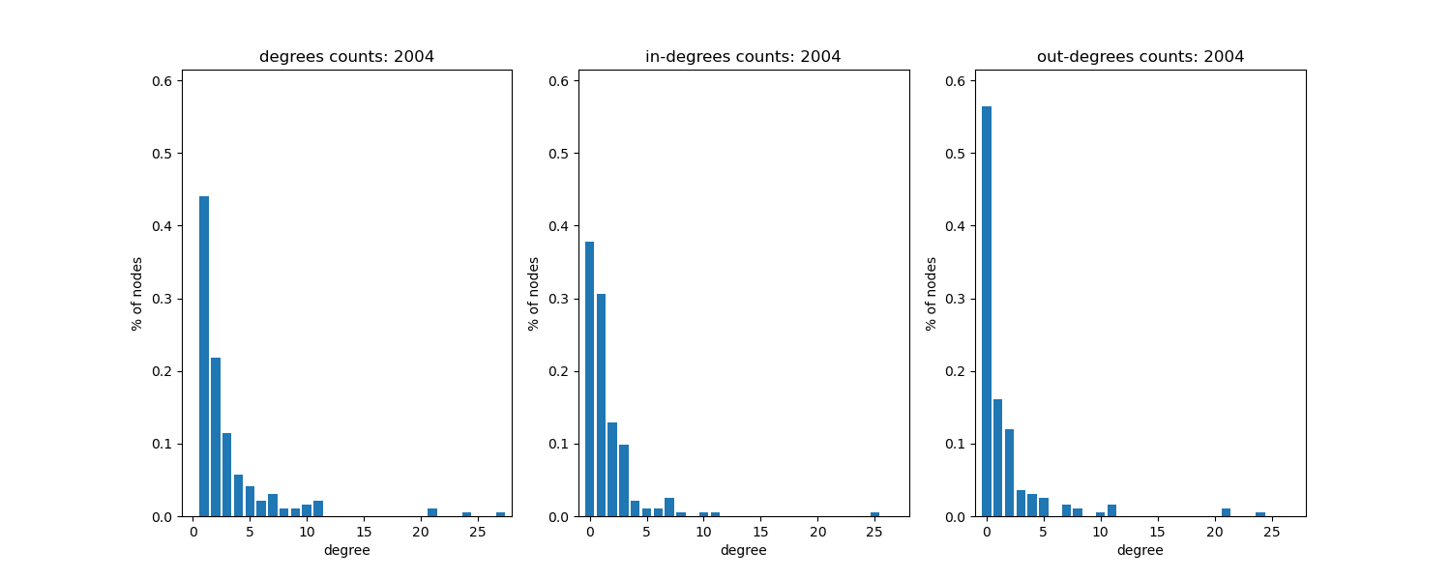
Degree distribution

Slide 11
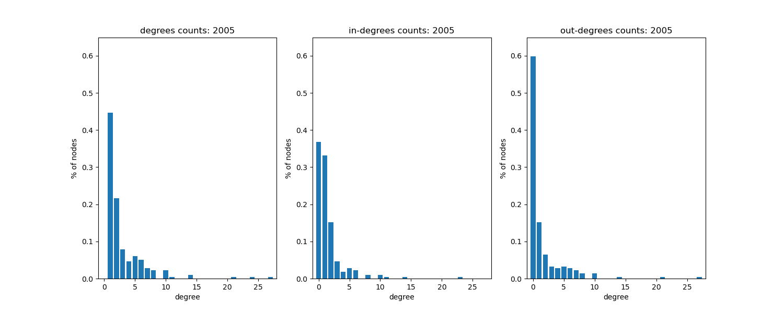
Degree distribution

Slide 12
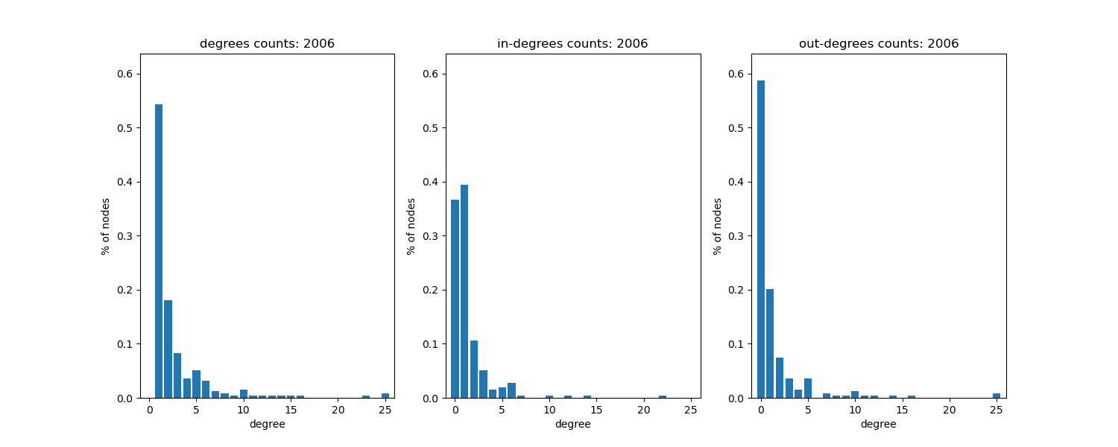
Degree distribution

Slide 13
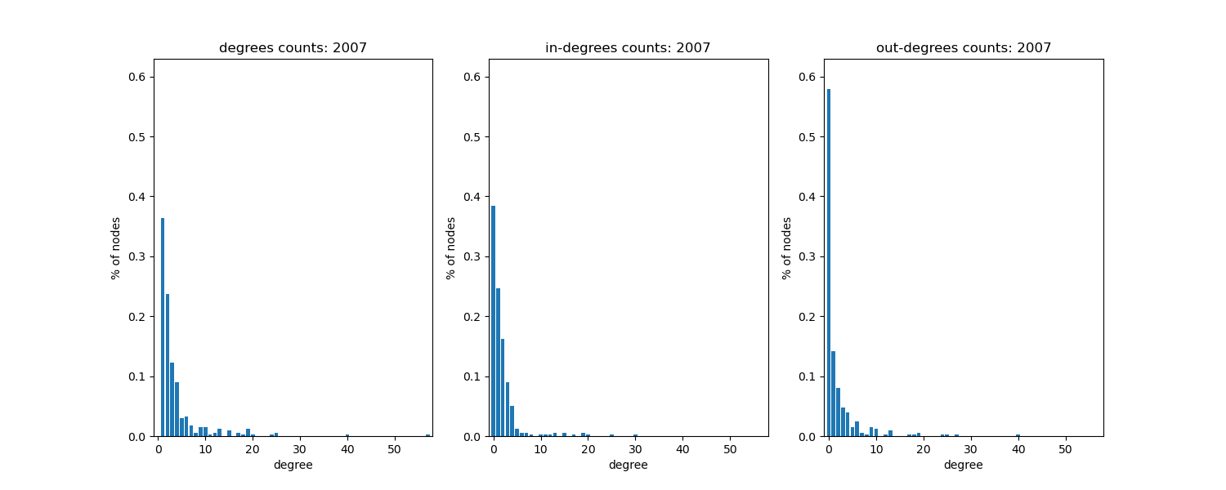
Degree distribution

Slide 14
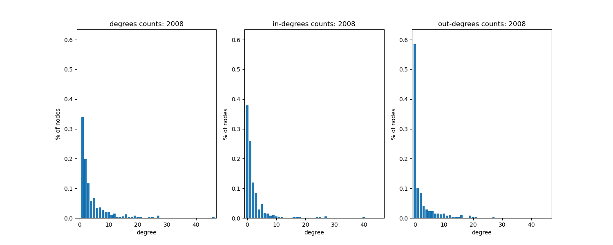
Degree distribution

Slide 15
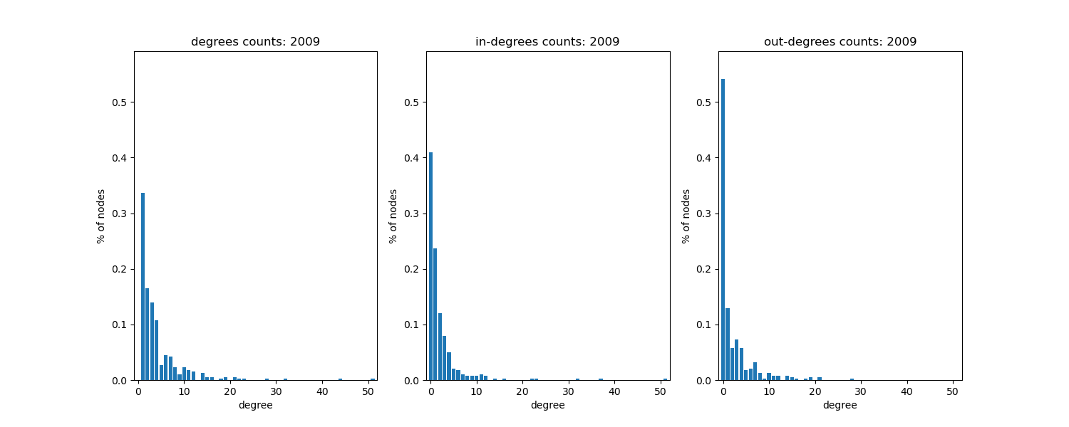
Degree distribution

Slide 16
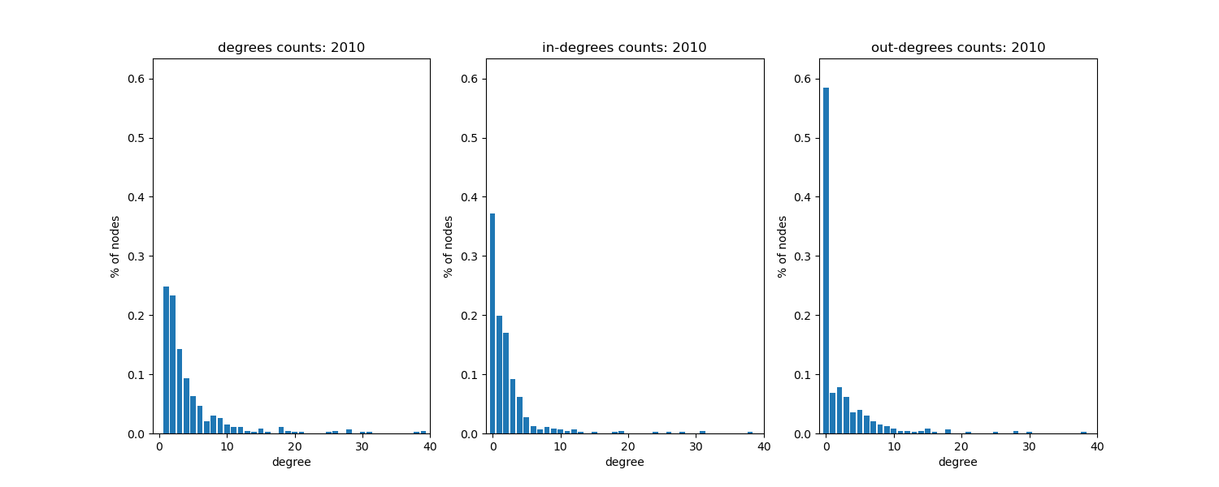
Degree distribution

Slide 17
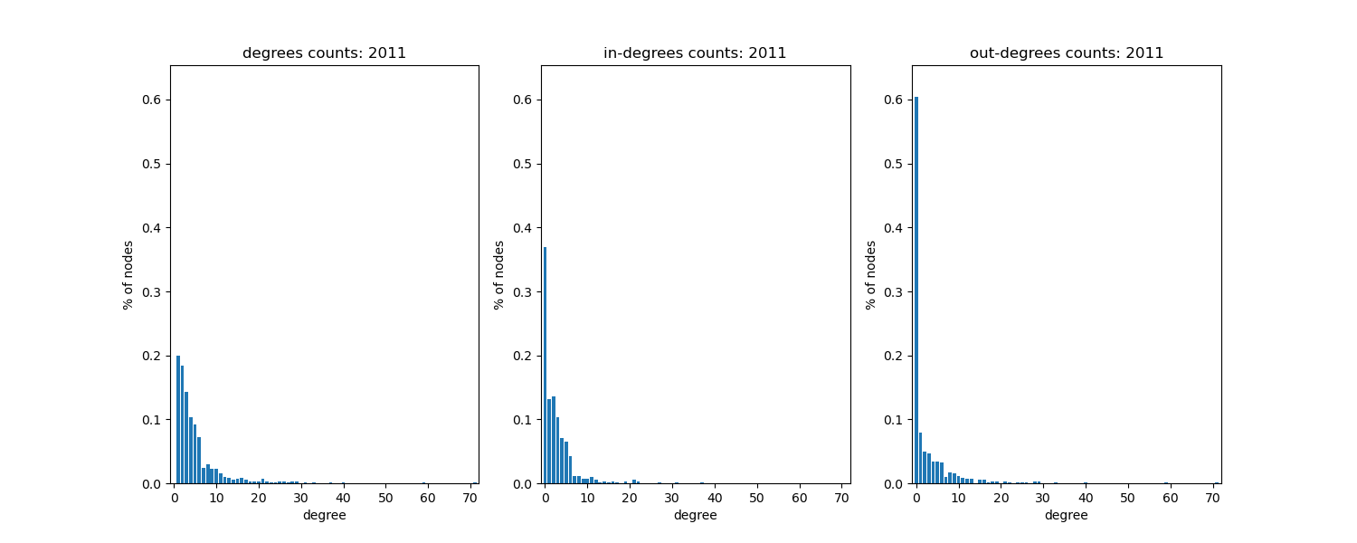
Degree distribution

Slide 18
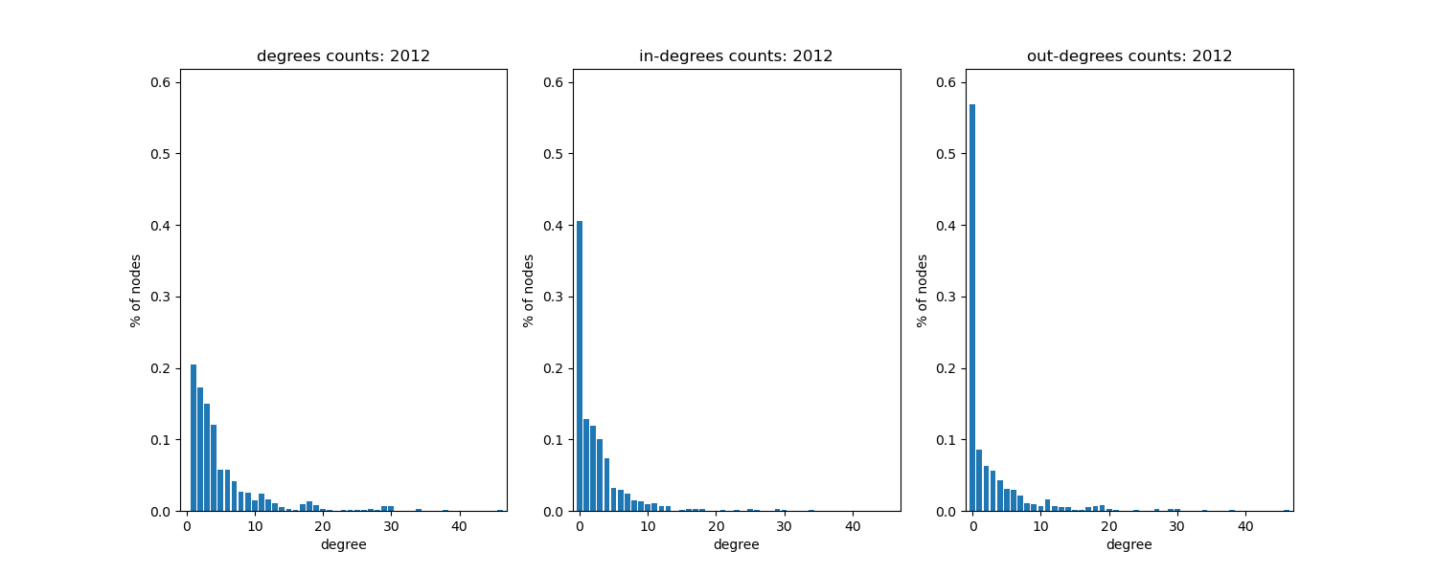
Degree distribution

Slide 19
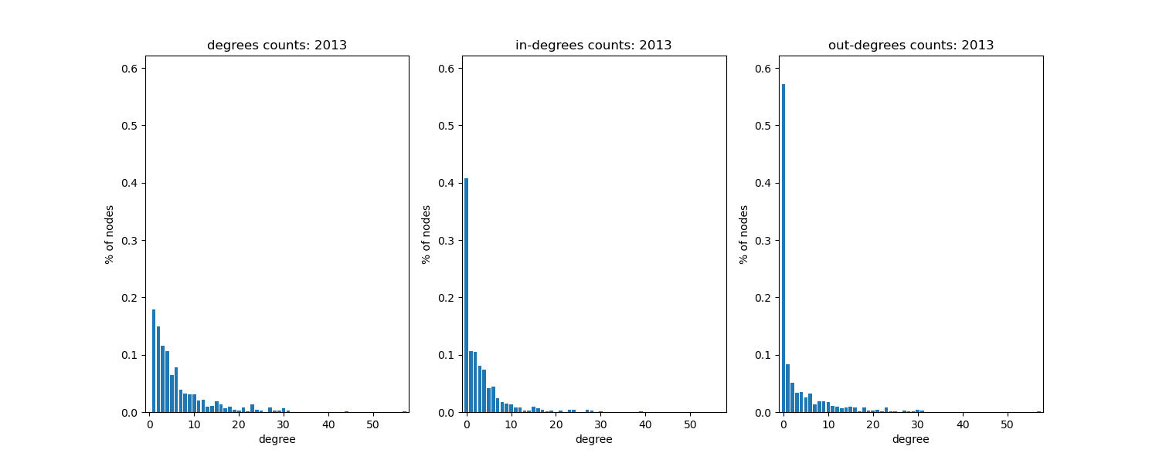
Degree distribution

Slide 20
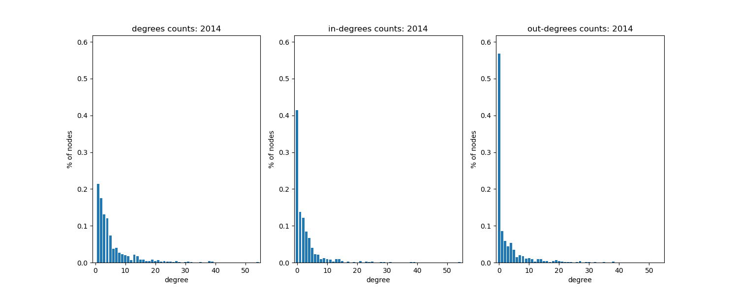
Degree distribution

Slide 21
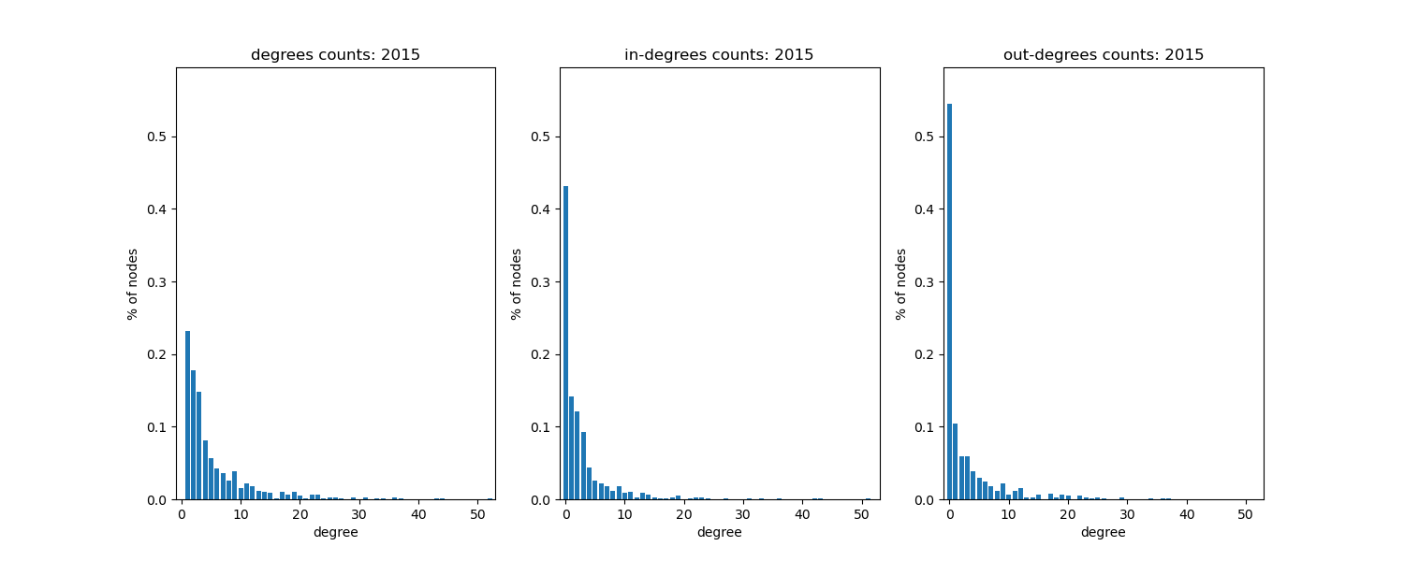
Degree distribution

Slide 22
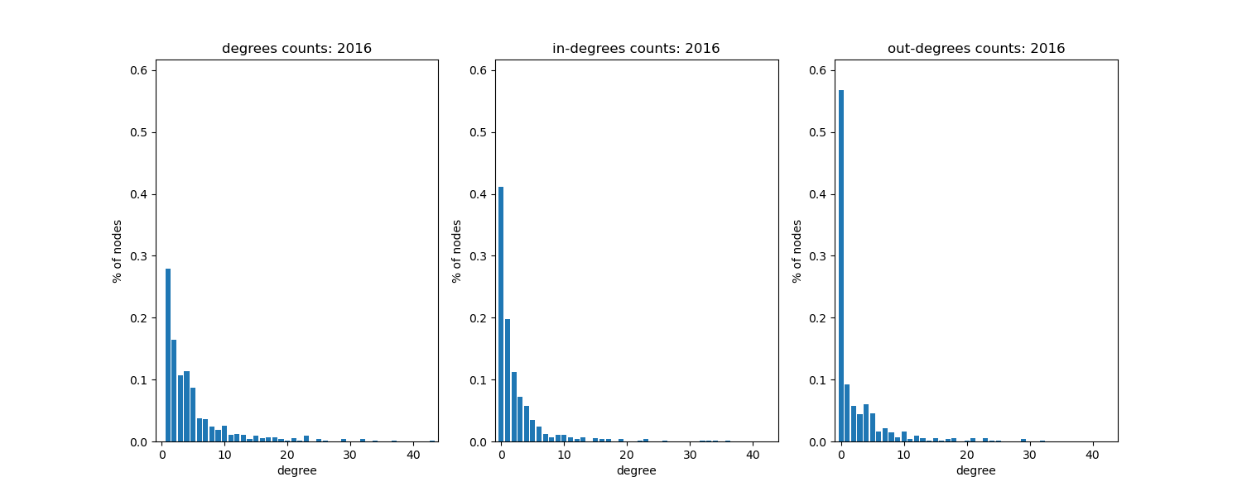
Degree distribution

Slide 23
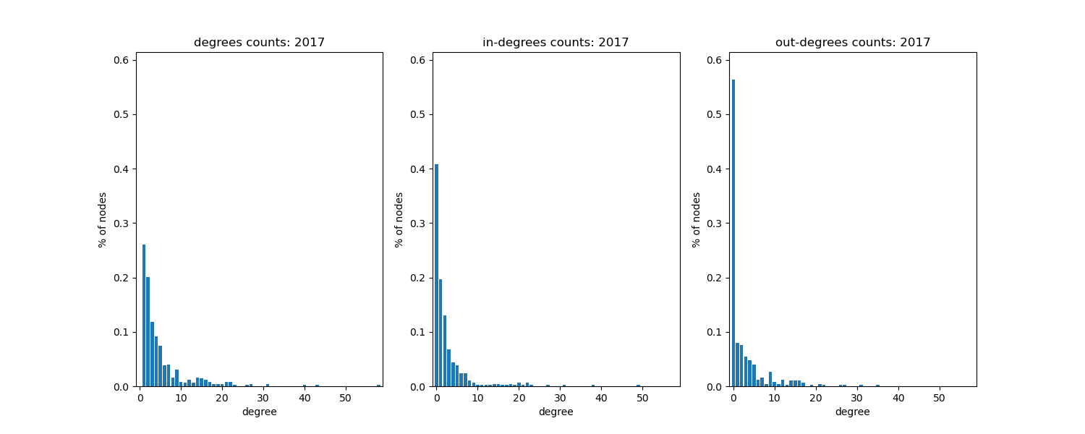
Degree distribution

Slide 24
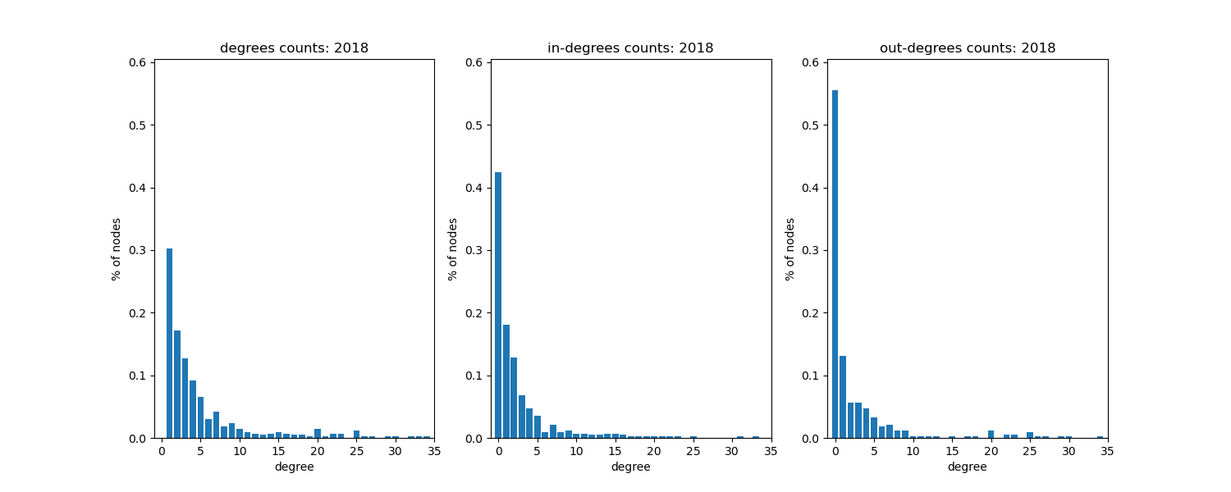
Degree distribution

Slide 25
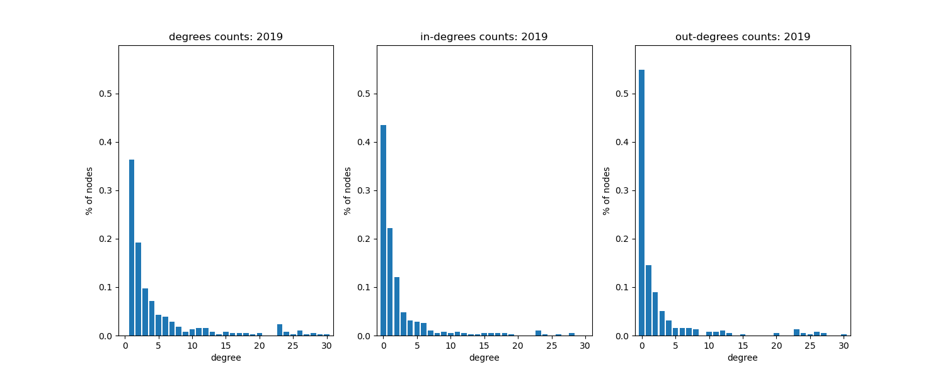
Degree distribution

Slide 26
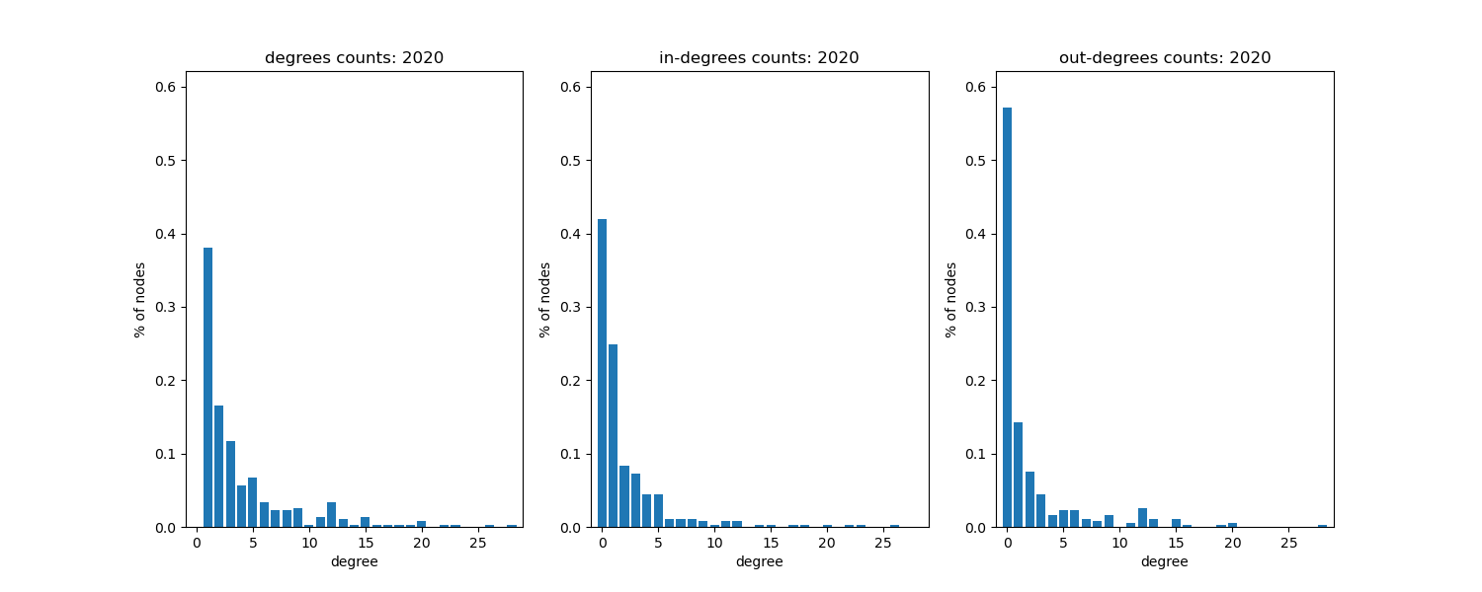
Degree distribution

Slide 27
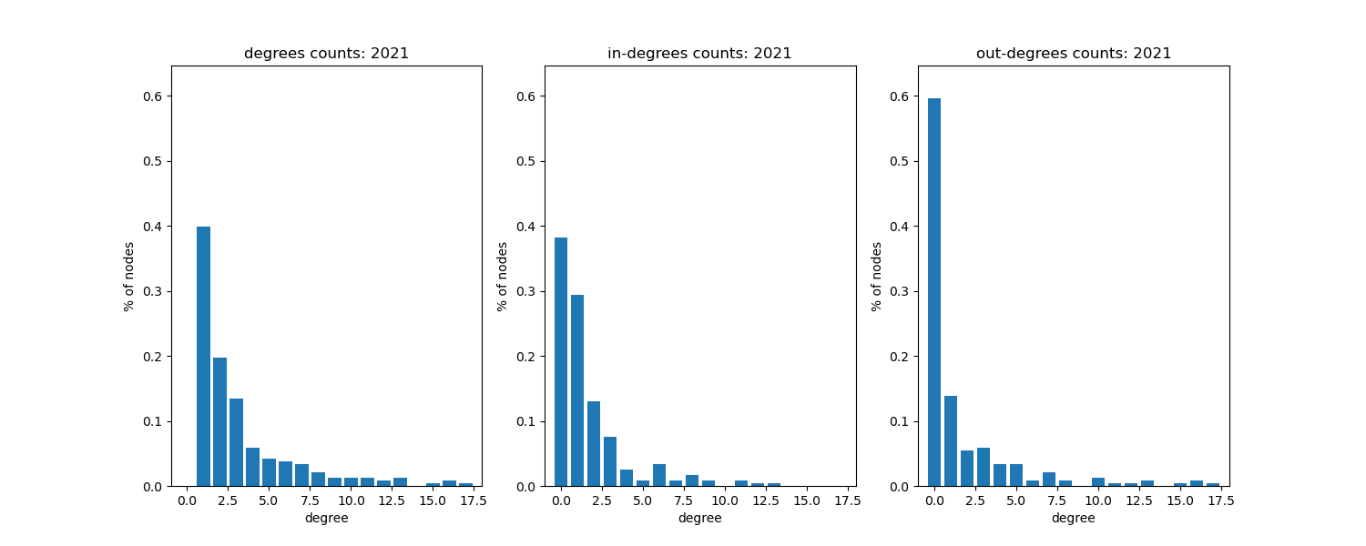
Degree distribution

Slide 28
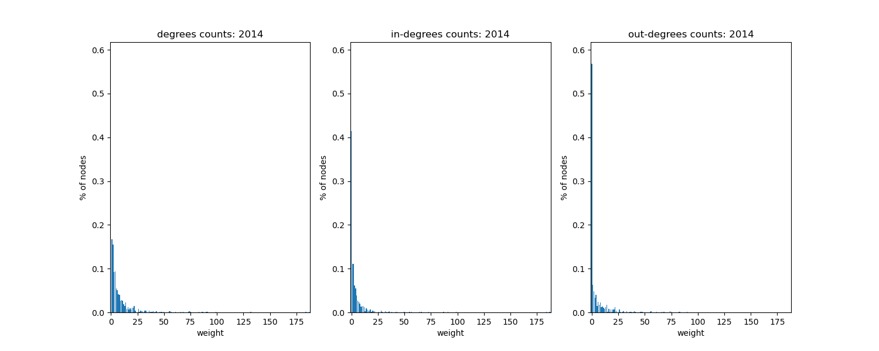
Weight distribution
example year, without replotting with new a new scale the plots can’t really be inspected
there did not seem to be any clear trend on yearly variation (similar to the degree distrubutios)

Slide 29
Conclusions and some possible next steps and questions
The network is largest (=most players and most cases) around 2012, why?
The overall shape of the degree and weight distributions are quite similar through the years
Weight distributions have few very large values, and they vary a lot yearly
There are more nodes with 0 out-degrees compared to nodes with 0 in-degrees
How do average/distributions for weights and degrees differ?
The stats could be compared to some random graphs, but the type of random graph should be chosen according to goals
Degree and weight distributions could be plotted with different scale
Network could be reconstructed bit differently (for example around the patents)
More calculations could be done for specific nodes
Are there other statistics that could be calculated?

Slide 30
Biggest players by years

Slide 31
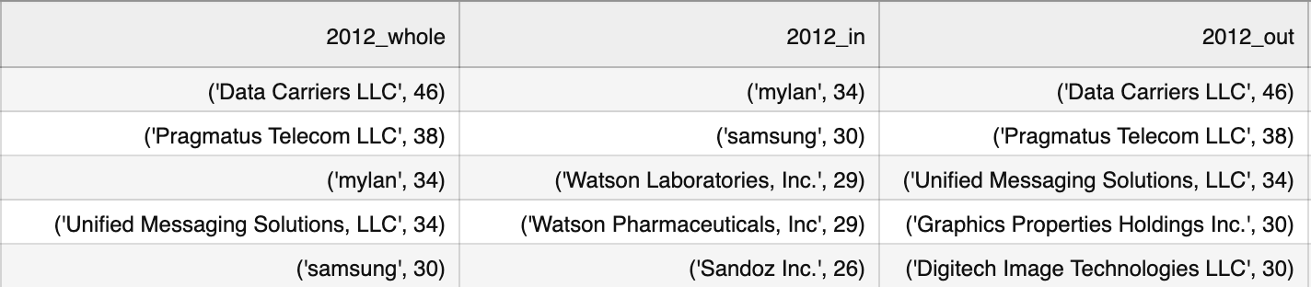
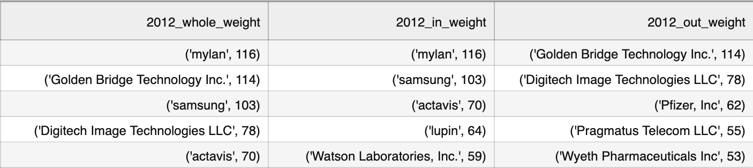
The top 5 nodes with highest degrees, in-degrees and out-degrees (upper table) was calculated and same for weights instead of degrees (lower table)
I couldn’t come up with a good way to visualize this yet, so i’ll not present the whole tables, but here are the tables of the year 2012:

Slide 32
Possible questions and next steps
Similar calculation could be done for the patents
Are the players in the in and out columns same?
Do the same names stay on top through the years?
What are the differences between the degree and weight tables?
Is the degree/weight mostly from a single or multiple patents?
Could high weight and low degree mean there is a “war” between some players?

Slide 33
Interesting specific wars

Slide 34
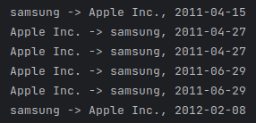
Single wars
There was famous battle between Apple and Samsung in 2011
The battle has its own wikipedia page
Huge battle, (1.049B$ resolution), but our data doesn’t show that
Here are all lawsuits between apple and samsung (and their daughter companies)

Slide 35
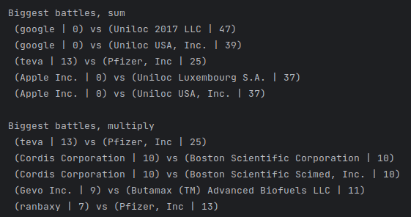
Big wars (?)
Let’s look at biggest battles in terms of number of lawsuits
Lot of one-sided battles
Interesting ones:
teva vs Pfizer
Cordis vs Boston

Slide 36
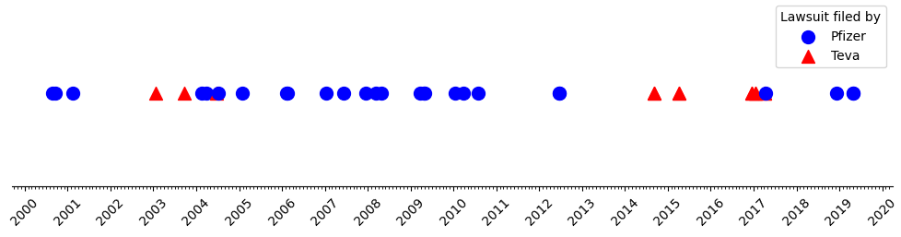
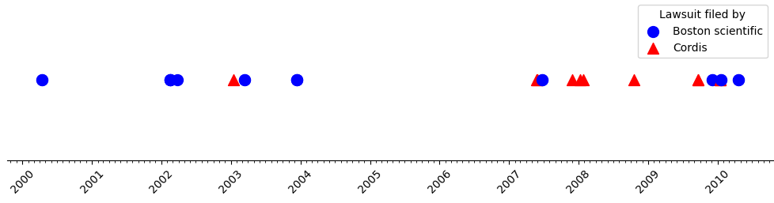
War timelines

Slide 37
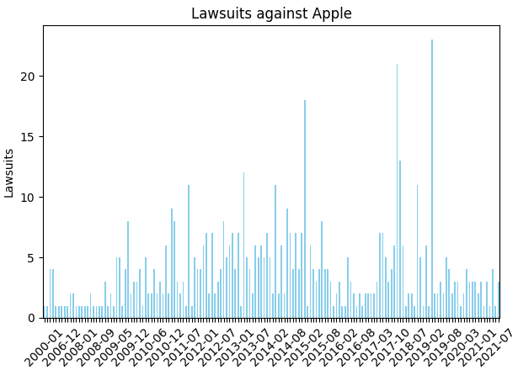
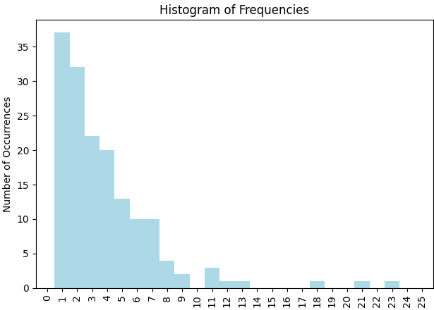
Lawsuits against Apple

Slide 38
One sided battles
Odd companies in the data, such as eDekka
Company does not have a logo (as far as we know)
BBC article about patent trolling
Unilock also alleged patent troll

Slide 39
Notes, remove before presentation
This section was about wars on scale of 2 companies. It does not analyse networks, but rather the underlying phenomenon.
conclusions:
Number of lawsuits does not necessarily correspond to the size of the war
It does not seem like there is some pattern in the timelines (this could change)
some of the “one sided battles” might be due to “patent trolling”,
other than that, I thought one sided battles are boring

Slide 40
Possible next steps and questions for the project
Looking more into the biggest players by year
Better visualization (possibly using gephi?)
Computing the stats for differently constructed network
Concentrating on a specific player(s) or patent(s) and their timeline
Finding more interesting wars
Backbone extraction
Previous research
How does the size of a company affect the behaviour?
Working with the stats for each year
How is the pharma sector different? (possibly more aggressive?)
Coming up with more possible research questions
How does the age of a patent affect the behaviour?
Is there a correlation between in and out degrees/weights?
High degree vs high weight

