Slide 1
Patent war dynamics 26.4.2024
Valo Hallman, Jenny-Rosa Mattila, Stanislav Andreev

Slide 2
Some trivia about patent trolls
“Does not use the patent for manufacturing / services”
Patent trolling not so much of a thing in europe, as loser pays for lawyers
In USA:
2006: 600 patent trolling lawsuits (these not based on our data)
2011: Business entities incurred $29 Billion in costs due to patent trolling
2012: 2900 patent trolling lawsuits
2012: Supreme court adds possibility for inter party review of the validity of the lawsuit
2013: Obama mentions Patent trolling as a major problem in his speech
2014: Supreme court makes it easier to award costs for frivolous patent lawsuits
2017: Supreme court rules that the lawsuits must be heard in the state of the defendant
2020s: Most patent lawsuits are still “trolling lawsuits”

Slide 3
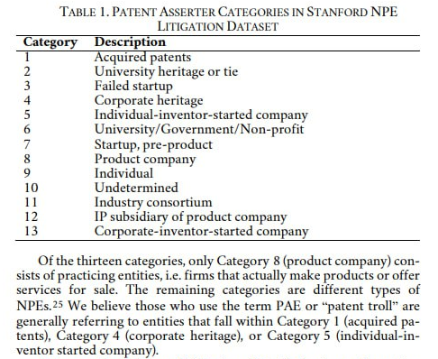
Trolls in our data
Other names for patent trolls (PAC, NPE, …)
Our data has a column telling if lawsuit is a NPE lawsuit, most are
Let’s filter the data:
Full network
Only trolling lawsuit edges
Only other NPE lawsuits edges
Only non-NPE lawsuits edges

Slide 4
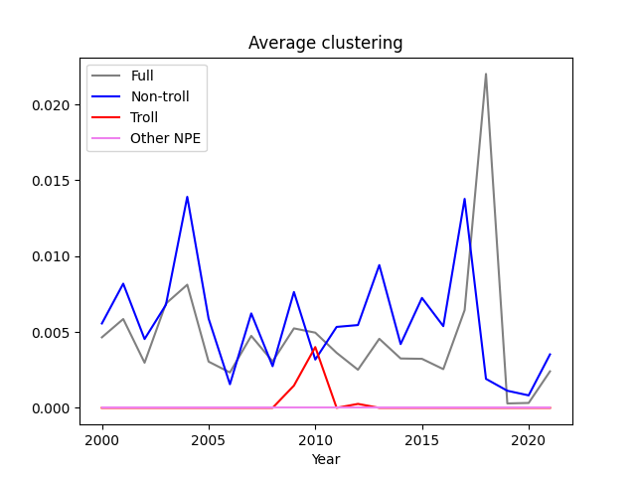

Slide 5
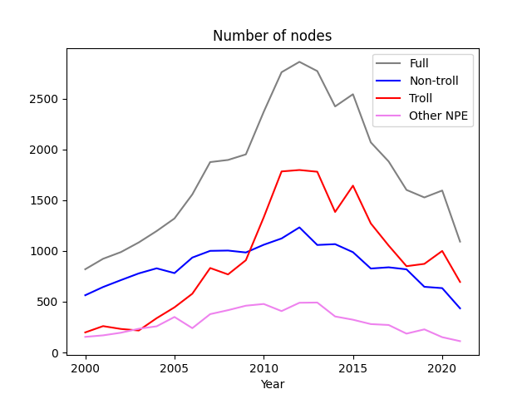

Slide 6
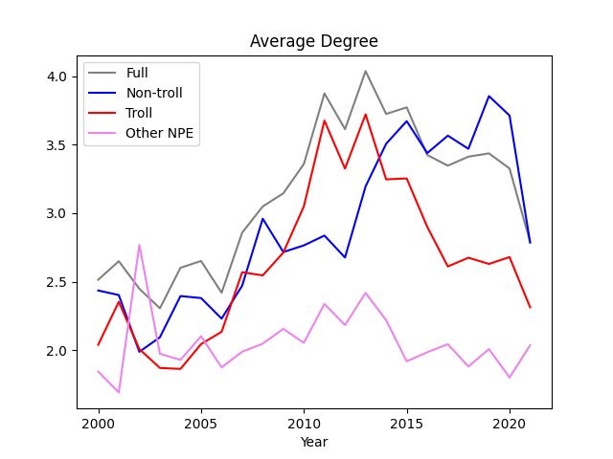

Slide 7
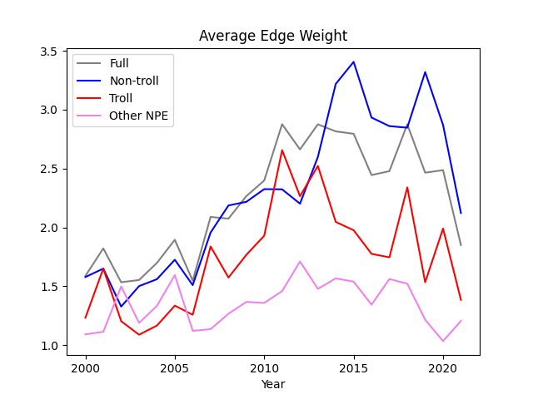

Slide 8
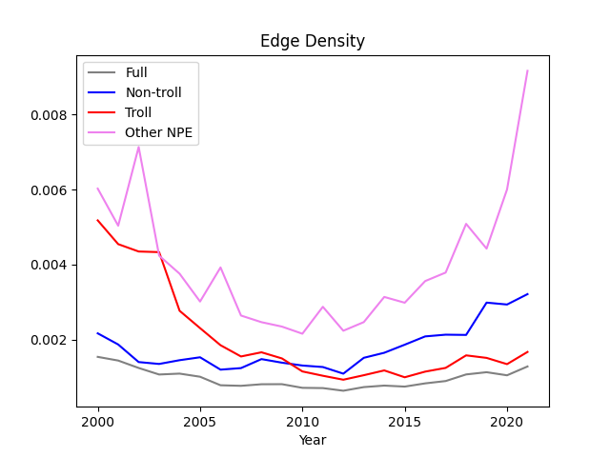

Slide 10
Conclusions
Patent trolls rarely sue other patent trolls
Filtering them out makes the network more connected
The peak of activity around 2012 does not seem to be related to trolling behavior, but rather it is an overall trend

Slide 11
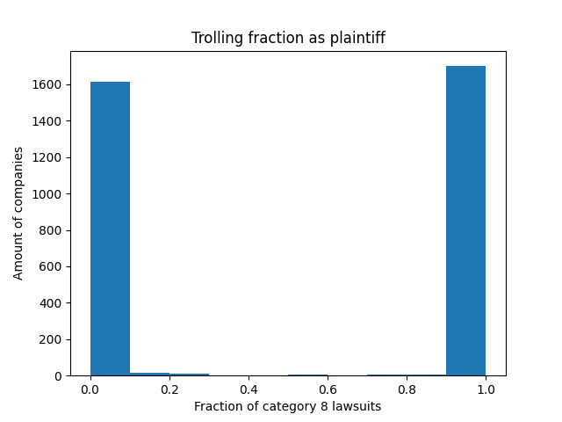
Is being troll binary
Yes, pretty much
As is being an NPE

Slide 12
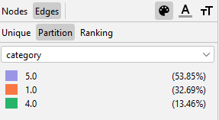

Patent troll activity visualization
Visualization tool: Gephi
Goals: observe clusters, monitor dynamics, find patterns
Variables to control:
Troll category
In-degree (number
of cases)
Company clusters

Slide 13
Patent troll activity visualization
The original idea was to have dynamic visualization based on time intervals.
However we were not able to produce reasonable dynamic visualization and focused on visualization of 5 4-years blocks (2000-2004-...-2022).
To have distinguished clusters we use Yifan Hu layout
It is a force-directed layout algorithm used for graph visualization. It aims to position nodes in a graph such that nodes connected by edges are close together while nodes without direct connections are pushed apart.

Slide 14
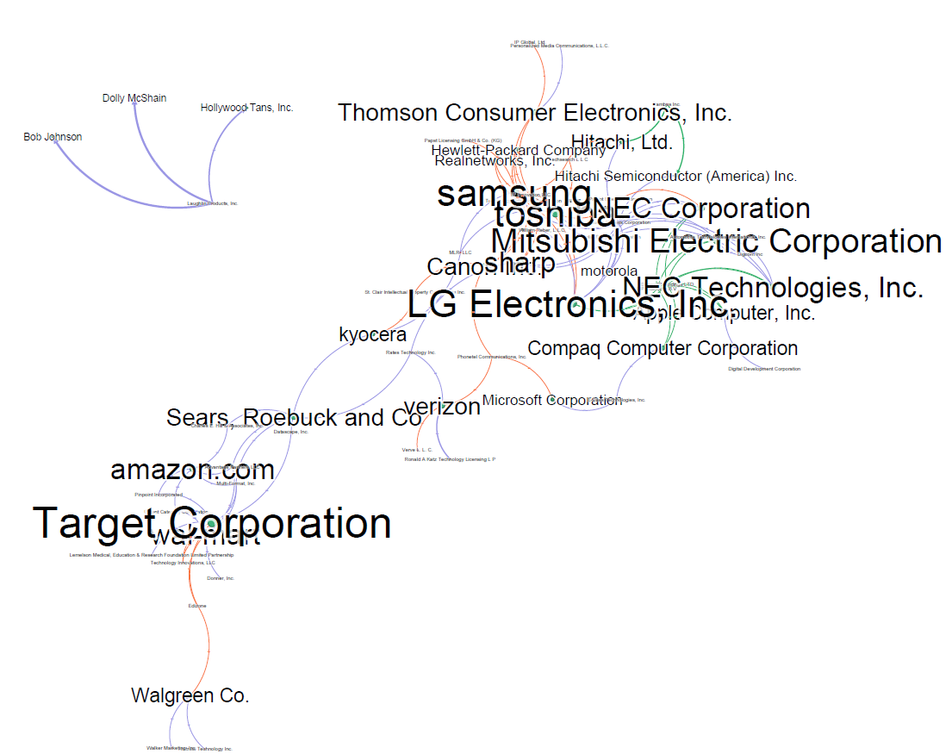
Patent trolls 2000-2004
3 clusters can be identified: distribution, electronics, movies
interesting enough there is no pharma clusters we reported before
different patent troll categories present in different clusters

Slide 15
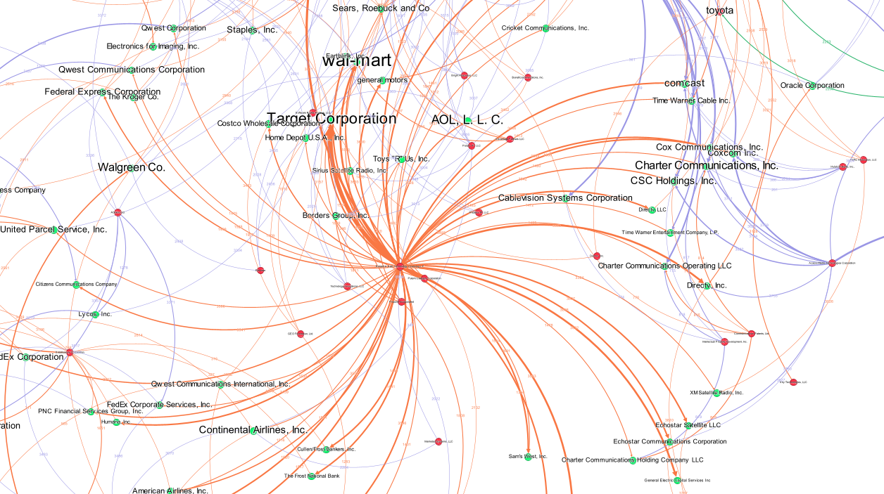
Patent trolls 2004-2008
Volume increased dramatically
More clusters (telecom, transportation, IT etc.)
Some trolls started to behave as multi-disciplinary players
more visualization: pdf or gephi

Slide 16
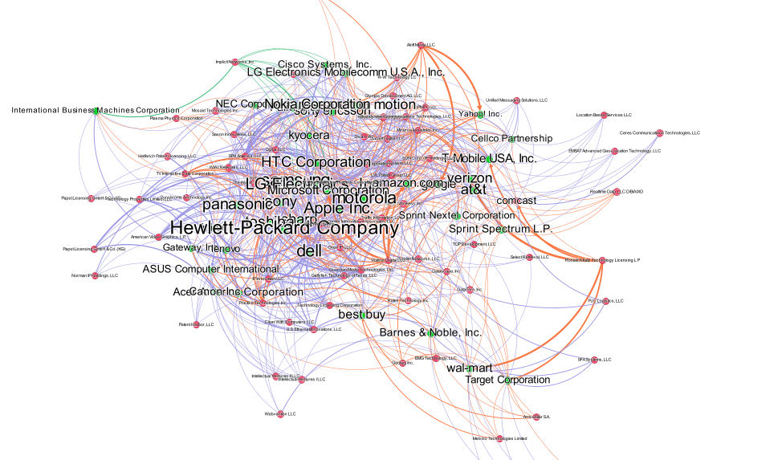
Patent trolls 2008-2022
Visual analysis makes sense only when special filtering is applied (like min edge degree etc.)
Many multi-disciplinary trolls
Still no pharma

Slide 17
trolling timelines
todo: research
actually not that interesting

Slide 18
Backbone extraction
Select most important nodes based on one of following:
sum of connection weights
degree
And then take the mst

Slide 19
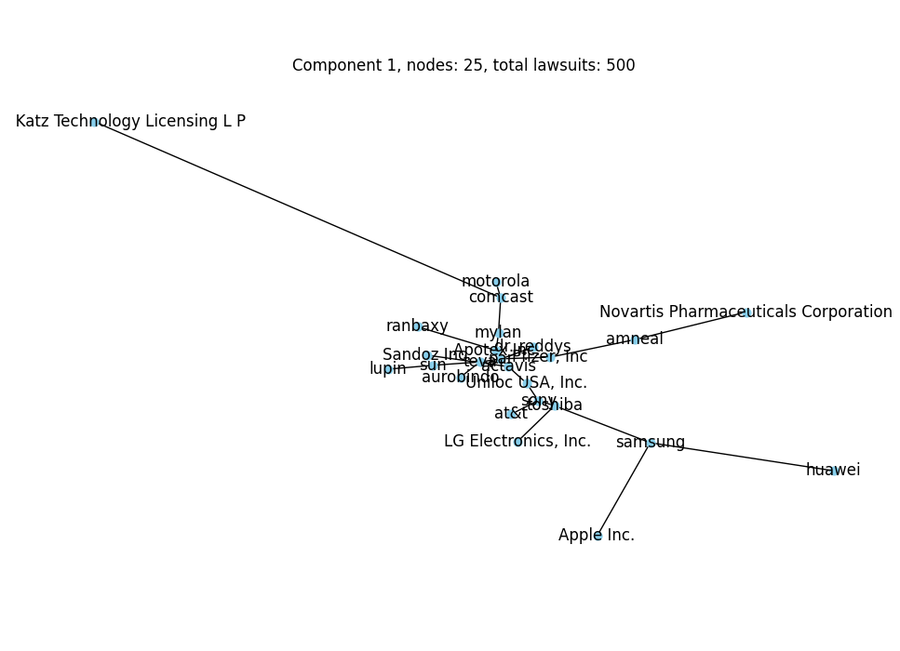
Nodes with the
most lawsuits
Creates only one
connected component

Slide 20
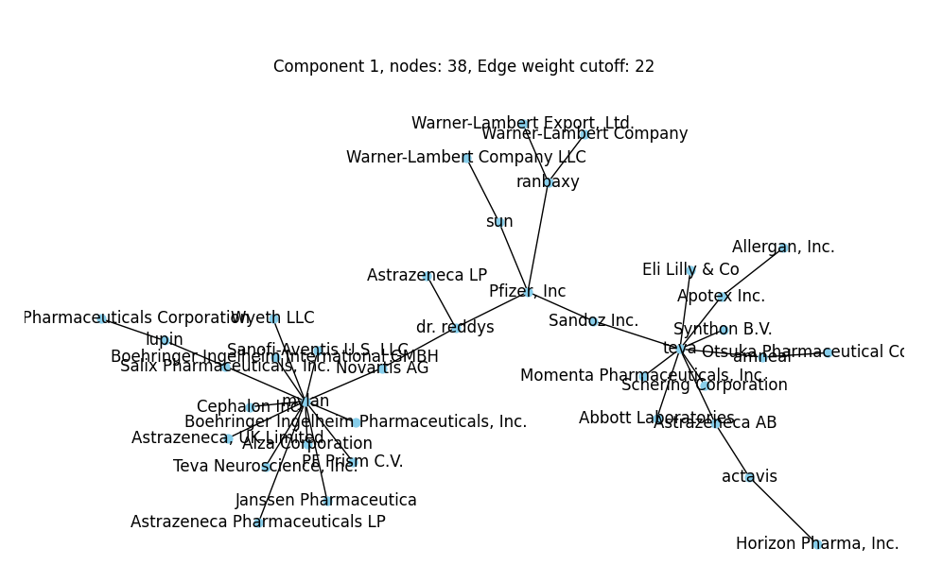
Nodes with highest total edge weight
Multiple connected components
1st: Pharma

Slide 21
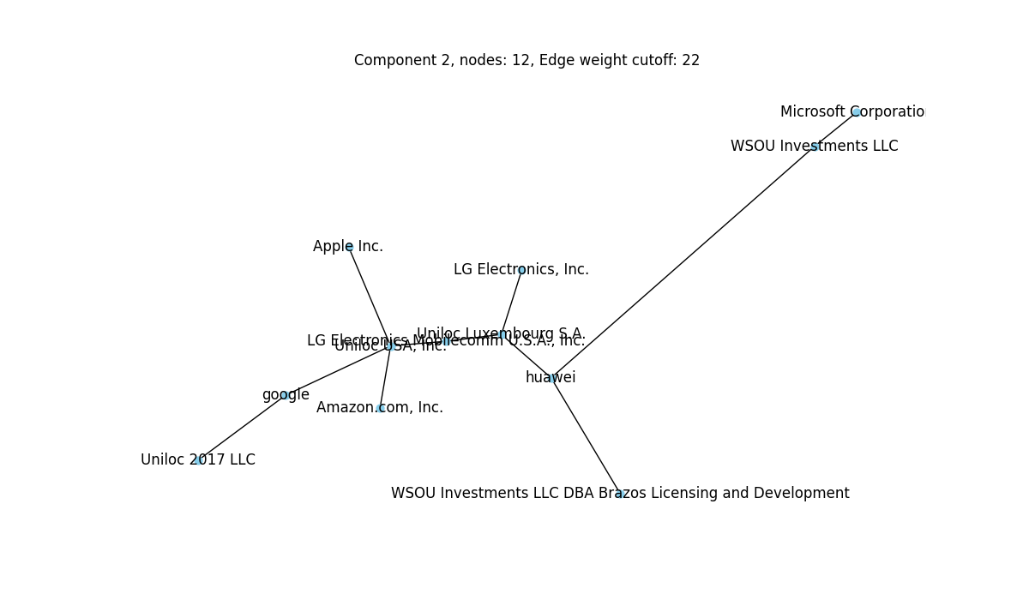
2nd: Tech

Slide 22
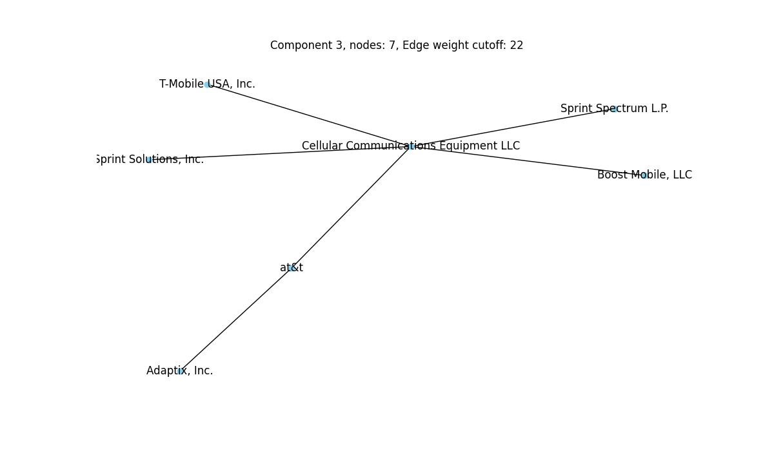
3rd: Communication

Slide 23
ideas
Todo: highlight trolls in backbone
prefilter cases based on category before backbone extraction

