Slide 1
IttBook
by
Stanislav Ivanov
Ivan Menov

Slide 2
Our social network website
Our back-end project focused on user interaction
Secured pages
Posts and real-time publishing comments system
Photos upload

Slide 3
Behind the scene
Technologies
Java Server Pages
JSTL, JDBC
AJAX
Web Services
Tools – Apache Maven, Tomcat 8.0

Slide 4
Design Patterns
MVC
Factory method
Data access object
Singleton

Slide 5
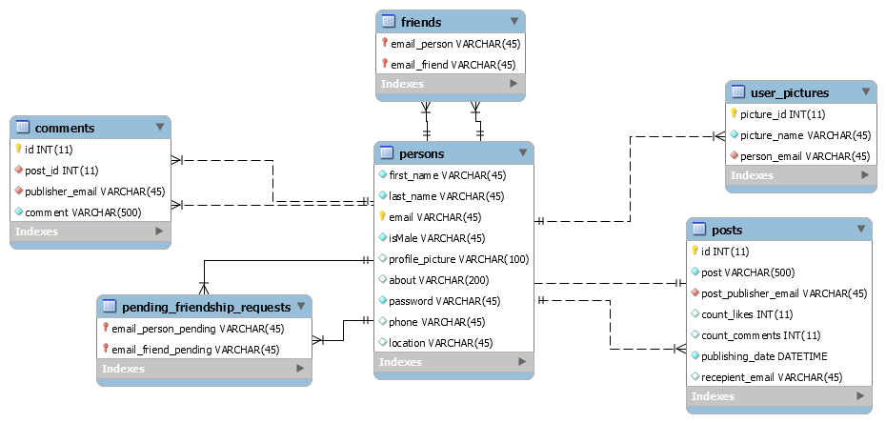
Database Model

Slide 6
Scenarios
Secured Login
Email, password check against database
Cache browser problem solved
Only certain pages are displayed for not logged user
Validated Register
Validation of user input
We keep our users data private
MD5 hashed passwords

Slide 7
Scenarios
Different Friends Feeds
Profile update
Our users can change their user profiles
Photos upload
They can add photos
Stored on the server
Different Access levels
Like button

Slide 8
Scenarios
Posting on different feeds
Real-time comments sharing system
Search
Session invalidation
Friendships
Add other users to your friendship list
Accept or Decline a friendship
Friendship list preview

Slide 9
Further development
Current Online users side bar
Picture liking
Interest groups

Slide 10
DEMO

