Slide 1
EJB
Enterprise Java Beans

Slide 2
Getting started
Web server
  Designed to serve HTTP content,
  Have HTTP response : sending back a HTML page (static HTML page, image, send a redirect, delegate the action to CGI, JSP, ASP, server-side JS)
Application server
  Expose business logic and processes,
  Other protocols as well
  Distributed components - remote invocation, distributed transactions
  Can include GUI, a web server, REST/JSON/SOAP interractions
  Jboss AS, IBM WebSphere, Oracle WebLogic

Slide 3
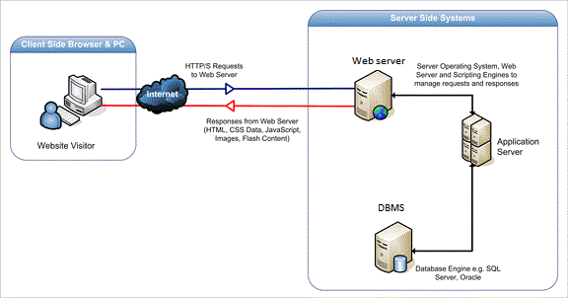
Servers

Slide 4
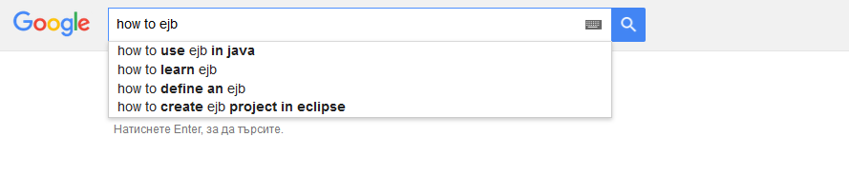
EJB?

Slide 5
Beans
Java Beans
  POJO
  Container to carry data between Servlets and JSP in MVC
EJBs
  Java EE (server based) component, AS needed
  Used for building the business logic and data access
  Session management, security, resource pooling, transactions

Slide 6
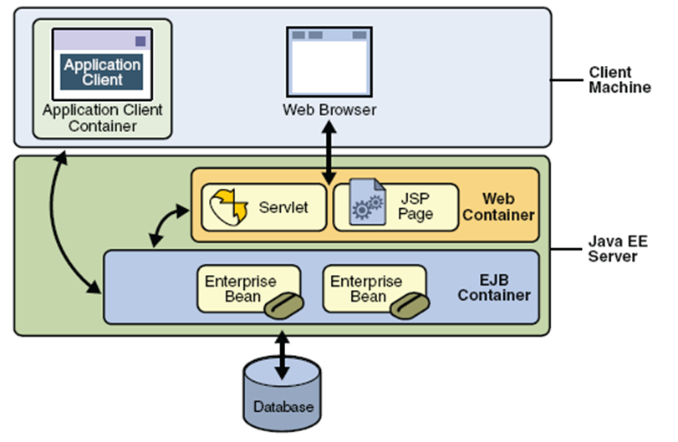

Slide 7
EJB types
Session Beans
  Stateful
  Stateless
Message-driven Beans
Entity Beans = JPA

Slide 8
Session Beans
Stateless session bean
Stateful session bean
Does not declare any instance variables. Can’t maintain state across methods
  + Scalability
Can hold client state across method invocations. Use instance variables. Then client sets values for them.
  - Resource intensive process

Slide 9
Message-driven beans
If needed to receive an asynchronous messages from other systems.
Example:
  Wholesaler have EJB application that uses message-driven bean to listen for purchase orders issued electronically from retailers.

Slide 10
Demo
Use AS
Implements javax.ejb.SessionBean interface
or use @Stateless
CalculatorEJB
CounterEJB

Slide 11
Thank you!

