Slide 1

Fundamental Principles of OOP
Inheritance, Encapsulation, Abstraction
SoftUni Team
Technical Trainers
Software University
http://softuni.bg

Slide 2
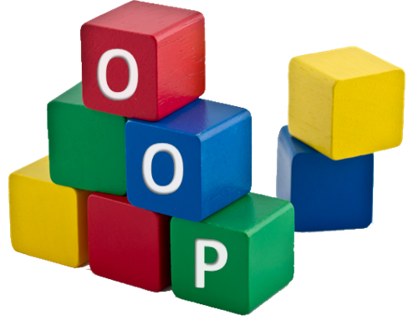



Table of Contents
Introduction to OOP in Python
Class
Object
Methods
Inheritance
Encapsulation
Key Points to Remember

Slide 3
Questions?
sli.do #python-fund

Slide 4
Introduction to OOPs in Python
What is it? Why to use it?

Slide 5
Classes and Objects
Python is a multi-paradigm programming language. Meaning, it supports different programming approach.
One of the popular approach to solve a programming problem is by creating objects. This is known as Object-Oriented Programming (OOP).
An object has two characteristics:
attributes
behavior

Slide 6
Classes and Objects
class Parrot:
def __init__(self, name, age):
self.name = name
self.age = age
def sing(self, song):
return "{} sings {}".format(self.name, song)
blu = Parrot("Blu", 10)
print(blu.sing("'Happy'"))
Properties/ attributes
Methods/ behavior
Instance of the class Parrot

Slide 7

Inheritance

Slide 8
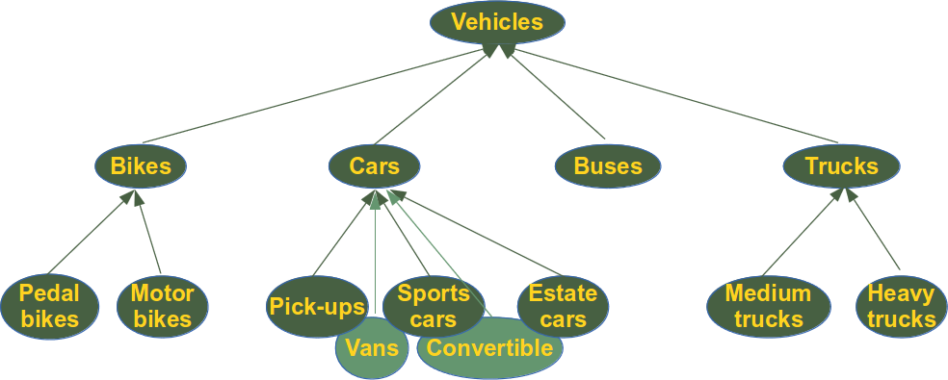
Inheritance
Inheritance is a way of creating new class for using details of existing class without modifying it.
The newly formed class is a derived class (or child class). Similarly, the existing class is a base class (or parent class).

Slide 9
Inheritance
class Person:
def __init__(self, first, last):
self.first_name = first
self.last_name = last
def get_name(self):
return self.first_name + “ ” + str(self.last_name)
class Employee(Person):
def __init__(self, first, last, staffnum):
Person.__init__(self, first, last)
#super().__init__() we could use that or the above
self.staff_number = staffnum
def get_employee(self):
return self.get_name() + “ ” + self.staff_number
Parent class
Child class

Slide 10
Inheritance
In the above program, we created two classes i.e. Person (parent class) and Employee (child class).
The child class inherits the functions of parent class. We can see this from get_name() method.
Additionally, we use super() function before __init__() method. This is because we want to pull the content of __init__() method from the parent class into the child class.

Slide 11
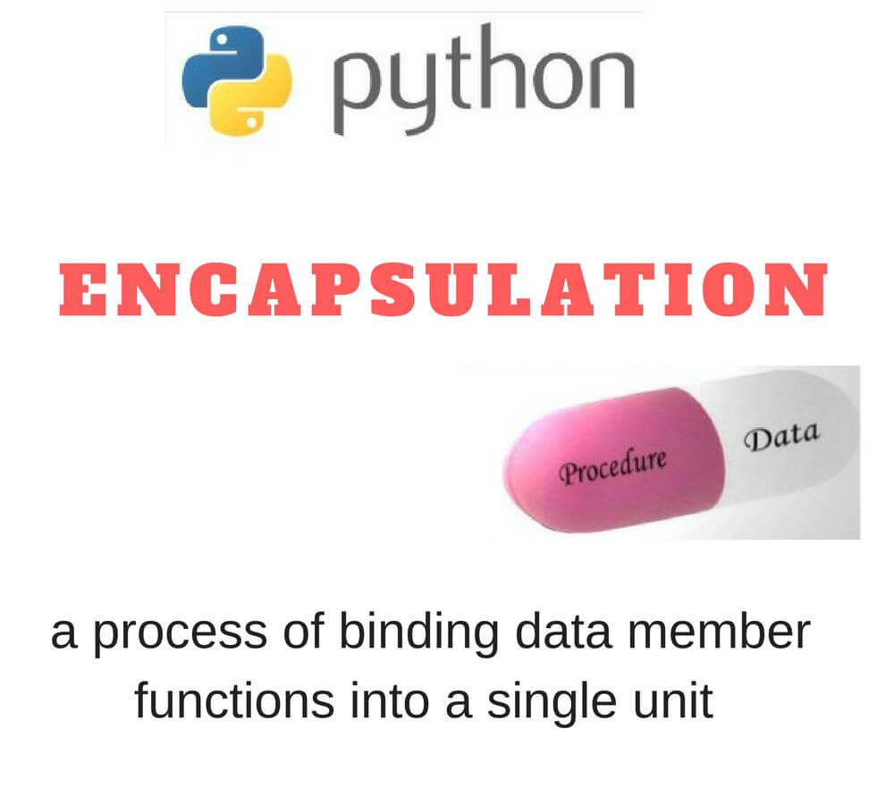

Slide 12
Encapsulation
Using OOP in Python, we can restrict access to methods and variables.
This prevent data from direct modification which is called encapsulation.
In Python, we denote private attribute using underscore as prefix i.e single “ _ “ or double “ __“.

Slide 13
Encapsulation
class Book:
def __init__(self, name, price):
self.__title = name
self.__price = price
def get_price(self):
return self.__price
def get_title(self):
return self.__title
__ ensures that this attribute is only visible in the class and no one can reach it/ modify it from outside
Getter for price

Slide 14
Decorators
class Person:
def __init__(self, name, age):
self.__name = name
self.__age = age
@property
def age(self):
return self.__age
@property
def name(self):
return self.__name
@age.setter
def age(self, age):
if age < 0:
raise Exception('Age must be positive number')
elif age > 180:
raise Exception('Age must be between 0-180')
else:
self.__age = age
def __str__(self):
return f'{self.name} {self.age}'
@{name}.setter is a setter
@property is a getter

Slide 15

Abstract Classes
Different behavior in different
languages

Slide 16
Abstract classes
Abstract classes are classes that contain one or more abstract methods. An abstract method is a method that is declared, but contains no implementation.
Subclasses of an abstract class in Python are not required to implement abstract methods of the parent class.

Slide 17
Abstract classes
class Bird:
def make_noise(self):
pass
class B(Bird):
pass
a = Bird()
b = B()
Parent class
If we start this program, we see that this is not an abstract class, because:
we can instantiate an instance from
we are not required to implement do_something in the class defintition of B
Child class

Slide 18
ABC module in Python
Python on its own doesn't provide abstract classes.
Yet, Python comes with a module which provides the infrastructure for defining Abstract Base Classes (ABCs). This module is called - for obvious reasons - abc.
from abc import ABC, abstractmethod

Slide 19
ABC module
from abc import ABC, abstractmethod
class Bird(ABC):
def __init__(self, name):
self.name = name
super().__init__()
@abstractmethod
def make_noise(self):
pass
This class is abstract and can not have instances
This decorator says to the children to implement the method

Slide 20
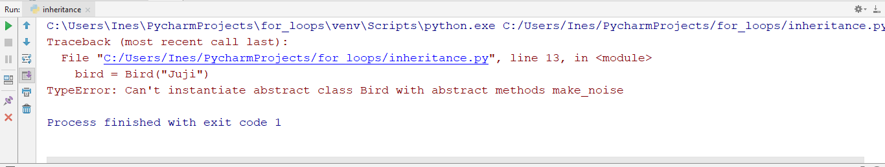
ABC module
A class that is derived from an abstract class cannot be instantiated unless all of its abstract methods are overridden.
If we try to instantiate it we will get the following error

Slide 21

OOP Principles
Live Exercises in Class (Lab)

Slide 22

Summary
The programming gets easy and efficient.
The class is sharable, so codes can be reused.
The productivity of programmers increases
Data is safe and secure with data abstraction.

Slide 24






Softuni Diamond Partners

Slide 25






SoftUni Diamond Partners

Slide 26
Trainings @ Software University (SoftUni)
Software University – High-Quality Education, Profession and Job for Software Developers
softuni.bg
Software University Foundation
http://softuni.foundation/
Software University @ Facebook
facebook.com/SoftwareUniversity
Software University Forums
forum.softuni.bg

