Slide 1

Magic methods
(dunder methods)
SoftUni Team
Technical Trainers
Software University
http://softuni.bg

Slide 2


Table of Contents
Binary Operators
Extended Assignments
Unary Operators
Comparison Operators
Overriding magic methods

Slide 3
Questions?
sli.do #python-fund

Slide 4
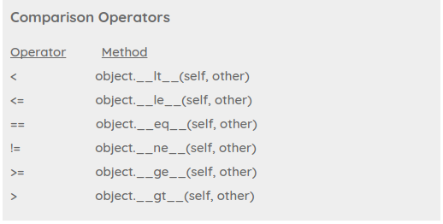
Magic methods
What are they?

Slide 5
Magic Methods
They are special methods with fixed names.
They are the methods with this clumsy syntax, i.e. the double
underscores at the beginning and the end.
The answer is, you don't have to invoke it directly. The invocation is realized behind the scenes.

Slide 6
Magic Methods
Every simple thing has a magic method
result = 10 + 5
a = 10
result = a.__add__(5)
The magic method for the "+" sign is the __add__ method.

Slide 7
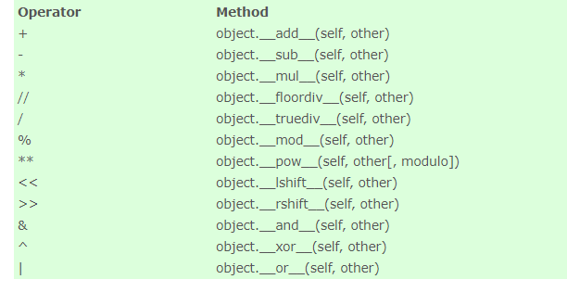
Binary Operators

Slide 8
Binary Operators
The mechanism works like this: If we have an expression "x + y" and x is an instance of class K, then Python will check the class definition of K. If K has a method __add__ it will be called with x.__add__(y), otherwise we will get an error message.

Slide 9
Shift to left
The numbers are represented in binary values.
12 = 0000 1100
with << we can move to the left ( n places shifted left)
12 << 2
00110000 = 48
2 is considered as ‘n’
Returns 48

Slide 10
Shift to right
48 >> 2
The binary value of 48 is "11 0000", after executing above
statement Right shift ( 2 places shifted right) returns the value 12
its binary value is "00 1100".
Returns 12

Slide 11
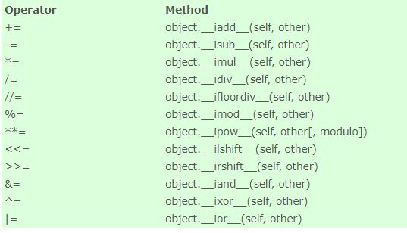
Extended Assignments

Slide 12
Extended Assignments
In python when we want to reassign the value of a variables we can do it in two possible ways:
a = 5
a = a + 10
a = 5
a += 10
a.__add__(10)
a.__iadd__(10)

Slide 13
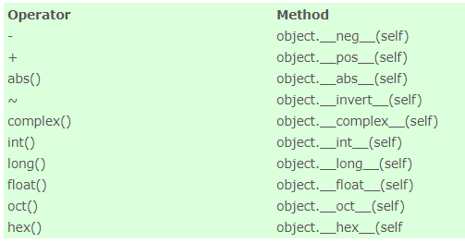
Unary Operators

Slide 14
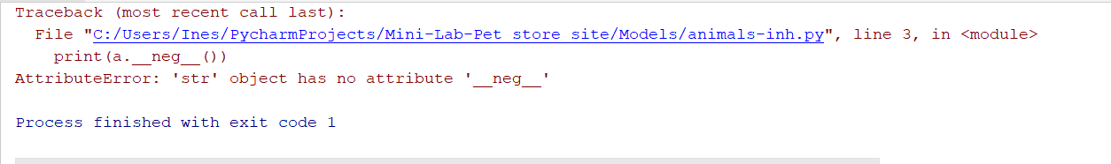
__neg__(obj)
Return object negated (-object).
a = 5
print(a.__neg__())
a = -5
print(a.__neg__())
a = ‘5’
print(a.__neg__())
Print -5
Print 5
error

Slide 15
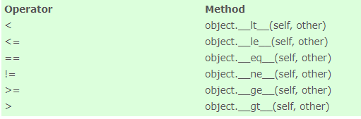
Comparison Operators

Slide 16
Operator ‘!=‘
Return object negated (-object).
a = 5 != 6
print(a)
a = not 5 == 6
print(a)
Print ‘True’
Print ‘True’

Slide 17
Overriding methods

Slide 18
Overriding methods in custom classes
We can overwrite behavior of magic methods in our custom classes
class MyClass: test = MyClass(5)
def __init__(self, num):
self.num = num
def __add__(self, x):
return self.num - x
print(test + 10) => -5
‘Overriding’ the add method

Slide 19
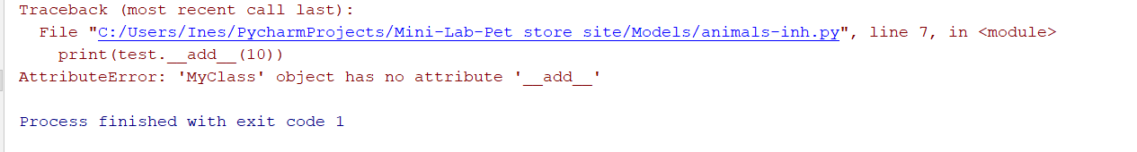
Exceptions
We can overwrite behavior of magic methods in our custom classes
class MyClass: test = MyClass(5)
def __init__(self, num):
self.num = num
print(test.__add__(10)) => -5

Slide 20
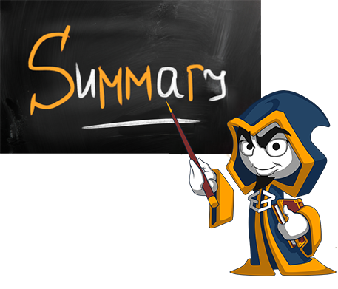
Summary
Magic methods == Dunder methods
We can override them in our classes.
We should be careful overwriting magic methods!

Slide 22






Softuni Diamond Partners

Slide 23






SoftUni Diamond Partners

Slide 24
Trainings @ Software University (SoftUni)
Software University – High-Quality Education, Profession and Job for Software Developers
softuni.bg
Software University Foundation
http://softuni.foundation/
Software University @ Facebook
facebook.com/SoftwareUniversity
Software University Forums
forum.softuni.bg

