Slide 1

Assessing Flaws in CAPTCHA Security through Progress in AI
Jaydon Stanislowski
University of Minnesota Morris

Slide 2
Outline
1
Introduction to CAPTCHAs
Modern CAPTCHAs
Reinforcement Learning
Attacking reCAPTCHA v3
Threat Analysis
Conclusion

Slide 3
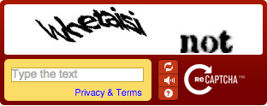
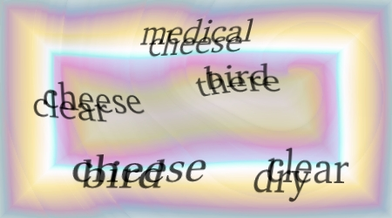
1. Introduction to CAPTCHA
2
What is a CAPTCHA?
Motivation
Early CAPTCHAs

Slide 4
What is a CAPTCHA?
3
CAPTCHA - Completely Automated Public Turing test to tell Computers and Humans Apart
Turing test - a thought experiment, measures machine intelligence with a human evaluator (Turing, 1950)
Tasks designed to be simple for humans, but hard for AI models
Designed by Luis von Ahn et al. in the early 2000s

Slide 5
Motivation
4
Artificial web traffic can have various malicious motives:
Credential stuffing/brute force attacks
Fake account creation and engagement
Spam, extortion
Web scraping
Despite this, it is more prevalent than ever

Slide 6
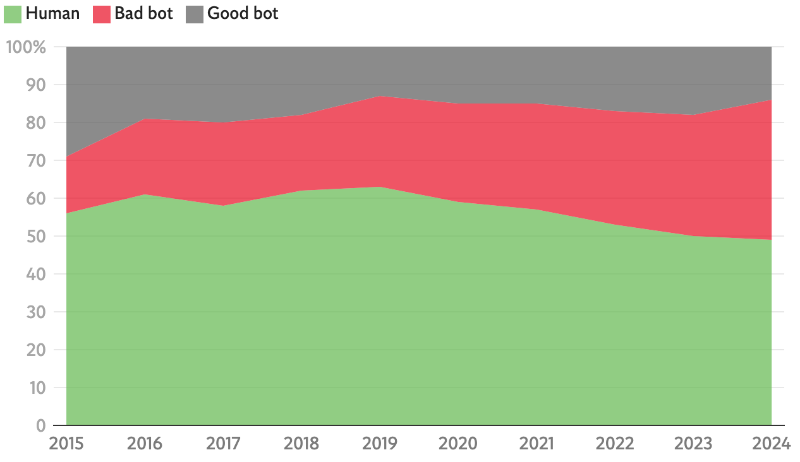
5
Area chart depicting the rise in artificial web traffic since 2015. | The Independent (adapted from Imperva 2025 Bad Bot Report)

Slide 7
Early CAPTCHAs
6
Text-based challenges:
Participants must transcribe text
Text is typically distorted to make it hard for machines to read
Random noise, warping, rotating, etc.

Slide 8
Early CAPTCHAs
7
reCAPTCHA: version 1 began as text-based
Developed by Luis von Ahn et al. in 2007
Acquired by Google two years later
Other text-based frameworks included Gimpy, hCAPTCHA, etc.
reCAPTCHA v1 deprecated in 2018. reCAPTCHA v3 is the latest version

Slide 9


2. Modern CAPTCHAs
8
Common Types
reCAPTCHA v3
Why reCAPTCHA?

Slide 10
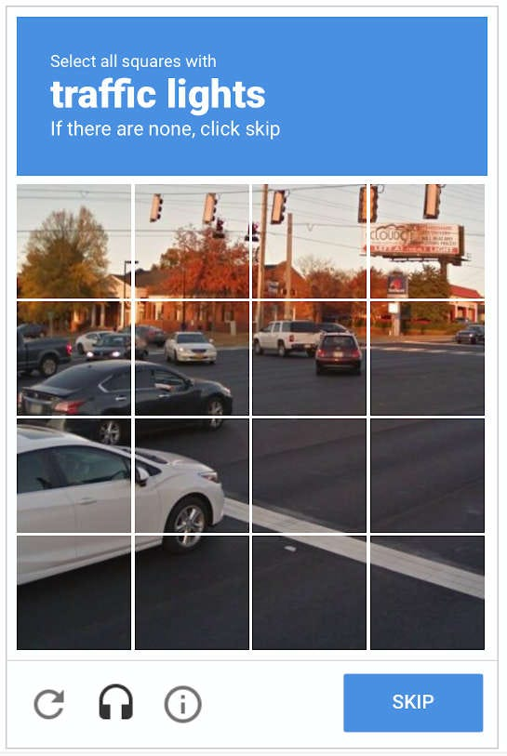
Common Types
9
Many challenge types exist now, but are outside of the scope of this presentation
Image-based challenges
Audio-based challenges
Spatial reasoning challenges

Slide 11
reCAPTCHA v3
10
Intended to reduce friction for real users, removing the actual "challenge," entirely invisible
Uses behavior metrics, calculates likelihood of a bot based on browser activity (cookies, inputs, etc.), directly embedded into site interactions
Earlier version, reCAPTCHA v2, did this using a checkbox challenge (i.e. not invisible)

Slide 12
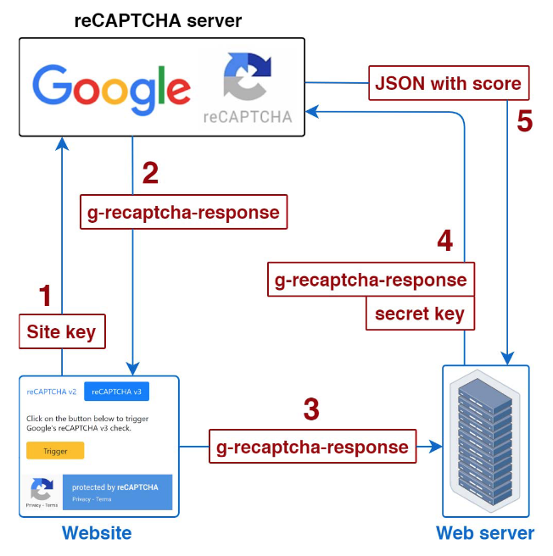
reCAPTCHA v3
11
reCAPTCHA v3 is invoked, the website sends metrics and invocation context to Google's servers, collected by the tool
Google generates a token to be verified by the site
reCAPTCHA v3 workflow | Joosen et al.

Slide 13
reCAPTCHA v3
12
The token is sent to the web server
The server verifies the token with the site's key and sends this to Google
Google returns a formatted score, which can be used by the website to take necessary actions
reCAPTCHA v3 workflow | Joosen et al.

Slide 14
reCAPTCHA v3
13
Considerations:
Code is proprietary, details are intentionally obfuscated
Calculations may be randomly skewed to deter probing
Score itself is not descriptive, only a discrete number {0.1, 0.3, 0.5, 0.7, 0.9}
Lower score means more likely to be a bot

Slide 15
Why reCAPTCHA?
14
Over 10 million websites as of 2025 (BuiltWith)
This includes GitHub, Reddit, Amazon, and more
Designs of reCAPTCHA v3 are applied in other CAPTCHA frameworks
Notably, Turnstile and newer versions of hCAPTCHA

Slide 16

3. Reinforcement Learning
15

Slide 17
Overview
16
Machine learning paradigm
Employed when computers interact with an environment
Applications in robotics, social media algorithms, strategy games, etc.
Agent is given a set of actions to do so, choices are initially random

Slide 18
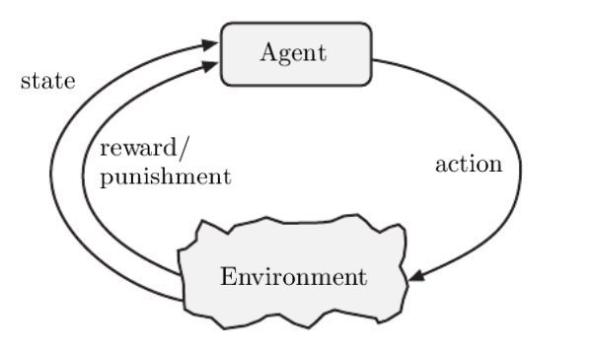
Overview
17
The agent observes its current state to alter chance of making decisions
Reward score influences these changes, agent must try to maximize it
Block diagram modeling basic principles of reinforcement learning | Tizhoosh, Taylor

Slide 19
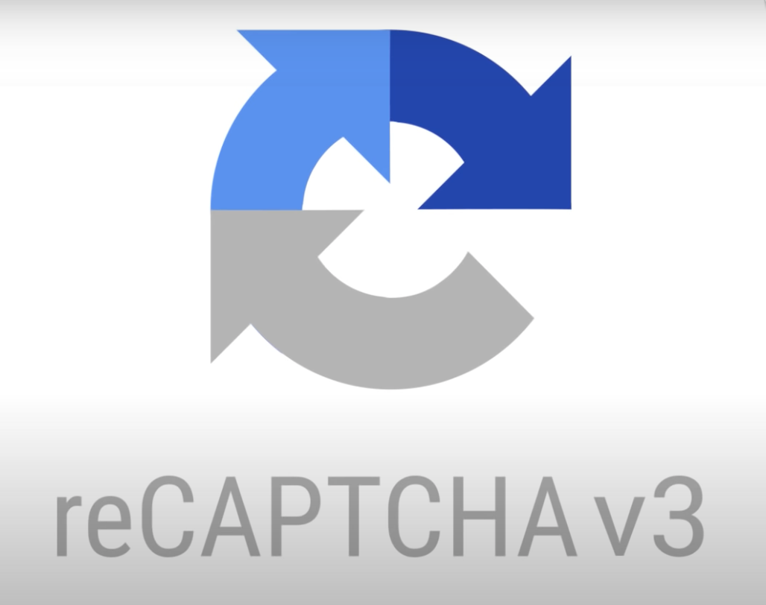
4. Attacking reCAPTCHA v3
18
Bypassing Behavior Metrics
Results

Slide 20
Bypassing Behavior Metrics
19
Browser activity that may be measured (Joosen et al., 2022):
Static features: presence of cookies, IP address, browser, operating system, etc.
Dynamic features: mouse and keyboard inputs, timings, request frequency
reCAPTCHA v3 obscures how much these are measured

Slide 21
Bypassing Behavior Metrics
20
Static features:
Sivakorn et al. (2016) determined static features to have a very strong positive influence on score
In such cases, dynamic features have very minimal effect
Goal of this research is to exploit dynamic features starting from a low score

Slide 22
Bypassing Behavior Metrics
21
Measuring dynamic features:
Treating the score as an "oracle" — specific states of the environment aren't needed. Instead, fine tune behaviors based on the output
The RL agent makes assumptions about its environment and learns accordingly

Slide 23
Bypassing Behavior Metrics
22
Joosen et al. trained their bot on three websites:
Website A: hosted by researchers, implementing reCAPTCHA v3; training only
Website B: hundreds of daily requests, only recently deployed reCAPTCHA v3; partial training
Website C: thousands of daily requests, already fully integrated reCAPTCHA v3; full deployment

Slide 24
Bypassing Behavior Metrics
23
Two modes of the bot were deployed in testing to assess score impact of dynamic features
Bezier: Can only move mouse in curved patterns and click, as well as time mouse inputs, hover duration, etc.
Abstract: Freedom over mouse movements and timings, plus keyboard inputs and scrolling

Slide 25
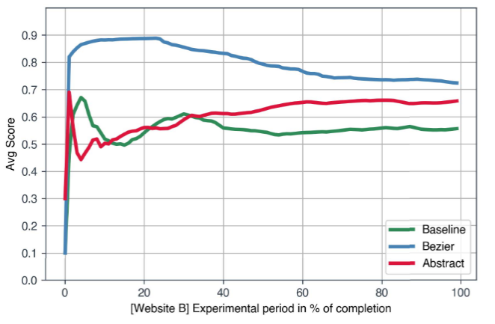
Results
24
A baseline (naive) algorithm was used to assess score improvement via RL
Bezier and Abstract deployed on B, with Abstract in its training mode
Average cumulative score over the period of evaluation for Website B | Joosen et al.

Slide 26
Results
25
On website C, researchers did not have access to the score. Intended to test Abstract's capabilities in a fully black-box environment
Success measured by evasion rate, frequency of v3 seeming to detect no bot activity
Evaluated for both high starting sessions (presence of static features) and low starting sessions

Slide 27

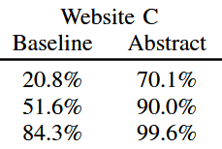
Results
26
Abstract almost perfectly avoided detection with static features
Starting from a low score with minimal static data, Abstract succeeded at a rate of ~70%
Evasion rate (in %) for both the Baseline and Abstract algorithms across different session types | Joosen et al.

Slide 28

Analysis
27
Research Implications
Limitations
Future of CAPTCHA Tools
Ethical Considerations

Slide 29
Research Implications
28
The results suggest that providing a CAPTCHA score is a vulnerability, can be exploited to:
Train machines to receive a passing score
Probe what behavior data is being measured

Slide 30
Research Implications
29
CAPTCHAs based on these metrics may be insecure as a whole:
They are easily bypassed by models trained to mimic human browsing
They are apparently biased in favor of static variables easily accounted for by attackers

Slide 31
Limitations
30
reCAPTCHA v3 is known to intentionally add random noise, obscuring the meaning of the score
Models cannot remain active over long periods of time, since excessive number of requests influences the score
Not accounting for combining CAPTCHA schemes or using different metrics-based CAPTCHA tools

Slide 32
Limitations
31
reCAPTCHA v3 likely employs adversarial learning
More study of how the tool has changed over time is needed, could improve or remain the same
This also makes past experiments harder to replicate

Slide 33
Future of CAPTCHA Tools
32
CAPTCHA tools may pivot to more complex challenges for humans, possibly focusing more on spatial reasoning and logic puzzles (many do already)
Current CAPTCHAs using behavior metrics may improve over time, but so will AI models to bypass them

Slide 34
Future of CAPTCHA Tools
33
Von Ahn et al. designed CAPTCHAs with the intention of being broken
As AI evolves, breaking CAPTCHA schemes is proof of progress in the field
CAPTCHA will always change as breakthroughs occur, but for how long will this remain effective?

Slide 35
Ethical Considerations
34
Responsible disclosure:
Researchers received permission from website owners before deploying their bots
Google was notified of these security concerns. The issue was closed as intended behavior, likely considered to be a "reasonable limitation" of the tool

Slide 36
Conclusion
35
CAPTCHA security is an important but persistent problem as AI becomes more sophisticated
Today's Captcha tools face challenges that reduce their effectiveness, but will continue to grow over time

Slide 37
Questions?

Slide 38
References
[1] Von Ahn, L., Blum, M., Hopper, N., & Langford, J. (2003). CAPTCHA: Using Hard AI Problems for Security. International Association for Cryptologic Research 2003. https://doi.org/10.1007/3-540-39200-9_18
[2] Turing, A. (1950). Computing Machinery and Intelligence. Mind, 59(236), 433–460. https://doi.org/10.1093/mind/LIX.236.433
[3] Von Ahn, L., Maurer, B., McMillen, C., Abraham, D., & Blum, M. (2008). reCAPTCHA: Human-Based Character Recognition via Web Security Measures. Science, 321(5895), 1465–1468. https://doi.org/10.1126/science.1160379
[4] Tizhoosh, H. R., & Taylor, G. W. (2006). Reinforced Contrast Adaptation. International Journal of Image and Graphics, 06(03), 377–392. https://doi.org/10.1142/s0219467806002379
[5] reCAPTCHA Usage Statistics. Trends.builtwith.com. Retrieved November 3, 2025, from https://trends.builtwith.com/widgets/reCAPTCHA
[6] Tsingenopoulos, I., Preuveneers, D., Desmet, L., & Joosen, W. (2022, June 1). Captcha me if you can: Imitation Games with Reinforcement Learning. IEEE Xplore. https://doi.org/10.1109/EuroSP53844.2022.00050
[7] Cuthbertson, A. (2025, April 15). Bots now make up more than half of global internet traffic. The Independent. https://www.the-independent.com/tech/bots-internet-traffic-ai-chatgpt-b2733450.html

