Slide 1
Pitching a Movie Recommender System
From: AI Entertainment
To: Netflix stakeholders

Slide 2

Johnny had a tough Week

Slide 3
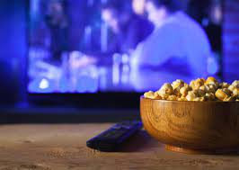
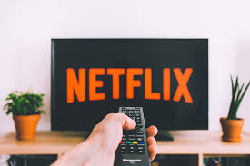
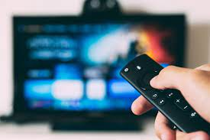
He searches for a movie

Slide 4

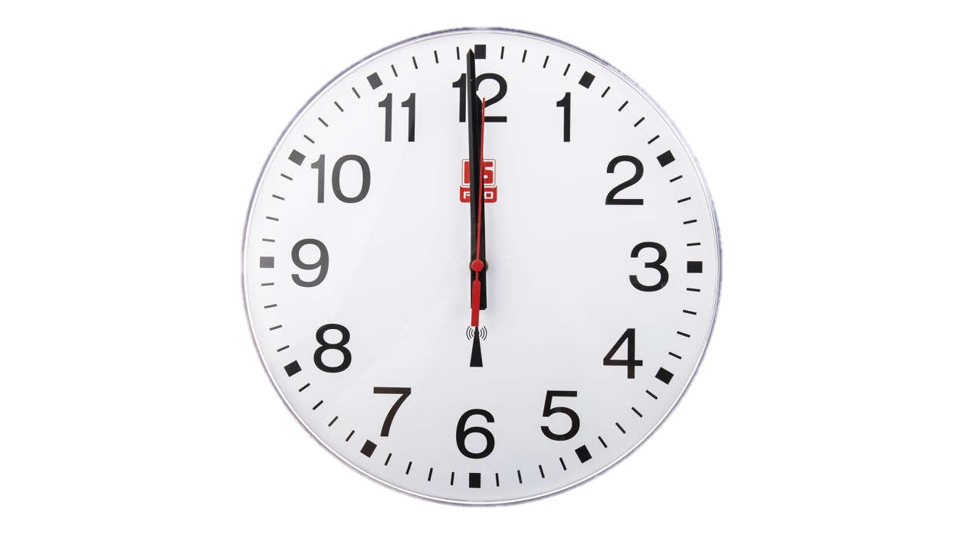
The search is taking long

Slide 5

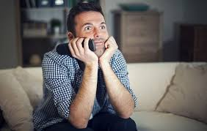
He finds a movie

Slide 6
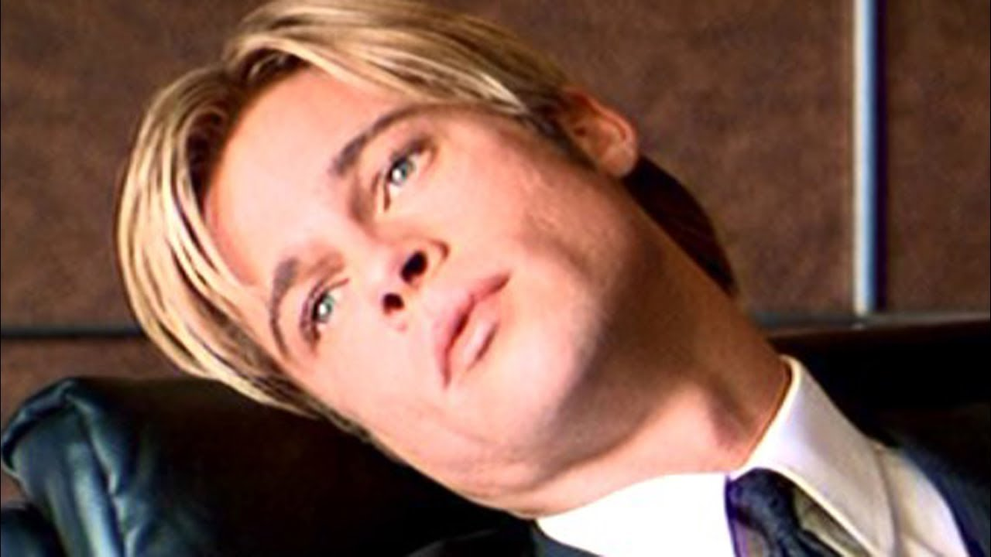
Boredom strikes!

Slide 7
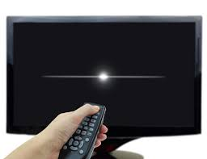
He switches off the TV

Slide 8
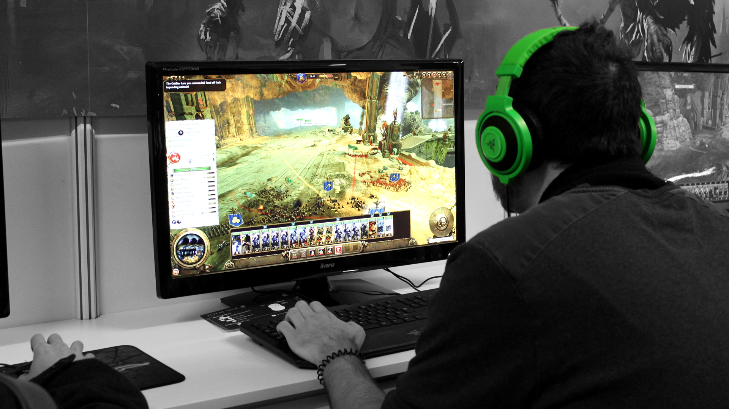
He plays PC games instead

Slide 9
What was Johnny’s problem?
Movie finding took too long
He scrolled passed good movies
He ended watching a movie not suited for his taste.
Johnny’s problem is not unique

Slide 10

How to solve the problem?
The same way Amazon did

Slide 11
The solution is …
A personalized movie recommender system

Slide 12
What does it do?
It automatically recommends movies to users once they sign in or finish watching a movie.
It will know what movies to recommend based on …
The user’s previous movie ratings,
The ratings of others similar users on your platform,
The information a user gives then he signs up.

Slide 13
How will it benefit?
Users will watch movies they have a high chance of enjoying,
Users will find movies fast.
= Users having a more enjoyable experience on your platform
= Users subscribing for longer and telling their friends.

Slide 14
How will we do this?
Instead of telling you, let’s show you…
DEMO TIME!!!

Slide 15
Where can we go from here?
The app is merely a Proof of Concept. Our actual plan is that …
The recommender can automatically track all users’s watch history and rating history.
Recommendations to be made as users sign in or when done watching a movie.
That the titles of the recommender movies not only appear, but their cover posters as well as how others have rated them.

