Slide 1
Pitching a Movie Recommender System
From: AI Entertainment
To: Netflix stakeholders
Notes:
Proposition Statement
Today we will show you how our movie recommender has the potential of improving your customers’ movie watching experience so that they stay subscribed to your platform for longer and tell all their friends about you.

Slide 2

Johnny had a tough Week

Slide 3
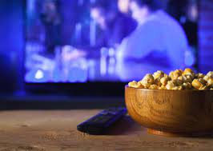

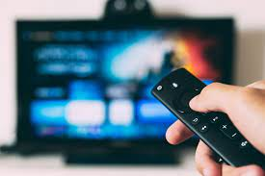
He searches for a movie

Slide 4

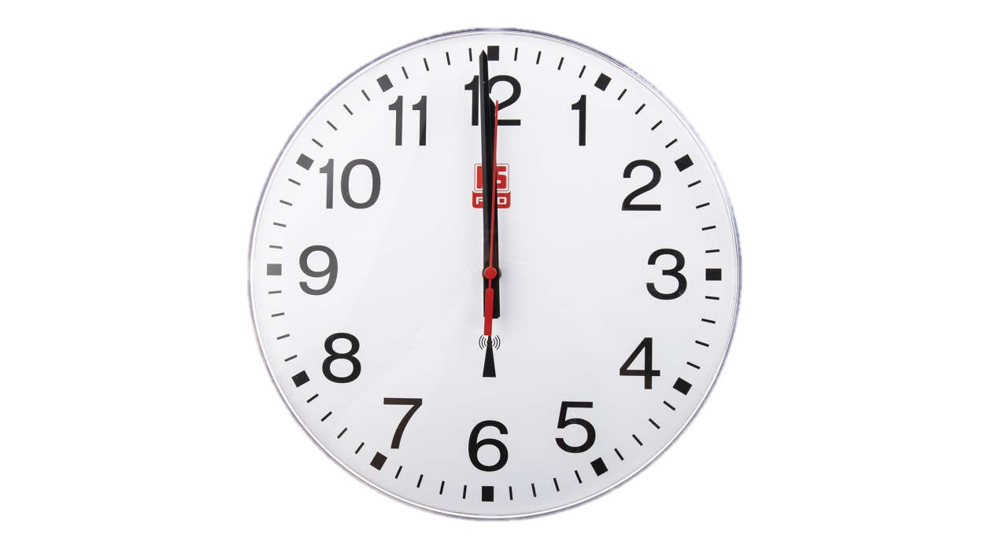
The search is taking long

Slide 5

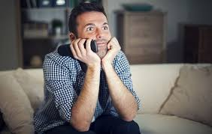
He finds a movie

Slide 6
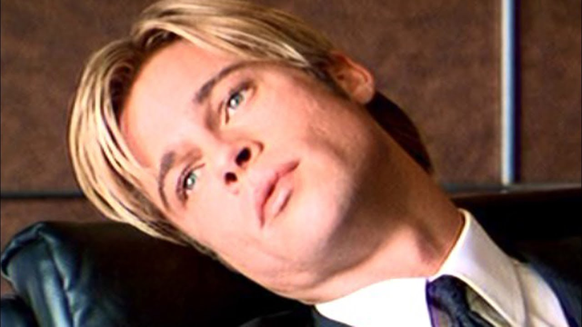
Boredom strikes!

Slide 7
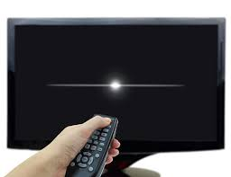
He switches off the TV

Slide 8

He plays PC games instead

Slide 9
What was Johnny’s problem?
Movie finding took too long
He scrolled passed good movies
He ended watching a movie not suited for his taste.
Johnny’s problem is not unique

Slide 10
BUT …
Johnny’s problem is not unique

Slide 11

How to solve the problem?
The same way Amazon did

Slide 12
The solution is …
A personalized movie recommender system

Slide 13
What does it do?
It automatically recommends movies to users once they sign in or finish watching a movie.
It will know what movies to recommend based on …
The user’s previous movie ratings,
The ratings of others similar users on your platform,
The information a user gives then he signs up.

Slide 14
How will it benefit?
Users will watch movies they have a high chance of enjoying,
Users will find movies fast.
= Users having a more enjoyable experience on your platform
= Users subscribing for longer and telling their friends.

Slide 15
How will we do this?
Instead of telling you, let’s show you…
DEMO TIME!!!

Slide 16
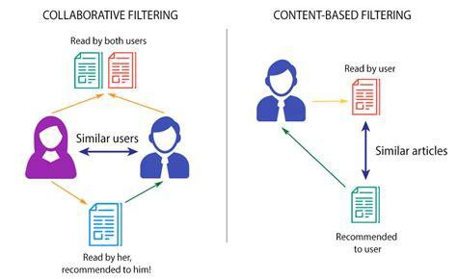

Slide 17
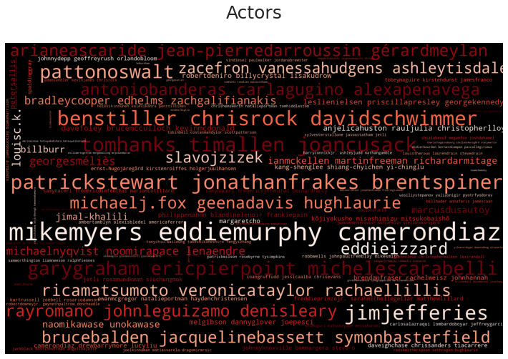
What influences a Content Based Model?
1. Actors

Slide 18
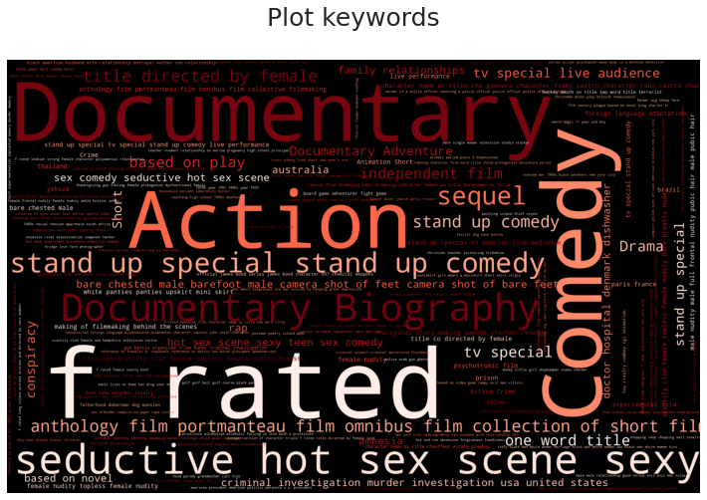
What influences a Content Based Model?
2. GENRES

Slide 19
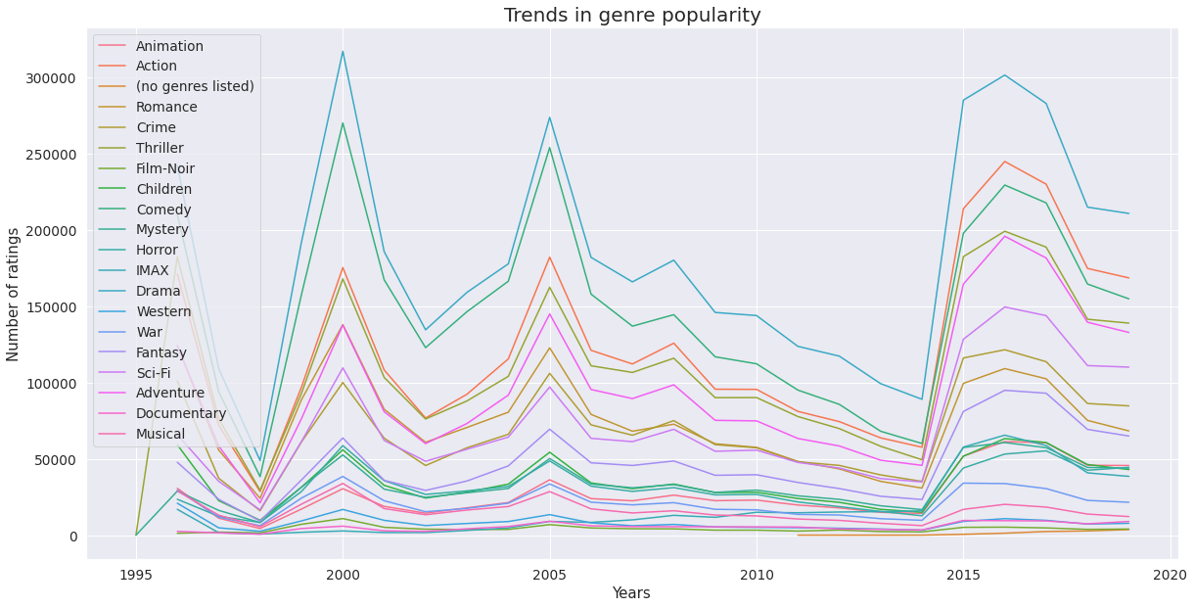
What influences a Content Based Model?
3. RELEASE YEAR

Slide 20
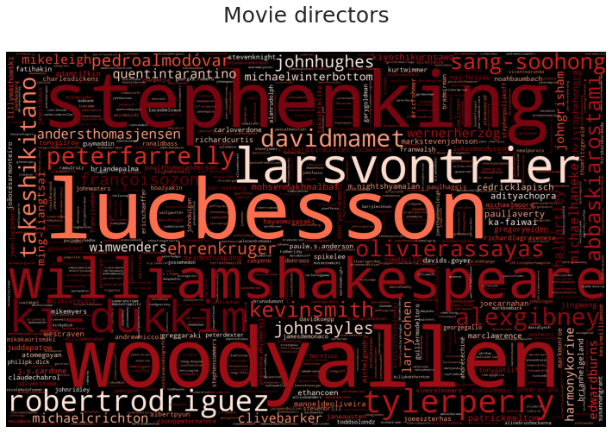
What influences a Content Based Model?
4. Directors

Slide 21
Different Types of Collaborative Models
Algorithm Name | RMSE
Singular-Value Decomposition (SVD) | .70
KNN Basic | .96
KNN Baseline | .87

Slide 22
Where can we go from here?
The app is merely a Proof of Concept. Our actual plan is that …
The recommender can automatically track all users’s watch history and rating history.
Recommendations to be made as users sign in or when done watching a movie.
That the titles of the recommender movies not only appear, but their cover posters as well as how others have rated them.

